Slide 1
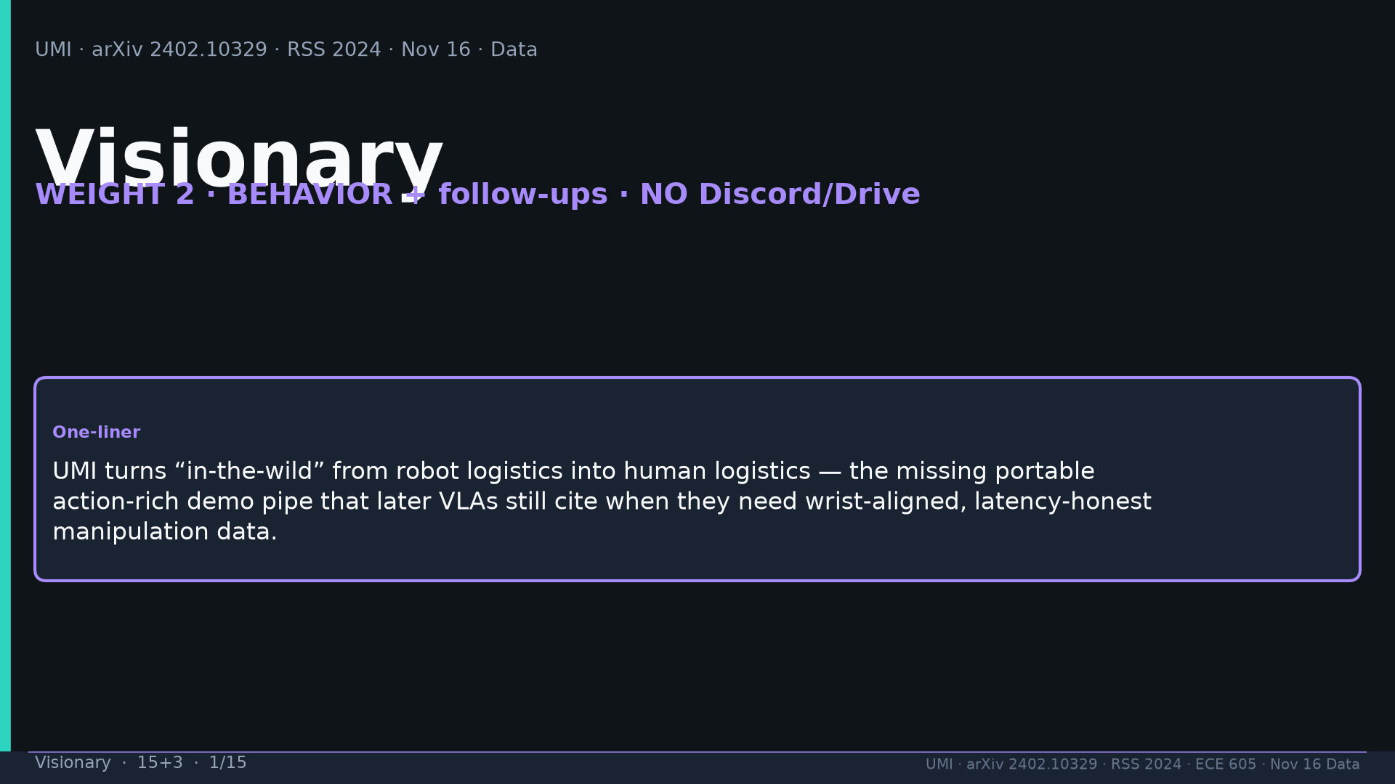
Notes:
Visionary · 15+3 · 1/15
Title. NO Discord/Drive. One-liner: turns in-the-wild from robot logistics into human logistics.
Tattoo: cup 100%/90% · toss 87.5% (no lat 57.5%) · wild 1400/30 → 71.7% vs narrow 0% · rel 100% vs abs 25% · fisheye vs 69° 55% · cloth 70%/30% · dish 70%/0% · Ta=6 @10Hz (20Hz toss)

Slide 2
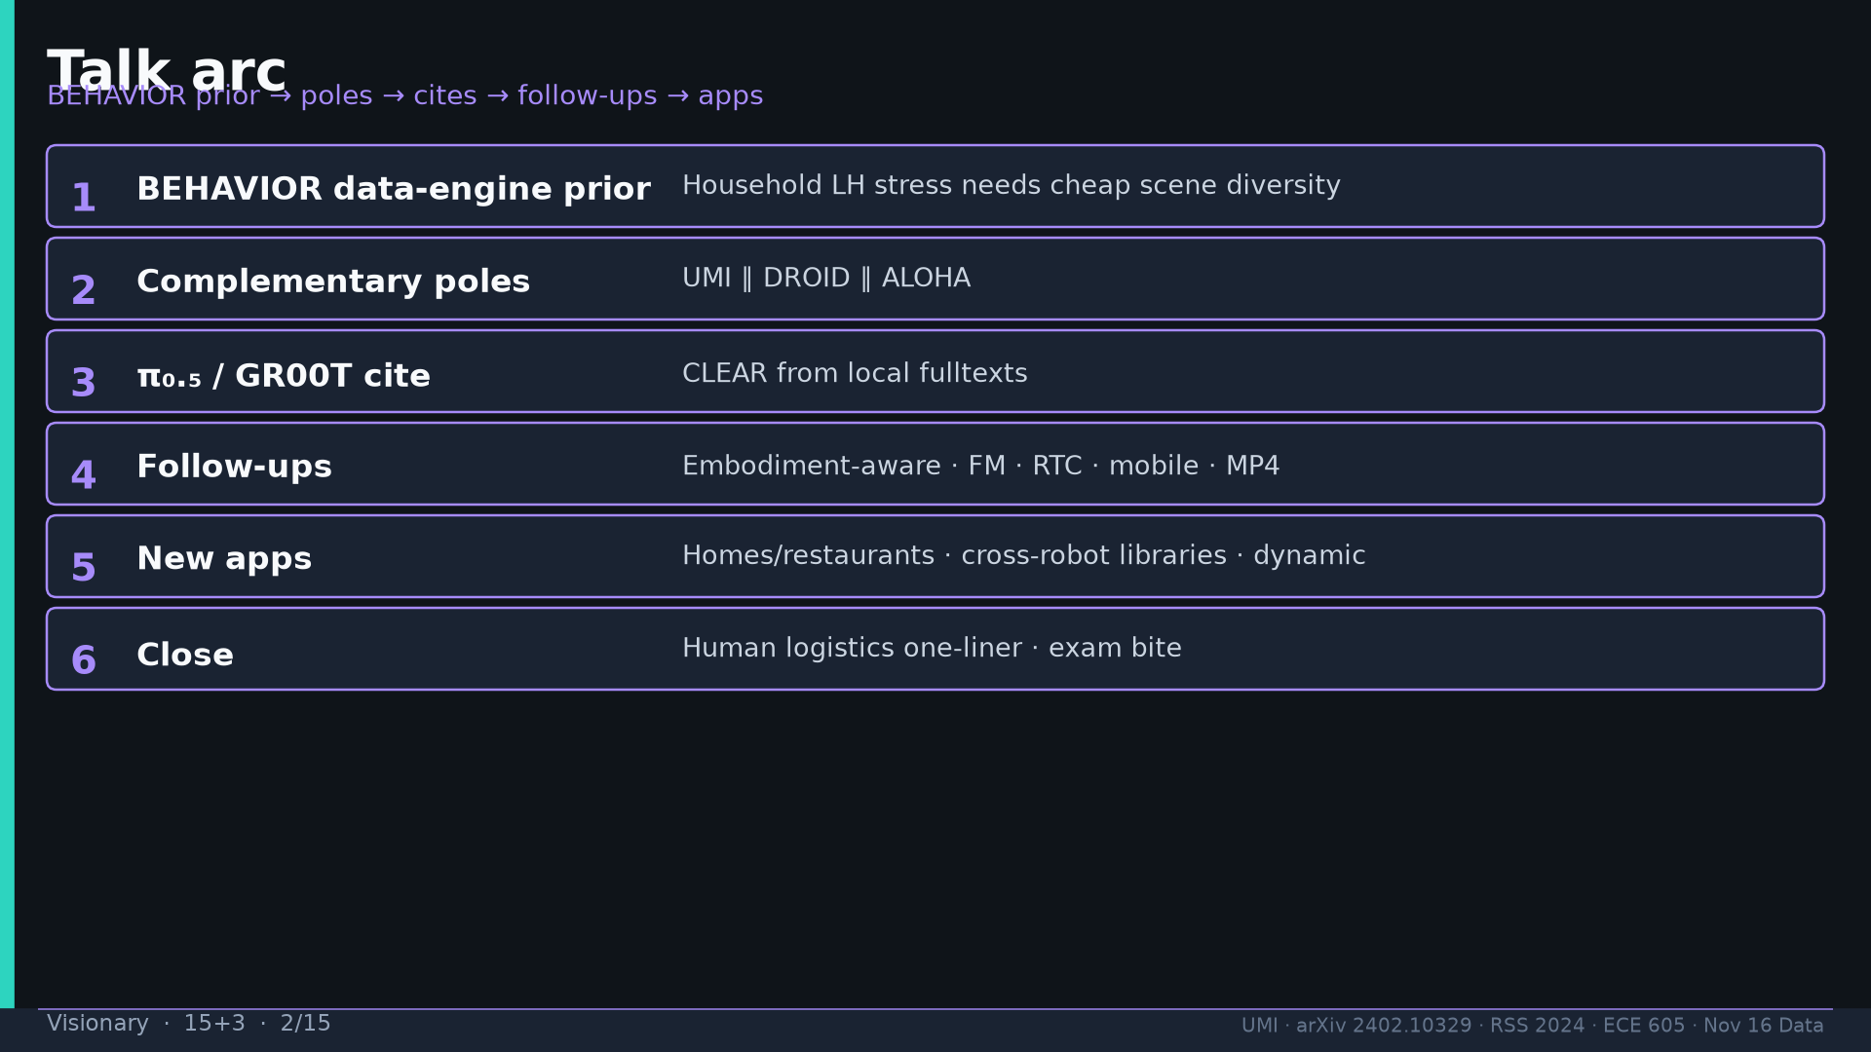
Notes:
Visionary · 15+3 · 2/15
Arc: BEHAVIOR prior → poles → cites → follow-ups → apps → close.
Tattoo: cup 100%/90% · toss 87.5% (no lat 57.5%) · wild 1400/30 → 71.7% vs narrow 0% · rel 100% vs abs 25% · fisheye vs 69° 55% · cloth 70%/30% · dish 70%/0% · Ta=6 @10Hz (20Hz toss)

Slide 3
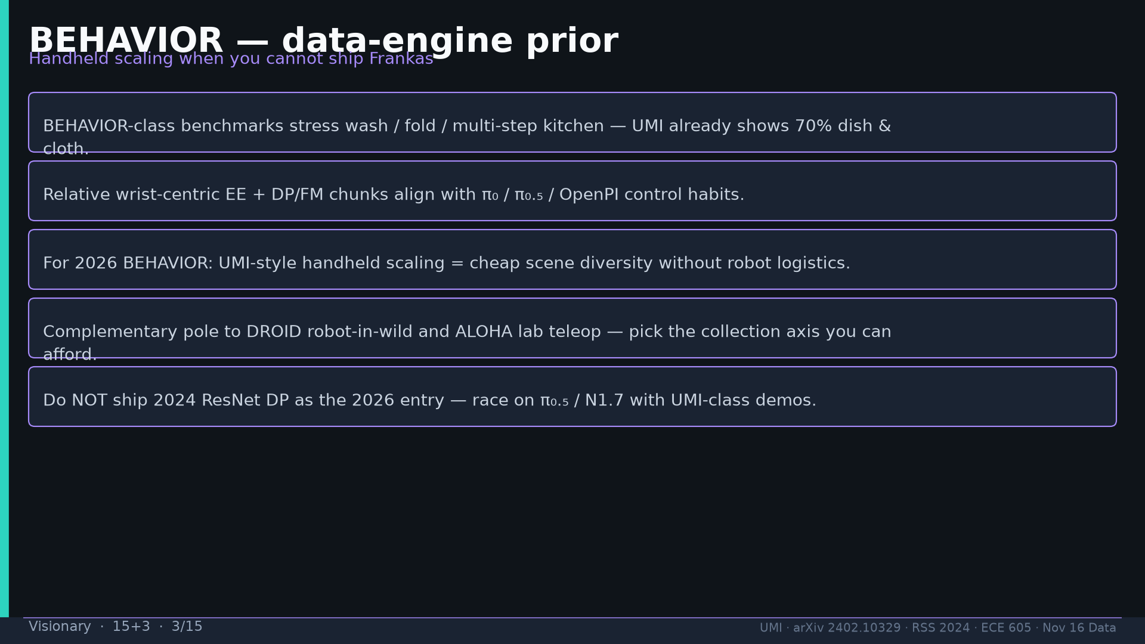
Notes:
Visionary · 15+3 · 3/15
BEHAVIOR: wash/fold/kitchen stress; relative wrist+chunks align π₀/π₀.₅; cheap scene diversity; complementary to DROID/ALOHA; don’t ship 2024 ResNet DP.
Tattoo: cup 100%/90% · toss 87.5% (no lat 57.5%) · wild 1400/30 → 71.7% vs narrow 0% · rel 100% vs abs 25% · fisheye vs 69° 55% · cloth 70%/30% · dish 70%/0% · Ta=6 @10Hz (20Hz toss)

Slide 4
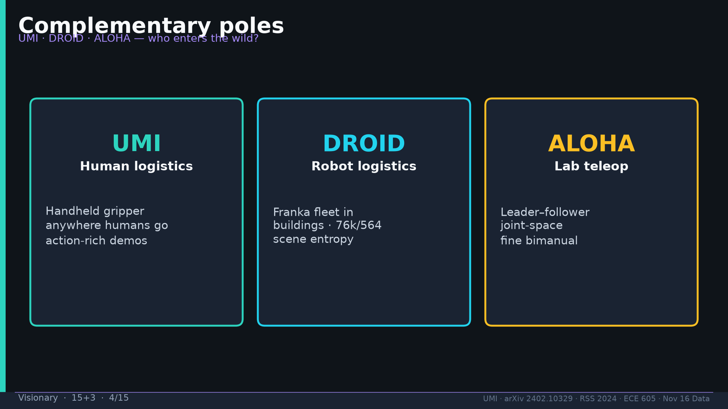
Notes:
Visionary · 15+3 · 4/15
Poles: UMI human logistics · DROID robot logistics · ALOHA lab teleop.
Tattoo: cup 100%/90% · toss 87.5% (no lat 57.5%) · wild 1400/30 → 71.7% vs narrow 0% · rel 100% vs abs 25% · fisheye vs 69° 55% · cloth 70%/30% · dish 70%/0% · Ta=6 @10Hz (20Hz toss)

Slide 5
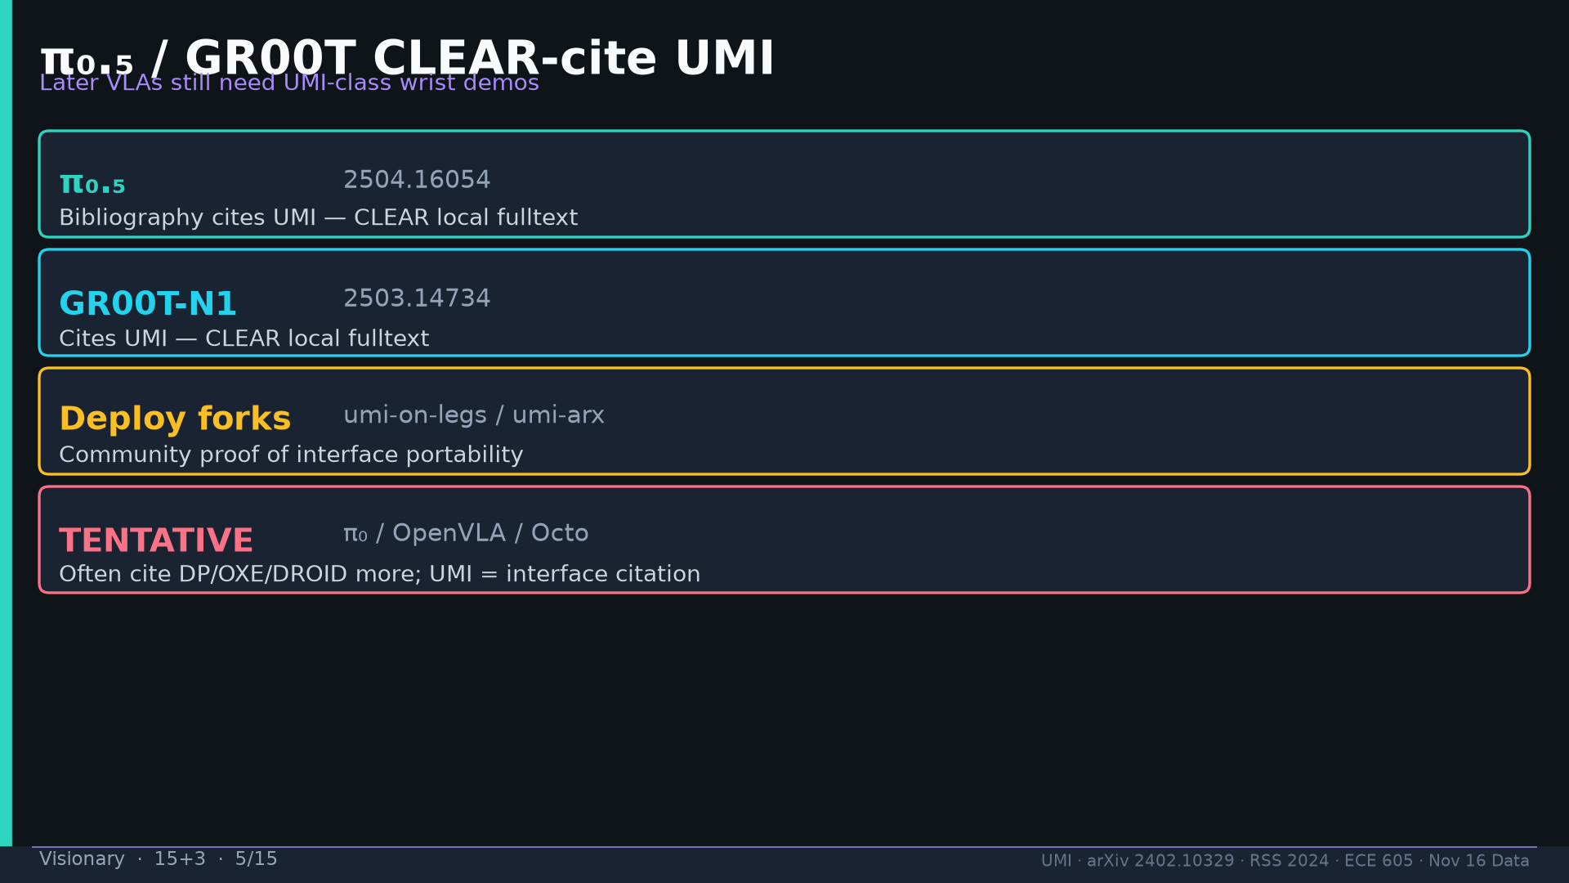
Notes:
Visionary · 15+3 · 5/15
CLEAR cites: π₀.₅ 2504.16054; GR00T-N1 2503.14734; umi-on-legs/umi-arx. TENTATIVE: π₀/OpenVLA/Octo primary-prior.
Tattoo: cup 100%/90% · toss 87.5% (no lat 57.5%) · wild 1400/30 → 71.7% vs narrow 0% · rel 100% vs abs 25% · fisheye vs 69° 55% · cloth 70%/30% · dish 70%/0% · Ta=6 @10Hz (20Hz toss)

Slide 6
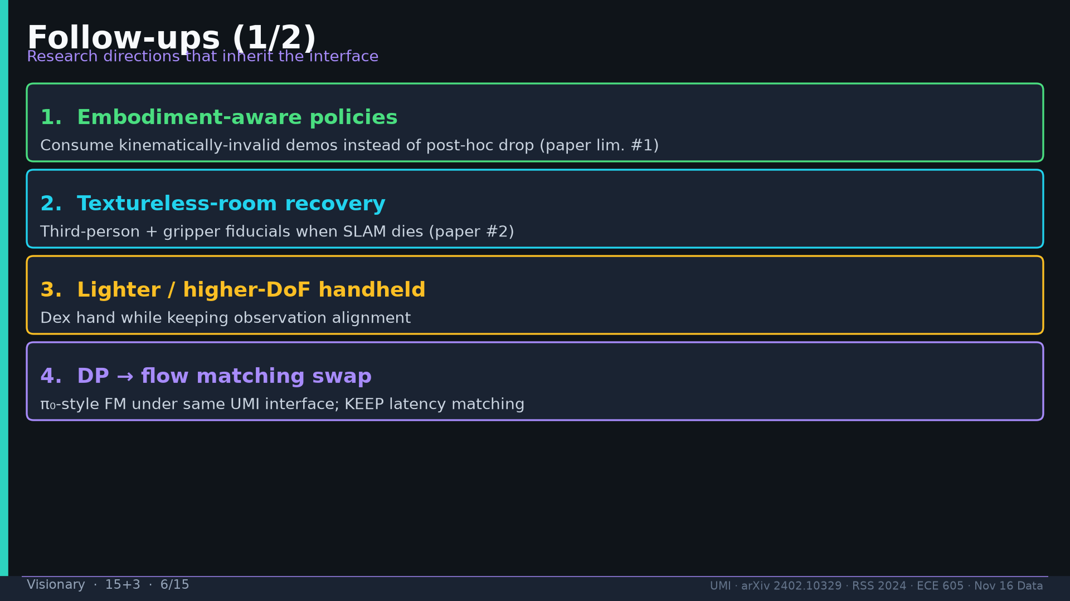
Notes:
Visionary · 15+3 · 6/15
Follow-ups 1–4: embodiment-aware invalid demos; textureless recovery; lighter/higher-DoF; DP→FM swap keep latency.
Tattoo: cup 100%/90% · toss 87.5% (no lat 57.5%) · wild 1400/30 → 71.7% vs narrow 0% · rel 100% vs abs 25% · fisheye vs 69° 55% · cloth 70%/30% · dish 70%/0% · Ta=6 @10Hz (20Hz toss)

Slide 7
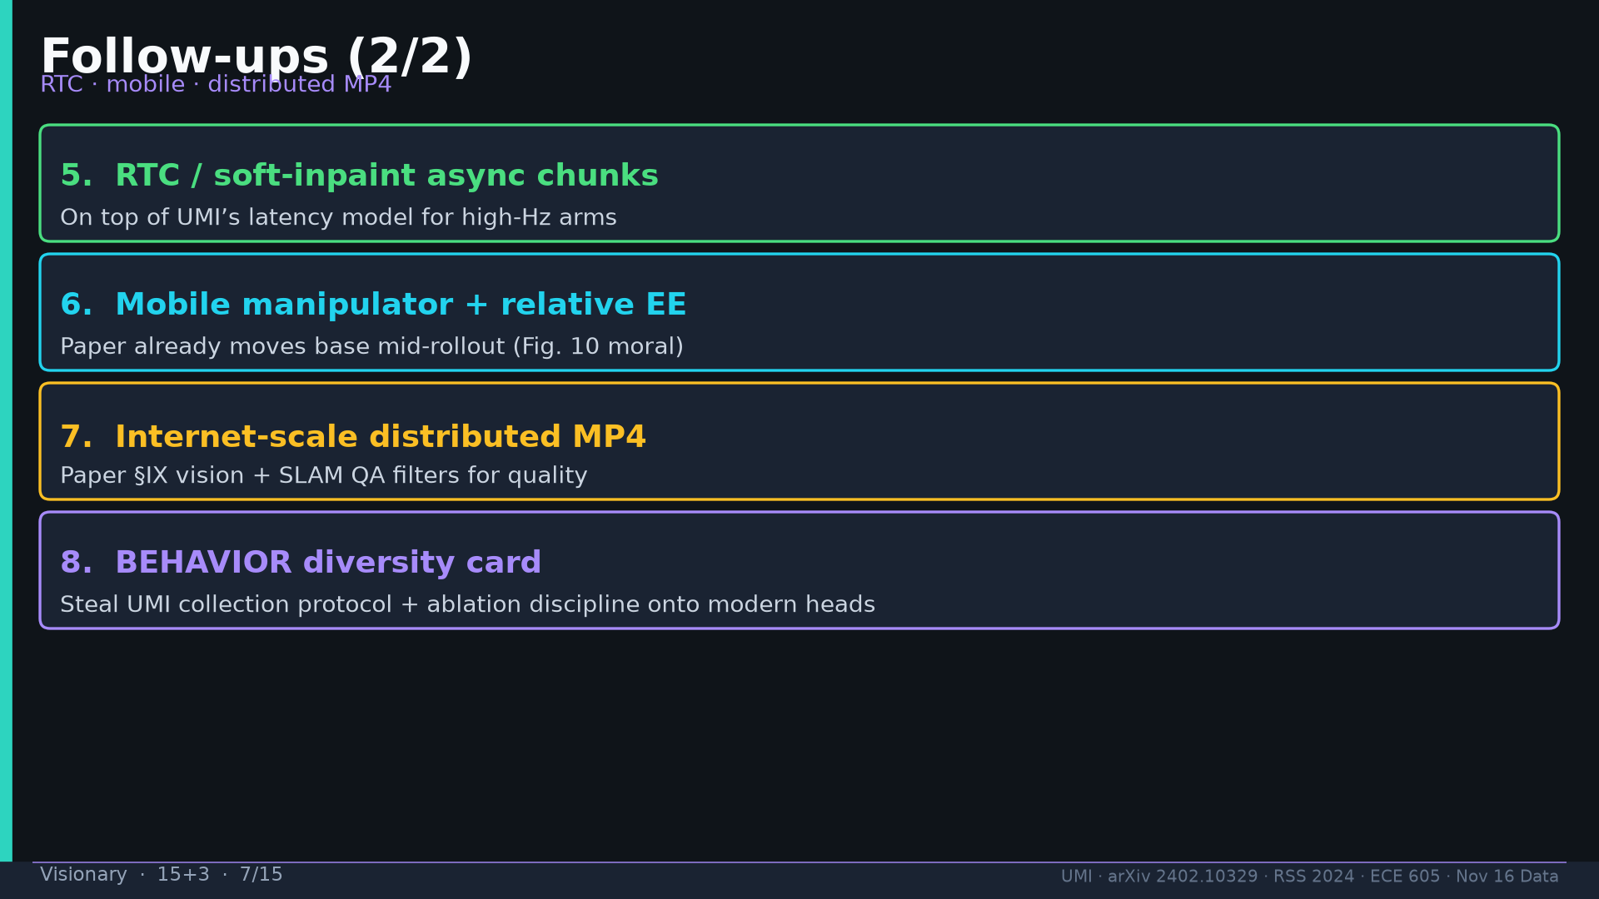
Notes:
Visionary · 15+3 · 7/15
Follow-ups 5–8: RTC/soft-inpaint; mobile+relative EE; distributed MP4+SLAM QA; BEHAVIOR diversity card.
Tattoo: cup 100%/90% · toss 87.5% (no lat 57.5%) · wild 1400/30 → 71.7% vs narrow 0% · rel 100% vs abs 25% · fisheye vs 69° 55% · cloth 70%/30% · dish 70%/0% · Ta=6 @10Hz (20Hz toss)

Slide 8
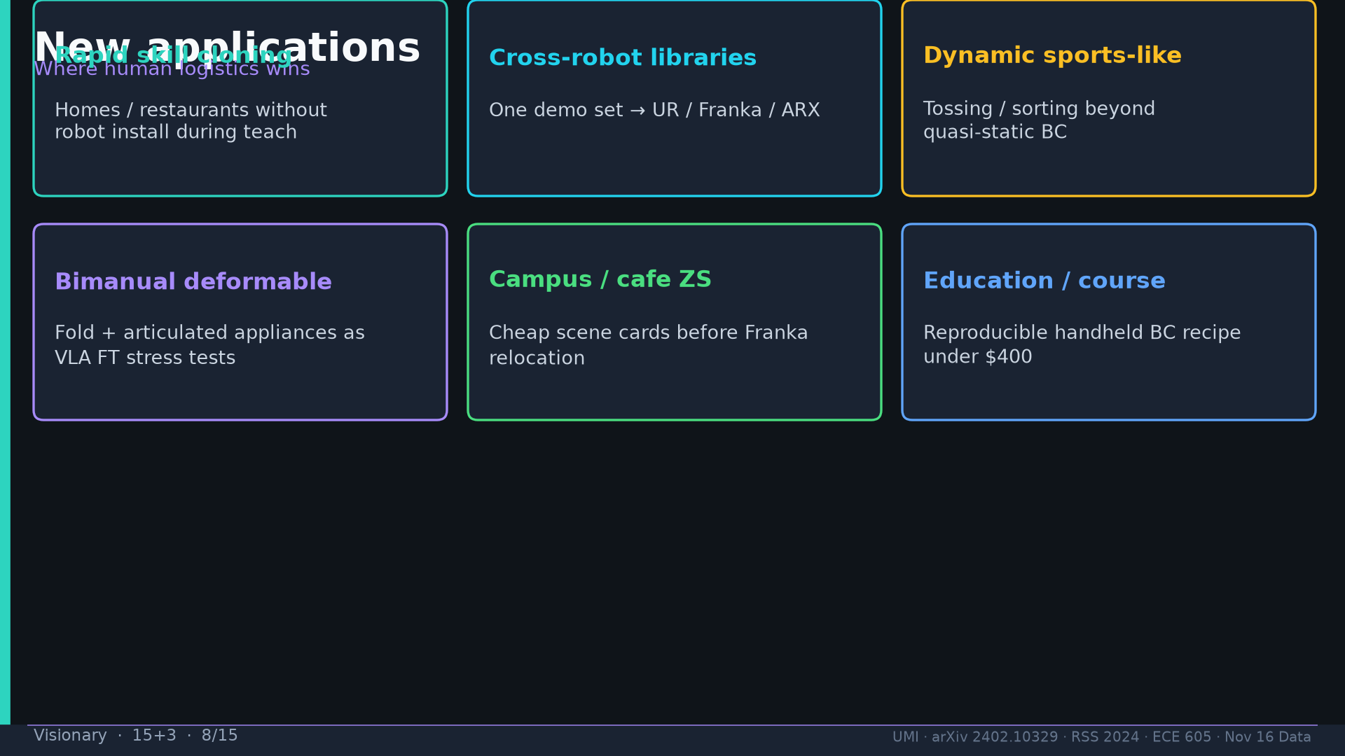
Notes:
Visionary · 15+3 · 8/15
New apps: homes/restaurants; cross-robot libraries; dynamic sports-like; bimanual deformable; campus ZS; education <$400.
Tattoo: cup 100%/90% · toss 87.5% (no lat 57.5%) · wild 1400/30 → 71.7% vs narrow 0% · rel 100% vs abs 25% · fisheye vs 69° 55% · cloth 70%/30% · dish 70%/0% · Ta=6 @10Hz (20Hz toss)

Slide 9
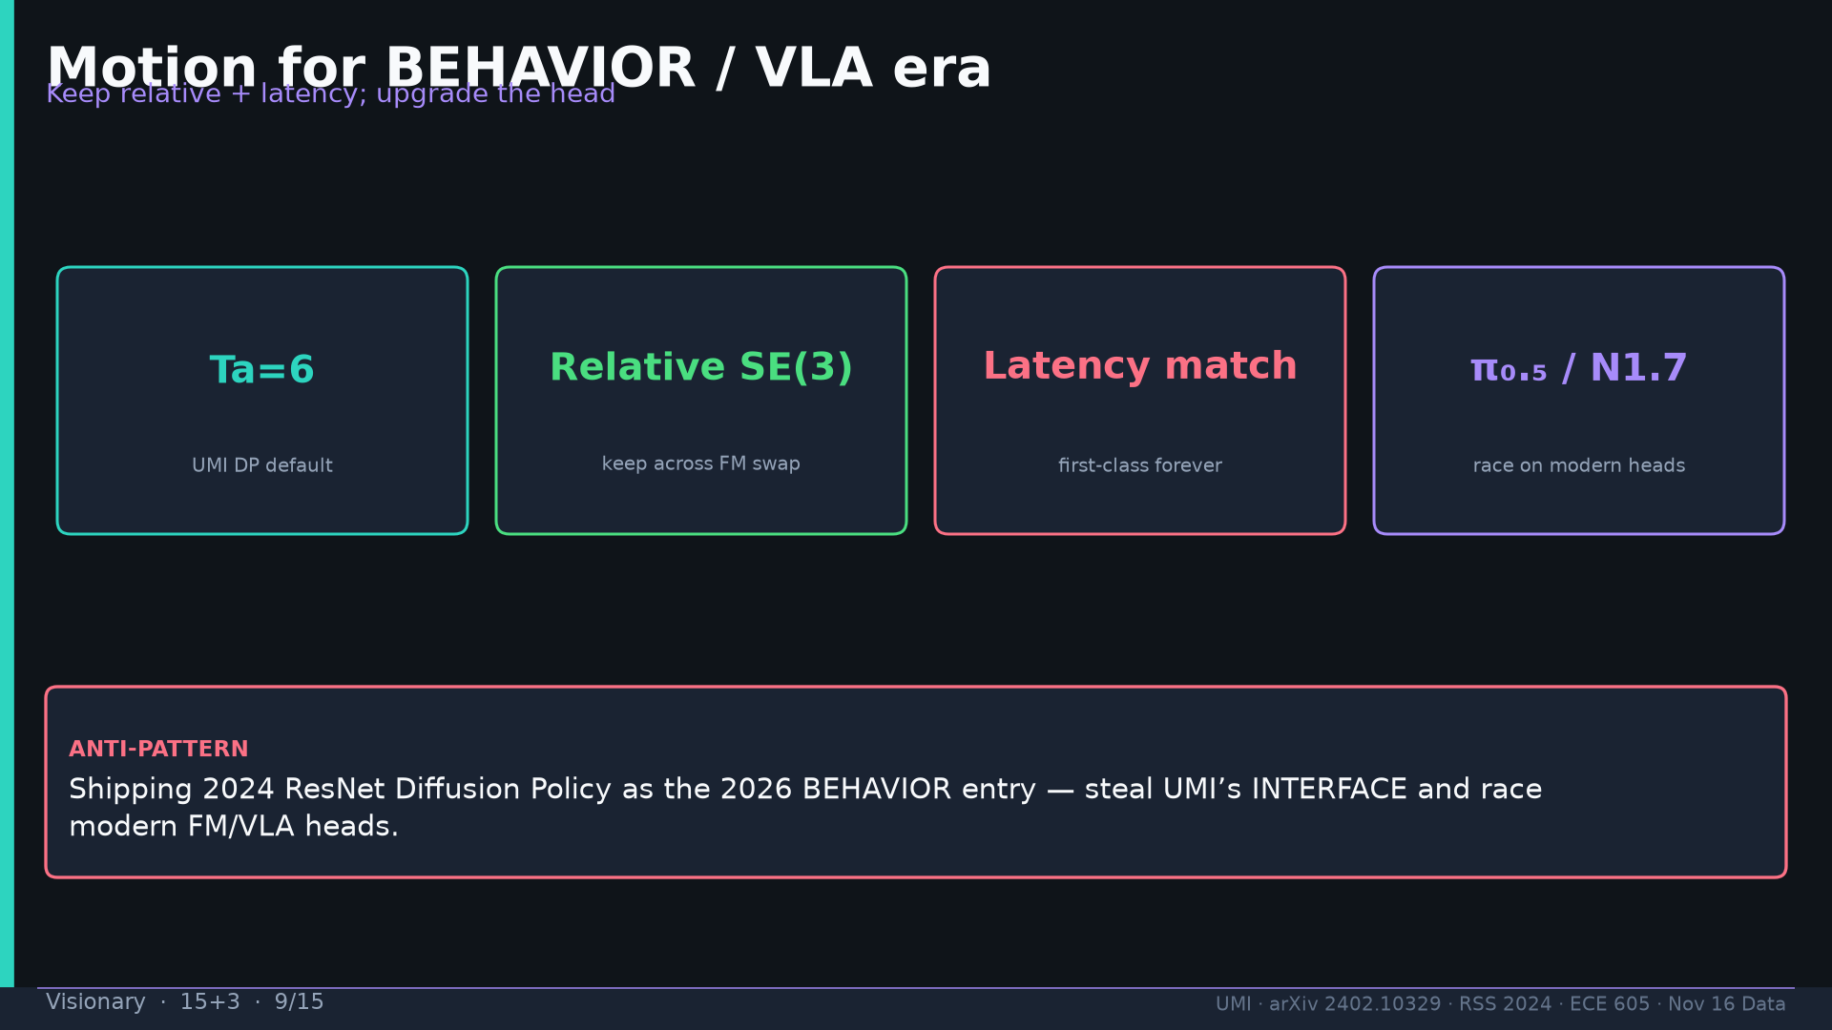
Notes:
Visionary · 15+3 · 9/15
Motion: keep relative+latency; upgrade head to π₀.₅/N1.7. Anti-pattern: shipping 2024 ResNet DP as 2026 entry.
Tattoo: cup 100%/90% · toss 87.5% (no lat 57.5%) · wild 1400/30 → 71.7% vs narrow 0% · rel 100% vs abs 25% · fisheye vs 69° 55% · cloth 70%/30% · dish 70%/0% · Ta=6 @10Hz (20Hz toss)

Slide 10
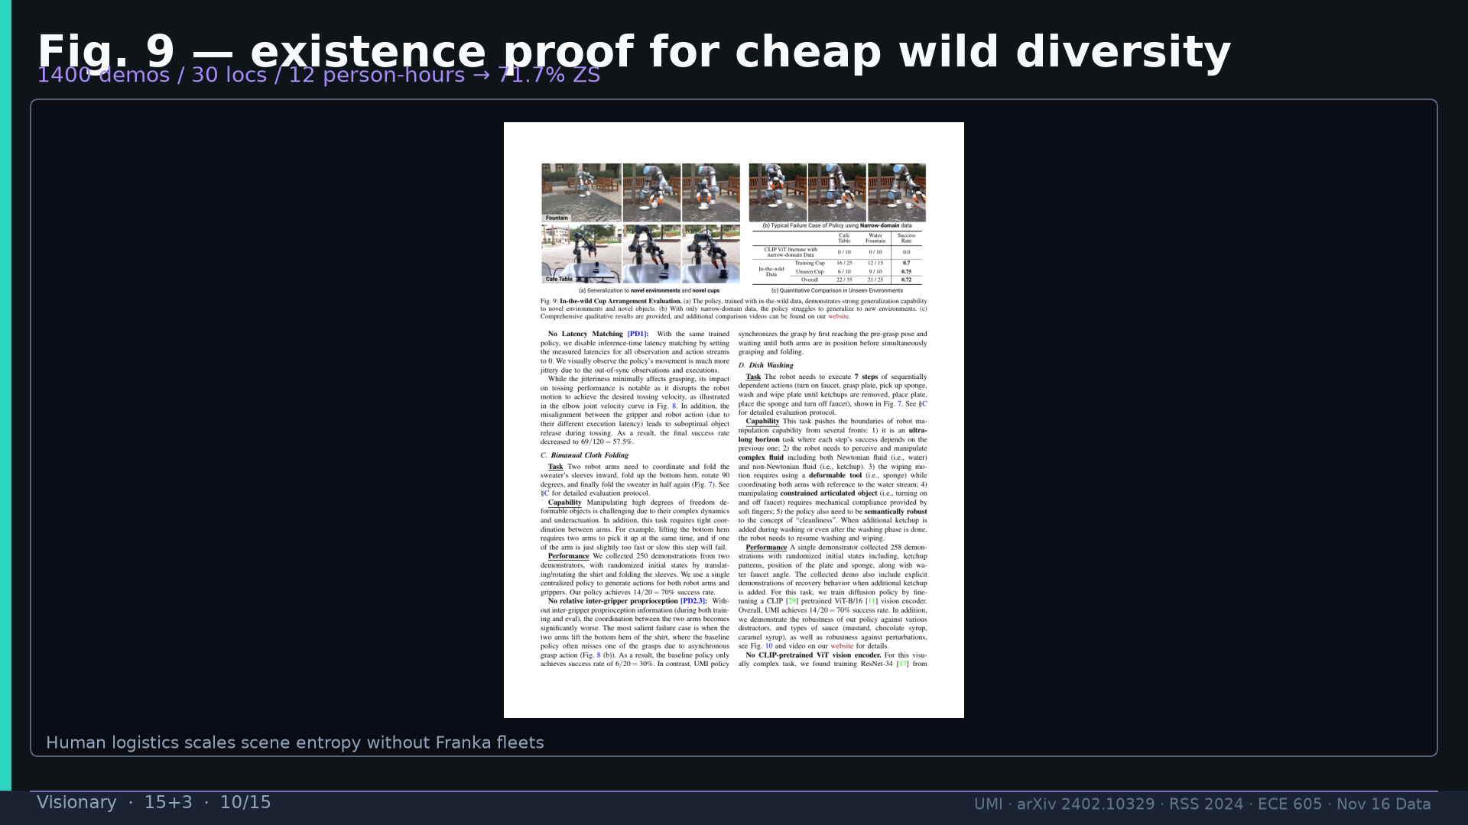
Notes:
Visionary · 15+3 · 10/15
Fig.9 existence proof: 1400/30/12p-h → 71.7% ZS via human logistics.
Tattoo: cup 100%/90% · toss 87.5% (no lat 57.5%) · wild 1400/30 → 71.7% vs narrow 0% · rel 100% vs abs 25% · fisheye vs 69° 55% · cloth 70%/30% · dish 70%/0% · Ta=6 @10Hz (20Hz toss)

Slide 11
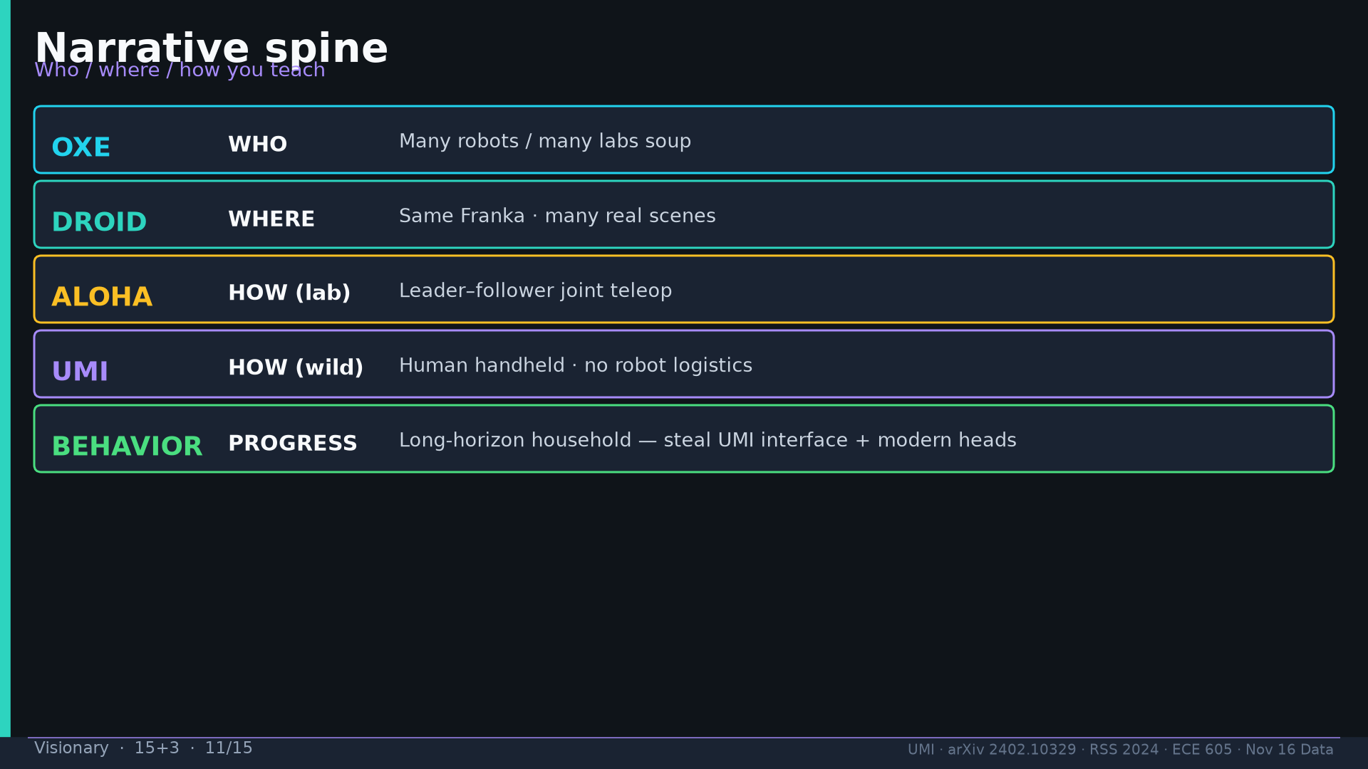
Notes:
Visionary · 15+3 · 11/15
Narrative: OXE=who · DROID=where · ALOHA=how(lab) · UMI=how(wild) · BEHAVIOR=progress.
Tattoo: cup 100%/90% · toss 87.5% (no lat 57.5%) · wild 1400/30 → 71.7% vs narrow 0% · rel 100% vs abs 25% · fisheye vs 69° 55% · cloth 70%/30% · dish 70%/0% · Ta=6 @10Hz (20Hz toss)

Slide 12
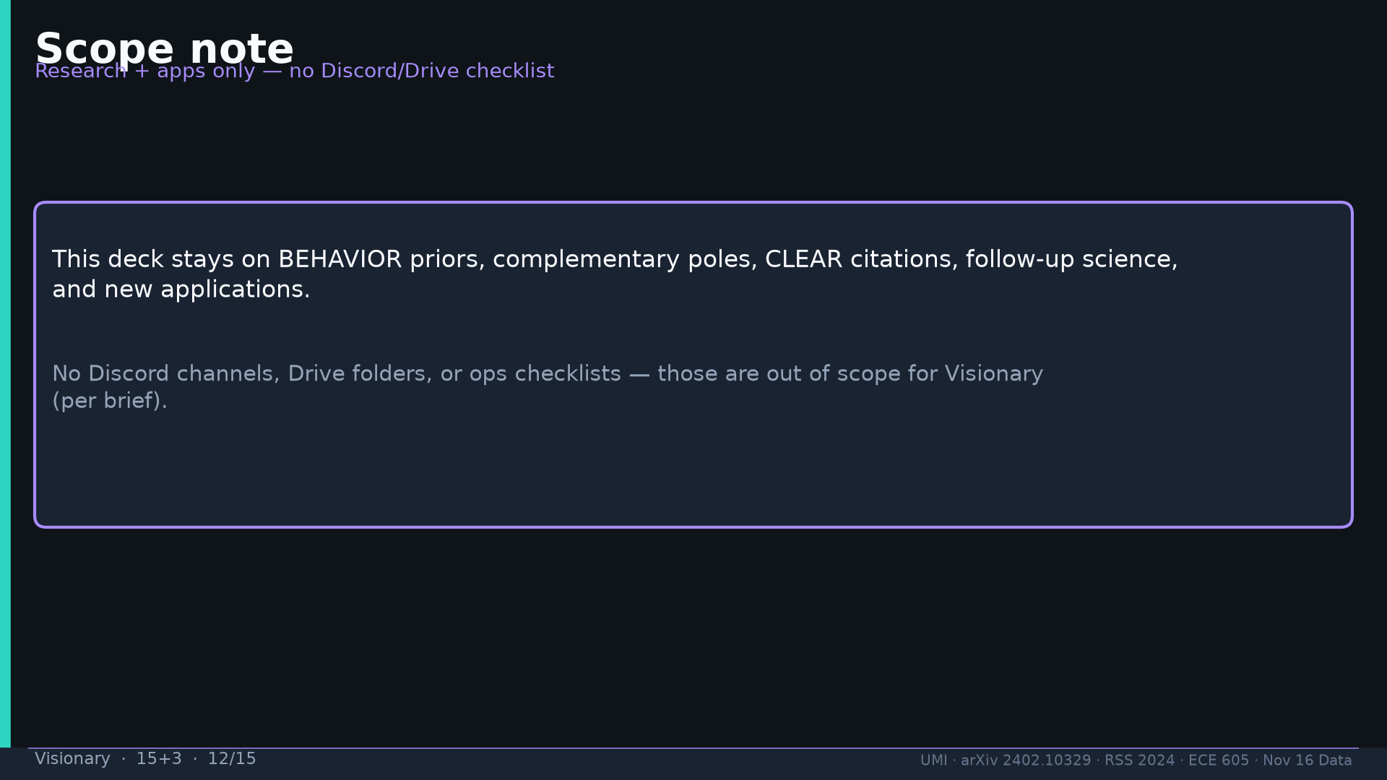
Notes:
Visionary · 15+3 · 12/15
Scope: research+apps only — NO Discord/Drive checklist in this deck.
Tattoo: cup 100%/90% · toss 87.5% (no lat 57.5%) · wild 1400/30 → 71.7% vs narrow 0% · rel 100% vs abs 25% · fisheye vs 69° 55% · cloth 70%/30% · dish 70%/0% · Ta=6 @10Hz (20Hz toss)

Slide 13
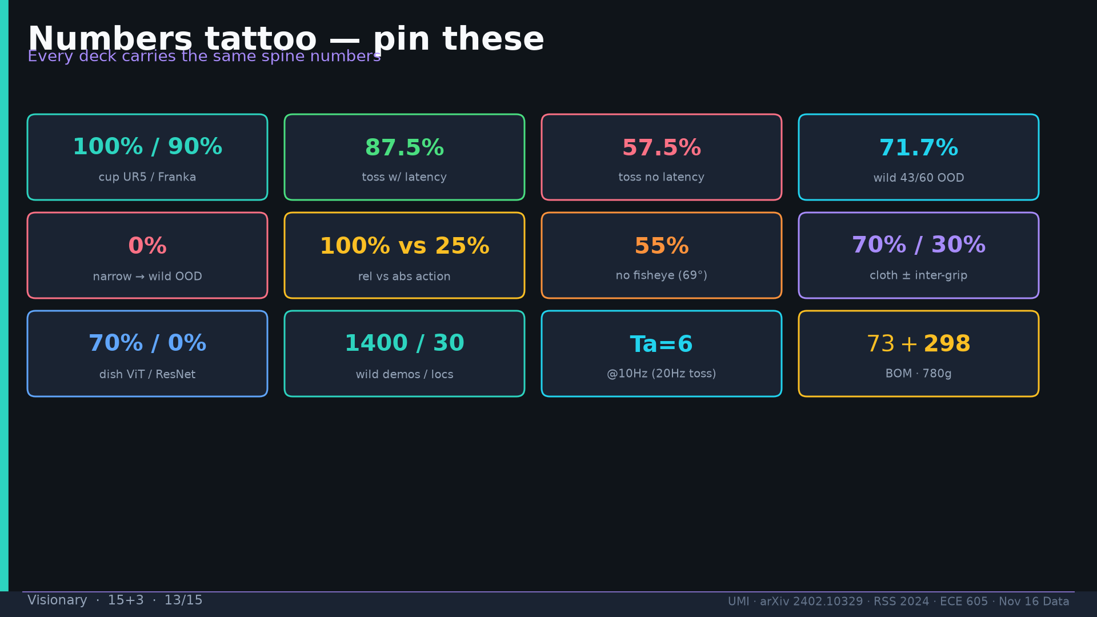
Notes:
Visionary · 15+3 · 13/15
Tattoo.
Tattoo: cup 100%/90% · toss 87.5% (no lat 57.5%) · wild 1400/30 → 71.7% vs narrow 0% · rel 100% vs abs 25% · fisheye vs 69° 55% · cloth 70%/30% · dish 70%/0% · Ta=6 @10Hz (20Hz toss)

Slide 14
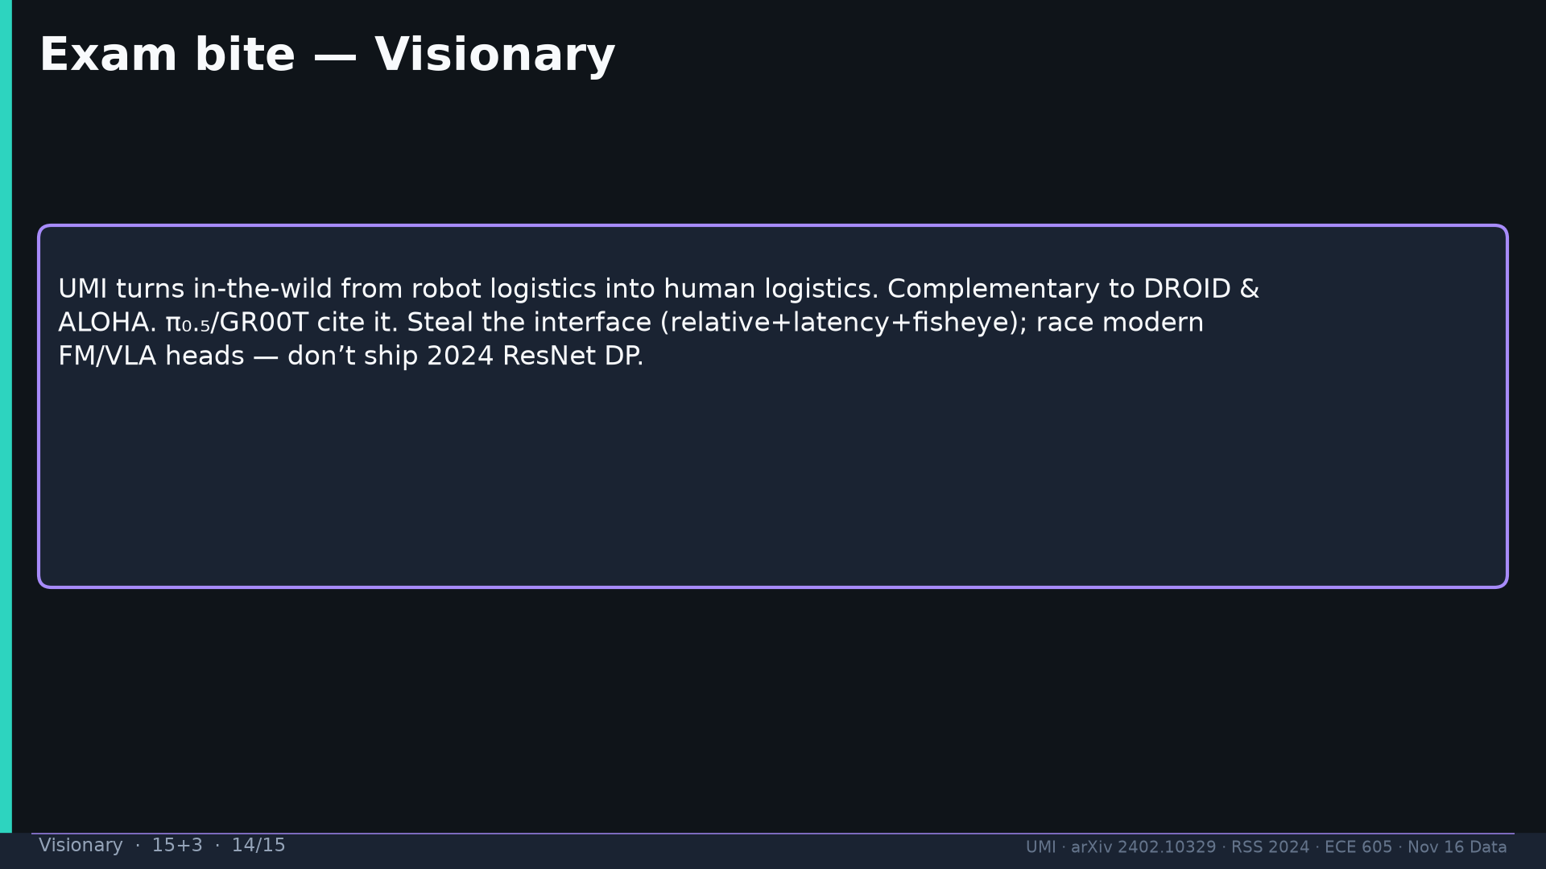
Notes:
Visionary · 15+3 · 14/15
Exam: human logistics; complementary poles; CLEAR cites; steal interface not 2024 DP head.
Tattoo: cup 100%/90% · toss 87.5% (no lat 57.5%) · wild 1400/30 → 71.7% vs narrow 0% · rel 100% vs abs 25% · fisheye vs 69° 55% · cloth 70%/30% · dish 70%/0% · Ta=6 @10Hz (20Hz toss)

Slide 15
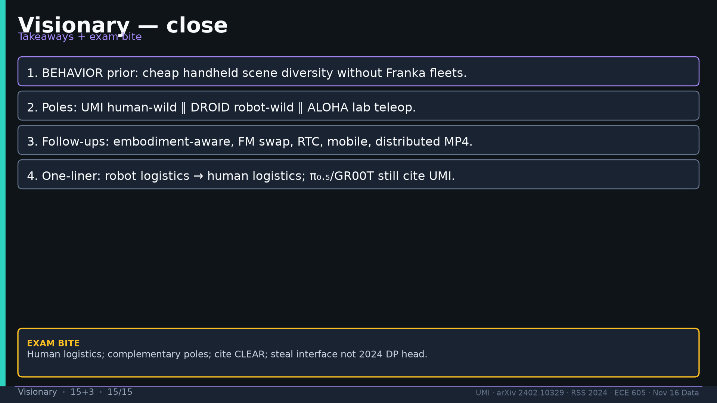
Notes:
Visionary · 15+3 · 15/15
Close. No Discord/Drive content anywhere in deck.
Tattoo: cup 100%/90% · toss 87.5% (no lat 57.5%) · wild 1400/30 → 71.7% vs narrow 0% · rel 100% vs abs 25% · fisheye vs 69° 55% · cloth 70%/30% · dish 70%/0% · Ta=6 @10Hz (20Hz toss)

