Slide 1
LAST SHEET · ALTERNATIVE APPROACHES · EMPIRICIST
Smoke the knives.
Do not reprint Fig. 5.
Ablation Bot AUTHORITATIVE ranks 1–7 (re-aligned over DELIVERABLE pending note). Primary: RC1 FVLMoE vs π₀, RC2 fusion, RC3 insertion metrics. Smoke ≠ paper claims.
#1
#2
#3
#4
#5
#6
#7
Tab.3 fusion
Insert Plug
Insert USB
Averages
Occlusion
Multi-task
Pump caveat
Y
Y
Y
Y
Part
Part
cite
Pass: directional morals on fusion + insertion with force_fusion logged.
Fail: writing “we reproduced Fig.5 60.5%” off a 1-task stub. N: paper-scale Flexiv / 8×4090.
ForceVLA · arXiv 2505.22159v3 · Alt approaches · LAST sheet · Club Pack
Empiricist 1 / 12
Notes:
All seats empty — balanced Empiricist, not weight-3 over-index.
• AUTHORITATIVE: /workspace/papers/forcevla-2505.22159-ablations.md ranks 1–7. Folded over DELIVERABLE's PDF-only pending ranks.
• Course smoke RC cards: RC1 fvlmoe_vs_pi0, RC2 fusion_stage, RC3 insertion_metrics PRIMARY; Partial gen/router; N paper-scale.
• Smoke ≠ Tab.1 / Fig.5 absolute paper claims.

Slide 2
SHARED SPINE · TATTOO ON EVERY DECK
Five facts that do not change with the seat
01
Late 6-axis F/T + FVLMoE
After VLM (PaliGemma/SigLIP): project wrench → force token → FVLMoE (E=4, top-1) → additive guide into π₀ flow-matching action head. Force stays late.
02
Contact-rich on Flexiv
Insert USB / plug, pump bottle, wipe board, peel cucumber. ForceVLA-Data: 244 traj / ~140k steps / ~50 demos per task. Quest3 teleop.
03
Must-cites
Avg 60.5 vs π₀-base w/o F 37.3 (+23.2). Naive w/ F only 40.2 (+2.9). Early MoE-before-VLM 0% → late FVLMoE 80% (Tab.3). Occlusion 90%. FAST+naive force 31.0→14.2.
04
CLEAR contrasts
NOT MoPA-PD ancestor (MoPA = MP privilege→vision student; ForceVLA = deploy force into VLA). NOT JEPA/WM child. No π₀.₅ bake-off — do not invent.
05
Number hygiene
Typo fix: 37.3 = w/o F (not w/ F). Preserve paper numbers. No invented BEHAVIOR SR. Pump caveat: naive w/F 83 > ForceVLA 67 — do not overclaim.
ForceVLA · arXiv 2505.22159v3 · Alt approaches · LAST sheet · Club Pack
Empiricist 2 / 12
Notes:
Shared spine — say this before the role-specific argument.
• Late 6-axis F/T token + FVLMoE (E=4 top-1) after VLM → additive guide into π₀ FM action head.
• Contact-rich insert/wipe/peel on Flexiv; ForceVLA-Data 244 traj / 140k / ~50/task.
• Must-cites: 60.5 vs 37.3 (+23.2); naive w/F 40.2 (+2.9); early MoE 0% / late FVLMoE 80%; occlusion 90%; FAST+naive 31→14.2.
• NOT MoPA-PD ancestor. NOT JEPA/WM child. No π₀.₅ bake-off.
• Typo: 37.3 = w/o F. Pump: naive 83 > ForceVLA 67. No invented BEHAVIOR SR.
• Empiricist use: paper numbers stay citations. Your runs are labeled smoke. Never paste a smoke SR into a Fig.5 cell.

Slide 3
ABLATION BOT · RANKS 1–7
AUTHORITATIVE — fold over DELIVERABLE pending
1
Tab.3 fusion-stage
Y
Early MoE 0% / concat 60 / FVLMoE 80. Cleanest FVLMoE test.
2
Fig.5 Insert Plug
Y
fast 25/30; base 45/60; ForceVLA 80. Abstract 80% story.
3
Fig.5 Insert USB
Y
Force on/off NULL for π₀ (0/0, 5/5); FVLMoE only gain → 25.
4
Fig.5 averages + FAST hurt
Y
60.5 vs 37.3 (+23.2); naive +2.9; fast 31.0→14.2.
5
Tab.2 occl / Obj Gen.2
Part
Occlusion 90 vs 60/30; Obj Gen.2 40. Naive can hurt.
6
Tab.5 multi-task
Part
Avg 67.5 vs 42.5 / 5 / 0. Plug saturates both force methods.
7
Pump Bottle reversal
cite
Naive w/F 83 > ForceVLA 67. Falsifier — do not overclaim.
ForceVLA · arXiv 2505.22159v3 · Alt approaches · LAST sheet · Club Pack
Empiricist 3 / 12
Notes:
Minimum package: #1+#2+#3+#4 (as RC1/RC2/RC3 morals), Partial #5/#6, cite #7 Pump.
• Honorable not top-7: Tab.1 peel continuous; Wipe Board FAST win; Fig.9 router (no SR).
• DELIVERABLE had PDF-derived ranks with Ablation Bot PENDING — this deck uses Ablation Bot order.

Slide 4
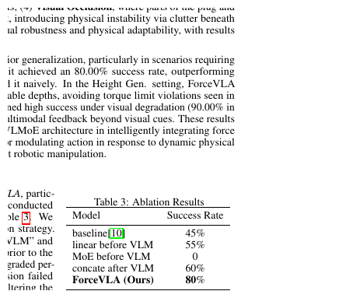
PRIMARY · RANK 1 · RC2
Fusion stage: early MoE 0% vs late FVLMoE 80%
#1 / RC2 smoke
{early_linear, early_moe_stub, late_concat, late_fvlmoe} on 1 task / short FT.
Hard log
force_fusion = early_linear | early_moe | concat | fvlmoe. force_source = true|est|stub.
Paper moral
Late ≥ early. Early MoE must not win (cite 0% if untrainable).
Not required
Matched Tab.3 80% absolute. Task identity for Tab.3 is underspecified — treat as plug-scale correspondence.
ForceVLA · arXiv 2505.22159v3 · Alt approaches · LAST sheet · Club Pack
Empiricist 4 / 12
Notes:
Rank 1. Table 3 §5.4. Ablation Bot: only labeled ablation; cleanest FVLMoE test.
• Late stage only: concat 60 vs FVLMoE 80 (+20).
• Early: linear 55 vs MoE 0 — 0% may be unstable training; still highest-value rerun.
• Pass: late ≥ early directional. Fail: claiming Tab.3 80% from stub.

Slide 5
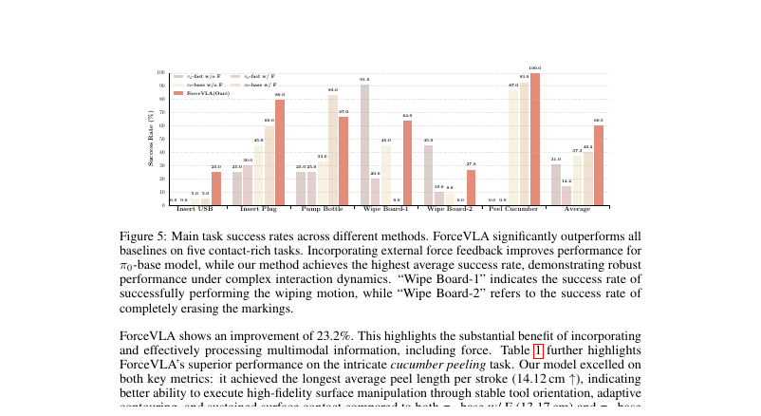
PRIMARY · RANKS 2–3 · RC3
Insert Plug 80% story + USB force-null
#2 Insert Plug
25/30 → 45/60 → 80
Naive +15 on base; FVLMoE +20 more.
#3 Insert USB
Force on/off NULL for π₀
fast 0/0; base 5/5; FVLMoE 25 only gain.
RC3 harness
Log SR, align error, peak |F|. Prefer Plug; USB shows modality≠gain.
ForceVLA · arXiv 2505.22159v3 · Alt approaches · LAST sheet · Club Pack
Empiricist 5 / 12
Notes:
Ranks 2–3. Do not cite 80% for USB.
• Eval protocol: 20 trials insertion. Quote printed labels; some rates not integer multiples of 1/20 (Pump 33/67/83).
• RC3: metrics JSON filled even on stub/replay. No invented paper scores.

Slide 6
PRIMARY · RANK 4 · RC1
Averages +23.2 and the FAST hurt
π₀-fast w/ F
14.2%
naive force HURTS
π₀-fast w/o F
31.0%
FAST foil
π₀-base w/o F
37.3%
headline foil (typo: not w/ F)
π₀-base w/ F
40.2%
+2.9 only
ForceVLA
60.5%
+23.2 vs 37.3
ForceVLA · arXiv 2505.22159v3 · Alt approaches · LAST sheet · Club Pack
Empiricist 6 / 12
Notes:
Rank 4 / RC1 PRIMARY bakeoff moral.
• Matched-budget: FVLMoE vs π₀-base w/o F vs naive w/ F on 1 contact-rich task.
• Pass: directional FVLMoE ≥ concat ≥ none on SR or contact metrics. Not required: 5-task 60.5 absolute.
• Do not treat π₀-fast + naive F as a fair FVLMoE substitute.

Slide 7
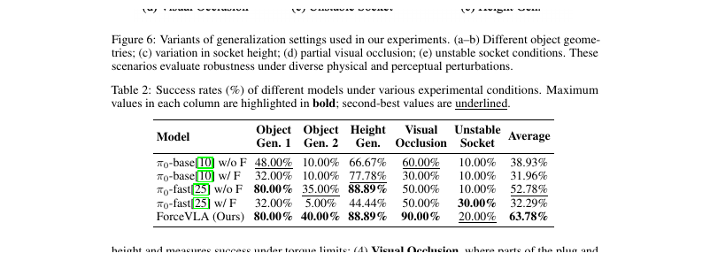
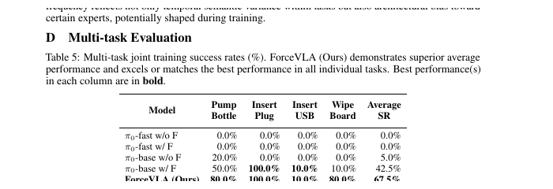
PARTIAL · RANK 5–6
Occlusion Partial · multi-task Partial/cite
#5 RC5 Partial
Occlusion stub: mask socket/plug ROI. Force-on ≥ force-off directional.
Paper: ForceVLA 90%; base w/F 30% (naive hurts).
#6 Tab.5 Partial/cite
Optional 2-task short joint FT; else cite 67.5 / 42.5 / 5 / 0.
Plug 100 both force methods — does not isolate FVLMoE.
USB 10% both — soft precision insert.
ForceVLA · arXiv 2505.22159v3 · Alt approaches · LAST sheet · Club Pack
Empiricist 7 / 12
Notes:
Partial add-ons. Unstable socket cite (ForceVLA 20; fast w/F 30).
• Router Fig.9 Partial RC6: log top-1 vs progress; do not claim Fig.9 reproduction. Expert-0 ~half tokens — interpretive.

Slide 8
CAVEAT · RANK 7
Pump Bottle: naive w/F 83 > ForceVLA 67
Falsifier column
Replication order
Fig.5 Pump: fast 25/25; base w/o F 33; base w/F 83; ForceVLA 67. Naive state-concat beats FVLMoE by 16 pp.
Replicate Plug/USB first. Treat Pump as a falsifier, not a confirmation. Do not bury it in speaker notes only.
Tab.5 regime shift
Honesty rule
Under joint train Pump flips: ForceVLA 80 > base w/F 50. Regime matters — log training regime.
Never brief 'ForceVLA wins every contact task.' Avg +23.2 and Plug 80 survive; Pump does not.
ForceVLA · arXiv 2505.22159v3 · Alt approaches · LAST sheet · Club Pack
Empiricist 8 / 12
Notes:
Ablation Bot rank 7: necessary caveat. Do not overclaim.
• Wipe Board-1: fast w/o F 91 > ForceVLA 64 — another negative control if testing 'force always helps'.

Slide 9
COURSE SMOKE MATRIX
RC0–RC7 · what Y / Partial / N mean
RC0
data ingest
Y
Schema {V^b,V^h,s,f∈R^6,a,L}; wrench dim=6; <1h
RC1
FVLMoE vs π₀
Y
3 methods × 1 task short; log force_fusion
RC2
fusion stage
Y
early vs late; early_moe must not win
RC3
insertion metrics
Y
SR / align / peak|F| harness; no invented scores
RC4
data scale
Y/P
{10,25,50} demos stub or coverage report
RC5
occlusion gen
Part
mask ROI; directional force-on ≥ off
RC6
router log
Part
top-1 hist; non-degenerate only
RC7
multi-task
cite
optional 2-task stub; else Tab.5 cite
—
paper Flexiv
N
8×4090 / 5-task 20-trial protocol out of course
ForceVLA · arXiv 2505.22159v3 · Alt approaches · LAST sheet · Club Pack
Empiricist 9 / 12
Notes:
Scout success: RC1+RC2+RC3 (+RC0) with directional morals + honest force_source.
• Est. GPU-h: RC0 0–1; RC3 1–4; RC2 6–20; RC1 8–24; paper single ~9h cite/N; multi ≫24 N.

Slide 10
WHAT NOT TO CLAIM
Smoke hygiene — refuse these sentences
No Fig.5 laundry
No Tab.3 laundry
No stub = ForceVLA-Data
Do not claim 60.5% absolute from 1-task Partial smoke. Label smoke SR as smoke.
Do not claim 80% without matched task + fusion settings. Cite 0% if early MoE untrainable.
Sim/stub wrench ≠ ForceVLA-Data reproduction. Log force_source honestly.
No FAST+F substitute
No paper-scale as smoke
No invented bars / π₀.₅
π₀-fast + naive F regresses 31→14.2. Not a fair FVLMoE stand-in.
8×4090 / 30k multi-task / full 5-task Flexiv eval = N for course.
Quote prose/tables/printed labels. No π₀.₅ numbers. No invented BEHAVIOR SR.
ForceVLA · arXiv 2505.22159v3 · Alt approaches · LAST sheet · Club Pack
Empiricist 10 / 12
Notes:
DELIVERABLE §4 what-NOT-to-claim, reinforced after Ablation Bot fold.
• Typo fix preserved: 37.3 = w/o F.

Slide 11
NUMBERS TO CITE (LOCKED)
Do not round away — refuse laundering foils
Averages
Insertion
Ablation / gen
ForceVLA 60.5; base w/o F 37.3; w/F 40.2; fast w/o F 31.0; w/F 14.2; Δ +23.2
Plug 80; USB 25 (π₀ force-null). Peel 14.12 cm / 7 strokes.
Tab.3: 45 / 55 / 0 / 60 / 80. Occlusion 90. Gen avg 63.78.
Data / train
Hyperparams
One-liner
244 traj / 140k / ~50/task. LR 2.5e-5→2.5e-6. Multi 30k/~12h 2×4090. Single 10k/~9h.
Force 6→2048; MoE D=2048, E=4, k=1, 8 heads; action expert 1024; Adam β 0.9/0.95; bf16; clip 1.0
Quote 60.5/37.3/+23.2, occlusion 90, early MoE 0 vs late 80; refuse FAST or π₀.₅ as headline foil.
ForceVLA · arXiv 2505.22159v3 · Alt approaches · LAST sheet · Club Pack
Empiricist 11 / 12
Notes:
Empiricist one-liner from pack.
• Multi-task ForceVLA avg 67.5 (plug 100, USB 10).

Slide 12
CLOSE
Directional morals. Honest force_source. No Fig.5 reprint.
Minimum: RC1 + RC2 + RC3 with Ablation Bot morals #1–#4.
Cite Pump #7. Partial occlusion/router. N paper-scale Flexiv.
If someone pastes smoke SR into a Fig.5 cell — that run fails Empiricist review.
Next: Archaeologist — π₀ parent → late force → FVLMoE → FM; CLEAR vs MoPA / JEPA.
ForceVLA · arXiv 2505.22159v3 · Alt approaches · LAST sheet · Club Pack
Empiricist 12 / 12
Notes:
End Empiricist. Balanced Club Pack depth.

