Slide 1
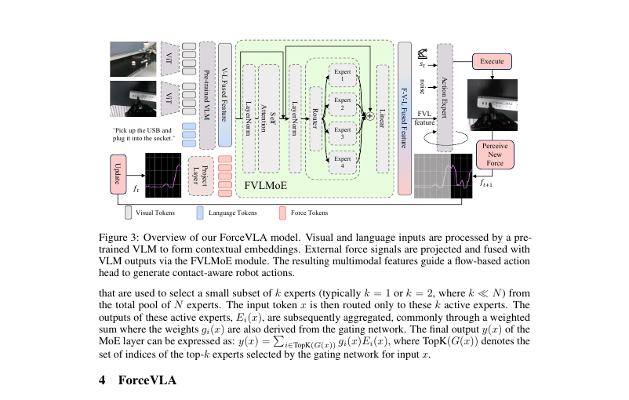
LAST SHEET · ALTERNATIVE APPROACHES · ARCHAEOLOGIST
Force joins the
token zoo late.
π₀ parent → late 6D force token → FVLMoE (4 experts, top-1) → additive FM guidance. Association cortex for force; π₀'s FM head stays motor cortex.
ForceVLA · arXiv 2505.22159v3 · Alt approaches · LAST sheet · Club Pack
Archaeologist 1 / 12
Notes:
Archaeologist open. Genealogy talk, not a product pitch.
• One-liner: Force joins the VLA token zoo AFTER the pretrained VLM — FVLMoE is association cortex; π₀ FM head stays motor cortex.
• Exam bite on its own slide later.

Slide 2
SHARED SPINE · TATTOO ON EVERY DECK
Five facts that do not change with the seat
01
Late 6-axis F/T + FVLMoE
After VLM (PaliGemma/SigLIP): project wrench → force token → FVLMoE (E=4, top-1) → additive guide into π₀ flow-matching action head. Force stays late.
02
Contact-rich on Flexiv
Insert USB / plug, pump bottle, wipe board, peel cucumber. ForceVLA-Data: 244 traj / ~140k steps / ~50 demos per task. Quest3 teleop.
03
Must-cites
Avg 60.5 vs π₀-base w/o F 37.3 (+23.2). Naive w/ F only 40.2 (+2.9). Early MoE-before-VLM 0% → late FVLMoE 80% (Tab.3). Occlusion 90%. FAST+naive force 31.0→14.2.
04
CLEAR contrasts
NOT MoPA-PD ancestor (MoPA = MP privilege→vision student; ForceVLA = deploy force into VLA). NOT JEPA/WM child. No π₀.₅ bake-off — do not invent.
05
Number hygiene
Typo fix: 37.3 = w/o F (not w/ F). Preserve paper numbers. No invented BEHAVIOR SR. Pump caveat: naive w/F 83 > ForceVLA 67 — do not overclaim.
ForceVLA · arXiv 2505.22159v3 · Alt approaches · LAST sheet · Club Pack
Archaeologist 2 / 12
Notes:
Shared spine — say this before the role-specific argument.
• Late 6-axis F/T token + FVLMoE (E=4 top-1) after VLM → additive guide into π₀ FM action head.
• Contact-rich insert/wipe/peel on Flexiv; ForceVLA-Data 244 traj / 140k / ~50/task.
• Must-cites: 60.5 vs 37.3 (+23.2); naive w/F 40.2 (+2.9); early MoE 0% / late FVLMoE 80%; occlusion 90%; FAST+naive 31→14.2.
• NOT MoPA-PD ancestor. NOT JEPA/WM child. No π₀.₅ bake-off.
• Typo: 37.3 = w/o F. Pump: naive 83 > ForceVLA 67. No invented BEHAVIOR SR.
• Archaeologist use: spine is the lineage tattoo. Contrasts with MoPA/JEPA are CLEAR labels, not ancestry.

Slide 3
GENEALOGY
π₀ parent → late force → FVLMoE → FM
1
2
3
PaliGemma / SigLIP VLM
π₀ FM action expert
Late 6-axis force token
Vision + language contextual embeddings. Pretrained geometry to protect.
Conditional flow matching + action chunks. Vision+language+proprio parent.
φ_F: R^6 → 2048 AFTER VLM. Not early into VL prefix.
4
5
6
FVLMoE E=4 top-1
Additive FM suffix
ForceVLA-Data + Flexiv
Attn refine → sparse MoE → residual → project 2048→1024.
G_FVLMoE added to proprio + noisy-action features each denoising step.
244 traj / 140k / ~50/task. Contact-rich real policy.
ForceVLA · arXiv 2505.22159v3 · Alt approaches · LAST sheet · Club Pack
Archaeologist 3 / 12
Notes:
Walk the genealogy top-left to bottom-right.
• CLEAR: builds upon the π₀ framework (Black et al. 2410.24164).
• CLEAR: ForceVLA does not replace FM with FAST.
• Biological metaphor in paper: late fusion ≈ higher-level cortical association.

Slide 4
PRIORS ABSORBED (CLEAR)
What ForceVLA cites as parents and neighbors
π₀ Black et al.
PaliGemma / SigLIP
Flow matching
Direct architectural parent. PaliGemma + FM action expert. Baselines π₀-base / π₀-fast ± force.
Beyer et al.; Zhai et al. VLM backbone for VL contextual embeddings.
Lipman et al.; Liu rectified flow. Action expert family retained.
FAST Pertsch et al.
VLA lineage
MoE lineage
Baseline action-tokenization foil (π₀-fast). Not ForceVLA's head.
OpenVLA / RT-1 / RT-2 / Octo / OXE / DROID / Bridge — related work. Numbers foil is π₀.
Shazeer MoE, Switch, GShard, V-MoE, ST-MoE, LIMOE; robotics MoE (MORE, ChatVLA).
ForceVLA · arXiv 2505.22159v3 · Alt approaches · LAST sheet · Club Pack
Archaeologist 4 / 12
Notes:
Force/tactile neighbors: ForceMimic, FoAR, TacDiffusion, Adaptive Compliance, FORGE, Xie & Correll survey; TLA, Tac-Man.
• π₀.₅ cited as related VLA [21] — NOT experimental foil here.

Slide 5
CLEAR CONTRAST · MOPA-PD
Same Alt row. Opposite arrow. Not an ancestor.
MoPA-PD (2111.06383)
ForceVLA (2505.22159)
Train-time privilege
Classical MP (RRT-Connect) inside MoPA-RL → visual BC → asymmetric SAC.
Deploy
Planner-free pixels. Geometry privilege removed at ship time.
Syllabus
Prior Alt approaches row. Privileged teacher → vision student.
Deploy-time modality
Add 6-axis F/T into a π₀-class VLA via late MoE fusion.
Deploy
Force stream stays at inference. FM action head retained.
Syllabus
LAST Alt row. Complementary question: missing modality for contact-rich VLA.
ForceVLA · arXiv 2505.22159v3 · Alt approaches · LAST sheet · Club Pack
Archaeologist 5 / 12
Notes:
CLEAR contrast labels only. Do not invent MoPA ancestry.
• Inverse arrow: MoPA removes privilege at deploy; ForceVLA adds sensor privilege at deploy.
• Sibling path: /workspace/distill-mopa-quiet/ — CLEAR contrast decks exist.

Slide 6
CLEAR CONTRAST · JEPA / WM / Π₀.₅
Poles and absences — do not invent links
JEPA / LeWM / Cosmos
π₀.₅ (2504.16054)
CLEAR contrast poles only. ForceVLA is not a world-model paper. No latent prediction claim.
Cited in related work [21]. ABSENT from experiments. Sibling literature — not measured. Do not invent bake-off.
π₀-FAST
Classical impedance
Baseline family with/without force. ForceVLA keeps FM. Mythbust: adding force ≠ switching FM↔FAST.
Background of contact-rich control. ForceVLA learns force-conditioned chunks end-to-end rather than hand-tuned compliance loops.
ForceVLA · arXiv 2505.22159v3 · Alt approaches · LAST sheet · Club Pack
Archaeologist 6 / 12
Notes:
Mythbust checklist from summary.
• OpenVLA cited in intro only — not an experimental baseline.
• Sibling: /workspace/pi0-quiet/, /workspace/fast-quiet/, /workspace/pi05-quiet/ (mythbust only).

Slide 7
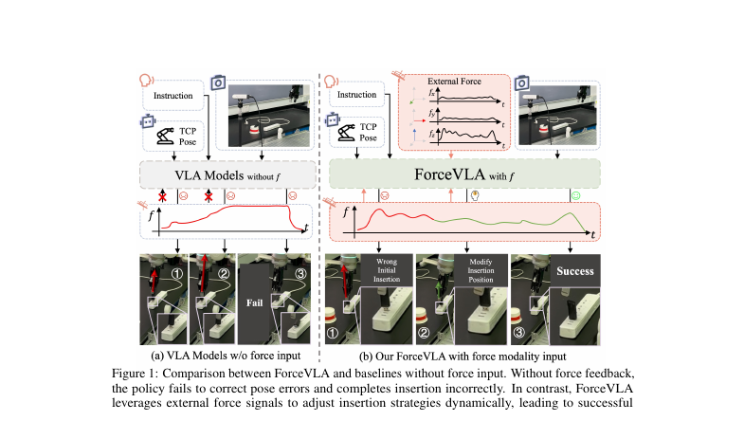
FIG. 1 · FAILURE MODE THAT INVENTS THE LINEAGE
Vision-only VLA meets contact; force corrects
ForceVLA · arXiv 2505.22159v3 · Alt approaches · LAST sheet · Club Pack
Archaeologist 7 / 12
Notes:
Fig.1 is the origin myth slide: without force, pose errors go uncorrected; with force, insertion strategy adapts.
• This is why force becomes a first-class modality after the VLM, not a state-concat afterthought.
• Ties to Tab.3: early MoE into VLM destroys pretrained features; late fusion preserves them.

Slide 8
ARCHITECTURAL DIMS (TABLE 4)
What got bolted onto π₀ — exact specs
Force projection
Linear 6 → D_VLM = 2048
Pre-MoE encoder
D=2048, N_H=8, D_h=256; MLP expansion 1
MoE
E=4 MLP experts, top-k=1; router 2048→4
MoE out / action
2048→1024; action out 1024→32
State / action proj
32 → D_act_e = 1024; τ-MLP 2-layer Swish
Inject
Element-wise add G_FVLMoE into FM suffix
ForceVLA · arXiv 2505.22159v3 · Alt approaches · LAST sheet · Club Pack
Archaeologist 8 / 12
Notes:
App B Table 4. No sweep over expert count, top-k, or loss weight.
• Train: Adam β 0.9/0.95; LR 2.5e-5→2.5e-6; bf16; clip 1.0; single ~9h / multi ~12h.

Slide 9
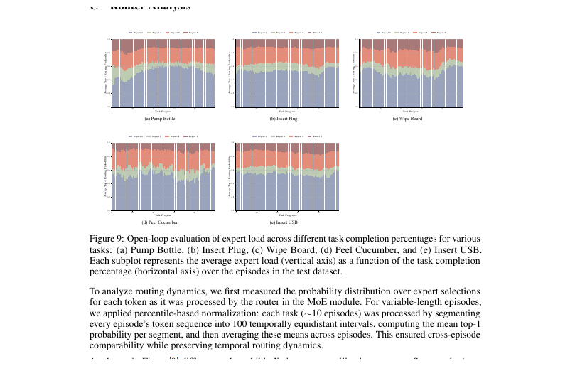
ROUTER ARCHAEOLOGY · FIG. 9
Phase specialization — TENTATIVE labels
Expert 0
~half of tokens. Hypothesized generalist.
Selective
Experts 1/3 more phase-specific on insert/peel.
Wipe
Steadier single-expert preference.
Status
TENTATIVE functional labels. Not proven causal roles. No expert-dropout ablation.
ForceVLA · arXiv 2505.22159v3 · Alt approaches · LAST sheet · Club Pack
Archaeologist 9 / 12
Notes:
App C. Open-loop ~10 episodes/task, percentile-normalized bins.
• Useful after a checkpoint exists; not an SR ablation.

Slide 10
EXAM BITE
Memorize this sentence
ForceVLA = π₀ + late 6D force token + FVLMoE
(4 experts, top-1) additively guiding FM chunks;
+23.2 pts avg vs vision-only π₀-base;
early MoE-into-VLM → 0%.
CLEAR: not MoPA-PD ancestor; not JEPA child; no π₀.₅ bake-off.
CLEAR: keeps FM (not FAST); foil is π₀-base/fast ± force.
ForceVLA · arXiv 2505.22159v3 · Alt approaches · LAST sheet · Club Pack
Archaeologist 10 / 12
Notes:
Exam bite from Archaeologist pack — say it aloud.
• Bonus: occlusion 90%; naive concat +2.9 only; FAST+naive 31→14.2.

Slide 11
LINEAGE TABLE (CLEAR VS TENTATIVE)
Refuse fabrications
Builds on π₀ FM + PaliGemma
CLEAR
Foil = π₀-base / π₀-fast ± force
CLEAR
Empirical π₀.₅ comparison
ABSENT — do not invent
Action head = flow matching
CLEAR
Late ≫ early MoE-into-VLM
CLEAR (Tab.3)
MoPA-PD / JEPA ancestry
FALSE — contrast only
ForceVLA-Data 244 / 140k
CLEAR
Expert-0 = generalist role
TENTATIVE
BEHAVIOR official baseline
TENTATIVE / unverified
ForceVLA · arXiv 2505.22159v3 · Alt approaches · LAST sheet · Club Pack
Archaeologist 11 / 12
Notes:
Consistency notes from summary. Do not fabricate Discord/Drive artifacts or LONGEST-seat imbalance.

Slide 12
CLOSE
Late force. Parent is π₀. Contrasts are labeled.
Association cortex for force. Motor cortex stays FM.
Say the exam bite. Refuse MoPA/JEPA ancestry and invented π₀.₅ numbers.
Next: Visionary — BEHAVIOR contact-rich; F/T + late MoE on modern VLA; NO Discord/Drive.
ForceVLA · arXiv 2505.22159v3 · Alt approaches · LAST sheet · Club Pack
Archaeologist 12 / 12
Notes:
End Archaeologist.

