Slide 1
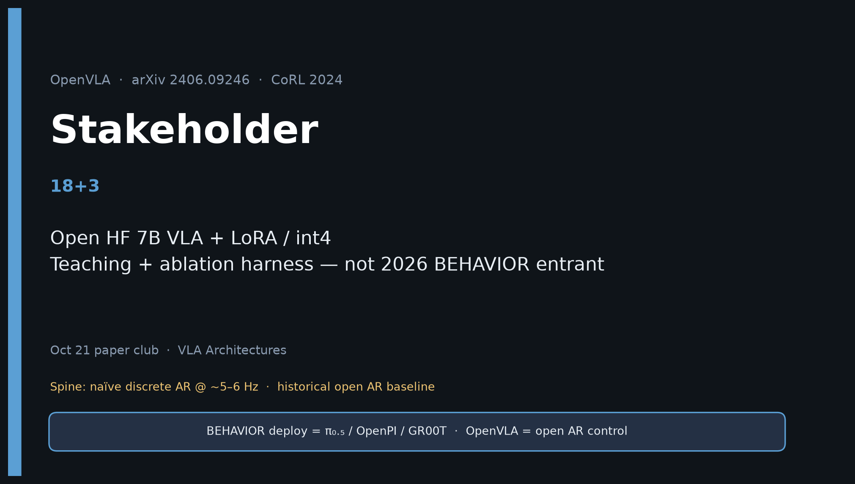
Stakeholder · 18+3 · 1/18
Notes:
STAKEHOLDER — 18+3. No redo later — this is the durable briefing.
You own: buy/build. Open HF 7B + LoRA/int4 for teaching + ablation.
2026: NOT BEHAVIOR entrant — ship π₀.₅/GR00T. Keep OpenVLA in harness as AR control.
Open with taxonomy so leadership hears the action-family frame first.

Slide 2
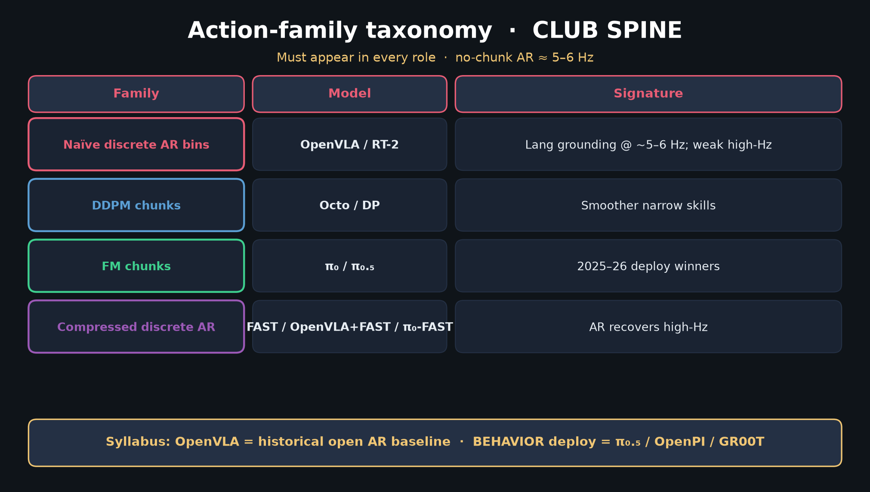
Stakeholder · 18+3 · 2/18
Notes:
TAXONOMY — leadership version of the club spine.
OpenVLA = naïve discrete AR. Deploy winners = FM chunks (π₀.₅).

Slide 3
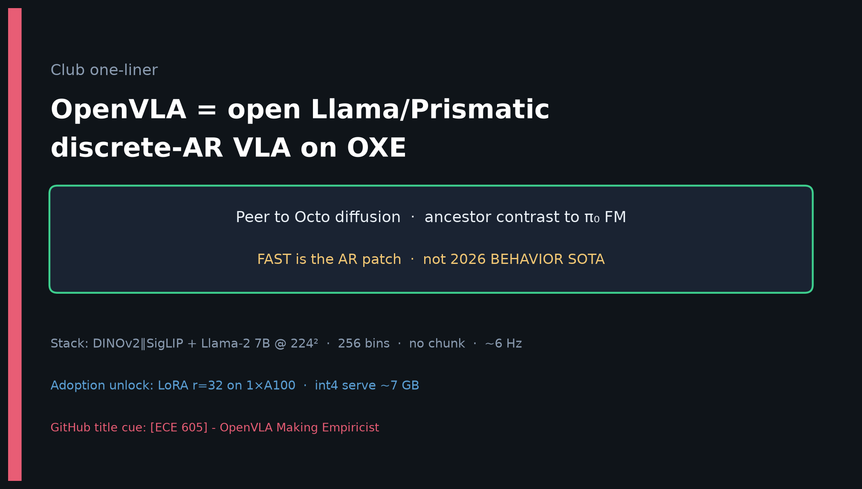
Stakeholder · 18+3 · 3/18
Notes:
ONE-LINER — what the room remembers in one breath.

Slide 4
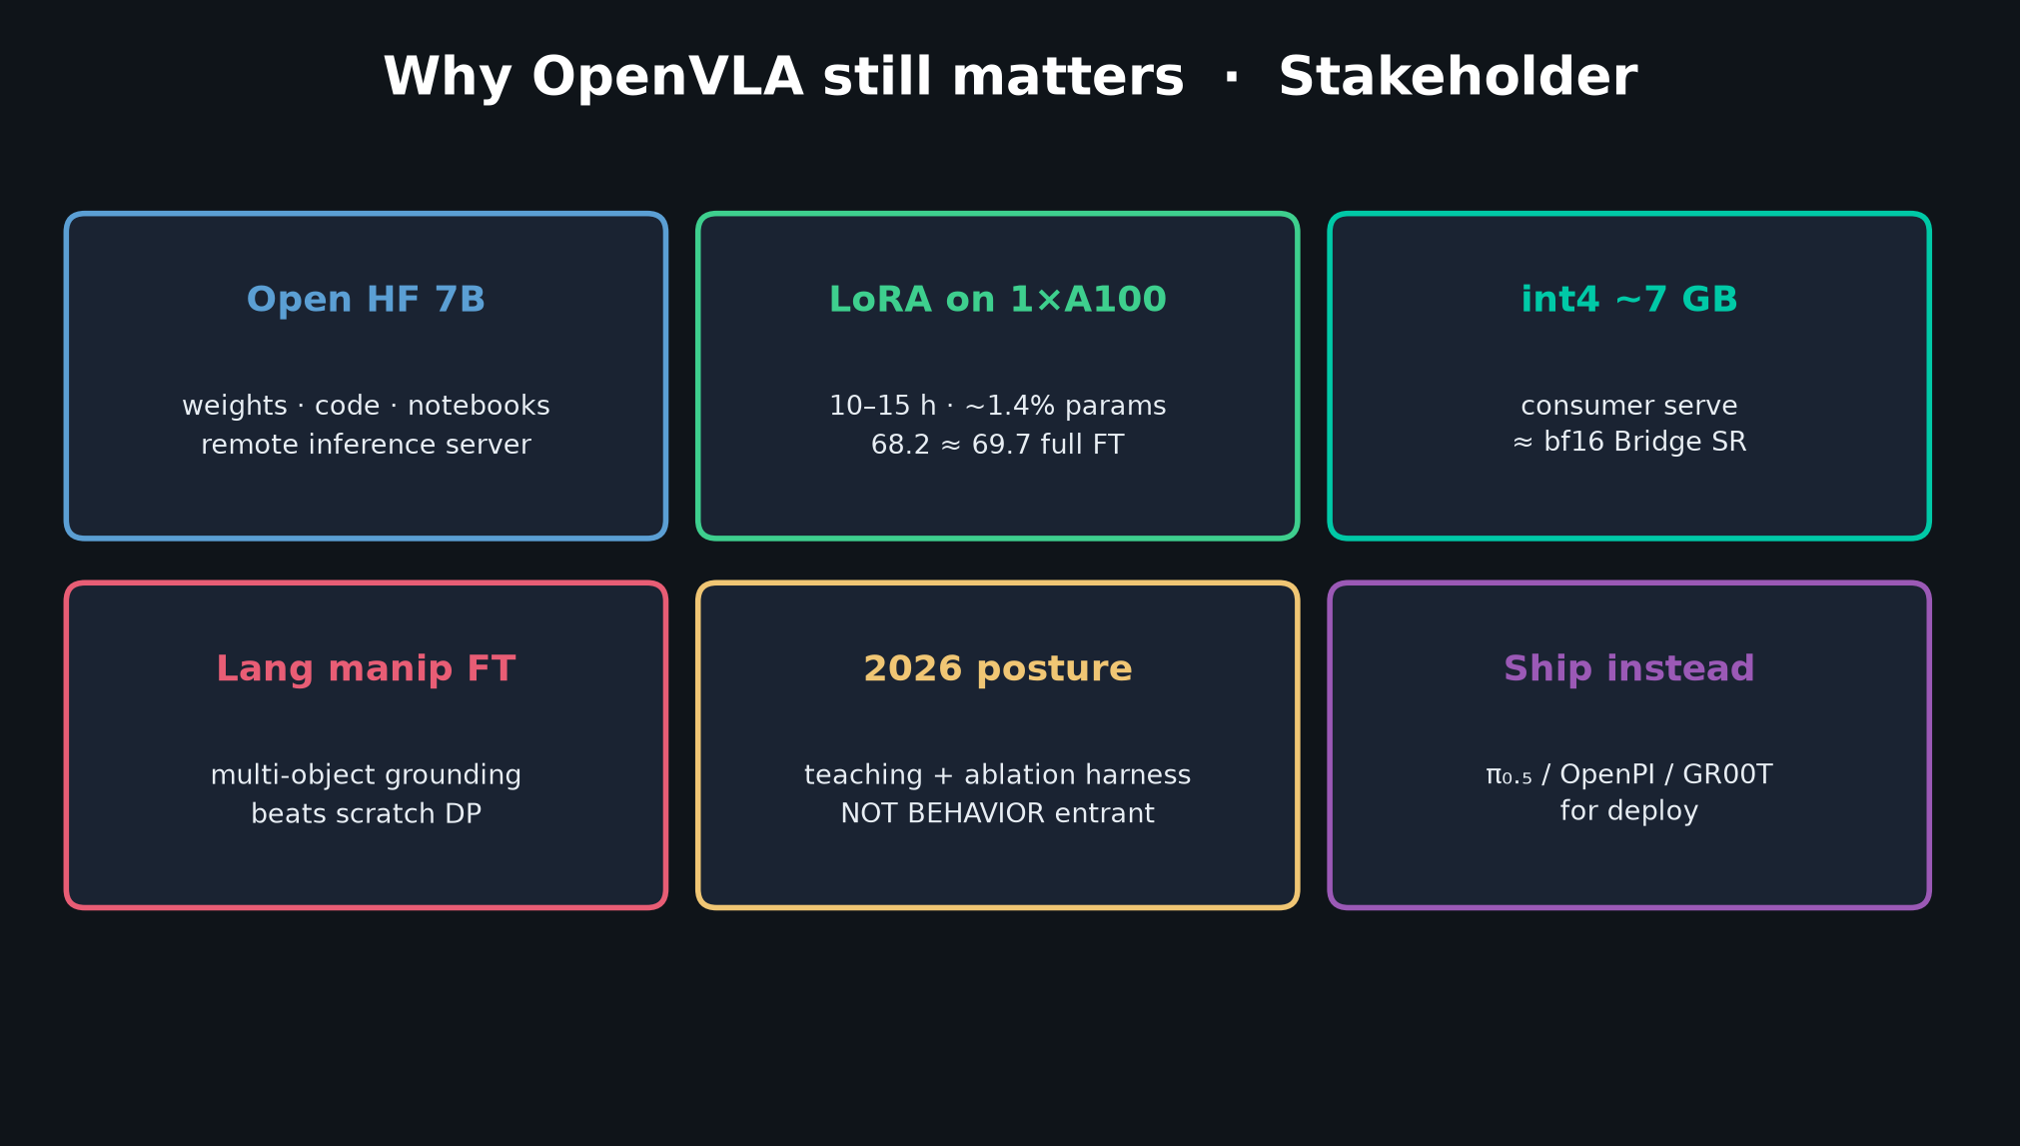
Stakeholder · 18+3 · 4/18
Notes:
VALUE CARDS — open HF, LoRA 1×A100, int4 ~7 GB, lang FT, 2026 posture, ship instead.

Slide 5
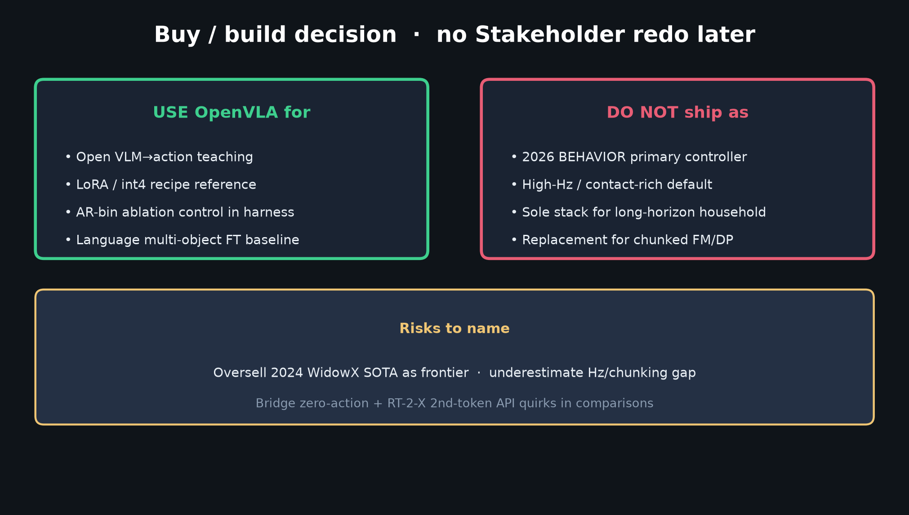
Stakeholder · 18+3 · 5/18
Notes:
DECISION — USE for teaching/LoRA/AR control; DO NOT ship as BEHAVIOR primary.
Risks: oversell WidowX SOTA; underestimate Hz gap; Bridge/RT-2-X comparison quirks.

Slide 6
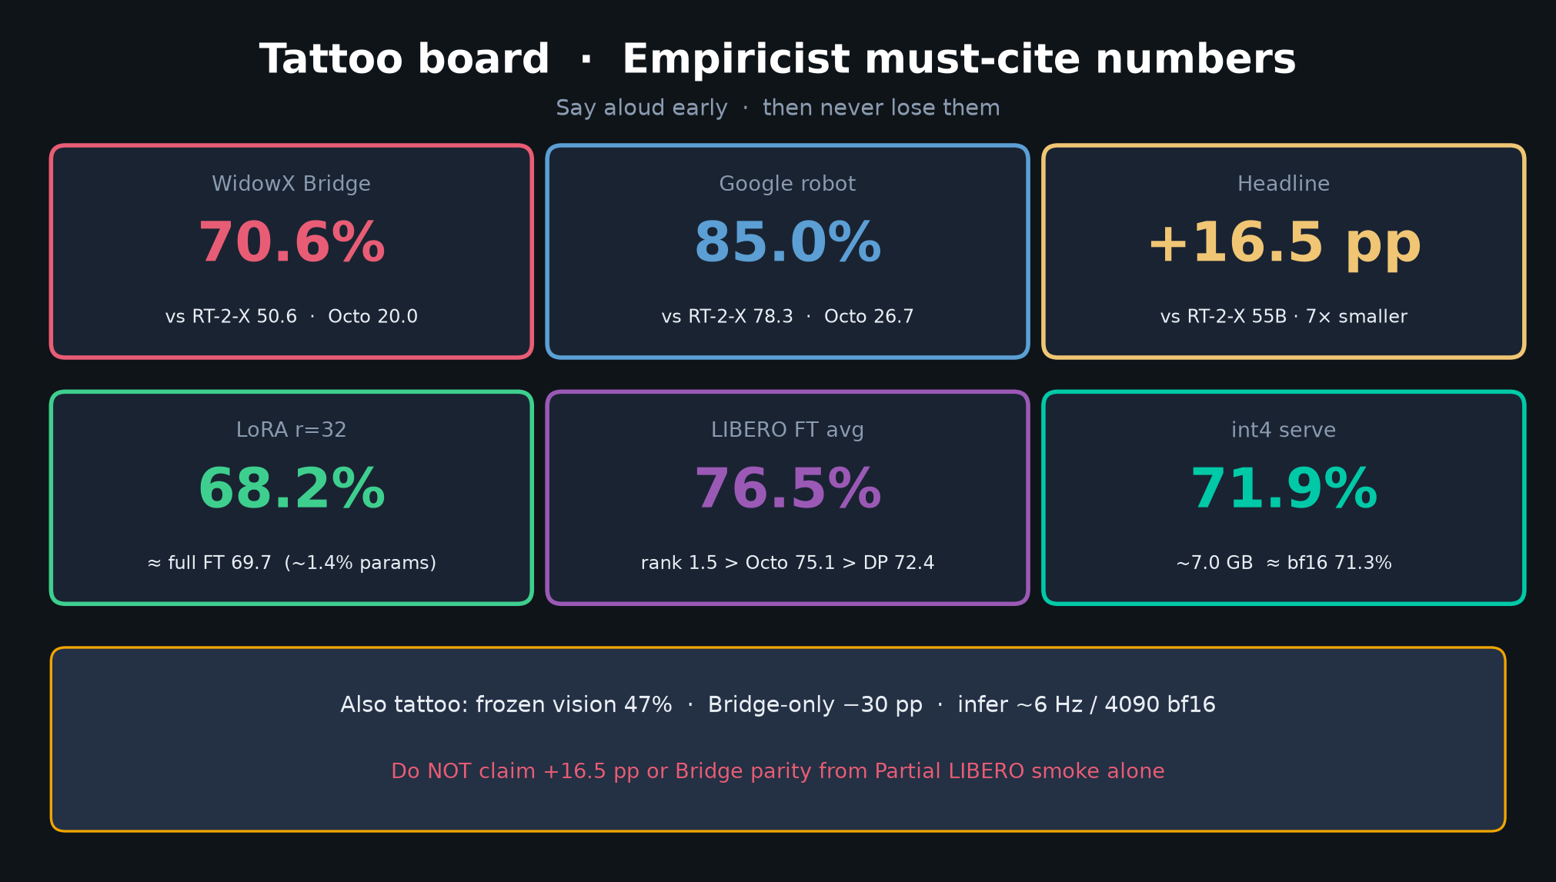
Stakeholder · 18+3 · 6/18
Notes:
TATTOOS — the numbers leadership asks for.
70.6 WidowX · 85.0 Google · LoRA≈full · 76.5 LIBERO · int4 ~7 GB.

Slide 7
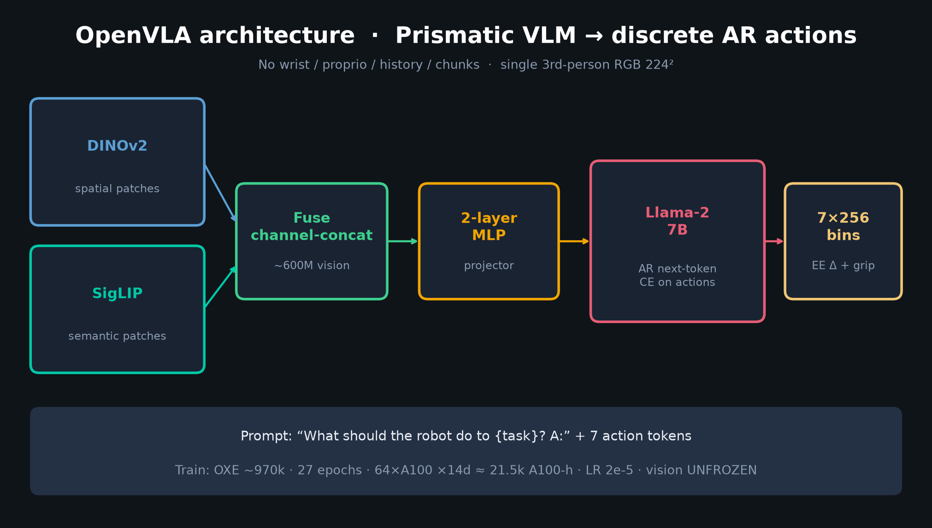
Stakeholder · 18+3 · 7/18
Notes:
ARCHITECTURE glance — enough method for non-specialists.

Slide 8
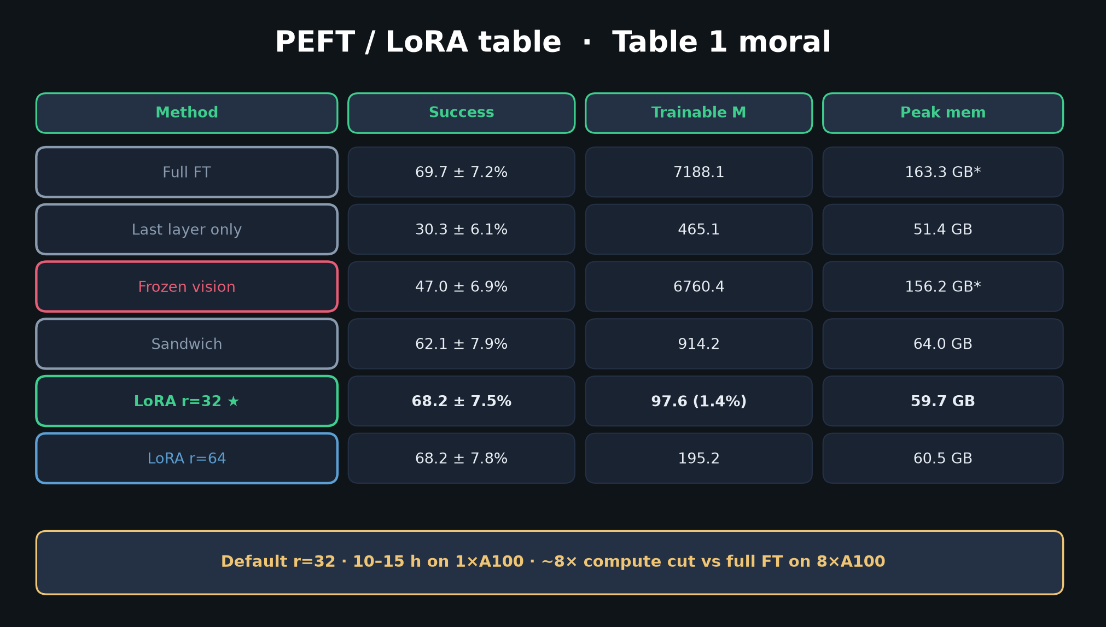
Stakeholder · 18+3 · 8/18
Notes:
PEFT — why LoRA is the adoption unlock (cost story).

Slide 9
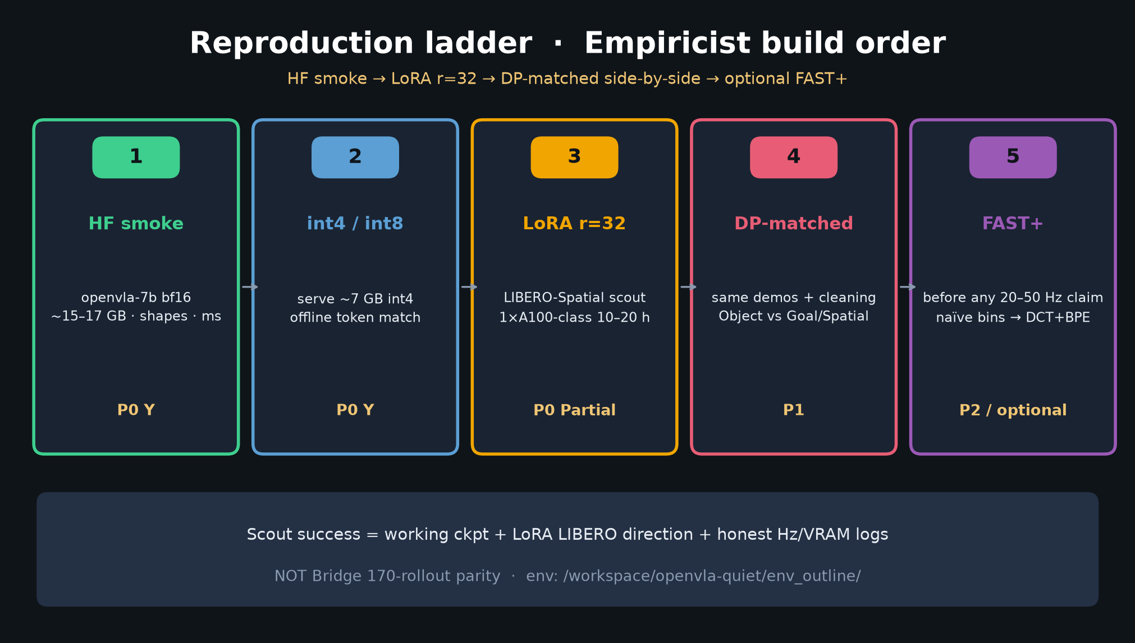
Stakeholder · 18+3 · 9/18
Notes:
LADDER — what eng actually runs tomorrow (P0→P1).

Slide 10
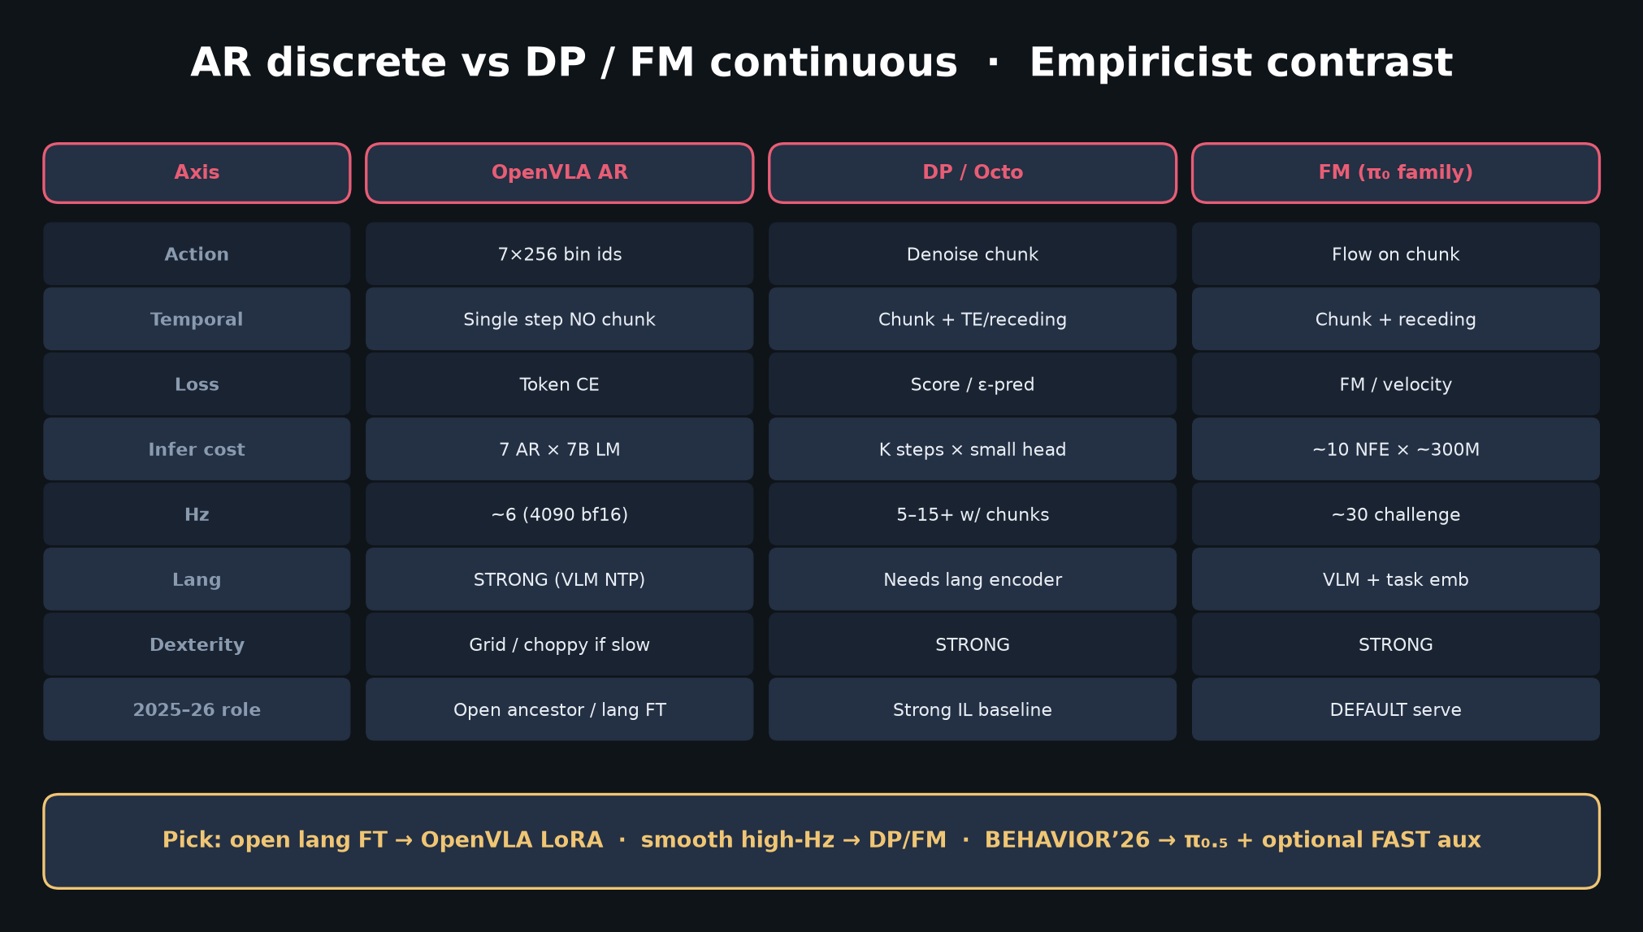
Stakeholder · 18+3 · 10/18
Notes:
AR vs FM — why deploy budget stays on π₀.₅/GR00T.

Slide 11
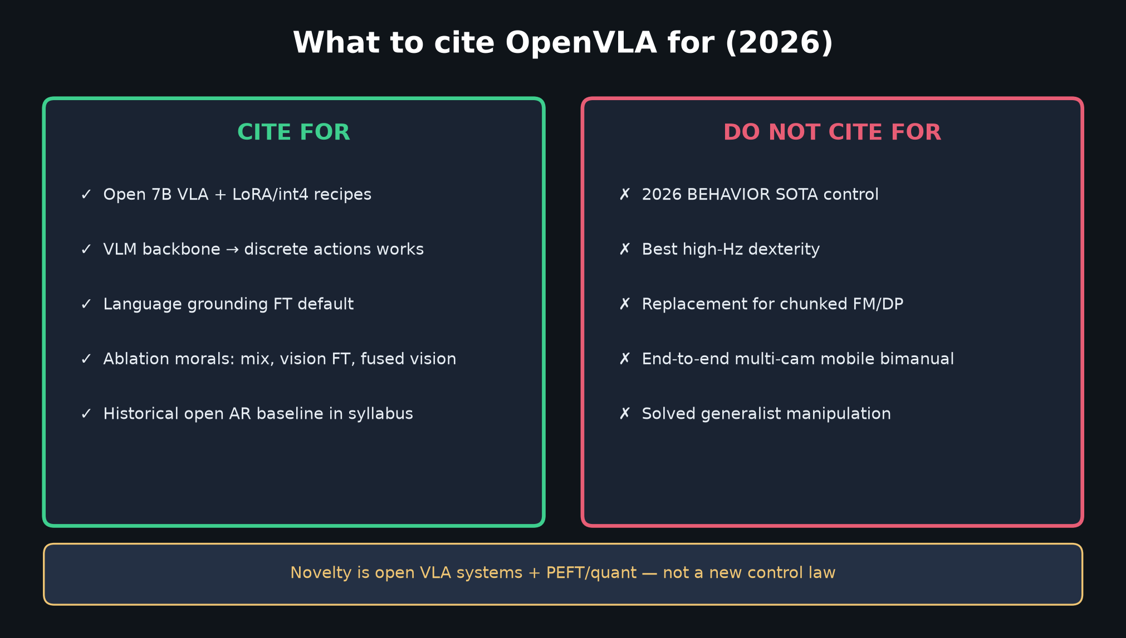
Stakeholder · 18+3 · 11/18
Notes:
CITE TABLE — what to put on roadmap slides / what not to claim.

Slide 12
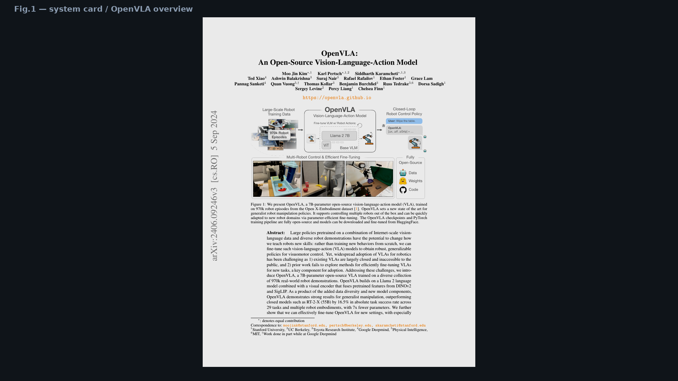
Stakeholder · 18+3 · 12/18
Notes:
PAPER COVER / Fig.1 — existence proof: open weights+code+multi-robot.

Slide 13
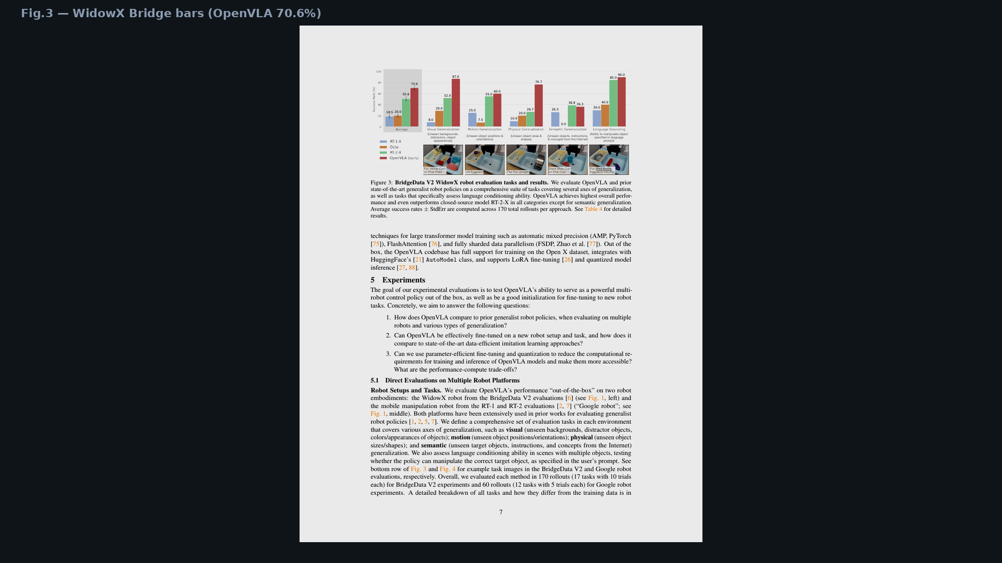
Stakeholder · 18+3 · 13/18
Notes:
Fig.3 WidowX — +16.5 pp narrative visual (with caveats deferred to Reviewer).

Slide 14
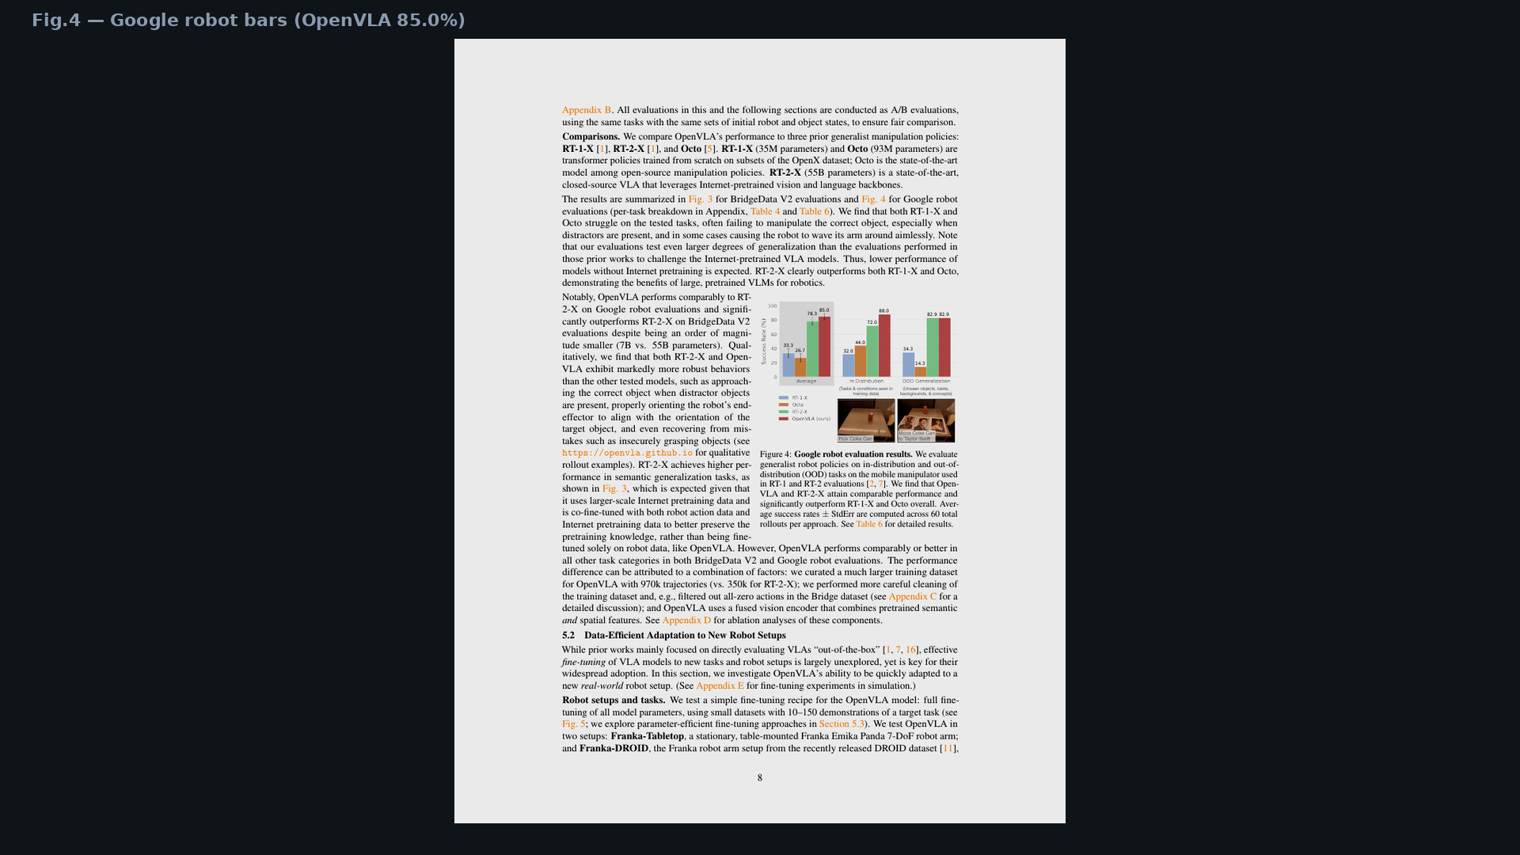
Stakeholder · 18+3 · 14/18
Notes:
Fig.4 Google — 85.0% OOB.

Slide 15
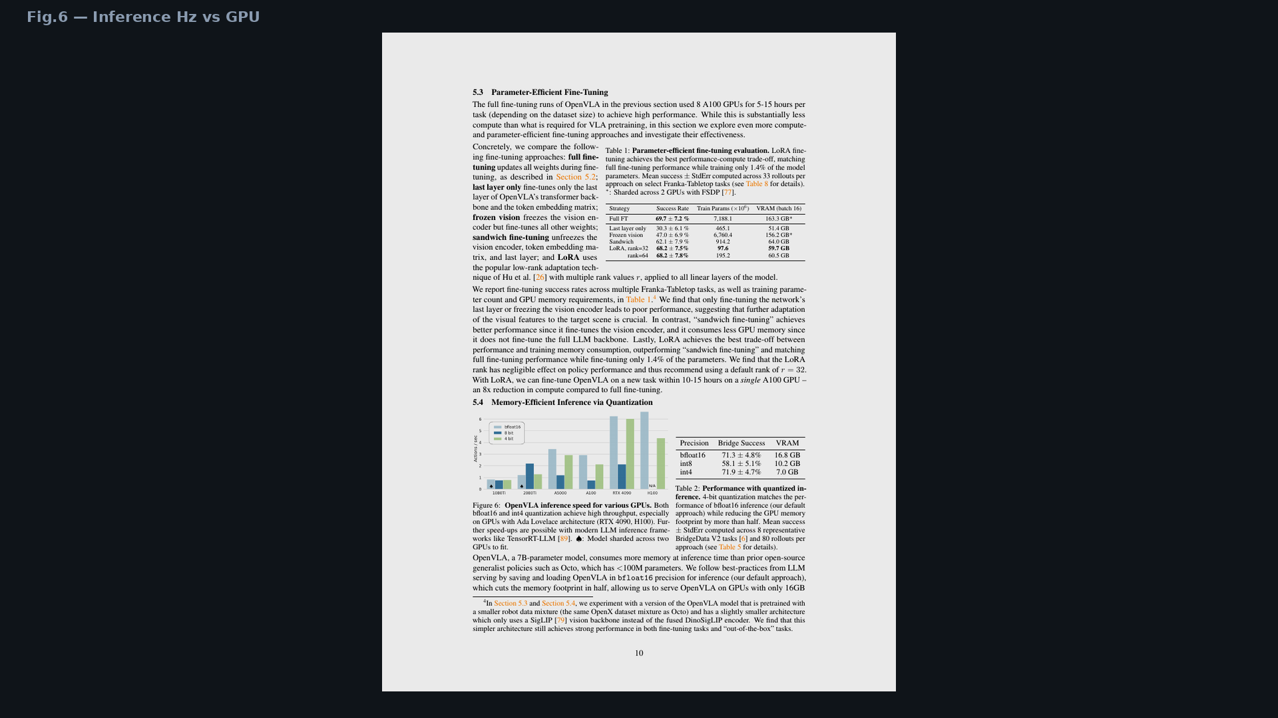
Stakeholder · 18+3 · 15/18
Notes:
Fig.6 Hz — the operational risk number (~6 Hz).

Slide 16
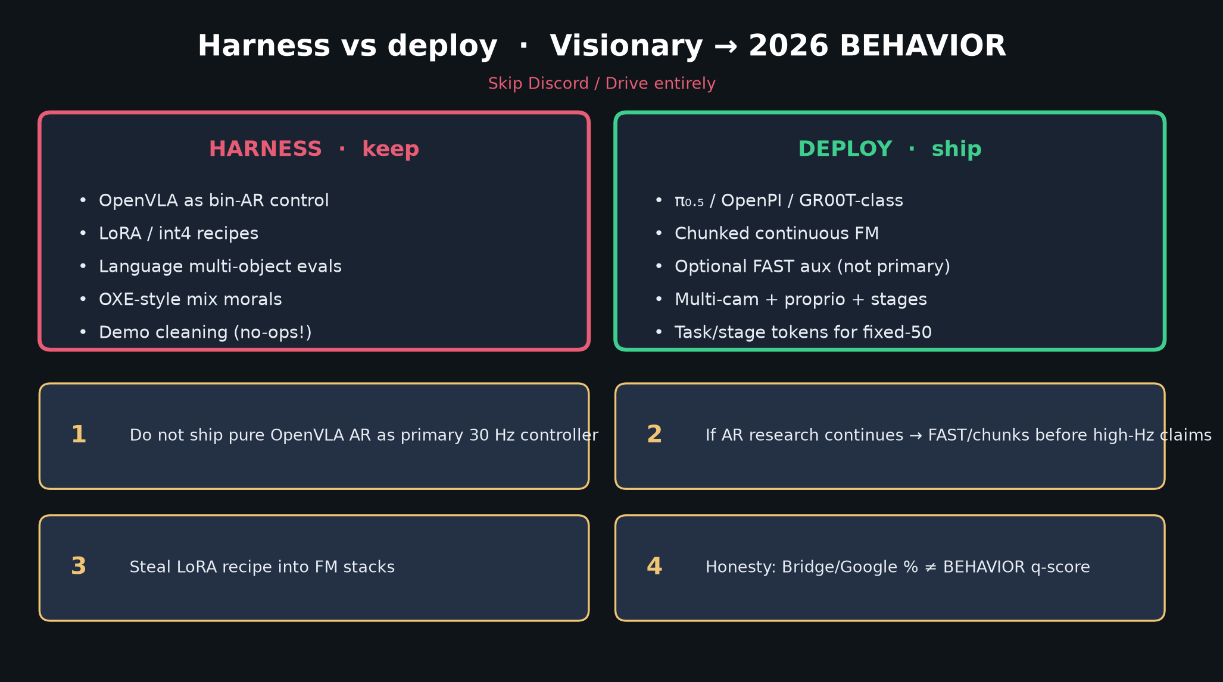
Stakeholder · 18+3 · 16/18
Notes:
VISIONARY bridge — harness vs deploy without owning that seat.

Slide 17
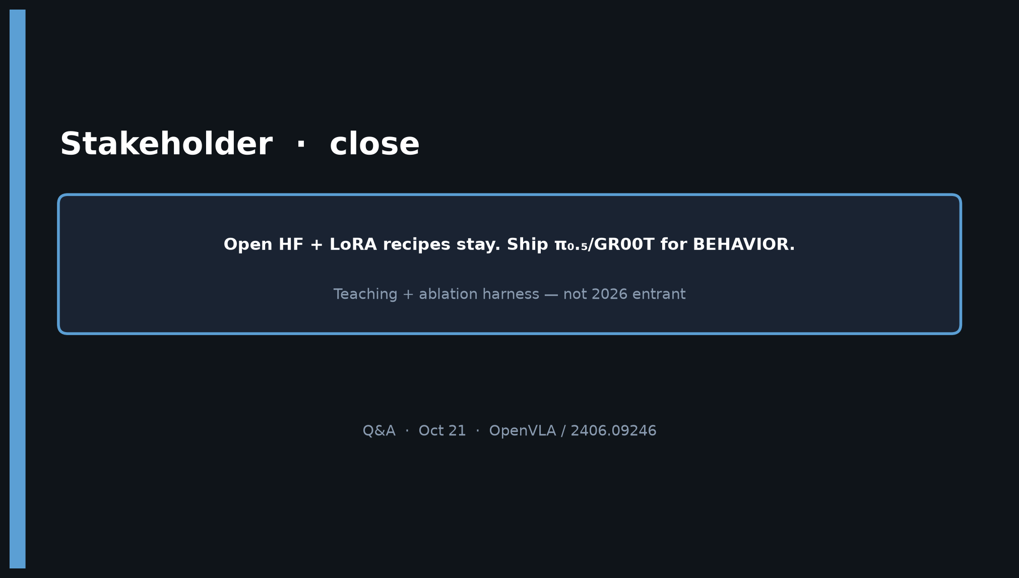
Stakeholder · 18+3 · 17/18
Notes:
CLOSE — Open HF + LoRA stay. Ship π₀.₅/GR00T for BEHAVIOR.
Teaching + ablation harness — not 2026 entrant.

Slide 18
Stakeholder · 18+3 · 18/18
Notes:
BACKUP — decision slide for Q&A.

