Slide 1
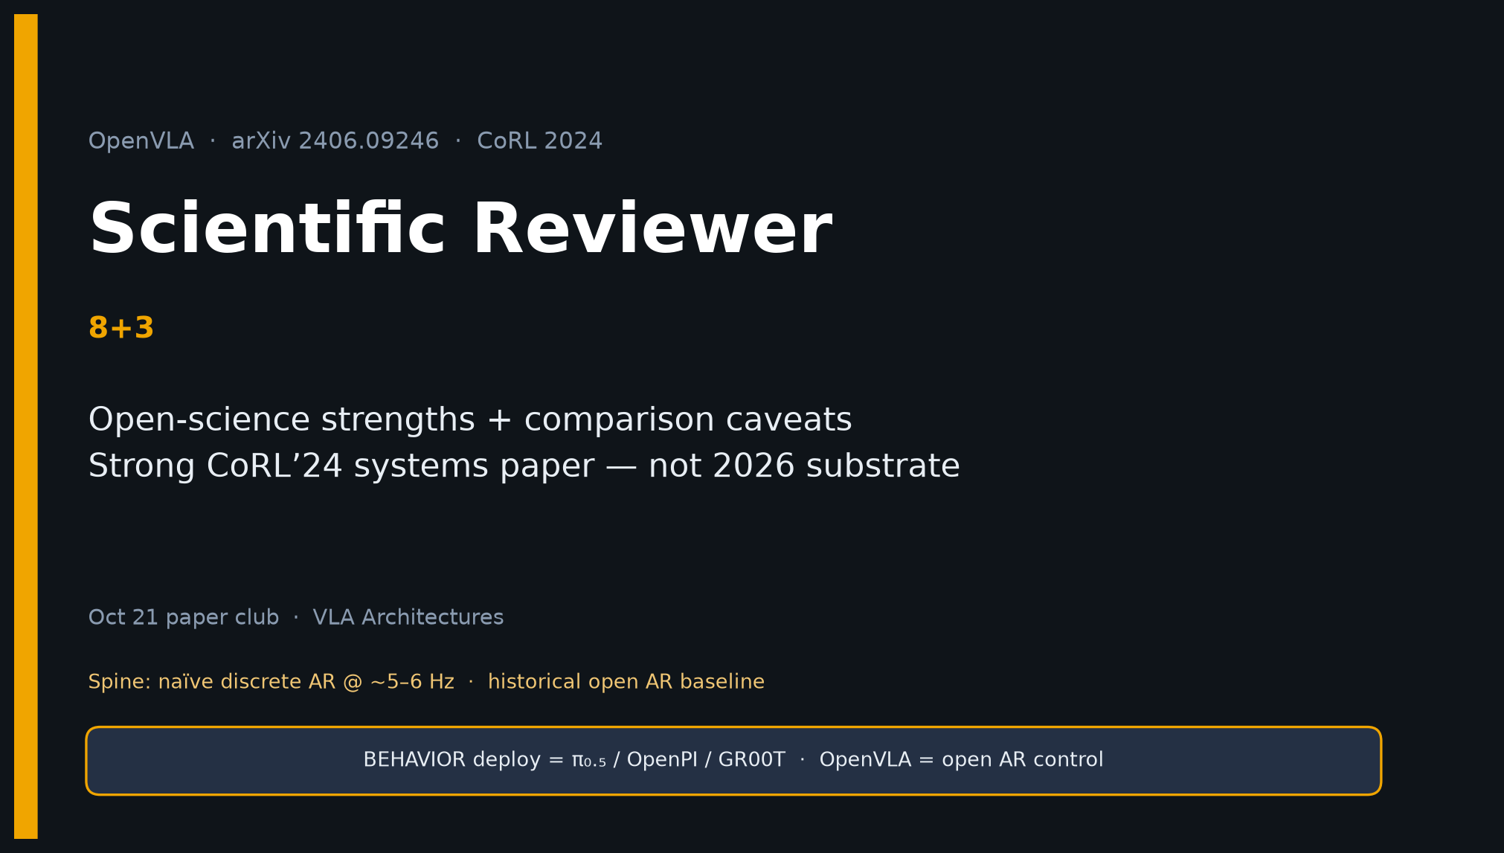
Scientific Reviewer · 8+3 · 1/11
Notes:
SCIENTIFIC REVIEWER — 8+3. Short talk.
Strengths → weaknesses → verdict.
Cite as open 7B VLA + PEFT/quant — NOT as 2026 substrate.
Open with taxonomy so citation frame is visible.

Slide 2
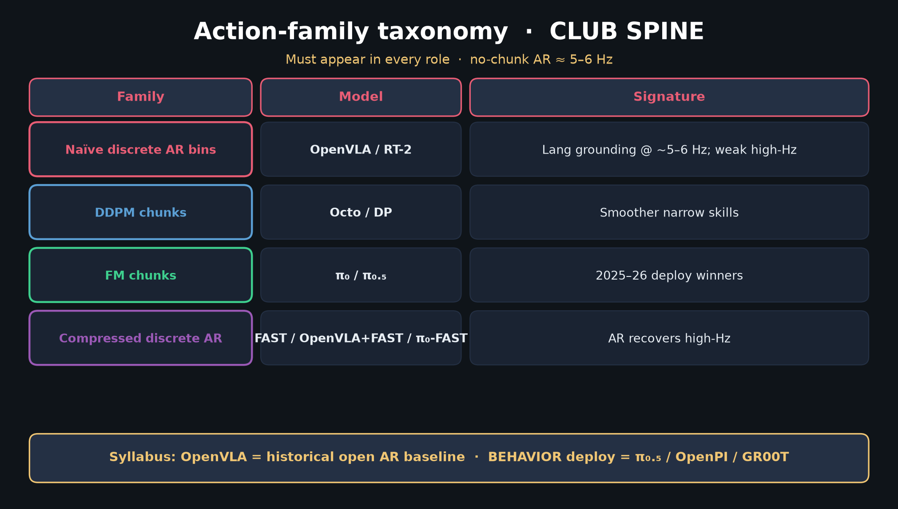
Scientific Reviewer · 8+3 · 2/11
Notes:
TAXONOMY — citation hygiene: OpenVLA is naïve discrete AR, not FM deploy.

Slide 3
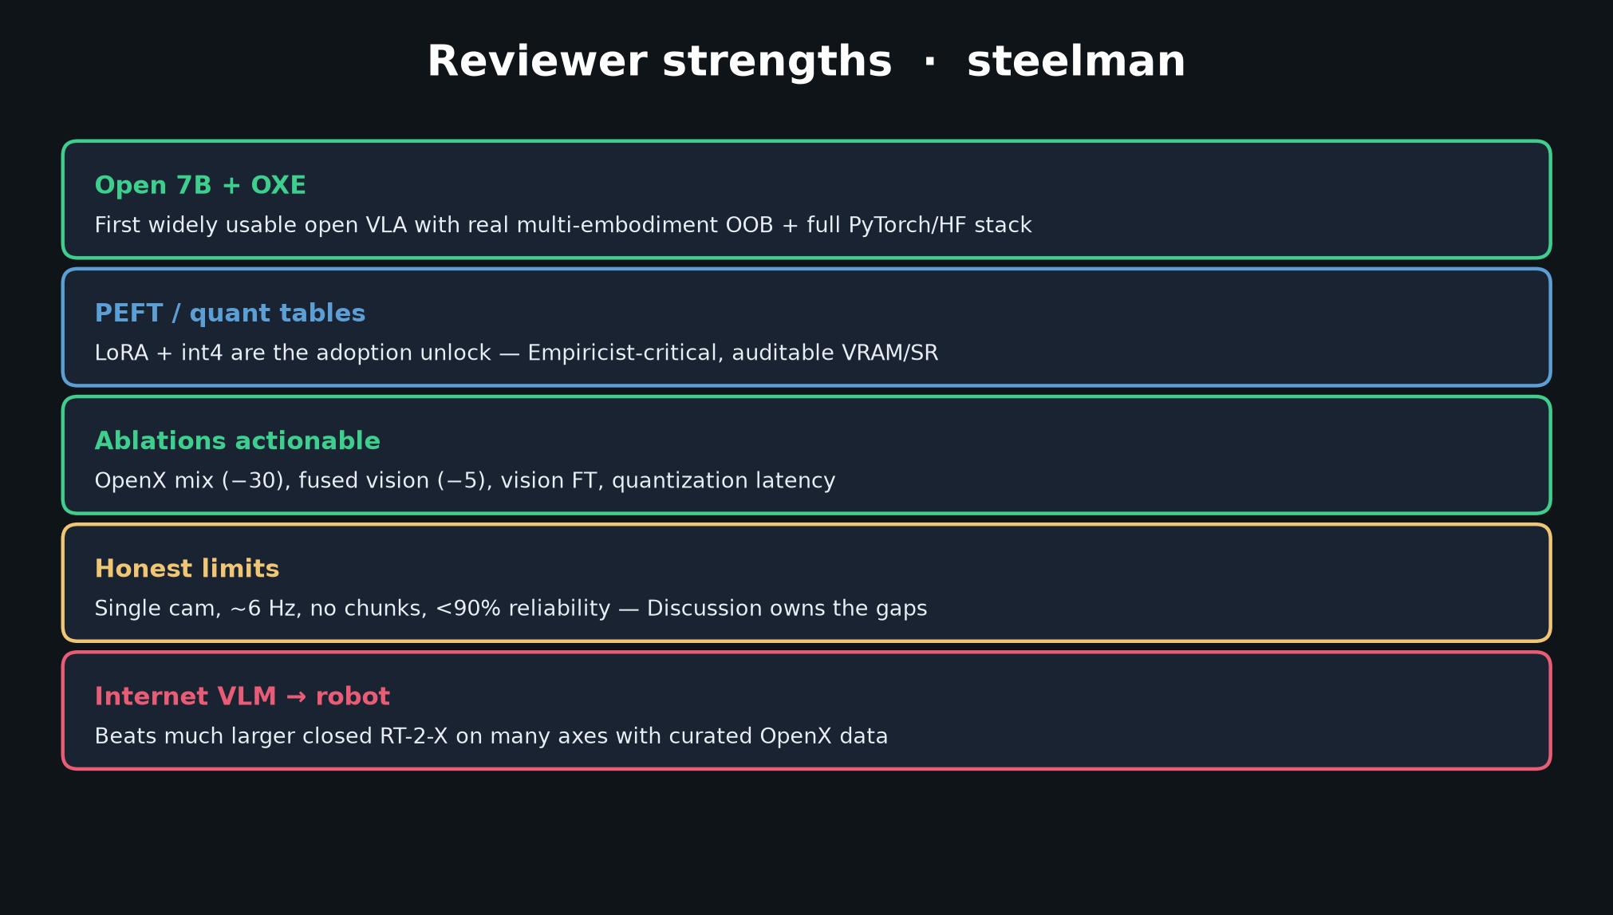
Scientific Reviewer · 8+3 · 3/11
Notes:
STRENGTHS — open 7B+OXE; PEFT/quant; actionable ablations; honest limits; VLM→robot.

Slide 4
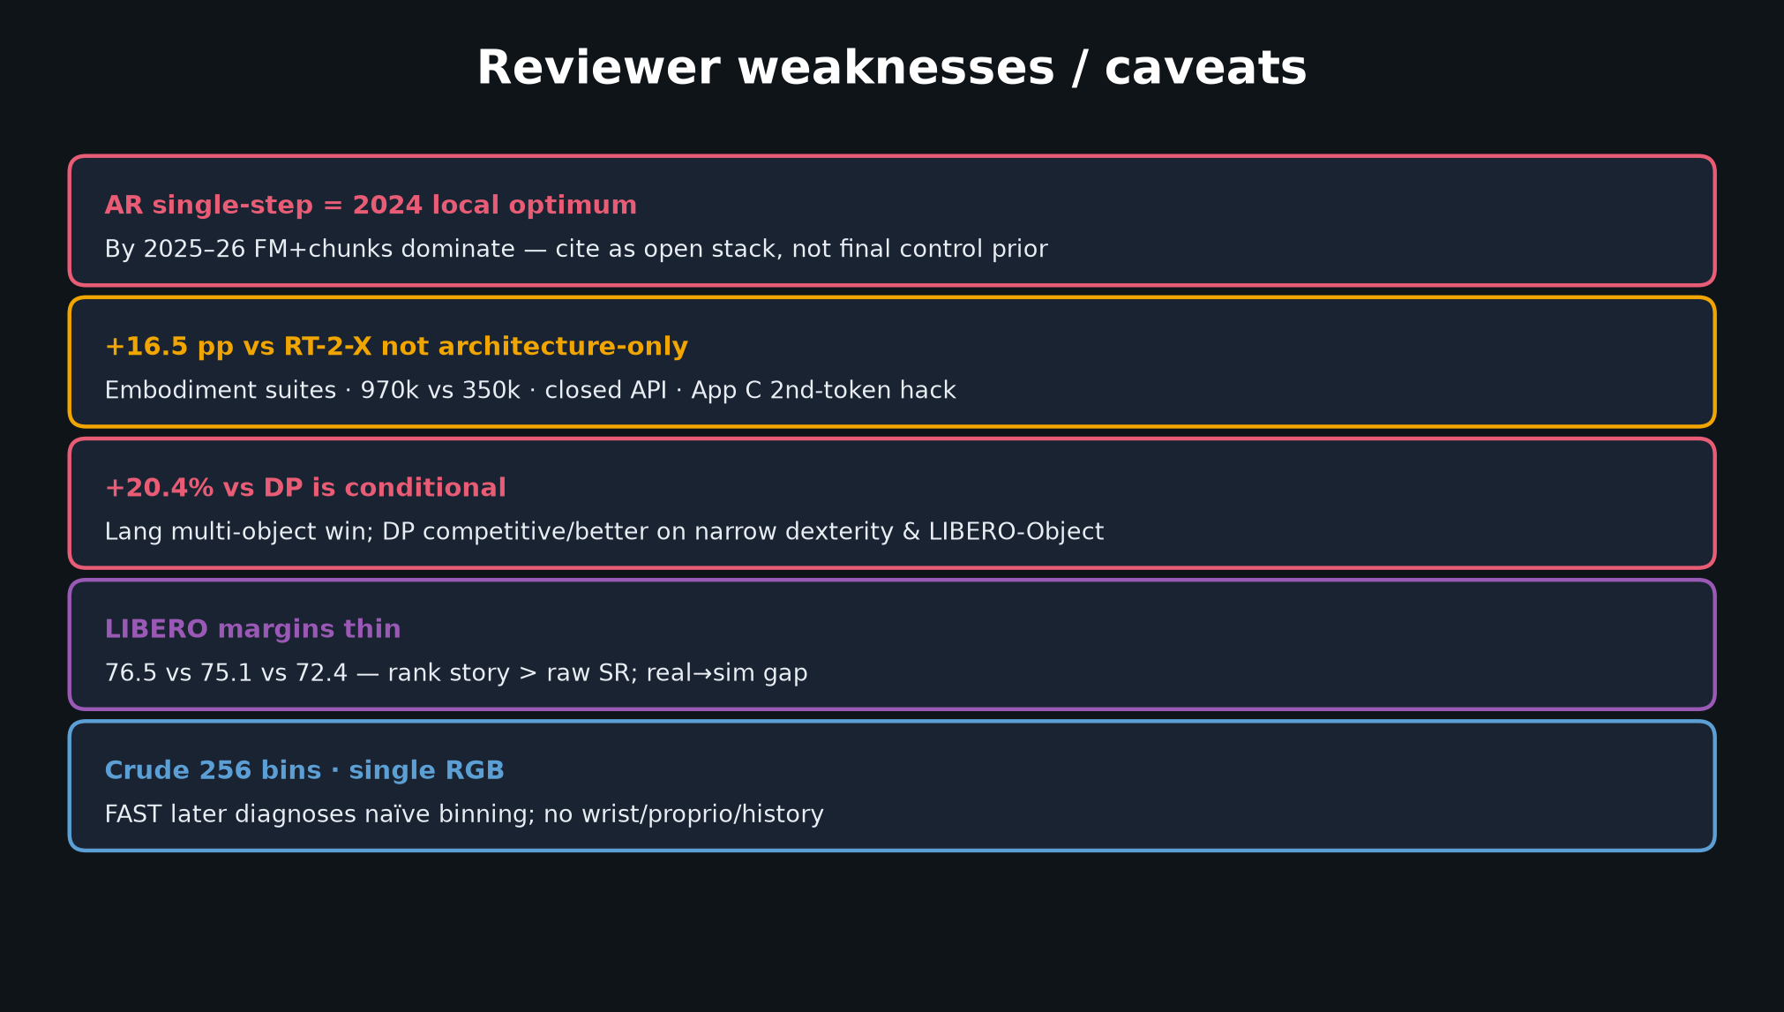
Scientific Reviewer · 8+3 · 4/11
Notes:
WEAKNESSES — AR local optimum; +16.5 not architecture-only; +20.4 conditional; thin LIBERO; crude bins/single RGB.

Slide 5
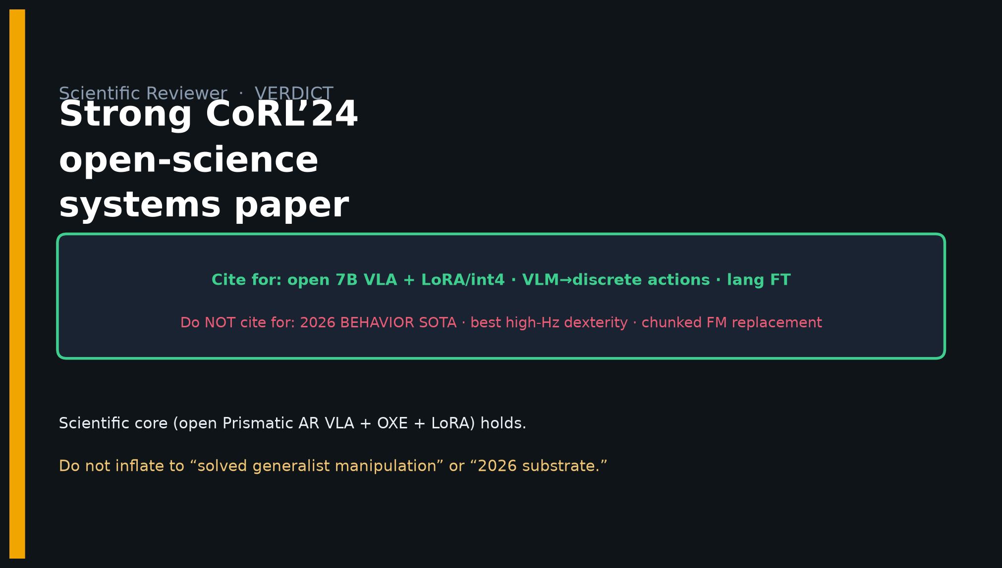
Scientific Reviewer · 8+3 · 5/11
Notes:
VERDICT MUST — Strong CoRL’24 open-science systems paper. Cite PEFT/open VLA. Do NOT cite as 2026 substrate.

Slide 6
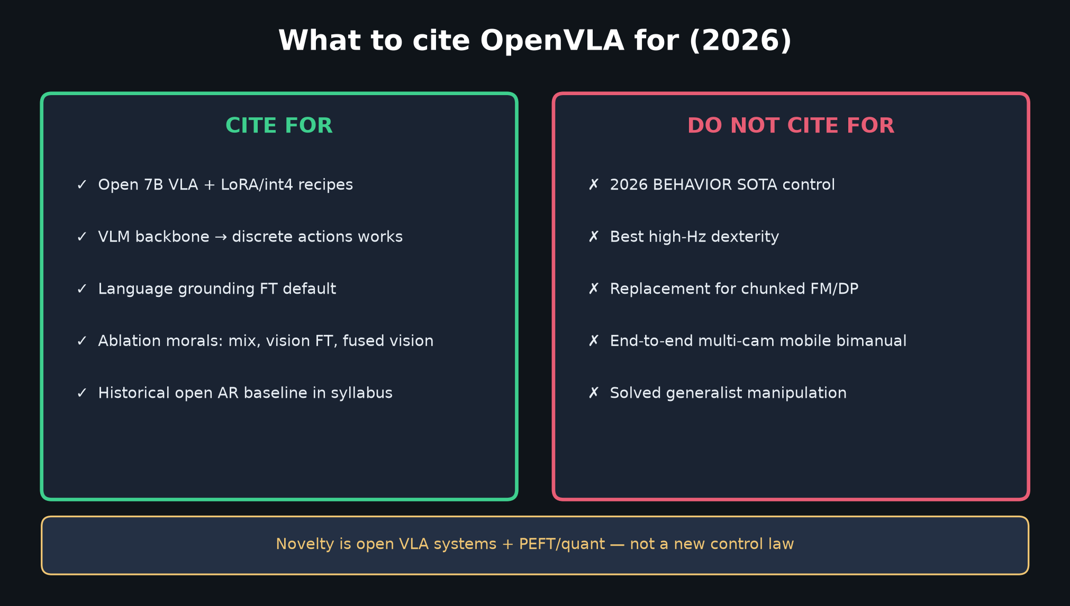
Scientific Reviewer · 8+3 · 6/11
Notes:
CITE TABLE — concrete for/against list for the room.

Slide 7
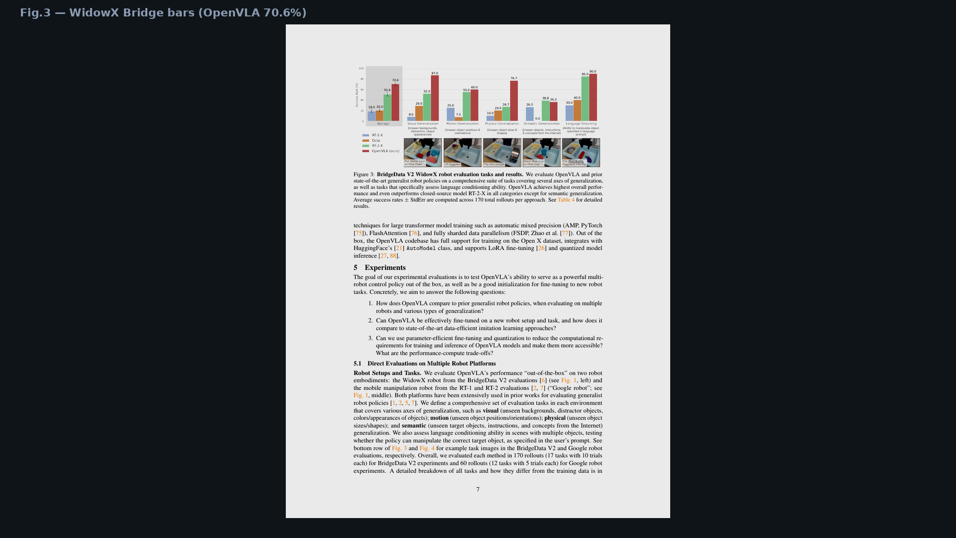
Scientific Reviewer · 8+3 · 7/11
Notes:
Fig.3 evidence — directional systems win; note App C quirks if challenged.

Slide 8
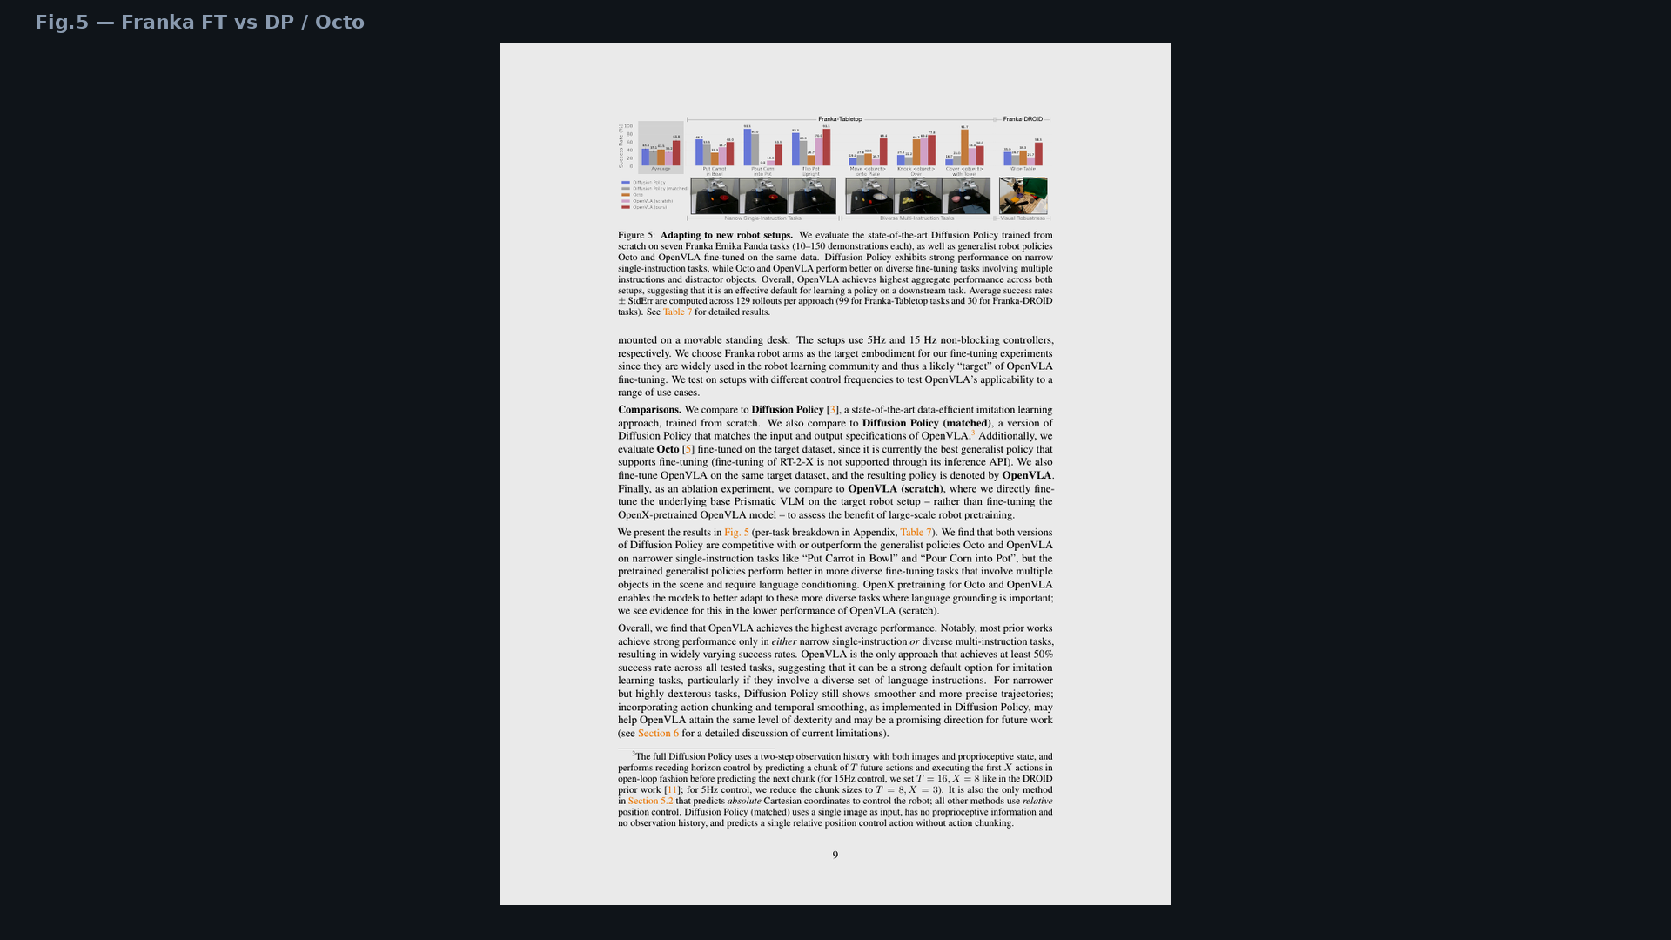
Scientific Reviewer · 8+3 · 8/11
Notes:
Fig.5 — when discussing vs DP, insist on lang vs dexterity split.

Slide 9
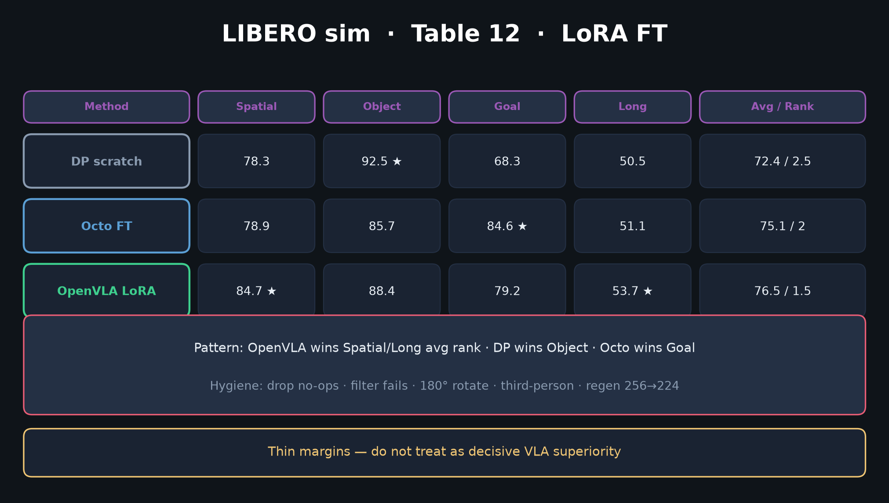
Scientific Reviewer · 8+3 · 9/11
Notes:
LIBERO thin margins — rank > raw SR; do not oversell.

Slide 10
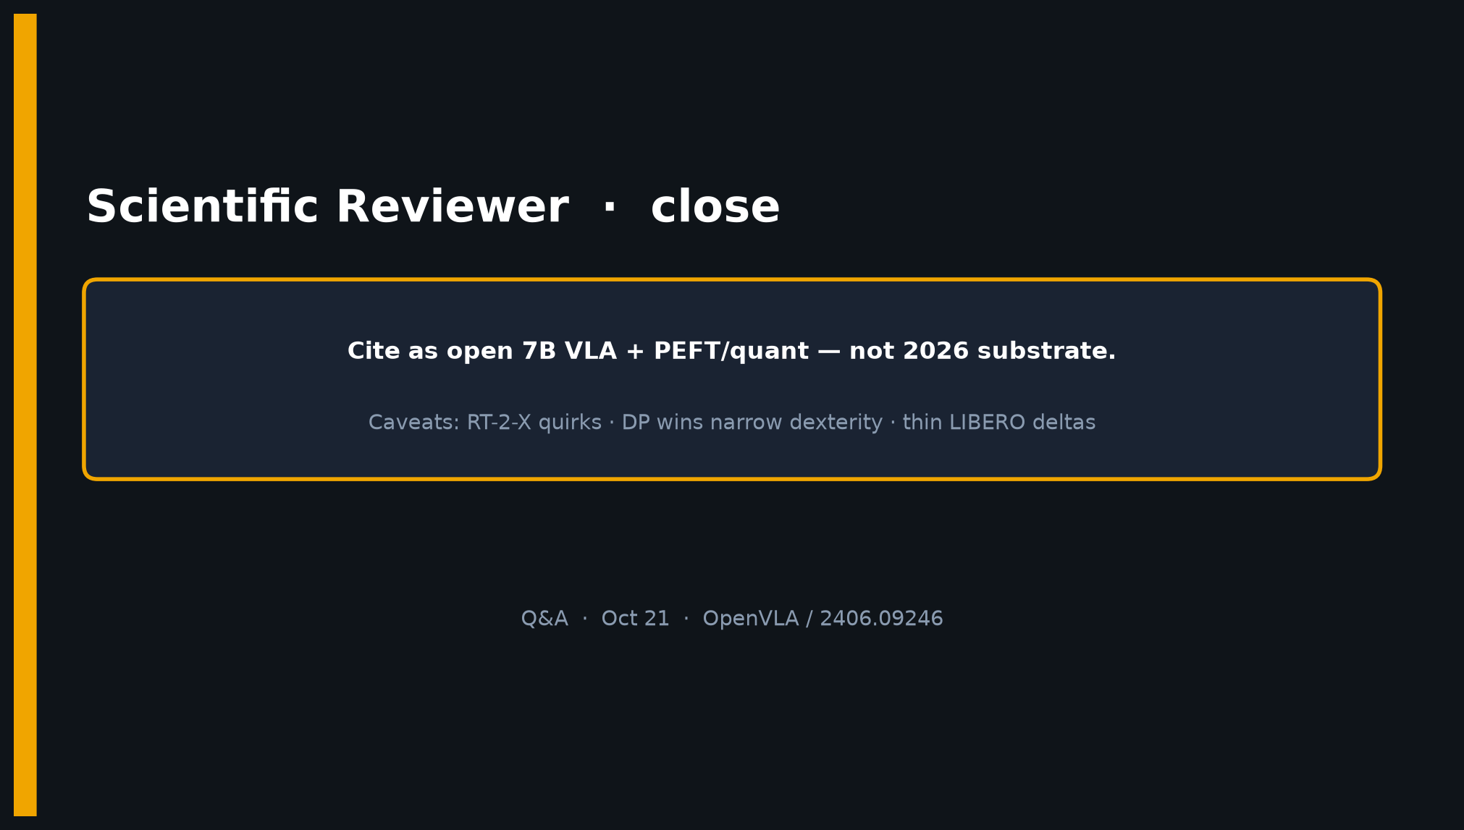
Scientific Reviewer · 8+3 · 10/11
Notes:
CLOSE — Cite open 7B + PEFT/quant; caveats RT-2-X quirks / DP dexterity / thin LIBERO.

Slide 11
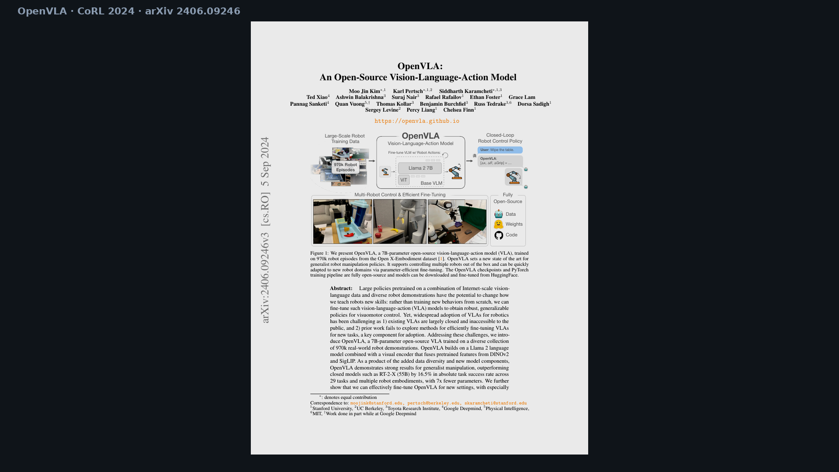
Scientific Reviewer · 8+3 · 11/11
Notes:
BACKUP cover.

