Slide 1
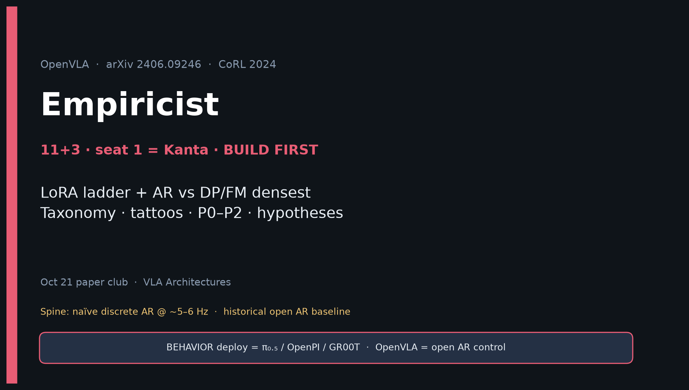
Empiricist · 11+3 · 1/16
Notes:
EMPIRICIST OPENING — seat 1 = Kanta (YOU). Timing 11+3. DENSEST DECK. BUILD FIRST.
You own: LoRA ladder, tattoos, AR vs DP/FM, P0–P2 priority, GPU honesty.
ONE SENTENCE:
OpenVLA is the open discrete-AR VLA baseline — reproduce LoRA/LIBERO morals, then contrast AR bins vs DP/FM chunks; do not claim 2026 BEHAVIOR SOTA.
MUST OPEN WITH TAXONOMY:
| Naïve discrete AR bins | OpenVLA / RT-2 | Lang @ ~5–6 Hz; weak high-Hz |
| DDPM chunks | Octo / DP | Smoother narrow skills |
| FM chunks | π₀ / π₀.₅ | 2025–26 deploy winners |
| Compressed discrete AR | FAST / OpenVLA+FAST / π₀-FAST | AR recovers high-Hz |
GitHub title cue: [ECE 605] - OpenVLA Making Empiricist

Slide 2
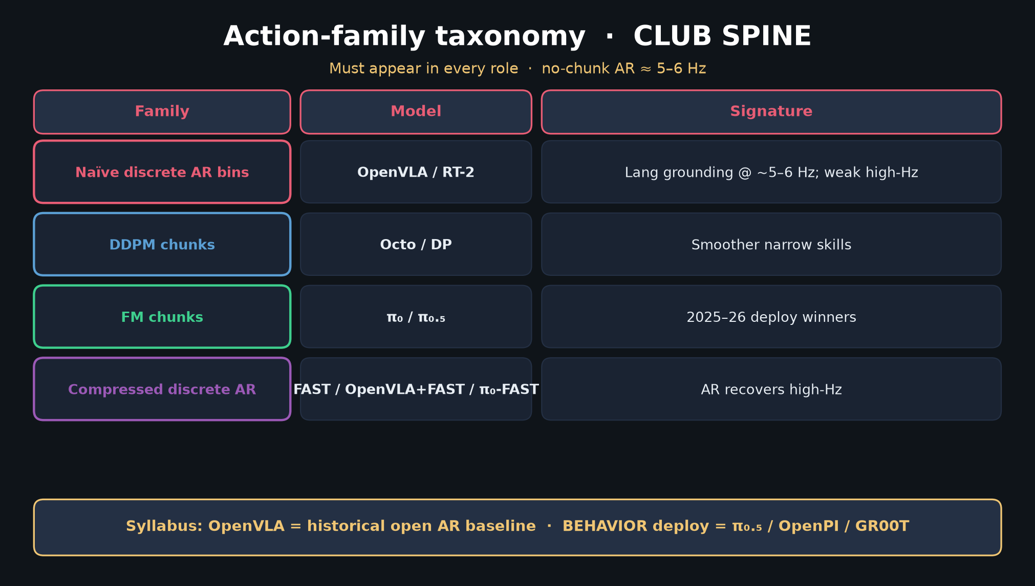
Empiricist · 11+3 · 2/16
Notes:
TAXONOMY — CLUB SPINE. Say aloud first 60–90s. Every seat needs this frame.
No-chunk AR ≈ 5–6 Hz. Historical open AR baseline.
BEHAVIOR deploy = π₀.₅ / OpenPI / GR00T — not vanilla OpenVLA bins.
Spend time on Family / Model / Signature columns. Hand FM deploy to Visionary; hand genealogy to Archaeologist.

Slide 3
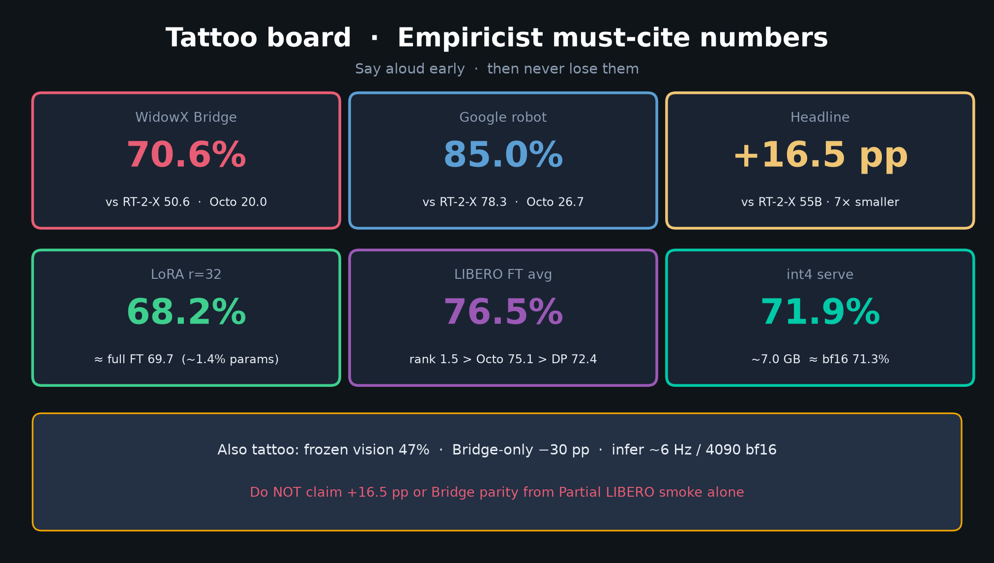
Empiricist · 11+3 · 3/16
Notes:
TATTOO BOARD — memorize and say early.
WidowX 70.6% vs RT-2-X 50.6 / Octo 20
Google 85.0%
LoRA 68.2 ≈ full 69.7
LIBERO FT 76.5
int4 71.9% @ ~7 GB
Do NOT claim +16.5 pp RT-2-X or Bridge parity from Partial LIBERO smoke alone.

Slide 4
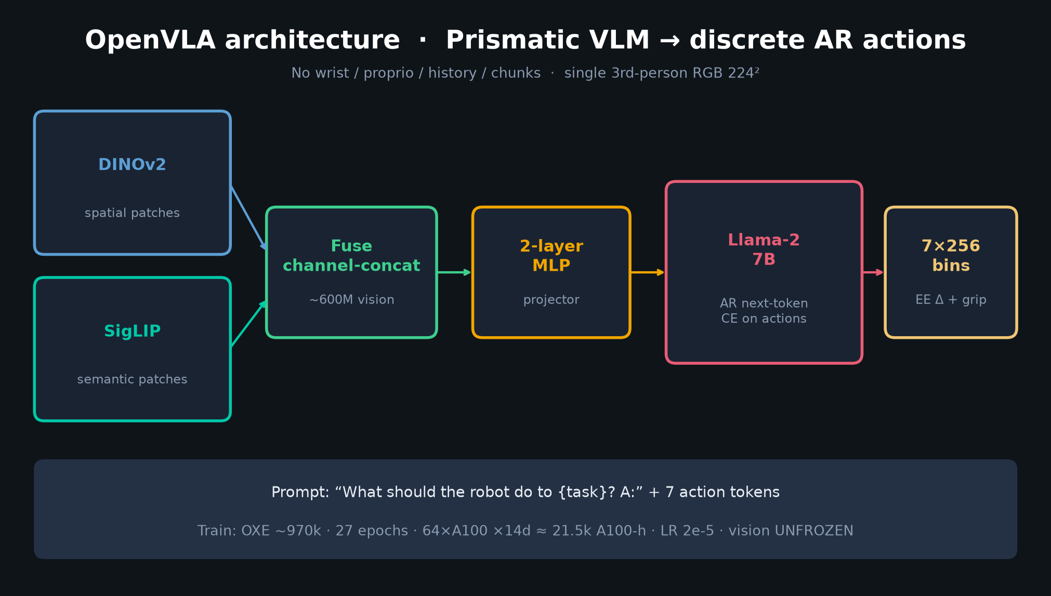
Empiricist · 11+3 · 4/16
Notes:
ARCHITECTURE — DINOv2∥SigLIP → MLP → Llama-2 7B → 7×256 bins.
Knobs: 224², vision UNFROZEN, CE on action tokens only, no chunk/wrist/proprio/history.
Prompt: “What should the robot do to {task}? A:”
Train ~21.5k A100-h — Defer re-pretrain; use released HF ckpt.

Slide 5
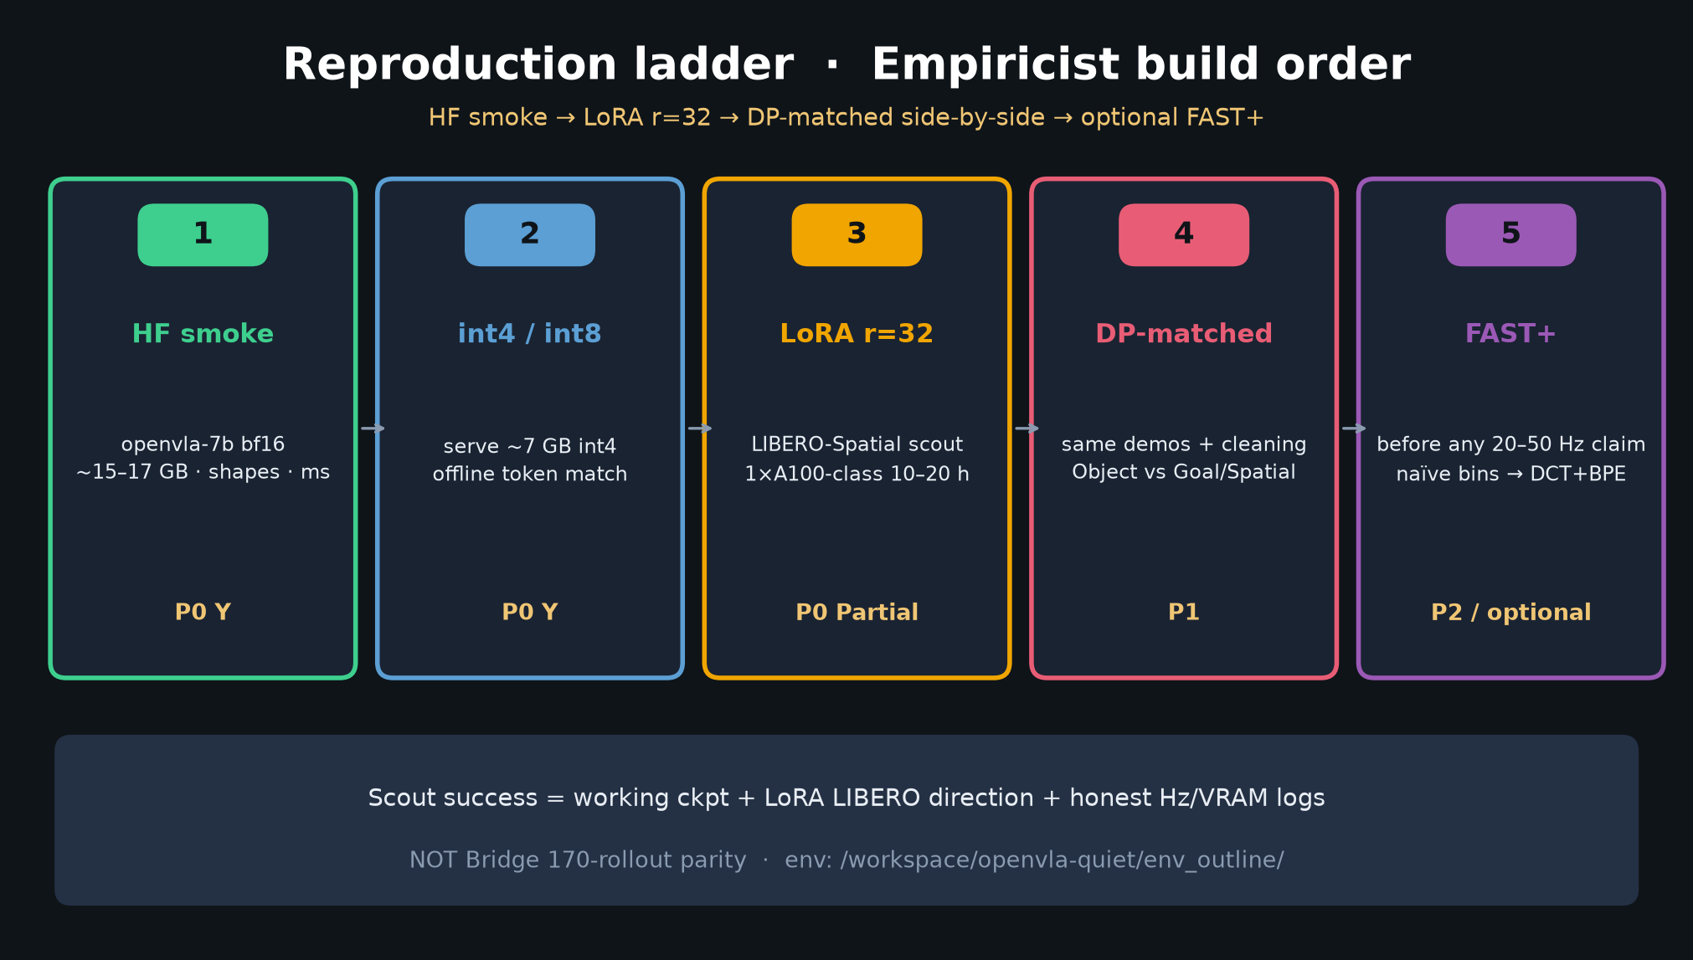
Empiricist · 11+3 · 5/16
Notes:
REPRODUCTION LADDER — your build order.
1 HF smoke bf16 (~15–17 GB)
2 int4/int8 serve (~7 GB)
3 LoRA r=32 LIBERO-Spatial scout
4 DP-matched side-by-side (Object vs Goal/Spatial)
5 Optional FAST+ before any high-Hz claim
Scout success = working ckpt + LoRA direction + honest Hz/VRAM — NOT Bridge 170 parity.
Env: /workspace/openvla-quiet/env_outline/

Slide 6
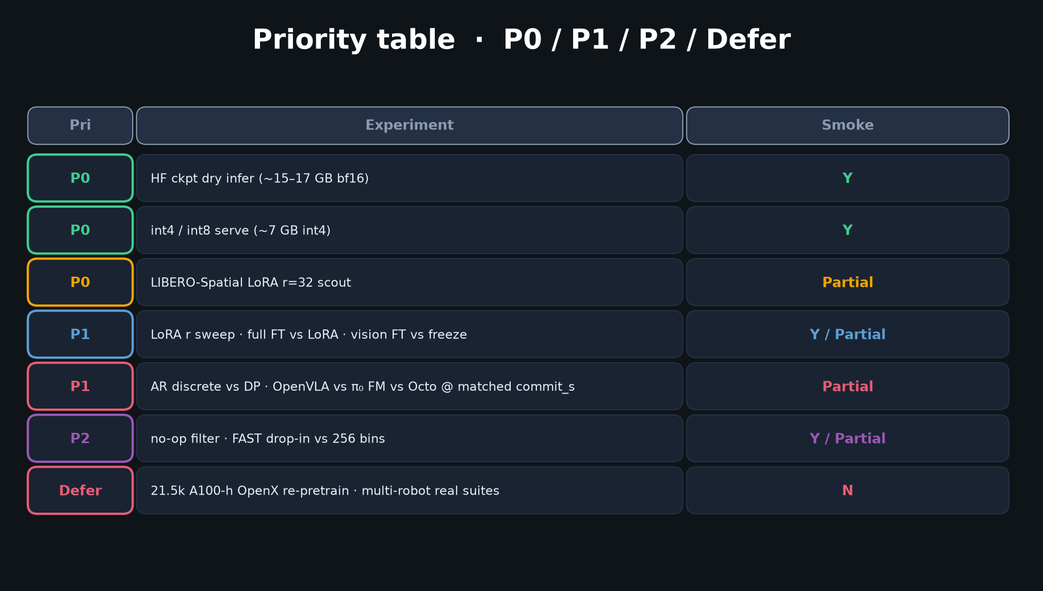
Empiricist · 11+3 · 6/16
Notes:
PRIORITY TABLE — P0 Y / P0 Partial / P1 / P2 / Defer.
P0: HF dry infer; int4/int8; LIBERO-Spatial LoRA r=32
P1: LoRA r sweep; full FT vs LoRA; vision FT; AR vs DP; OpenVLA vs π₀ vs Octo @ matched commit_s
P2: no-op filter; FAST vs 256 bins
Defer: 21.5k A100-h OpenX; multi-robot real suites
Quiet budget ≲40–80 GPU-h.

Slide 7
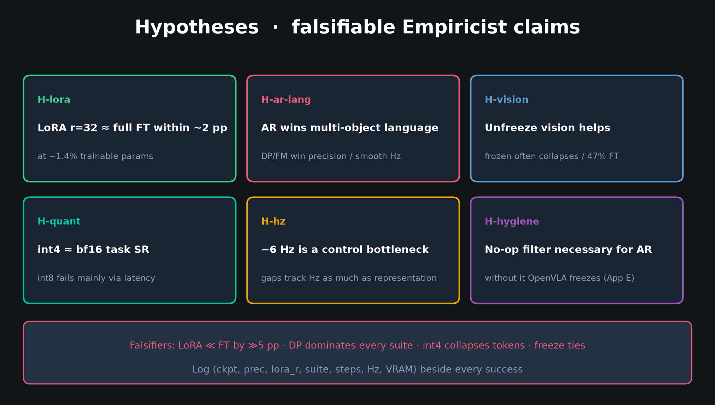
Empiricist · 11+3 · 7/16
Notes:
HYPOTHESES — what you are testing / falsifying.
H-lora: LoRA r=32 ≈ full FT within ~2 pp
H-ar-lang: AR wins multi-object lang; DP/FM win precision/smooth Hz
H-vision: unfreeze helps
H-quant: int4 ≈ bf16; int8 fails via latency
H-hz: ~6 Hz is a control bottleneck
H-hygiene: no-op filter necessary
Falsifiers in DELIVERABLE §3. Log (ckpt, prec, lora_r, suite, steps, Hz, VRAM).

Slide 8
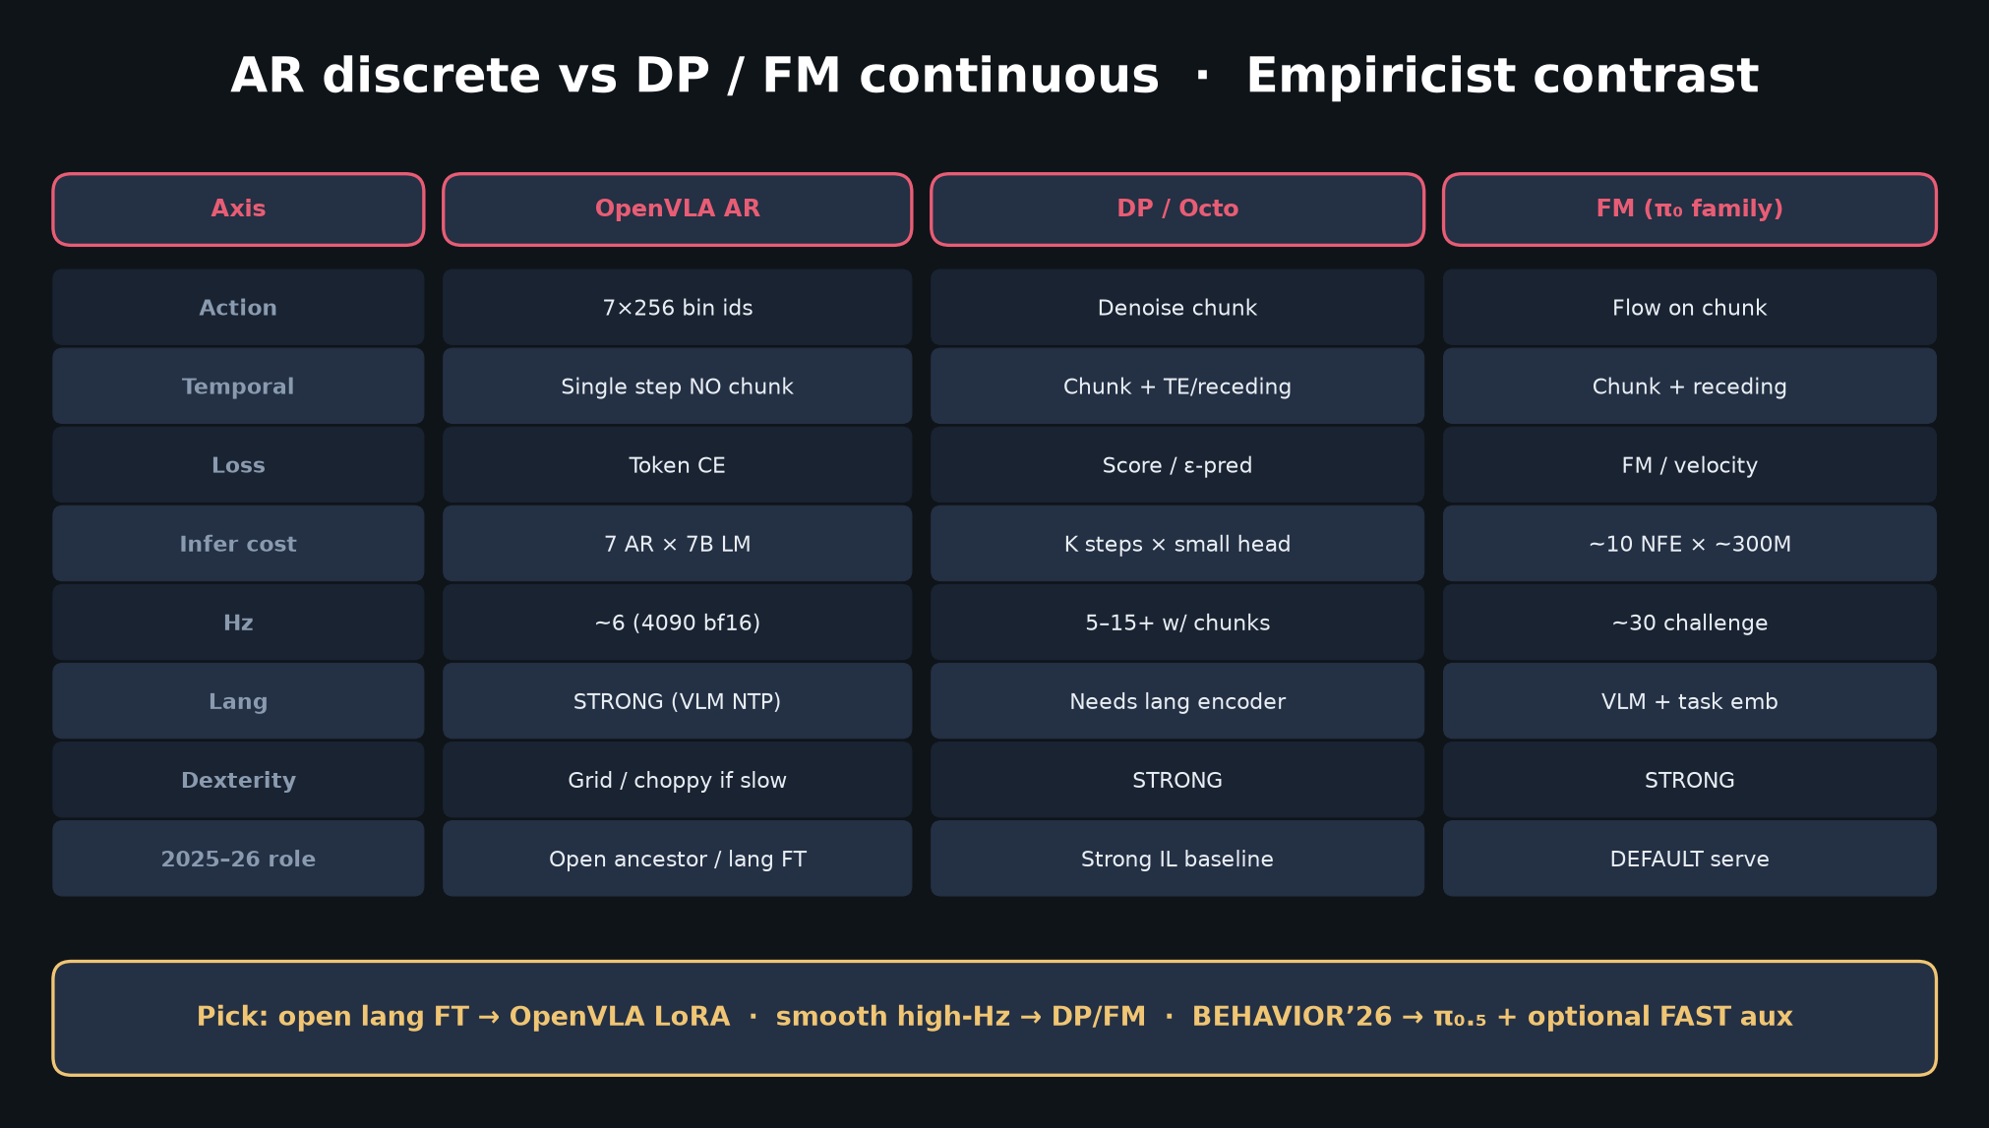
Empiricist · 11+3 · 8/16
Notes:
AR vs DP/FM CONTRAST — densest control slide.
OpenVLA: single-step 7 AR tokens × 7B @ ~6 Hz
DP/Octo: denoise chunks, smoother narrow skills
π₀ family: FM chunks @ ~30 Hz — 2025–26 default serve
Operator cheat-sheet:
• Need open VLM lang FT quickly → OpenVLA LoRA
• Need smooth high-Hz / contact-rich → DP or FM
• 2026 BEHAVIOR-like → π₀.₅ / OpenPI; AR/FAST as train aux

Slide 9
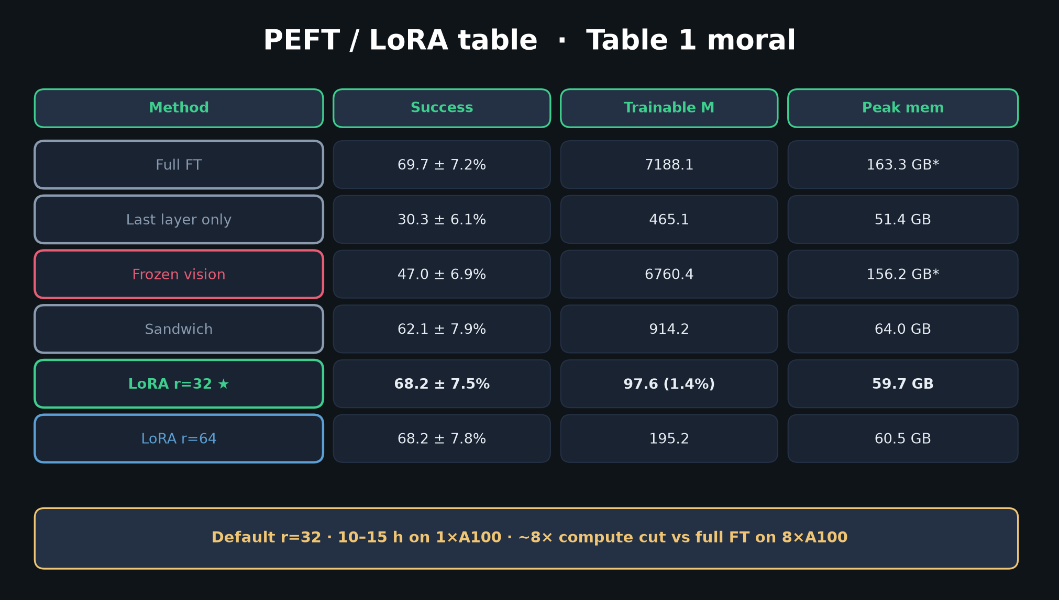
Empiricist · 11+3 · 9/16
Notes:
PEFT TABLE — Table 1 moral.
LoRA r=32: 68.2 ± 7.5% ≈ full 69.7 ± 7.2% at 97.6M (1.4%) / 59.7 GB
Frozen vision 47% — unfreeze is load-bearing
Default r=32; 10–15 h on 1×A100; ~8× compute cut vs full FT

Slide 10
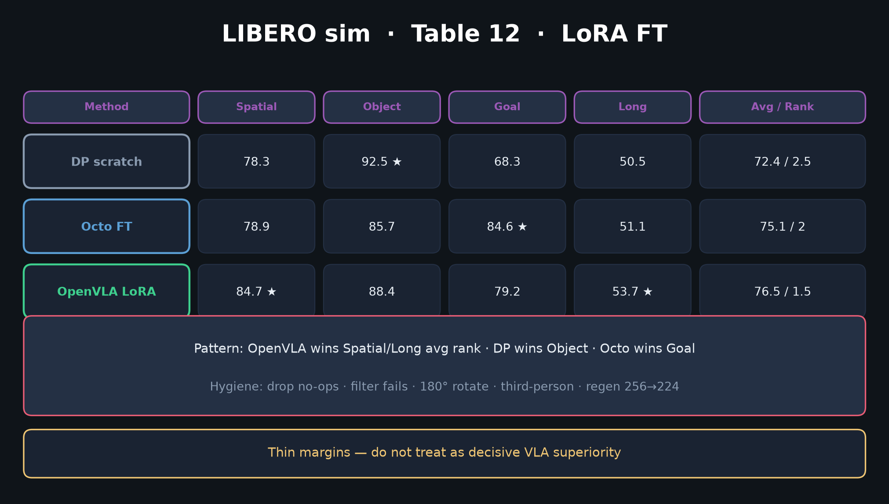
Empiricist · 11+3 · 10/16
Notes:
LIBERO Table 12 — OpenVLA LoRA avg 76.5 / rank 1.5.
Spatial OpenVLA 84.7 · Object DP 92.5 · Goal Octo 84.6 · Long OpenVLA 53.7
Thin margins — rank story > raw SR. Hygiene critical (no-ops!).
Label Partial if you cannot afford 500×3 seeds.

Slide 11
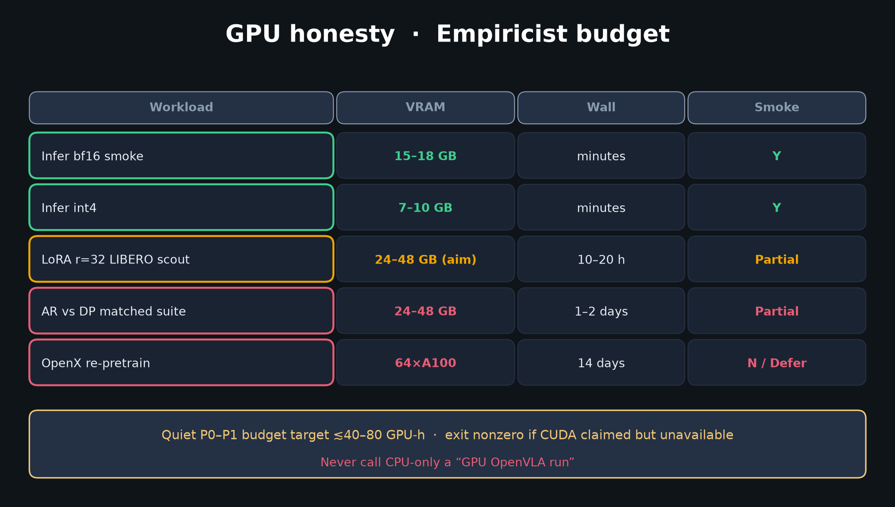
Empiricist · 11+3 · 11/16
Notes:
GPU BUDGET — honesty rules.
Infer bf16 15–18 GB Y · int4 7–10 GB Y · LoRA scout Partial · OpenX Defer N
Exit nonzero if CUDA claimed but unavailable. Never call CPU-only a GPU OpenVLA run.

Slide 12
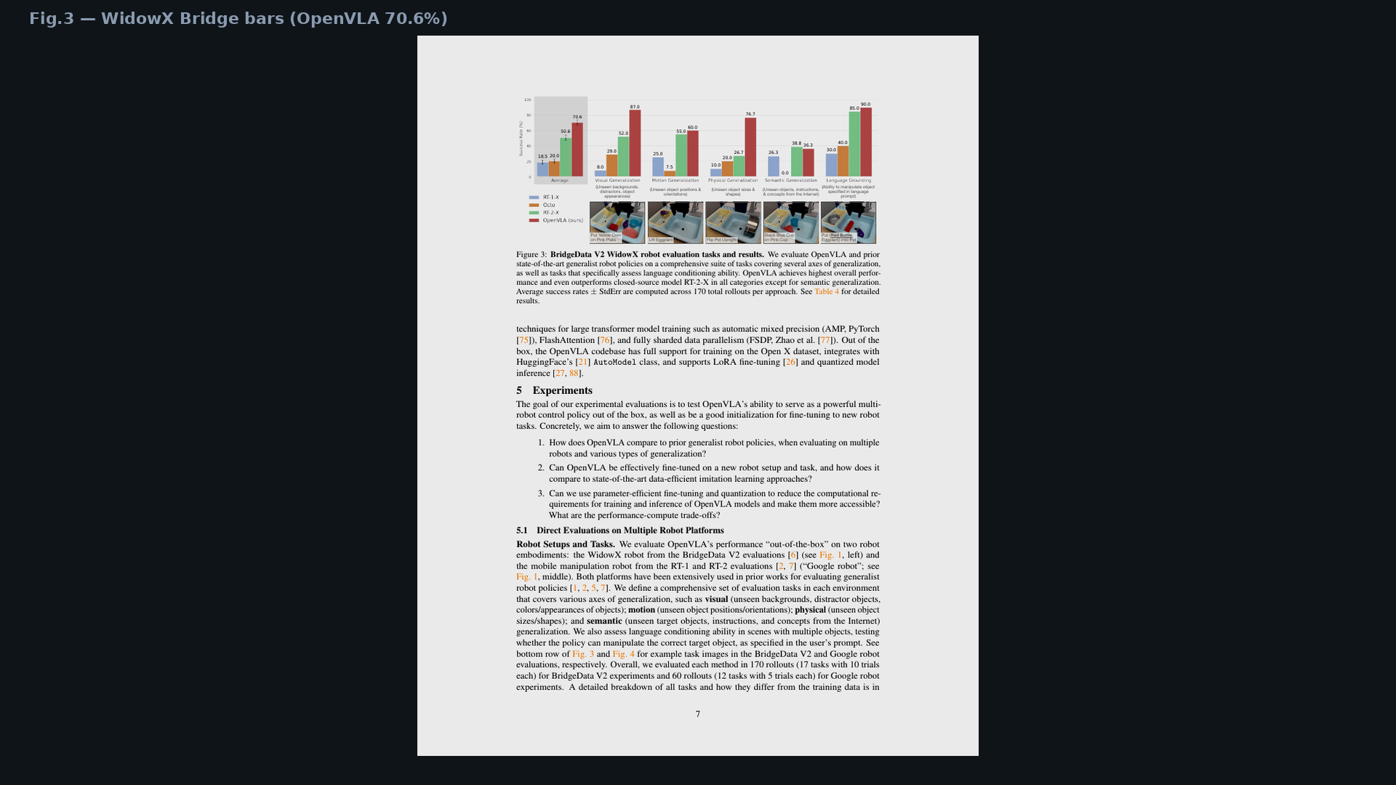
Empiricist · 11+3 · 12/16
Notes:
PAPER FIG.3 — WidowX Bridge bars. Point at OpenVLA 70.6 vs RT-2-X 50.6 / Octo 20.
Bibliographic visual; 30–45s. Empiricist owns the numbers, not just the chart.

Slide 13
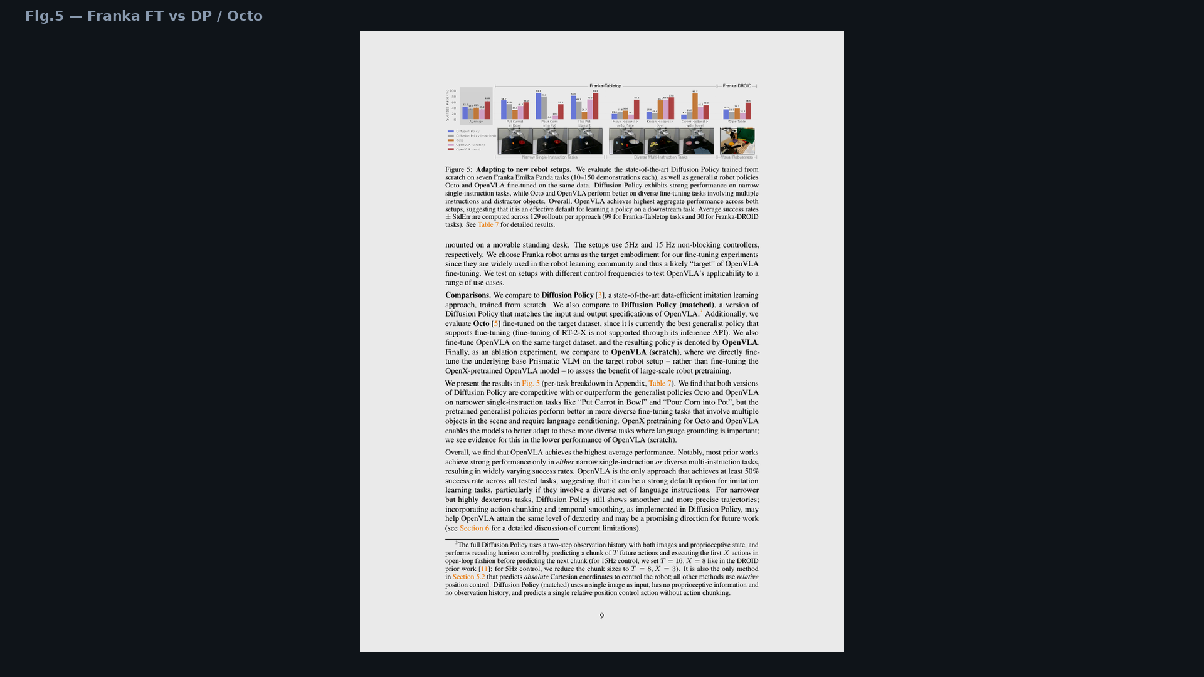
Empiricist · 11+3 · 13/16
Notes:
PAPER FIG.5 — Franka FT. Pattern: DP wins narrow single-instruction; OpenVLA wins multi-instruction language.
Abstract +20.4% vs DP is the lang/multi-task claim — say the condition.

Slide 14
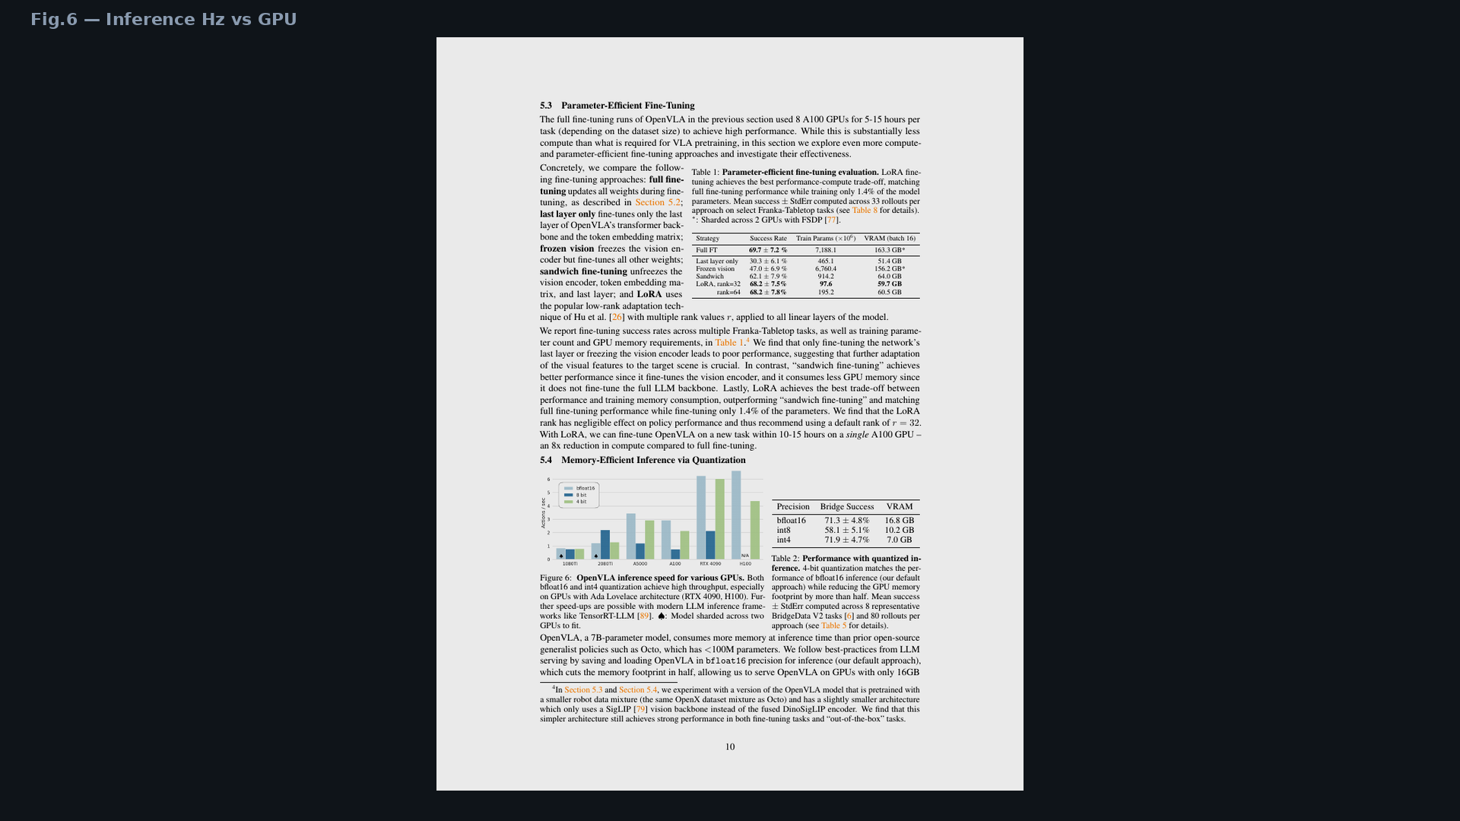
Empiricist · 11+3 · 14/16
Notes:
PAPER FIG.6 — Hz vs GPU. ~6 Hz bf16 on 4090 is the control-stack tattoo.
Connect to H-hz and why FAST/chunks come before high-Hz claims.

Slide 15
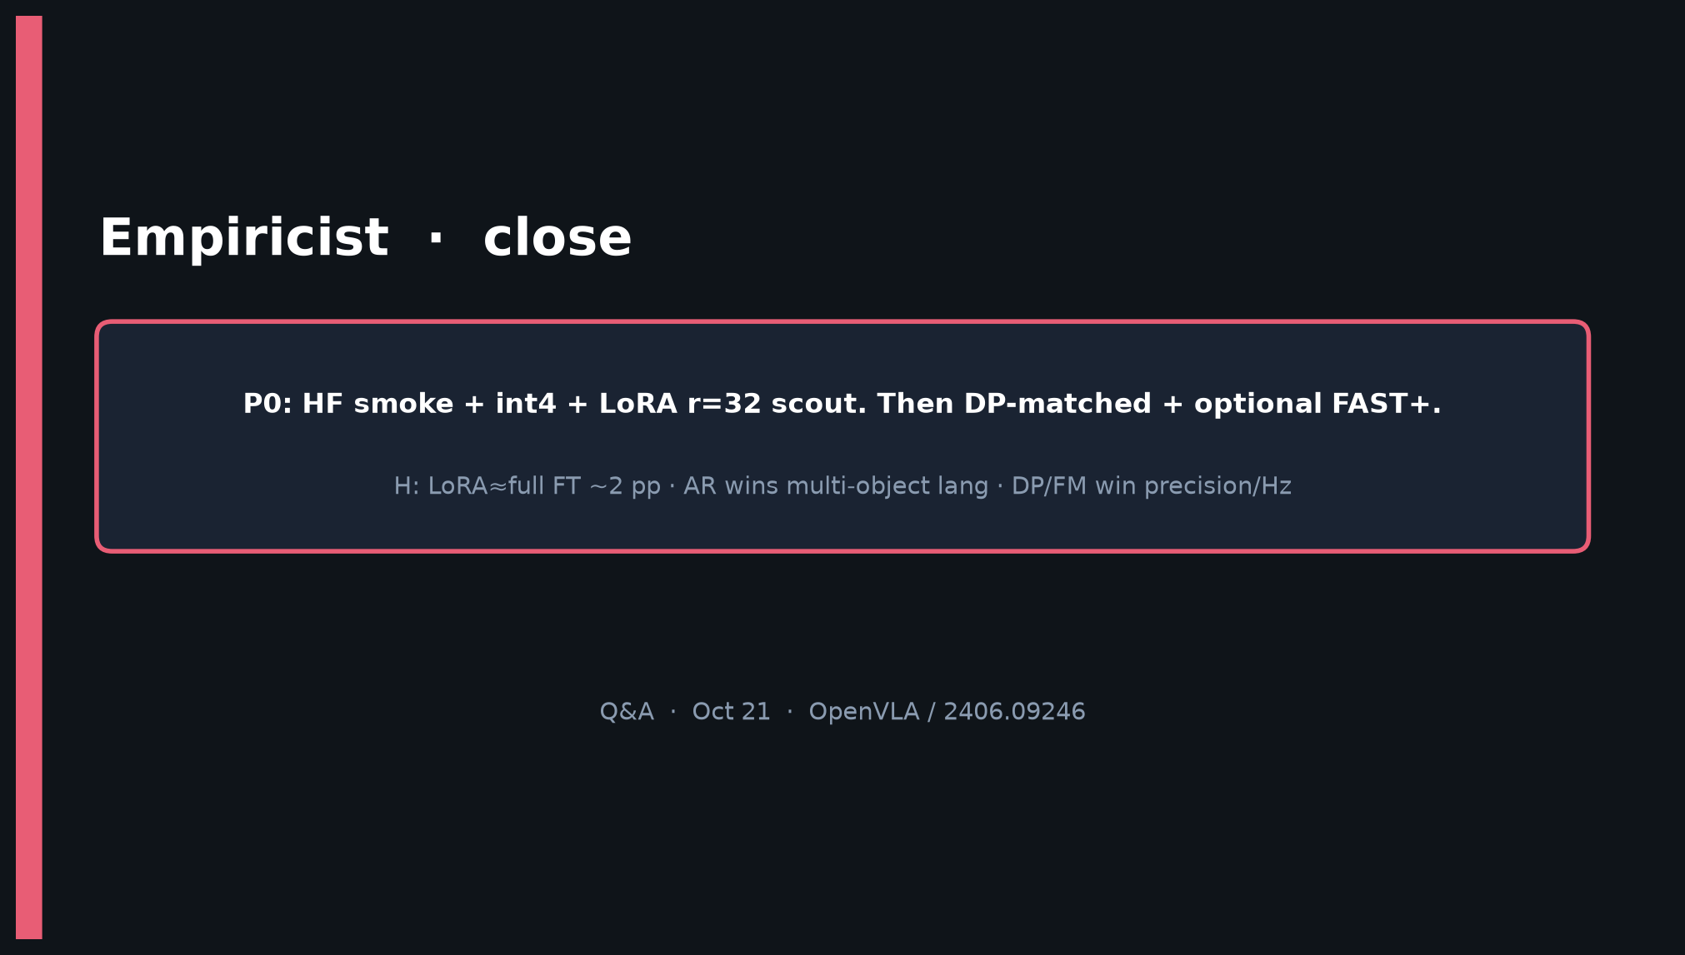
Empiricist · 11+3 · 15/16
Notes:
CLOSE — P0 smoke + LoRA ladder + AR vs FM honesty is the bar.
H: LoRA≈full ~2 pp · AR wins multi-object lang · DP/FM win precision/Hz.
Hand genealogy to Archaeologist; hand deploy bet to Visionary.

Slide 16
Empiricist · 11+3 · 16/16
Notes:
BACKUP — taxonomy again if room challenges action-family framing mid-Q&A.

