Slide 1
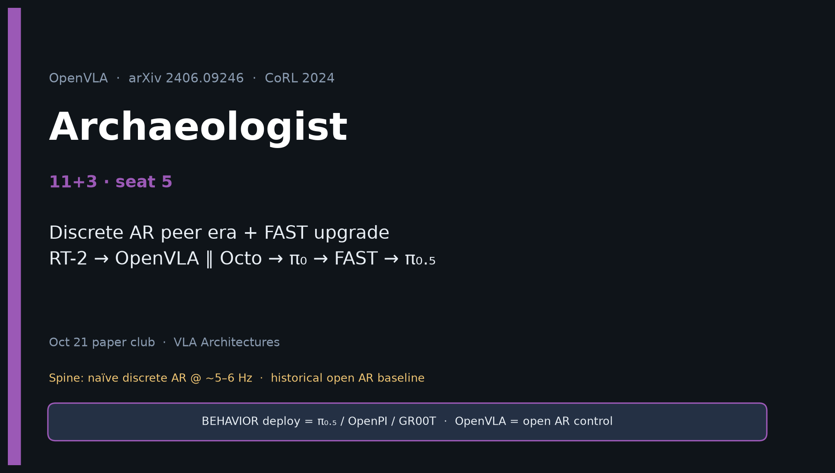
Archaeologist · 11+3 · 1/14
Notes:
ARCHAEOLOGIST — 11+3 · seat 5.
You own genealogy and peer-era framing.
RT-2-style discrete AR → OpenVLA (open) ∥ Octo (diffusion) → π₀ (FM) → FAST → π₀.₅/OpenPI/BEHAVIOR.
Never collapse OpenVLA into “the” 2026 VLA.

Slide 2
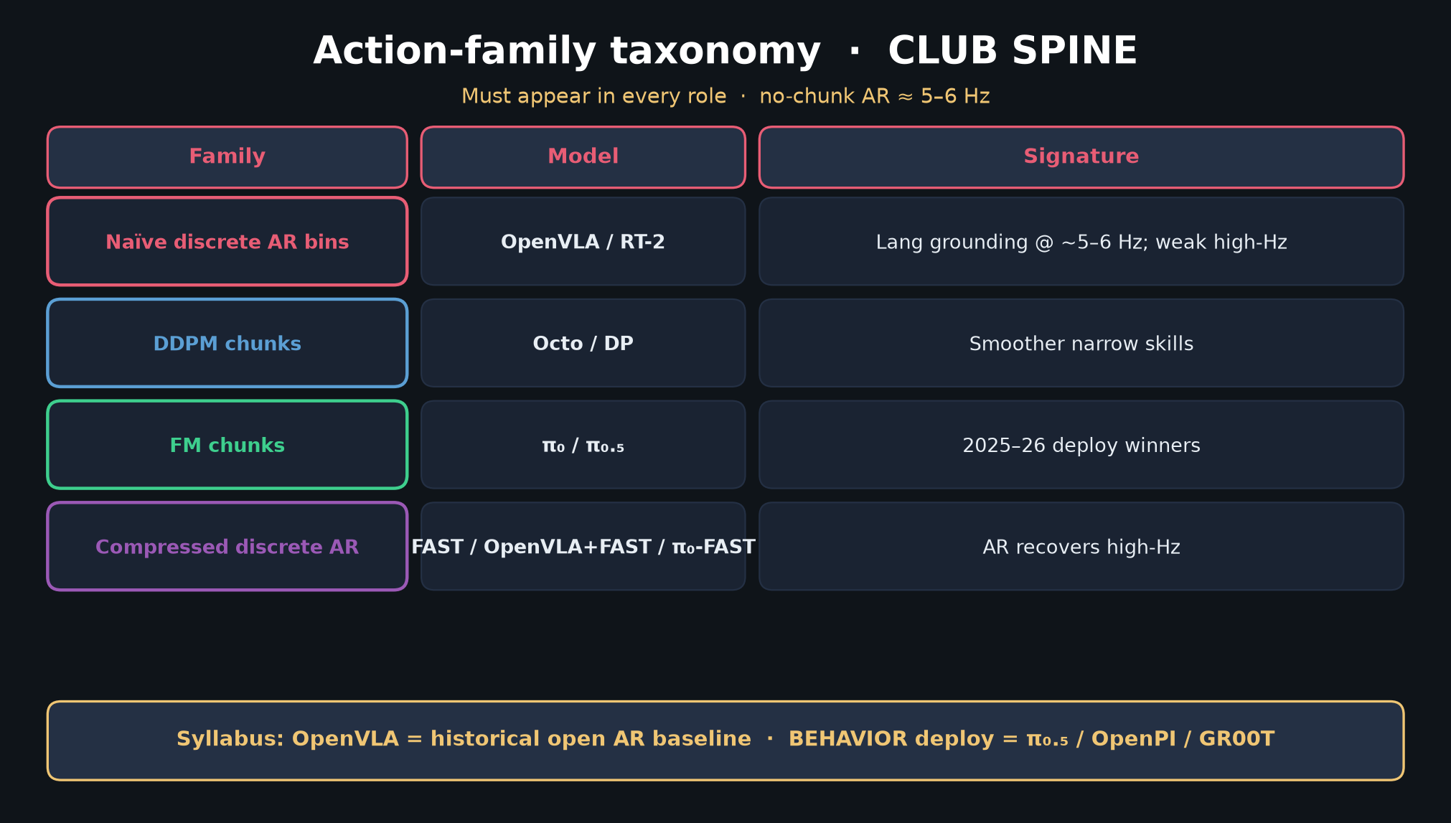
Archaeologist · 11+3 · 2/14
Notes:
TAXONOMY — action-family is the Archaeologist’s primary sorting key.

Slide 3
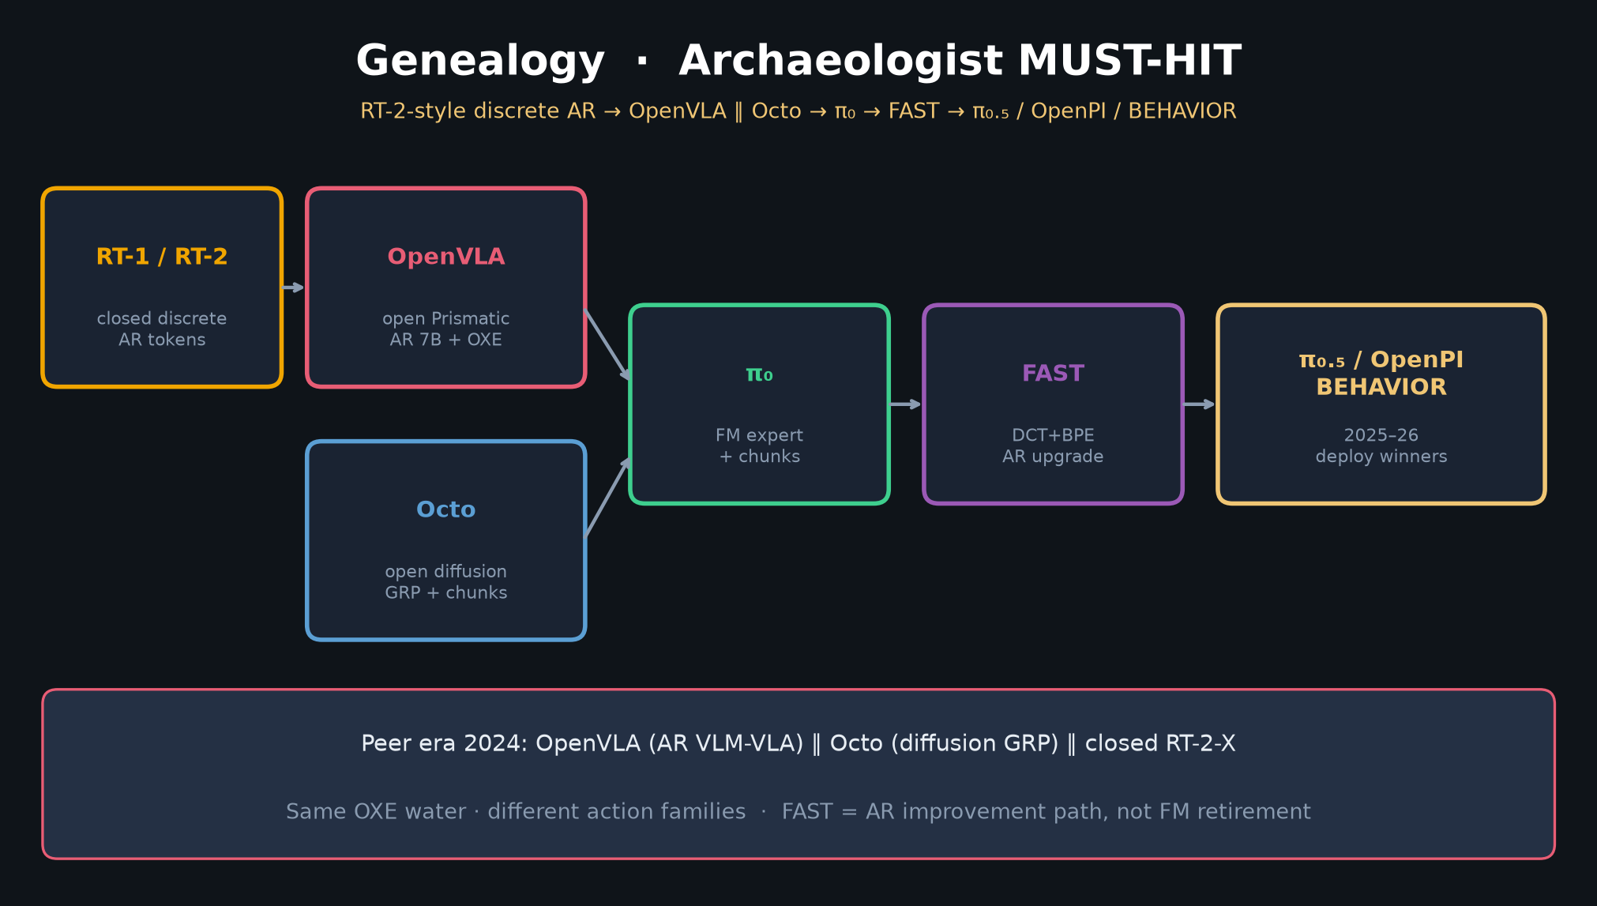
Archaeologist · 11+3 · 3/14
Notes:
GENEALOGY MUST — spend 90–120s.
RT-2 → OpenVLA ∥ Octo → π₀ → FAST → π₀.₅/OpenPI/BEHAVIOR.
Same OXE water · different action families. FAST = AR upgrade path, not FM retirement.

Slide 4
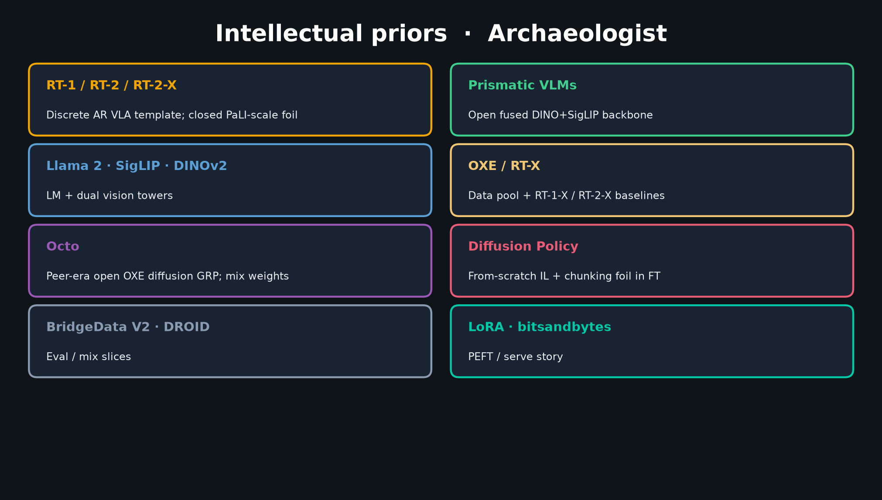
Archaeologist · 11+3 · 4/14
Notes:
PRIORS — RT-1/2, Prismatic, Llama-2, SigLIP+DINOv2, OXE, Octo peer, DP foil, LoRA.

Slide 5
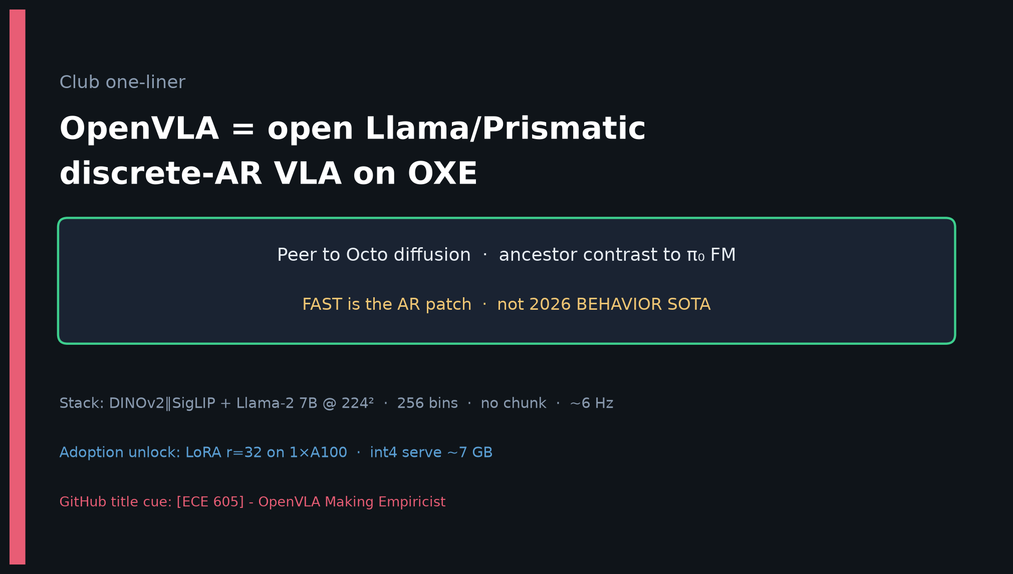
Archaeologist · 11+3 · 5/14
Notes:
ONE-LINER — compressed historical claim.

Slide 6
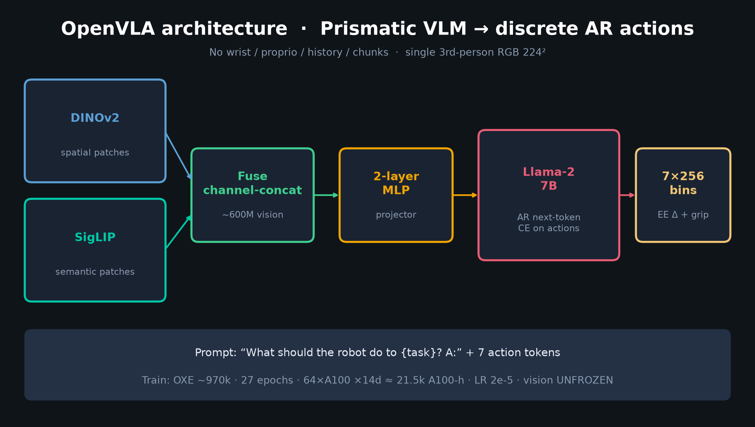
Archaeologist · 11+3 · 6/14
Notes:
ARCHITECTURE as historical artifact — naïve bins + vocab overwrite + no chunking.
Situate why FAST later diagnoses this exact failure mode.

Slide 7
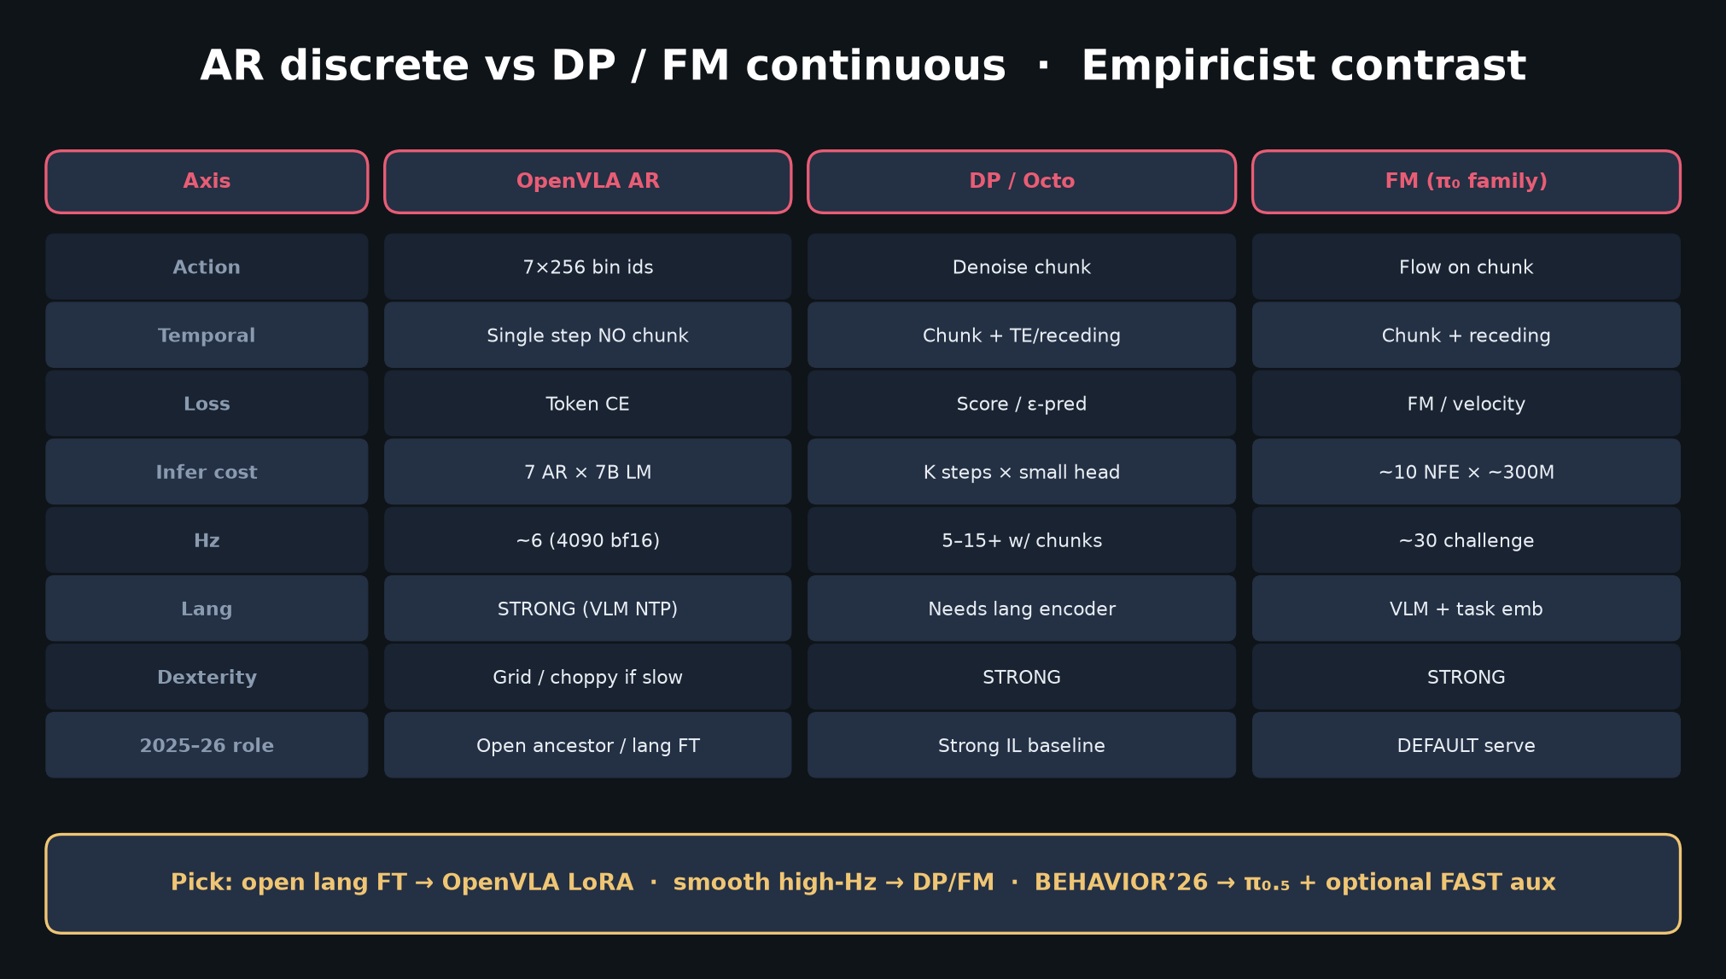
Archaeologist · 11+3 · 7/14
Notes:
AR vs FM — situates OpenVLA historically against continuous chunk winners.

Slide 8
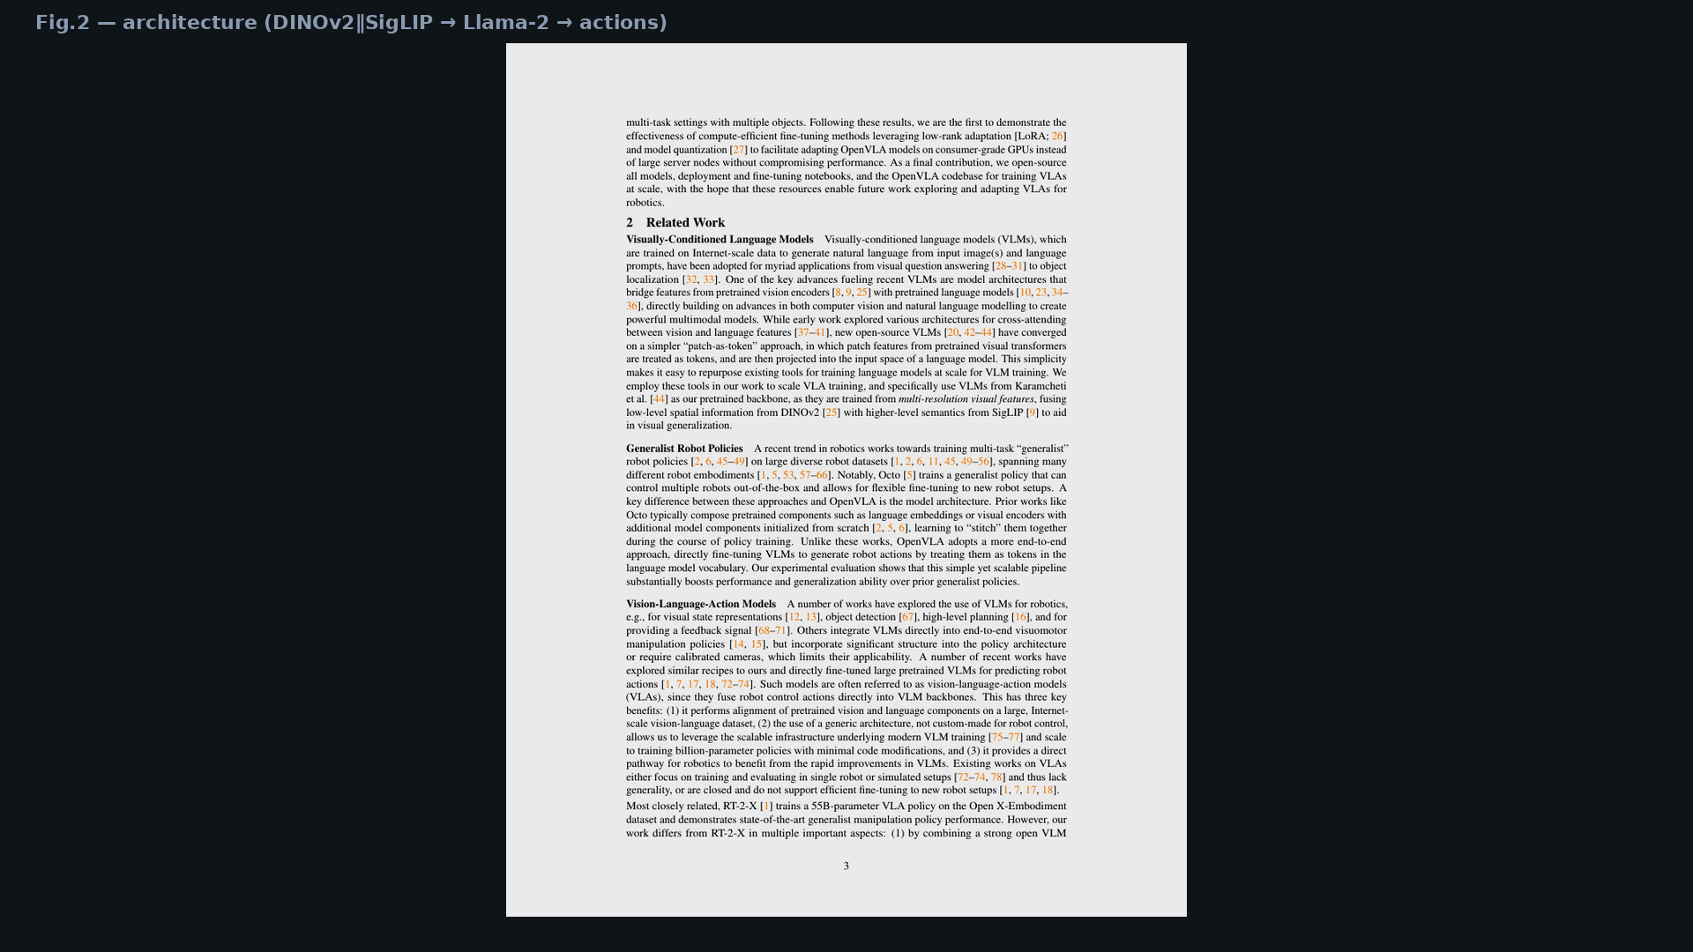
Archaeologist · 11+3 · 8/14
Notes:
Fig.2 architecture page — bibliographic visual of the Prismatic lock-in.

Slide 9
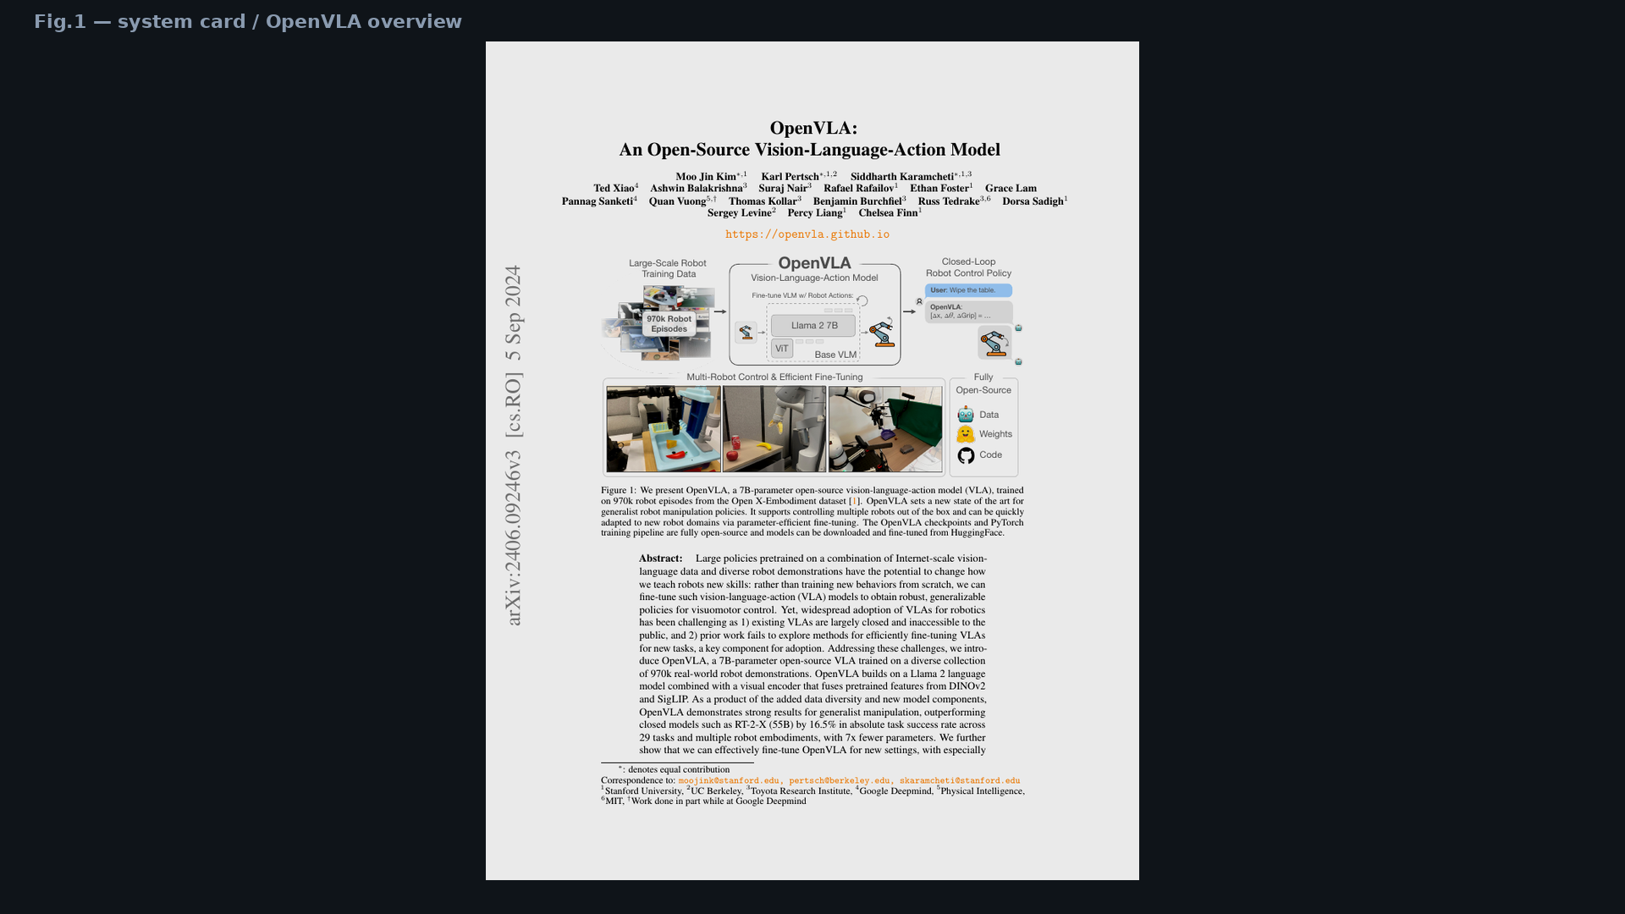
Archaeologist · 11+3 · 9/14
Notes:
Fig.1 system card — open data/weights/code as the open-science pivot vs closed RT-2-X.

Slide 10
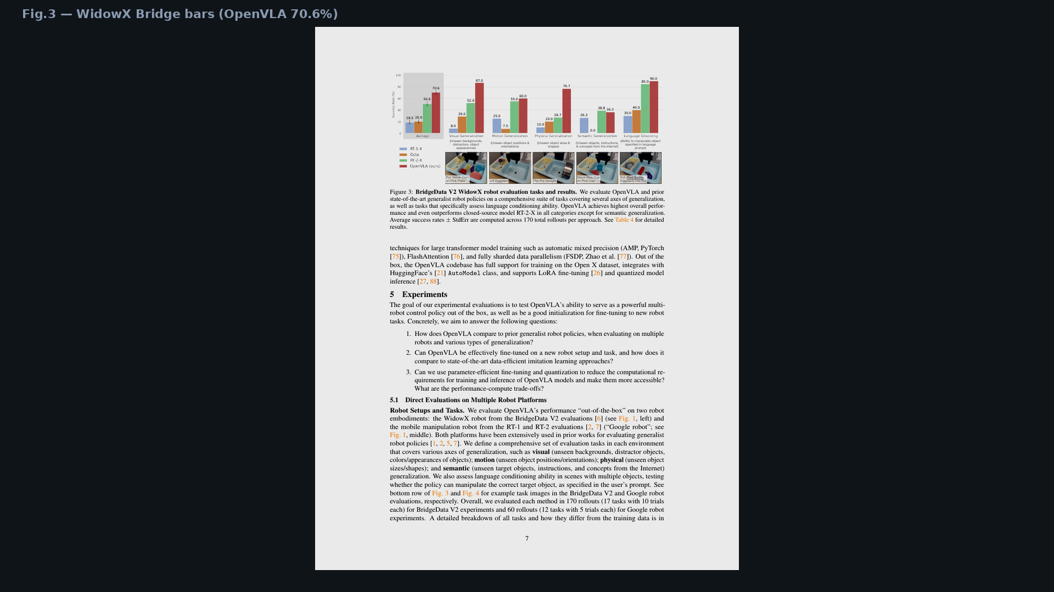
Archaeologist · 11+3 · 10/14
Notes:
Fig.3 — peer-era OOB vs RT-2-X / Octo on Bridge.

Slide 11
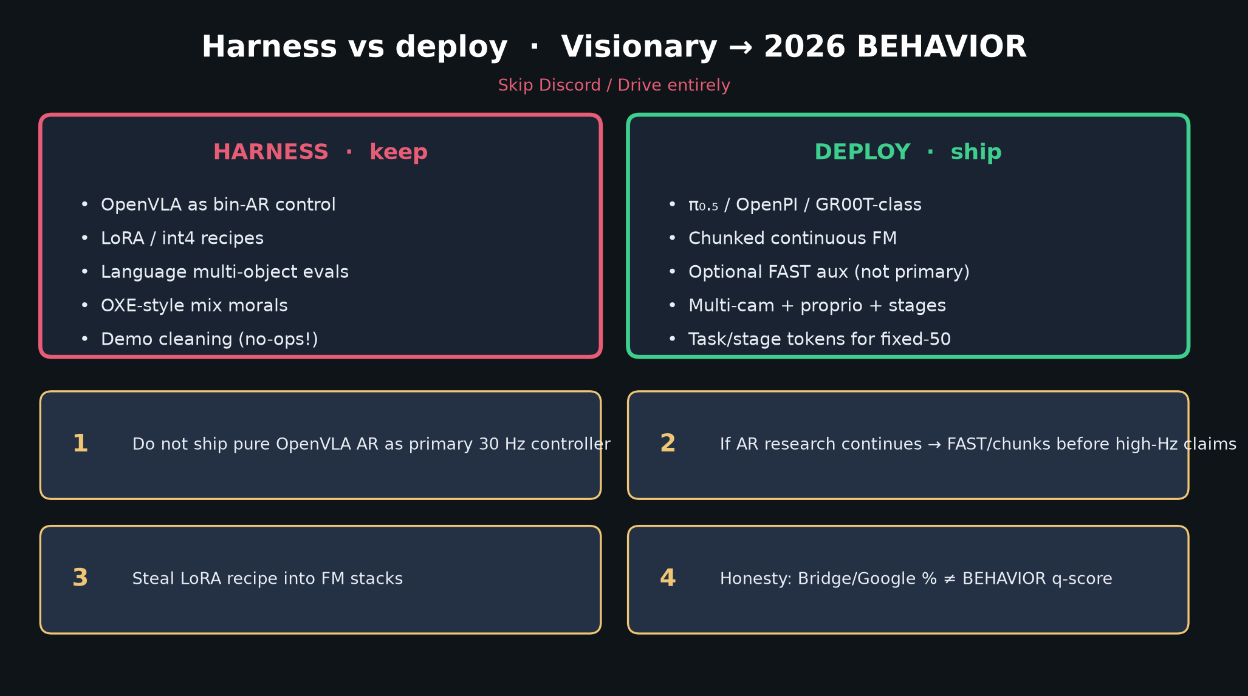
Archaeologist · 11+3 · 11/14
Notes:
FORWARD TO BEHAVIOR — where this node sits relative to ’25–’26 deploy.

Slide 12
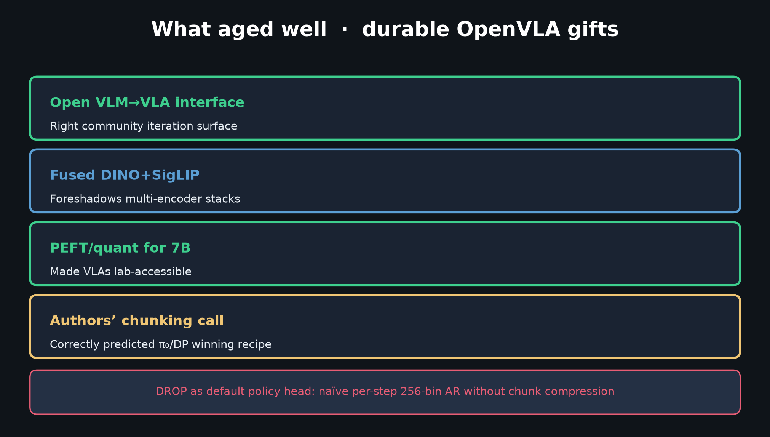
Archaeologist · 11+3 · 12/14
Notes:
DURABLE GIFTS — what the lineage keeps even after the bin head is retired.

Slide 13
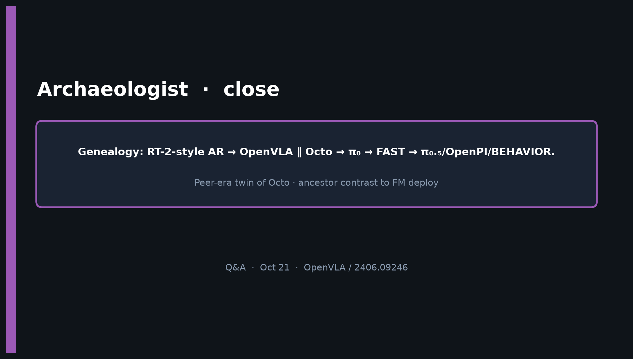
Archaeologist · 11+3 · 13/14
Notes:
CLOSE — Genealogy: RT-2-style AR → OpenVLA ∥ Octo → π₀ → FAST → π₀.₅/OpenPI/BEHAVIOR.
Peer-era twin of Octo · ancestor contrast to FM deploy.

Slide 14
Archaeologist · 11+3 · 14/14
Notes:
BACKUP genealogy.

