Slide 1
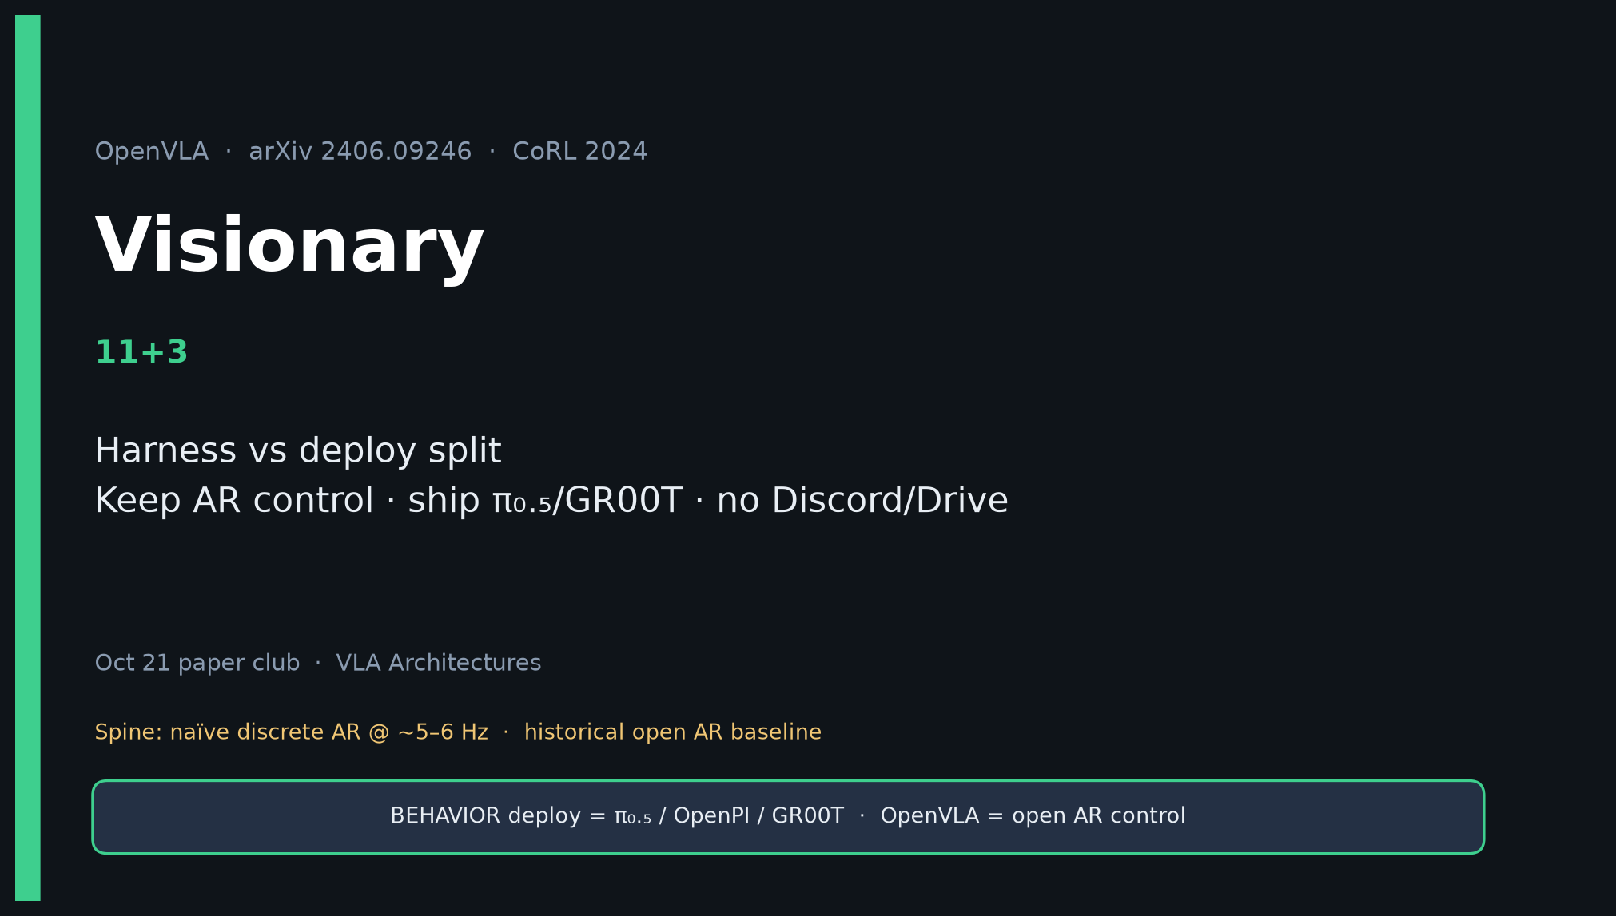
Visionary · 11+3 · 1/14
Notes:
VISIONARY — 11+3.
Harness vs deploy split. Keep OpenVLA as bin-AR control; ship π₀.₅/GR00T.
Steal LoRA recipe. If AR continues → FAST/chunks before high-Hz claims.
SKIP Discord/Drive entirely.
Open with taxonomy so strategy never confuses AR baseline with deploy SOTA.

Slide 2
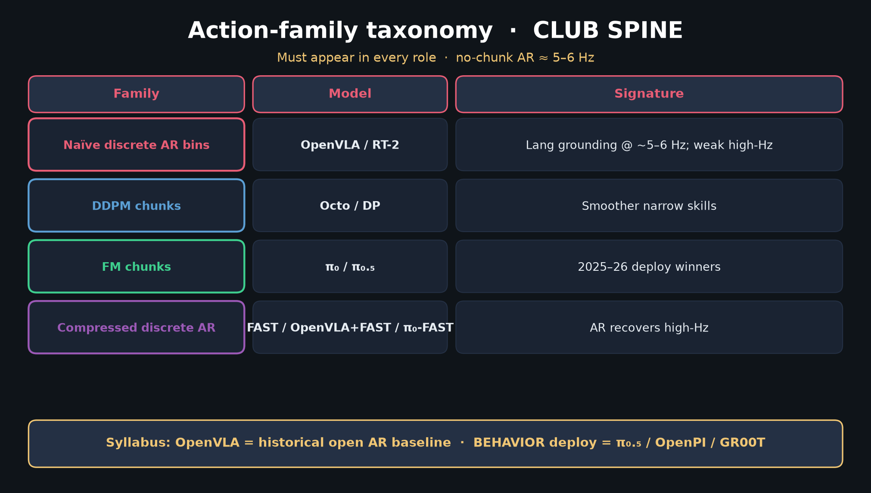
Visionary · 11+3 · 2/14
Notes:
TAXONOMY — strategy foundation. FM chunks = deploy winners; OpenVLA = AR control.

Slide 3
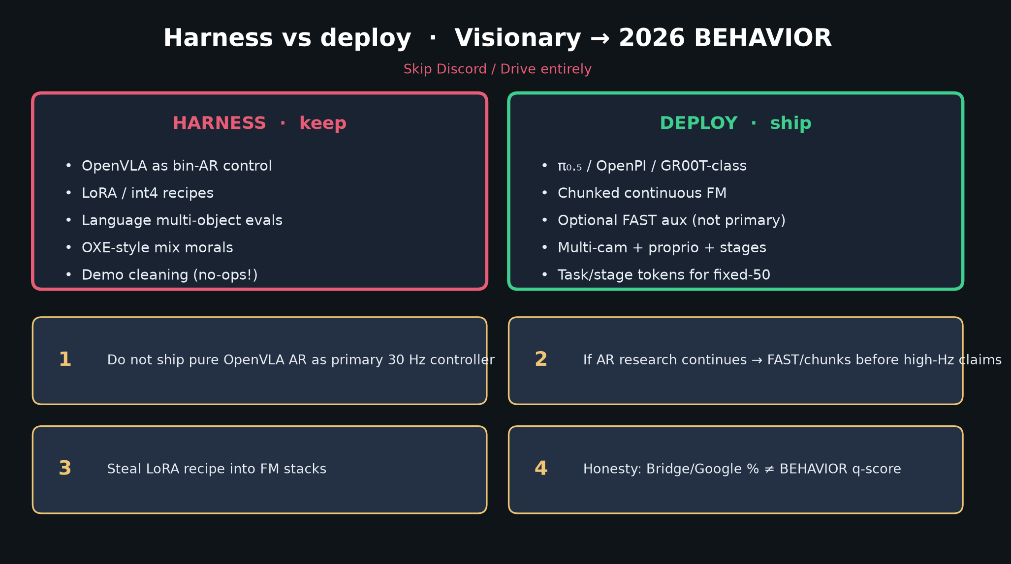
Visionary · 11+3 · 3/14
Notes:
HARNESS vs DEPLOY MUST — keep morals/LoRA/AR control; ship π₀.₅/OpenPI/GR00T.
Bets 1–4 on the slide. No Discord/Drive.

Slide 4
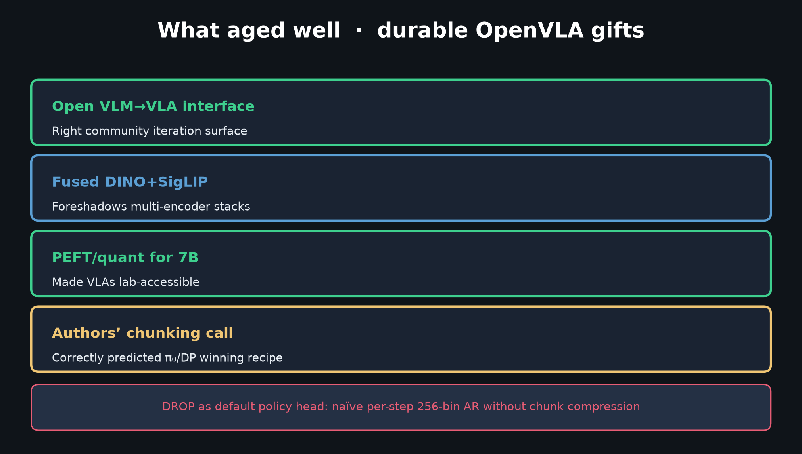
Visionary · 11+3 · 4/14
Notes:
DURABLE GIFTS — open VLM→VLA, fused vision, PEFT/quant, authors’ chunking call.

Slide 5
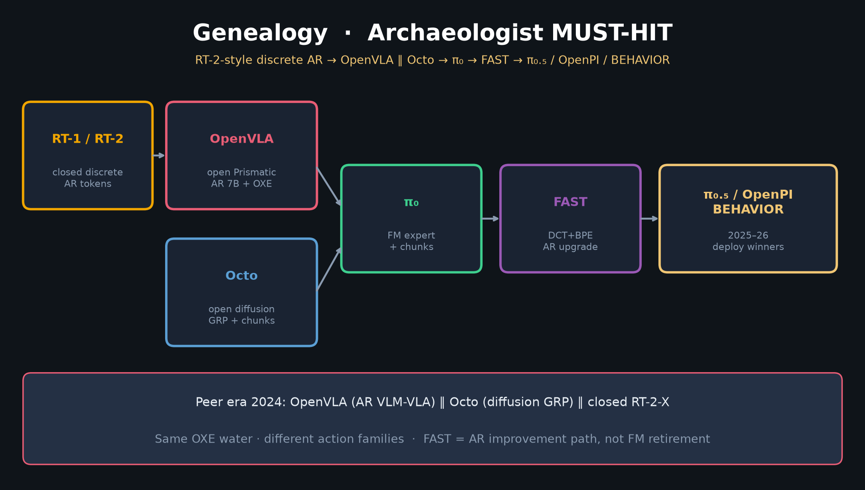
Visionary · 11+3 · 5/14
Notes:
GENEALOGY — so Oct proposals don’t mislabel the stack.

Slide 6
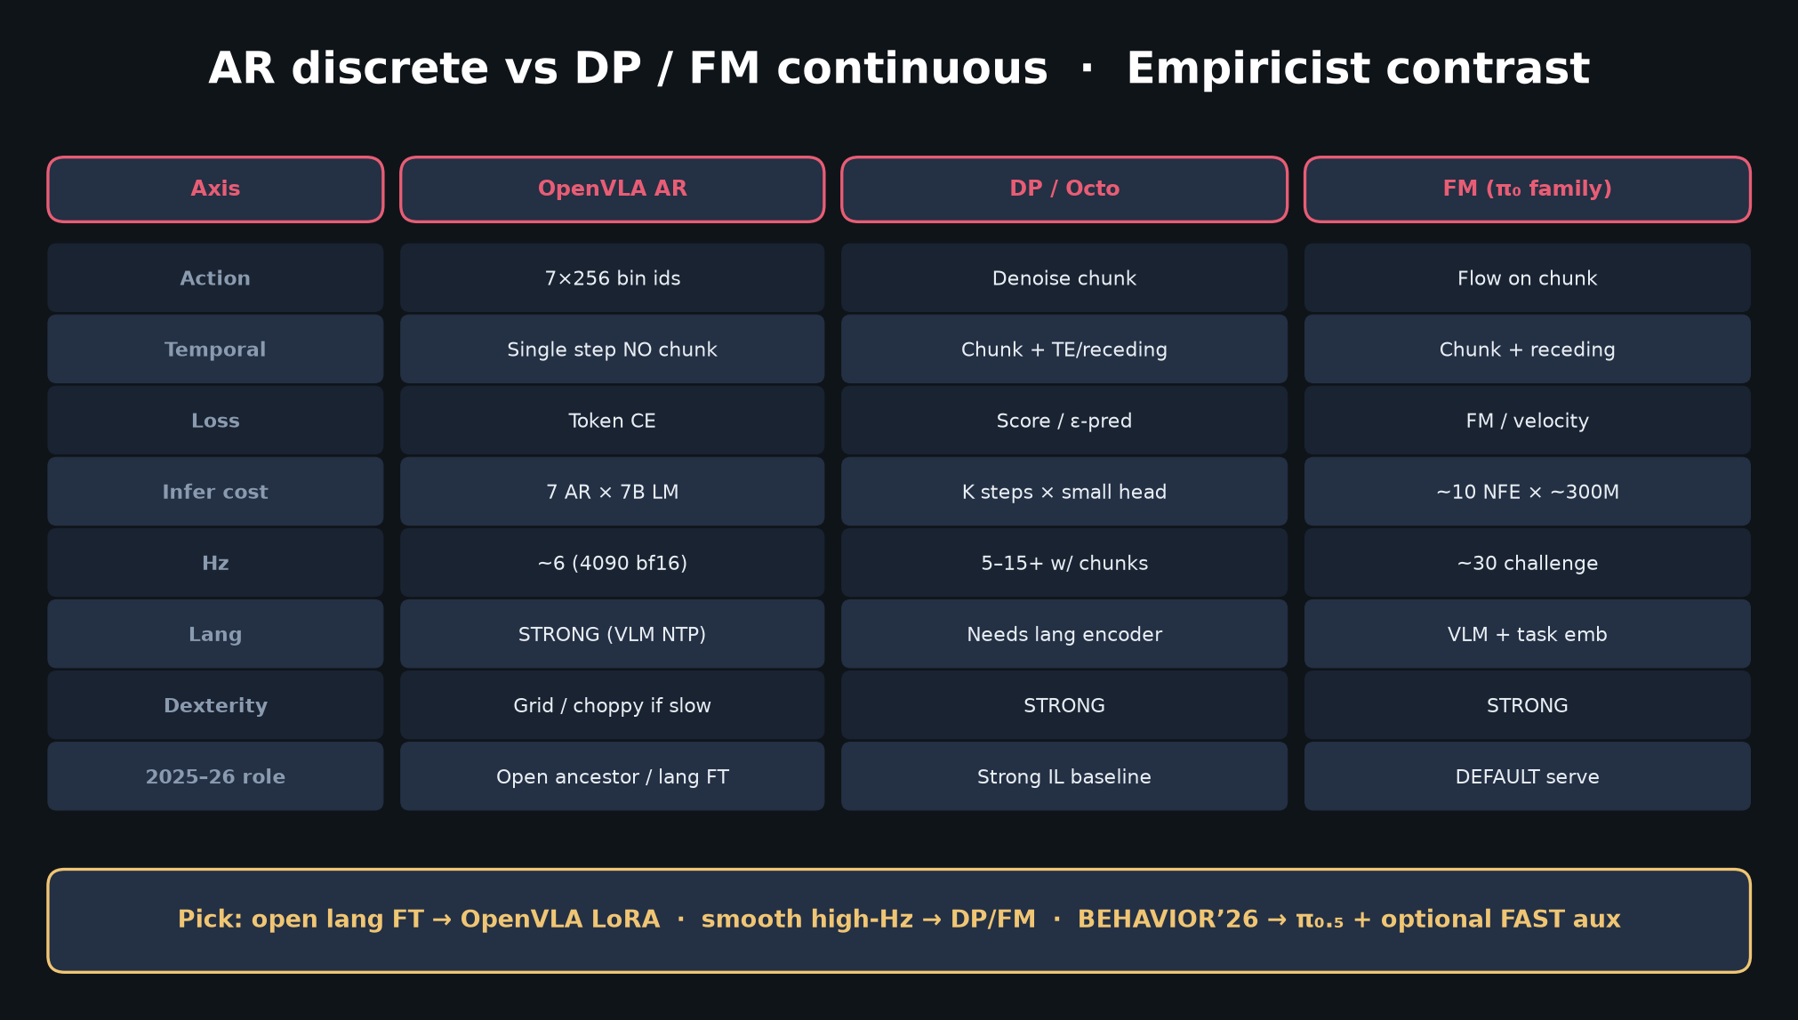
Visionary · 11+3 · 6/14
Notes:
AR vs FM — why deploy stays continuous chunks (+ optional FAST aux).

Slide 7
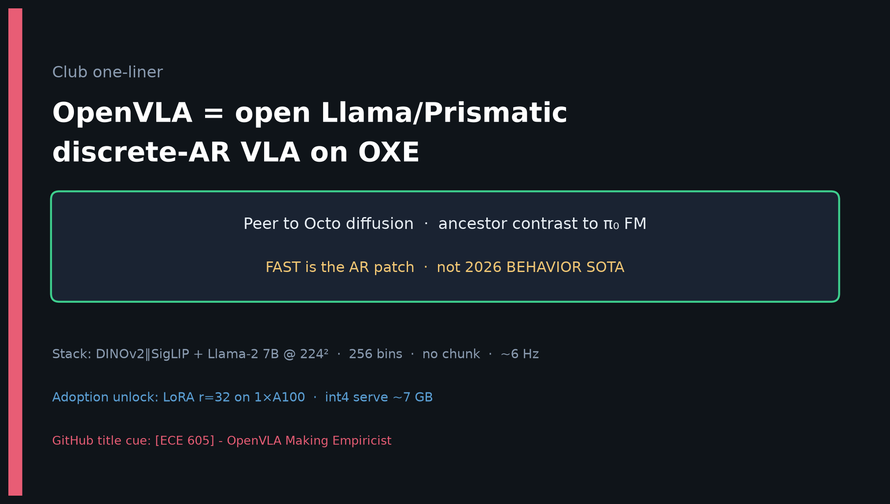
Visionary · 11+3 · 7/14
Notes:
ONE-LINER — strategy sentence for the room.

Slide 8
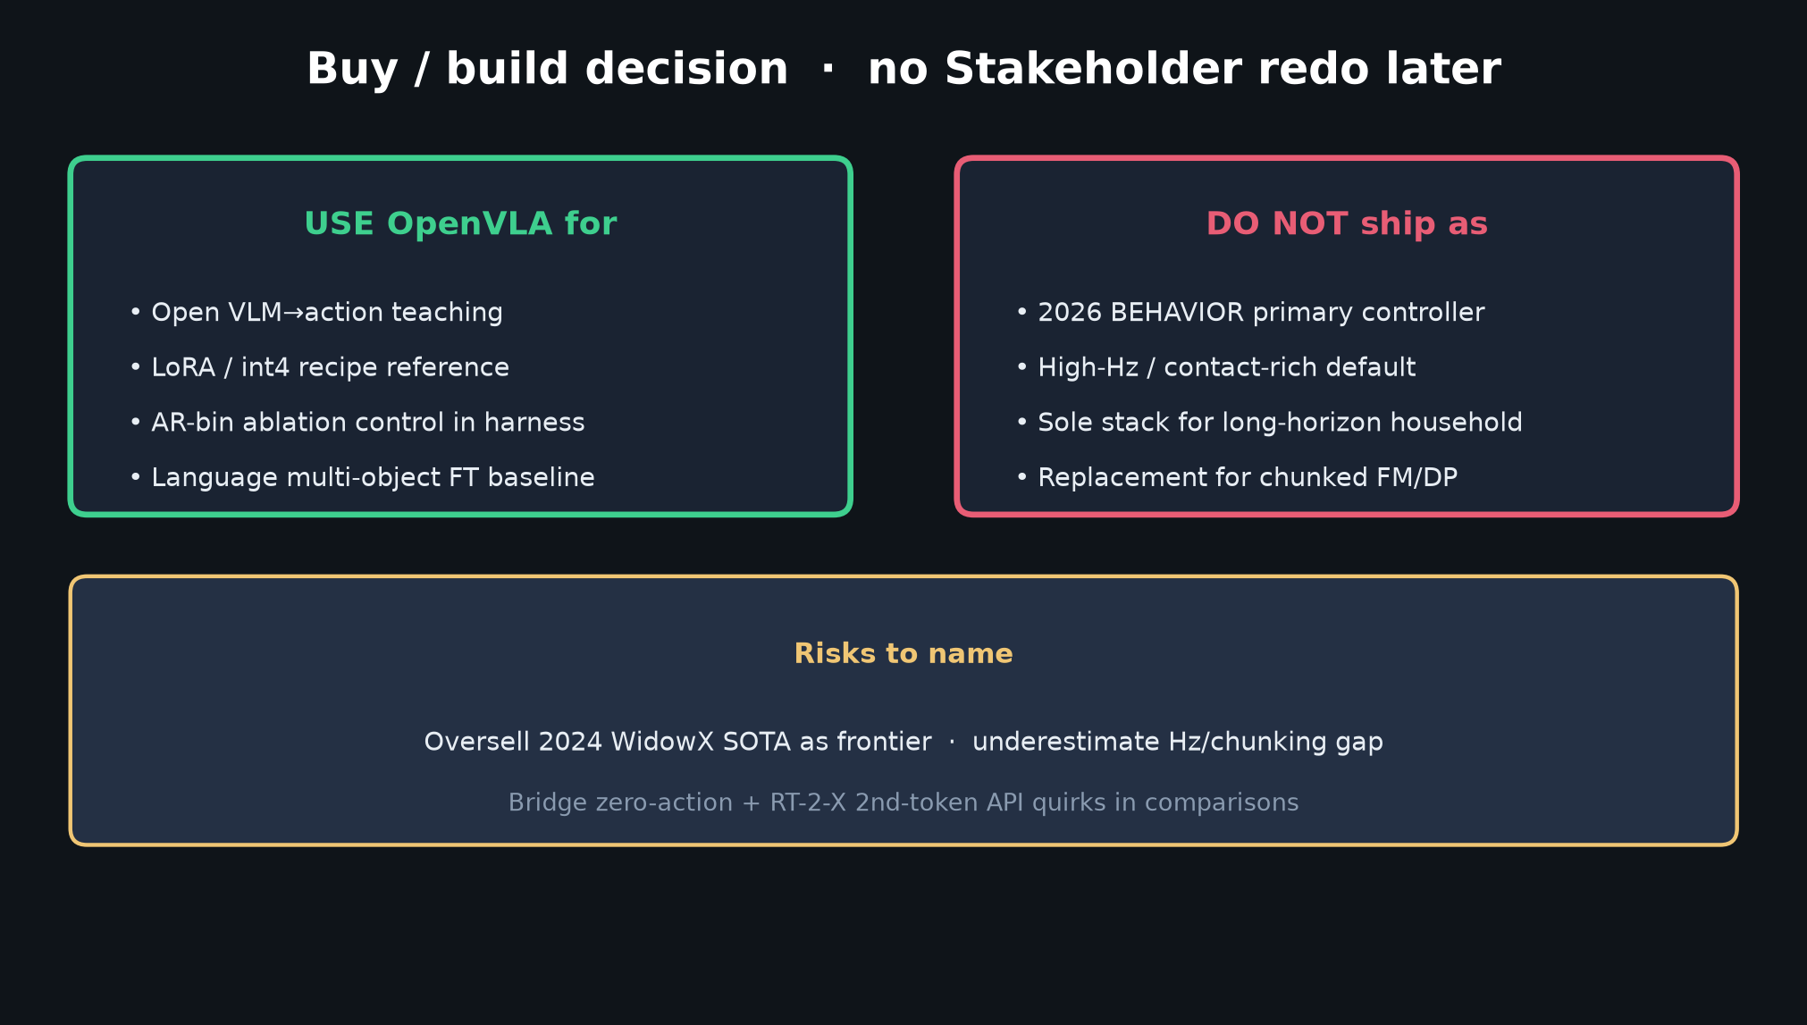
Visionary · 11+3 · 8/14
Notes:
STAKEHOLDER DECISION — align Visionary with durable buy/build.

Slide 9
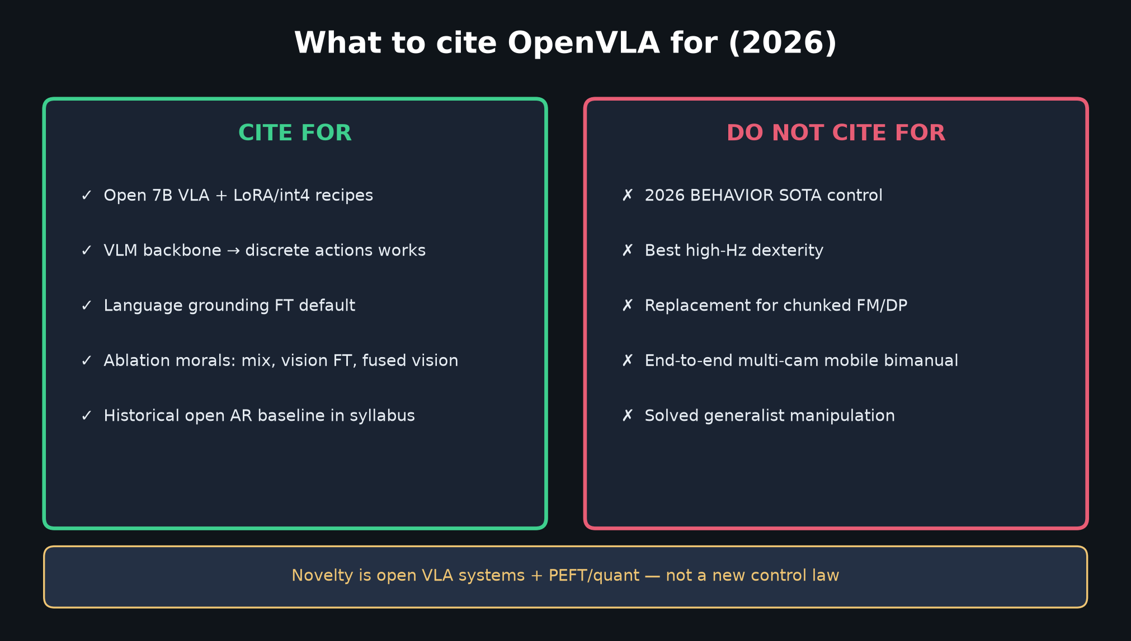
Visionary · 11+3 · 9/14
Notes:
CITE TABLE — what 2026 proposals should/shouldn’t claim.

Slide 10
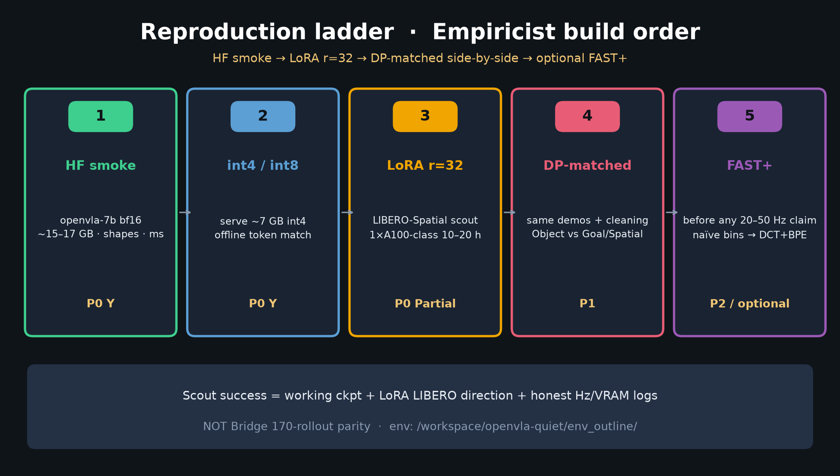
Visionary · 11+3 · 10/14
Notes:
EMPIRICIST LADDER — what Visionary asks Empiricist to measure for ’26 transfer
(LoRA morals, AR vs FM, optional FAST+).

Slide 11
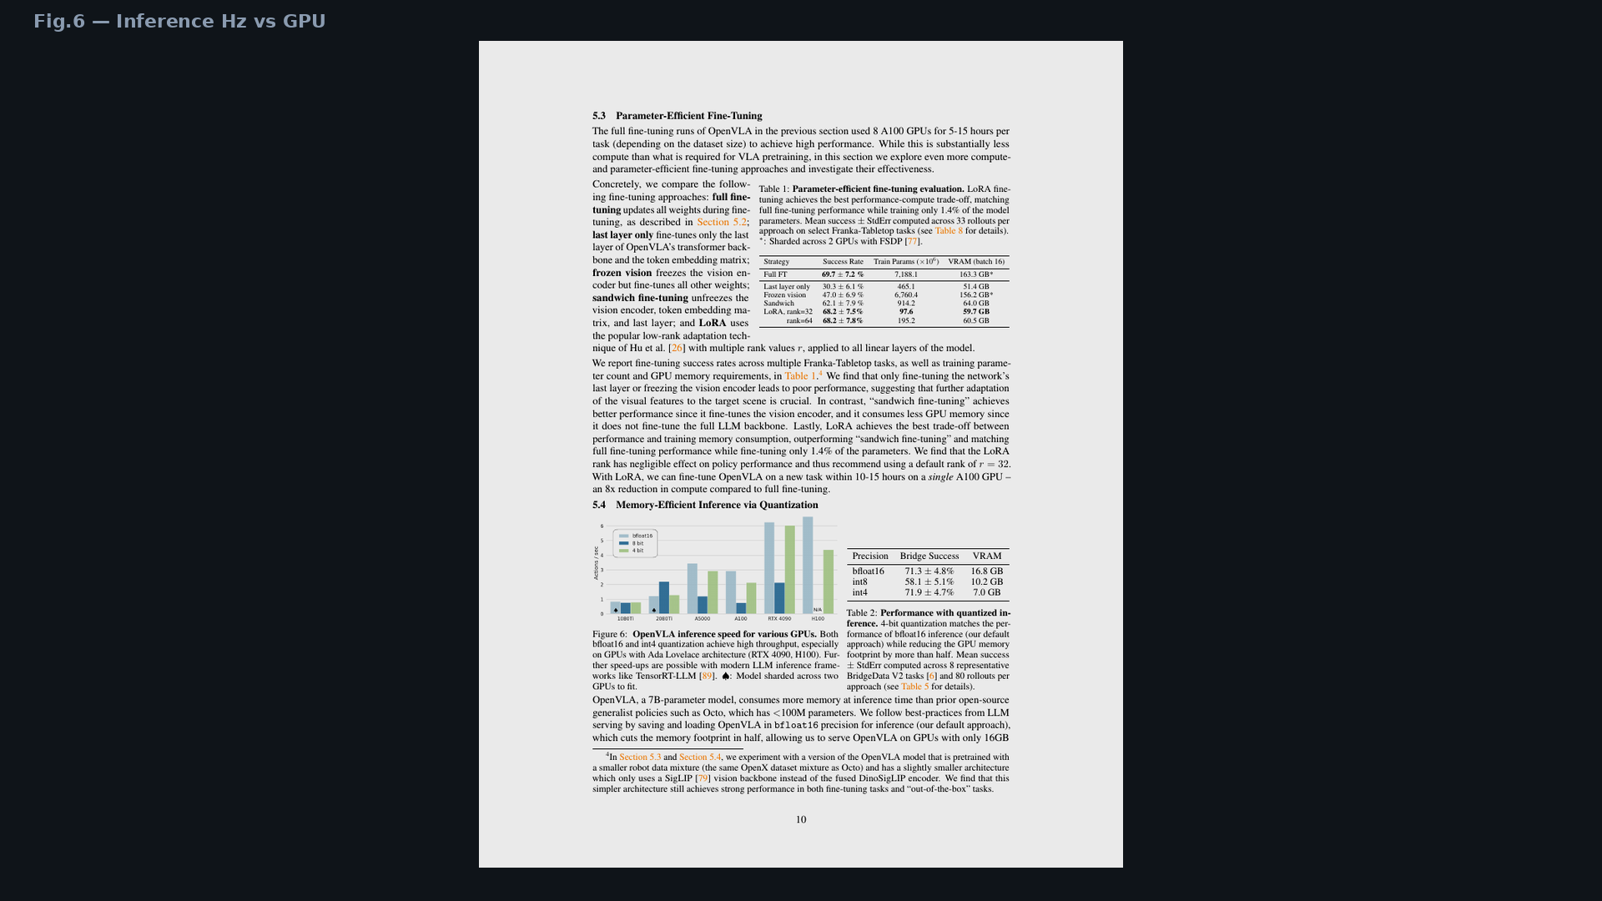
Visionary · 11+3 · 11/14
Notes:
Fig.6 Hz — the operational reason pure OpenVLA AR is not the ’26 controller.

Slide 12
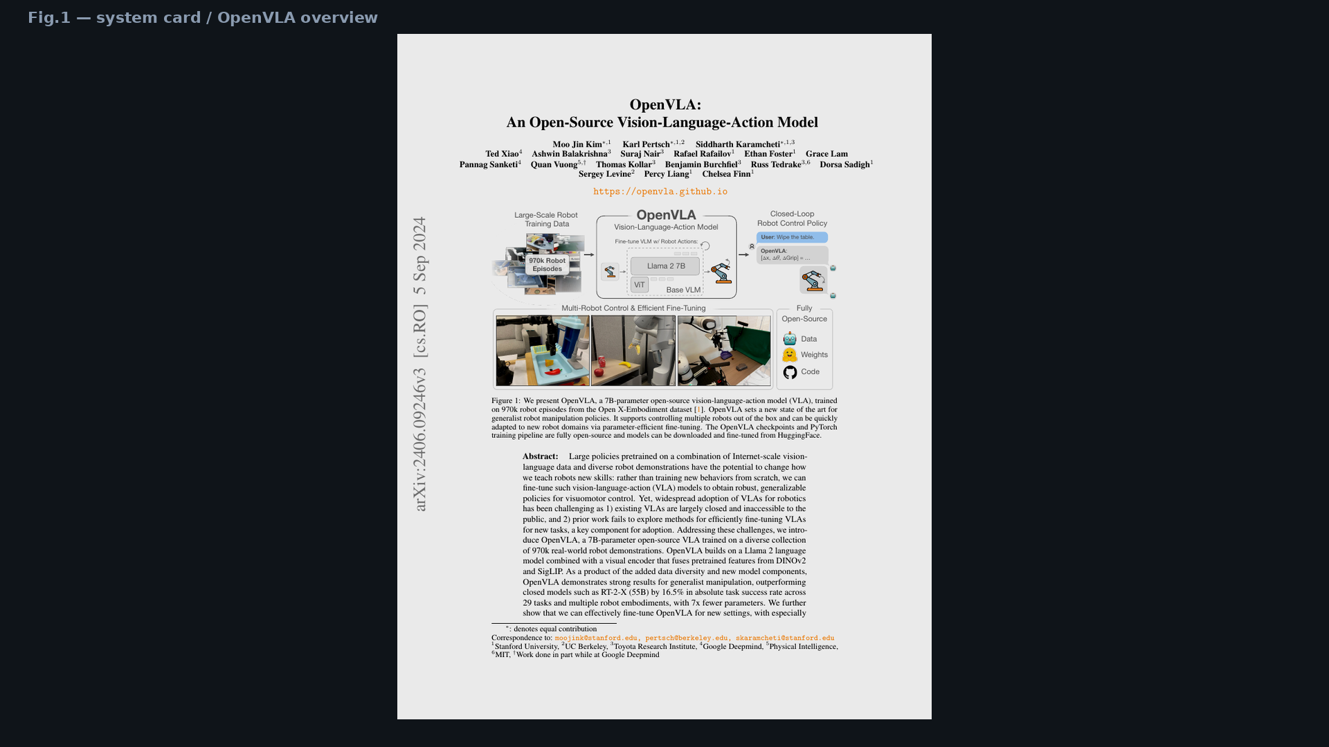
Visionary · 11+3 · 12/14
Notes:
Fig.1 — open release norms Visionary wants to keep even after swapping the head.

Slide 13
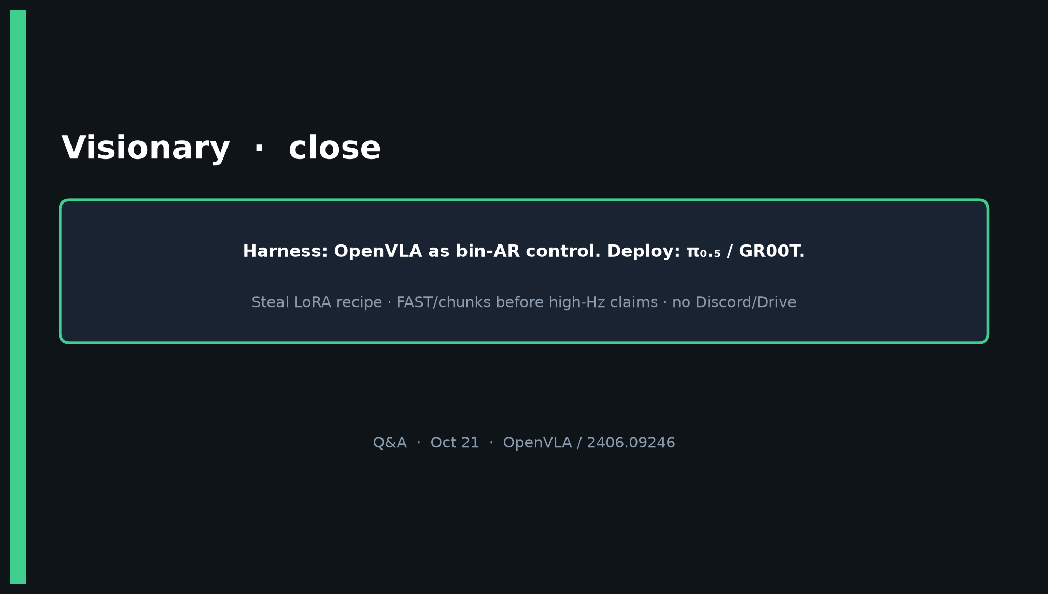
Visionary · 11+3 · 13/14
Notes:
CLOSE — Harness: OpenVLA bin-AR control. Deploy: π₀.₅/GR00T.
Steal LoRA · FAST/chunks before high-Hz · no Discord/Drive.

Slide 14
Visionary · 11+3 · 14/14
Notes:
BACKUP harness vs deploy.

