Slide 1
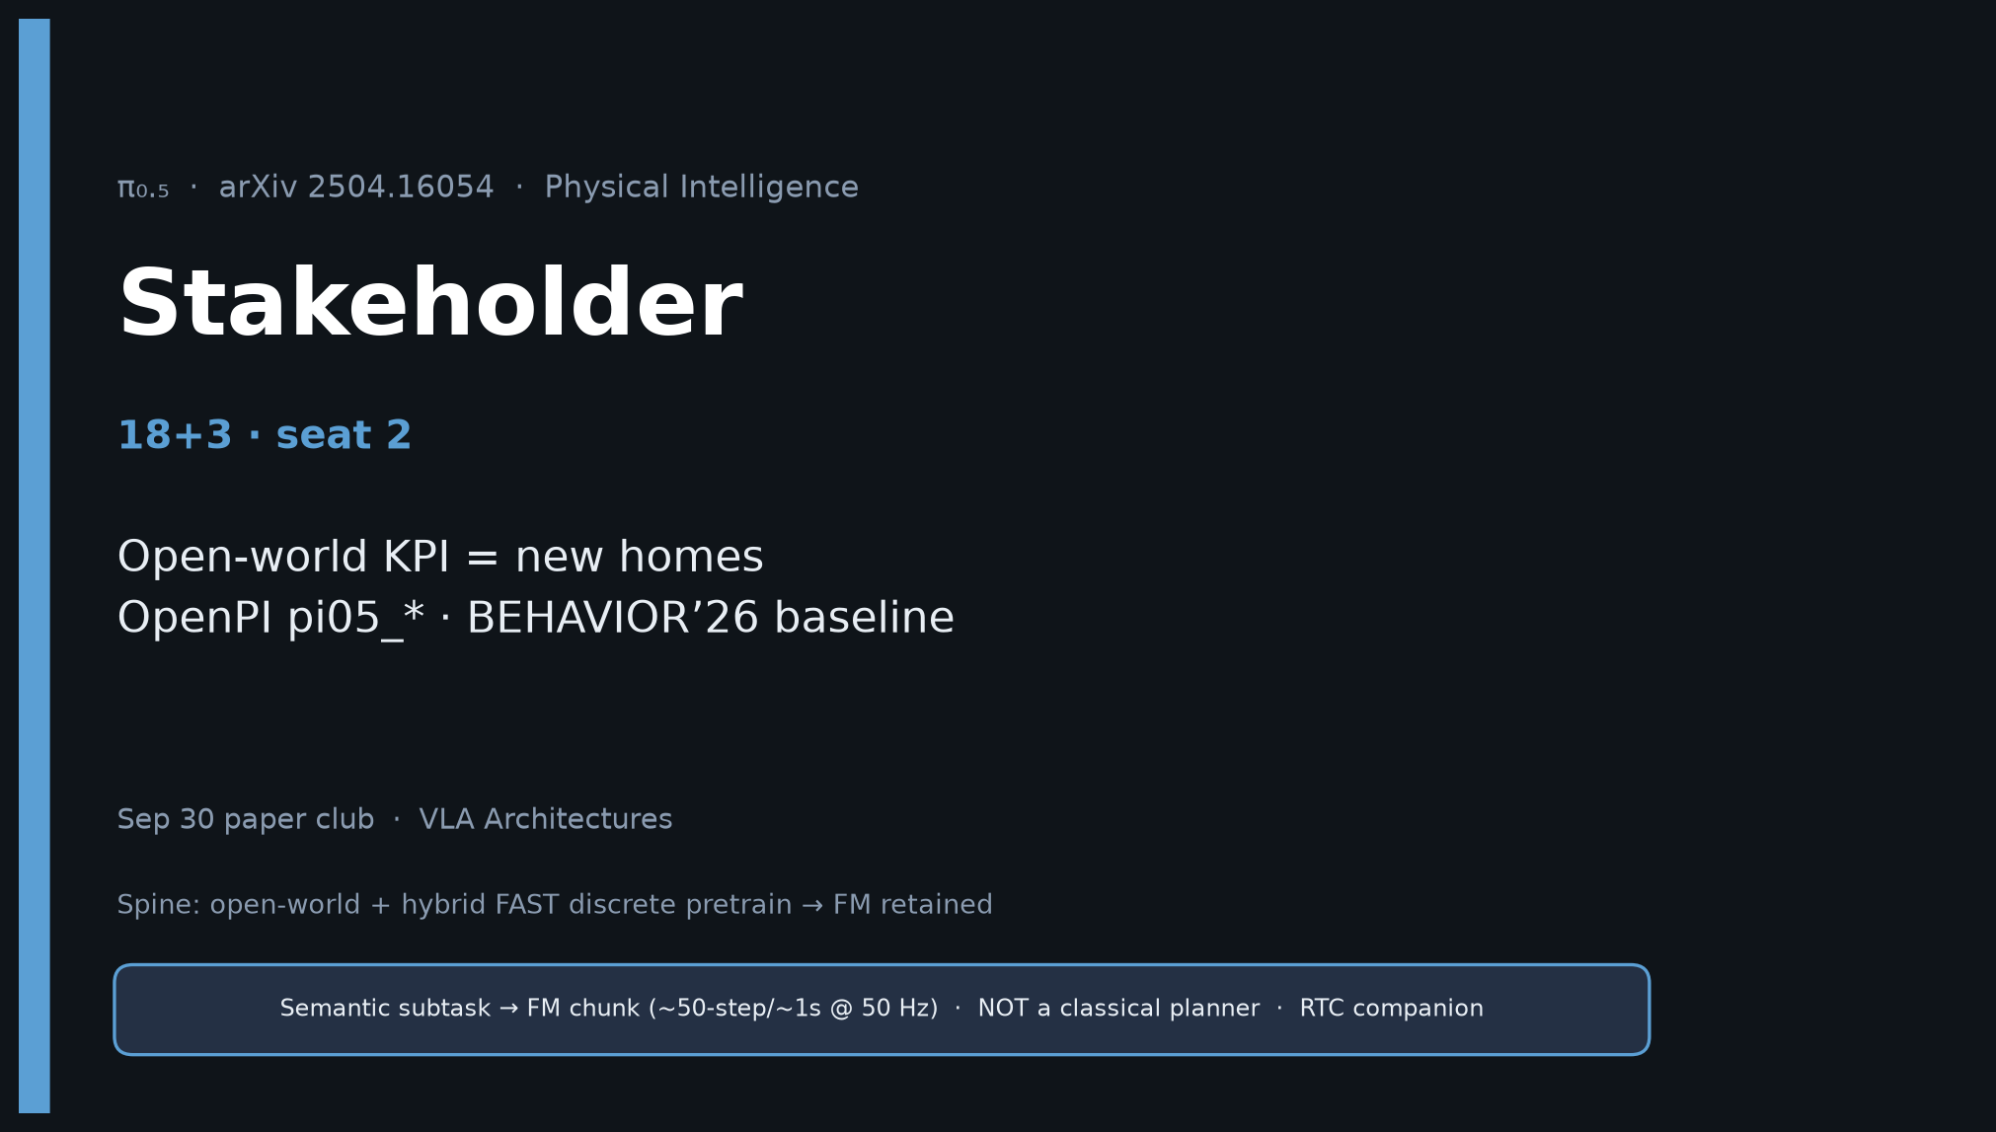
Stakeholder · 18+3 · 1/18
Notes:
STAKEHOLDER OPENING — 18+3. Open-world KPI + OpenPI/BEHAVIOR’26.
Decision frame: treat π₀.₅ as the baseline VLA stack for 2026 household-sim and real-home generalization.
Ignore FAST-replaced-FM myths when budgeting control stacks.

Slide 2
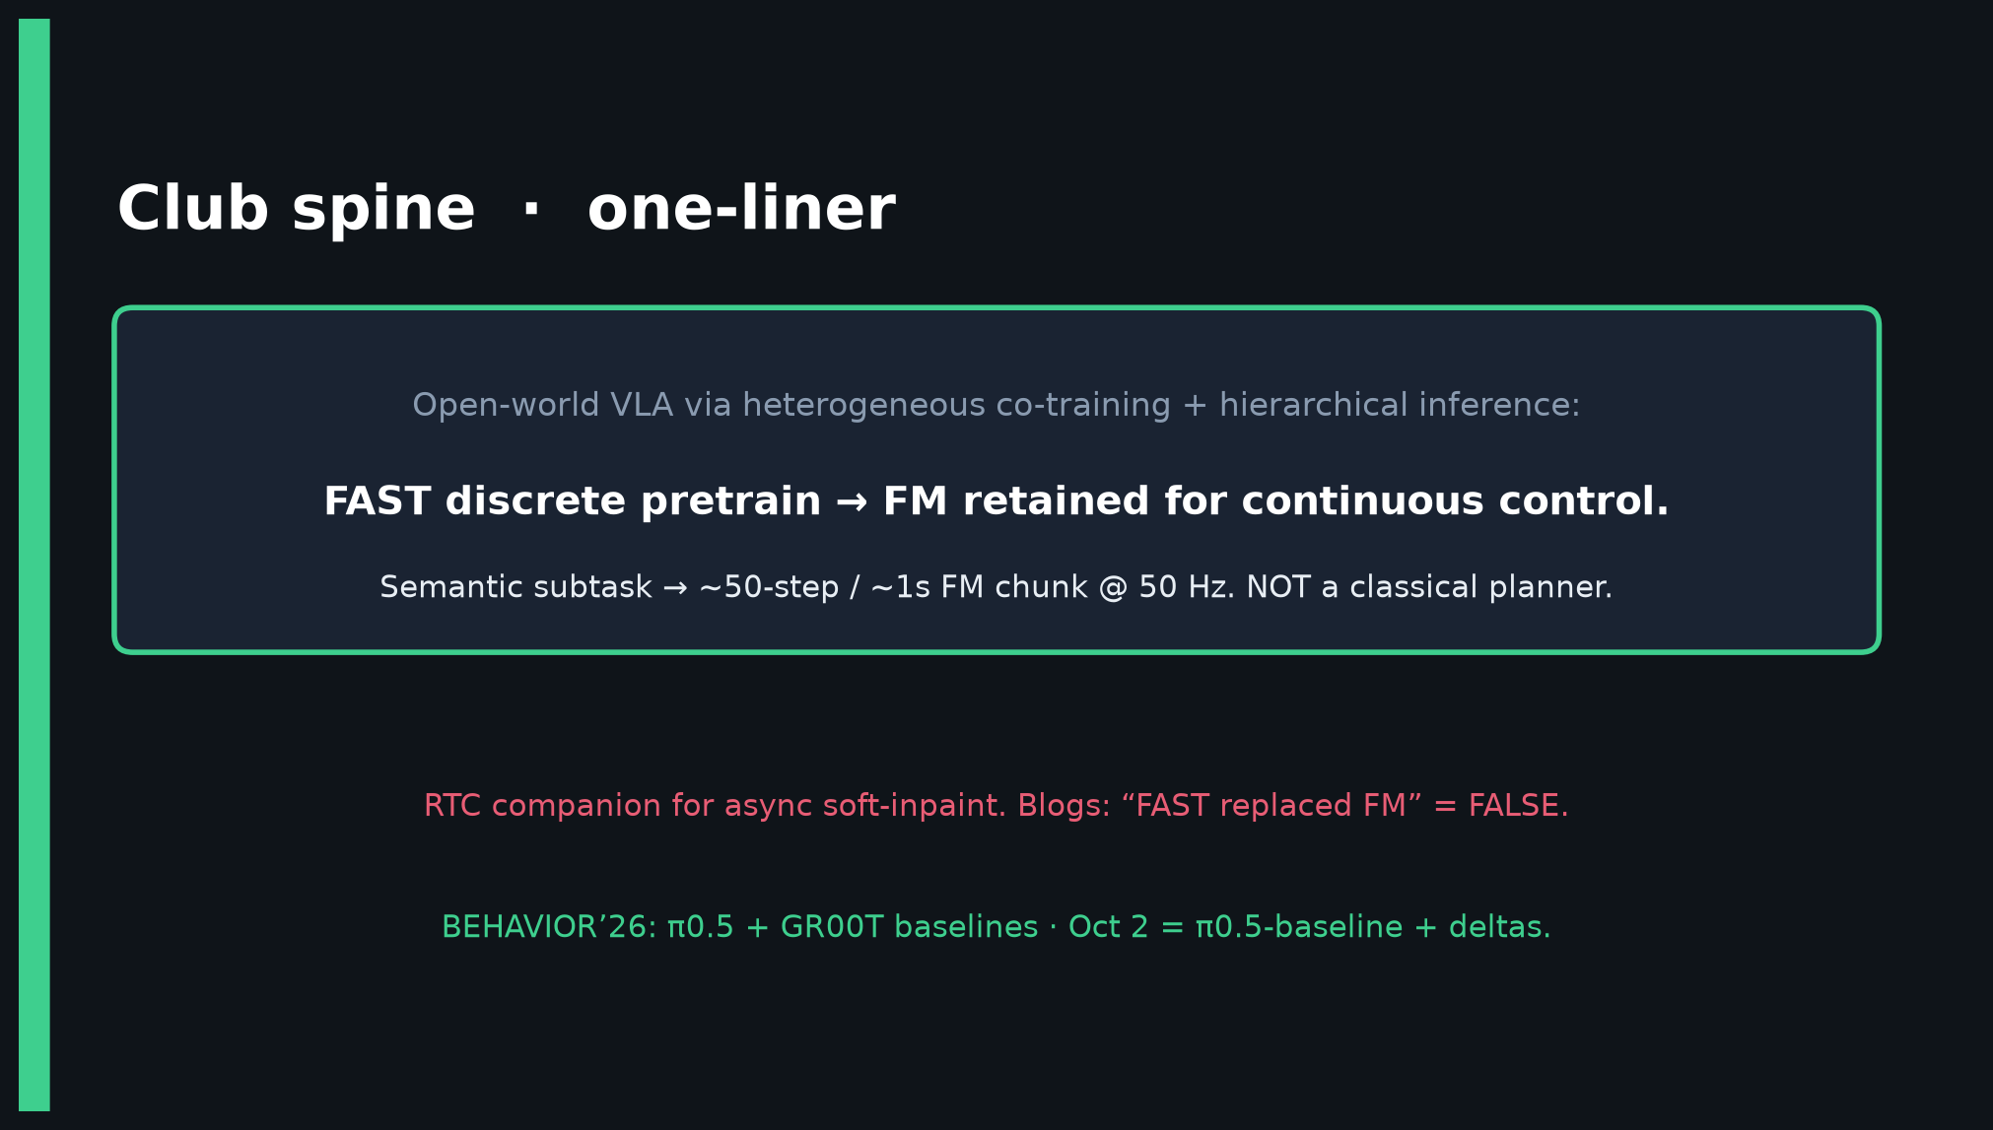
Stakeholder · 18+3 · 2/18
Notes:
SPINE — same club line. Open-world + hybrid FAST→FM retained. Not a planner.

Slide 3
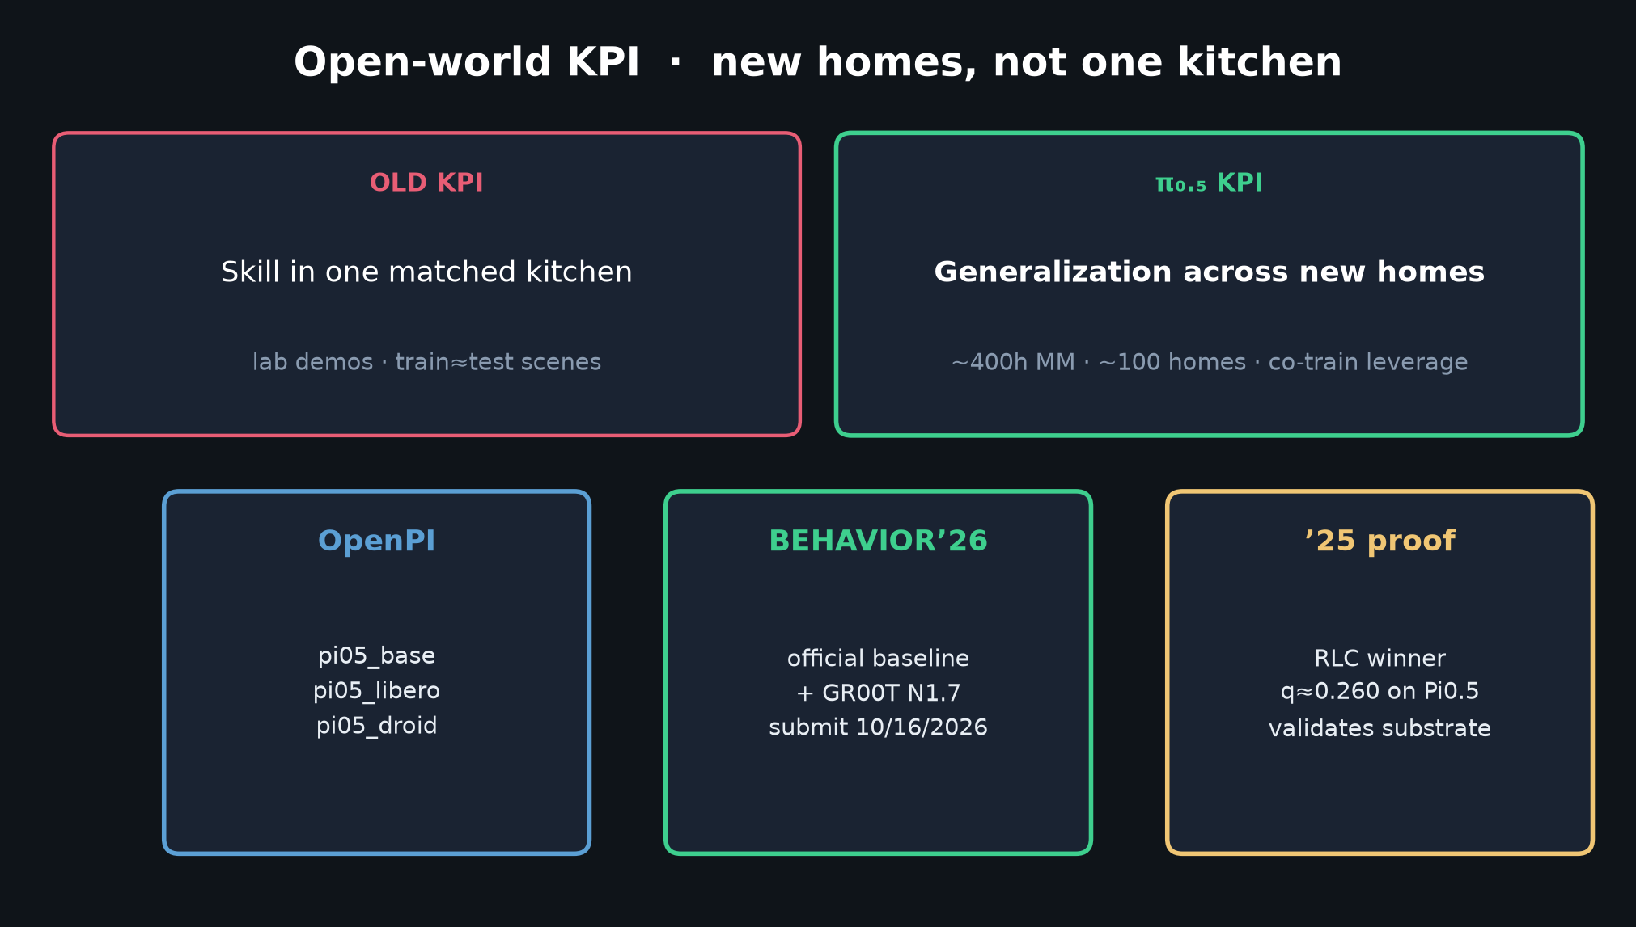
Stakeholder · 18+3 · 3/18
Notes:
KPI SHIFT — old = skill in one kitchen; new = generalization across homes.
~400h MM in ~100 homes leveraged by other robots + web + language coaching.

Slide 4
Stakeholder · 18+3 · 4/18
Notes:
OPENPI + BEHAVIOR’26 + ’25 proof — three pillars.
pi05_base / pi05_libero / pi05_droid = default FT start.
BEHAVIOR’26 official baselines: π0.5 + GR00T N1.7.
’25 RLC winner q≈0.260 on Pi0.5 validates substrate.

Slide 5
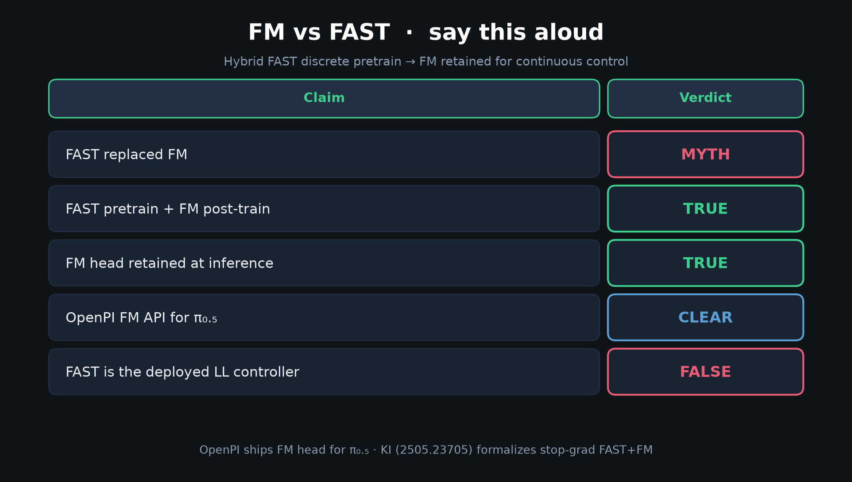
Stakeholder · 18+3 · 5/18
Notes:
MYTH TABLE — stakeholders must not fund “FAST-only replace FM” roadmaps.
FM fine-tunes + optional RTC is the correct budget line.

Slide 6
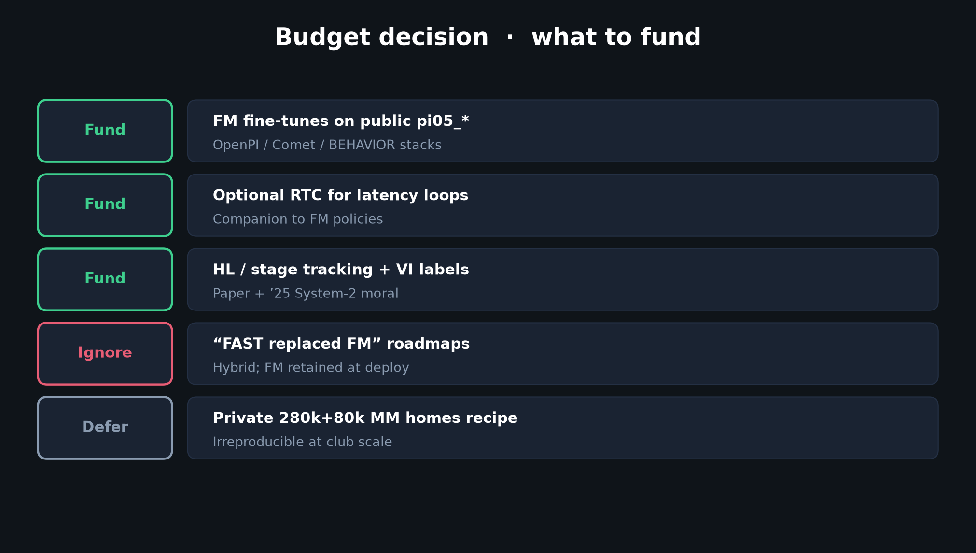
Stakeholder · 18+3 · 6/18
Notes:
BUDGET DECISION — Fund / Ignore / Defer table.
Fund FM FT, RTC, HL/VI. Ignore FAST-replaced myths. Defer private 280k recipe.

Slide 7
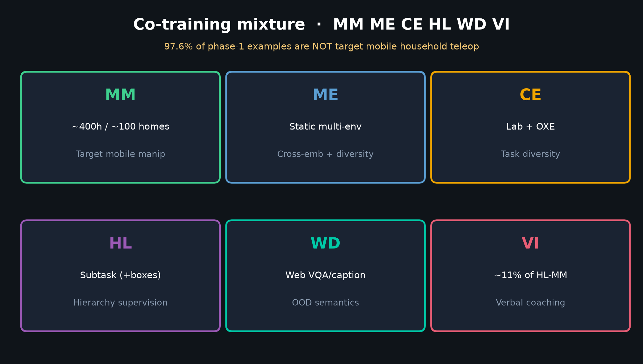
Stakeholder · 18+3 · 7/18
Notes:
DATA MIXTURE — MM ME CE HL WD VI.
97.6% phase-1 non-MM: co-training is the leverage story for medium MM data.

Slide 8
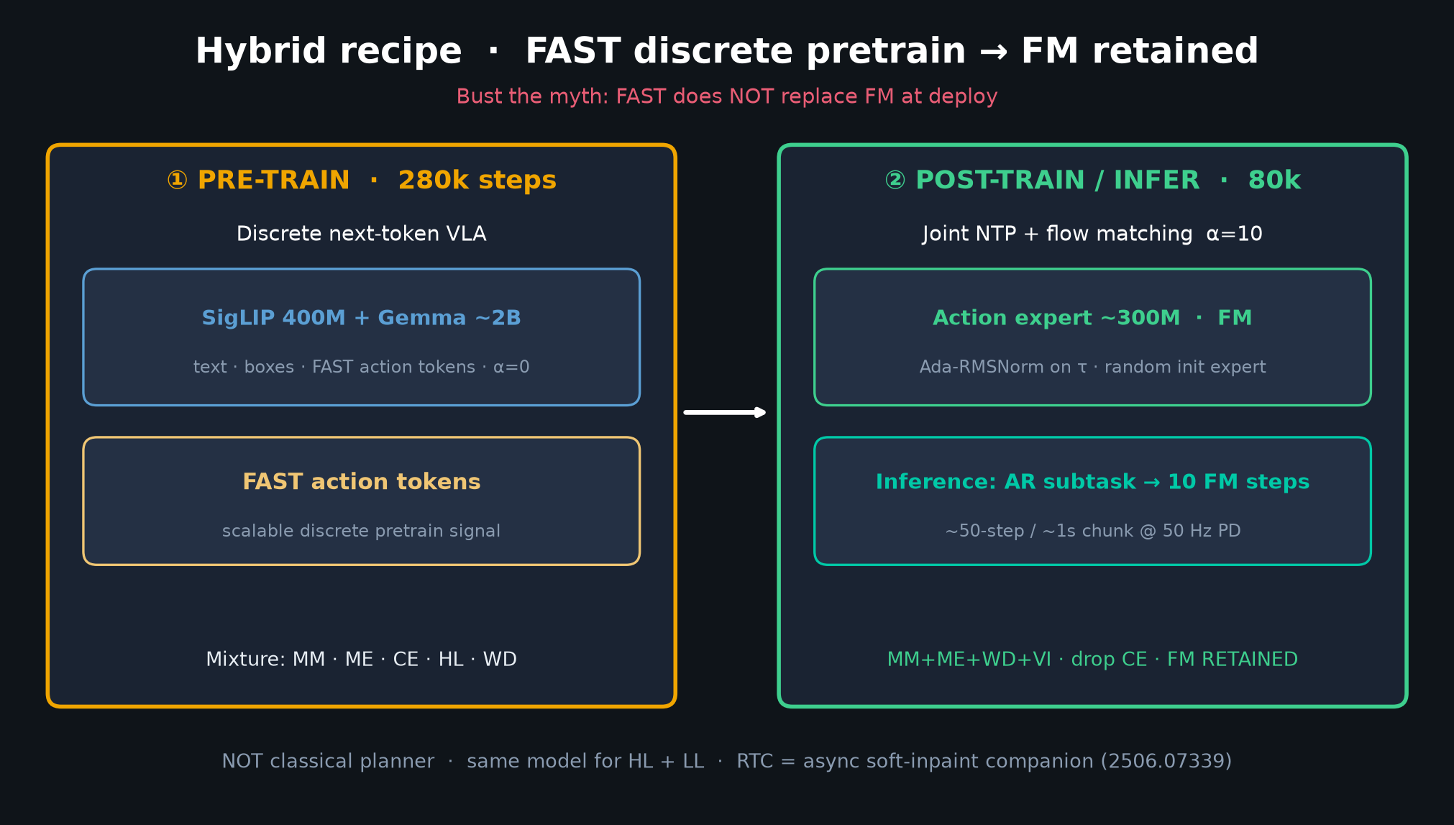
Stakeholder · 18+3 · 8/18
Notes:
HYBRID RECIPE — what you are buying when you adopt pi05_*.
FAST pretrain for scale; FM retained for smooth long-horizon control.

Slide 9
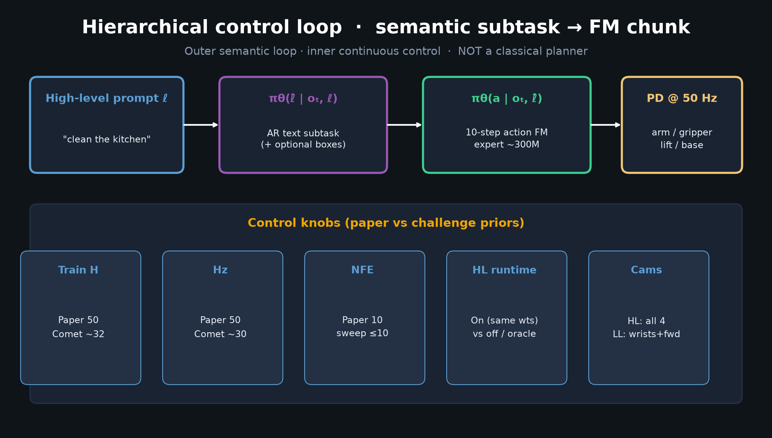
Stakeholder · 18+3 · 9/18
Notes:
CONTROL LOOP — semantic outer, FM inner. 18–19 DoF PD @ 50 Hz. No traj planner.

Slide 10
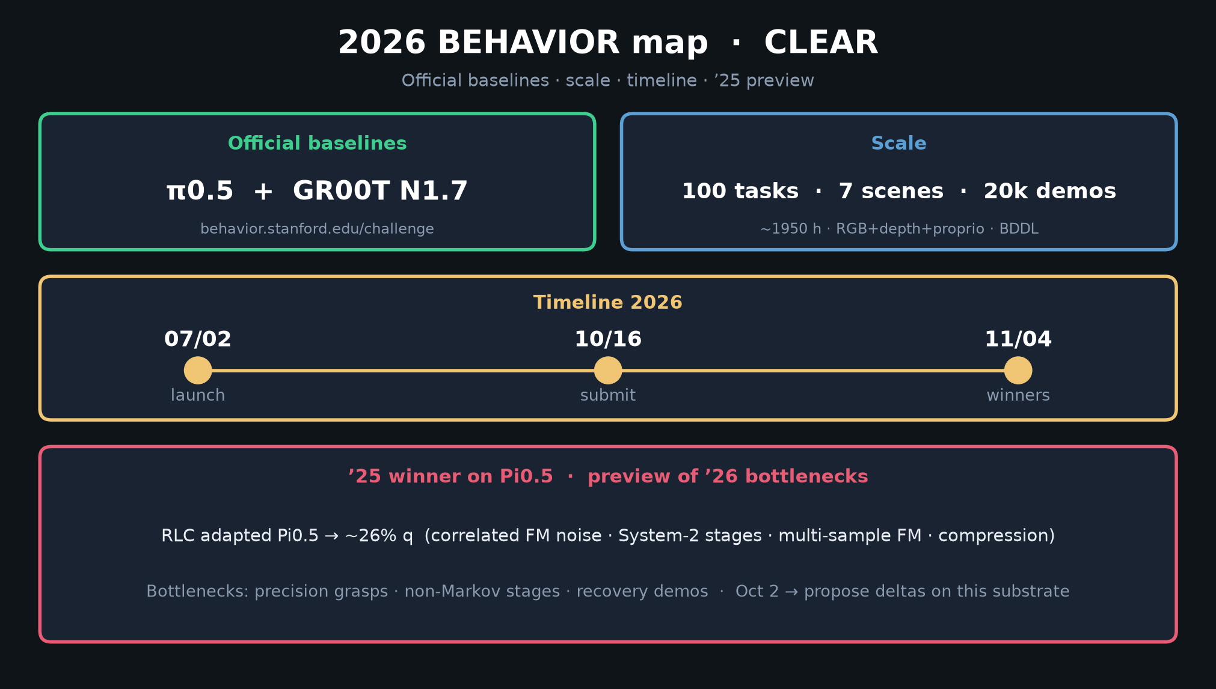
Stakeholder · 18+3 · 10/18
Notes:
2026 MAP — timeline and scale for challenge stakeholders.
Submit 10/16/2026. Start from baseline, not greenfield.

Slide 11
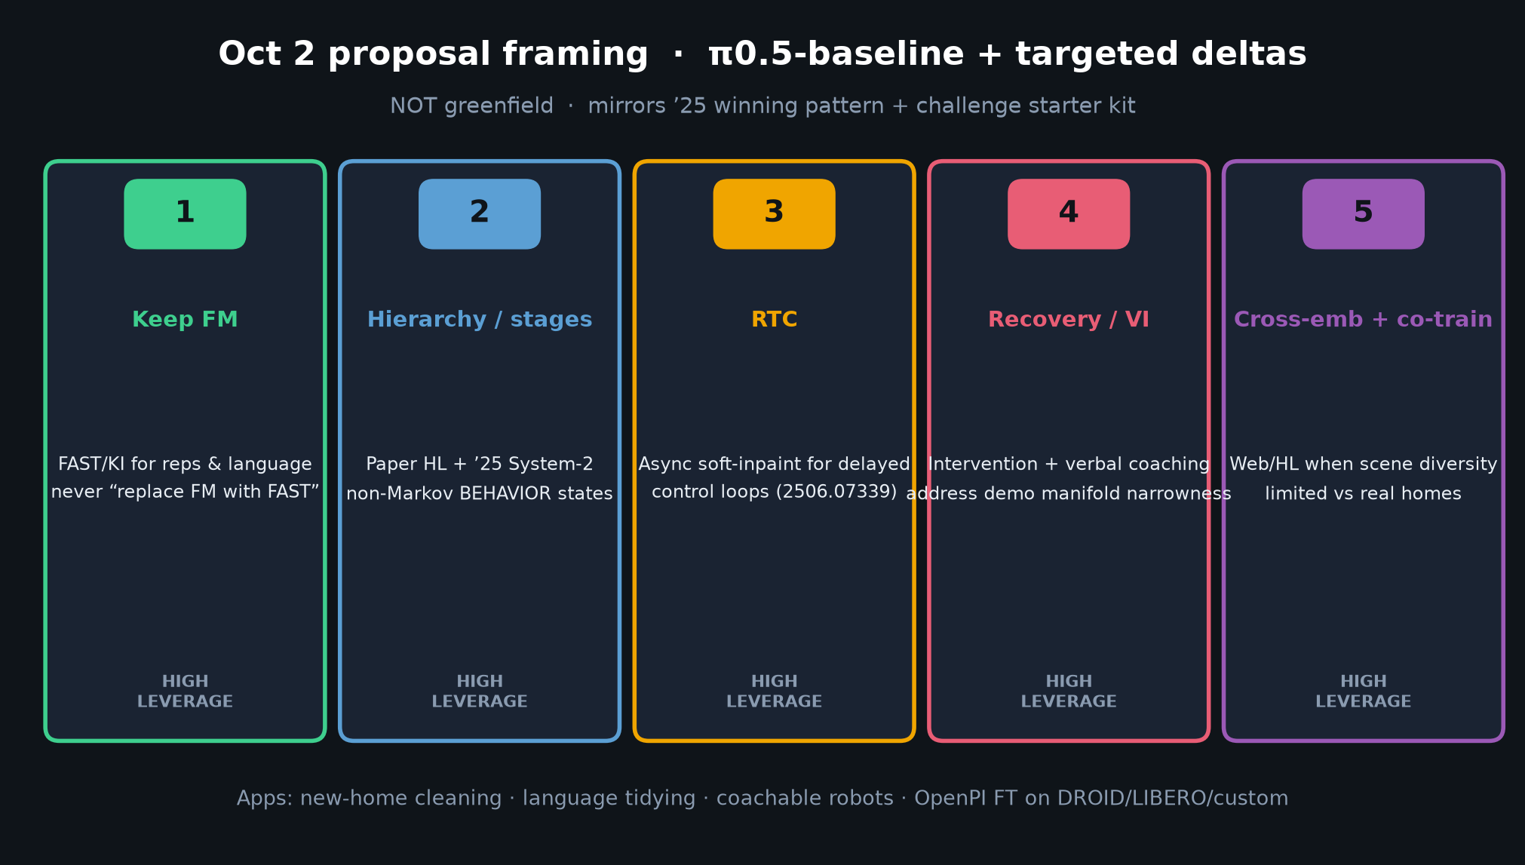
Stakeholder · 18+3 · 11/18
Notes:
OCT 2 DELTAS — proposal framing for nearby deadline.
π0.5-baseline + Keep FM / hierarchy / RTC / VI / co-train.

Slide 12
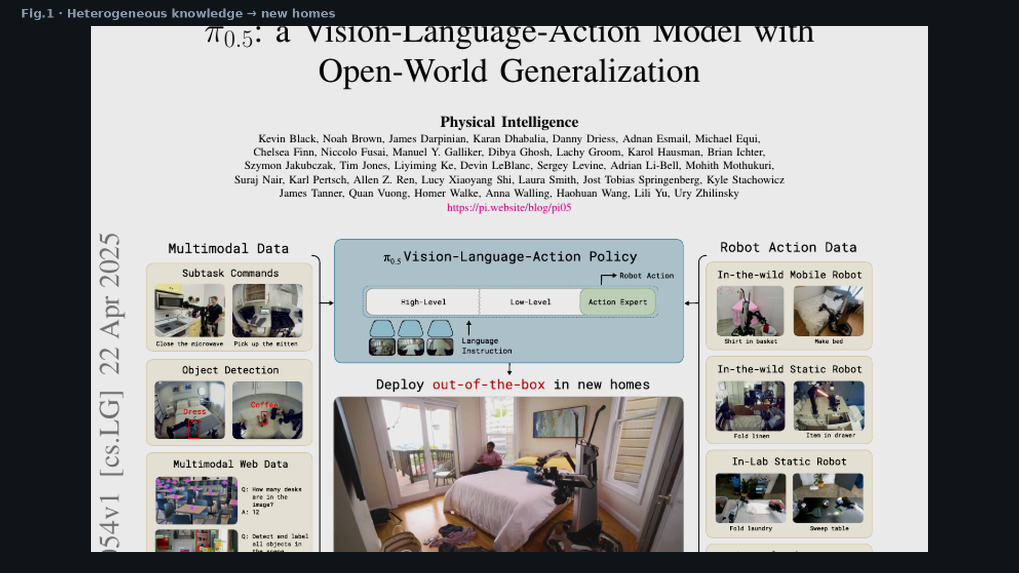
Stakeholder · 18+3 · 12/18
Notes:
FIG.1 — product vision: out-of-the-box new homes.

Slide 13
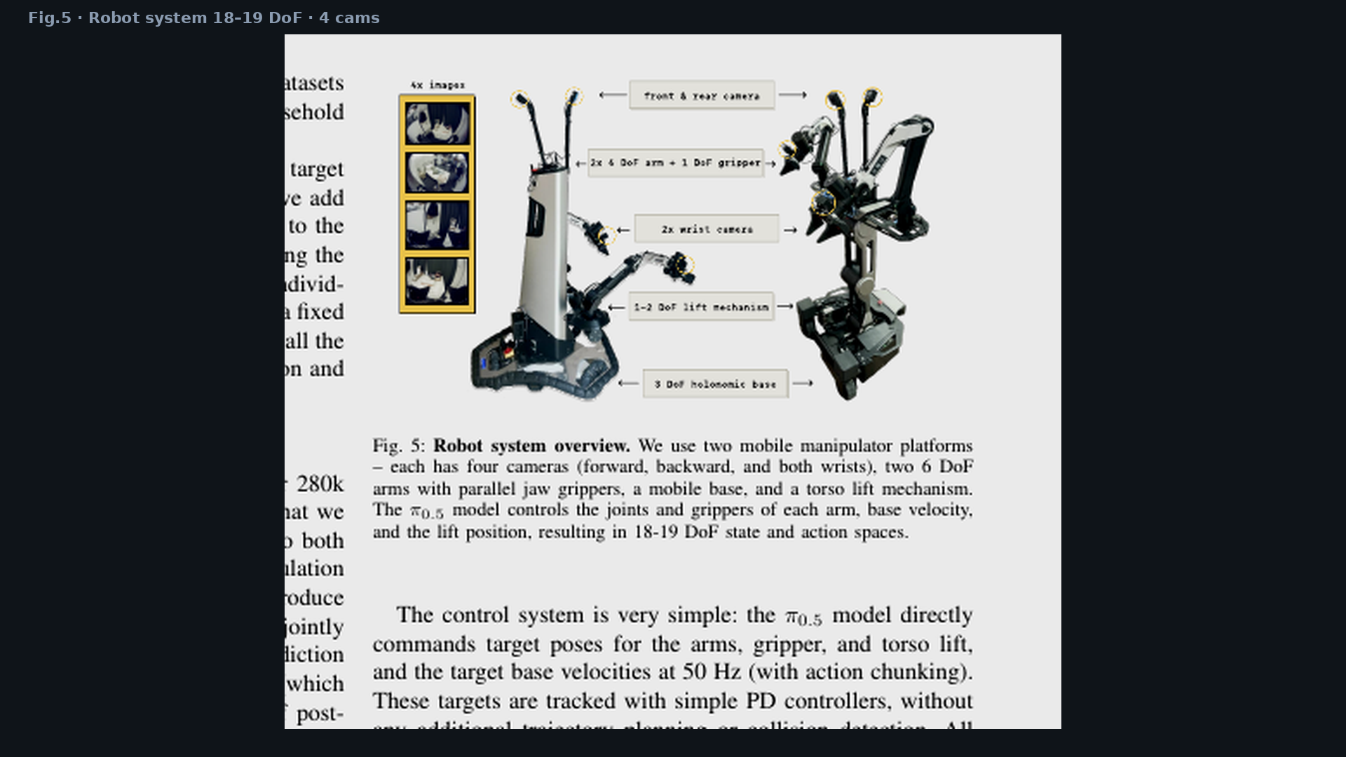
Stakeholder · 18+3 · 13/18
Notes:
FIG.5 — hardware: 4 cams, 18–19 DoF, dual mobile manipulators.

Slide 14
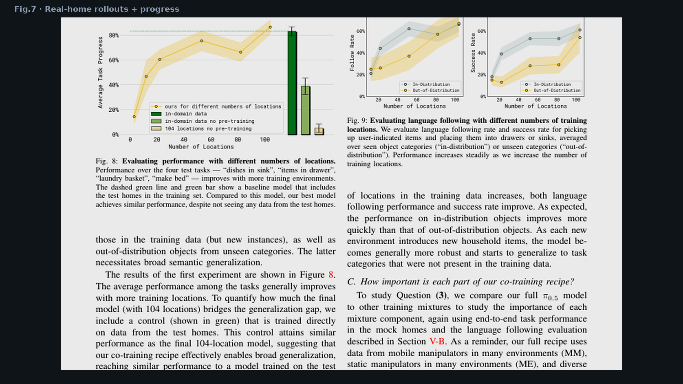
Stakeholder · 18+3 · 14/18
Notes:
FIG.7 — real-home results. Existence proof for open-world KPI.

Slide 15
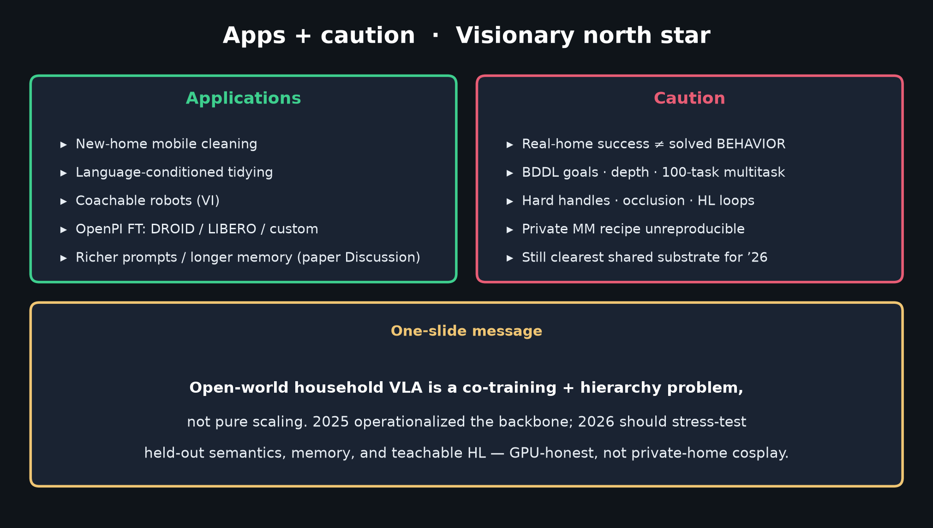
Stakeholder · 18+3 · 15/18
Notes:
LIMITATIONS stakeholders budget: hard handles, occlusion, HL distraction loops,
simple prompts, modest memory, private data. Still fund FM path.

Slide 16
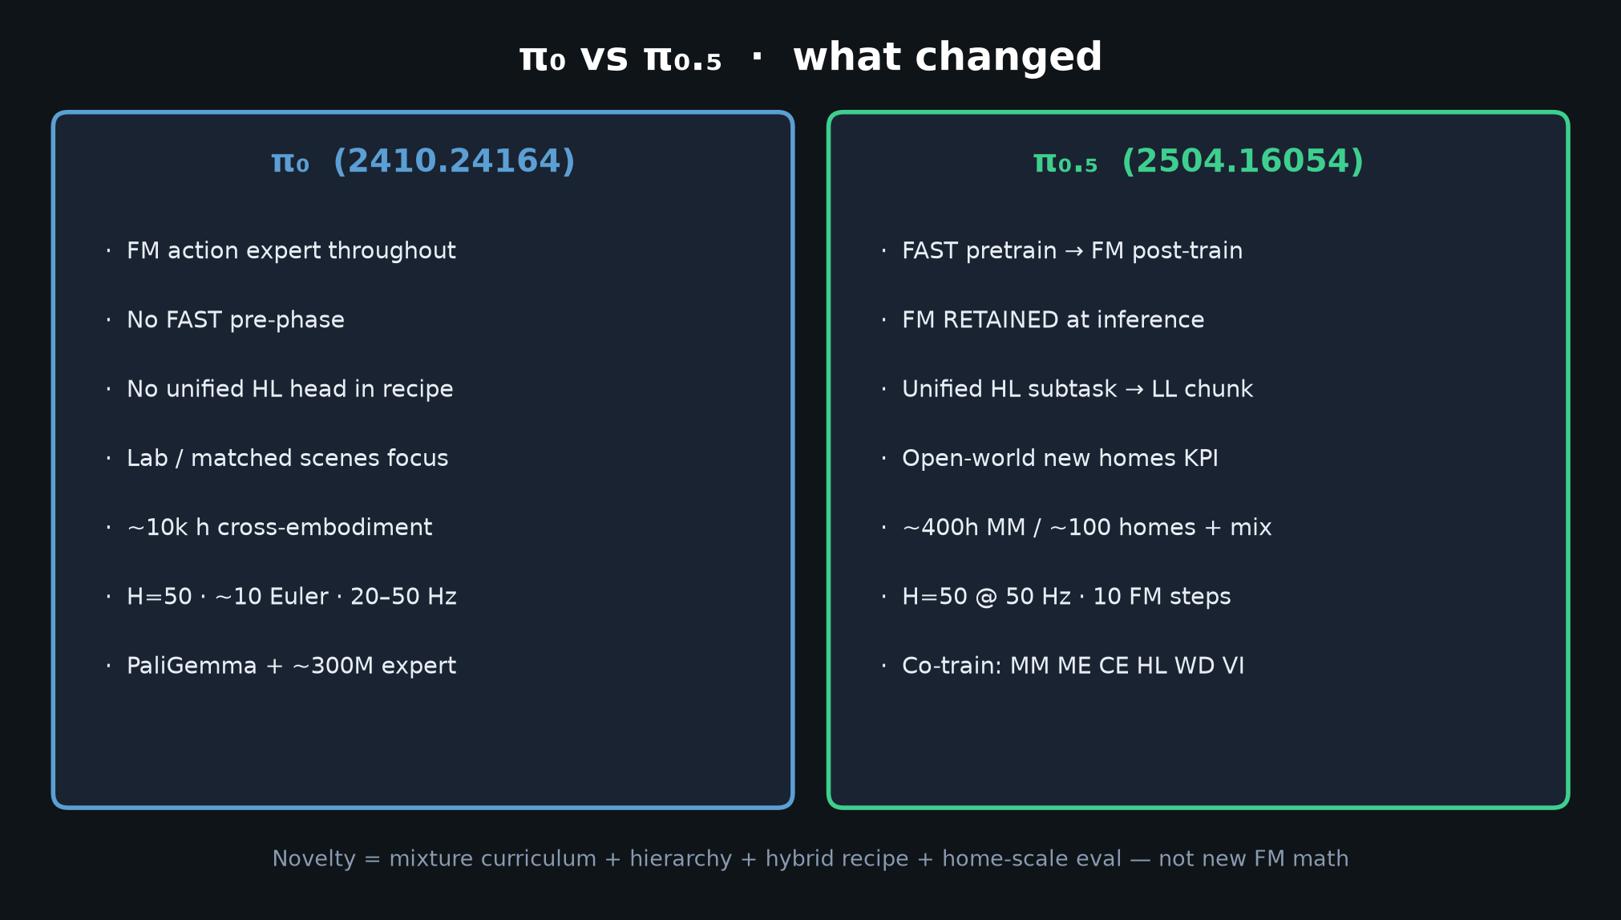
Stakeholder · 18+3 · 16/18
Notes:
π₀ vs π₀.₅ — why upgrade the reference stack.

Slide 17
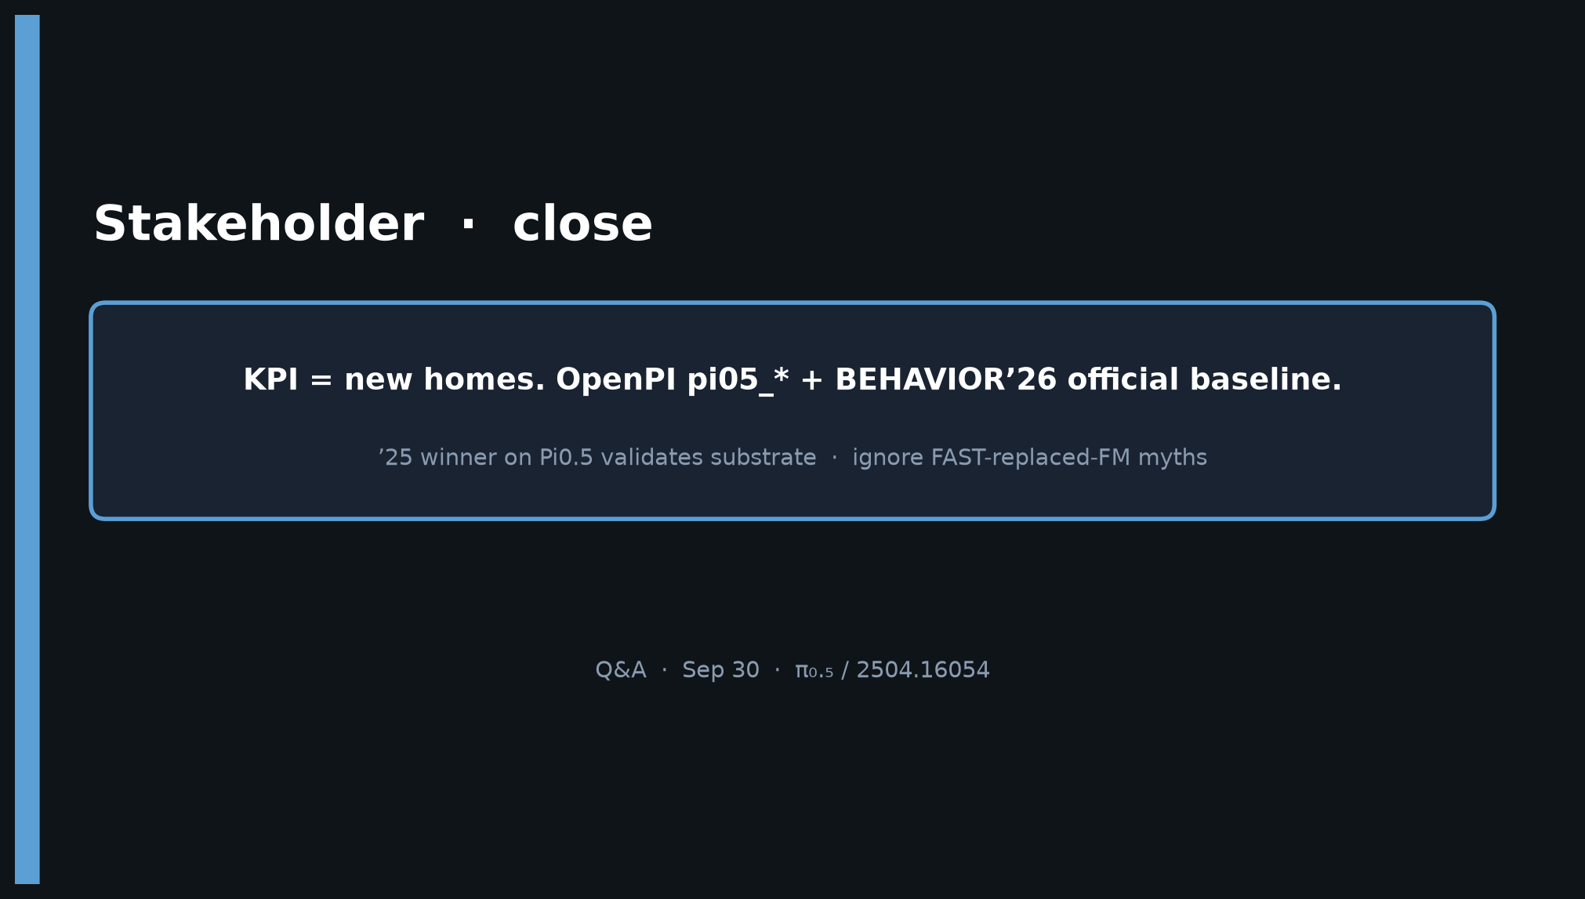
Stakeholder · 18+3 · 17/18
Notes:
CLOSE — KPI = new homes. OpenPI pi05_* + BEHAVIOR’26 baseline.
’25 winner validates. Ignore FAST-replaced-FM myths. Q&A.

Slide 18
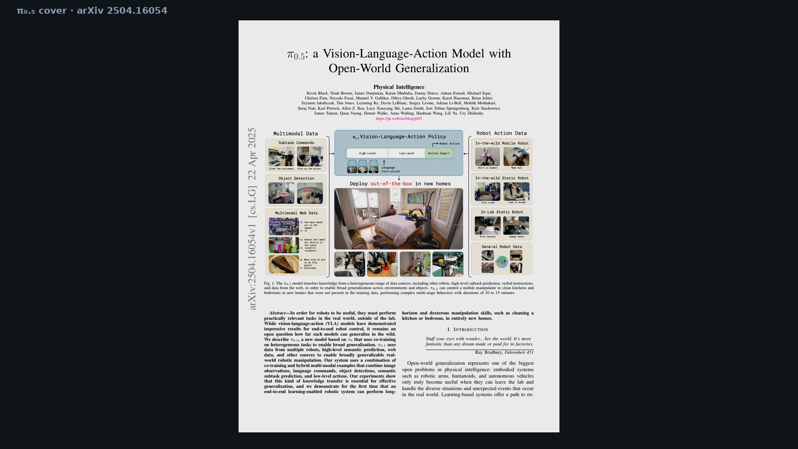
Stakeholder · 18+3 · 18/18
Notes:
BACKUP — cover page.

