Slide 1
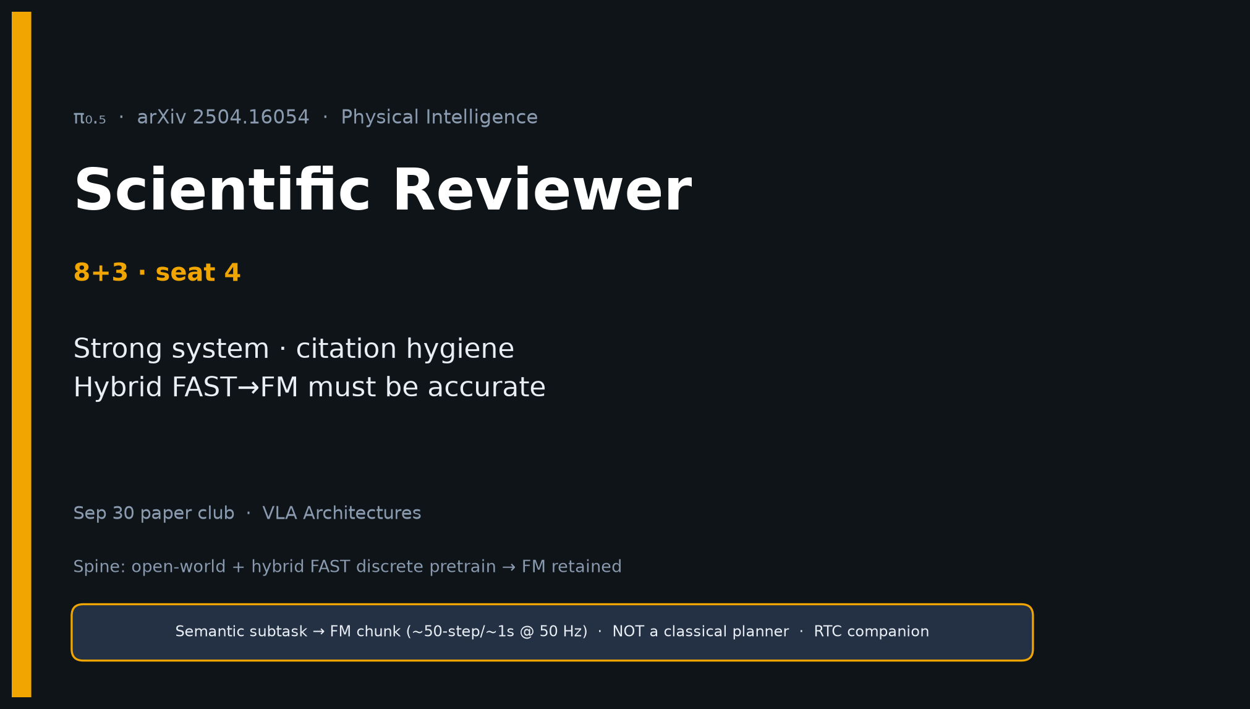
Scientific Reviewer · 8+3 · 1/11
Notes:
SCIENTIFIC REVIEWER — 8+3. Strengths + caveats + hybrid citation hygiene.
Verdict direction: credible open-world VLA advance; cite FAST→FM accurately.

Slide 2
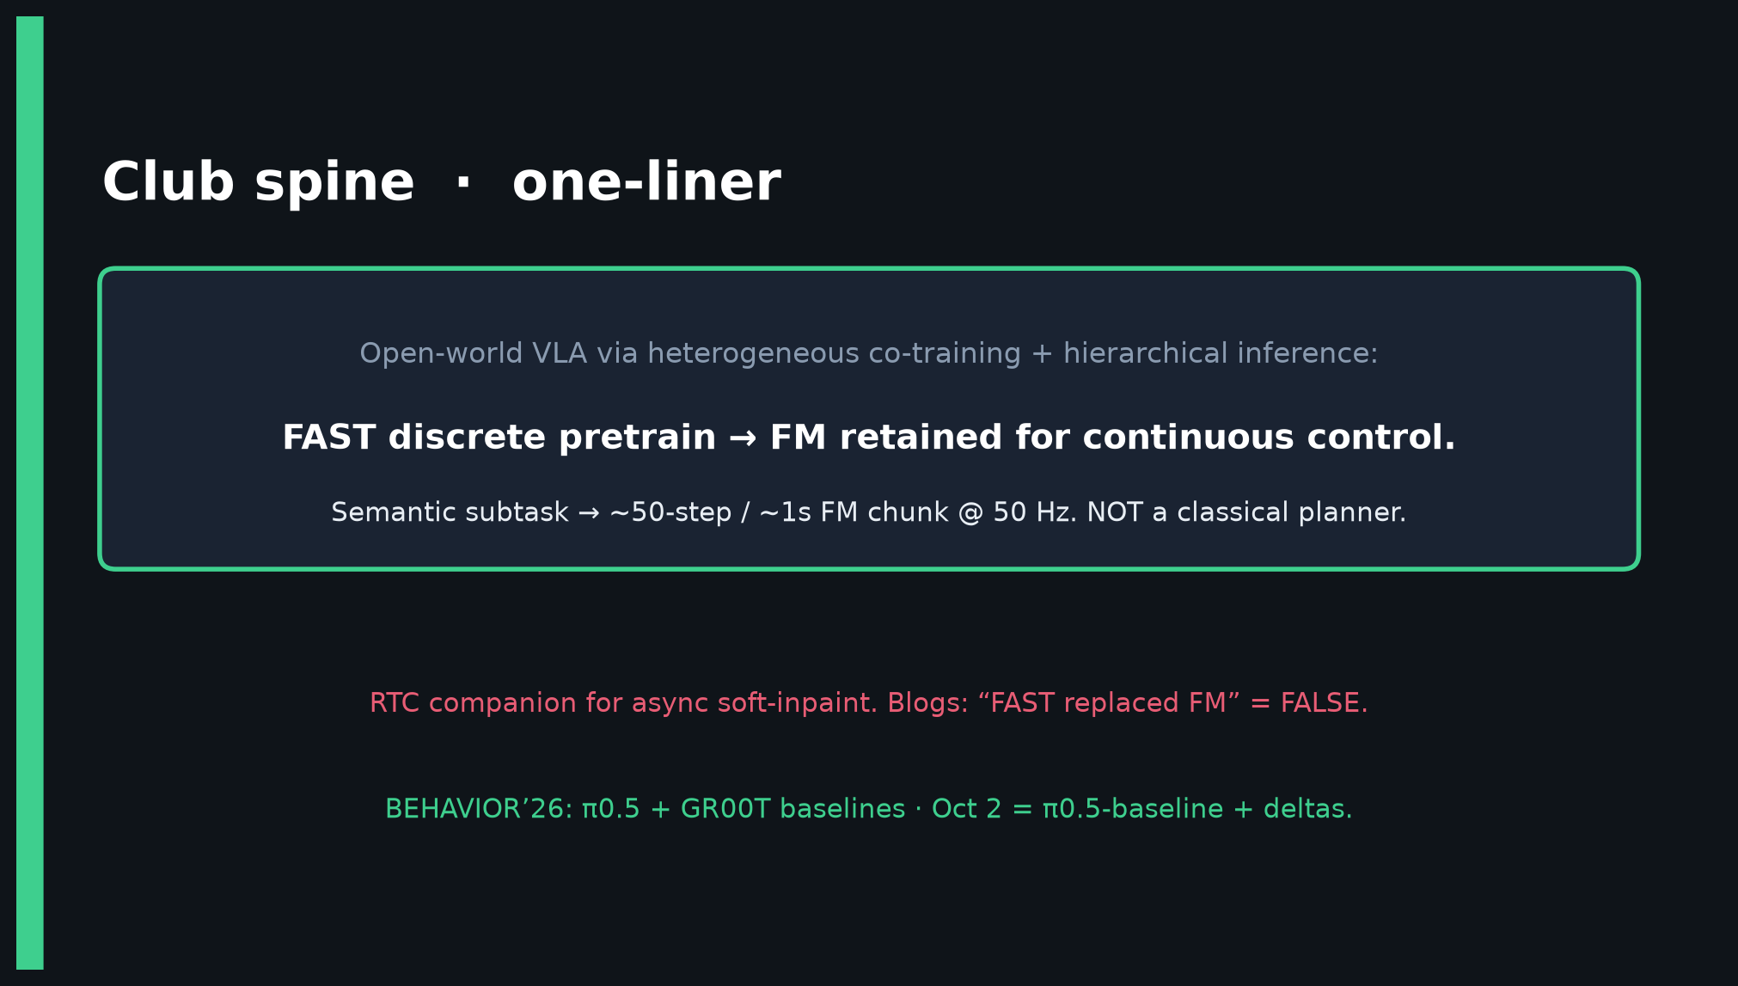
Scientific Reviewer · 8+3 · 2/11
Notes:
SPINE reminder — hybrid FAST pretrain, FM retained. Not classical planner.

Slide 3
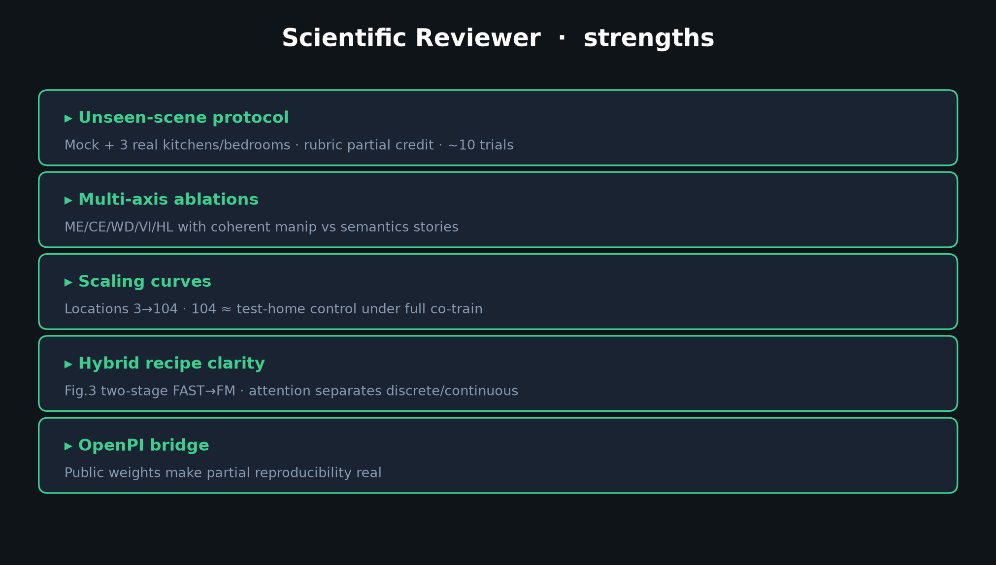
Scientific Reviewer · 8+3 · 3/11
Notes:
STRENGTHS — unseen protocol, ablations, scaling, Fig.3 hybrid clarity, OpenPI bridge.

Slide 4
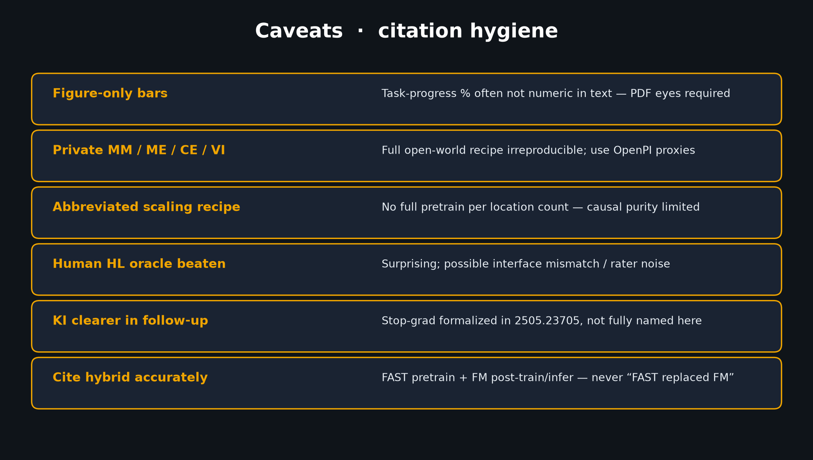
Scientific Reviewer · 8+3 · 4/11
Notes:
CAVEATS — figure-only bars; private MM; abbreviated scaling; human-HL surprise;
KI clearer in follow-up; MUST cite hybrid accurately.

Slide 5
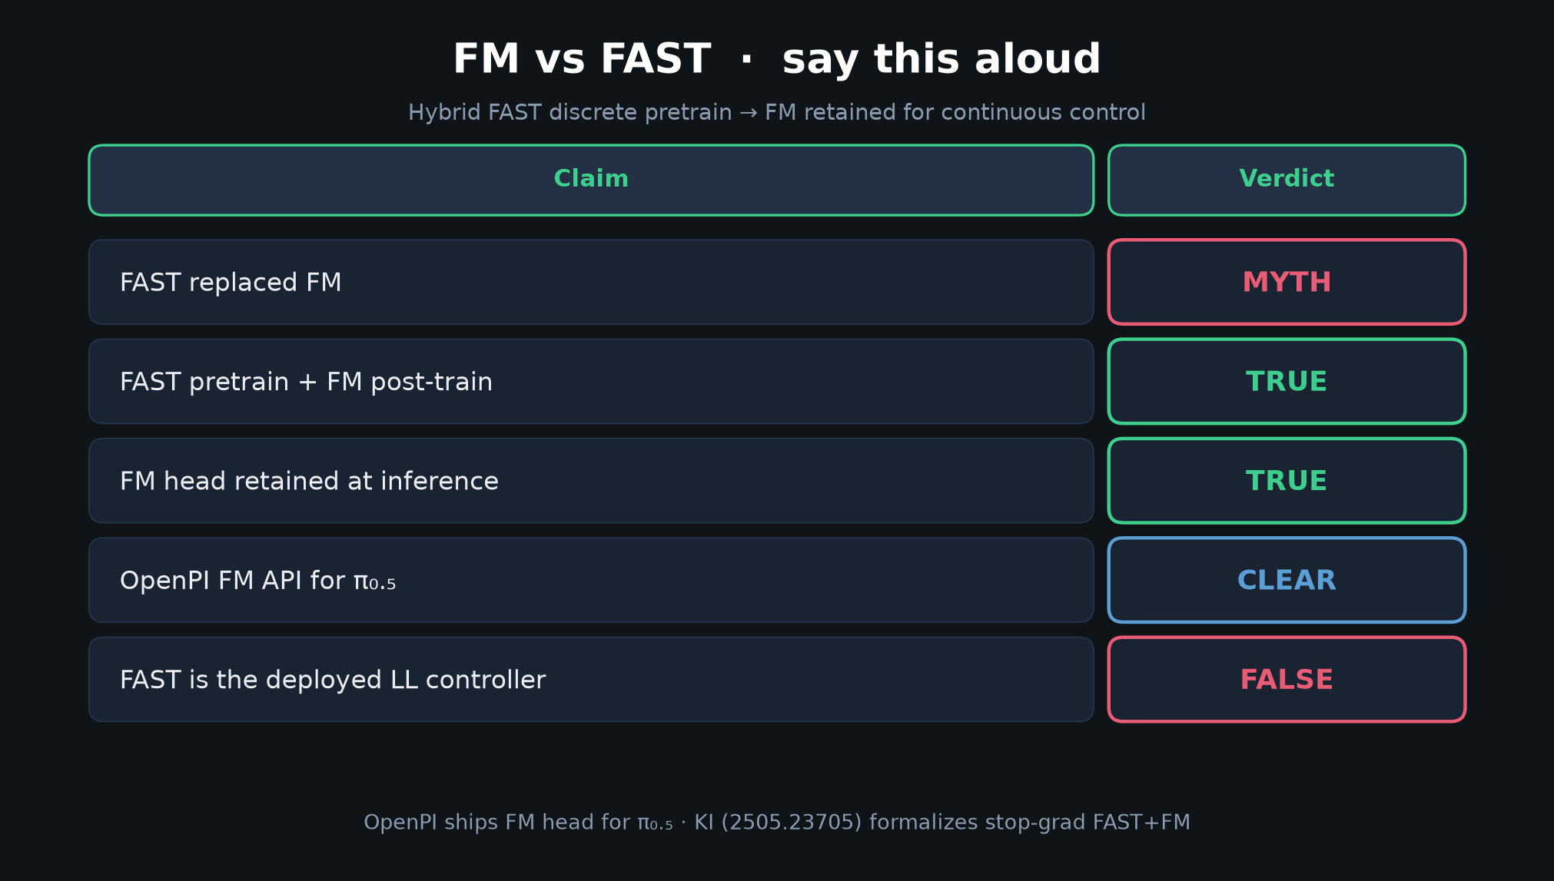
Scientific Reviewer · 8+3 · 5/11
Notes:
MYTH TABLE — citation hygiene slide. Peer-review failure mode = mis-citing FAST vs FM.

Slide 6
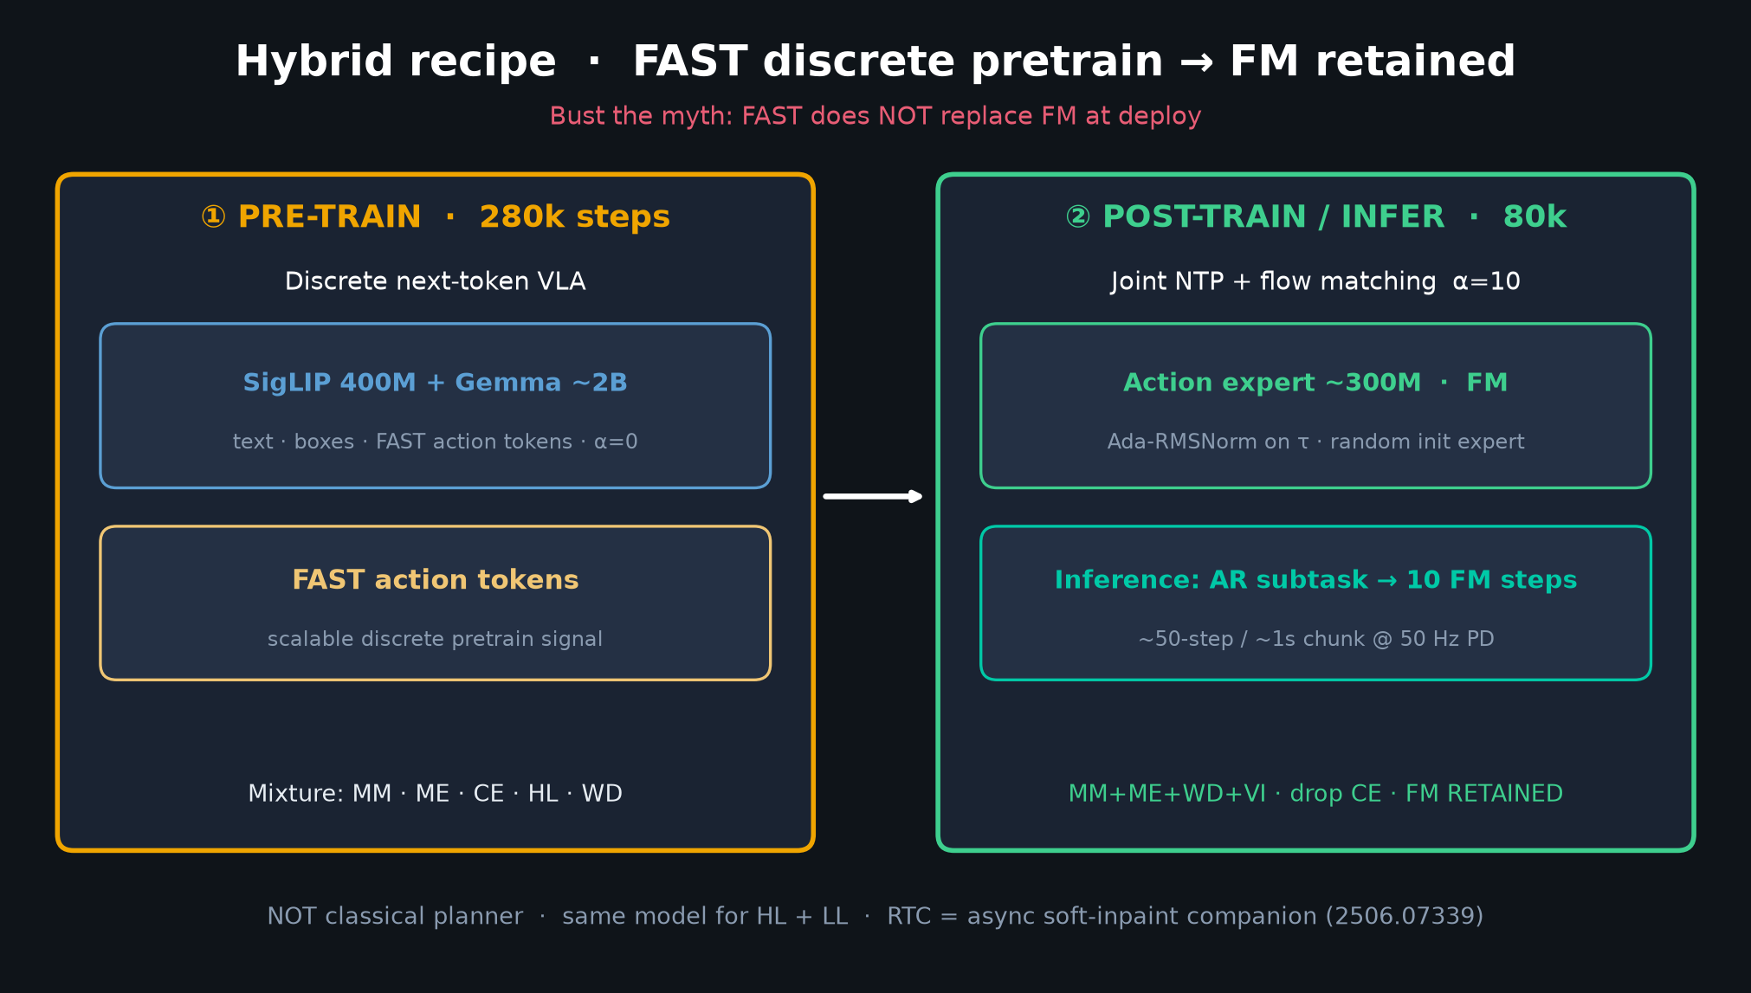
Scientific Reviewer · 8+3 · 6/11
Notes:
HYBRID DIAGRAM — what accurate citation looks like.

Slide 7
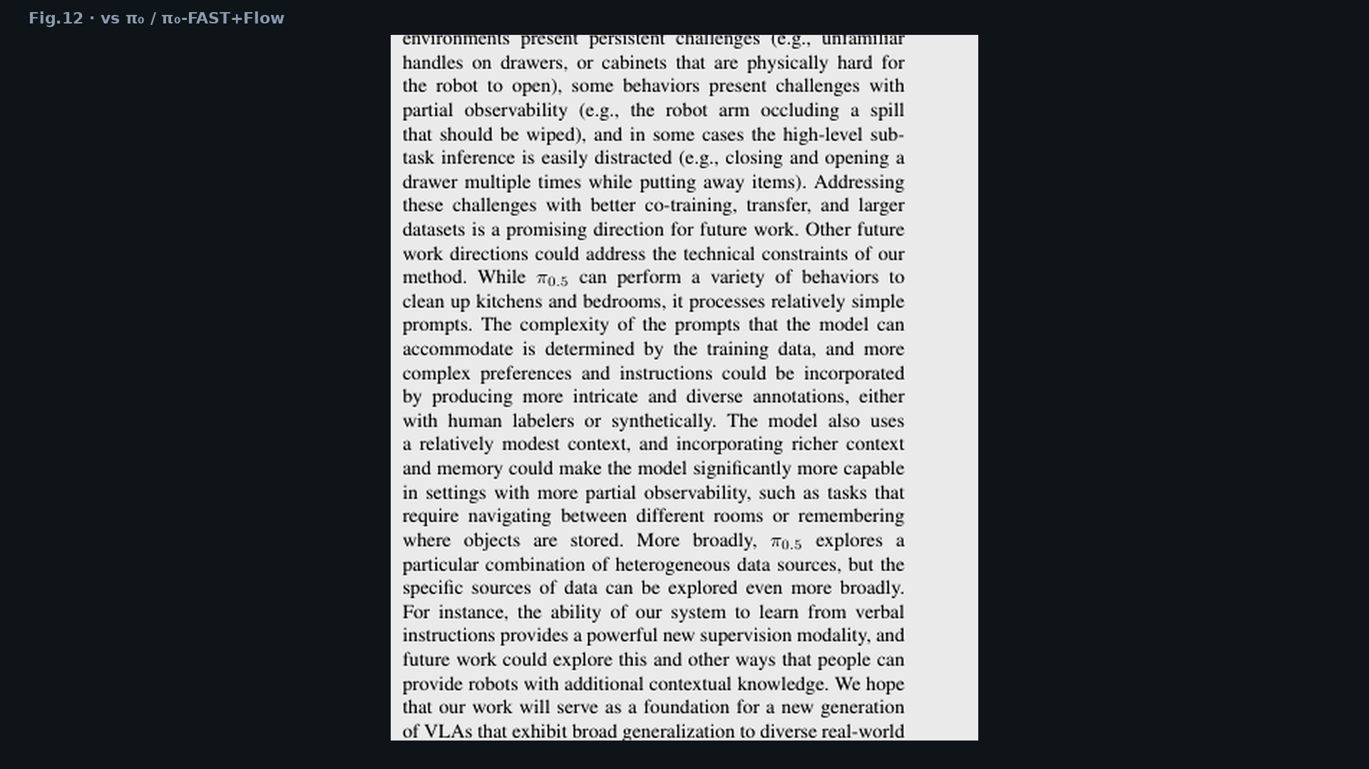
Scientific Reviewer · 8+3 · 7/11
Notes:
FIG.12 — vs π₀ / π₀-FAST+Flow under matched robot data. Core comparative claim.

Slide 8
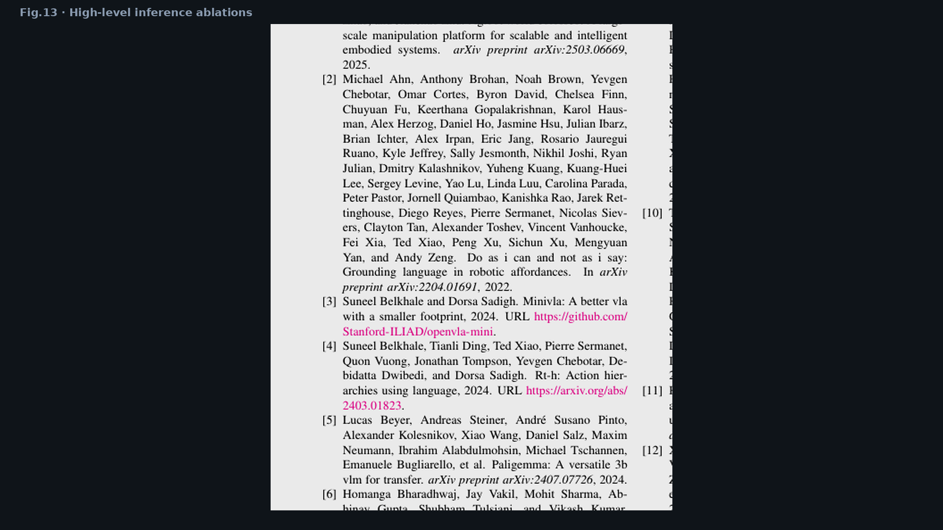
Scientific Reviewer · 8+3 · 8/11
Notes:
FIG.13 — HL ablations. Note: model beats human HL oracle on average — surprising; discuss carefully.

Slide 9
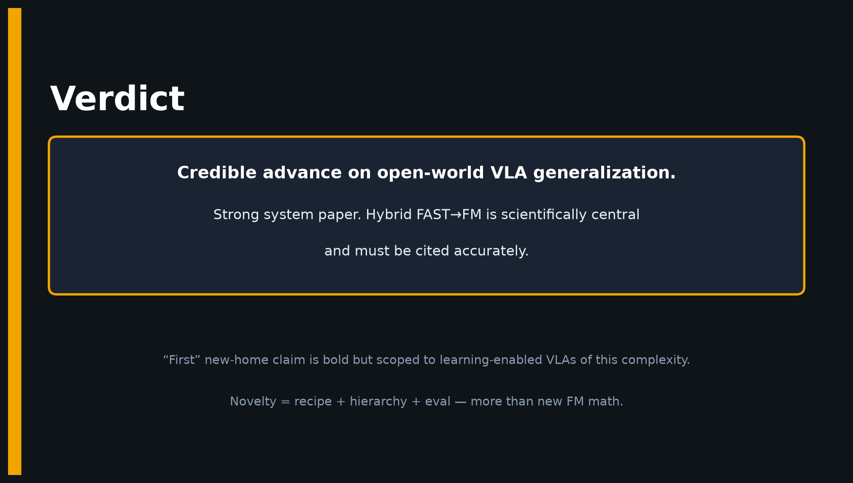
Scientific Reviewer · 8+3 · 9/11
Notes:
VERDICT — Credible advance. Hybrid FAST→FM scientifically central. Novelty = recipe + hierarchy + eval.

Slide 10
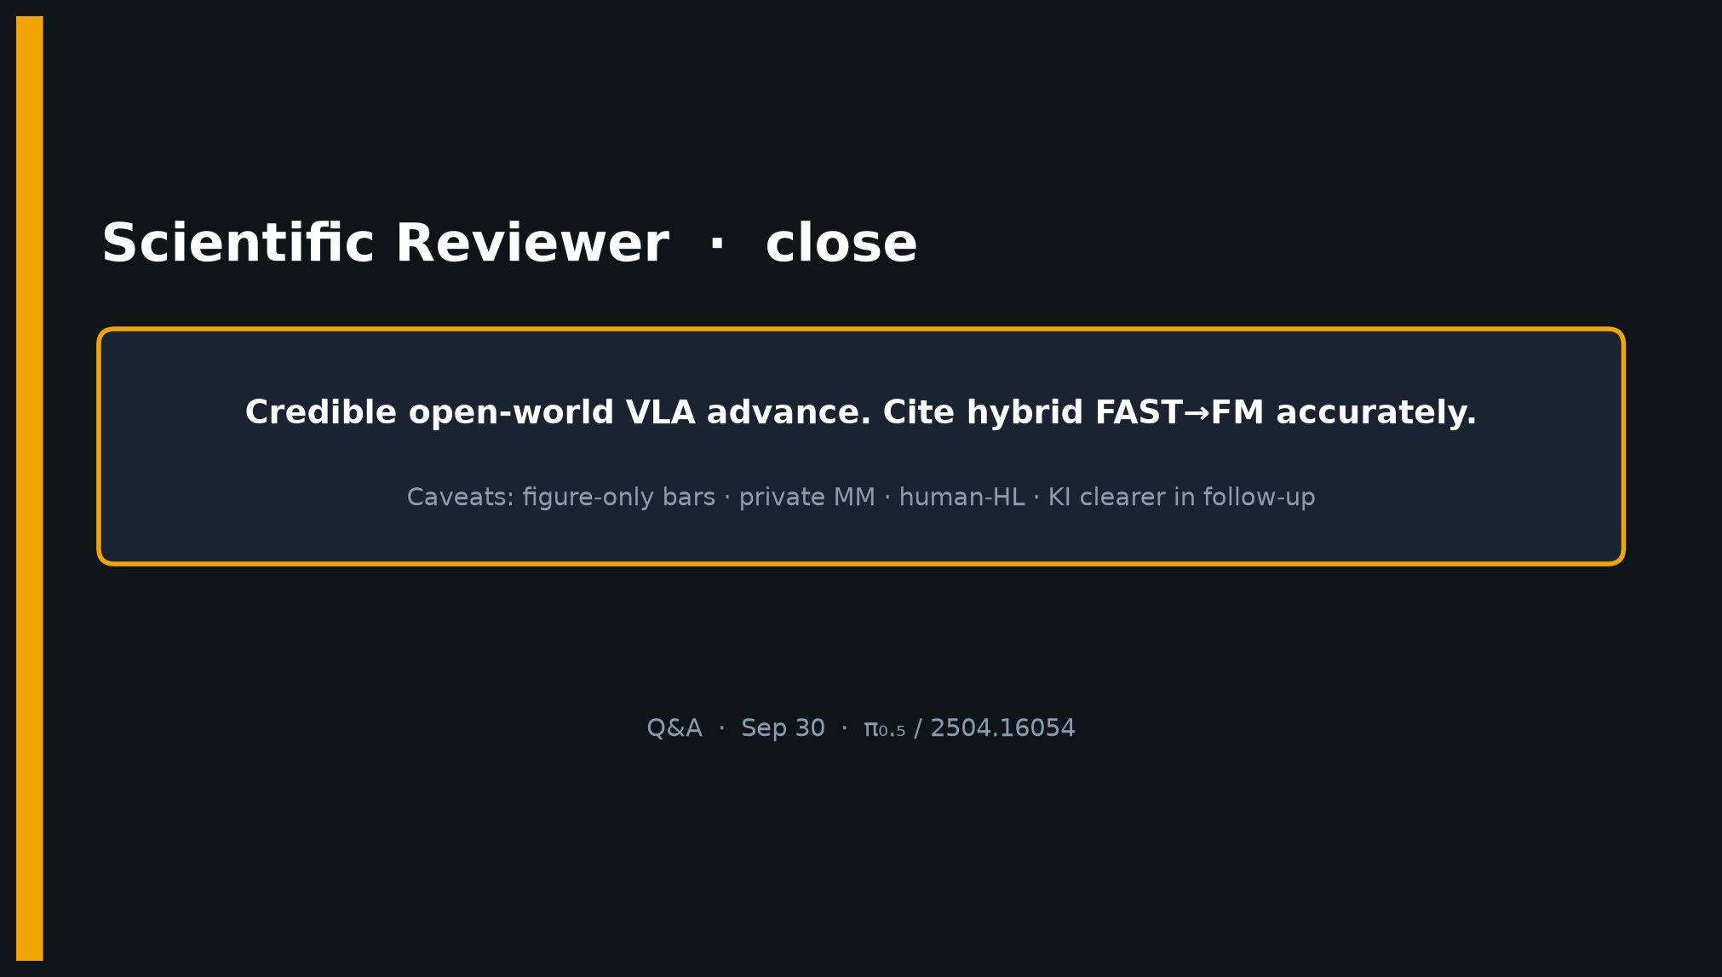
Scientific Reviewer · 8+3 · 10/11
Notes:
CLOSE — cite hybrid accurately; private-data limits honest. Q&A.

Slide 11
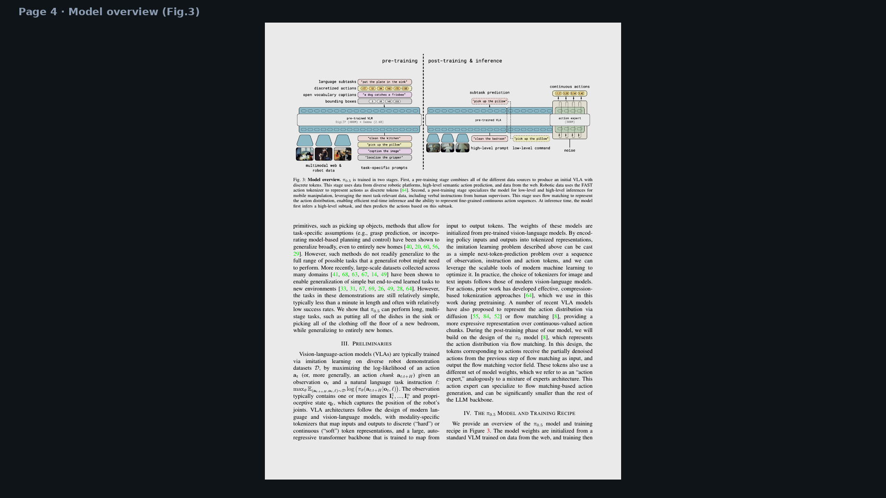
Scientific Reviewer · 8+3 · 11/11
Notes:
BACKUP — Fig.3 page full.

