Slide 1
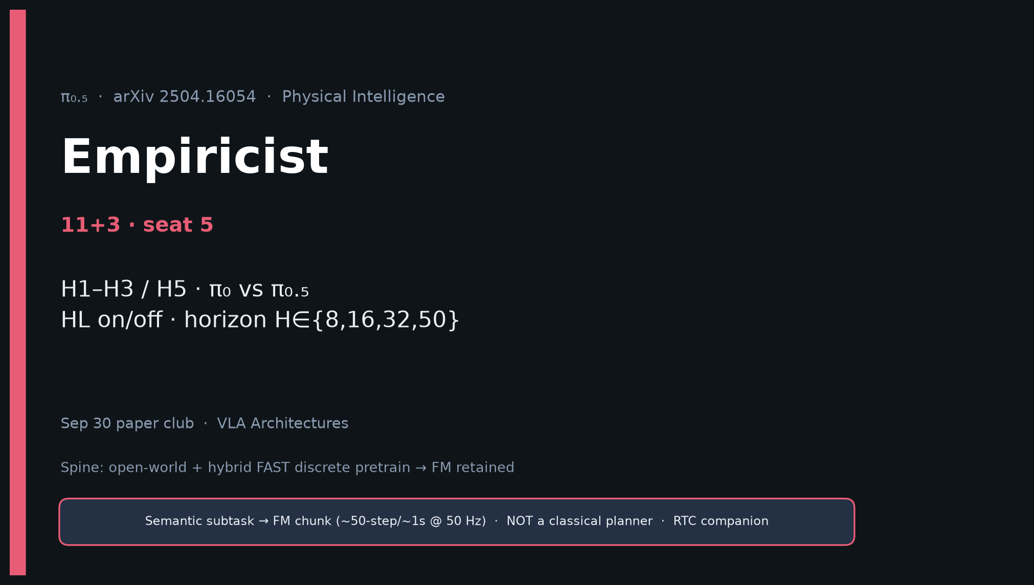
Empiricist · 11+3 · 1/14
Notes:
EMPIRICIST — 11+3. H1–H3/H5; π₀ vs π₀.₅; HL on/off; H∈{8,16,32,50}; budget notes.
Minimal matrix: {pi0|pi05} × {HL on|off} × {scene ID|OOD} on public OpenPI/BEHAVIOR proxy.

Slide 2
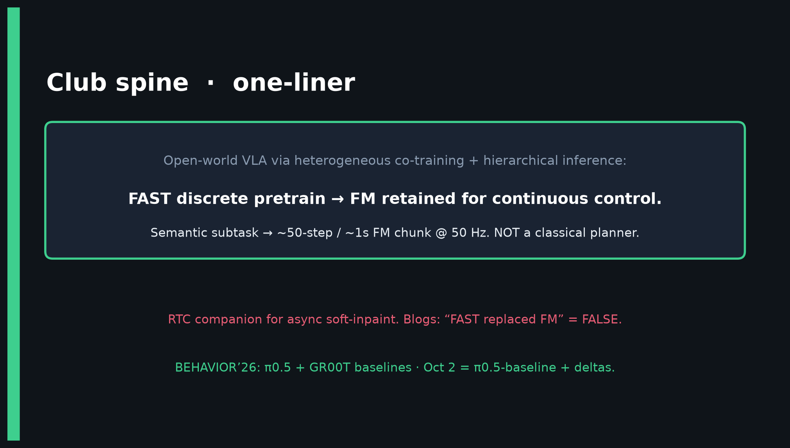
Empiricist · 11+3 · 2/14
Notes:
SPINE — quote success only with (policy, HL, mix, scene, H, Hz, NFE, ms, GPU).

Slide 3
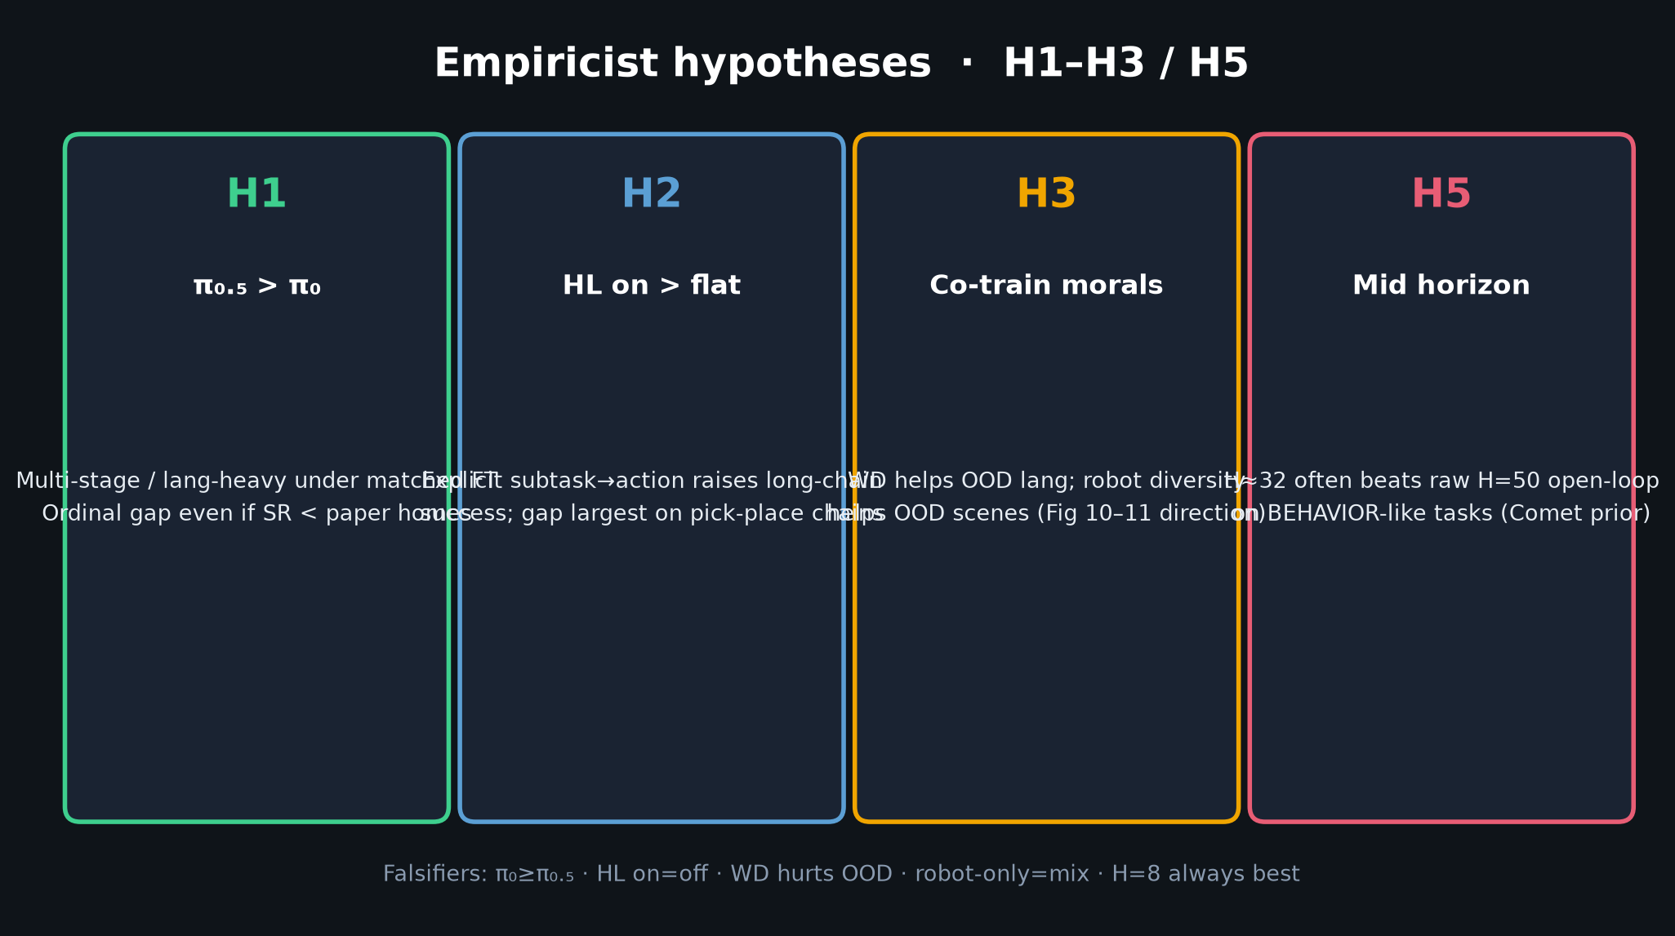
Empiricist · 11+3 · 3/14
Notes:
HYPOTHESES H1–H3/H5.
H1: π₀.₅ > π₀ under matched FT on multi-stage/lang.
H2: HL on > flat on long chains.
H3: WD→OOD lang; robot diversity→OOD scenes.
H5: mid horizon ~32 often beats raw H=50 open-loop.

Slide 4
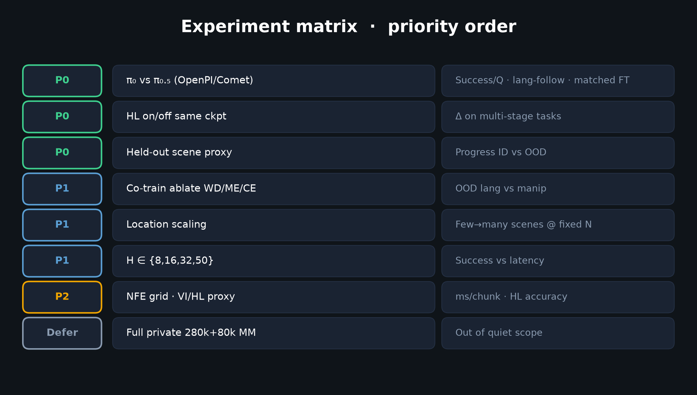
Empiricist · 11+3 · 4/14
Notes:
EXPERIMENT MATRIX — P0/P1/P2/Defer.
P0: π₀ vs π₀.₅; HL on/off; held-out scene.
P1: co-train ablate; location scaling; H sweep.
Defer: full private MM recipe.

Slide 5
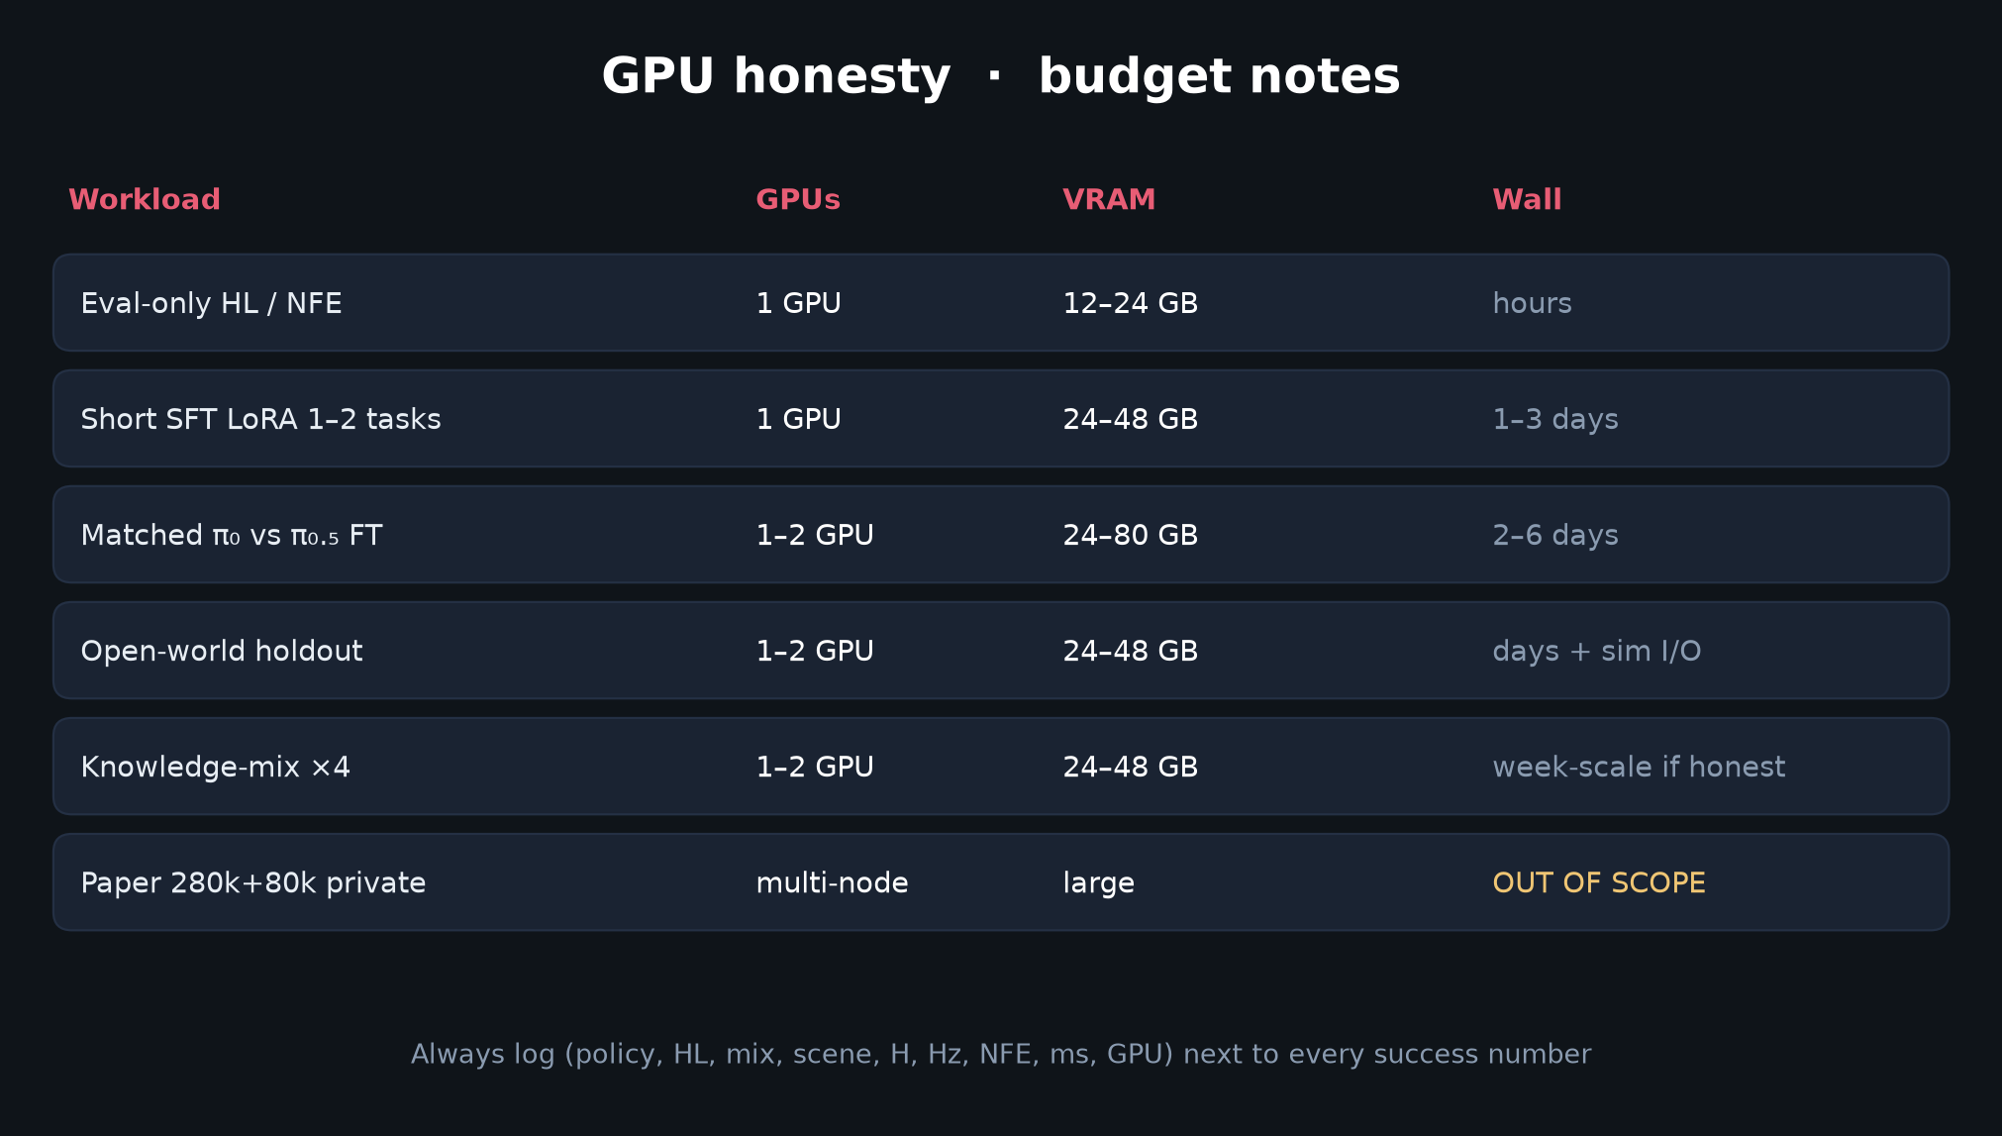
Empiricist · 11+3 · 5/14
Notes:
GPU BUDGET — eval 12–24 GB; short FT 24–48 GB. Env outlines in /workspace/pi05-quiet/env_outline/.

Slide 6
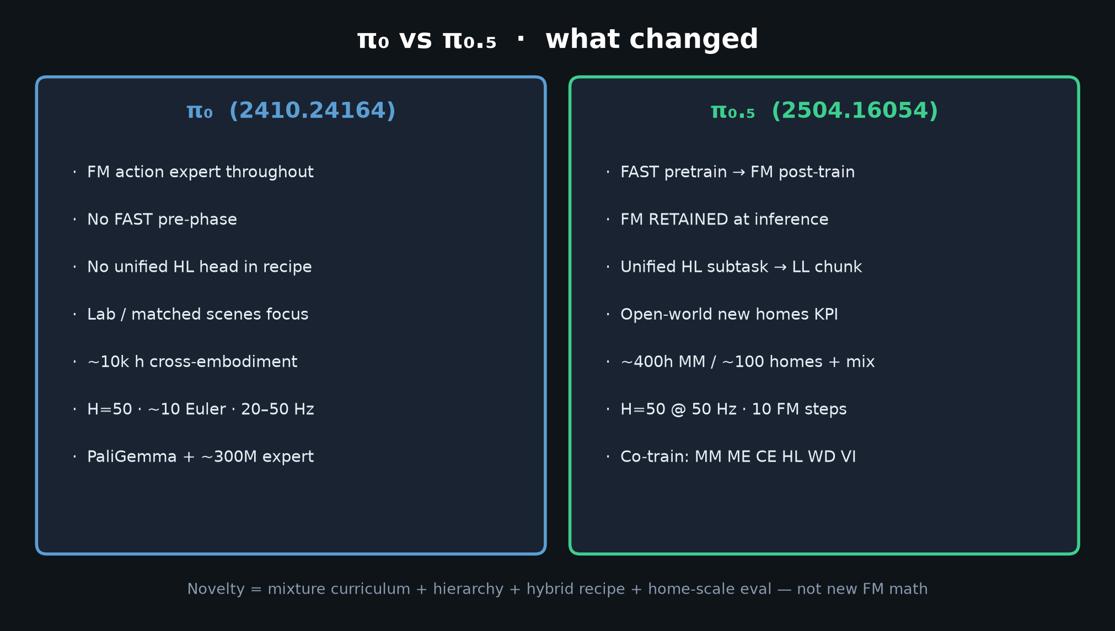
Empiricist · 11+3 · 6/14
Notes:
π₀ vs π₀.₅ — what the P0 comparison isolates.

Slide 7
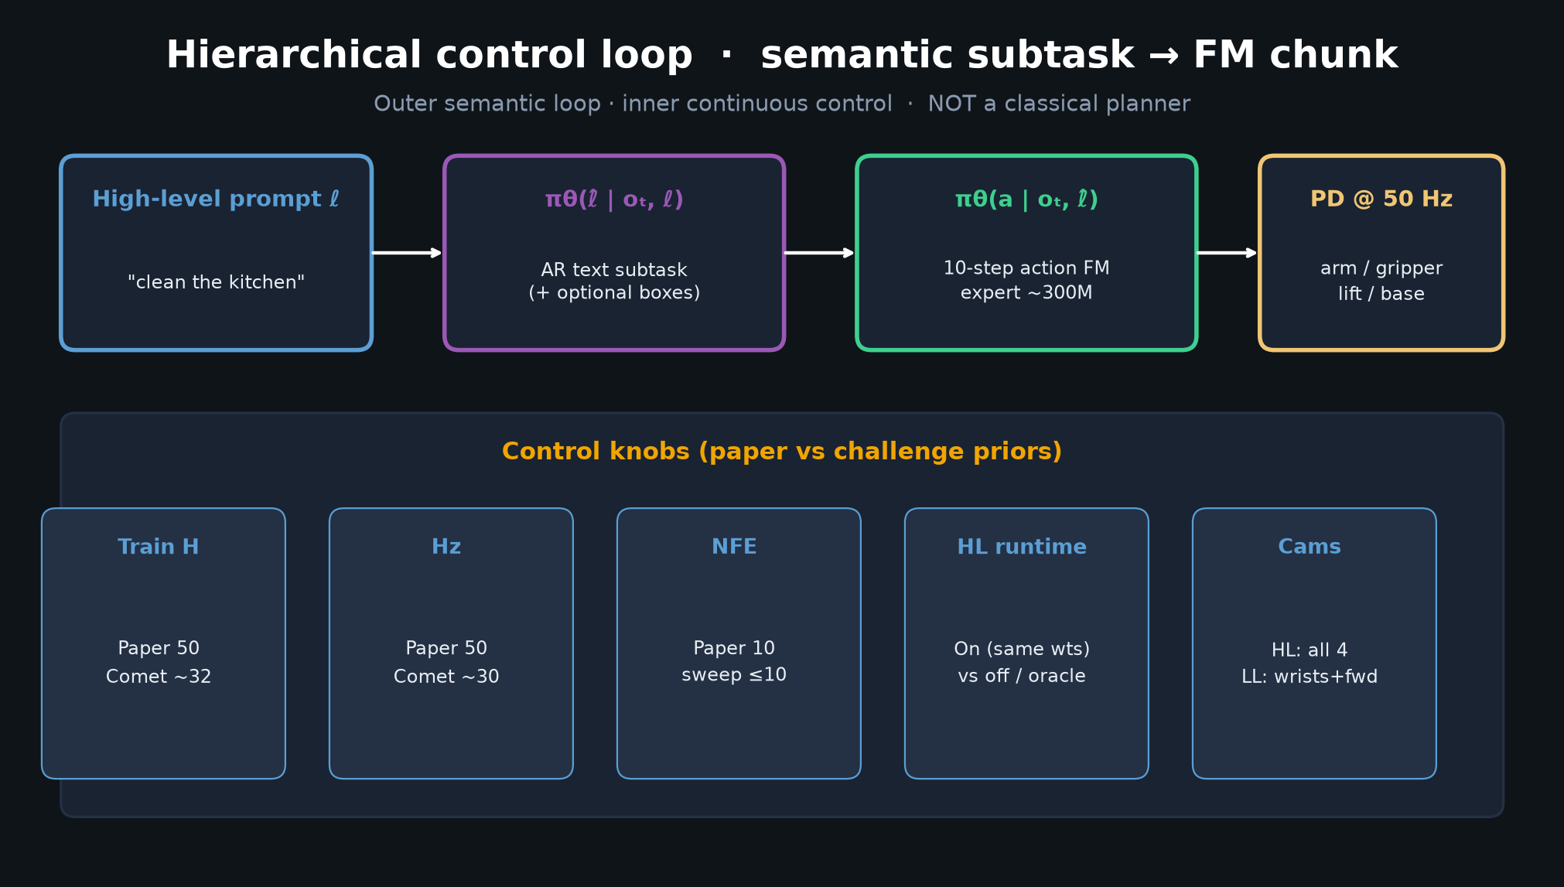
Empiricist · 11+3 · 7/14
Notes:
CONTROL LOOP KNOPS — H, Hz, NFE, HL. Paper vs Comet priors.

Slide 8
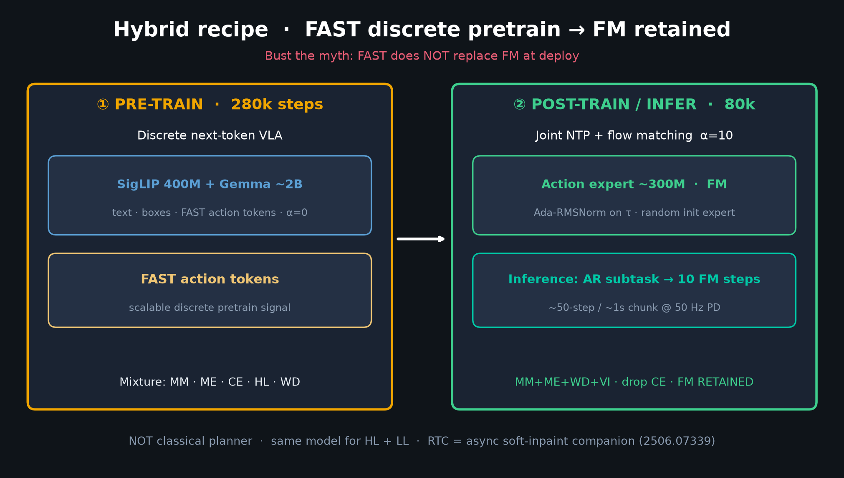
Empiricist · 11+3 · 8/14
Notes:
HYBRID — know what you are ablating (FAST phase vs FM head). Never run “FAST replaced FM” as a claim.

Slide 9
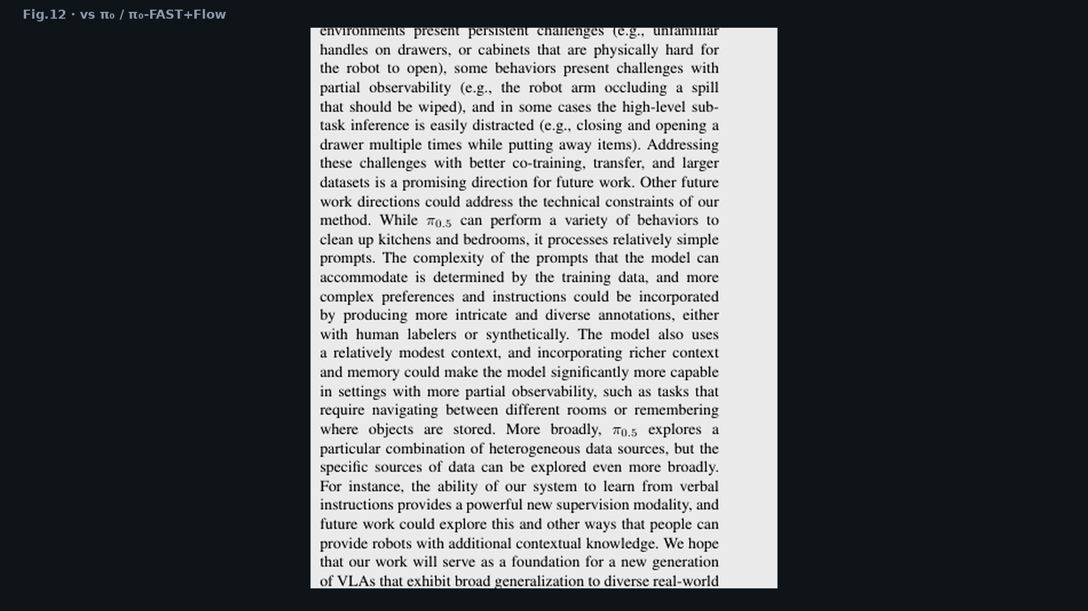
Empiricist · 11+3 · 9/14
Notes:
FIG.12 — paper comparative claim to reproduce directionally on public weights.

Slide 10
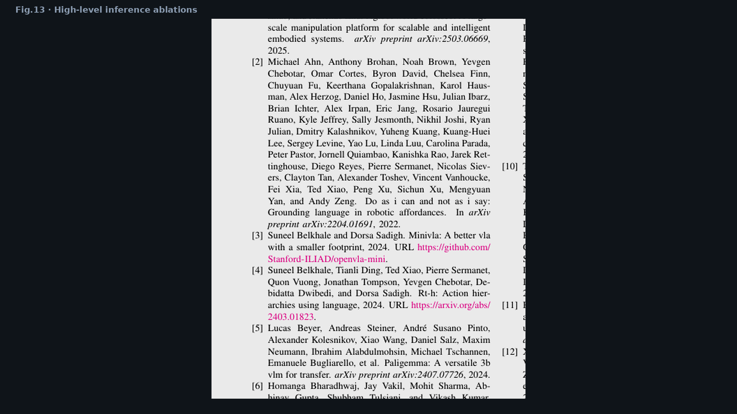
Empiricist · 11+3 · 10/14
Notes:
FIG.13 — HL on/off moral. Implicit HL strong; full HL best; no VI hurts.

Slide 11
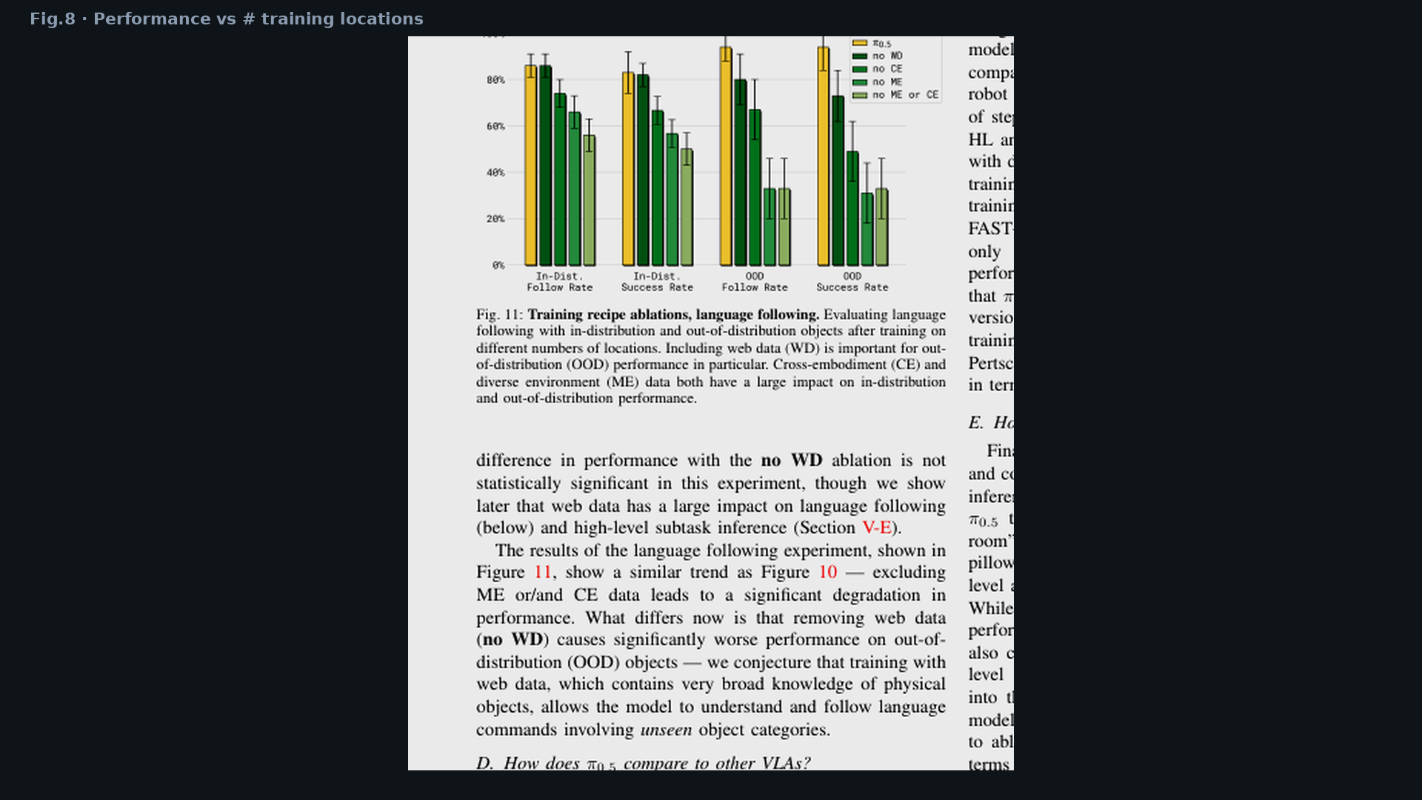
Empiricist · 11+3 · 11/14
Notes:
FIG.8 — location scaling. More scenes at fixed samples → better OOD under co-train.

Slide 12
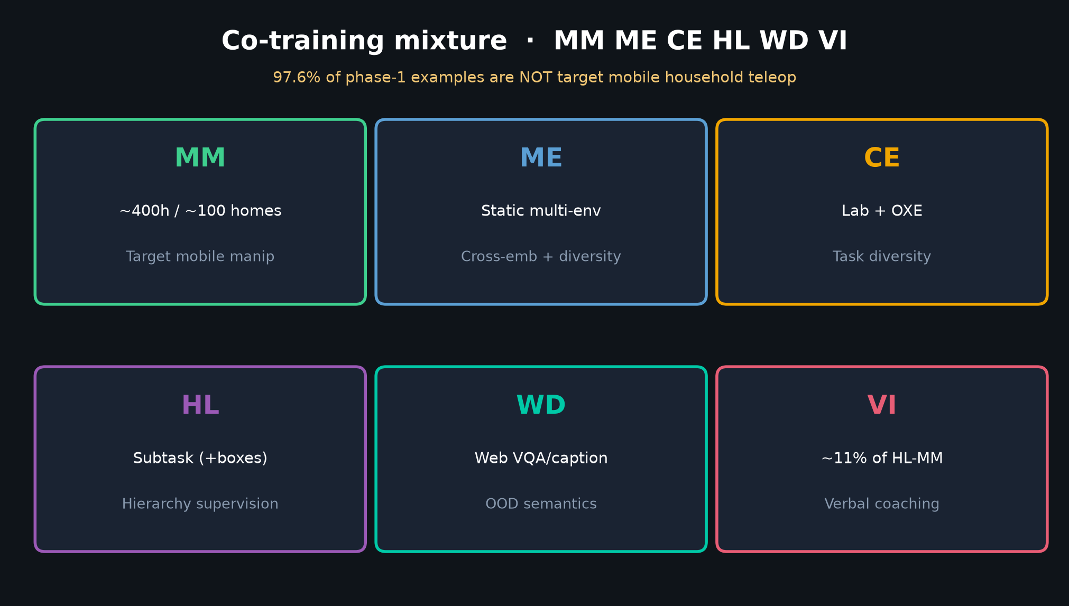
Empiricist · 11+3 · 12/14
Notes:
DATA MIXTURE — what WD/ME/CE/VI flags mean in ablations.

Slide 13
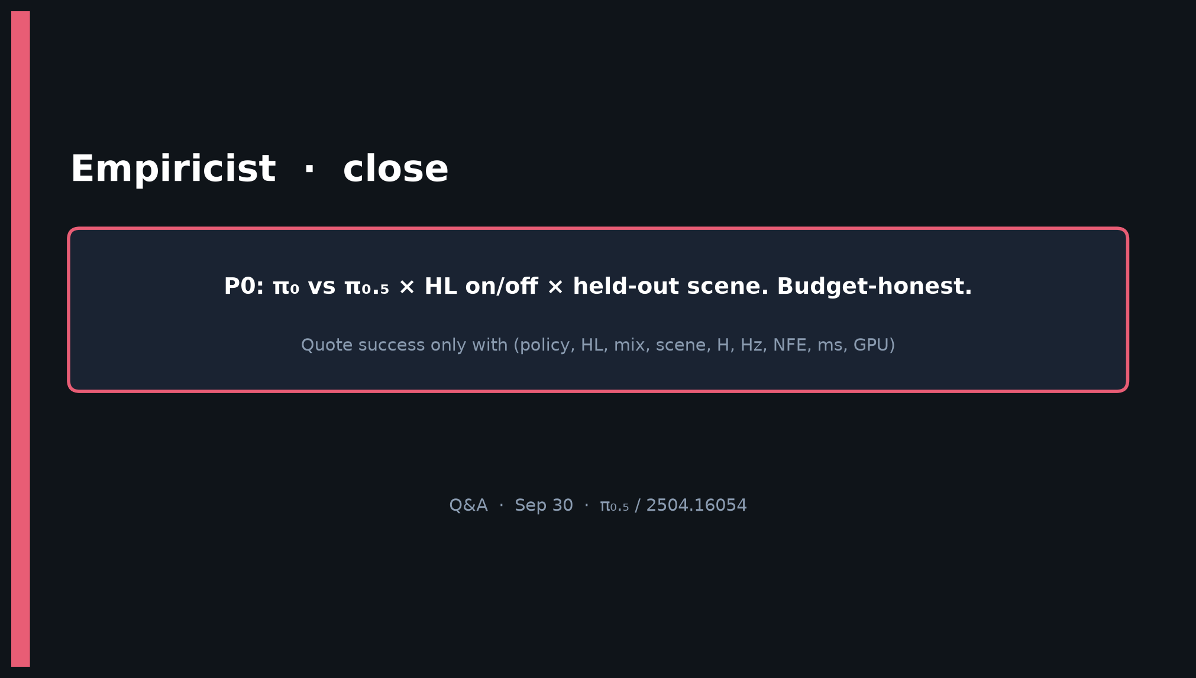
Empiricist · 11+3 · 13/14
Notes:
CLOSE — P0 matrix + budget-honest logging. Q&A.

Slide 14
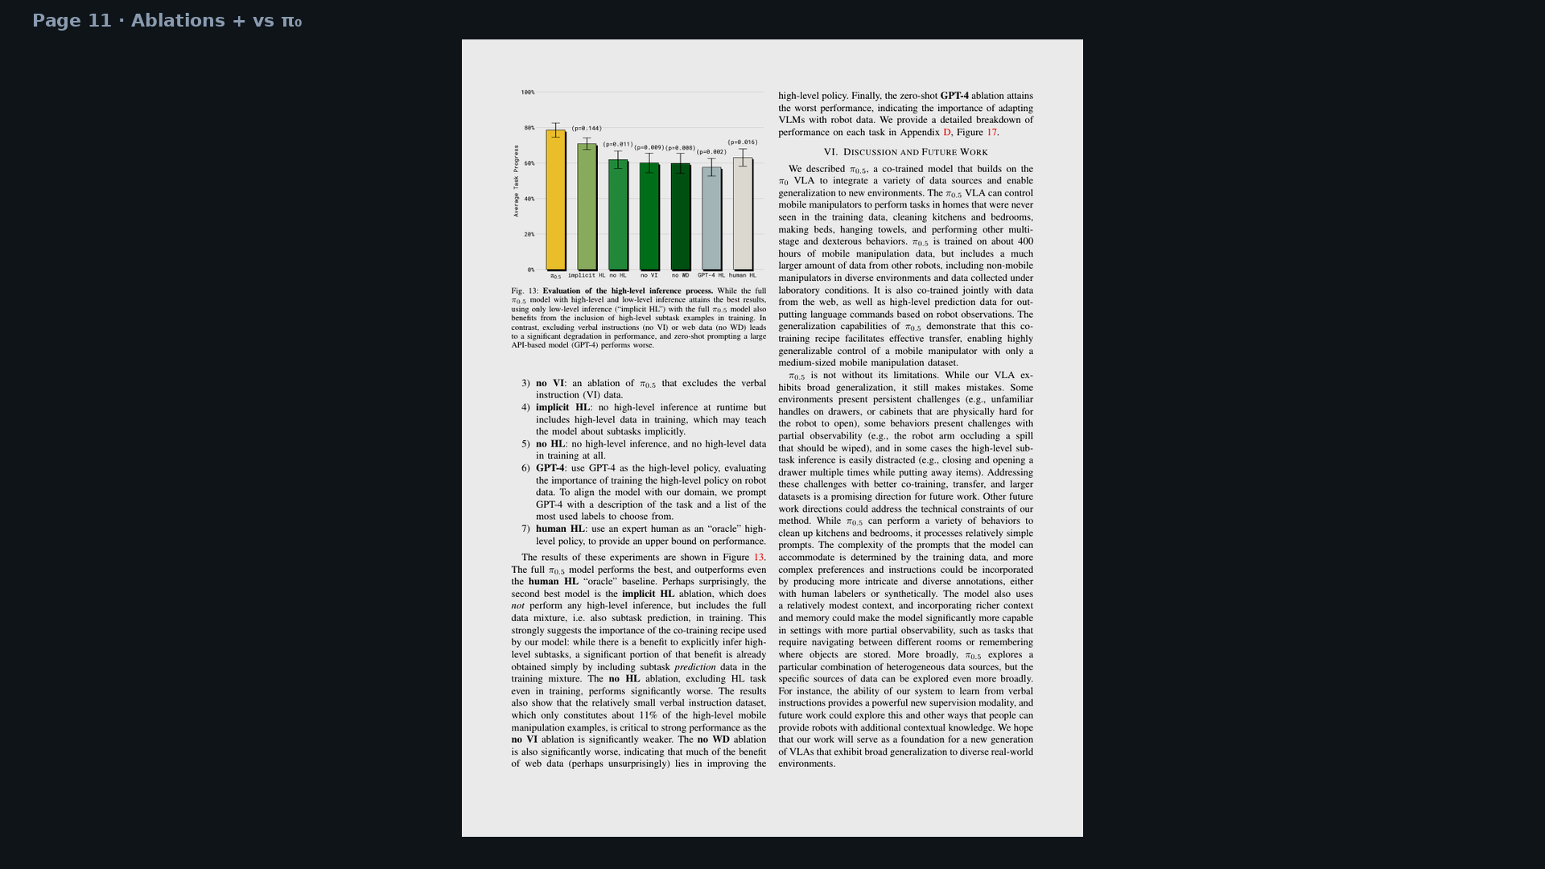
Empiricist · 11+3 · 14/14
Notes:
BACKUP — page 11 ablations.

