Slide 1
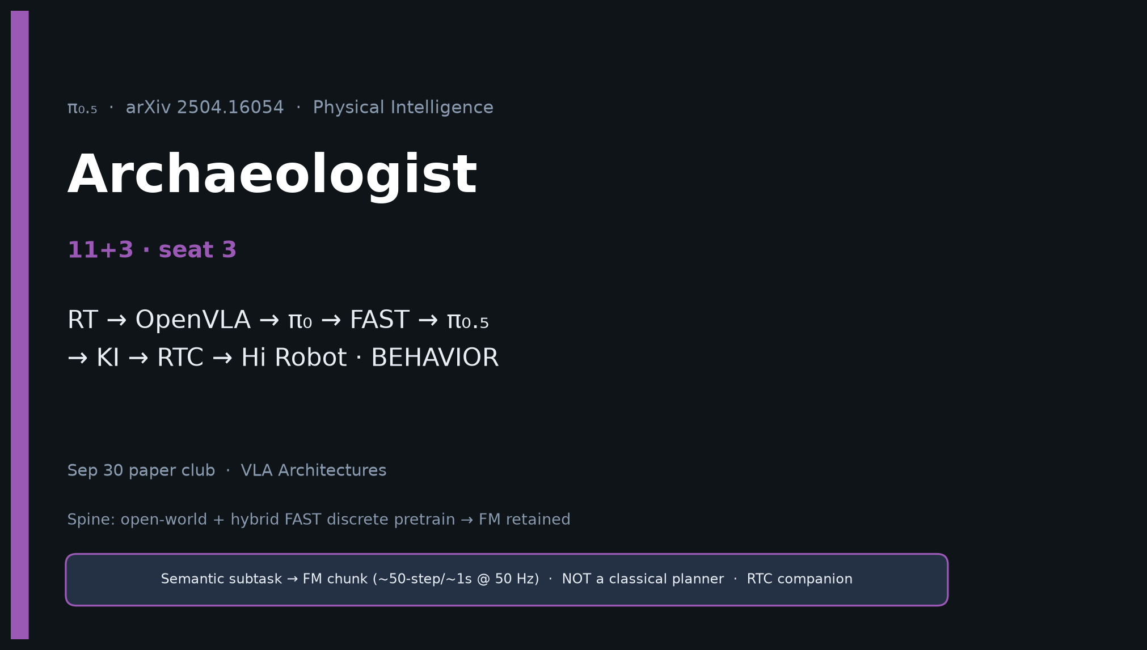
Archaeologist · 11+3 · 1/14
Notes:
ARCHAEOLOGIST — 11+3. Lineage + what’s new.
Timeline: RT/OpenVLA/Octo/OXE → π₀ → FAST → π₀.₅ → KI → RTC → Hi Robot.
BEHAVIOR-1K → ’25 → ’26.
What’s new: mixture, unified HL/LL, VI, home-scale eval.

Slide 2
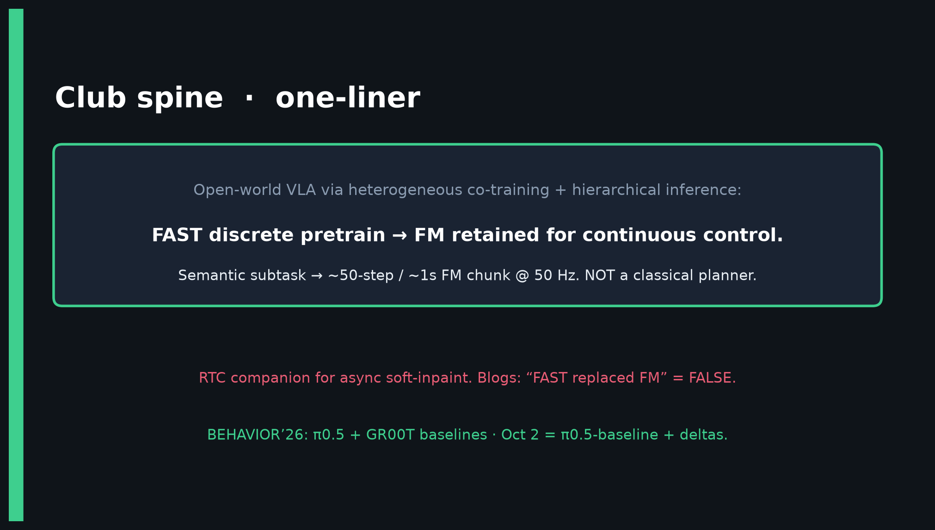
Archaeologist · 11+3 · 2/14
Notes:
SPINE — place π₀.₅ in the club genealogy correctly (FM retained).

Slide 3
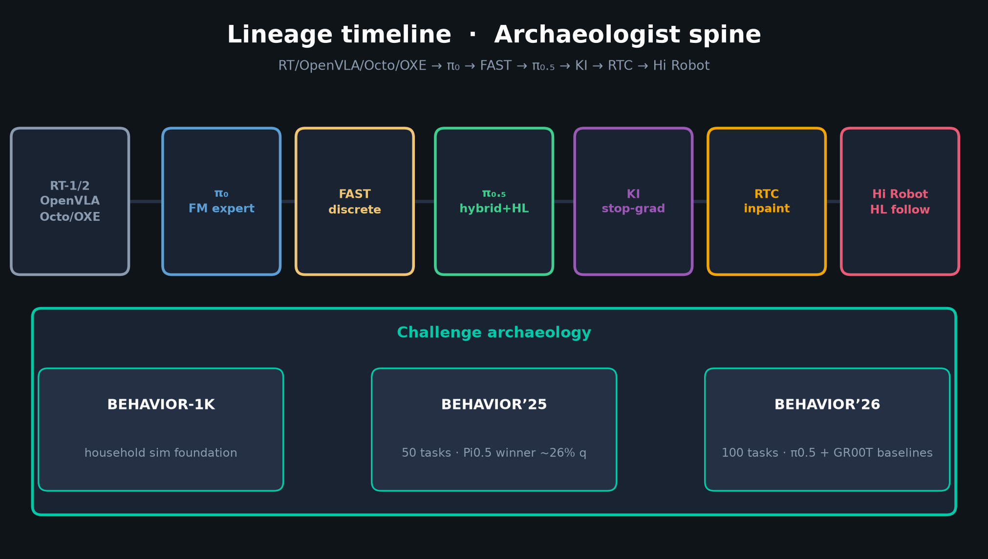
Archaeologist · 11+3 · 3/14
Notes:
LINEAGE TIMELINE — MUST-HIT.
RT-1/2, OpenVLA, Octo, OXE → π₀ (FM) → FAST → π₀.₅ (open-world+hybrid+HL) → KI → RTC → Hi Robot.
Challenge: BEHAVIOR-1K → ’25 Pi0.5 winner → ’26 π0.5 baseline.

Slide 4
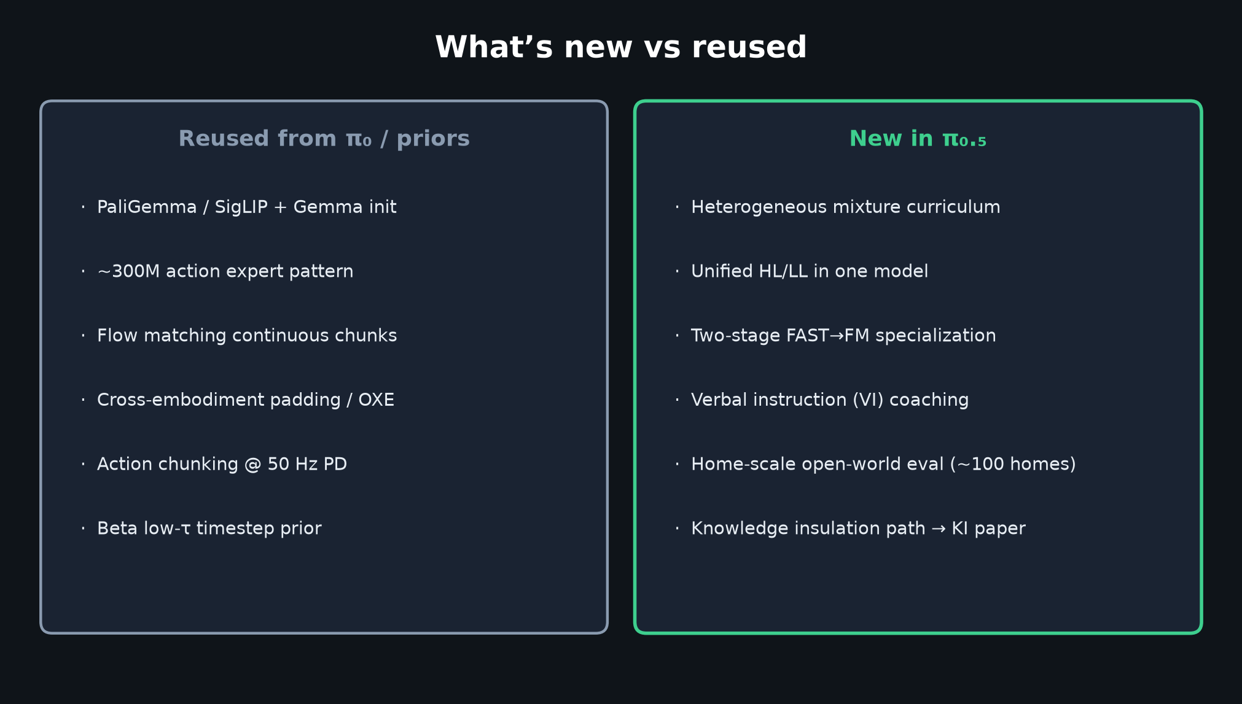
Archaeologist · 11+3 · 4/14
Notes:
WHAT’S NEW vs REUSED.
Reused: PaliGemma init, action expert, FM chunks, OXE padding.
New: mixture curriculum, unified HL/LL, FAST→FM specialization, VI, home-scale eval.

Slide 5
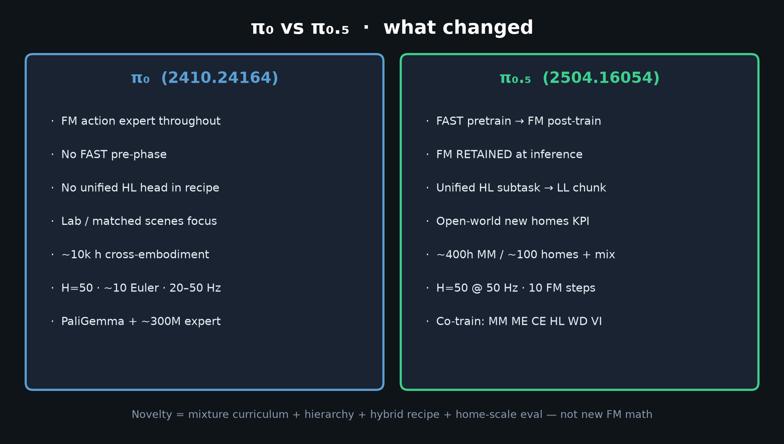
Archaeologist · 11+3 · 5/14
Notes:
π₀ vs π₀.₅ — the pivot this paper locks.

Slide 6
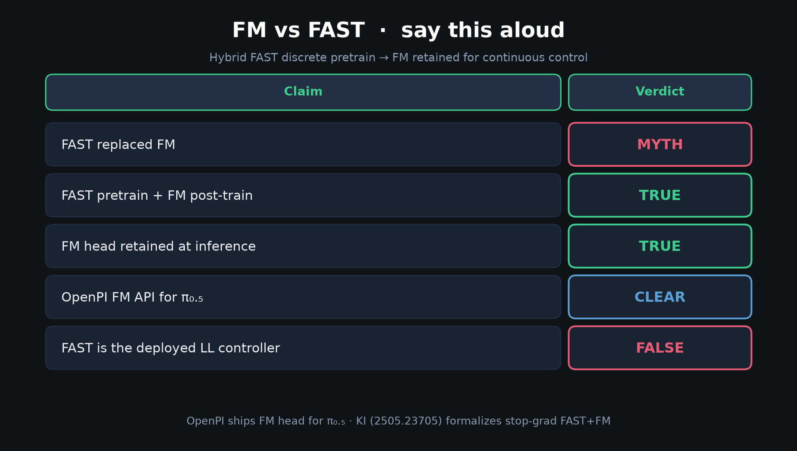
Archaeologist · 11+3 · 6/14
Notes:
MYTH TABLE — archaeological correction: blogs mis-periodize FAST vs FM.

Slide 7
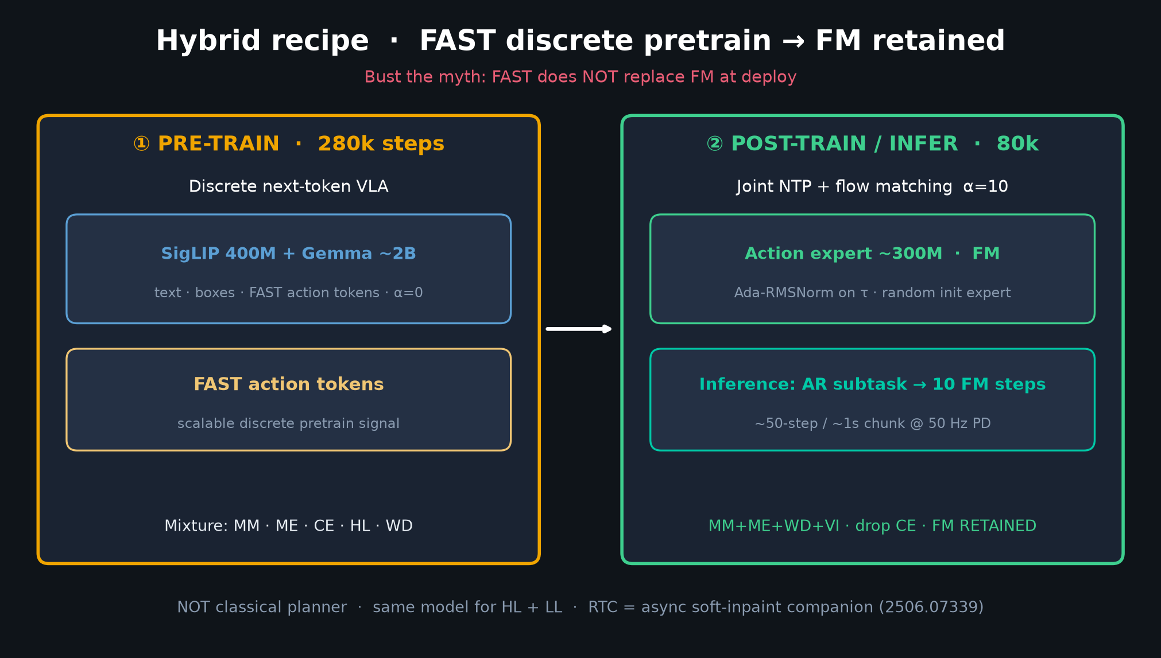
Archaeologist · 11+3 · 7/14
Notes:
HYBRID RECIPE — the technical hinge between FAST paper and π₀.₅ system paper.

Slide 8
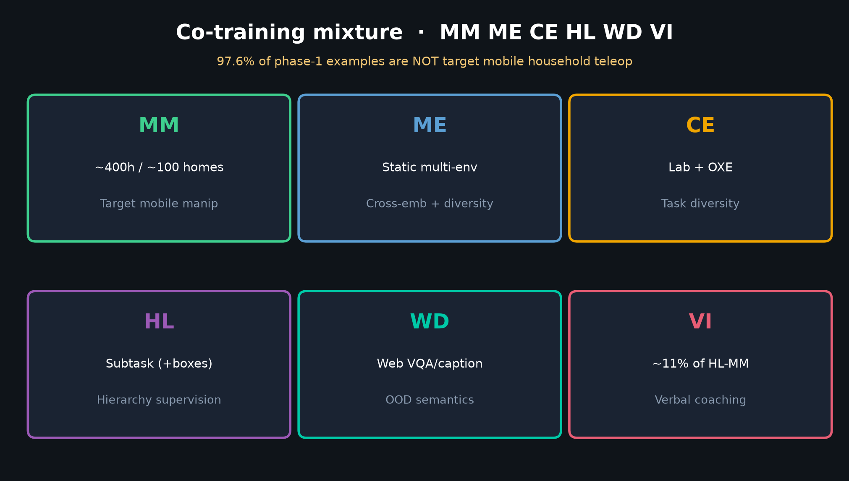
Archaeologist · 11+3 · 8/14
Notes:
DATA MIXTURE archaeology — CapsFusion/COCO/Cambrian/PixMo/VQAv2 + VI language teleop.

Slide 9
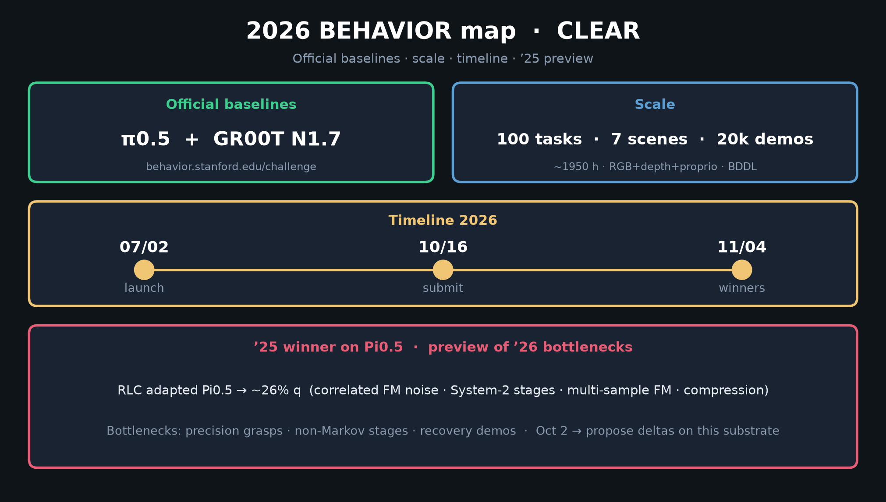
Archaeologist · 11+3 · 9/14
Notes:
2026 MAP — challenge archaeology endpoint.

Slide 10
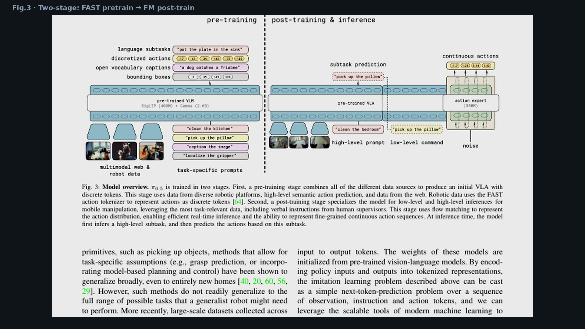
Archaeologist · 11+3 · 10/14
Notes:
FIG.3 — visual primary source for hybrid claim.

Slide 11
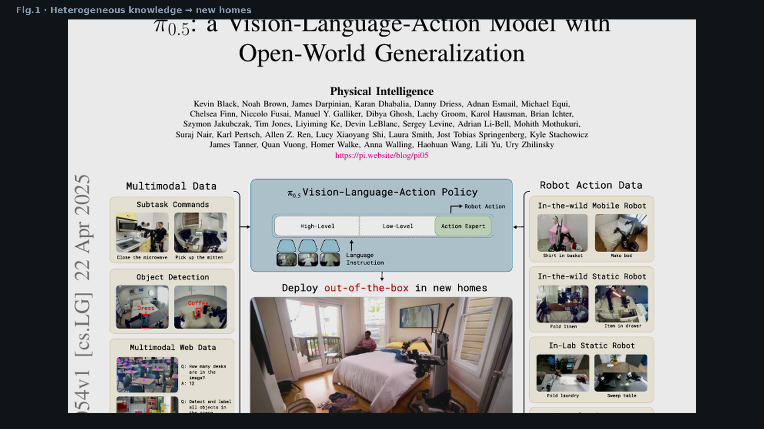
Archaeologist · 11+3 · 11/14
Notes:
FIG.1 — heterogeneous sources diagram as intellectual-history artifact.

Slide 12
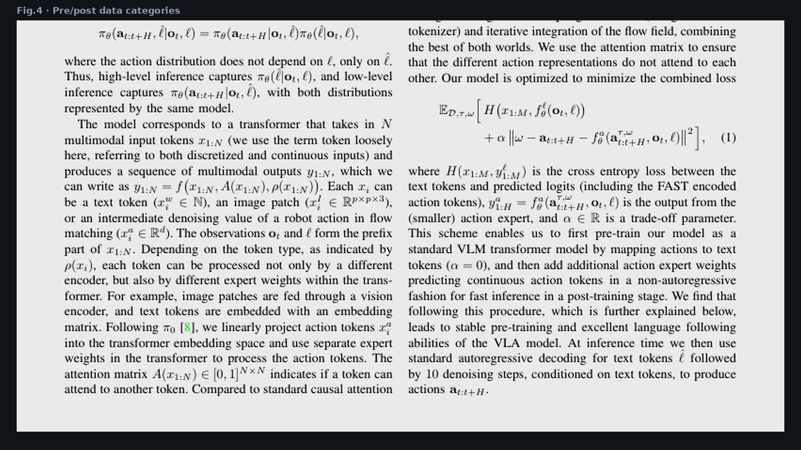
Archaeologist · 11+3 · 12/14
Notes:
FIG.4 — pre/post data categories.

Slide 13
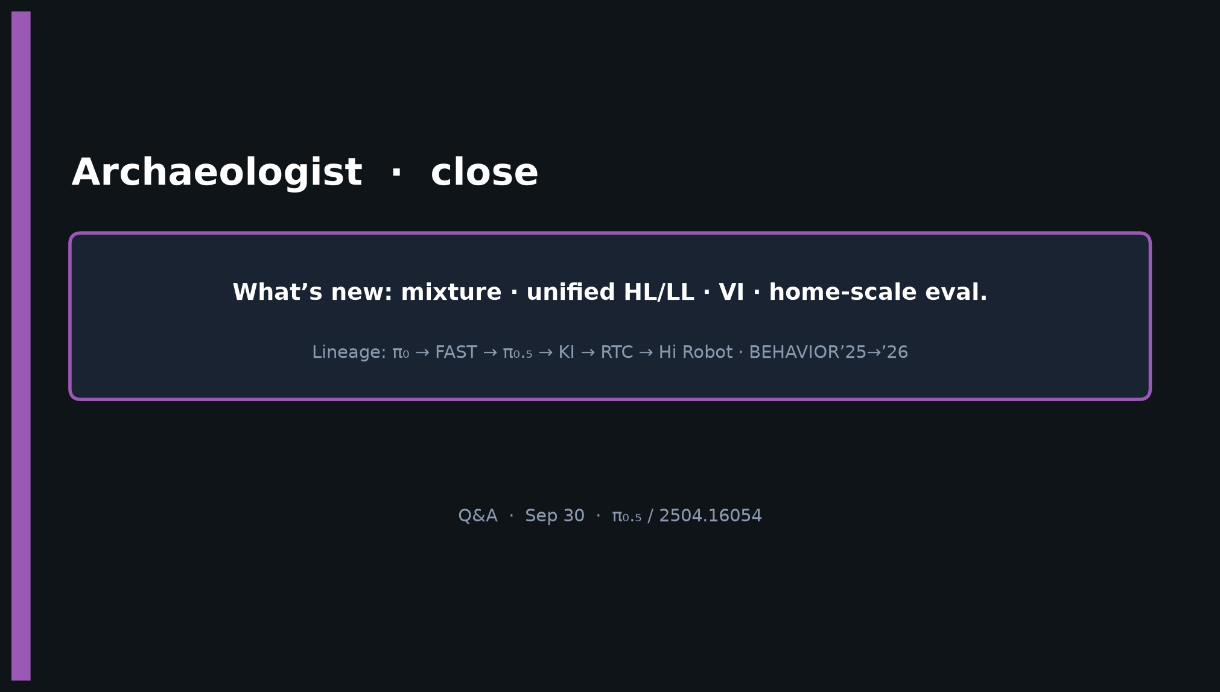
Archaeologist · 11+3 · 13/14
Notes:
CLOSE — what’s new: mixture · unified HL/LL · VI · home-scale eval. Q&A.

Slide 14
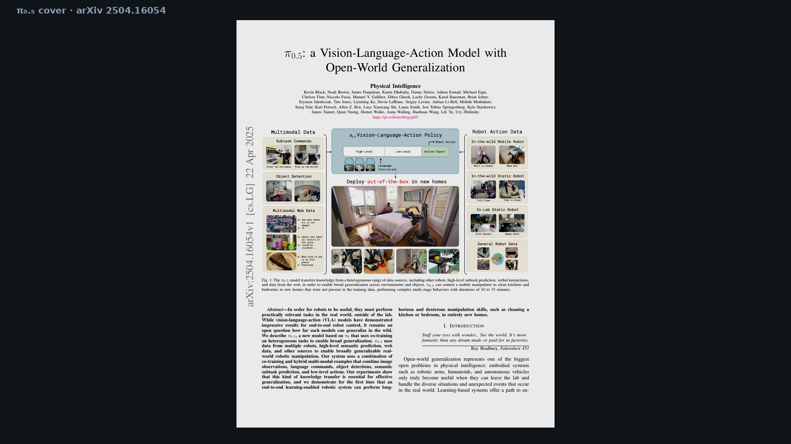
Archaeologist · 11+3 · 14/14
Notes:
BACKUP — cover.

