Slide 1
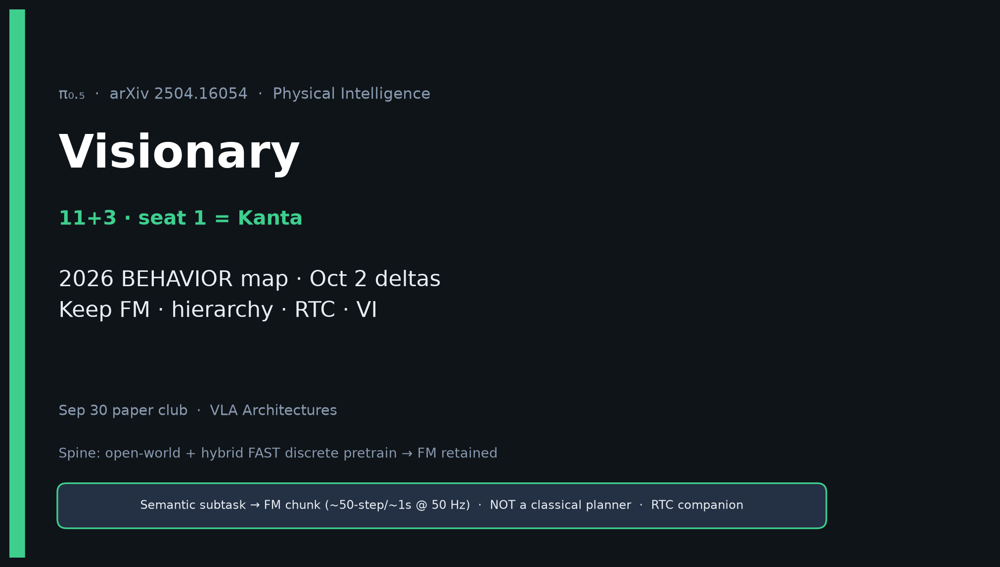
Visionary · 11+3 · 1/15
Notes:
VISIONARY OPENING — seat 1 = Kanta (YOU). Timing 11+3. DENSEST DECK. BUILD FIRST.
You own strategy: 2026 BEHAVIOR map + Oct 2 proposal deltas.
ONE SENTENCE for the room:
π₀.₅ shows open-world household VLA is a co-training + hierarchy problem — FAST pretrain, FM retained — and it is already the 2026 BEHAVIOR baseline substrate.
MUST SAY:
• FAST replaced FM = MYTH. Hybrid: FAST discrete pretrain → FM continuous post-train / infer.
• Hierarchical: semantic subtask → FM chunk (~50-step/~1s @ 50 Hz). NOT a classical planner.
• Oct 2 = π0.5-baseline + targeted deltas, not greenfield.
• Skip Discord/Drive.
Nearby deadline: Oct 2 summary proposal.

Slide 2
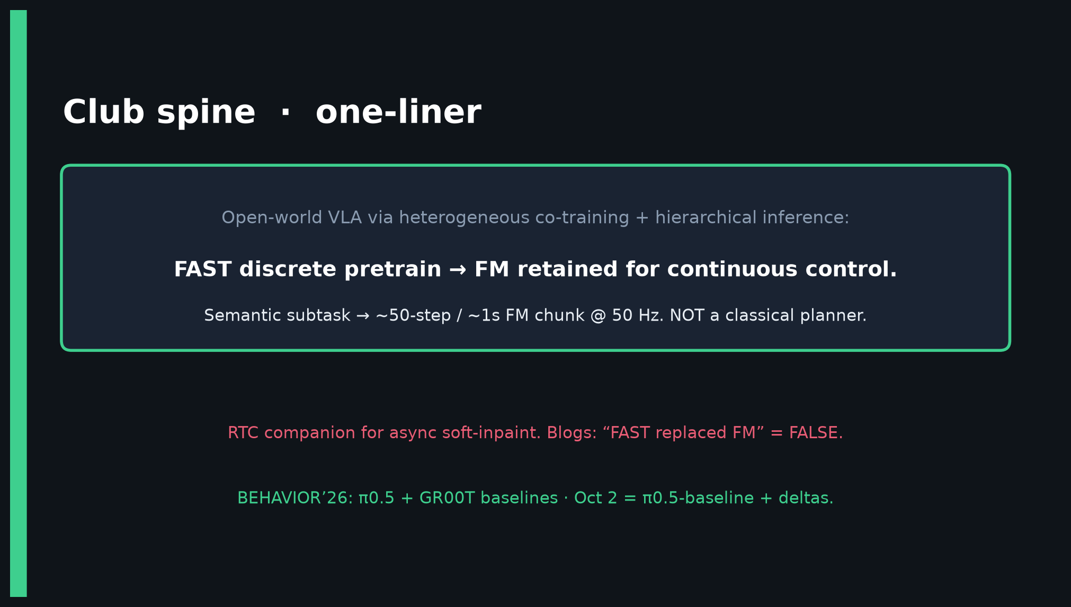
Visionary · 11+3 · 2/15
Notes:
CLUB SPINE — deliver early.
Open-world + hybrid FAST discrete pretrain → FM retained for continuous control.
Semantic subtask → ~50-step/~1s FM chunk @ 50 Hz. NOT a classical planner.
RTC companion for async soft-inpaint (2506.07339).
Hand Empiricist: H · Hz · NFE · HL on/off · mix flags.

Slide 3
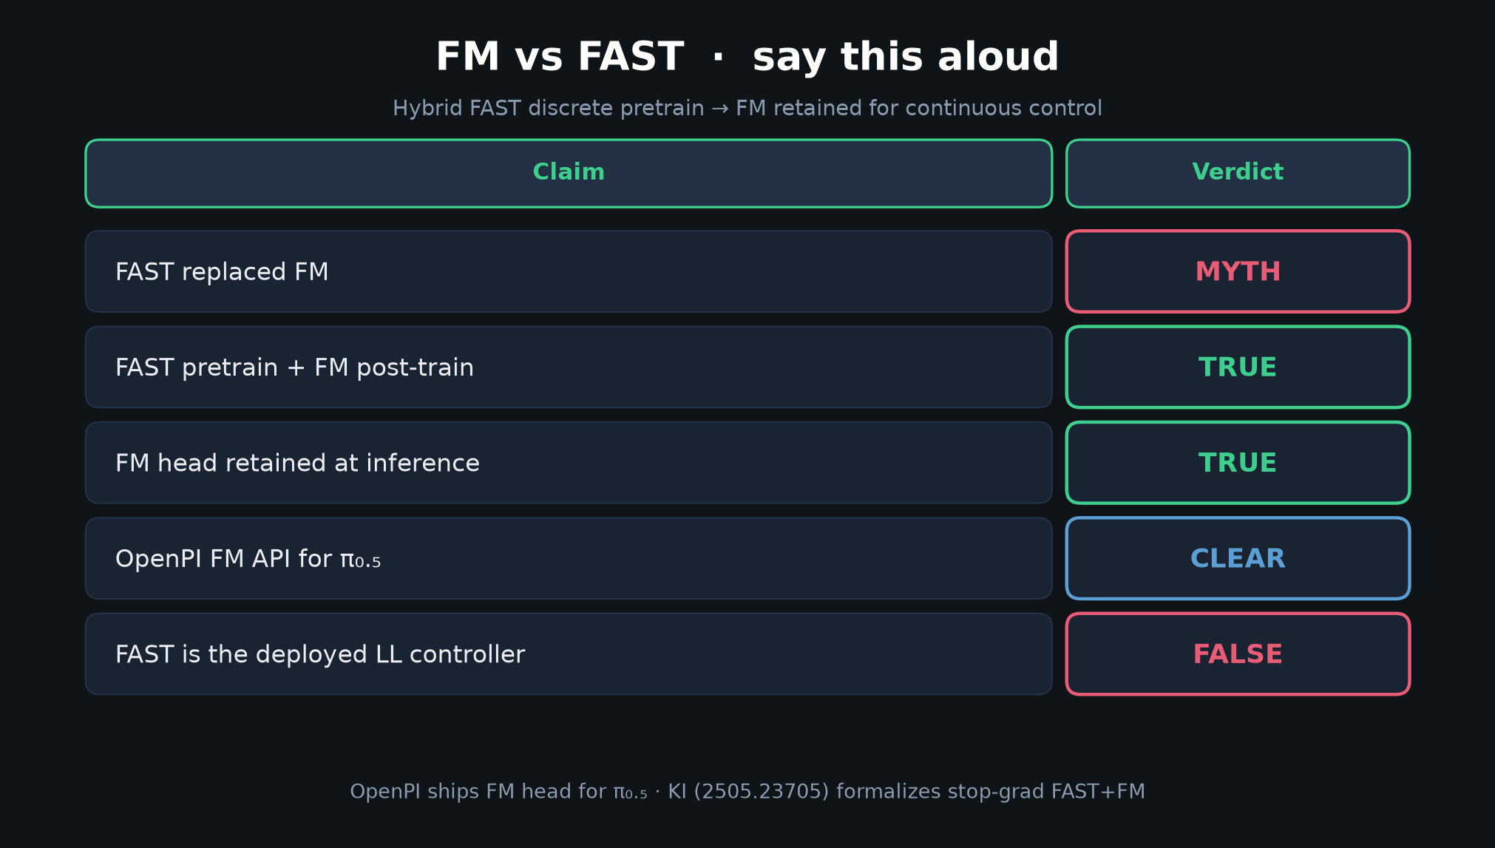
Visionary · 11+3 · 3/15
Notes:
FM vs FAST FLAG TABLE — SAY ALOUD. Densest correction slide.
| Claim | Verdict |
| FAST replaced FM | MYTH |
| FAST pretrain + FM post-train | TRUE |
| FM head retained at infer | TRUE |
| OpenPI FM API for π₀.₅ | CLEAR |
| FAST is the deployed LL controller | FALSE |
Spend 60–90s. This prevents the room from cargo-culting discrete-only control.

Slide 4
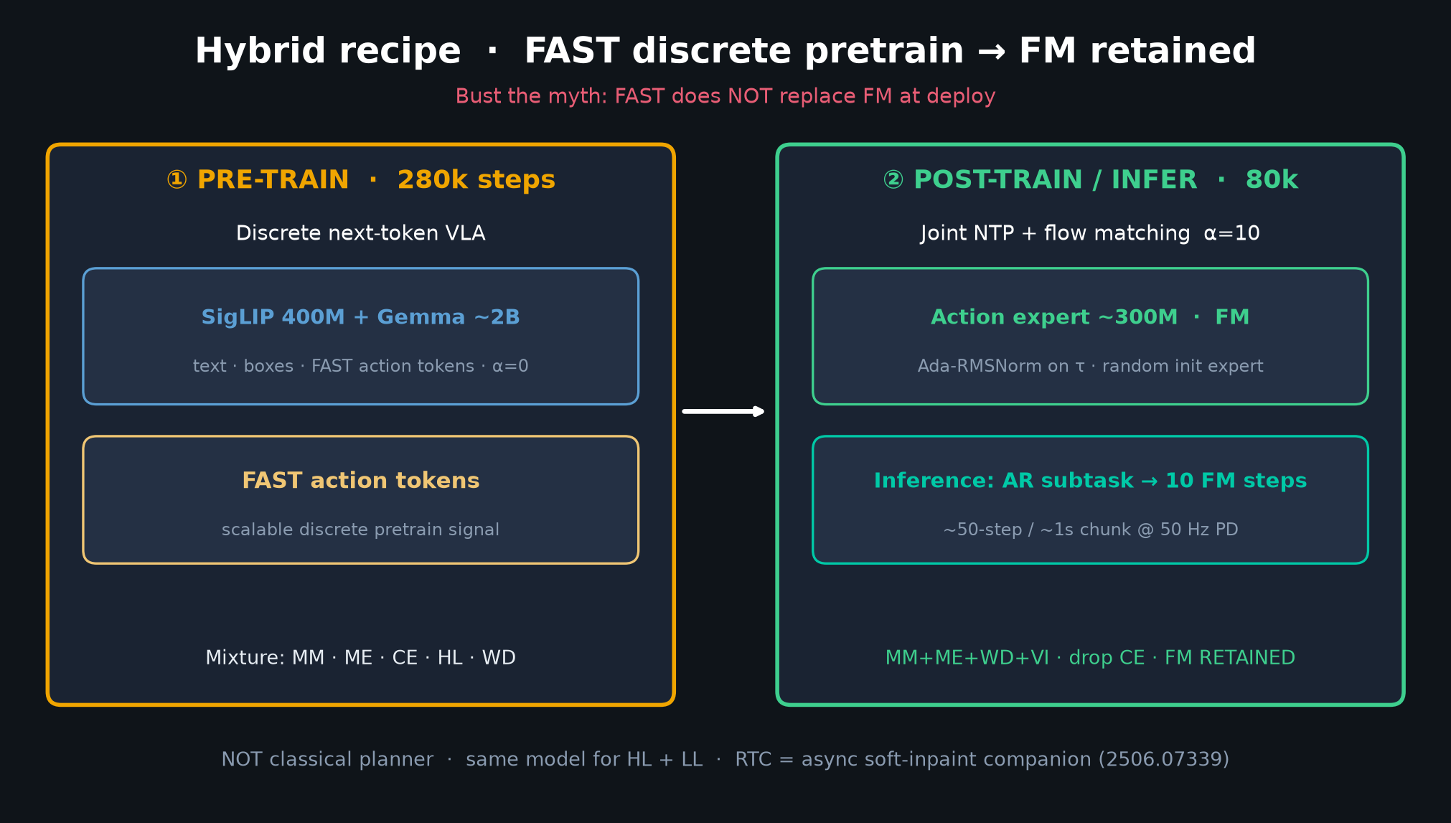
Visionary · 11+3 · 4/15
Notes:
HYBRID FAST→FM DIAGRAM — paper Fig.3 spirit.
① Pre-train 280k: discrete next-token (text, boxes, FAST); α=0.
② Post-train 80k: joint NTP + FM α=10; action expert ~300M; Ada-RMSNorm on τ.
Inference: AR subtask then 10 FM steps → PD @ 50 Hz.
KI (2505.23705) formalizes stop-grad FAST+FM; OpenPI ships FM head for π₀.₅.

Slide 5
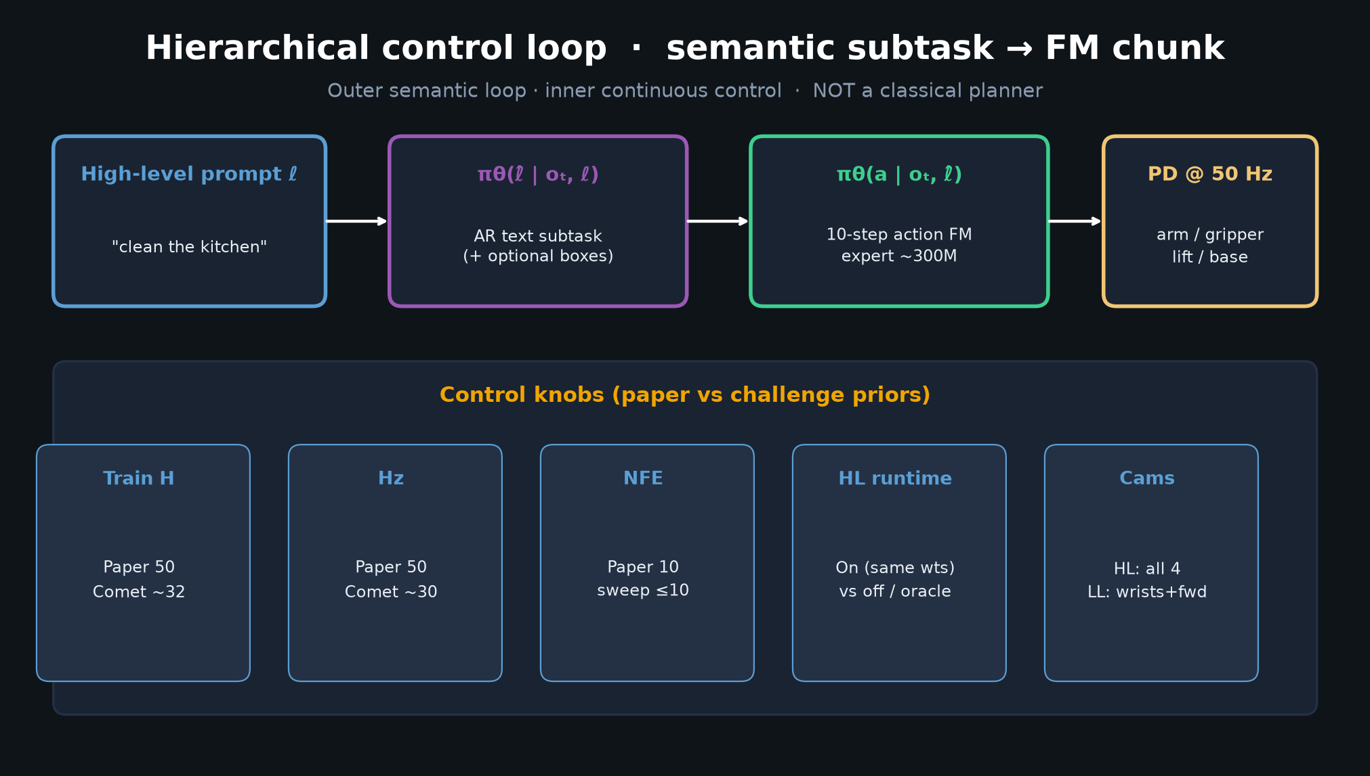
Visionary · 11+3 · 5/15
Notes:
HL→FM CONTROL LOOP — hierarchical, not planner.
ℓ ("clean the kitchen") → π(ℓ̂|o,ℓ) AR subtask → π(a|o,ℓ̂) 10-step FM → PD @ 50 Hz.
Replan: new HL (lower freq) and/or new LL chunk.
Control knobs: paper H=50 @ 50 Hz vs Comet H≈32 @ 30 Hz receding — year-updated priors.
RTC = async soft-inpaint when inference delay bites.

Slide 6
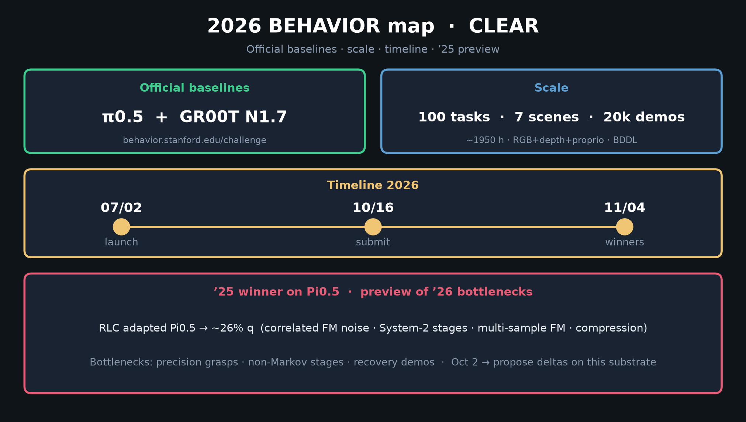
Visionary · 11+3 · 6/15
Notes:
2026 BEHAVIOR MAP — CLEAR. Highest-value Visionary slide.
Baselines: π0.5 + GR00T N1.7.
Scale: 100 tasks / 7 scenes / 20k demos (~1950 h).
Timeline: launch ~07/02 → submit 10/16 → winners ~11/04/2026.
’25 winner on Pi0.5 ~26% q (correlated FM noise, System-2 stages, multi-sample FM, compression)
→ preview of ’26 bottlenecks: grasps, non-Markov stages, recovery.
Spend 90–120s. This is your payoff for Oct 2.

Slide 7
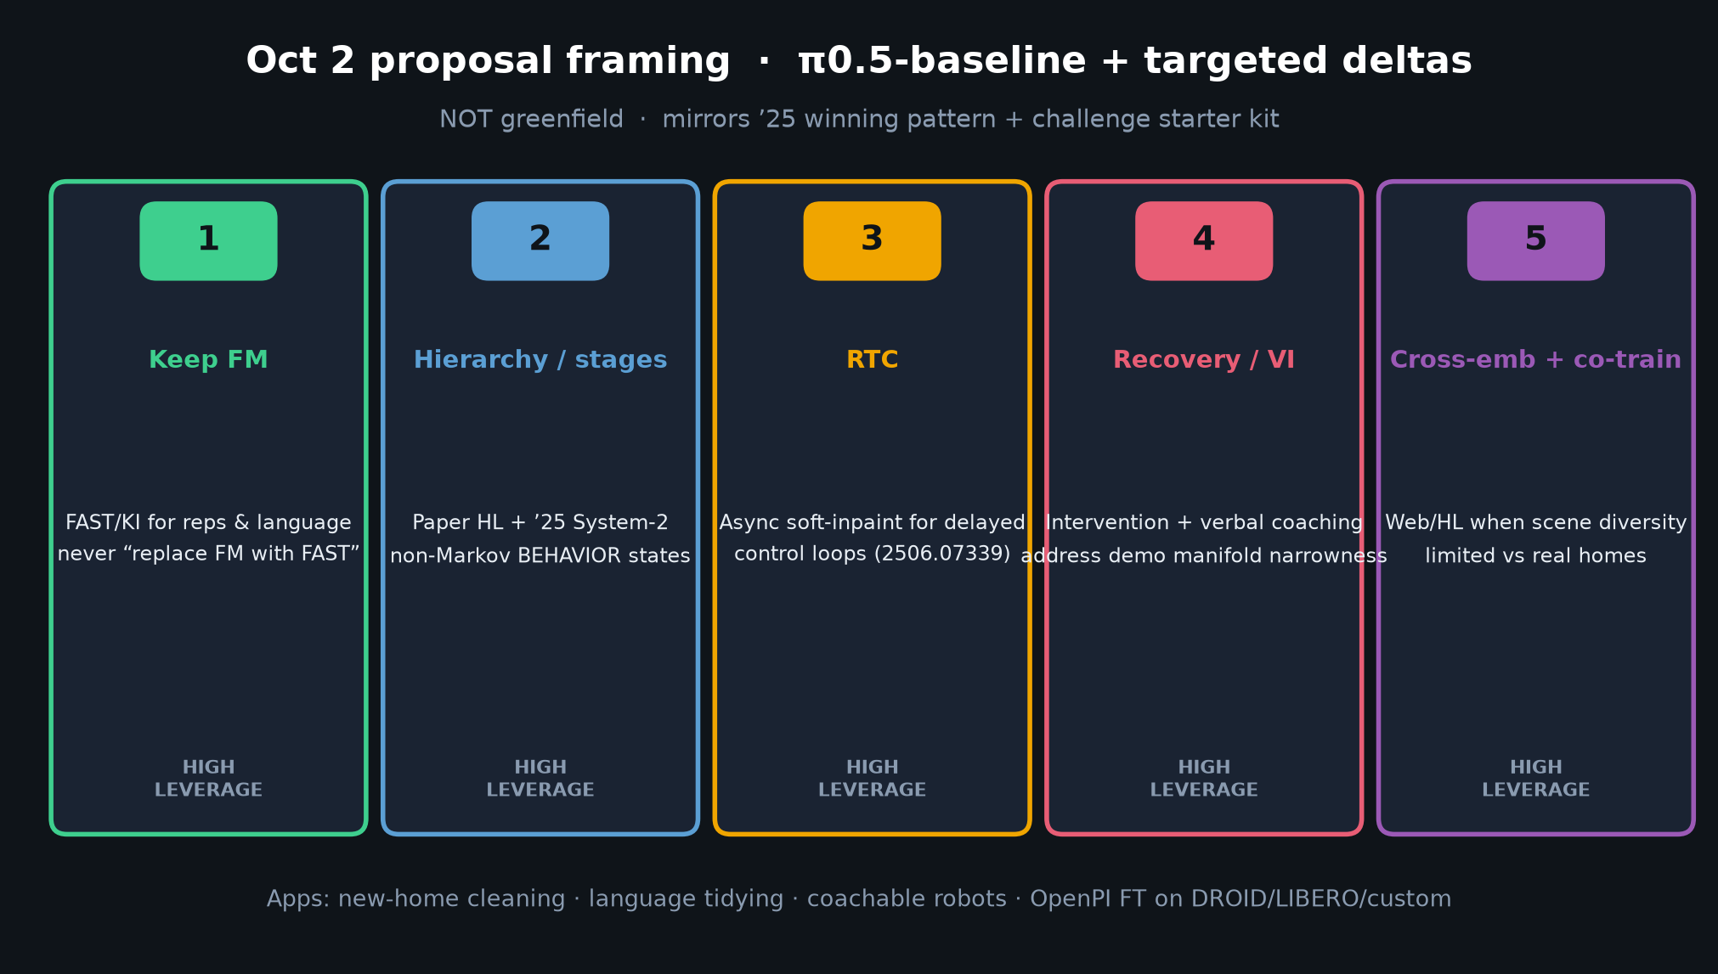
Visionary · 11+3 · 7/15
Notes:
OCT 2 PROPOSAL FRAMING — π0.5-baseline + targeted deltas, NOT greenfield.
High-leverage deltas 1–5:
1 Keep FM; FAST/KI for reps/language — never replace FM with FAST
2 Hierarchy / stage tracking (paper HL + ’25 System-2)
3 RTC for delayed control loops
4 Recovery / VI-style intervention data
5 Cross-embodiment + web/HL co-training when scene diversity limited
Mirrors winning’25 pattern and challenge starter kit.

Slide 8
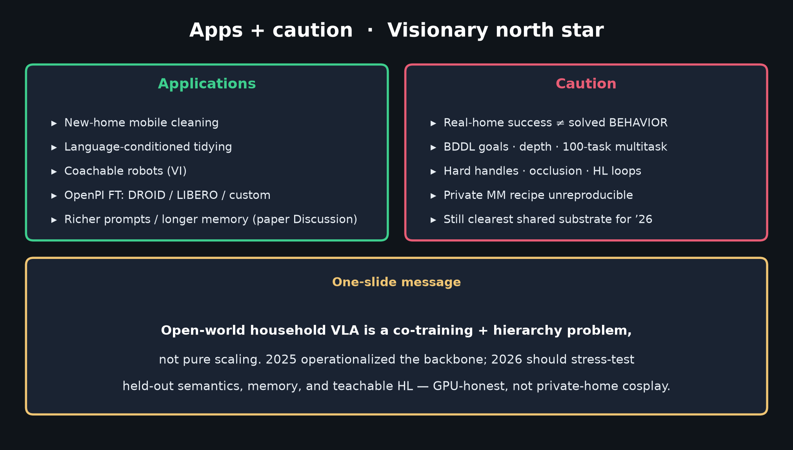
Visionary · 11+3 · 8/15
Notes:
APPS + CAUTION.
Apps: new-home cleaning, language tidying, coachable robots (VI), OpenPI FT on DROID/LIBERO/custom.
Caution: real-home success ≠ solved BEHAVIOR (BDDL, depth, 100-task multitask).
Still clearest shared substrate linking PI open-world, OpenPI, and 2026 baseline.
One-slide message: co-training + hierarchy, not pure scaling. Skip Discord/Drive.

Slide 9
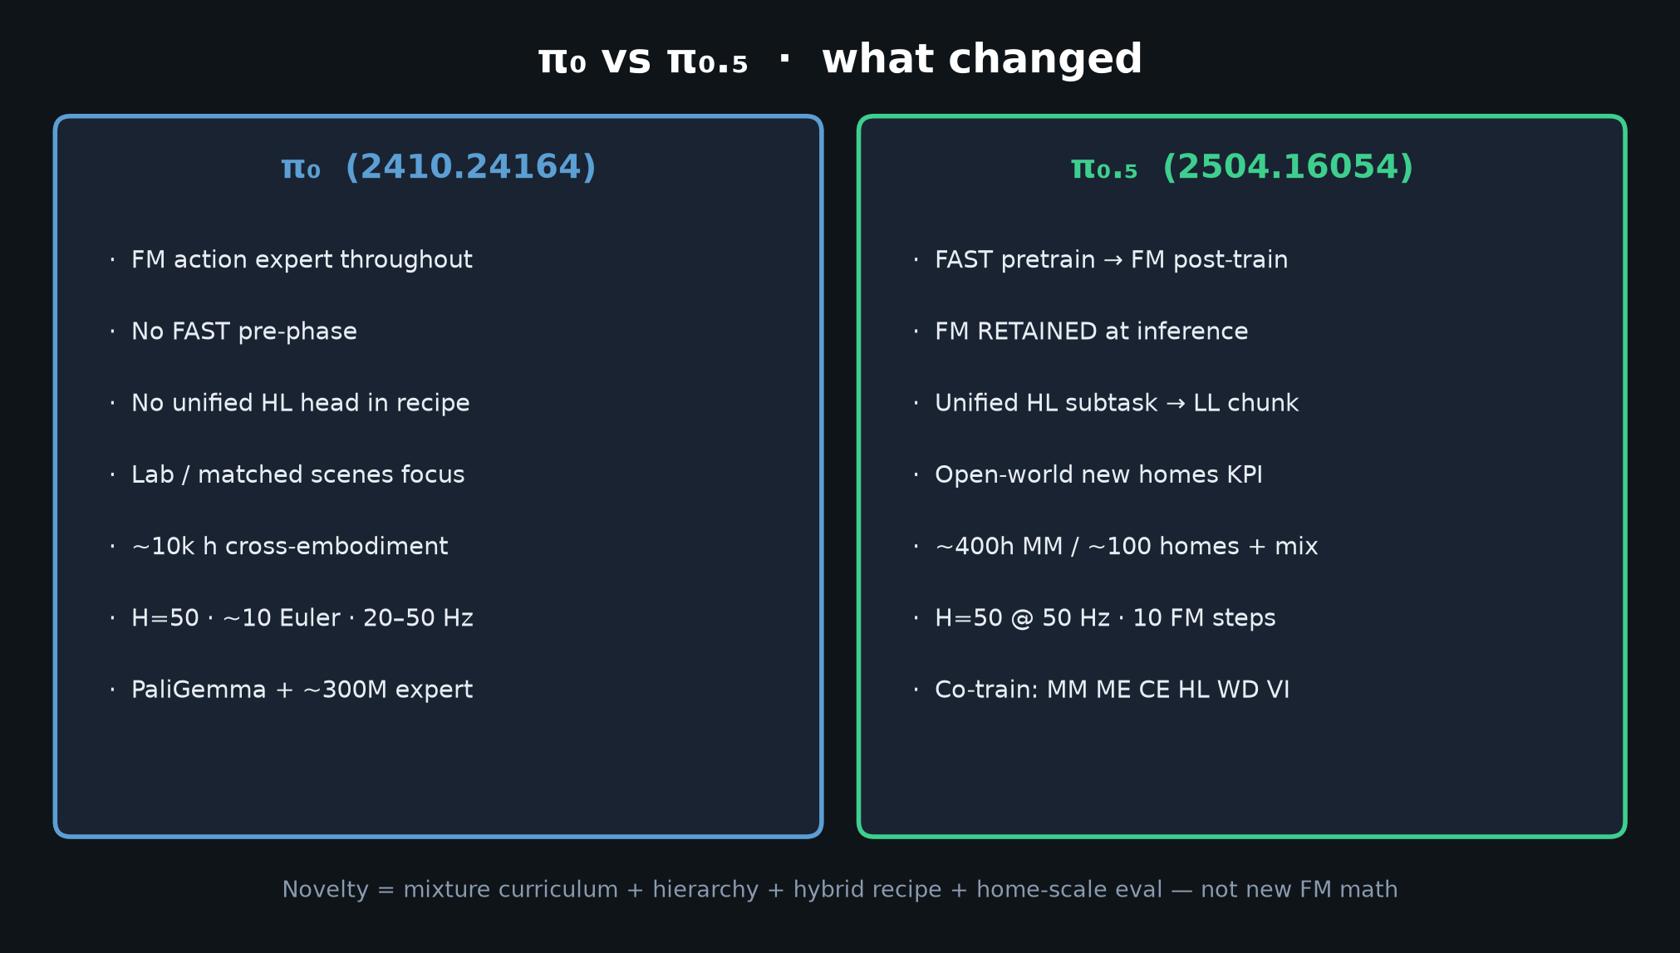
Visionary · 11+3 · 9/15
Notes:
π₀ vs π₀.₅ — what changed for strategy.
π₀: always FM; no FAST pre-phase; no unified HL.
π₀.₅: FAST→FM hybrid; unified HL/LL; open-world new homes; mixture MM/ME/CE/HL/WD/VI.
Novelty = recipe + hierarchy + eval — not new FM math. Keep FM.

Slide 10
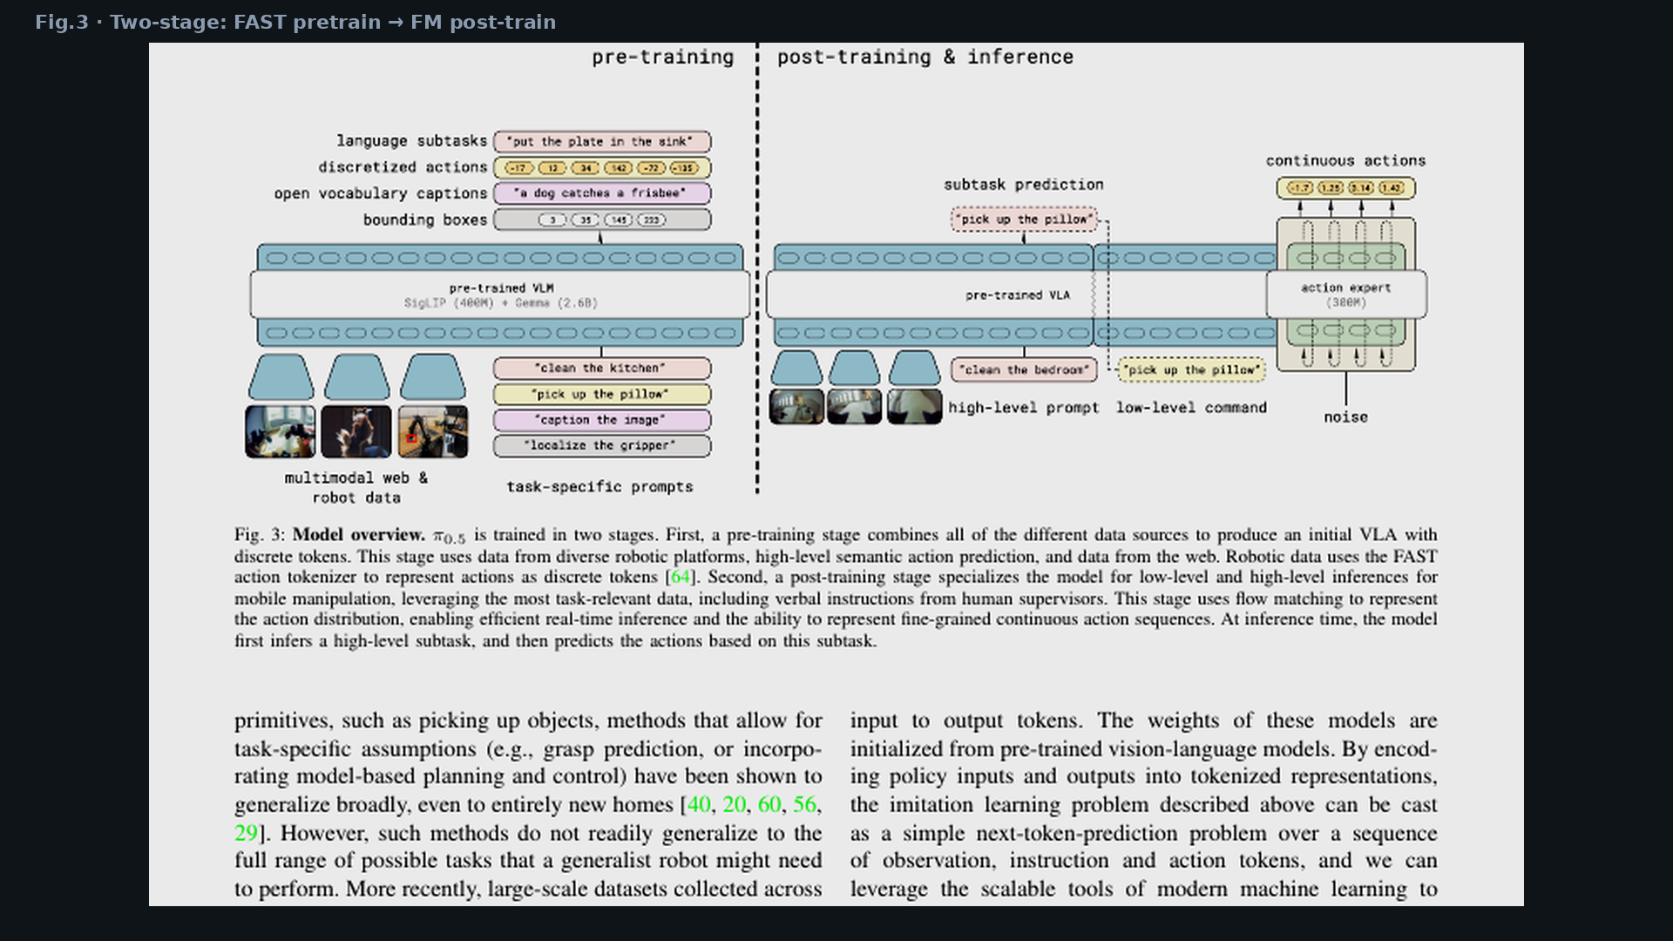
Visionary · 11+3 · 10/15
Notes:
PAPER FIG.3 — two-stage visual proof of hybrid claim.
Point: left = FAST discrete pretrain; right = FM action expert at post-train/infer.
Same model does HL subtask then LL continuous chunk.

Slide 11
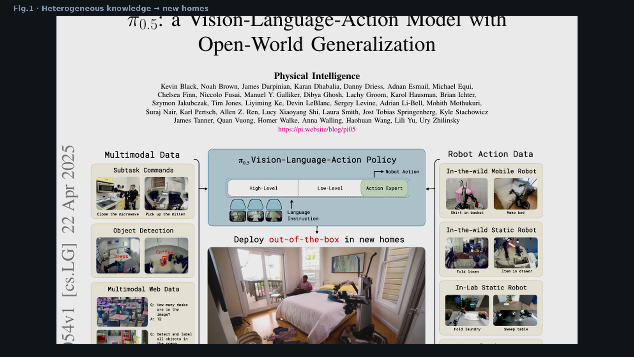
Visionary · 11+3 · 11/15
Notes:
PAPER FIG.1 — heterogeneous knowledge sources → deploy out-of-the-box in new homes.
10–15 min multi-stage behaviors claimed. This is the open-world vision slide.

Slide 12
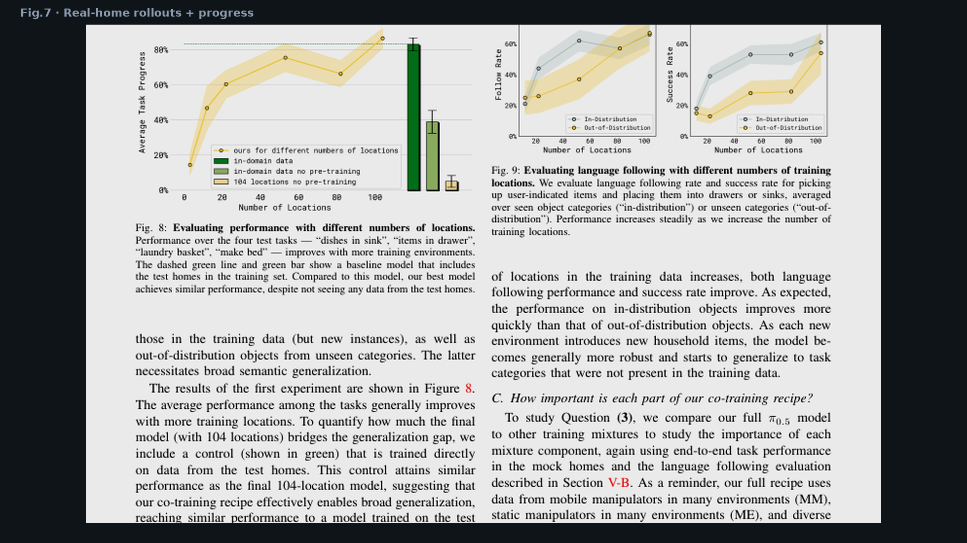
Visionary · 11+3 · 12/15
Notes:
PAPER FIG.7 — real-home quantitative progress. Unseen kitchens/bedrooms.
Use as existence proof that open-world KPI is measurable, then bridge to sim BEHAVIOR’26.

Slide 13
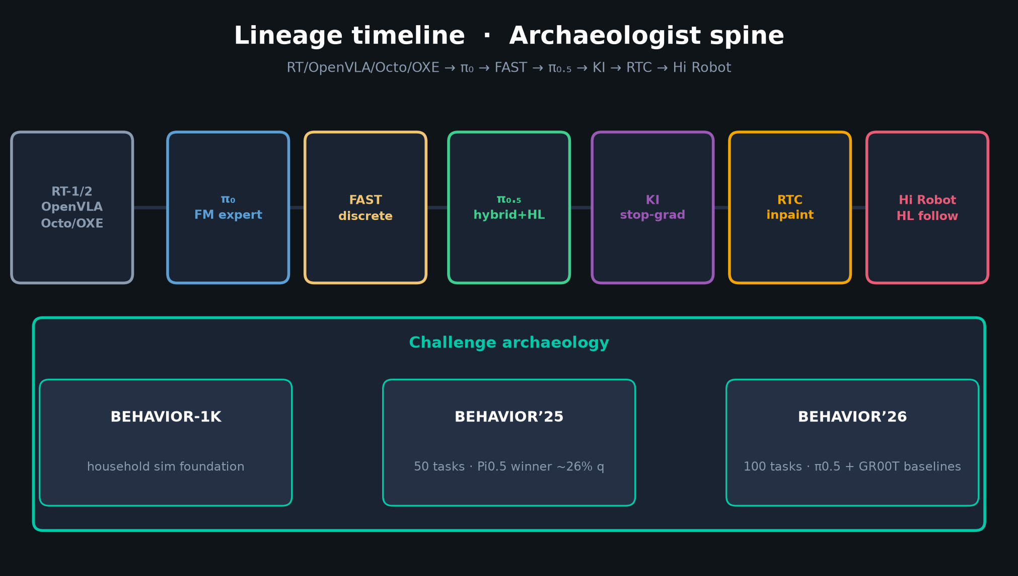
Visionary · 11+3 · 13/15
Notes:
LINEAGE BRIDGE — hand to Archaeologist if present; else 30s yourself.
RT/OpenVLA/Octo → π₀ → FAST → π₀.₅ → KI → RTC → Hi Robot.
BEHAVIOR-1K → ’25 (Pi0.5 winner) → ’26 (π0.5 baseline).

Slide 14
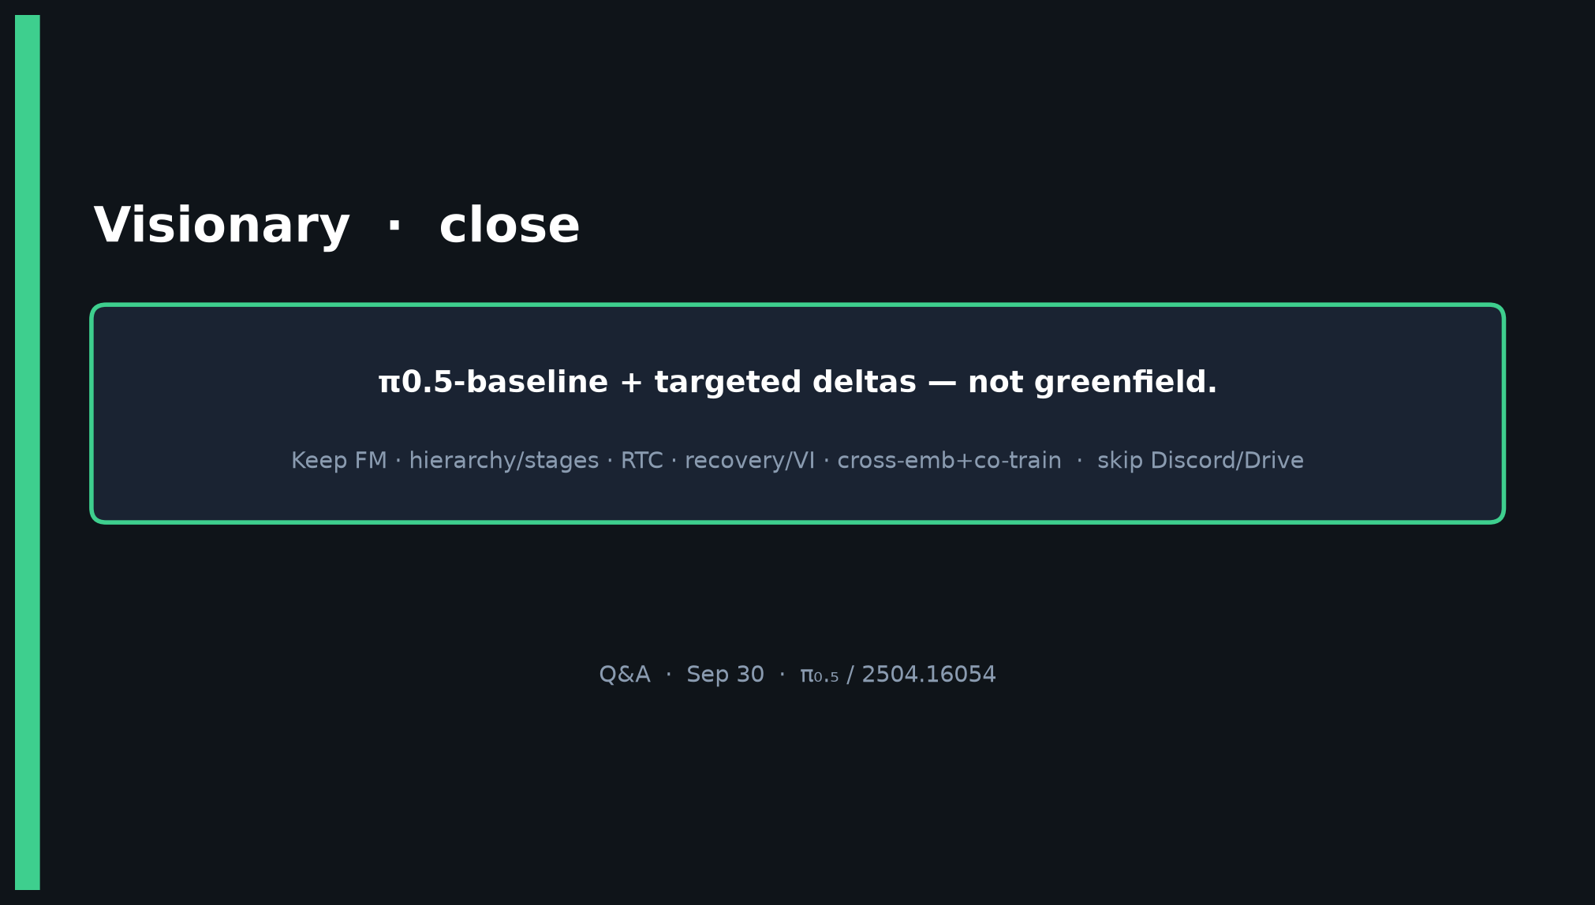
Visionary · 11+3 · 14/15
Notes:
CLOSE — seat 1 = Kanta.
π0.5-baseline + targeted deltas — not greenfield.
Keep FM · hierarchy/stages · RTC · recovery/VI · cross-emb+co-train.
Skip Discord/Drive. Q&A.

Slide 15
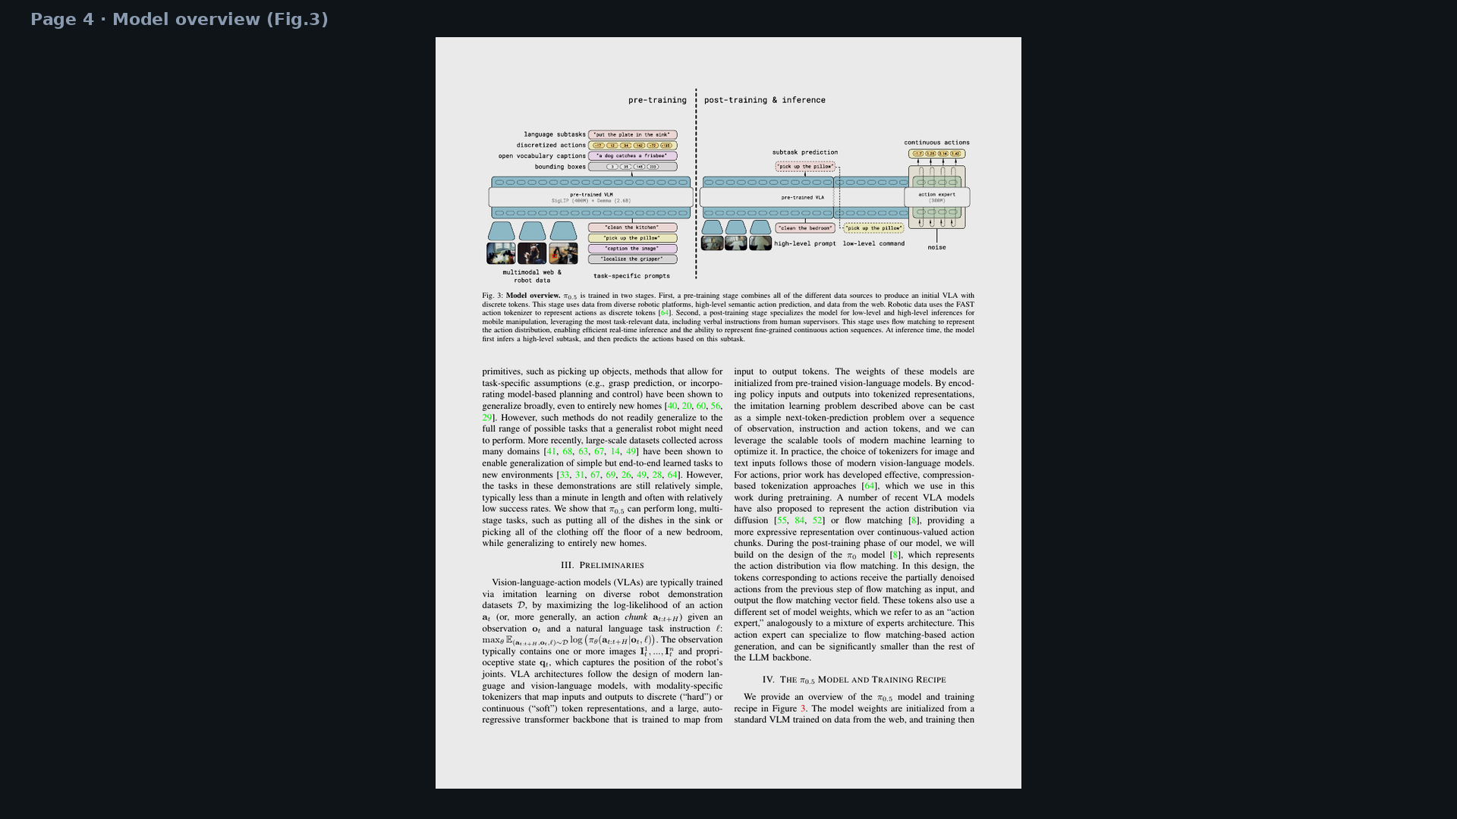
Visionary · 11+3 · 15/15
Notes:
BACKUP — full page 4 model overview if someone challenges hybrid claim.

