Slide 1
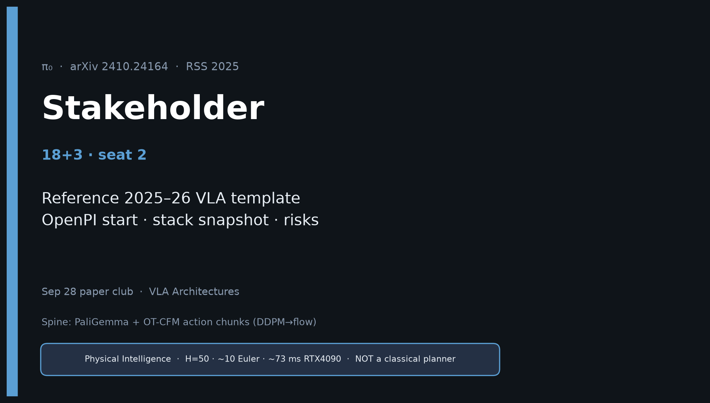
Stakeholder · 18+3 · 1/15
Notes:
STAKEHOLDER — seat 2 · 18+3.
You own: why π₀ is the reference 2025–26 VLA template for lab/product planning.
Do NOT redo Archaeologist’s full citation archaeology. Steal the club line once, then stay on value.
No Stakeholder redo later — this deck is the durable briefing.

Slide 2
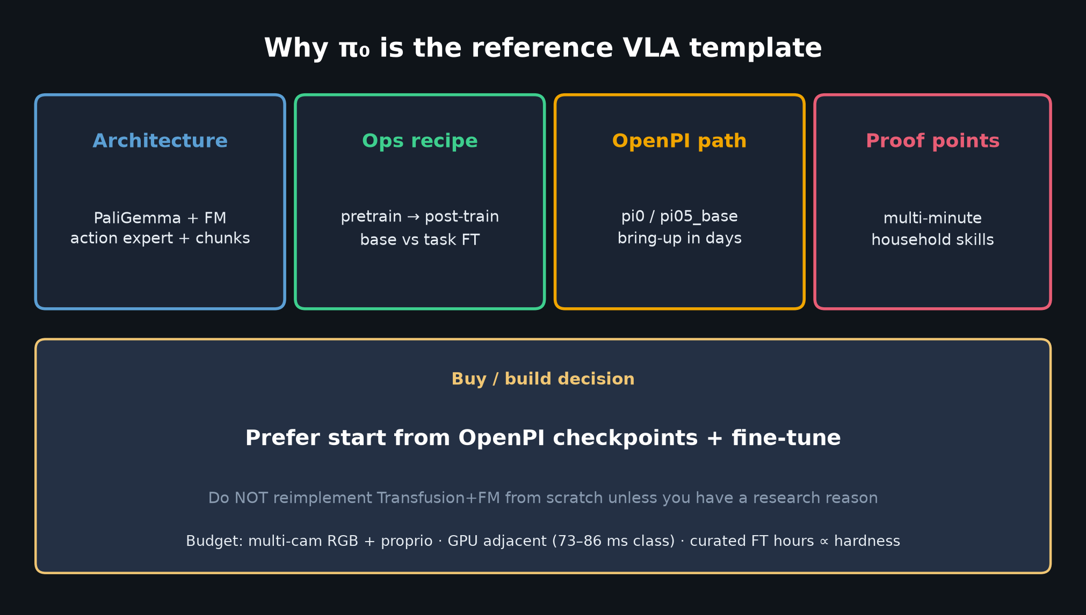
Stakeholder · 18+3 · 2/15
Notes:
VALUE CARDS — architecture template, ops recipe, OpenPI path, proof points.
Buy/build: start from OpenPI pi0 / pi05_base + FT. Do not reimplement from scratch.

Slide 3
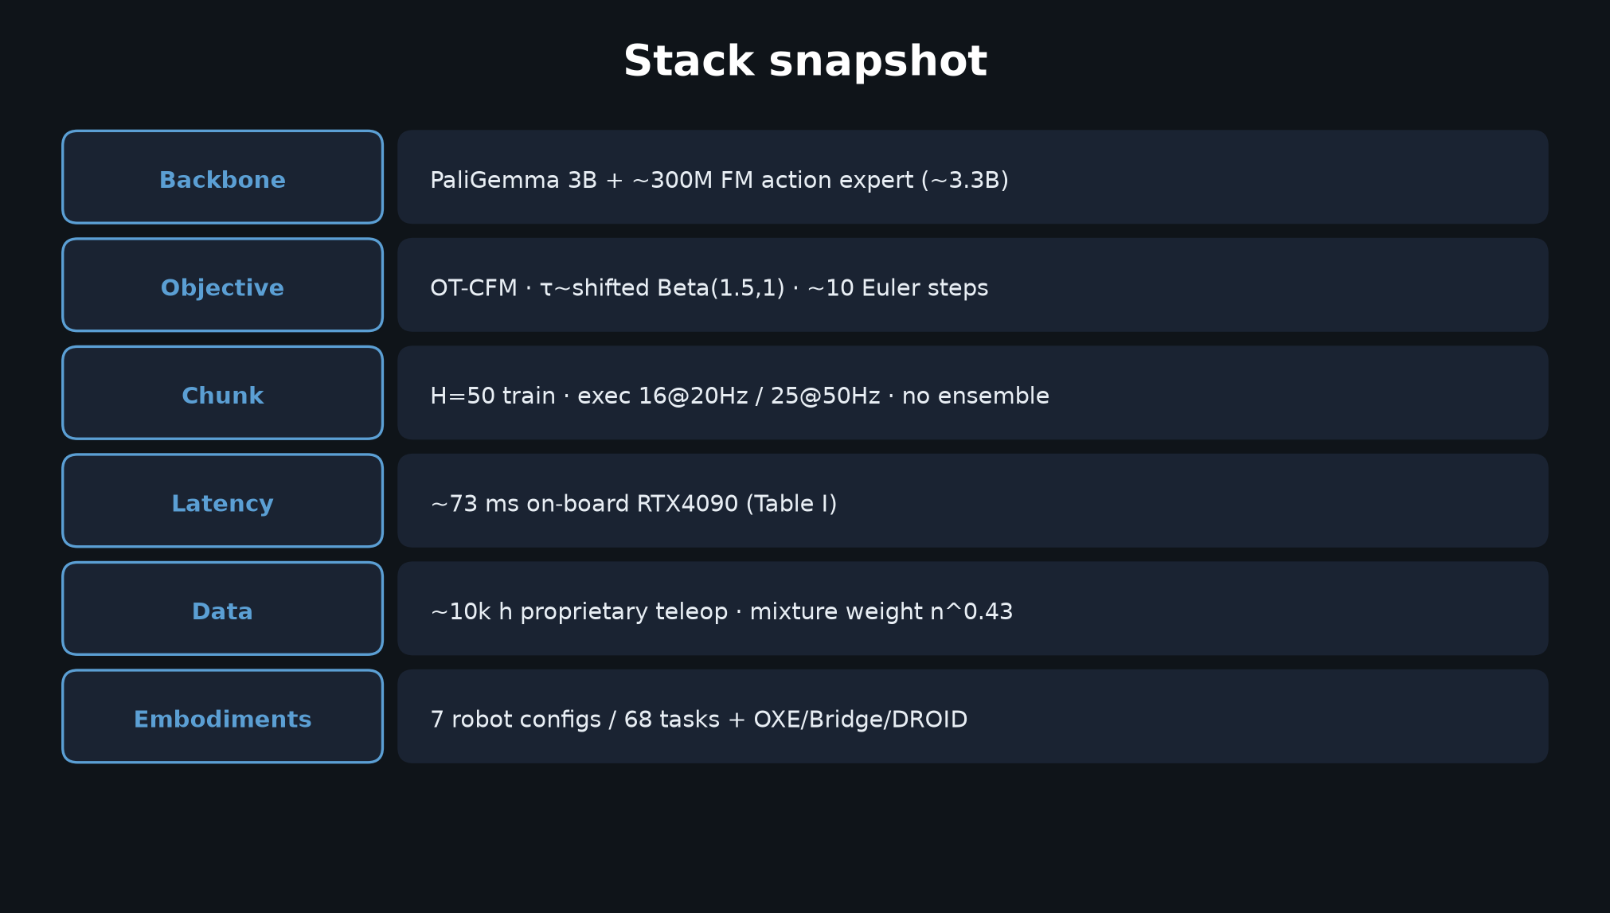
Stakeholder · 18+3 · 3/15
Notes:
STACK SNAPSHOT — numbers leadership remembers.
PaliGemma+300M expert · OT-CFM · H=50 · ~73 ms · ~10k h · 7 robots/68 tasks.

Slide 4
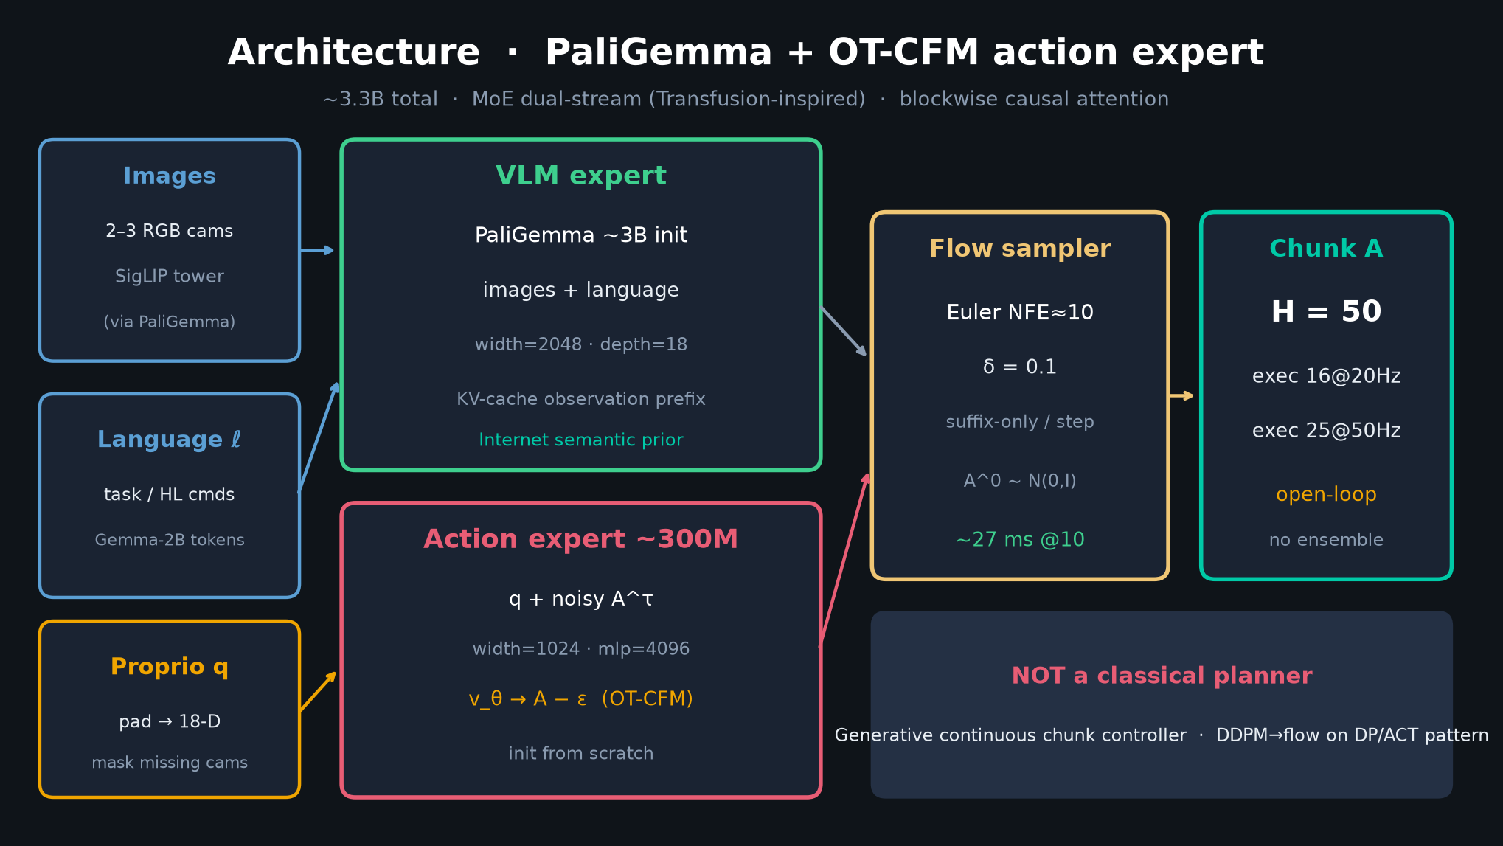
Stakeholder · 18+3 · 4/15
Notes:
ARCHITECTURE for non-specialists — VLM semantic prior + action expert → chunks.
NOT a classical planner banner is intentional for leadership.

Slide 5
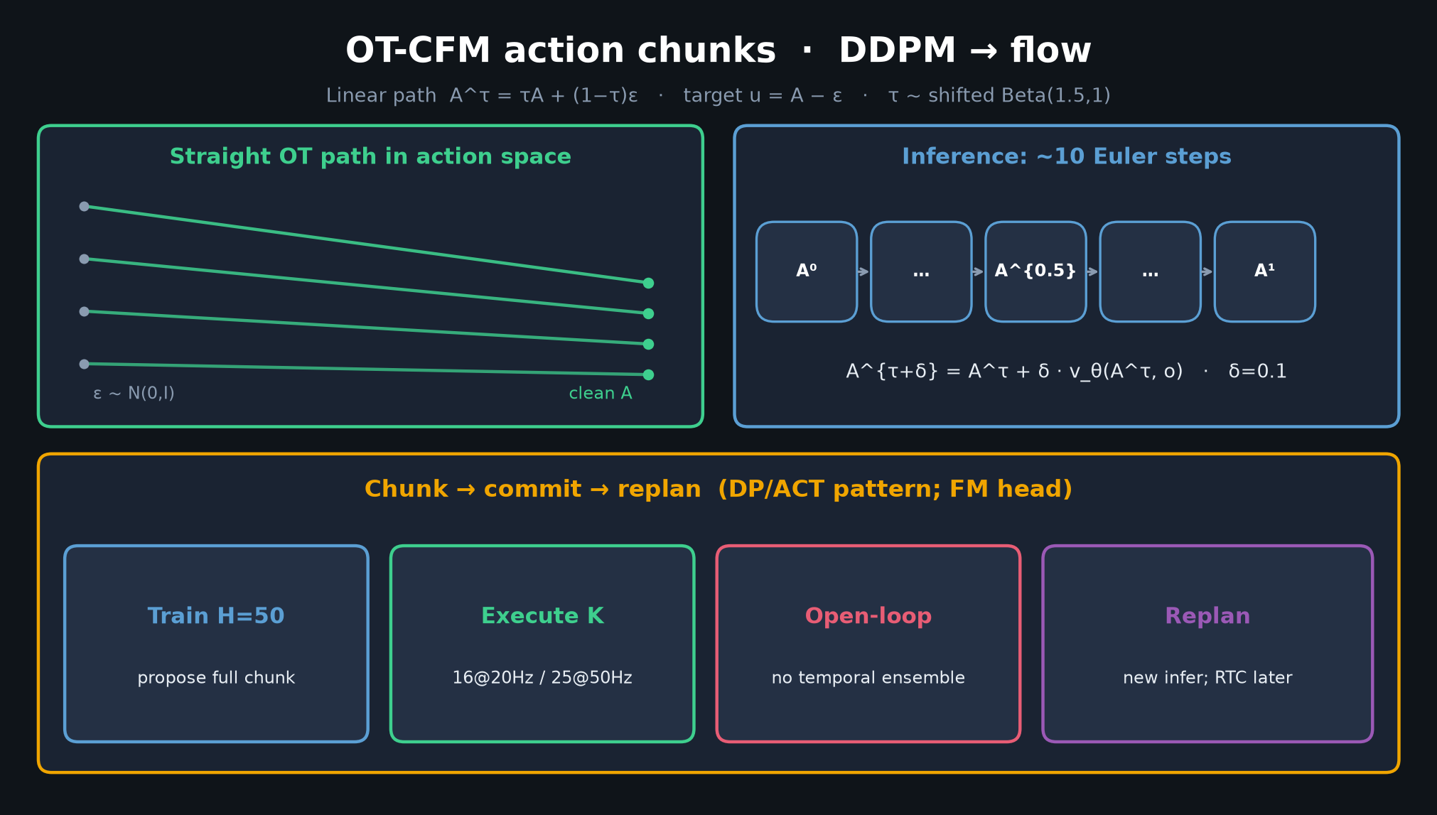
Stakeholder · 18+3 · 5/15
Notes:
CONTROL SPINE — chunk → commit → replan. OpenPI/BEHAVIOR still assume this.

Slide 6
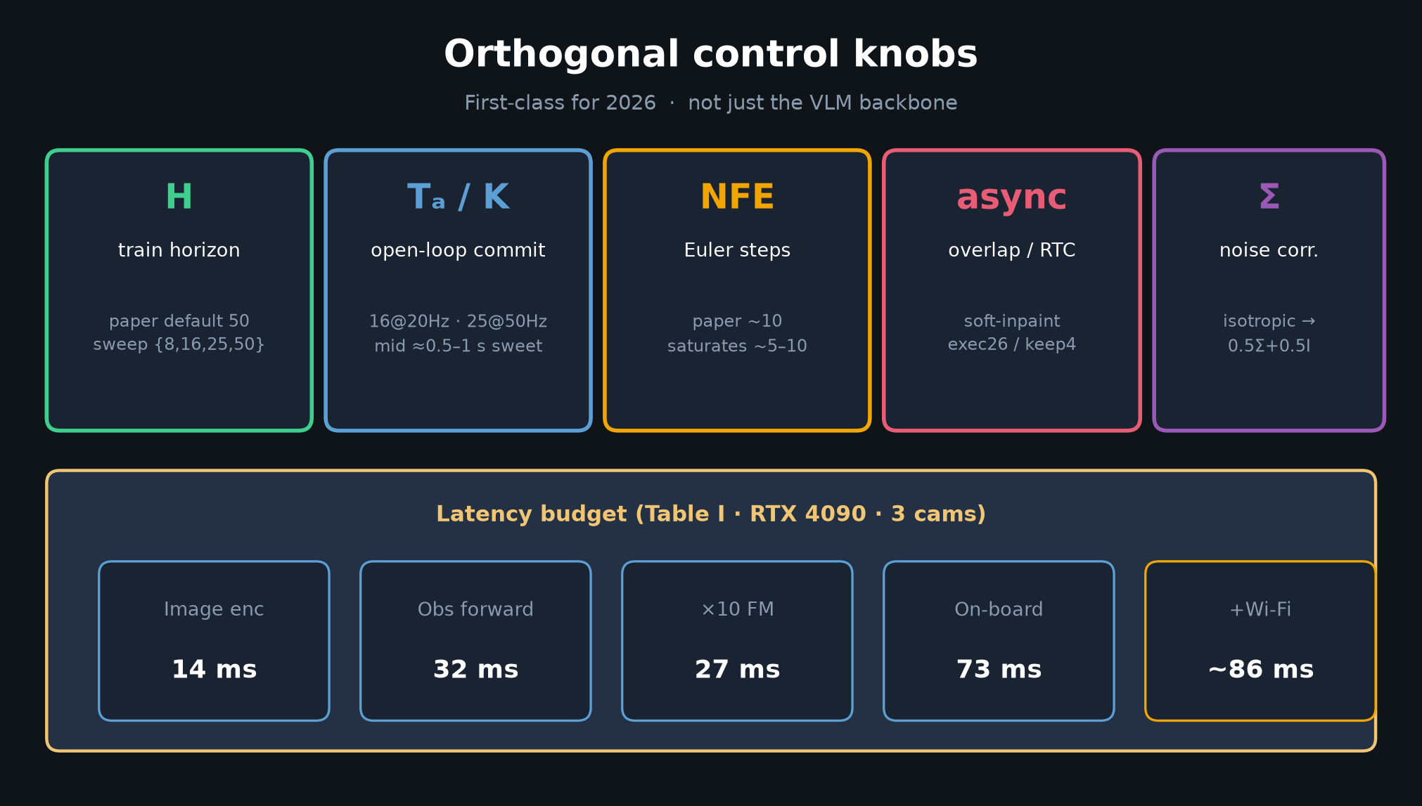
Stakeholder · 18+3 · 6/15
Notes:
KNOBS + LATENCY — budget multi-cam + 73–86 ms class GPU adjacent to robot.

Slide 7
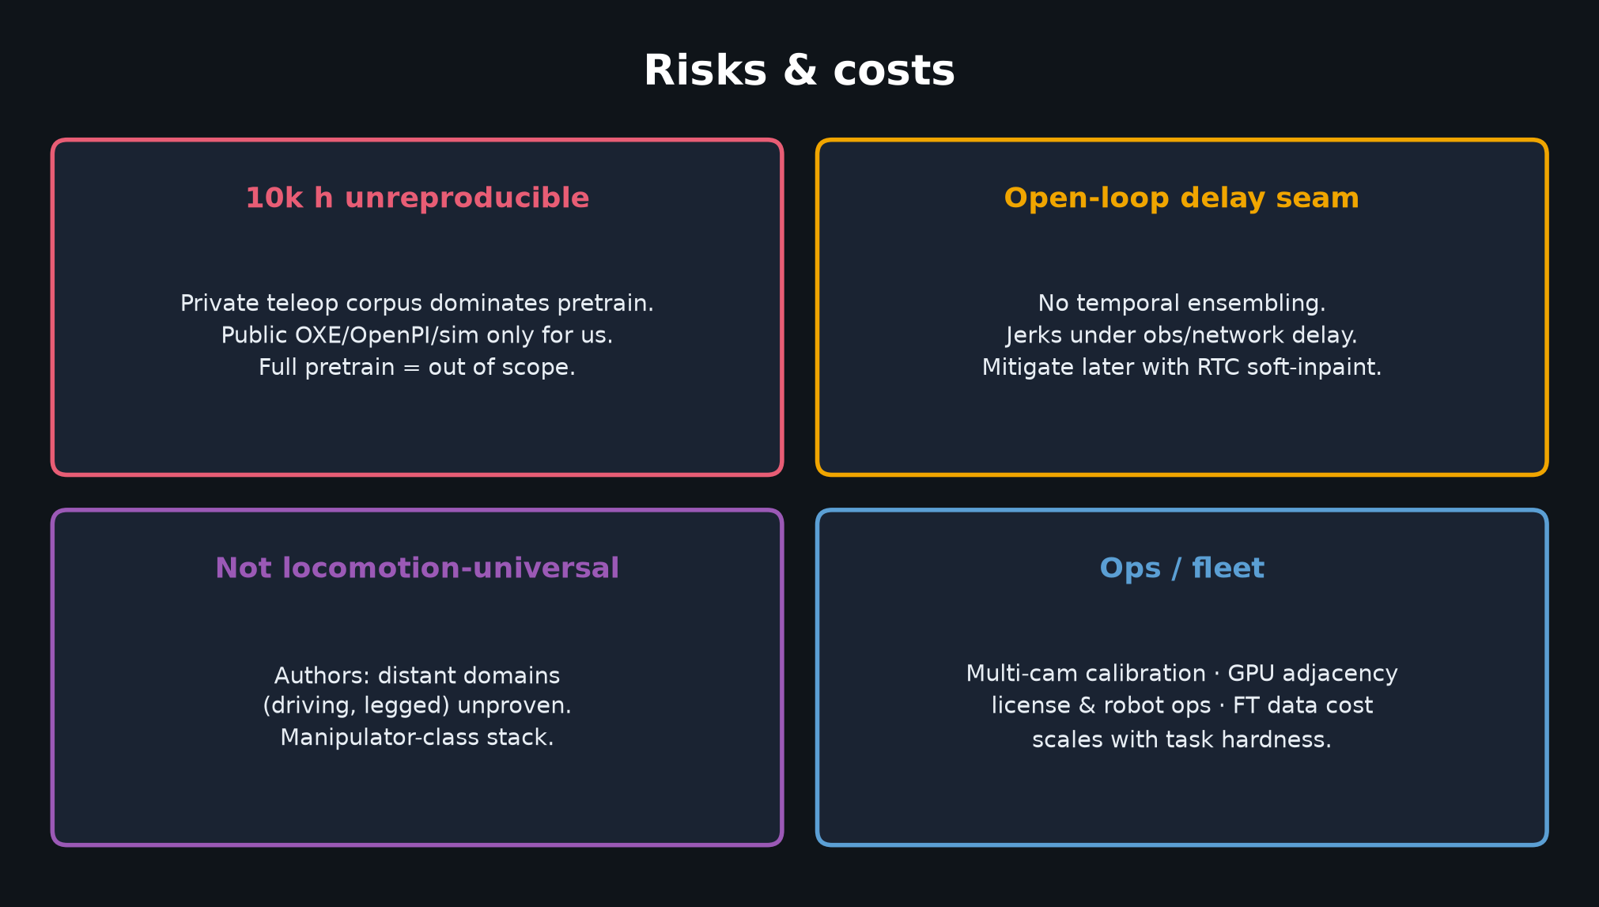
Stakeholder · 18+3 · 7/15
Notes:
RISKS — 10k h unreproducible; open-loop delay seam; not locomotion-universal; fleet ops.
Say risks aloud; do not soft-pedal private data.

Slide 8
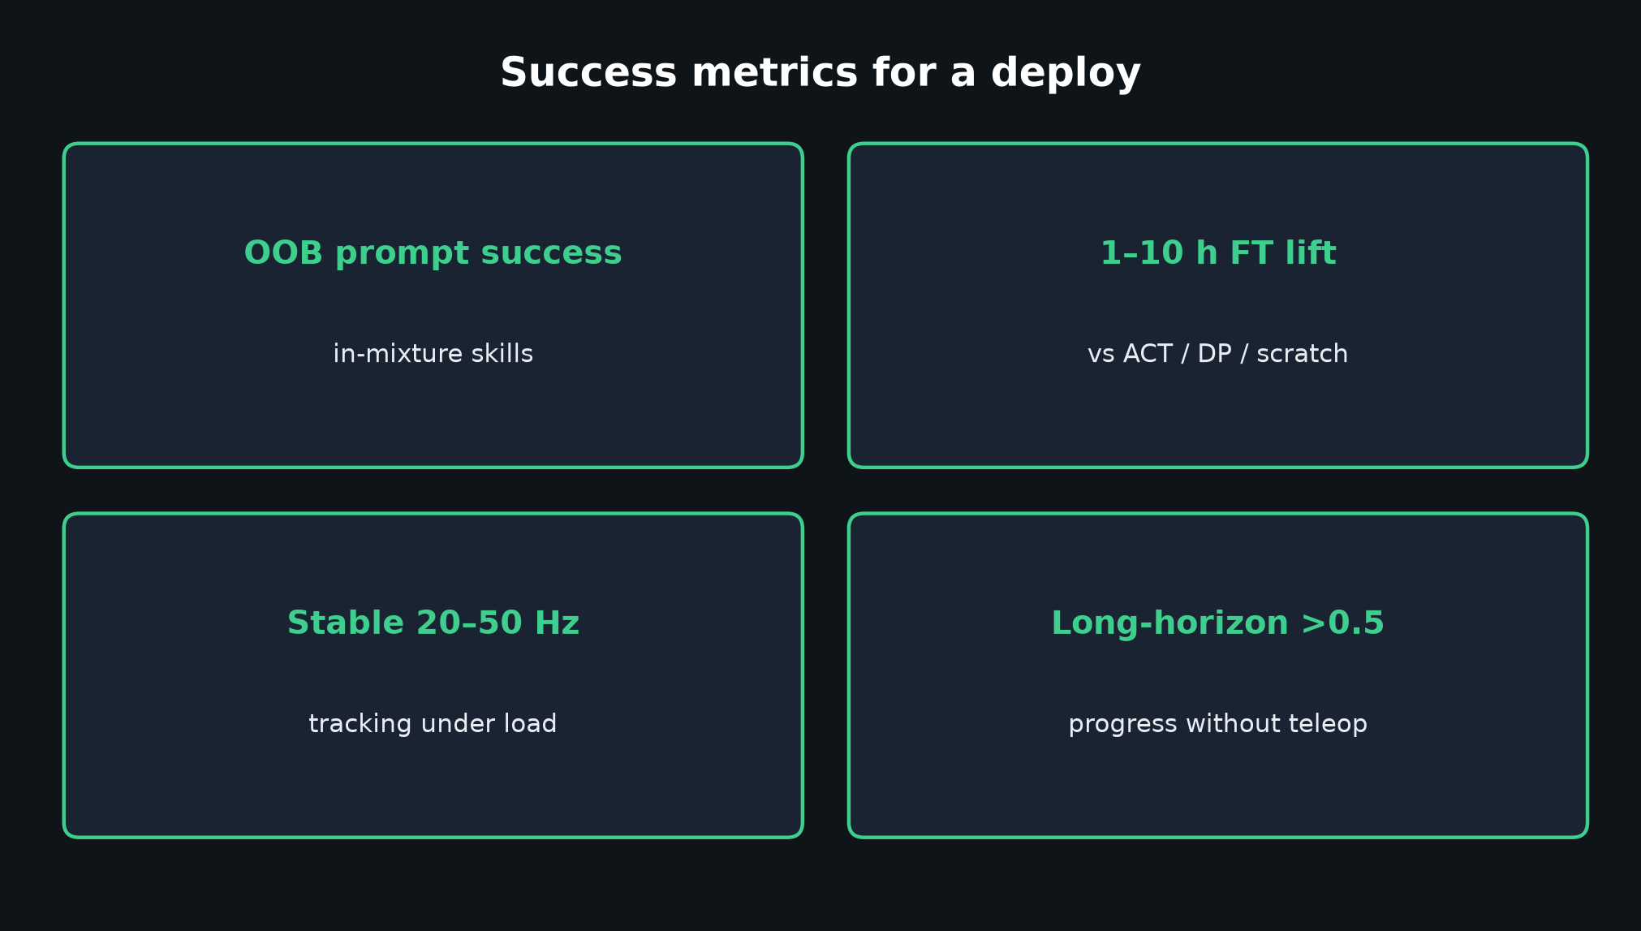
Stakeholder · 18+3 · 8/15
Notes:
SUCCESS METRICS for a deploy program.

Slide 9
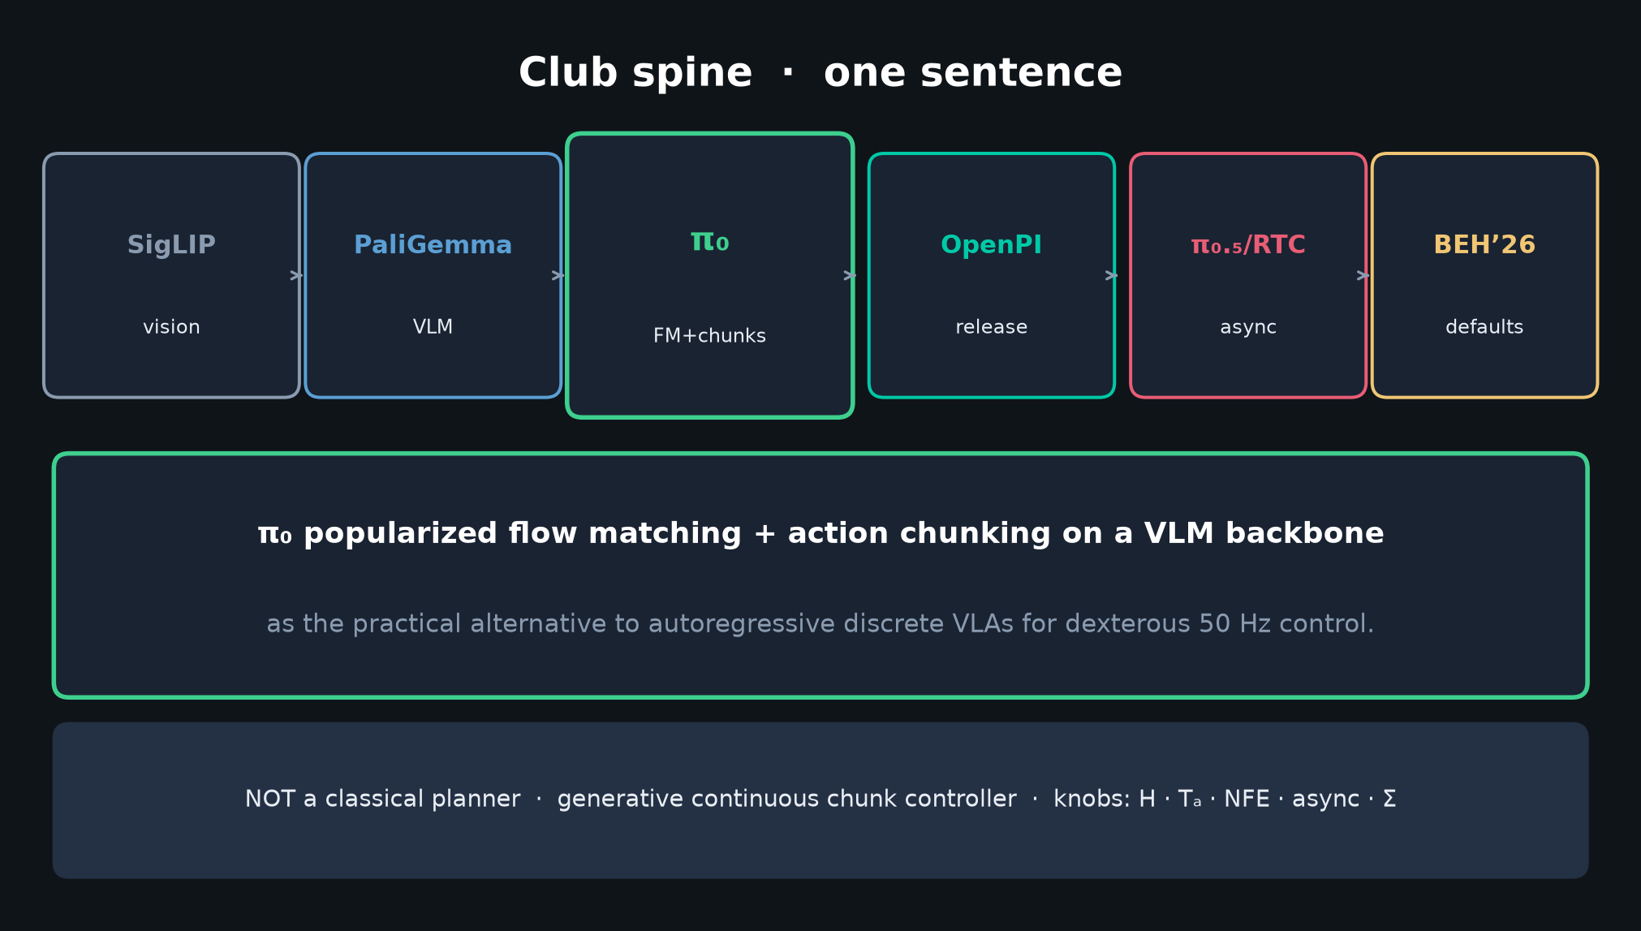
Stakeholder · 18+3 · 9/15
Notes:
CLUB LINE compressed — strategic dependency into OpenPI / BEHAVIOR without claiming you train DP.

Slide 10
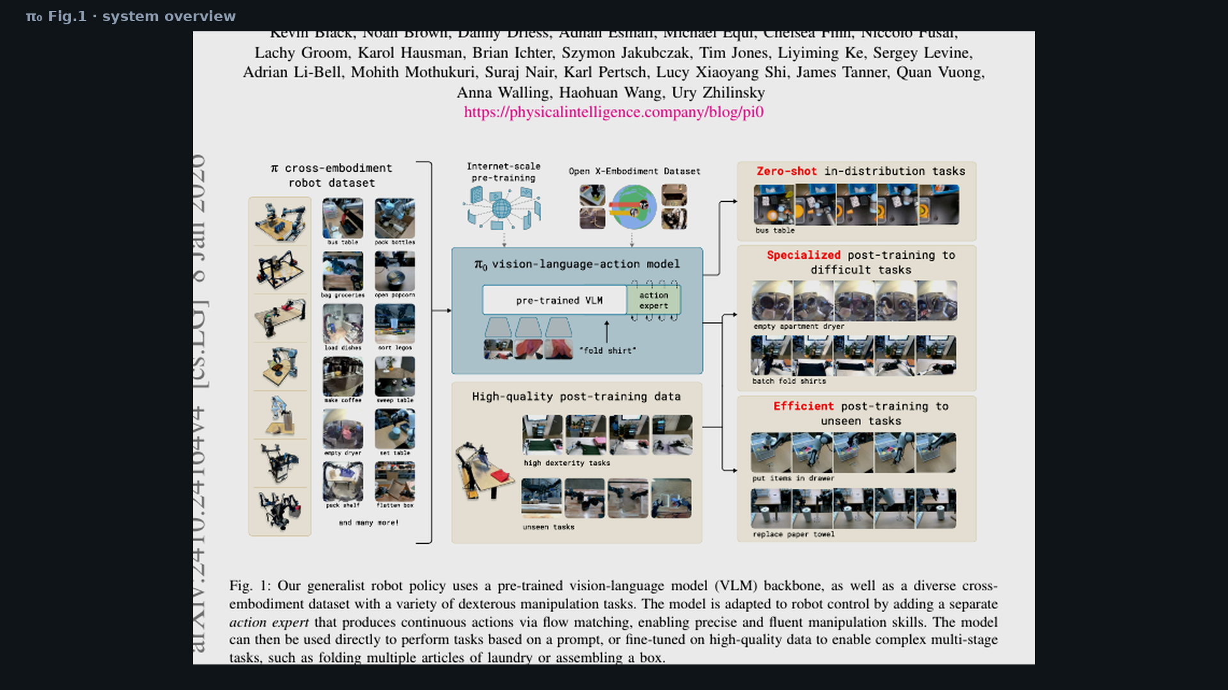
Stakeholder · 18+3 · 10/15
Notes:
PAPER FIG 1 — show the original system diagram so leadership sees it is not your invention.

Slide 11
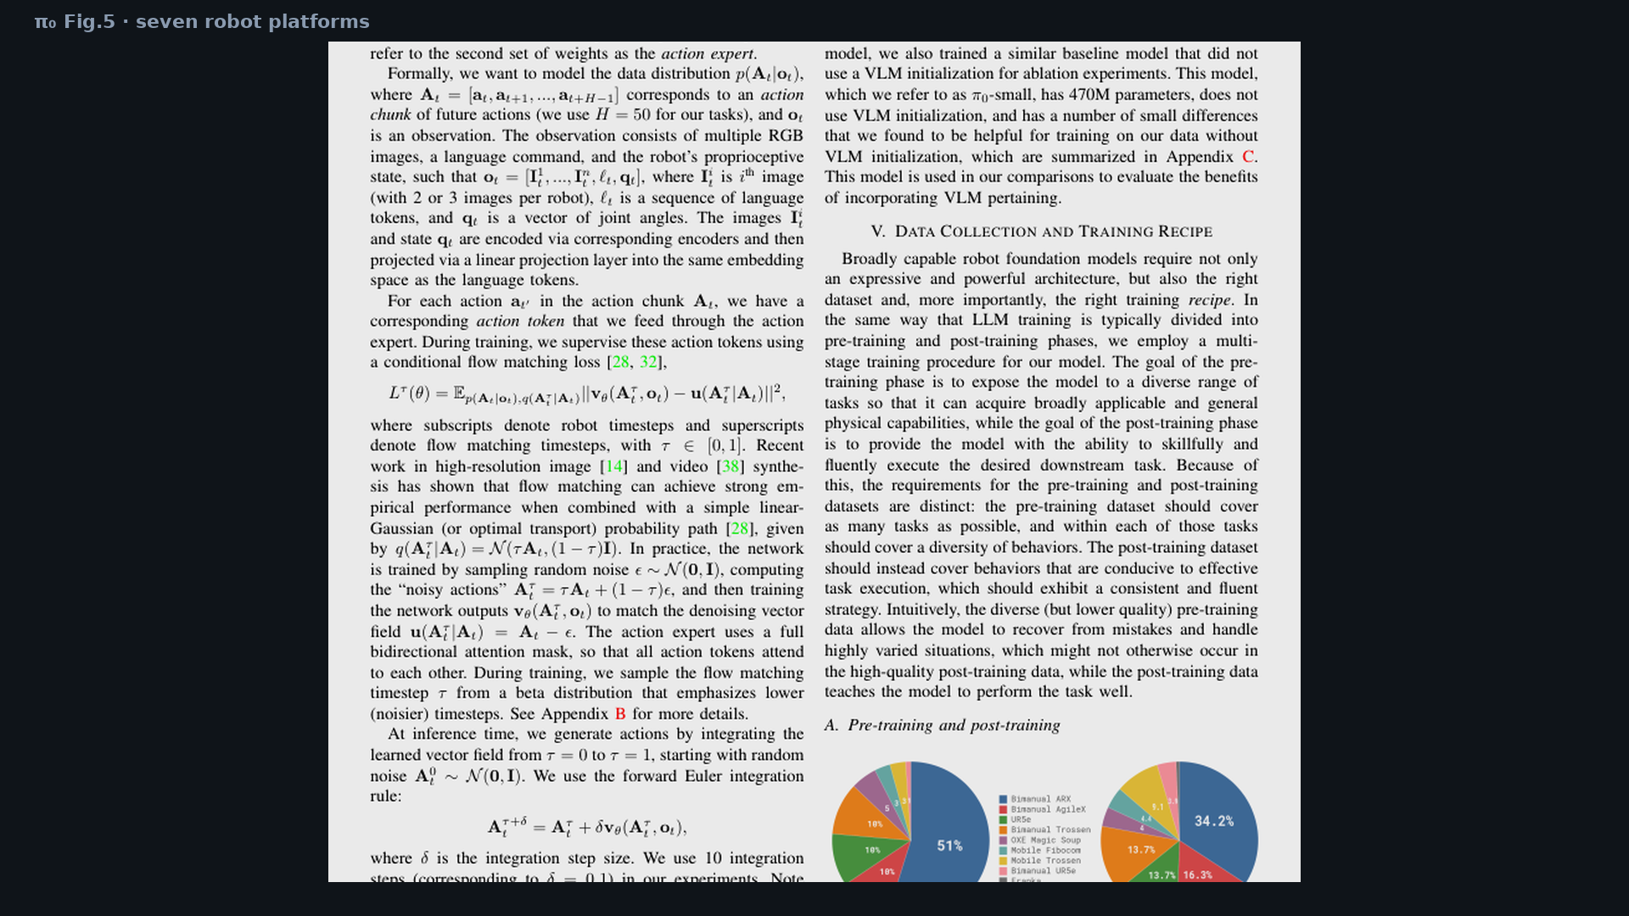
Stakeholder · 18+3 · 11/15
Notes:
PAPER FIG 5 — seven platforms = product breadth claim.

Slide 12
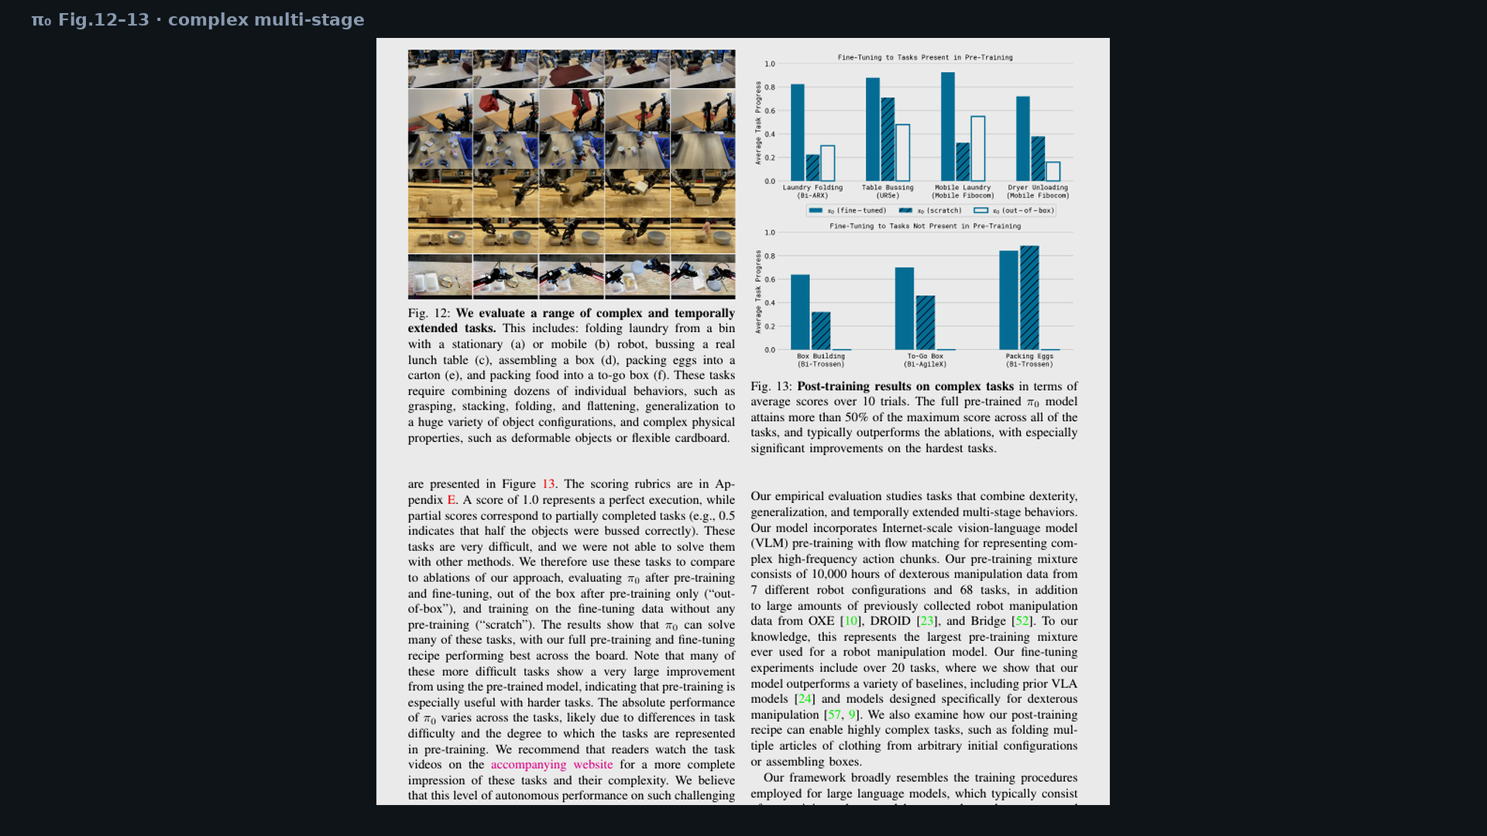
Stakeholder · 18+3 · 12/15
Notes:
PAPER FIG 12–13 — multi-minute household skills that prior open VLAs did not show.

Slide 13
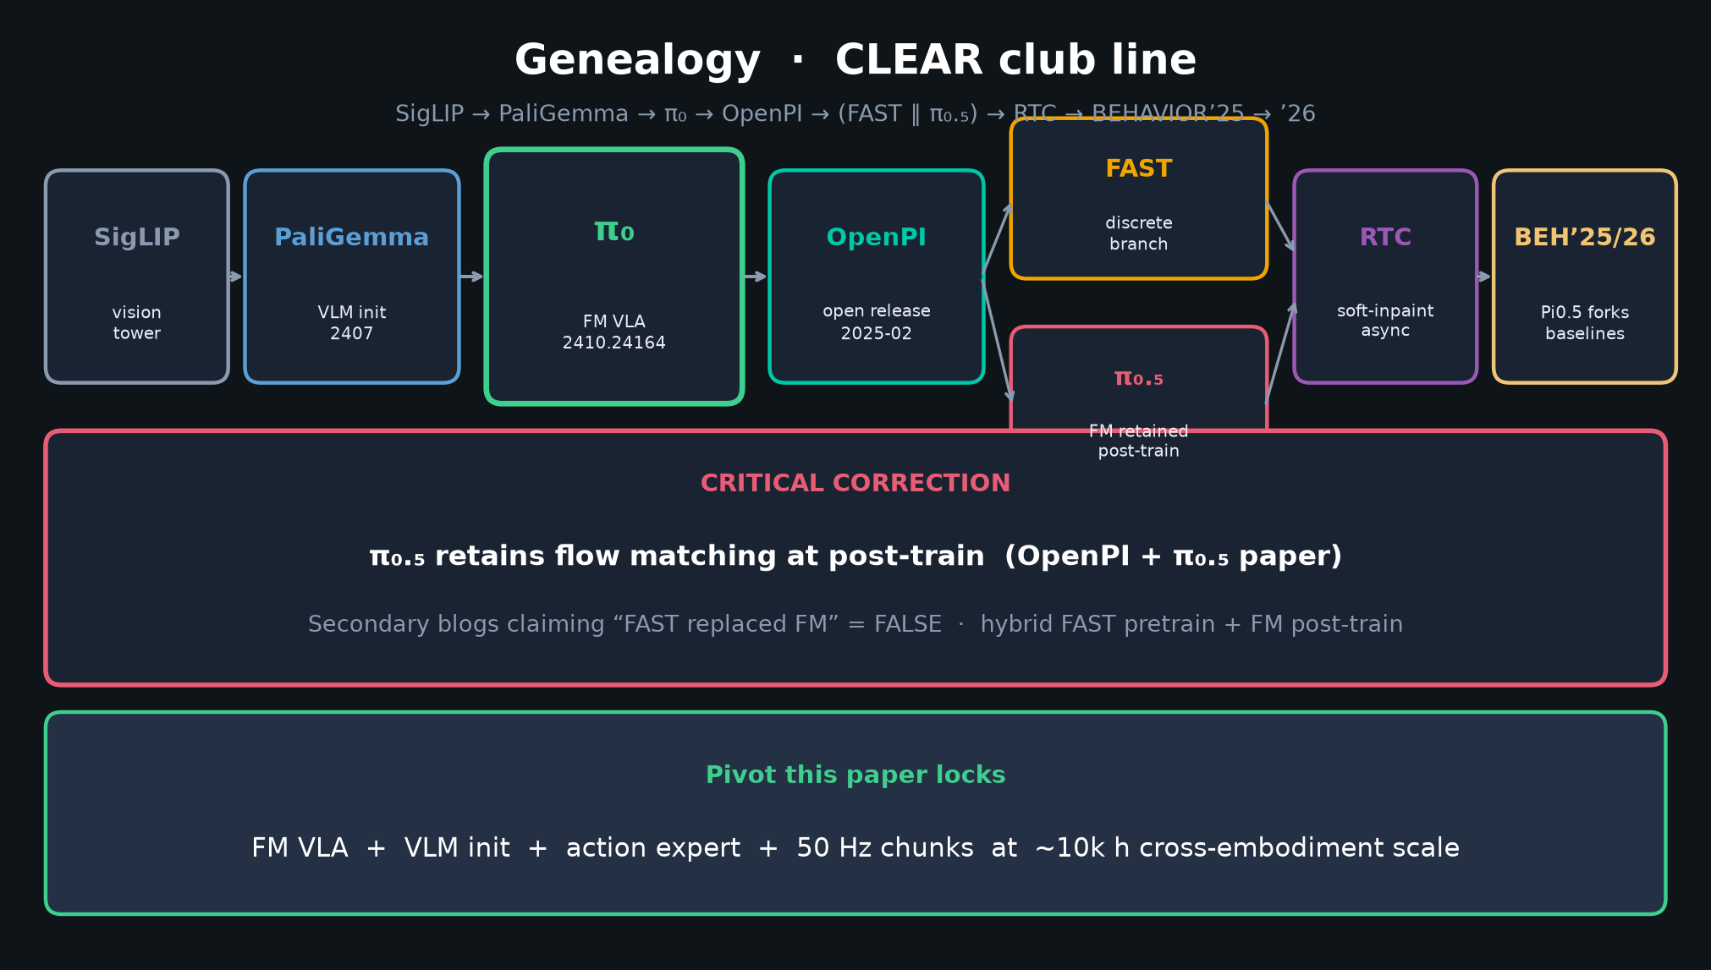
Stakeholder · 18+3 · 13/15
Notes:
GENEALOGY glance — where OpenPI / π₀.₅ / RTC sit for roadmap bets.

Slide 14
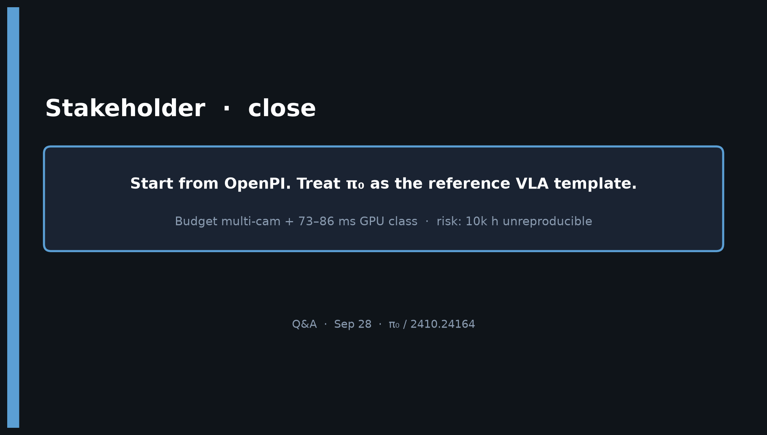
Stakeholder · 18+3 · 14/15
Notes:
CLOSE — Start from OpenPI. Treat π₀ as reference template. Hand risks to Reviewer/Empiricist.

Slide 15
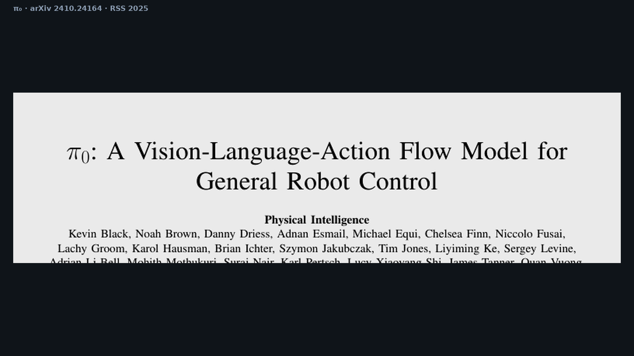
Stakeholder · 18+3 · 15/15
Notes:
Backup cover.

