Slide 1

Scientific Reviewer · 8+3 · 1/10
Notes:
SCIENTIFIC REVIEWER — seat 4 · 8+3. Short talk.
Strengths → weaknesses → verdict. Cite figures carefully.

Slide 2
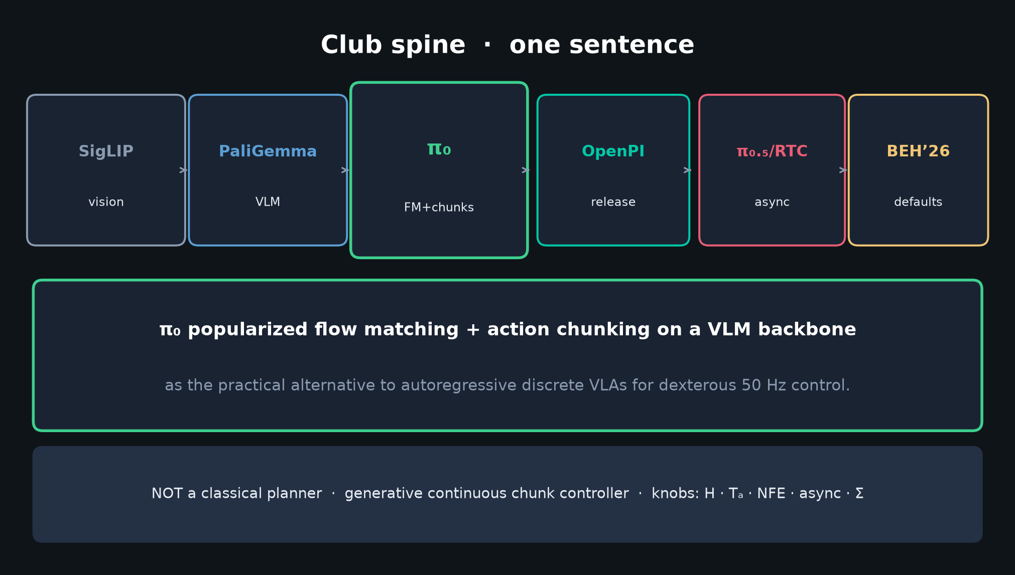
Scientific Reviewer · 8+3 · 2/10
Notes:
CLAIM UNDER REVIEW (say once):
A flow-matching VLA on PaliGemma, with large cross-embodiment pretrain + curated post-train, yields generalist control exceeding prior VLAs and specialized imitation on dexterous/long-horizon real tasks.

Slide 3
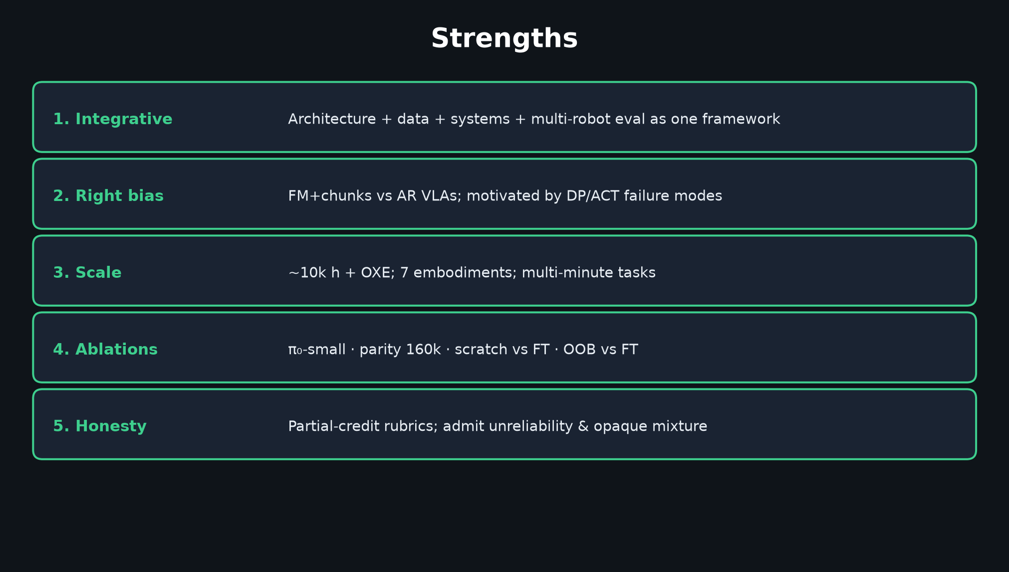
Scientific Reviewer · 8+3 · 3/10
Notes:
STRENGTHS (60–90s). Integrative clarity; right inductive bias; scale; ablations; honesty.

Slide 4
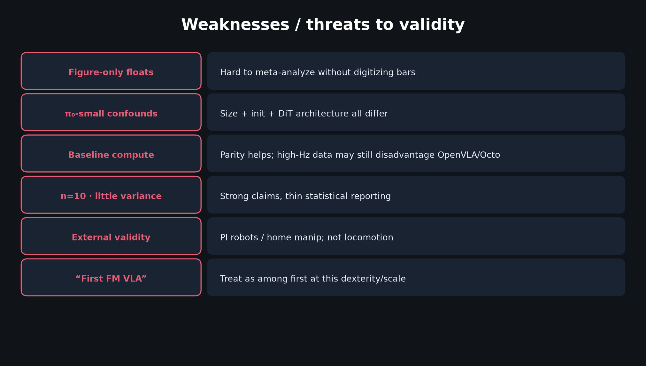
Scientific Reviewer · 8+3 · 4/10
Notes:
WEAKNESSES — figure-only floats; π₀-small confounds; baseline compute; n=10; external validity; priority claim hygiene.

Slide 5
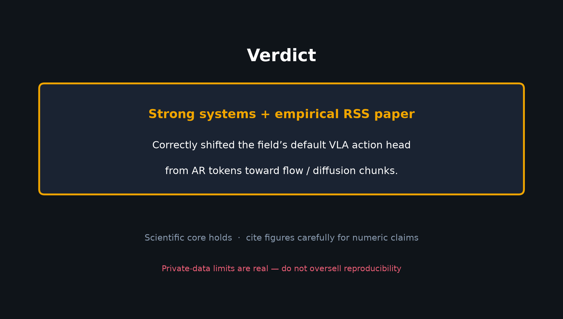
Scientific Reviewer · 8+3 · 5/10
Notes:
VERDICT slide — strong systems+empirical RSS; shifted field to flow/diffusion chunks.
Private-data limits honest.

Slide 6
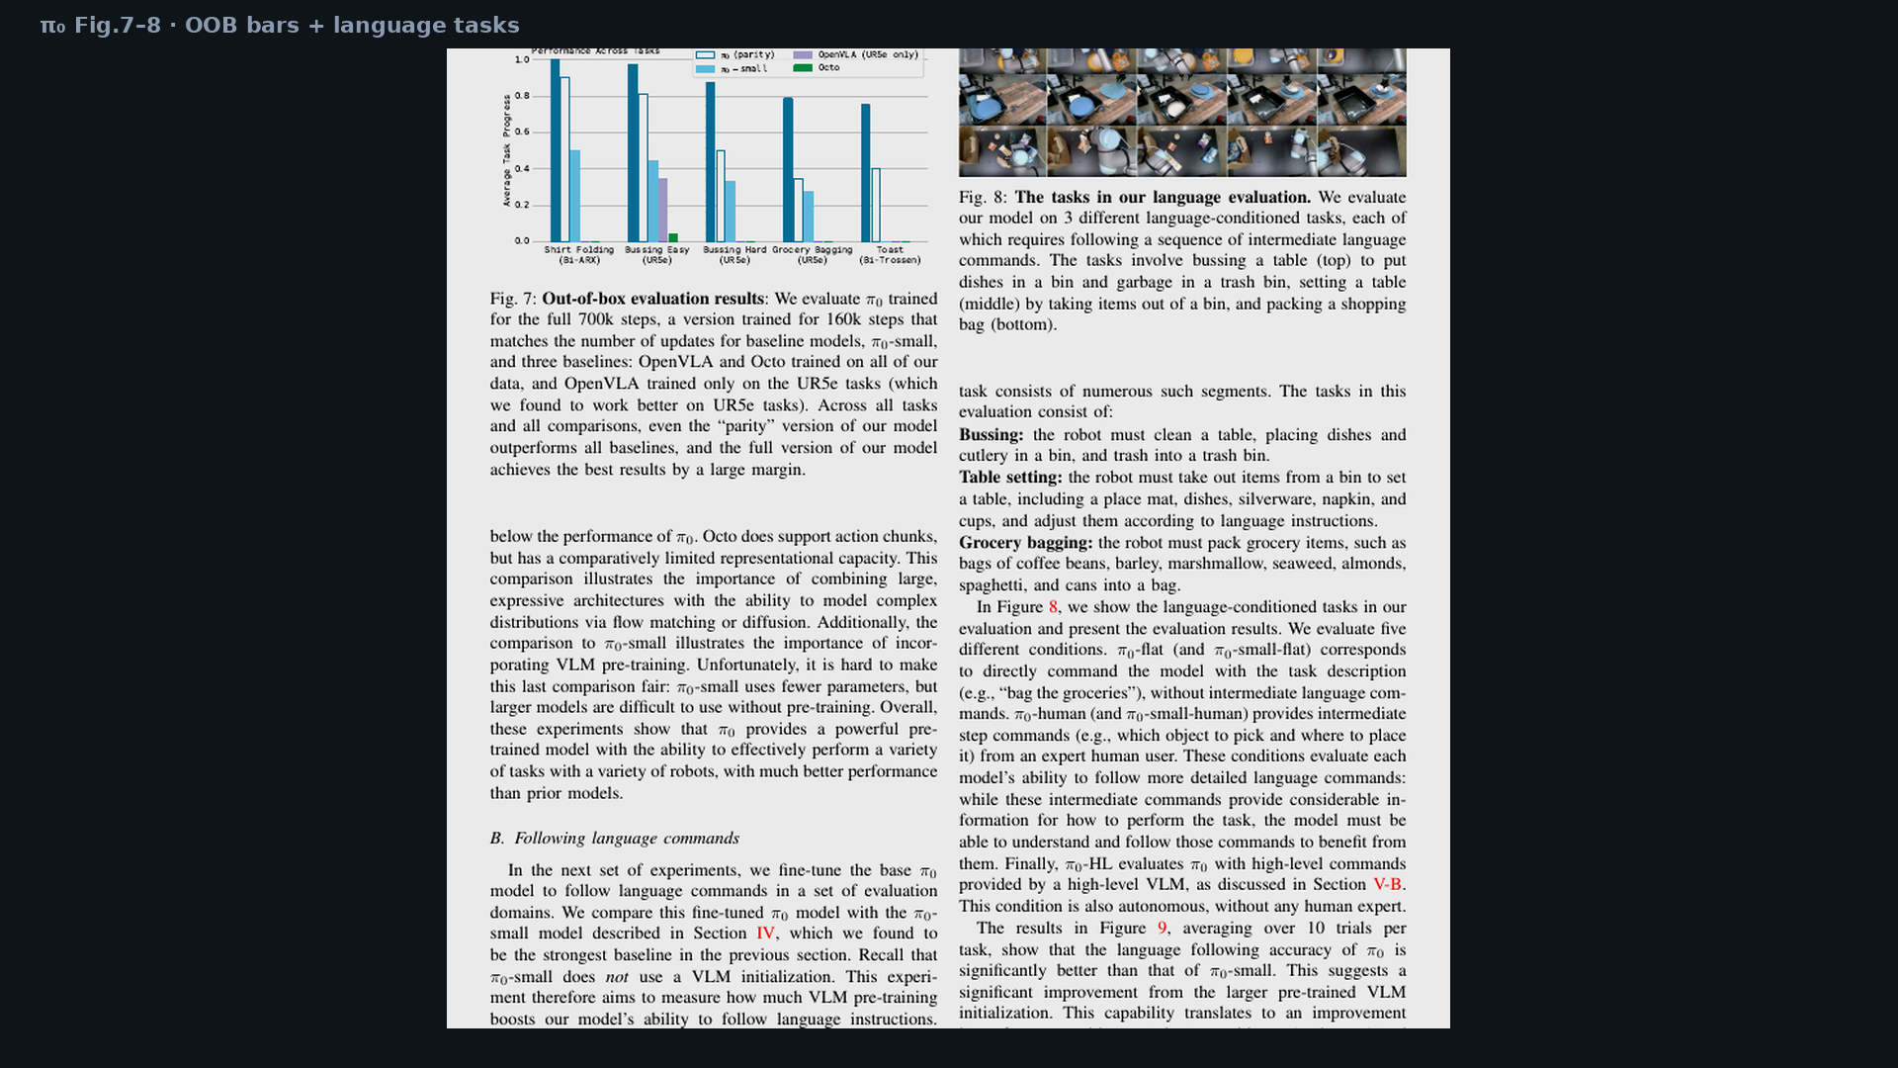
Scientific Reviewer · 8+3 · 6/10
Notes:
Fig.7 — when you say “cite figures carefully,” gesture here for OOB magnitudes.

Slide 7
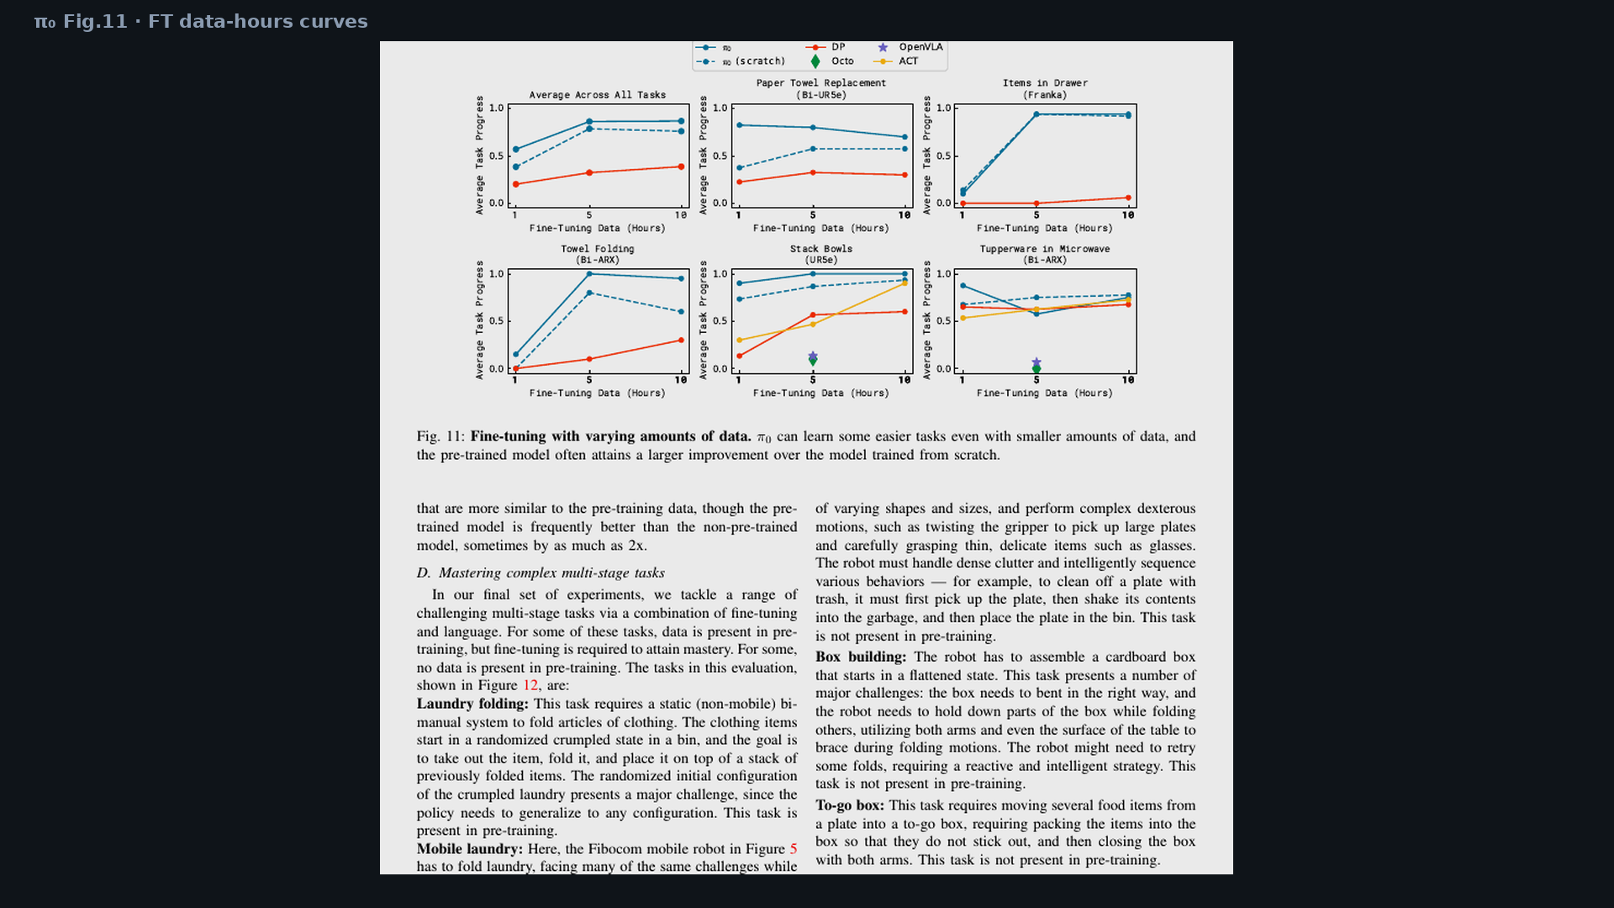
Scientific Reviewer · 8+3 · 7/10
Notes:
Fig.11 — FT scaling; pretrain helps low-data / similar tasks.

Slide 8
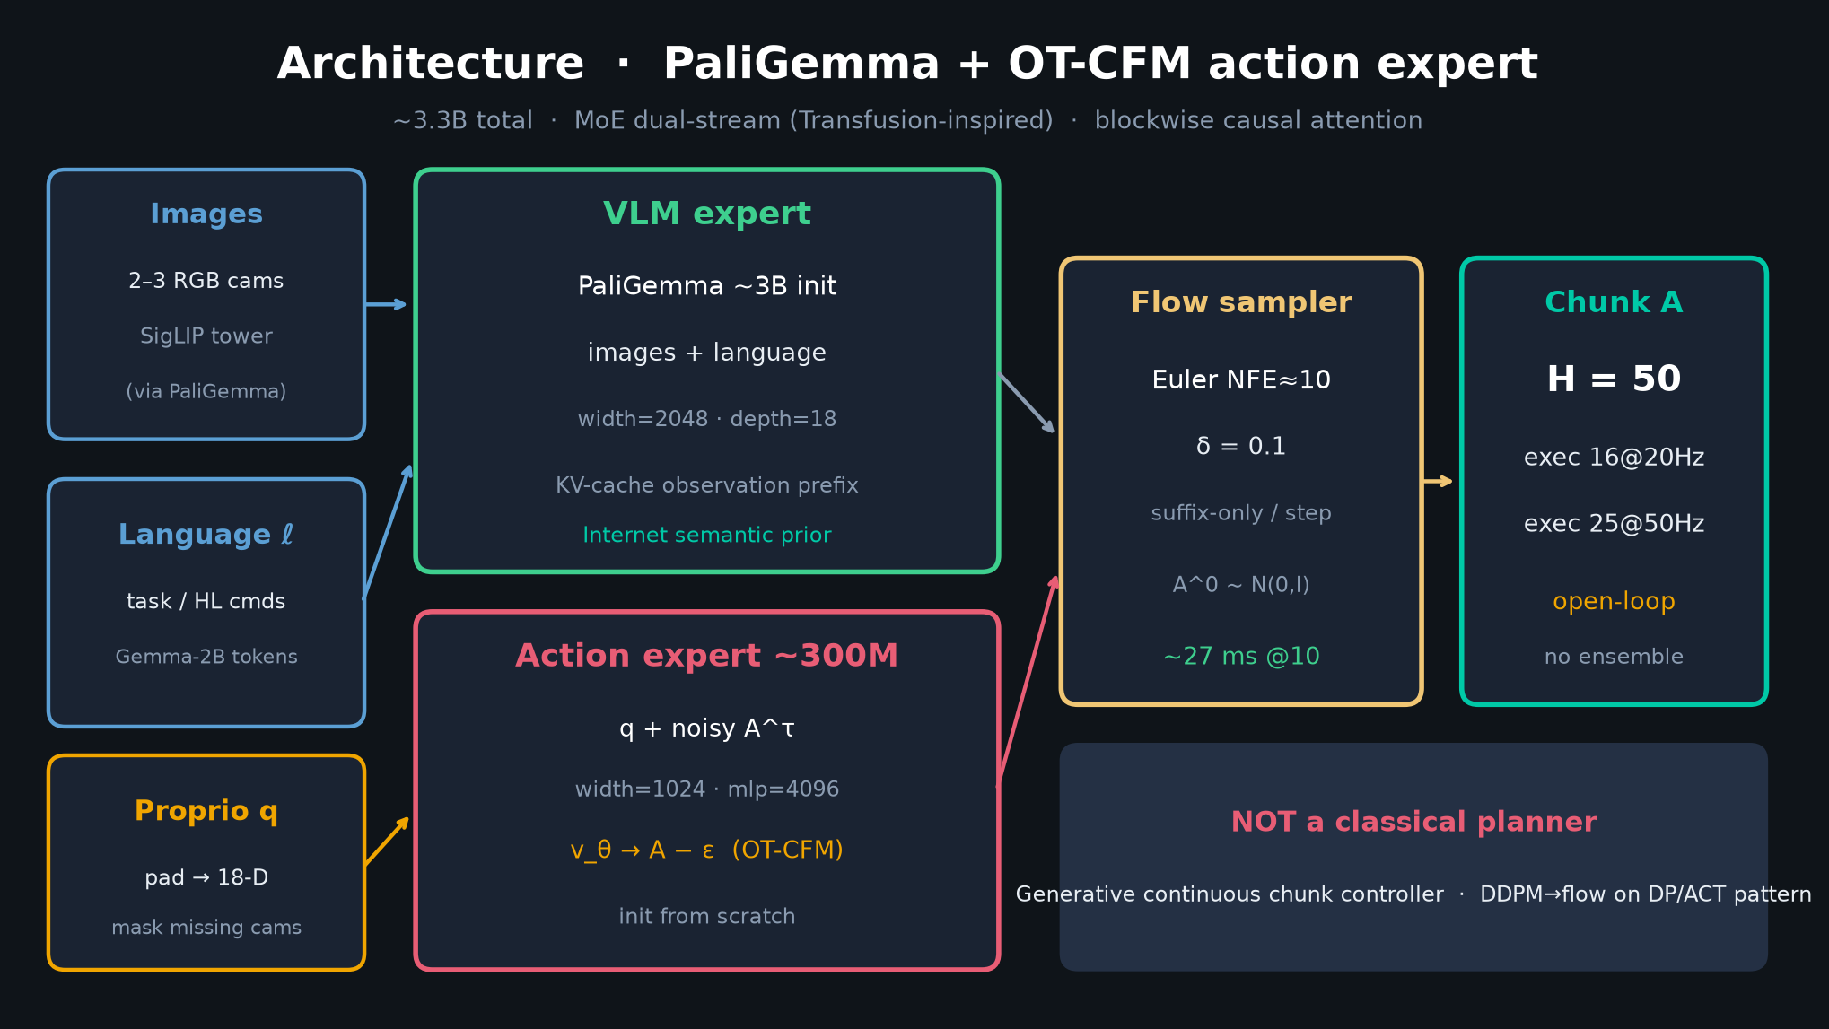
Scientific Reviewer · 8+3 · 8/10
Notes:
Architecture — isolate what is systems contribution vs priority marketing.

Slide 9
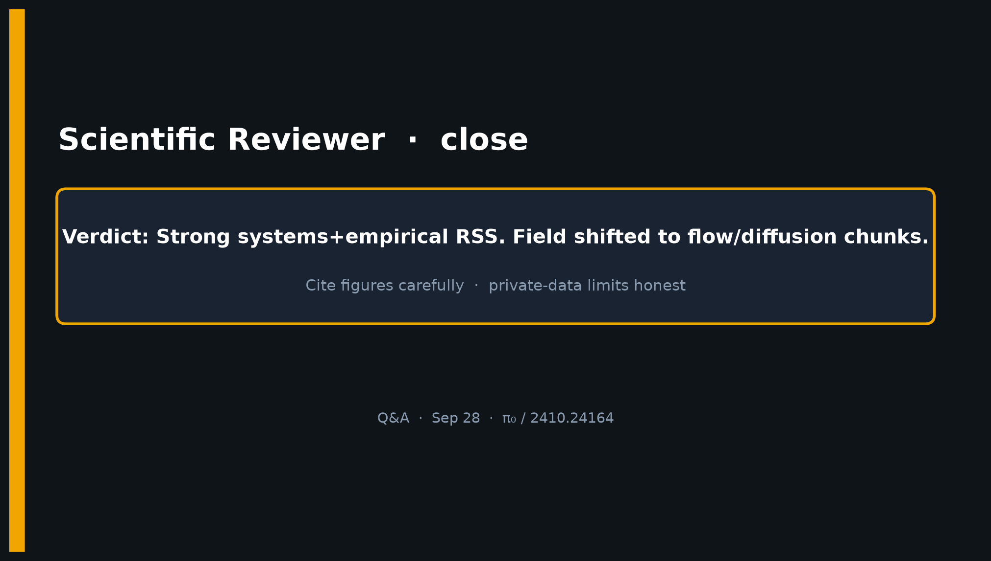
Scientific Reviewer · 8+3 · 9/10
Notes:
CLOSE / Q&A — scientific core holds; demand hygiene on numeric reuse.

Slide 10
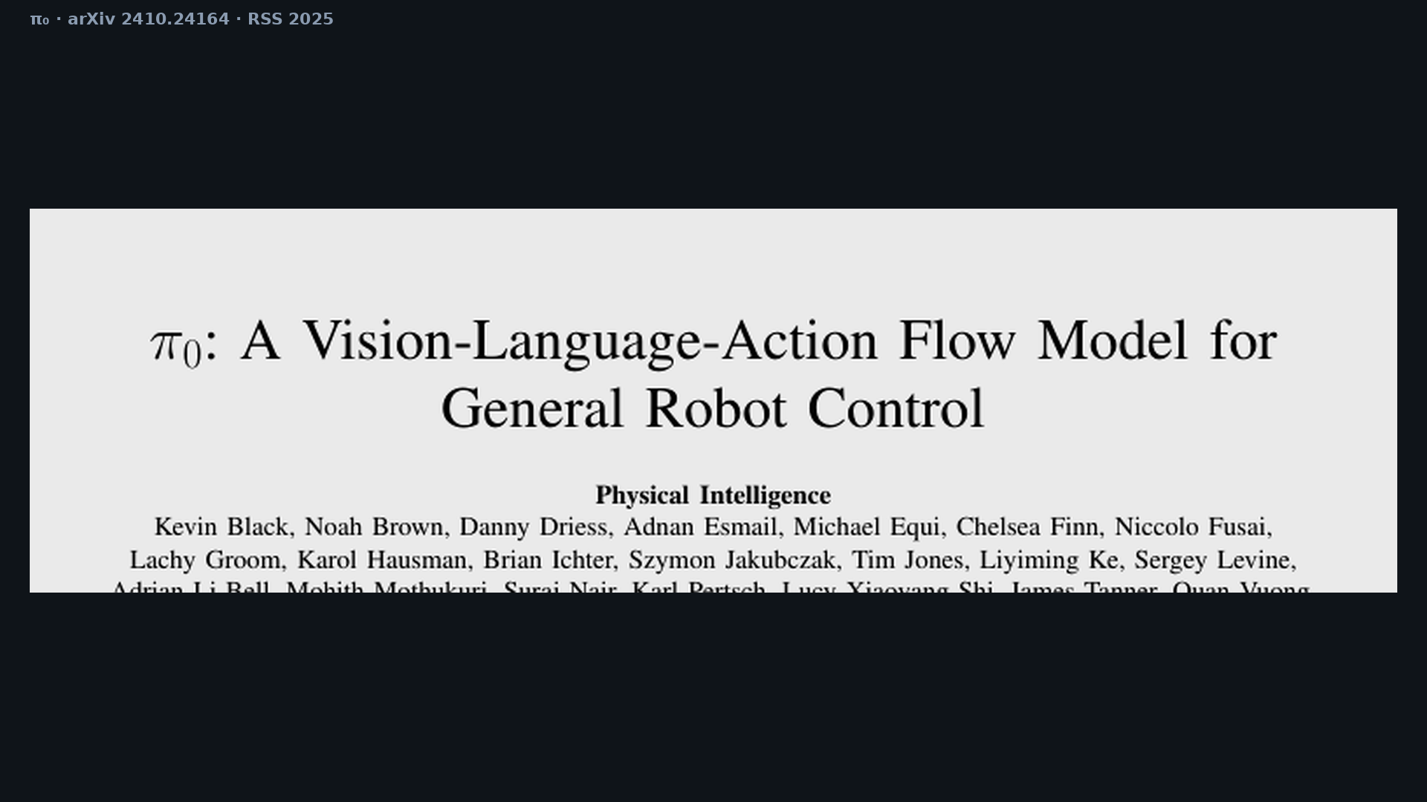
Scientific Reviewer · 8+3 · 10/10
Notes:
Backup cover.

