Slide 1
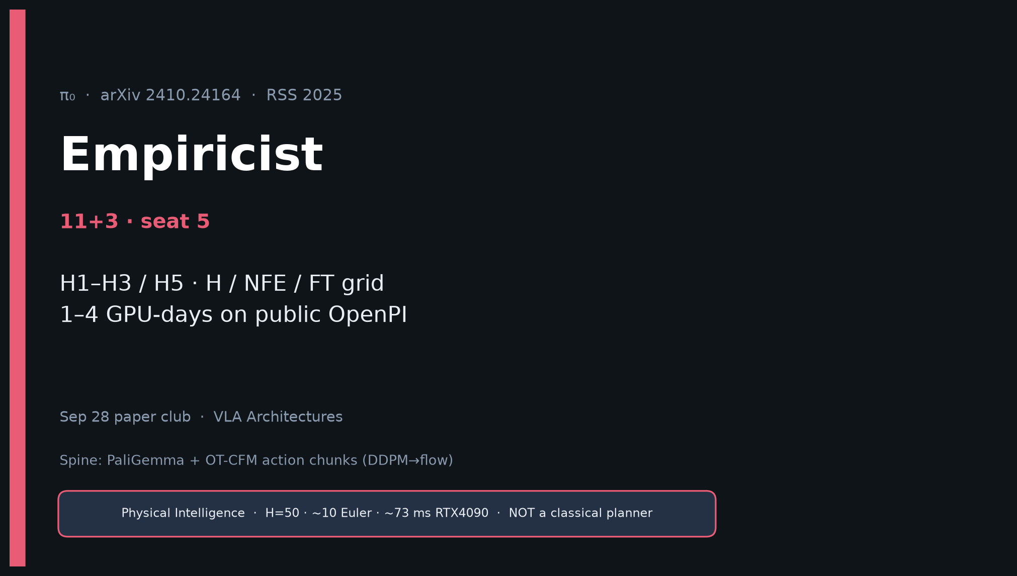
Empiricist · 11+3 · 1/13
Notes:
EMPIRICIST — seat 5 · 11+3.
You own H / NFE / FT knobs. Quiet scout on public OpenPI — 1–4 GPU-days, not weeks.
Outlines in env_outline/ — no cluster jobs in quiet mode.
Quote success only with (H, K, Hz, NFE, ms, GPU).

Slide 2
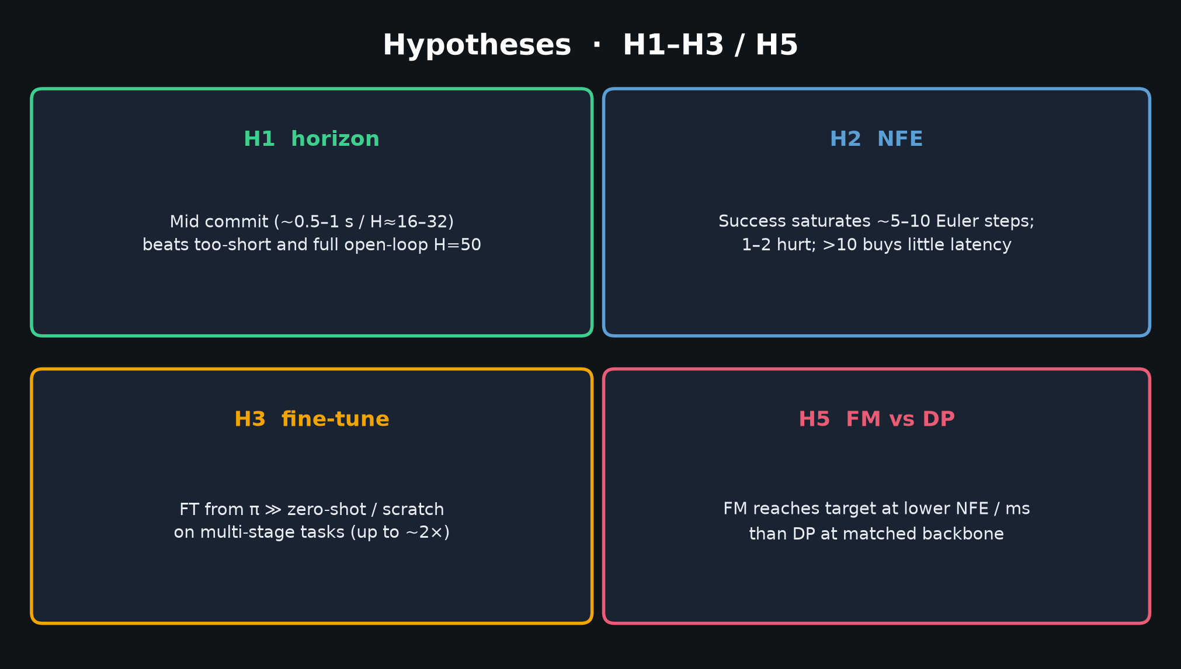
Empiricist · 11+3 · 2/13
Notes:
HYPOTHESES H1–H3 / H5.
H1 mid commit · H2 NFE saturates 5–10 · H3 FT ≫ scratch · H5 FM lower NFE than DP.

Slide 3
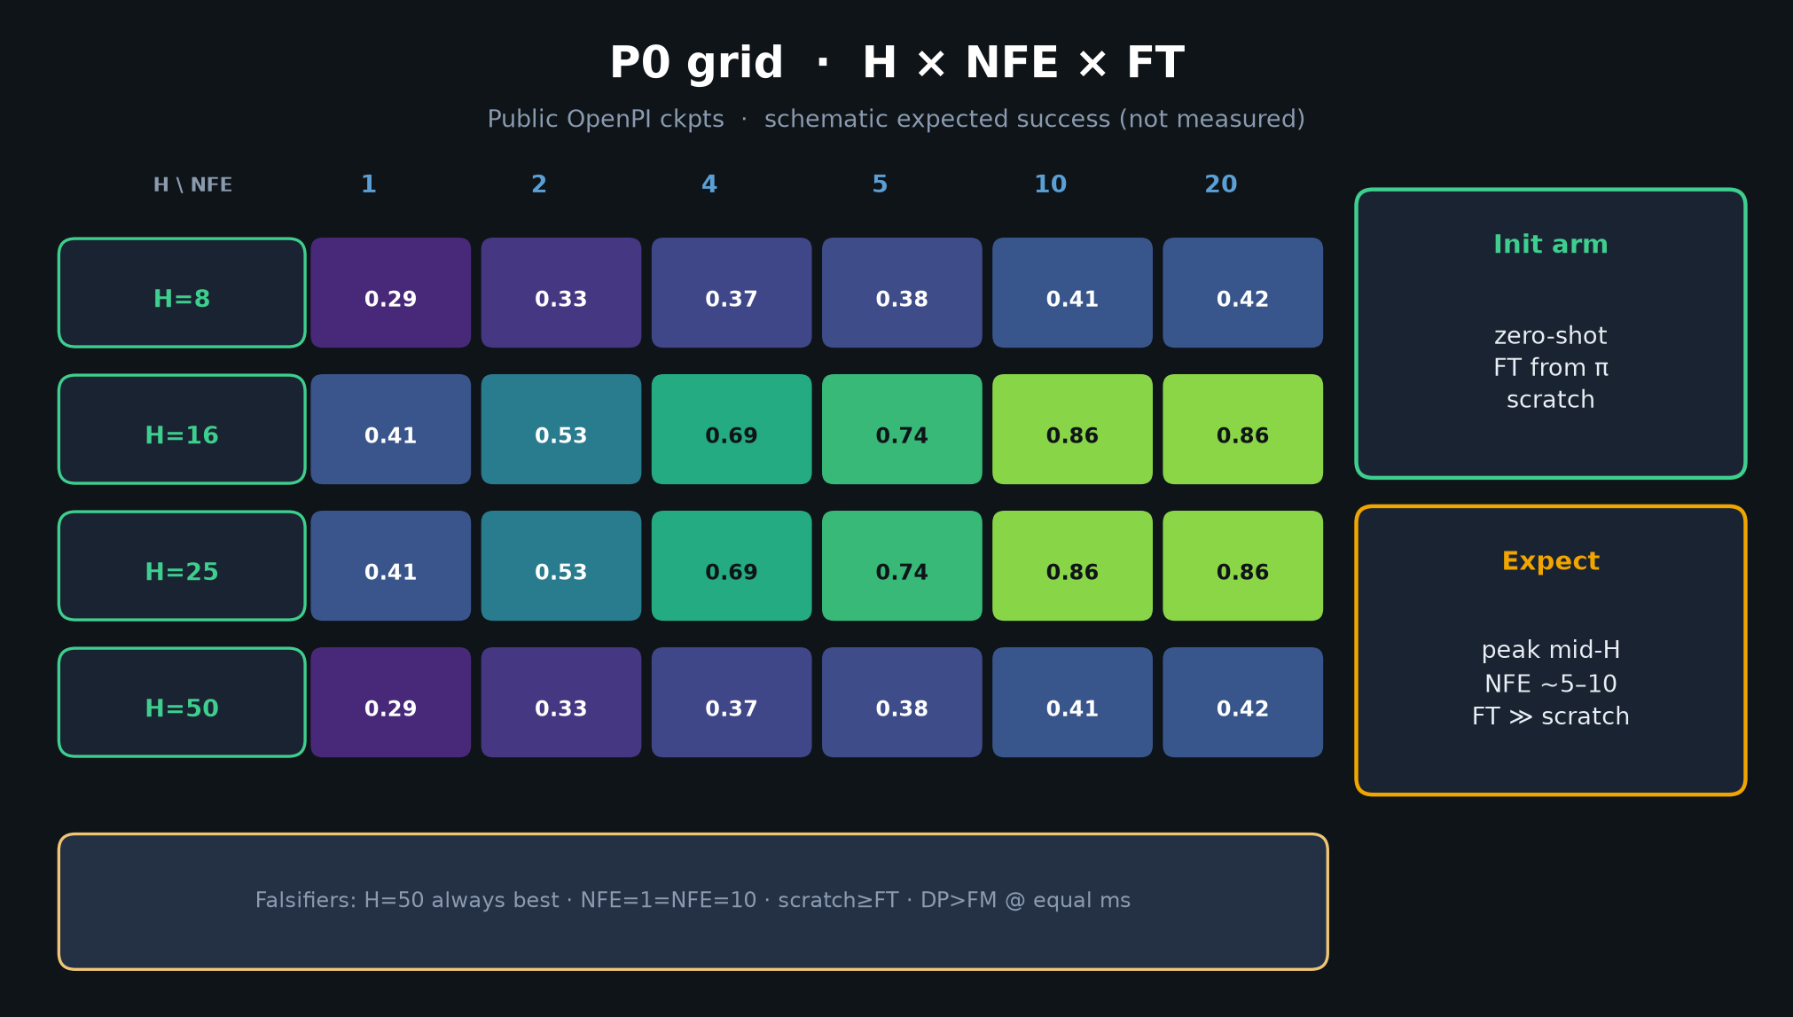
Empiricist · 11+3 · 3/13
Notes:
P0 GRID — THE Empiricist figure.
H∈{8,16,25,50} × NFE∈{1,2,4,5,10,20} × {zero-shot, FT, scratch}.
Schematic expected surface — peak mid-H, NFE knee ~5–10.
Falsifiers listed on slide.

Slide 4
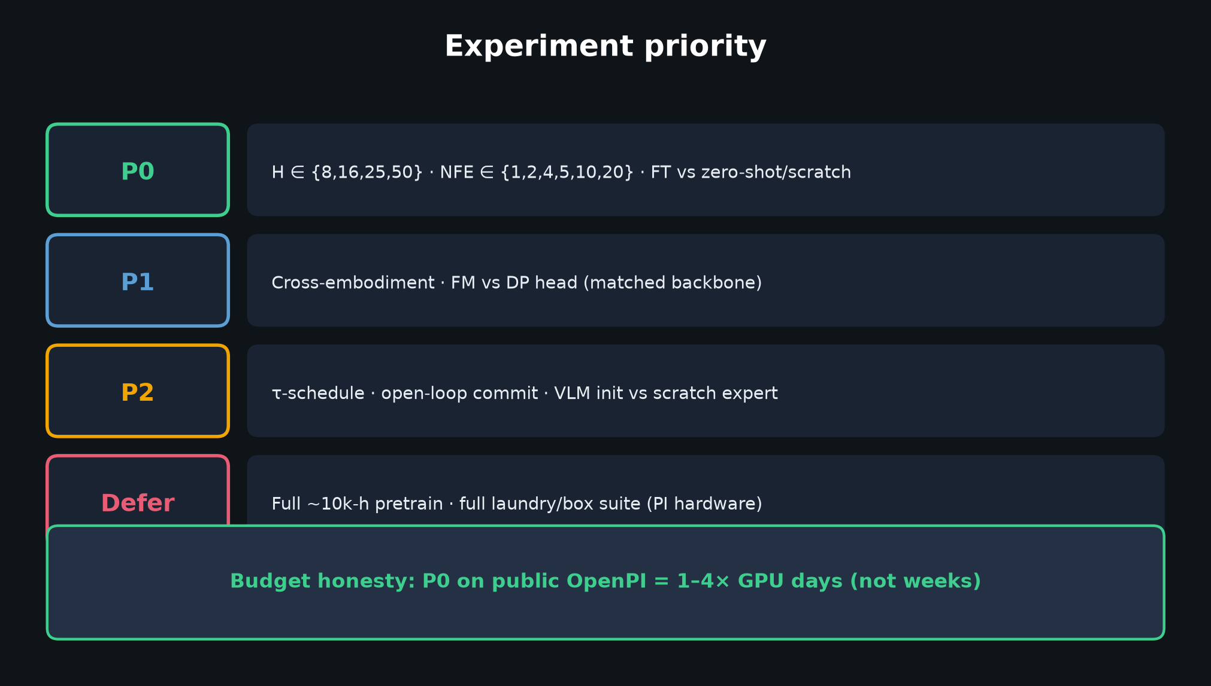
Empiricist · 11+3 · 4/13
Notes:
PRIORITY TABLE — P0 grid · P1 cross-emb / FM vs DP · P2 τ / commit / VLM init · Defer full 10k h.

Slide 5
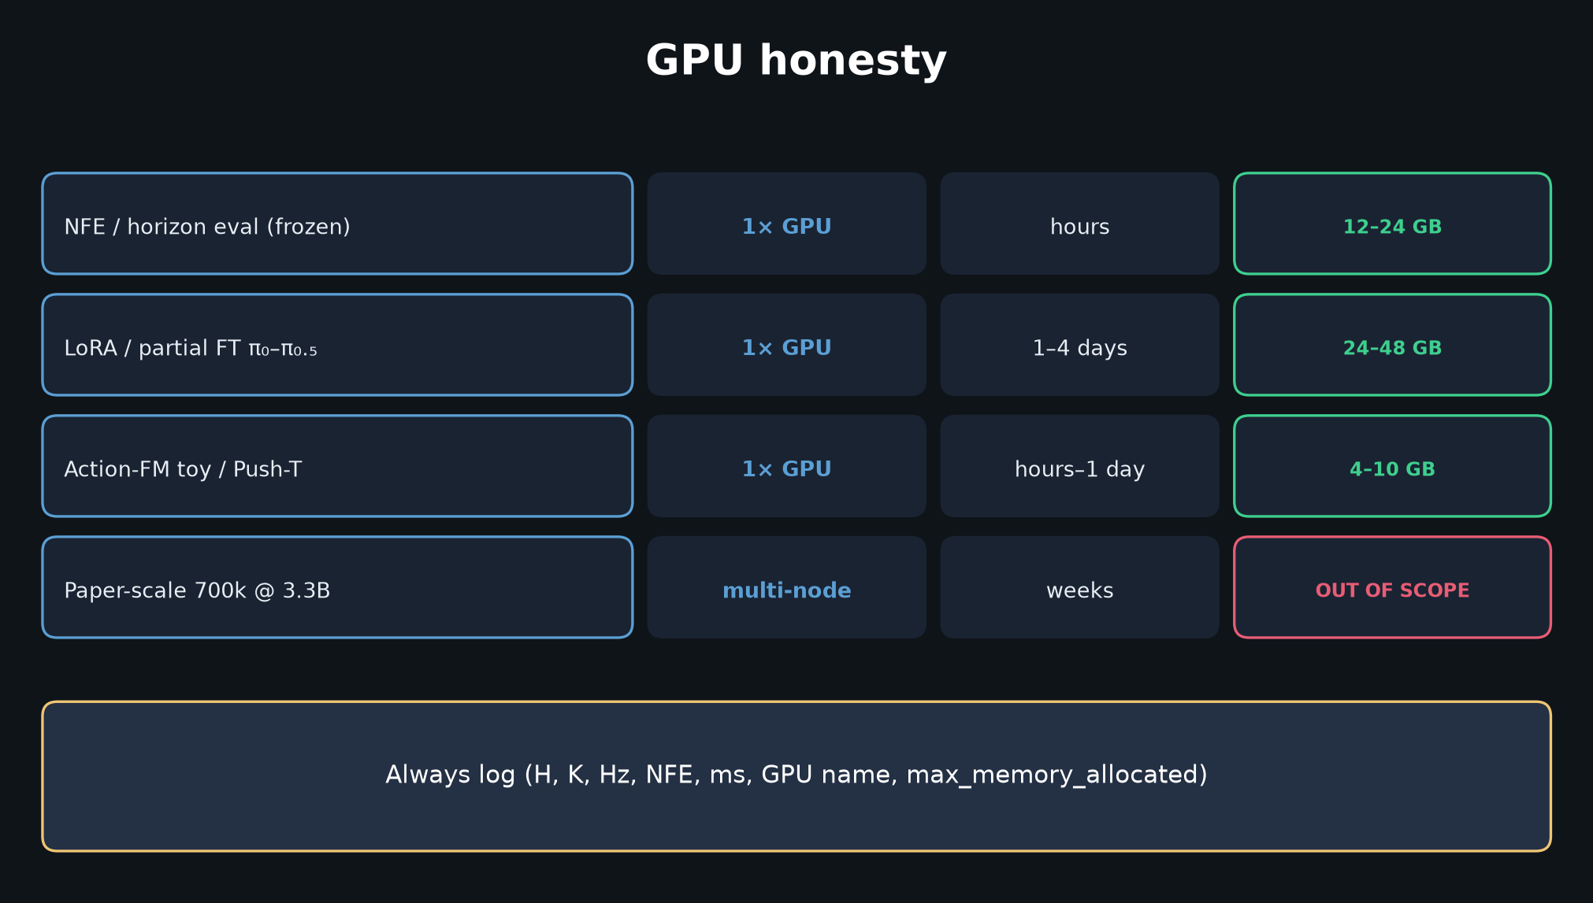
Empiricist · 11+3 · 5/13
Notes:
GPU HONESTY — eval hours; LoRA 1–4 days; paper-scale OUT OF SCOPE.

Slide 6
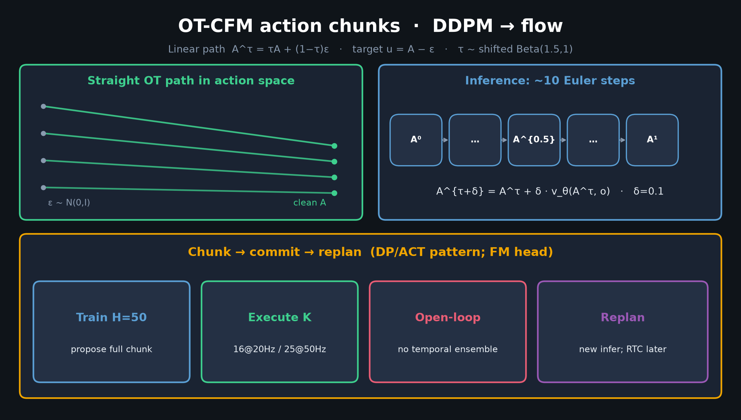
Empiricist · 11+3 · 6/13
Notes:
CONTROL SPINE — map H/K to commit seconds = K/Hz.

Slide 7
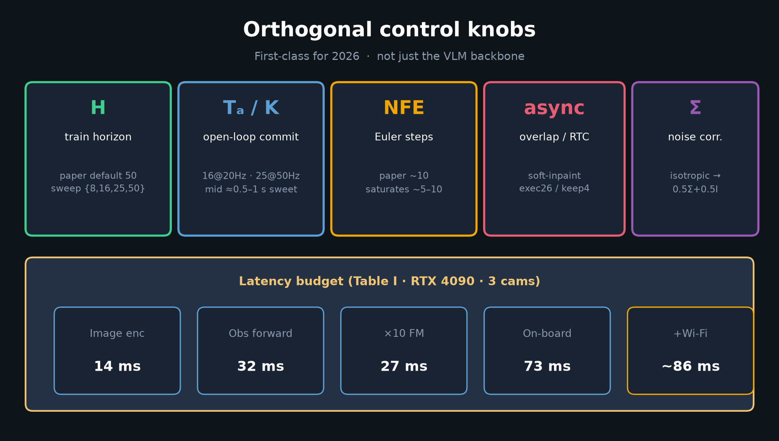
Empiricist · 11+3 · 7/13
Notes:
KNOBS reminder including async/Σ for later P1/P2 with RTC/BEHAVIOR ideas.

Slide 8
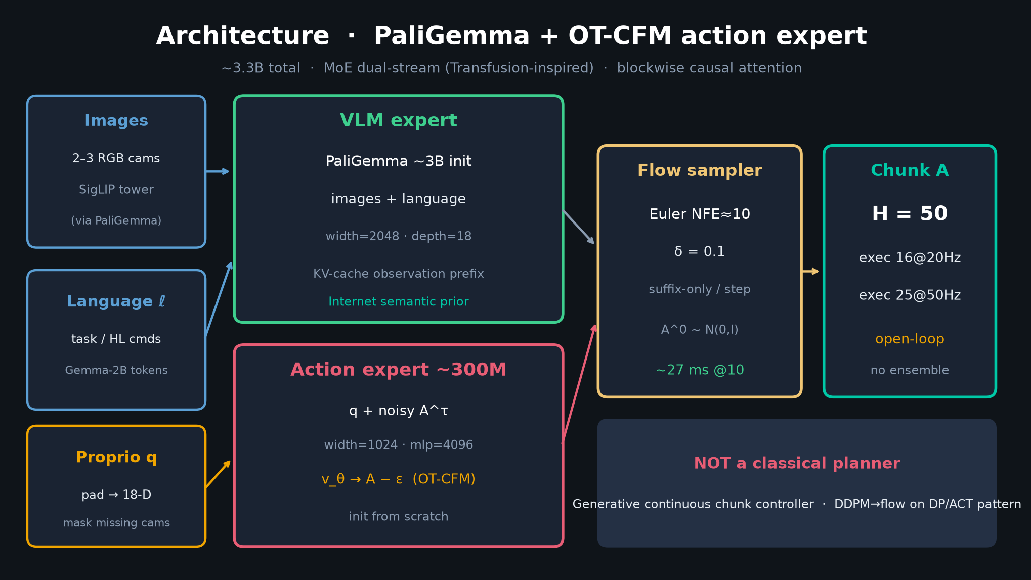
Empiricist · 11+3 · 8/13
Notes:
ARCHITECTURE — implementation checklist: cache obs KV; suffix FM steps; pad actions 18-D.

Slide 9
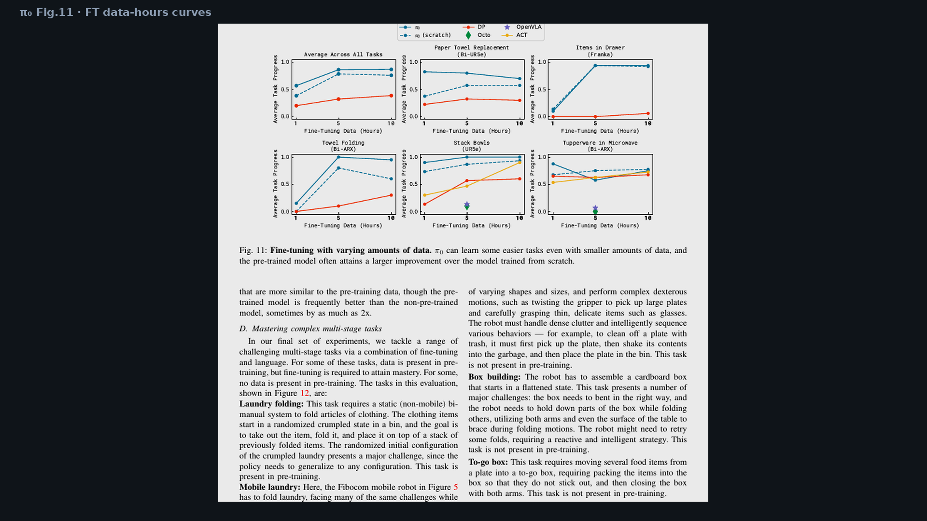
Empiricist · 11+3 · 9/13
Notes:
PAPER FIG 11 — FT hours curves = qualitative target shapes for H3.

Slide 10
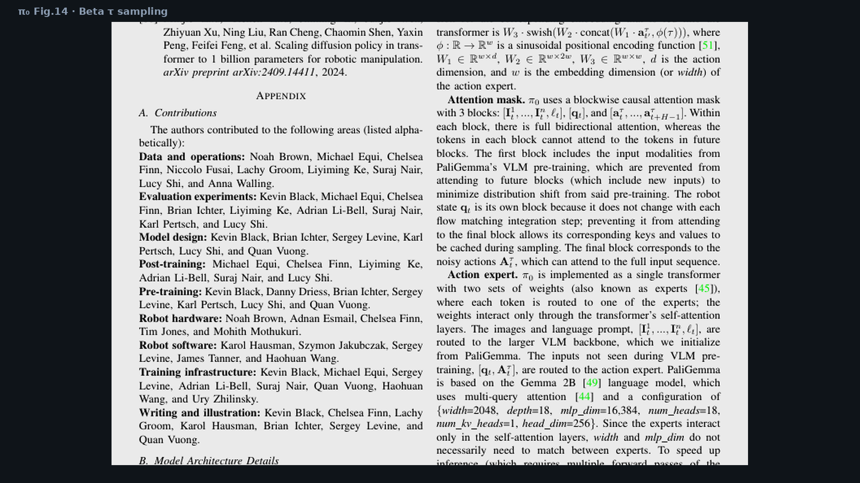
Empiricist · 11+3 · 10/13
Notes:
PAPER FIG 14 — Beta τ schedule; P2 ablation Uniform vs Beta.

Slide 11
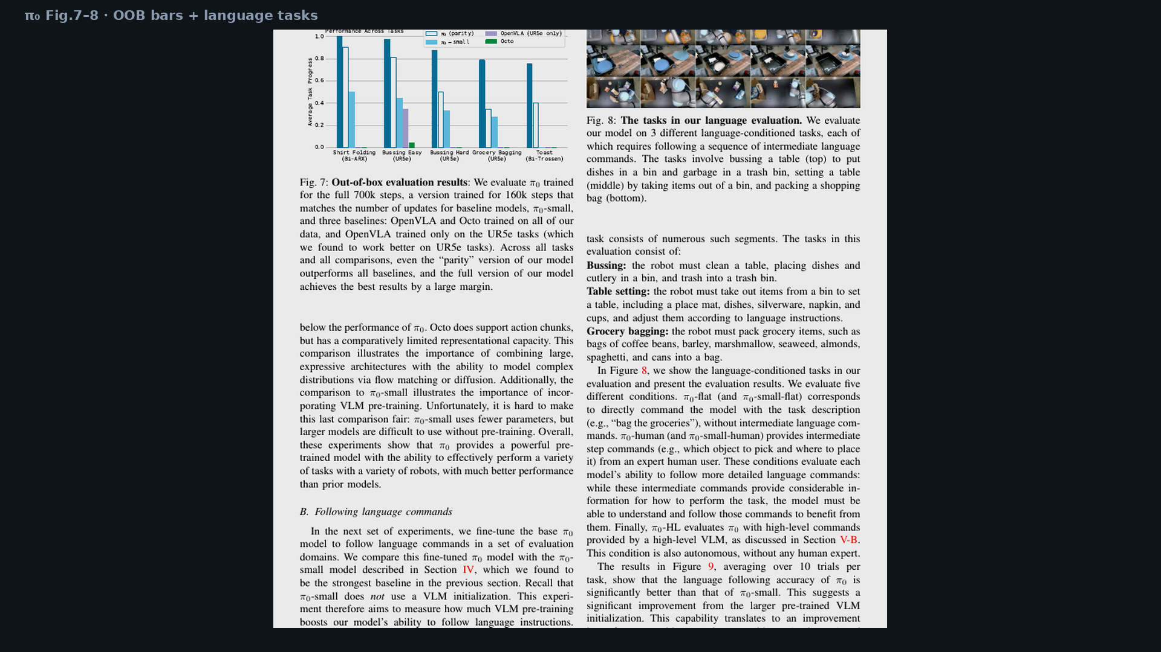
Empiricist · 11+3 · 11/13
Notes:
PAPER TABLE I latency vibe via knobs slide already shown; Fig.7 for OOB baseline context.

Slide 12
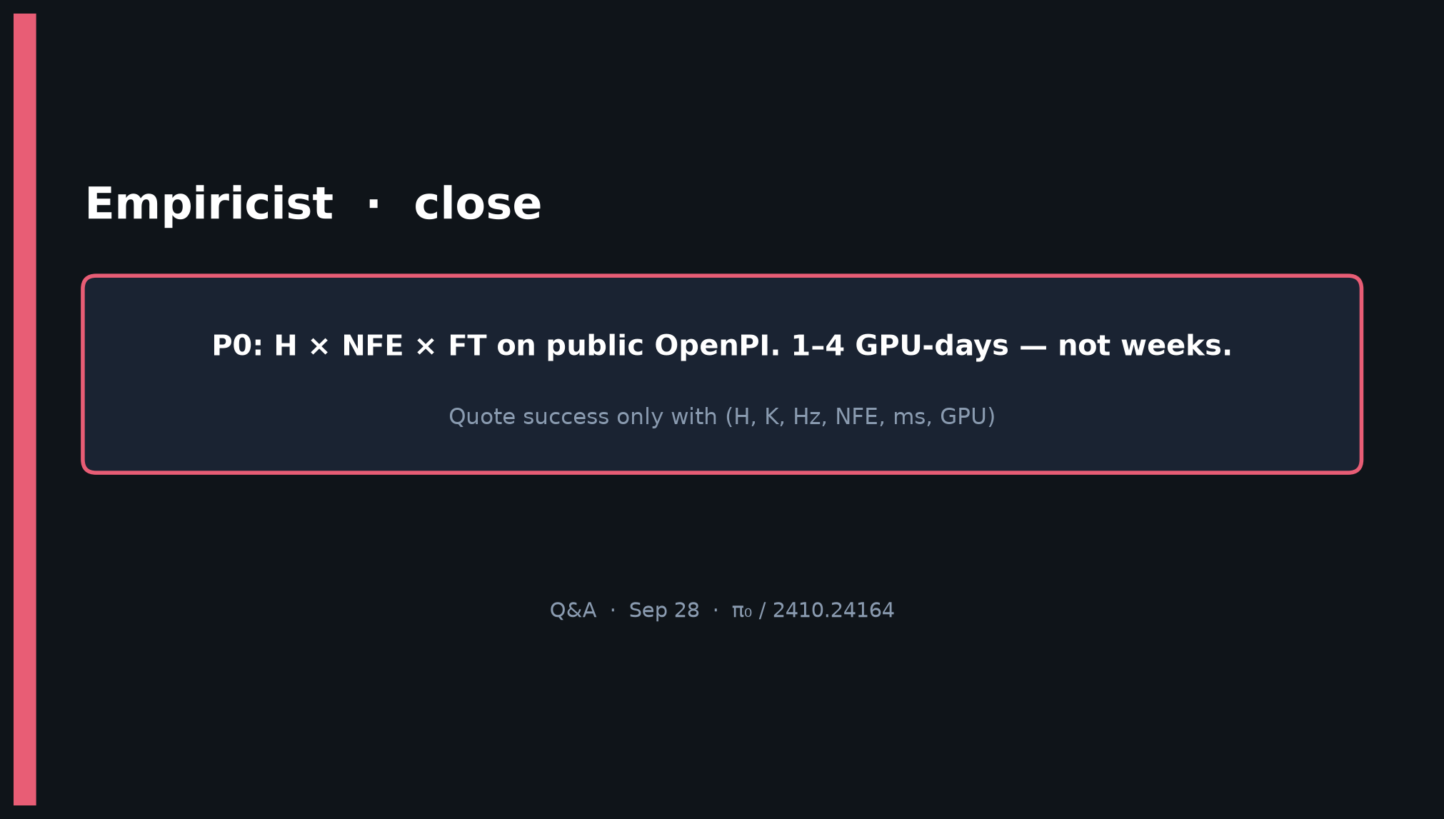
Empiricist · 11+3 · 12/13
Notes:
CLOSE — P0 on public OpenPI in 1–4 GPU-days. Hand curves to Archaeologist for Sec narrative.

Slide 13
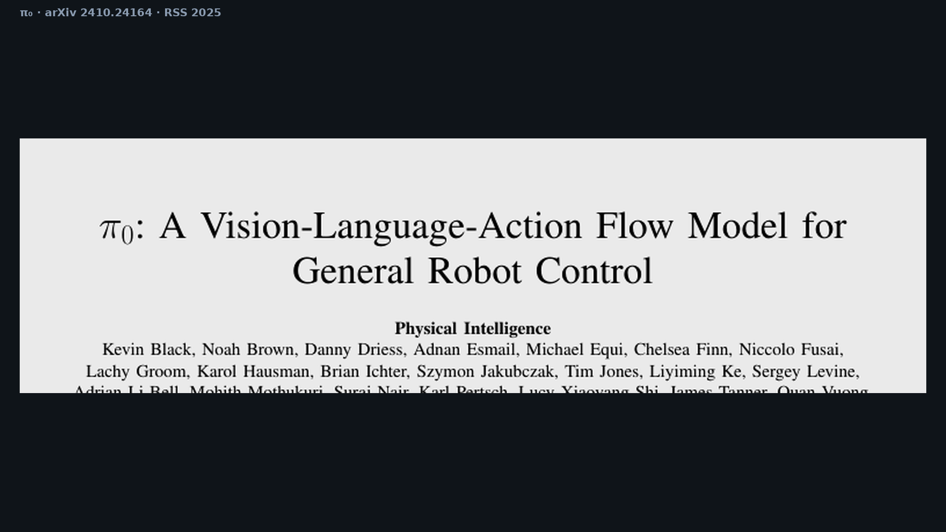
Empiricist · 11+3 · 13/13
Notes:
Backup cover.

