Slide 1
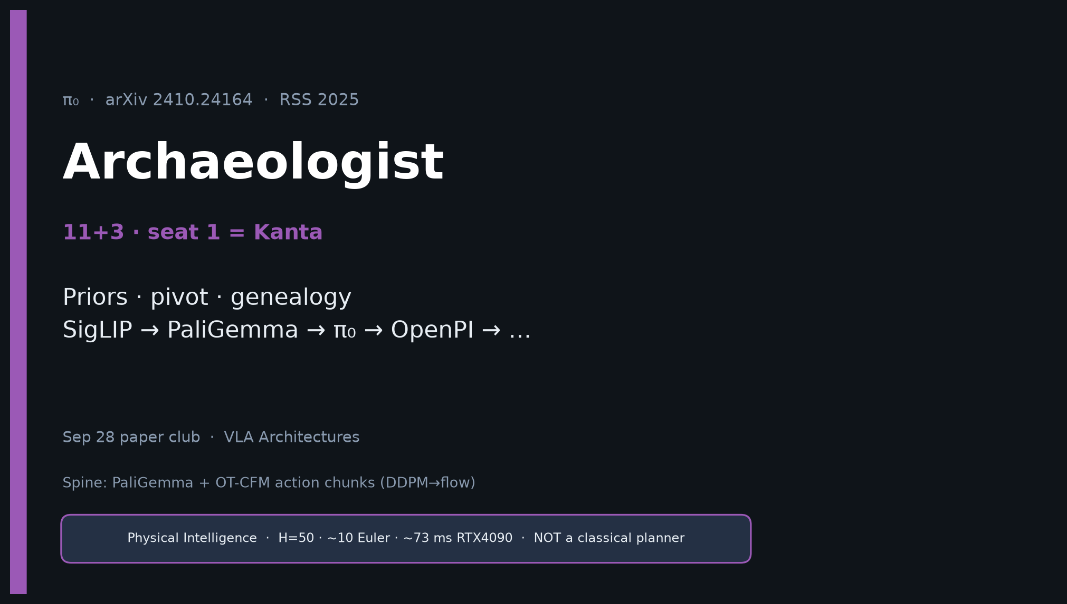
Archaeologist · 11+3 · 1/16
Notes:
ARCHAEOLOGIST OPENING — seat 1 = Kanta (YOU). Timing 11+3. DENSEST DECK.
You own intellectual history and the club genealogy.
ONE SENTENCE for the room:
π₀ locked flow-matching VLAs: PaliGemma init + action expert + 50 Hz continuous chunks at ~10k-hour cross-embodiment scale.
MUST SAY:
• π₀.₅ retains FM at post-train — blogs saying FAST replaced FM are FALSE.
• NOT a classical planner — generative continuous chunk controller.
• Genealogy: SigLIP → PaliGemma → π₀ → OpenPI → (FAST ∥ π₀.₅) → RTC → BEHAVIOR’25 → ’26.
Do NOT claim BEHAVIOR trains Diffusion Policy. Do NOT invent citations.

Slide 2
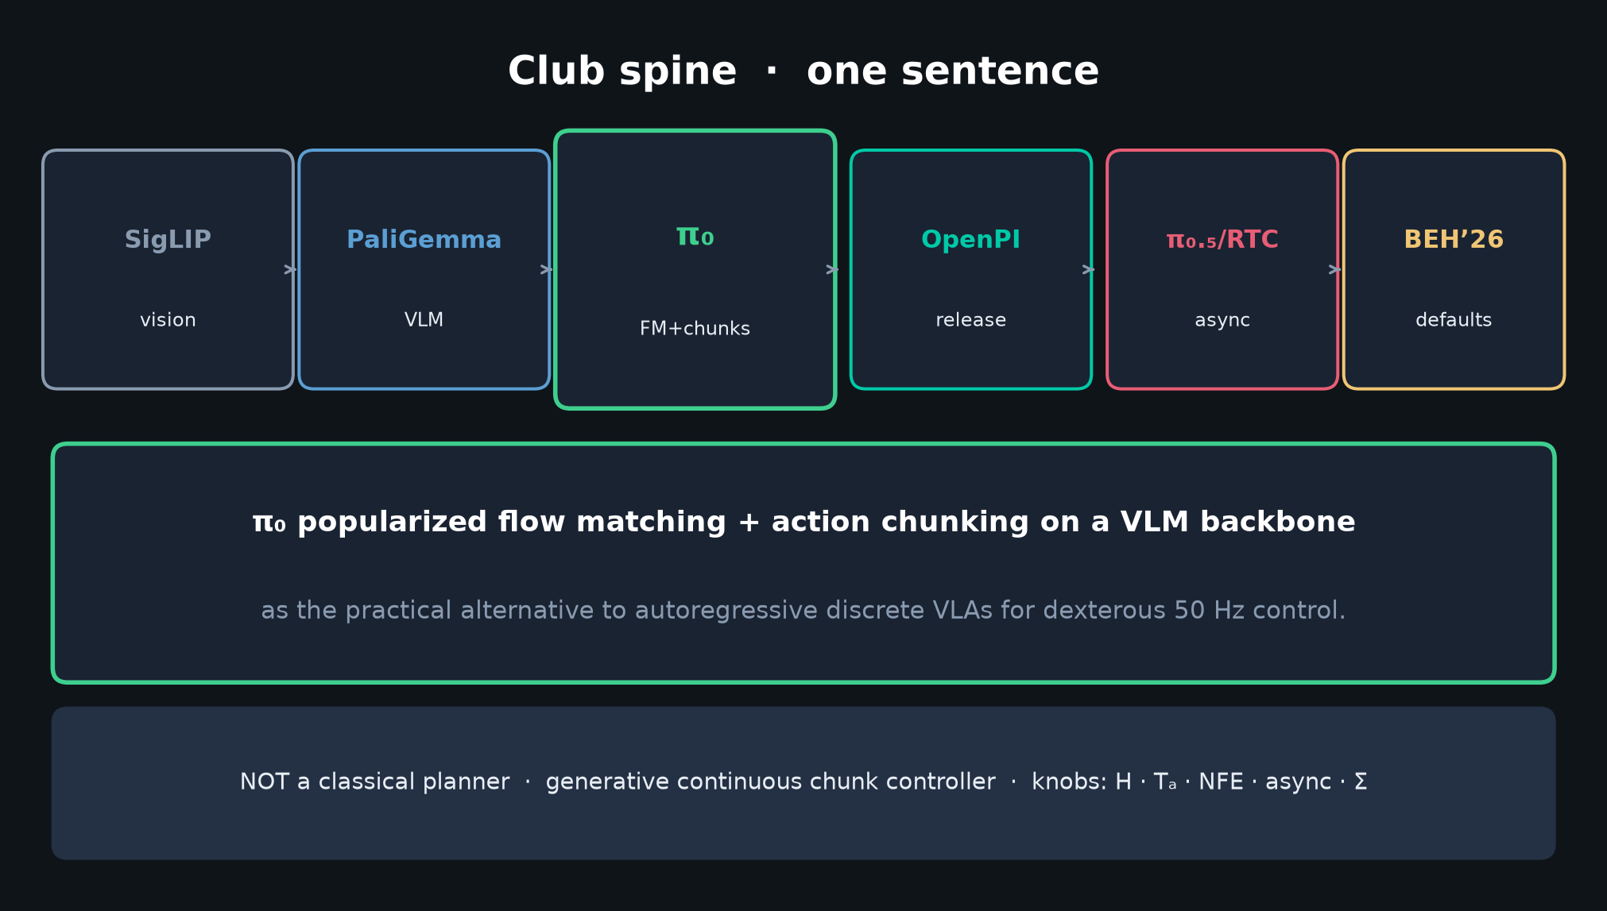
Archaeologist · 11+3 · 2/16
Notes:
CLUB SPINE / ONE-LINER — deliver early so the room knows where you are going.
π₀ popularized FM + action chunking on a VLM backbone as the practical alternative to AR discrete VLAs for dexterous 50 Hz control.
Spine knobs you will hand to Empiricist: H · Tₐ · NFE · async overlap · Σ.

Slide 3
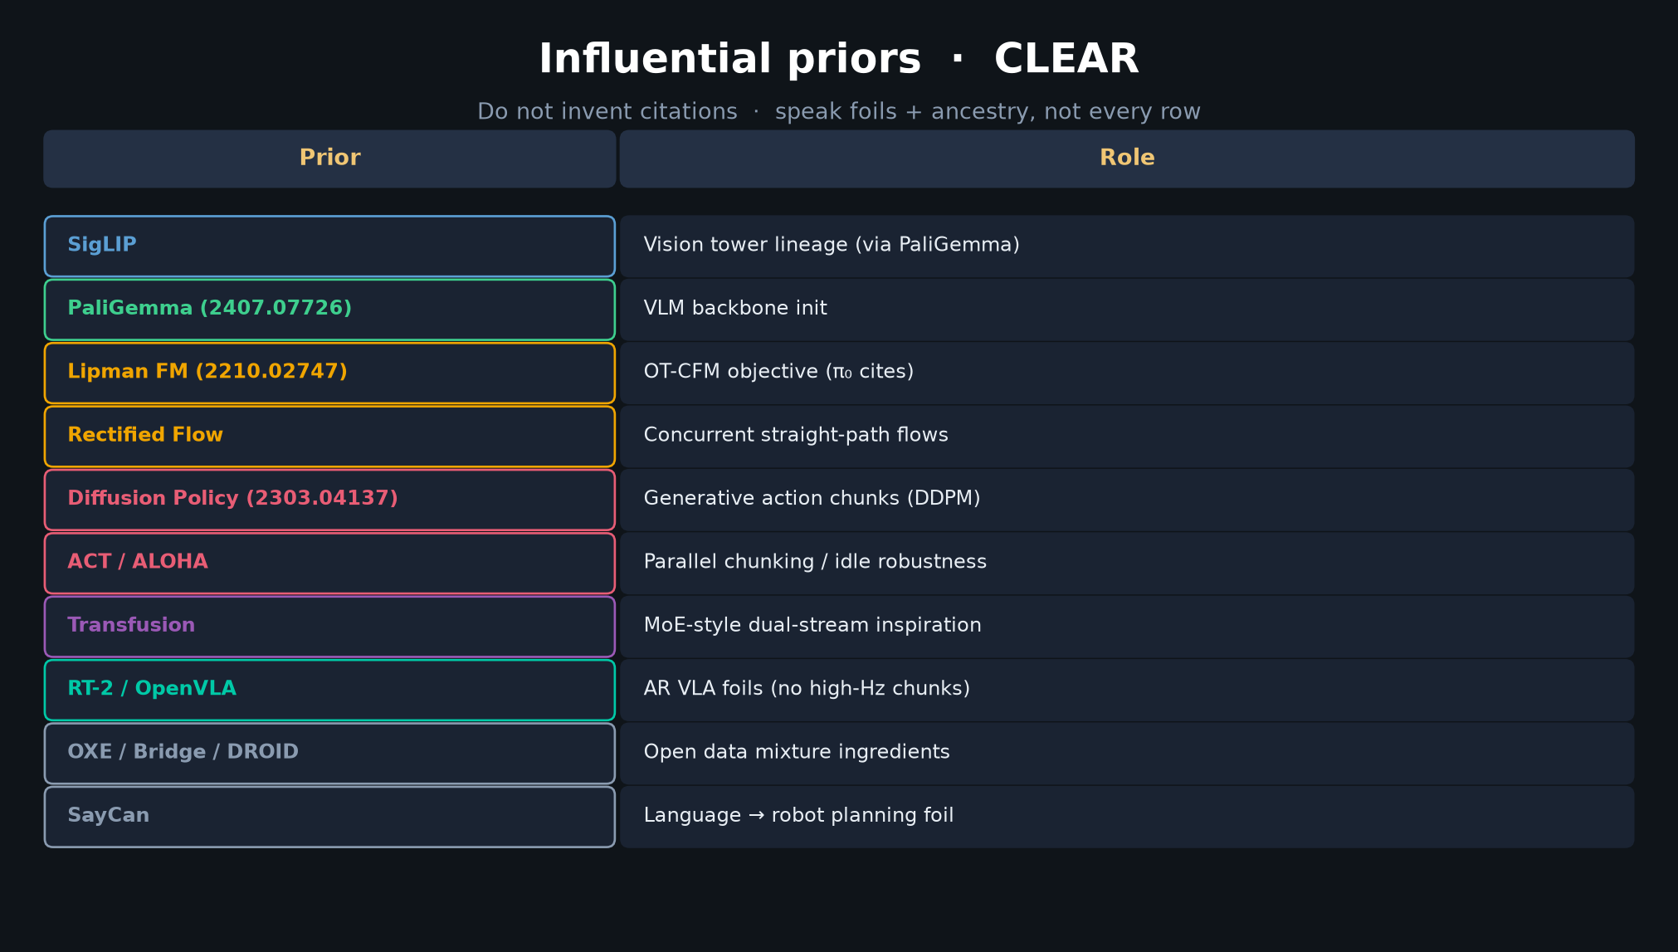
Archaeologist · 11+3 · 3/16
Notes:
PRIOR TABLE — densest slide. Do NOT read every row. Speak FOILS + ANCESTRY.
Must-hit ancestry:
• SigLIP → PaliGemma (VLM init CLEAR)
• Lipman FM + Rectified Flow (OT-CFM CLEAR cites)
• Diffusion Policy + ACT (chunk pattern; DDPM→flow)
• Transfusion (dual-stream MoE inspiration)
Must-hit foils:
• RT-2 / OpenVLA — AR discrete; fail high-Hz chunks
• SayCan — language→planning foil (HL interface)
Say: “Priors are VLM + generative chunks + FM theory. Novelty is the integrative lock at scale.”

Slide 4
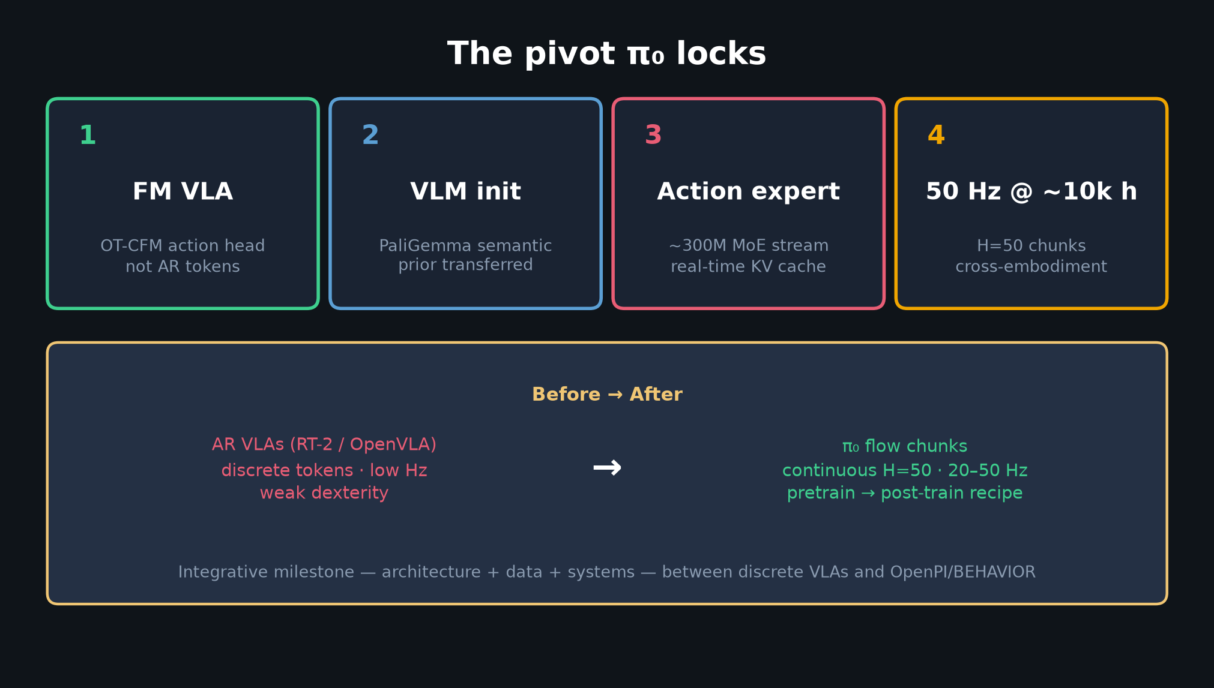
Archaeologist · 11+3 · 4/16
Notes:
PIVOT THIS PAPER LOCKS — four ingredients.
1 FM VLA (not AR tokens)
2 VLM init (PaliGemma semantic prior)
3 Action expert (~300M, real-time KV)
4 50 Hz chunks at ~10k h cross-embodiment
Before/after: AR VLAs low-Hz → π₀ continuous H=50 at 20–50 Hz with pre→post recipe.

Slide 5
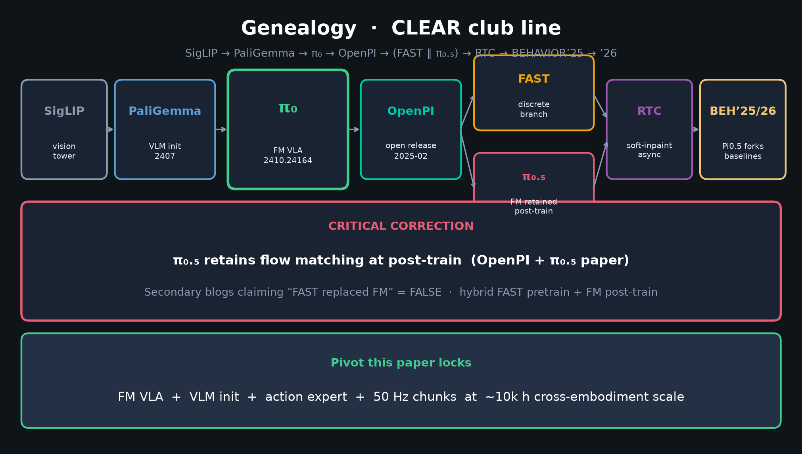
Archaeologist · 11+3 · 5/16
Notes:
GENEALOGY SLIDE — THE MUST-HIT for seat 1.
SigLIP → PaliGemma → **π₀** → OpenPI → (FAST ∥ π₀.₅) → RTC → BEHAVIOR’25 forks → BEHAVIOR’26 baselines.
CRITICAL CORRECTION on the slide:
π₀.₅ retains flow matching at post-train (OpenPI + paper).
Secondary blogs: “FAST replaced FM” = FALSE. Hybrid FAST pretrain + FM post-train.
Spend 90–120s here. This is your payoff.

Slide 6
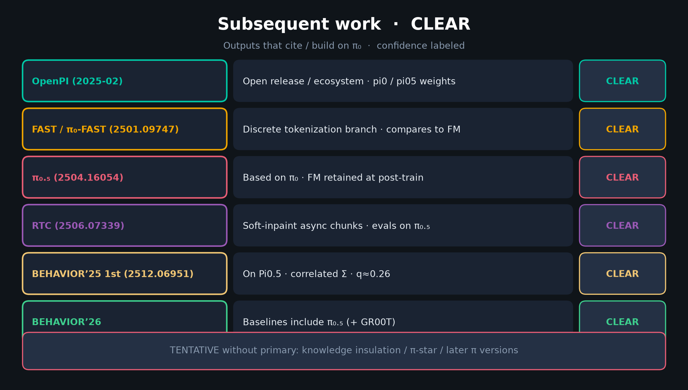
Archaeologist · 11+3 · 6/16
Notes:
SUBSEQUENT TABLE — CLEAR citations only.
OpenPI · FAST/π₀-FAST · π₀.₅ · RTC · BEHAVIOR’25 1st · BEHAVIOR’26 baselines.
Flag TENTATIVE: knowledge insulation / π-star without primary read.
Hand Empiricist the knobs; hand Visionary the ’26 defaults.

Slide 7
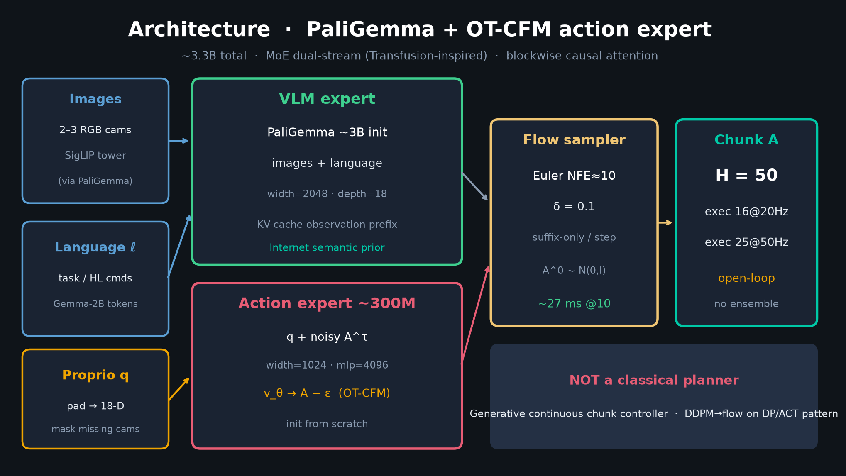
Archaeologist · 11+3 · 7/16
Notes:
ARCHITECTURE redraw — PaliGemma VLM expert + ~300M action expert + Euler sampler → H=50 chunk.
Point at: KV-cache obs prefix; suffix-only per flow step; NOT a classical planner banner.
MoE dual-stream inspired by Transfusion; blockwise causal [I,ℓ] | [q] | [A^τ].

Slide 8
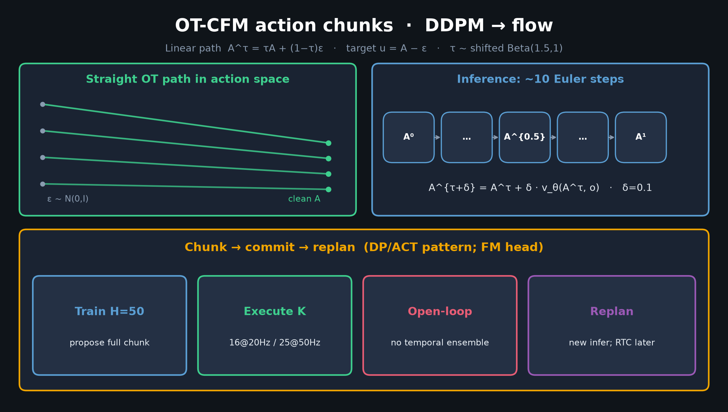
Archaeologist · 11+3 · 8/16
Notes:
OT-CFM CHUNK DIAGRAM — motion/control spine.
Linear path A^τ=τA+(1−τ)ε; target u=A−ε; ~10 Euler.
Train H=50 → execute K (16@20 / 25@50) open-loop → replan.
DP/ACT pattern with DDPM→flow. Later RTC soft-inpaint closes the latency seam.

Slide 9
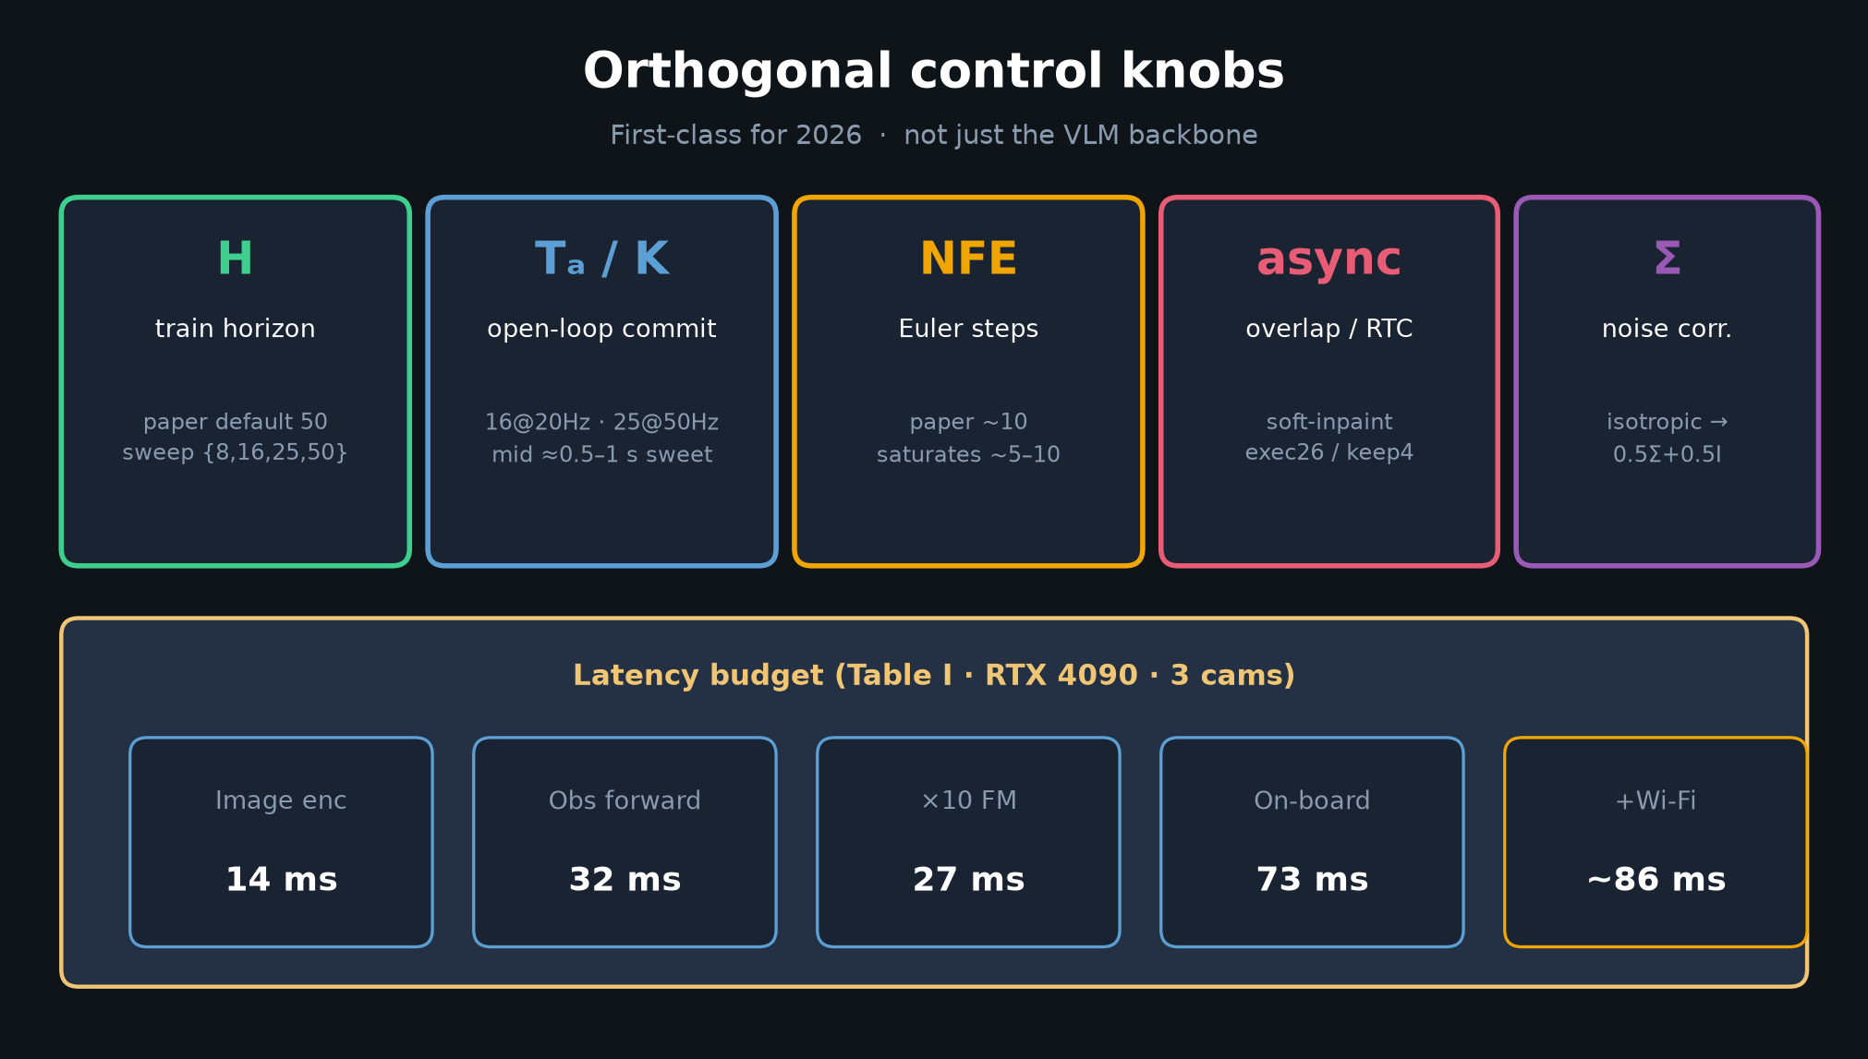
Archaeologist · 11+3 · 9/16
Notes:
ORTHOGONAL KNOBS — H · Tₐ · NFE · async · Σ + Table I latency.
First-class for 2026. Not just the backbone.
~73 ms on-board RTX4090 (14+32+27).

Slide 10
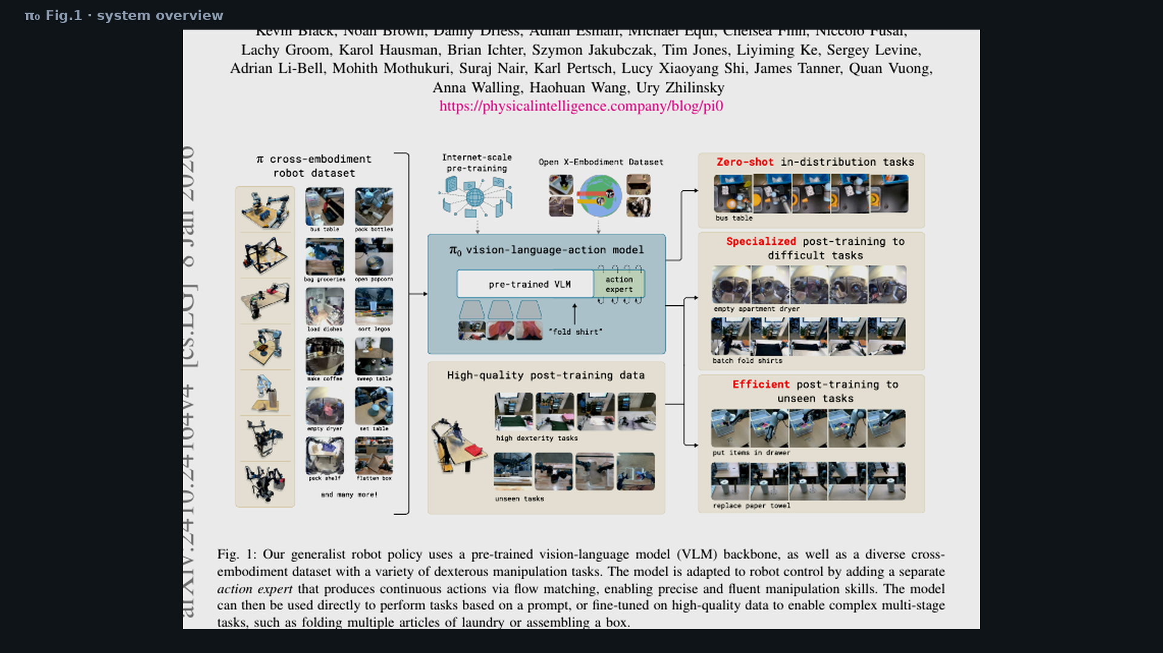
Archaeologist · 11+3 · 10/16
Notes:
PAPER FIG 1 — system overview crop. Point at VLM + action expert + zero-shot vs post-train paths.
Bibliographic visual; 30–45s.

Slide 11
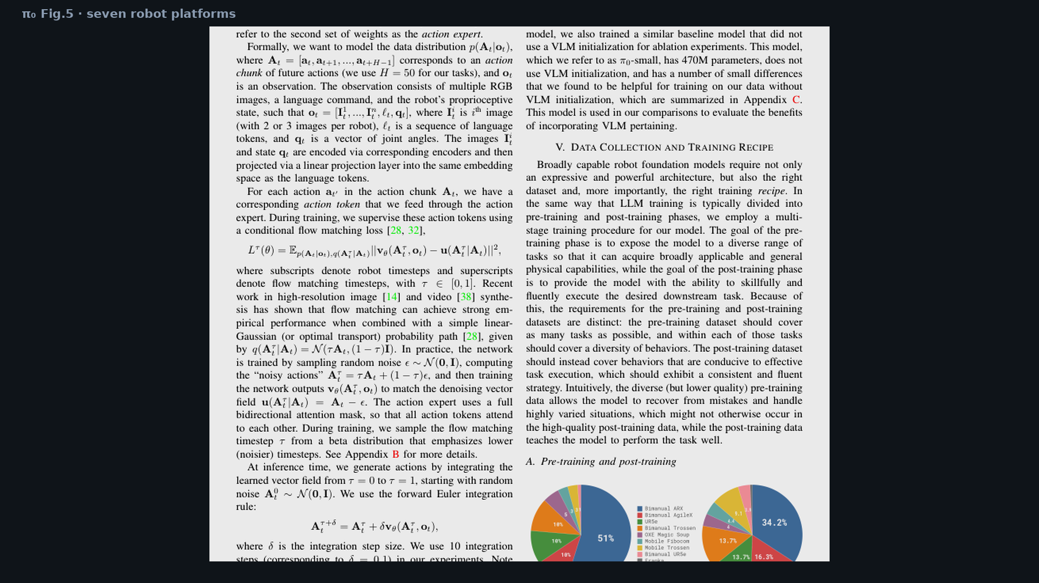
Archaeologist · 11+3 · 11/16
Notes:
PAPER FIG 5 — seven robot platforms. Cross-embodiment padding to 18-D; missing cams masked.
Supports the “scale matches the claim” part of the pivot.

Slide 12
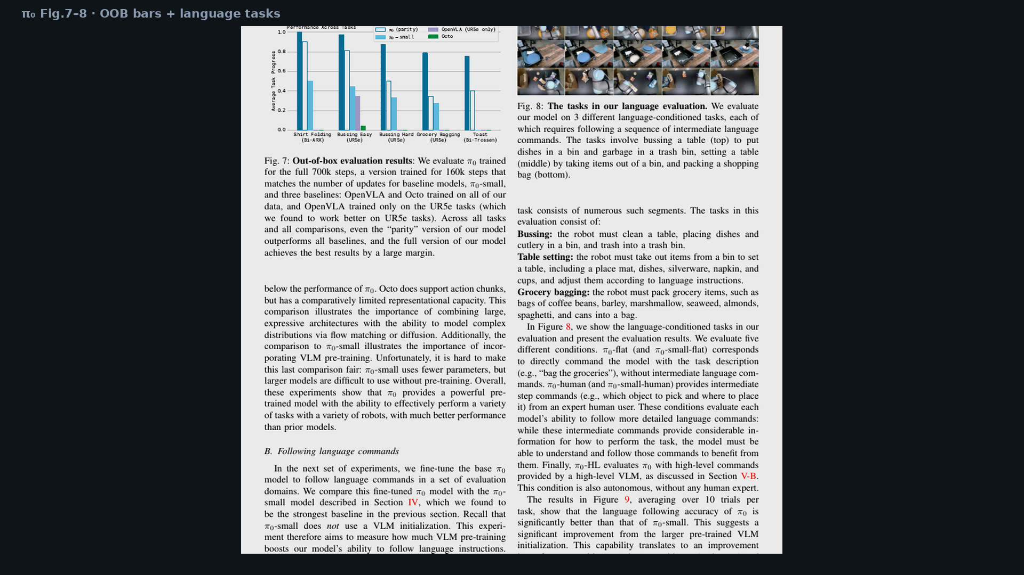
Archaeologist · 11+3 · 12/16
Notes:
PAPER FIG 7 — OOB vs OpenVLA/Octo/π₀-small. OpenVLA fails partly from no chunking.
Glance; Empiricist owns the re-run plan.

Slide 13
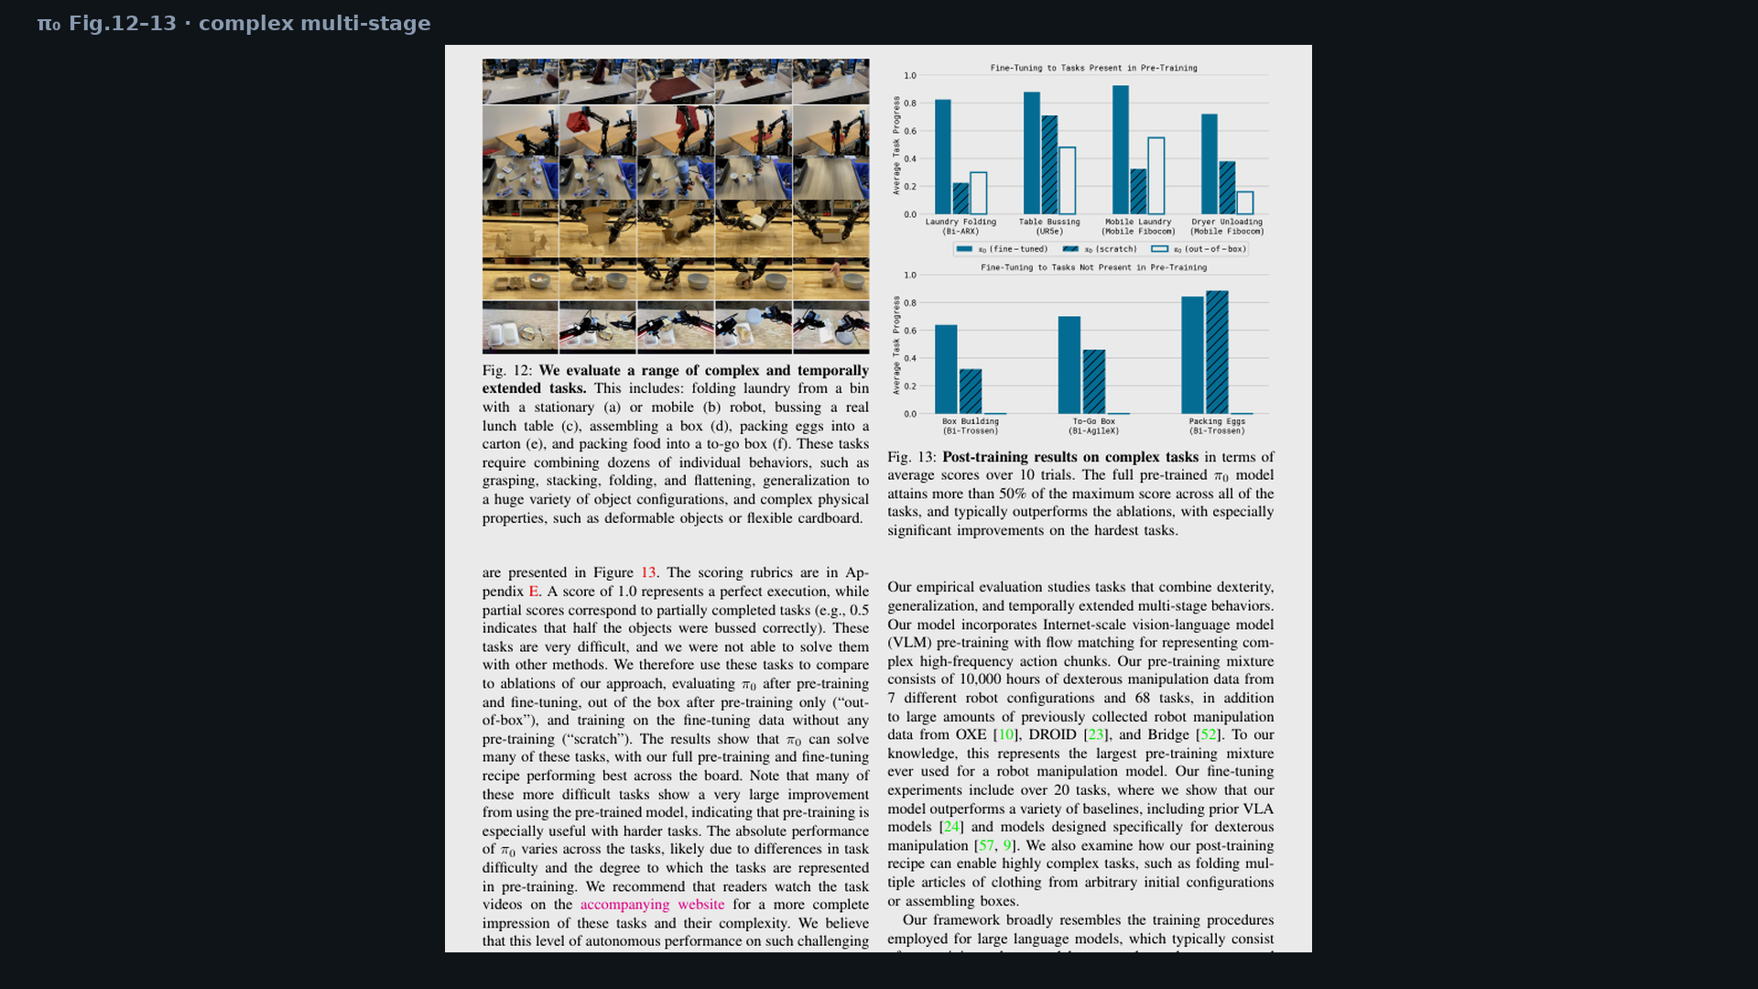
Archaeologist · 11+3 · 13/16
Notes:
PAPER FIG 12–13 — complex multi-stage. Pretrain+FT unlocks multi-minute household skills.
Caption claim: >50% max score across all tasks with FT.

Slide 14
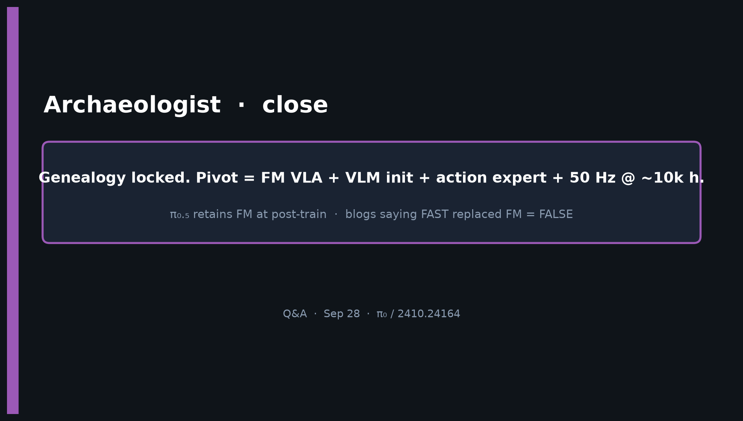
Archaeologist · 11+3 · 14/16
Notes:
CLOSE — restate genealogy + pivot + FALSE blog correction.
Q&A prompts:
• “Did FAST replace FM in π₀.₅?” → No; FM retained post-train.
• “Is π₀ a planner?” → No; generative chunk controller.
• “Does BEHAVIOR train DP?” → No; flow on Pi0.5; inherited chunk habit.

Slide 15
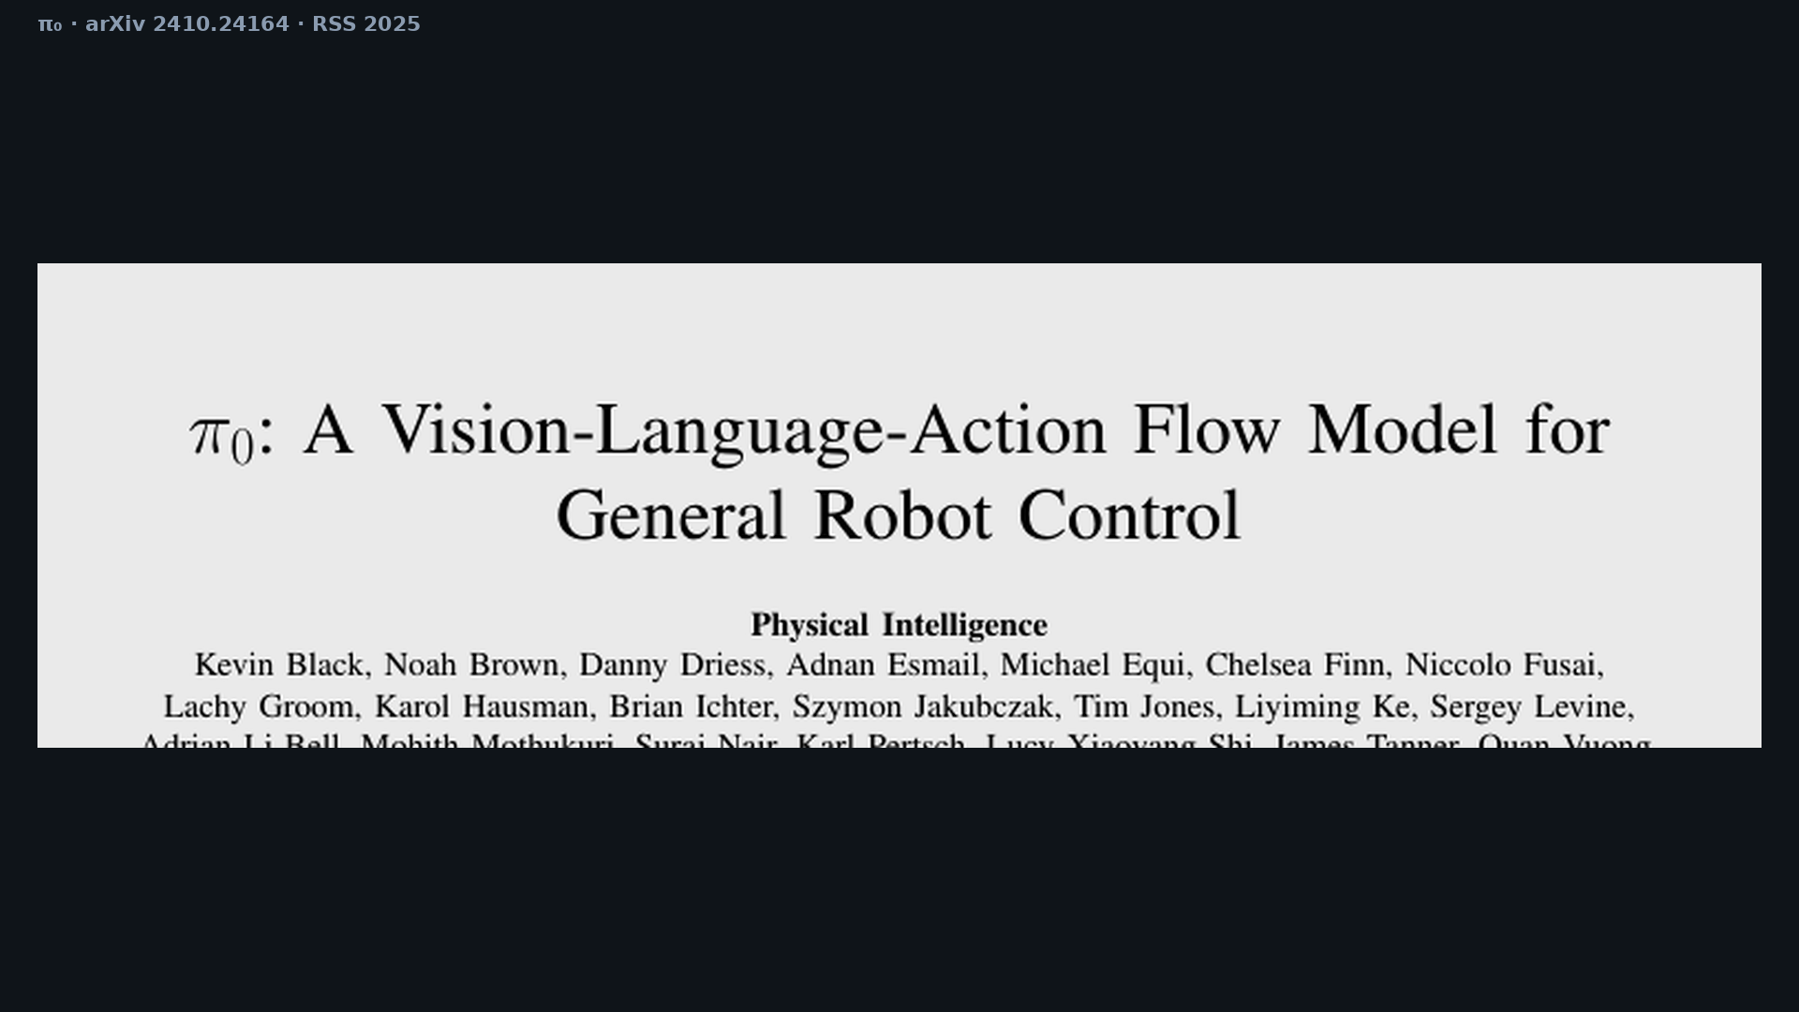
Archaeologist · 11+3 · 15/16
Notes:
BACKUP — paper cover / title block for bibliography if asked.
Black et al., Physical Intelligence. arXiv 2410.24164. RSS 2025.

Slide 16
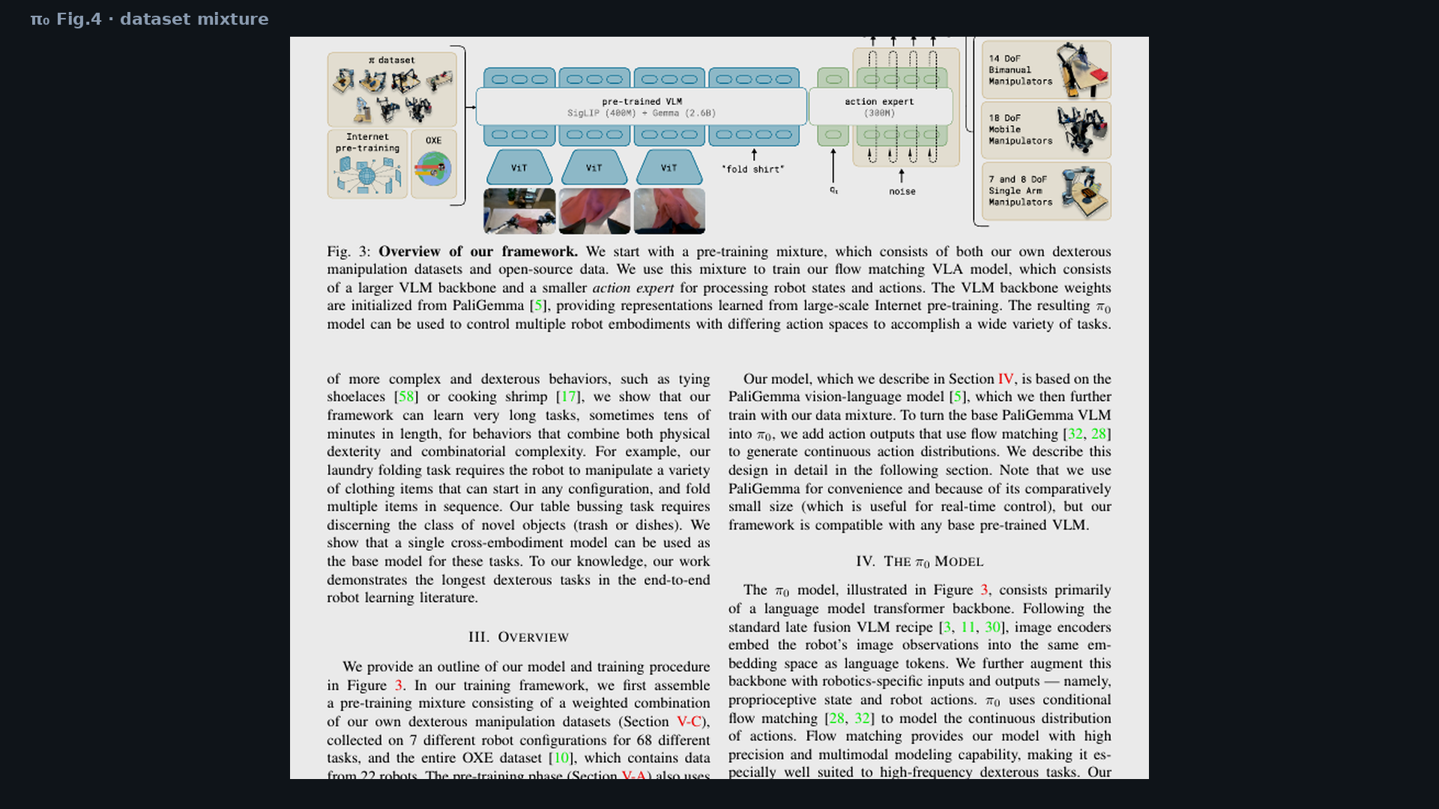
Archaeologist · 11+3 · 16/16
Notes:
SPARE — dataset mixture Fig.4 if someone asks about OXE vs proprietary weight.

