Slide 1
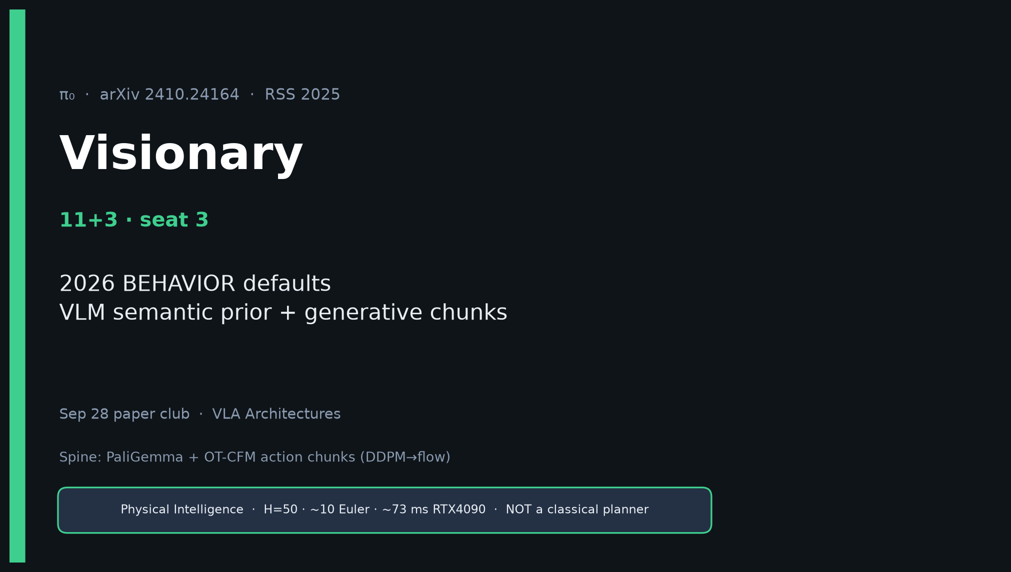
Visionary · 11+3 · 1/12
Notes:
VISIONARY — seat 3 · 11+3.
NO Discord / Drive digressions. Stay on 2026 BEHAVIOR control bets.
Durable idea: VLM semantic prior + generative continuous chunks.

Slide 2
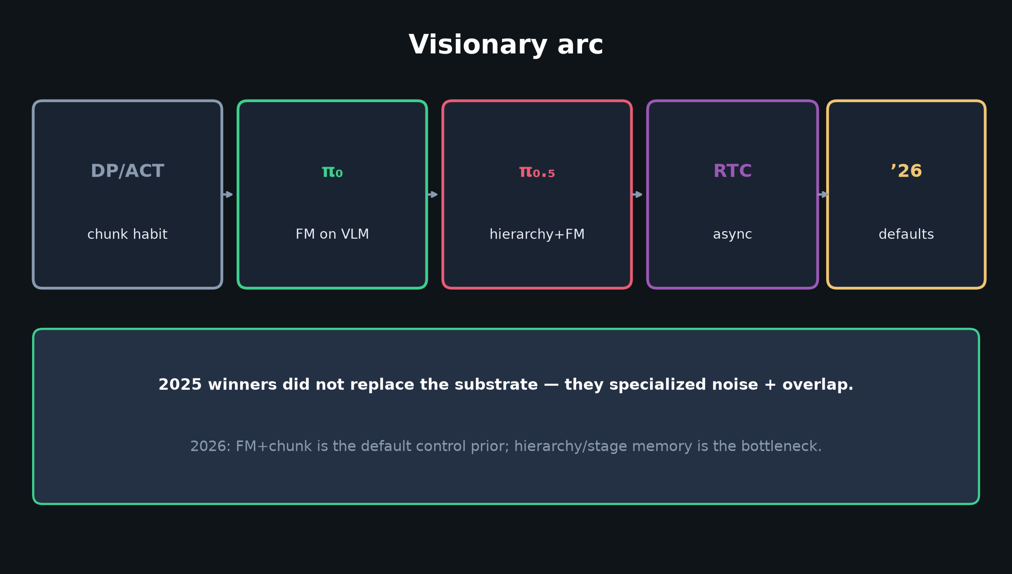
Visionary · 11+3 · 2/12
Notes:
VISIONARY ARC — DP/ACT chunk habit → π₀ FM on VLM → π₀.₅ hierarchy → RTC async → ’26 defaults.
2025 winners specialized noise+overlap; did not replace the substrate.

Slide 3
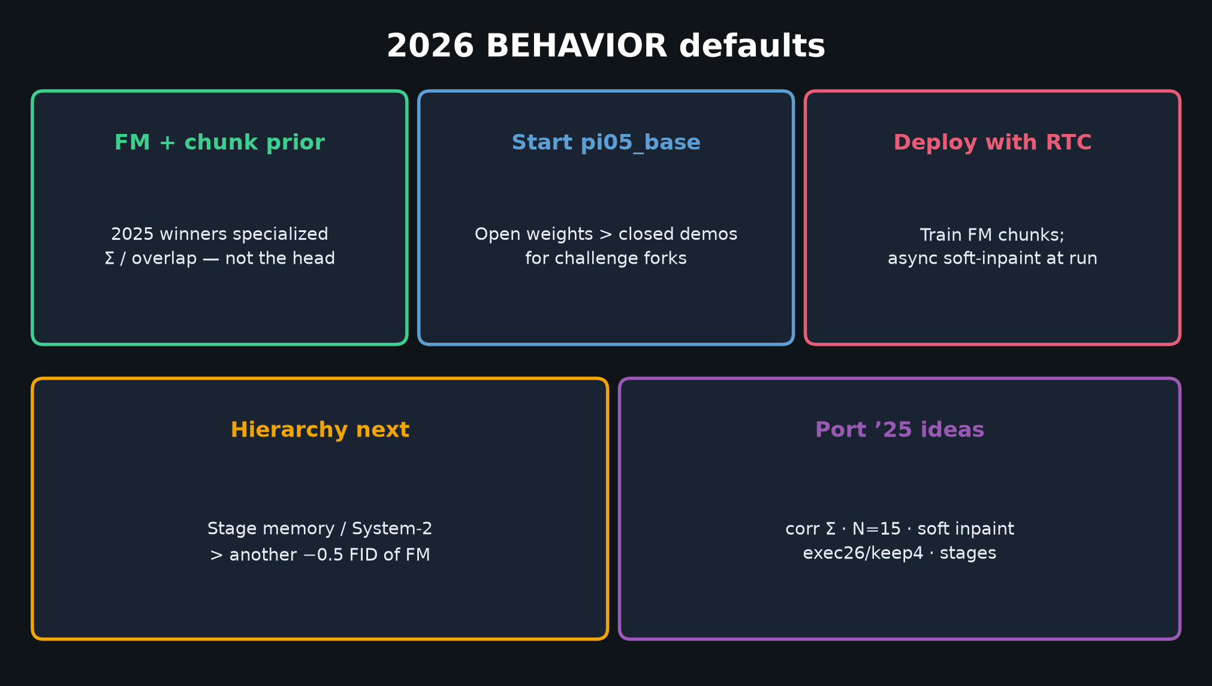
Visionary · 11+3 · 3/12
Notes:
2026 BEHAVIOR DEFAULTS — THE talk figure.
FM+chunk prior · start pi05_base · deploy RTC · hierarchy next · port ’25 ideas.

Slide 4
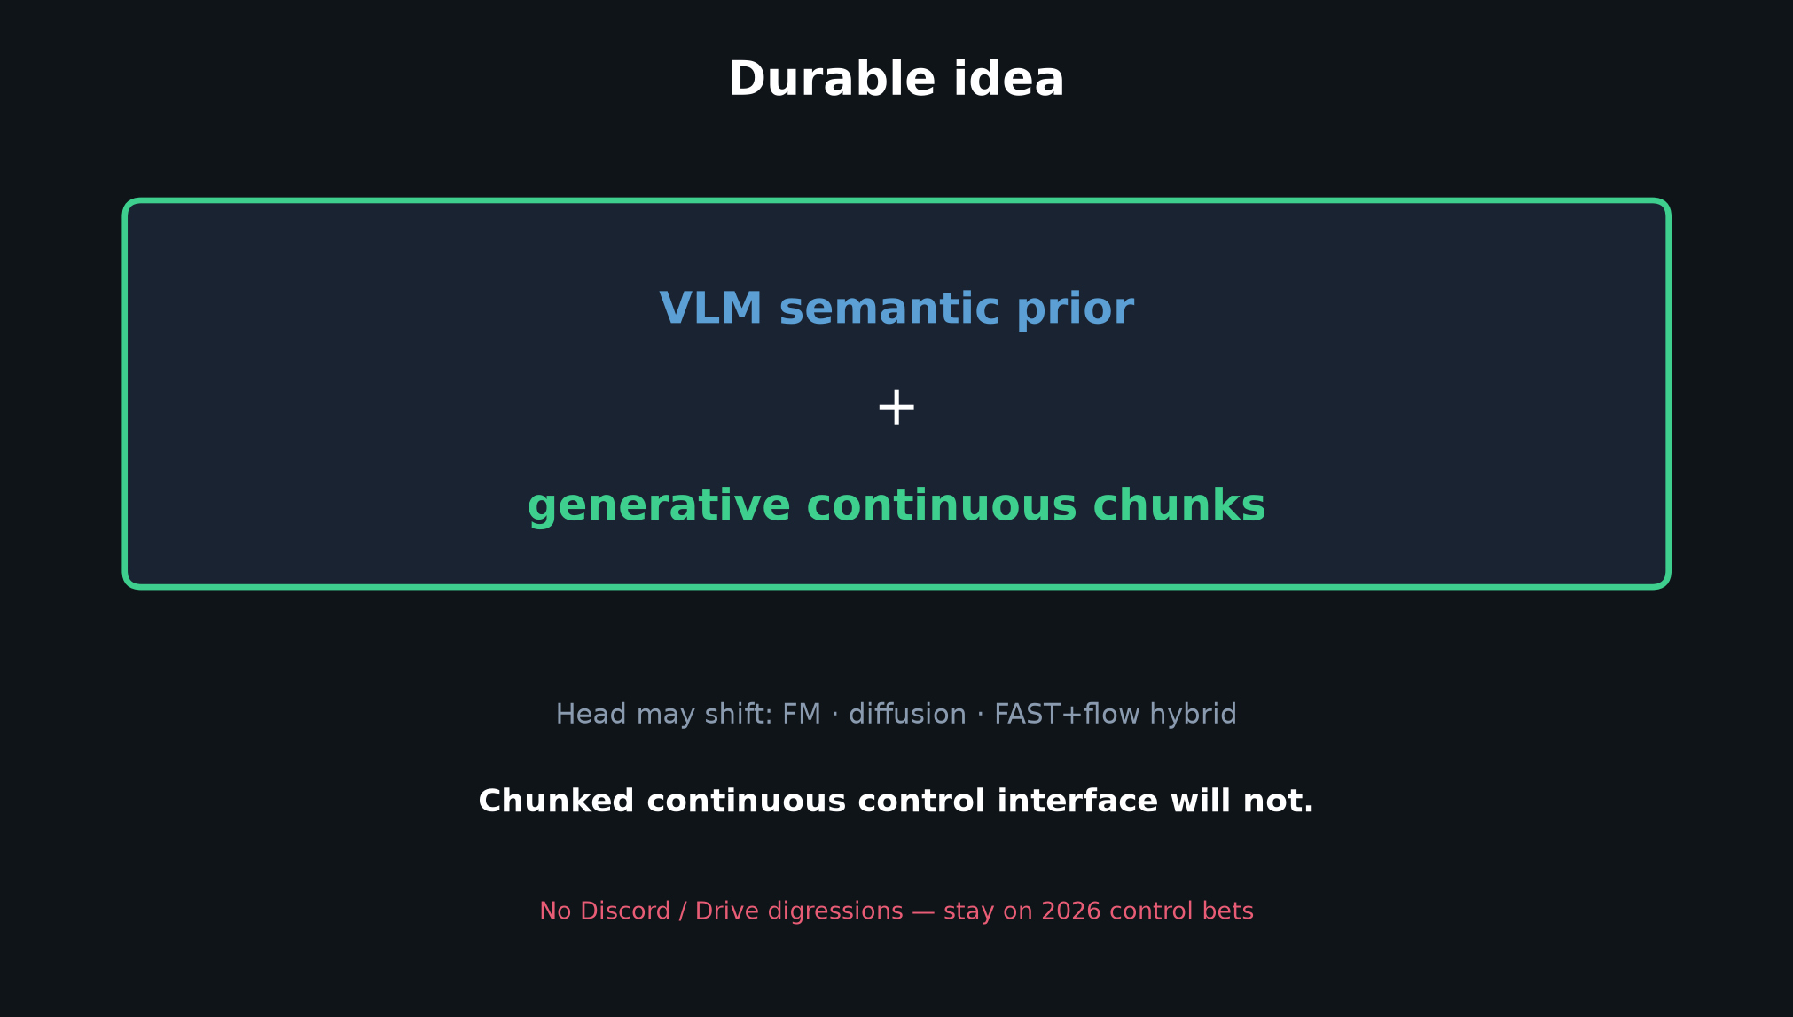
Visionary · 11+3 · 4/12
Notes:
DURABLE IDEA — head may shift; chunked continuous interface will not.

Slide 5
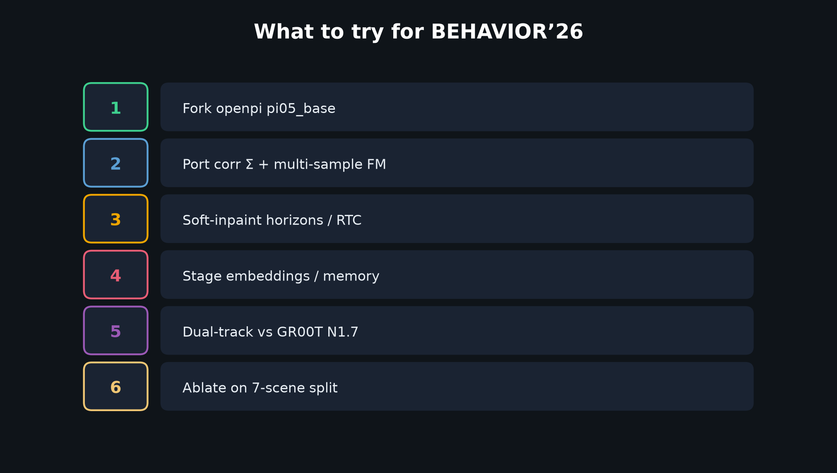
Visionary · 11+3 · 5/12
Notes:
WHAT TO TRY — six concrete steps. Dual-track vs GR00T on 7-scene split, not Twitter.

Slide 6
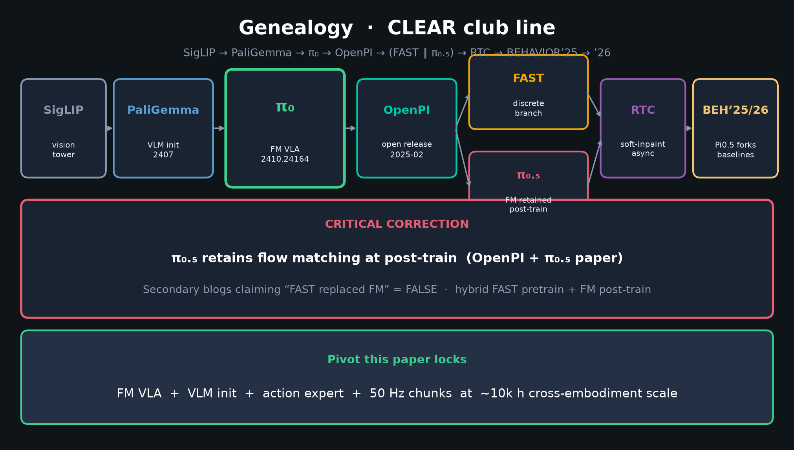
Visionary · 11+3 · 6/12
Notes:
GENEALOGY — show inheritance into BEHAVIOR without Discord/Drive.

Slide 7
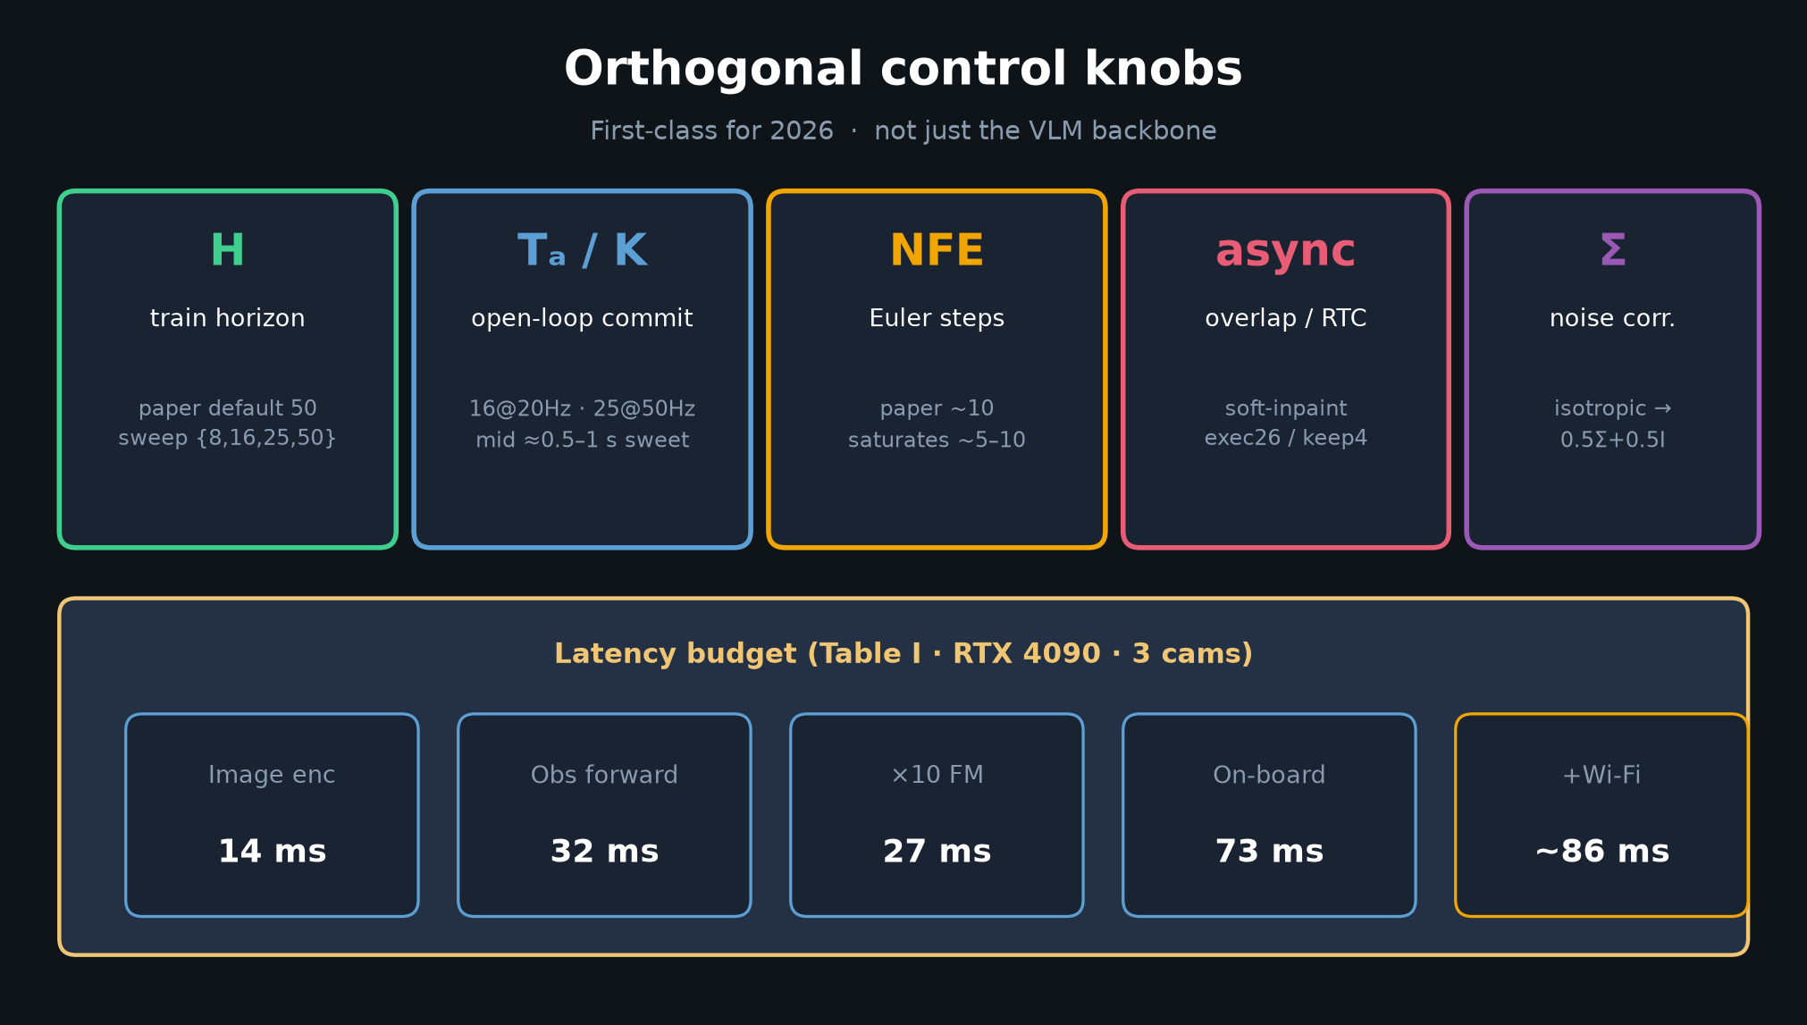
Visionary · 11+3 · 7/12
Notes:
KNOBS — H/Tₐ/NFE/async/Σ are the 2026 control research surface.

Slide 8
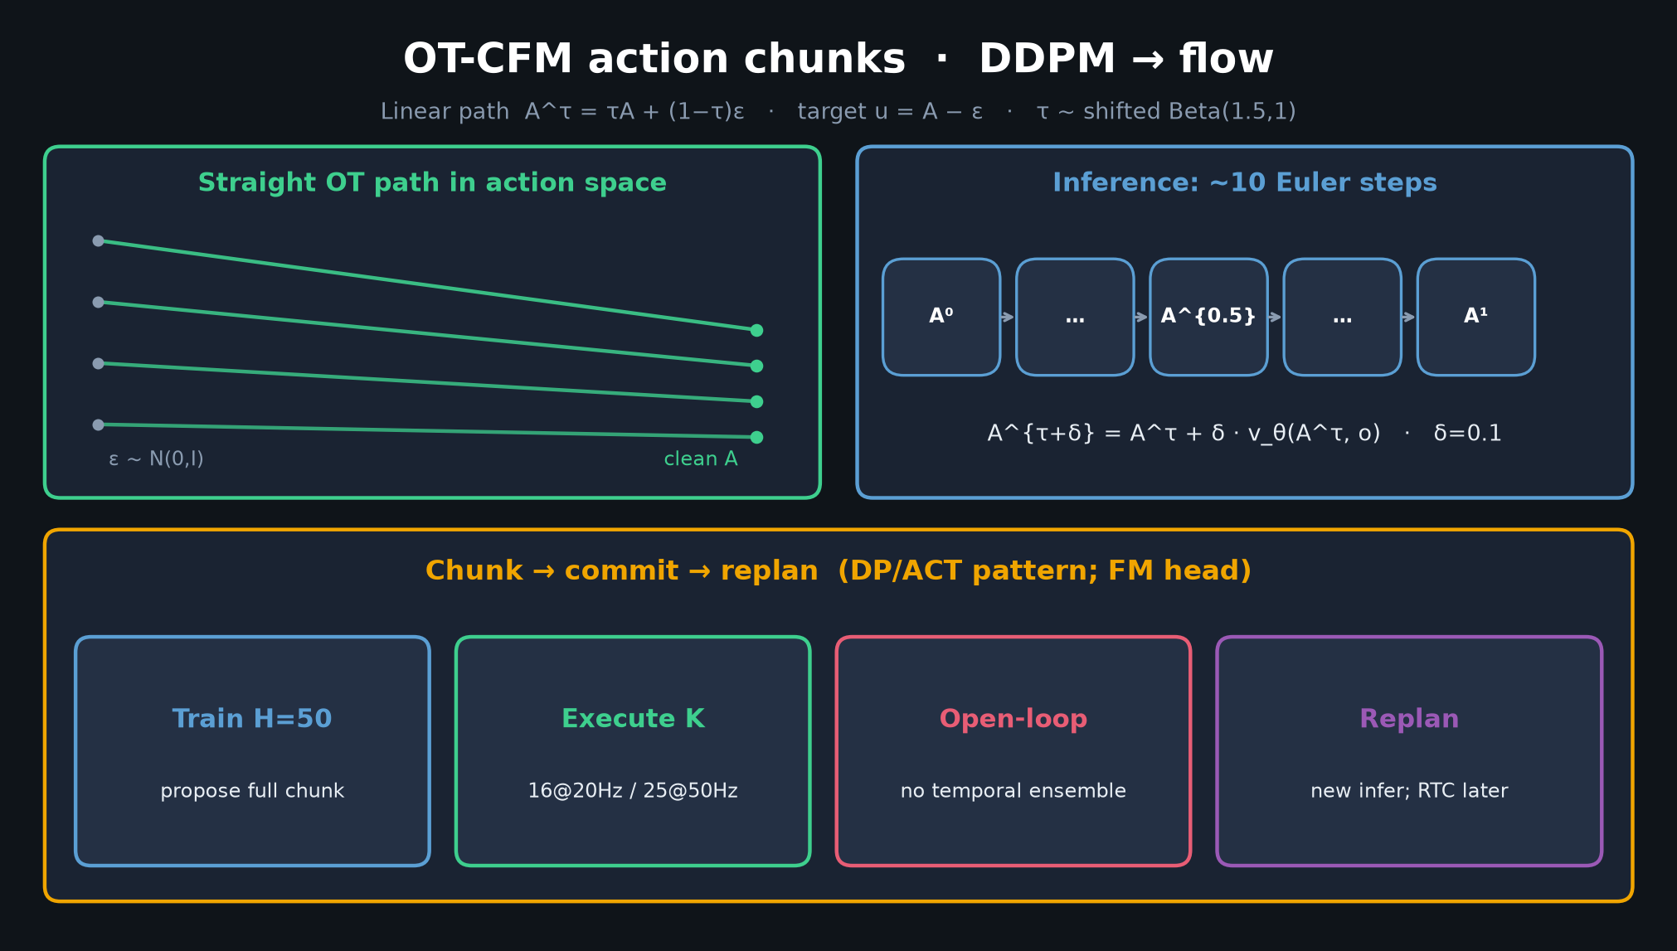
Visionary · 11+3 · 8/12
Notes:
OT-CFM chunks — train FM, deploy with RTC soft-inpaint.

Slide 9
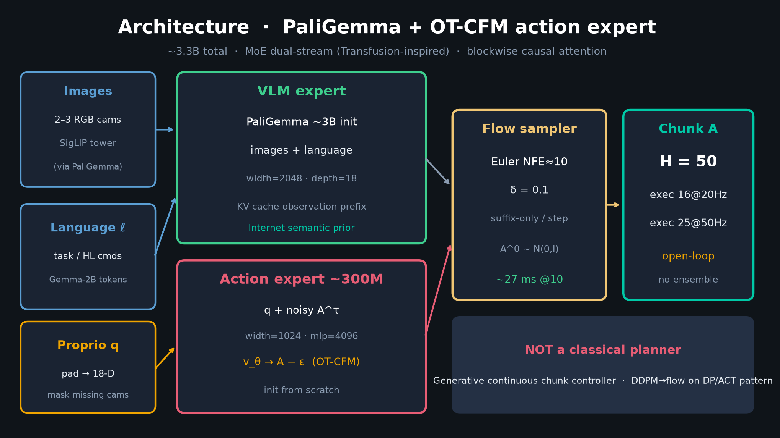
Visionary · 11+3 · 9/12
Notes:
ARCHITECTURE — why VLM prior + action expert remains the bet even as heads hybridize.

Slide 10
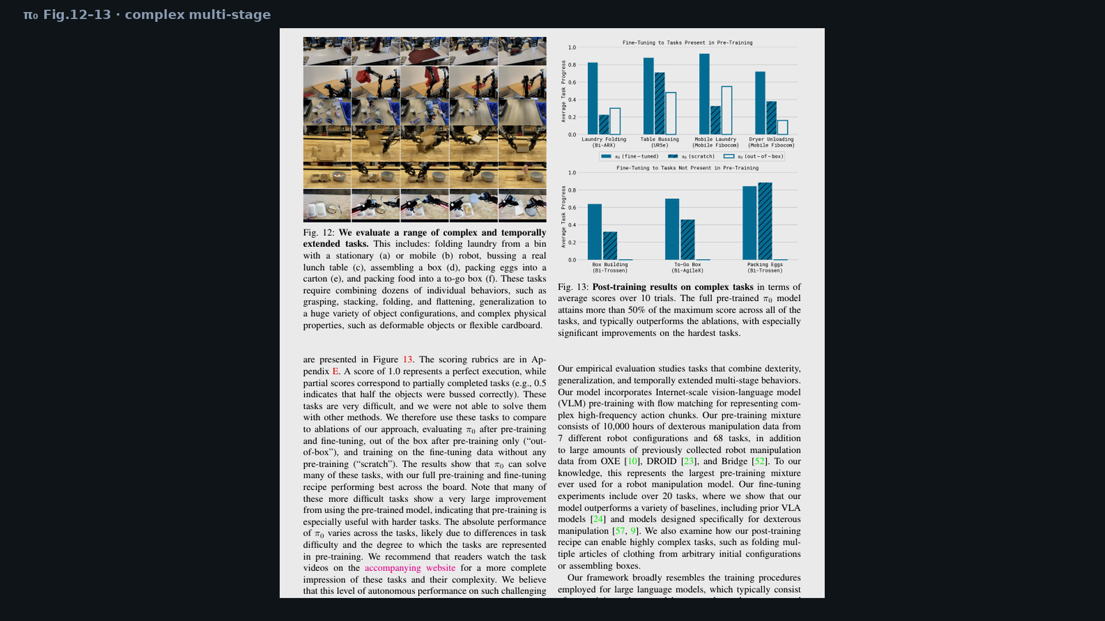
Visionary · 11+3 · 10/12
Notes:
PAPER FIG 13 — long-horizon household = why hierarchy/stage memory matters next.

Slide 11
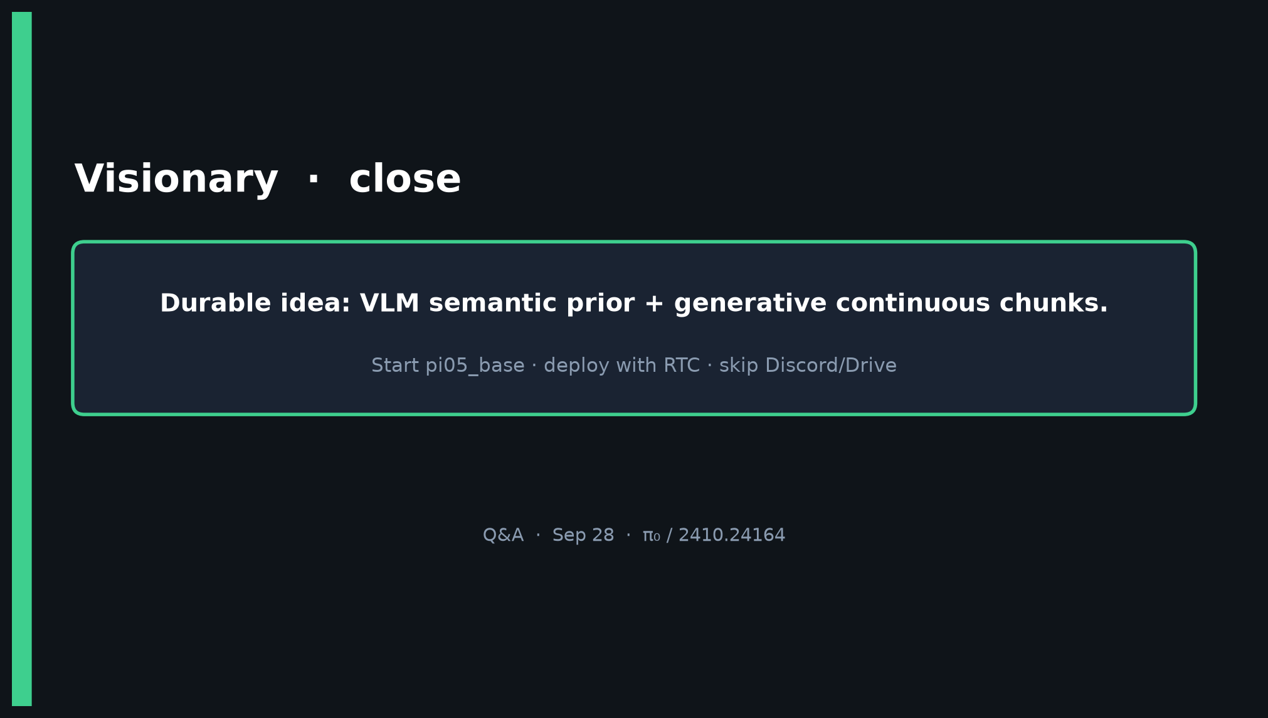
Visionary · 11+3 · 11/12
Notes:
CLOSE — durable idea; start pi05_base; RTC deploy; skip Discord/Drive.

Slide 12
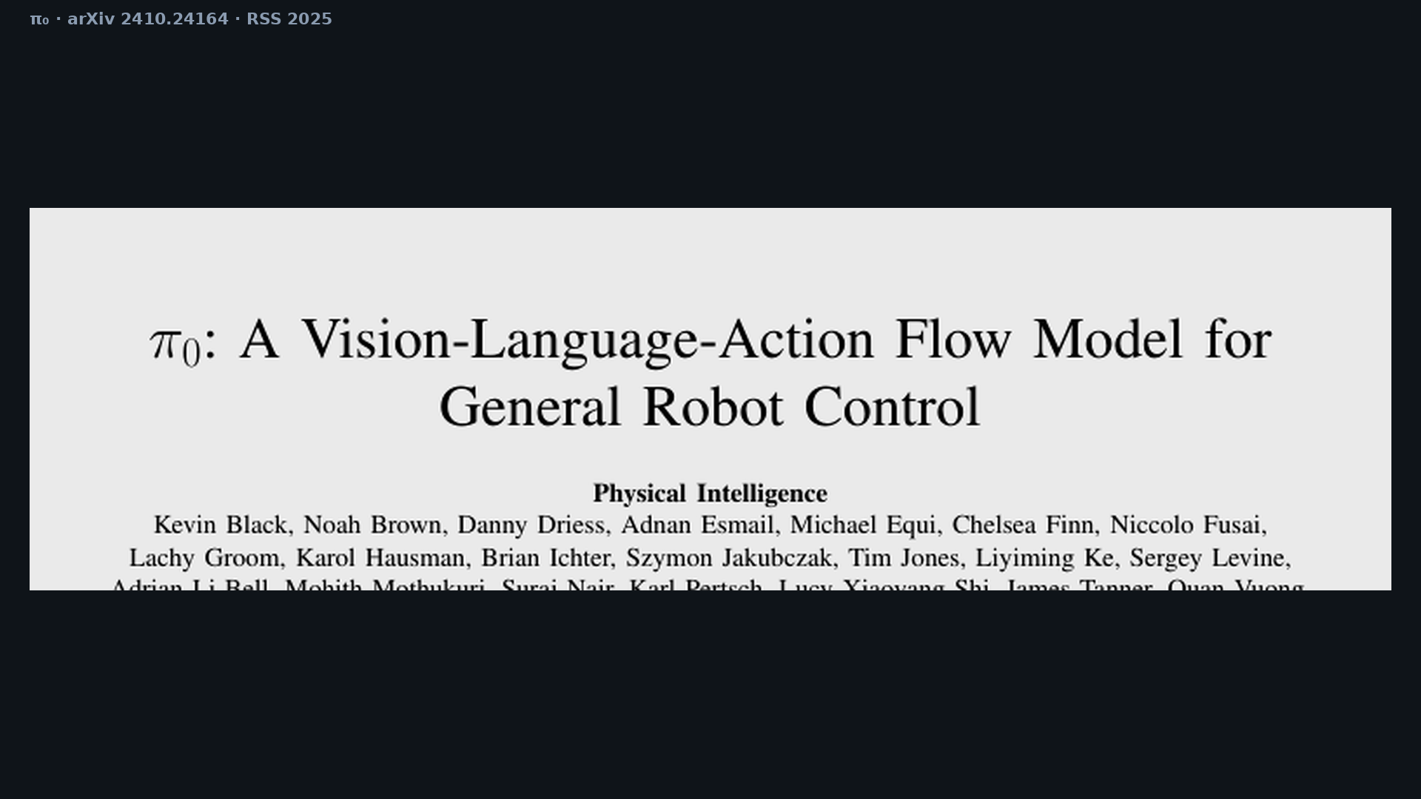
Visionary · 11+3 · 12/12
Notes:
Backup cover.

