Slide 1
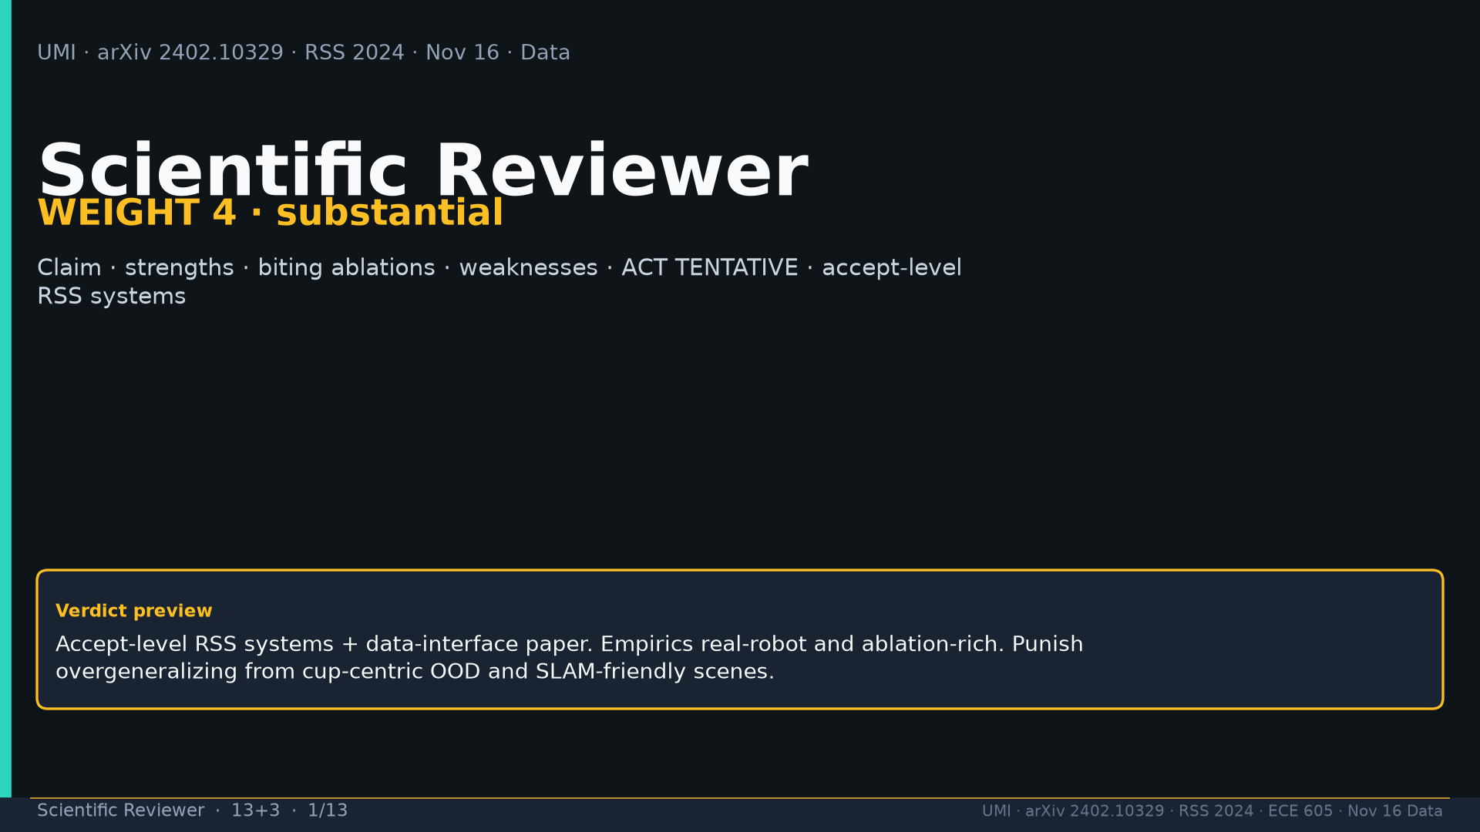
Notes:
Scientific Reviewer · 13+3 · 1/13
Title. Weight 4 substantial. Accept-level RSS systems; punish overclaim. ACT equal = TENTATIVE.
Tattoo: cup 100%/90% · toss 87.5% (no lat 57.5%) · wild 1400/30 → 71.7% vs narrow 0% · rel 100% vs abs 25% · fisheye vs 69° 55% · cloth 70%/30% · dish 70%/0% · Ta=6 @10Hz (20Hz toss)

Slide 2
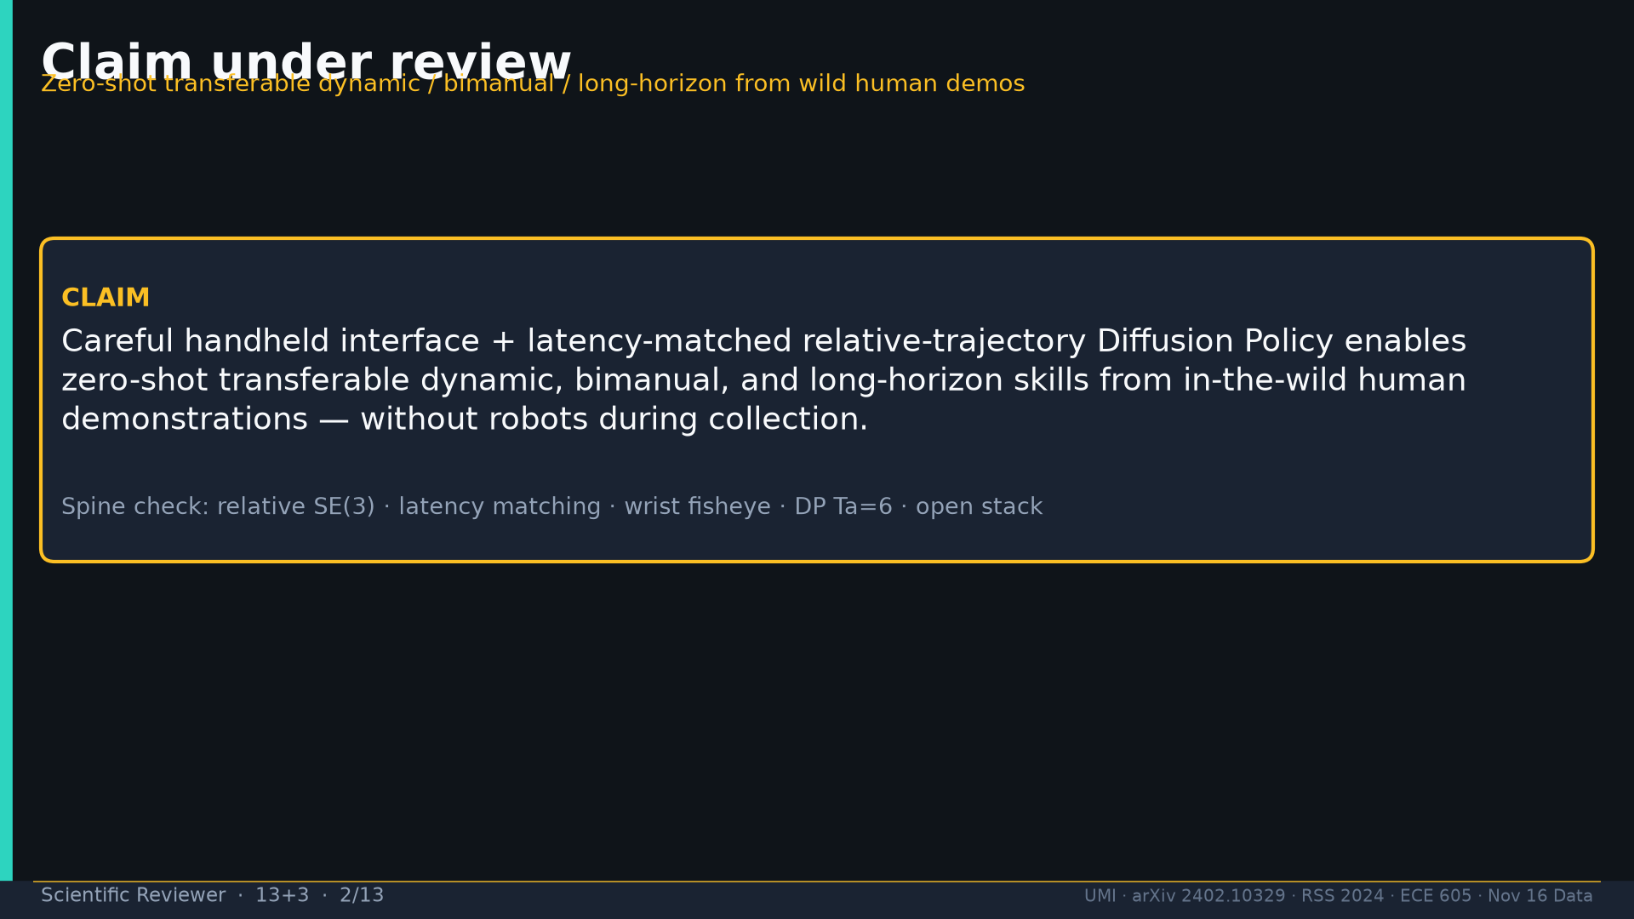
Notes:
Scientific Reviewer · 13+3 · 2/13
Claim: handheld interface + latency-matched relative-trajectory DP enables ZS transferable dynamic/bimanual/LH from wild human demos.
Tattoo: cup 100%/90% · toss 87.5% (no lat 57.5%) · wild 1400/30 → 71.7% vs narrow 0% · rel 100% vs abs 25% · fisheye vs 69° 55% · cloth 70%/30% · dish 70%/0% · Ta=6 @10Hz (20Hz toss)

Slide 3
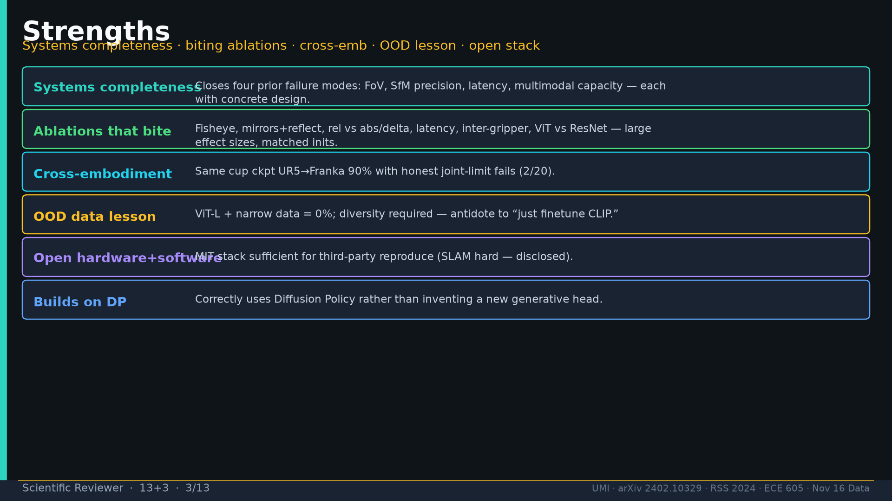
Notes:
Scientific Reviewer · 13+3 · 3/13
Strengths: systems completeness (FoV/SfM/latency/multimodal); biting ablations; cross-emb 90%; OOD data lesson (ViT+narrow=0%); open stack; builds on DP.
Tattoo: cup 100%/90% · toss 87.5% (no lat 57.5%) · wild 1400/30 → 71.7% vs narrow 0% · rel 100% vs abs 25% · fisheye vs 69° 55% · cloth 70%/30% · dish 70%/0% · Ta=6 @10Hz (20Hz toss)

Slide 4
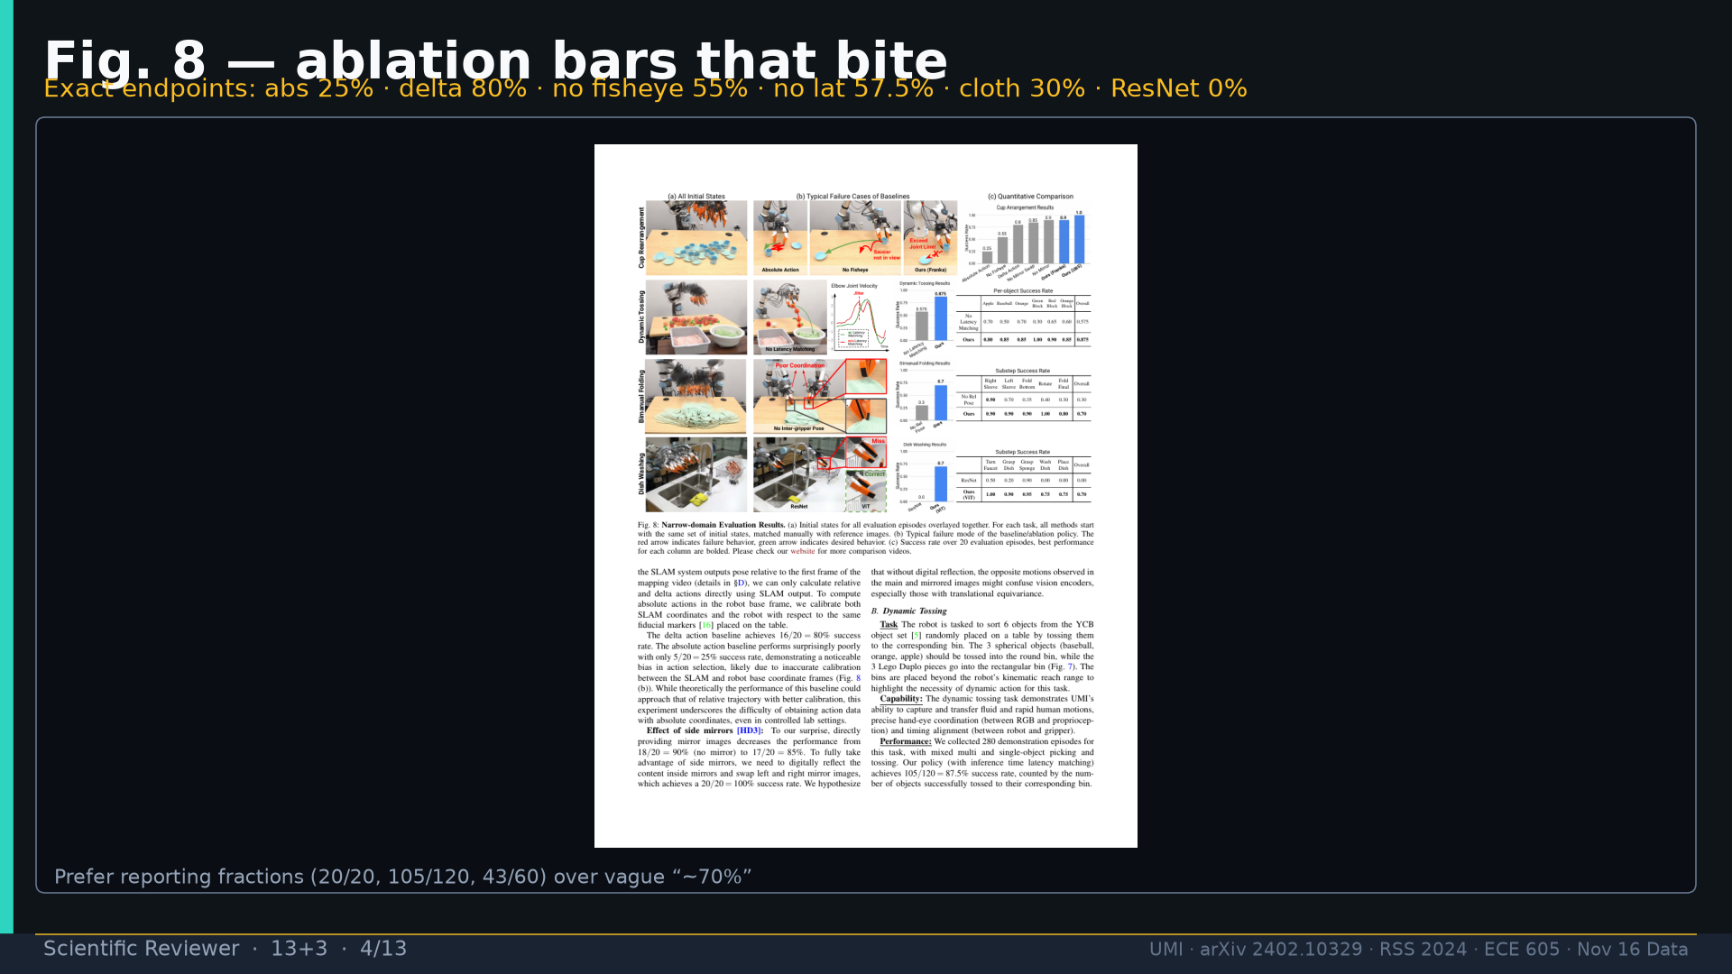
Notes:
Scientific Reviewer · 13+3 · 4/13
Fig.8 ablation bars. Prefer fractions: 20/20, 105/120, 5/20, 11/20, 69/120, 6/20, 0/10, 43/60.
Tattoo: cup 100%/90% · toss 87.5% (no lat 57.5%) · wild 1400/30 → 71.7% vs narrow 0% · rel 100% vs abs 25% · fisheye vs 69° 55% · cloth 70%/30% · dish 70%/0% · Ta=6 @10Hz (20Hz toss)

Slide 5
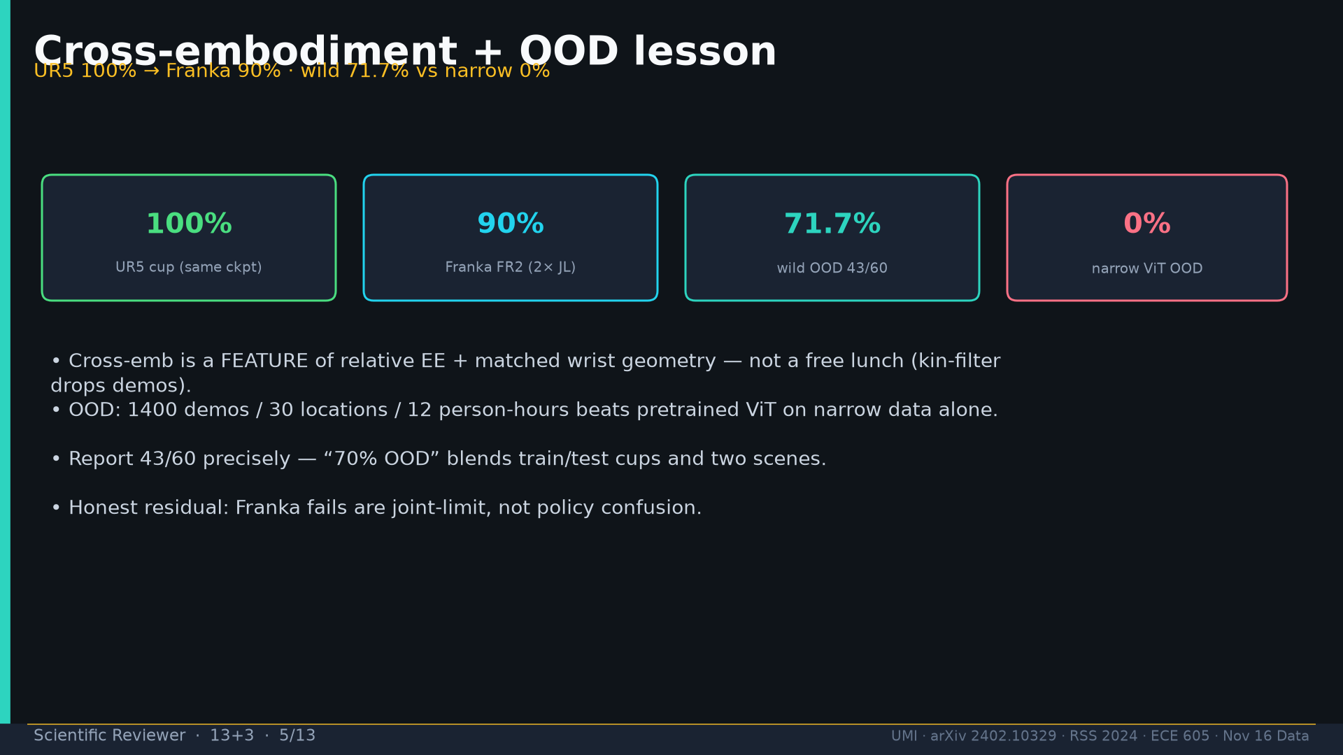
Notes:
Scientific Reviewer · 13+3 · 5/13
Cross-emb UR5 100→Franka 90 (2 JL). Wild 43/60=71.7% vs narrow 0%. Report 43/60 not vague 70%.
Tattoo: cup 100%/90% · toss 87.5% (no lat 57.5%) · wild 1400/30 → 71.7% vs narrow 0% · rel 100% vs abs 25% · fisheye vs 69° 55% · cloth 70%/30% · dish 70%/0% · Ta=6 @10Hz (20Hz toss)

Slide 6
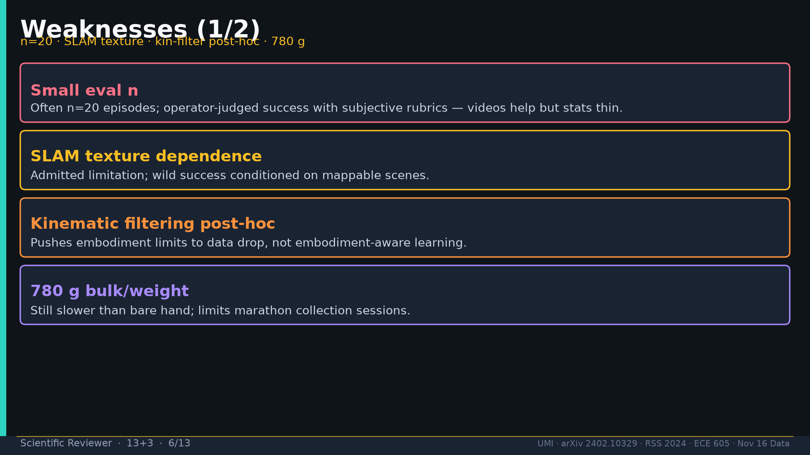
Notes:
Scientific Reviewer · 13+3 · 6/13
Weak1: n=20; SLAM texture; kin-filter post-hoc; 780g bulk.
Tattoo: cup 100%/90% · toss 87.5% (no lat 57.5%) · wild 1400/30 → 71.7% vs narrow 0% · rel 100% vs abs 25% · fisheye vs 69° 55% · cloth 70%/30% · dish 70%/0% · Ta=6 @10Hz (20Hz toss)

Slide 7
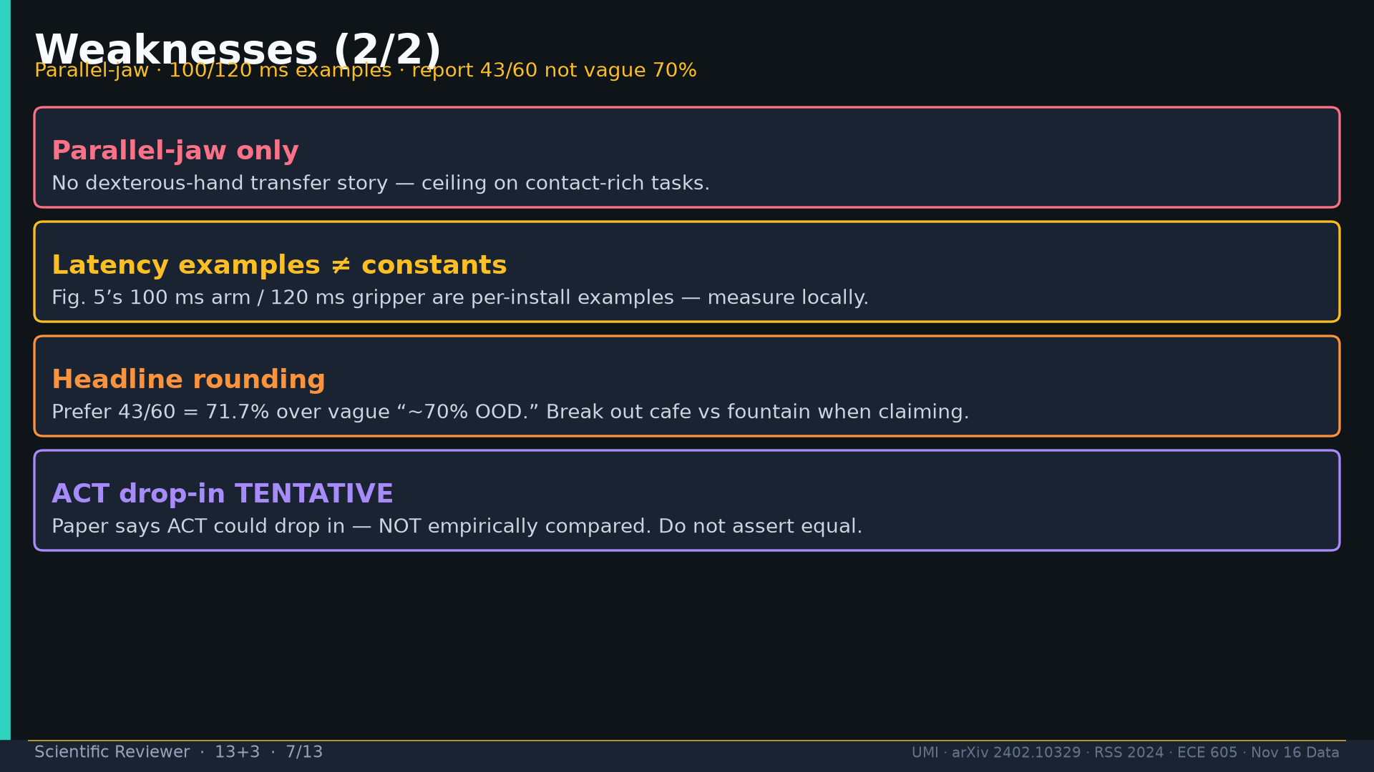
Notes:
Scientific Reviewer · 13+3 · 7/13
Weak2: parallel-jaw only; 100/120 ms examples≠constants; headline rounding; ACT drop-in TENTATIVE.
Tattoo: cup 100%/90% · toss 87.5% (no lat 57.5%) · wild 1400/30 → 71.7% vs narrow 0% · rel 100% vs abs 25% · fisheye vs 69° 55% · cloth 70%/30% · dish 70%/0% · Ta=6 @10Hz (20Hz toss)

Slide 8
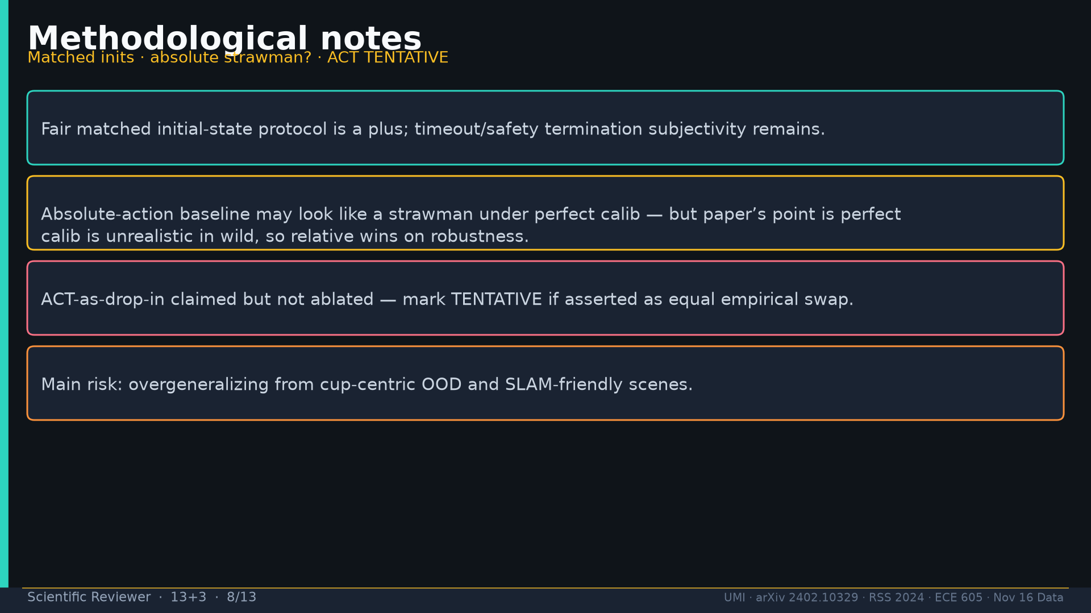
Notes:
Scientific Reviewer · 13+3 · 8/13
Method notes: matched inits plus; abs baseline robustness point; ACT not ablated; risk overgeneralizing cup OOD.
Tattoo: cup 100%/90% · toss 87.5% (no lat 57.5%) · wild 1400/30 → 71.7% vs narrow 0% · rel 100% vs abs 25% · fisheye vs 69° 55% · cloth 70%/30% · dish 70%/0% · Ta=6 @10Hz (20Hz toss)

Slide 9
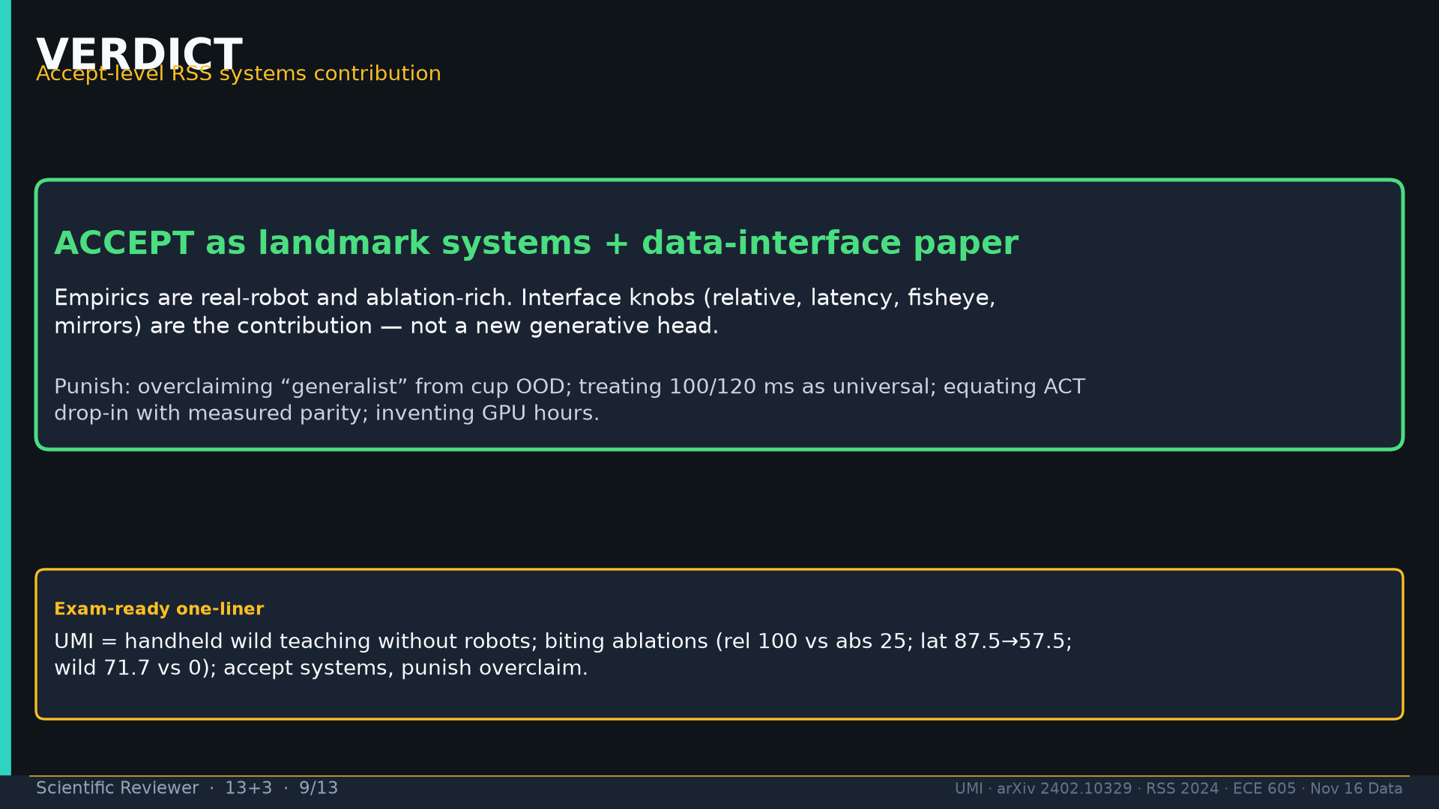
Notes:
Scientific Reviewer · 13+3 · 9/13
VERDICT: Accept landmark systems+data-interface. Punish generalist marketing / invented hours / ACT parity claim.
Tattoo: cup 100%/90% · toss 87.5% (no lat 57.5%) · wild 1400/30 → 71.7% vs narrow 0% · rel 100% vs abs 25% · fisheye vs 69° 55% · cloth 70%/30% · dish 70%/0% · Ta=6 @10Hz (20Hz toss)

Slide 10
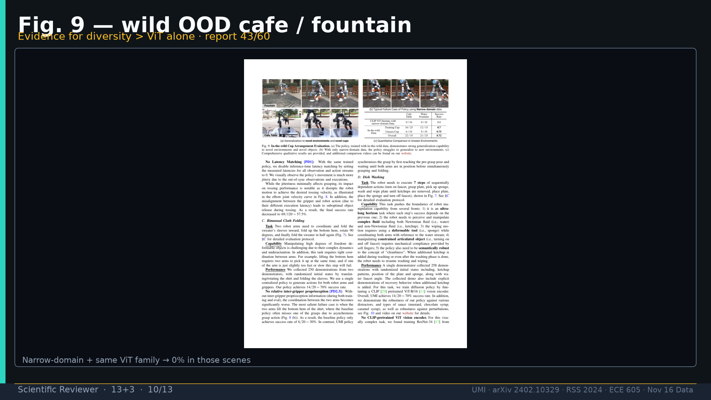
Notes:
Scientific Reviewer · 13+3 · 10/13
Fig.9 wild OOD evidence for diversity > ViT alone.
Tattoo: cup 100%/90% · toss 87.5% (no lat 57.5%) · wild 1400/30 → 71.7% vs narrow 0% · rel 100% vs abs 25% · fisheye vs 69° 55% · cloth 70%/30% · dish 70%/0% · Ta=6 @10Hz (20Hz toss)

Slide 11
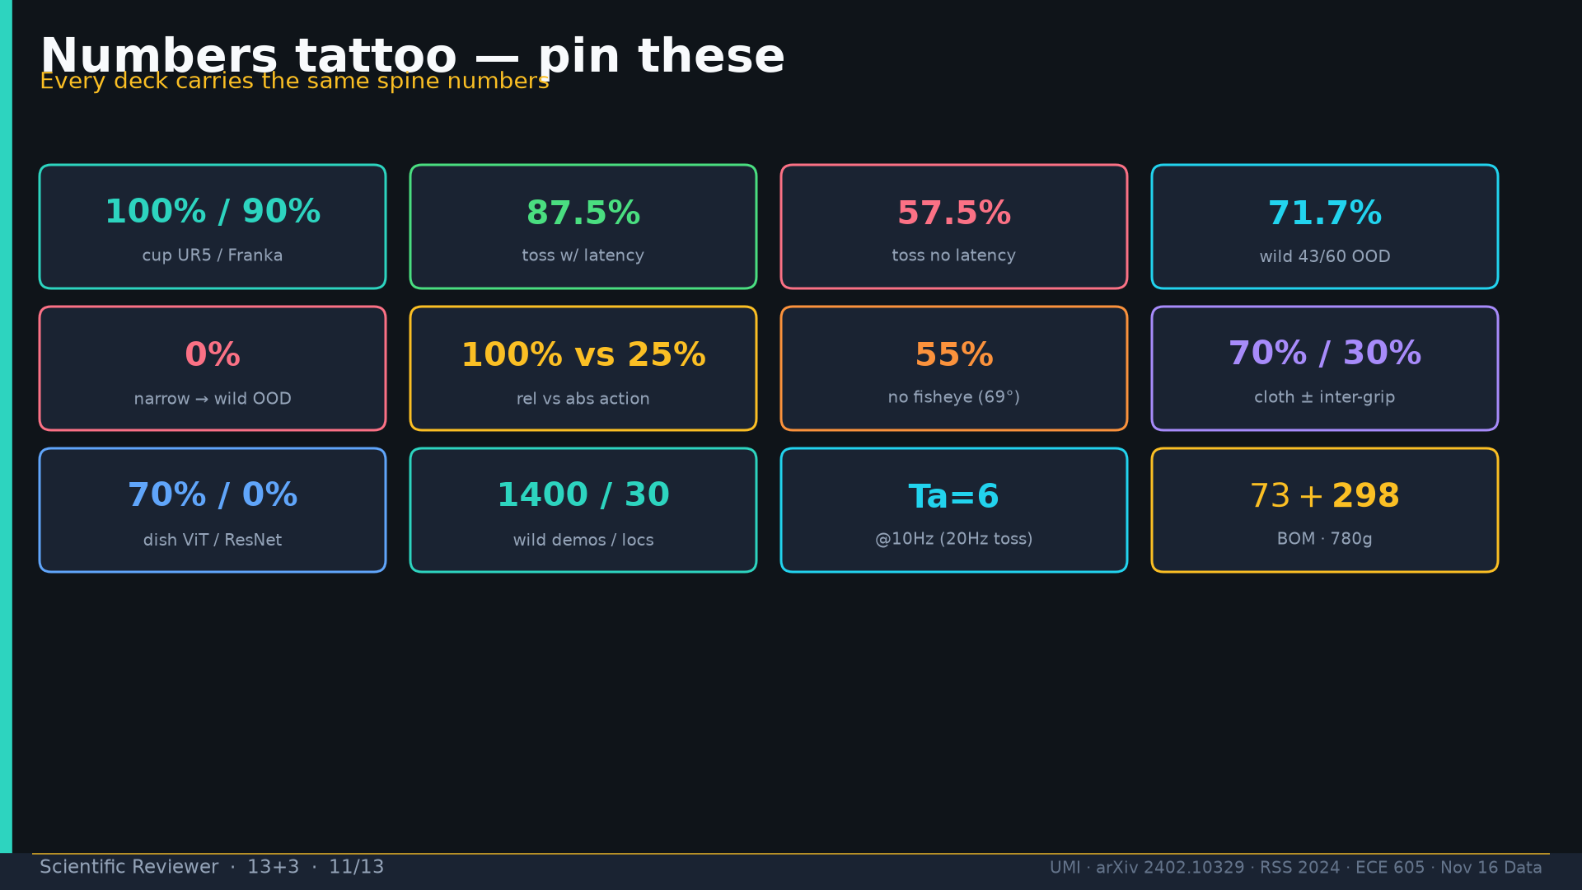
Notes:
Scientific Reviewer · 13+3 · 11/13
Tattoo.
Tattoo: cup 100%/90% · toss 87.5% (no lat 57.5%) · wild 1400/30 → 71.7% vs narrow 0% · rel 100% vs abs 25% · fisheye vs 69° 55% · cloth 70%/30% · dish 70%/0% · Ta=6 @10Hz (20Hz toss)

Slide 12
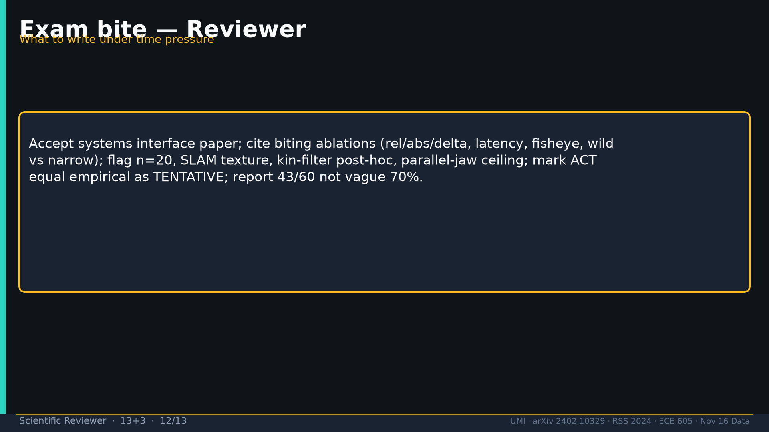
Notes:
Scientific Reviewer · 13+3 · 12/13
Exam: accept systems; cite biting ablations; flag n=20/SLAM/kin-filter/jaw; ACT=TENTATIVE; report 43/60.
Tattoo: cup 100%/90% · toss 87.5% (no lat 57.5%) · wild 1400/30 → 71.7% vs narrow 0% · rel 100% vs abs 25% · fisheye vs 69° 55% · cloth 70%/30% · dish 70%/0% · Ta=6 @10Hz (20Hz toss)

Slide 13
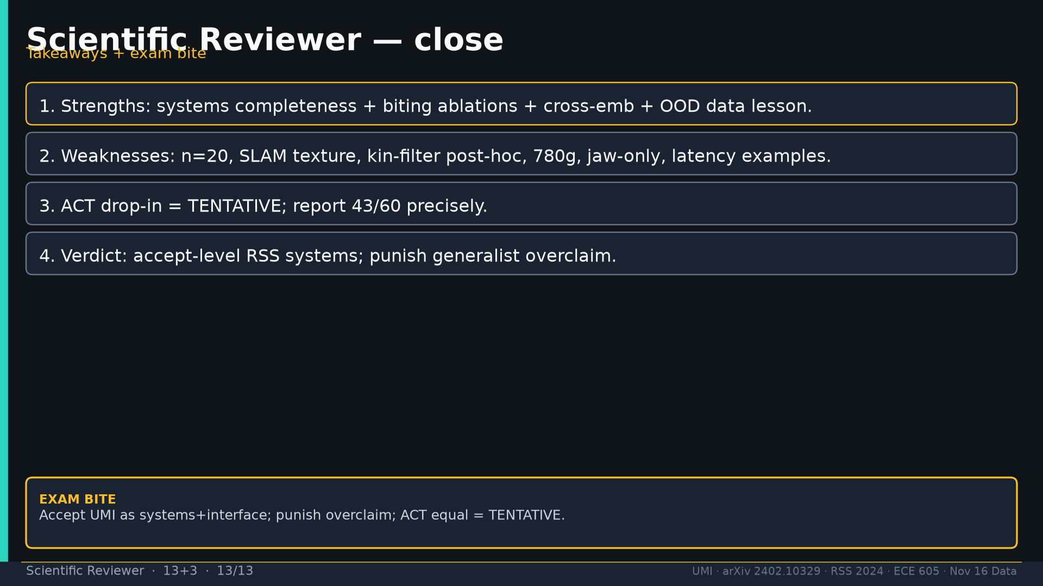
Notes:
Scientific Reviewer · 13+3 · 13/13
Close takeaways.
Tattoo: cup 100%/90% · toss 87.5% (no lat 57.5%) · wild 1400/30 → 71.7% vs narrow 0% · rel 100% vs abs 25% · fisheye vs 69° 55% · cloth 70%/30% · dish 70%/0% · Ta=6 @10Hz (20Hz toss)

