Slide 1
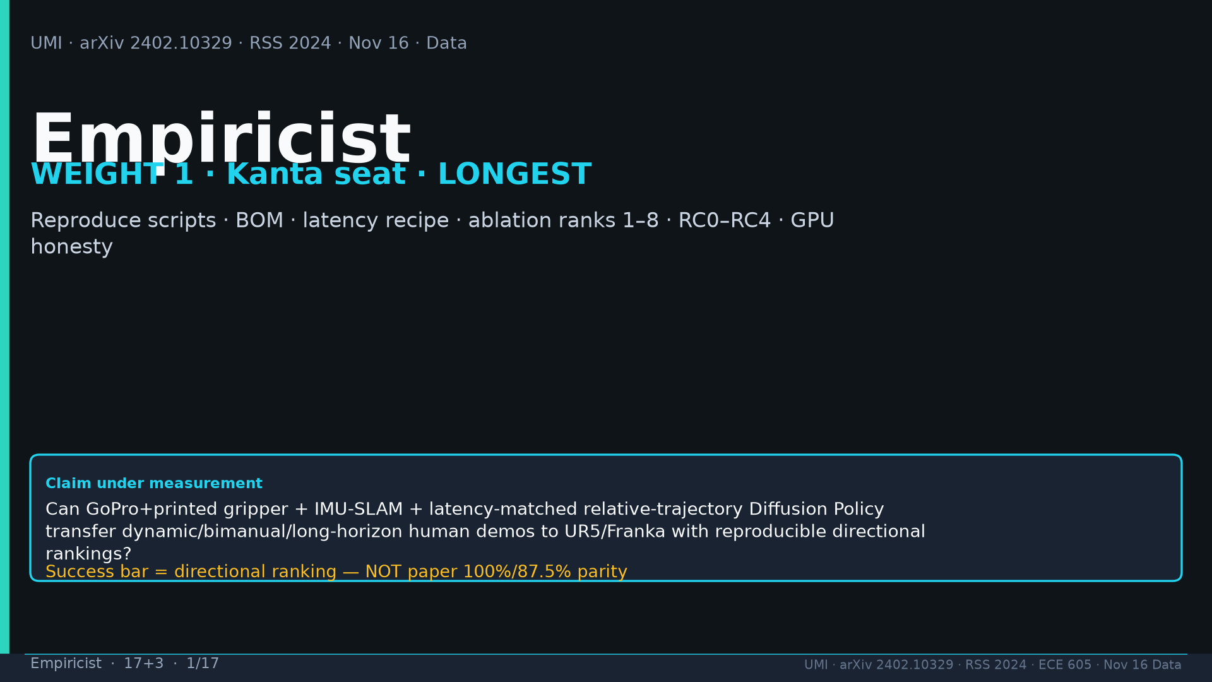
Notes:
Empiricist · 17+3 · 1/17
Title. WEIGHT 1 Kanta seat LONGEST. Claim under measurement. Success bar = DIRECTIONAL ranking NOT paper 100%/87.5% parity.
Tattoo: cup 100%/90% · toss 87.5% (no lat 57.5%) · wild 1400/30 → 71.7% vs narrow 0% · rel 100% vs abs 25% · fisheye vs 69° 55% · cloth 70%/30% · dish 70%/0% · Ta=6 @10Hz (20Hz toss)

Slide 2
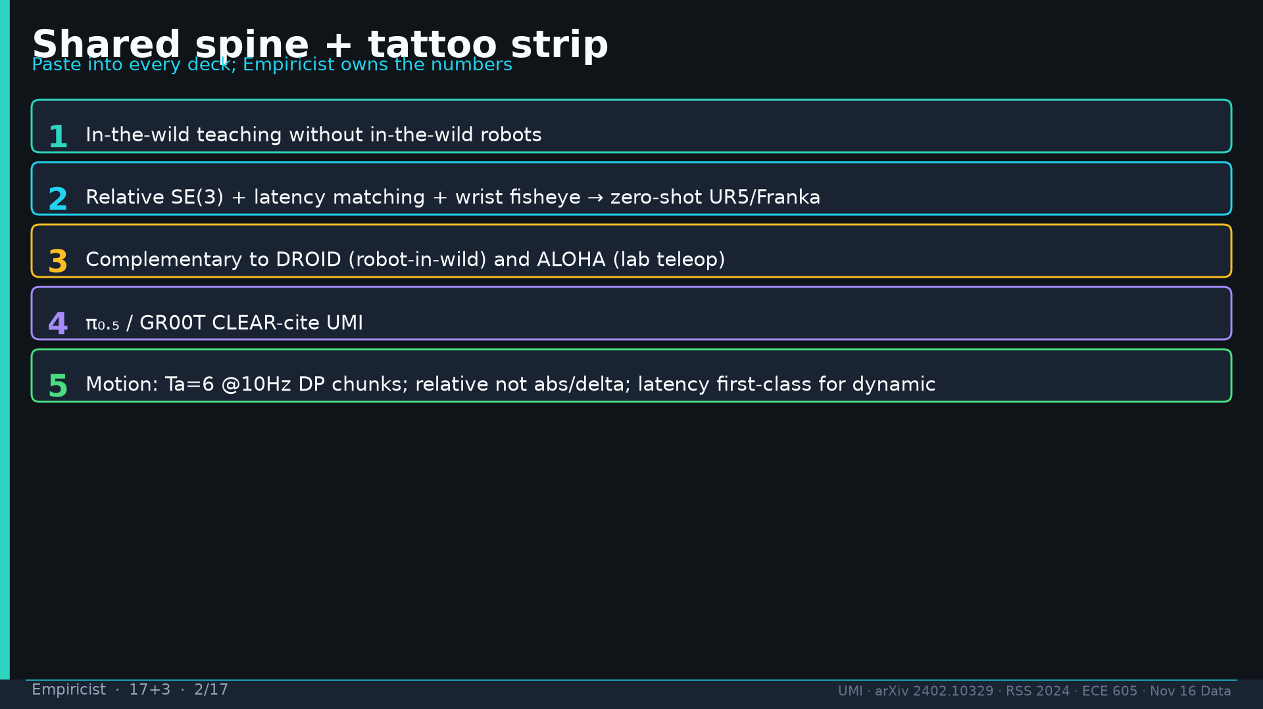
Notes:
Empiricist · 17+3 · 2/17
Shared spine 1–5: wild without robots; relative+latency+fisheye→UR5/Franka; complementary DROID/ALOHA; π₀.₅/GR00T cite; Ta=6 @10Hz.
Tattoo: cup 100%/90% · toss 87.5% (no lat 57.5%) · wild 1400/30 → 71.7% vs narrow 0% · rel 100% vs abs 25% · fisheye vs 69° 55% · cloth 70%/30% · dish 70%/0% · Ta=6 @10Hz (20Hz toss)

Slide 3
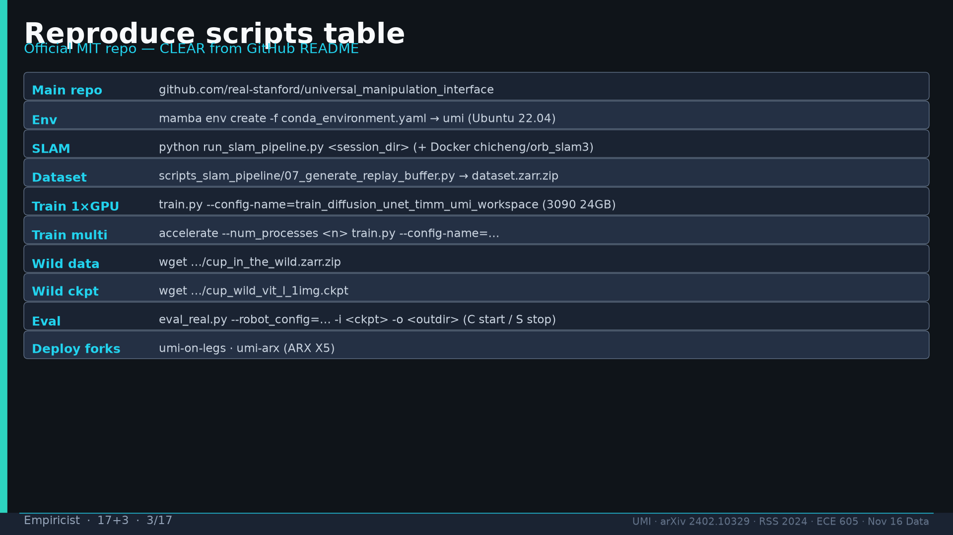
Notes:
Empiricist · 17+3 · 3/17
Reproduce scripts: repo MIT; mamba conda_environment.yaml; run_slam_pipeline.py; 07_generate_replay_buffer.py; train.py train_diffusion_unet_timm_umi_workspace; accelerate multi; cup_in_the_wild.zarr.zip; cup_wild_vit_l ckpt; eval_real.py; umi-on-legs/umi-arx; ORB_SLAM3 Docker chicheng/orb_slam3.
Tattoo: cup 100%/90% · toss 87.5% (no lat 57.5%) · wild 1400/30 → 71.7% vs narrow 0% · rel 100% vs abs 25% · fisheye vs 69° 55% · cloth 70%/30% · dish 70%/0% · Ta=6 @10Hz (20Hz toss)

Slide 4
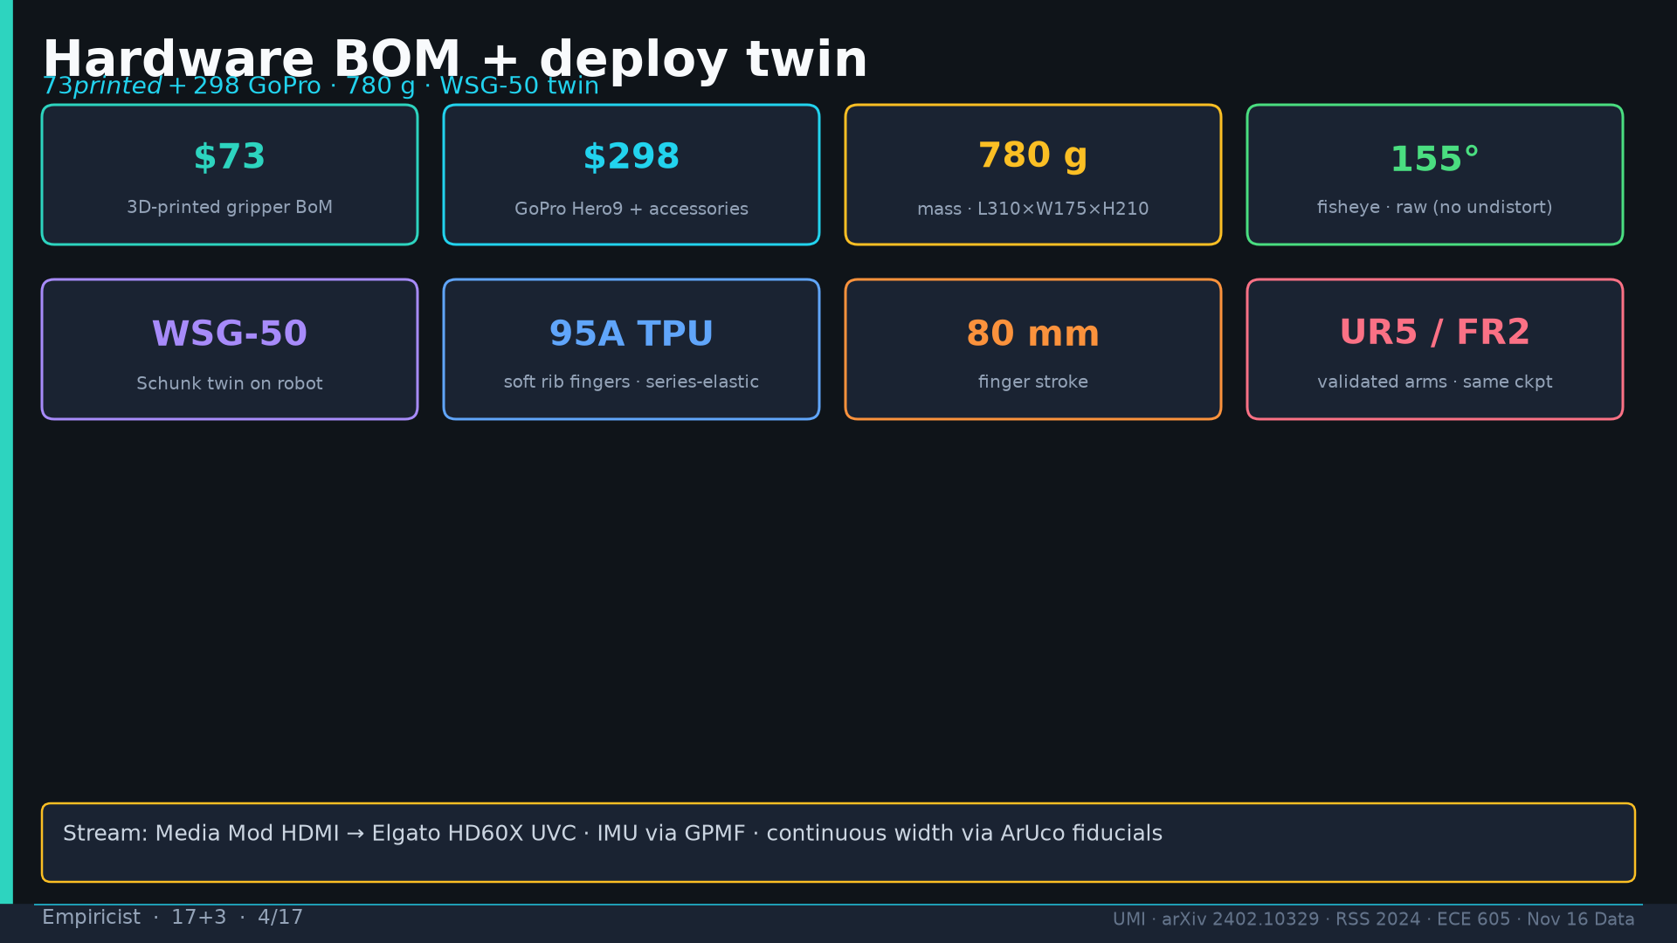
Notes:
Empiricist · 17+3 · 4/17
BOM: $73 printed + $298 GoPro Hero9; 780g; 155° fisheye raw; WSG-50 twin; 95A TPU; 80mm stroke; UR5/FR2; Elgato HD60X; GPMF IMU; ArUco width.
Tattoo: cup 100%/90% · toss 87.5% (no lat 57.5%) · wild 1400/30 → 71.7% vs narrow 0% · rel 100% vs abs 25% · fisheye vs 69° 55% · cloth 70%/30% · dish 70%/0% · Ta=6 @10Hz (20Hz toss)

Slide 5
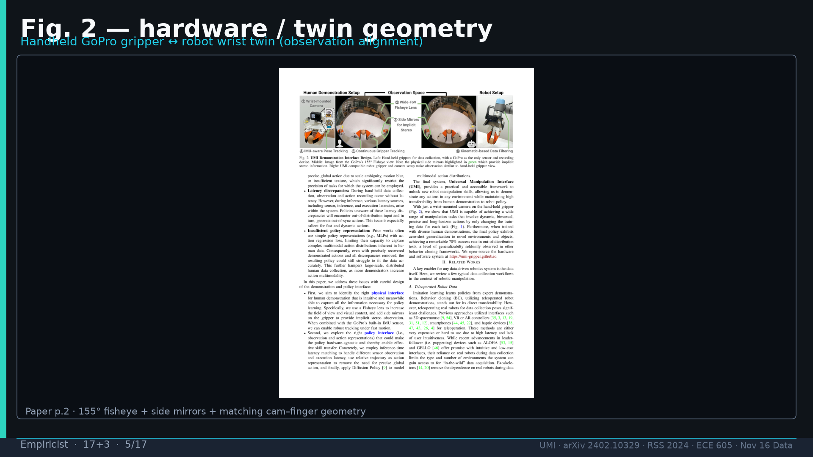
Notes:
Empiricist · 17+3 · 5/17
Fig.2 hardware twin geometry — observation alignment is the point.
Tattoo: cup 100%/90% · toss 87.5% (no lat 57.5%) · wild 1400/30 → 71.7% vs narrow 0% · rel 100% vs abs 25% · fisheye vs 69° 55% · cloth 70%/30% · dish 70%/0% · Ta=6 @10Hz (20Hz toss)

Slide 6
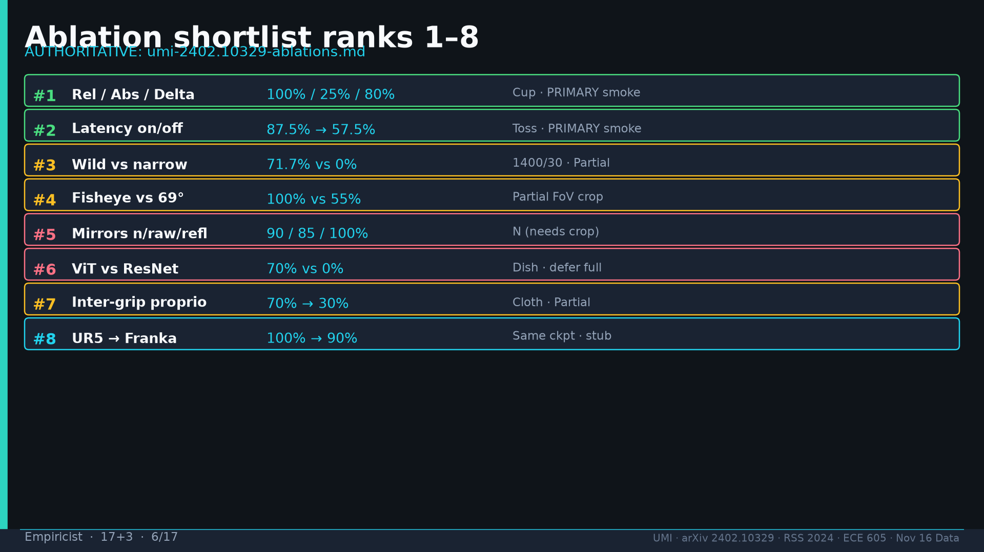
Notes:
Empiricist · 17+3 · 6/17
Ablation ranks 1–8 AUTHORITATIVE from Ablation Bot: #1 Rel/Abs/Delta 100/25/80 PRIMARY; #2 latency 87.5→57.5 PRIMARY; #3 wild 71.7 vs 0 Partial; #4 fisheye 55% Partial; #5 mirrors 90/85/100 N; #6 ViT/ResNet 70/0 defer; #7 inter-grip 70→30 Partial; #8 UR5→Franka 100→90 stub.
Tattoo: cup 100%/90% · toss 87.5% (no lat 57.5%) · wild 1400/30 → 71.7% vs narrow 0% · rel 100% vs abs 25% · fisheye vs 69° 55% · cloth 70%/30% · dish 70%/0% · Ta=6 @10Hz (20Hz toss)

Slide 7
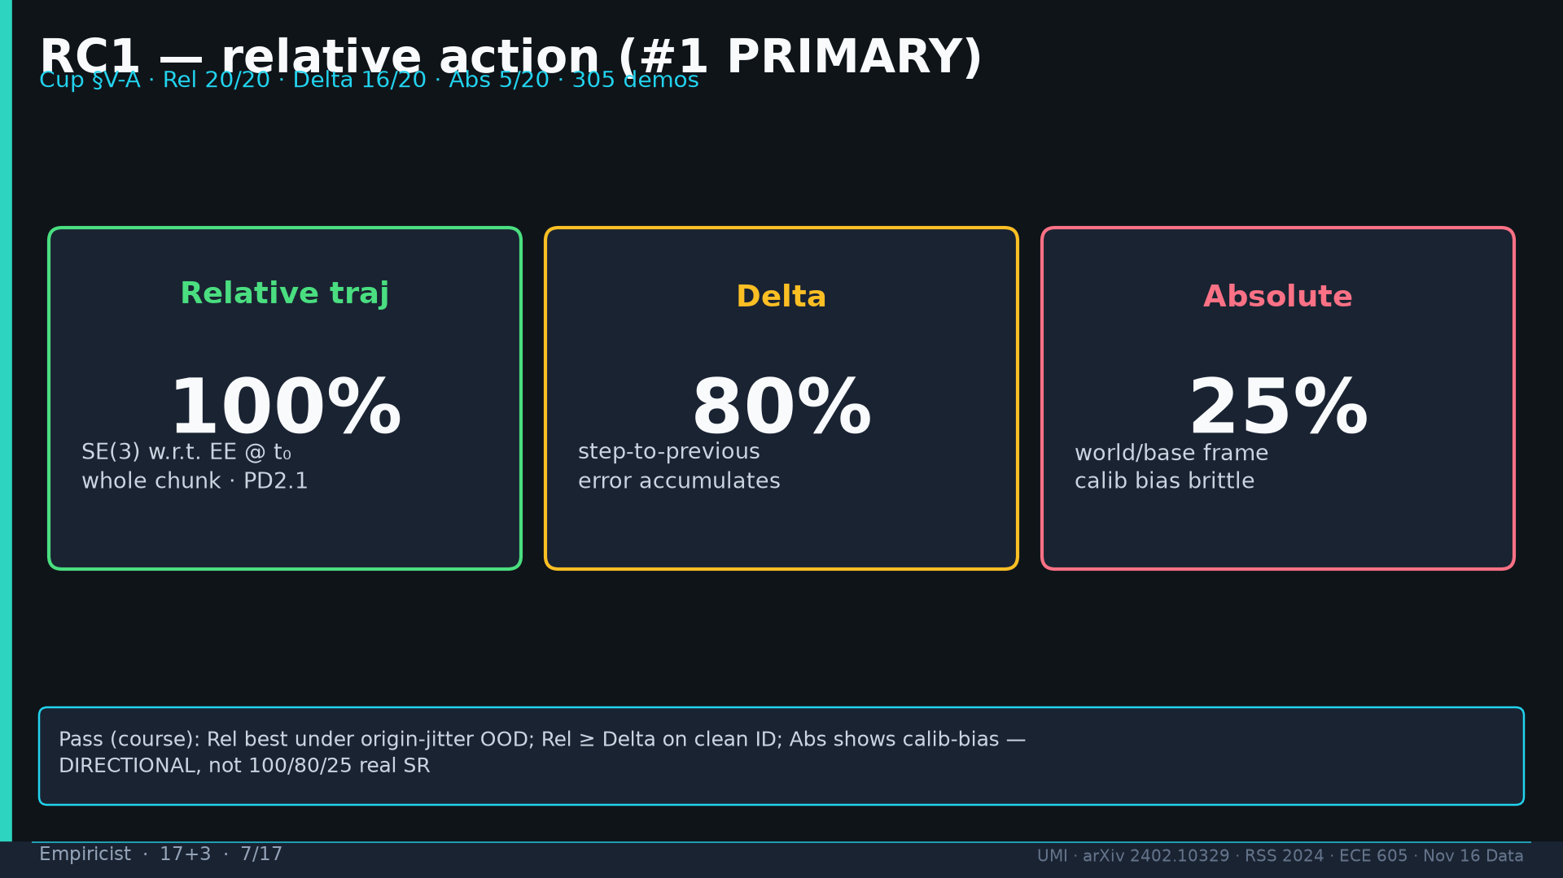
Notes:
Empiricist · 17+3 · 7/17
RC1 PRIMARY: same data/task; action_repr∈{relative_traj,absolute,delta}; 305 demos paper; pass=Rel best under origin-jitter OOD; Abs shows calib bias; DIRECTIONAL not 100/80/25 real SR. Budget 1 GPU 2–8h. Fail if Abs secretly recentered.
Tattoo: cup 100%/90% · toss 87.5% (no lat 57.5%) · wild 1400/30 → 71.7% vs narrow 0% · rel 100% vs abs 25% · fisheye vs 69° 55% · cloth 70%/30% · dish 70%/0% · Ta=6 @10Hz (20Hz toss)

Slide 8
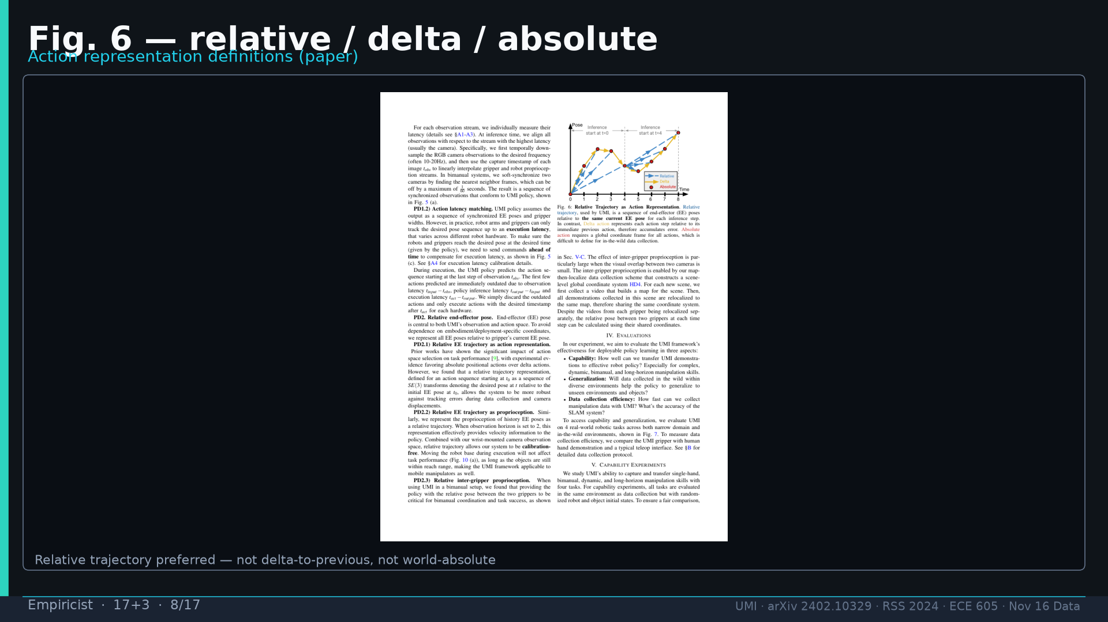
Notes:
Empiricist · 17+3 · 8/17
Fig.6 definitions: relative = SE(3) w.r.t. EE at chunk start; NOT delta-to-previous; NOT world-absolute.
Tattoo: cup 100%/90% · toss 87.5% (no lat 57.5%) · wild 1400/30 → 71.7% vs narrow 0% · rel 100% vs abs 25% · fisheye vs 69° 55% · cloth 70%/30% · dish 70%/0% · Ta=6 @10Hz (20Hz toss)

Slide 9
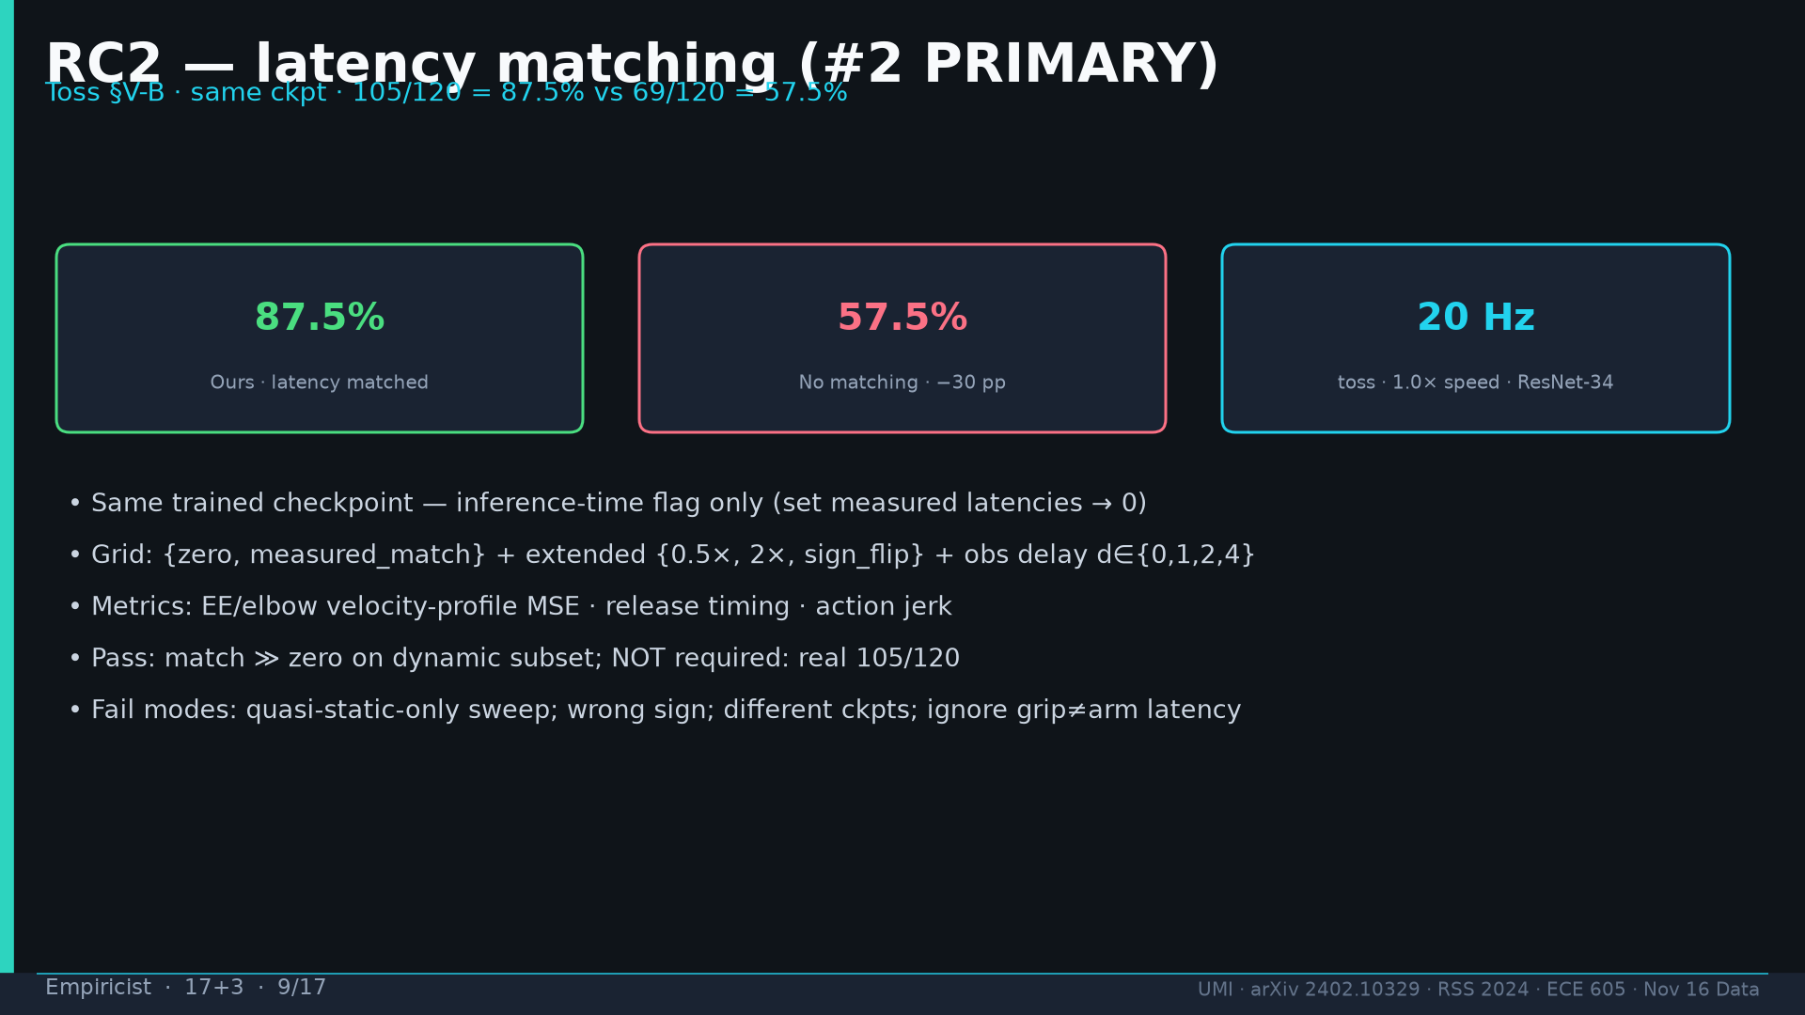
Notes:
Empiricist · 17+3 · 9/17
RC2 PRIMARY: same ckpt; toggle latencies→0; 105/120 vs 69/120; 20Hz toss 1.0× ResNet-34; grid zero/match + half/double/sign_flip; vel-MSE/timing; pass match≫zero on dynamic; NOT require 105/120. Fail if only quasi-static.
Tattoo: cup 100%/90% · toss 87.5% (no lat 57.5%) · wild 1400/30 → 71.7% vs narrow 0% · rel 100% vs abs 25% · fisheye vs 69° 55% · cloth 70%/30% · dish 70%/0% · Ta=6 @10Hz (20Hz toss)

Slide 10
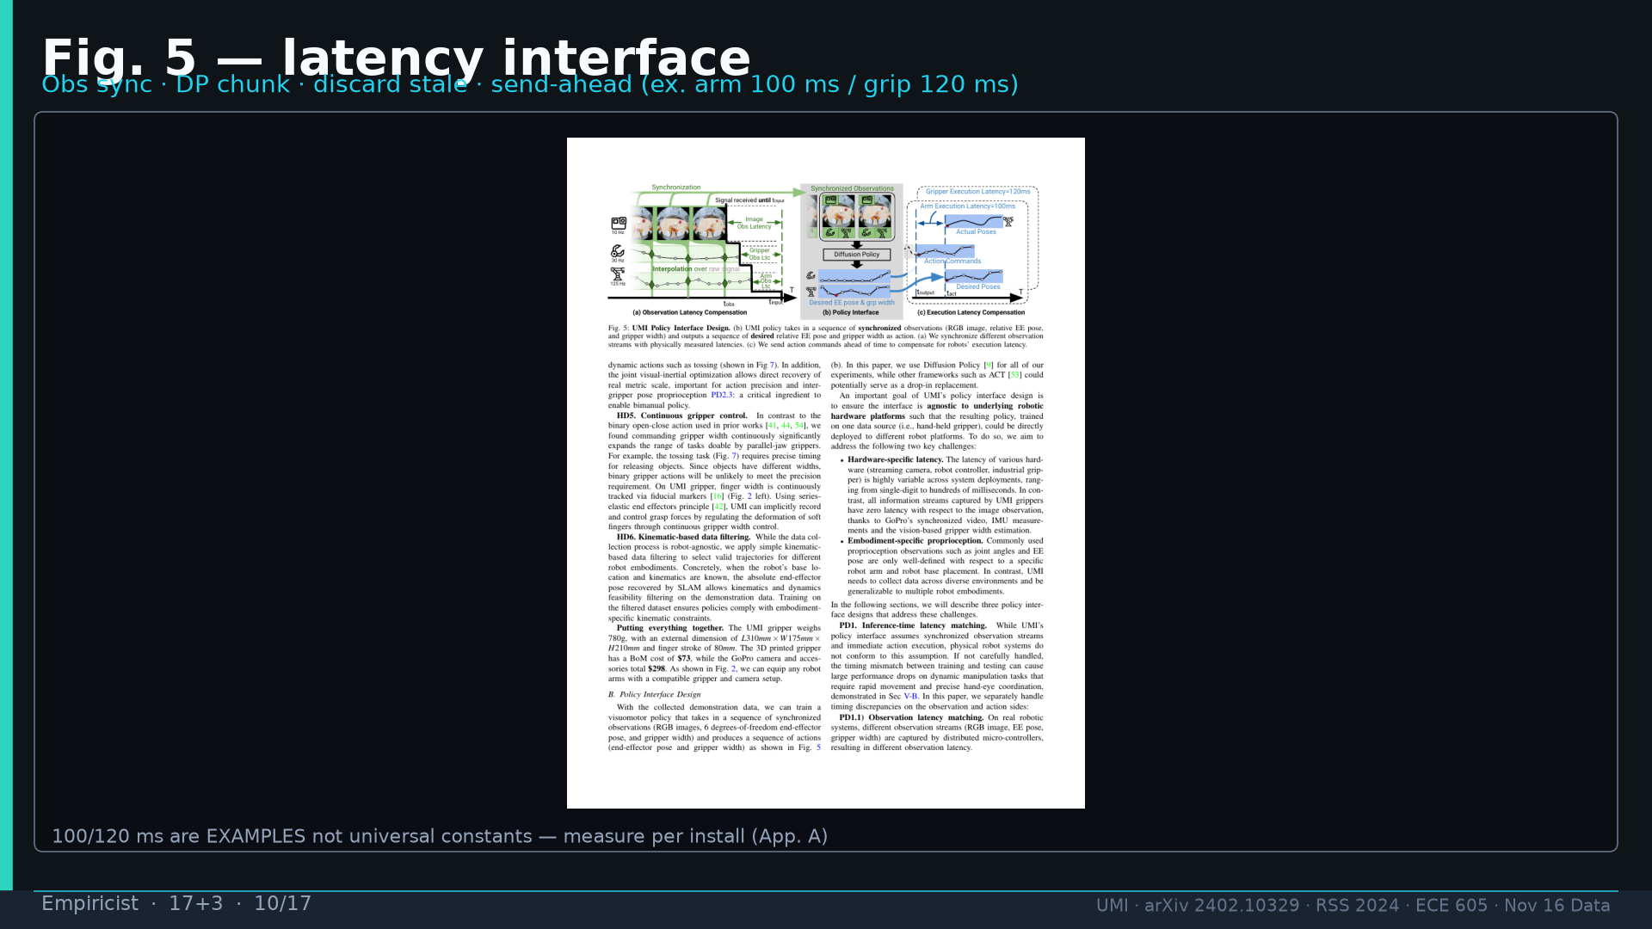
Notes:
Empiricist · 17+3 · 10/17
Fig.5: obs sync + discard stale + send-ahead. Arm 100ms / grip 120ms EXAMPLES — measure per install.
Tattoo: cup 100%/90% · toss 87.5% (no lat 57.5%) · wild 1400/30 → 71.7% vs narrow 0% · rel 100% vs abs 25% · fisheye vs 69° 55% · cloth 70%/30% · dish 70%/0% · Ta=6 @10Hz (20Hz toss)

Slide 11
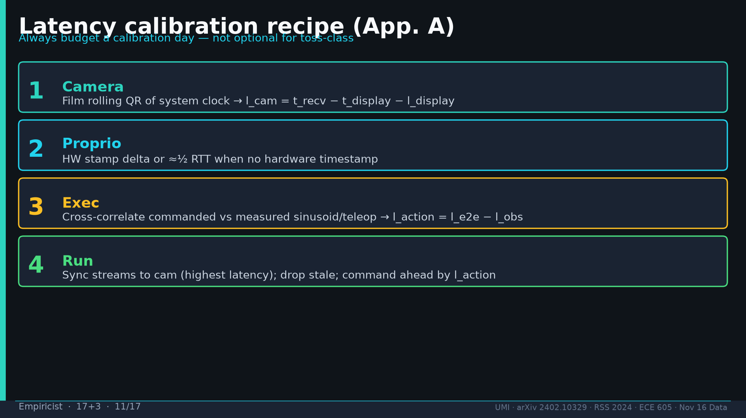
Notes:
Empiricist · 17+3 · 11/17
App.A recipe: (1) cam rolling QR (2) proprio HW stamp or ½RTT (3) exec cross-corr (4) sync to cam; drop stale; command ahead. Always budget calibration day.
Tattoo: cup 100%/90% · toss 87.5% (no lat 57.5%) · wild 1400/30 → 71.7% vs narrow 0% · rel 100% vs abs 25% · fisheye vs 69° 55% · cloth 70%/30% · dish 70%/0% · Ta=6 @10Hz (20Hz toss)

Slide 12
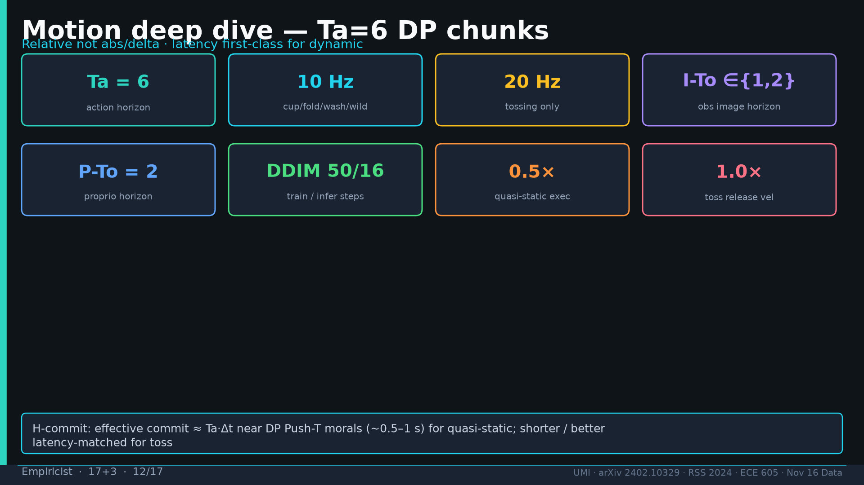
Notes:
Empiricist · 17+3 · 12/17
Motion: Ta=6; 10Hz most / 20Hz toss; I-To∈{1,2} P-To=2; DDIM 50/16; 0.5× quasi-static 1.0× toss; H-commit ≈ Ta·Δt near 0.5–1s quasi-static.
Tattoo: cup 100%/90% · toss 87.5% (no lat 57.5%) · wild 1400/30 → 71.7% vs narrow 0% · rel 100% vs abs 25% · fisheye vs 69° 55% · cloth 70%/30% · dish 70%/0% · Ta=6 @10Hz (20Hz toss)

Slide 13
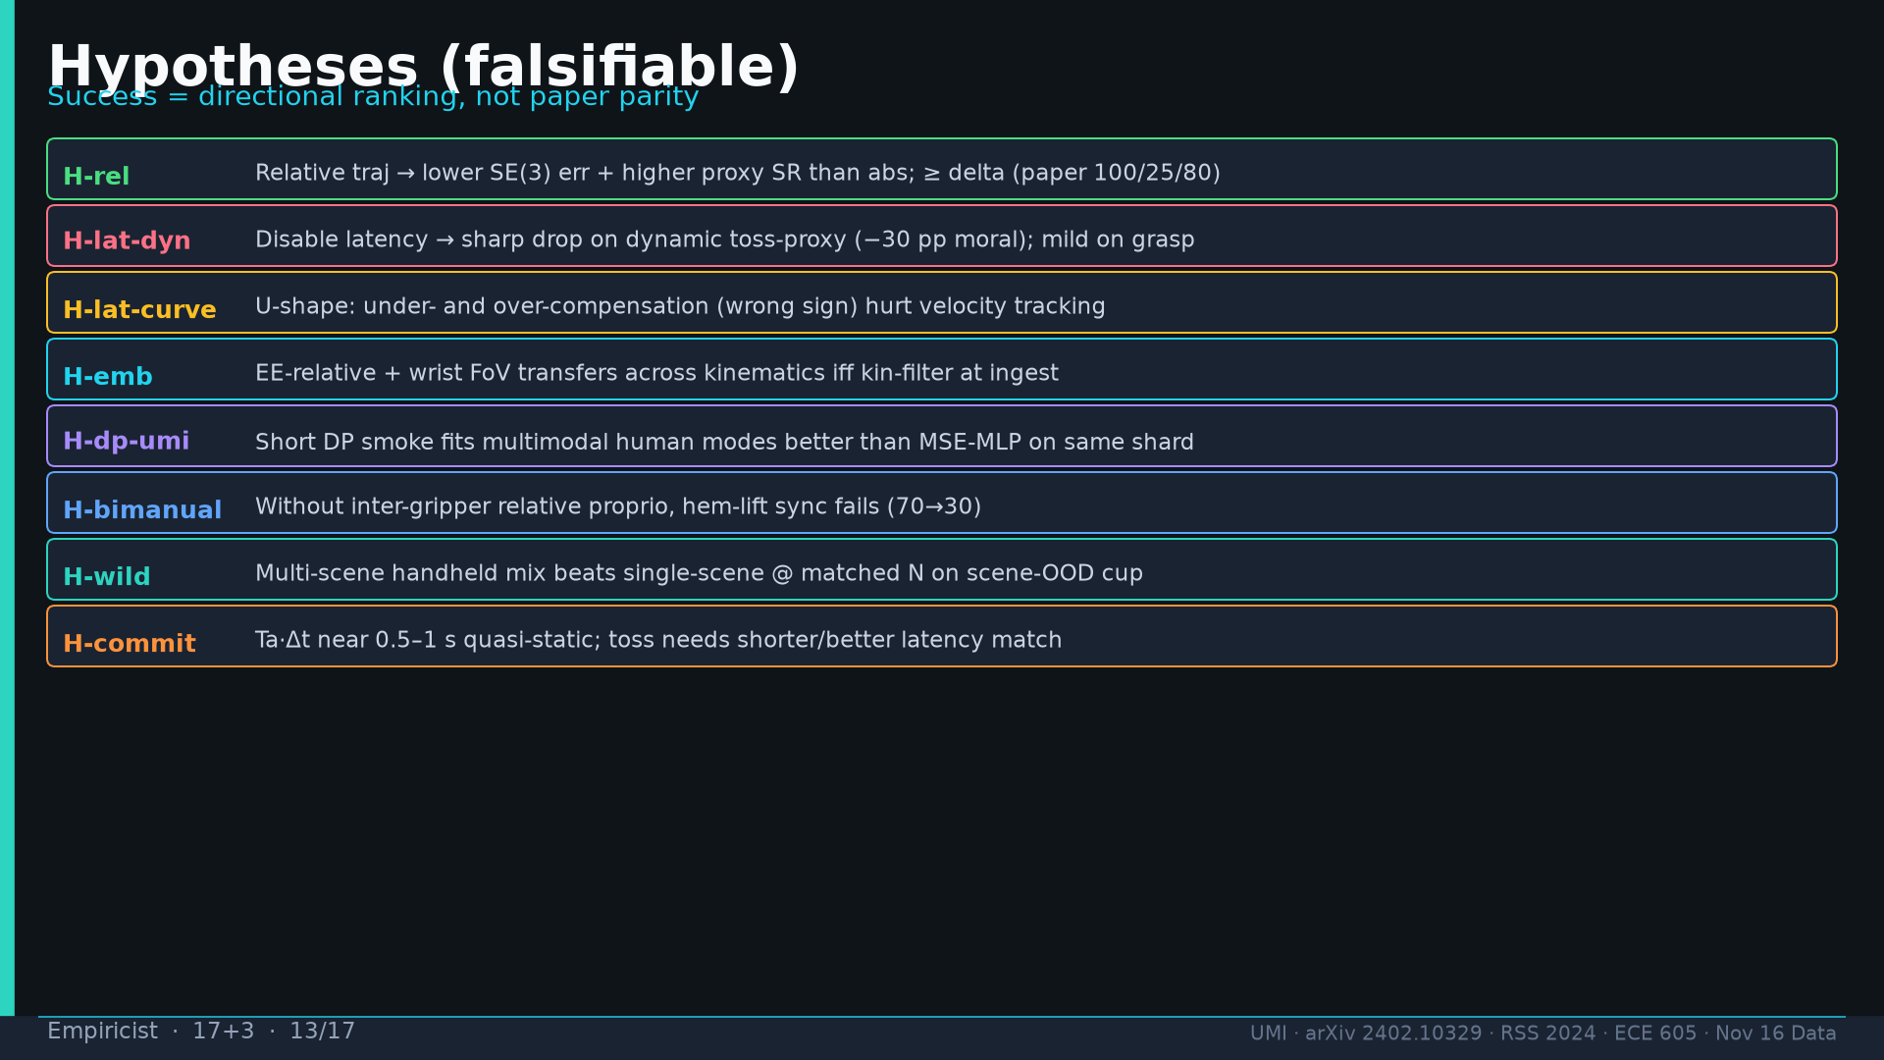
Notes:
Empiricist · 17+3 · 13/17
Hypotheses H-rel / H-lat-dyn / H-lat-curve / H-emb / H-dp-umi / H-bimanual / H-wild / H-commit. Falsifiers listed in DELIVERABLE. Success=directional.
Tattoo: cup 100%/90% · toss 87.5% (no lat 57.5%) · wild 1400/30 → 71.7% vs narrow 0% · rel 100% vs abs 25% · fisheye vs 69° 55% · cloth 70%/30% · dish 70%/0% · Ta=6 @10Hz (20Hz toss)

Slide 14
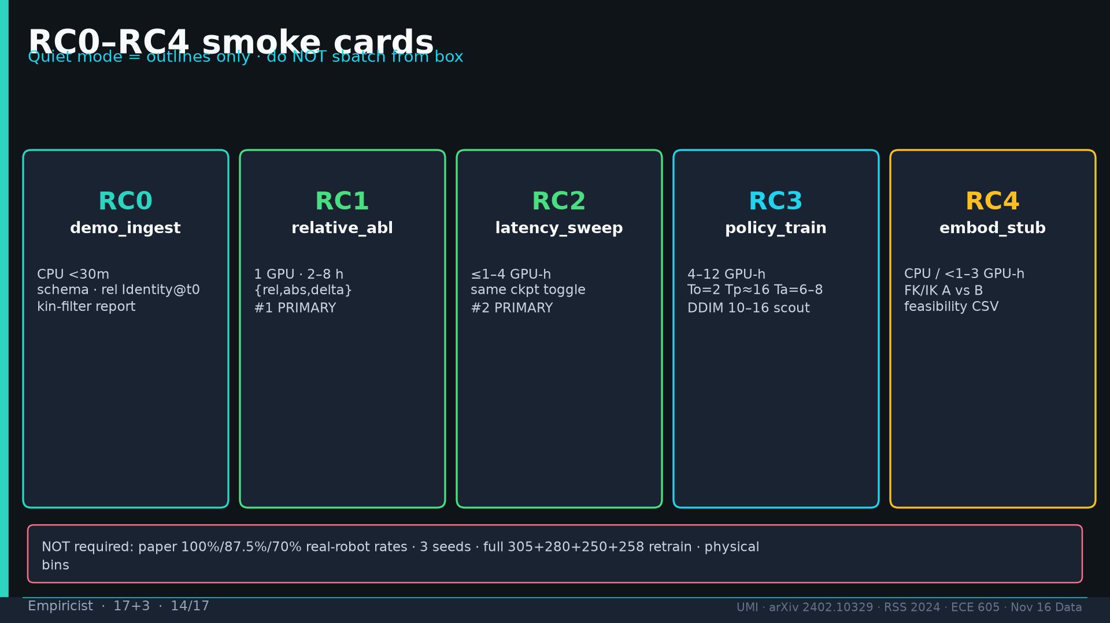
Notes:
Empiricist · 17+3 · 14/17
RC0 ingest CPU gate; RC1 rel abl; RC2 latency; RC3 policy smoke 4–12 GPU-h; RC4 embodiment stub. Quiet=outlines only do NOT sbatch. Not required: paper rates / 3 seeds / full retrain.
Tattoo: cup 100%/90% · toss 87.5% (no lat 57.5%) · wild 1400/30 → 71.7% vs narrow 0% · rel 100% vs abs 25% · fisheye vs 69° 55% · cloth 70%/30% · dish 70%/0% · Ta=6 @10Hz (20Hz toss)

Slide 15
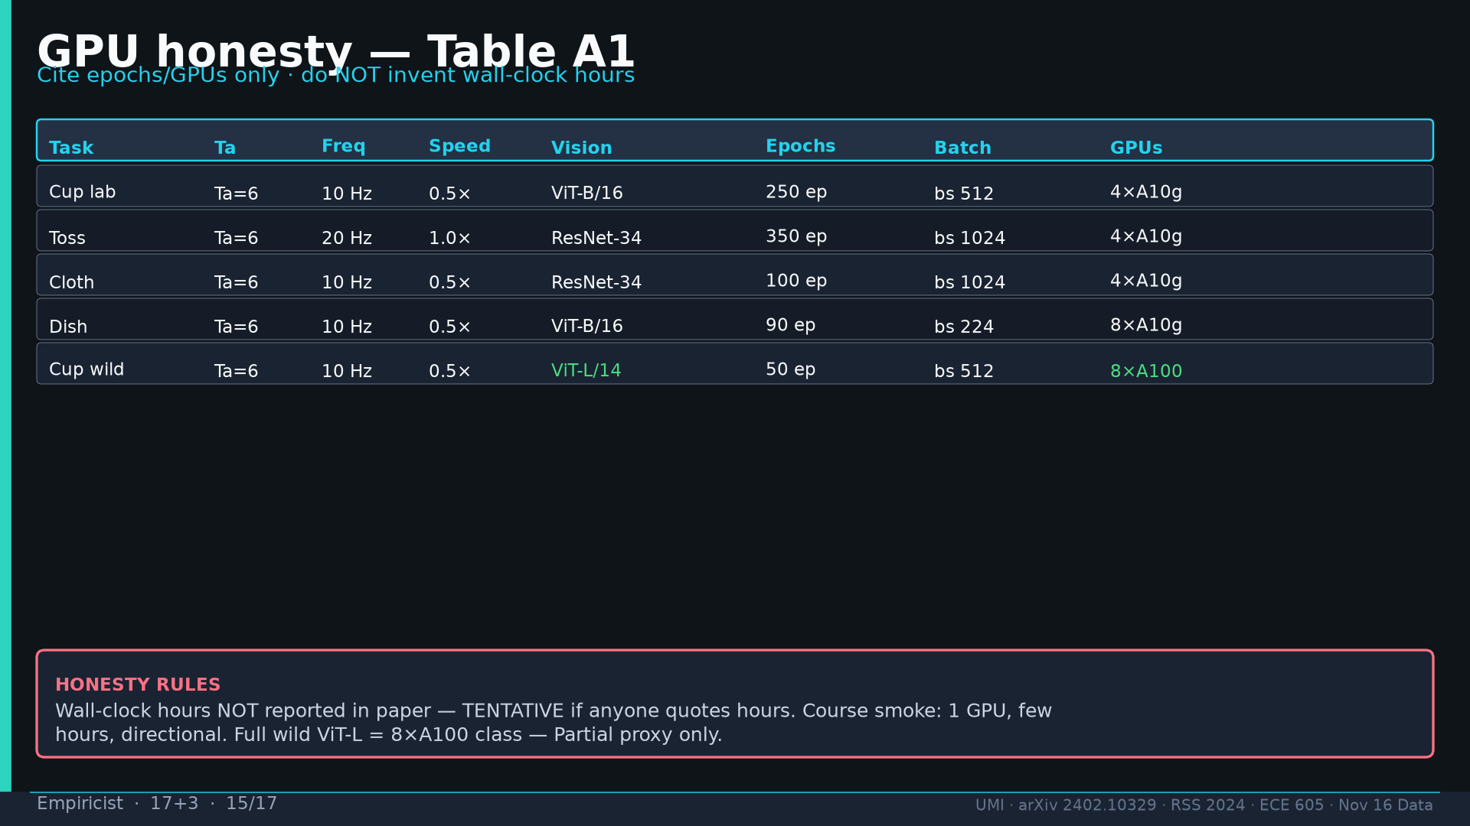
Notes:
Empiricist · 17+3 · 15/17
GPU Table A1: lab 4×A10g (dish 8×A10g); wild 8×A100 ViT-L/14 50ep bs512. Wall-clock hours NOT in paper — do NOT invent. Course smoke 1 GPU few hours.
Tattoo: cup 100%/90% · toss 87.5% (no lat 57.5%) · wild 1400/30 → 71.7% vs narrow 0% · rel 100% vs abs 25% · fisheye vs 69° 55% · cloth 70%/30% · dish 70%/0% · Ta=6 @10Hz (20Hz toss)

Slide 16
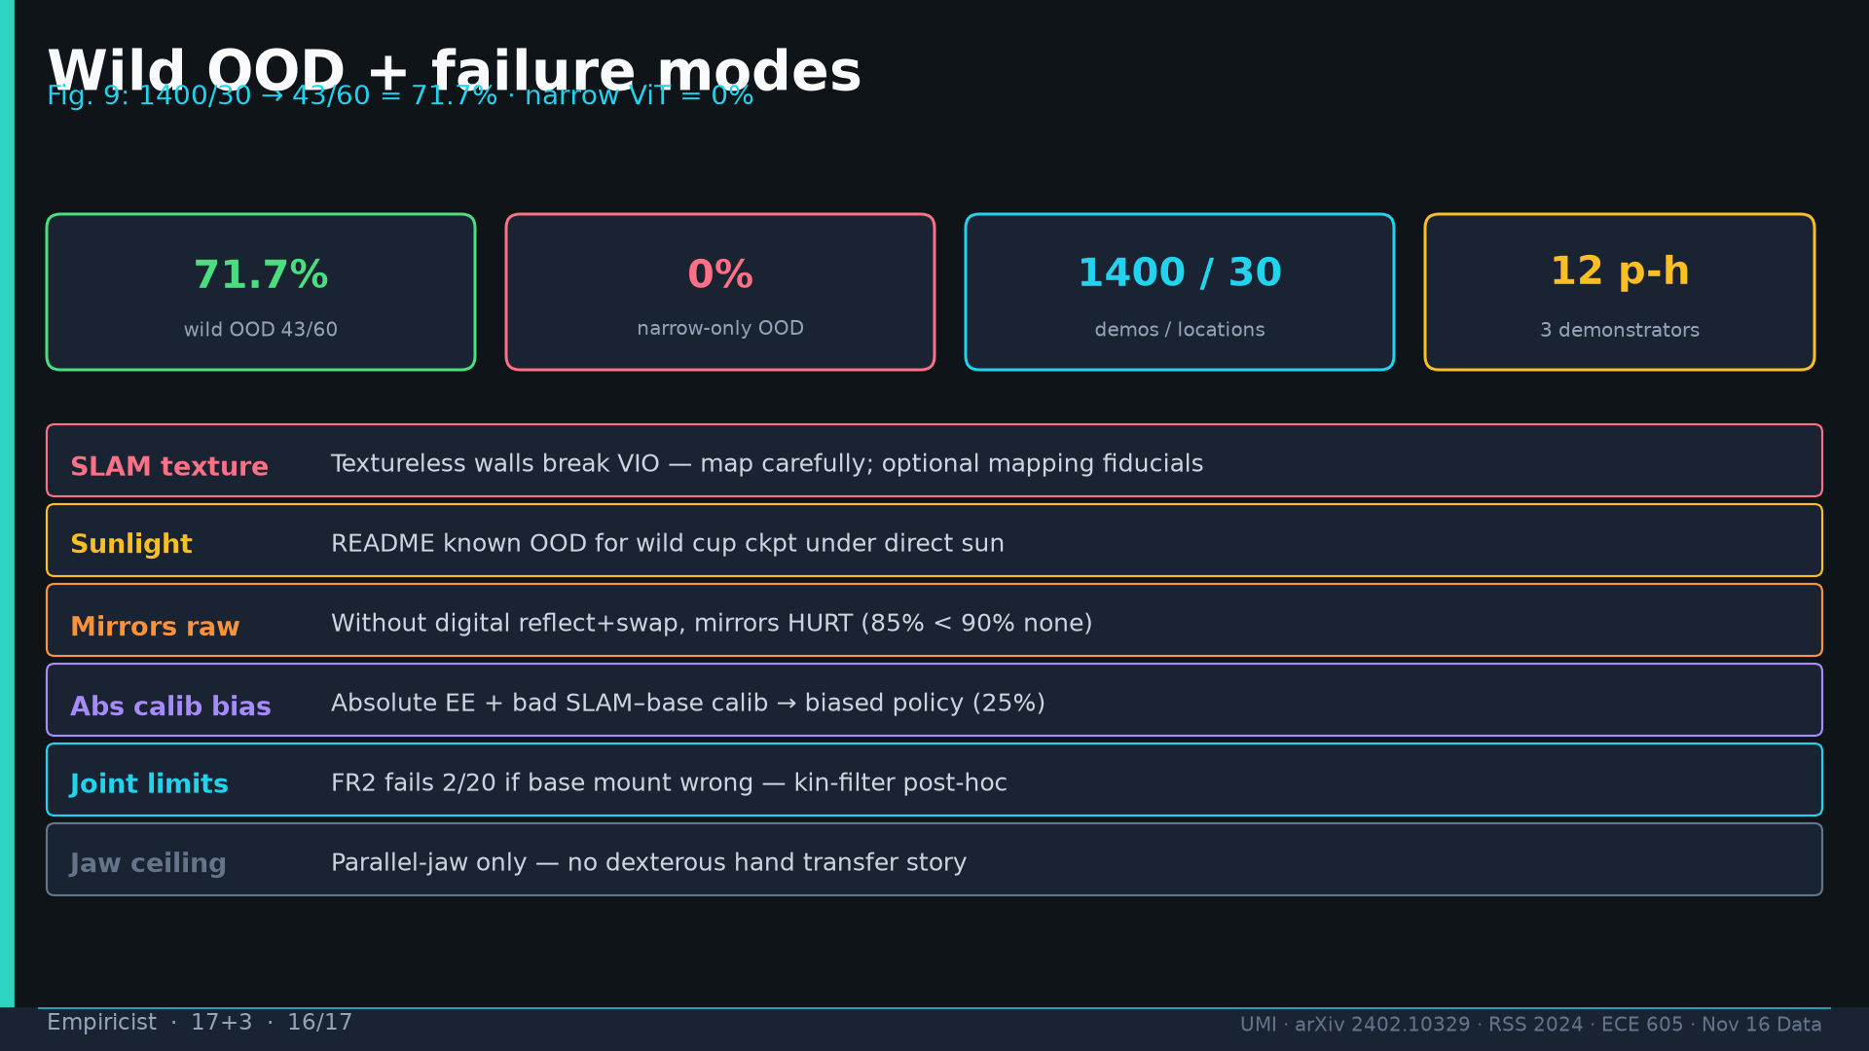
Notes:
Empiricist · 17+3 · 16/17
Failures: SLAM textureless; sunlight OOD; mirrors without reflect hurt; abs calib bias; FR2 joint limits; jaw ceiling. Wild 1400/30→43/60=71.7% vs narrow 0%.
Tattoo: cup 100%/90% · toss 87.5% (no lat 57.5%) · wild 1400/30 → 71.7% vs narrow 0% · rel 100% vs abs 25% · fisheye vs 69° 55% · cloth 70%/30% · dish 70%/0% · Ta=6 @10Hz (20Hz toss)

Slide 17
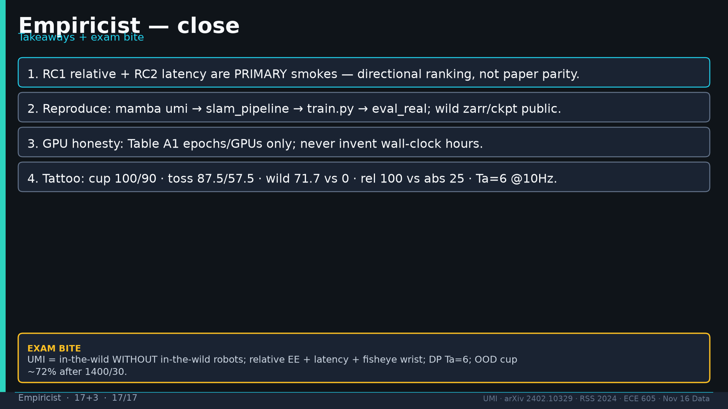
Notes:
Empiricist · 17+3 · 17/17
Close: RC1+RC2 primary; reproduce stack; GPU honesty; tattoo numbers. Exam: UMI=wild without robots; relative+latency+fisheye; Ta=6; OOD ~72% after 1400/30.
Tattoo: cup 100%/90% · toss 87.5% (no lat 57.5%) · wild 1400/30 → 71.7% vs narrow 0% · rel 100% vs abs 25% · fisheye vs 69° 55% · cloth 70%/30% · dish 70%/0% · Ta=6 @10Hz (20Hz toss)

