Slide 1
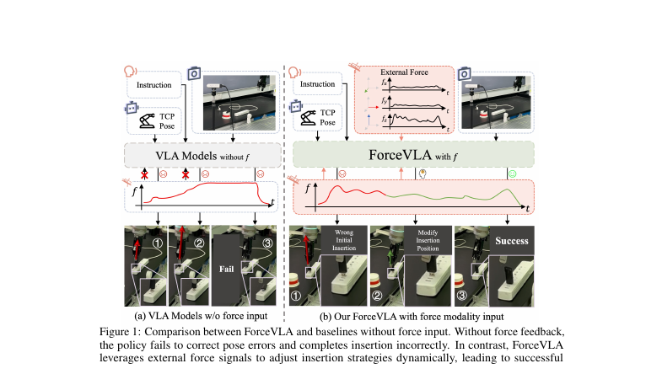
LAST SHEET · ALTERNATIVE APPROACHES · STAKEHOLDER
Buy late MoE
when F/T exists.
ForceVLA keeps your π₀ FM controller and ships 6-axis force through FVLMoE. Yu*, Liu*, Yu† et al. — arXiv 2505.22159v3. LAST Alt row.
60.5 vs 37.3 (+23.2)
naive F +2.9 only
early MoE → 0%
Don't concat-only. FAST + naive force hurts (31→14.2). Pitch contact-rich specialist augmentation — not a π₀.₅ open-world replacement.
ForceVLA · arXiv 2505.22159v3 · Alt approaches · LAST sheet · Club Pack
Stakeholder 1 / 12
Notes:
Stakeholder open. LAST Alt approaches row on the undated sheet. All seats empty — Club Pack, equal depth.
• Paper: ForceVLA. arXiv 2505.22159v3 (18 Sep 2025). Preprint under review.
• Buy: late force token + FVLMoE on π₀-class FM when reliable 6-axis F/T exists and tasks are insert/wipe/press/peel.
• Fig.1: vision-only fails misaligned plug; ForceVLA corrects via force → success.
• Chips are paper numbers: 60.5 vs 37.3 (+23.2); naive concat +2.9; Tab.3 early MoE 0%.

Slide 2
SHARED SPINE · TATTOO ON EVERY DECK
Five facts that do not change with the seat
01
Late 6-axis F/T + FVLMoE
After VLM (PaliGemma/SigLIP): project wrench → force token → FVLMoE (E=4, top-1) → additive guide into π₀ flow-matching action head. Force stays late.
02
Contact-rich on Flexiv
Insert USB / plug, pump bottle, wipe board, peel cucumber. ForceVLA-Data: 244 traj / ~140k steps / ~50 demos per task. Quest3 teleop.
03
Must-cites
Avg 60.5 vs π₀-base w/o F 37.3 (+23.2). Naive w/ F only 40.2 (+2.9). Early MoE-before-VLM 0% → late FVLMoE 80% (Tab.3). Occlusion 90%. FAST+naive force 31.0→14.2.
04
CLEAR contrasts
NOT MoPA-PD ancestor (MoPA = MP privilege→vision student; ForceVLA = deploy force into VLA). NOT JEPA/WM child. No π₀.₅ bake-off — do not invent.
05
Number hygiene
Typo fix: 37.3 = w/o F (not w/ F). Preserve paper numbers. No invented BEHAVIOR SR. Pump caveat: naive w/F 83 > ForceVLA 67 — do not overclaim.
ForceVLA · arXiv 2505.22159v3 · Alt approaches · LAST sheet · Club Pack
Stakeholder 2 / 12
Notes:
Shared spine — say this before the role-specific argument.
• Late 6-axis F/T token + FVLMoE (E=4 top-1) after VLM → additive guide into π₀ FM action head.
• Contact-rich insert/wipe/peel on Flexiv; ForceVLA-Data 244 traj / 140k / ~50/task.
• Must-cites: 60.5 vs 37.3 (+23.2); naive w/F 40.2 (+2.9); early MoE 0% / late FVLMoE 80%; occlusion 90%; FAST+naive 31→14.2.
• NOT MoPA-PD ancestor. NOT JEPA/WM child. No π₀.₅ bake-off.
• Typo: 37.3 = w/o F. Pump: naive 83 > ForceVLA 67. No invented BEHAVIOR SR.
• Stakeholder use: these five lines are the buying brief. Rest is when to buy, when to walk, and which risks you own.

Slide 3
WHY LAST ALT ROW
After MoPA-PD, lock the deploy-side force answer
MoPA was train privilege
Vision-only π₀ still fails contact
Prior Alt row: classical MP at train → vision student. ForceVLA is the complementary arrow: add a sensor modality to a deployed VLA.
Misaligned insert, occlusion, surface force. Semantic VLAs inherit open-world strength and still jam on wrench-dominated phases.
No new foundation pretrain
Closes the Alt column
Keep PaliGemma + FM action expert. Productize F/T + late MoE. HIGH force/contact flag without restarting pretrain.
Sheet ends with force-in-VLA before pure open-world weeks. Stakeholder needs a buy/walk, not a genealogy lecture.
ForceVLA · arXiv 2505.22159v3 · Alt approaches · LAST sheet · Club Pack
Stakeholder 3 / 12
Notes:
Why schedule ForceVLA as LAST Alternative approaches.
• CLEAR contrast with MoPA-PD: opposite mechanism, same syllabus slot.
• CLEAR foil is vision-only π₀, not OpenVLA tables and not π₀.₅ (unmeasured).
• After MoPA's train-time classical privilege, stakeholders ask: what do we buy for real F/T robots already on OpenPI/π₀?

Slide 4
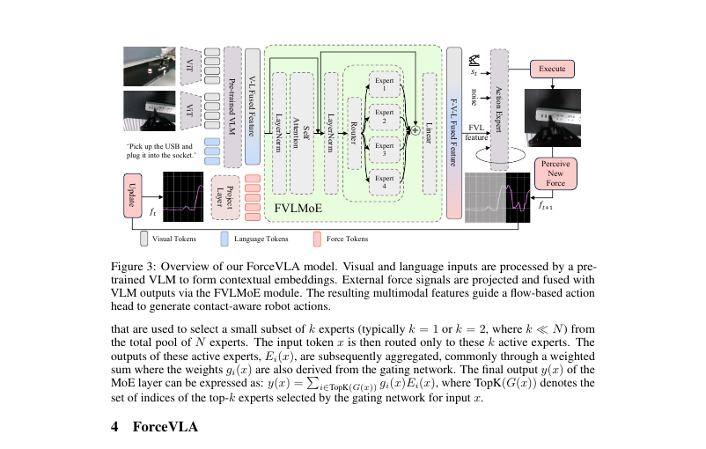
FIG. 3 · THE PRODUCT SHAPE
Late force. Sparse MoE. FM head stays.
After VLM
E=4 top-1
Not FAST
Force token lands post PaliGemma. Pretrained VL geometry preserved.
FVLMoE routes VL+force; residual → 1024 → additive FM suffix.
ForceVLA keeps flow matching. π₀-fast is a baseline foil only.
ForceVLA · arXiv 2505.22159v3 · Alt approaches · LAST sheet · Club Pack
Stakeholder 4 / 12
Notes:
Walk Fig. 3 left to right.
• VLM fuses vision+language first. Linear φ_F: R^6 → 2048 force token.
• FVLMoE: concat → MHSA encoder → 4 MLP experts, top-1 router → project to action expert width.
• Additive G_FVLMoE into FM denoising suffix with proprio + noisy actions. Closed loop via new wrench each step.
• Do not pitch this as switching FM↔FAST. ForceVLA keeps FM.

Slide 5
BUY / WALK
Buy late MoE when F/T exists. Walk concat-only.
BUY THE PATTERN
WALK / DO NOT BOLT
Reliable 6-axis F/T on the arm
Integrated or retrofit. Tasks = insert / wipe / press / peel-like.
Already shipping π₀ / OpenPI FM
Keep the controller. Add late force token + FVLMoE. Collect sync F/T demos (~50/task here).
Contact is the failure mode
Vision-only stacks jam on alignment / occlusion / compliance. That is the buy.
No F/T hardware
Pattern blocked. Estimated wrench / tactile skins are research paths (paper limitation).
Just concat force to state
Paper: +2.9 pts only (37.3→40.2). Budget the MoE / late-fusion engineering.
FAST-only compact policies
Naive force hurts π₀-fast 31.0→14.2. Don't bolt F/T without capacity / pretrain story.
ForceVLA · arXiv 2505.22159v3 · Alt approaches · LAST sheet · Club Pack
Stakeholder 5 / 12
Notes:
Buy / walk. Left column is the only honest purchase.
• Open-world π₀.₅ homes without F/T: keep that stack for language; add ForceVLA-style fusion only where F/T exists. Paper did not beat π₀.₅.
• Code/data 'will be released' — verify github.com/ft-robotic/ForceVLA + sites.google.com/view/forcevla2025 before roadmap commit.

Slide 6
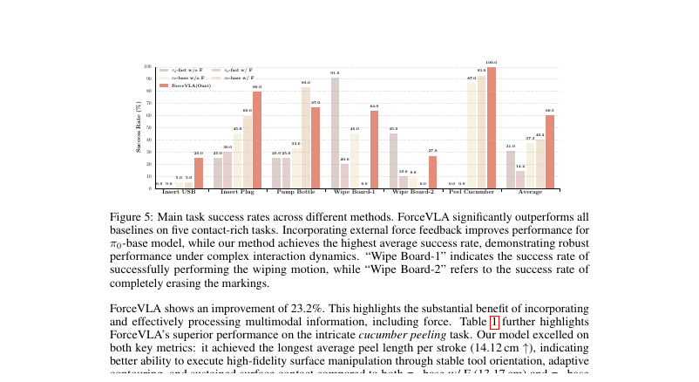
FIG. 5 · THE EFFICIENCY BUY
Fusion quality beats force presence
Headline
60.5 vs 37.3 (+23.2)
vs π₀-base w/o F. Typo fix: 37.3 is w/o F.
Naive concat
40.2 (+2.9 only)
Presence ≠ integration.
FAST warning
31.0 → 14.2 when force is bolted naively.
Plug headline
ForceVLA 80% on Insert Plug.
ForceVLA · arXiv 2505.22159v3 · Alt approaches · LAST sheet · Club Pack
Stakeholder 6 / 12
Notes:
Fig. 5 averages and must-cites.
• ForceVLA 60.5; base w/o F 37.3; base w/F 40.2; fast w/o F 31.0; fast w/F 14.2.
• Insert Plug: 80 / 60 / 45 (ForceVLA / base w/F / base w/o F).
• Pump caveat for honesty later: base w/F 83 > ForceVLA 67 — do not sell 'wins every column'.
• USB: ForceVLA 25; both base 5; both fast 0. Still hard.

Slide 7
RISKS YOU WILL OWN
Four costs the abstract does not waive
F/T cost + estimated wrench
Sync demos are not free
Paper uses estimated external wrench on integrated Flexiv-class sensing. Calibration and accessibility are stated limitations.
ForceVLA-Data: 244 traj / ~50 per task. OXE alone does not give you wrench-synced contact demos.
USB and unstable socket
Not a π₀.₅ replacement
Multi-task USB stays at 10%. Unstable Socket: ForceVLA 20% (π₀-fast w/F best at 30%). Not a universal fix.
Pitch contact-rich specialist augmentation. Do not brief open-world homes as solved. No π₀.₅ numbers in this paper.
ForceVLA · arXiv 2505.22159v3 · Alt approaches · LAST sheet · Club Pack
Stakeholder 7 / 12
Notes:
Read all four risks. Do not soften.
• Limitations section: estimated wrench; high-cost integrated F/T platforms; future lower-cost external F/T.
• Code/data release status: verify before committing product timeline.
• Product one-liner: modality productization — keep π₀ FM; ship F/T + FVLMoE when contact is the failure mode.

Slide 8
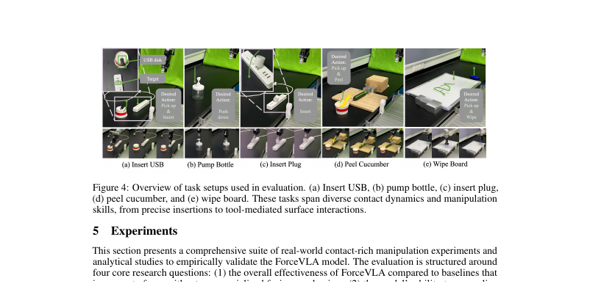
FIG. 4 · THE TASK SUITE
Five contact-rich Flexiv tasks — what you are buying for
Insert
Press / wipe
Surface
USB + plug. Alignment + force-controlled seating. Plug is the 80% story; USB stays hard.
Pump bottle; wipe motion vs full erase. Continuous contact force.
Cucumber peel: length↑ / strokes↓. Continuous tool force, not binary insert.
ForceVLA · arXiv 2505.22159v3 · Alt approaches · LAST sheet · Club Pack
Stakeholder 8 / 12
Notes:
Fig. 4 task gallery. Real Flexiv Rizon + Dahuan gripper + 6-axis F/T.
• Eval: 20 trials insert/pump; 10 wipe; 15 peel × 15 strokes.
• Train ~50 demos/task. Quest3 teleop, 5 expert operators.

Slide 9
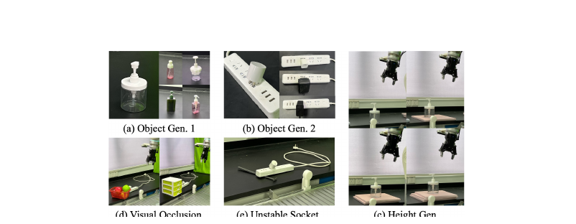
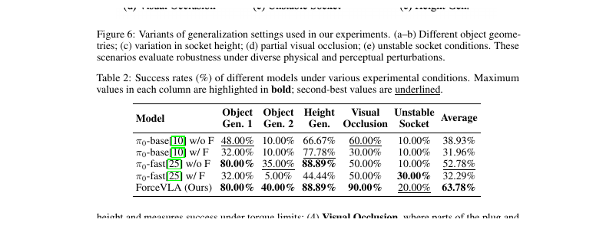
OCCLUSION IS THE PRODUCT DEMO
When vision fails, force must carry — Tab.2 90%
Visual Occlusion
ForceVLA 90%
π₀-base w/o F 60%
π₀-base w/ F 30% (naive hurts)
Gen average
ForceVLA 63.78%
Unstable Socket still weak: ForceVLA 20; fast w/F 30 best.
Buy message
Force substitutes when wrist cam / clutter occludes contact.
ForceVLA · arXiv 2505.22159v3 · Alt approaches · LAST sheet · Club Pack
Stakeholder 9 / 12
Notes:
Table 2 / Fig. 6. Occlusion is the stakeholder demo reel.
• Naive force drops occlusion on π₀-base 60→30. Fusion method matters under shift too.
• Obj Gen.2 (plug type): ForceVLA 40; fast w/o F 35; fast w/F collapses to 5.
• Do not claim ForceVLA wins Unstable Socket.

Slide 10
SIBLING CONTRAST (CLEAR LABELS)
Same Alt row as MoPA. Opposite arrow. Not a JEPA child.
vs MoPA-PD
vs π₀ / FAST
MoPA: privileged classical MP at train → distill to vision. ForceVLA: deploy force modality into a VLA. Shared syllabus slot; inverse mechanism.
π₀ is parent foil / backbone. π₀-fast is baseline family. ForceVLA keeps FM. Naive force on FAST hurts.
vs π₀.₅
vs JEPA / WM
Cited in related work only. No bake-off. Do not invent wins/losses. Open-world language stays π₀.₅-class; force is contact specialist.
CLEAR contrast poles only. ForceVLA is not a world-model paper. Do not invent ancestry.
ForceVLA · arXiv 2505.22159v3 · Alt approaches · LAST sheet · Club Pack
Stakeholder 10 / 12
Notes:
CLEAR labels only when briefing siblings in /workspace/distill-mopa-quiet, pi0-quiet, fast-quiet.
• Mythbust: adding force ≠ switching FM↔FAST for ForceVLA itself.
• Mythbust: MoPA-PD is contrast, not ancestor.

Slide 11
DECISION CARD
What to say in the LAST Alt seat
Schedule
Buy
LAST Alt approaches row. Locks force-in-VLA before closing the sheet.
Late MoE fusion pattern on π₀ FM when F/T exists and contact fails vision-only.
Do not buy
One-liner
Concat-only. FAST+naive force. Claim that vision-only homes are solved.
ForceVLA is modality productization: keep π₀ FM; ship F/T + FVLMoE when contact is the failure mode.
ForceVLA · arXiv 2505.22159v3 · Alt approaches · LAST sheet · Club Pack
Stakeholder 11 / 12
Notes:
Stakeholder close.
• Product one-liner from pack: modality productization play.
• Stakeholder one-liner: Schedule as LAST Alt row to lock force-in-VLA; buy late MoE fusion, not a claim that vision-only homes are solved.

Slide 12
CLOSE
Buy late MoE. Refuse concat-only. No π₀.₅ laundry.
ForceVLA = π₀ + late 6D force + FVLMoE → contact-rich Flexiv policy.
Say: 60.5 vs 37.3 (+23.2). Naive +2.9. Early MoE 0%. Occlusion 90%. FAST+F hurts.
Do not say: beats π₀.₅; MoPA ancestor; JEPA child; invented BEHAVIOR SR; wins Pump vs naive.
Next: Scientific Reviewer grades late MoE as the real contribution.
ForceVLA · arXiv 2505.22159v3 · Alt approaches · LAST sheet · Club Pack
Stakeholder 12 / 12
Notes:
End. Hand off to Reviewer seat with the same spine numbers.
• Preserve paper numbers. Typo: 37.3 = w/o F.
• Pump Bottle: naive w/F 83 > ForceVLA 67 — honest caveat if asked.

