Slide 1
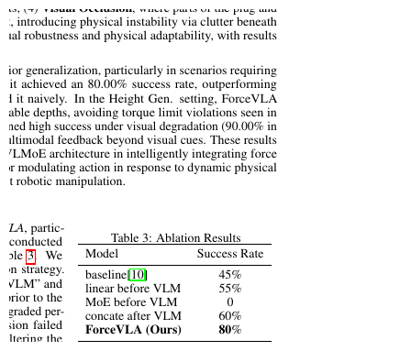
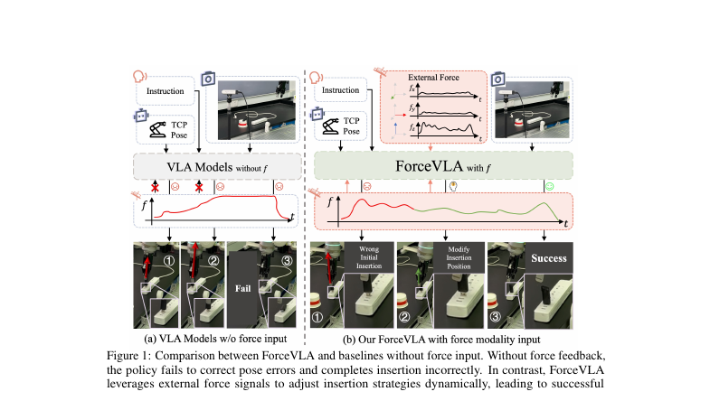
LAST SHEET · ALTERNATIVE APPROACHES · SCIENTIFIC REVIEWER
Late MoE is the
real contribution.
Naive force is a straw improvement. Grade HIGH for Alt contact-rich syllabus; narrow on embodiment and open-world. Soft: multi-task USB 10%, unstable socket, no π₀.₅.
Tab.3 0% → 80%
60.5 vs 37.3 / 40.2
Occlusion 90%
USB multi 10%
ForceVLA · arXiv 2505.22159v3 · Alt approaches · LAST sheet · Club Pack
Scientific Reviewer 1 / 12
Notes:
Reviewer open. Claims under review: (1) force as first-class + FVLMoE improves contact-rich VLA vs π₀; (2) late ≫ early; (3) naive concat insufficient; (4) gen under shifts; (5) router phase-aware.
• Verdict preview: accept late-fusion + MoE-over-concat on reported Flexiv suite. Do not upgrade to 'solved contact-rich foundation model' or 'beats π₀.₅'.

Slide 2
SHARED SPINE · TATTOO ON EVERY DECK
Five facts that do not change with the seat
01
Late 6-axis F/T + FVLMoE
After VLM (PaliGemma/SigLIP): project wrench → force token → FVLMoE (E=4, top-1) → additive guide into π₀ flow-matching action head. Force stays late.
02
Contact-rich on Flexiv
Insert USB / plug, pump bottle, wipe board, peel cucumber. ForceVLA-Data: 244 traj / ~140k steps / ~50 demos per task. Quest3 teleop.
03
Must-cites
Avg 60.5 vs π₀-base w/o F 37.3 (+23.2). Naive w/ F only 40.2 (+2.9). Early MoE-before-VLM 0% → late FVLMoE 80% (Tab.3). Occlusion 90%. FAST+naive force 31.0→14.2.
04
CLEAR contrasts
NOT MoPA-PD ancestor (MoPA = MP privilege→vision student; ForceVLA = deploy force into VLA). NOT JEPA/WM child. No π₀.₅ bake-off — do not invent.
05
Number hygiene
Typo fix: 37.3 = w/o F (not w/ F). Preserve paper numbers. No invented BEHAVIOR SR. Pump caveat: naive w/F 83 > ForceVLA 67 — do not overclaim.
ForceVLA · arXiv 2505.22159v3 · Alt approaches · LAST sheet · Club Pack
Scientific Reviewer 2 / 12
Notes:
Shared spine — say this before the role-specific argument.
• Late 6-axis F/T token + FVLMoE (E=4 top-1) after VLM → additive guide into π₀ FM action head.
• Contact-rich insert/wipe/peel on Flexiv; ForceVLA-Data 244 traj / 140k / ~50/task.
• Must-cites: 60.5 vs 37.3 (+23.2); naive w/F 40.2 (+2.9); early MoE 0% / late FVLMoE 80%; occlusion 90%; FAST+naive 31→14.2.
• NOT MoPA-PD ancestor. NOT JEPA/WM child. No π₀.₅ bake-off.
• Typo: 37.3 = w/o F. Pump: naive 83 > ForceVLA 67. No invented BEHAVIOR SR.
• Reviewer use: spine numbers are the accepted cites. Soft claims live after Tab.3 / Fig.5.

Slide 3
CLAIMS UNDER REVIEW
Five claims. Grade each, not the abstract alone.
C1
Force + FVLMoE ≫ π₀ baselines on contact-rich SR
HOLDS — 60.5 vs 37.3/40.2; plug 80%
C2
Late fusion ≫ early into pretrained VLM
HOLDS — Tab.3 MoE-before 0% vs ForceVLA 80%
C3
Naive concat insufficient vs MoE fusion
HOLDS on avg (+2.9 vs +23.2); soft on Pump
C4
Generalizes under object/height/occlusion/unstable
PARTIAL — occlusion 90%; unstable not best
C5
Router learns phase-aware specialization
INTERPRETIVE — Fig.9; Expert-0 generalist is hypothesis
ForceVLA · arXiv 2505.22159v3 · Alt approaches · LAST sheet · Club Pack
Scientific Reviewer 3 / 12
Notes:
Grade the claims separately.
• C1–C2 are the systems contribution. C3 needs the Pump caveat (naive 83 > ForceVLA 67 on that column).
• C4: ForceVLA gen avg 63.78%; Unstable Socket ForceVLA 20 vs fast w/F 30.
• C5: App.C interpretive; no expert-count / top-k ablation.

Slide 4
KNIFE · TABLE 3
Early MoE destroys the VLM. Late FVLMoE wins.
Causal knife
MoE before VLM → 0%
ForceVLA (late) → 80%
Same late stage: concat 60 → FVLMoE 80 (+20 pp).
Early linear 55%; baseline 45%.
Softness
Task identity / trial N for Tab.3 underspecified vs main protocol. Numeric match to Insert Plug is correspondence, not a stated identity.
Authors' rule
Introduce force AFTER VLM. How you fuse beats presence.
ForceVLA · arXiv 2505.22159v3 · Alt approaches · LAST sheet · Club Pack
Scientific Reviewer 4 / 12
Notes:
Table 3 §5.4. Highest-value single rerun is the 0% cell — if collapse vs architectural zero, early-vs-late conclusion softens.
• Do not assume 'concate after VLM' == §5.1 state-concat checkpoint. Different sentences in the paper.
• Pairwise: late concat vs FVLMoE is cleanest within-stage contrast.

Slide 5
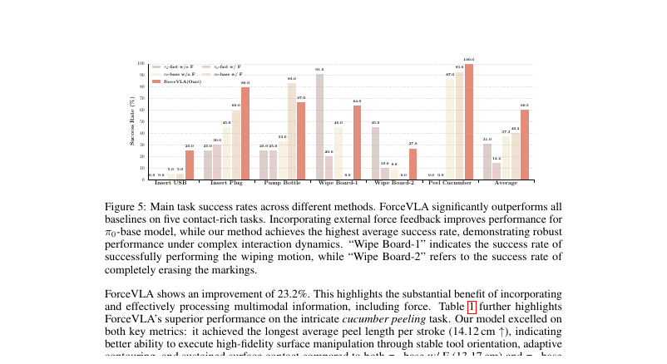
MAIN MATRIX · FIG. 5
Large gap. Force presence is not enough.
What holds
60.5 vs 37.3 (+23.2). Clear baseline matrix incl. π₀-fast.
Plug story
80 vs 60 vs 45. Naive helps; FVLMoE adds +20.
USB soft
25 vs 5/5/0/0. Force on/off null for both π₀.
Pump falsifier
Naive w/F 83 > ForceVLA 67. Do not overclaim every column.
ForceVLA · arXiv 2505.22159v3 · Alt approaches · LAST sheet · Club Pack
Scientific Reviewer 5 / 12
Notes:
Fig. 5 printed labels (Ablation Bot authoritative).
• FAST degradation 31→14.2 is real and important; representation-probe dissection is absent.
• Wipe Board-1: fast w/o F 91 beats ForceVLA 64 — paper states FAST's comparative advantage is wiping.
• Peel SR already high without FVLMoE (87/93/100); Table 1 continuous metrics still separate them.

Slide 6
WHAT HOLDS
Systems/methods preprint — accept these
Avg gap consistent
Tab.3 causal knife
60.5 vs 37.3 / 40.2 with π₀-base and π₀-fast ± force. Foil set is clear; OpenVLA is citation-only.
Early MoE-before-VLM 0% vs late FVLMoE 80%. Design rule: force after VLM; MoE over concat.
Occlusion 90%
Honest limitations
Strong multimodal story when vision degrades. Naive force can hurt under shift (base 60→30).
Estimated wrench; expensive F/T platforms; accessibility as future work. Related-work separates VLA / contact / MoE.
ForceVLA · arXiv 2505.22159v3 · Alt approaches · LAST sheet · Club Pack
Scientific Reviewer 6 / 12
Notes:
Cucumber Table 1 supports continuous contact control, not only binary insert: 14.12 cm / 7 strokes vs 13.17/10 vs 10.27/14.
• Accept late-fusion + MoE-over-concat claims on the reported Flexiv suite.

Slide 7
WHAT IS SOFT / THREATENED
Grade these without theatrical rejection
Multi-task USB 10%
Unstable socket
Tab.5 ForceVLA matches base w/F at 10% USB. Force MoE is not a universal precision-insert fix.
ForceVLA 20%; π₀-fast w/F 30% best. Gen claim is not uniform across conditions.
No π₀.₅ / OFT bake-off
Small N / one body
π₀.₅ cited [21] only. No OpenVLA-OFT / 2025 VLA heads. Do not invent a foundation-model ranking.
~50 demos/task; Flexiv only; Tab.3 task/N underspecified; router Expert-0 role interpretive; no CI/seeds.
ForceVLA · arXiv 2505.22159v3 · Alt approaches · LAST sheet · Club Pack
Scientific Reviewer 7 / 12
Notes:
Soft list is complete enough for a fair review.
• Fig.5 per-task bars are printed; averages + plug-80 + tables are the robust cites if OCR disputes a secondary bar.
• No expert-count / top-k / force-noise ablations. Fixed hyperparameters in Table 4.

Slide 8
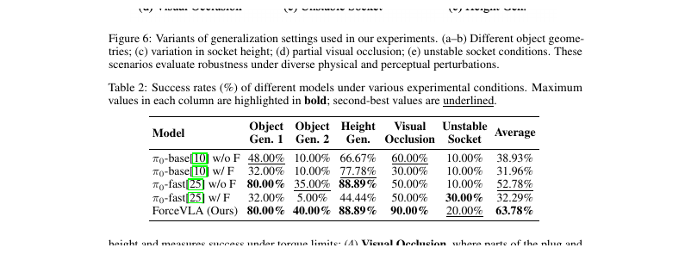
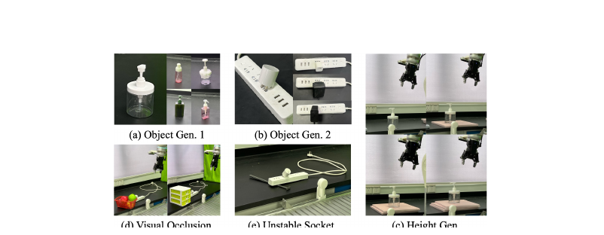
GENERALIZATION · TABLE 2
Occlusion strong. Unstable soft. Naive can hurt.
ForceVLA gen avg
63.78%
Occlusion 90%
Obj Gen.2 40%
Height 88.89% (tie w/ fast w/o F)
Threats
Unstable 20 < fast w/F 30
Naive force lowers both π₀ gen averages.
ForceVLA · arXiv 2505.22159v3 · Alt approaches · LAST sheet · Club Pack
Scientific Reviewer 8 / 12
Notes:
Table 2. Authors claim superior generalization; they do not discuss naive-force average drops or Unstable best cell.
• Reviewer should: credit occlusion; withhold blanket 'robust under all physical perturbations'.

Slide 9
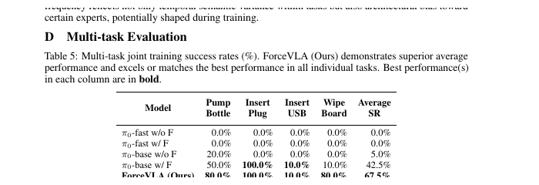
MULTI-TASK · TABLE 5
Joint regime. Plug saturates. USB stays soft.
ForceVLA avg 67.5
Does not isolate FVLMoE on plug
Pump/wipe 80; plug 100; USB 10. Beats base w/F 42.5 and fast 0.
Base w/F also 100% plug under joint train. USB ties at 10%.
Pump reversal disappears
π₀-fast joint collapse
Fig.5 Pump naive>ForceVLA; Tab.5 Pump ForceVLA 80 > base w/F 50. Regime matters.
Both fast variants 0% average. Capacity story is plausible, not dissected.
ForceVLA · arXiv 2505.22159v3 · Alt approaches · LAST sheet · Club Pack
Scientific Reviewer 9 / 12
Notes:
Appendix D. Not a controlled pair vs Fig.5 (joint vs per-task).
• Soft claim: do not treat Tab.5 plug 100 as FVLMoE-only evidence.

Slide 10
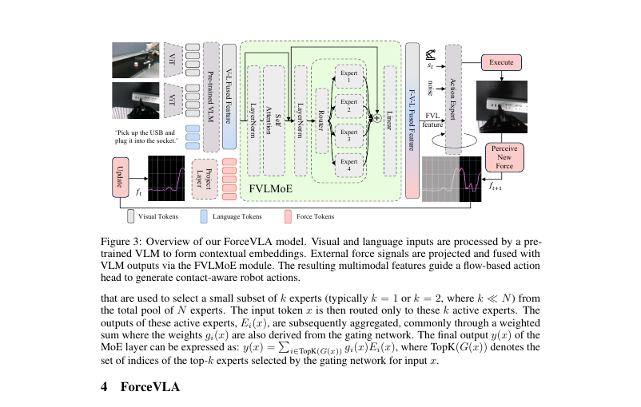
ARCHITECTURE CLAIMS
Late force token into FM — what is CLEAR
CLEAR
Builds on π₀ FM + PaliGemma. Force after VLM. E=4 top-1. Additive into FM suffix.
CLEAR foil
π₀-base / π₀-fast ± force. Not OpenVLA tables.
ABSENT
π₀.₅ bake-off. Expert-count sweep. Force-noise ablation. Sim split.
FALSE ancestry
Not MoPA-PD. Not JEPA/WM.
ForceVLA · arXiv 2505.22159v3 · Alt approaches · LAST sheet · Club Pack
Scientific Reviewer 10 / 12
Notes:
Architecture review checklist.
• Hyperparams fixed (Table 4): force 6→2048; MoE D=2048; action expert 1024.
• Training stated (App B): single-task ~9h/1×4090/10k; multi-task ~12h/2×4090/30k.

Slide 11
VERDICT
Accept late FVLMoE. Refuse foundation-model upgrade.
Systems/methods preprint for force-augmented VLA fusion.
ACCEPT: late fusion ≫ early; FVLMoE ≫ naive concat on reported Flexiv contact suite; occlusion story; honest hardware limitations.
WITHHOLD: solved contact-rich foundation model; beats π₀.₅; universal insert fix (USB 10% multi-task); uniform gen (unstable socket); causal Expert-0 labels.
Syllabus grade: HIGH for Alternative approaches / contact-rich. Embodiment and open-world: NARROW.
One-liner: Late FVLMoE is the real contribution; naive force is a straw improvement.
ForceVLA · arXiv 2505.22159v3 · Alt approaches · LAST sheet · Club Pack
Scientific Reviewer 11 / 12
Notes:
Reviewer close / one-liner from pack.
• Hand Empiricist the Ablation Bot ranks: Tab.3 first, then Insert Plug, USB null, averages, occlusion, multi-task, Pump caveat.

Slide 12
CLOSE
Grade the fusion. Keep the numbers honest.
Tab.3 0→80 and +23.2 avg are enough to accept the method claim.
Soft USB, unstable socket, Pump reversal, and missing π₀.₅ bake-off keep the paper in Alt-approaches — not foundation coronation.
Next: Empiricist smokes Ablation Bot ranks without reprinting Fig.5 as course smoke.
ForceVLA · arXiv 2505.22159v3 · Alt approaches · LAST sheet · Club Pack
Scientific Reviewer 12 / 12
Notes:
End Reviewer. Preserve typo fix: 37.3 = w/o F.

