Slide 1
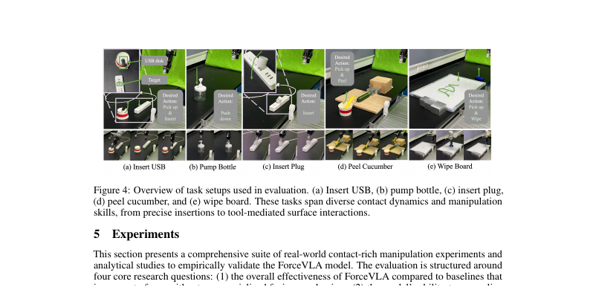
LAST SHEET · ALTERNATIVE APPROACHES · VISIONARY
BEHAVIOR contact-rich
needs wrist force.
Keep the modern VLA/FM controller. Make calibrated 6-axis F/T a first-class late token with sparse expert fusion so insert/wipe/occlusion phases stop being pure vision failures.
NO Discord / Drive
No invented BEHAVIOR SR
No π₀.₅ bake-off numbers
ForceVLA = 2025 blueprint
ForceVLA · arXiv 2505.22159v3 · Alt approaches · LAST sheet · Club Pack
Visionary 1 / 13
Notes:
Visionary open. Constraint: BEHAVIOR contact-rich focus; skip Discord/Drive deliverables.
• Durable idea: keep modern VLA/FM; late F/T + sparse MoE for contact phases.
• Do not invent official BEHAVIOR'25/'26 ForceVLA baseline status or π₀.₅ numerical comparisons.

Slide 2
SHARED SPINE · TATTOO ON EVERY DECK
Five facts that do not change with the seat
01
Late 6-axis F/T + FVLMoE
After VLM (PaliGemma/SigLIP): project wrench → force token → FVLMoE (E=4, top-1) → additive guide into π₀ flow-matching action head. Force stays late.
02
Contact-rich on Flexiv
Insert USB / plug, pump bottle, wipe board, peel cucumber. ForceVLA-Data: 244 traj / ~140k steps / ~50 demos per task. Quest3 teleop.
03
Must-cites
Avg 60.5 vs π₀-base w/o F 37.3 (+23.2). Naive w/ F only 40.2 (+2.9). Early MoE-before-VLM 0% → late FVLMoE 80% (Tab.3). Occlusion 90%. FAST+naive force 31.0→14.2.
04
CLEAR contrasts
NOT MoPA-PD ancestor (MoPA = MP privilege→vision student; ForceVLA = deploy force into VLA). NOT JEPA/WM child. No π₀.₅ bake-off — do not invent.
05
Number hygiene
Typo fix: 37.3 = w/o F (not w/ F). Preserve paper numbers. No invented BEHAVIOR SR. Pump caveat: naive w/F 83 > ForceVLA 67 — do not overclaim.
ForceVLA · arXiv 2505.22159v3 · Alt approaches · LAST sheet · Club Pack
Visionary 2 / 13
Notes:
Shared spine — say this before the role-specific argument.
• Late 6-axis F/T token + FVLMoE (E=4 top-1) after VLM → additive guide into π₀ FM action head.
• Contact-rich insert/wipe/peel on Flexiv; ForceVLA-Data 244 traj / 140k / ~50/task.
• Must-cites: 60.5 vs 37.3 (+23.2); naive w/F 40.2 (+2.9); early MoE 0% / late FVLMoE 80%; occlusion 90%; FAST+naive 31→14.2.
• NOT MoPA-PD ancestor. NOT JEPA/WM child. No π₀.₅ bake-off.
• Typo: 37.3 = w/o F. Pump: naive 83 > ForceVLA 67. No invented BEHAVIOR SR.
• Visionary use: spine numbers are real Flexiv cites. BEHAVIOR mapping is analogy + research direction — not a paper result.

Slide 3
WHY BEHAVIOR CARES
Household activities are dense with contact phases
Insert / seat
Drawers / lids / cabinets
Wipe / clean / spill
Plugs, USB, chargers, appliance connectors. Misalignment + occlusion — Fig.1 failure mode.
Contact detection + compliant push/pull. Expert routing for free-space vs contact phases.
Continuous force maintenance. Wipe Board and peel analogs in ForceVLA-Data.
Crowded counters
Food prep force
Open-world ≠ contact-solved
Wrist cam occludes contact. Lean on force when vision degrades — Tab.2 occlusion 90% moral.
Peel/cut/press phases. Continuous contact metrics (length↑ / strokes↓), not only binary SR.
π₀ / π₀.₅ semantic strength does not erase wrench-dominated failure modes.
ForceVLA · arXiv 2505.22159v3 · Alt approaches · LAST sheet · Club Pack
Visionary 3 / 13
Notes:
BEHAVIOR-class household activities map onto ForceVLA's task suite without claiming a measured BEHAVIOR baseline.
• Vision-only VLAs inherit open-world strength and still jam when forces/compliance dominate.

Slide 4
BLUEPRINT MAP
BEHAVIOR need → ForceVLA-shaped response
Plug / peg / USB / charger
F/T-conditioned insert chunks; occlusion robustness (90% moral)
Drawers / dishwashers / lids
Contact detection + compliant phases via expert routing
Wiping / cleaning surfaces
Continuous force maintenance (wipe/peel analogs)
Crowded counters / clutter
Lean on force when wrist cam occludes contact
Hybrid with π₀.₅ / RTC stacks
TENTATIVE: HL semantic loop + low-level FM+FVLMoE when wrist F/T present — NOT claimed by paper
Hardware path
Arms with integrated or retrofit F/T; calibrate; paper's estimated-wrench caveat
ForceVLA · arXiv 2505.22159v3 · Alt approaches · LAST sheet · Club Pack
Visionary 4 / 13
Notes:
From Visionary pack table. Mark TENTATIVE hybrid clearly.
• Tactile skins (TLA/Tac-Man) are parallel modalities — MoE could host them later (TENTATIVE extension).

Slide 5
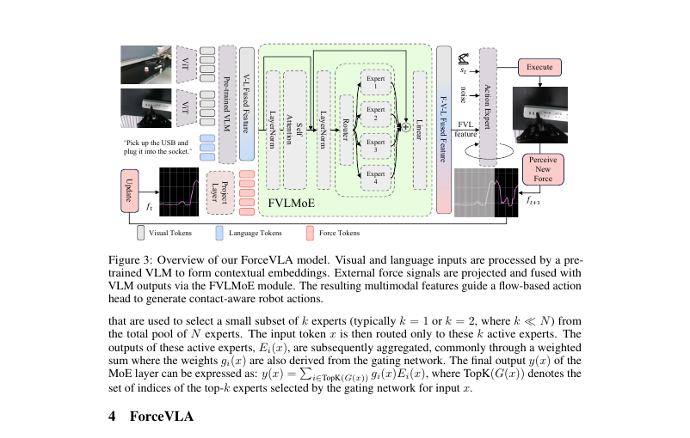
FIG. 3 · WHAT TO PORT
Drop-in late MoE on OpenPI-style FM stacks
Portable idea
FVLMoE block after VLM, before / into FM suffix.
CLEAR compatible
OpenPI π₀ checkpoints that retain FM + F/T datasets.
NOT measured
π₀.₅ / KI / RTC numerical gains. Do not invent.
Rule
Force AFTER VLM. Early MoE → 0% moral.
ForceVLA · arXiv 2505.22159v3 · Alt approaches · LAST sheet · Club Pack
Visionary 5 / 13
Notes:
Research recipe, not a paper claim of π₀.₅ gains.
• Multi-expert specialization for contact vs free-space is a natural follow-up.

Slide 6
F/T REQUIREMENTS (PRACTICAL)
What a BEHAVIOR contact stack must stream
6D wrench synced
Latency vs chunk rate
Integrated vs retrofit
Time-synced with RGB + proprio (ForceVLA-Data pattern). World/TCP frame consistent.
Wrench must arrive in time for FM chunk conditioning. Watch delay as a future ablation (paper lacks it).
Flexiv-class works in-paper. Authors flag lower-cost external F/T as accessibility future work.
Estimated wrench caveat
Tactile skins parallel
No F/T = blocked
Paper limitation: estimated external wrench today. Prefer high-fid transducers when porting.
TLA / Tac-Man family — not ForceVLA results. Same MoE could host image+F/T tokens later (TENTATIVE).
Without a force stream, this blueprint does not apply. Keep vision VLA for free-space language tasks.
ForceVLA · arXiv 2505.22159v3 · Alt approaches · LAST sheet · Club Pack
Visionary 6 / 13
Notes:
Hardware honesty. Do not pitch ForceVLA for arms that cannot sense wrench.
• Teleop: Quest3 pattern in Fig.8 — human demos with synced F/T.

Slide 7
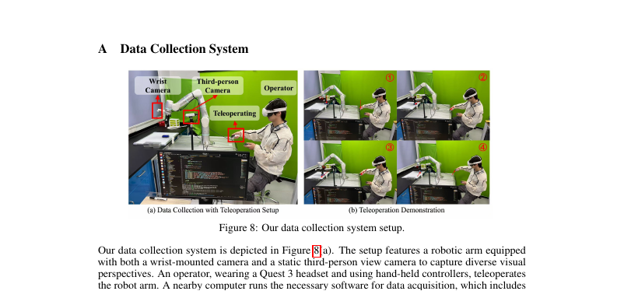
FIG. 8 · DATA REALITY
Contact-rich VLAs need sync F/T demos — not OXE alone
ForceVLA-Data
244 traj
~140k steps
~50 demos / task
Implication
BEHAVIOR contact suites need wrench-synced teleop or replay — language-only corpora will not unlock FVLMoE.
Release
Code/data 'will be released' — pin when public.
ForceVLA · arXiv 2505.22159v3 · Alt approaches · LAST sheet · Club Pack
Visionary 7 / 13
Notes:
Fig.8 Quest3 + Flexiv teleop. 5 expert operators, 5 tasks, varied pose.
• Visionary follow-up: public F/T datasets for OpenPI π₀ fine-tunes.

Slide 8
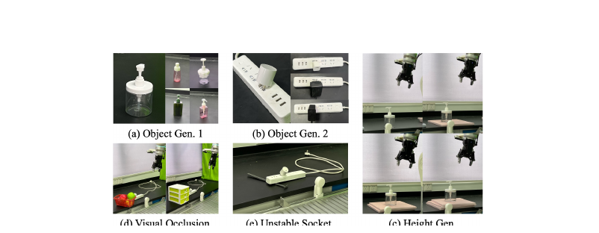
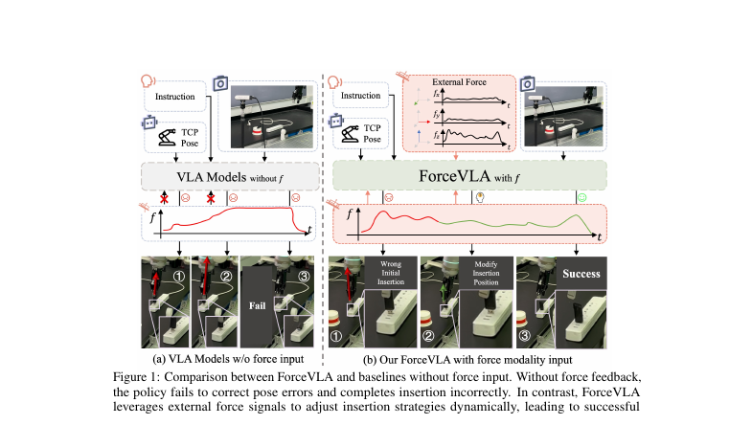
OCCLUSION AS THE HOUSEHOLD DEMO
When vision fails in clutter — force must carry
Visual Occlusion
90%
ForceVLA vs ≤60% π₀-base
Household read
Cable seating behind furniture; socket under clutter; wrist cam blocked by tool.
Still hard
Unstable Socket 20%. Physical instability ≠ solved by force MoE alone.
ForceVLA · arXiv 2505.22159v3 · Alt approaches · LAST sheet · Club Pack
Visionary 8 / 13
Notes:
Occlusion is the visionary demo reel for BEHAVIOR clutter.
• Naive force can hurt under shift — fusion quality still matters at home.

Slide 9
FOLLOW-UP RESEARCH DIRECTIONS
Seven threads — none invent paper numbers
1 Port FVLMoE
2 High-fid wrench
3 Tactile + F/T MoE
4 BEHAVIOR contact eval
Onto open π₀ / OpenPI with public F/T datasets. Drop-in late block.
Replace estimated wrench; ablate noise / delay (absent in paper).
Add tactile image tokens beside wrench in the same sparse MoE.
Insert / wipe / open categories with forced occlusion. No invented SR here.
5 Expert load balance
6 Low-cost retrofit F/T
7 USB-hard curriculum
— Refuse
Study Expert-0 generalist bias; rare contact events need capacity.
Paper's stated accessibility direction on common arms.
Force alone insufficient for fine alignment (multi-task USB 10%).
Discord/Drive packs. Invented BEHAVIOR baseline. Invented π₀.₅ bake-off.
ForceVLA · arXiv 2505.22159v3 · Alt approaches · LAST sheet · Club Pack
Visionary 9 / 13
Notes:
Follow-ups from Visionary pack. Mark research vs paper results.
• Safe contact under torque limits (Height Gen lesson) is another application thread.

Slide 10
NEW APPLICATIONS (CAREFUL)
Kitchen / clean / food / occluded seating
Kitchen plugs / appliances
Wipe / scrub profiles
Food prep peel/cut
Insert assist with force-corrected seating when sockets are occluded or soft.
Cleaning robots that maintain contact force, not just end-effector paths.
Force phases for peel/press. Continuous metrics matter (Tab.1 moral).
Occluded cable seating
Torque-limited depth
What not to pitch
Behind furniture / under desks — occlusion 90% is the analogy, not a BEHAVIOR score.
Height Gen lesson: scale interaction forces; avoid torque limit violations.
Force replacing language grounding. ForceVLA as π₀.₅ replacement. Official BEHAVIOR'26 baseline.
ForceVLA · arXiv 2505.22159v3 · Alt approaches · LAST sheet · Club Pack
Visionary 10 / 13
Notes:
Applications are directional. Preserve Pump caveat if someone asks 'always wins contact'.

Slide 11
HYBRID RECIPE (TENTATIVE)
Say the hedge out loud
TENTATIVE useful research recipe — NOT a ForceVLA paper claim:
1. Run a π₀.₅-style high-level semantic / open-world loop for language grounding.
2. Keep a low-level FM action expert for chunks.
3. When wrist F/T is present, augment with FVLMoE late force fusion for contact phases.
4. Eval contact categories under occlusion separately from free-space language success.
CLEAR: ForceVLA measured force MoE on π₀ FM only. No π₀.₅ / RTC numbers exist to cite.
CLEAR: no Discord, no Drive, no invented BEHAVIOR baseline status.
ForceVLA · arXiv 2505.22159v3 · Alt approaches · LAST sheet · Club Pack
Visionary 11 / 13
Notes:
This slide exists so Visionary does not accidentally invent a bake-off.
• Compatible in spirit with OpenPI-style stacks that retain FM.

Slide 12
ONE-LINER + CLOSE
2025 blueprint — not a π₀.₅ replacement
For BEHAVIOR contact-rich homes, pair modern VLAs with
wrist F/T + late MoE fusion
so insertion / wipe / occlusion phases stop being pure vision failures.
ForceVLA is the 2025 blueprint, not a π₀.₅ replacement.
Cite: 60.5 vs 37.3 (+23.2); early MoE 0%; occlusion 90%. Refuse invented BEHAVIOR SR.
ForceVLA · arXiv 2505.22159v3 · Alt approaches · LAST sheet · Club Pack
Visionary 12 / 13
Notes:
Visionary one-liner from pack.
• Club Pack complete: all five seats equal depth. No Discord/Drive.

Slide 13
SHEET CLOSE
LAST Alt row locked — force-in-VLA on the record
Stakeholder
Reviewer
Empiricist
Buy late MoE when F/T exists. Don't concat-only. FAST+naive hurts.
Late MoE real contrib. Soft USB 10% multi / unstable / no π₀.₅.
Ablation Bot ranks. Smoke ≠ Fig.5. Pump honesty.
Archaeologist
Visionary
Shared spine
π₀ → late force → FVLMoE → FM. CLEAR vs MoPA / JEPA.
BEHAVIOR contact-rich + F/T + late MoE. NO Discord/Drive.
60.5 / 37.3 / +23.2 · early 0% · occlusion 90% · not MoPA · not JEPA · no π₀.₅ bake-off.
ForceVLA · arXiv 2505.22159v3 · Alt approaches · LAST sheet · Club Pack
Visionary 13 / 13
Notes:
End Visionary / end Club Pack. Quiet pipeline — report absolute paths only.

