Slide 1
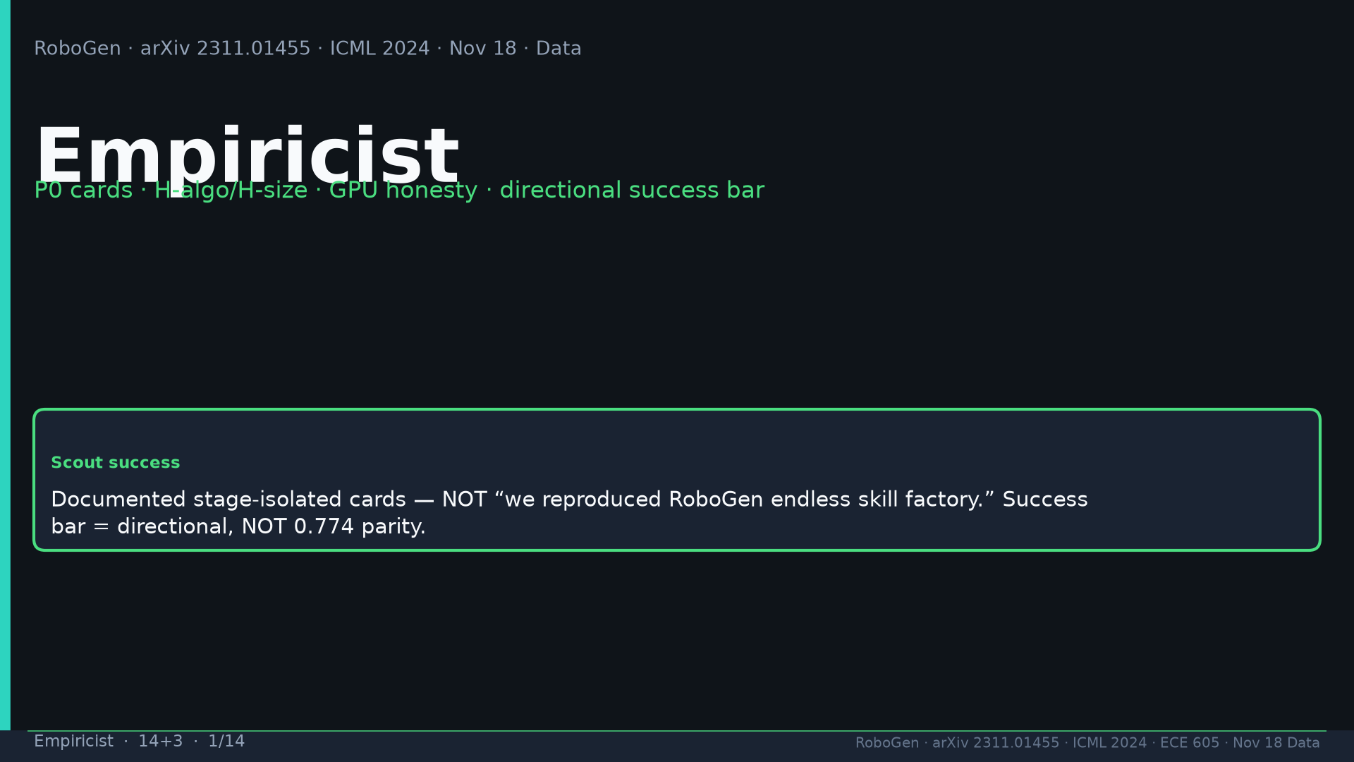
Notes:
[Empiricist · 14+3 · 1/14]
Title. Scout=stage-isolated cards NOT full factory reproduction. Success bar DIRECTIONAL not 0.774 parity.
Tattoo: success 0.774/69 · validity 19/155 fails · avg 3.13 substeps · Self-BLEU 0.284 (beats Behavior-100) · Fig.5 RL-only collapses · manip 0.745 / soft ~0.886 / loco ~0.833

Slide 2
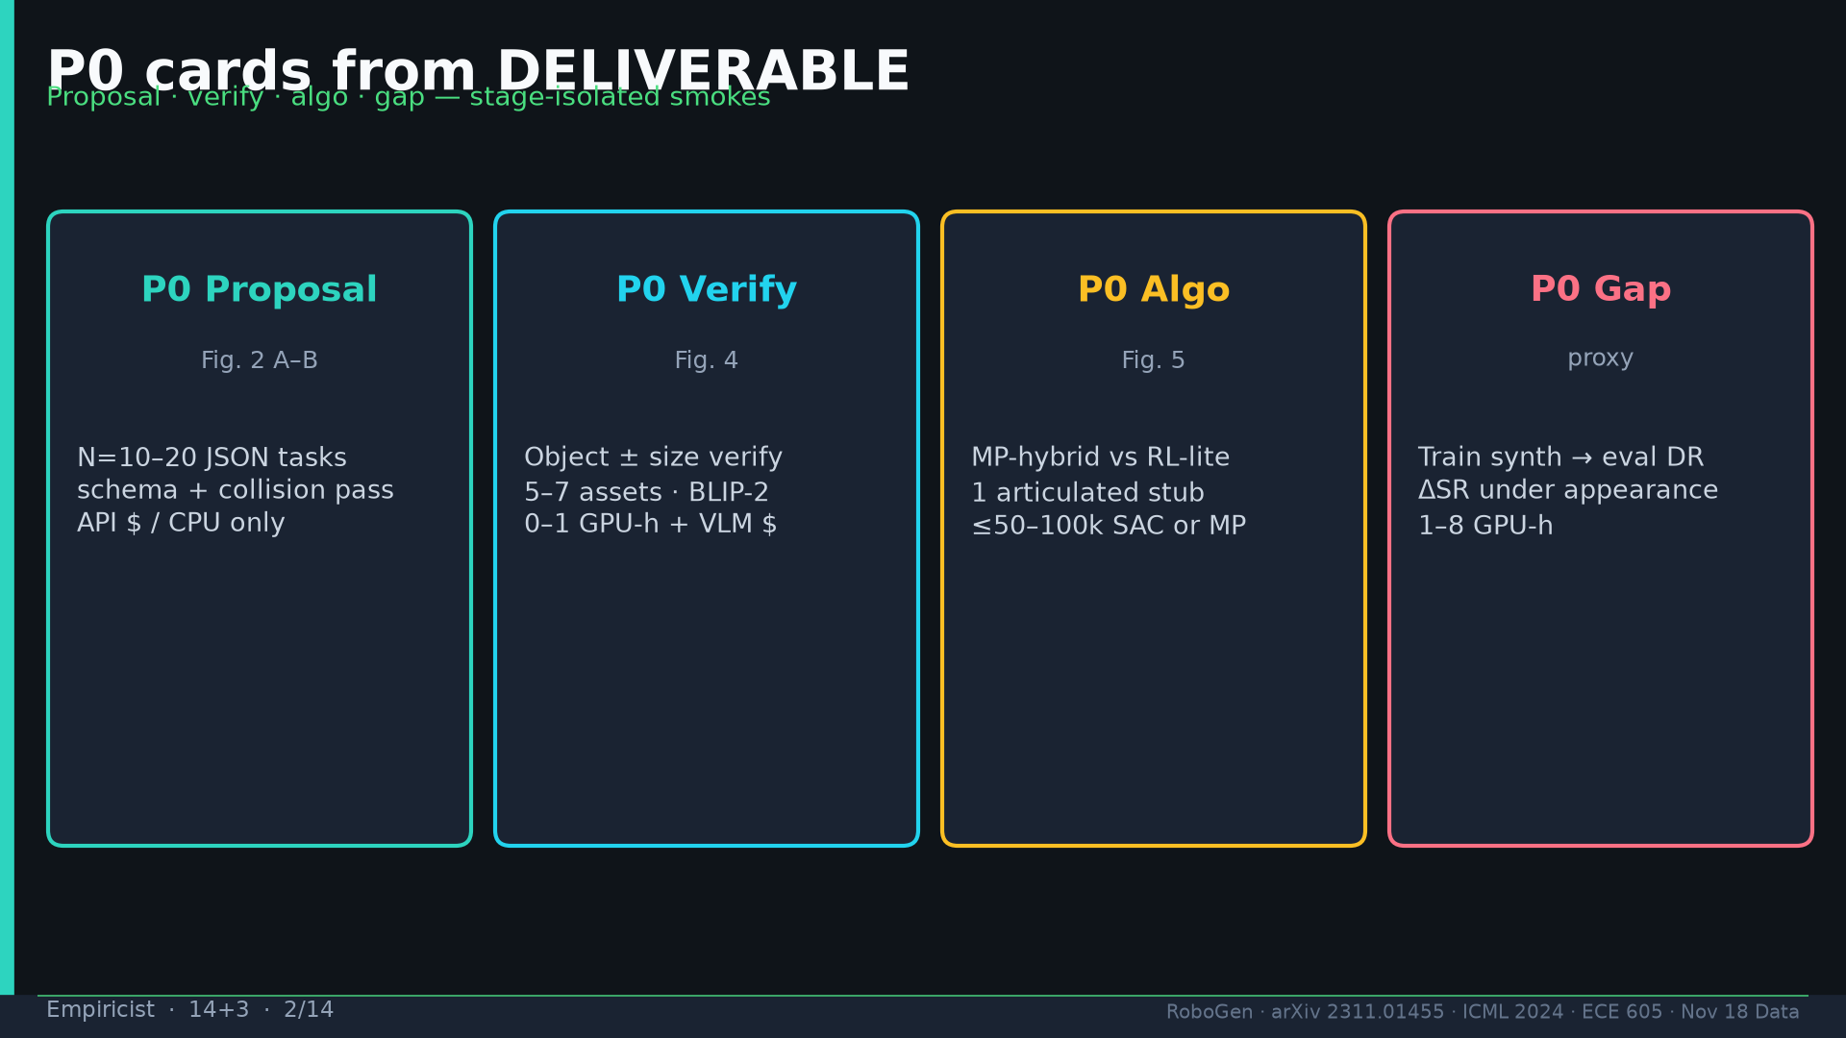
Notes:
[Empiricist · 14+3 · 2/14]
P0 cards: proposal N=20; verify Fig.4; algo Fig.5 hybrid vs RL-lite; gap proxy DR. Stage-isolated.
Tattoo: success 0.774/69 · validity 19/155 fails · avg 3.13 substeps · Self-BLEU 0.284 (beats Behavior-100) · Fig.5 RL-only collapses · manip 0.745 / soft ~0.886 / loco ~0.833

Slide 3
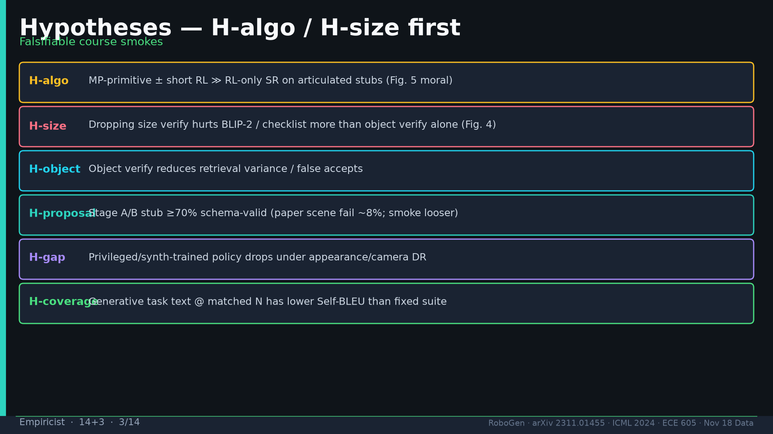
Notes:
[Empiricist · 14+3 · 3/14]
Hypotheses: H-algo MP≫RL-only; H-size verify dominates; H-object; H-proposal ≥70%; H-gap DR drop; H-coverage Self-BLEU.
Tattoo: success 0.774/69 · validity 19/155 fails · avg 3.13 substeps · Self-BLEU 0.284 (beats Behavior-100) · Fig.5 RL-only collapses · manip 0.745 / soft ~0.886 / loco ~0.833

Slide 4
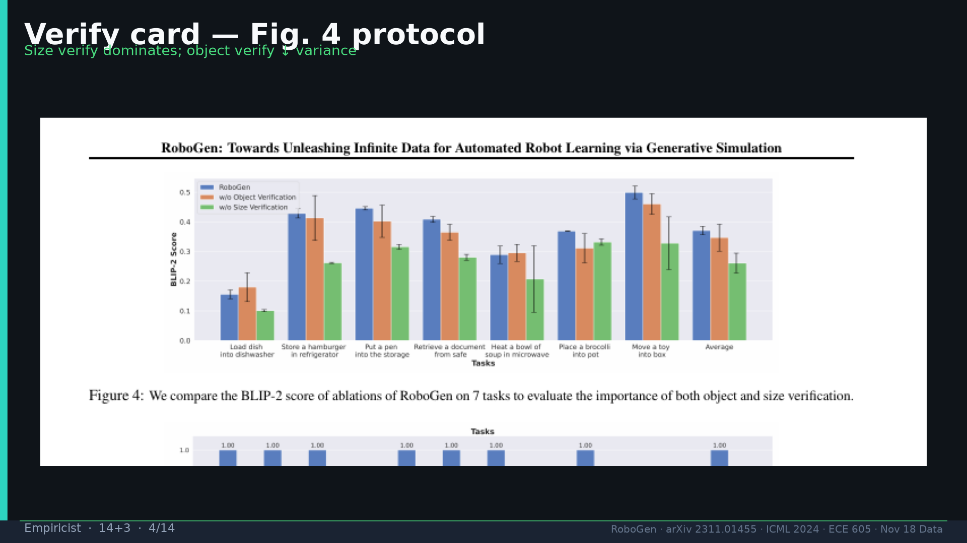
Notes:
[Empiricist · 14+3 · 4/14]
Fig.4 verify card protocol — size verify dominates.
Tattoo: success 0.774/69 · validity 19/155 fails · avg 3.13 substeps · Self-BLEU 0.284 (beats Behavior-100) · Fig.5 RL-only collapses · manip 0.745 / soft ~0.886 / loco ~0.833

Slide 5
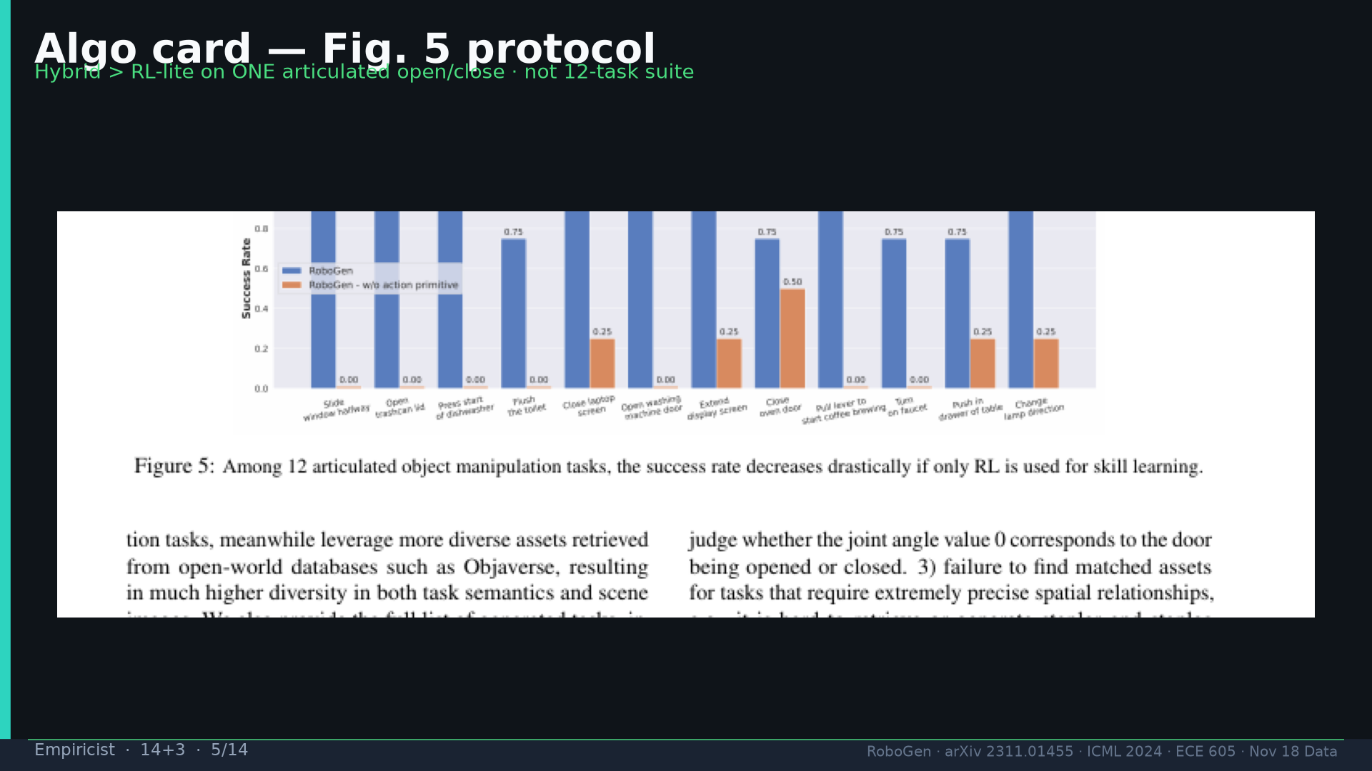
Notes:
[Empiricist · 14+3 · 5/14]
Fig.5 algo card — hybrid>RL-lite on ONE articulated stub; not 12-task suite.
Tattoo: success 0.774/69 · validity 19/155 fails · avg 3.13 substeps · Self-BLEU 0.284 (beats Behavior-100) · Fig.5 RL-only collapses · manip 0.745 / soft ~0.886 / loco ~0.833

Slide 6
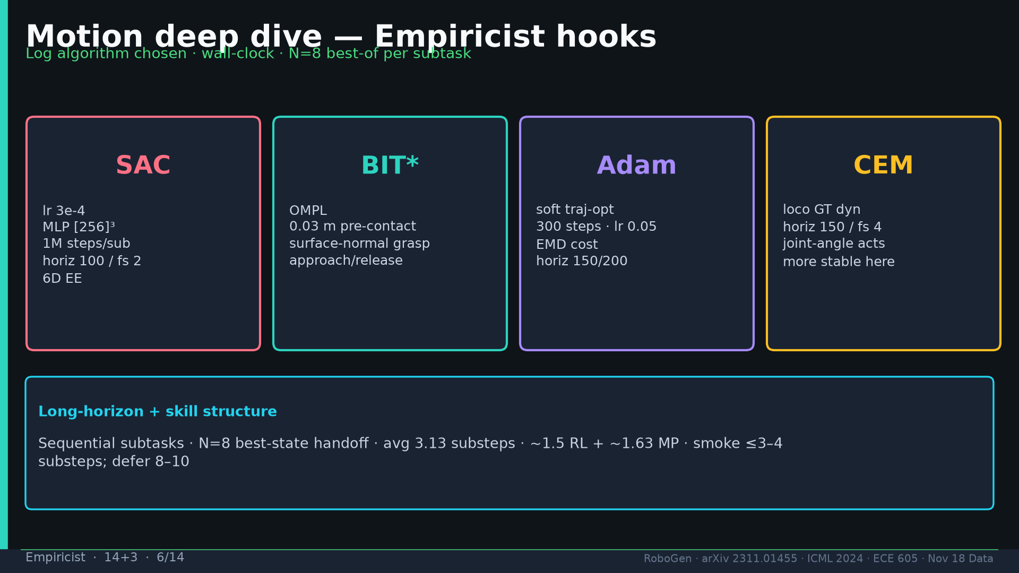
Notes:
[Empiricist · 14+3 · 6/14]
MOTION DEEP DIVE: SAC/BIT*/Adam/CEM knobs; N=8 handoff; 3.13/~1.5/~1.63. Log algo chosen + wall-clock.
Tattoo: success 0.774/69 · validity 19/155 fails · avg 3.13 substeps · Self-BLEU 0.284 (beats Behavior-100) · Fig.5 RL-only collapses · manip 0.745 / soft ~0.886 / loco ~0.833

Slide 7
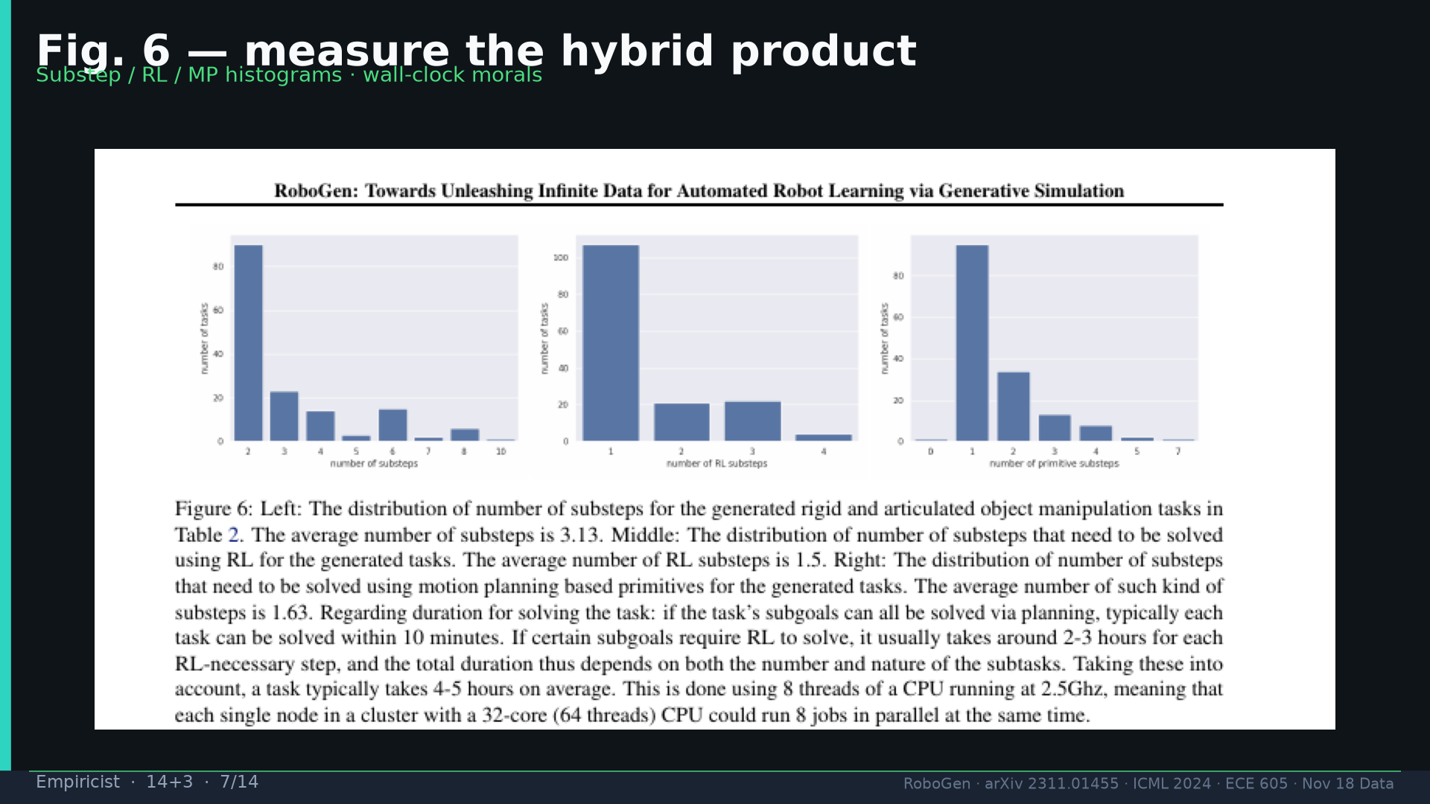
Notes:
[Empiricist · 14+3 · 7/14]
Fig.6 measure hybrid product + wall-clock morals.
Tattoo: success 0.774/69 · validity 19/155 fails · avg 3.13 substeps · Self-BLEU 0.284 (beats Behavior-100) · Fig.5 RL-only collapses · manip 0.745 / soft ~0.886 / loco ~0.833

Slide 8
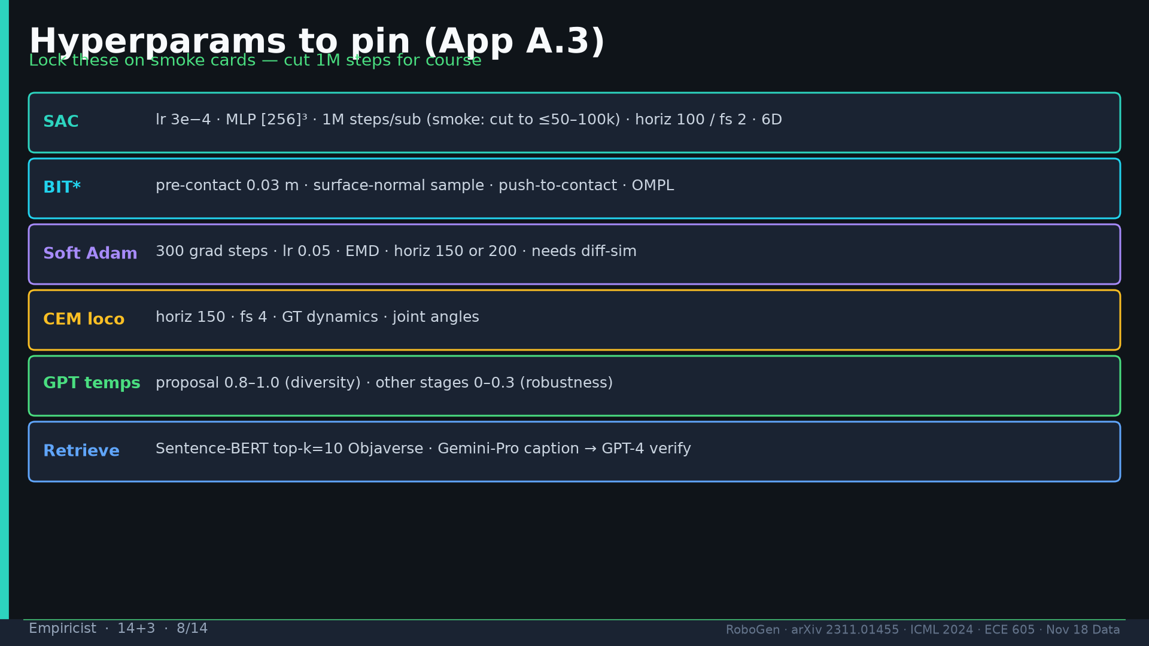
Notes:
[Empiricist · 14+3 · 8/14]
Hyperparams pin: SAC 1M/3e-4/[256]³ (cut for smoke); BIT* 0.03m; Adam 300/0.05; CEM 150/4; GPT T 0.8–1.0 / 0–0.3; k=10.
Tattoo: success 0.774/69 · validity 19/155 fails · avg 3.13 substeps · Self-BLEU 0.284 (beats Behavior-100) · Fig.5 RL-only collapses · manip 0.745 / soft ~0.886 / loco ~0.833

Slide 9
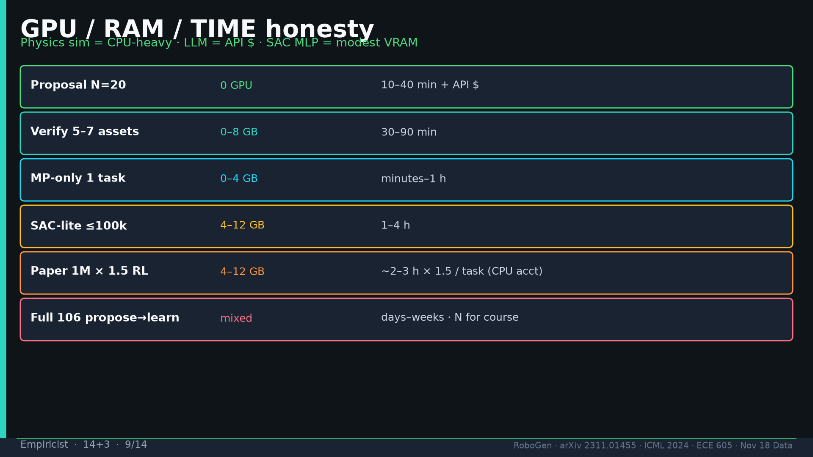
Notes:
[Empiricist · 14+3 · 9/14]
GPU honesty: proposal API$; verify 0–8GB; MP minutes; SAC-lite 1–4h; paper 1M CPU-heavy; full 106=N.
Tattoo: success 0.774/69 · validity 19/155 fails · avg 3.13 substeps · Self-BLEU 0.284 (beats Behavior-100) · Fig.5 RL-only collapses · manip 0.745 / soft ~0.886 / loco ~0.833

Slide 10
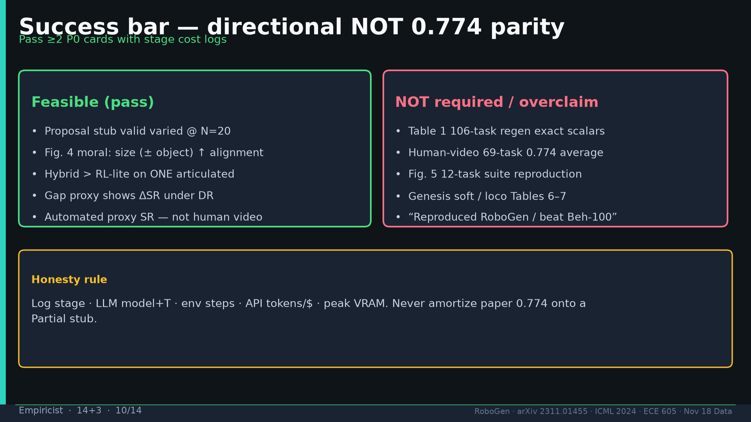
Notes:
[Empiricist · 14+3 · 10/14]
Success bar table: pass≥2 P0 with logs; never amortize 0.774 onto Partial stub.
Tattoo: success 0.774/69 · validity 19/155 fails · avg 3.13 substeps · Self-BLEU 0.284 (beats Behavior-100) · Fig.5 RL-only collapses · manip 0.745 / soft ~0.886 / loco ~0.833

Slide 11
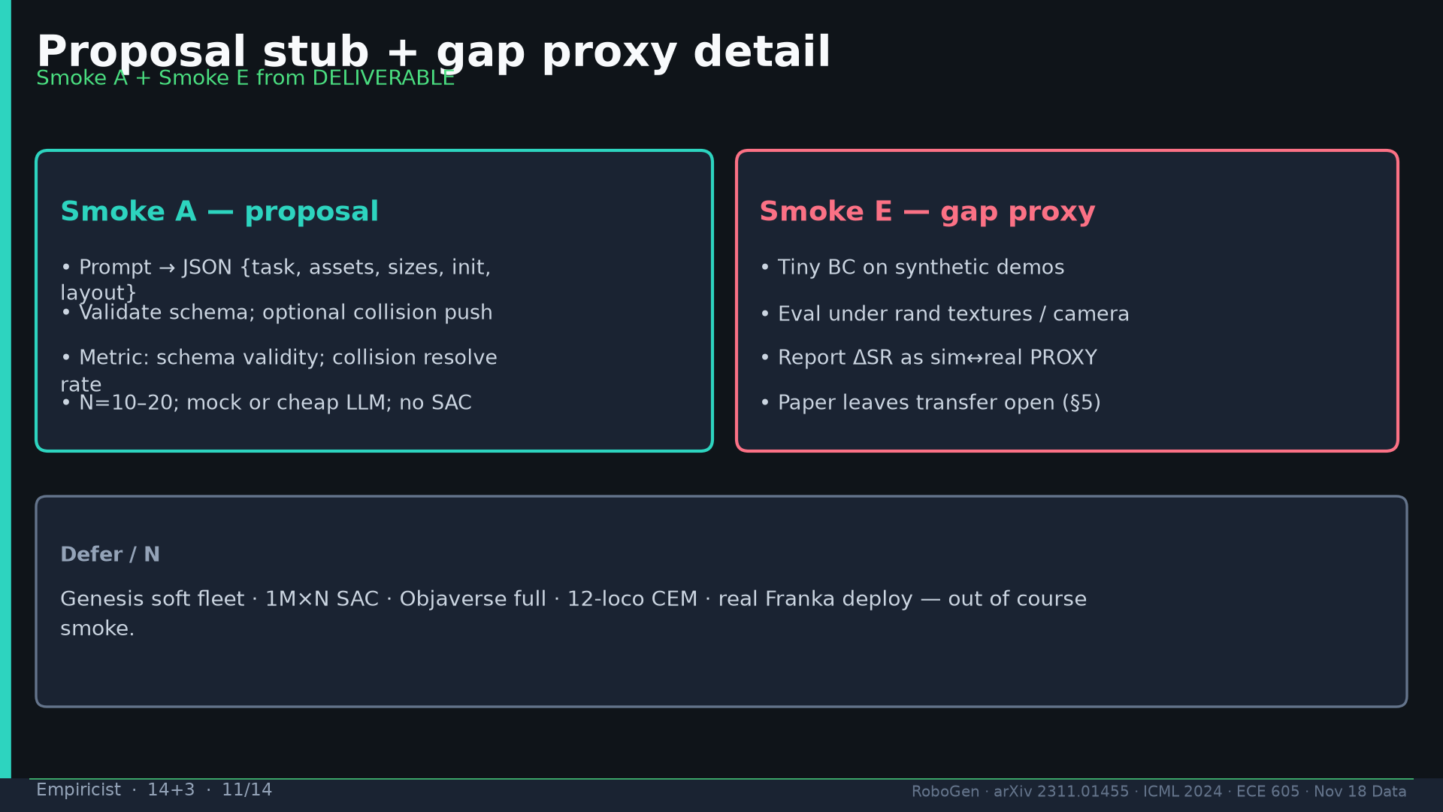
Notes:
[Empiricist · 14+3 · 11/14]
Proposal stub + gap proxy detail; defer Genesis/1M×N/loco/Franka.
Tattoo: success 0.774/69 · validity 19/155 fails · avg 3.13 substeps · Self-BLEU 0.284 (beats Behavior-100) · Fig.5 RL-only collapses · manip 0.745 / soft ~0.886 / loco ~0.833

Slide 12
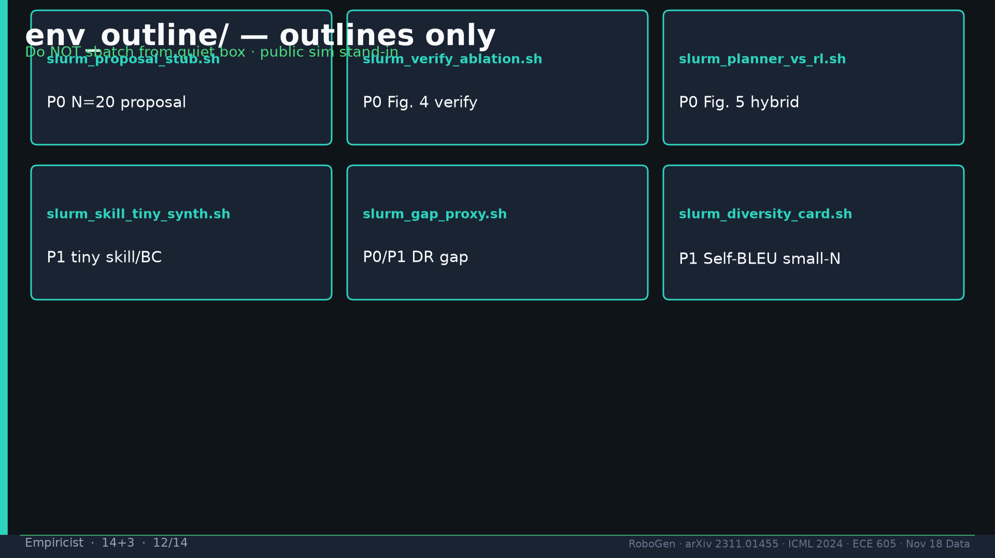
Notes:
[Empiricist · 14+3 · 12/14]
env_outline/ scripts outlines only — do NOT sbatch from quiet box.
Tattoo: success 0.774/69 · validity 19/155 fails · avg 3.13 substeps · Self-BLEU 0.284 (beats Behavior-100) · Fig.5 RL-only collapses · manip 0.745 / soft ~0.886 / loco ~0.833

Slide 13
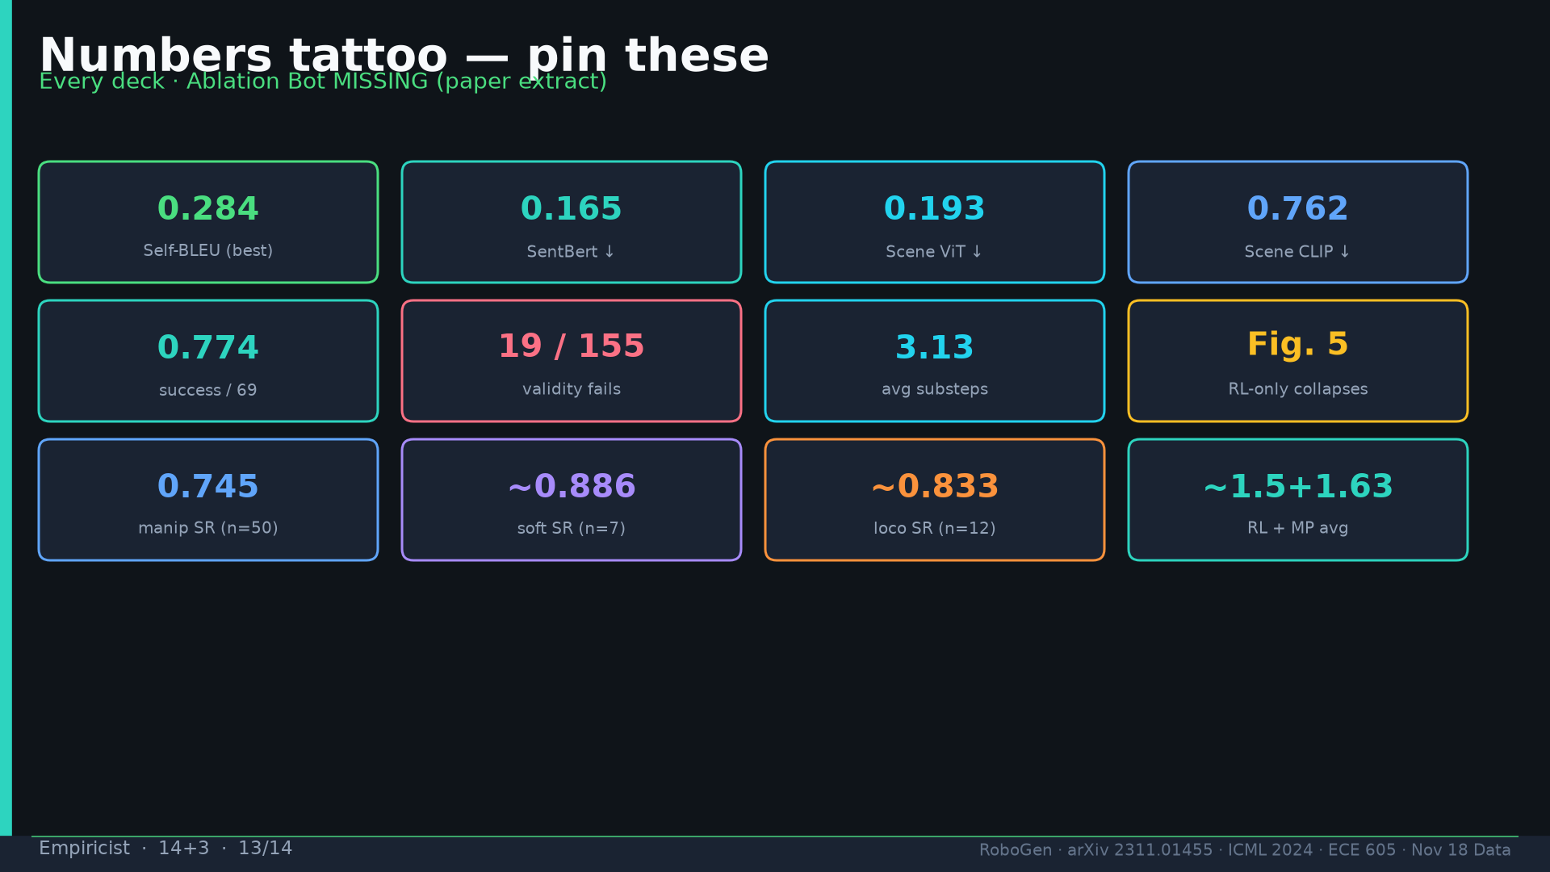
Notes:
[Empiricist · 14+3 · 13/14]
Tattoo.
Tattoo: success 0.774/69 · validity 19/155 fails · avg 3.13 substeps · Self-BLEU 0.284 (beats Behavior-100) · Fig.5 RL-only collapses · manip 0.745 / soft ~0.886 / loco ~0.833

Slide 14
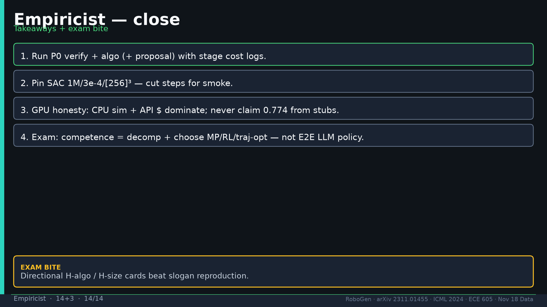
Notes:
[Empiricist · 14+3 · 14/14]
Close: P0 verify+algo; pin hparams; GPU honesty; exam decomp+choose.
Tattoo: success 0.774/69 · validity 19/155 fails · avg 3.13 substeps · Self-BLEU 0.284 (beats Behavior-100) · Fig.5 RL-only collapses · manip 0.745 / soft ~0.886 / loco ~0.833

