Slide 1
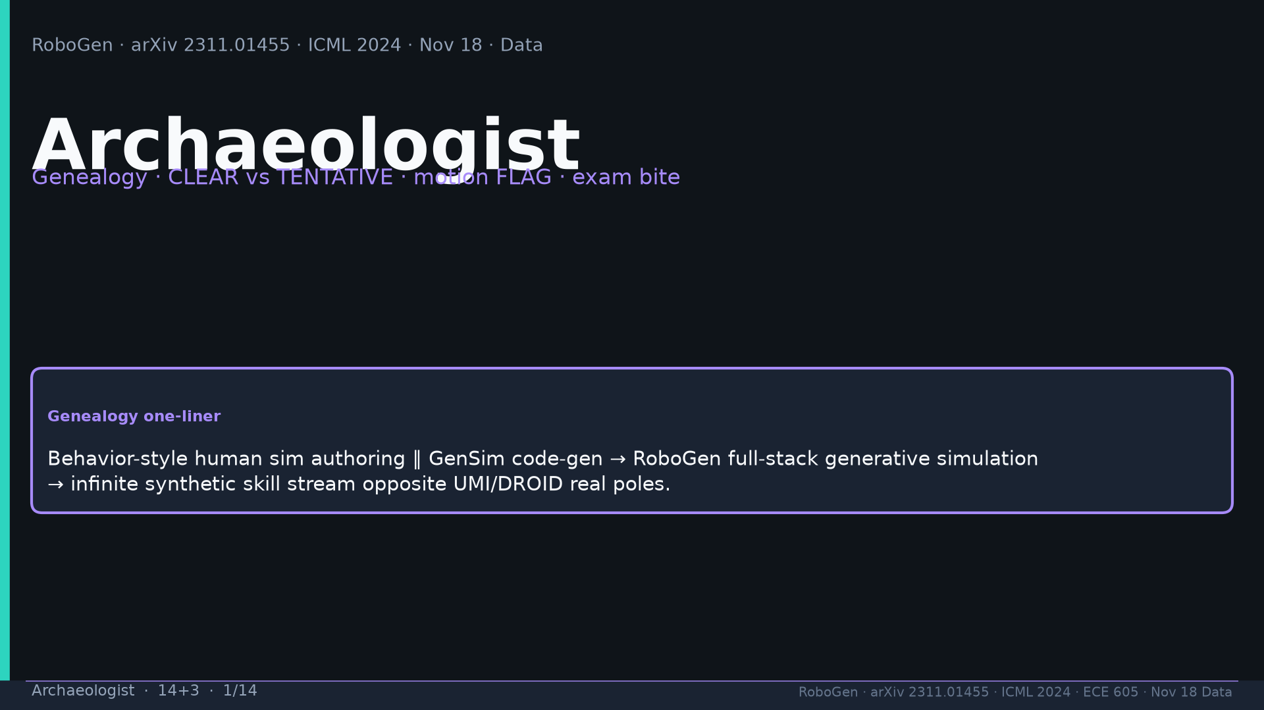
Notes:
[Archaeologist · 14+3 · 1/14]
Title. Genealogy one-liner: Behavior authoring ∥ GenSim → RoboGen full-stack → synthetic opposite UMI/DROID.
Tattoo: success 0.774/69 · validity 19/155 fails · avg 3.13 substeps · Self-BLEU 0.284 (beats Behavior-100) · Fig.5 RL-only collapses · manip 0.745 / soft ~0.886 / loco ~0.833

Slide 2
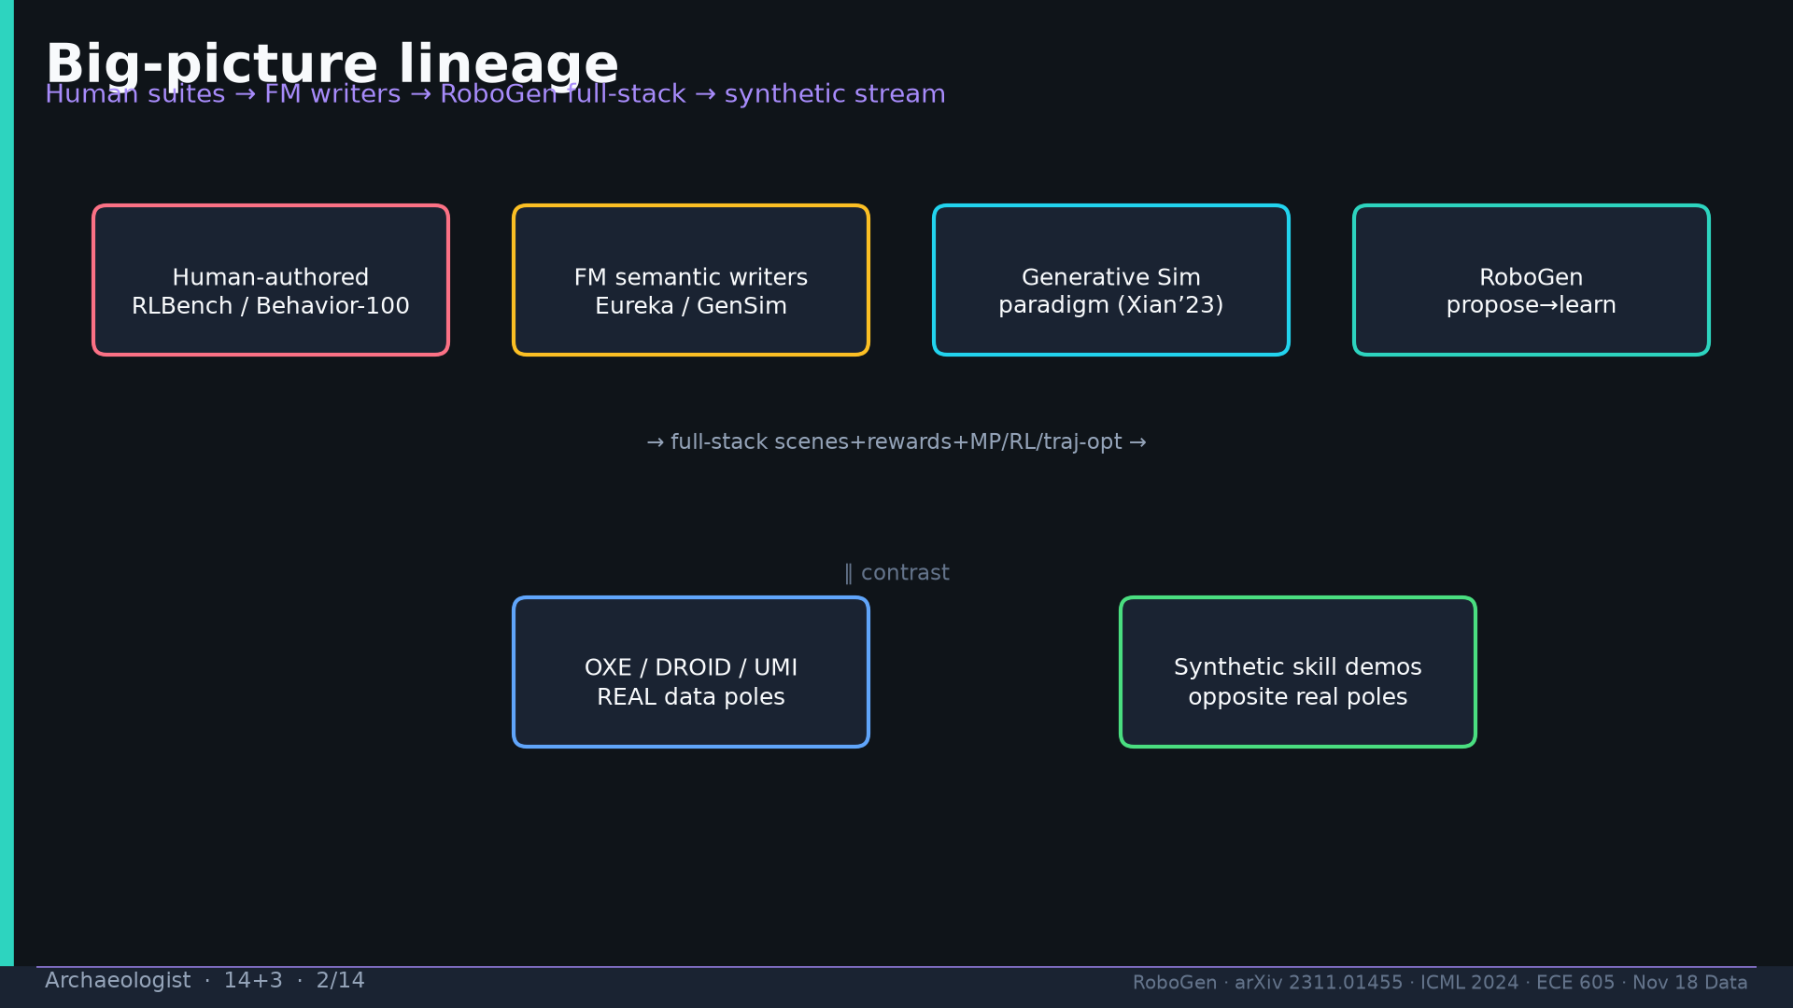
Notes:
[Archaeologist · 14+3 · 2/14]
Lineage diagram: human suites + FM writers + GenSim paradigm → RoboGen; contrast real poles.
Tattoo: success 0.774/69 · validity 19/155 fails · avg 3.13 substeps · Self-BLEU 0.284 (beats Behavior-100) · Fig.5 RL-only collapses · manip 0.745 / soft ~0.886 / loco ~0.833

Slide 3
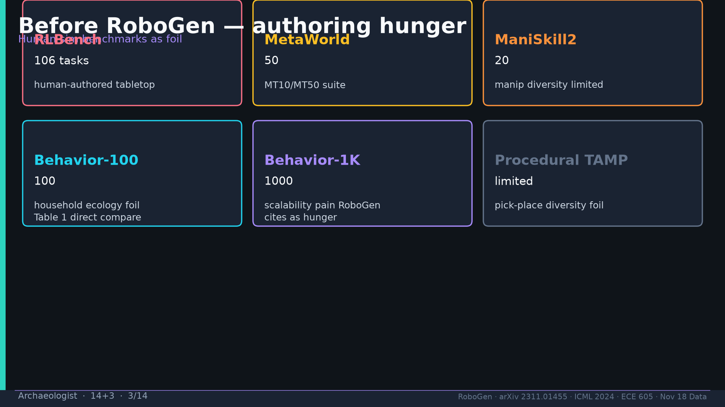
Notes:
[Archaeologist · 14+3 · 3/14]
Before: RLBench/MetaWorld/ManiSkill2/Behavior-100/1K authoring hunger.
Tattoo: success 0.774/69 · validity 19/155 fails · avg 3.13 substeps · Self-BLEU 0.284 (beats Behavior-100) · Fig.5 RL-only collapses · manip 0.745 / soft ~0.886 / loco ~0.833

Slide 4
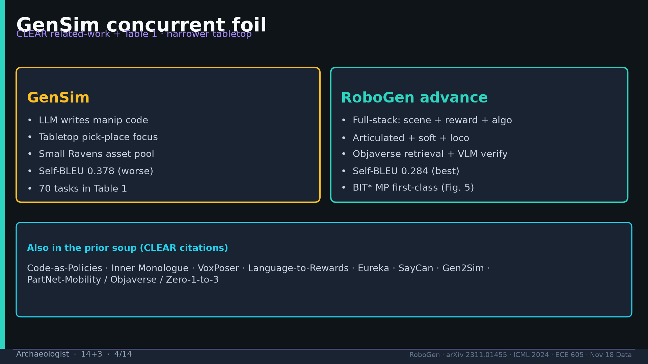
Notes:
[Archaeologist · 14+3 · 4/14]
GenSim foil: tabletop code-gen vs RoboGen full-stack artic/soft/loco + MP. Prior soup Eureka/CaP/etc.
Tattoo: success 0.774/69 · validity 19/155 fails · avg 3.13 substeps · Self-BLEU 0.284 (beats Behavior-100) · Fig.5 RL-only collapses · manip 0.745 / soft ~0.886 / loco ~0.833

Slide 5
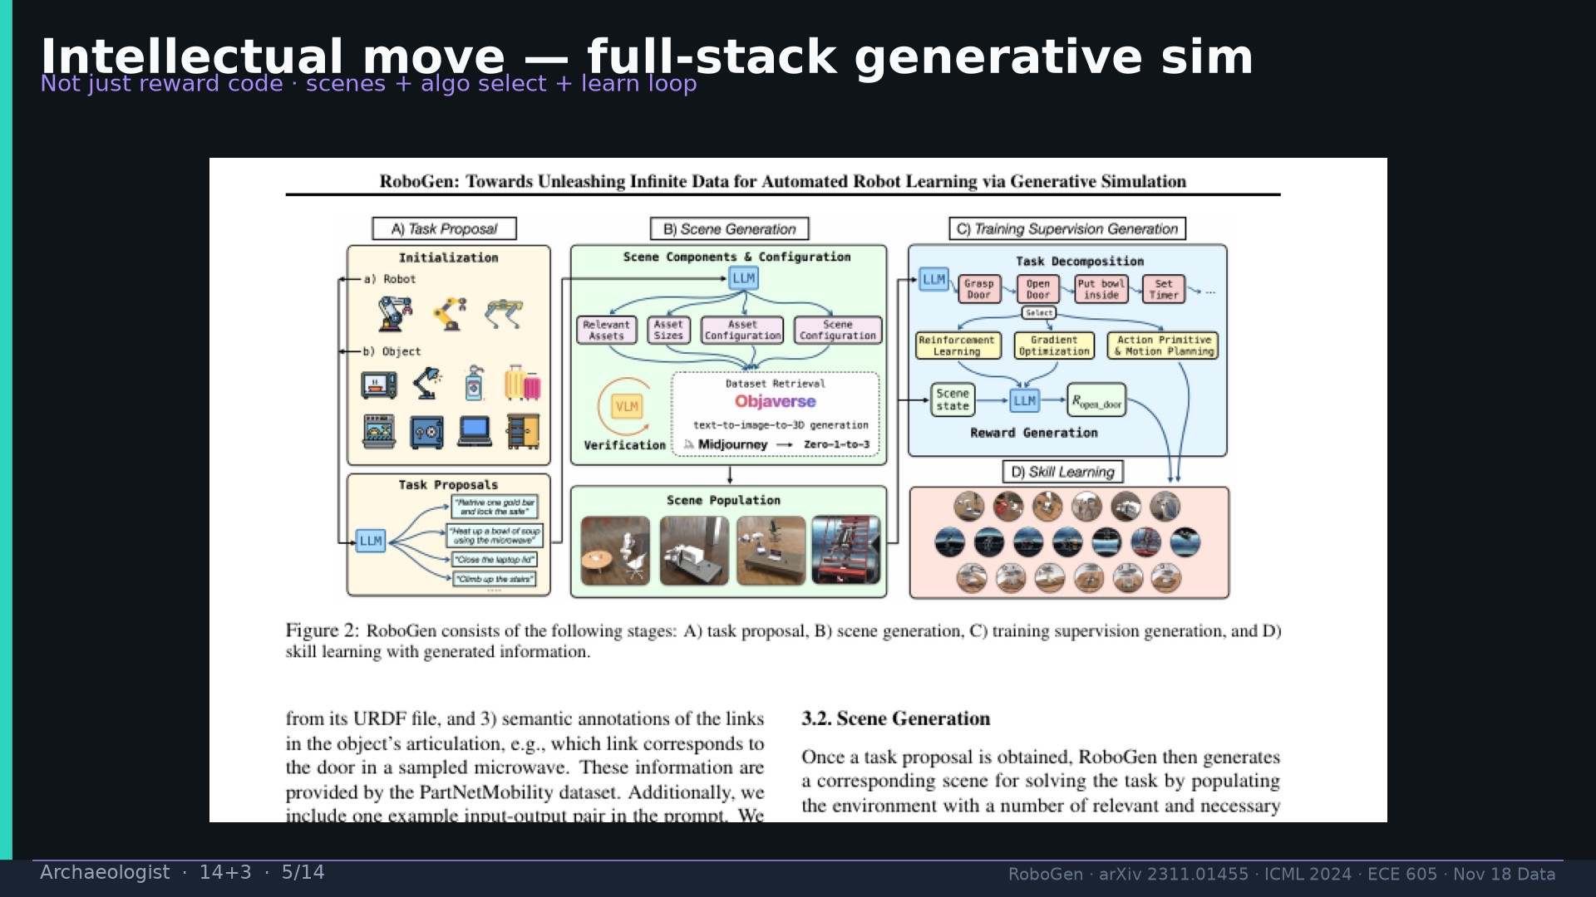
Notes:
[Archaeologist · 14+3 · 5/14]
Intellectual move = Fig.2 full-stack generative sim.
Tattoo: success 0.774/69 · validity 19/155 fails · avg 3.13 substeps · Self-BLEU 0.284 (beats Behavior-100) · Fig.5 RL-only collapses · manip 0.745 / soft ~0.886 / loco ~0.833

Slide 6
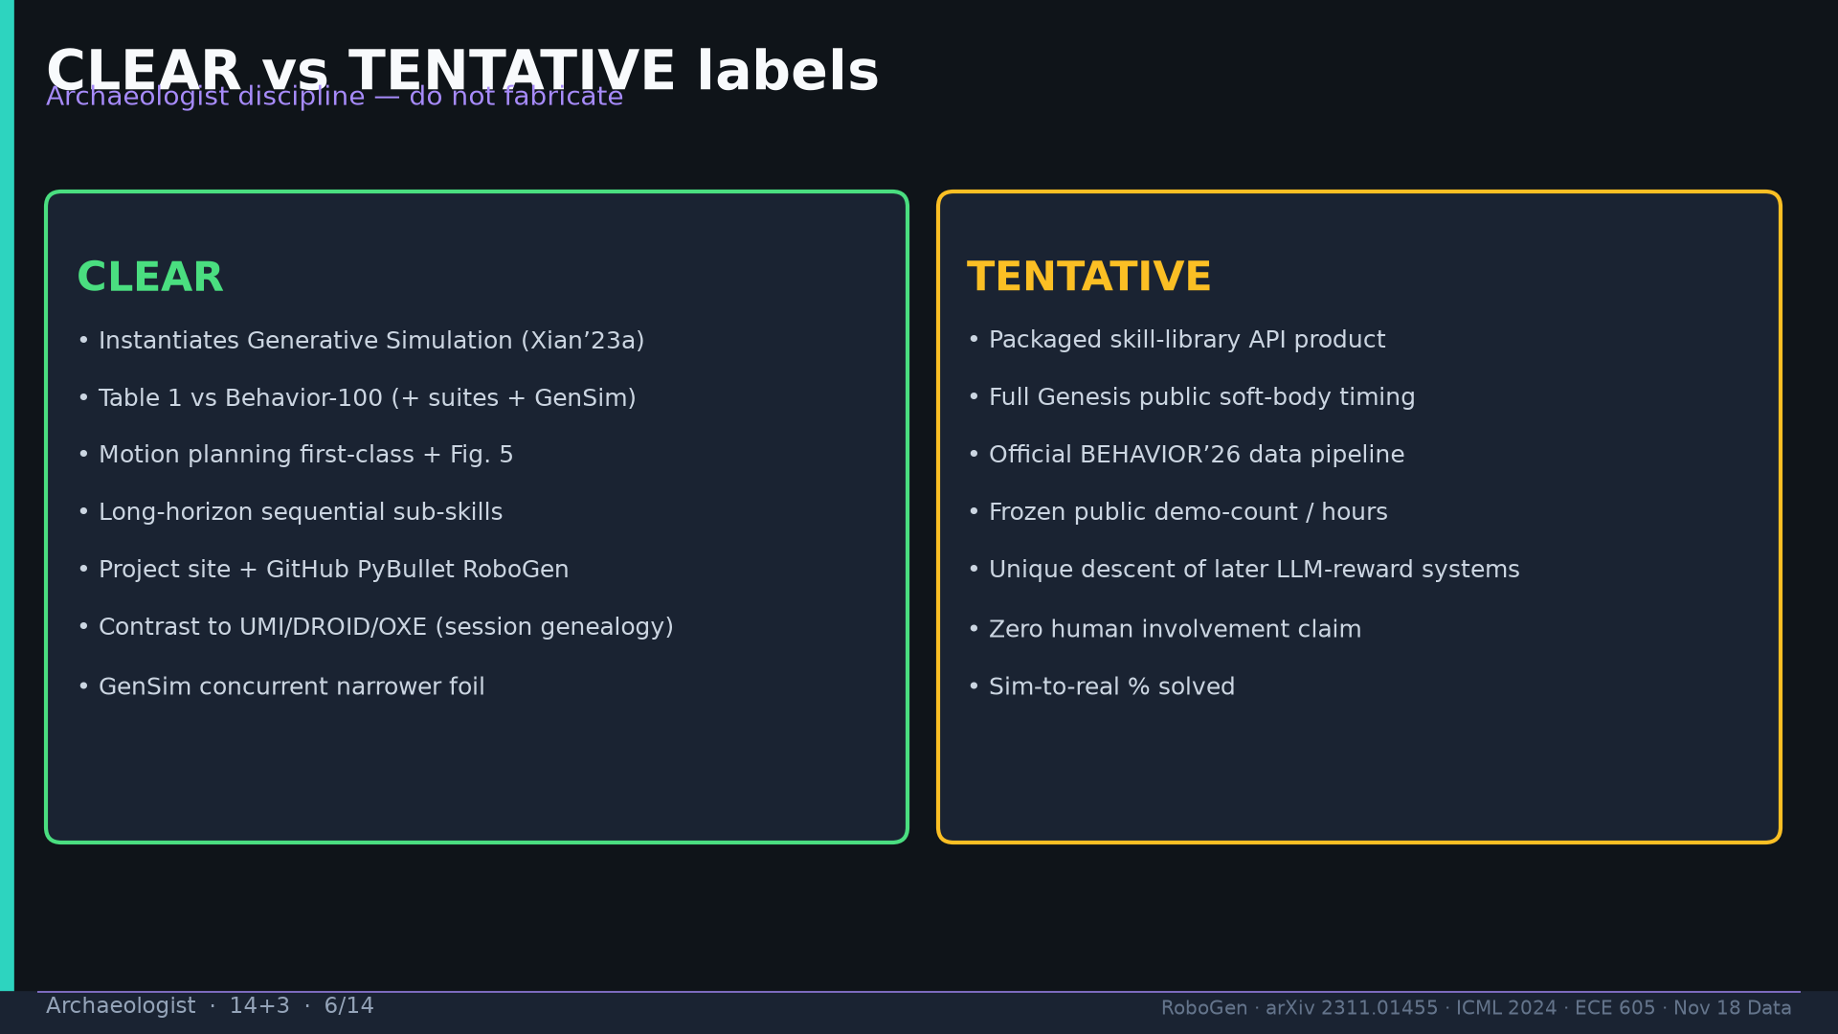
Notes:
[Archaeologist · 14+3 · 6/14]
CLEAR vs TENTATIVE discipline table. Packaged skill API / Genesis timing / BEHAVIOR’26 official = TENTATIVE.
Tattoo: success 0.774/69 · validity 19/155 fails · avg 3.13 substeps · Self-BLEU 0.284 (beats Behavior-100) · Fig.5 RL-only collapses · manip 0.745 / soft ~0.886 / loco ~0.833

Slide 7
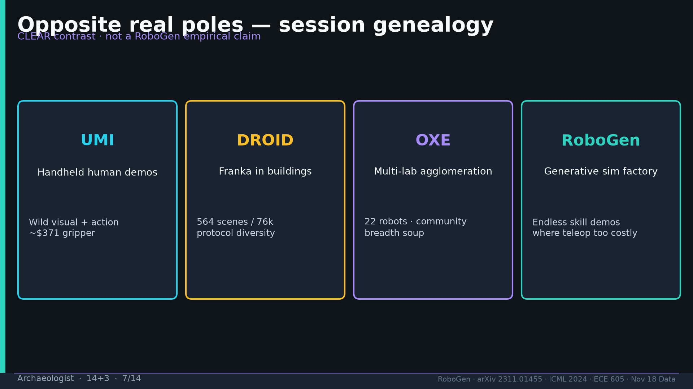
Notes:
[Archaeologist · 14+3 · 7/14]
Opposite real poles UMI/DROID/OXE vs RoboGen sim factory — session genealogy CLEAR contrast.
Tattoo: success 0.774/69 · validity 19/155 fails · avg 3.13 substeps · Self-BLEU 0.284 (beats Behavior-100) · Fig.5 RL-only collapses · manip 0.745 / soft ~0.886 / loco ~0.833

Slide 8
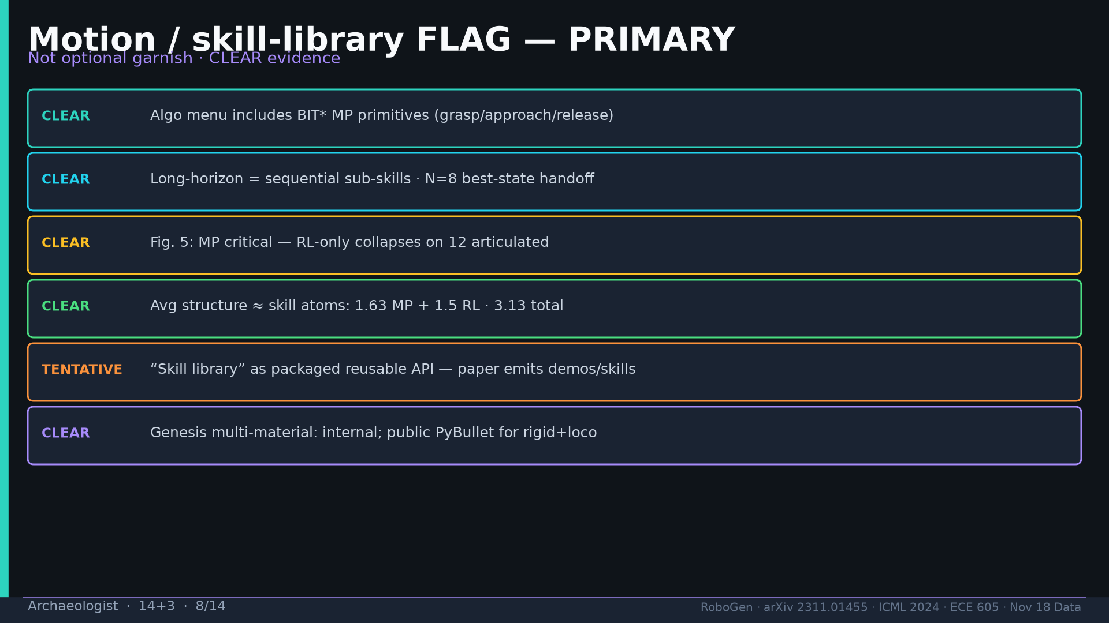
Notes:
[Archaeologist · 14+3 · 8/14]
MOTION/SKILL-LIBRARY FLAG PRIMARY: BIT* CLEAR; N=8 CLEAR; Fig.5 CLEAR; 3.13 structure CLEAR; library product TENTATIVE.
Tattoo: success 0.774/69 · validity 19/155 fails · avg 3.13 substeps · Self-BLEU 0.284 (beats Behavior-100) · Fig.5 RL-only collapses · manip 0.745 / soft ~0.886 / loco ~0.833

Slide 9
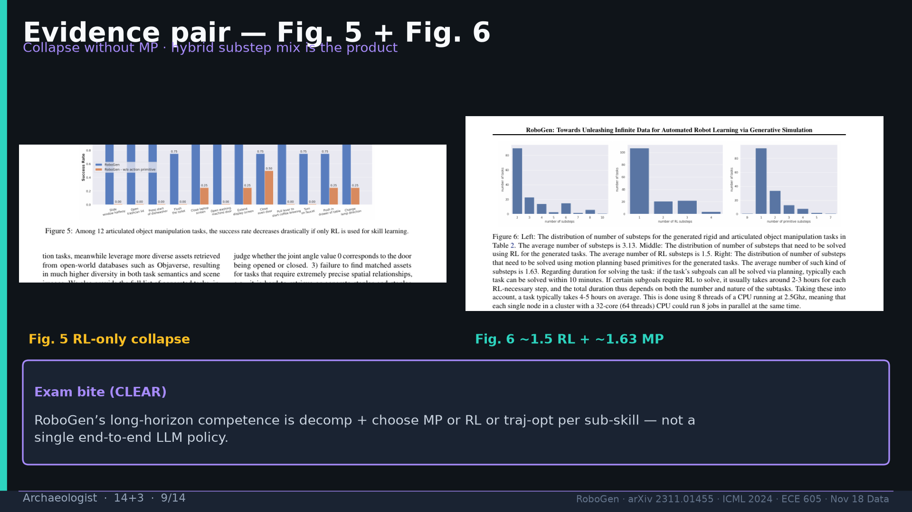
Notes:
[Archaeologist · 14+3 · 9/14]
Evidence pair Fig.5+Fig.6. Exam bite: decomp+choose NOT E2E LLM policy.
Tattoo: success 0.774/69 · validity 19/155 fails · avg 3.13 substeps · Self-BLEU 0.284 (beats Behavior-100) · Fig.5 RL-only collapses · manip 0.745 / soft ~0.886 / loco ~0.833

Slide 10
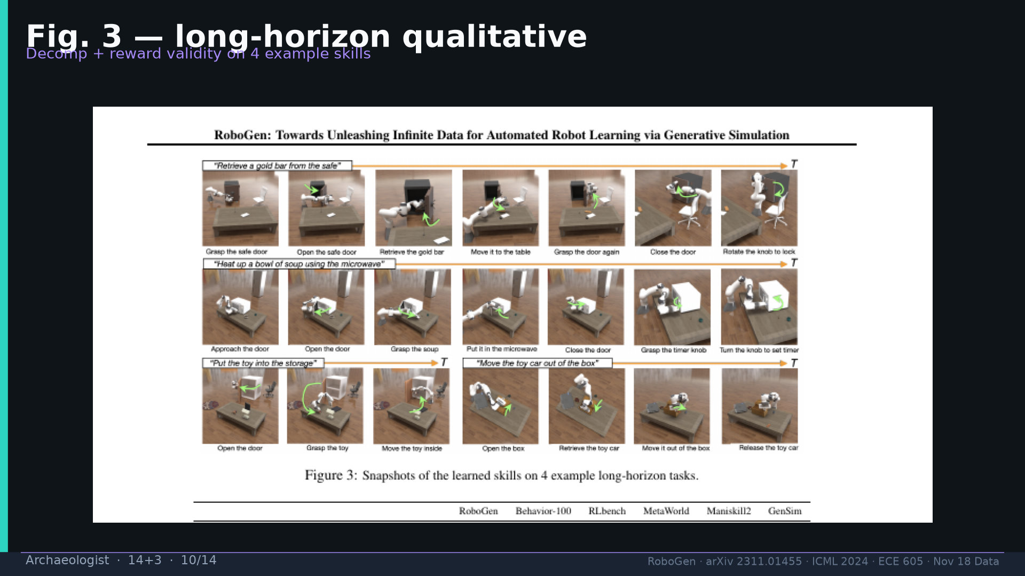
Notes:
[Archaeologist · 14+3 · 10/14]
Fig.3 long-horizon qualitative decomp validity.
Tattoo: success 0.774/69 · validity 19/155 fails · avg 3.13 substeps · Self-BLEU 0.284 (beats Behavior-100) · Fig.5 RL-only collapses · manip 0.745 / soft ~0.886 / loco ~0.833

Slide 11
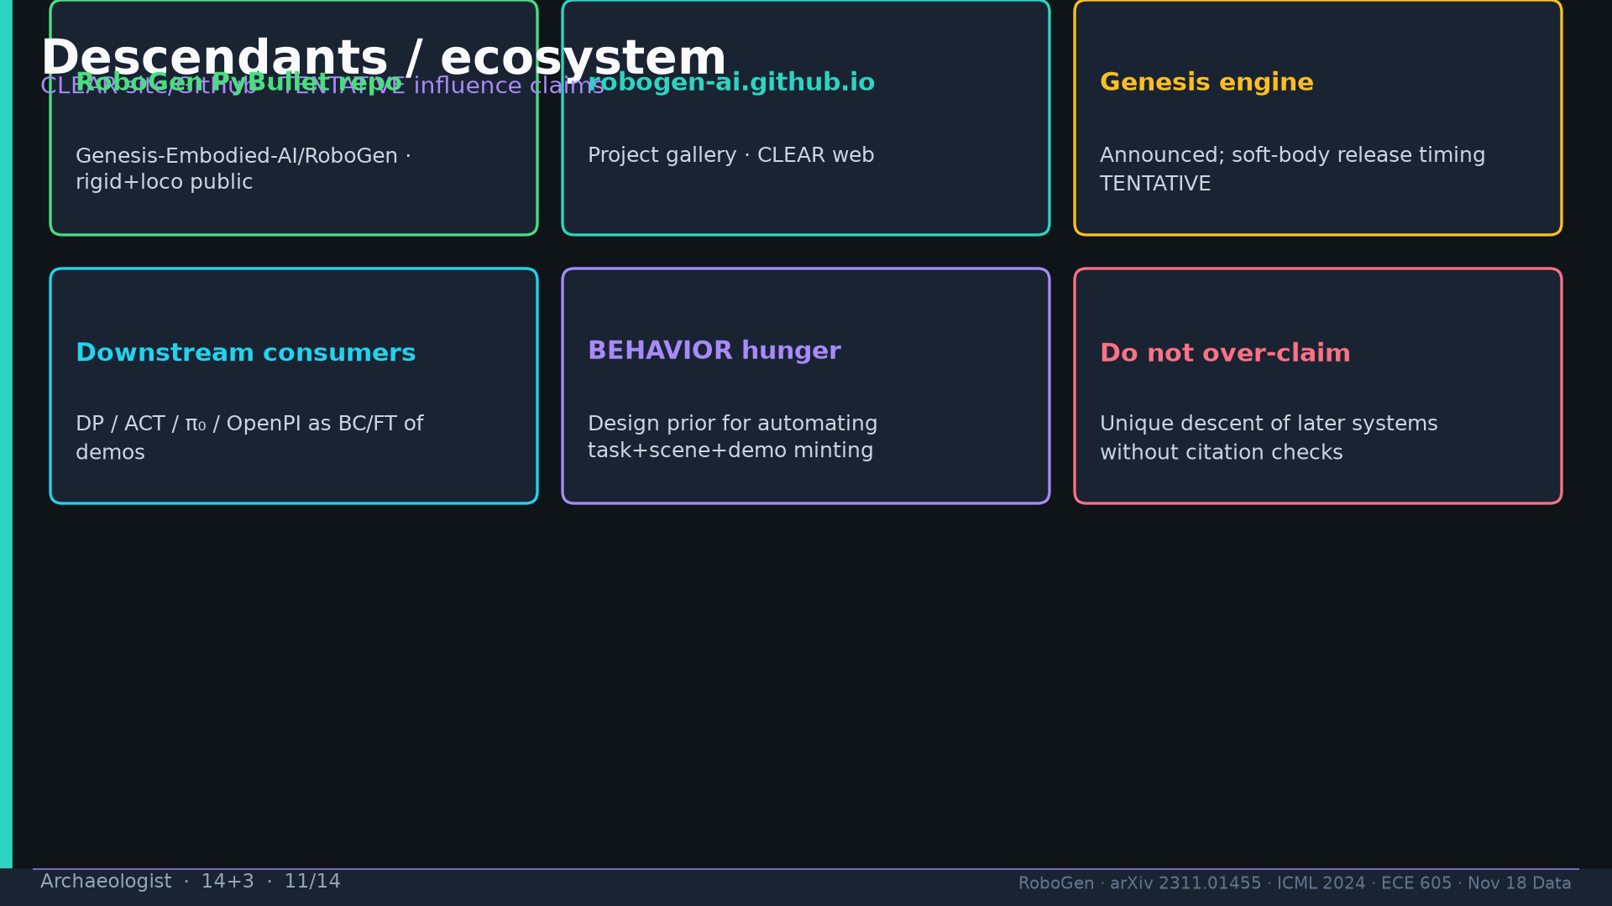
Notes:
[Archaeologist · 14+3 · 11/14]
Descendants: PyBullet repo CLEAR; Genesis timing TENTATIVE; don’t overclaim unique descent.
Tattoo: success 0.774/69 · validity 19/155 fails · avg 3.13 substeps · Self-BLEU 0.284 (beats Behavior-100) · Fig.5 RL-only collapses · manip 0.745 / soft ~0.886 / loco ~0.833

Slide 12
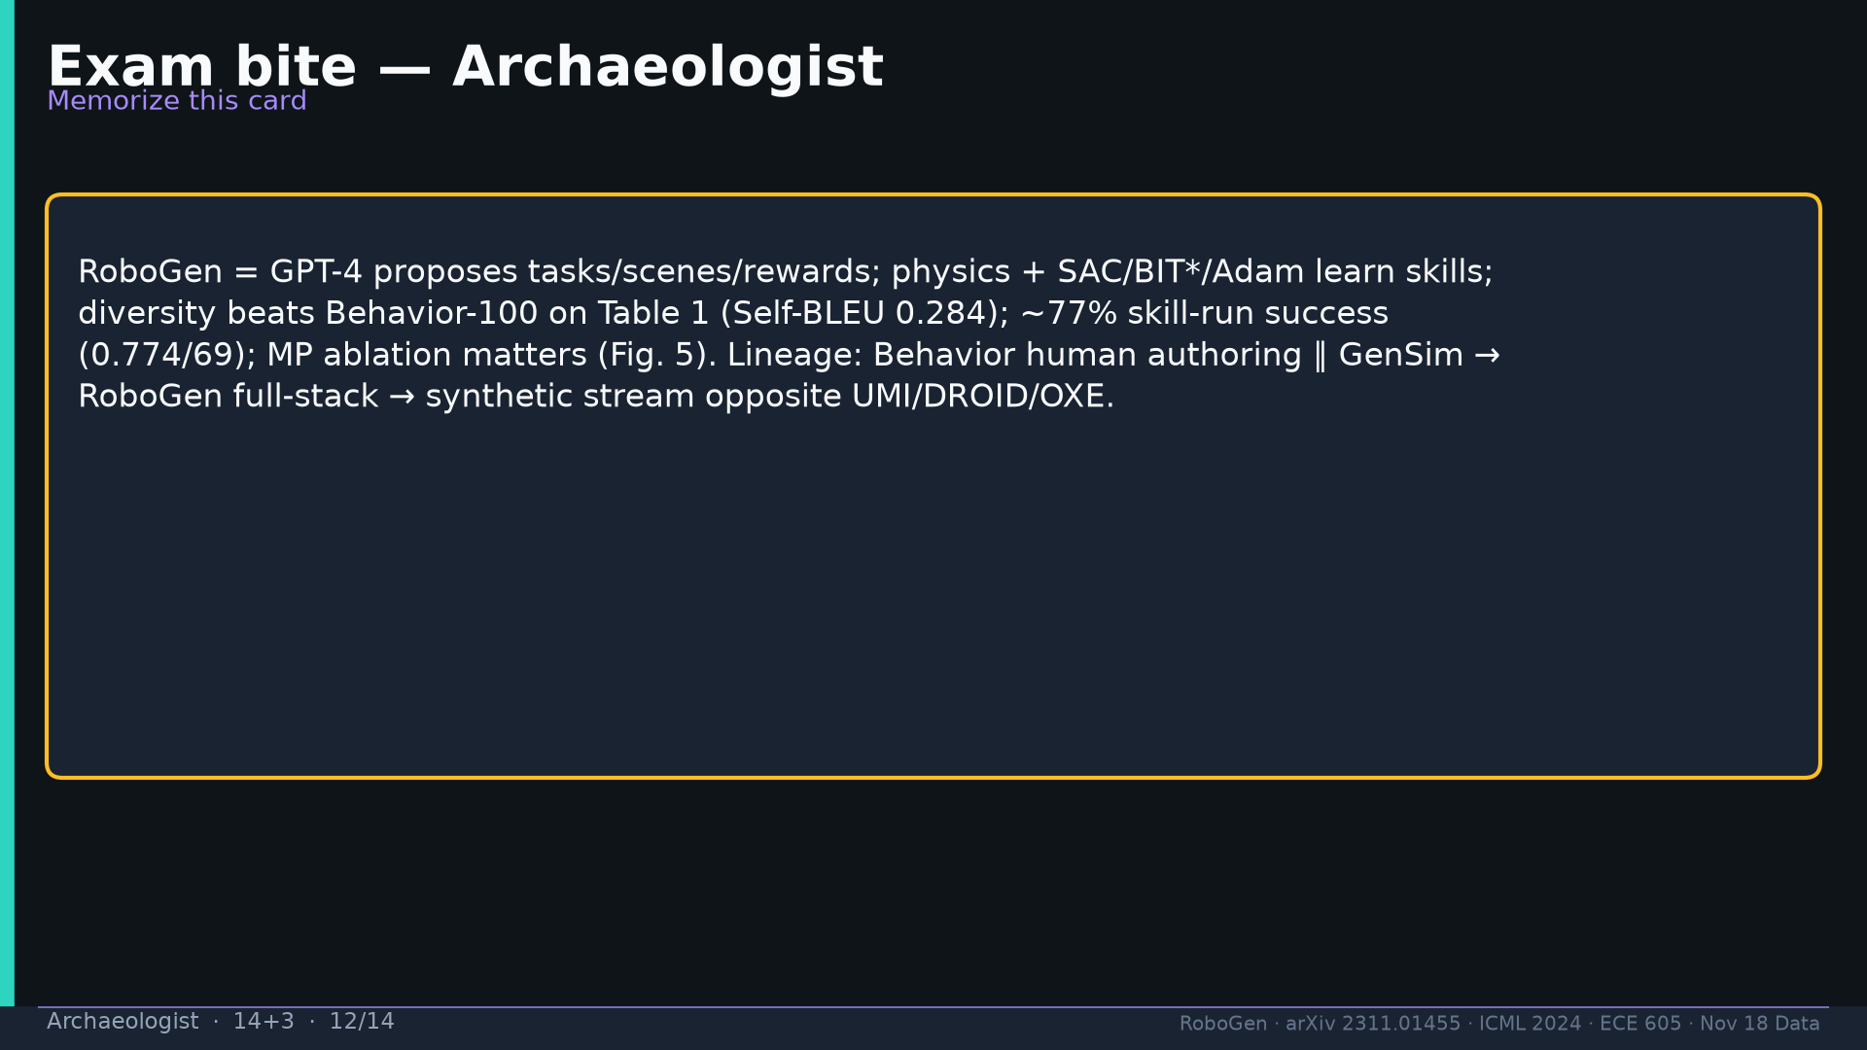
Notes:
[Archaeologist · 14+3 · 12/14]
Exam bite memorization card.
Tattoo: success 0.774/69 · validity 19/155 fails · avg 3.13 substeps · Self-BLEU 0.284 (beats Behavior-100) · Fig.5 RL-only collapses · manip 0.745 / soft ~0.886 / loco ~0.833

Slide 13
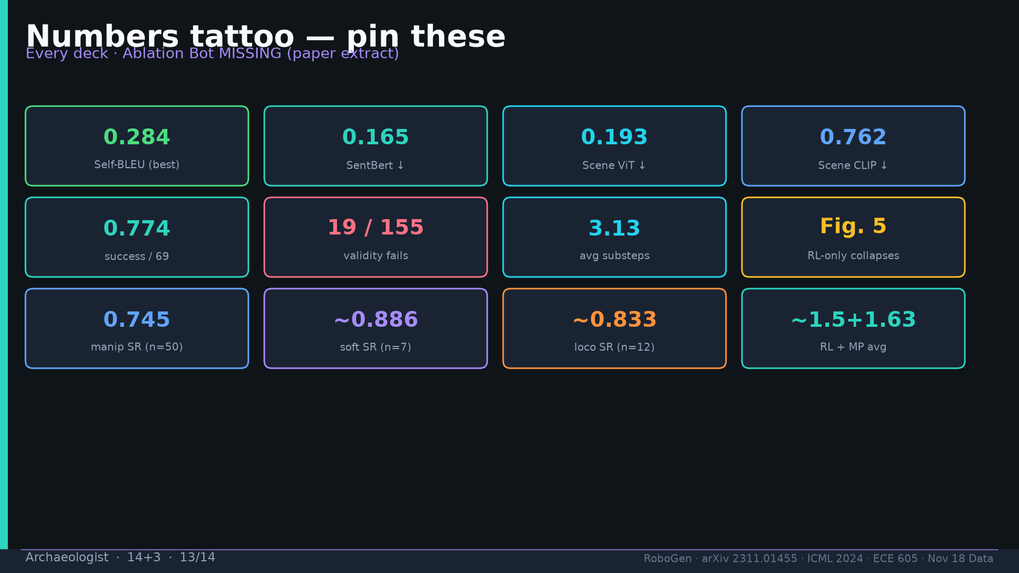
Notes:
[Archaeologist · 14+3 · 13/14]
Tattoo.
Tattoo: success 0.774/69 · validity 19/155 fails · avg 3.13 substeps · Self-BLEU 0.284 (beats Behavior-100) · Fig.5 RL-only collapses · manip 0.745 / soft ~0.886 / loco ~0.833

Slide 14
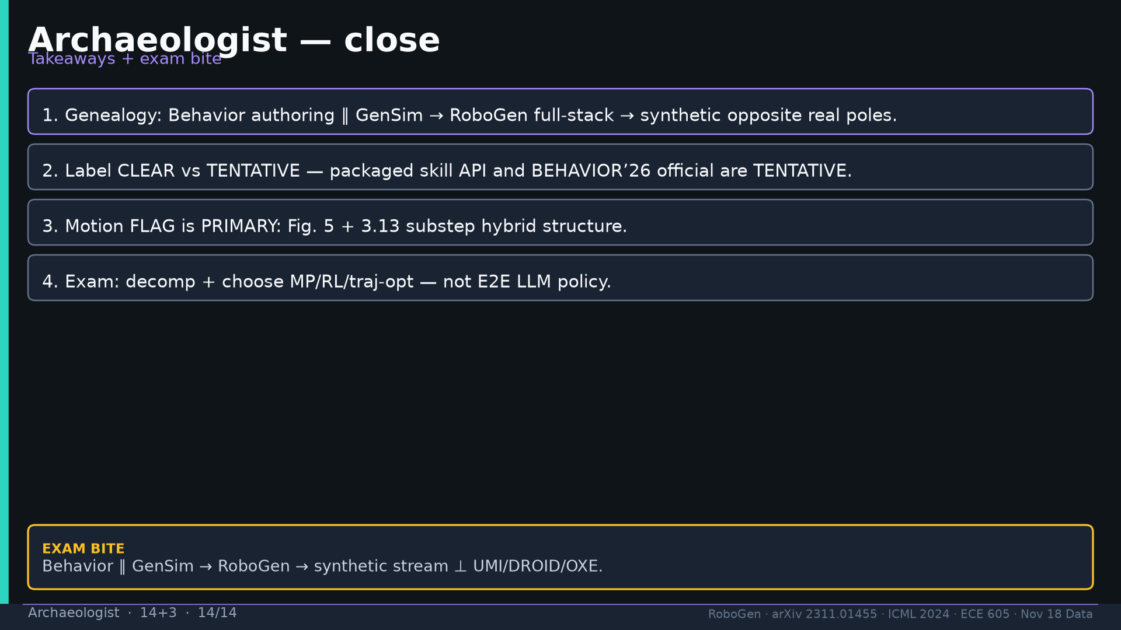
Notes:
[Archaeologist · 14+3 · 14/14]
Close takeaways + exam.
Tattoo: success 0.774/69 · validity 19/155 fails · avg 3.13 substeps · Self-BLEU 0.284 (beats Behavior-100) · Fig.5 RL-only collapses · manip 0.745 / soft ~0.886 / loco ~0.833

