Slide 1
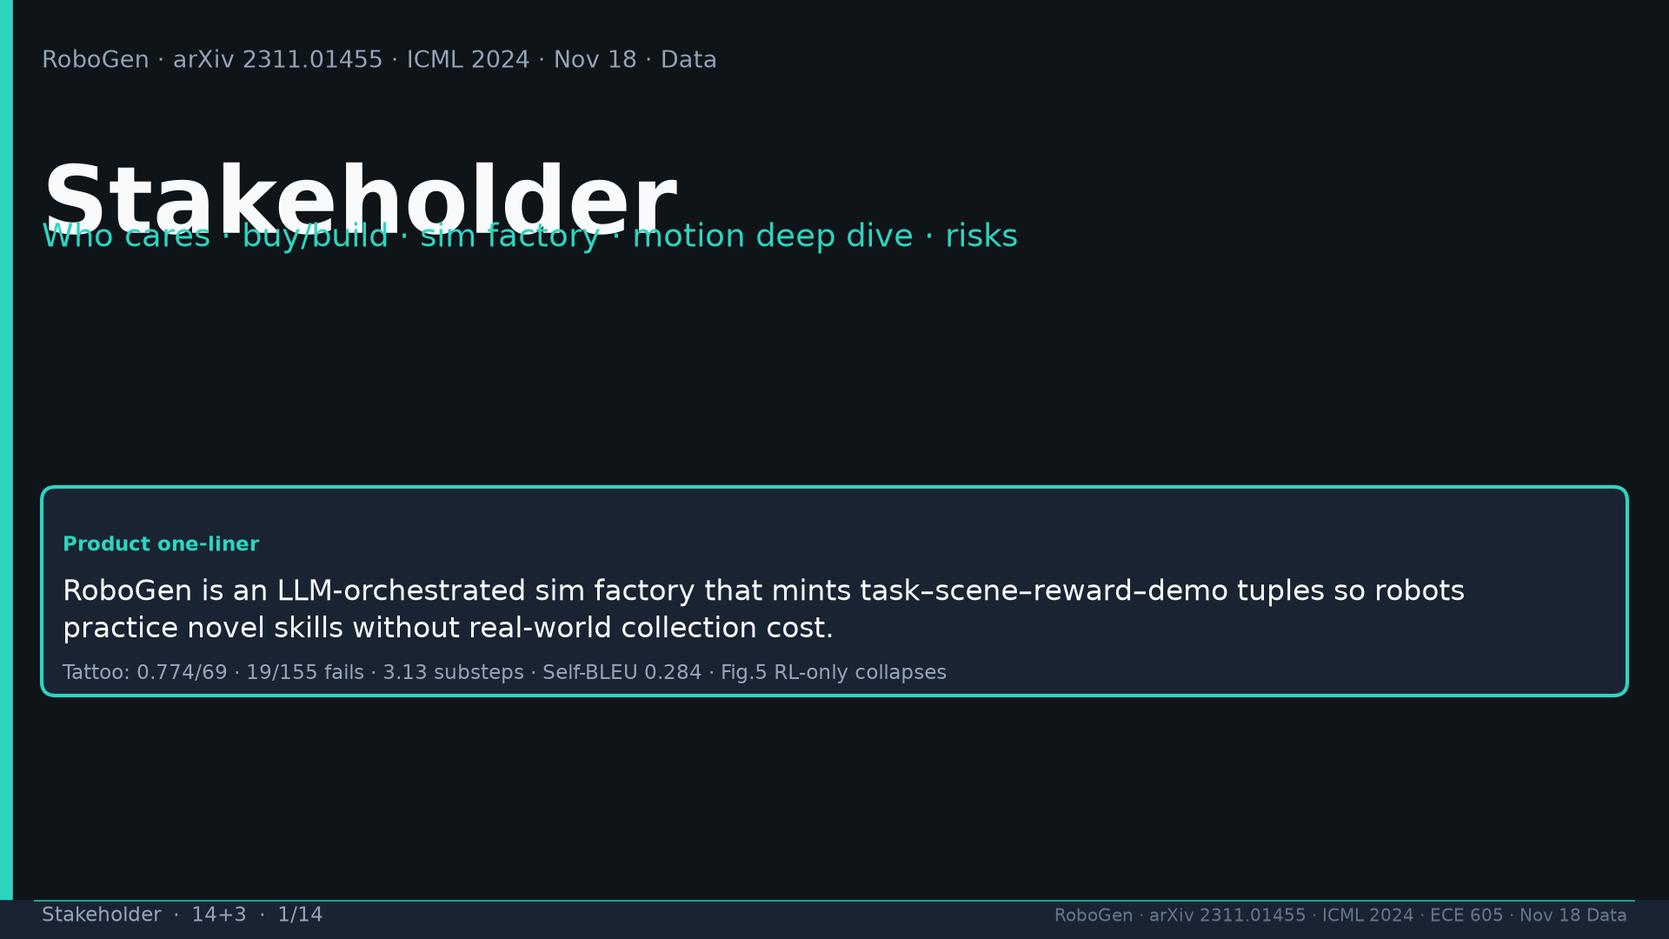
Notes:
[Stakeholder · 14+3 · 1/14]
Title. Product: LLM-orchestrated sim factory minting task–scene–reward–demo tuples. Tattoo 0.774/69 · 19/155 · 3.13 · 0.284 · Fig.5.
Tattoo: success 0.774/69 · validity 19/155 fails · avg 3.13 substeps · Self-BLEU 0.284 (beats Behavior-100) · Fig.5 RL-only collapses · manip 0.745 / soft ~0.886 / loco ~0.833

Slide 2
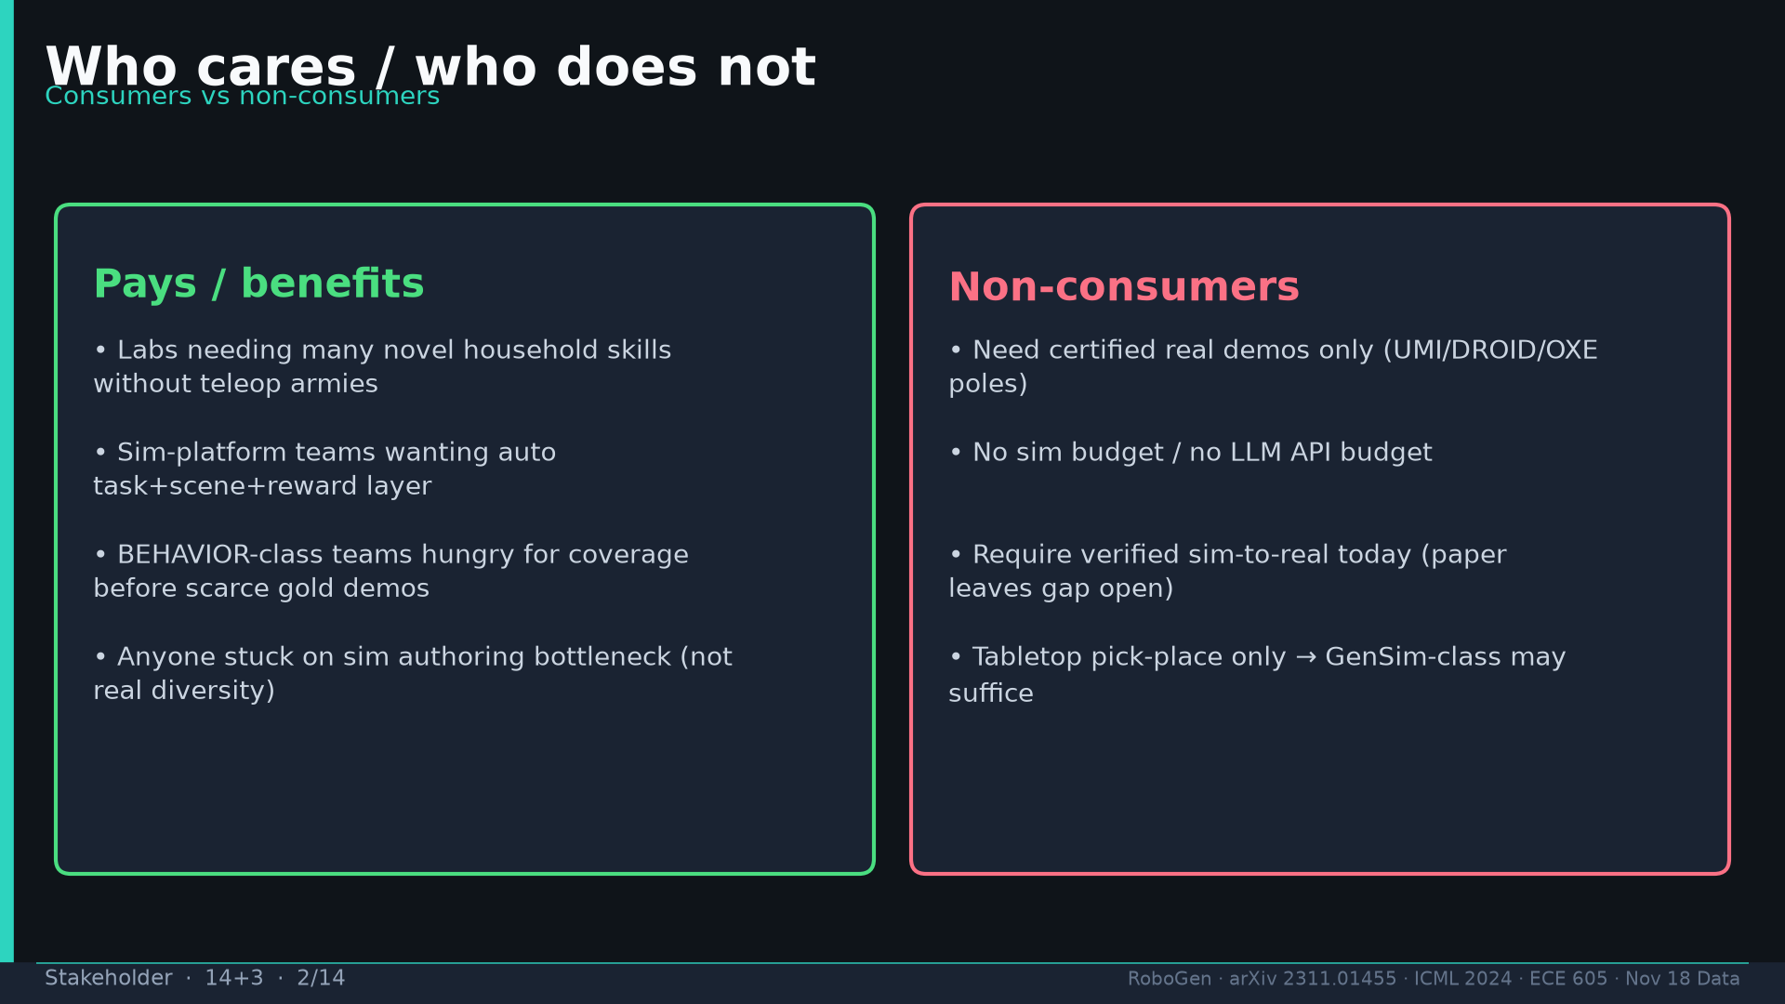
Notes:
[Stakeholder · 14+3 · 2/14]
Who pays: labs needing novel skills without teleop; sim platforms; BEHAVIOR coverage. Non-consumers: certified real only; no sim/API; need sim2real today; GenSim-class pick-place.
Tattoo: success 0.774/69 · validity 19/155 fails · avg 3.13 substeps · Self-BLEU 0.284 (beats Behavior-100) · Fig.5 RL-only collapses · manip 0.745 / soft ~0.886 / loco ~0.833

Slide 3
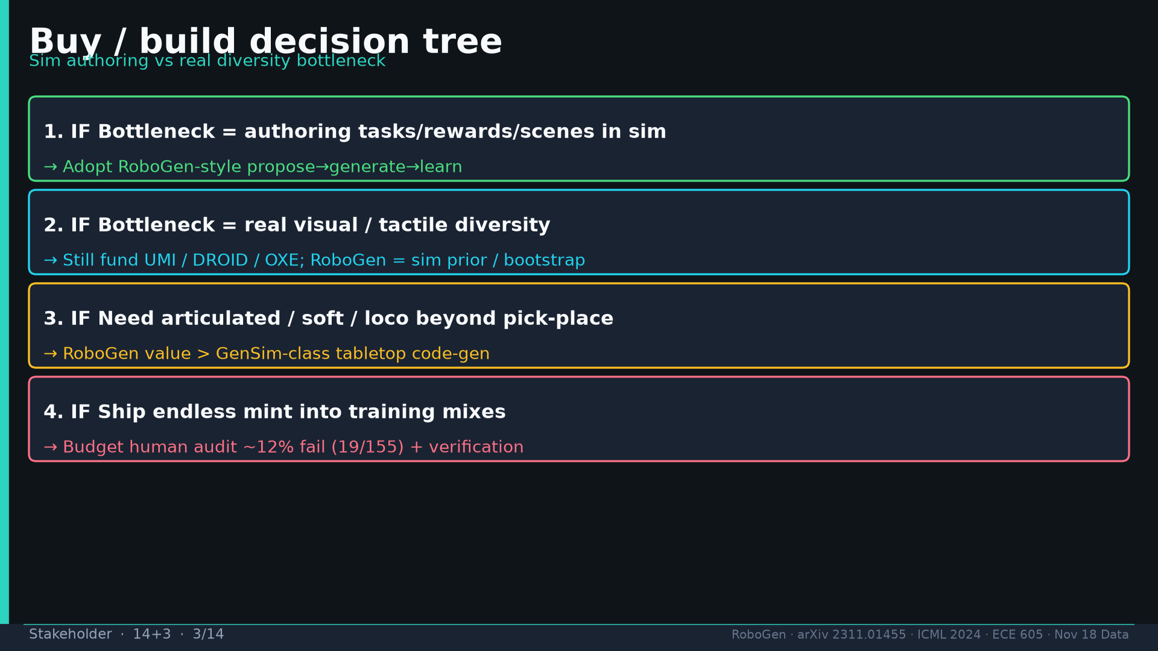
Notes:
[Stakeholder · 14+3 · 3/14]
Buy/build: (1) sim authoring bottleneck→RoboGen (2) real diversity→UMI/DROID/OXE + RoboGen prior (3) artic/soft/loco→RoboGen>GenSim (4) always budget ~12% human audit.
Tattoo: success 0.774/69 · validity 19/155 fails · avg 3.13 substeps · Self-BLEU 0.284 (beats Behavior-100) · Fig.5 RL-only collapses · manip 0.745 / soft ~0.886 / loco ~0.833

Slide 4
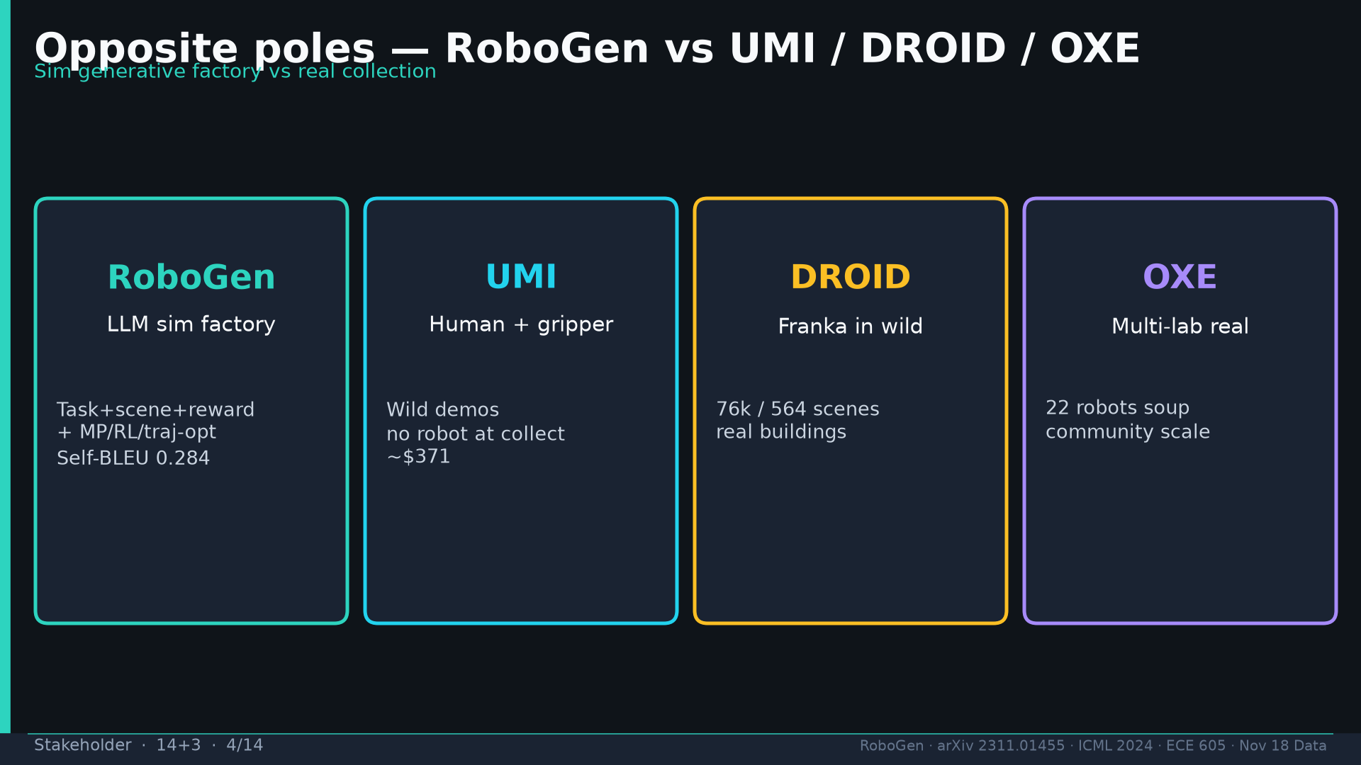
Notes:
[Stakeholder · 14+3 · 4/14]
Poles: RoboGen=sim factory; UMI=human+gripper; DROID=Franka wild; OXE=multi-lab real. Opposite poles.
Tattoo: success 0.774/69 · validity 19/155 fails · avg 3.13 substeps · Self-BLEU 0.284 (beats Behavior-100) · Fig.5 RL-only collapses · manip 0.745 / soft ~0.886 / loco ~0.833

Slide 5
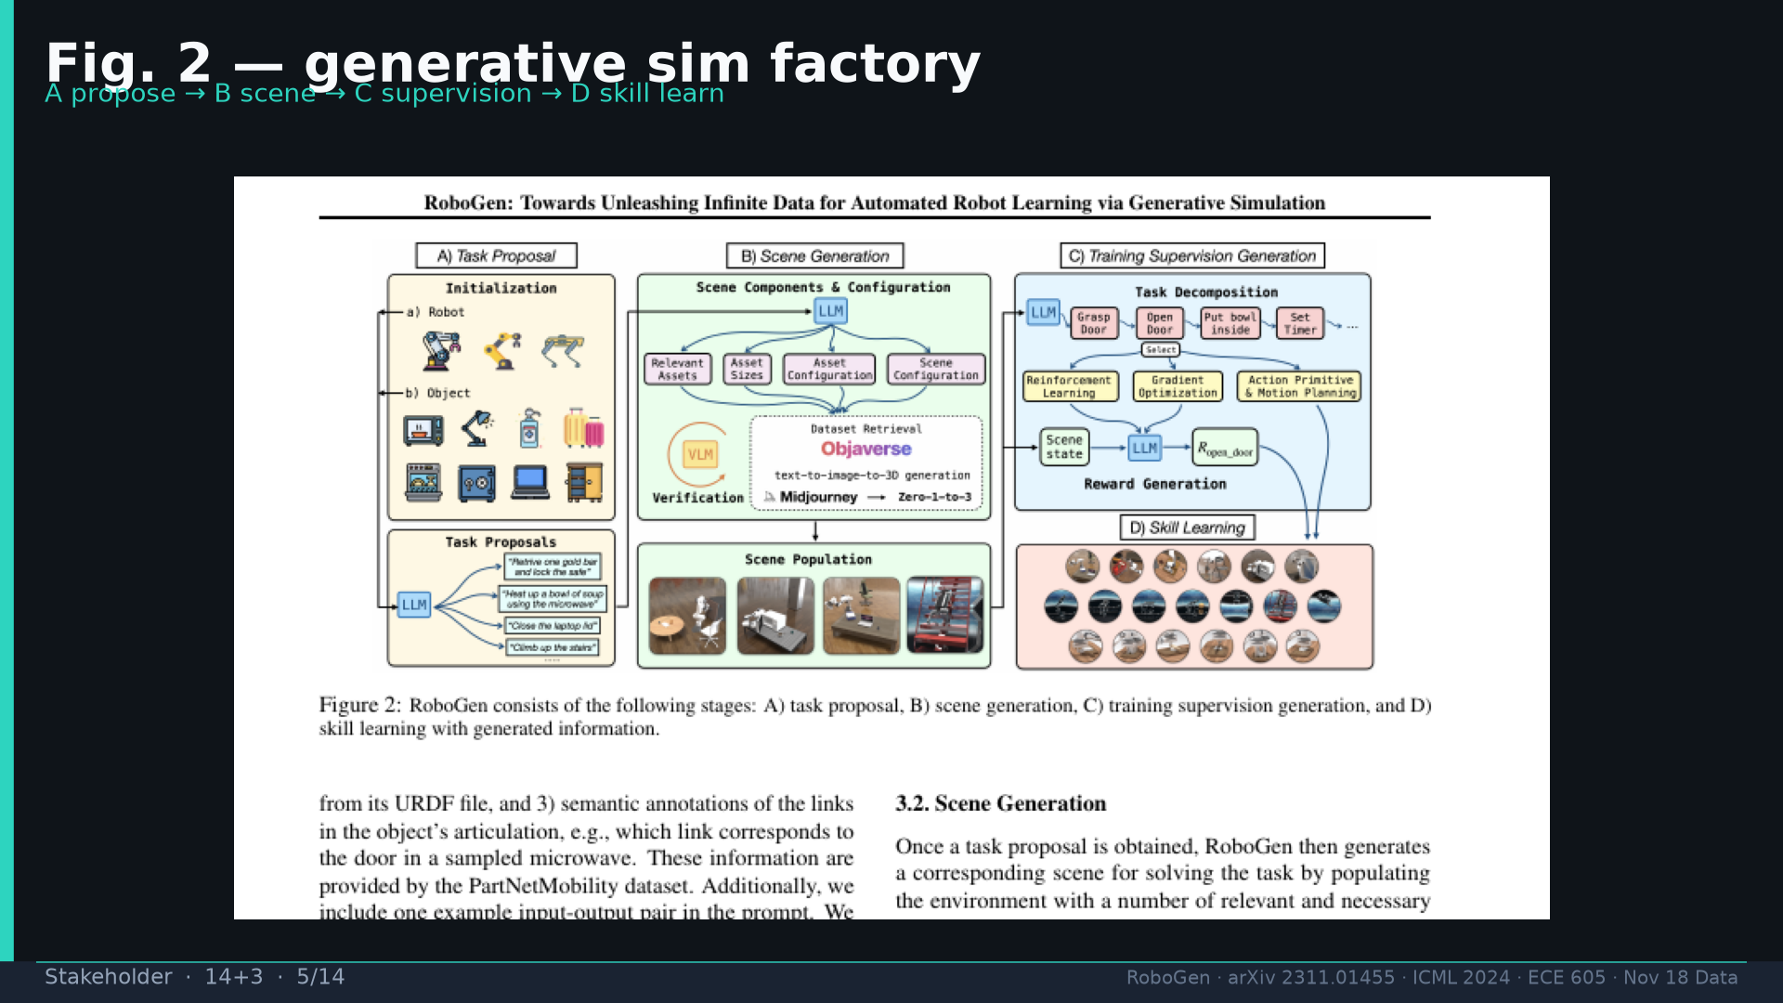
Notes:
[Stakeholder · 14+3 · 5/14]
Fig.2 pipeline A propose→B scene→C supervision (algo select)→D skill learn. Image-first.
Tattoo: success 0.774/69 · validity 19/155 fails · avg 3.13 substeps · Self-BLEU 0.284 (beats Behavior-100) · Fig.5 RL-only collapses · manip 0.745 / soft ~0.886 / loco ~0.833

Slide 6
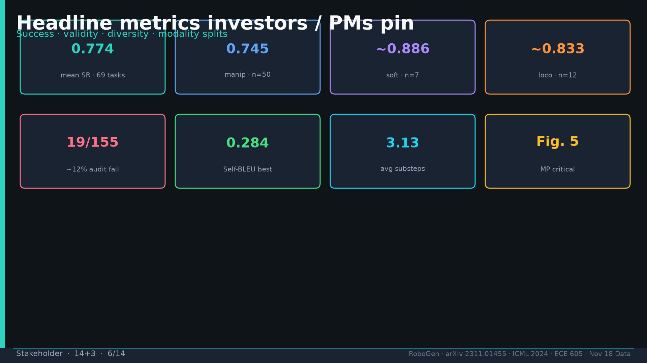
Notes:
[Stakeholder · 14+3 · 6/14]
Headline metrics: 0.774/69; manip 0.745; soft~0.886; loco~0.833; 19/155; Self-BLEU 0.284; 3.13; Fig.5.
Tattoo: success 0.774/69 · validity 19/155 fails · avg 3.13 substeps · Self-BLEU 0.284 (beats Behavior-100) · Fig.5 RL-only collapses · manip 0.745 / soft ~0.886 / loco ~0.833

Slide 7
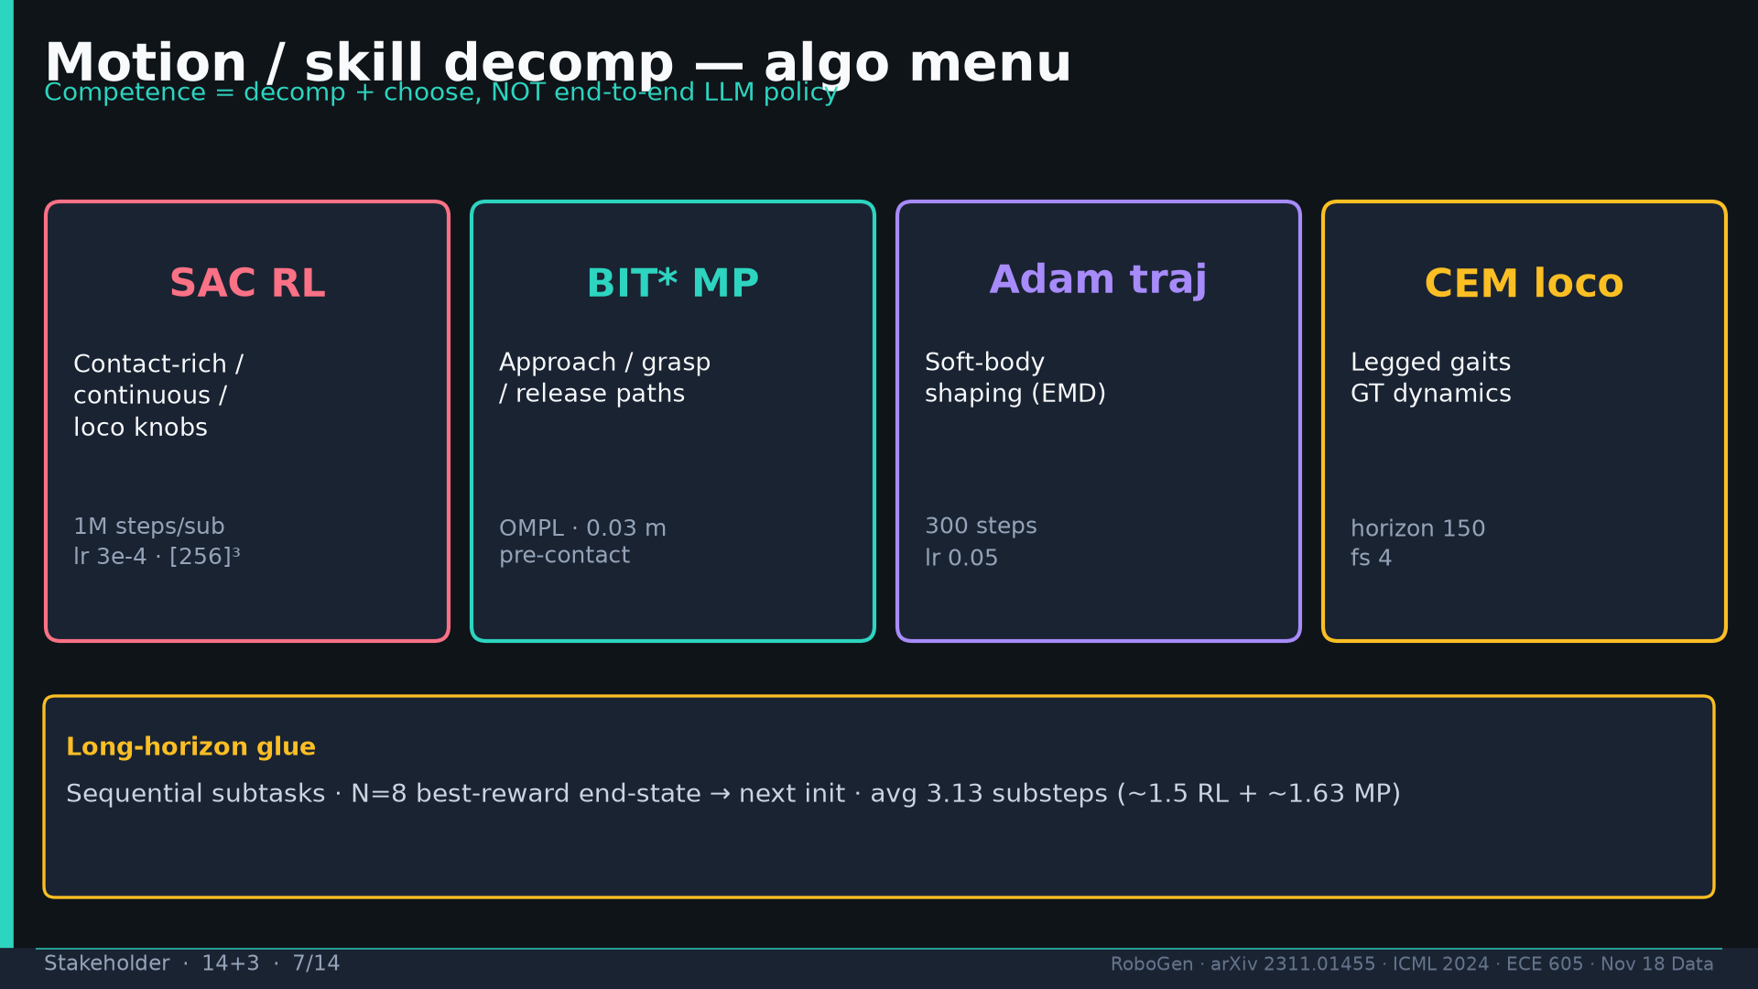
Notes:
[Stakeholder · 14+3 · 7/14]
MOTION DEEP DIVE: SAC RL vs BIT* MP vs Adam soft vs CEM loco. Long-horizon N=8 best-state handoff. Exam: competence=decomp+choose NOT E2E LLM policy.
Tattoo: success 0.774/69 · validity 19/155 fails · avg 3.13 substeps · Self-BLEU 0.284 (beats Behavior-100) · Fig.5 RL-only collapses · manip 0.745 / soft ~0.886 / loco ~0.833

Slide 8
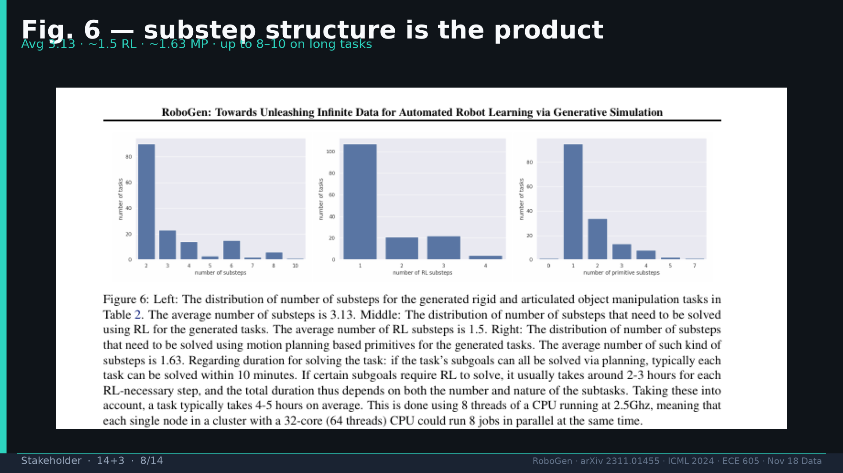
Notes:
[Stakeholder · 14+3 · 8/14]
Fig.6 substep hist: avg 3.13; ~1.5 RL + ~1.63 MP. Planning ≤10min; RL 2–3h; task 4–5h CPU.
Tattoo: success 0.774/69 · validity 19/155 fails · avg 3.13 substeps · Self-BLEU 0.284 (beats Behavior-100) · Fig.5 RL-only collapses · manip 0.745 / soft ~0.886 / loco ~0.833

Slide 9
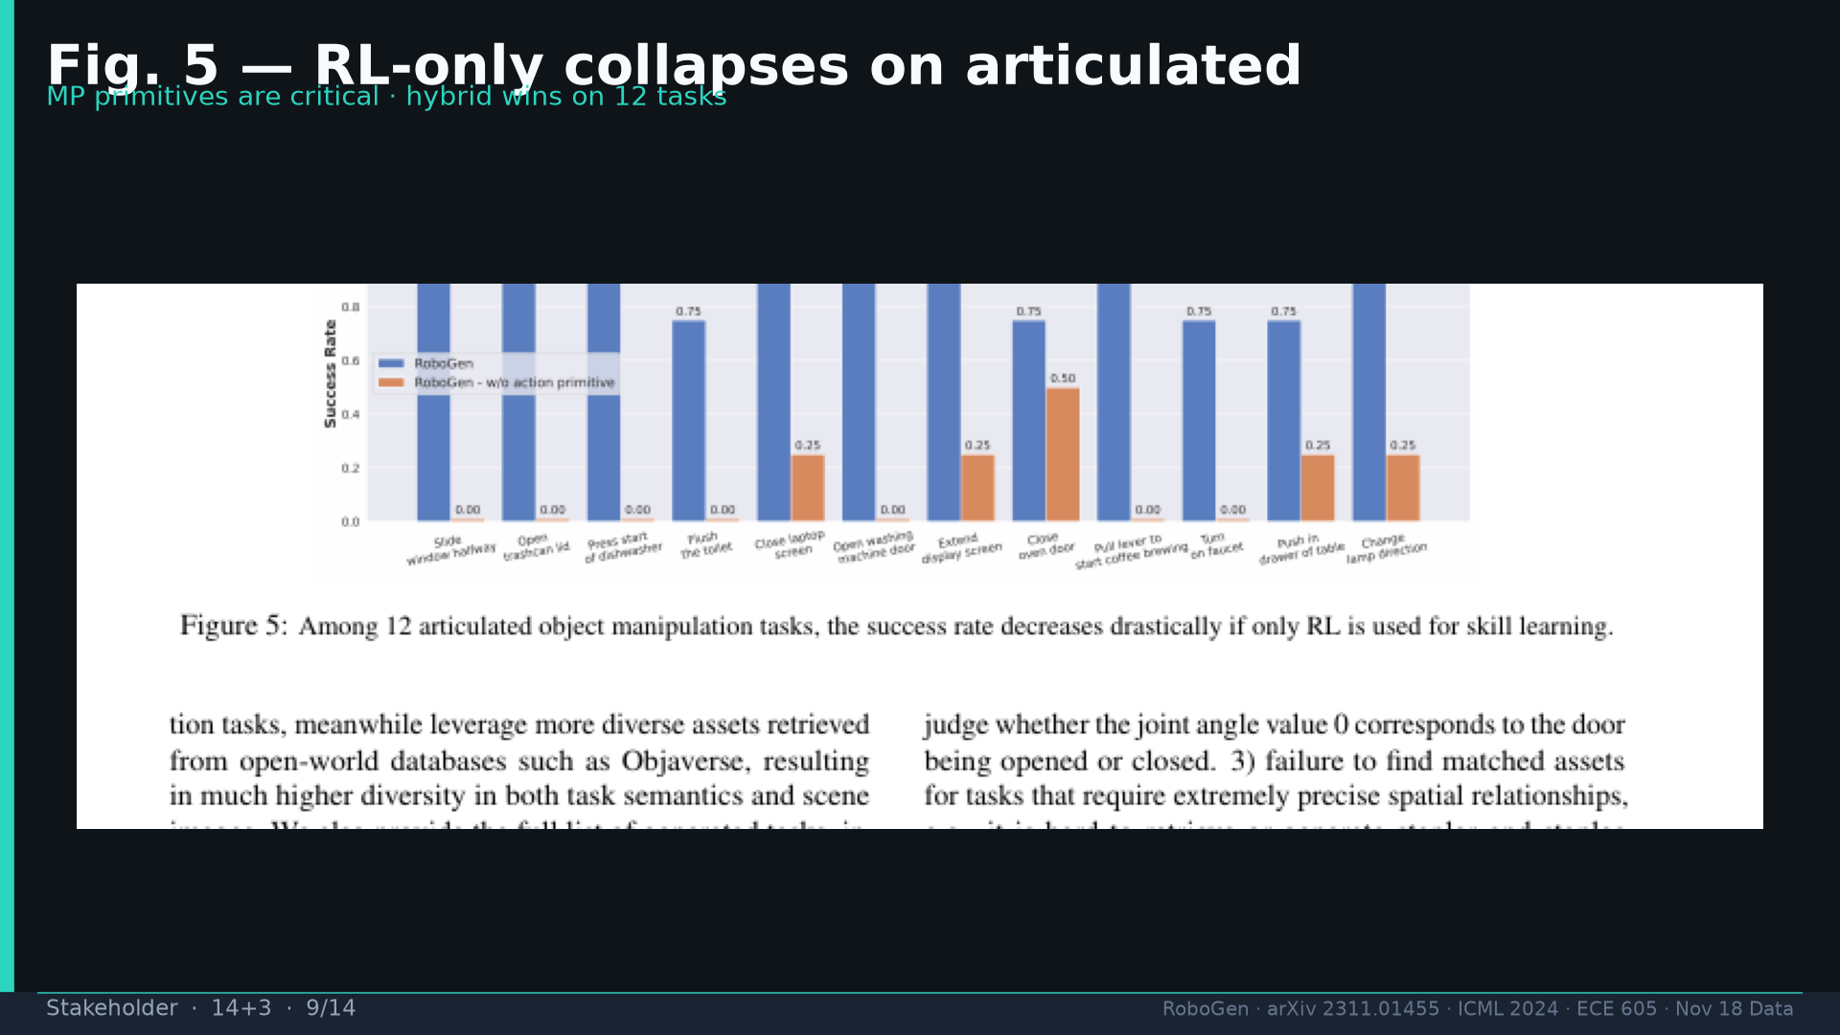
Notes:
[Stakeholder · 14+3 · 9/14]
Fig.5: RL-only collapses on 12 articulated — MP primitives critical. Hybrid is the product.
Tattoo: success 0.774/69 · validity 19/155 fails · avg 3.13 substeps · Self-BLEU 0.284 (beats Behavior-100) · Fig.5 RL-only collapses · manip 0.745 / soft ~0.886 / loco ~0.833

Slide 10
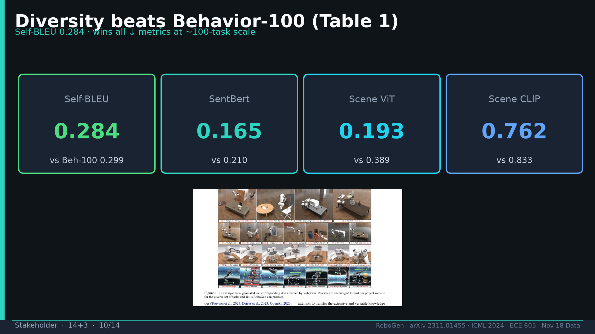
Notes:
[Stakeholder · 14+3 · 10/14]
Table1 diversity: Self-BLEU 0.284 beats Behavior-100; Fig.1 collage breadth.
Tattoo: success 0.774/69 · validity 19/155 fails · avg 3.13 substeps · Self-BLEU 0.284 (beats Behavior-100) · Fig.5 RL-only collapses · manip 0.745 / soft ~0.886 / loco ~0.833

Slide 11
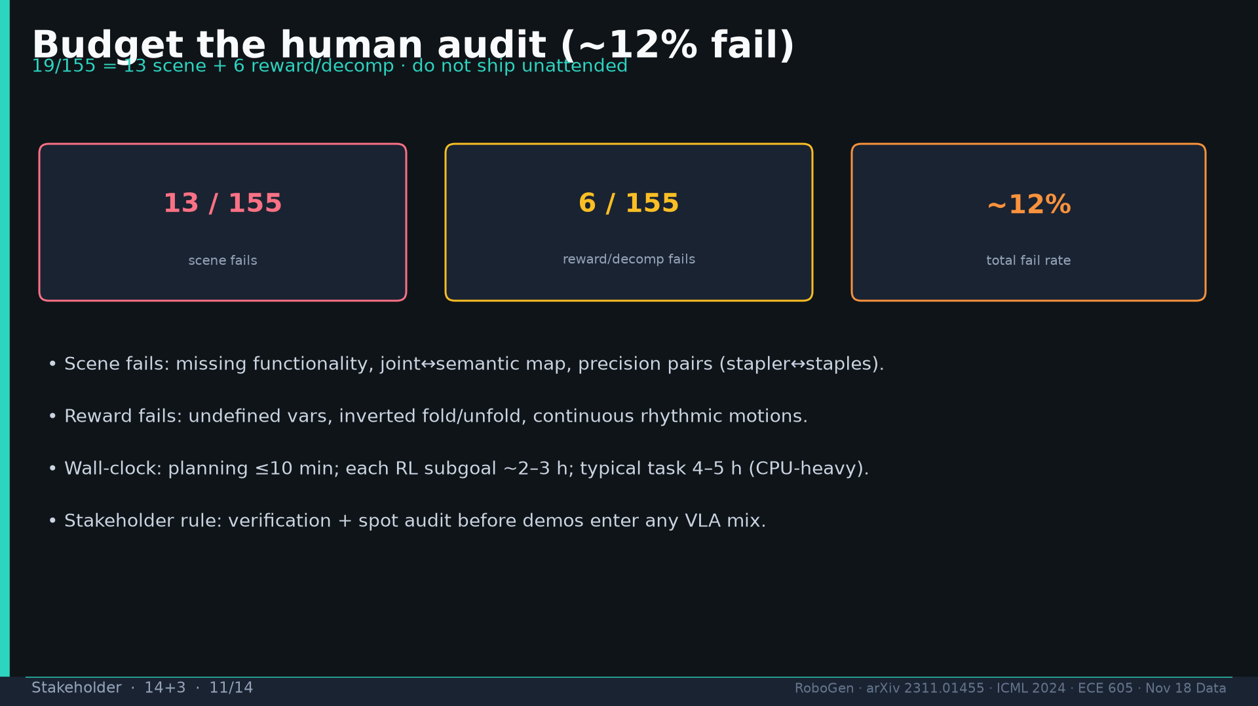
Notes:
[Stakeholder · 14+3 · 11/14]
Budget human audit 19/155 (~12%): 13 scene + 6 reward. Verification before mix.
Tattoo: success 0.774/69 · validity 19/155 fails · avg 3.13 substeps · Self-BLEU 0.284 (beats Behavior-100) · Fig.5 RL-only collapses · manip 0.745 / soft ~0.886 / loco ~0.833

Slide 12
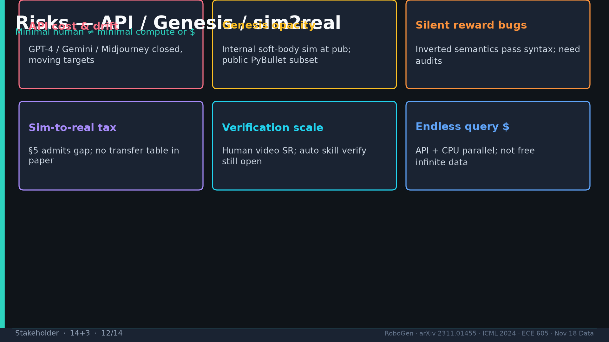
Notes:
[Stakeholder · 14+3 · 12/14]
Risks: API drift; Genesis opacity; silent reward bugs; sim2real tax; verification scale; endless query $.
Tattoo: success 0.774/69 · validity 19/155 fails · avg 3.13 substeps · Self-BLEU 0.284 (beats Behavior-100) · Fig.5 RL-only collapses · manip 0.745 / soft ~0.886 / loco ~0.833

Slide 13
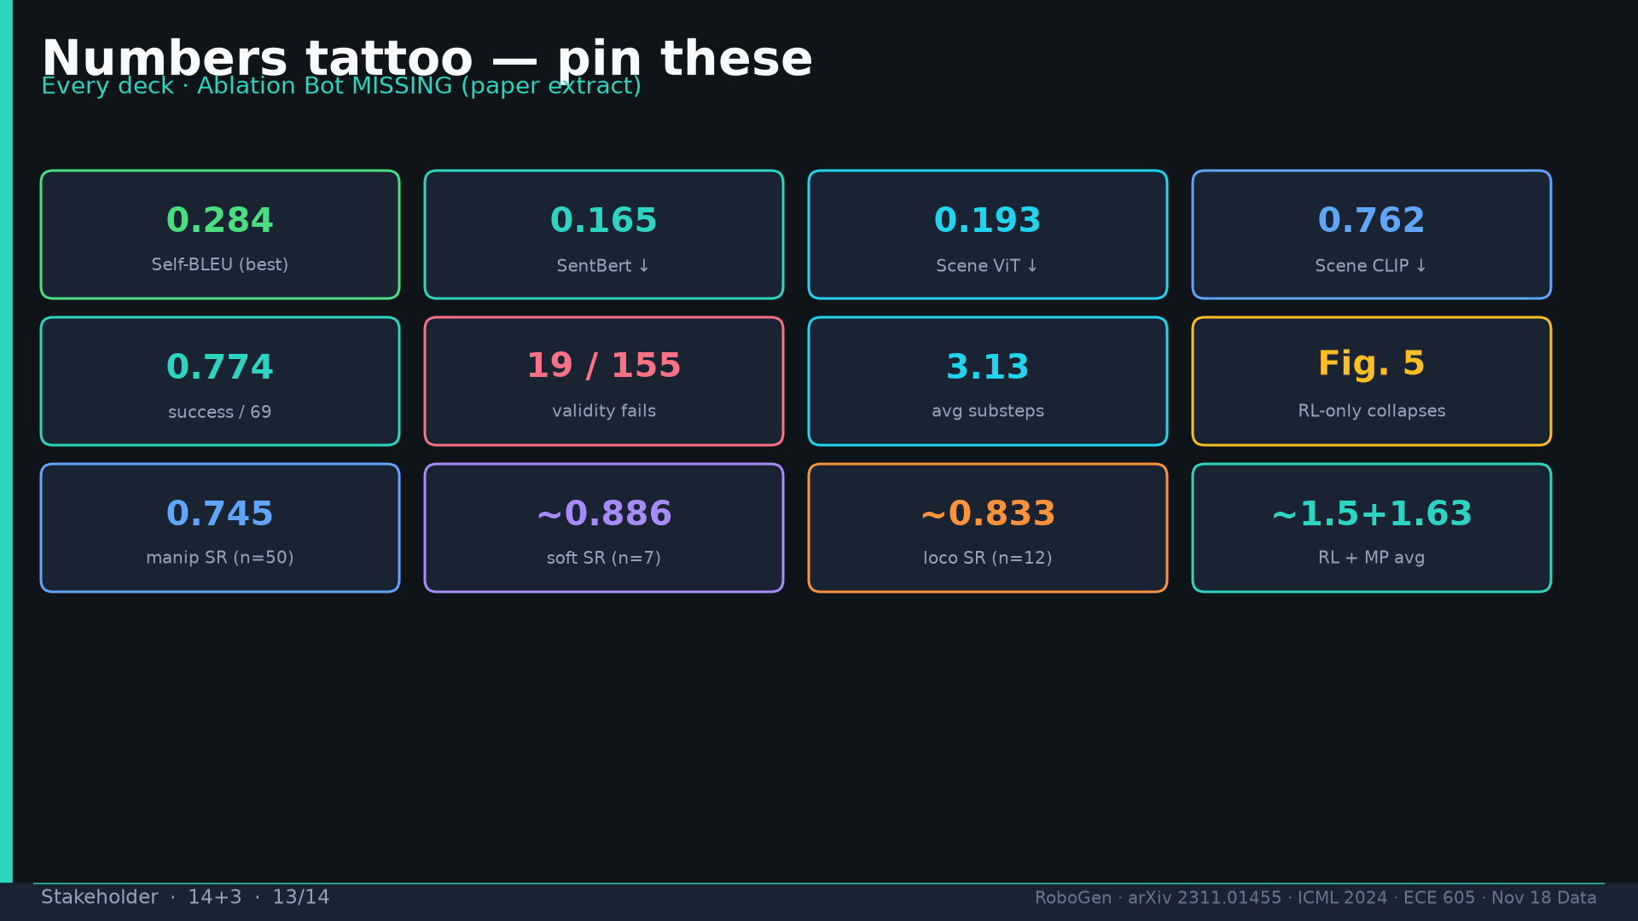
Notes:
[Stakeholder · 14+3 · 13/14]
Tattoo card shared across decks.
Tattoo: success 0.774/69 · validity 19/155 fails · avg 3.13 substeps · Self-BLEU 0.284 (beats Behavior-100) · Fig.5 RL-only collapses · manip 0.745 / soft ~0.886 / loco ~0.833

Slide 14
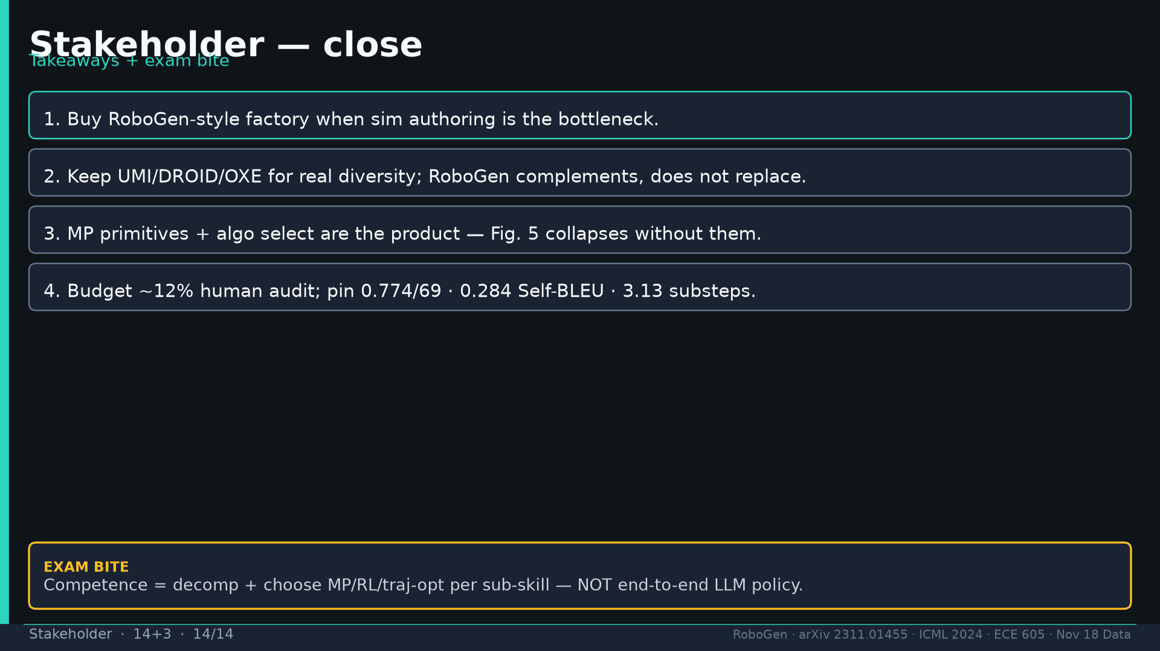
Notes:
[Stakeholder · 14+3 · 14/14]
Close four takeaways + exam bite. Q&A.
Tattoo: success 0.774/69 · validity 19/155 fails · avg 3.13 substeps · Self-BLEU 0.284 (beats Behavior-100) · Fig.5 RL-only collapses · manip 0.745 / soft ~0.886 / loco ~0.833

