Slide 1
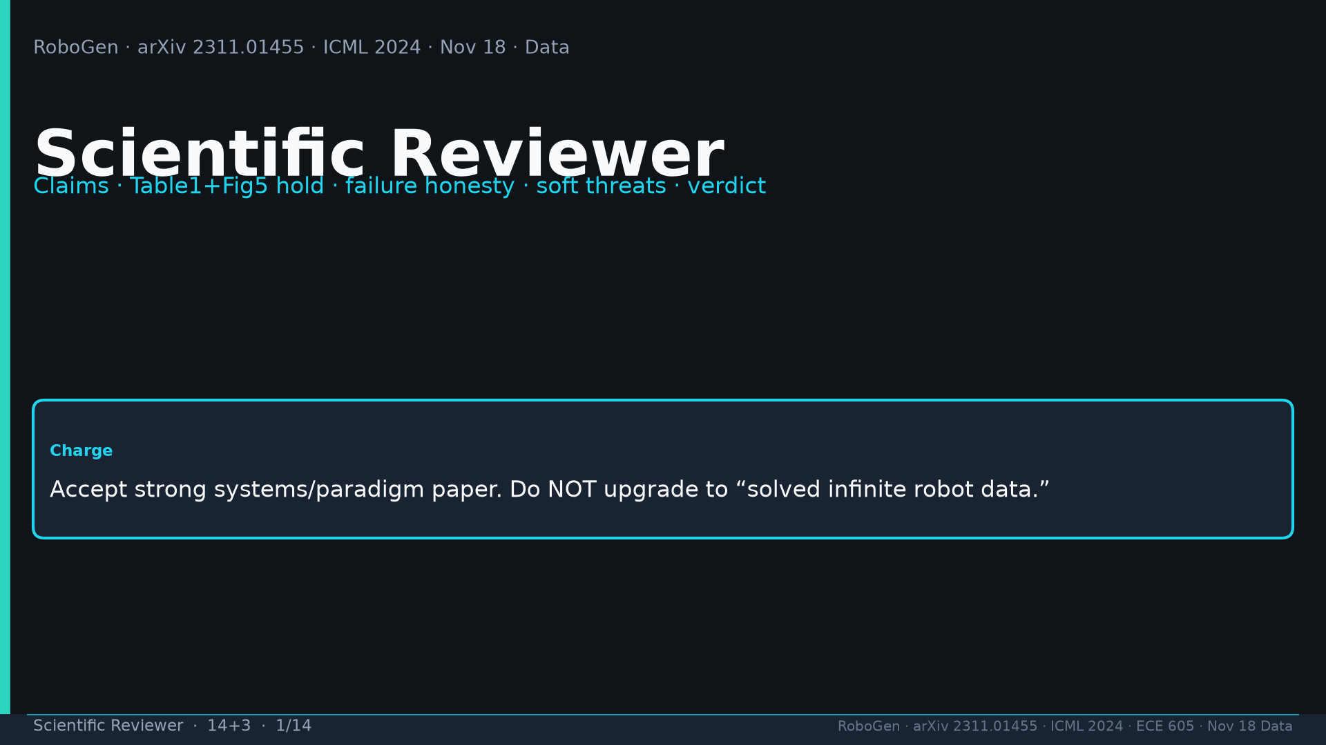
Notes:
[Scientific Reviewer · 14+3 · 1/14]
Title. Charge: accept strong systems/paradigm; do NOT upgrade to solved infinite robot data.
Tattoo: success 0.774/69 · validity 19/155 fails · avg 3.13 substeps · Self-BLEU 0.284 (beats Behavior-100) · Fig.5 RL-only collapses · manip 0.745 / soft ~0.886 / loco ~0.833

Slide 2
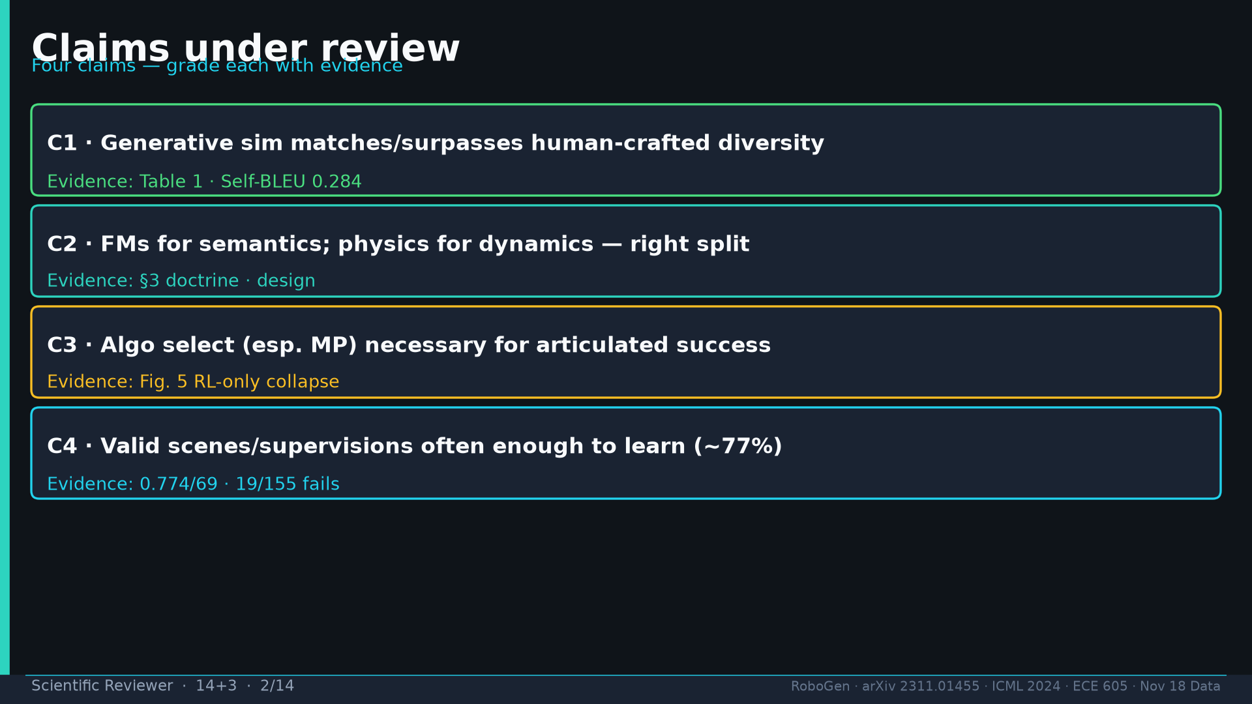
Notes:
[Scientific Reviewer · 14+3 · 2/14]
Four claims: C1 diversity Table1; C2 FM semantics not actions; C3 algo select/MP necessary; C4 valid enough for ~0.774.
Tattoo: success 0.774/69 · validity 19/155 fails · avg 3.13 substeps · Self-BLEU 0.284 (beats Behavior-100) · Fig.5 RL-only collapses · manip 0.745 / soft ~0.886 / loco ~0.833

Slide 3
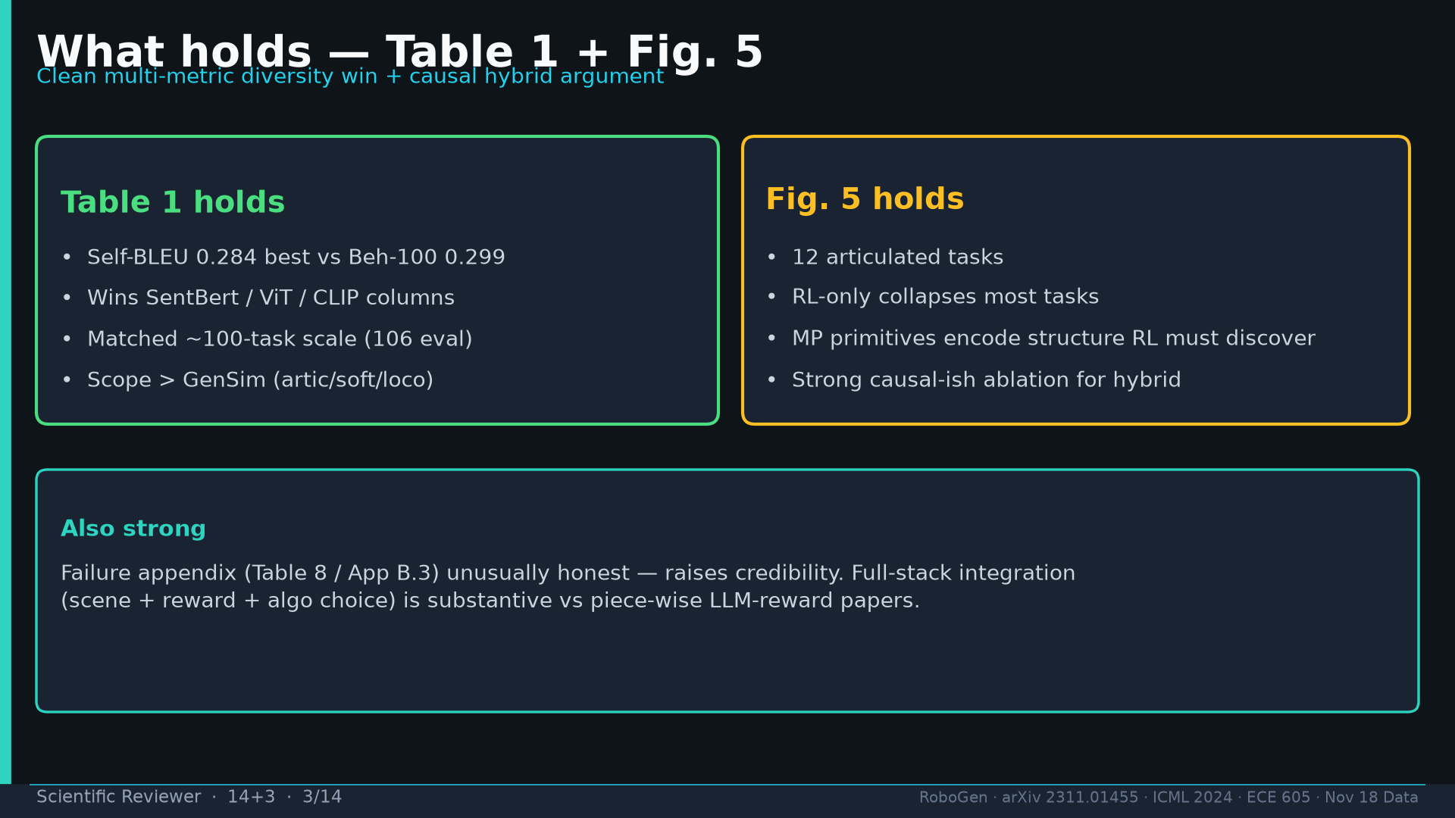
Notes:
[Scientific Reviewer · 14+3 · 3/14]
What holds: Table1 multi-metric win; Fig.5 causal hybrid; honest failure appendix; scope>GenSim.
Tattoo: success 0.774/69 · validity 19/155 fails · avg 3.13 substeps · Self-BLEU 0.284 (beats Behavior-100) · Fig.5 RL-only collapses · manip 0.745 / soft ~0.886 / loco ~0.833

Slide 4
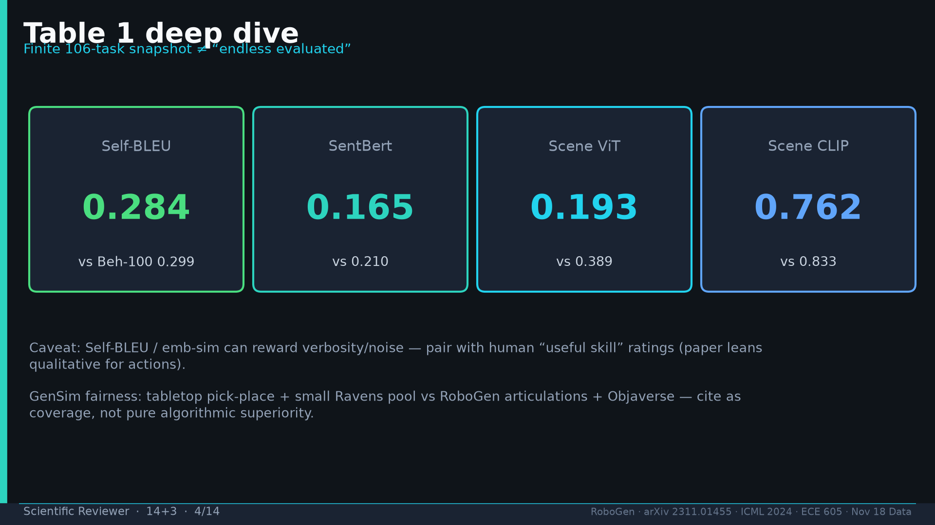
Notes:
[Scientific Reviewer · 14+3 · 4/14]
Table1 deep: 0.284/0.165/0.193/0.762. Caveat Self-BLEU vanity; GenSim fairness=coverage not pure algo.
Tattoo: success 0.774/69 · validity 19/155 fails · avg 3.13 substeps · Self-BLEU 0.284 (beats Behavior-100) · Fig.5 RL-only collapses · manip 0.745 / soft ~0.886 / loco ~0.833

Slide 5
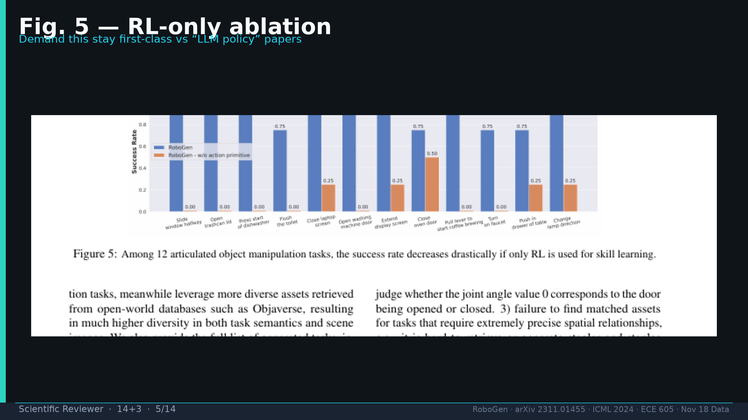
Notes:
[Scientific Reviewer · 14+3 · 5/14]
Fig.5 RL-only collapse — demand first-class vs LLM-policy papers.
Tattoo: success 0.774/69 · validity 19/155 fails · avg 3.13 substeps · Self-BLEU 0.284 (beats Behavior-100) · Fig.5 RL-only collapses · manip 0.745 / soft ~0.886 / loco ~0.833

Slide 6
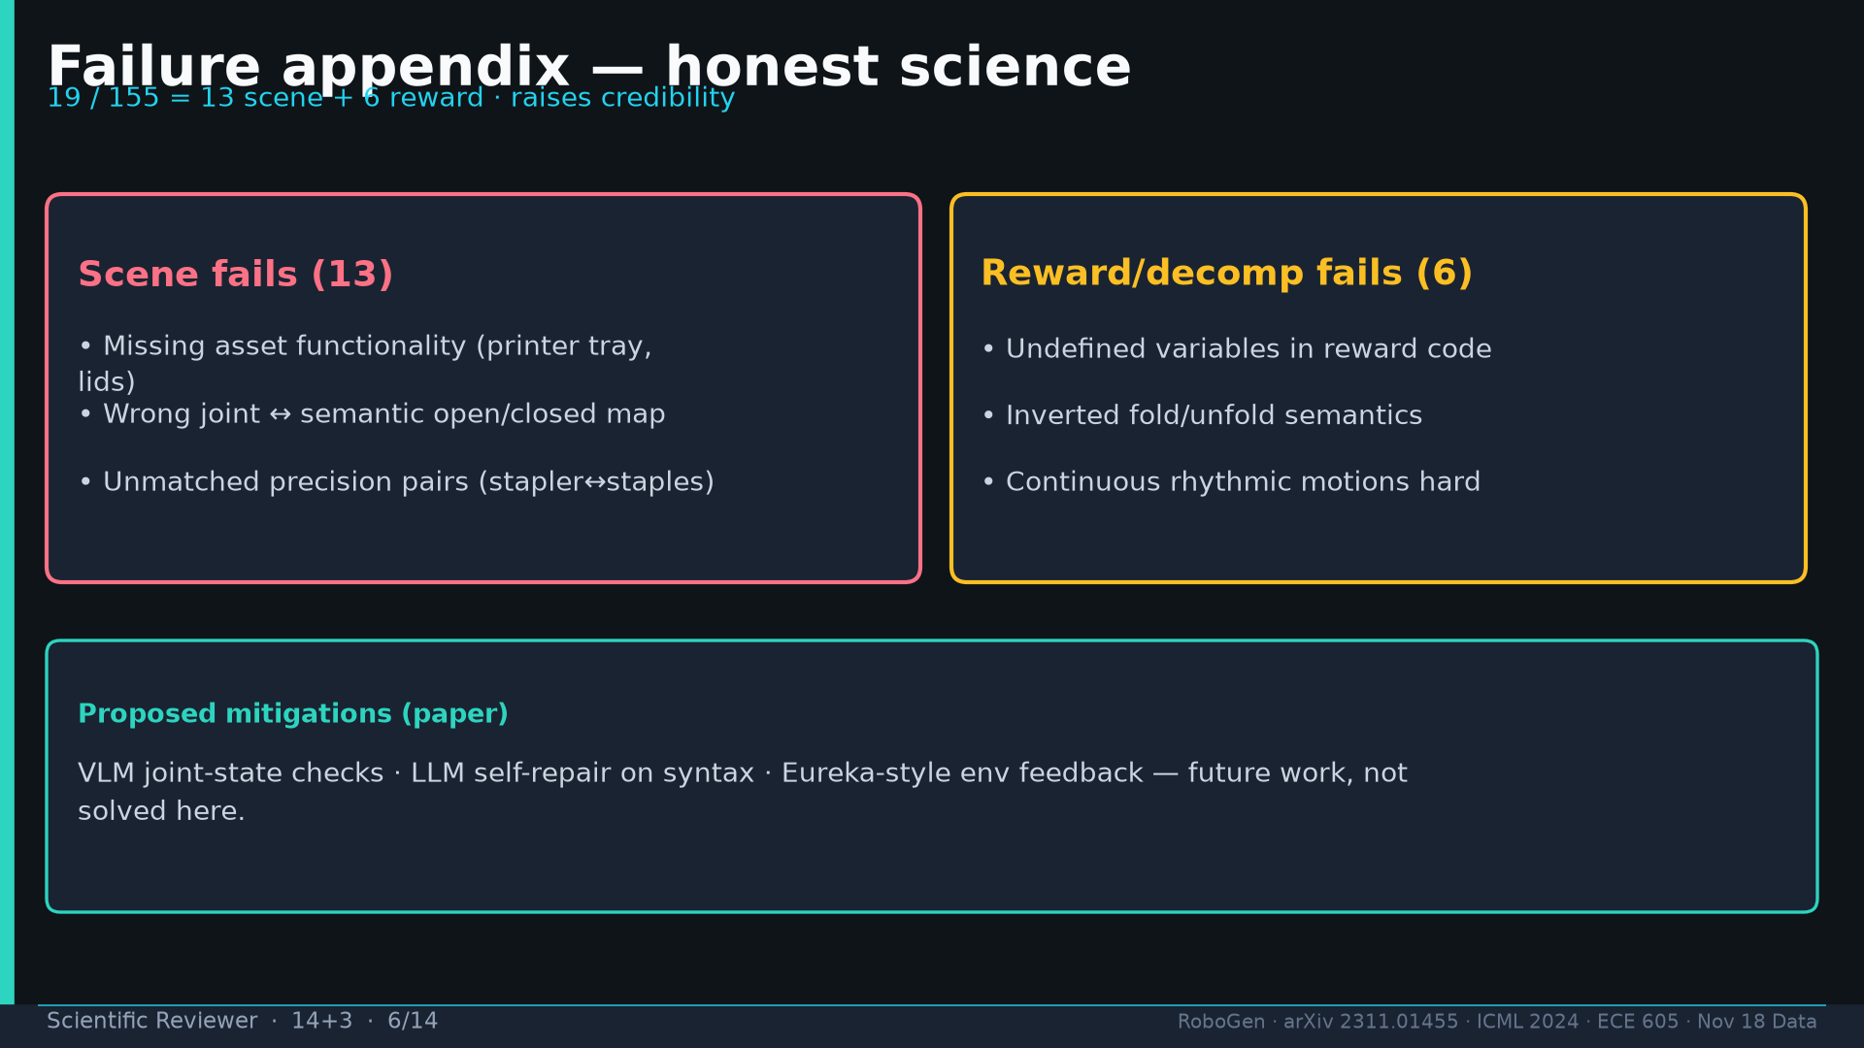
Notes:
[Scientific Reviewer · 14+3 · 6/14]
Failure appendix 19/155 honest: 13 scene + 6 reward. Mitigations proposed future.
Tattoo: success 0.774/69 · validity 19/155 fails · avg 3.13 substeps · Self-BLEU 0.284 (beats Behavior-100) · Fig.5 RL-only collapses · manip 0.745 / soft ~0.886 / loco ~0.833

Slide 7
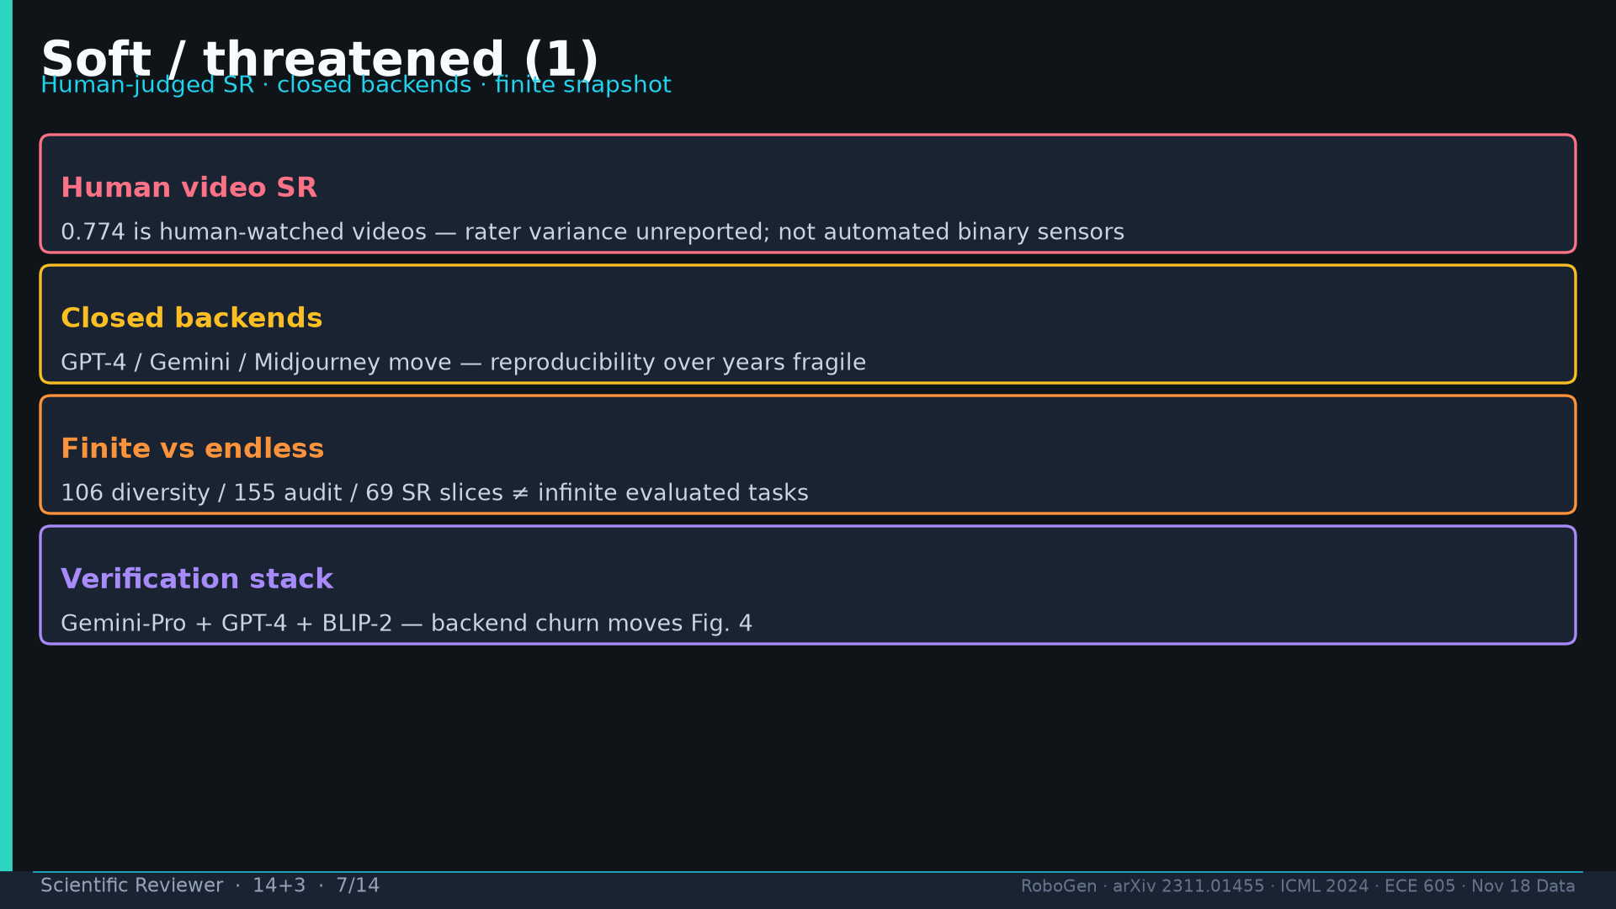
Notes:
[Scientific Reviewer · 14+3 · 7/14]
Soft1: human video SR; closed backends; finite vs endless rhetoric; verification stack churn.
Tattoo: success 0.774/69 · validity 19/155 fails · avg 3.13 substeps · Self-BLEU 0.284 (beats Behavior-100) · Fig.5 RL-only collapses · manip 0.745 / soft ~0.886 / loco ~0.833

Slide 8
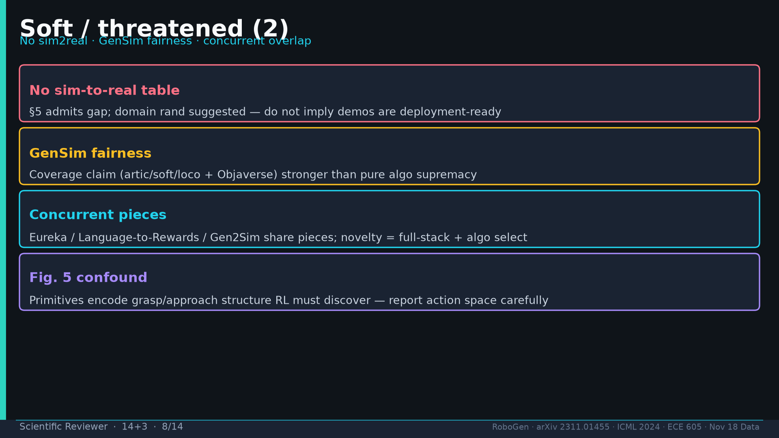
Notes:
[Scientific Reviewer · 14+3 · 8/14]
Soft2: no sim2real; GenSim fairness; concurrent Eureka/Gen2Sim overlap; Fig.5 action-space confound.
Tattoo: success 0.774/69 · validity 19/155 fails · avg 3.13 substeps · Self-BLEU 0.284 (beats Behavior-100) · Fig.5 RL-only collapses · manip 0.745 / soft ~0.886 / loco ~0.833

Slide 9
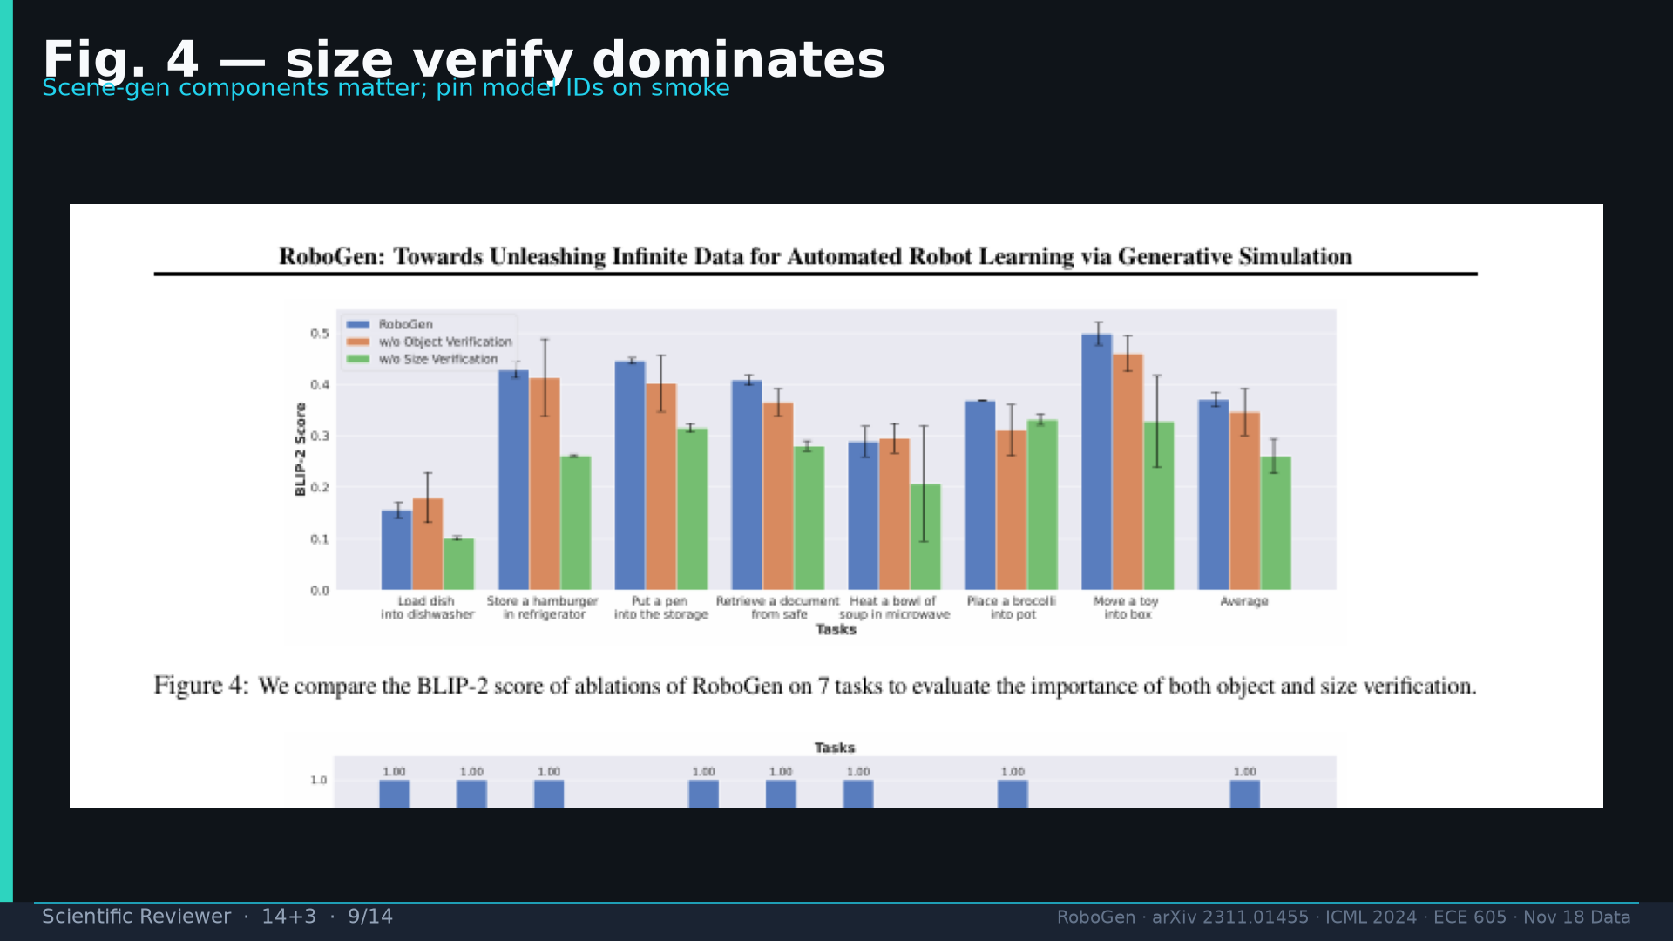
Notes:
[Scientific Reviewer · 14+3 · 9/14]
Fig.4 size verify dominates BLIP-2; pin model IDs.
Tattoo: success 0.774/69 · validity 19/155 fails · avg 3.13 substeps · Self-BLEU 0.284 (beats Behavior-100) · Fig.5 RL-only collapses · manip 0.745 / soft ~0.886 / loco ~0.833

Slide 10
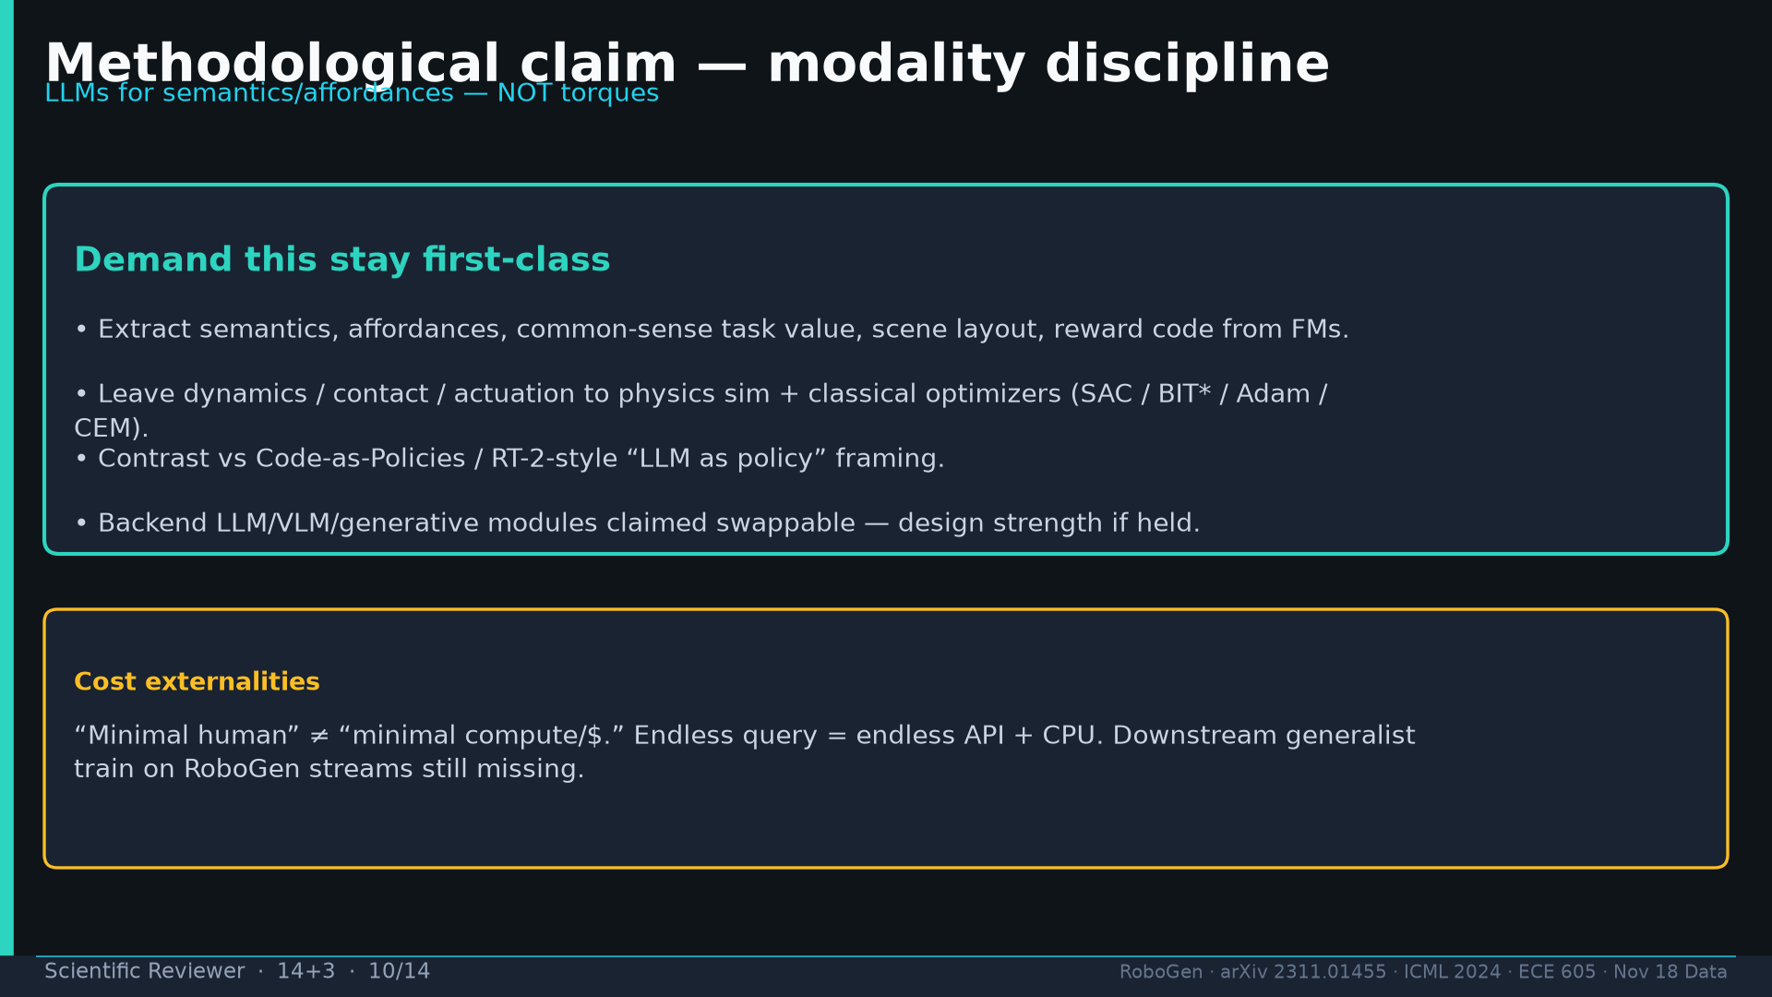
Notes:
[Scientific Reviewer · 14+3 · 10/14]
Modality discipline: LLMs for semantics NOT torques. Minimal human ≠ minimal $.
Tattoo: success 0.774/69 · validity 19/155 fails · avg 3.13 substeps · Self-BLEU 0.284 (beats Behavior-100) · Fig.5 RL-only collapses · manip 0.745 / soft ~0.886 / loco ~0.833

Slide 11
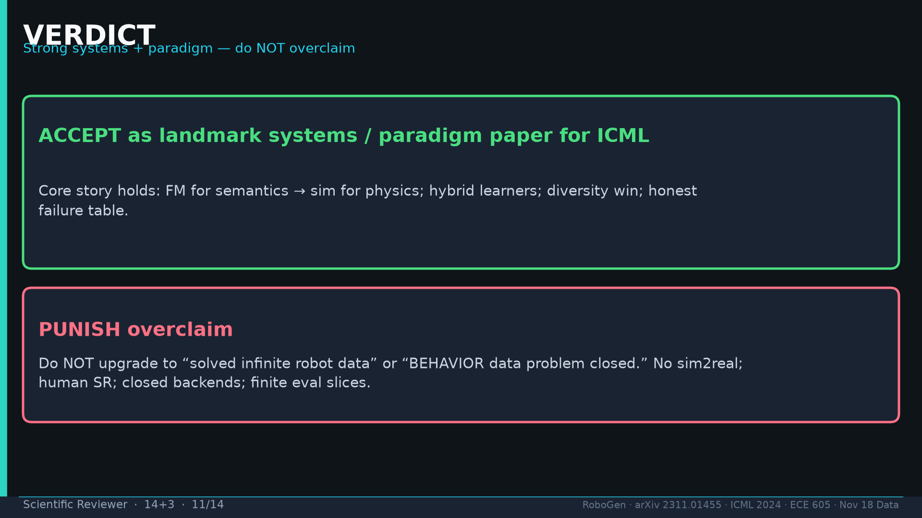
Notes:
[Scientific Reviewer · 14+3 · 11/14]
VERDICT: ACCEPT systems/paradigm. PUNISH infinite-data / BEHAVIOR-closed overclaim.
Tattoo: success 0.774/69 · validity 19/155 fails · avg 3.13 substeps · Self-BLEU 0.284 (beats Behavior-100) · Fig.5 RL-only collapses · manip 0.745 / soft ~0.886 / loco ~0.833

Slide 12
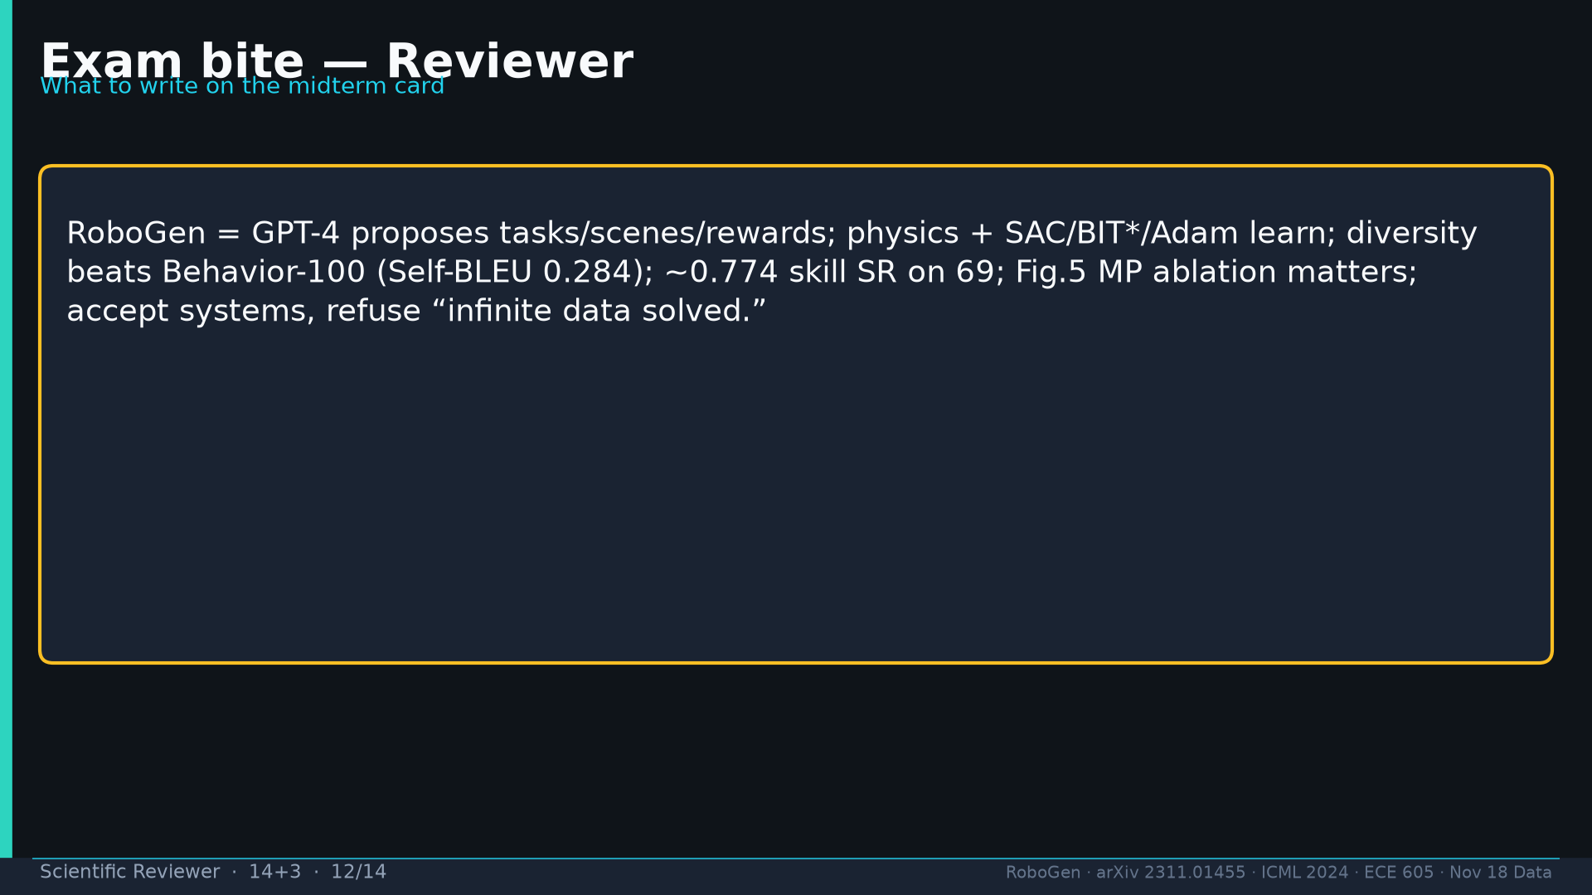
Notes:
[Scientific Reviewer · 14+3 · 12/14]
Exam bite card for midterm.
Tattoo: success 0.774/69 · validity 19/155 fails · avg 3.13 substeps · Self-BLEU 0.284 (beats Behavior-100) · Fig.5 RL-only collapses · manip 0.745 / soft ~0.886 / loco ~0.833

Slide 13
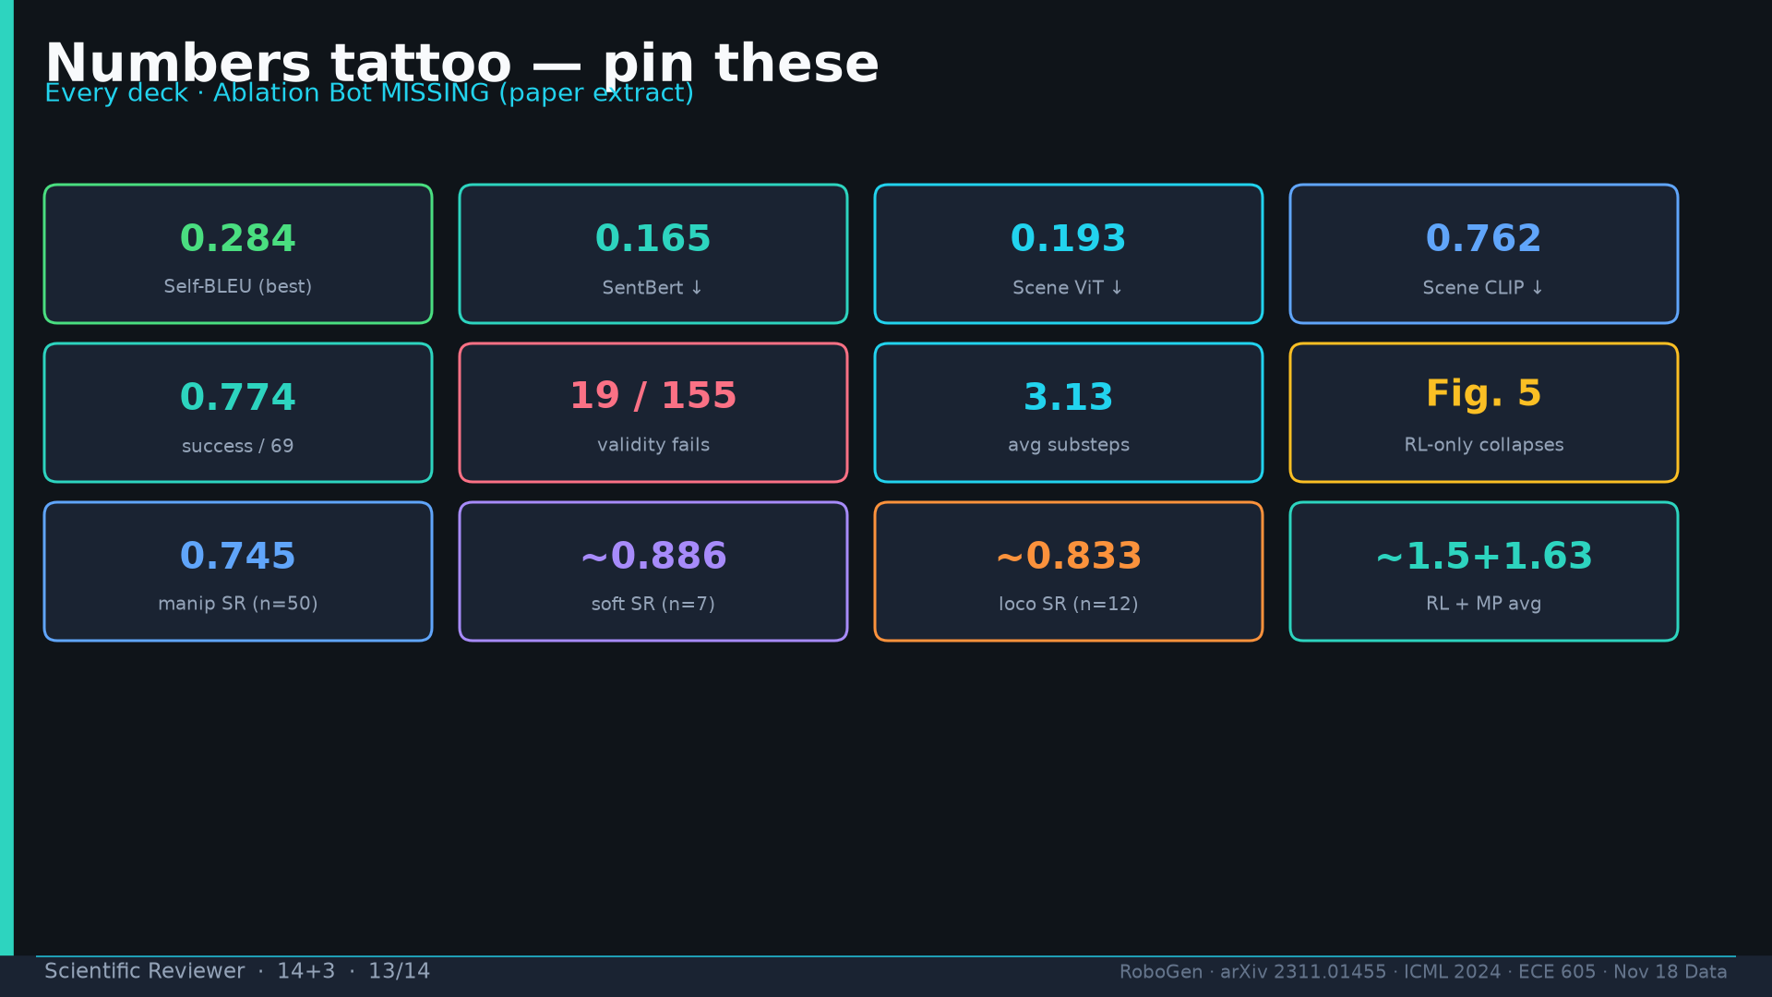
Notes:
[Scientific Reviewer · 14+3 · 13/14]
Tattoo.
Tattoo: success 0.774/69 · validity 19/155 fails · avg 3.13 substeps · Self-BLEU 0.284 (beats Behavior-100) · Fig.5 RL-only collapses · manip 0.745 / soft ~0.886 / loco ~0.833

Slide 14
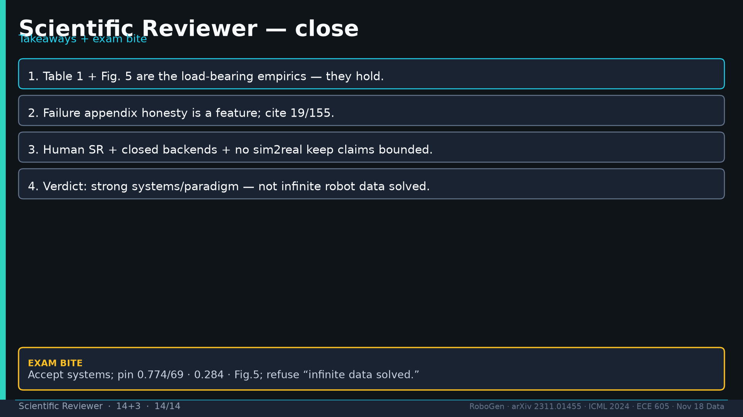
Notes:
[Scientific Reviewer · 14+3 · 14/14]
Close takeaways + exam.
Tattoo: success 0.774/69 · validity 19/155 fails · avg 3.13 substeps · Self-BLEU 0.284 (beats Behavior-100) · Fig.5 RL-only collapses · manip 0.745 / soft ~0.886 / loco ~0.833

