Slide 1
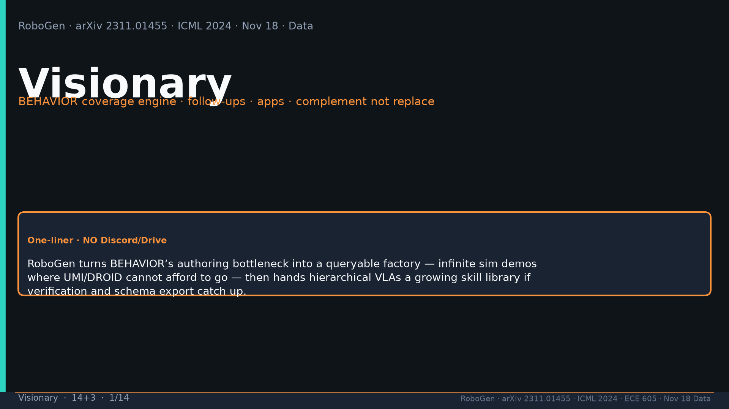
Notes:
[Visionary · 14+3 · 1/14]
Title. NO Discord/Drive. BEHAVIOR coverage engine; complement not replace real poles.
Tattoo: success 0.774/69 · validity 19/155 fails · avg 3.13 substeps · Self-BLEU 0.284 (beats Behavior-100) · Fig.5 RL-only collapses · manip 0.745 / soft ~0.886 / loco ~0.833

Slide 2
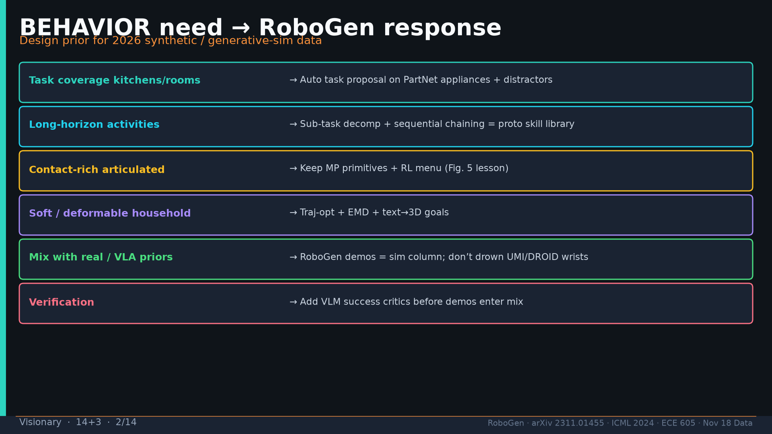
Notes:
[Visionary · 14+3 · 2/14]
BEHAVIOR need→response table: coverage, long-horizon, artic MP+RL, soft, mix, verify.
Tattoo: success 0.774/69 · validity 19/155 fails · avg 3.13 substeps · Self-BLEU 0.284 (beats Behavior-100) · Fig.5 RL-only collapses · manip 0.745 / soft ~0.886 / loco ~0.833

Slide 3
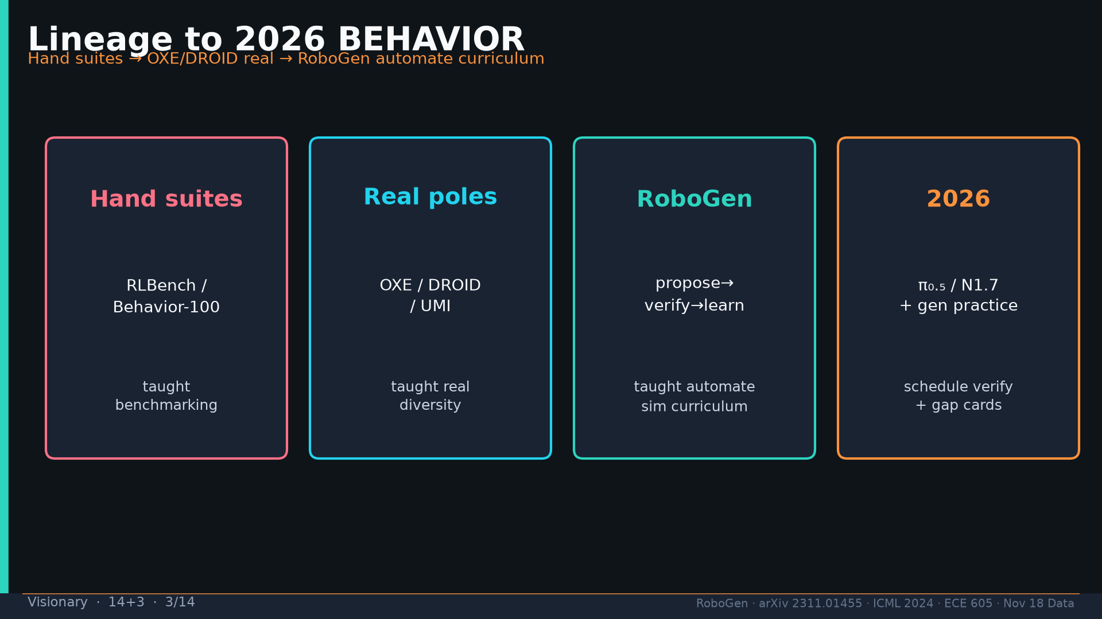
Notes:
[Visionary · 14+3 · 3/14]
Lineage to 2026: hand suites→real poles→RoboGen automate curriculum→schedule gen practice with verify+gap.
Tattoo: success 0.774/69 · validity 19/155 fails · avg 3.13 substeps · Self-BLEU 0.284 (beats Behavior-100) · Fig.5 RL-only collapses · manip 0.745 / soft ~0.886 / loco ~0.833

Slide 4
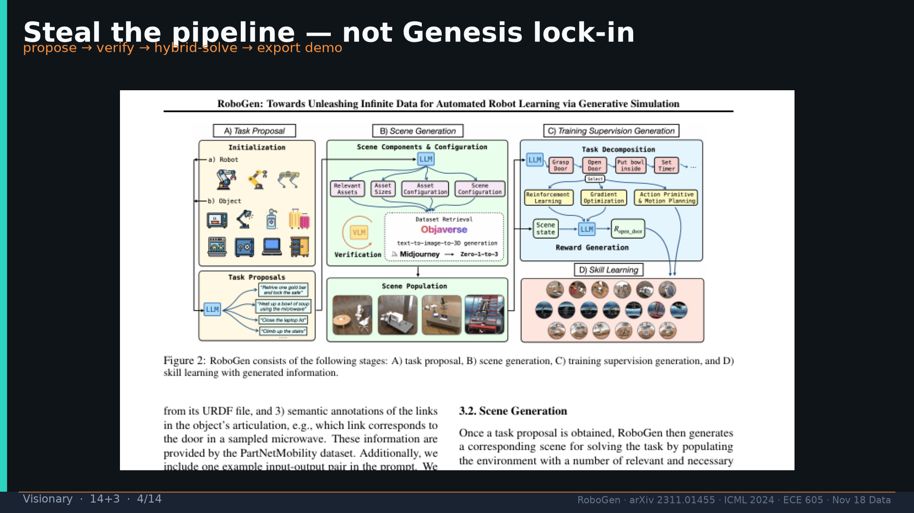
Notes:
[Visionary · 14+3 · 4/14]
Steal pipeline not Genesis lock-in: propose→verify→hybrid-solve→export.
Tattoo: success 0.774/69 · validity 19/155 fails · avg 3.13 substeps · Self-BLEU 0.284 (beats Behavior-100) · Fig.5 RL-only collapses · manip 0.745 / soft ~0.886 / loco ~0.833

Slide 5
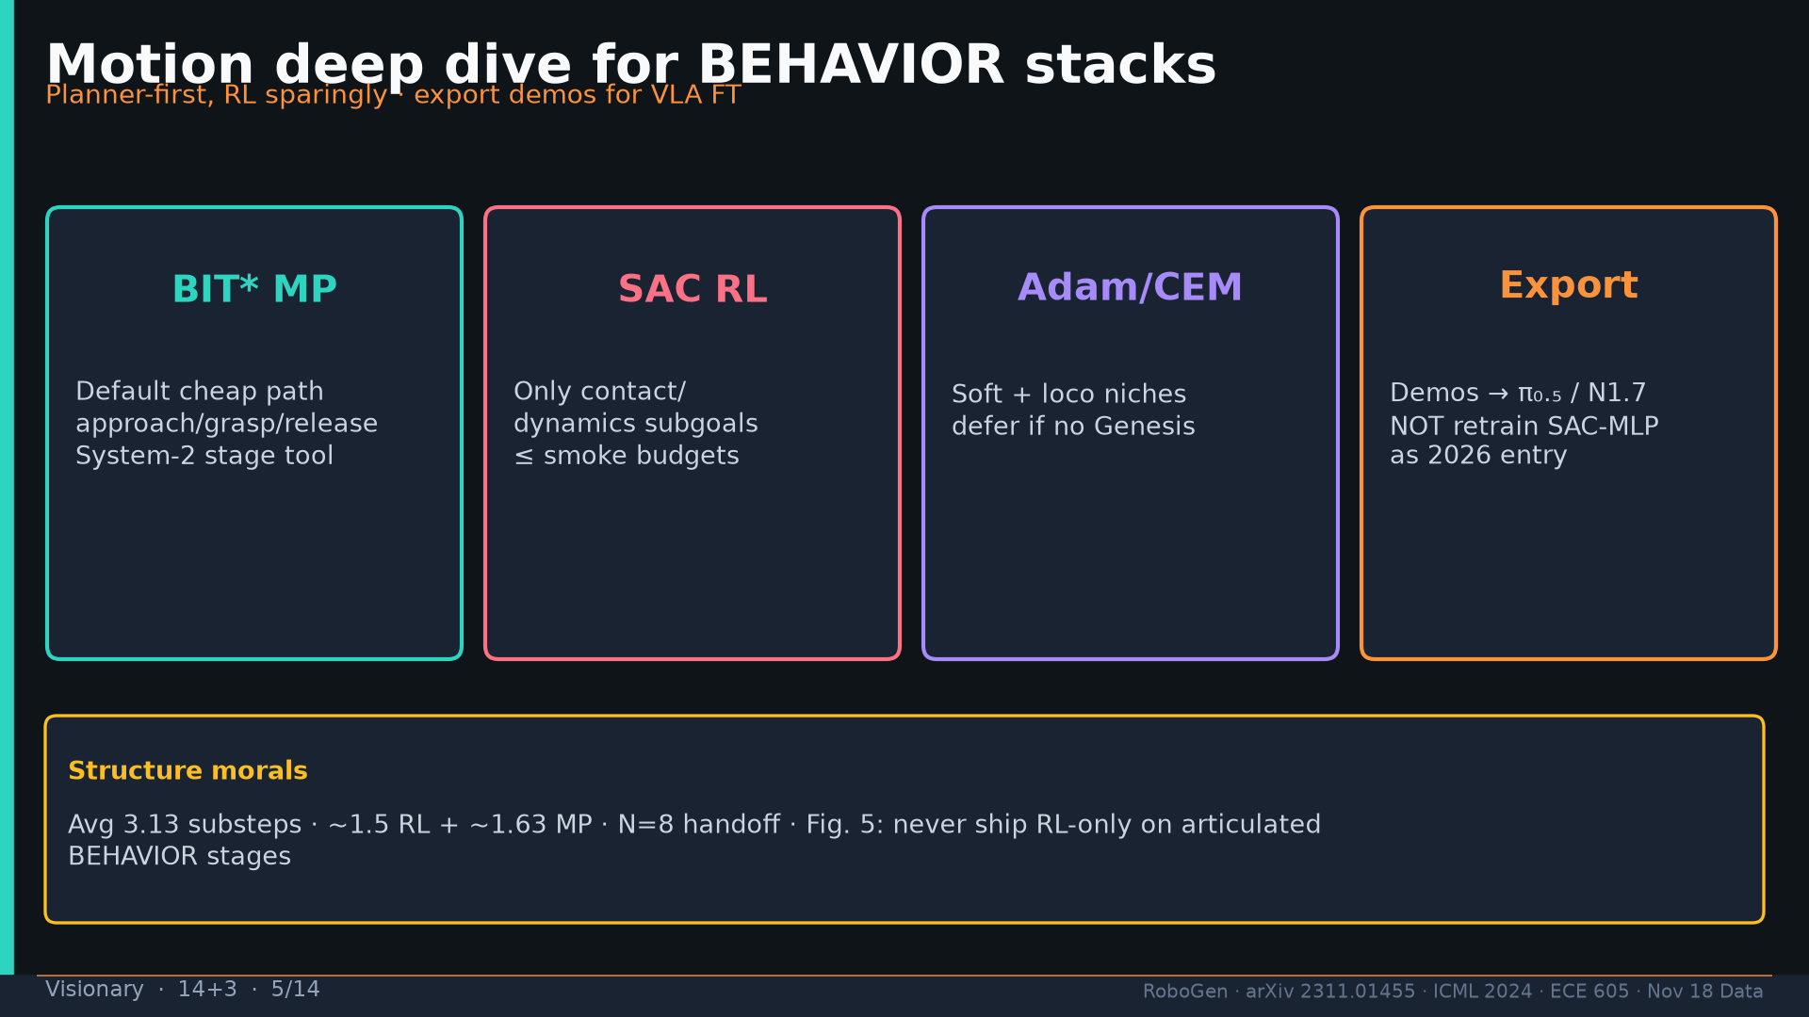
Notes:
[Visionary · 14+3 · 5/14]
MOTION for BEHAVIOR: planner-first RL sparingly; export to π₀.₅/N1.7; Fig.5 lesson; 3.13 structure.
Tattoo: success 0.774/69 · validity 19/155 fails · avg 3.13 substeps · Self-BLEU 0.284 (beats Behavior-100) · Fig.5 RL-only collapses · manip 0.745 / soft ~0.886 / loco ~0.833

Slide 6
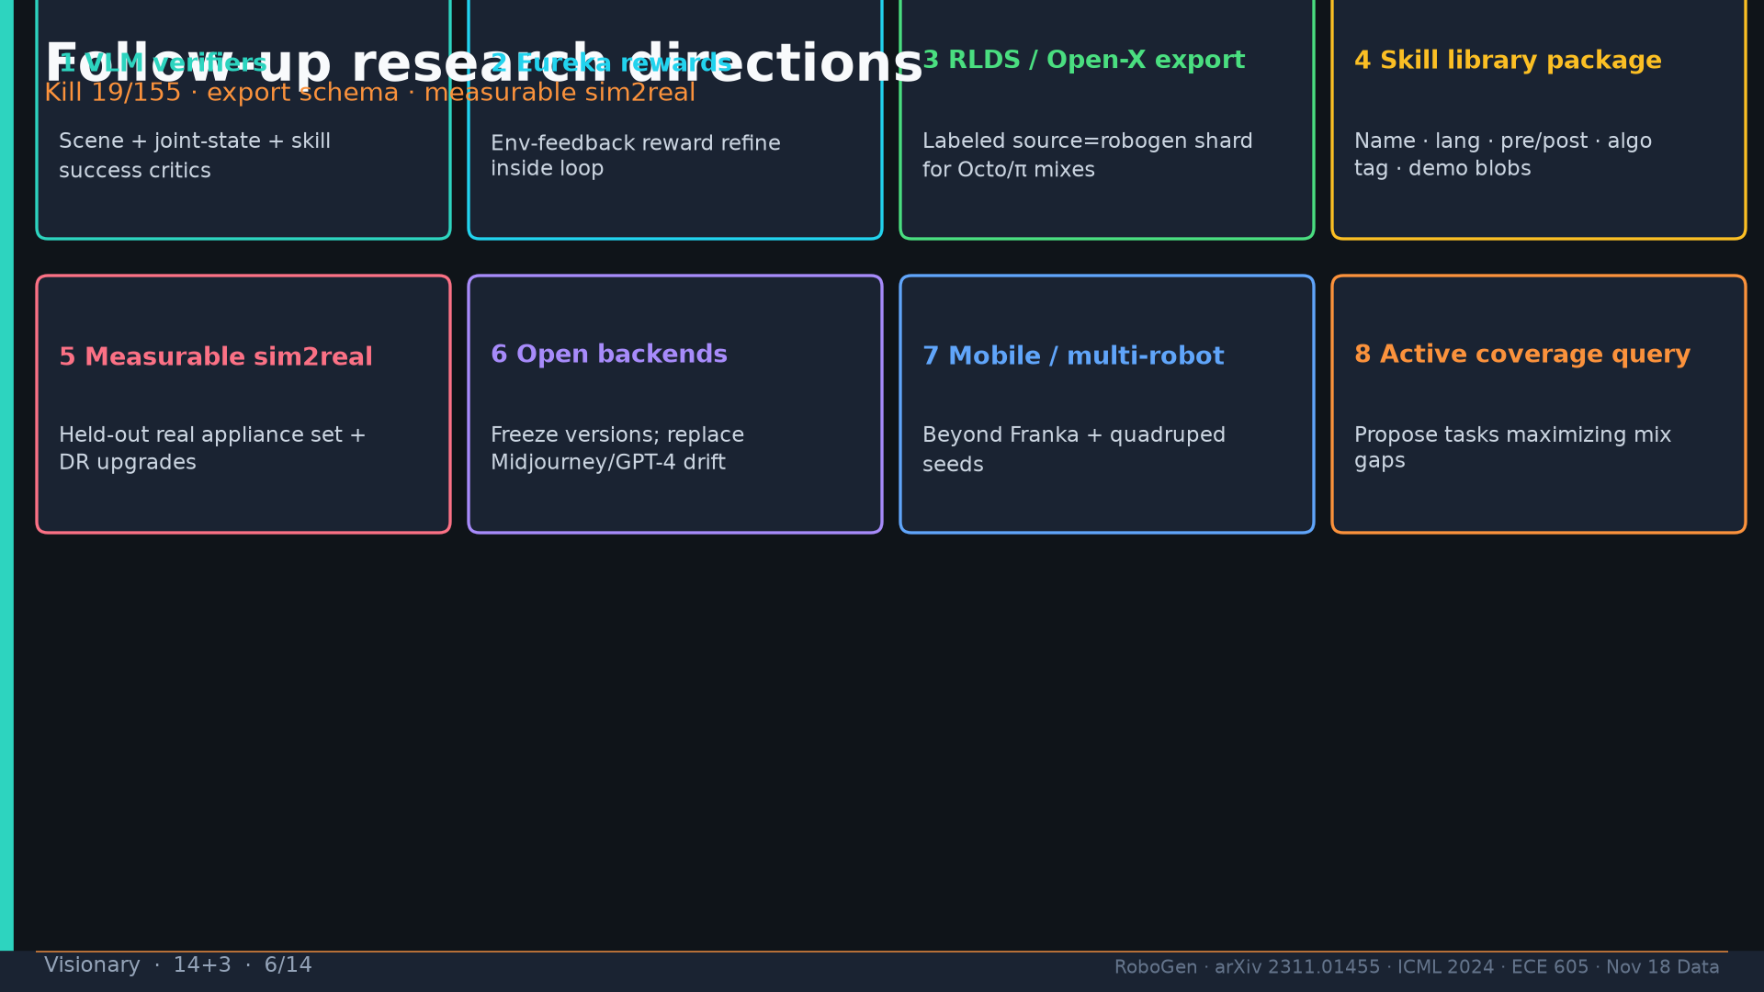
Notes:
[Visionary · 14+3 · 6/14]
Follow-ups: VLM verifiers; Eureka; RLDS export; skill library package; measurable sim2real; open backends; mobile; active coverage.
Tattoo: success 0.774/69 · validity 19/155 fails · avg 3.13 substeps · Self-BLEU 0.284 (beats Behavior-100) · Fig.5 RL-only collapses · manip 0.745 / soft ~0.886 / loco ~0.833

Slide 7
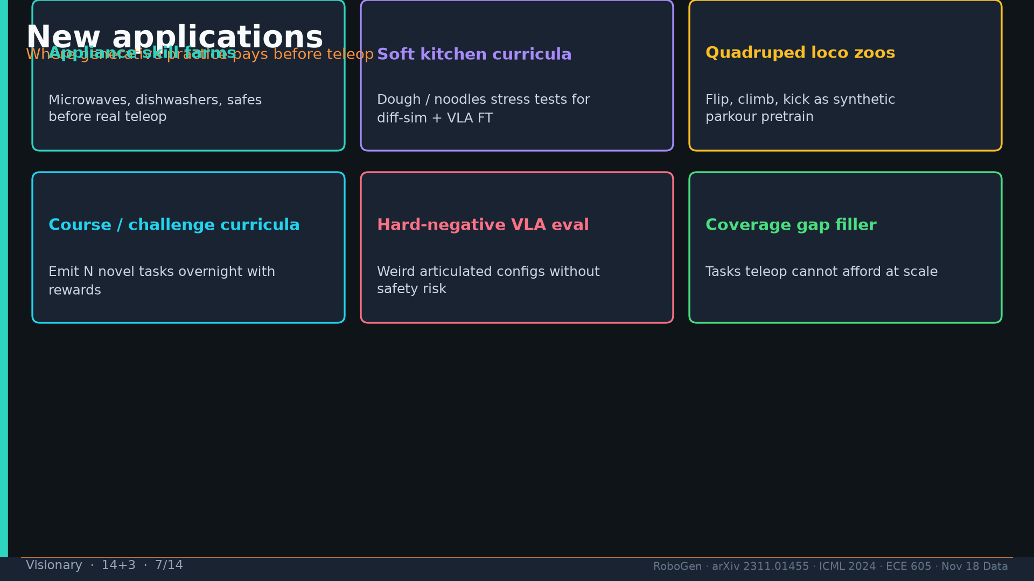
Notes:
[Visionary · 14+3 · 7/14]
New apps: appliance farms; soft kitchen; loco zoos; course curricula; hard-neg eval; gap filler.
Tattoo: success 0.774/69 · validity 19/155 fails · avg 3.13 substeps · Self-BLEU 0.284 (beats Behavior-100) · Fig.5 RL-only collapses · manip 0.745 / soft ~0.886 / loco ~0.833

Slide 8
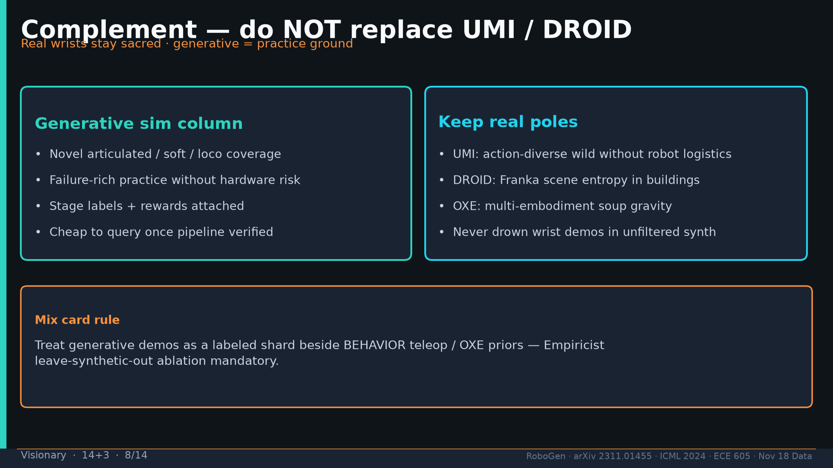
Notes:
[Visionary · 14+3 · 8/14]
Complement NOT replace UMI/DROID/OXE. Mix card + leave-synthetic-out ablation.
Tattoo: success 0.774/69 · validity 19/155 fails · avg 3.13 substeps · Self-BLEU 0.284 (beats Behavior-100) · Fig.5 RL-only collapses · manip 0.745 / soft ~0.886 / loco ~0.833

Slide 9
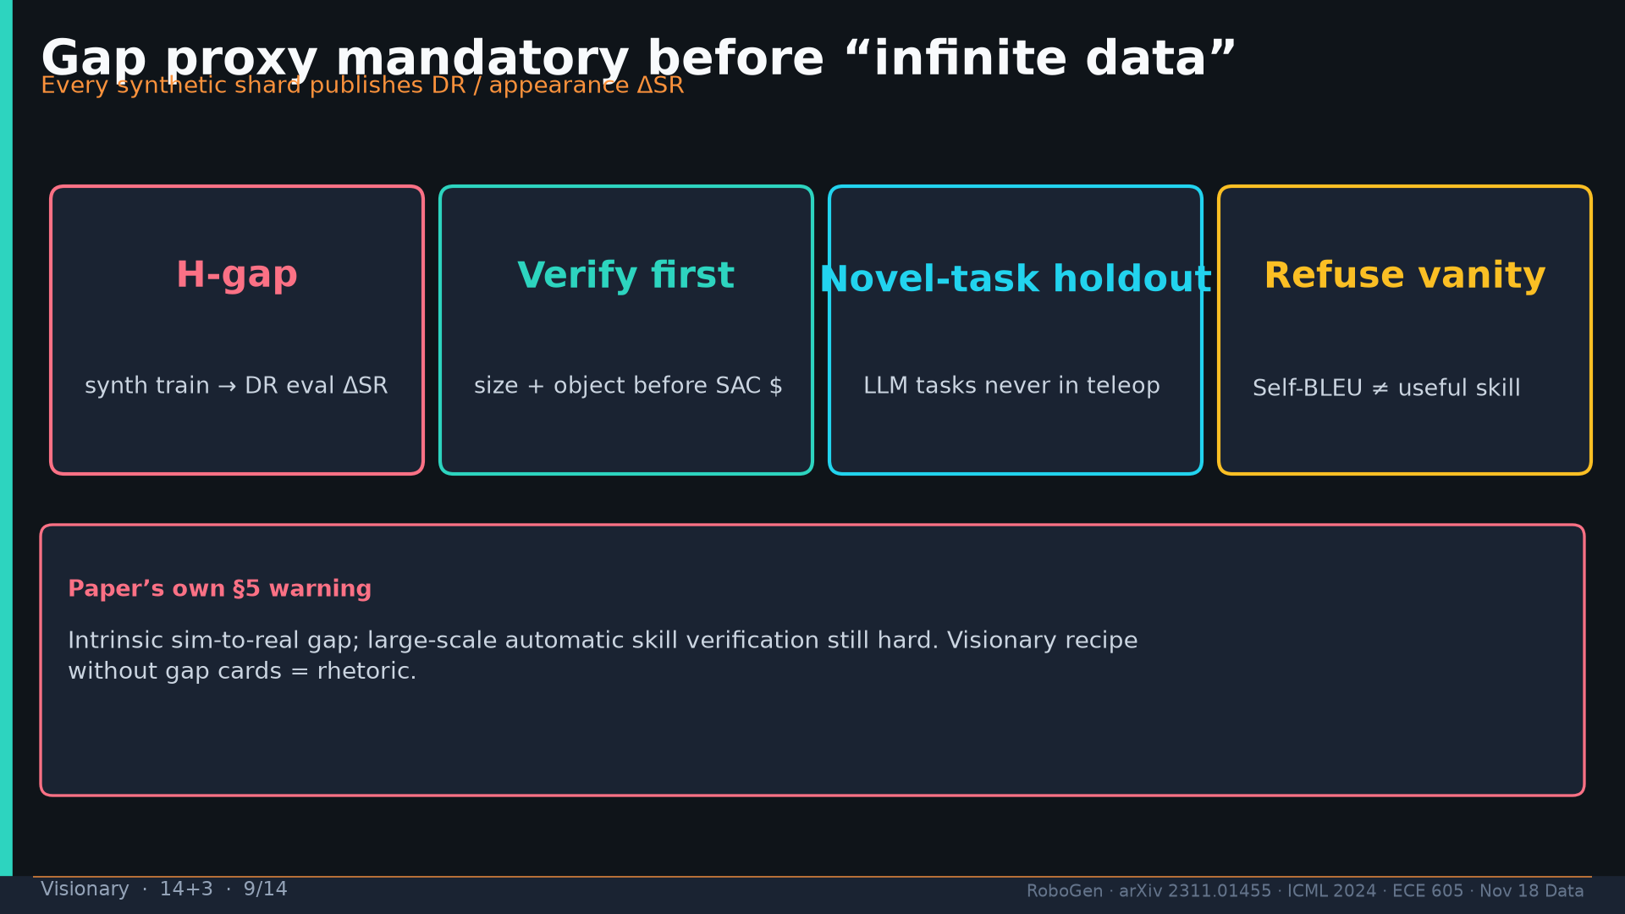
Notes:
[Visionary · 14+3 · 9/14]
Gap proxy mandatory before infinite-data rhetoric. §5 warning.
Tattoo: success 0.774/69 · validity 19/155 fails · avg 3.13 substeps · Self-BLEU 0.284 (beats Behavior-100) · Fig.5 RL-only collapses · manip 0.745 / soft ~0.886 / loco ~0.833

Slide 10
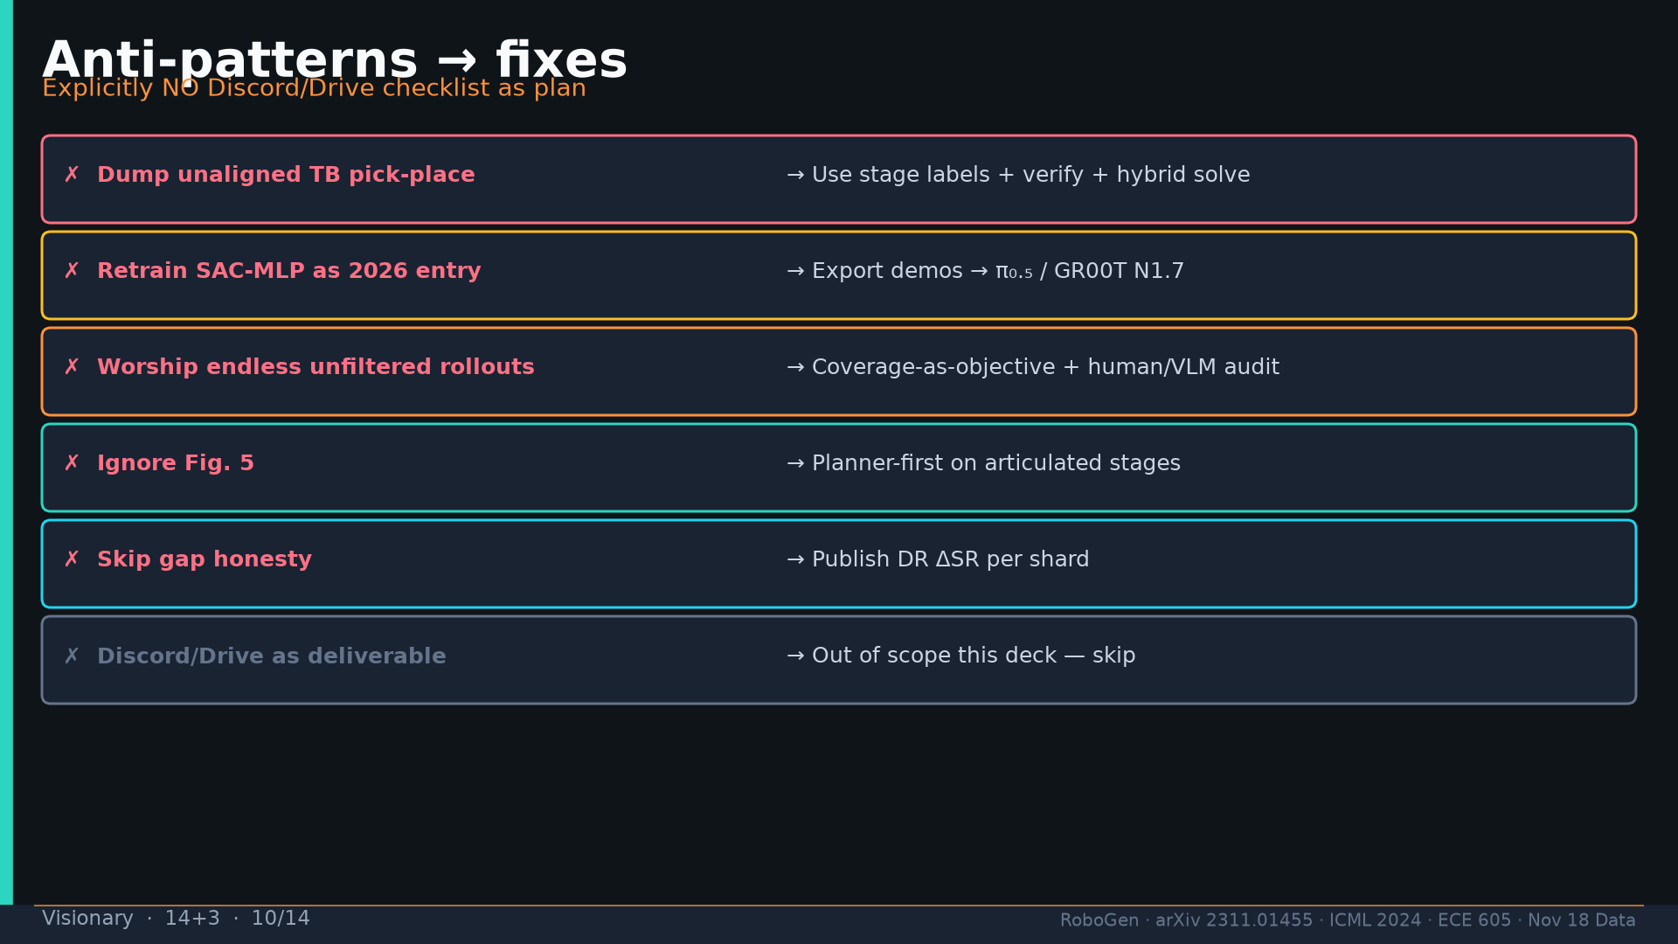
Notes:
[Visionary · 14+3 · 10/14]
Anti-patterns→fixes. Explicitly NO Discord/Drive as plan.
Tattoo: success 0.774/69 · validity 19/155 fails · avg 3.13 substeps · Self-BLEU 0.284 (beats Behavior-100) · Fig.5 RL-only collapses · manip 0.745 / soft ~0.886 / loco ~0.833

Slide 11
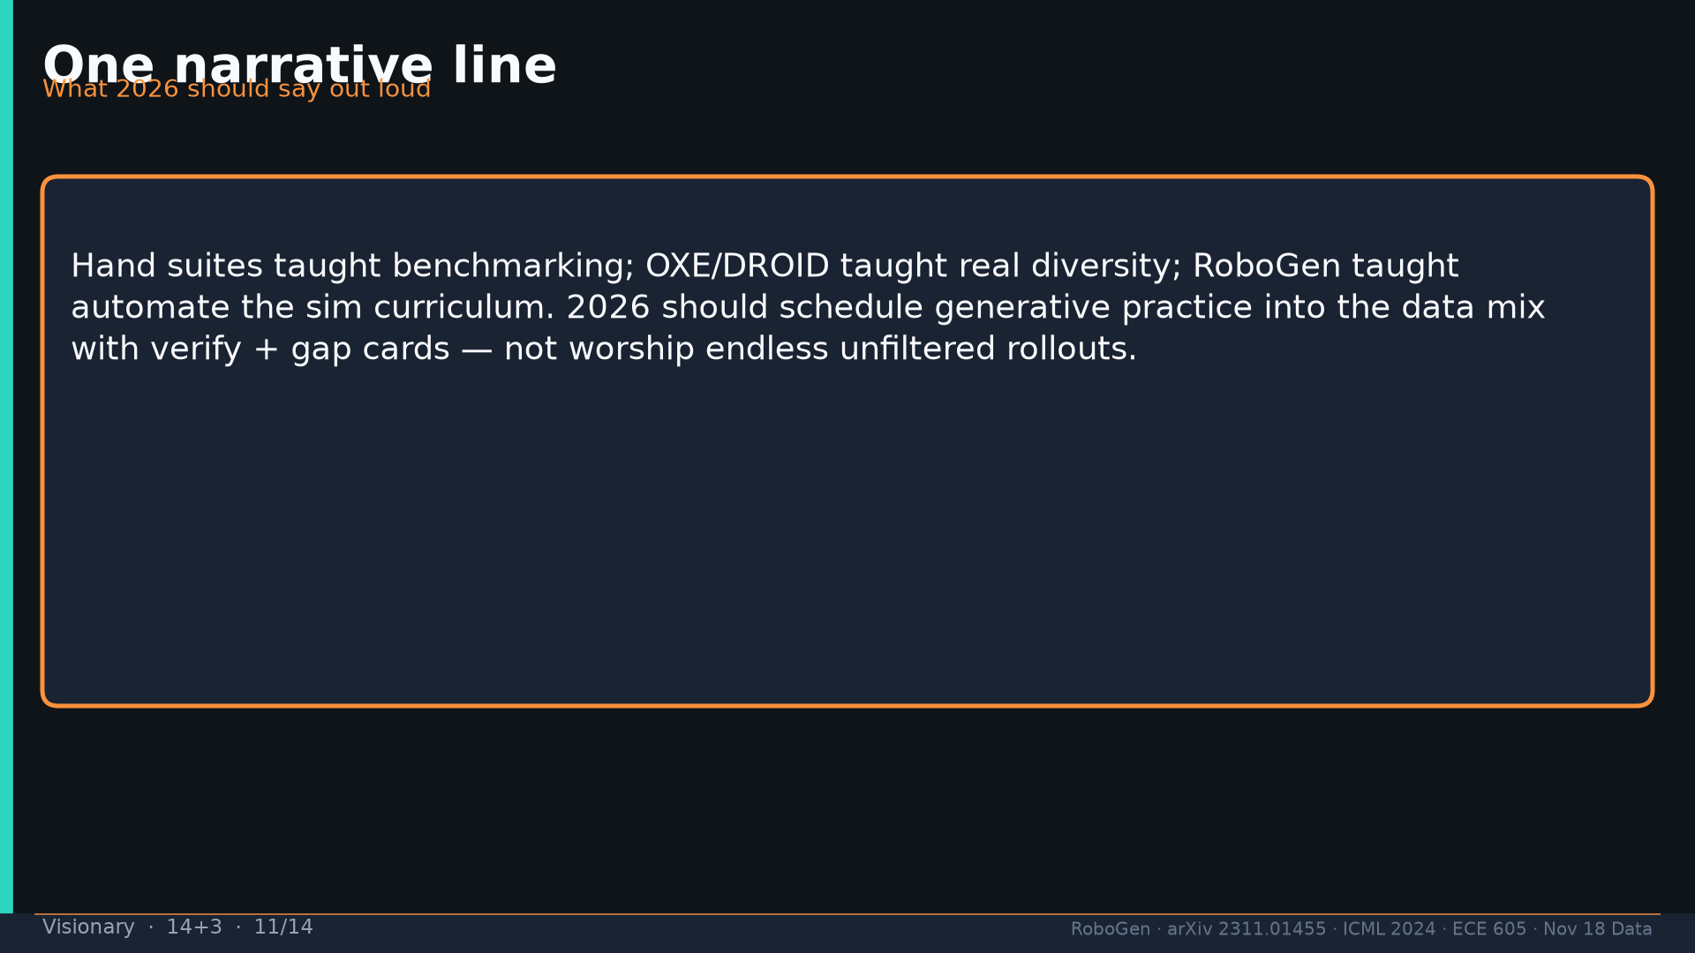
Notes:
[Visionary · 14+3 · 11/14]
One narrative line for 2026.
Tattoo: success 0.774/69 · validity 19/155 fails · avg 3.13 substeps · Self-BLEU 0.284 (beats Behavior-100) · Fig.5 RL-only collapses · manip 0.745 / soft ~0.886 / loco ~0.833

Slide 12
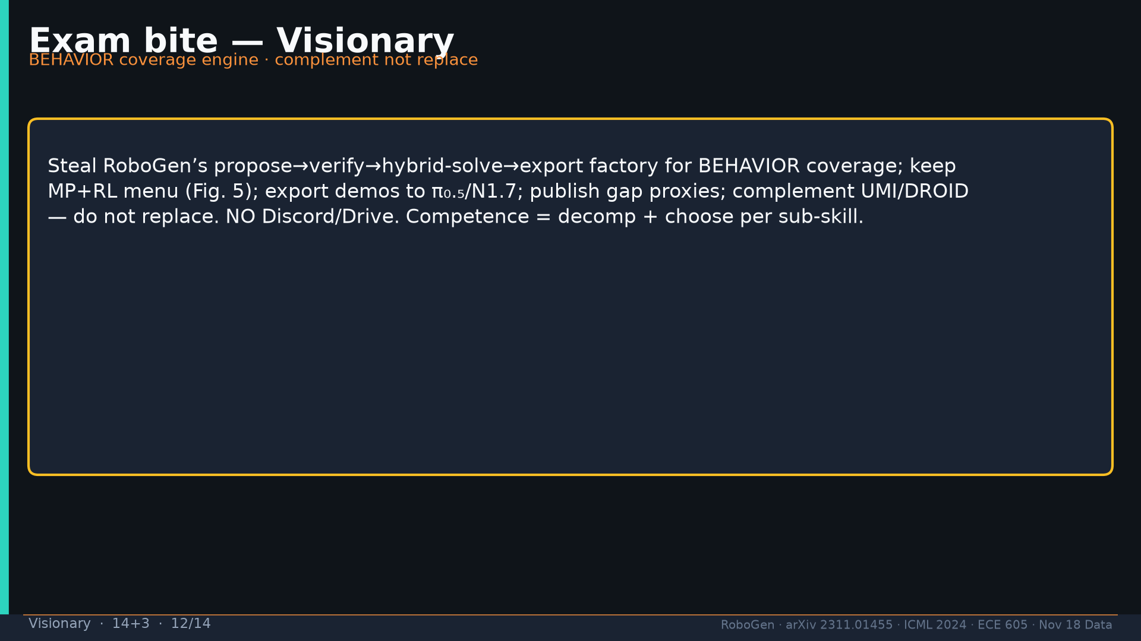
Notes:
[Visionary · 14+3 · 12/14]
Exam bite: coverage engine; MP+RL; export demos; gap; complement; NO Discord/Drive.
Tattoo: success 0.774/69 · validity 19/155 fails · avg 3.13 substeps · Self-BLEU 0.284 (beats Behavior-100) · Fig.5 RL-only collapses · manip 0.745 / soft ~0.886 / loco ~0.833

Slide 13
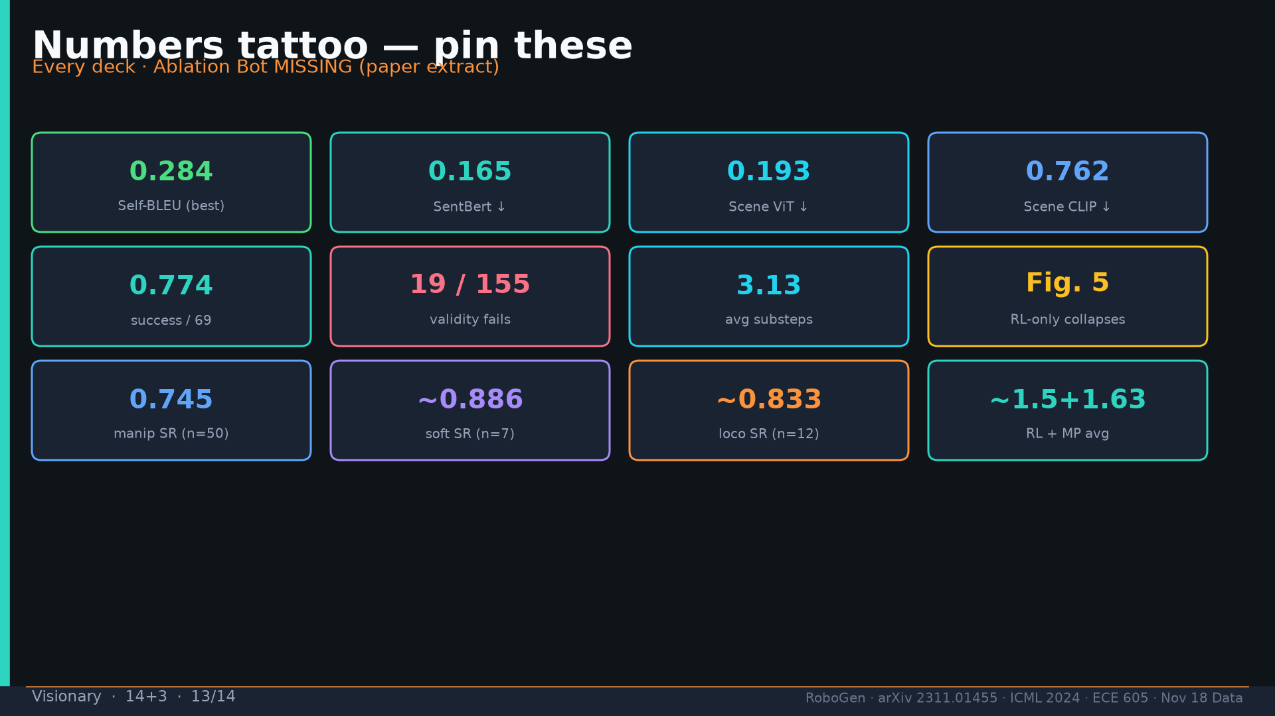
Notes:
[Visionary · 14+3 · 13/14]
Tattoo.
Tattoo: success 0.774/69 · validity 19/155 fails · avg 3.13 substeps · Self-BLEU 0.284 (beats Behavior-100) · Fig.5 RL-only collapses · manip 0.745 / soft ~0.886 / loco ~0.833

Slide 14
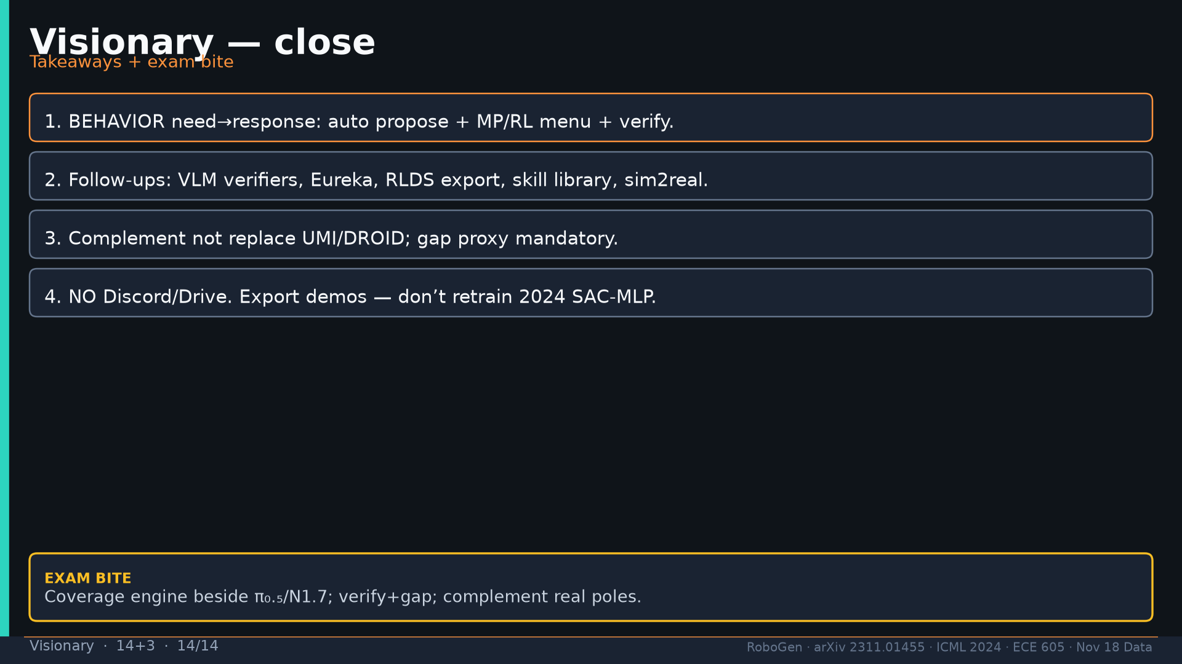
Notes:
[Visionary · 14+3 · 14/14]
Close. NO Discord/Drive content in deck.
Tattoo: success 0.774/69 · validity 19/155 fails · avg 3.13 substeps · Self-BLEU 0.284 (beats Behavior-100) · Fig.5 RL-only collapses · manip 0.745 / soft ~0.886 / loco ~0.833

