Slide 1
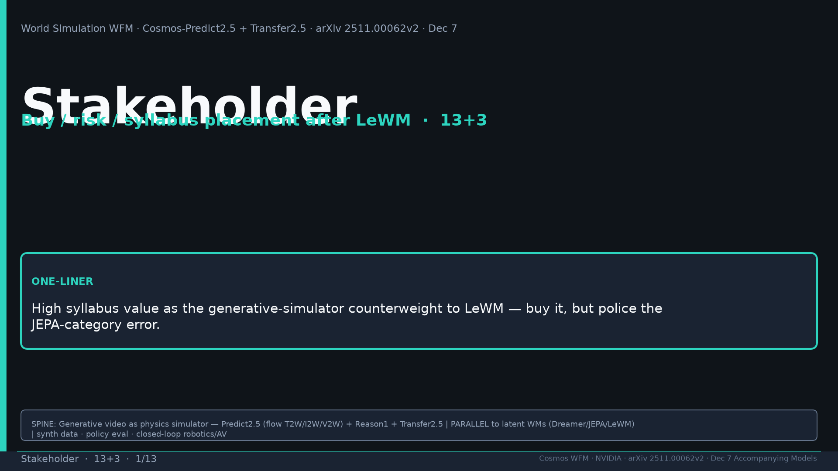
Notes:
Title. Buy generative counterweight after LeWM; police JEPA-category error. Tattoo: Real2Real 24/30 vs 5/30 · PAI T2W 0.768 / I2W 0.810 · Bridge PSNR 24.95 · DreamGen IF≠VLA SR · AV LET-AP 0.394 · Transfer 3.5× · 200M · 2B/14B · PARALLEL generative WFM

Slide 2
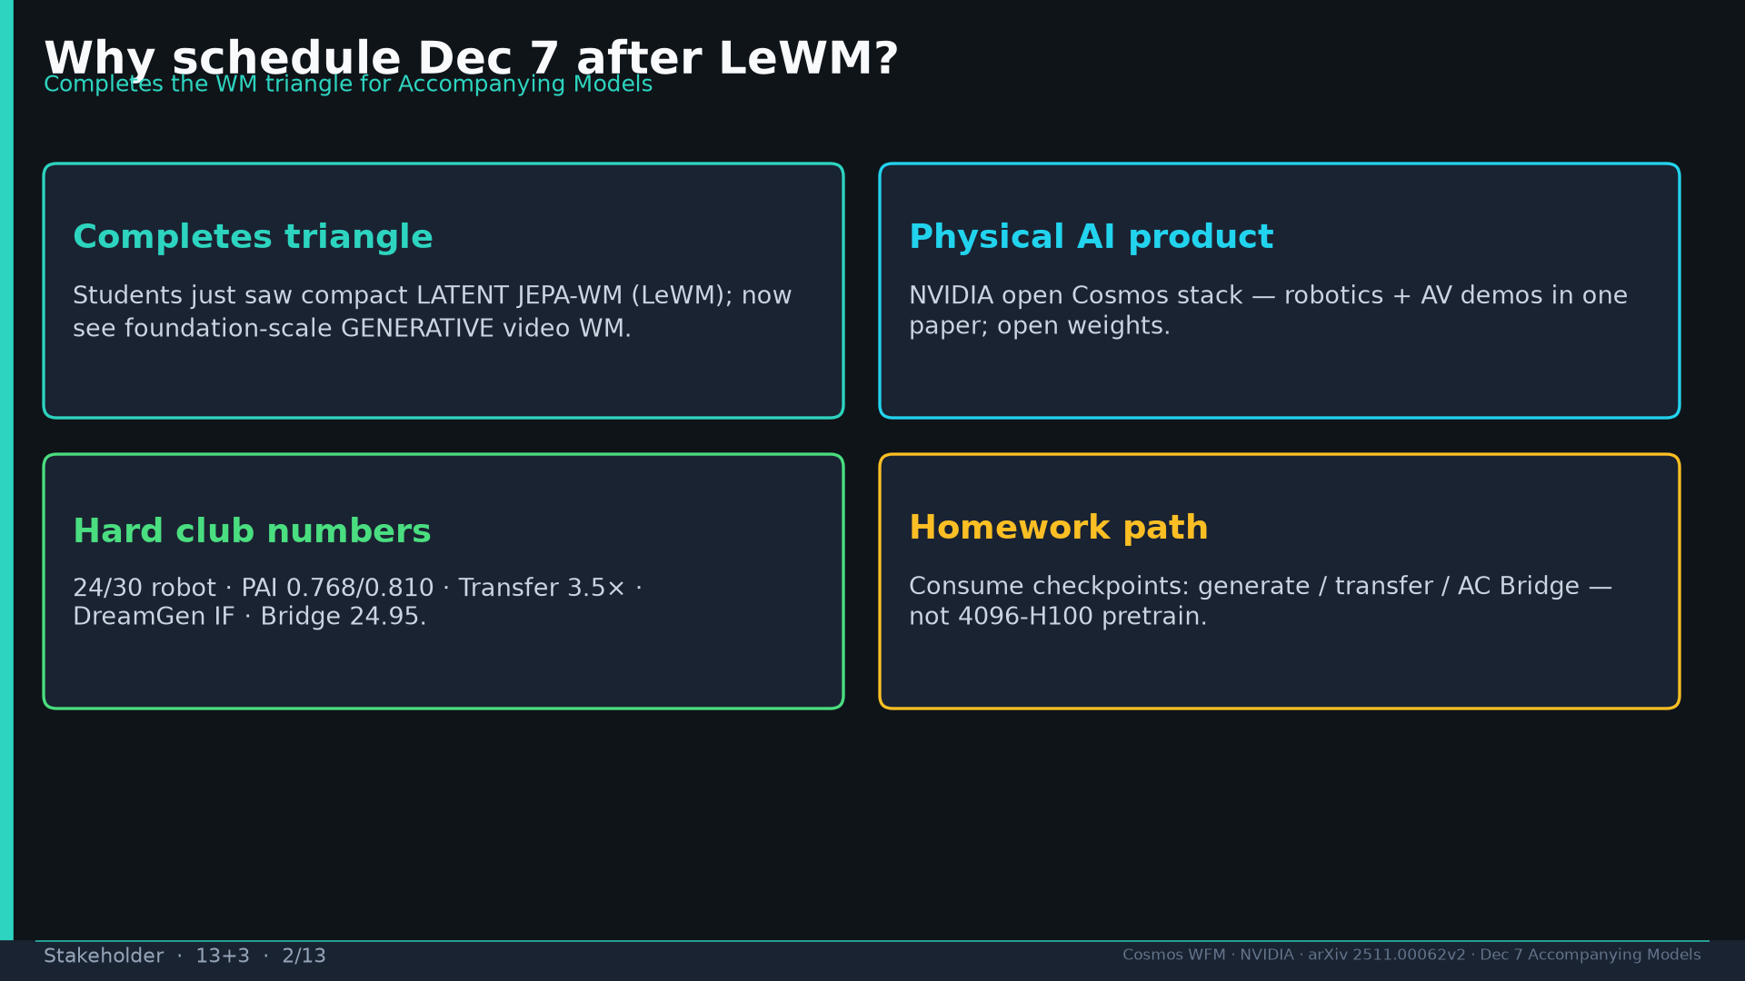
Notes:
Why after LeWM: completes WM triangle; Physical AI product; hard numbers; open weights homework.

Slide 3
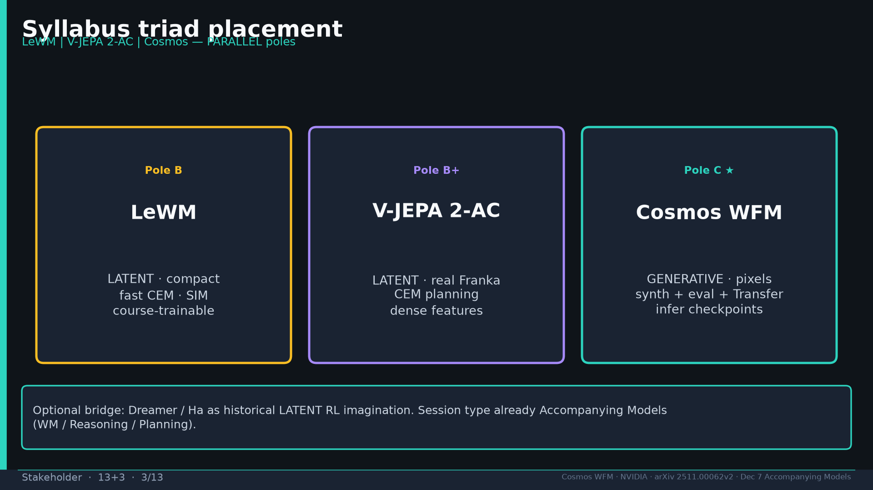
Notes:
Triad placement: LeWM | V-JEPA 2-AC | Cosmos — PARALLEL poles.

Slide 4
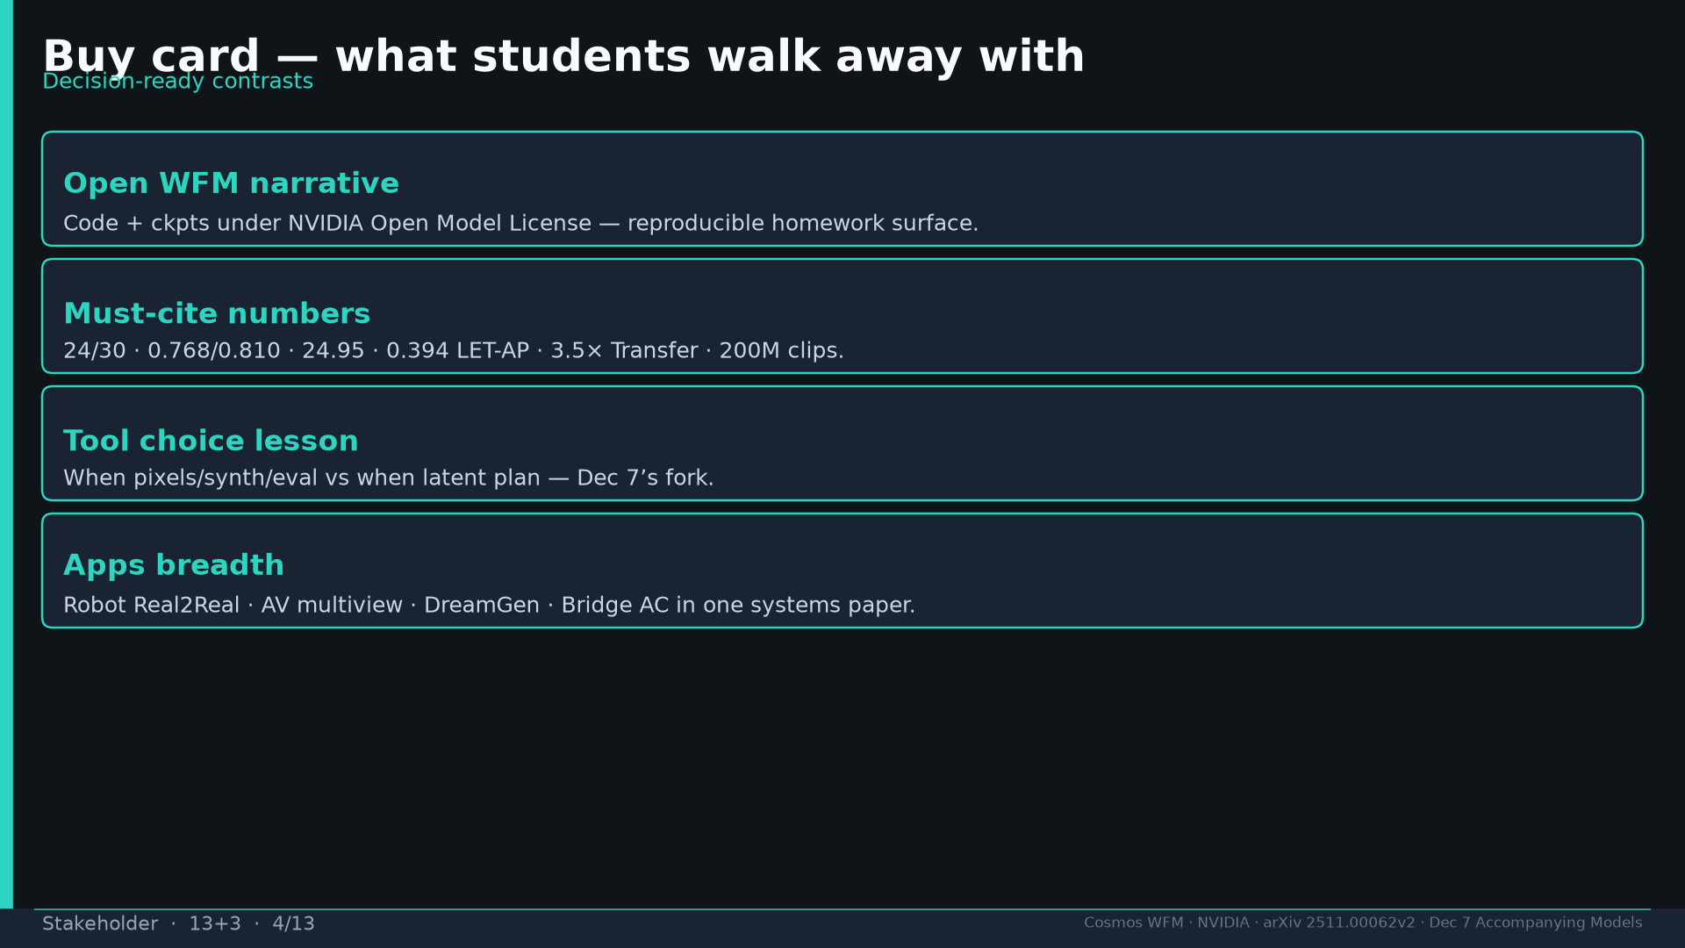
Notes:
Buy detail: open narrative, must-cites, tool choice lesson, apps breadth.

Slide 5
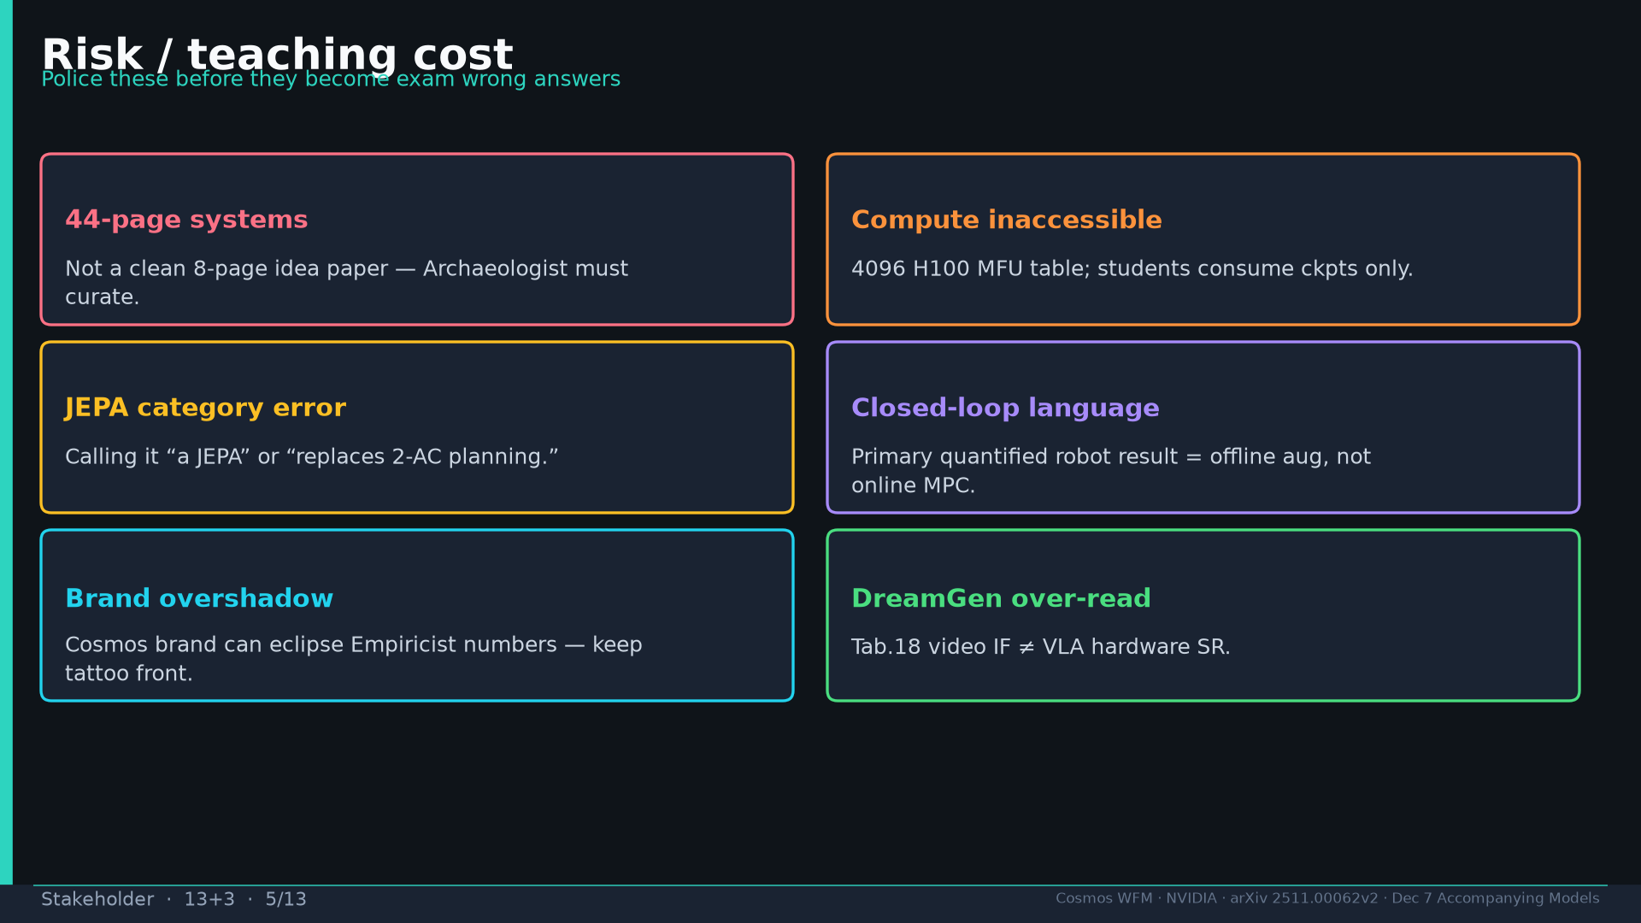
Notes:
Risks: 44-page systems; compute; JEPA error; closed-loop language; brand; DreamGen over-read.

Slide 6
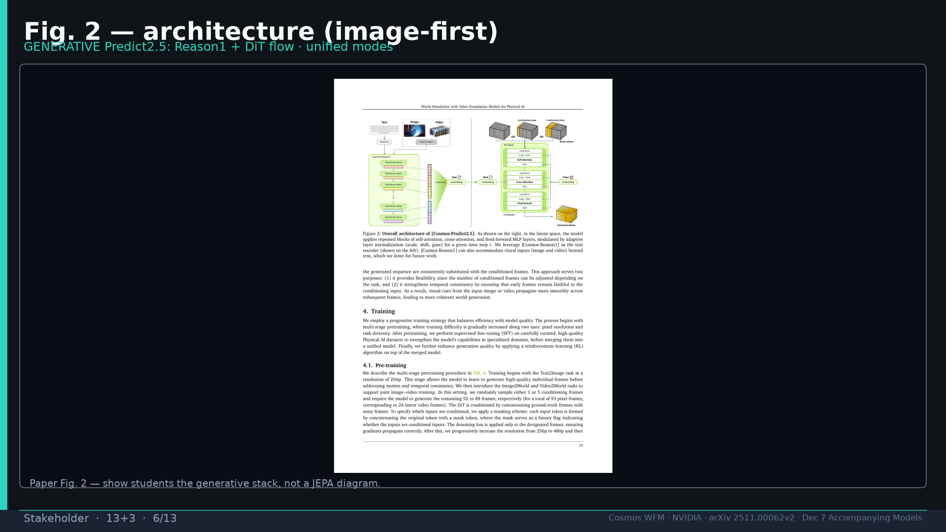
Notes:
Fig.2 architecture image-first.

Slide 7
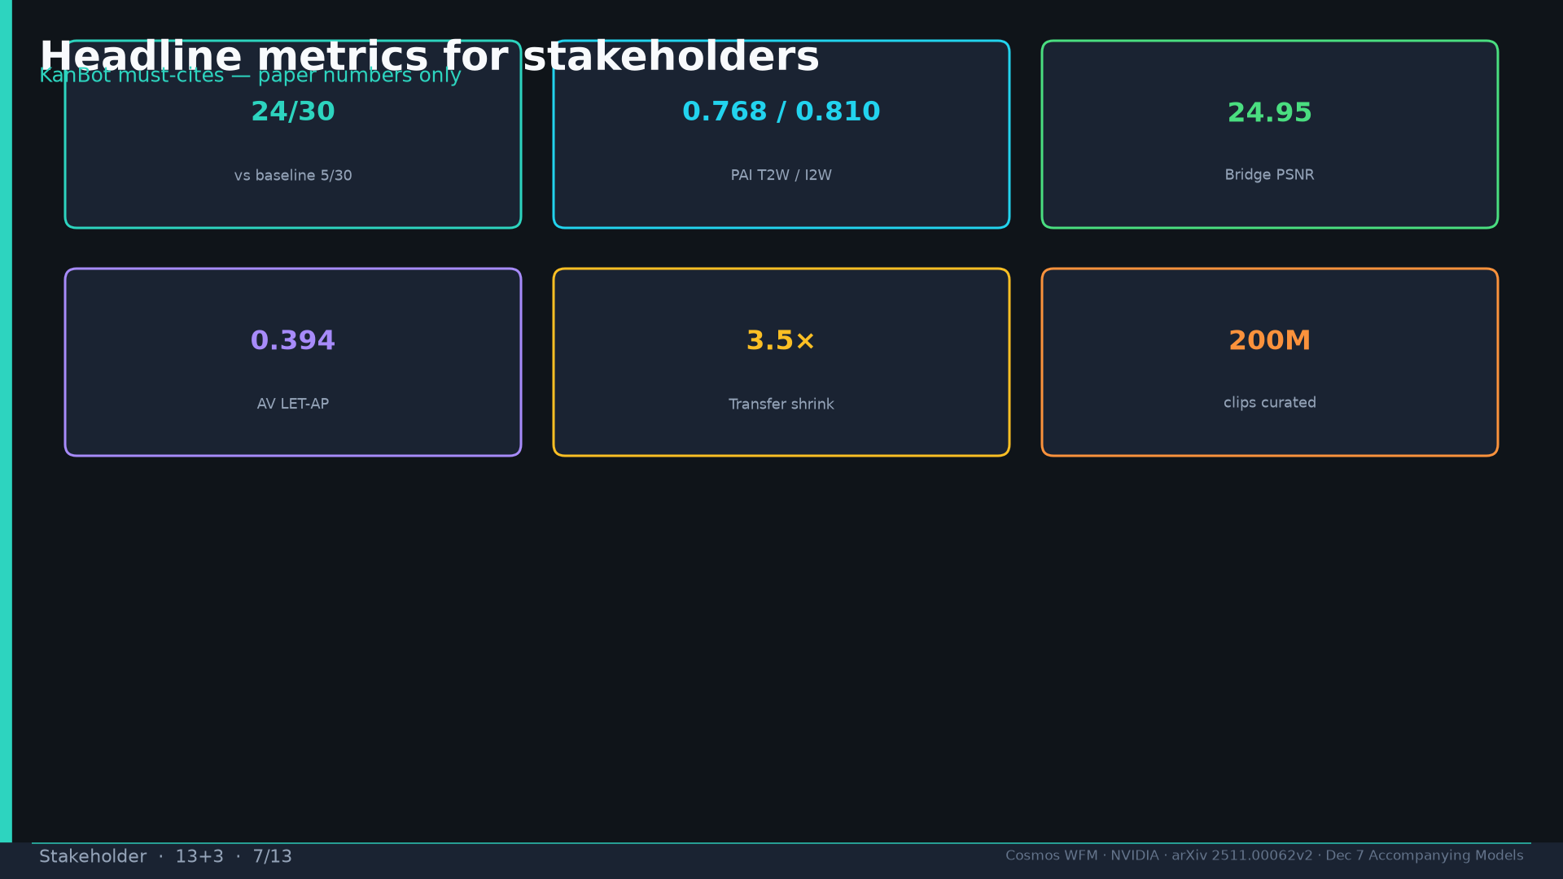
Notes:
Headline metrics chips.

Slide 8
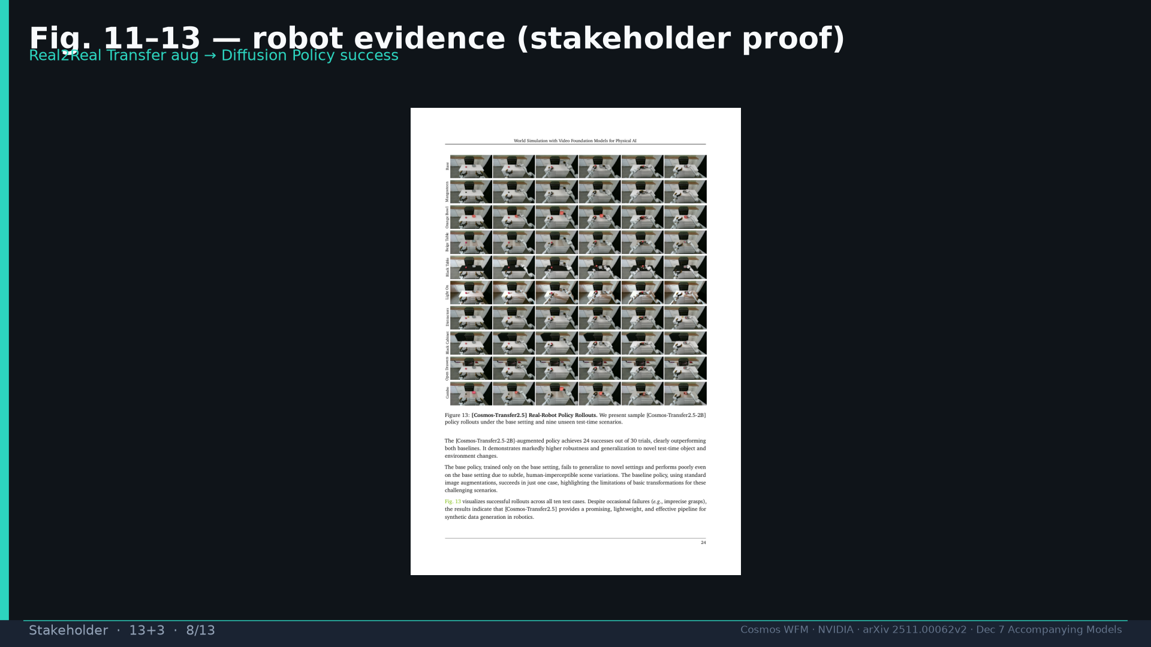
Notes:
Fig.13 robot proof for stakeholders.

Slide 9
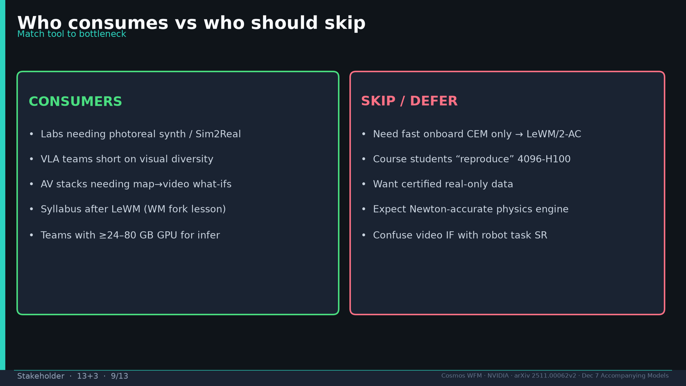
Notes:
Who consumes vs skip.

Slide 10
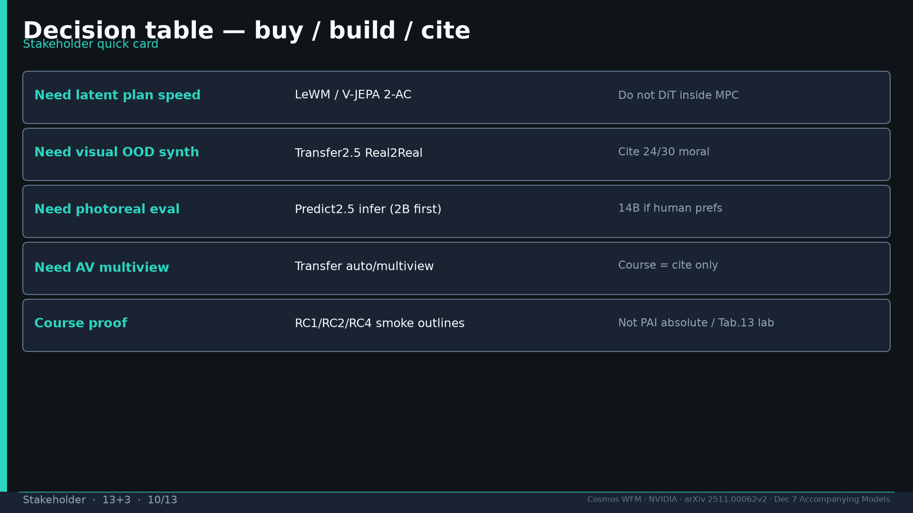
Notes:
Decision table buy/build/cite.

Slide 11
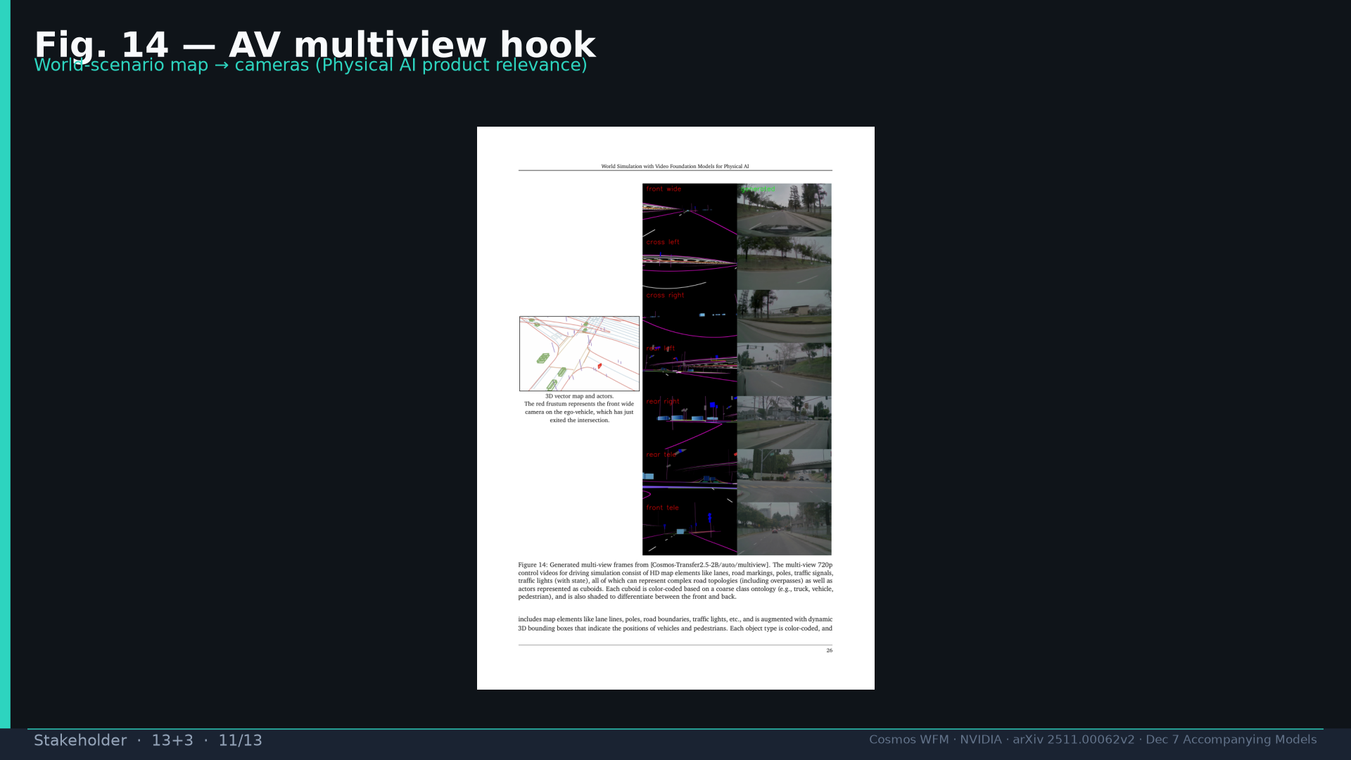
Notes:
Fig.14 AV product relevance.

Slide 12
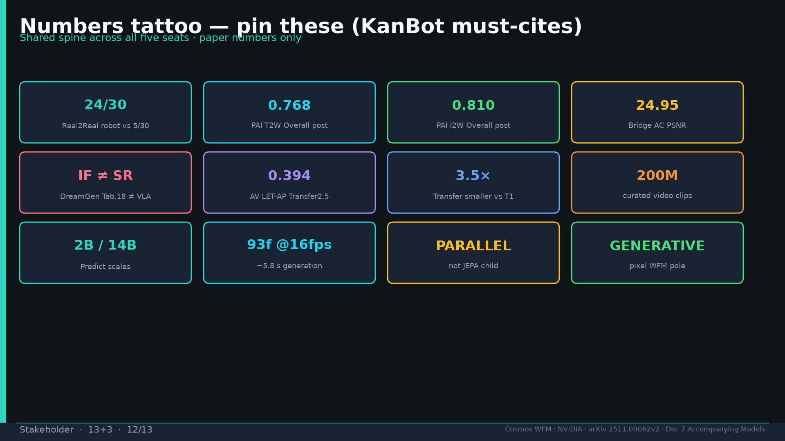
Notes:
Tattoo.

Slide 13
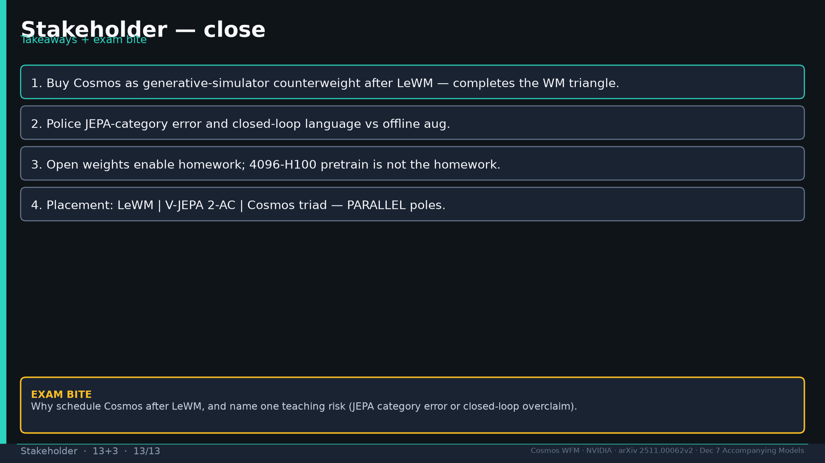
Notes:
Close + exam why after LeWM + one teaching risk.

