Slide 1
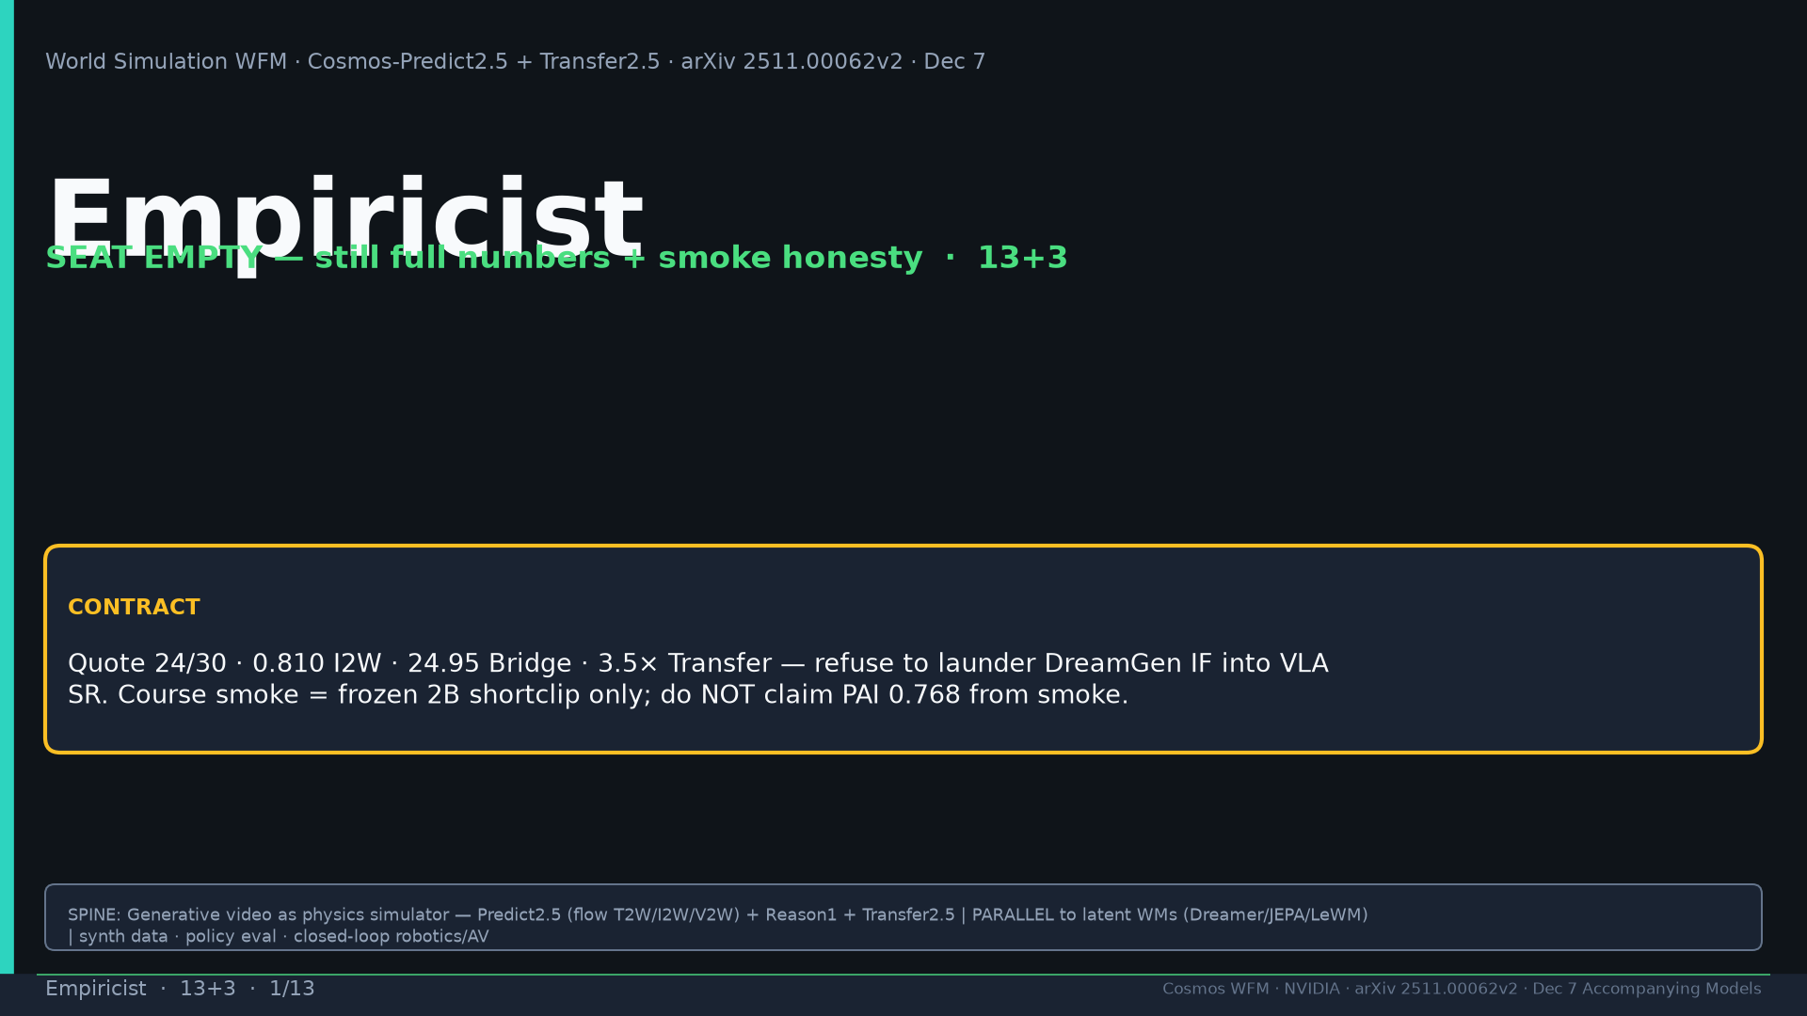
Notes:
Title. Seat EMPTY — still produce numbers/smoke honesty. Refuse DreamGen IF→VLA SR. Tattoo: Real2Real 24/30 vs 5/30 · PAI T2W 0.768 / I2W 0.810 · Bridge PSNR 24.95 · DreamGen IF≠VLA SR · AV LET-AP 0.394 · Transfer 3.5× · 200M · 2B/14B · PARALLEL generative WFM

Slide 2
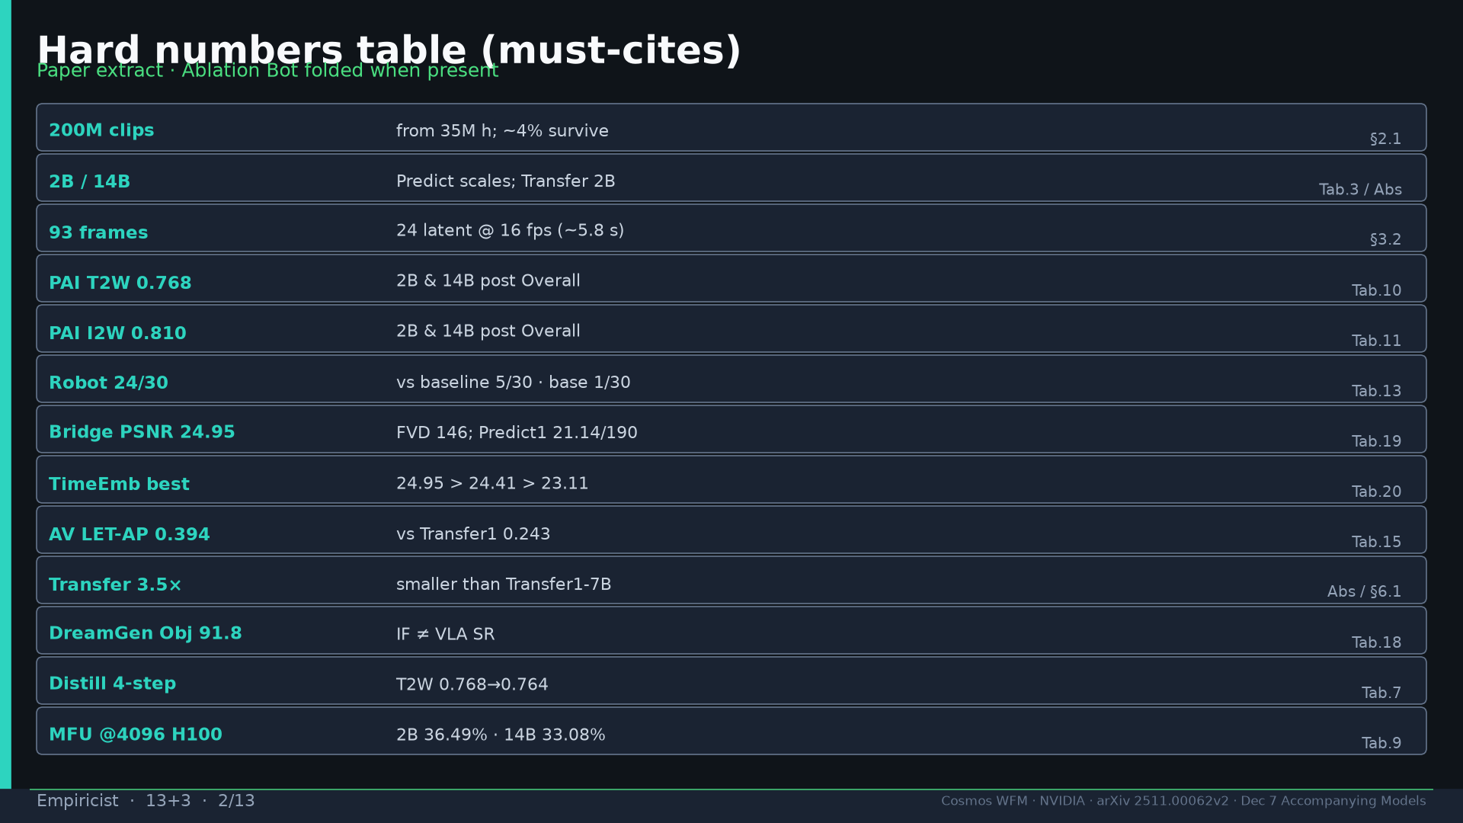
Notes:
Hard numbers table must-cites + 200M, 2B/14B, 93f, distill, MFU.

Slide 3
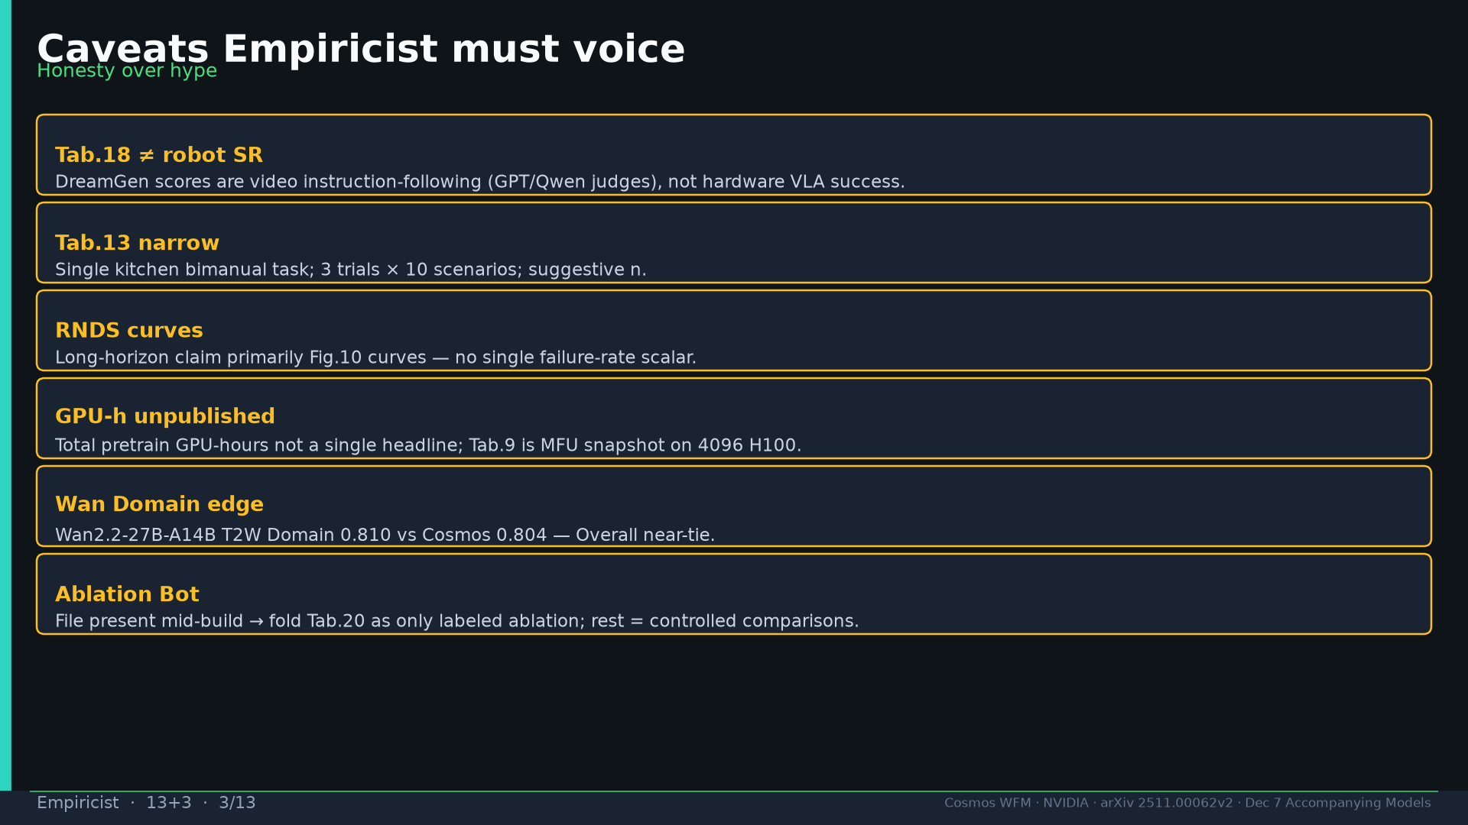
Notes:
Caveats: Tab.18≠SR; Tab.13 narrow; RNDS curves; GPU-h unpublished; Wan Domain; Ablation Bot folded.

Slide 4
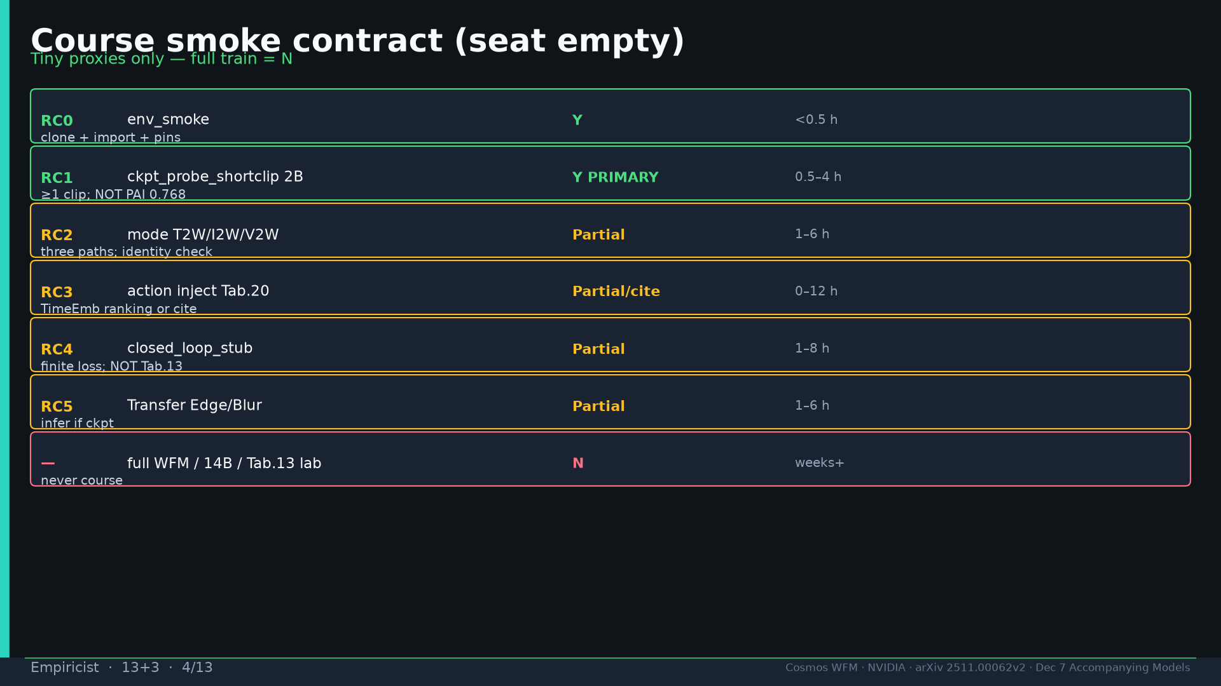
Notes:
Smoke contract RC0–RC5; full train N.

Slide 5
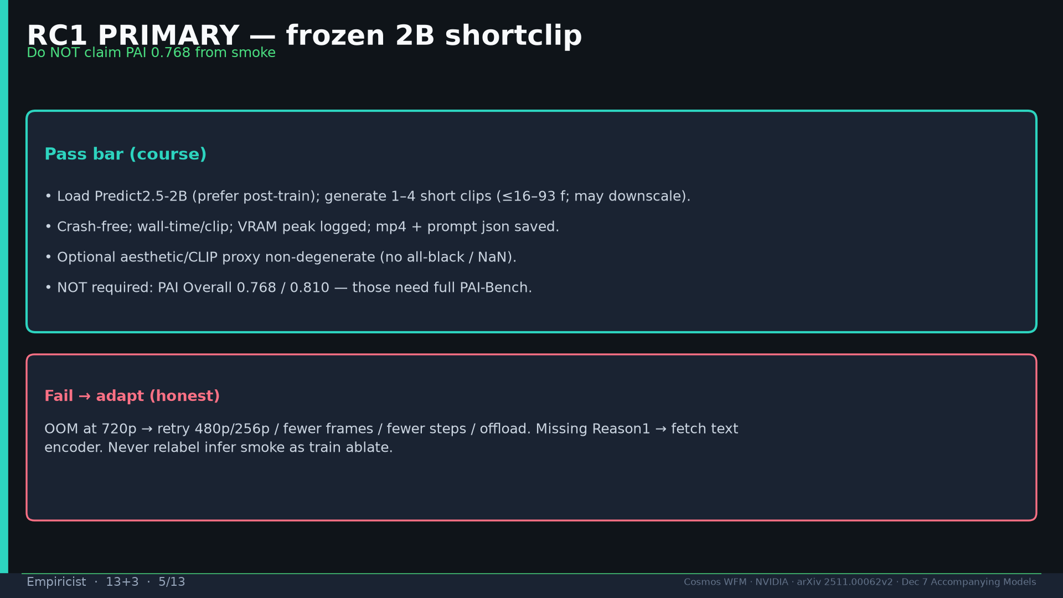
Notes:
RC1 PRIMARY: frozen 2B shortclip — do NOT claim PAI 0.768 from smoke.

Slide 6
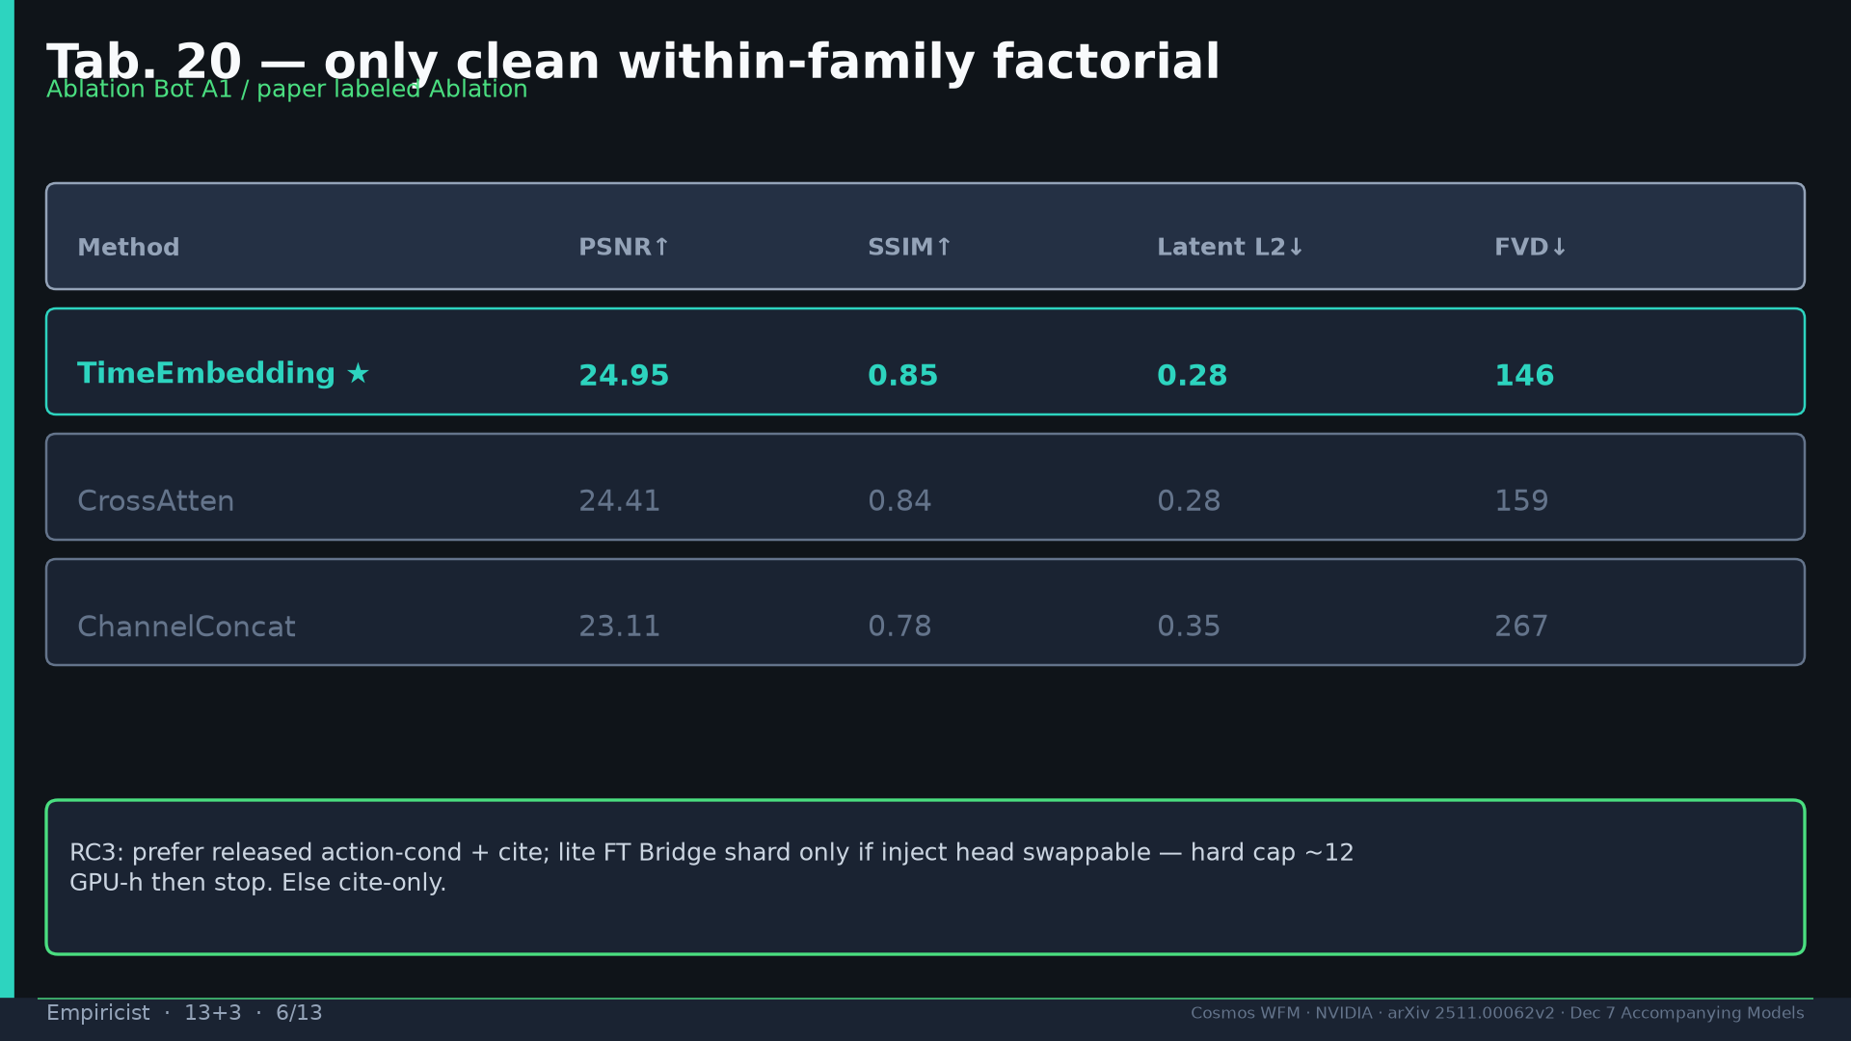
Notes:
Tab.20 TimeEmb > Cross > Concat — only clean factorial.

Slide 7
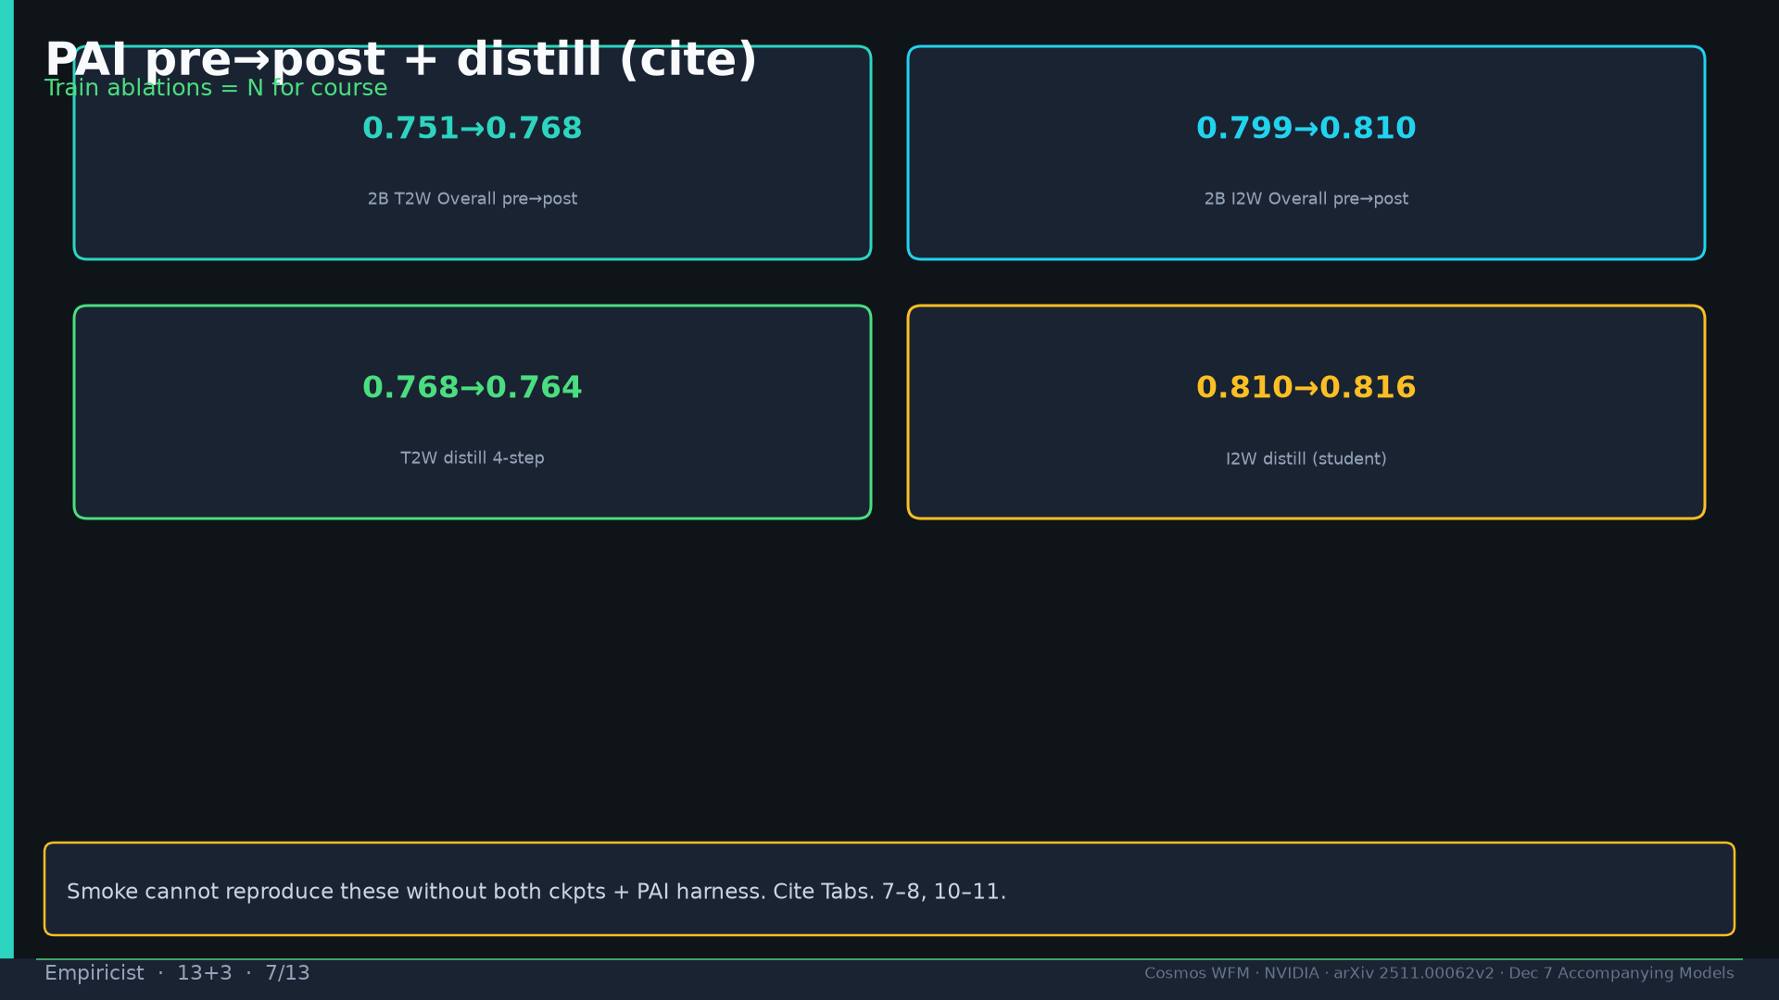
Notes:
PAI pre→post + distill cite-only.

Slide 8
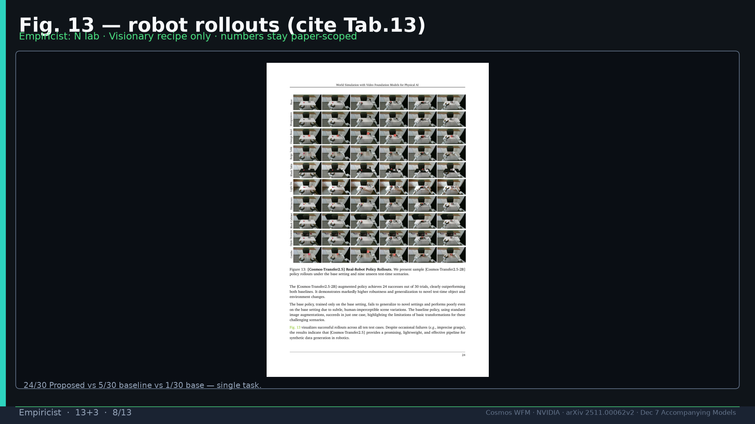
Notes:
Fig.13 cite Tab.13; N lab.

Slide 9
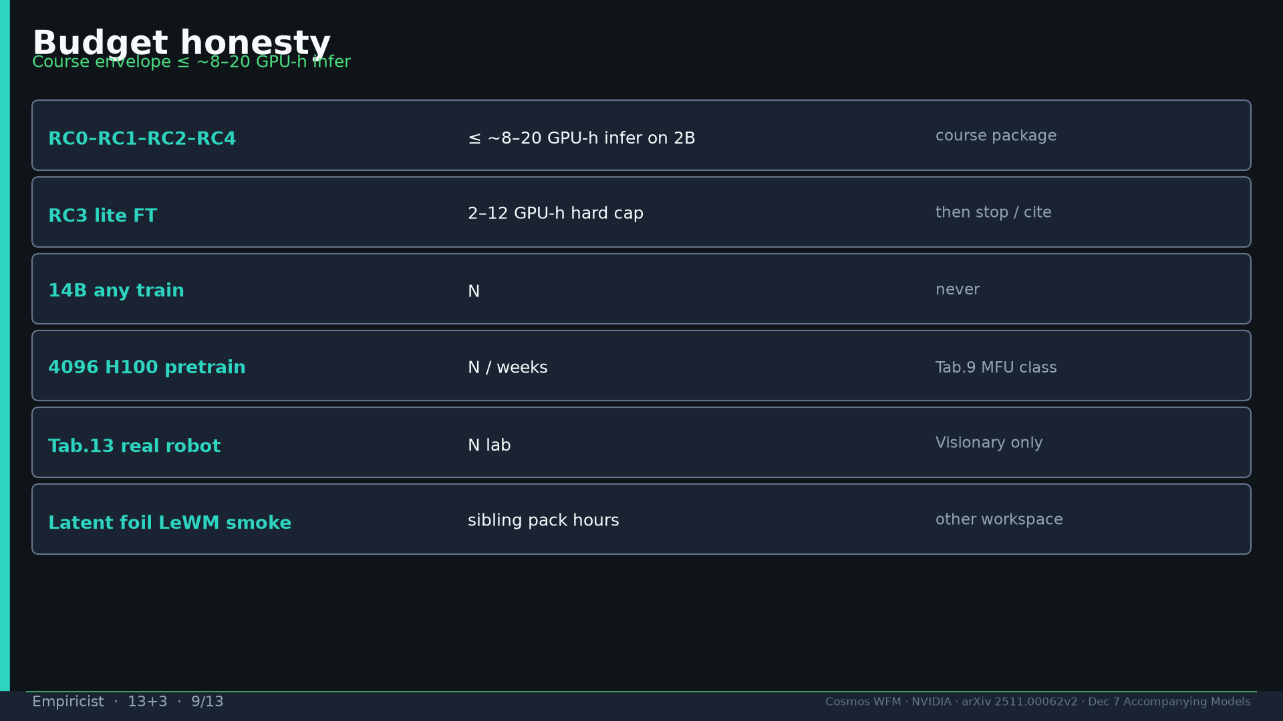
Notes:
Budget honesty course envelope.

Slide 10
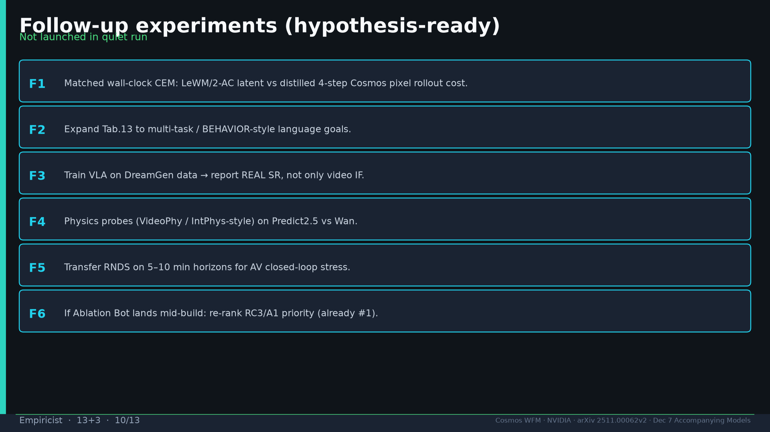
Notes:
Follow-ups F1–F6 hypothesis-ready.

Slide 11
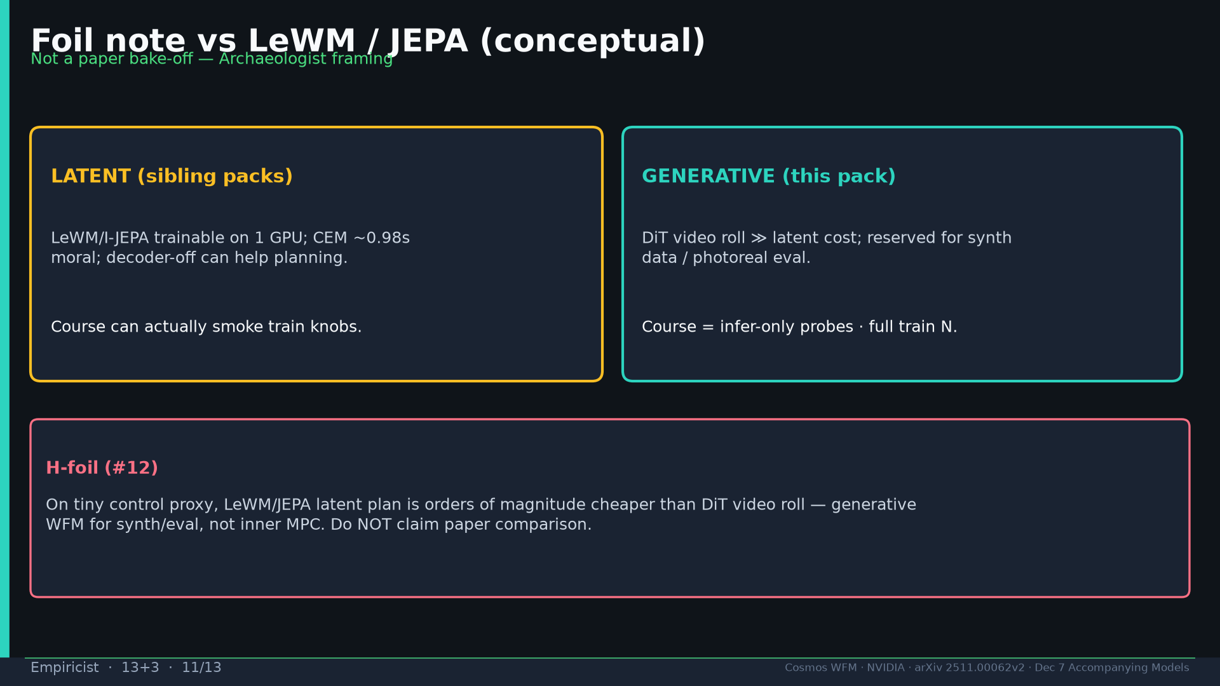
Notes:
Foil vs LeWM conceptual — not paper bake-off.

Slide 12
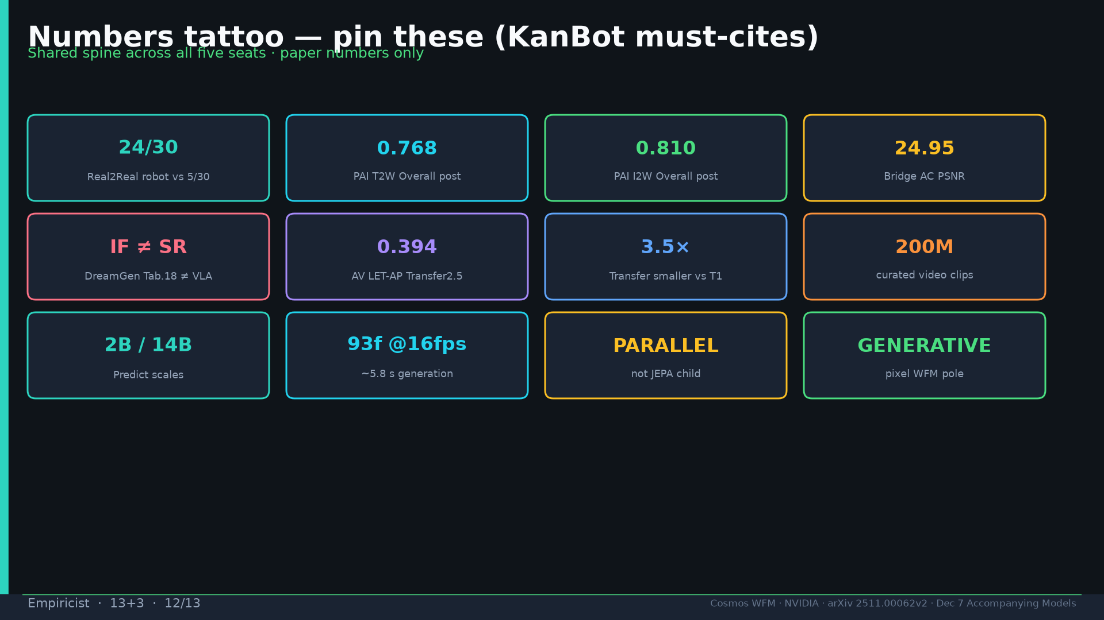
Notes:
Tattoo.

Slide 13
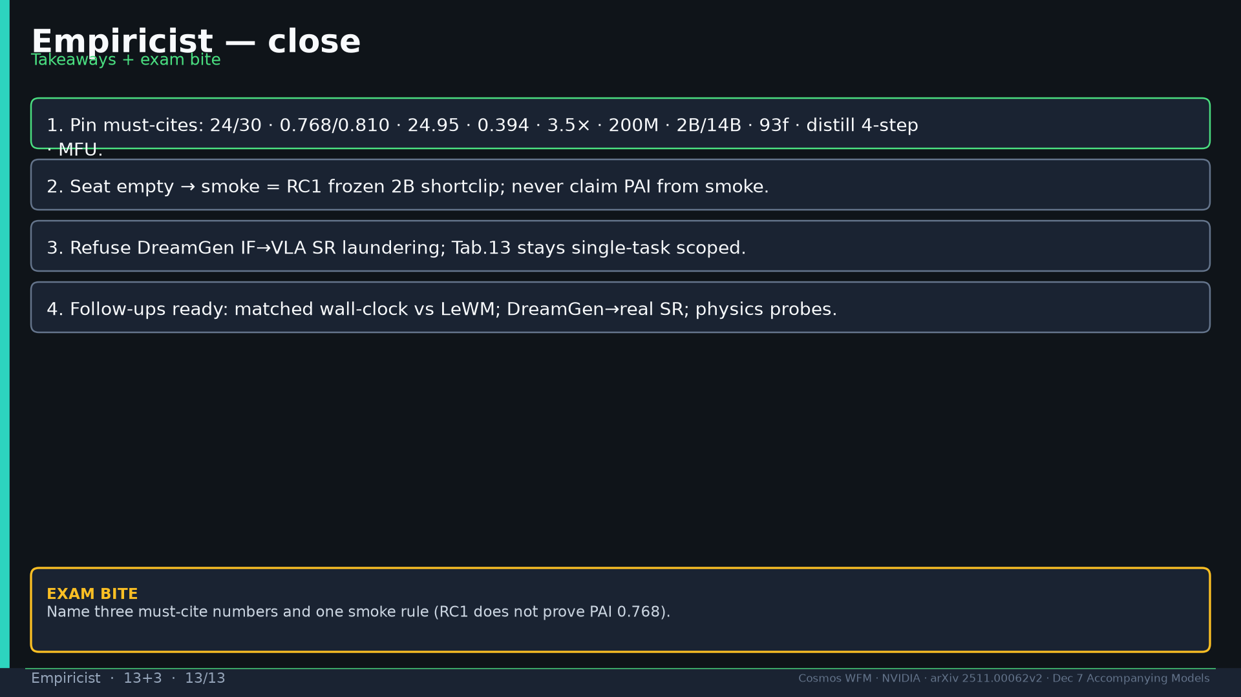
Notes:
Close + exam three numbers + smoke rule.

