Slide 1
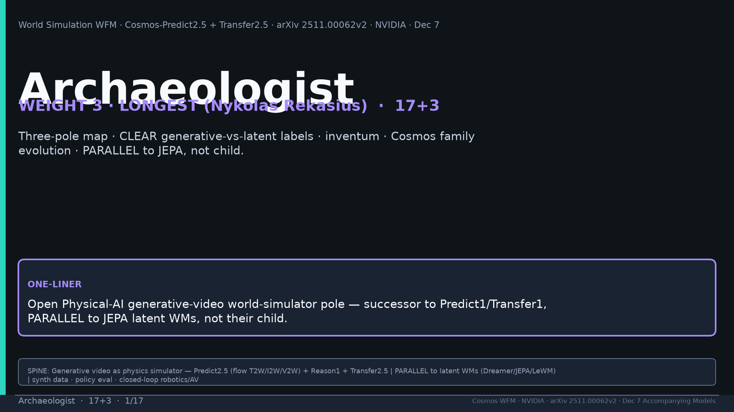
Notes:
Title. WEIGHT 3 Nykolas. One-liner: open Physical-AI generative-video world-simulator — PARALLEL to JEPA, not child. Tattoo: Real2Real 24/30 vs 5/30 · PAI T2W 0.768 / I2W 0.810 · Bridge PSNR 24.95 · DreamGen IF≠VLA SR · AV LET-AP 0.394 · Transfer 3.5× · 200M · 2B/14B · PARALLEL generative WFM

Slide 2
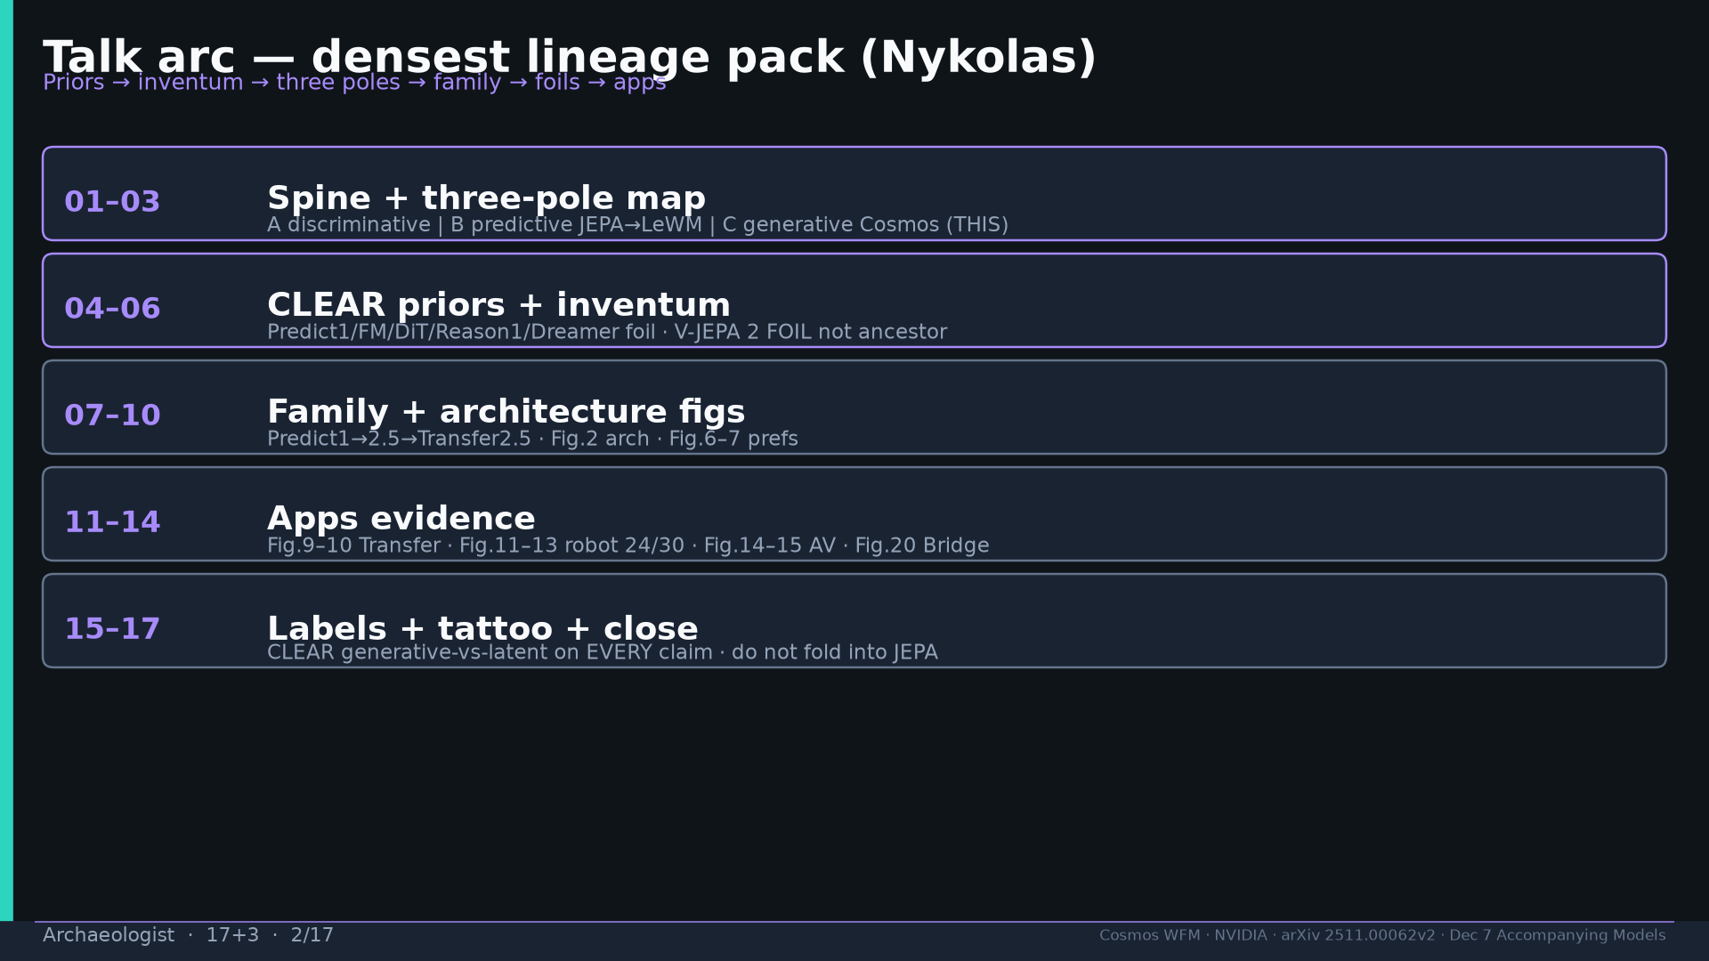
Notes:
Talk arc: three-pole → priors → inventum → family → apps → CLEAR/TENTATIVE.

Slide 3
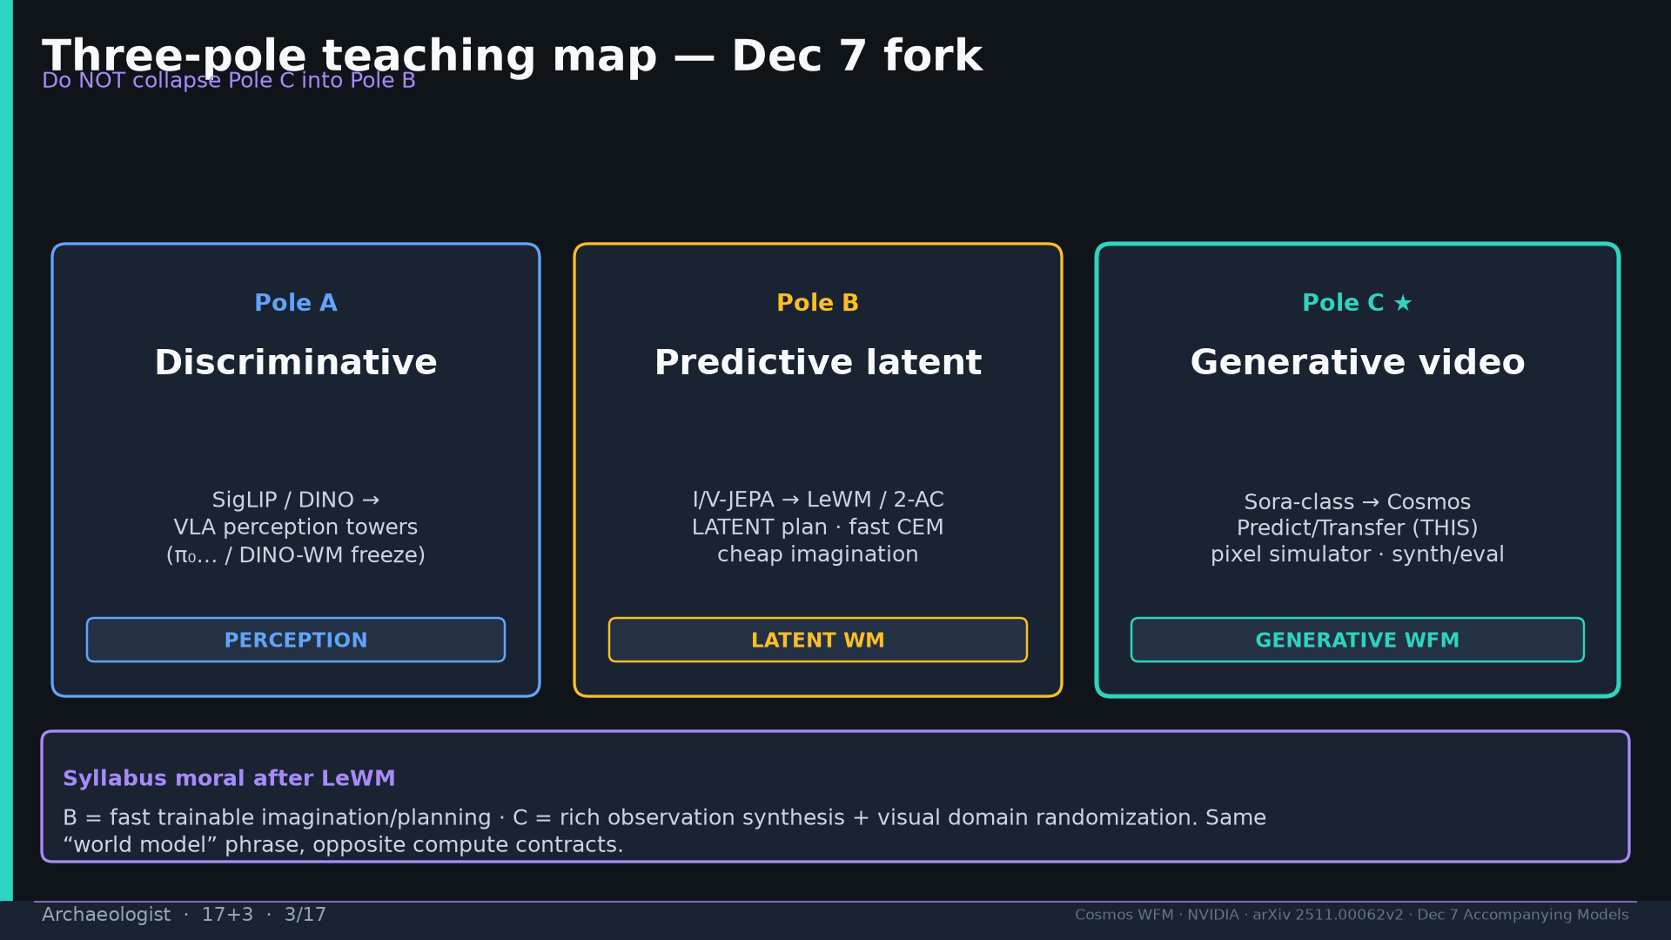
Notes:
Three poles: A discriminative SigLIP/DINO | B predictive I/V-JEPA→LeWM/2-AC LATENT | C generative Cosmos THIS. Do not collapse C into B.

Slide 4
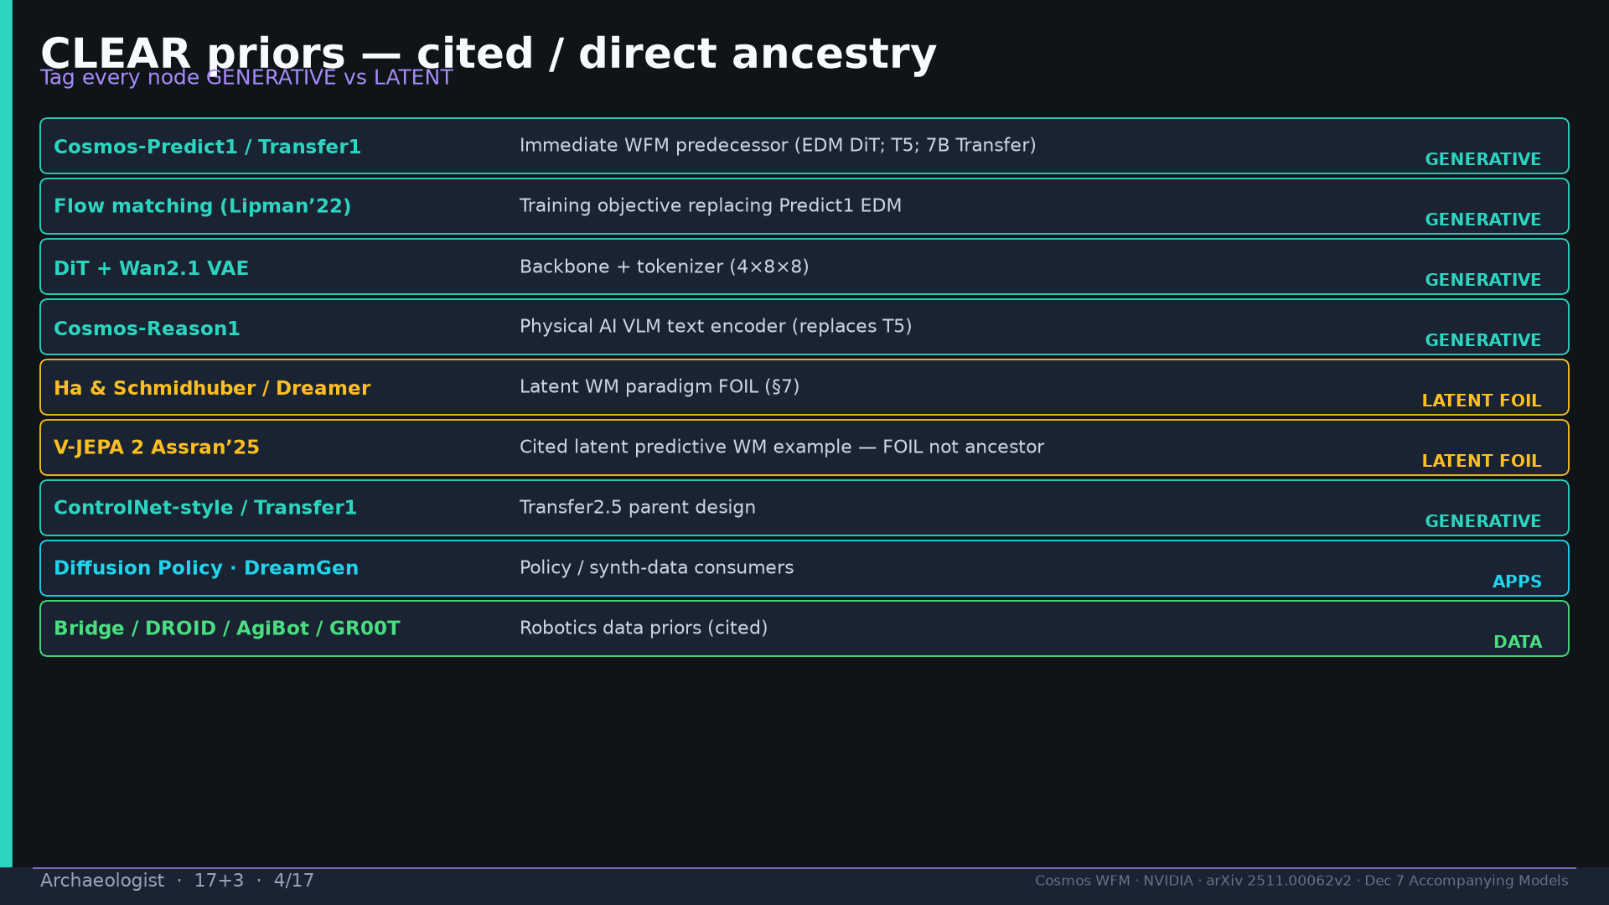
Notes:
CLEAR priors tagged GENERATIVE vs LATENT FOIL. V-JEPA 2 = foil not ancestor. Predict1/FM/DiT/Reason1/ControlNet/DP/Bridge/DROID/AgiBot/GR00T.

Slide 5
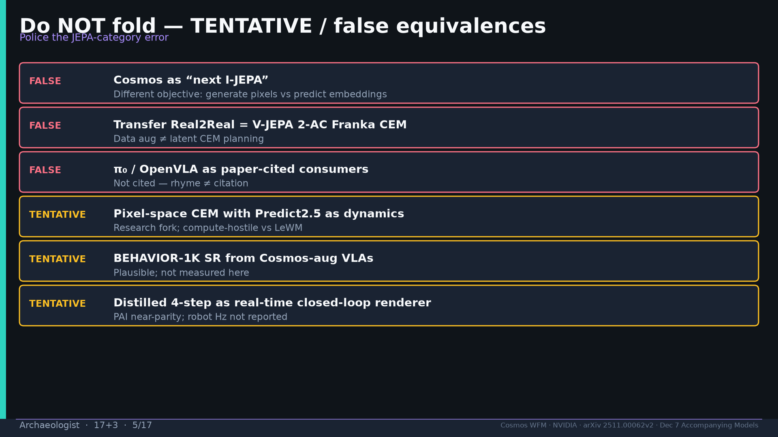
Notes:
Do NOT fold: Cosmos≠next I-JEPA; Transfer≠2-AC CEM; π₀ not cited; pixel CEM TENTATIVE.

Slide 6
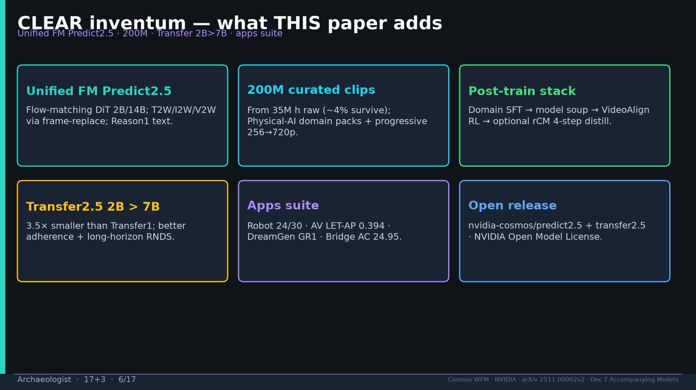
Notes:
Inventum: unified FM Predict2.5; 200M; Transfer 2B>7B; apps 24/30+AV+DreamGen+Bridge; open release.

Slide 7
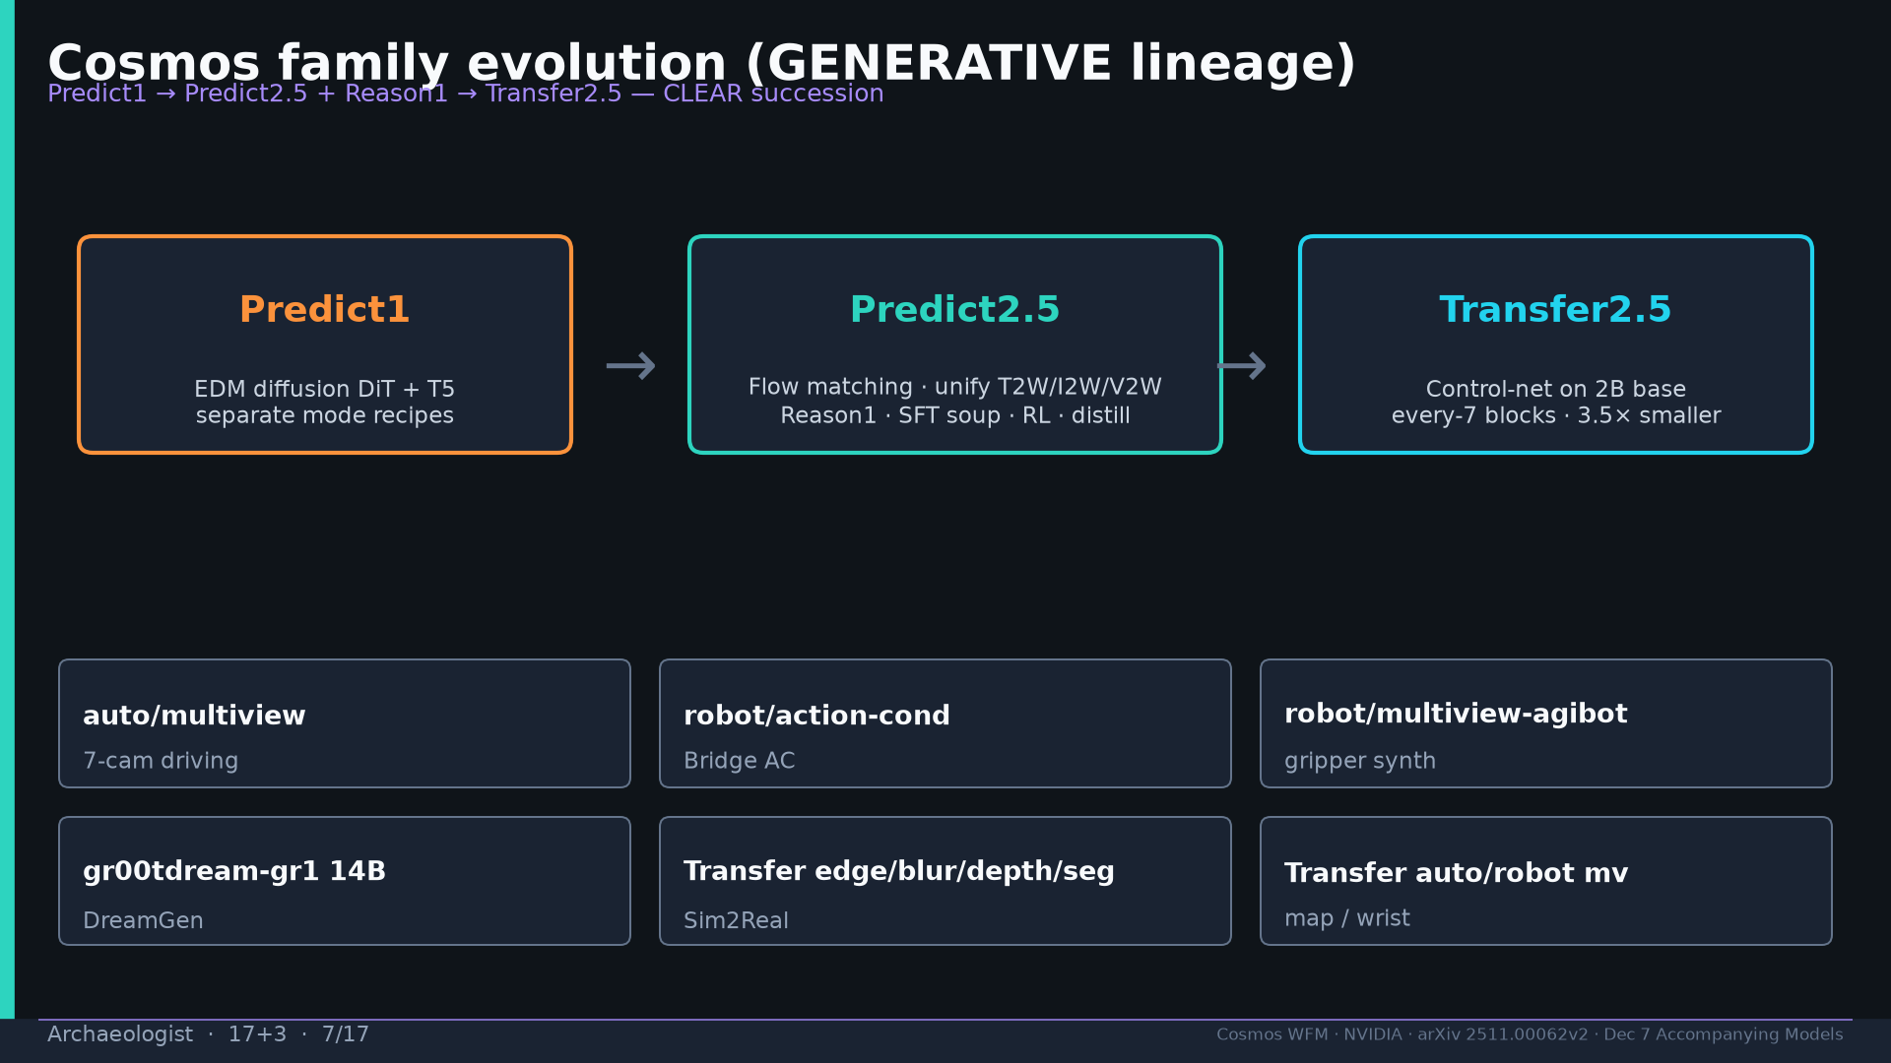
Notes:
Family evolution GENERATIVE lineage Predict1→Predict2.5+Reason1→Transfer2.5 + specialty ckpts.

Slide 8
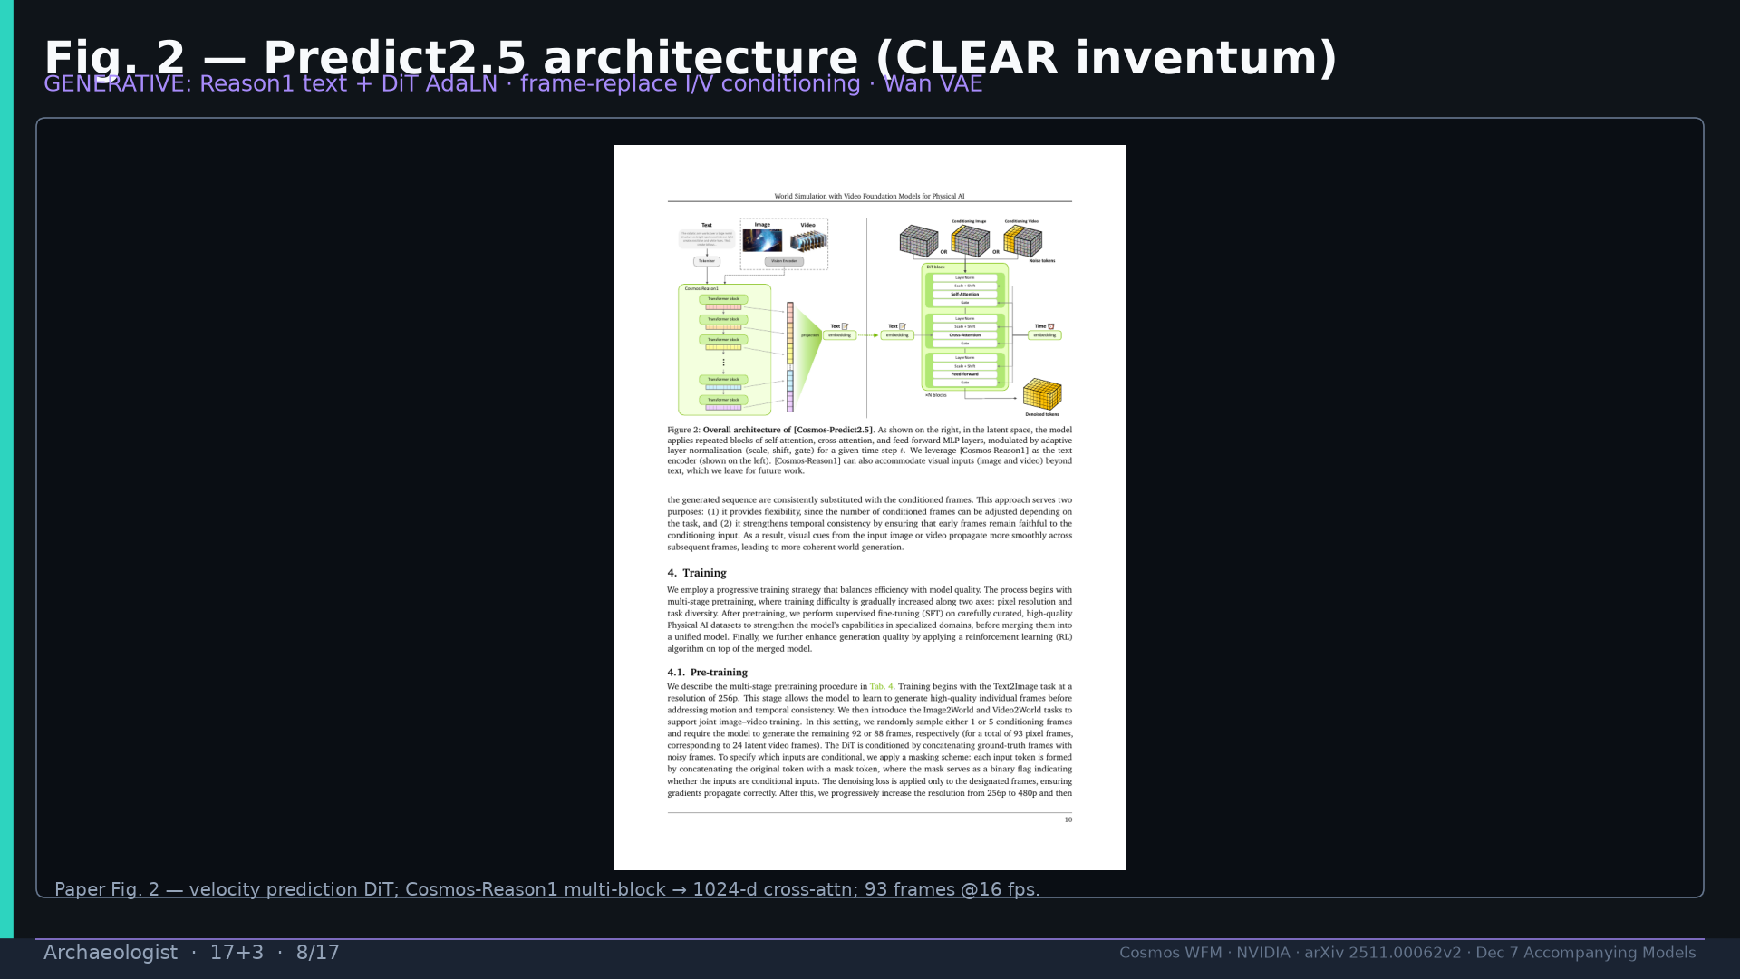
Notes:
Fig.2 architecture — Reason1 + DiT flow + frame-replace modes. GENERATIVE label.

Slide 9
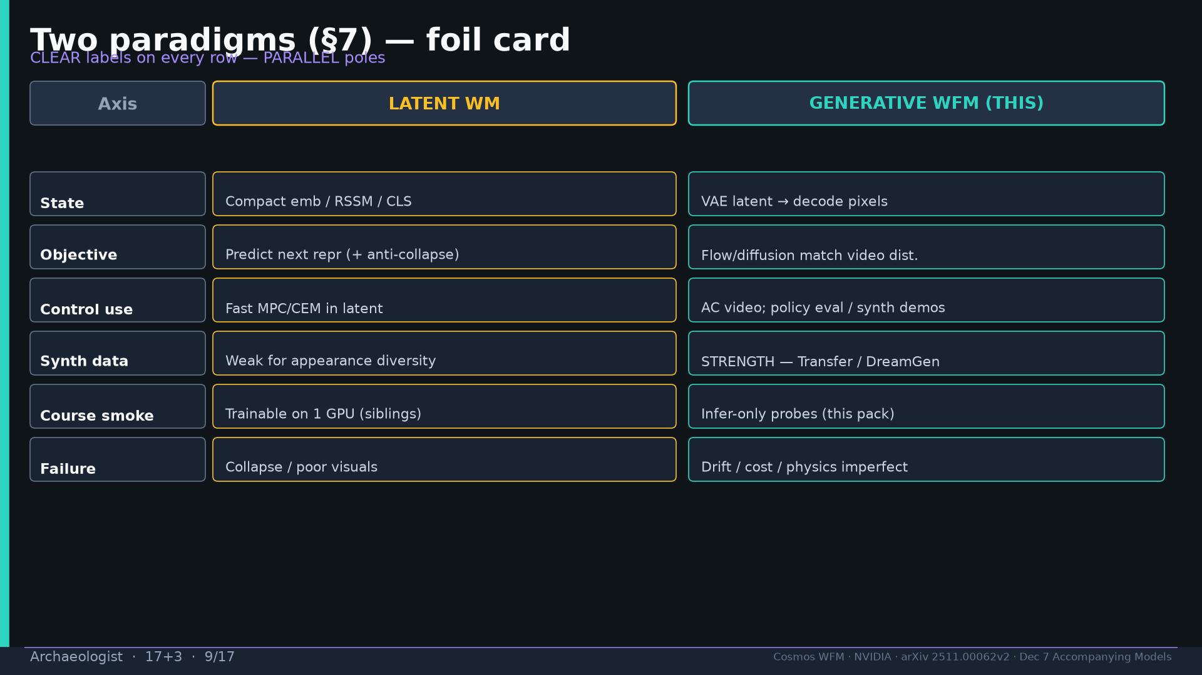
Notes:
§7 paradigms table: LATENT vs GENERATIVE on every axis. Same phrase, opposite compute contracts.

Slide 10
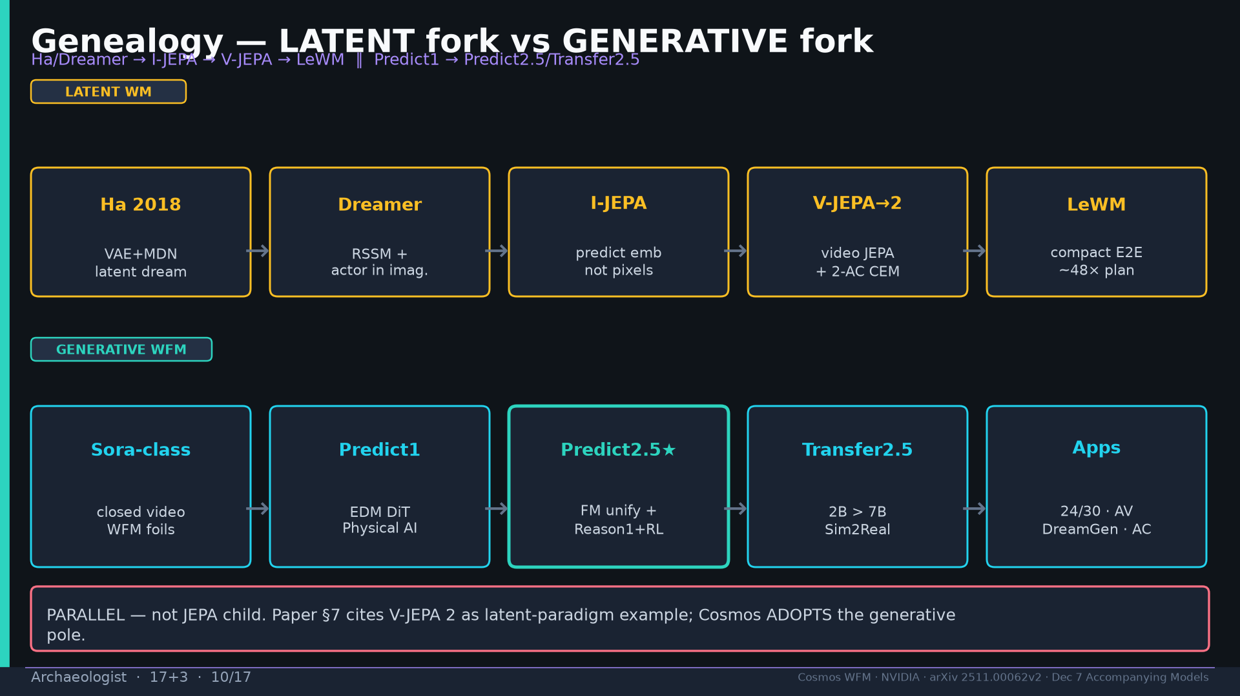
Notes:
Genealogy fork: Ha→Dreamer→I-JEPA→V-JEPA→LeWM LATENT ∥ Sora→Predict1→Predict2.5→Transfer2.5 GENERATIVE. PARALLEL.

Slide 11
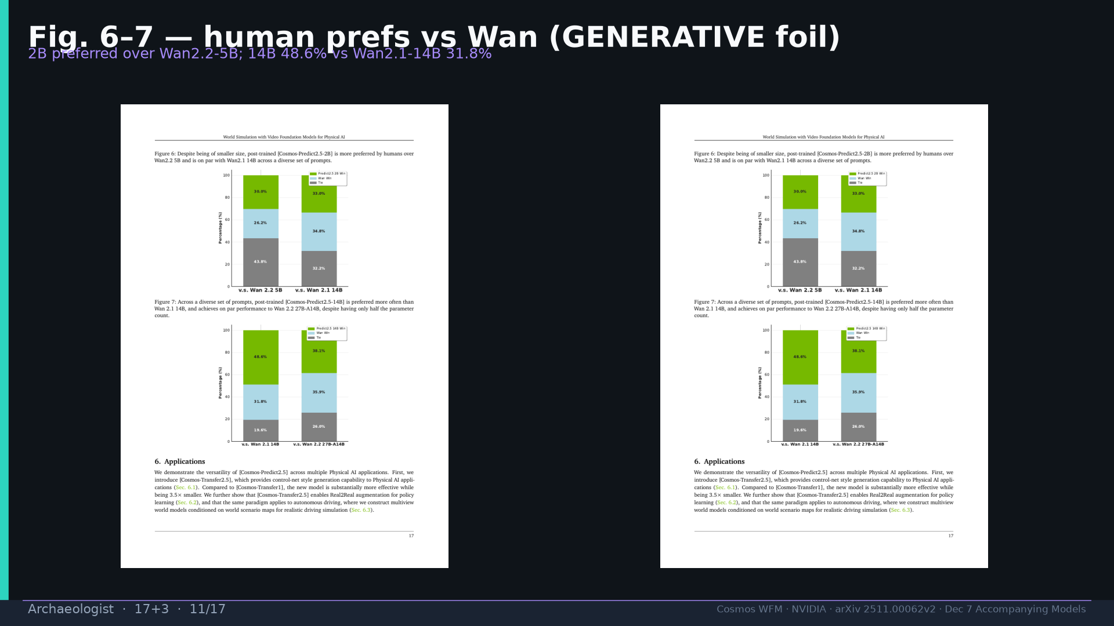
Notes:
Fig.6–7 human prefs vs Wan. 14B 48.6% vs Wan2.1-14B 31.8%.

Slide 12
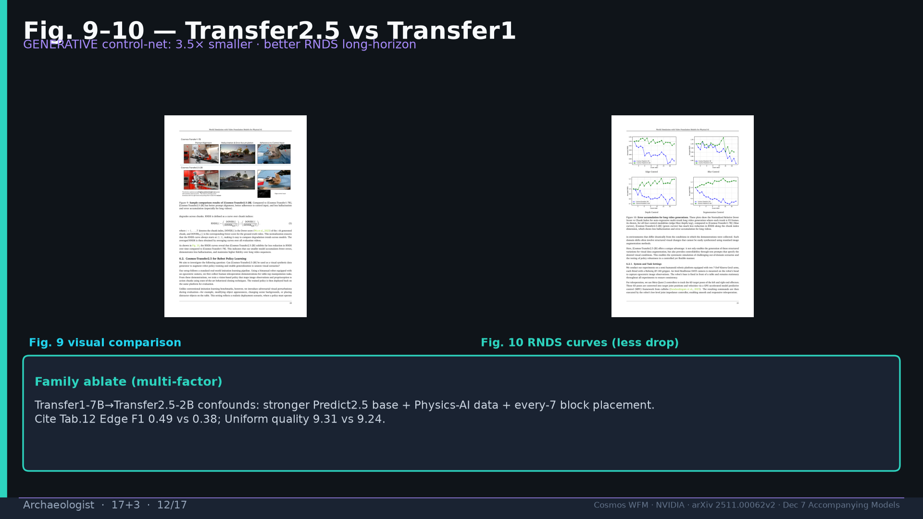
Notes:
Fig.9–10 Transfer: 3.5× smaller; RNDS less drop. Multi-factor family leap.

Slide 13
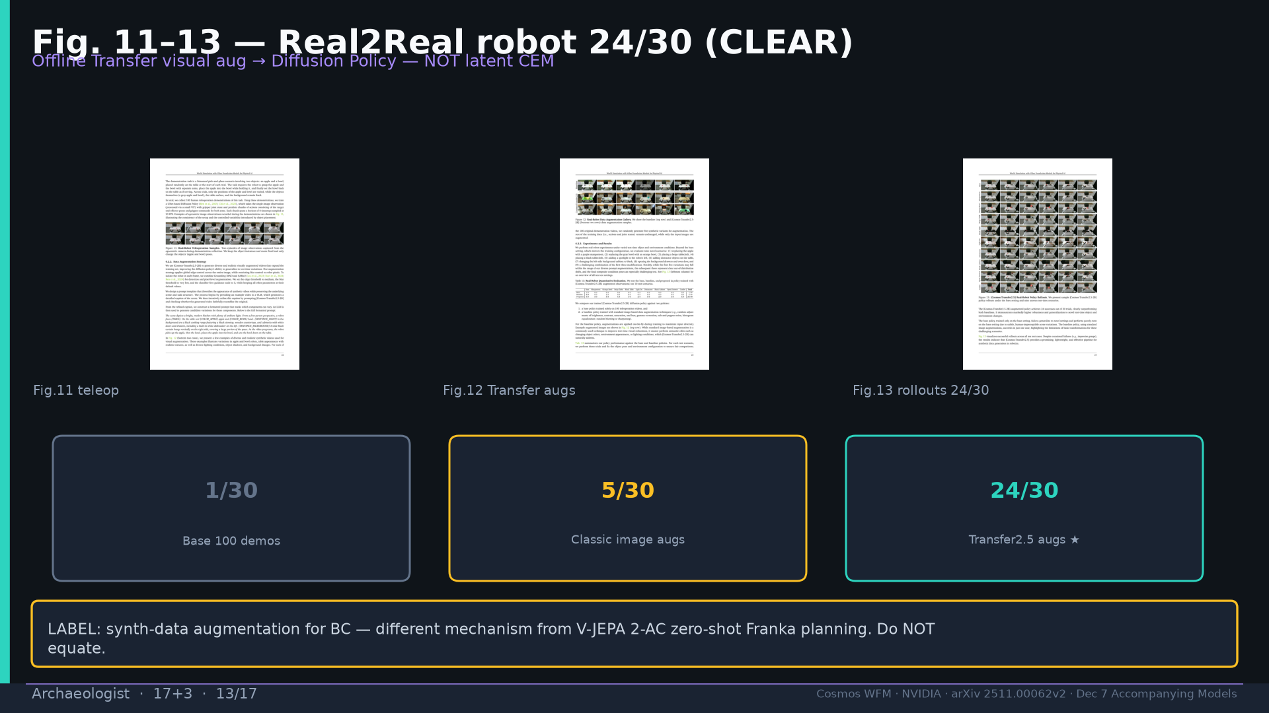
Notes:
Fig.11–13 robot 24/30. LABEL: offline synth-data aug ≠ latent CEM.

Slide 14
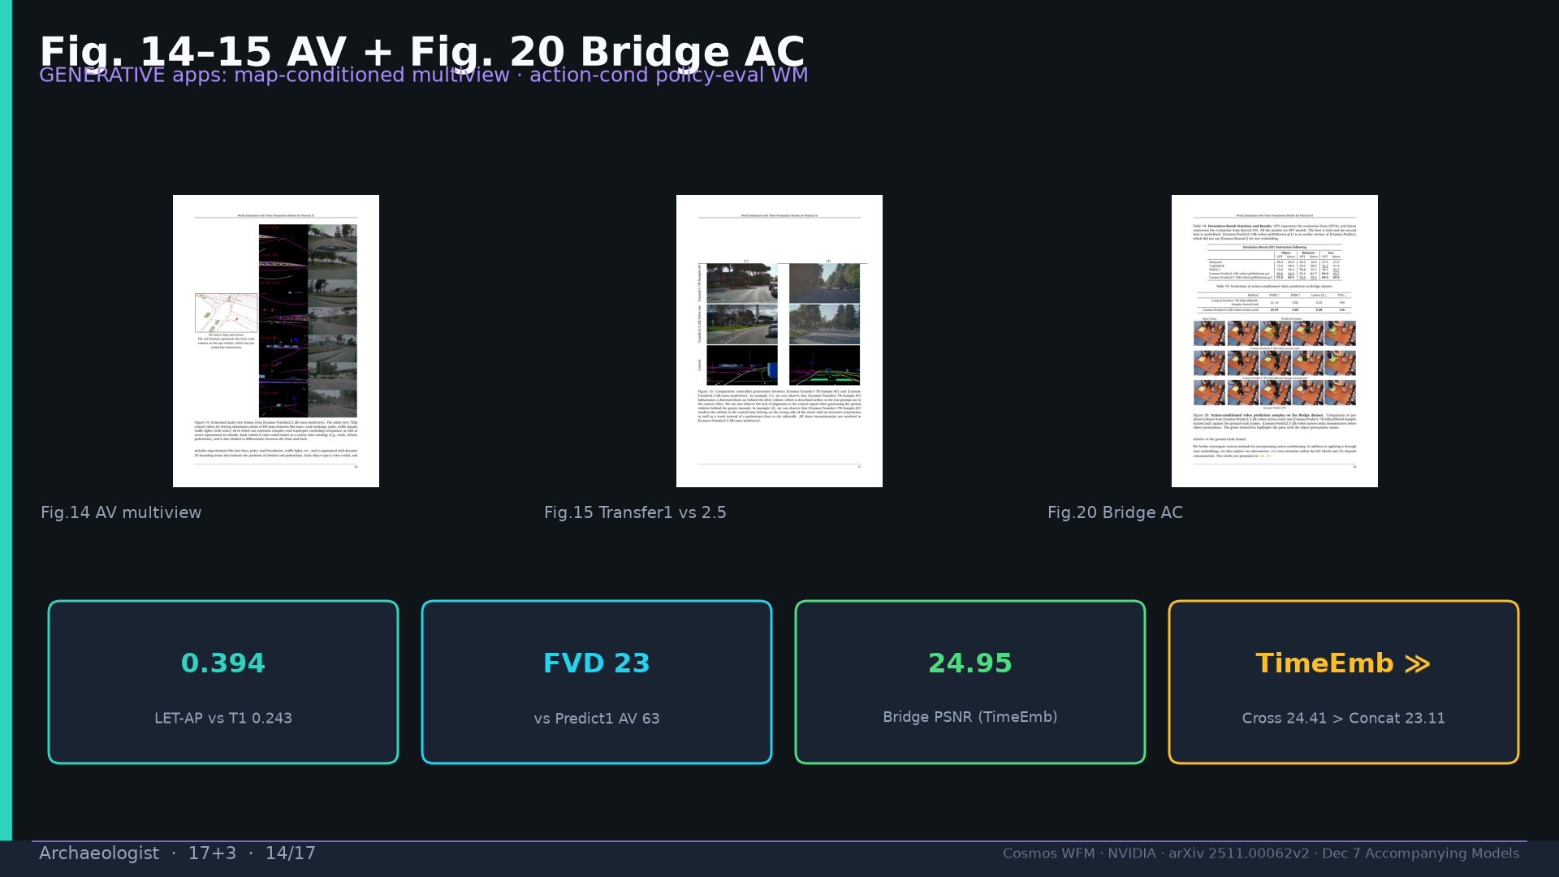
Notes:
Fig.14–15 AV LET-AP 0.394; Fig.20 Bridge PSNR 24.95 TimeEmb best.

Slide 15
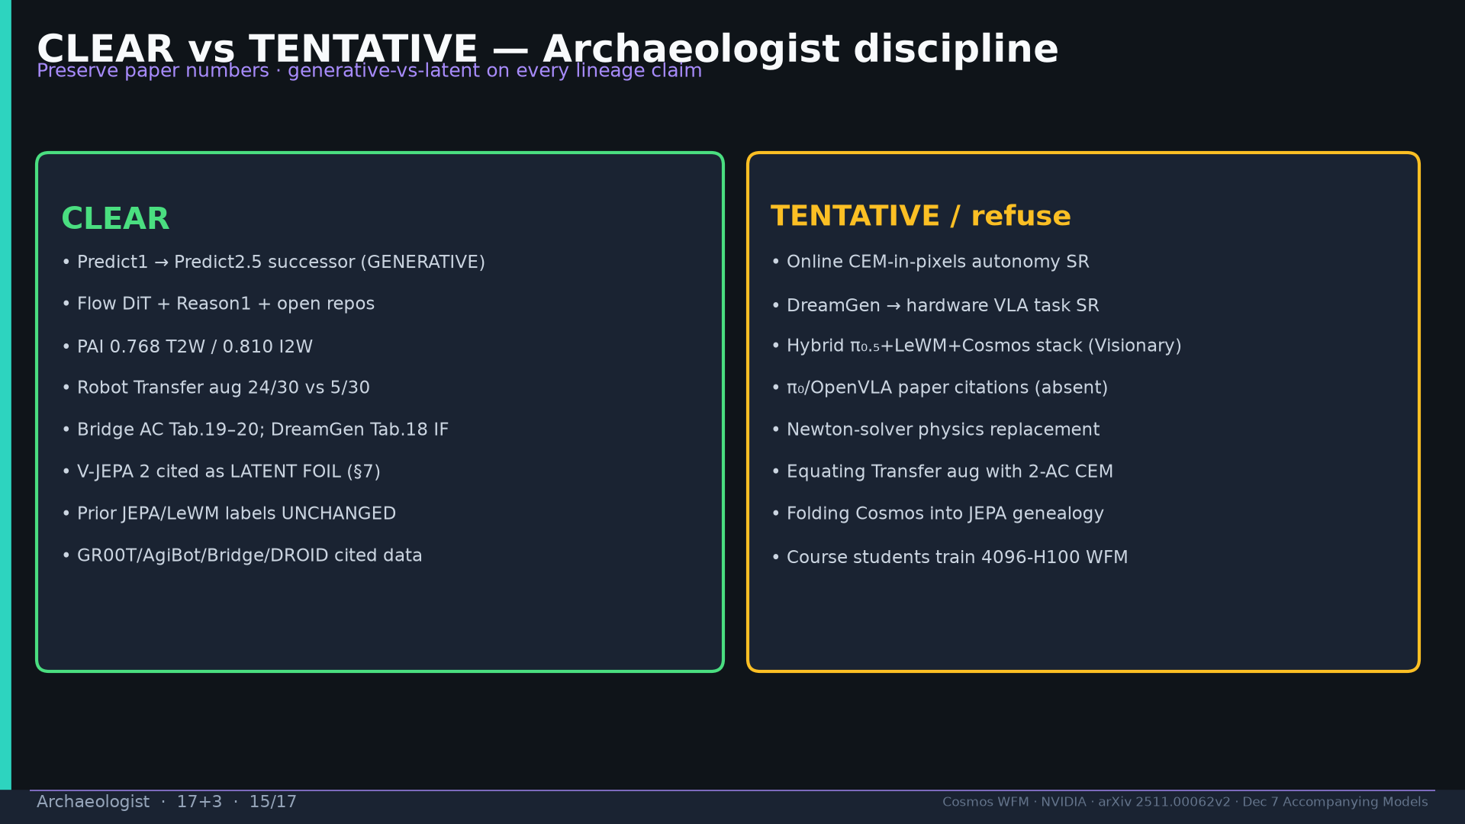
Notes:
CLEAR vs TENTATIVE board. Preserve JEPA pack labels unchanged.

Slide 16
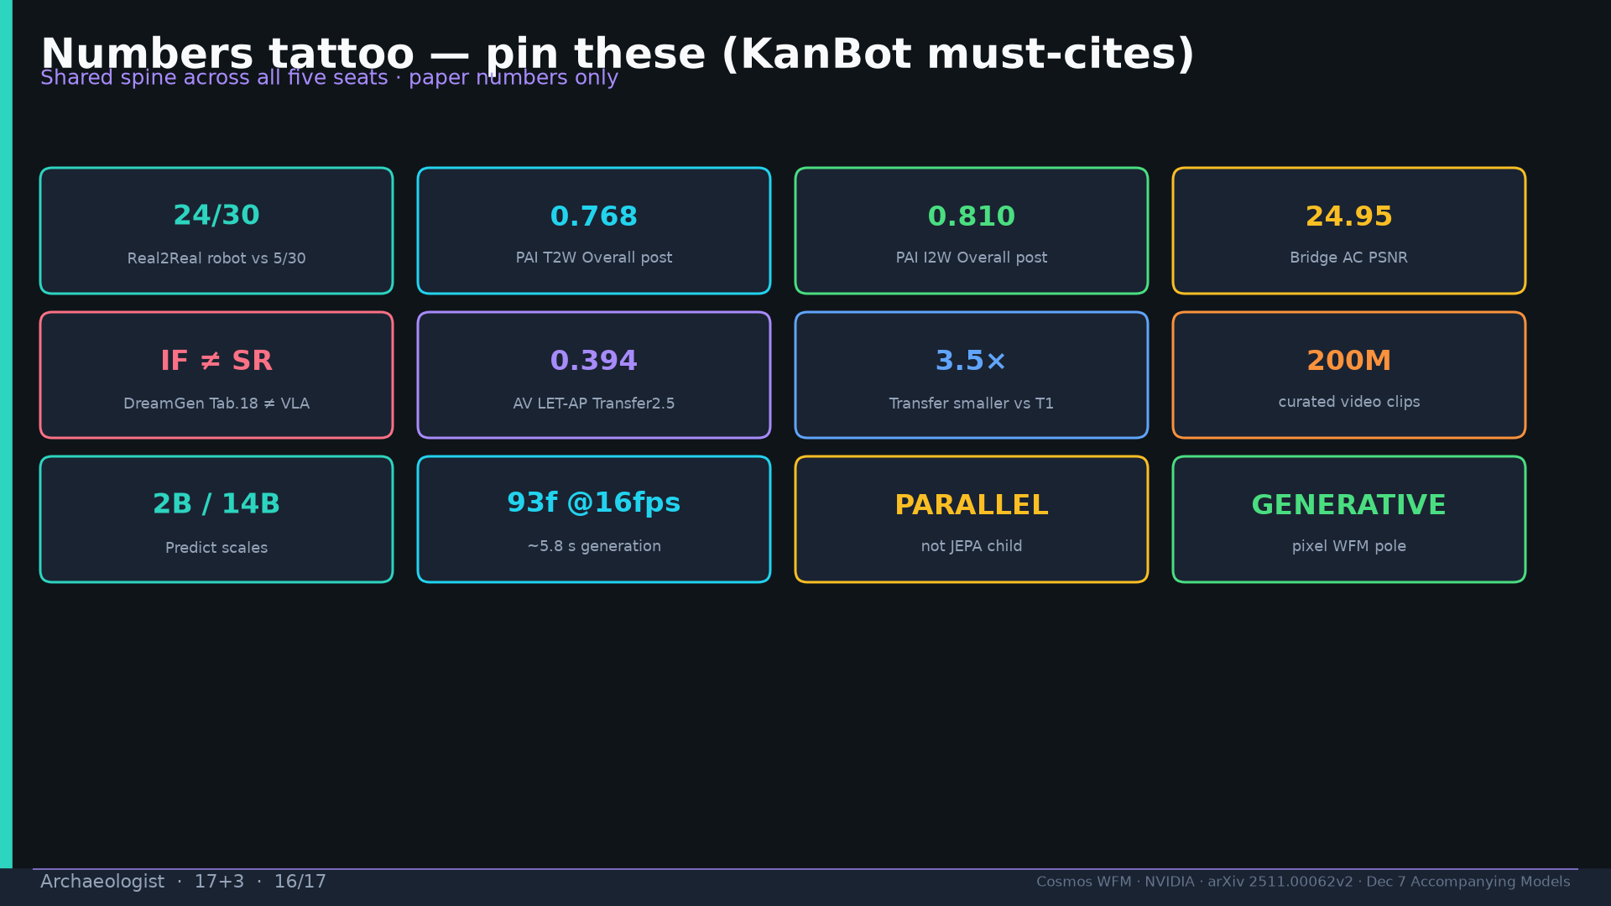
Notes:
Tattoo must-cites.

Slide 17
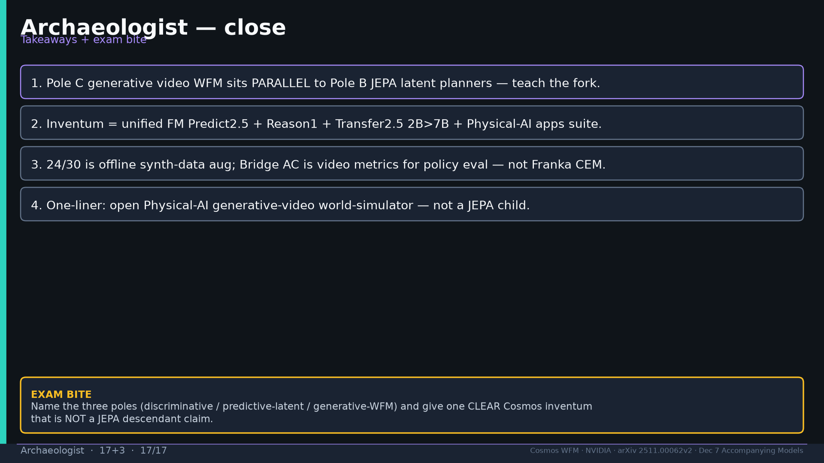
Notes:
Close + exam: three poles + one CLEAR inventum not JEPA descendant.

