Slide 1
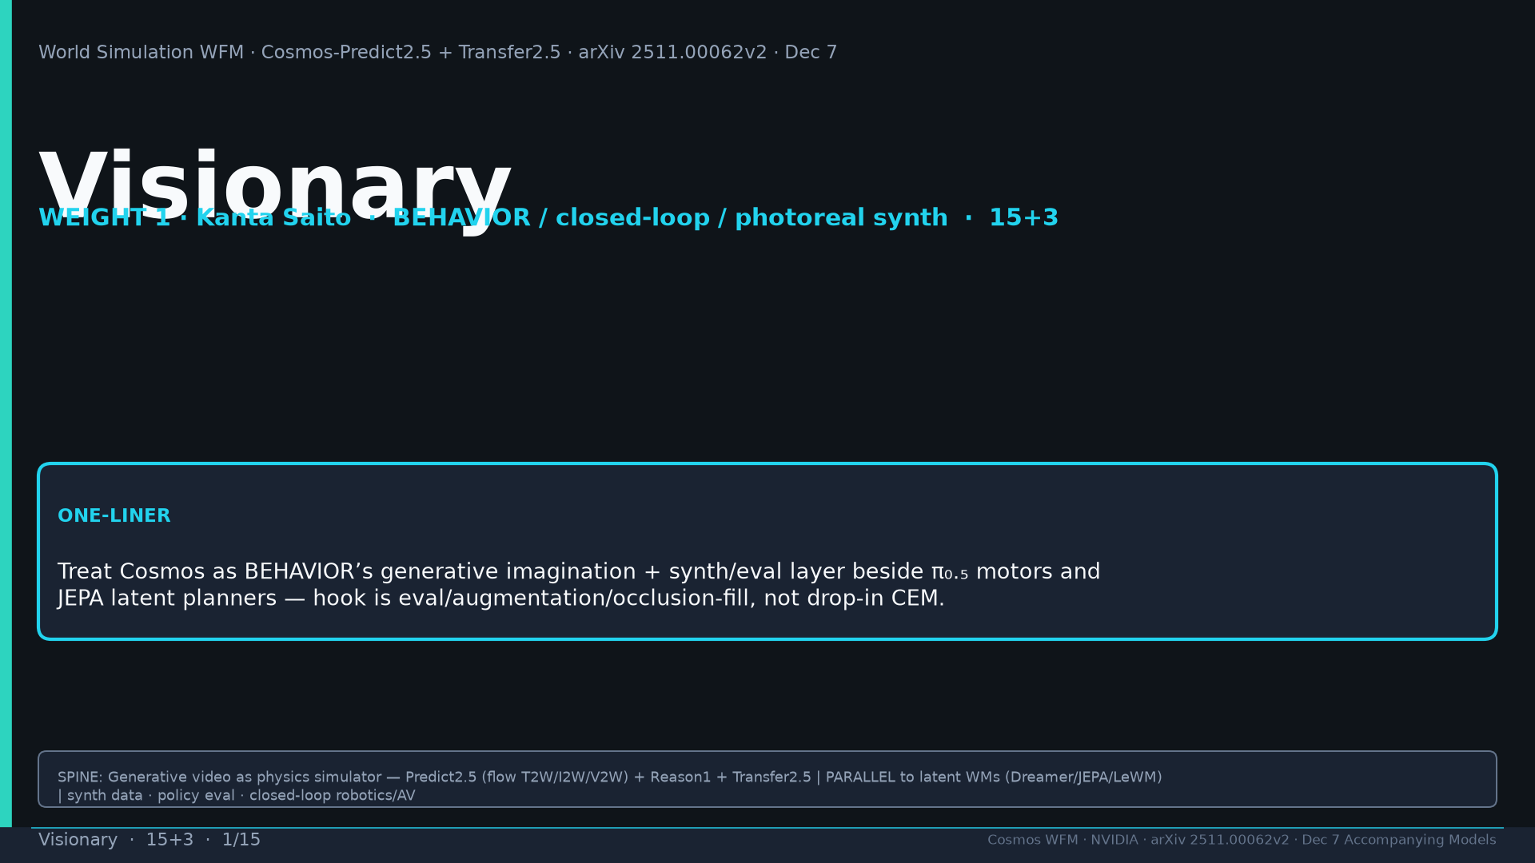
Notes:
Title. WEIGHT 1 Kanta. Cosmos = generative imagination + synth/eval beside π₀.₅ and JEPA planners. NO Discord/Drive. Tattoo: Real2Real 24/30 vs 5/30 · PAI T2W 0.768 / I2W 0.810 · Bridge PSNR 24.95 · DreamGen IF≠VLA SR · AV LET-AP 0.394 · Transfer 3.5× · 200M · 2B/14B · PARALLEL generative WFM

Slide 2
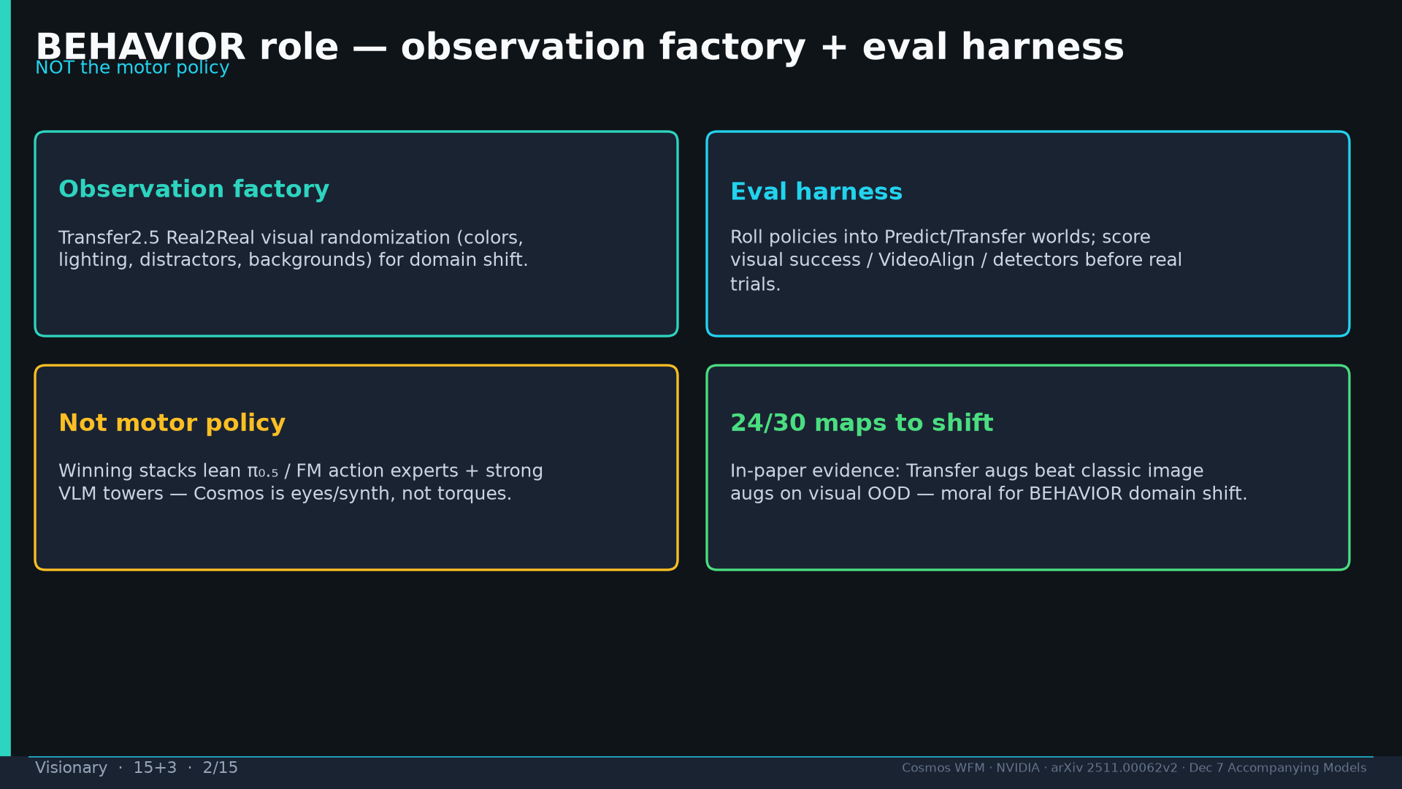
Notes:
BEHAVIOR: observation factory + eval harness — NOT motor policy. 24/30 maps to visual domain shift.

Slide 3
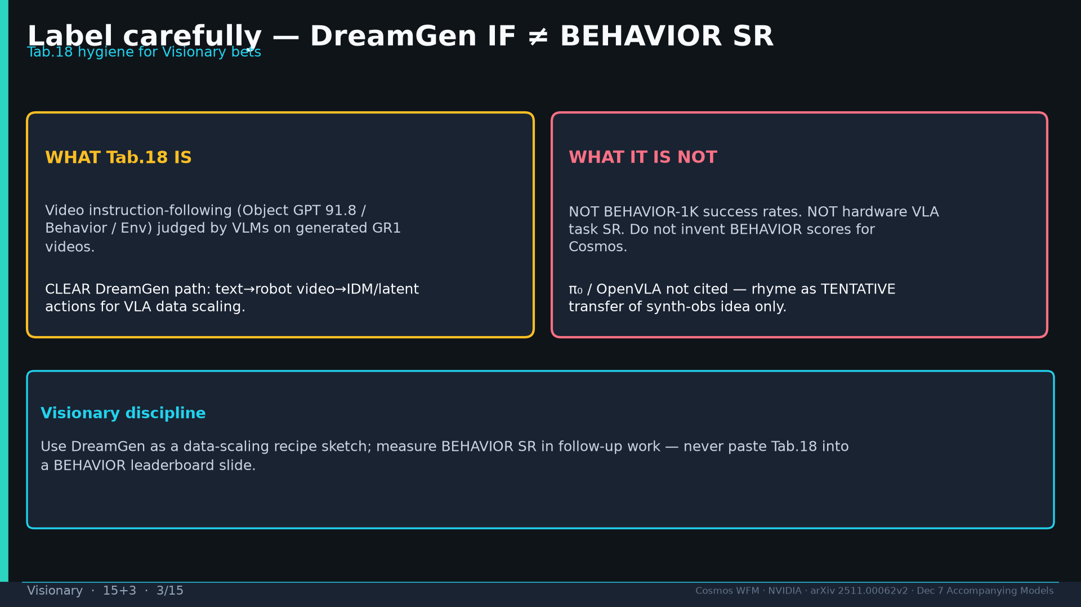
Notes:
DreamGen IF ≠ BEHAVIOR SR. Tab.18 hygiene. π₀ rhyme = TENTATIVE only.

Slide 4
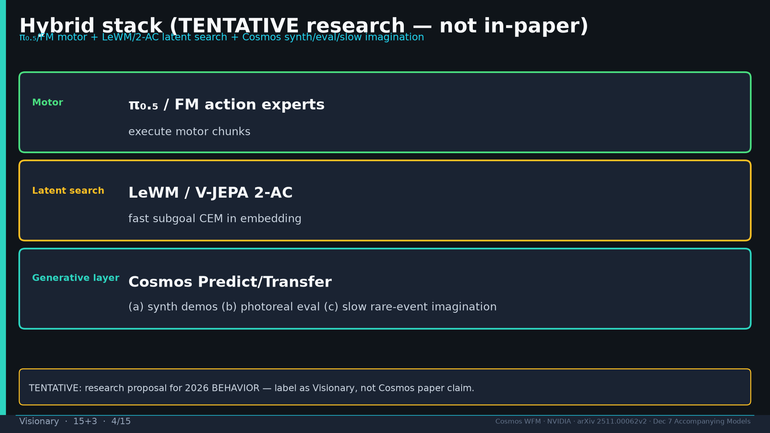
Notes:
Hybrid TENTATIVE: π₀.₅/FM motor + LeWM/2-AC latent search + Cosmos synth/eval/slow imagination.

Slide 5
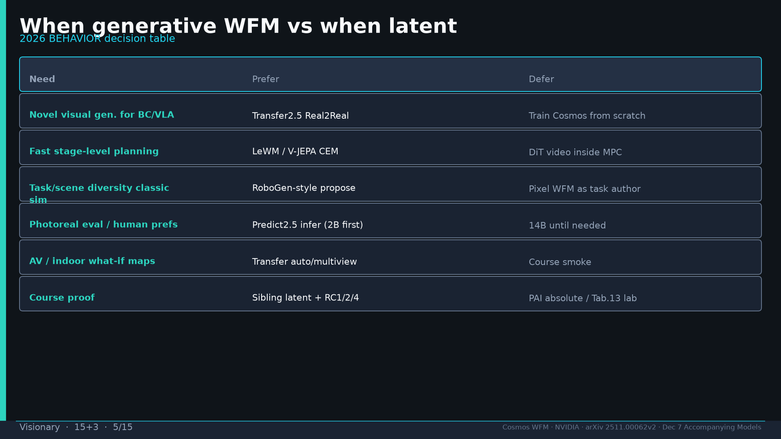
Notes:
Decision table when generative vs latent for 2026 BEHAVIOR.

Slide 6
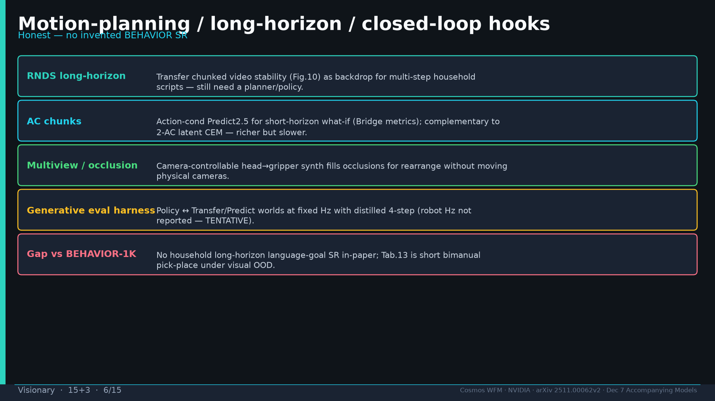
Notes:
Hooks honest: RNDS, AC chunks, multiview, eval harness; gap vs BEHAVIOR-1K language-goal SR.

Slide 7
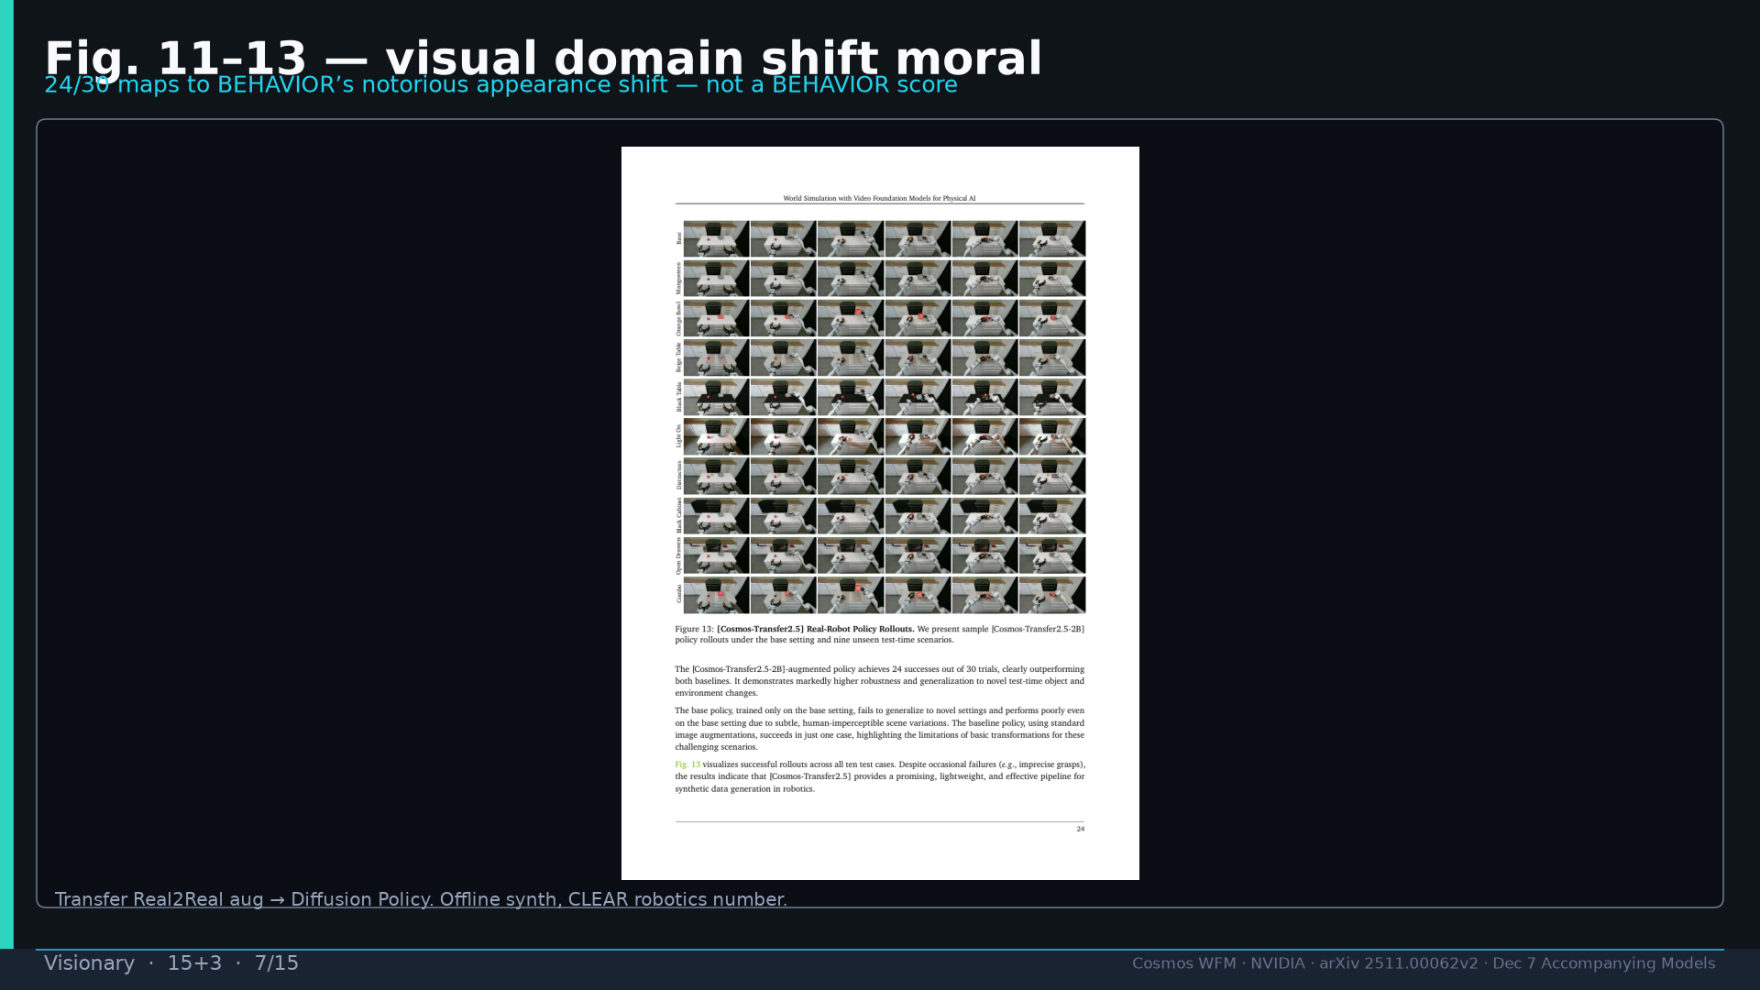
Notes:
Fig.13 robot moral for appearance shift — not a BEHAVIOR score.

Slide 8
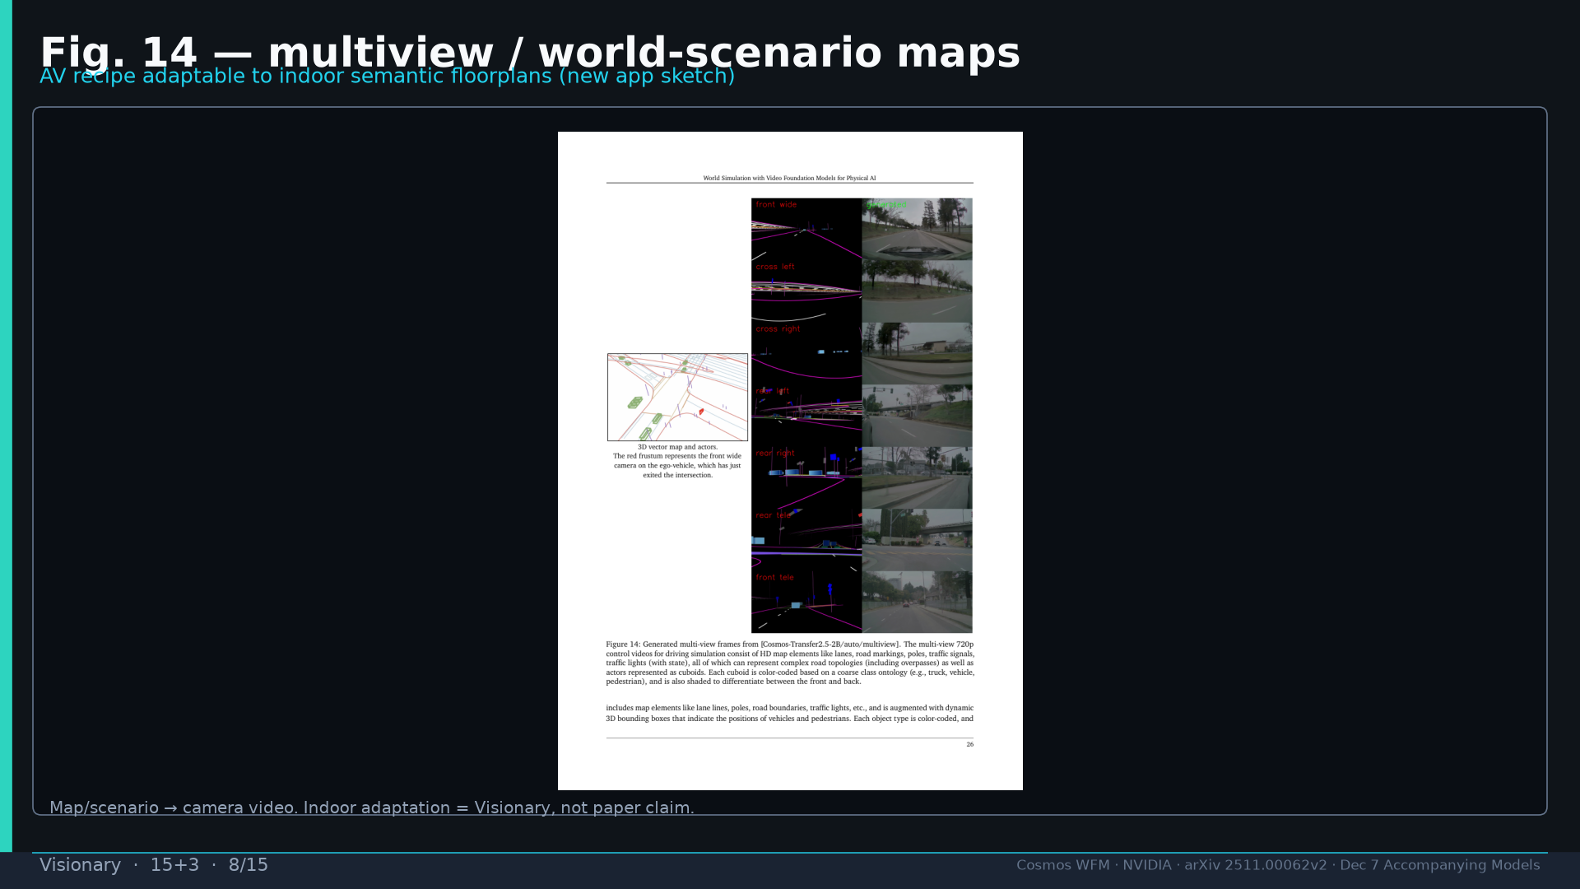
Notes:
Fig.14 AV multiview → indoor floorplan sketch (Visionary).

Slide 9
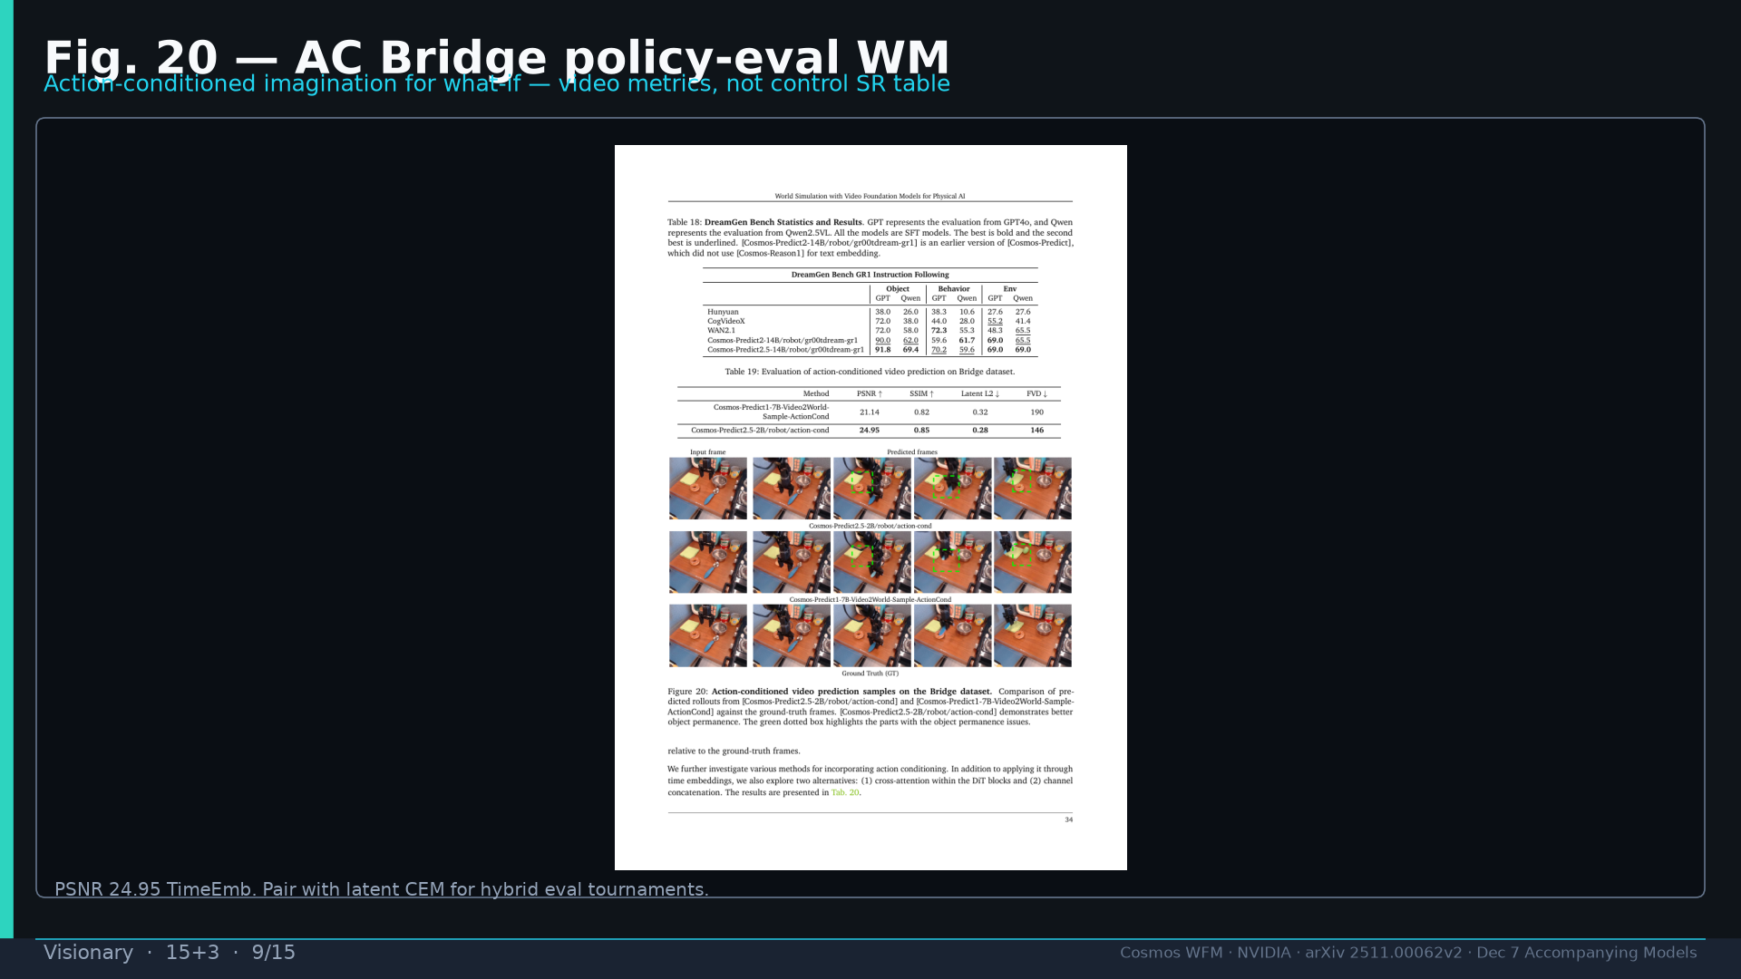
Notes:
Fig.20 Bridge AC what-if — video metrics.

Slide 10
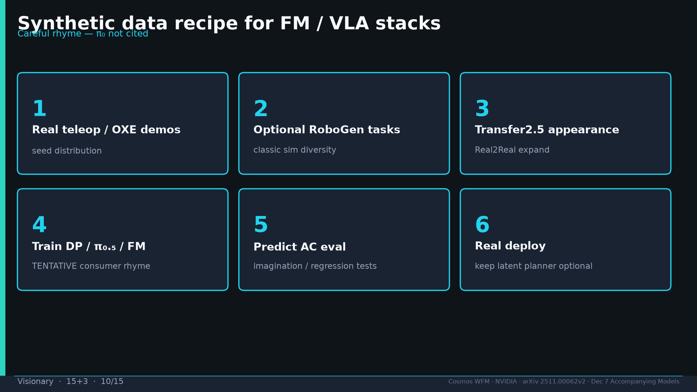
Notes:
Synth recipe teleop→RoboGen→Transfer→DP/π₀.₅→AC eval→deploy.

Slide 11
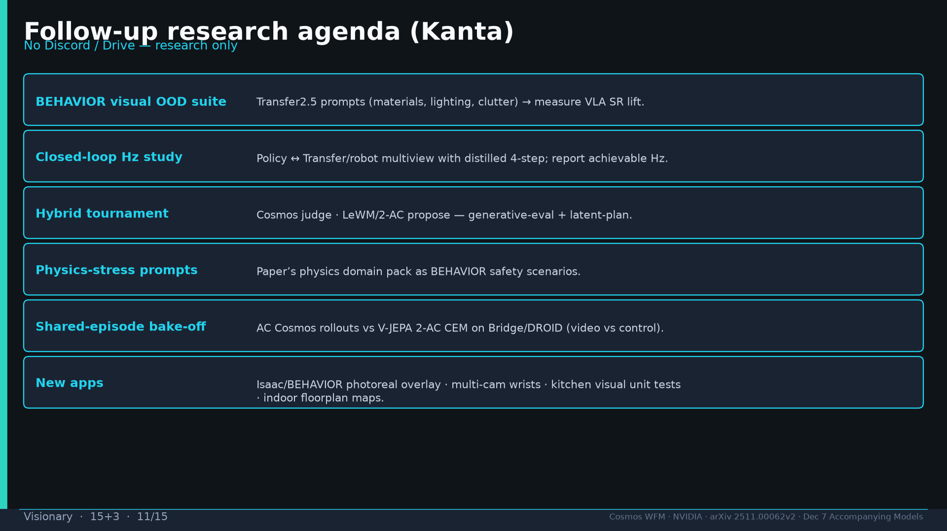
Notes:
Follow-up agenda; new apps; no Discord/Drive.

Slide 12
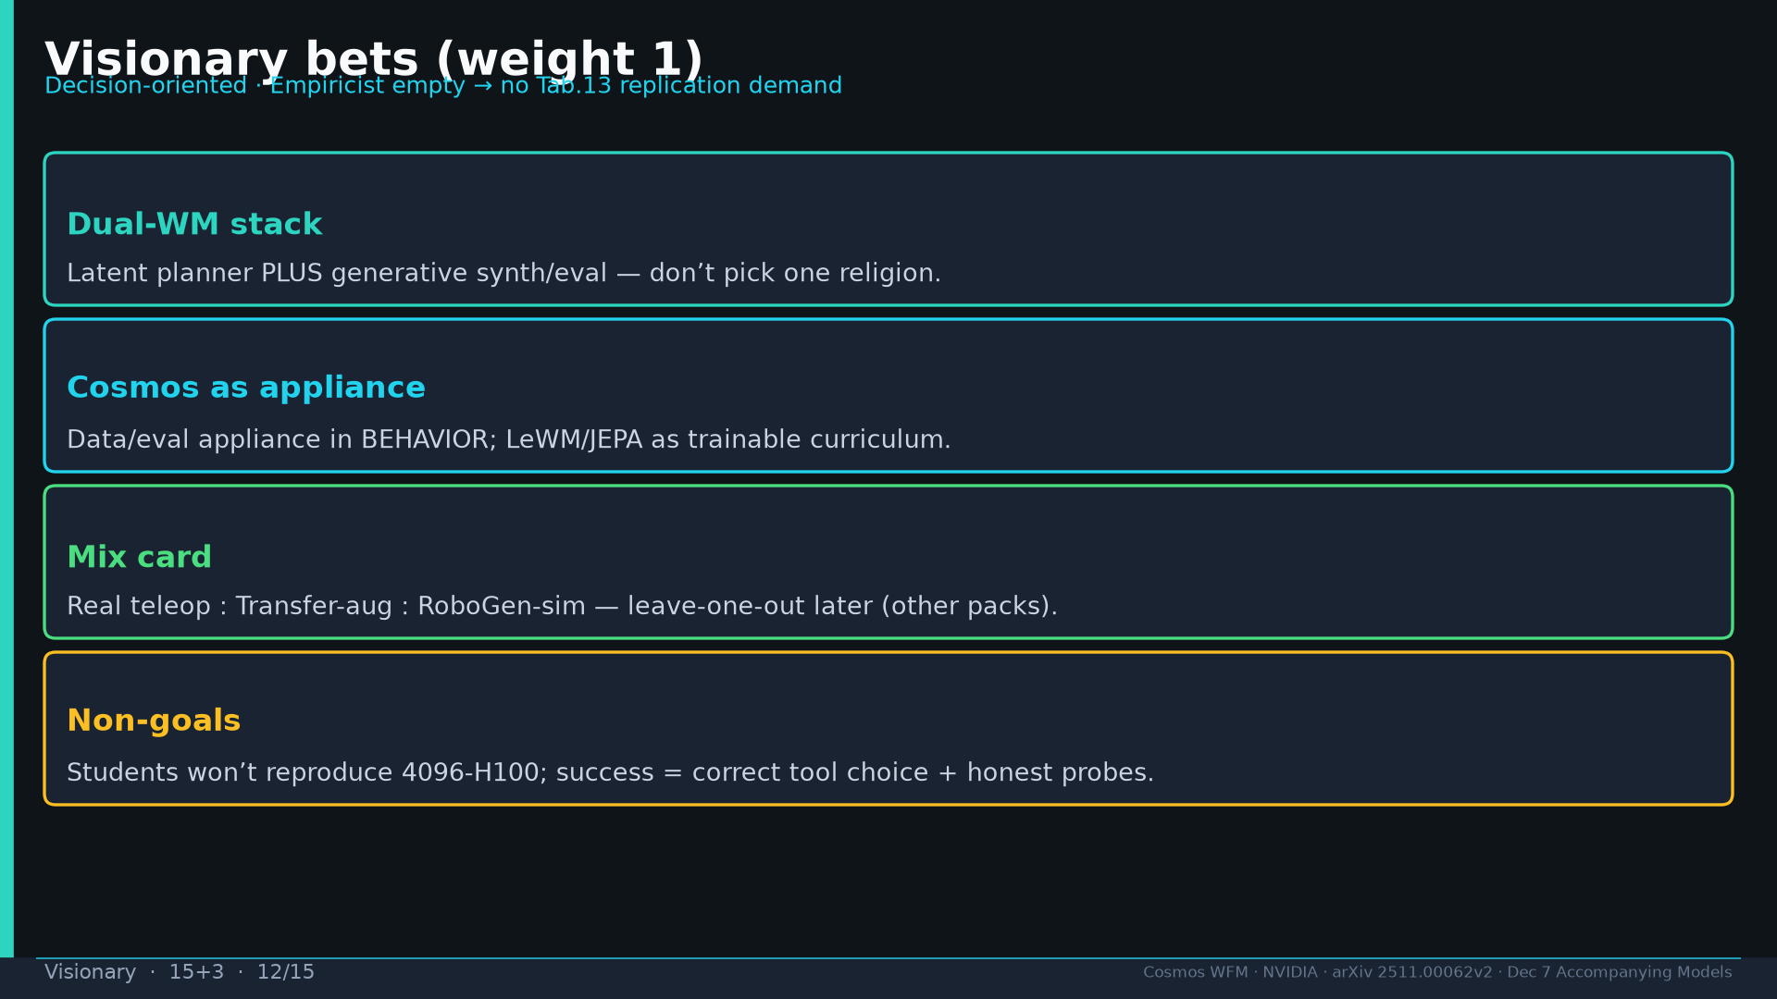
Notes:
Four bets: dual-WM; appliance; mix card; non-goals.

Slide 13
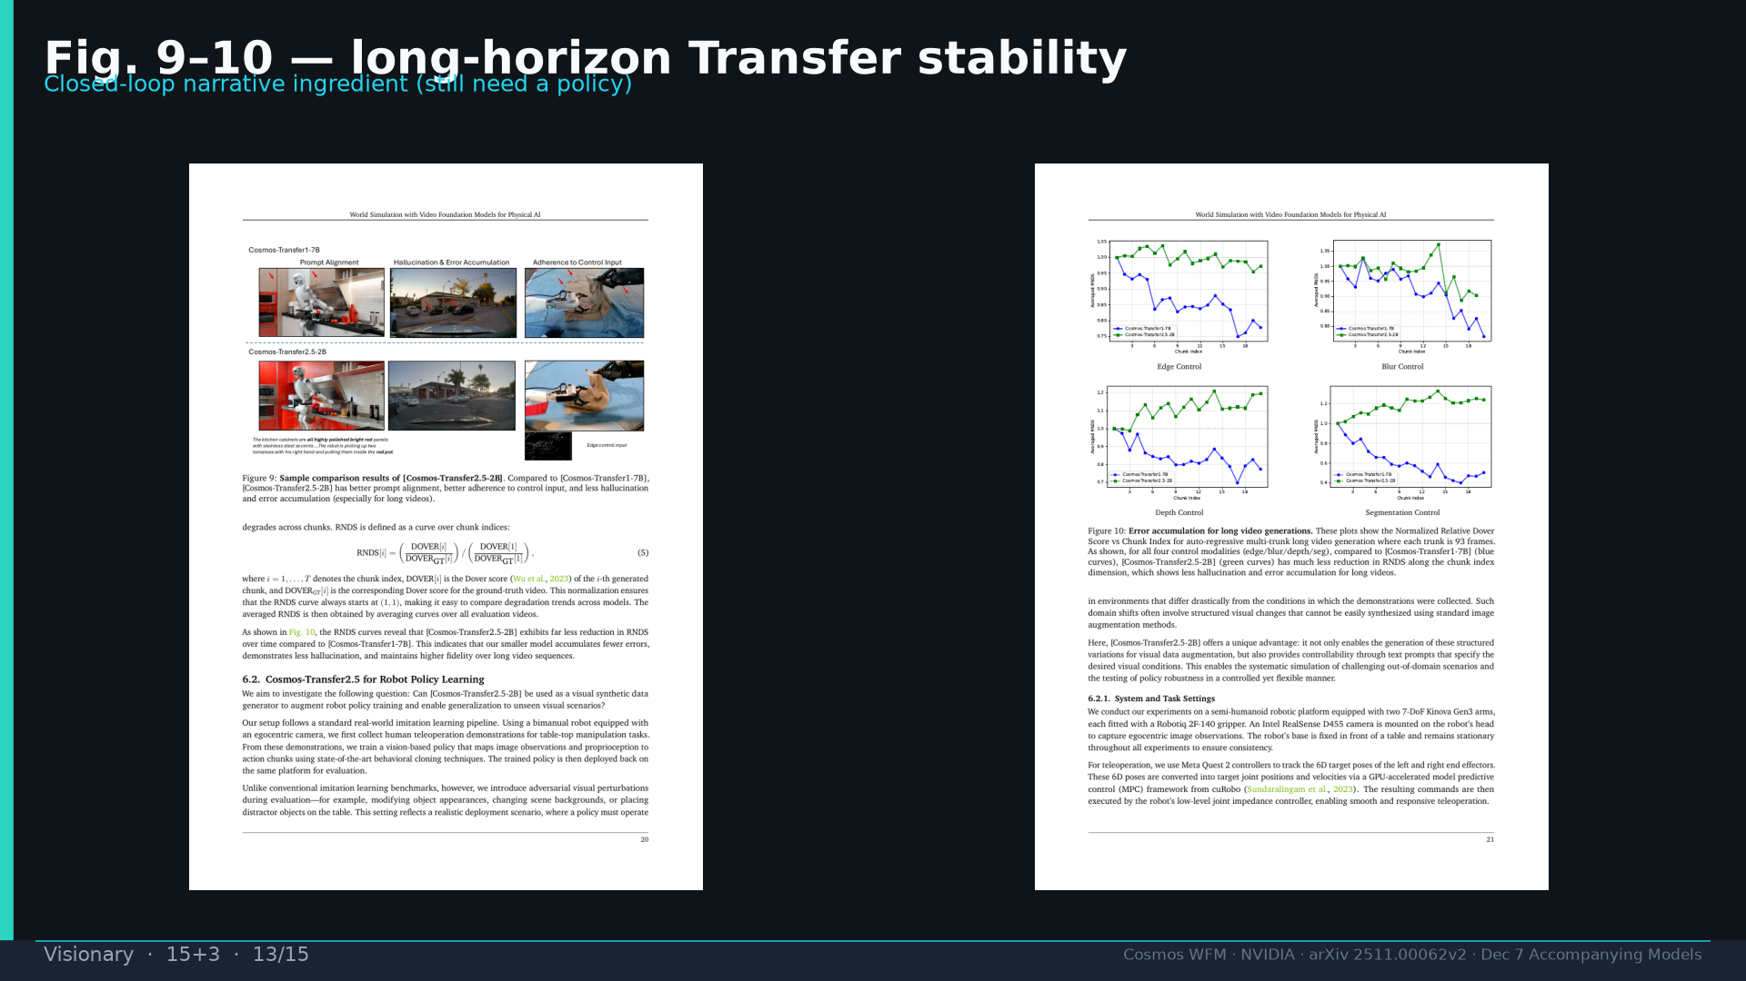
Notes:
Fig.9–10 Transfer long-horizon stability narrative.

Slide 14
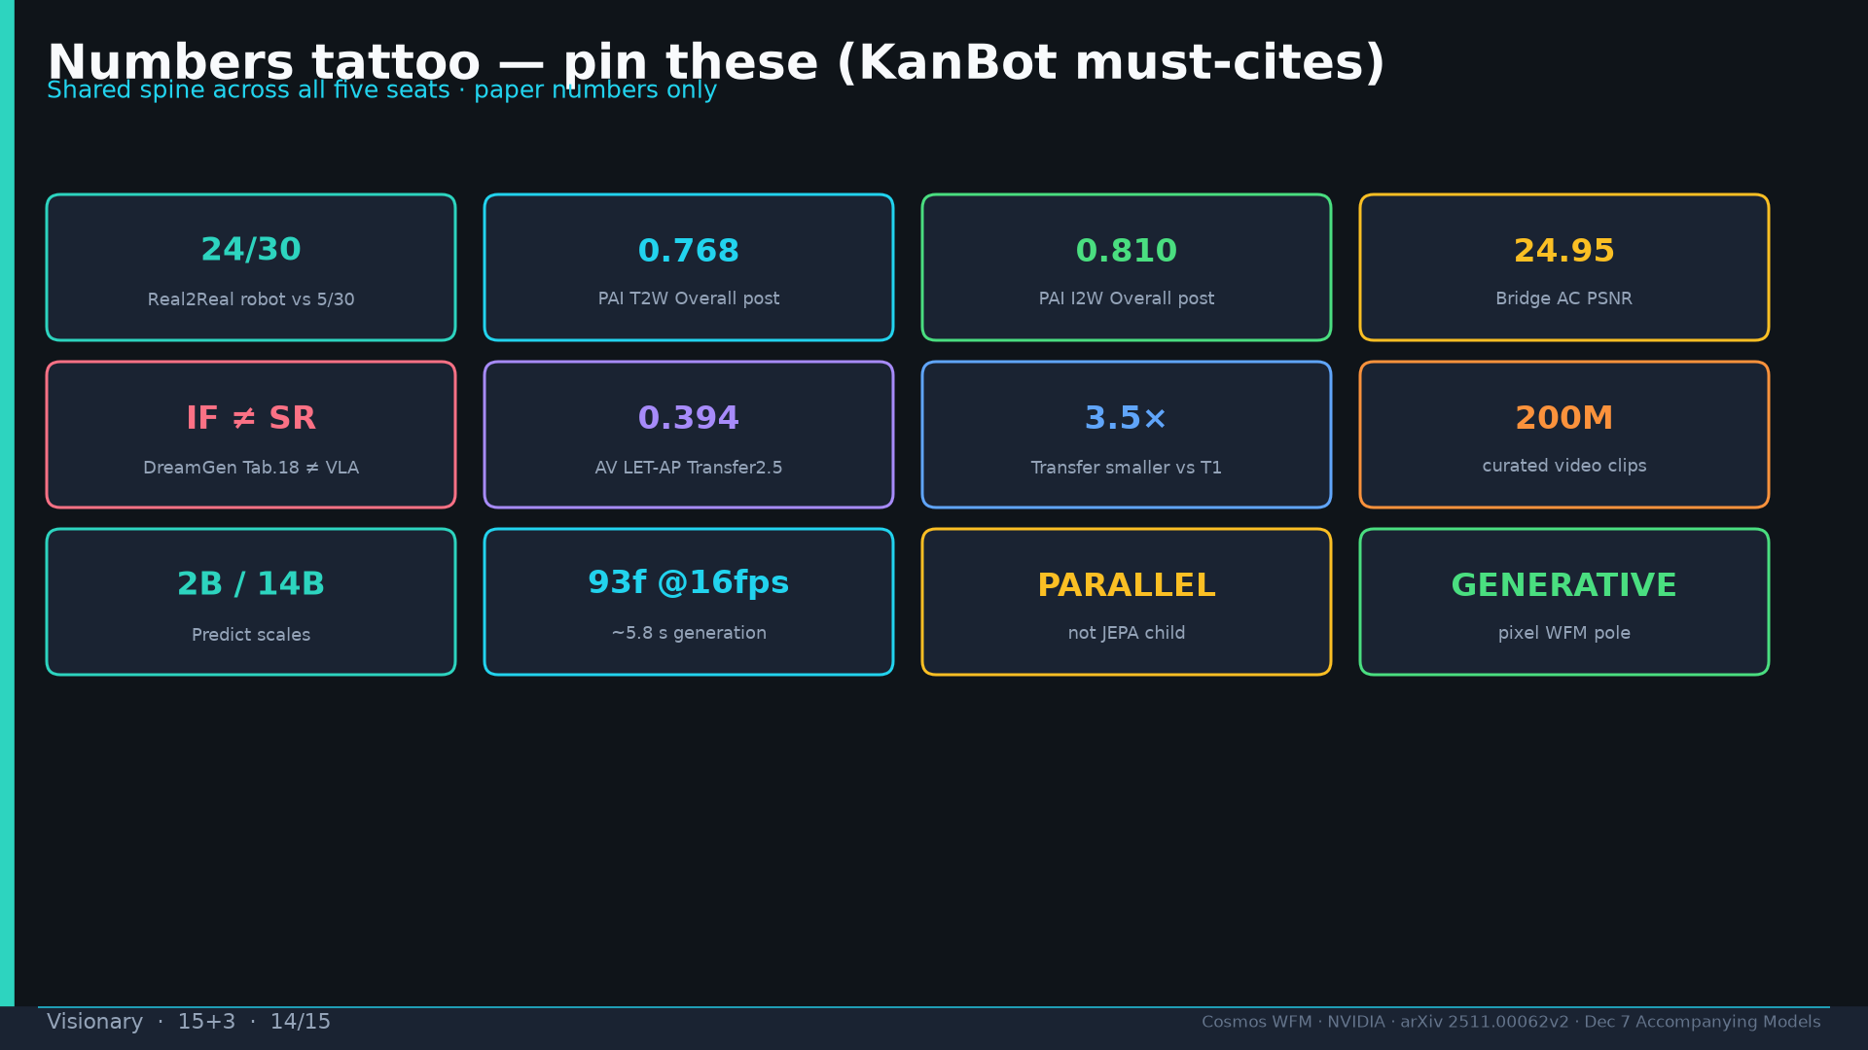
Notes:
Tattoo.

Slide 15
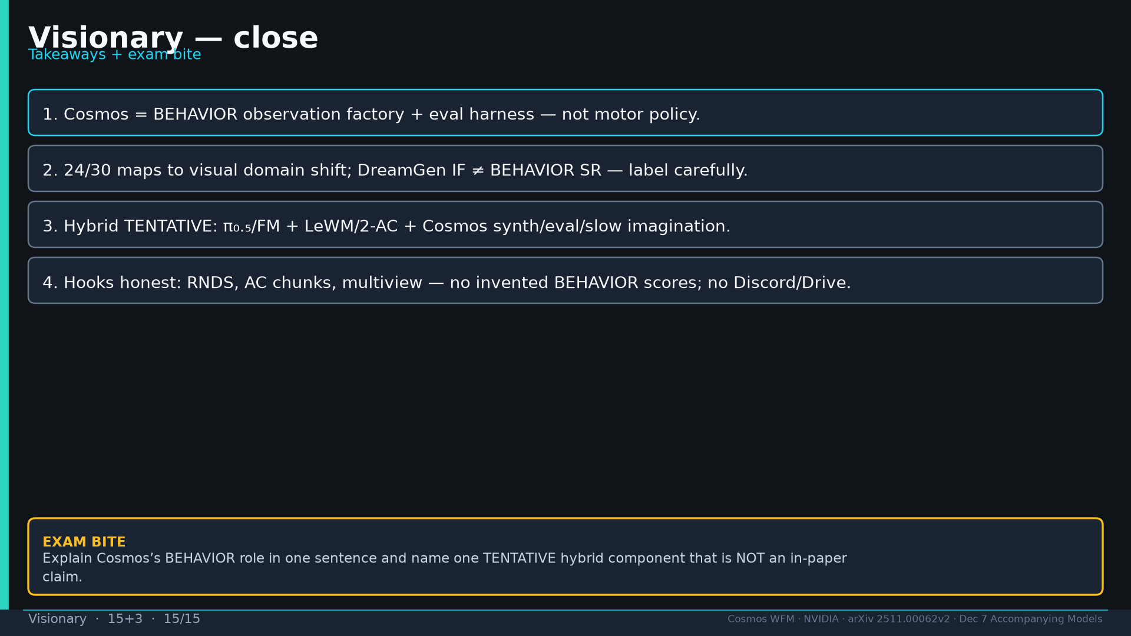
Notes:
Close + exam on BEHAVIOR role + TENTATIVE hybrid.

