Slide 1
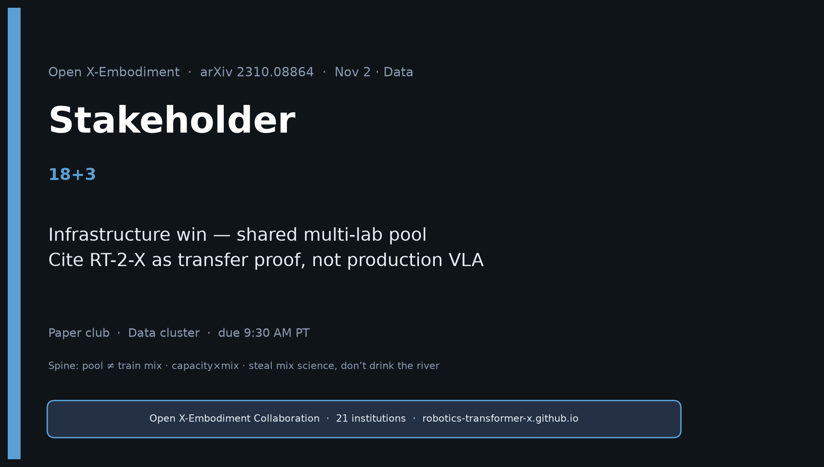
Stakeholder · 18+3 · 1/18
Notes:
STAKEHOLDER — 18+3. Infrastructure framing.
Open shared pool enabled community generalists without each lab building PaLI-scale data.
Cite as infrastructure win; treat RT-2-X as transfer existence proof not production VLA;
invest in modality coverage + long-horizon, not only more pick-place hours.
No Stakeholder redo later — this deck is complete.

Slide 2
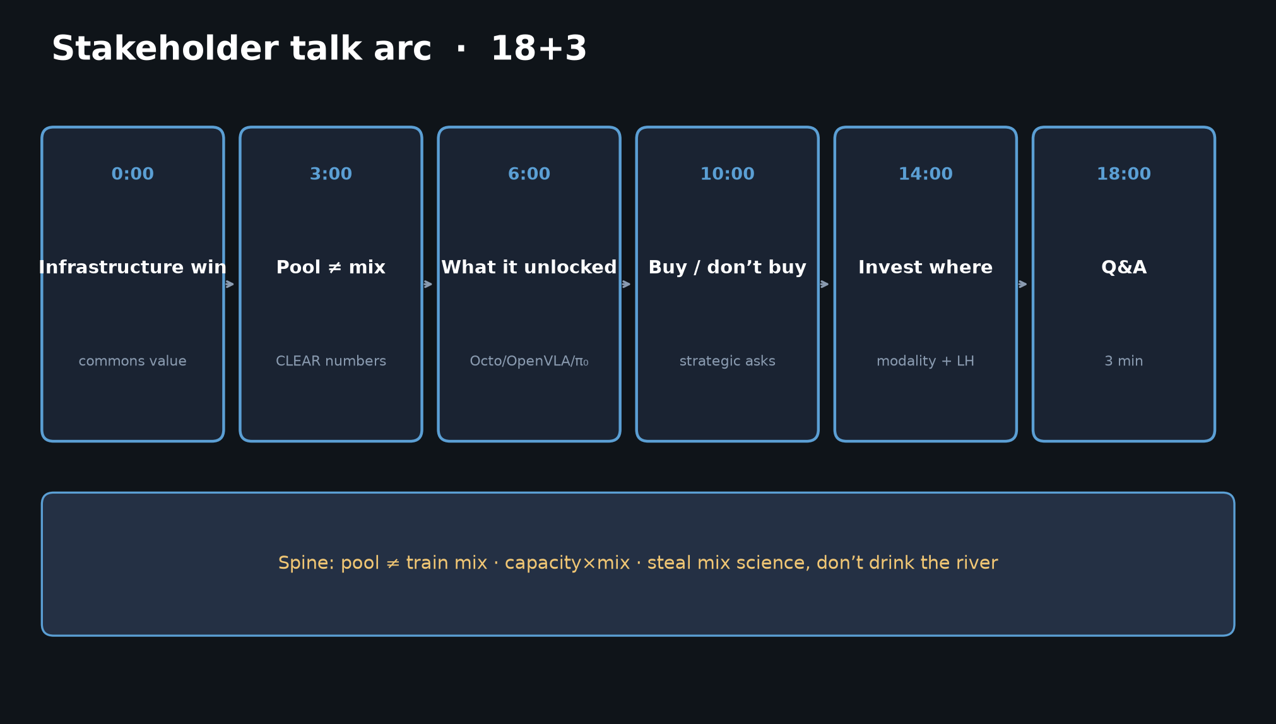
Stakeholder · 18+3 · 2/18
Notes:
TALK ARC — 18 minutes. More runway; still image-first.
1) Infrastructure win ~3m
2) Pool ≠ mix CLEAR numbers ~3m
3) What it unlocked (lineage) ~4m
4) Buy / don’t buy + strategic asks ~4m
5) Headlines + capacity caveat ~3m
6) Close ~1m + Q&A 3m

Slide 3
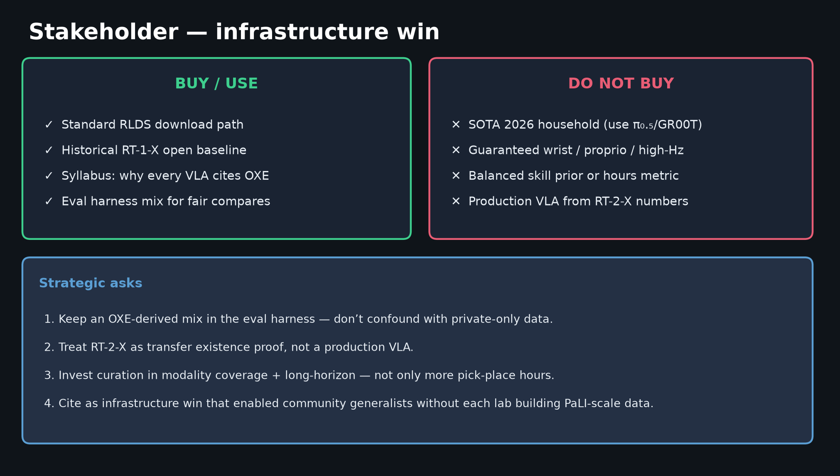
Stakeholder · 18+3 · 3/18
Notes:
VALUE / ASK — buy vs don’t buy + strategic asks.
BUY: RLDS path, RT-1-X baseline, syllabus grounding, eval-harness mix.
DON’T: 2026 SOTA household, wrist guarantees, production VLA from RT-2-X.
Asks: keep OXE-derived mix in eval; RT-2-X = existence proof; invest modality + long-horizon.

Slide 4
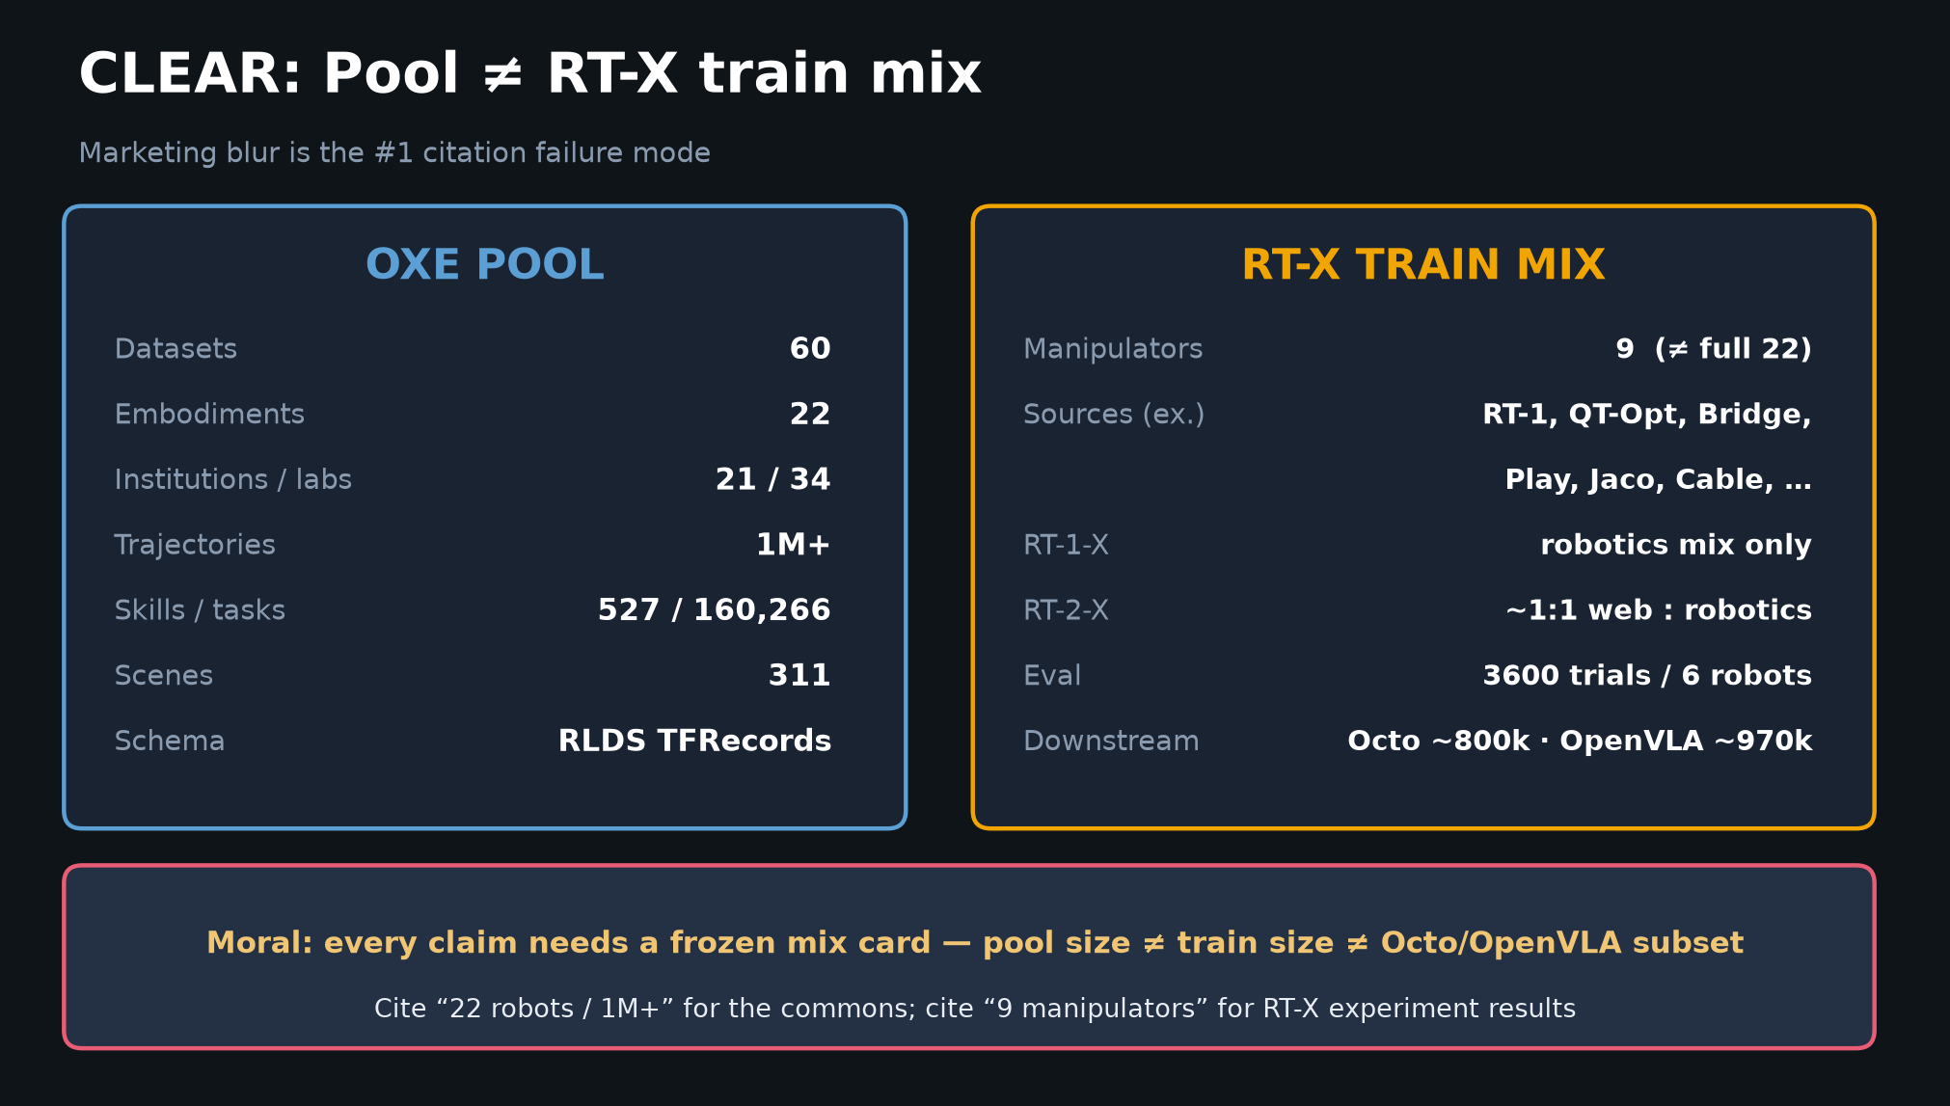
Stakeholder · 18+3 · 4/18
Notes:
POOL ≠ TRAIN MIX — the stakeholder must not blur these in external talks.

Slide 5
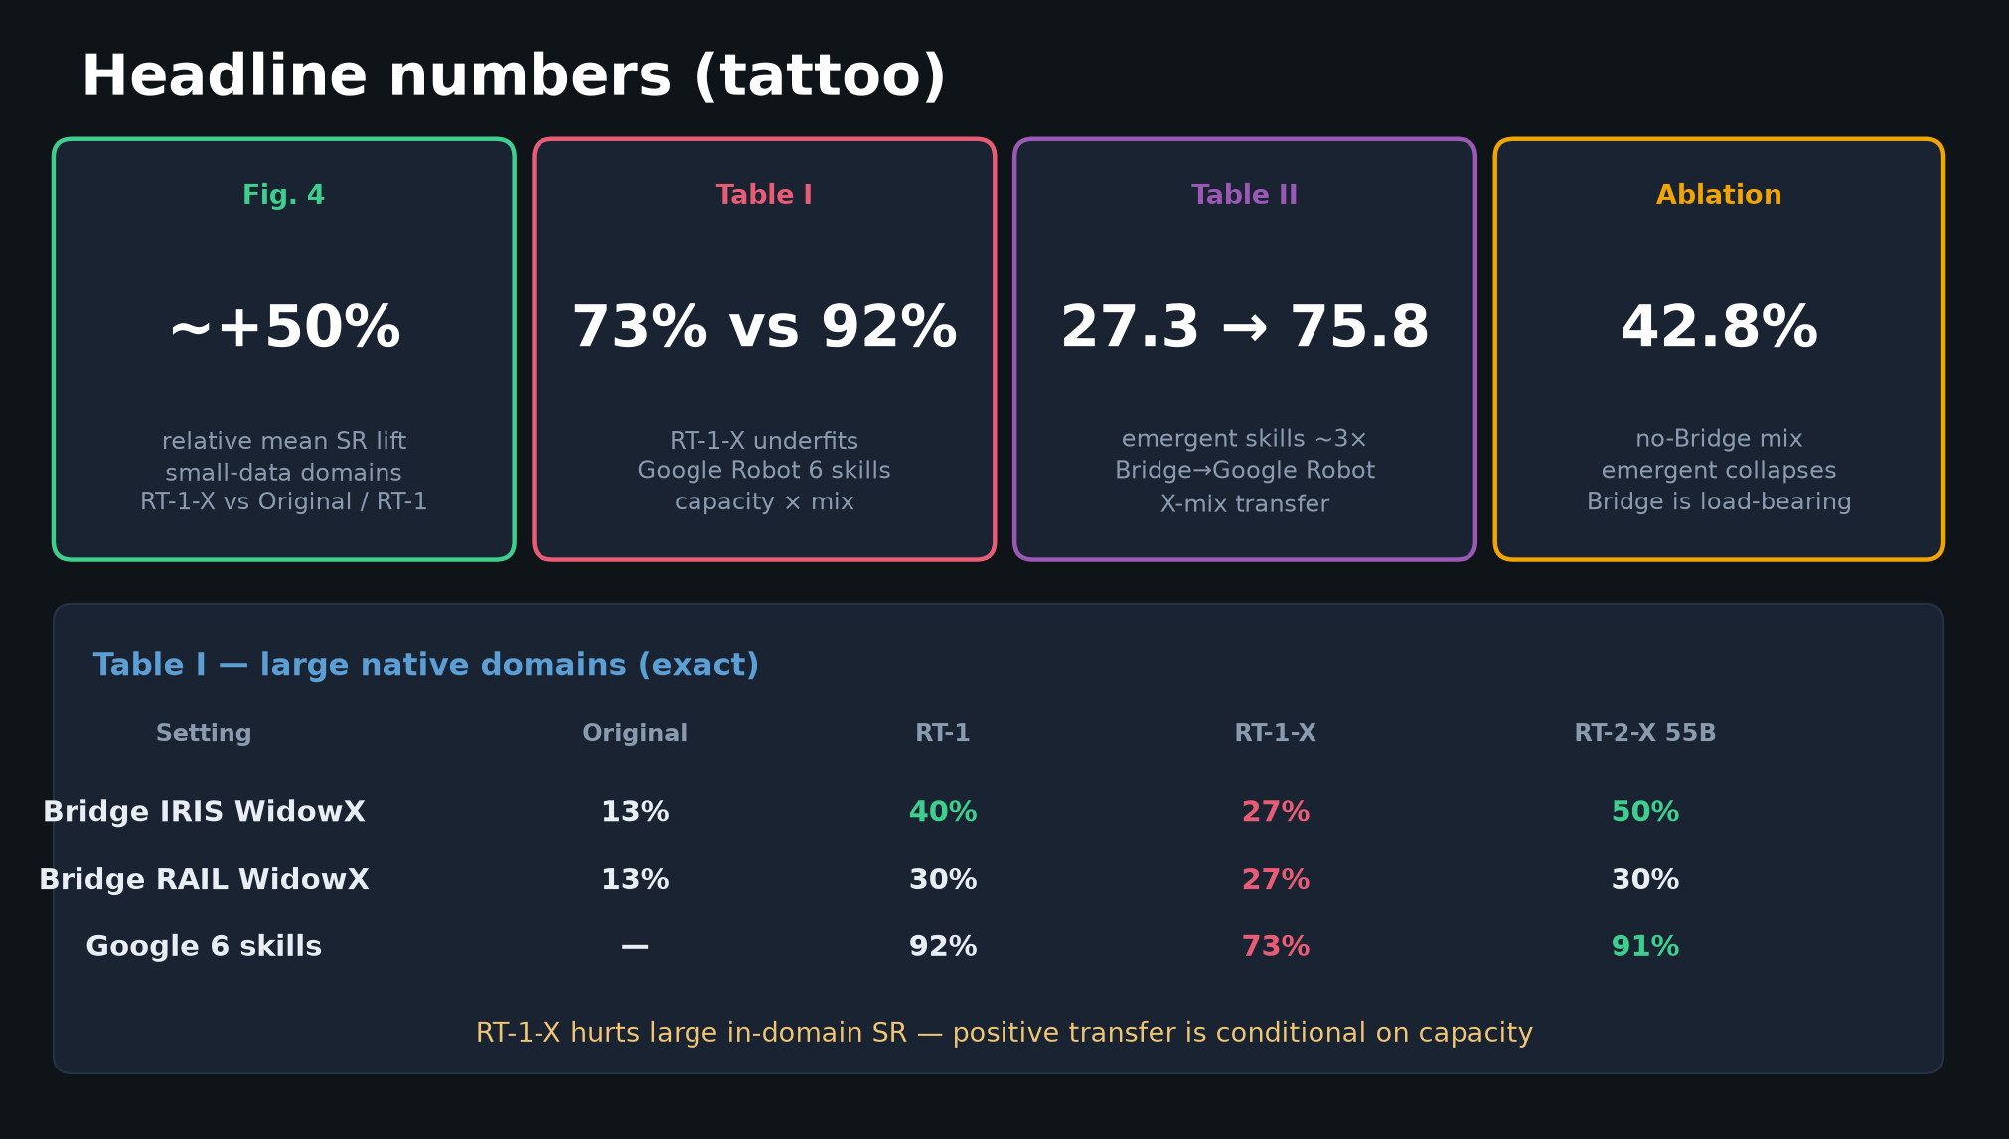
Stakeholder · 18+3 · 5/18
Notes:
HEADLINES for exec literacy.
+50% small-domain · 73 vs 92 underfit · 27.3→75.8 emergent · no-Bridge 42.8.

Slide 6
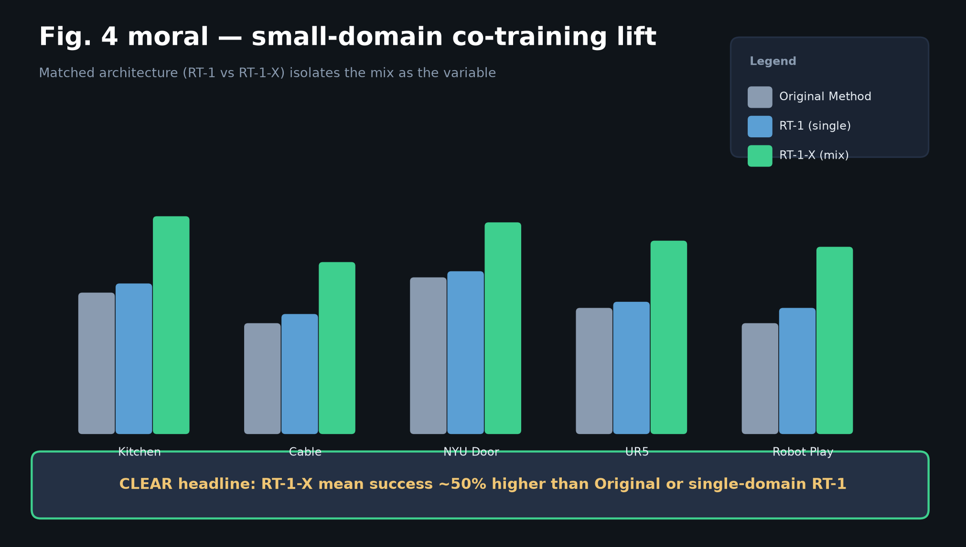
Stakeholder · 18+3 · 6/18
Notes:
FIG.4 lift schematic — co-training helps small labs most. Infrastructure moral: shared pool lifts the long tail of labs.

Slide 7
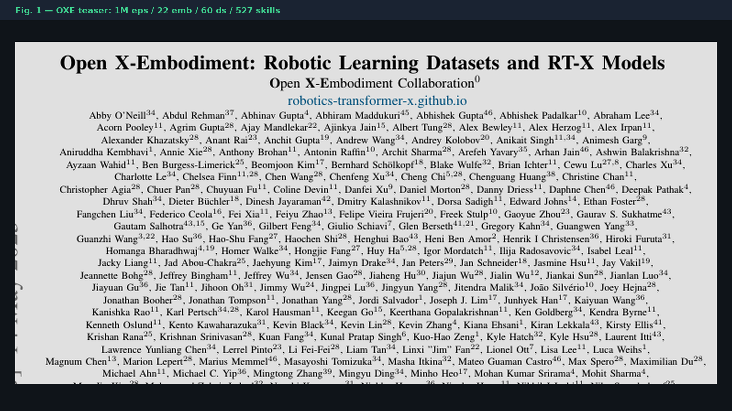
Stakeholder · 18+3 · 7/18
Notes:
PAPER FIG.1 teaser — the poster image of the commons.

Slide 8
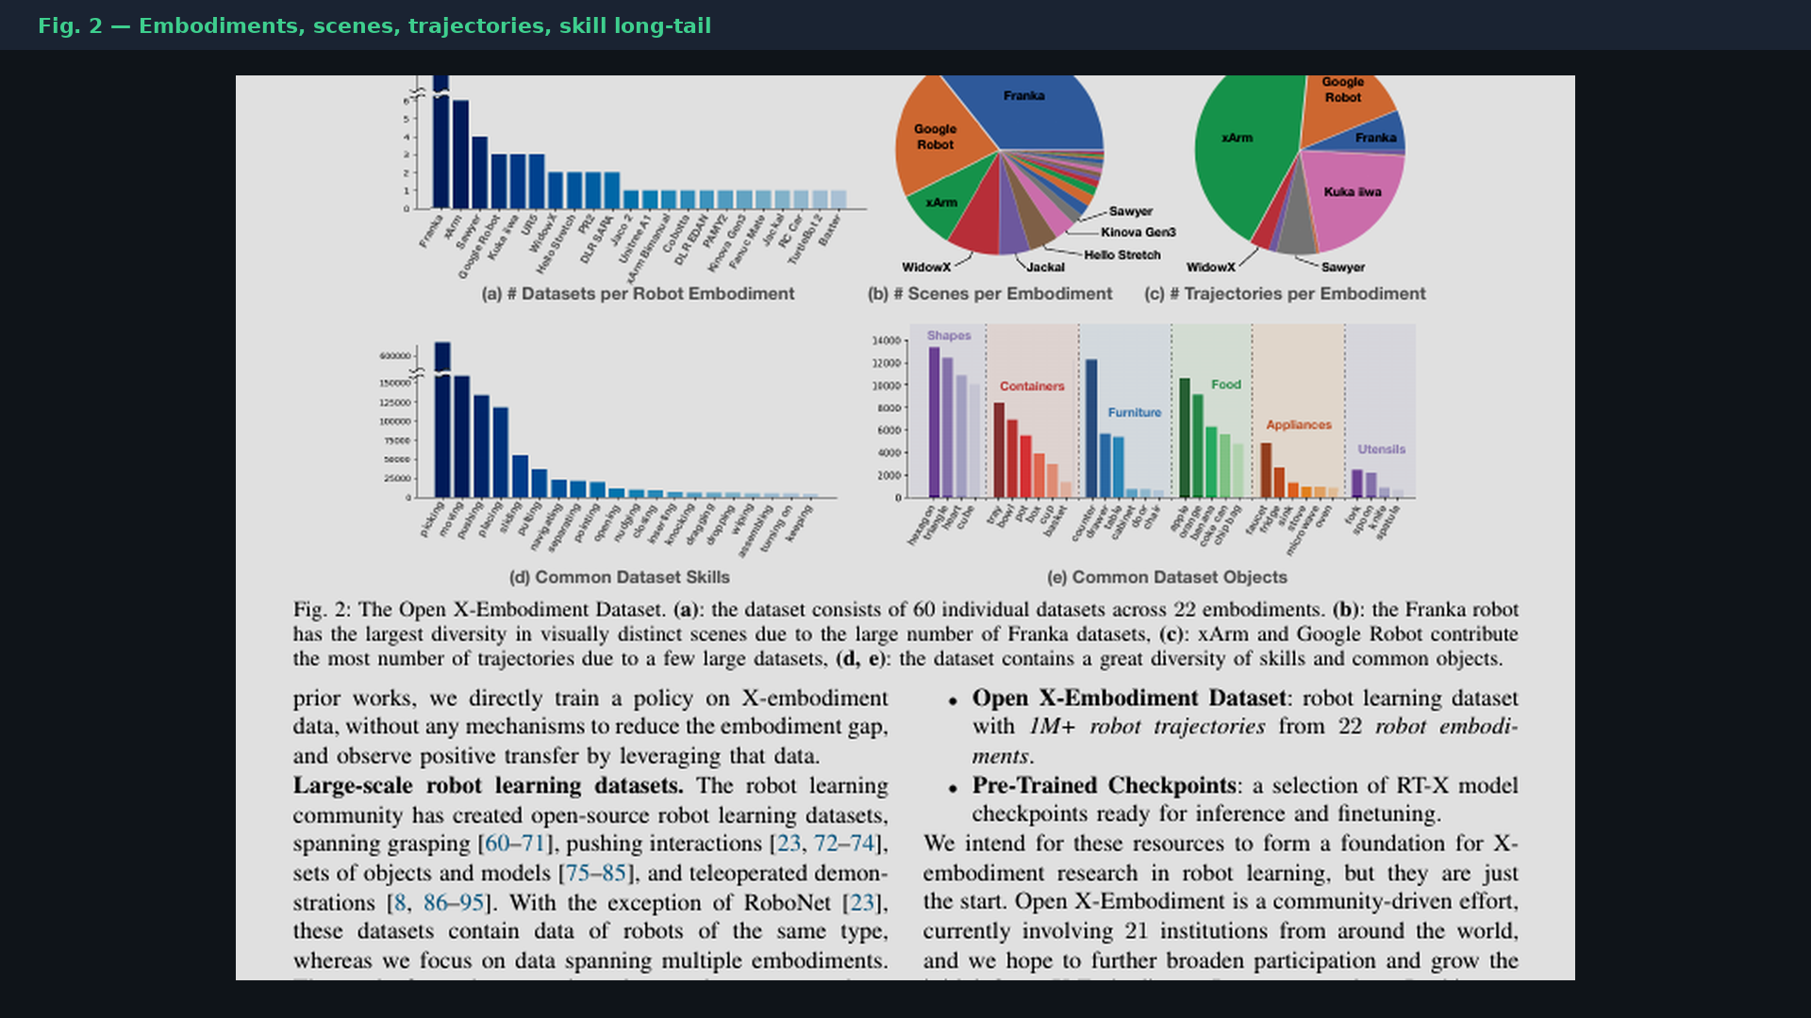
Stakeholder · 18+3 · 8/18
Notes:
PAPER FIG.2 — embodiment / scene / trajectory diversity. Franka scene-diverse; xArm & Google traj-heavy; pick-place dominates skill mass.

Slide 9
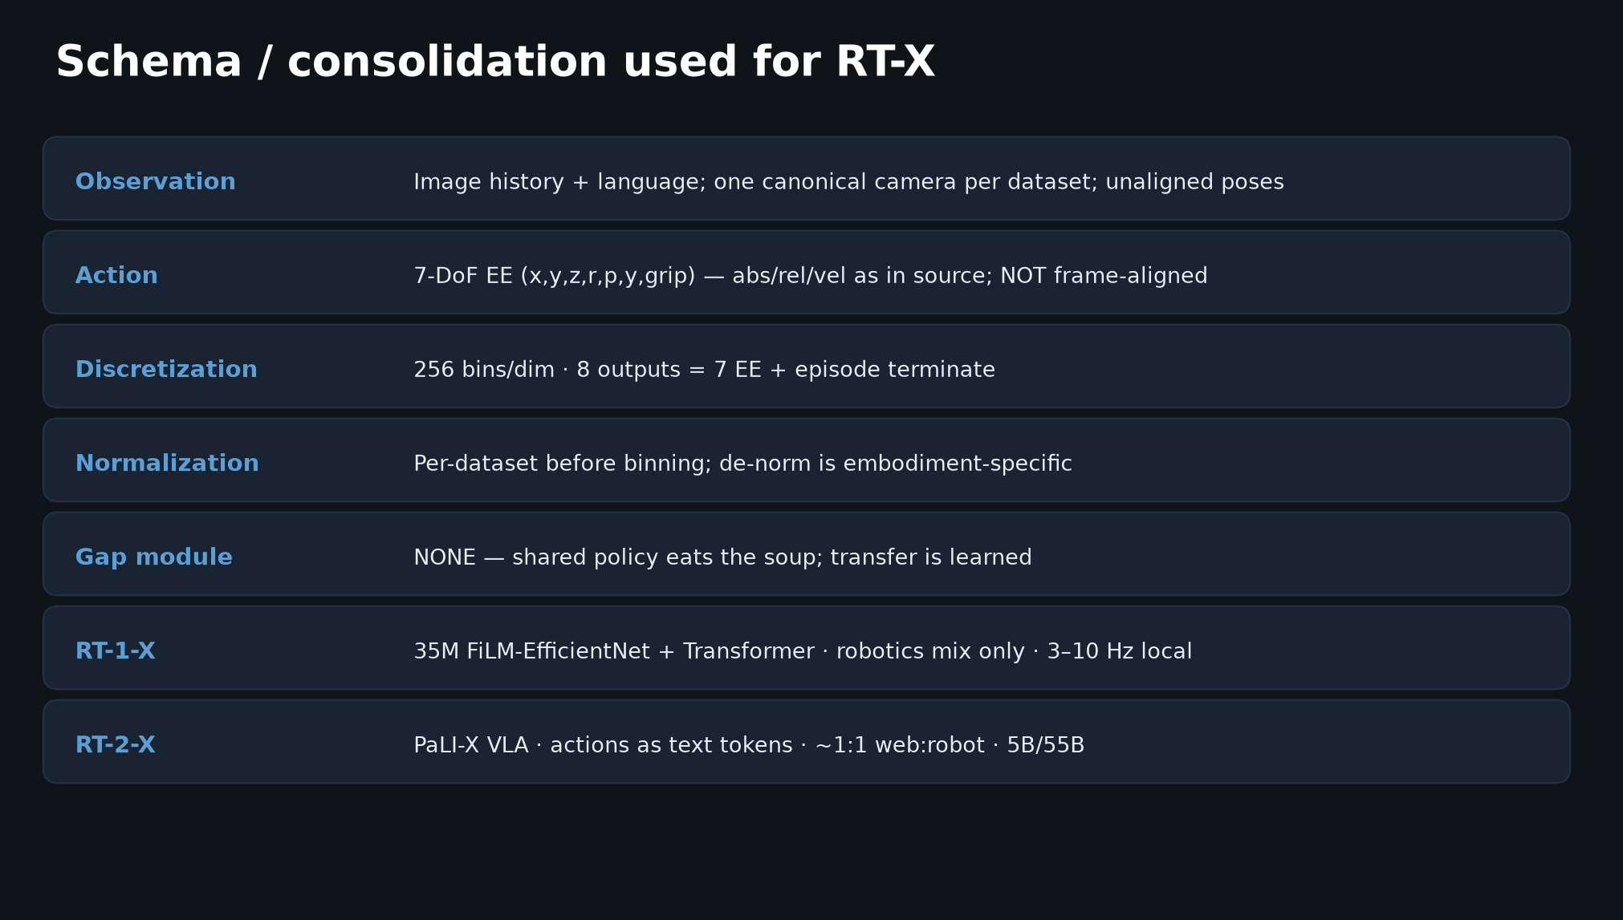
Stakeholder · 18+3 · 9/18
Notes:
SCHEMA — what “standardization” actually meant (and what it didn’t: no EE frame alignment, no gap module).

Slide 10
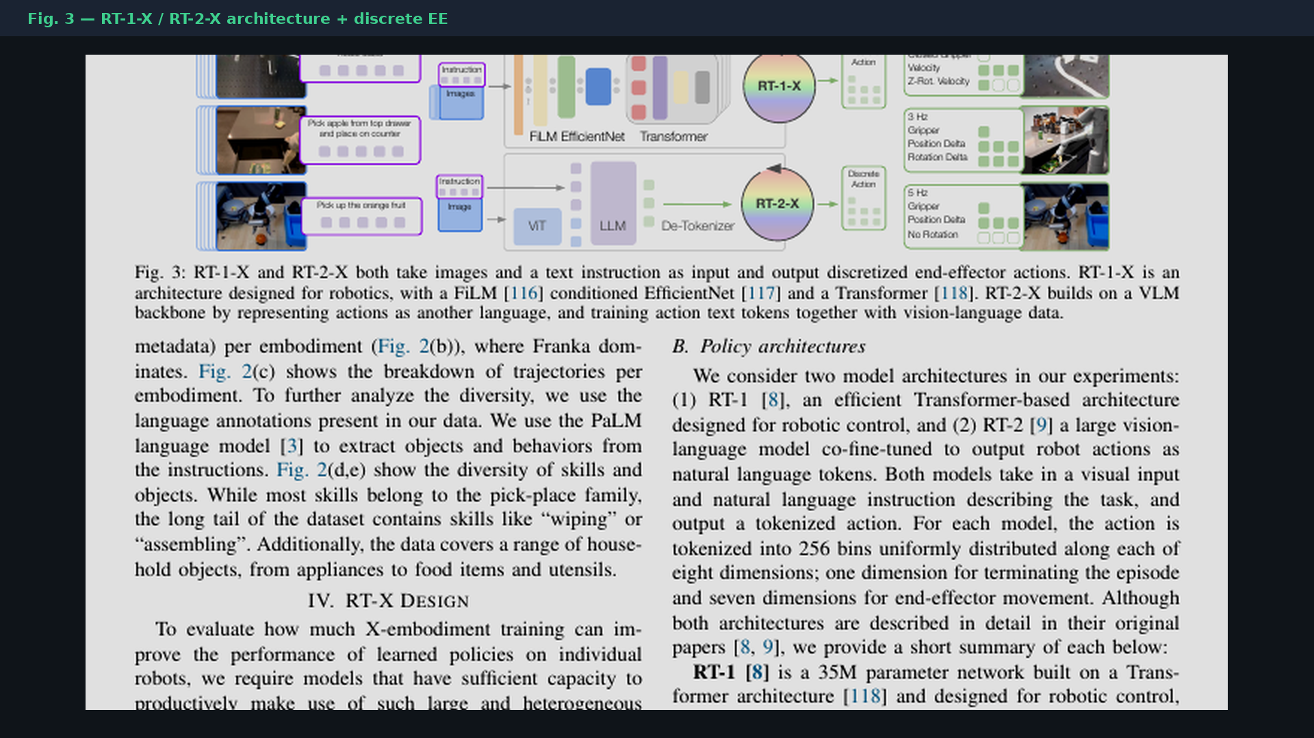
Stakeholder · 18+3 · 10/18
Notes:
PAPER FIG.3 — RT-1-X / RT-2-X. Point once: two model families, one mix story.

Slide 11
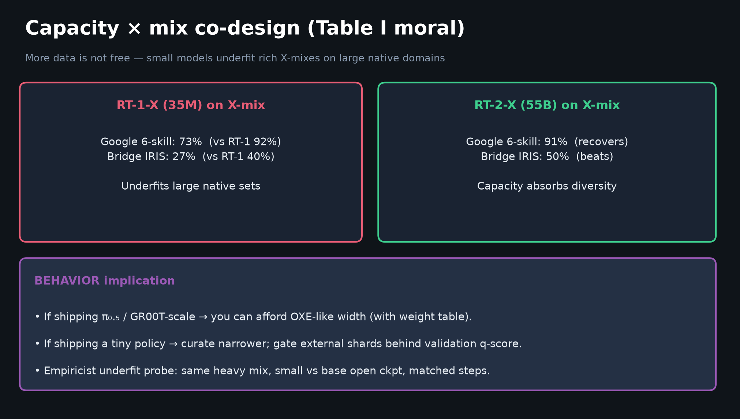
Stakeholder · 18+3 · 11/18
Notes:
CAPACITY × MIX — honest caveat for leadership: more data can HURT without capacity. RT-2-X recovers. Implication: don’t force tiny policies onto full soup.

Slide 12
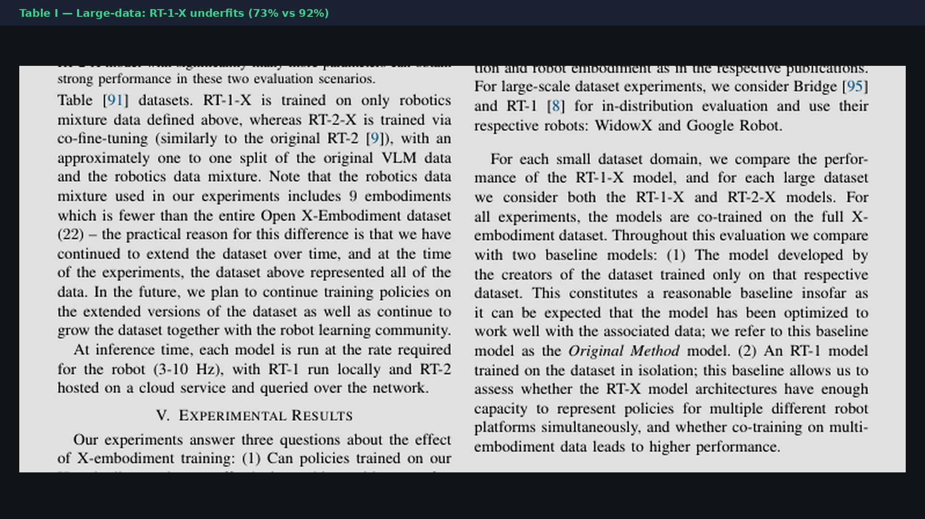
Stakeholder · 18+3 · 12/18
Notes:
TABLE I paper crop — 73% vs 92% visual.

Slide 13
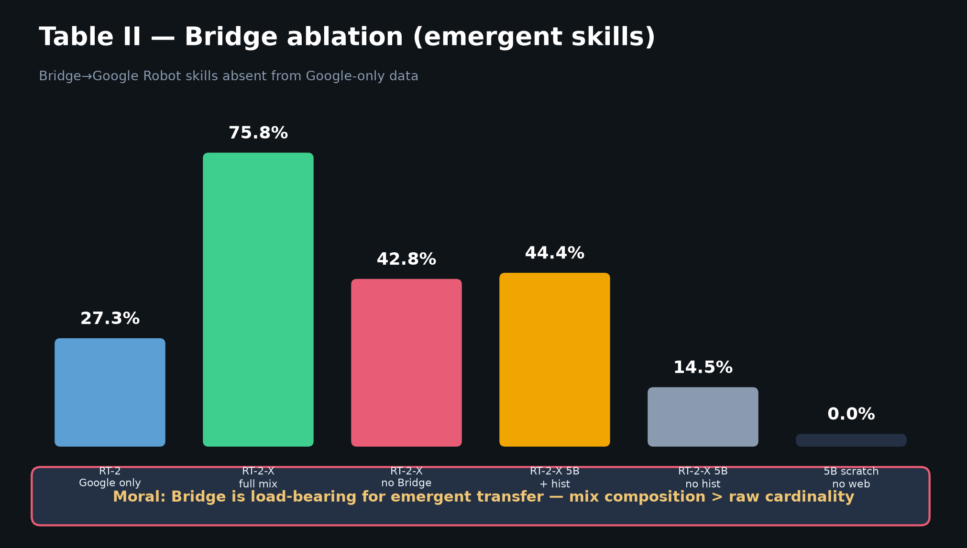
Stakeholder · 18+3 · 13/18
Notes:
BRIDGE ABLATION — mix composition is an investment decision, not just “more datasets.”

Slide 14
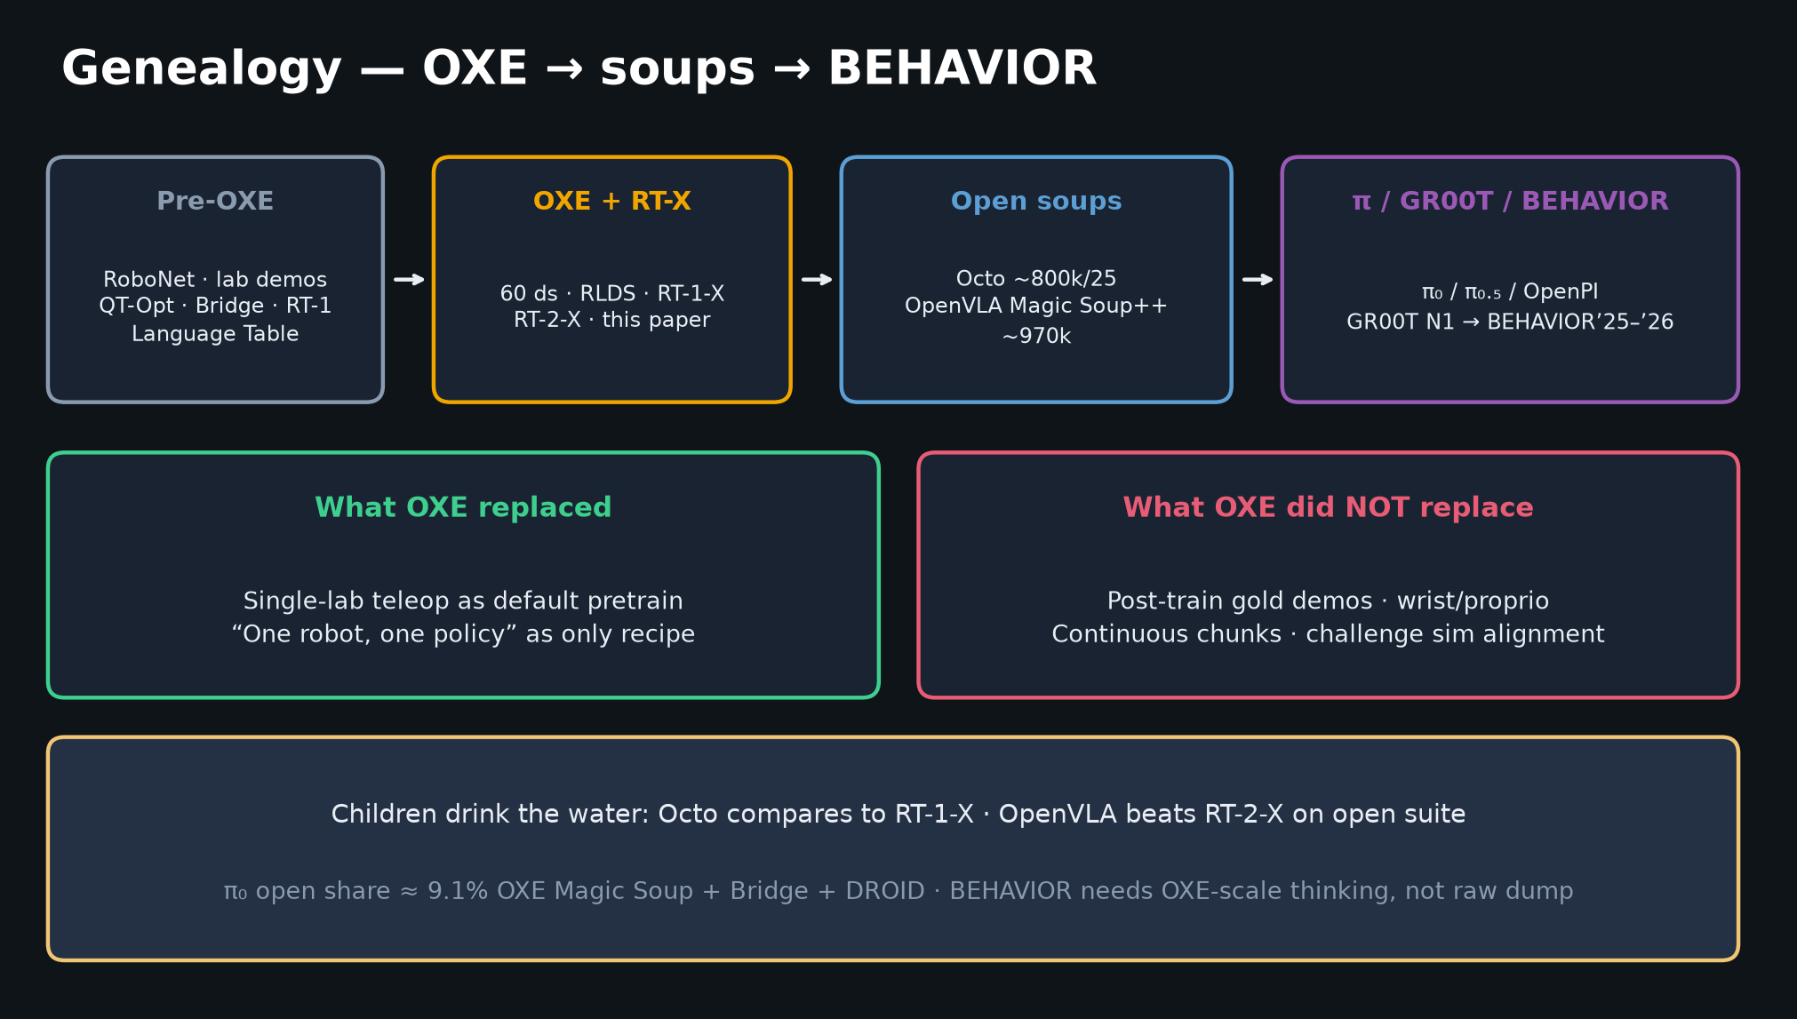
Stakeholder · 18+3 · 14/18
Notes:
GENEALOGY — what your investment bought: the water supply for Octo/OpenVLA/π₀/BEHAVIOR data stories.

Slide 15
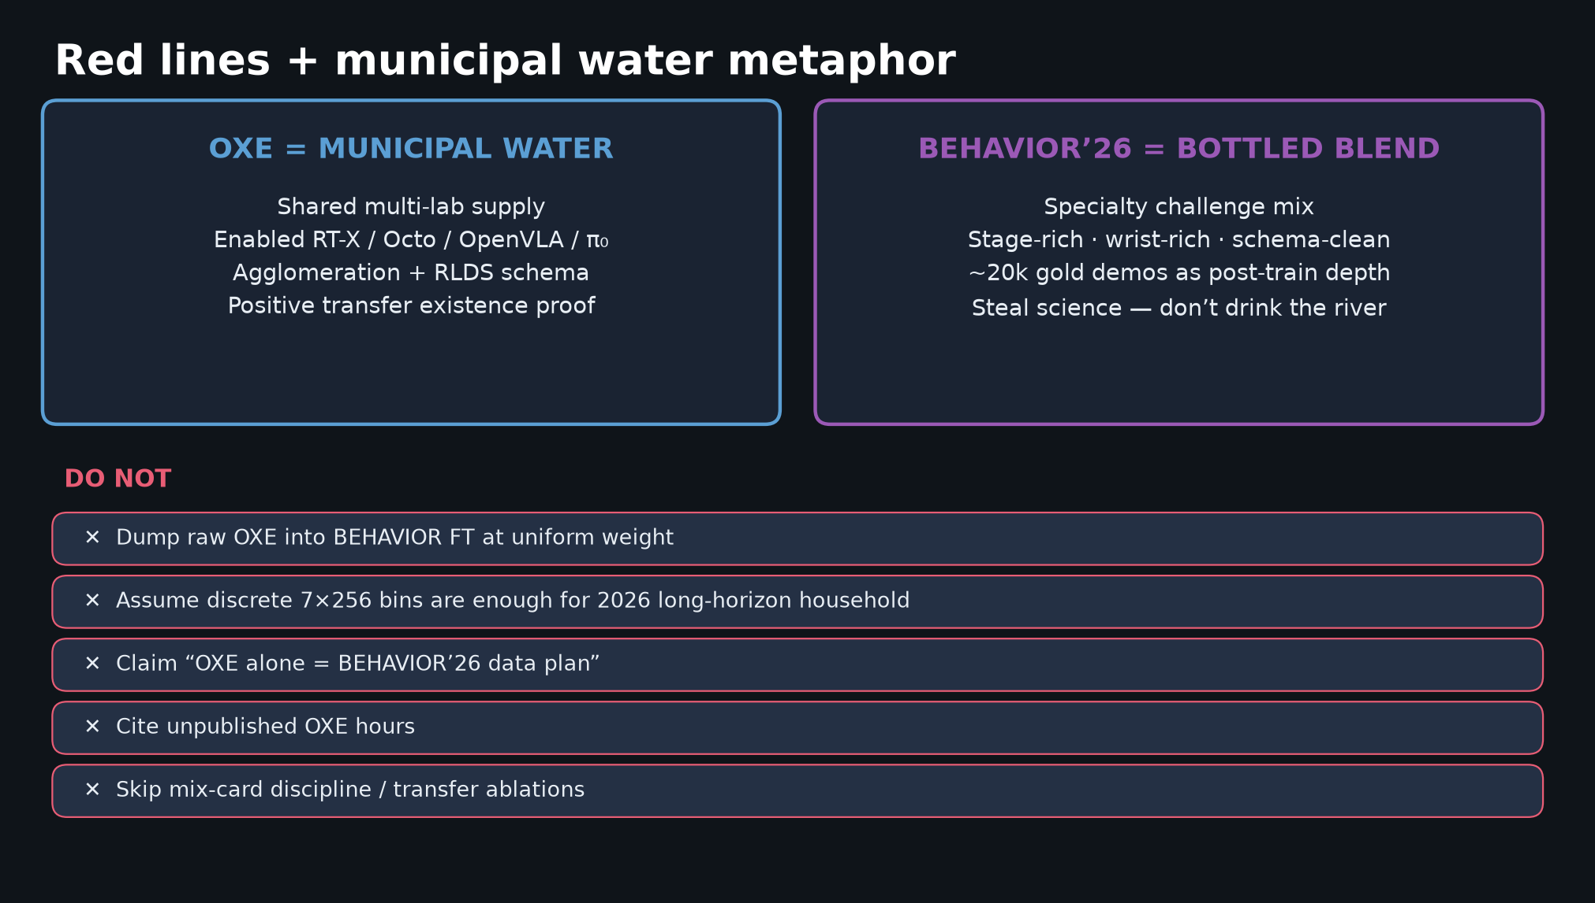
Stakeholder · 18+3 · 15/18
Notes:
RED LINES for product narrative — don’t claim OXE alone is the 2026 household plan.

Slide 16
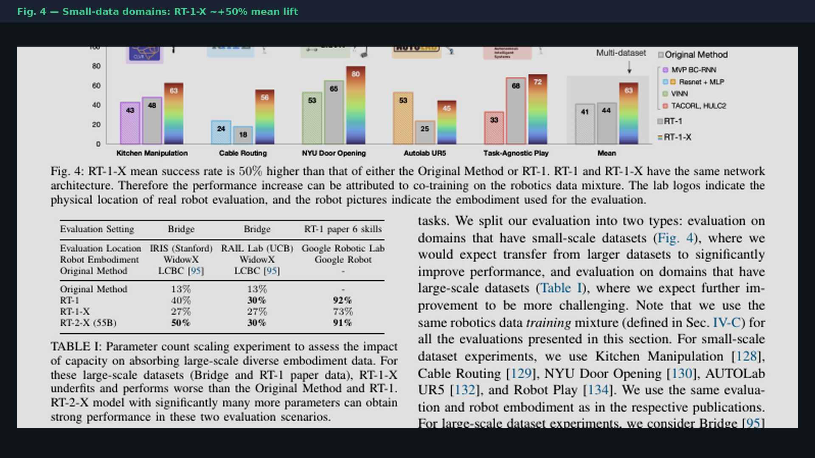
Stakeholder · 18+3 · 16/18
Notes:
PAPER FIG.4 crop — optional glance.

Slide 17
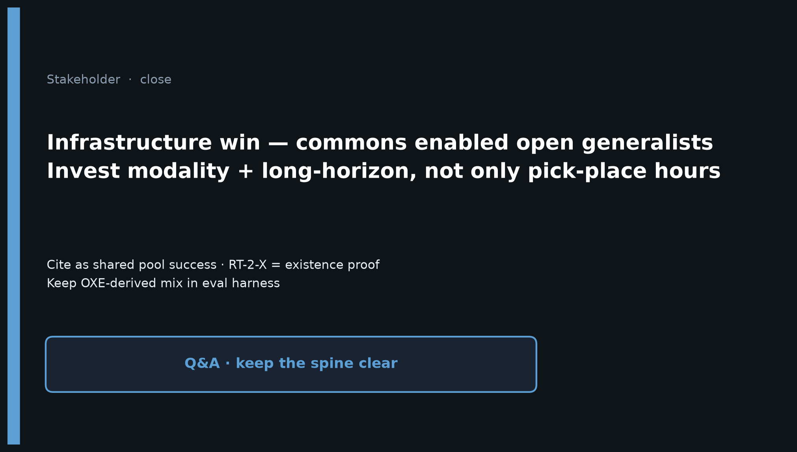
Stakeholder · 18+3 · 17/18
Notes:
CLOSE — Infrastructure win; cite as commons; invest modality + long-horizon; RT-2-X = existence proof not production VLA.

Slide 18
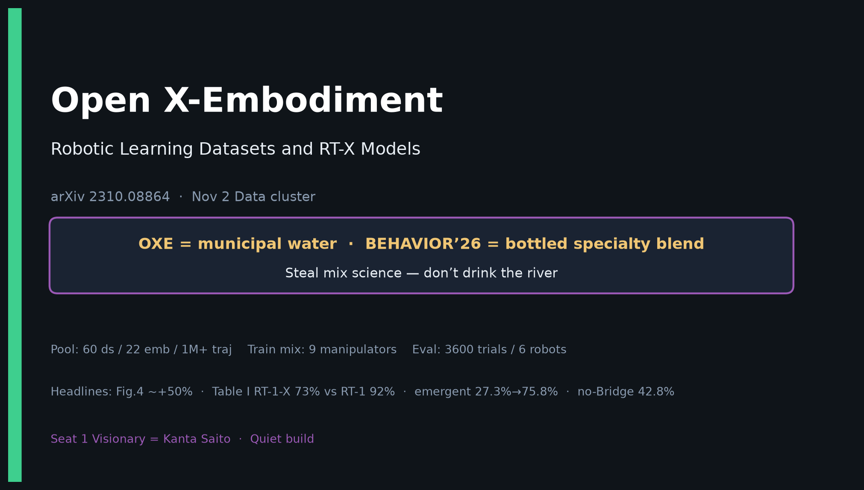
Stakeholder · 18+3 · 18/18
Notes:
COVER BACKUP.

