Slide 1
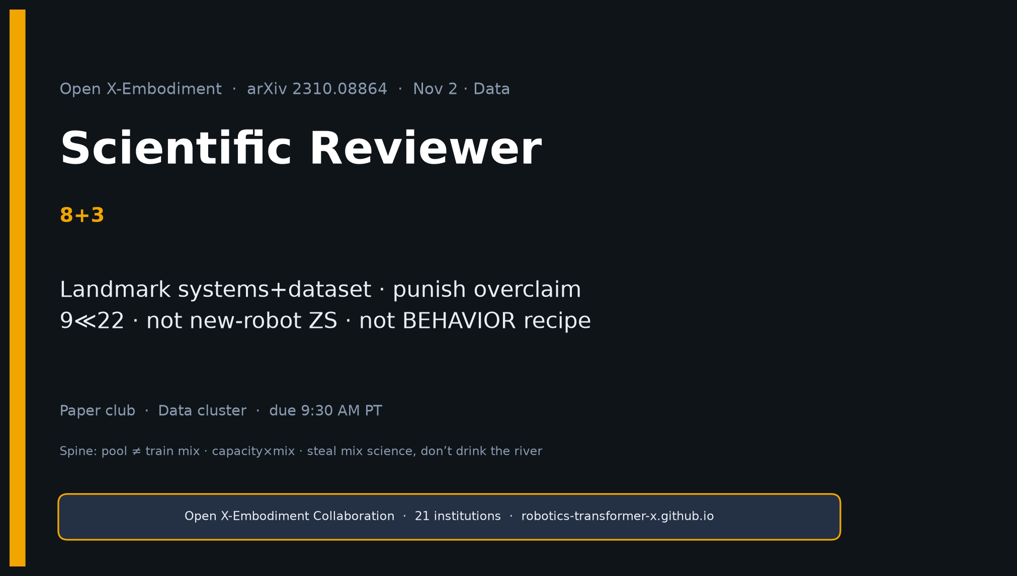
Scientific Reviewer · 8+3 · 1/12
Notes:
SCIENTIFIC REVIEWER — 8+3. Tight.
Holds: matched RT-1 vs RT-1-X isolates mix; capacity caveat honest; Bridge ablation.
Punish: “generalist X-robot” ≠ zero-shot new hardware; 9≪22 blur; PaLM skill ontology; 55B unrepro.
Verdict: landmark systems+dataset paper — not complete BEHAVIOR recipe.

Slide 2
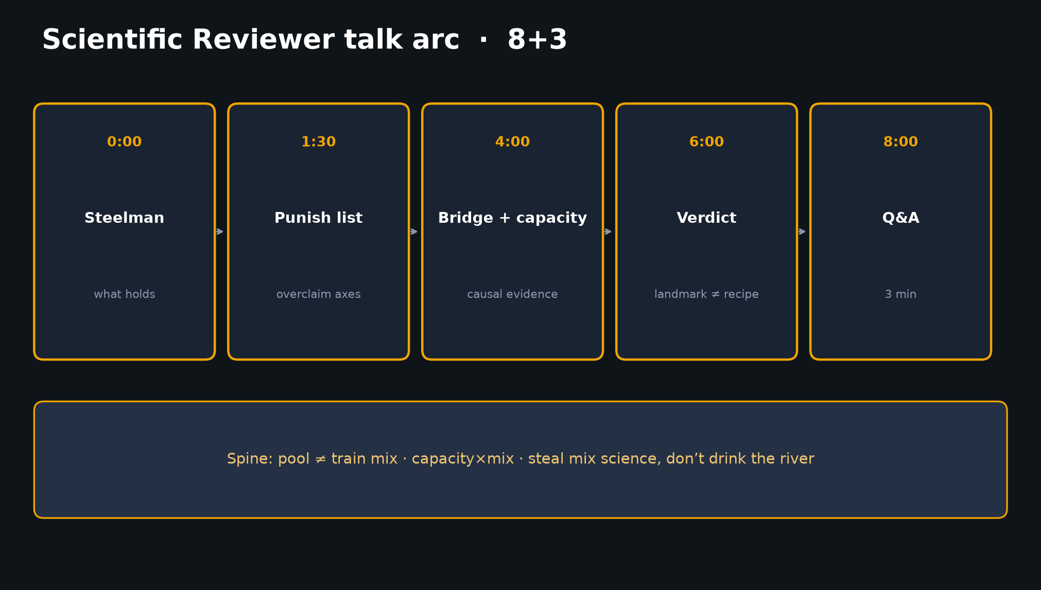
Scientific Reviewer · 8+3 · 2/12
Notes:
TALK ARC — 8 minutes. Do not overrun.
1) Steelman / holds ~90s
2) Punish list ~2.5m
3) Bridge + capacity evidence ~2m
4) Verdict ~90s
5) Q&A 3m

Slide 3
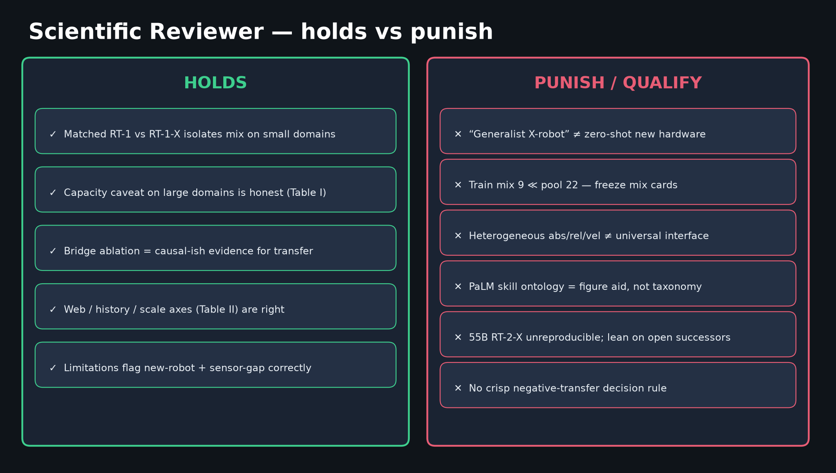
Scientific Reviewer · 8+3 · 3/12
Notes:
HOLDS VS PUNISH — THE critique board.
Lead with praise so critiques land. Then punish marketing blur and unreproducible 55B claims.
Demand frozen mix cards for every “X-embodiment” claim.
Causal identification caveat: Fig.4 confounds volume/diversity/language vs embodiment count per se — ask matched-hour controls.

Slide 4
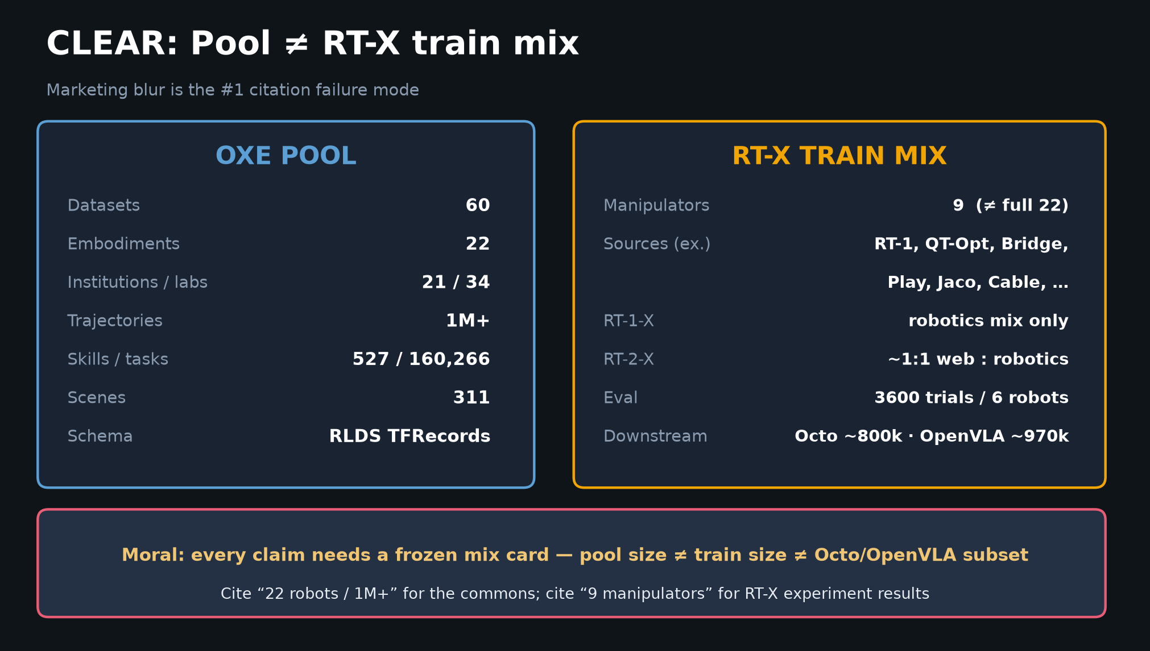
Scientific Reviewer · 8+3 · 4/12
Notes:
POOL ≠ MIX — punish 9≪22 blur explicitly.

Slide 5
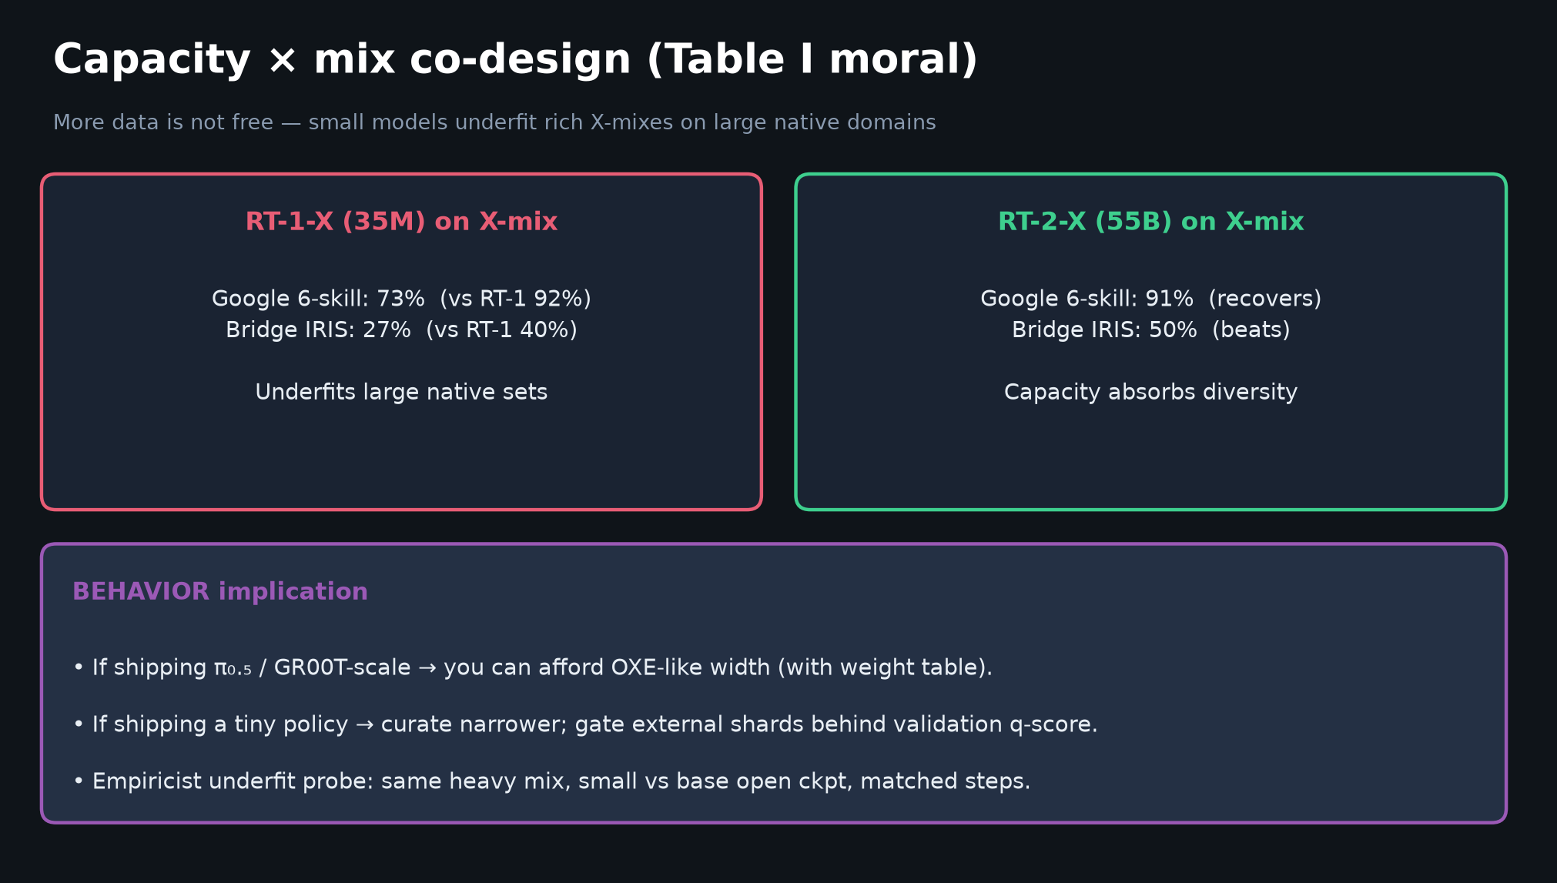
Scientific Reviewer · 8+3 · 5/12
Notes:
TABLE I — capacity caveat is scientifically honest. Positive transfer is conditional.

Slide 6
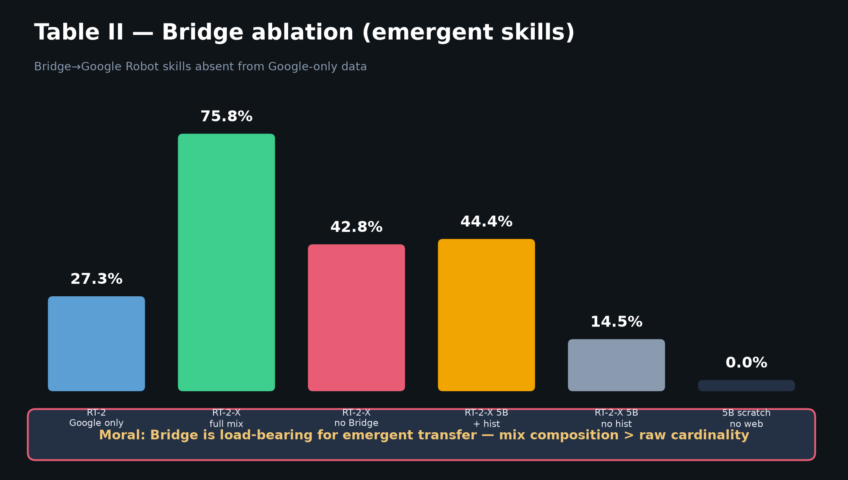
Scientific Reviewer · 8+3 · 6/12
Notes:
BRIDGE ABLATION — strongest causal-ish evidence in the paper. Praise this; demand more negative-transfer analysis.

Slide 7
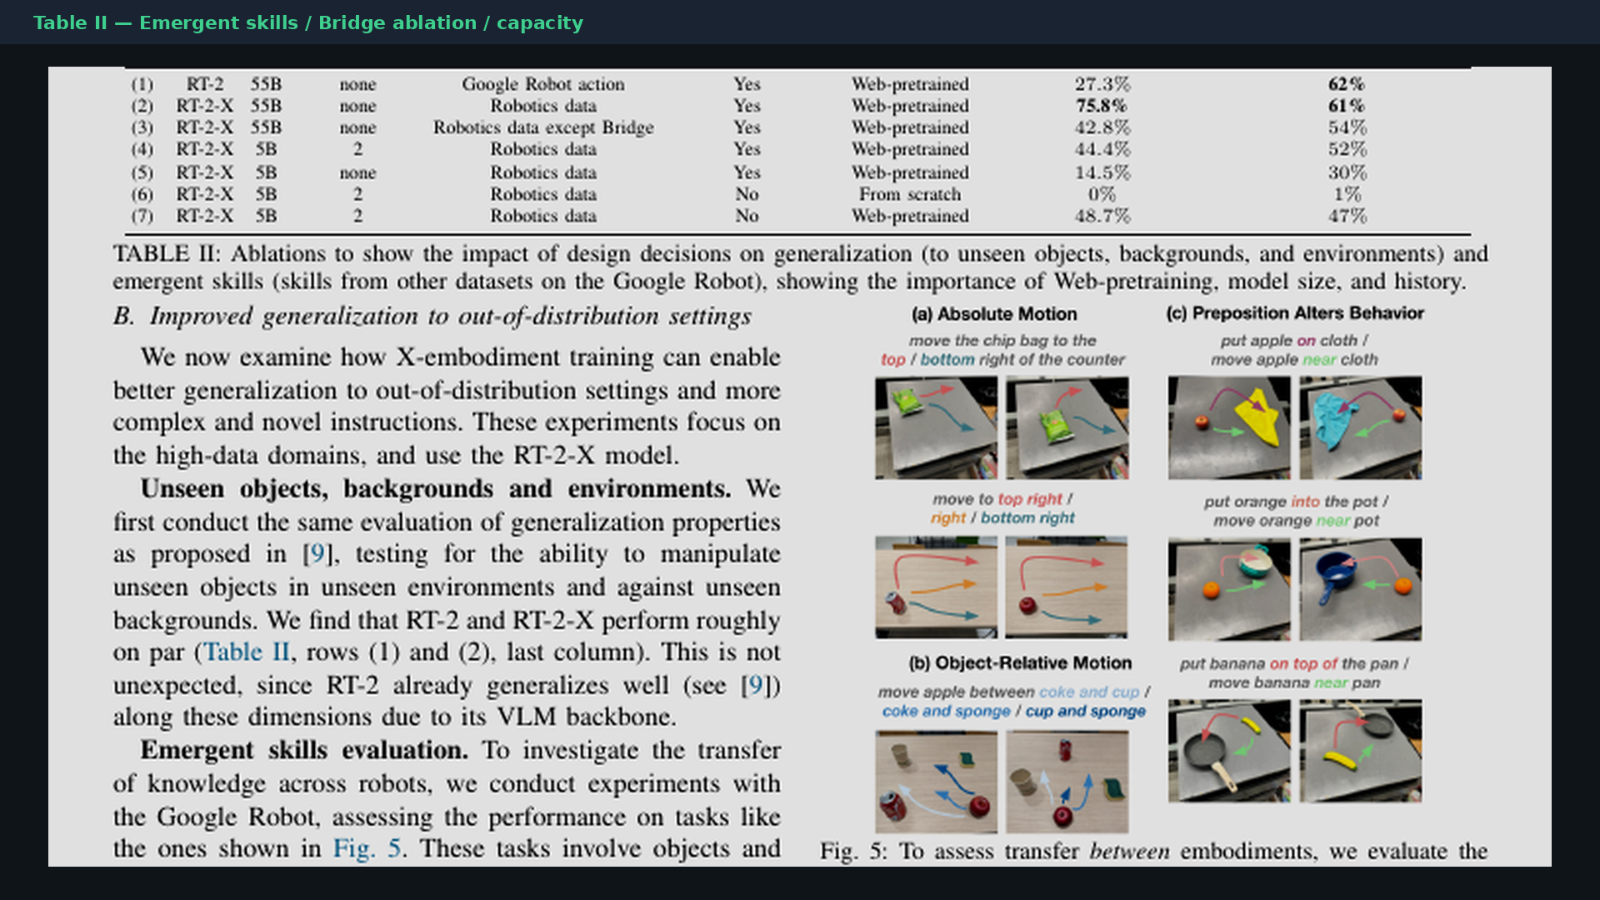
Scientific Reviewer · 8+3 · 7/12
Notes:
PAPER TABLE II crop — emergent + ablations.

Slide 8
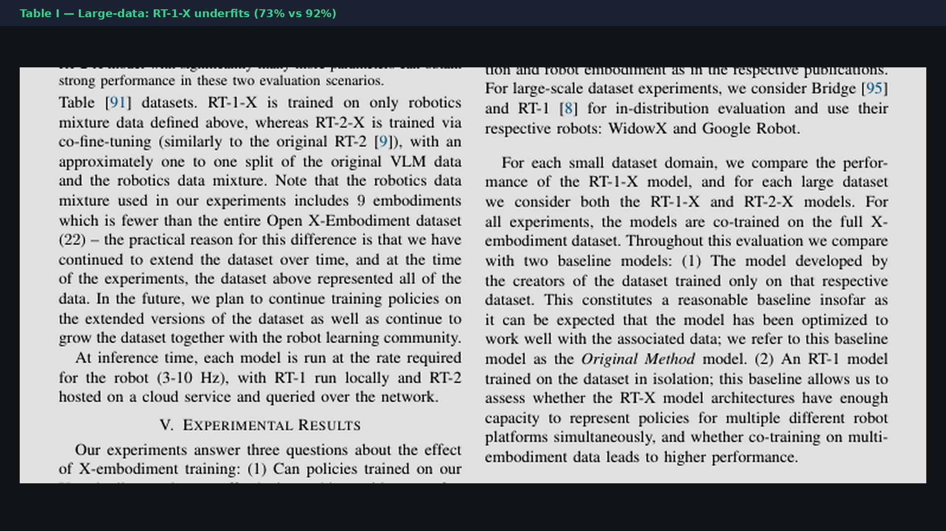
Scientific Reviewer · 8+3 · 8/12
Notes:
PAPER TABLE I crop.

Slide 9
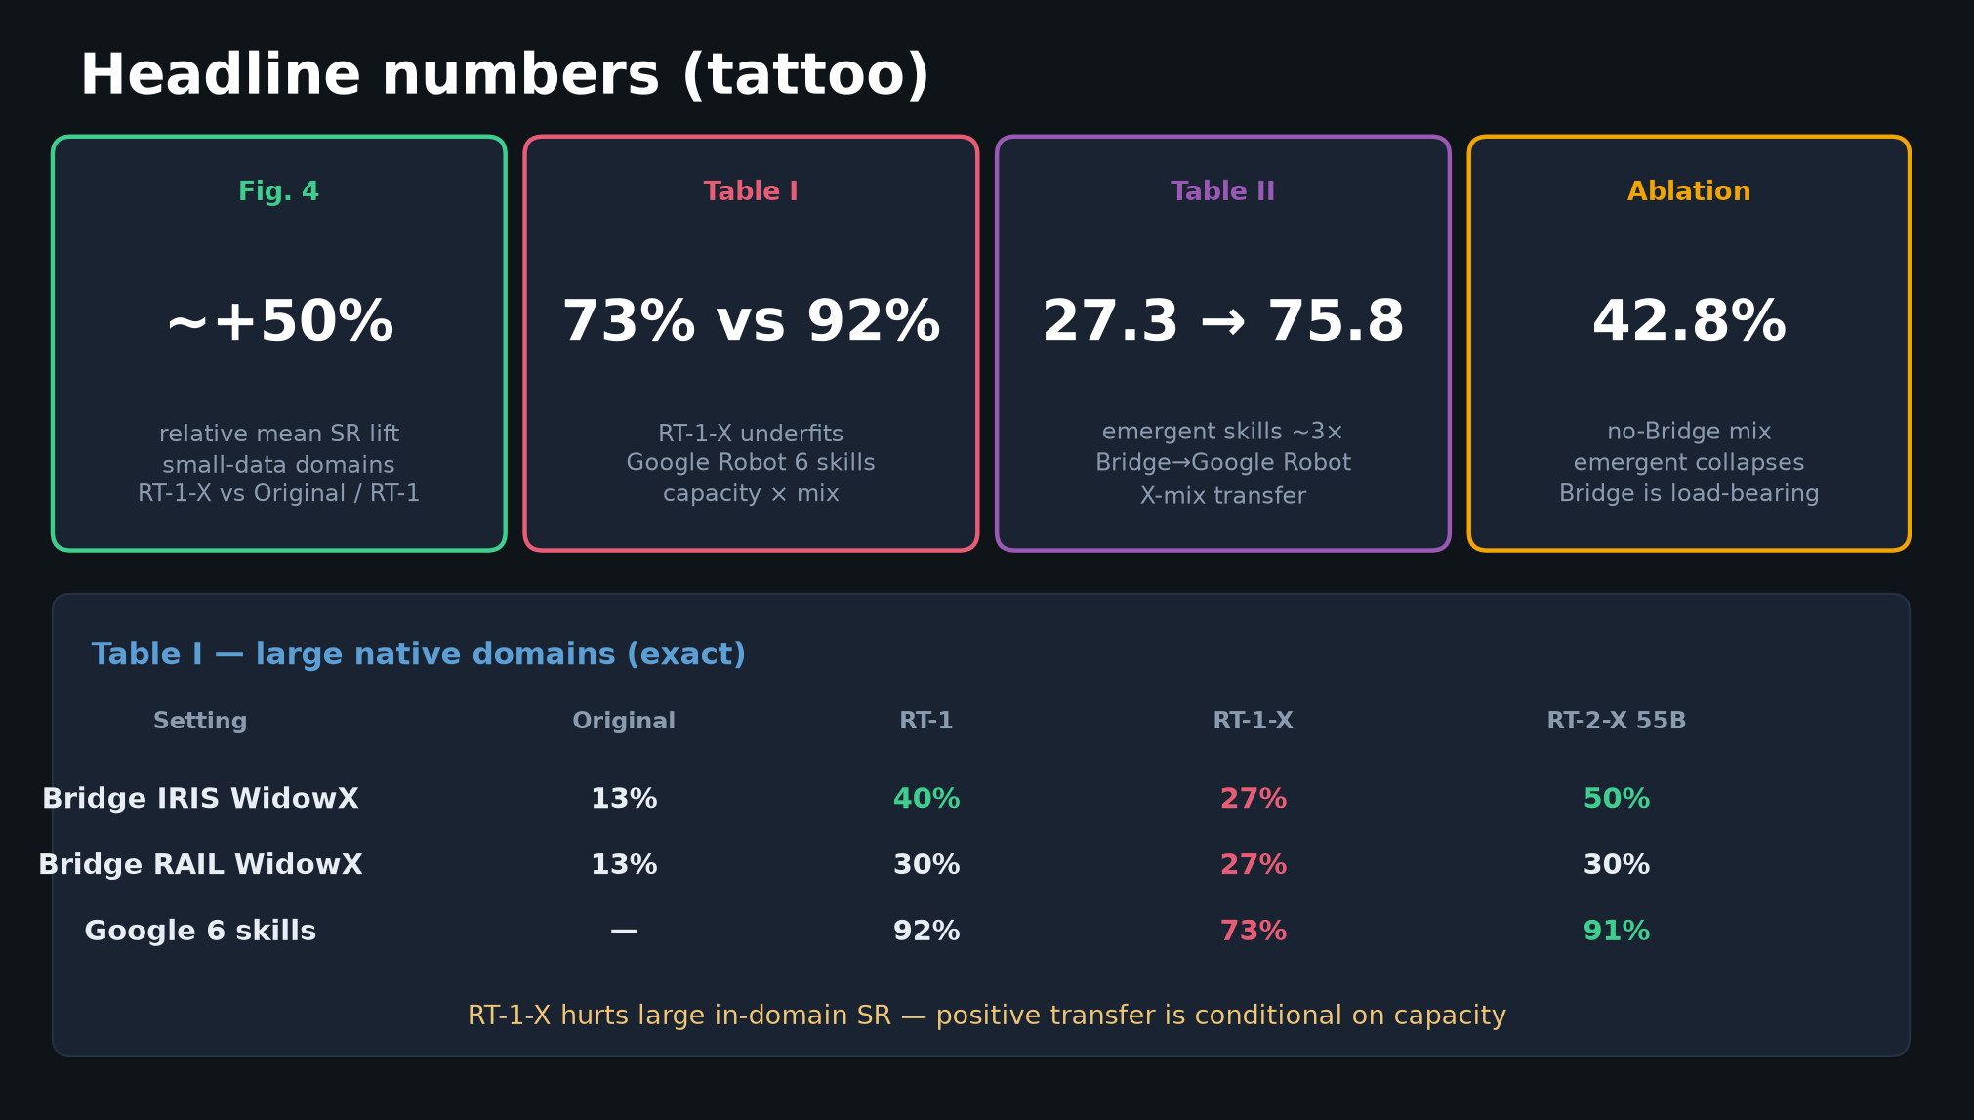
Scientific Reviewer · 8+3 · 9/12
Notes:
HEADLINES with reporting discipline — pair every % with setting.

Slide 10
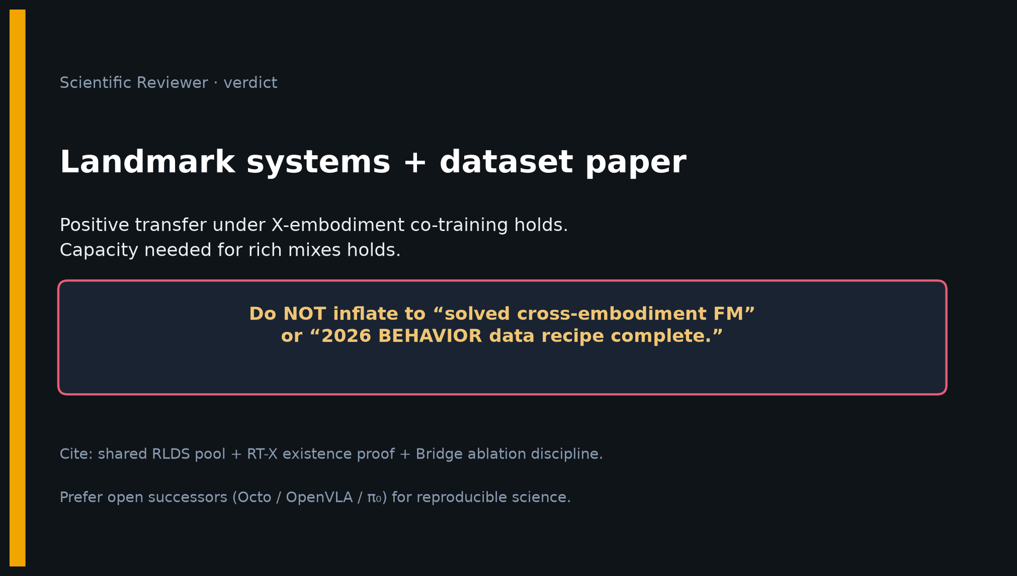
Scientific Reviewer · 8+3 · 10/12
Notes:
VERDICT slide.
Landmark systems+dataset. Core holds. Do not inflate to solved cross-embodiment FM or complete BEHAVIOR recipe.
Prefer open successors for reproducible science.

Slide 11
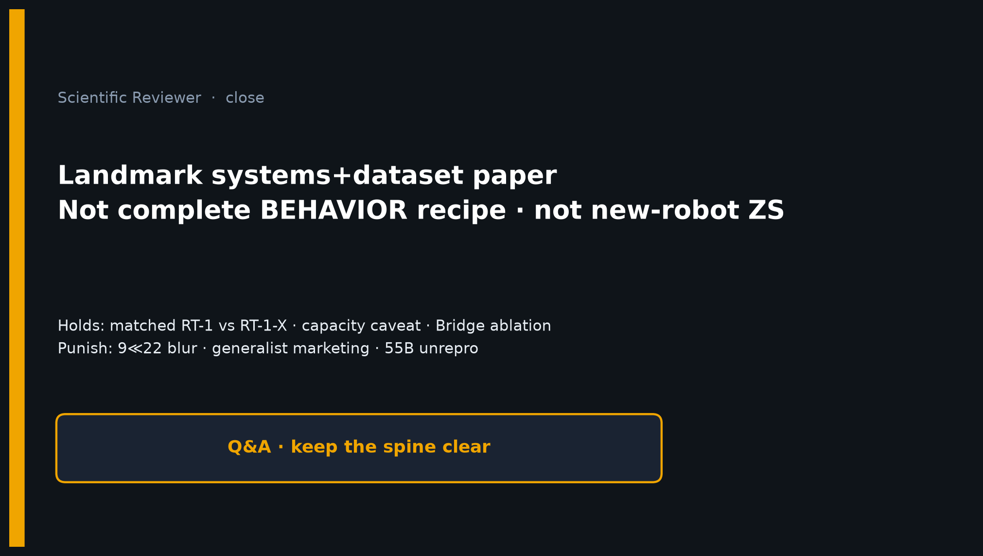
Scientific Reviewer · 8+3 · 11/12
Notes:
CLOSE / Q&A — new-robot generalization? matched-trajectory controls? when does adding a dataset hurt?

Slide 12
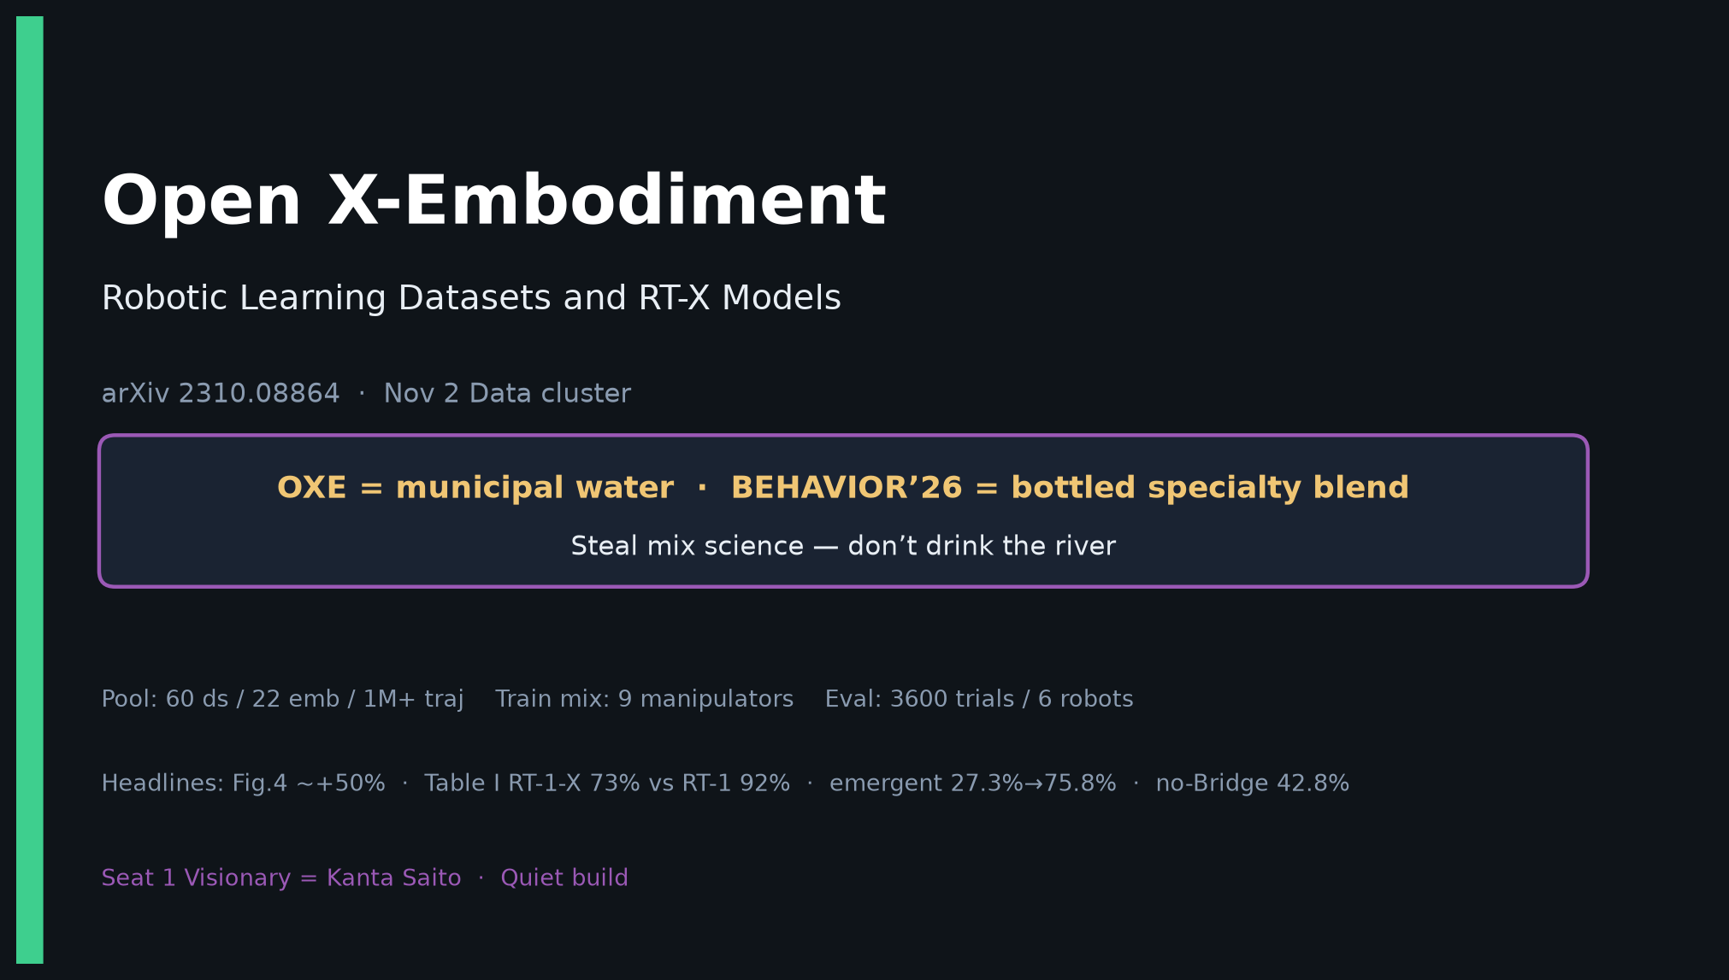
Scientific Reviewer · 8+3 · 12/12
Notes:
COVER BACKUP.

