Slide 1
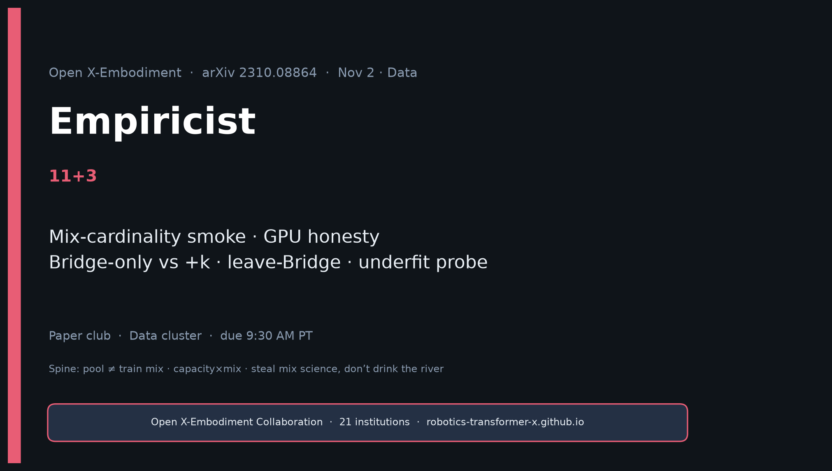
Empiricist · 11+3 · 1/14
Notes:
EMPIRICIST — 11+3. Mix-cardinality smoke. GPU honesty.
P0 Y: RLDS shard inventory/loader smoke; mix-cardinality (Bridge-only vs +2 vs +5) on open policy FT
P0 Partial: Leave-Bridge-out (Table II moral)
P1: small-domain lift; capacity×mix; embodiment LOO; same mix → Octo/OpenVLA/π₀
Defer: Full RT-1-X / RT-2-X retrain; TB-class full OXE mirror
Separate pool vs RT-X mix vs Octo 800k vs OpenVLA 970k.

Slide 2
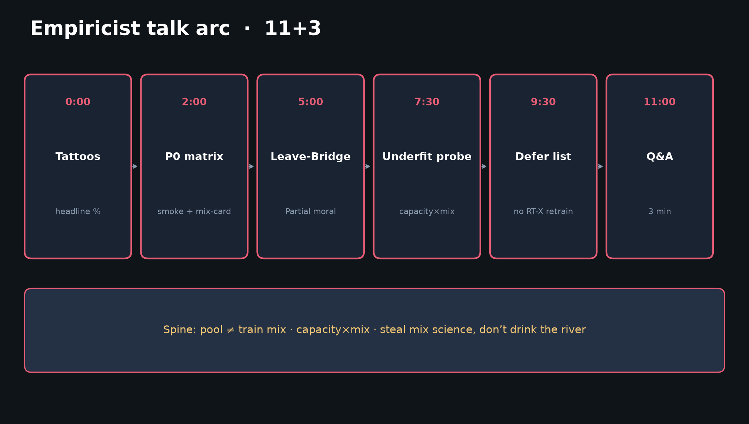
Empiricist · 11+3 · 2/14
Notes:
TALK ARC — tattoos → P0 matrix → leave-Bridge → underfit → defer.

Slide 3
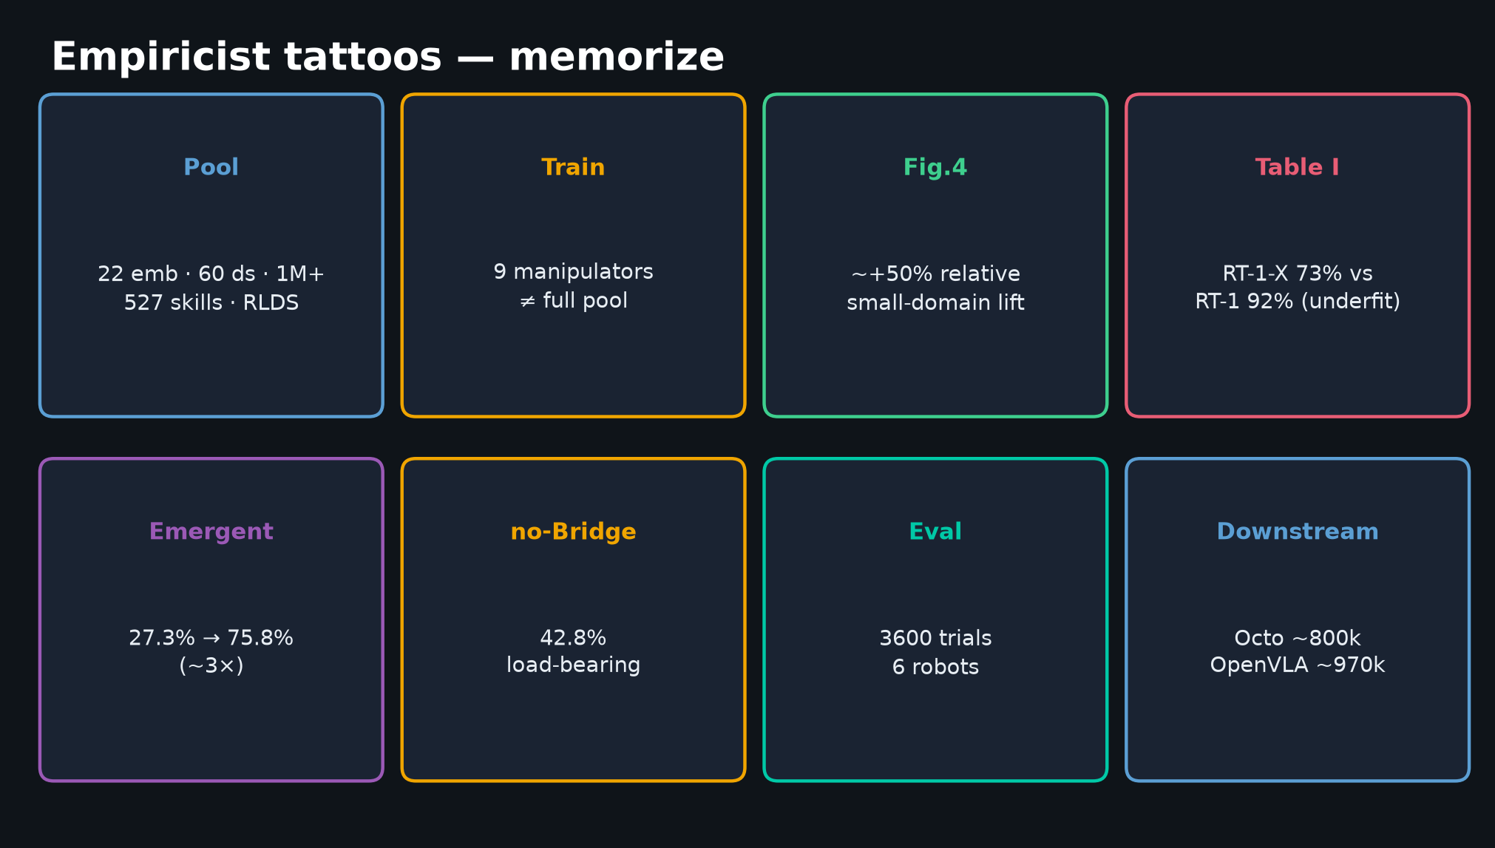
Empiricist · 11+3 · 3/14
Notes:
TATTOOS — memorize before any smoke run.
22/60/1M+ · 9 manipulators · +50% · 73 vs 92 · 27.3→75.8 · no-Bridge 42.8 · 3600/6 · Octo 800k / OpenVLA 970k.

Slide 4
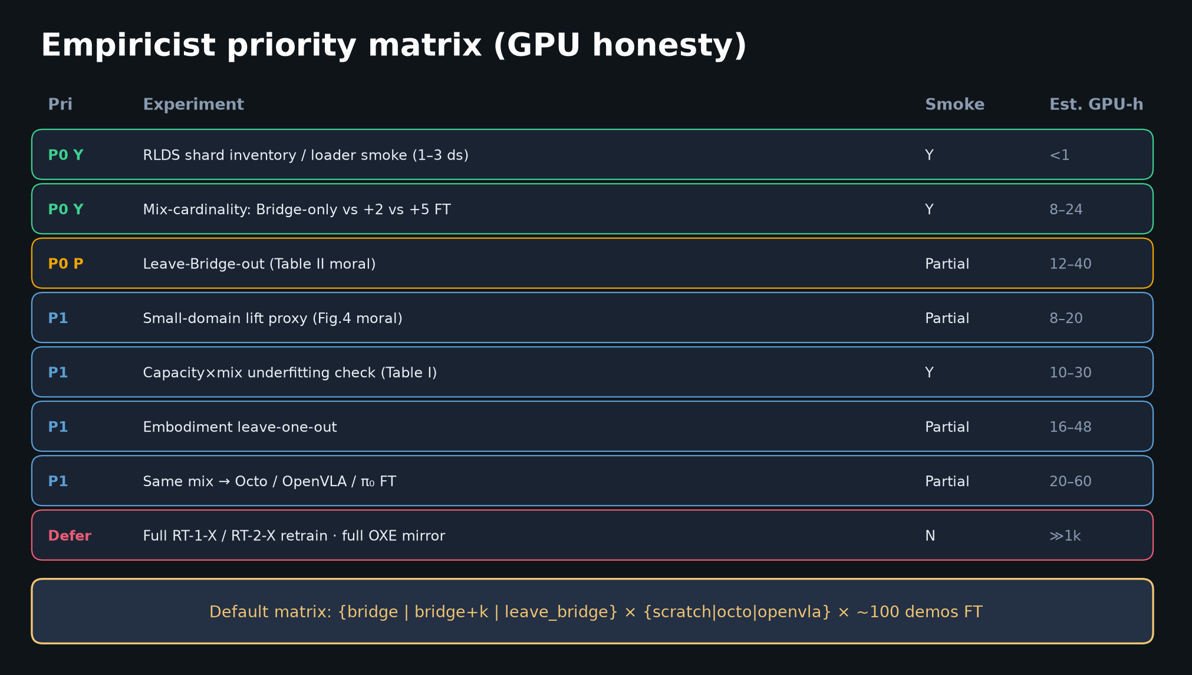
Empiricist · 11+3 · 4/14
Notes:
PRIORITY MATRIX — default Empiricist surface.
Smoke success = working subset loader + ≥2 mix cards with directional SR/MSE + GPU/disk logs.
NOT multi-lab RT-X parity.

Slide 5
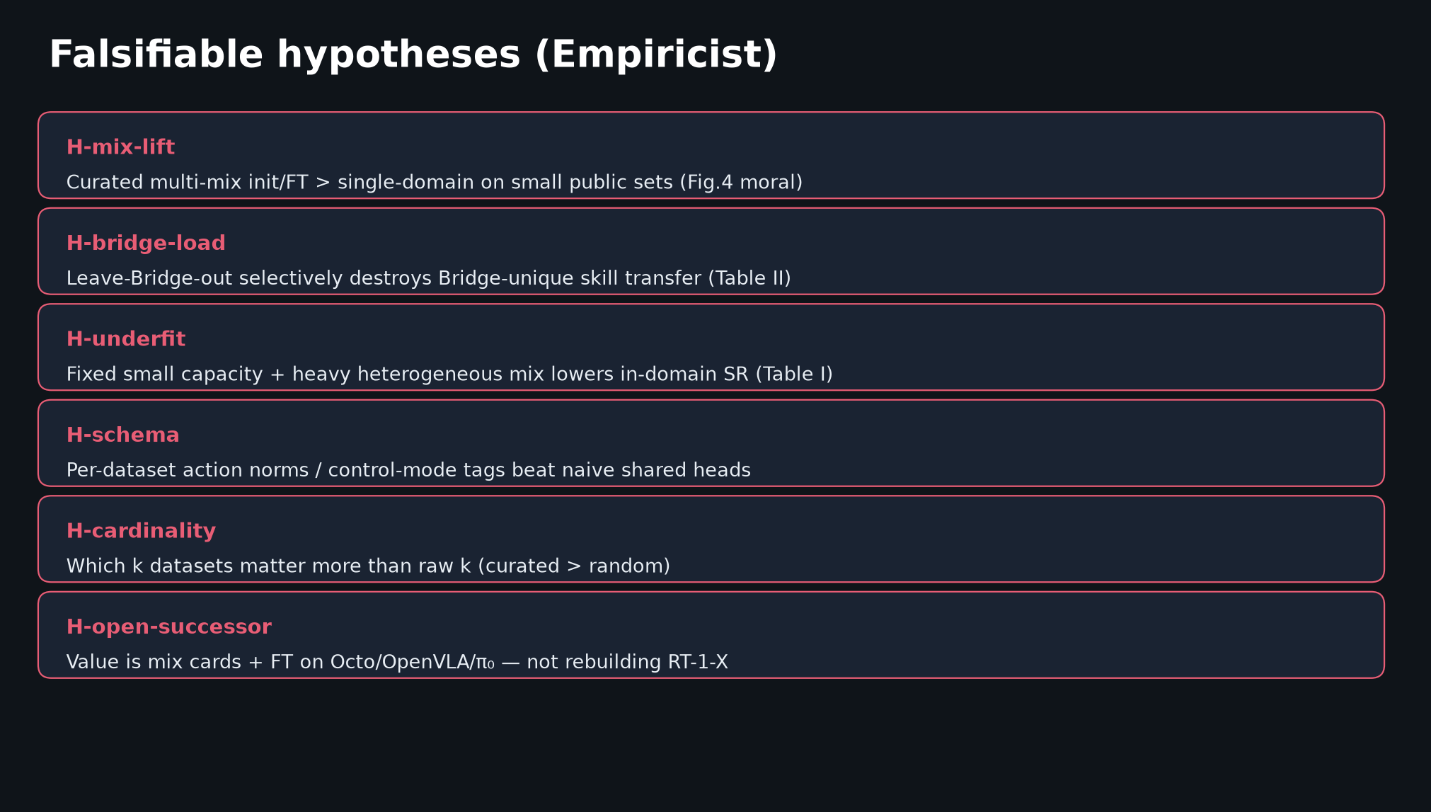
Empiricist · 11+3 · 5/14
Notes:
HYPOTHESES — falsifiable. State H-mix-lift / H-bridge-load / H-underfit as primary.
Falsifiers: mix≈scratch; leave-Bridge≈full; small never underfits; untagged≈tagged; random k = curated k.

Slide 6
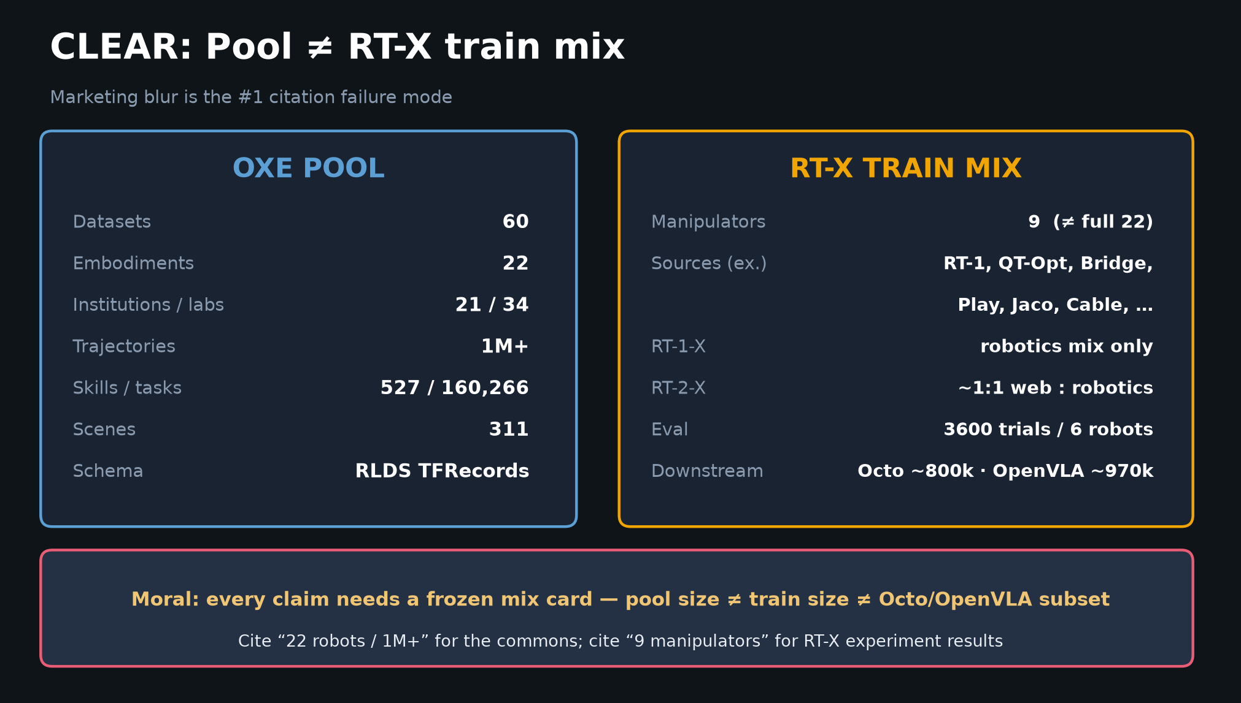
Empiricist · 11+3 · 6/14
Notes:
POOL ≠ MIX — log which one you actually downloaded.

Slide 7
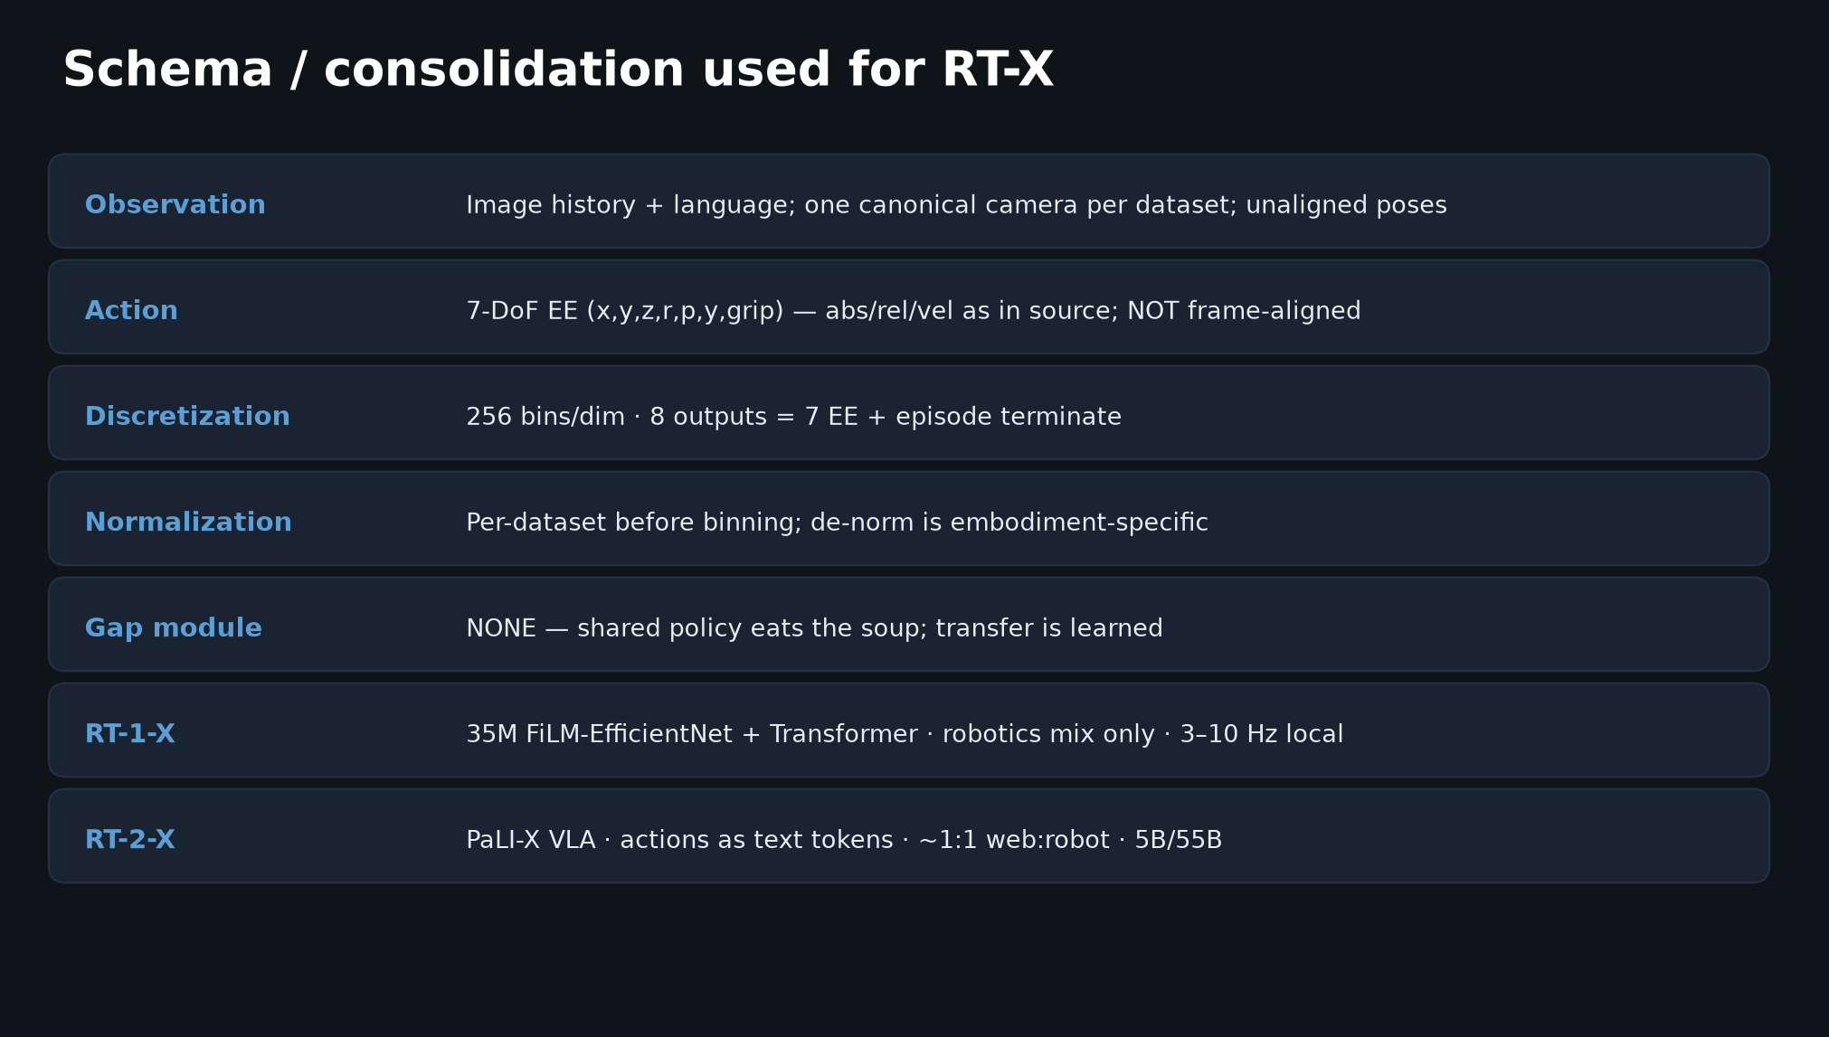
Empiricist · 11+3 · 7/14
Notes:
SCHEMA hygiene — always log (embodiment_id, control_mode, action_dim, cam_keys, lang_frac) + mix card hash.

Slide 8
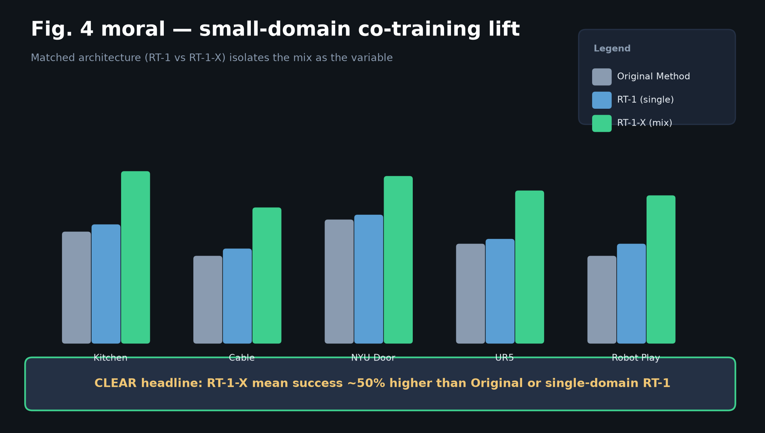
Empiricist · 11+3 · 8/14
Notes:
FIG.4 lift — directional target for small-domain proxy; do NOT claim +50% from Partial single-domain smoke.

Slide 9
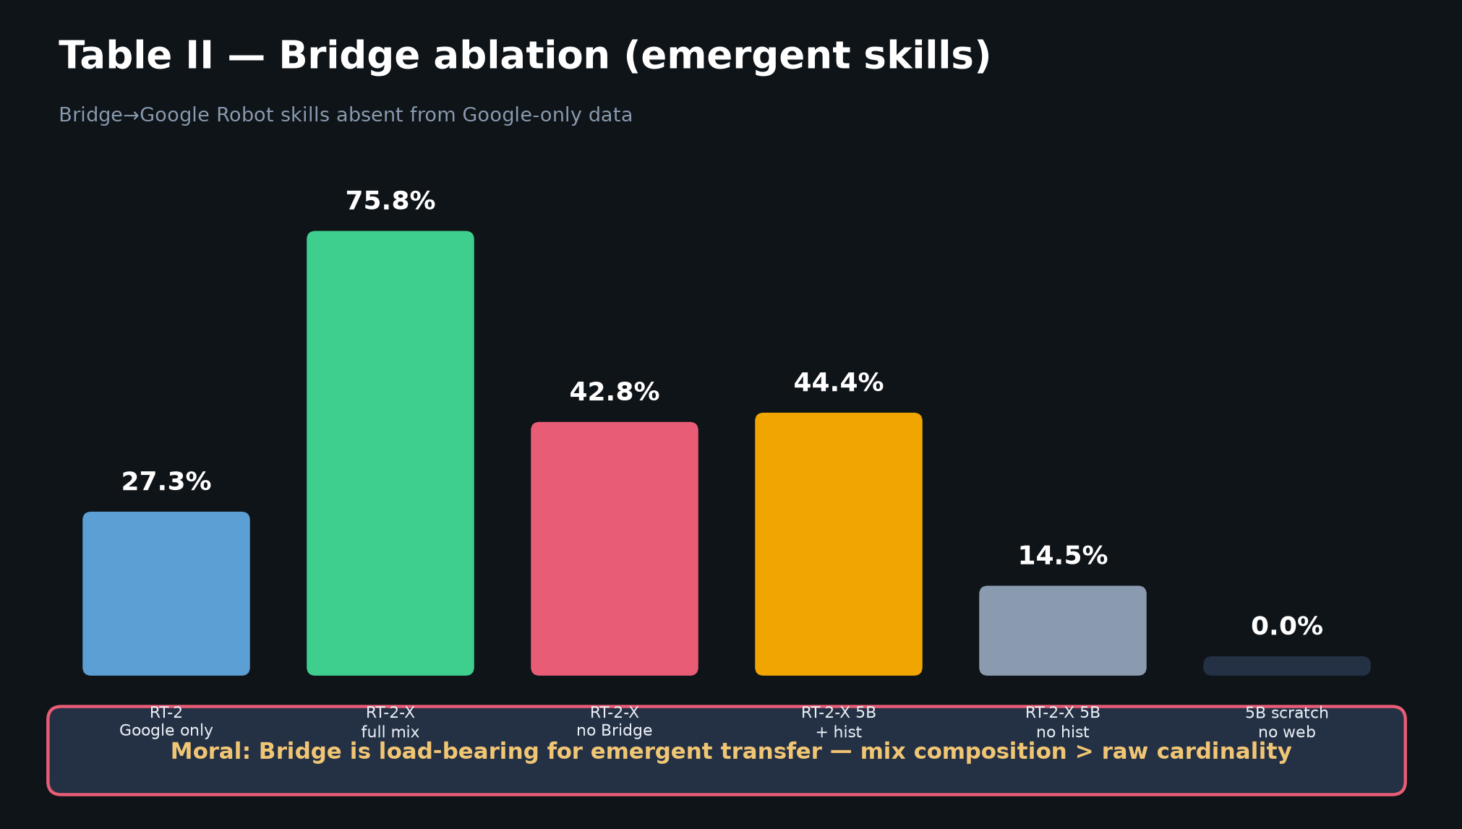
Empiricist · 11+3 · 9/14
Notes:
BRIDGE ABLATION — Partial leave-Bridge-out moral; exact 75.8→42.8 not required on Google Robot protocol.

Slide 10
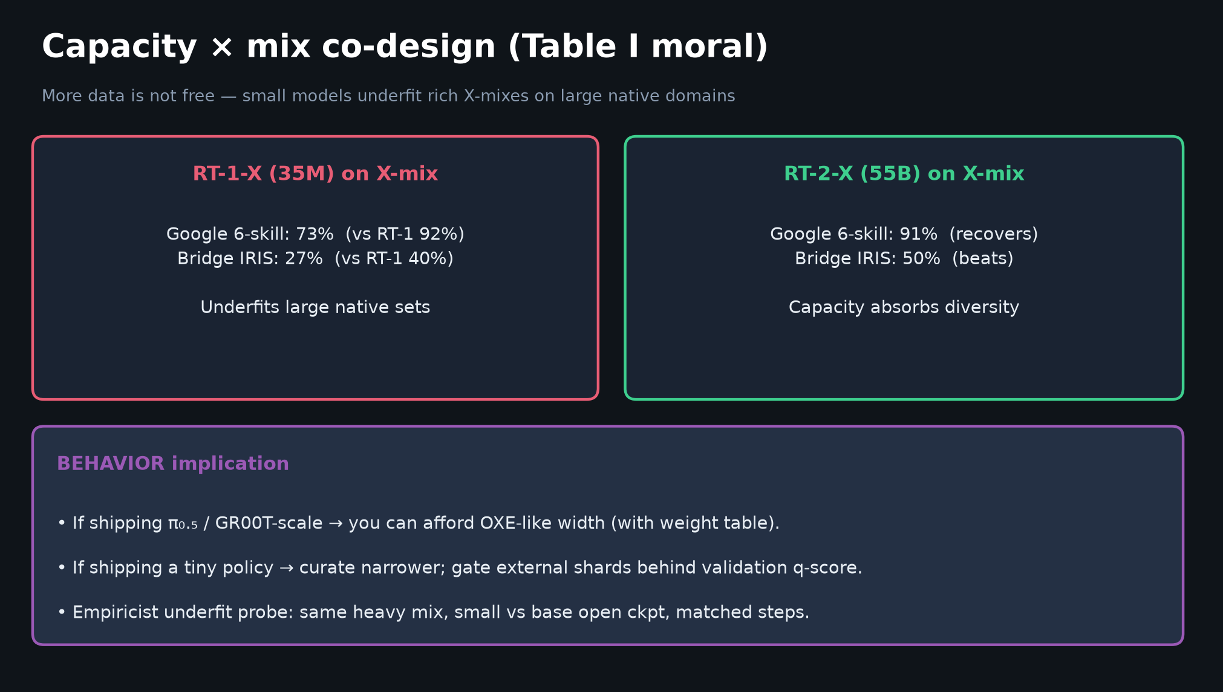
Empiricist · 11+3 · 10/14
Notes:
CAPACITY × MIX underfit probe — small vs base open ckpt on same heavy mix.

Slide 11
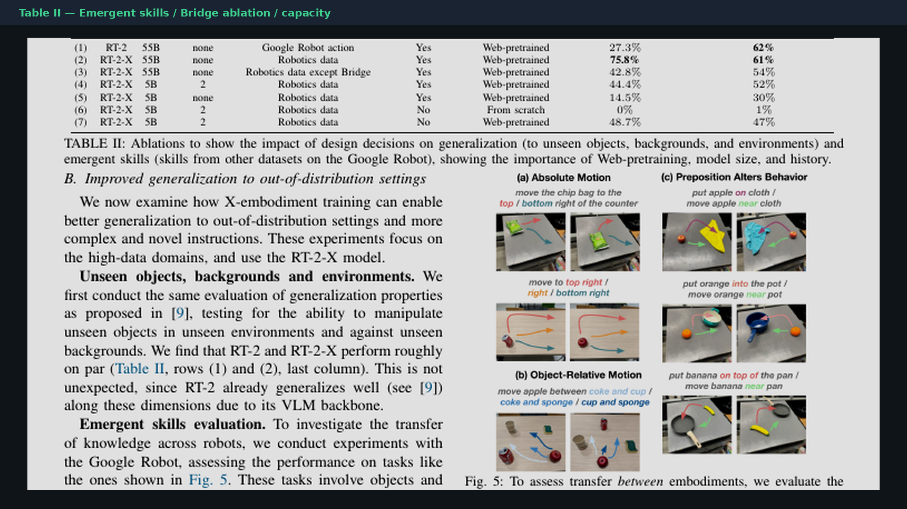
Empiricist · 11+3 · 11/14
Notes:
PAPER TABLE II — reference for ablation design.

Slide 12
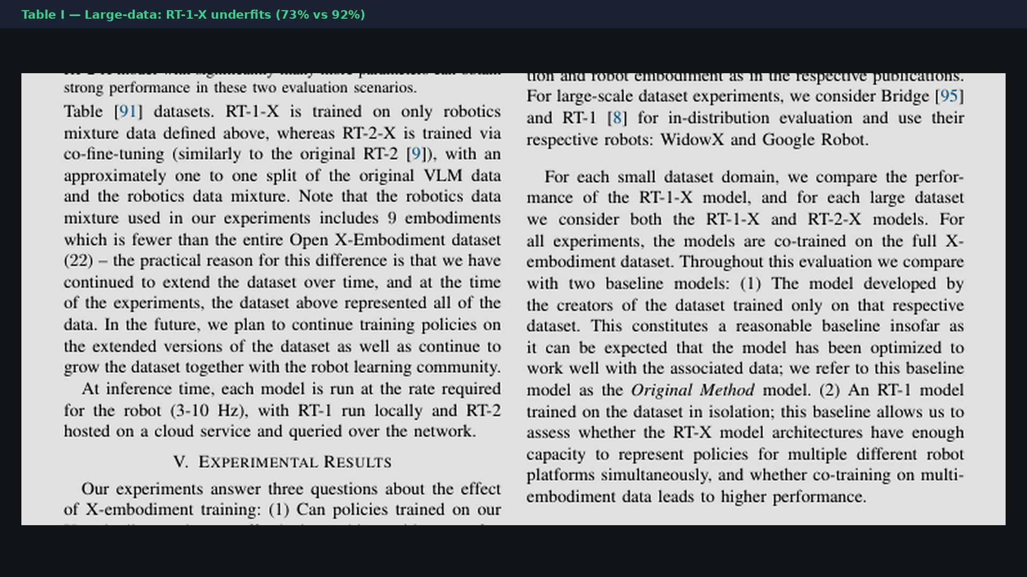
Empiricist · 11+3 · 12/14
Notes:
PAPER TABLE I — underfit numbers.

Slide 13
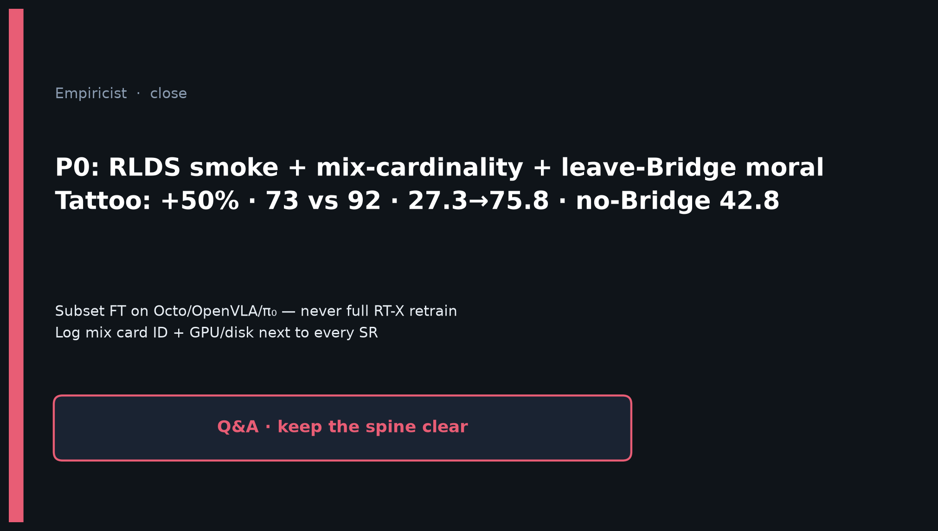
Empiricist · 11+3 · 13/14
Notes:
CLOSE — P0 smoke + mix-cardinality; never full RT-X retrain; log mix card + GPU next to every SR.

Slide 14
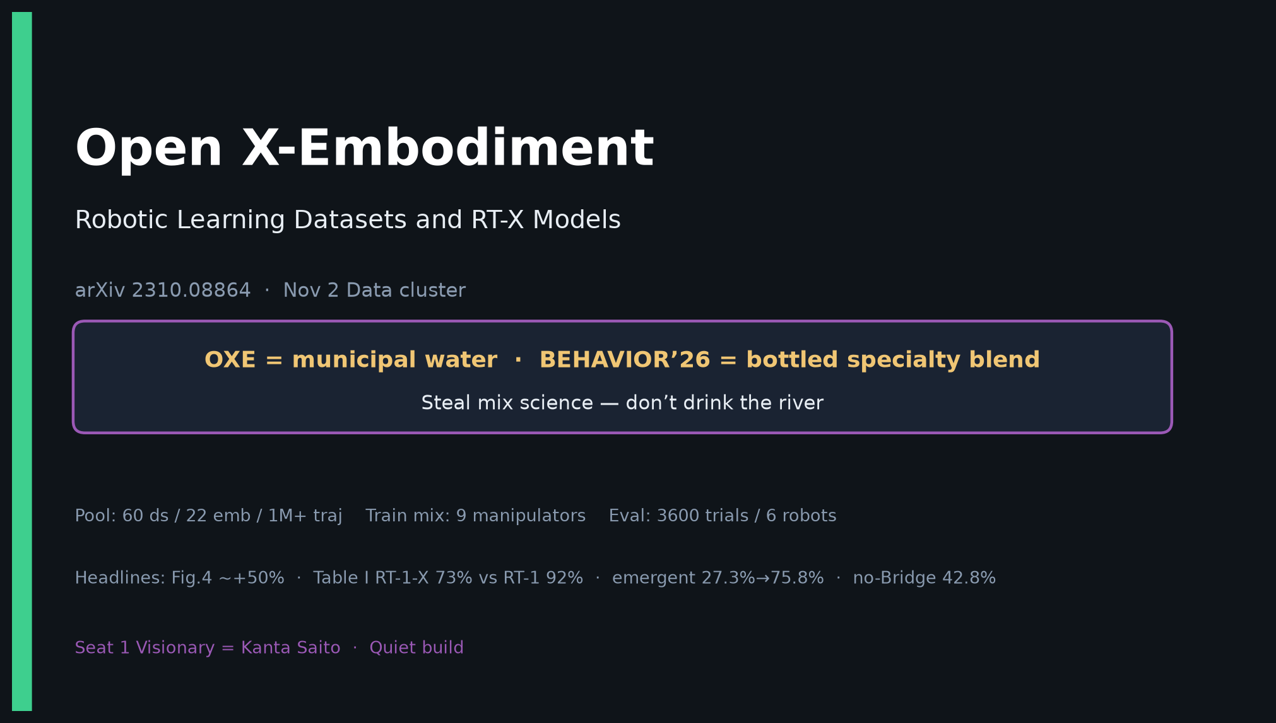
Empiricist · 11+3 · 14/14
Notes:
COVER BACKUP.

