Slide 1
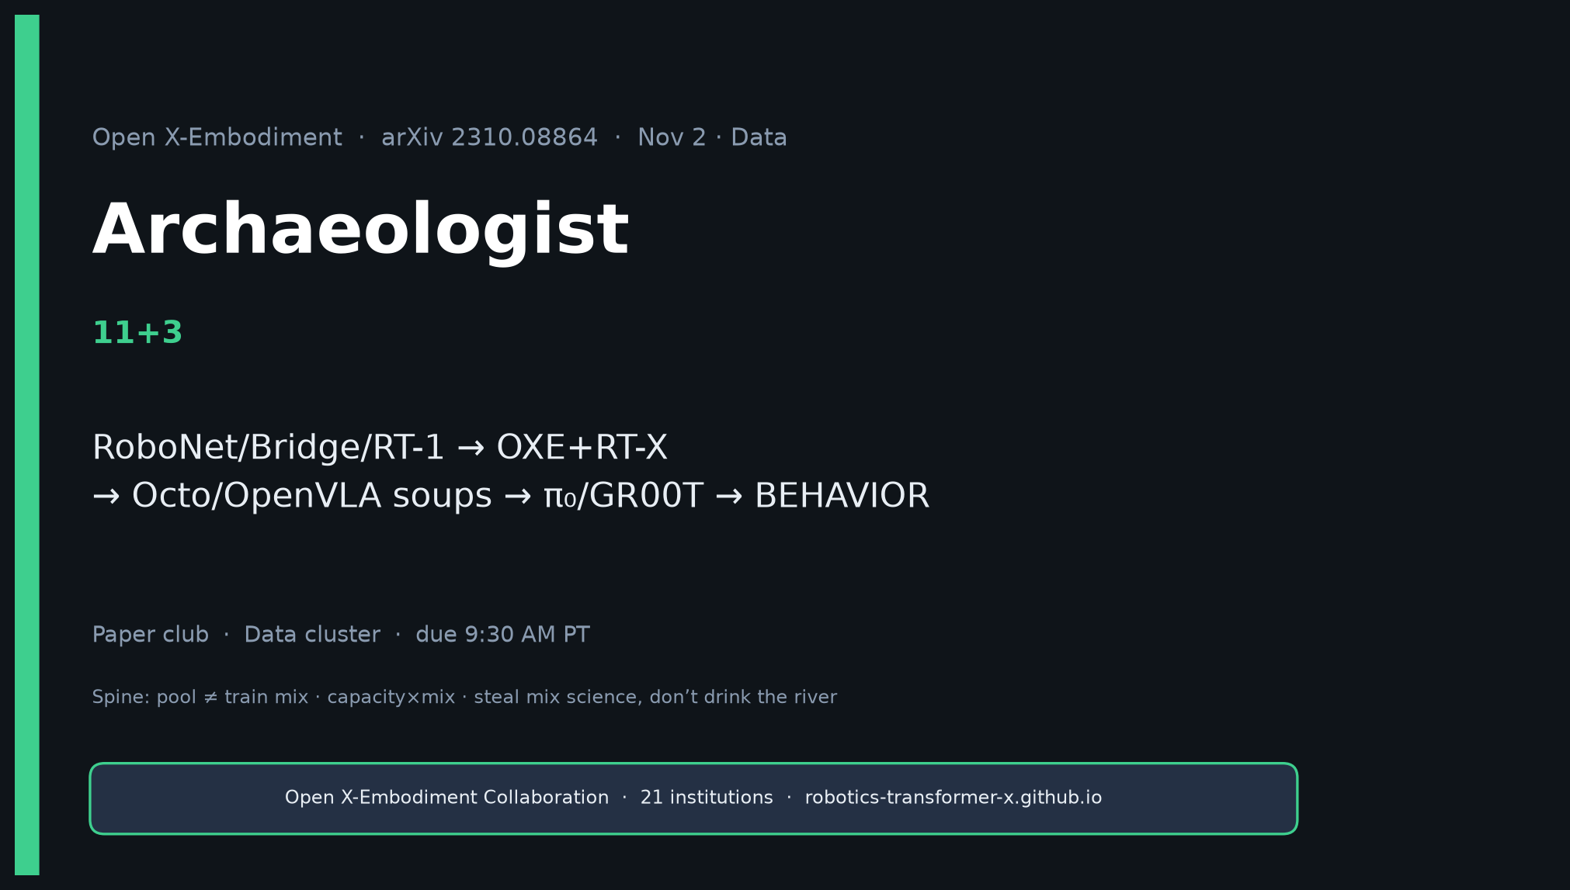
Archaeologist · 11+3 · 1/14
Notes:
ARCHAEOLOGIST — 11+3. OXE → soups → BEHAVIOR.
Genealogy MUST:
RoboNet/lab demos/QT-Opt/Bridge/RT-1 → OXE+RT-X → Octo/OpenVLA soups → π₀/OpenPI/π₀.₅/GR00T → BEHAVIOR’25–’26.
OXE replaced single-lab pretrain assumption; did NOT replace need for post-train demos, wrist/proprio, continuous chunks, challenge sim alignment.

Slide 2
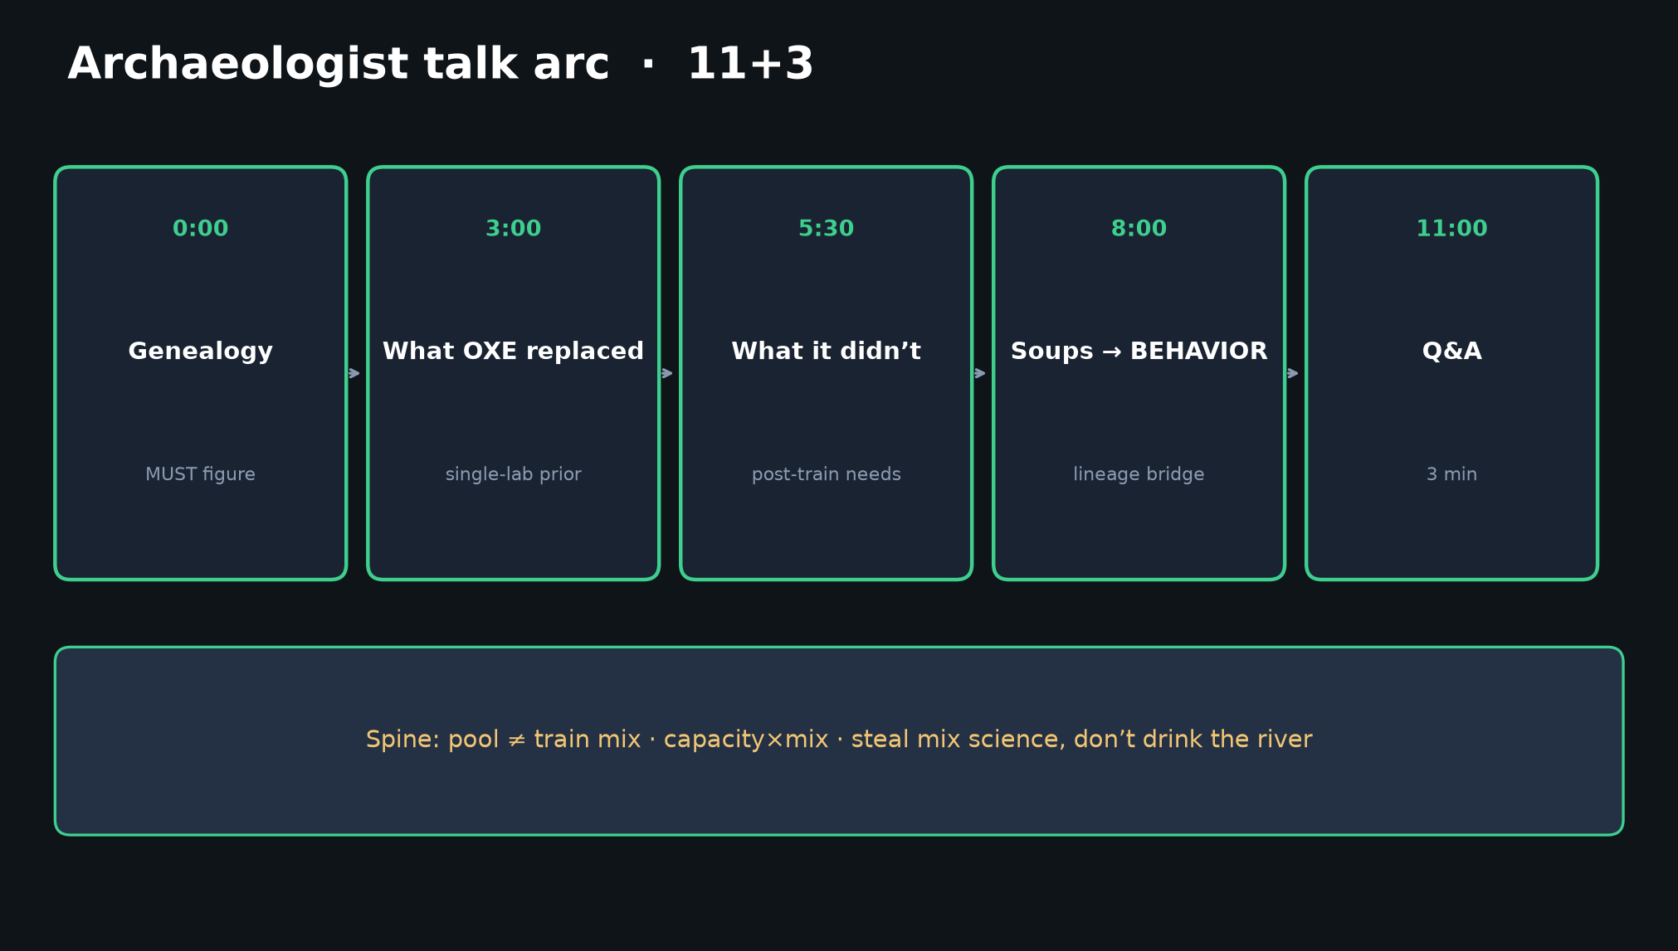
Archaeologist · 11+3 · 2/14
Notes:
TALK ARC — genealogy first, then replaced / not replaced, then soups bridge.

Slide 3
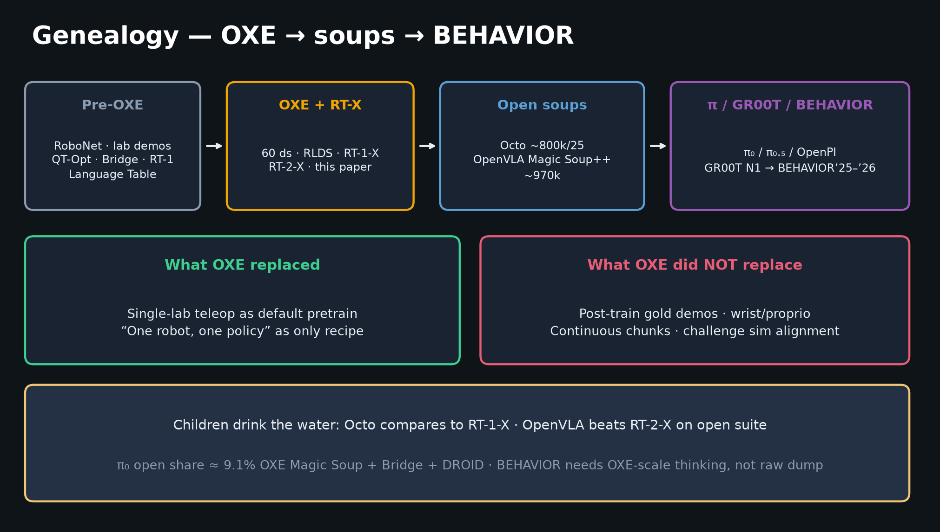
Archaeologist · 11+3 · 3/14
Notes:
GENEALOGY — THE MUST FIGURE. Spend ~3 minutes walking the arrows.
Children: Octo curated OXE; OpenVLA Magic Soup++; π₀ open fraction 9.1%; FAST fixes AR bins; BEHAVIOR needs OXE-scale thinking not raw dump.

Slide 4
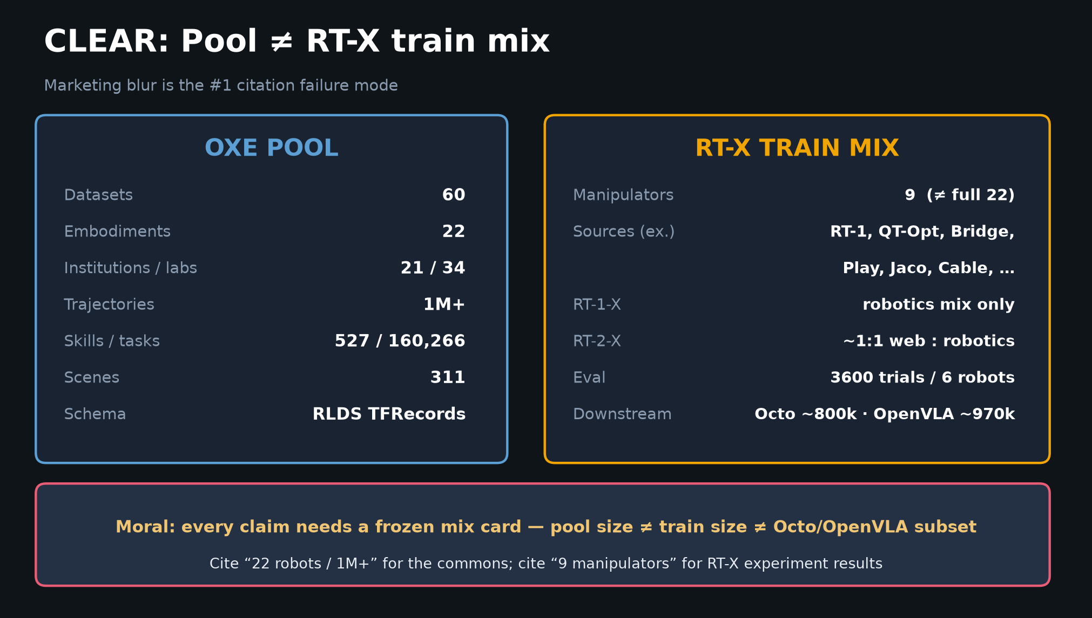
Archaeologist · 11+3 · 4/14
Notes:
POOL ≠ MIX historically — dataset grew after reported runs; experimental mix froze at 9. Later soups are curated subsets, not the river.

Slide 5
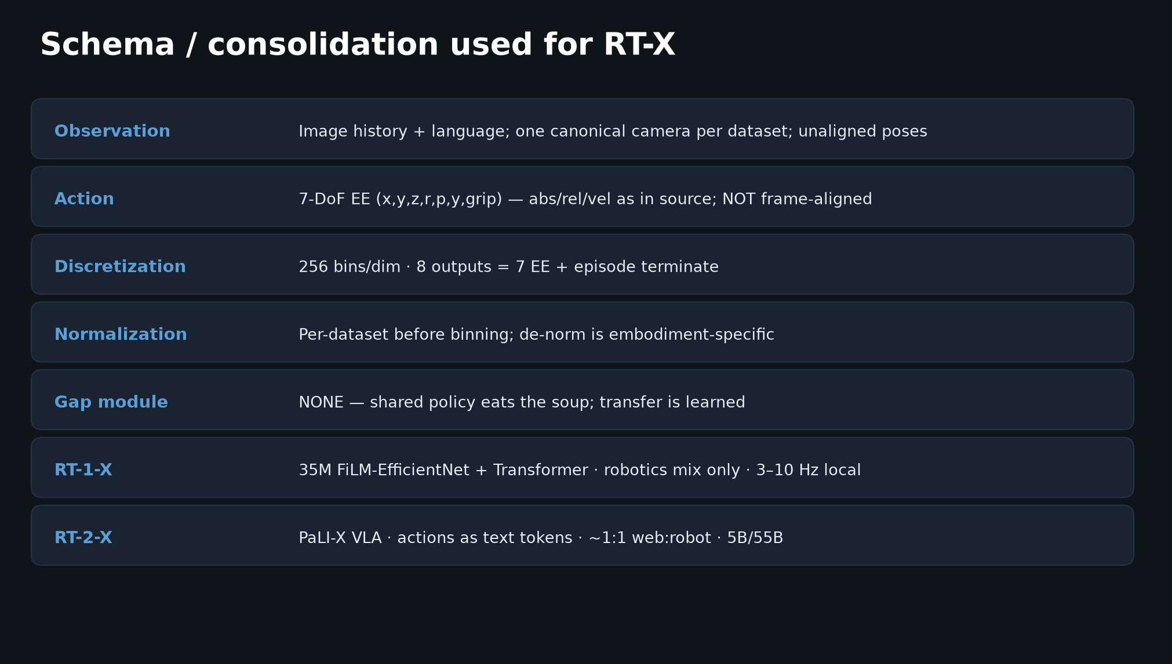
Archaeologist · 11+3 · 5/14
Notes:
SCHEMA as historical compromise — coarse 7-DoF EE, no frame alignment, no gap module. Good enough to show transfer; later packs fixed action heads.

Slide 6
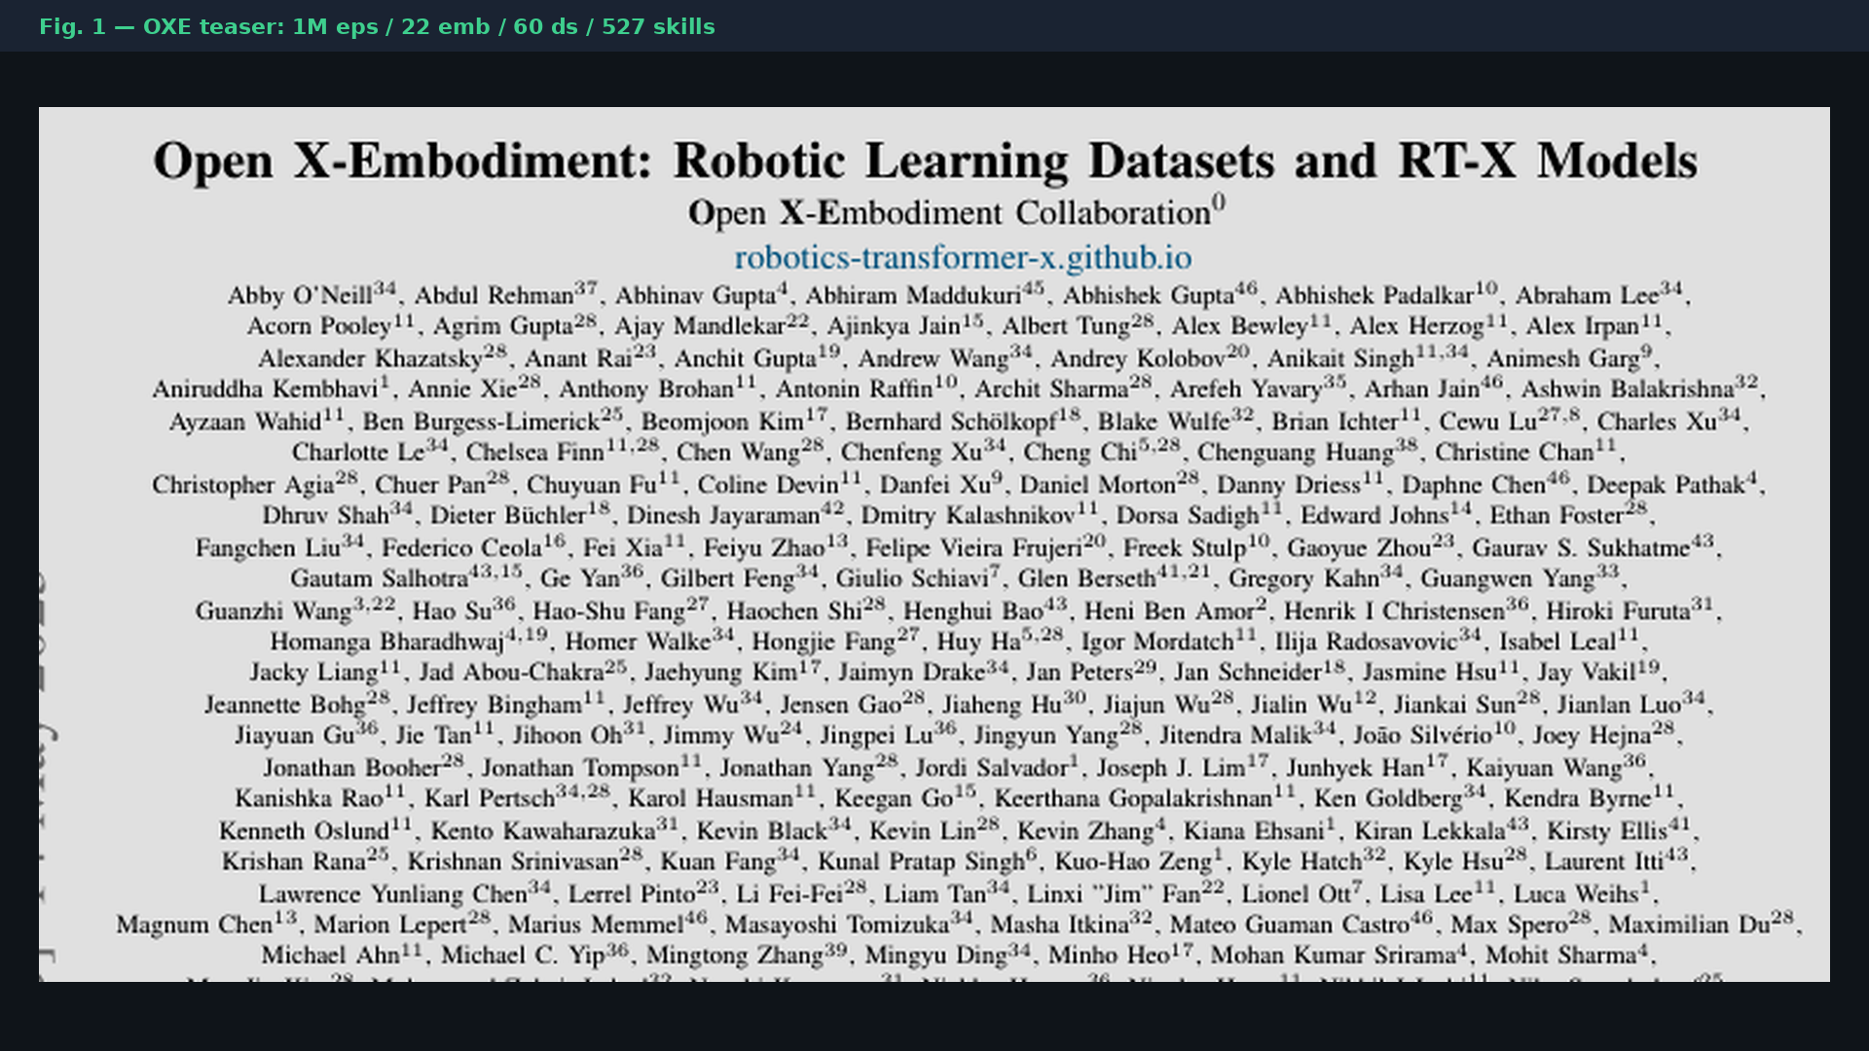
Archaeologist · 11+3 · 6/14
Notes:
PAPER FIG.1 — the teaser that defined the commons era.

Slide 7
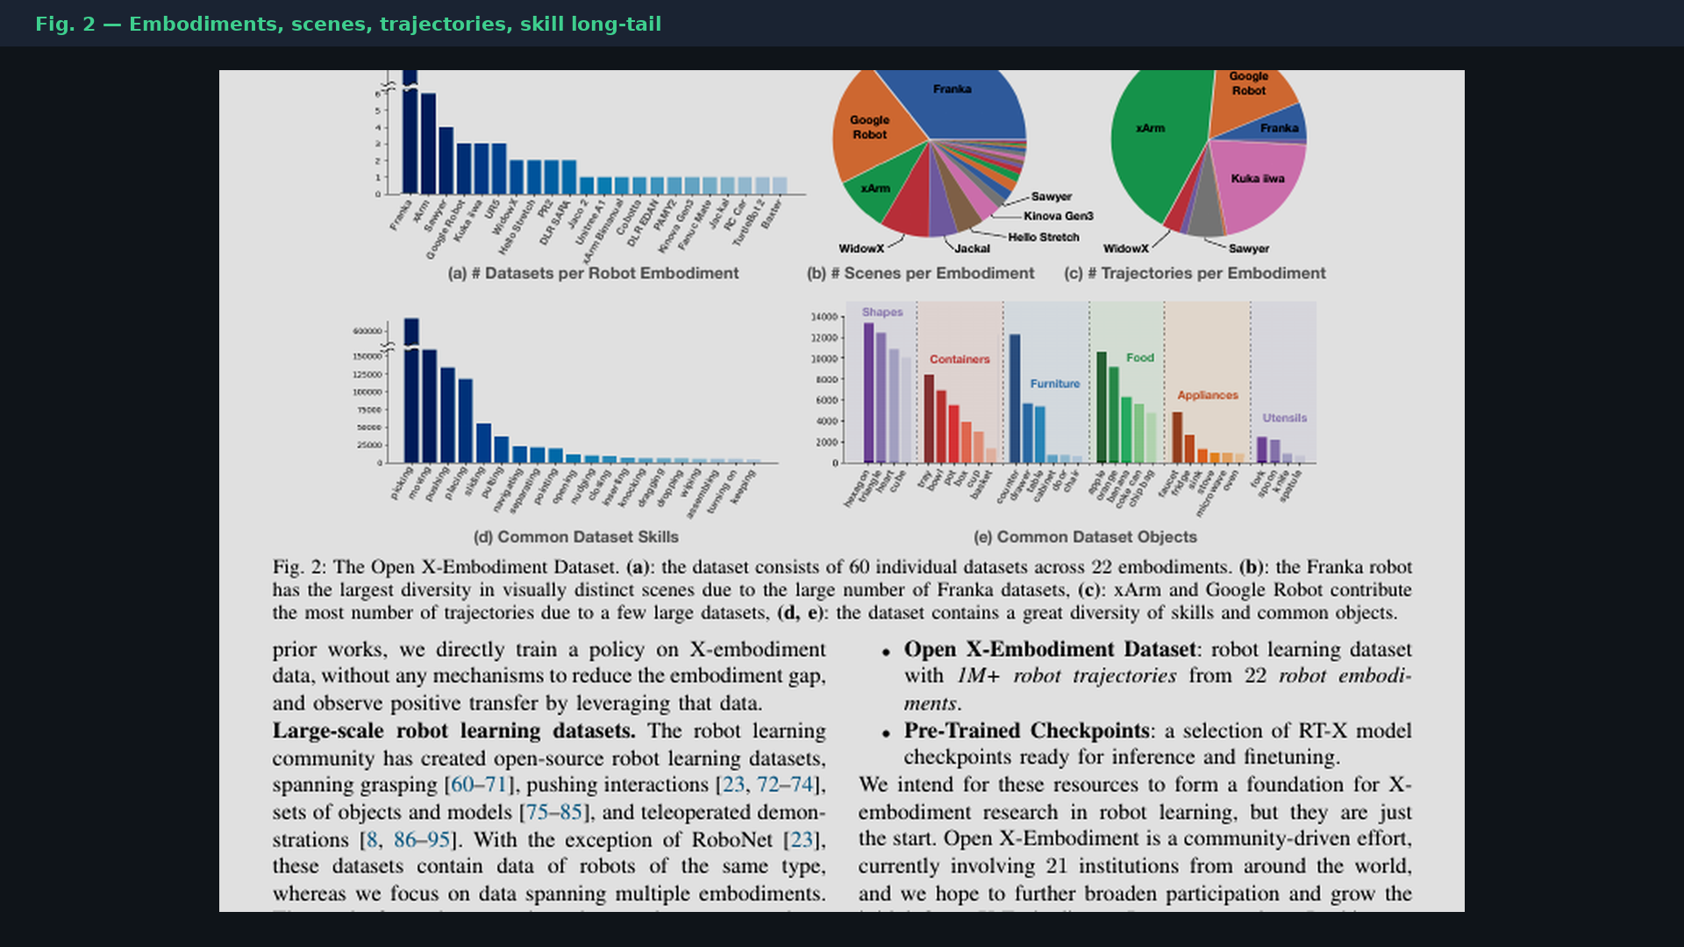
Archaeologist · 11+3 · 7/14
Notes:
PAPER FIG.2 — diversity axes that later mix science had to rebalance (pick-place overweight).

Slide 8
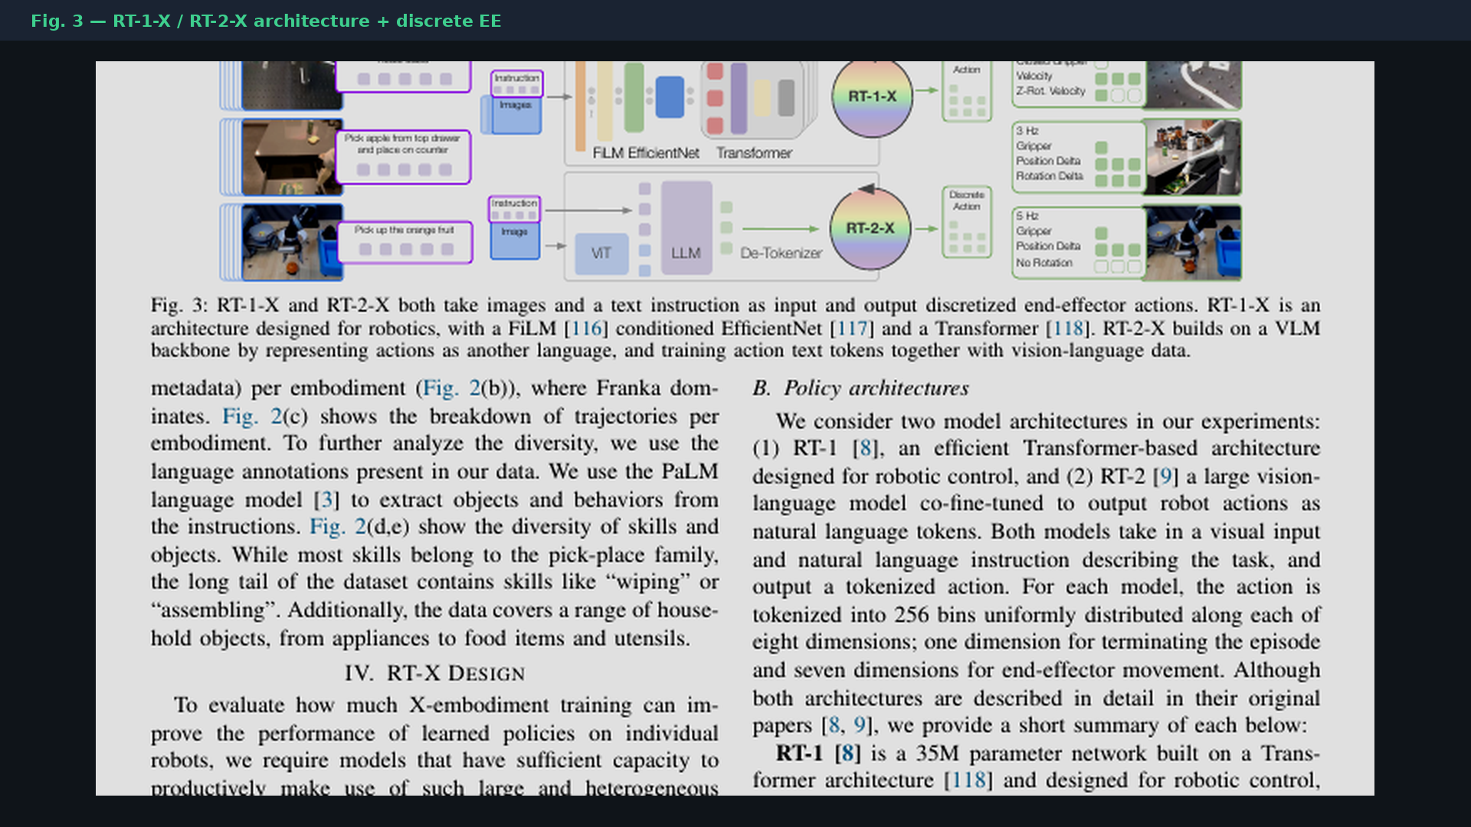
Archaeologist · 11+3 · 8/14
Notes:
PAPER FIG.3 — RT-X as the first existence-proof policies on the pool.

Slide 9
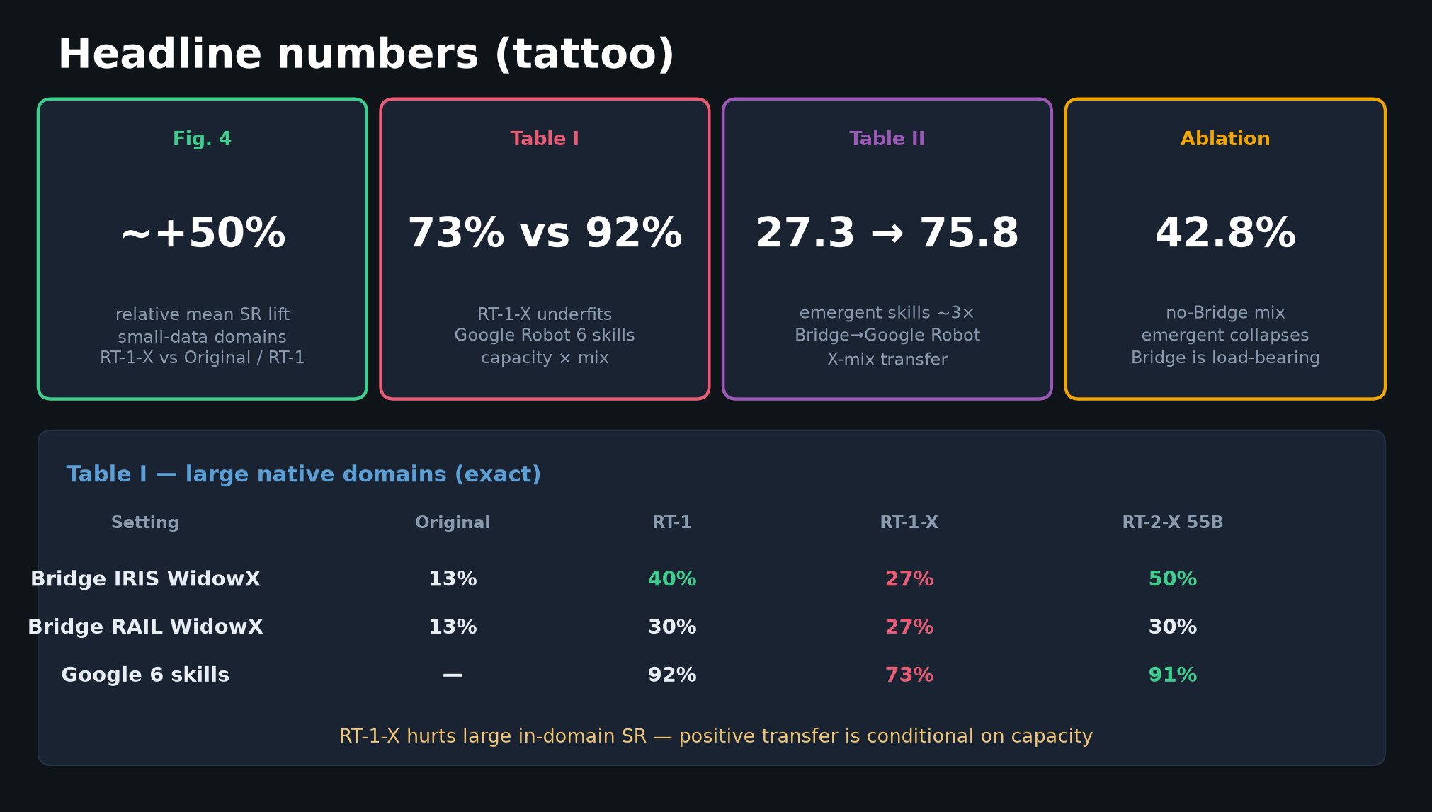
Archaeologist · 11+3 · 9/14
Notes:
HEADLINES as historical claims — +50%, underfit, emergent 3×, Bridge load-bearing — each became a recipe ingredient for soups.

Slide 10
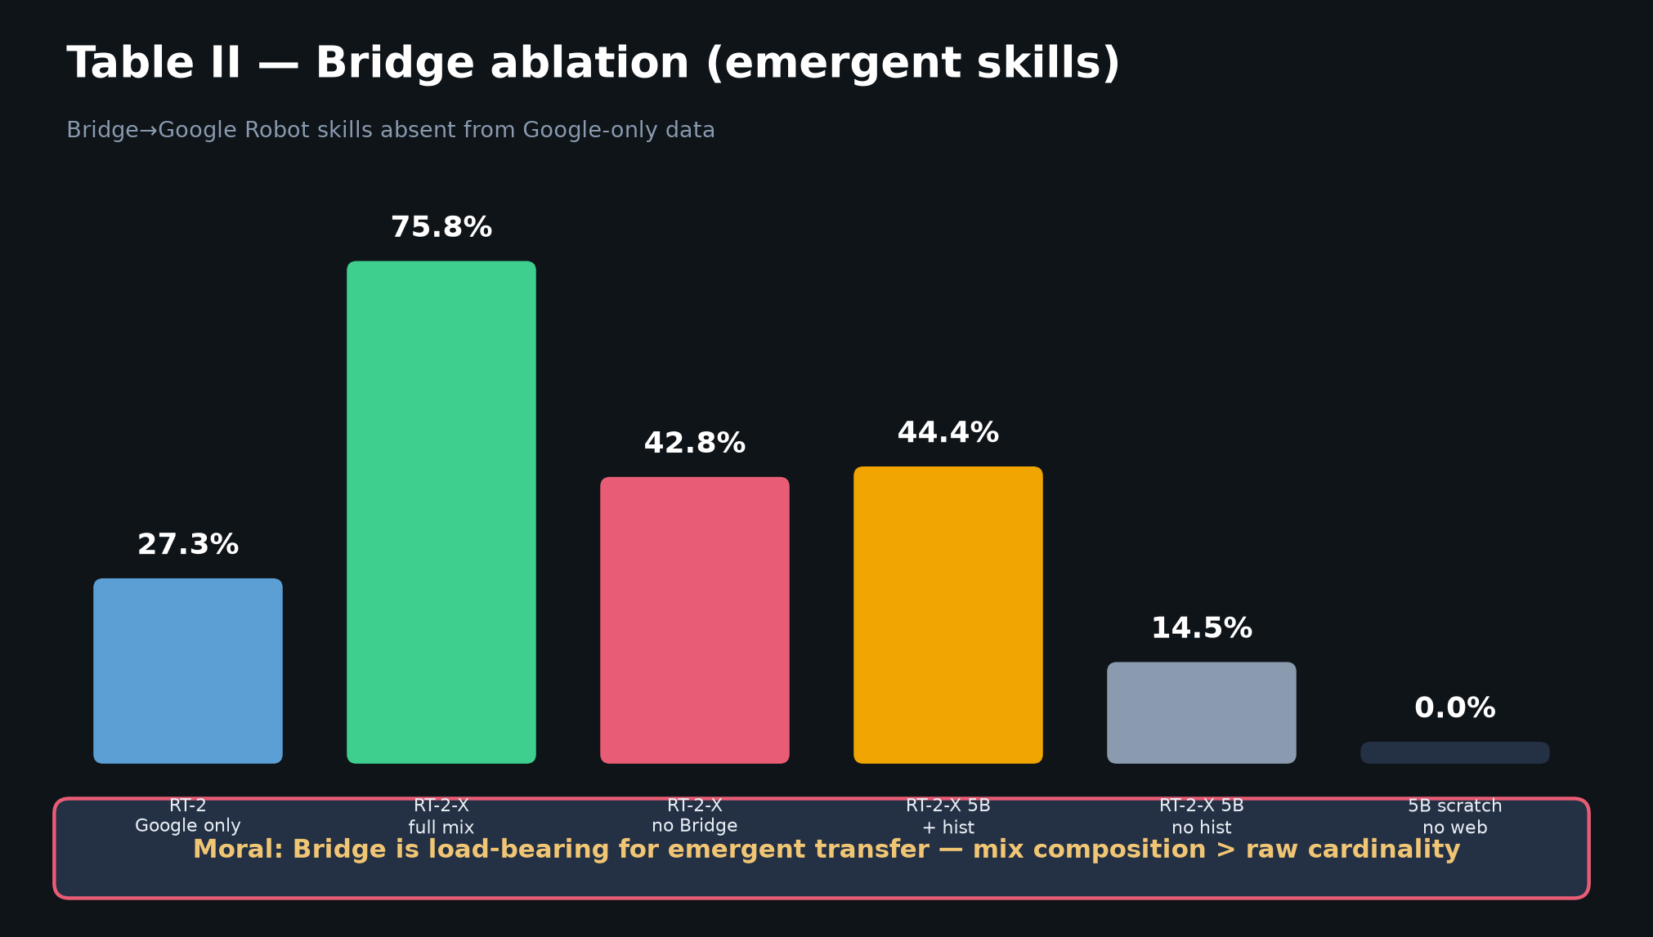
Archaeologist · 11+3 · 10/14
Notes:
BRIDGE ABLATION — the mix-science ancestor of Octo 25 vs 11 vs 1 and OpenVLA DROID drop.

Slide 11
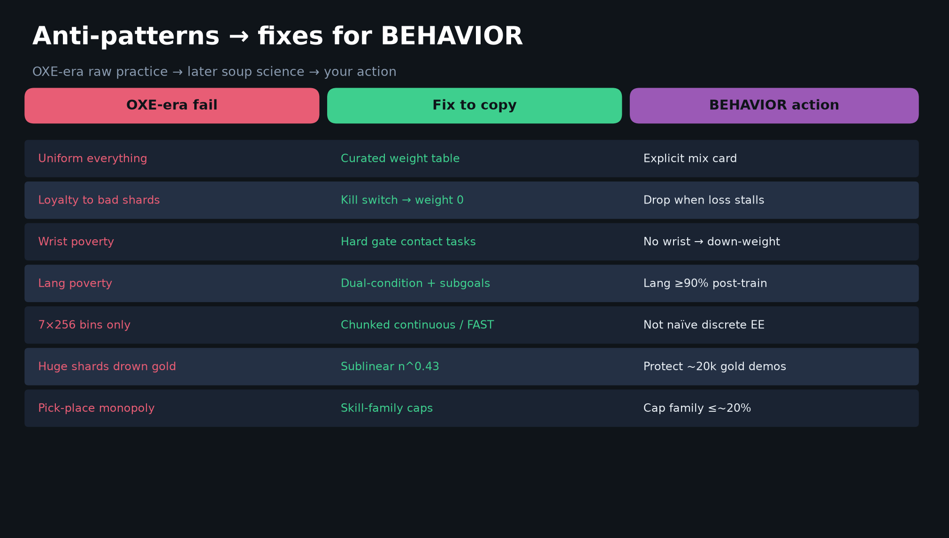
Archaeologist · 11+3 · 11/14
Notes:
ANTI-PATTERNS history — how later papers cooked the soup. Archaeologist frames Visionary’s table as historical patches.

Slide 12
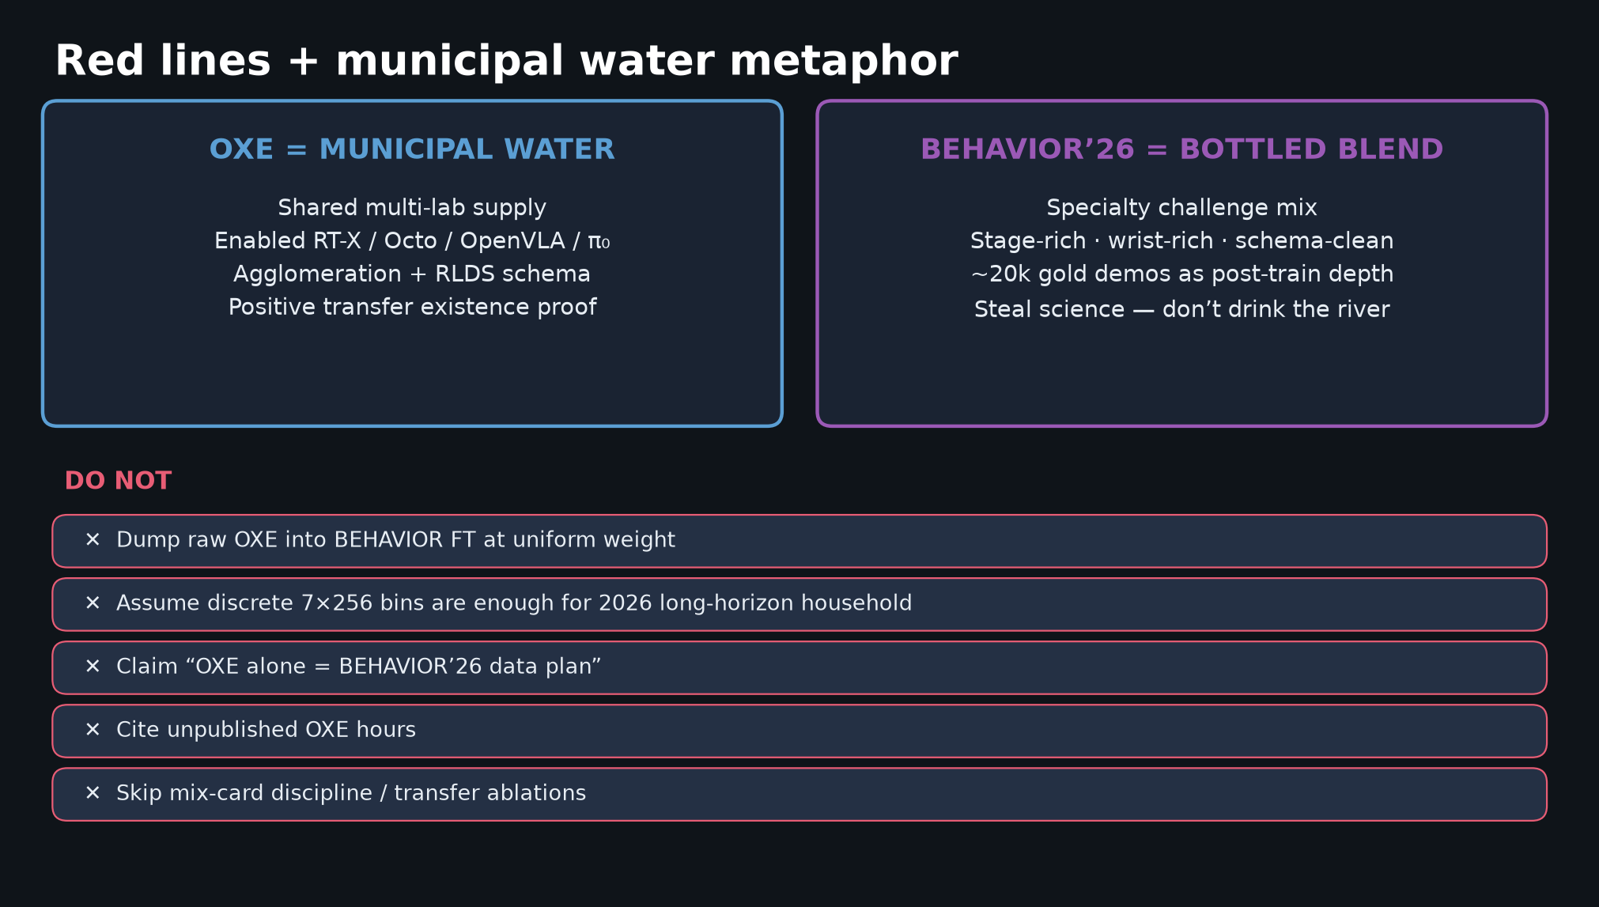
Archaeologist · 11+3 · 12/14
Notes:
METAPHOR in lineage language — municipal water → bottled blend. OXE is the gravity well; BEHAVIOR grades the finetune.

Slide 13
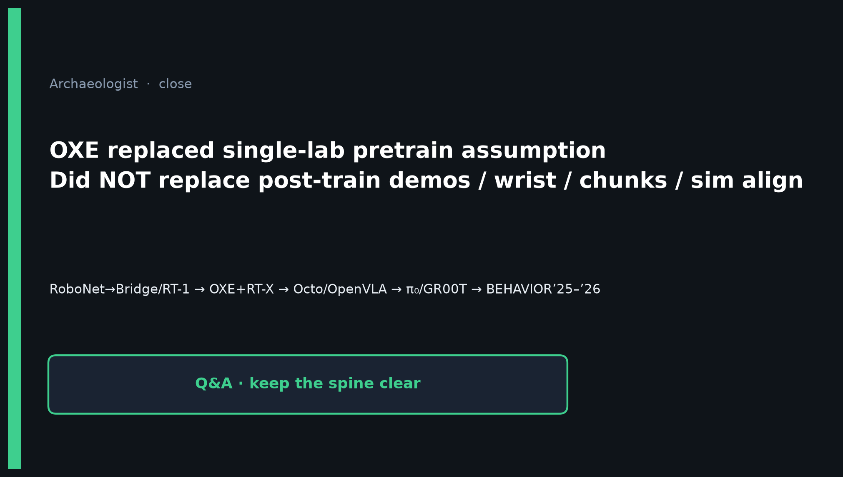
Archaeologist · 11+3 · 13/14
Notes:
CLOSE — OXE replaced single-lab prior; did not replace post-train / wrist / chunks / sim align. Lineage into BEHAVIOR’25–’26.

Slide 14
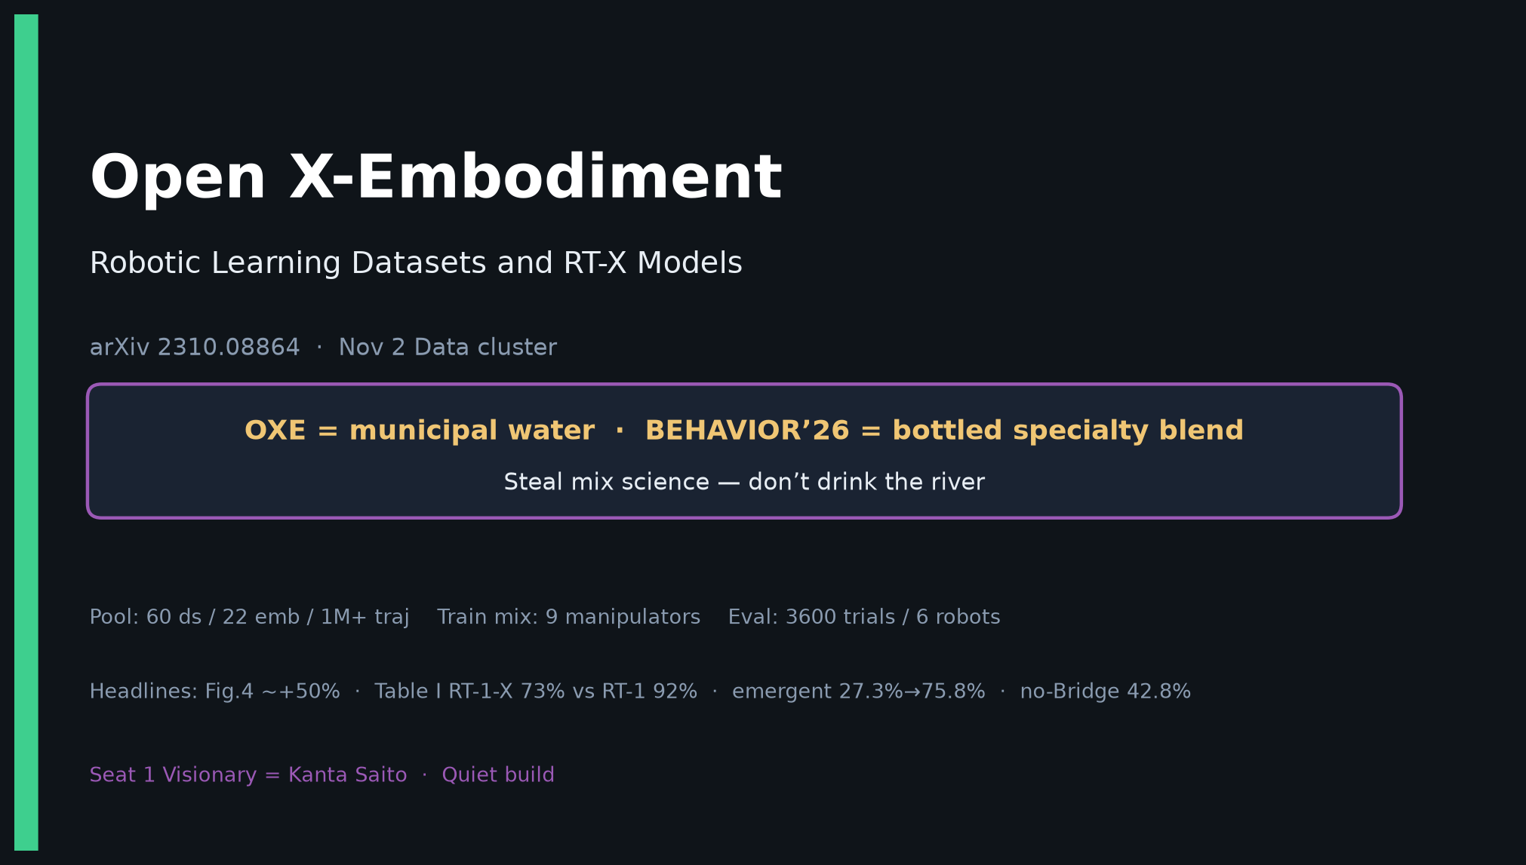
Archaeologist · 11+3 · 14/14
Notes:
COVER BACKUP.

