Slide 1
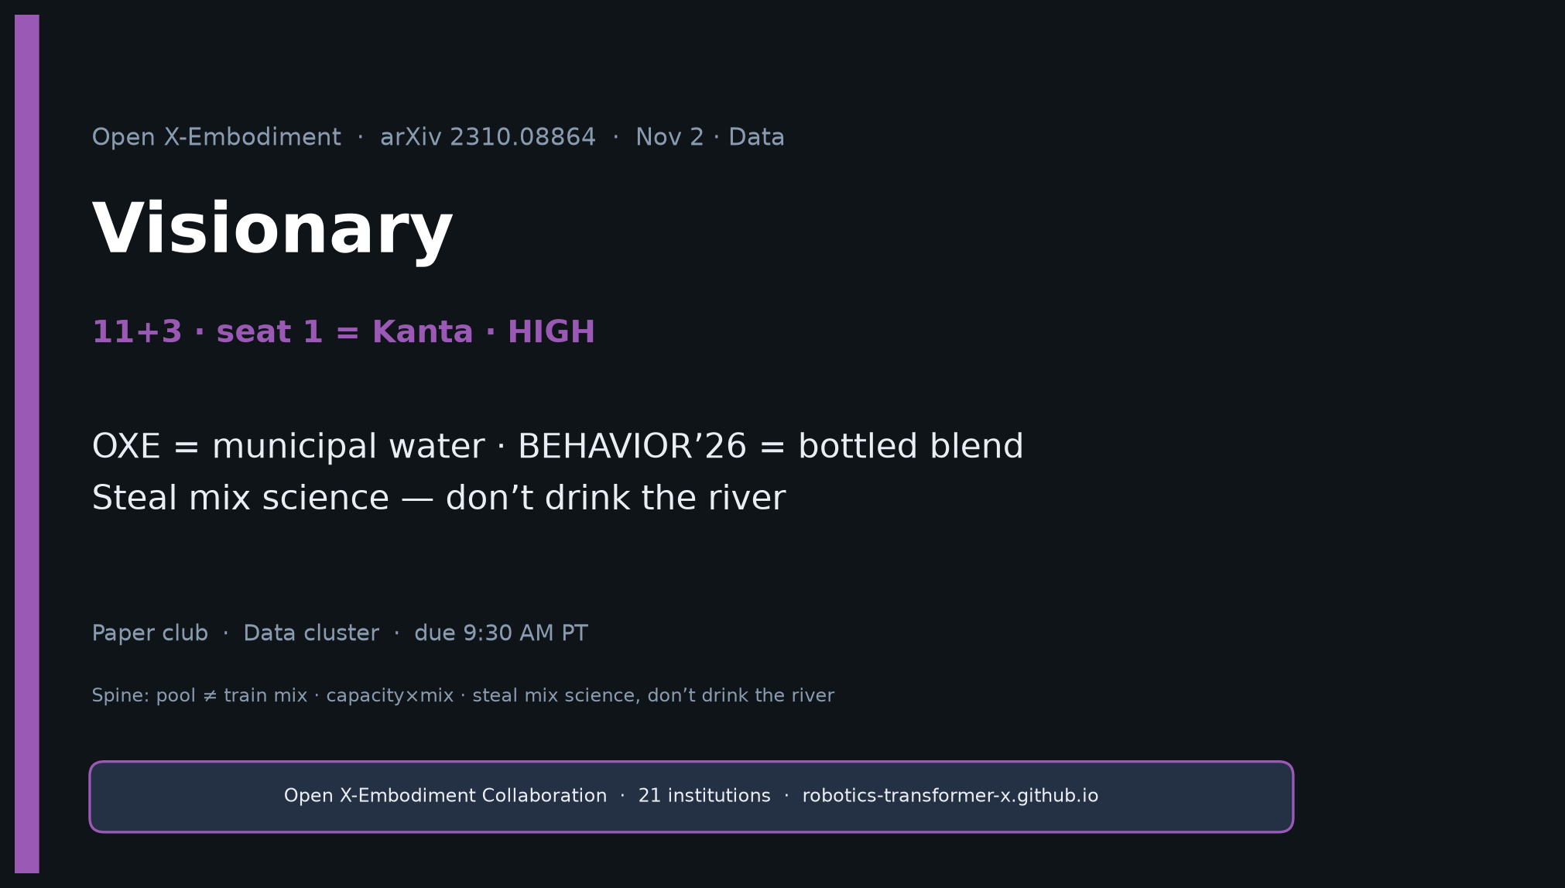
Visionary · 11+3 · 1/16
Notes:
VISIONARY — seat 1 = Kanta Saito (YOU) · HIGH PRIORITY · timing 11+3.
ONE SENTENCE for the room:
OXE = municipal water for generalist robot policies; BEHAVIOR’26 = bottled specialty blend — steal mix science, don’t drink the river.
MUST DELIVER:
• Steal list 1–5 (width, schema, lang column, transfer ablations, capacity×mix)
• Anti-patterns → fixes table (THE densest figure)
• Concrete 4-stage recipe (Prior / Mid-sim / Post-gold / Holdout)
• Red lines: no uniform raw OXE dump; no “bins enough for 2026”; no “OXE alone = BEHAVIOR plan”
• Metaphor: municipal water vs bottled blend
GitHub title: [ECE 605] - Open X-Embodiment Making Visionary
NO Discord / Drive.

Slide 2
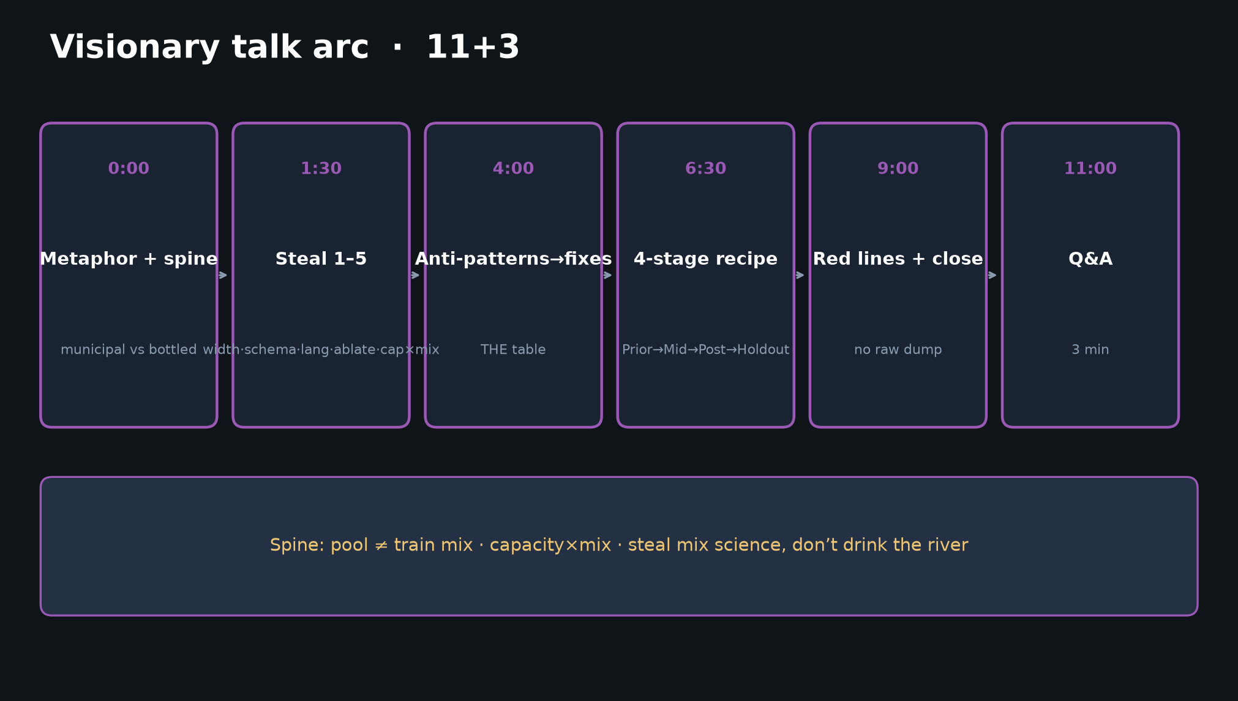
Visionary · 11+3 · 2/16
Notes:
TALK ARC — 11 minutes. Densest deck; do not skip anti-patterns or recipe.
1) Metaphor + spine ~90s
2) Steal 1–5 ~2.5 min
3) Anti-patterns→fixes THE table ~2.5 min
4) 4-stage recipe ~2.5 min
5) Red lines + checklist + close ~2 min
6) Q&A 3 min
Spine: pool ≠ train mix; capacity×mix; steal mix science, don’t drink the river.

Slide 3
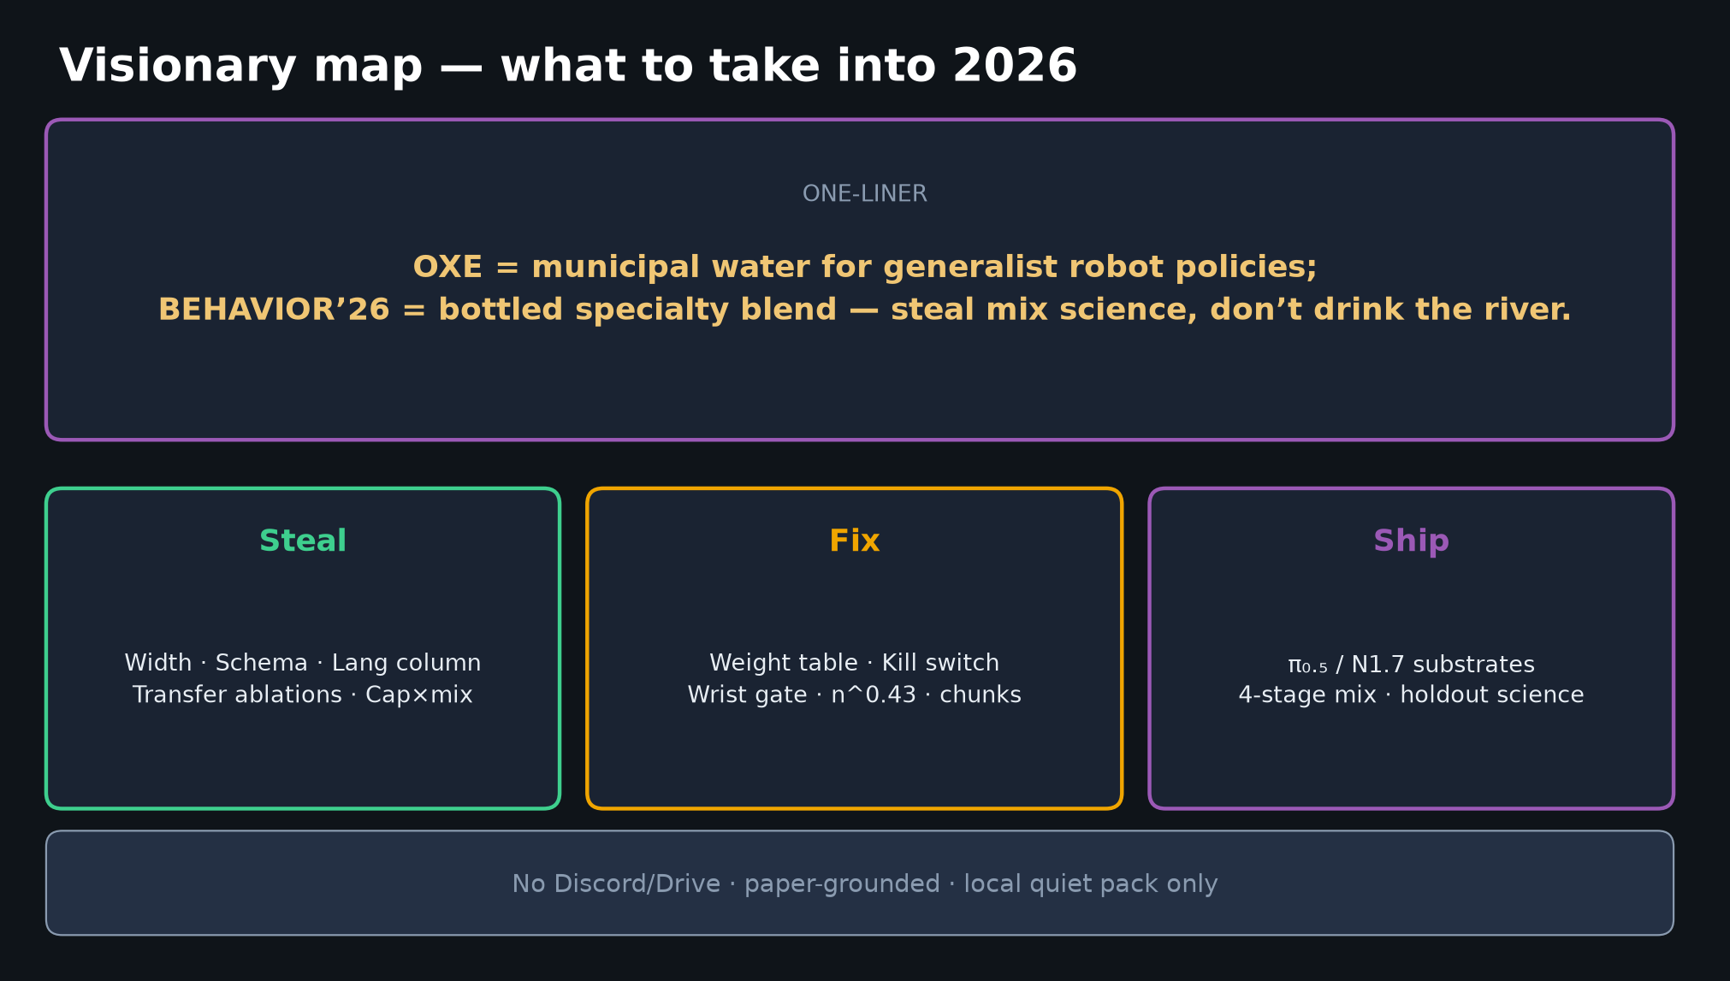
Visionary · 11+3 · 3/16
Notes:
VISIONARY MAP — one-liner + Steal / Fix / Ship.
Say: “You do not drink raw river water; you also do not pretend a municipal plant alone wins a sommelier contest.”
OXE proved agglomeration works. Octo/OpenVLA/π₀ proved you still have to cook the soup.
Ship on π₀.₅ / N1.7 substrates with stage-rich, wrist-rich, schema-clean challenge data.

Slide 4
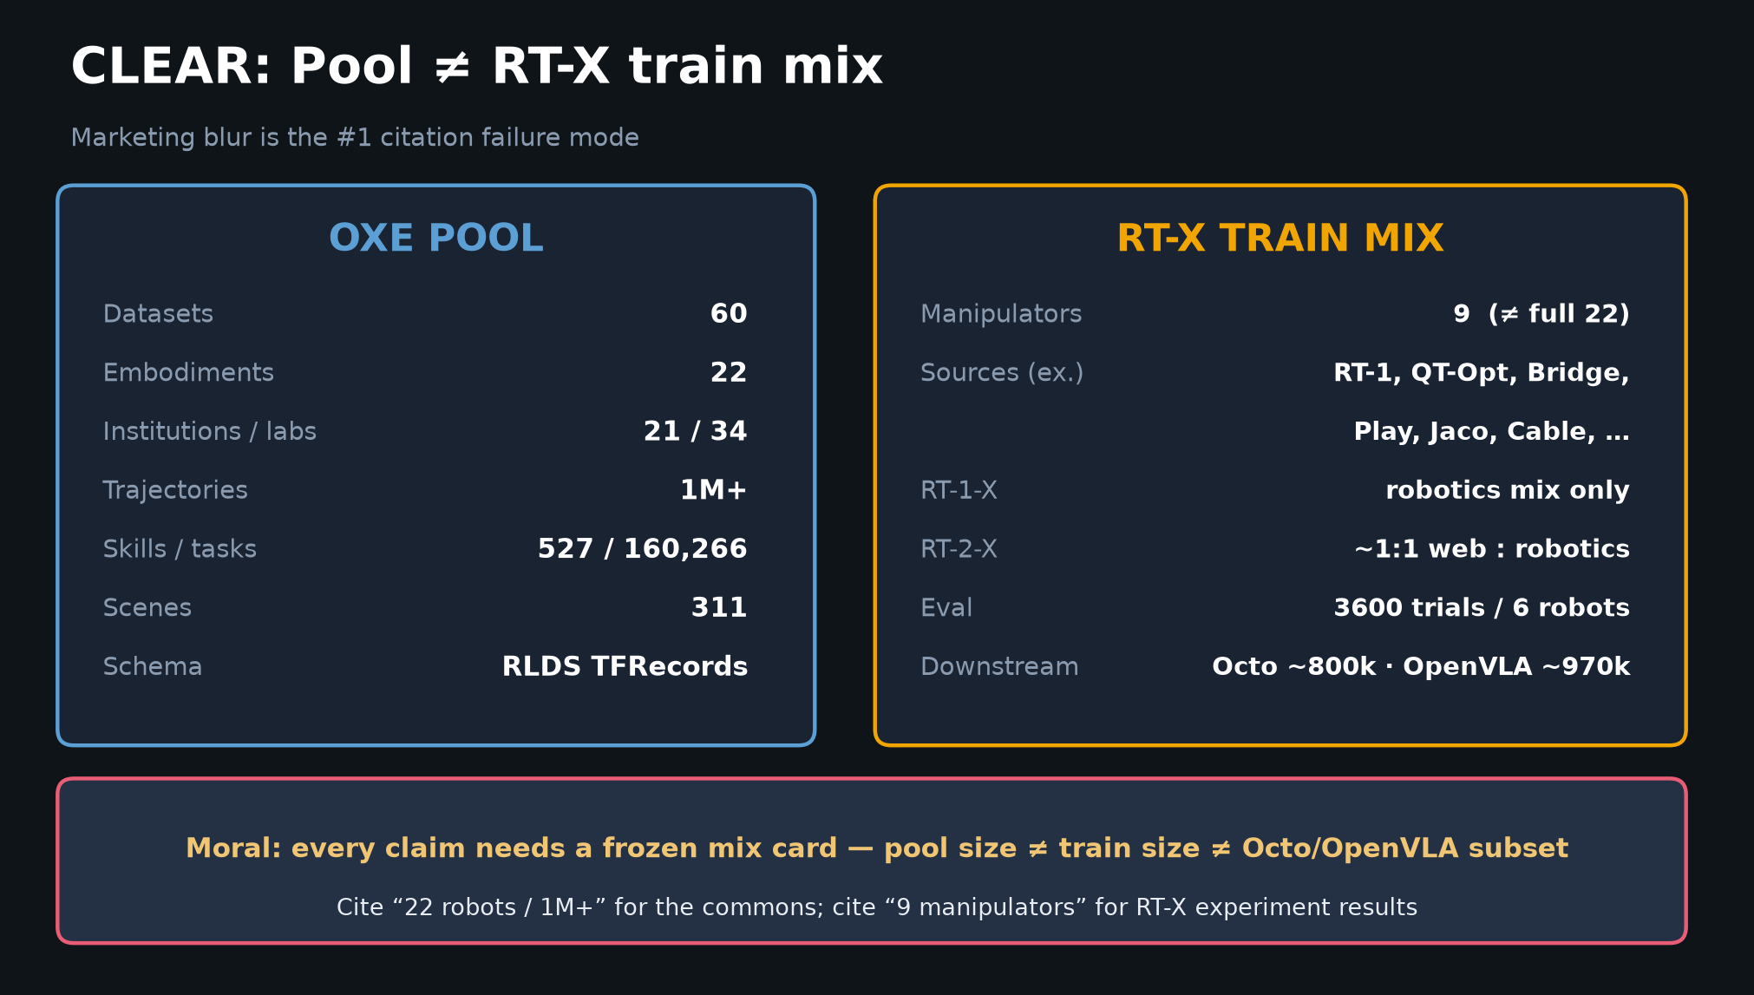
Visionary · 11+3 · 4/16
Notes:
POOL ≠ TRAIN MIX — CLEAR table. Cite correctly.
POOL: 60 datasets / 22 embodiments / 1M+ traj / RLDS
RT-X TRAIN: 9 manipulators (≠ full 22) / 3600 trials / 6 robots
Downstream: Octo ~800k curated · OpenVLA Magic Soup++ ~970k · π₀ open share ~9.1%
Every claim needs a frozen mix card.

Slide 5
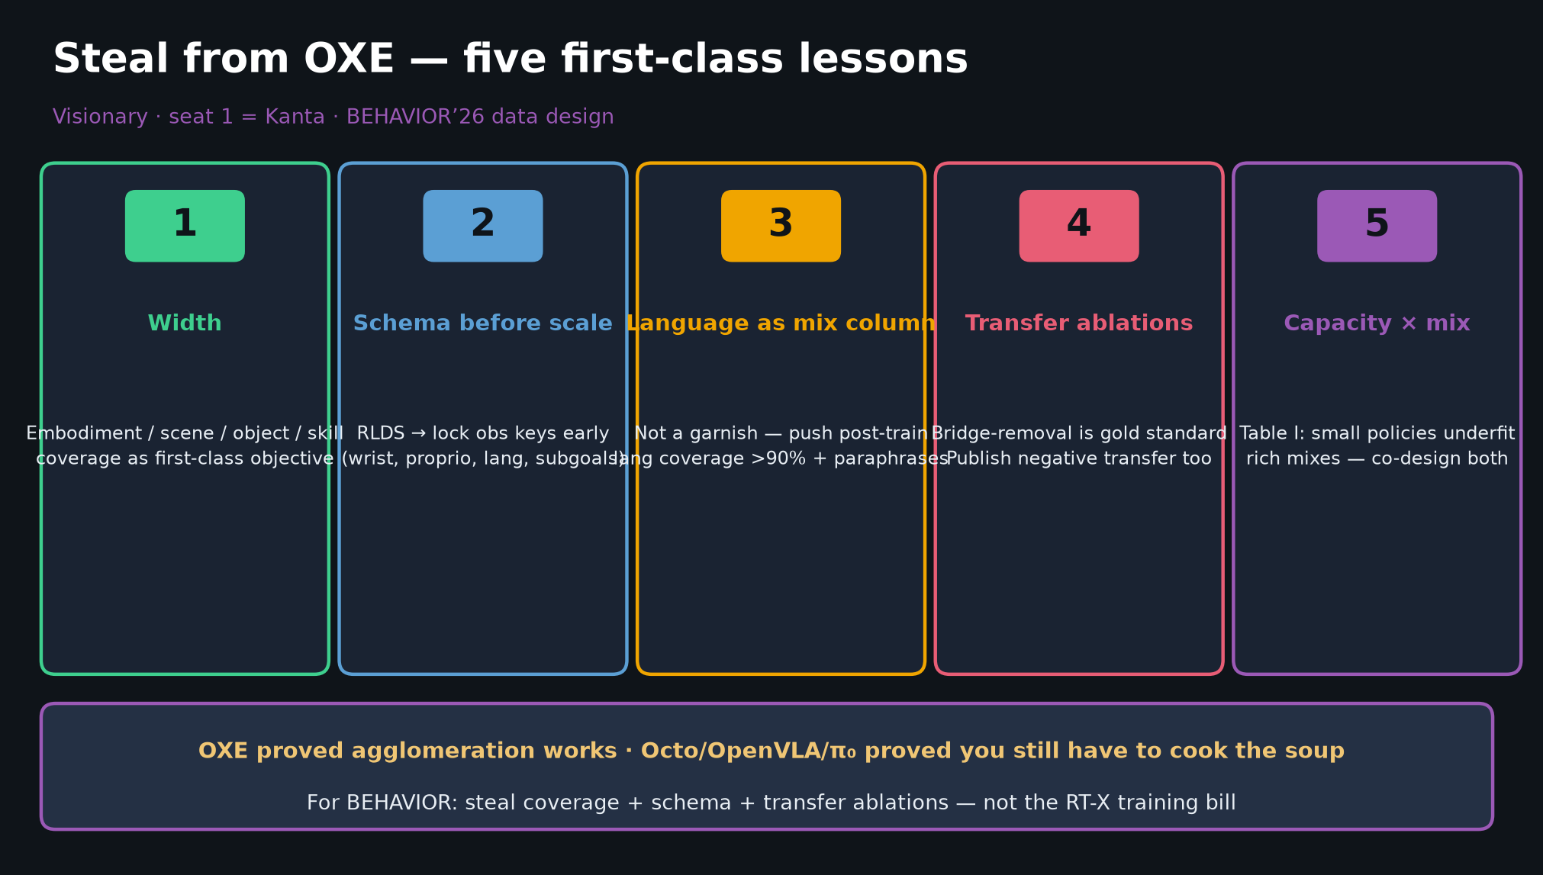
Visionary · 11+3 · 5/16
Notes:
STEAL FROM OXE — five first-class lessons. Say each aloud.
1. WIDTH — embodiment/scene/object/skill coverage as first-class (not polish one room)
2. SCHEMA BEFORE SCALE — RLDS lesson; lock obs keys early (wrist, proprio, lang, subgoals)
3. LANGUAGE AS MIX COLUMN — push BEHAVIOR post-train >90% + paraphrases (Octo later measured ~56% lang poverty)
4. TRANSFER ABLATIONS — Bridge-removal gold; publish negative transfer too
5. CAPACITY × MIX — Table I: small policies underfit rich mixes; co-design both
For BEHAVIOR: maximize task×object×house-region coverage, not just demo count on easiest 10.

Slide 6
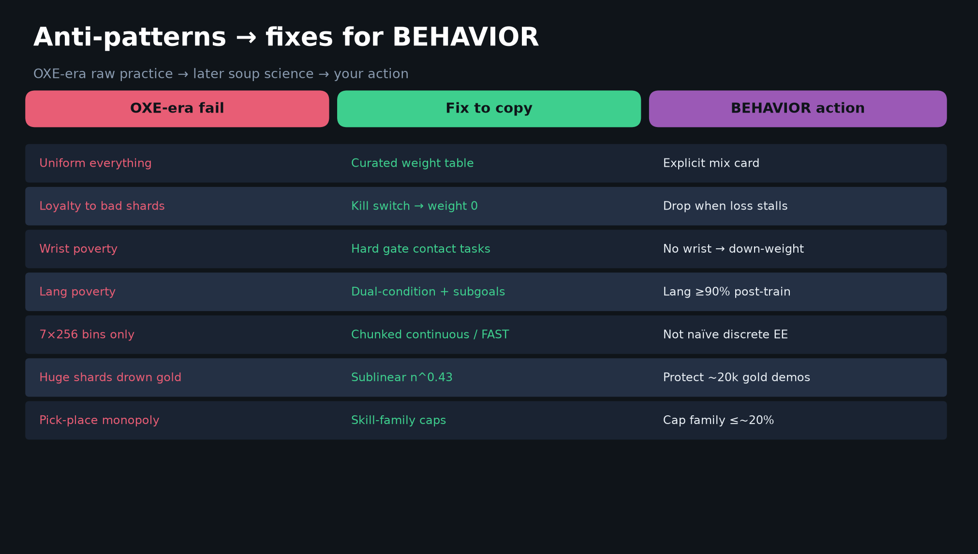
Visionary · 11+3 · 6/16
Notes:
ANTI-PATTERNS → FIXES — THE densest talk figure. Spend ~2.5 min.
| OXE-era fail | Fix | BEHAVIOR action |
| Uniform everything | Weight table | Explicit mix card |
| Loyalty to bad shards | Kill switch → 0 | Drop when loss stalls |
| Wrist poverty | Hard gate contact | No wrist → down-weight |
| Lang poverty | Dual-condition + subgoals | Lang ≥90% post-train |
| 7×256 bins only | Chunked continuous / FAST | Not naïve discrete EE |
| Huge shards drown gold | Sublinear n^0.43 | Protect ~20k gold |
| Pick-place monopoly | Skill-family caps | Cap family ≤~20% |
Say: “These are the curation patches that turned OXE agglomeration into working soups.”

Slide 7
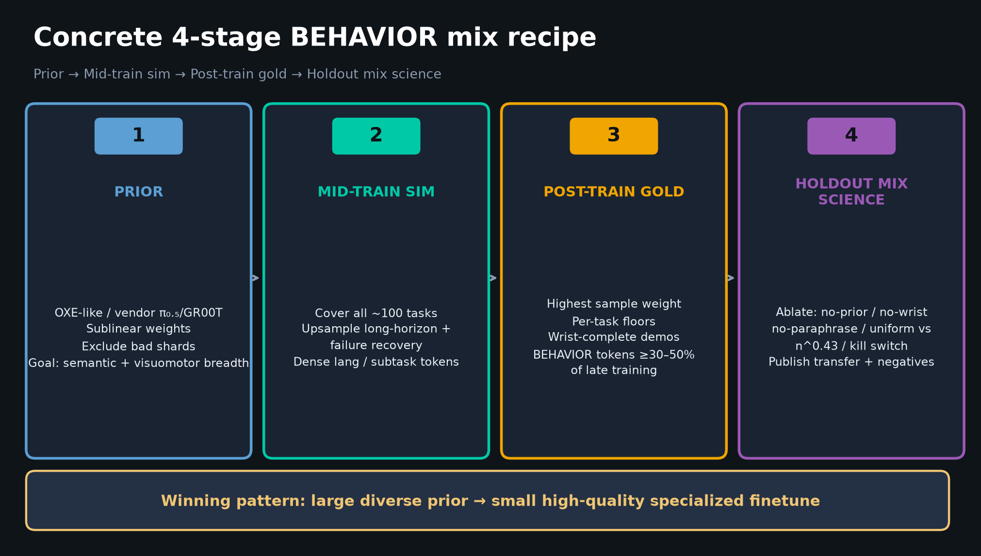
Visionary · 11+3 · 7/16
Notes:
4-STAGE RECIPE — concrete, actionable.
1. PRIOR: OXE-like / vendor π₀.₅/GR00T; sublinear weights; exclude bad shards
2. MID-TRAIN SIM: cover all tasks; upsample long-horizon + recovery; dense lang/subtask tokens
3. POST-TRAIN GOLD: highest sample weight; per-task floors; wrist-complete; BEHAVIOR tokens ≥30–50% of late training
4. HOLDOUT MIX SCIENCE: ablate no-prior / no-wrist / no-paraphrase / uniform vs n^0.43 / kill switch
Winning pattern historically: large diverse prior → small high-quality specialized finetune.
~20k demos / ~100 tasks ≈ post-train depth, NOT a second OXE.

Slide 8
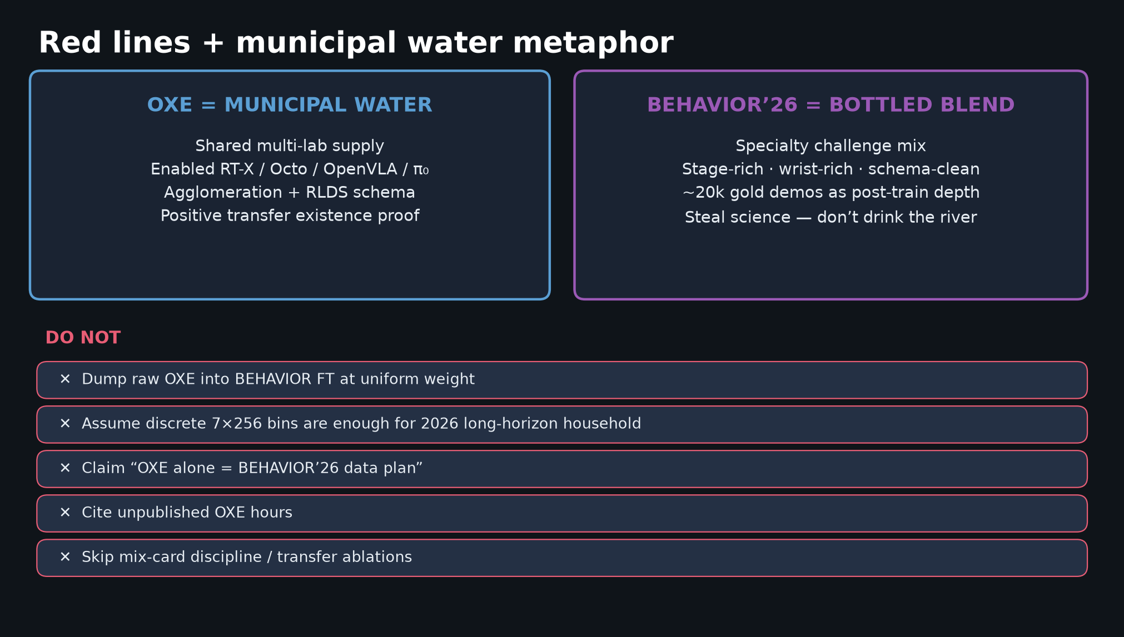
Visionary · 11+3 · 8/16
Notes:
RED LINES — say firmly.
✕ No uniform raw OXE dump into BEHAVIOR FT
✕ No “discrete bins enough for 2026”
✕ No “OXE alone = BEHAVIOR plan”
✕ No unpublished OXE hours
✕ No skipping mix-card / transfer ablations
Municipal water vs bottled blend — keep the metaphor visible.

Slide 9
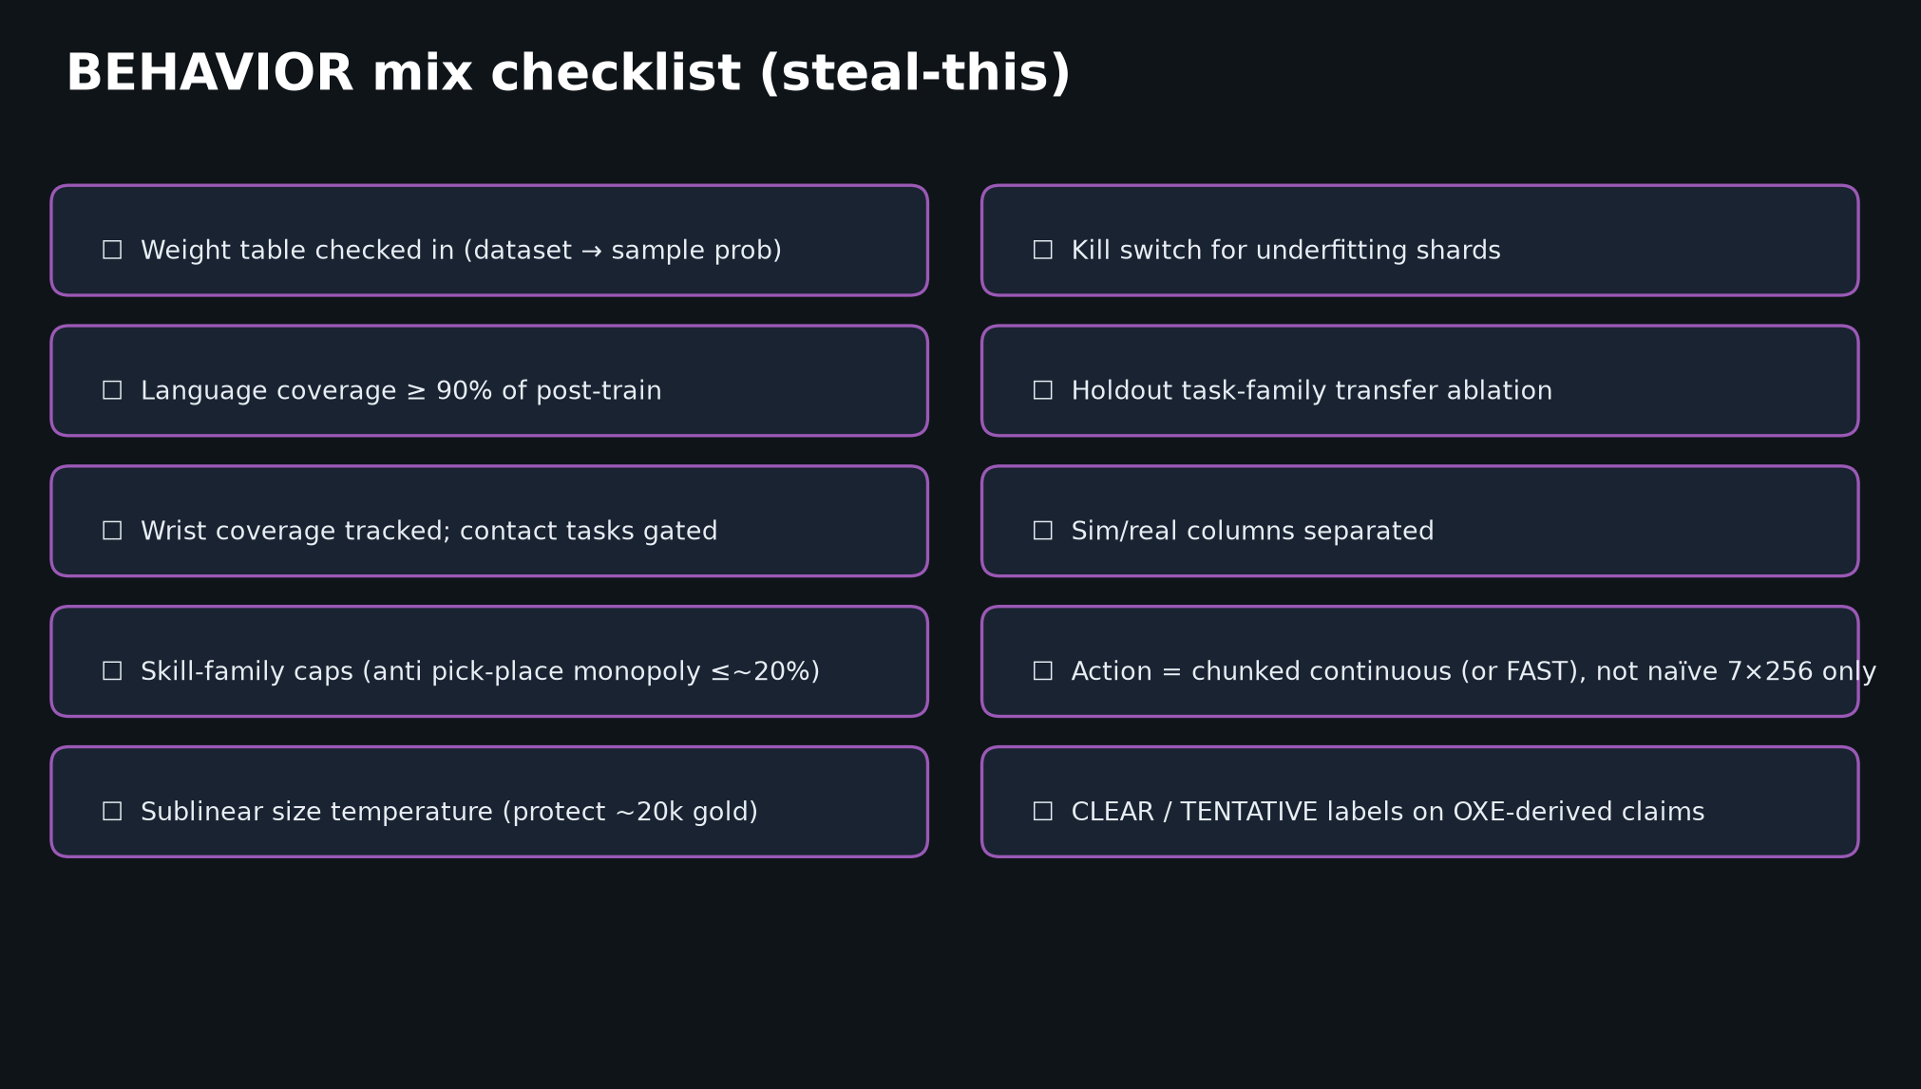
Visionary · 11+3 · 9/16
Notes:
CHECKLIST — leave-behind for the team.
Weight table · lang ≥90% · wrist gate · skill caps ≤20% · n^0.43 · kill switch · holdout ablation · sim/real columns · chunked continuous/FAST · CLEAR/TENTATIVE labels.
If someone only remembers one slide from Visionary, this + steal cards.

Slide 10
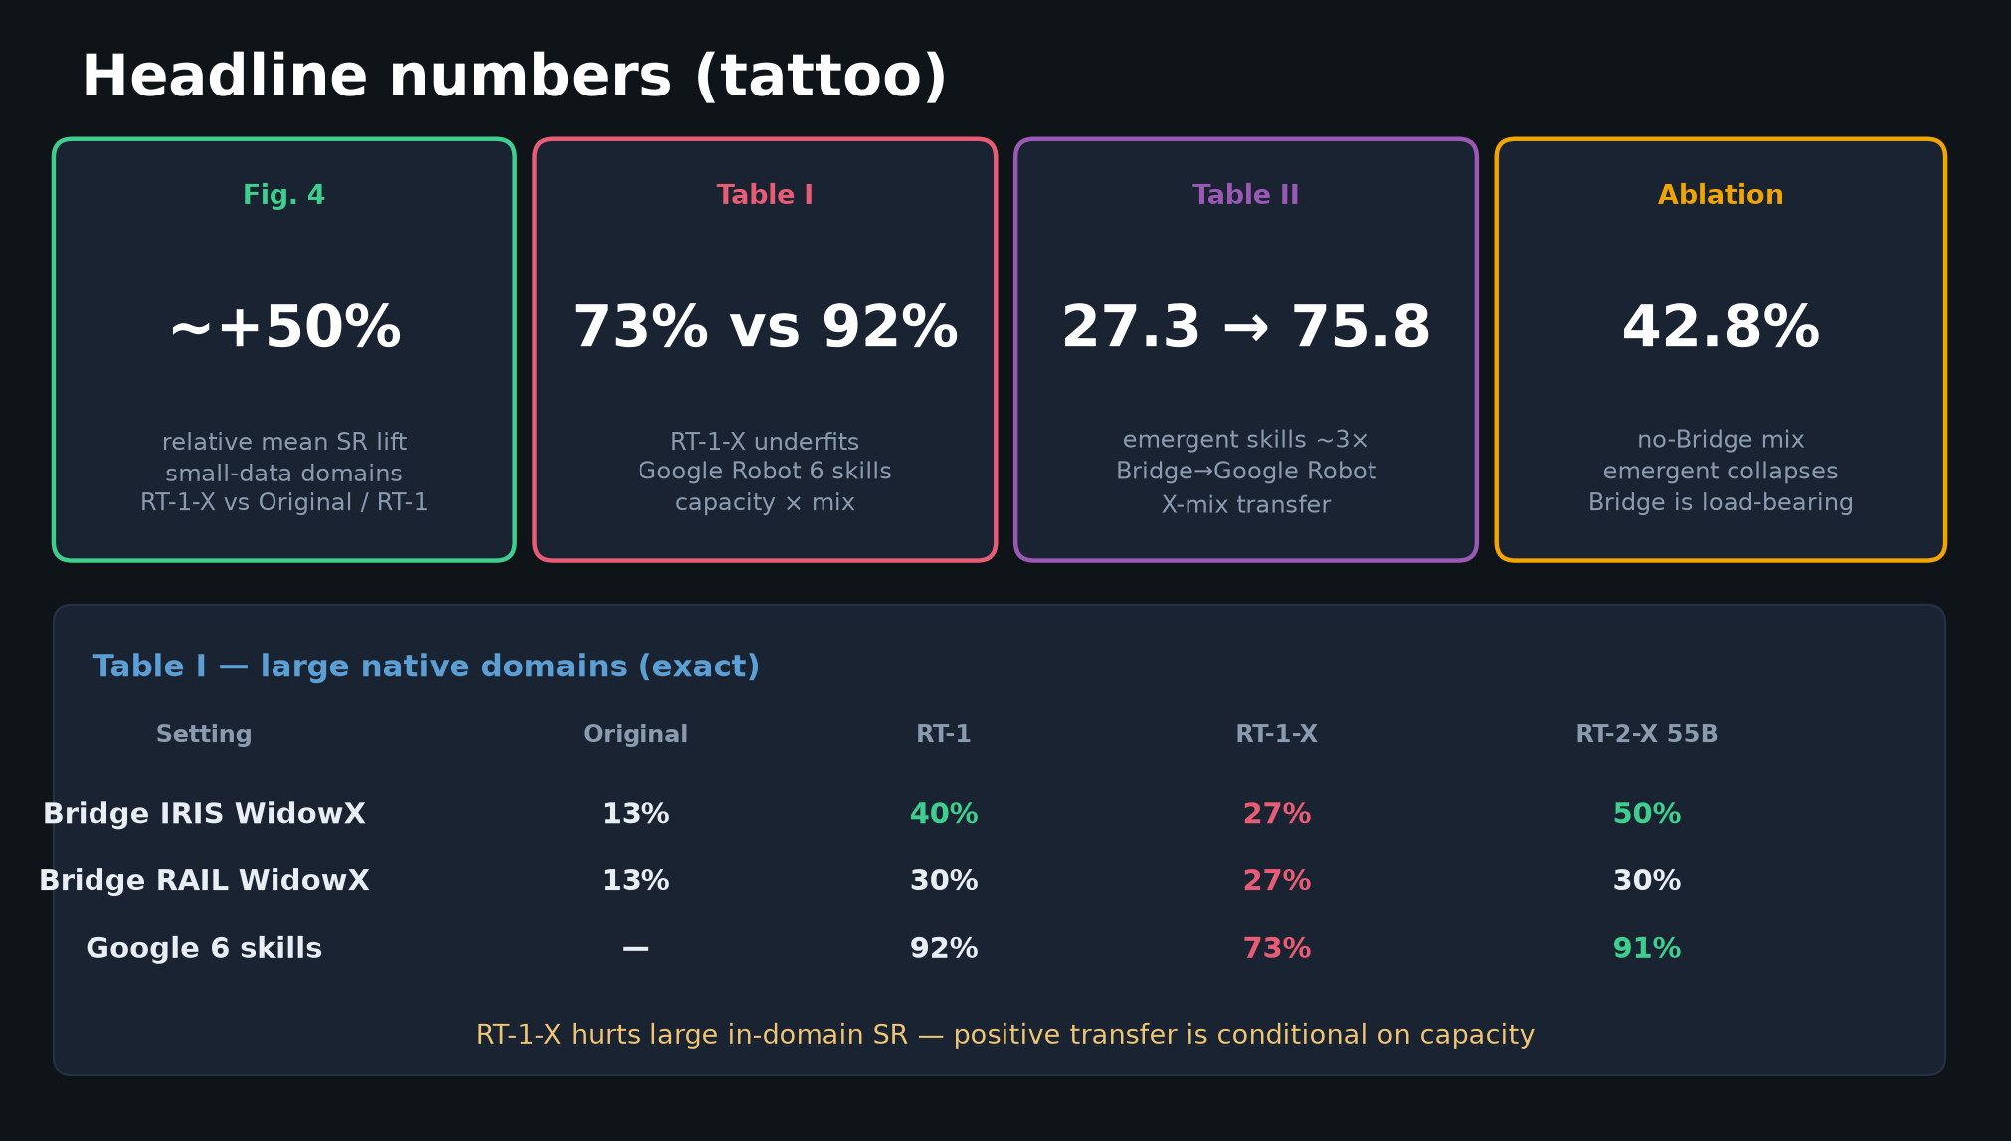
Visionary · 11+3 · 10/16
Notes:
HEADLINES — why the science supports the recipe.
Fig.4 ~+50% relative small-domain lift from co-training
Table I RT-1-X 73% vs RT-1 92% — underfit on large native
Table II emergent 27.3%→75.8% (~3×)
no-Bridge 42.8% — composition matters
Capacity×mix is not optional co-design.

Slide 11
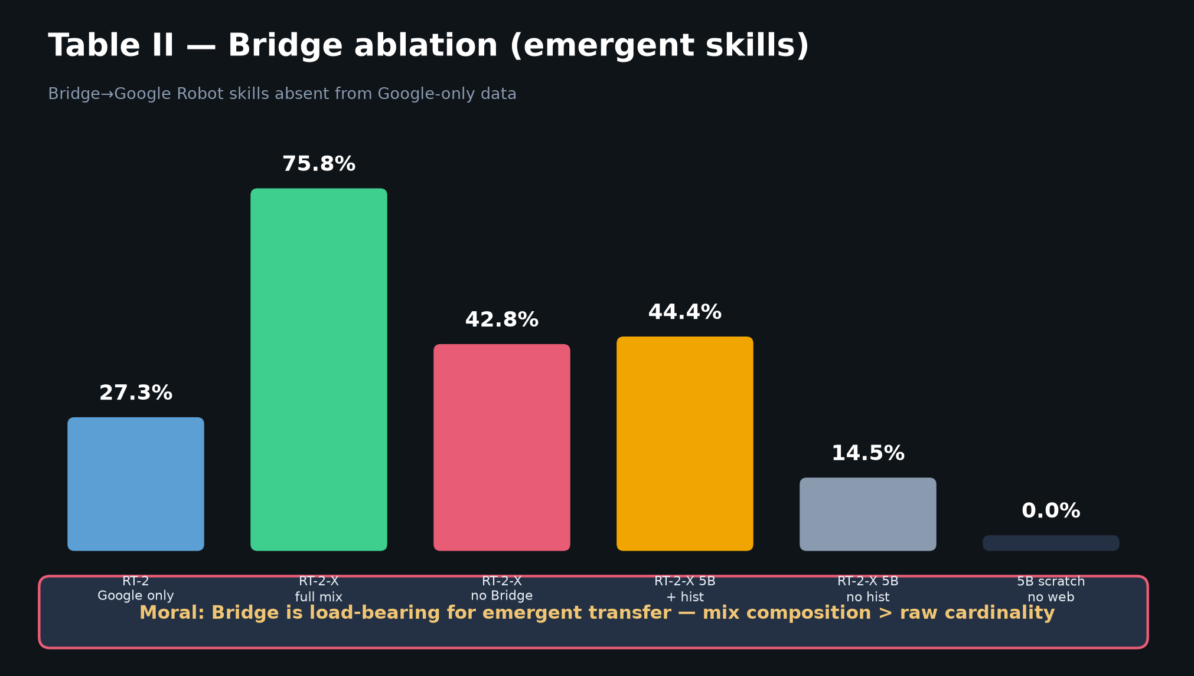
Visionary · 11+3 · 11/16
Notes:
BRIDGE ABLATION — gold-standard mix experiment to copy.
Full mix emergent 75.8% → no-Bridge 42.8%.
For BEHAVIOR: hold out task families; show mixing helps; publish negatives.
Also: web pretrain critical; 55B≫5B; history helps small models.

Slide 12
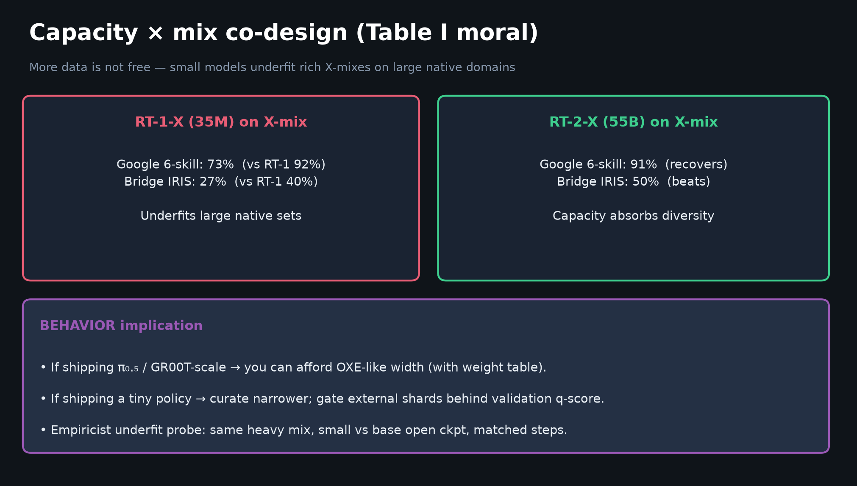
Visionary · 11+3 · 12/16
Notes:
CAPACITY × MIX — Table I moral for BEHAVIOR entry choice.
If π₀.₅/GR00T-scale → can afford width (with weight table).
If tiny policy → curate narrower; gate external data behind validation q-score.
Empiricist underfit probe is the Visionary-compatible path under GPU honesty.

Slide 13
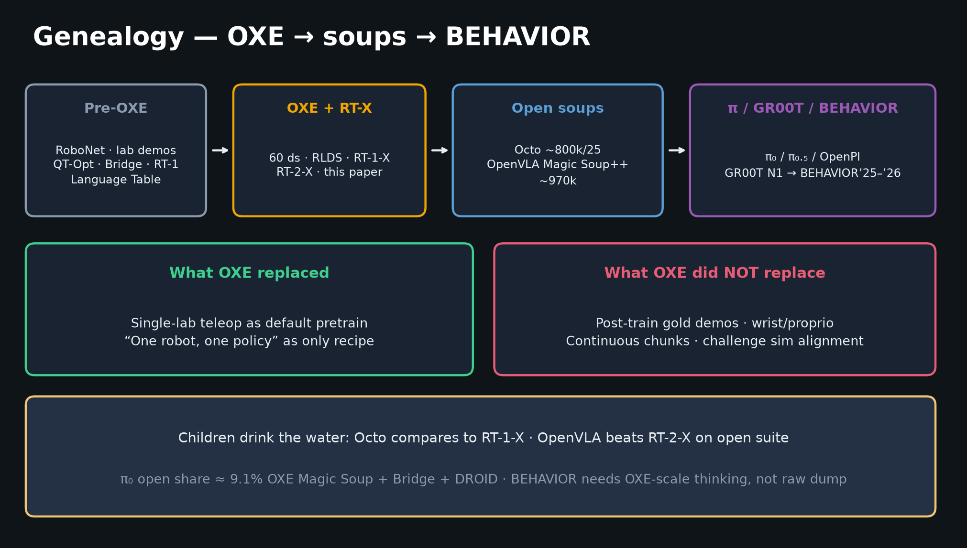
Visionary · 11+3 · 13/16
Notes:
GENEALOGY — where OXE sits.
RoboNet/Bridge/RT-1 → OXE+RT-X → Octo/OpenVLA soups → π₀/OpenPI/π₀.₅/GR00T → BEHAVIOR’25–’26.
OXE replaced single-lab pretrain assumption.
Did NOT replace need for post-train demos, wrist/proprio, continuous chunks, challenge sim alignment.
BEHAVIOR’26 inherits OXE’s mix discipline more than its RT-1 discrete buckets.

Slide 14
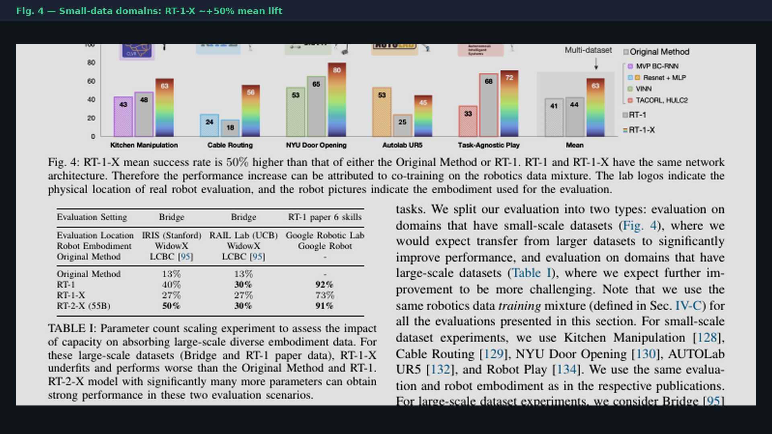
Visionary · 11+3 · 14/16
Notes:
PAPER FIG.4 crop — glance if challenged on +50% claim.
CLEAR headline from caption; bar heights approximate from page render.

Slide 15
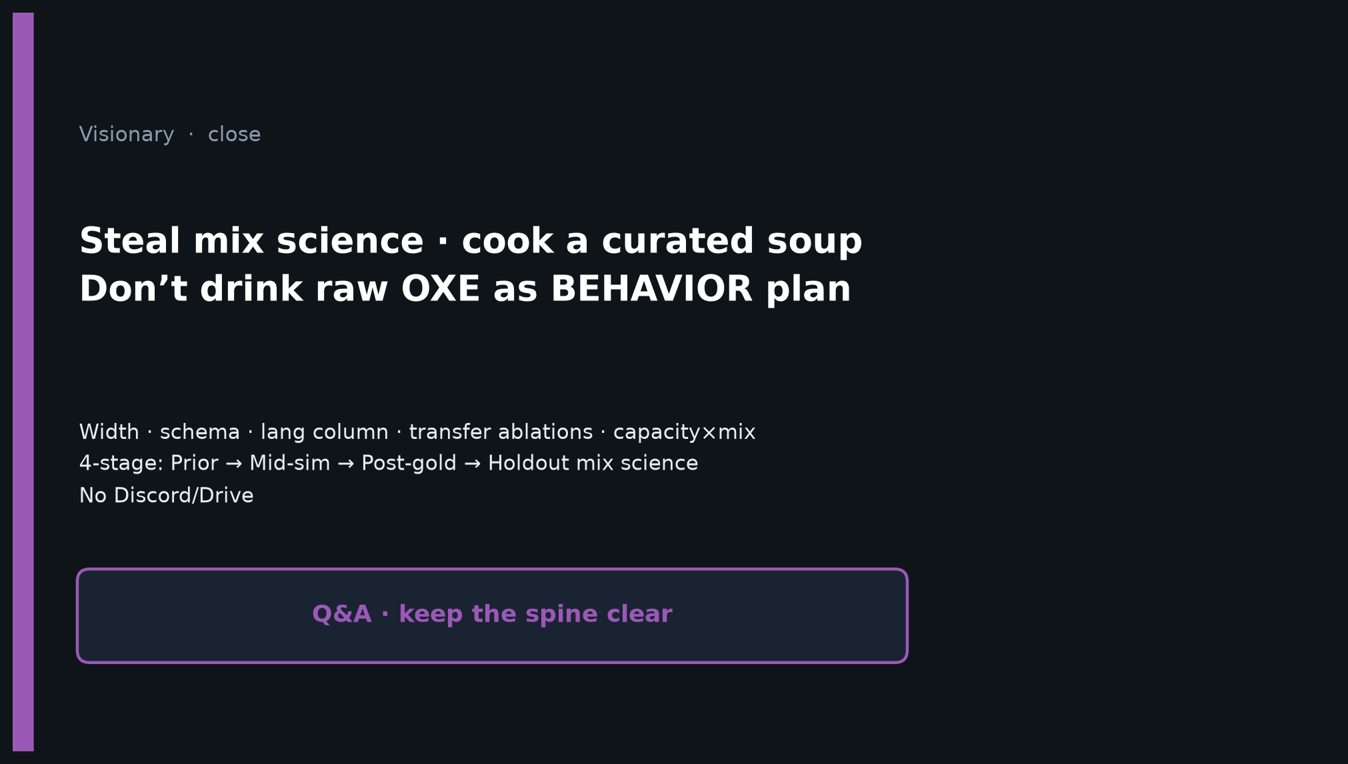
Visionary · 11+3 · 15/16
Notes:
CLOSE — Visionary.
Steal mix science · cook a curated soup · don’t drink raw OXE as BEHAVIOR plan.
Width · schema · lang column · transfer ablations · capacity×mix.
4-stage: Prior → Mid-sim → Post-gold → Holdout mix science.
No Discord/Drive.
Q&A prompts: “Would you put OXE in the prior or mid-train?” “What’s your kill-switch criterion?” “How do you protect 20k gold from n-scale shards?”

Slide 16
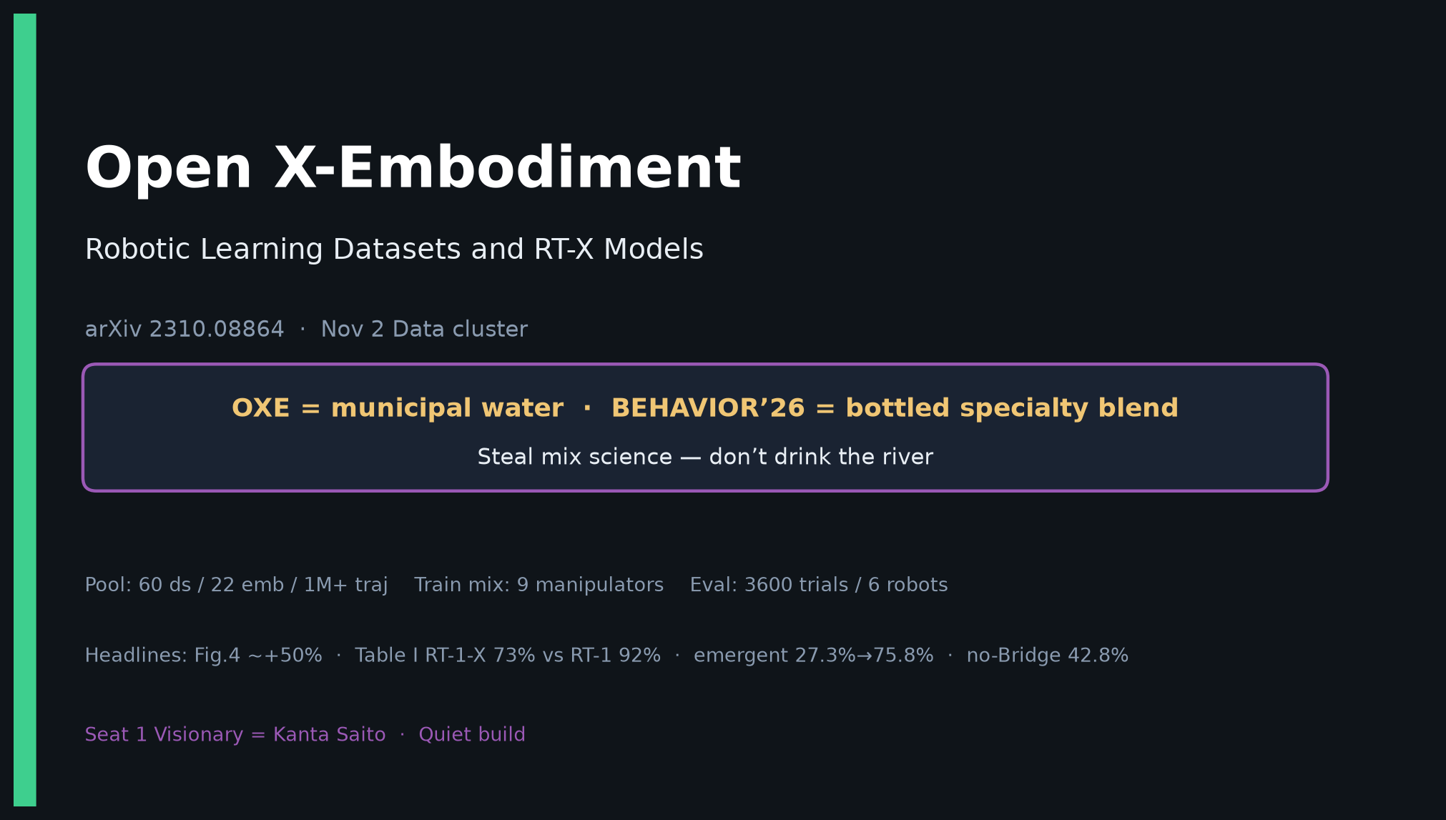
Visionary · 11+3 · 16/16
Notes:
COVER BACKUP — if projector fails or need one-slide summary.

