Slide 1
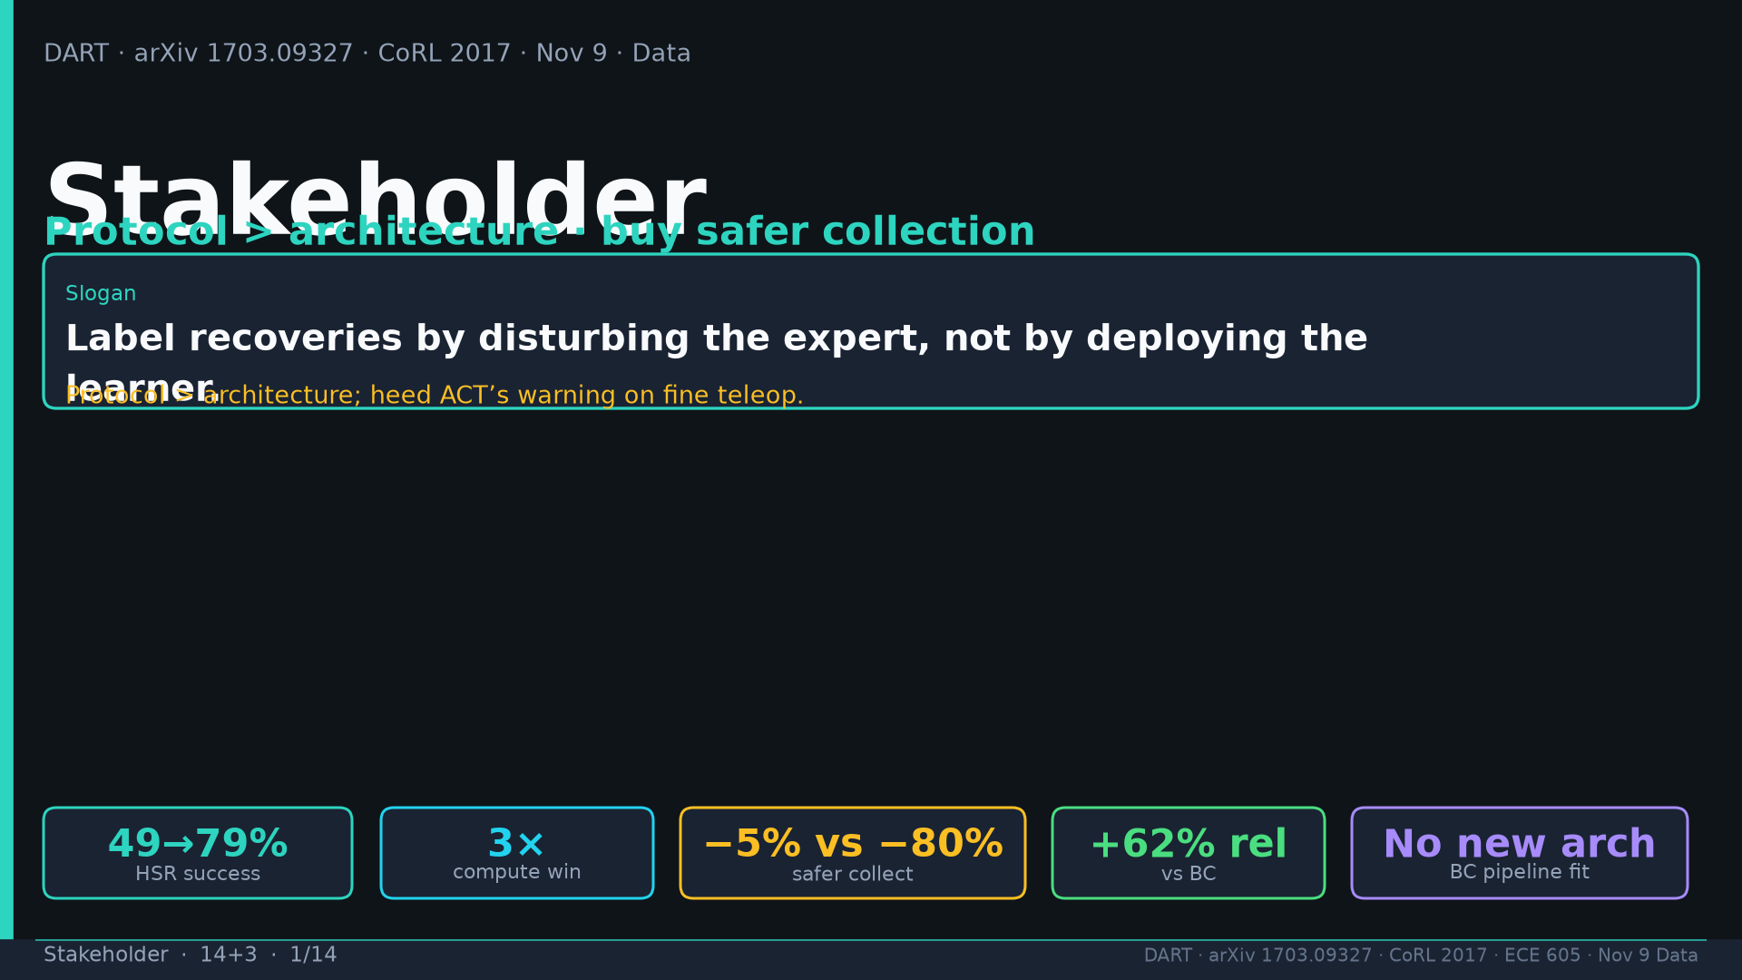
Notes:
Title. Protocol>architecture. Slogan + tattoo chips 49→79 / 3× / −5 vs −80 / +62 / no new arch.

Slide 2
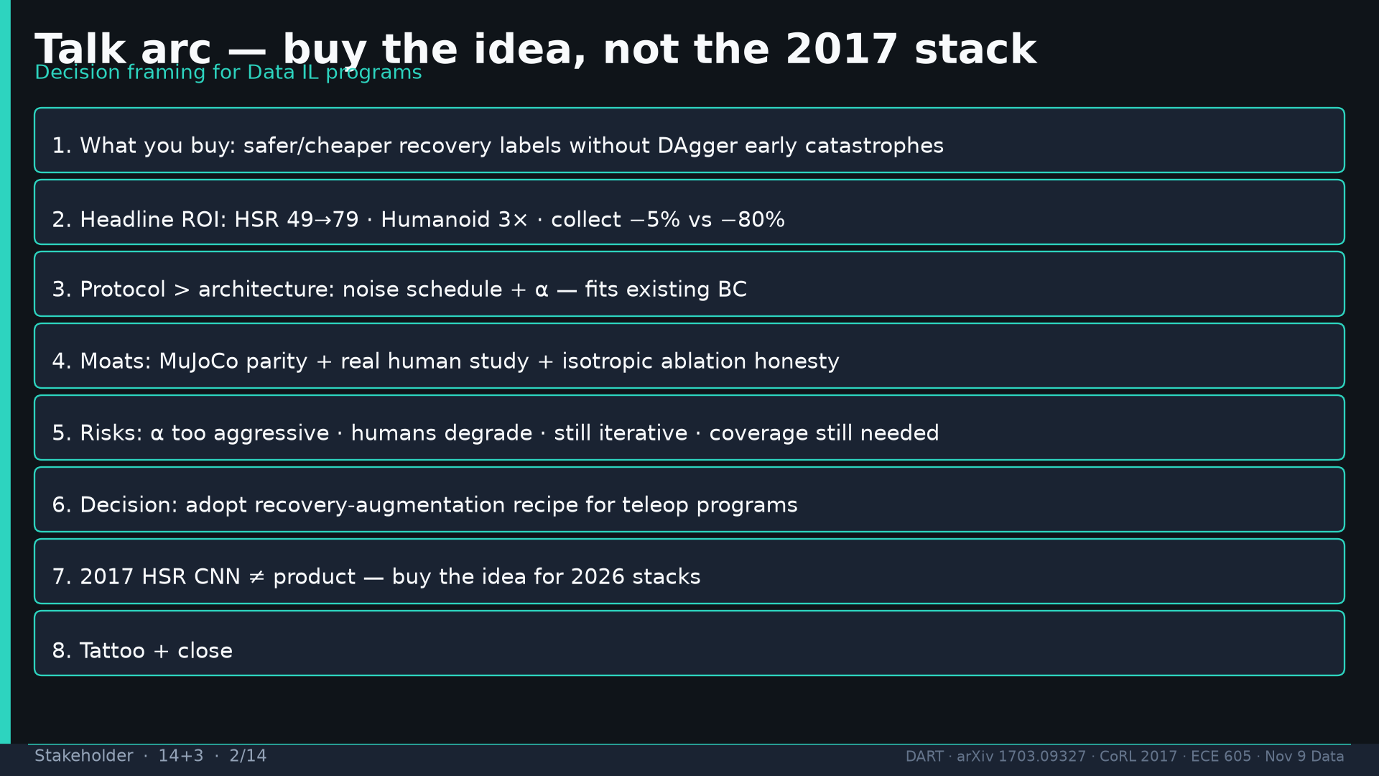
Notes:
Talk arc: buy → ROI → protocol → vs DAgger → moats → risks → decision → noise axes → evidence → tattoo.

Slide 3
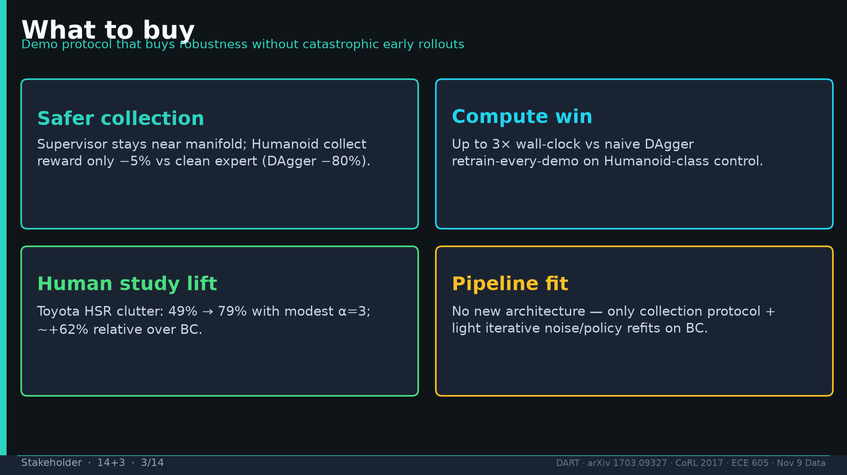
Notes:
Buy: safer collection, 3× compute, HSR lift, BC pipeline fit — no architecture change.

Slide 4
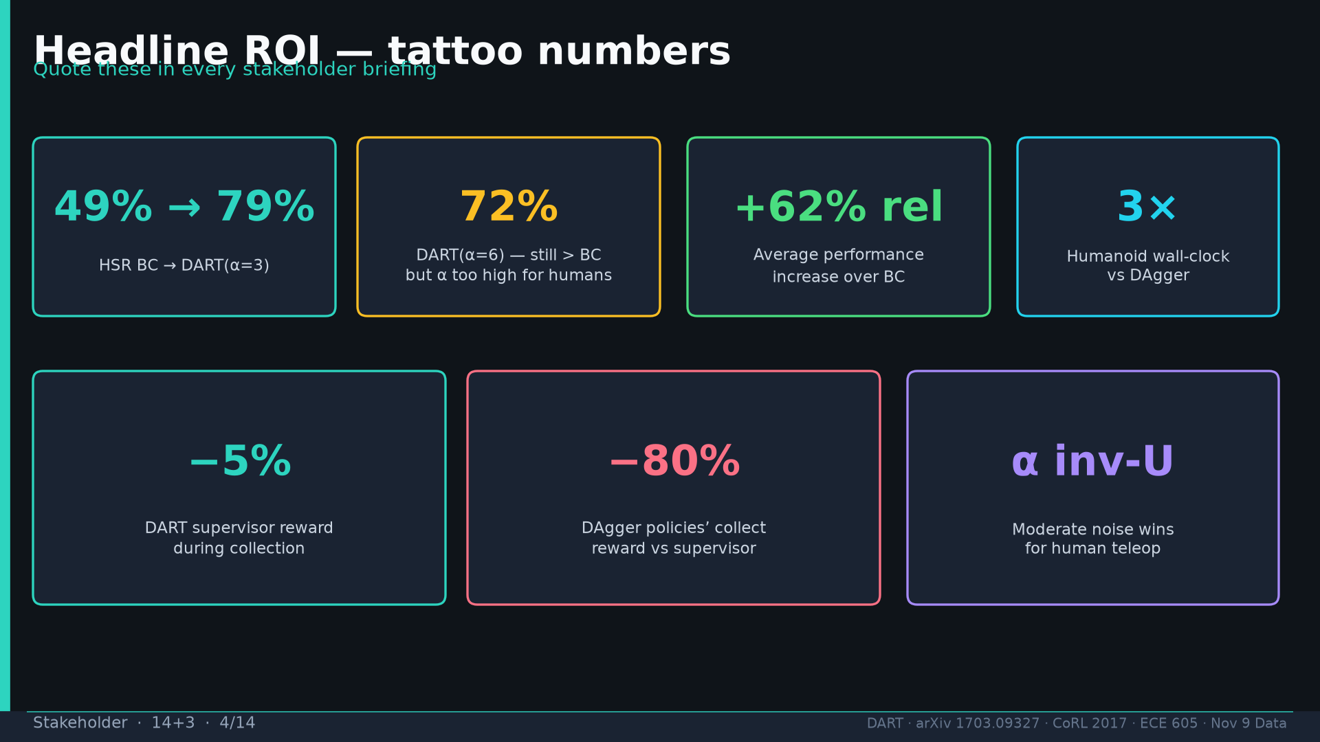
Notes:
ROI tattoo: 49/79/72 / +62% / 3× / −5% vs −80% / α inverted-U.

Slide 5
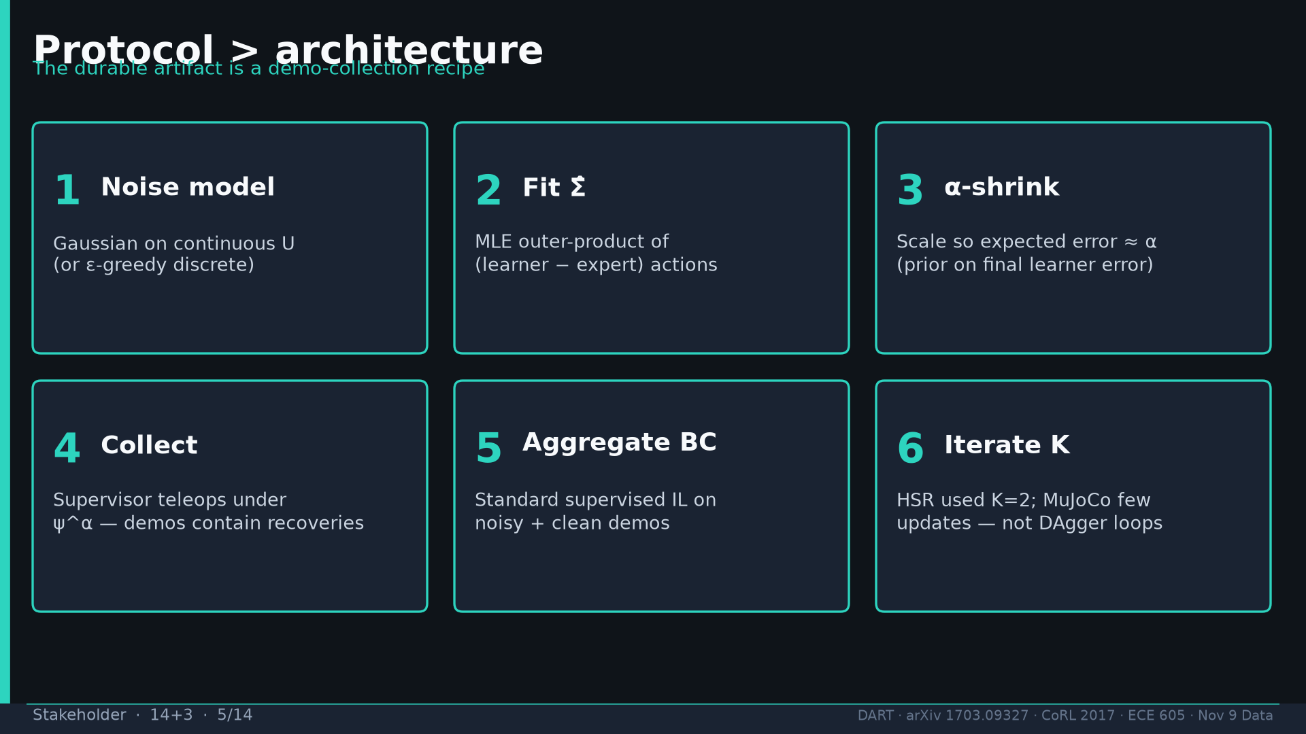
Notes:
Protocol steps: noise model → Σ̂ → α-shrink → collect → aggregate BC → iterate K.

Slide 6
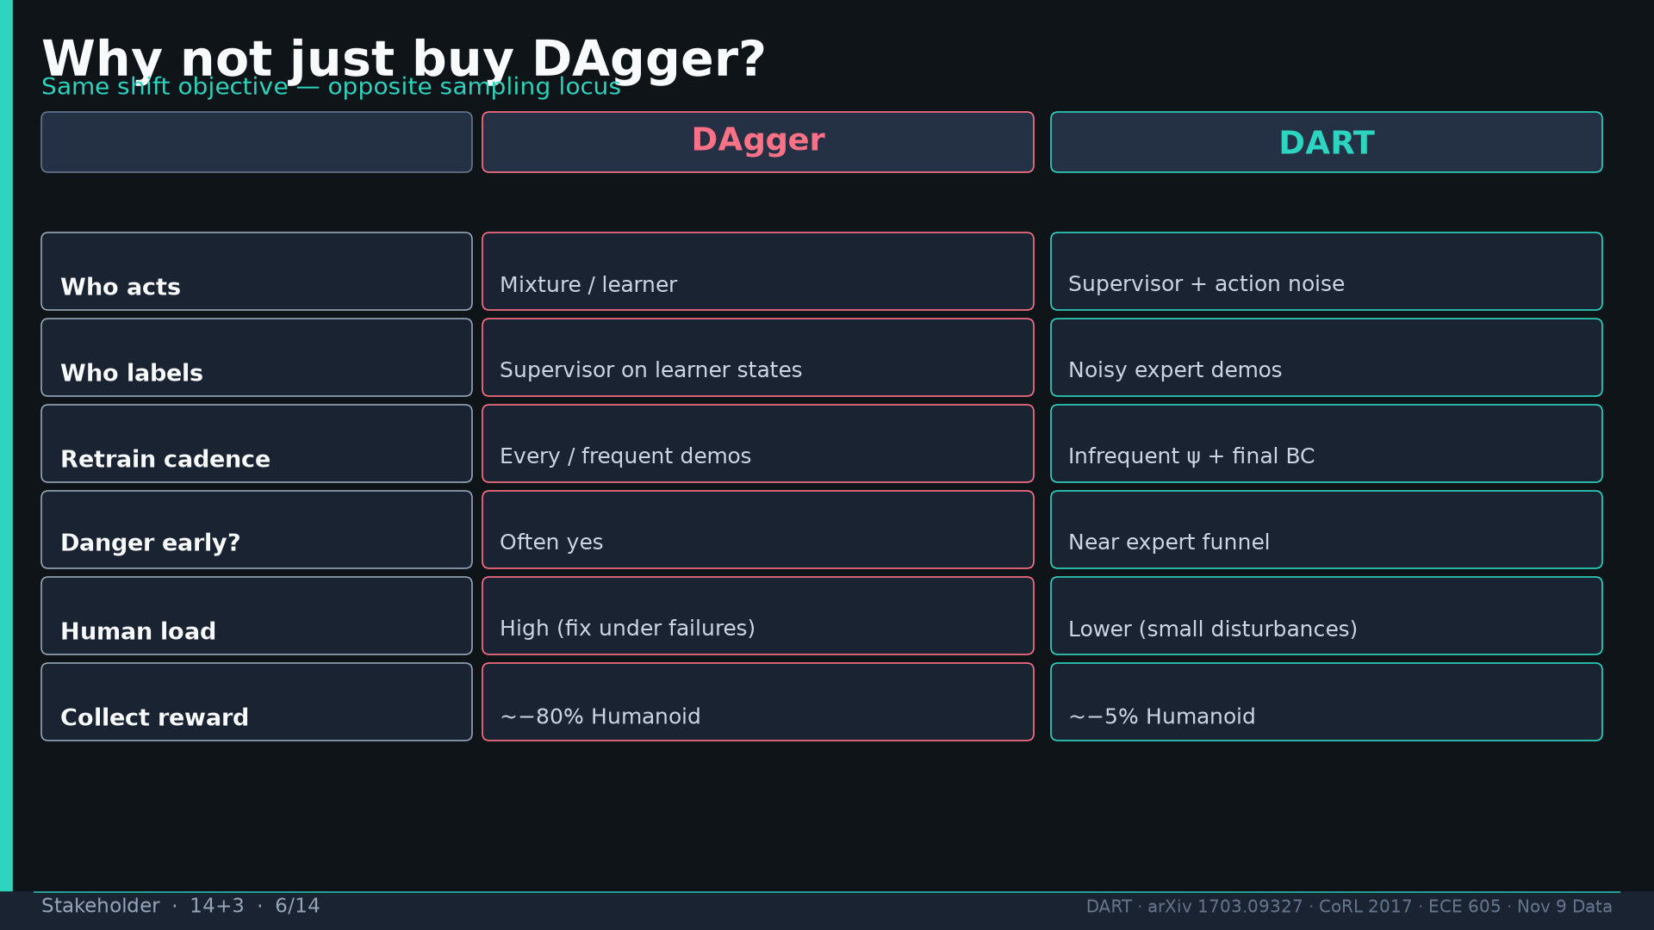
Notes:
Vs DAgger table: who acts/labels, retrain, danger, human load, collect reward.

Slide 7
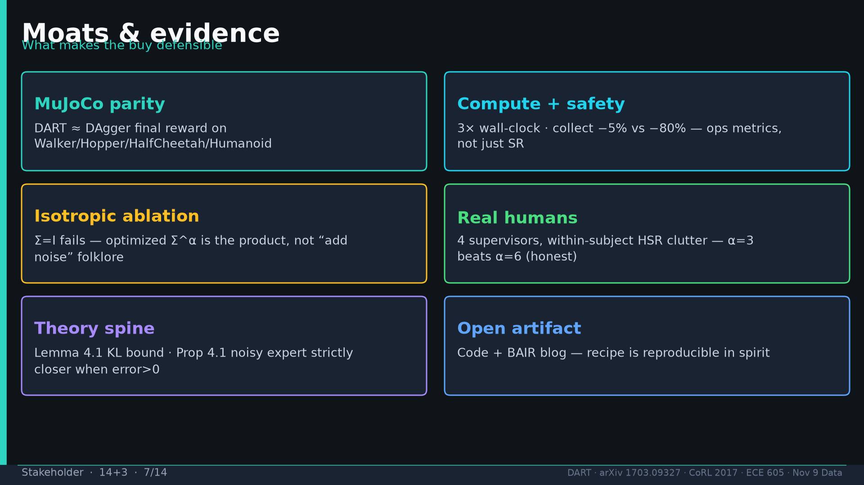
Notes:
Moats: MuJoCo parity, compute+safety, isotropic ablation, real humans, theory, open code.

Slide 8
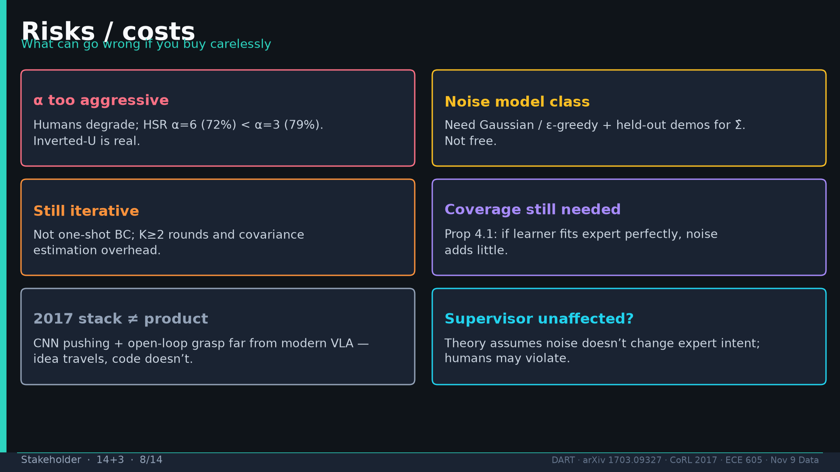
Notes:
Risks: α too aggressive, noise class, still iterative, coverage, 2017≠product, supervisor-unaffected.

Slide 9
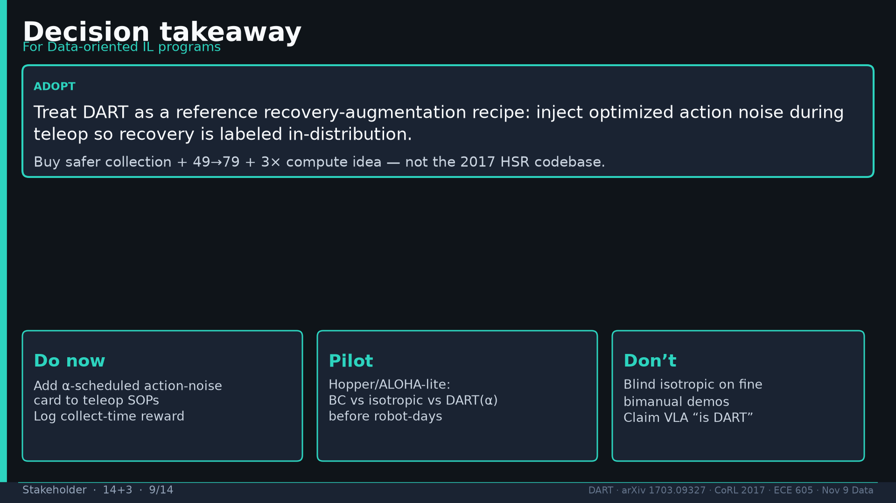
Notes:
Decision: adopt recovery-augmentation recipe; do/pilot/don’t cards.

Slide 10
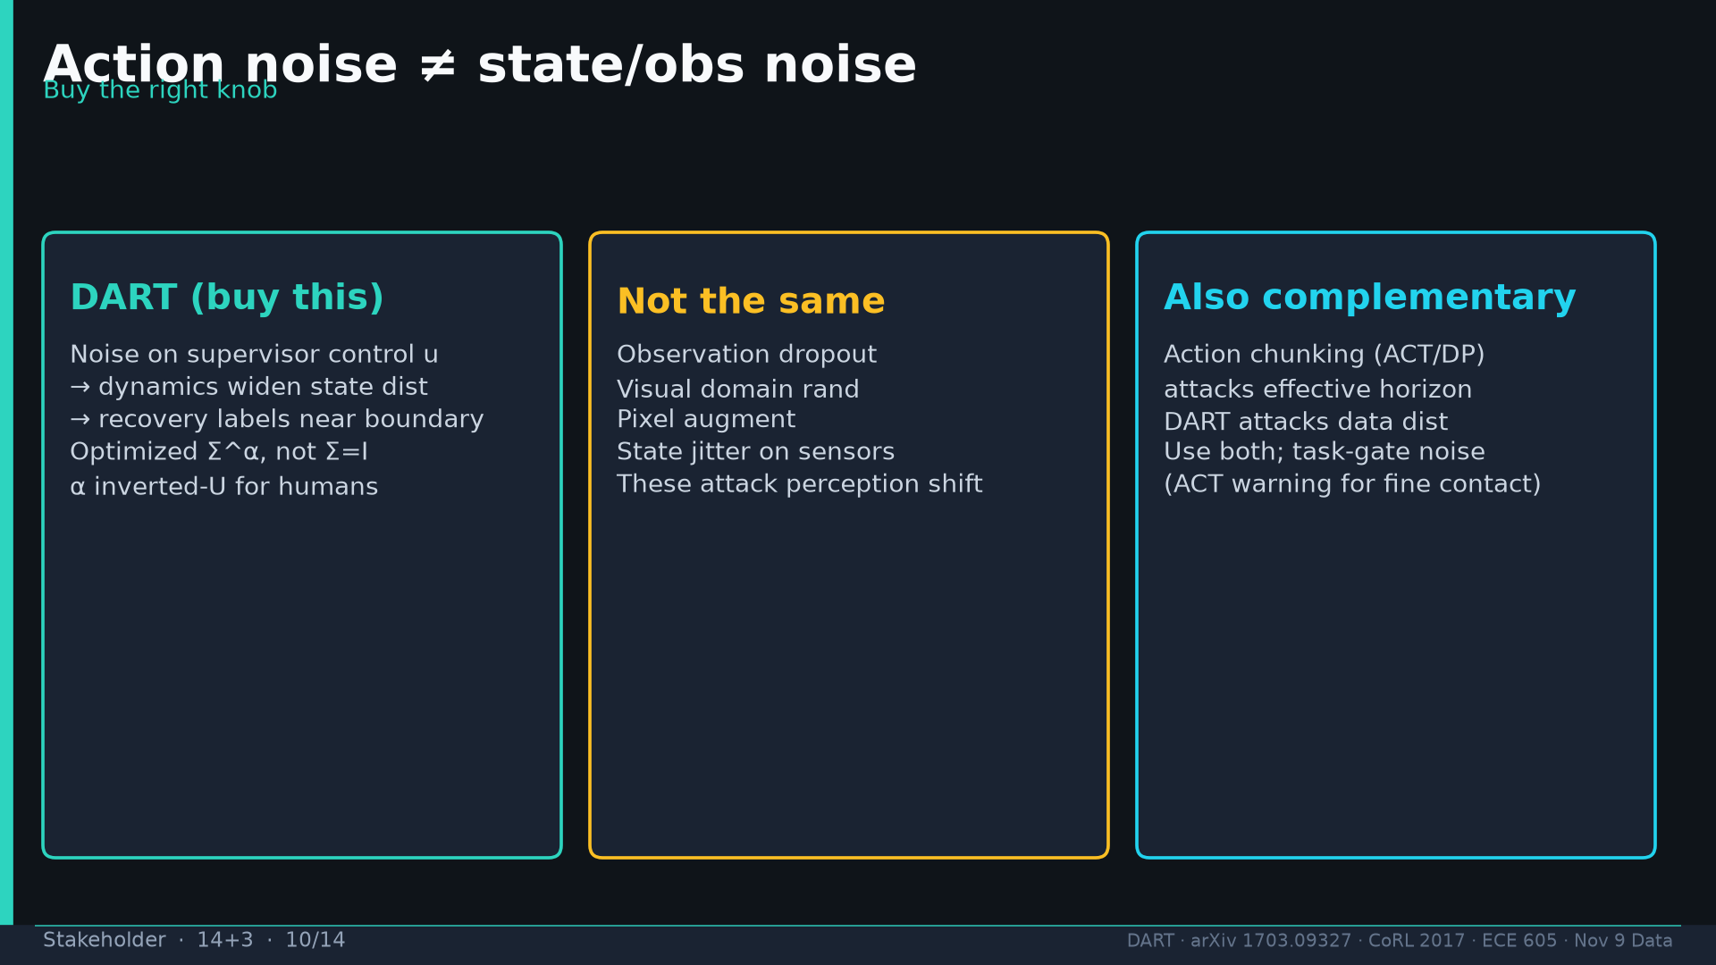
Notes:
Action≠state≠chunking — buy the right knob; complementary to chunking.

Slide 11
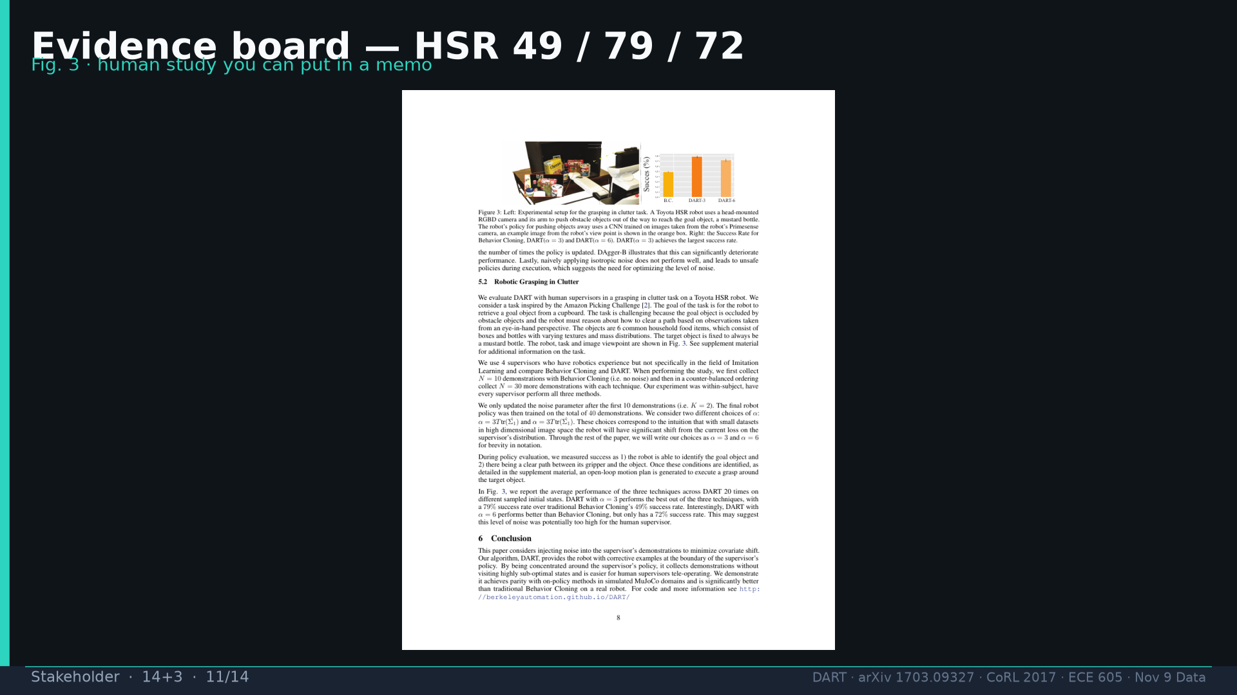
Notes:
Fig.3 HSR evidence board.

Slide 12
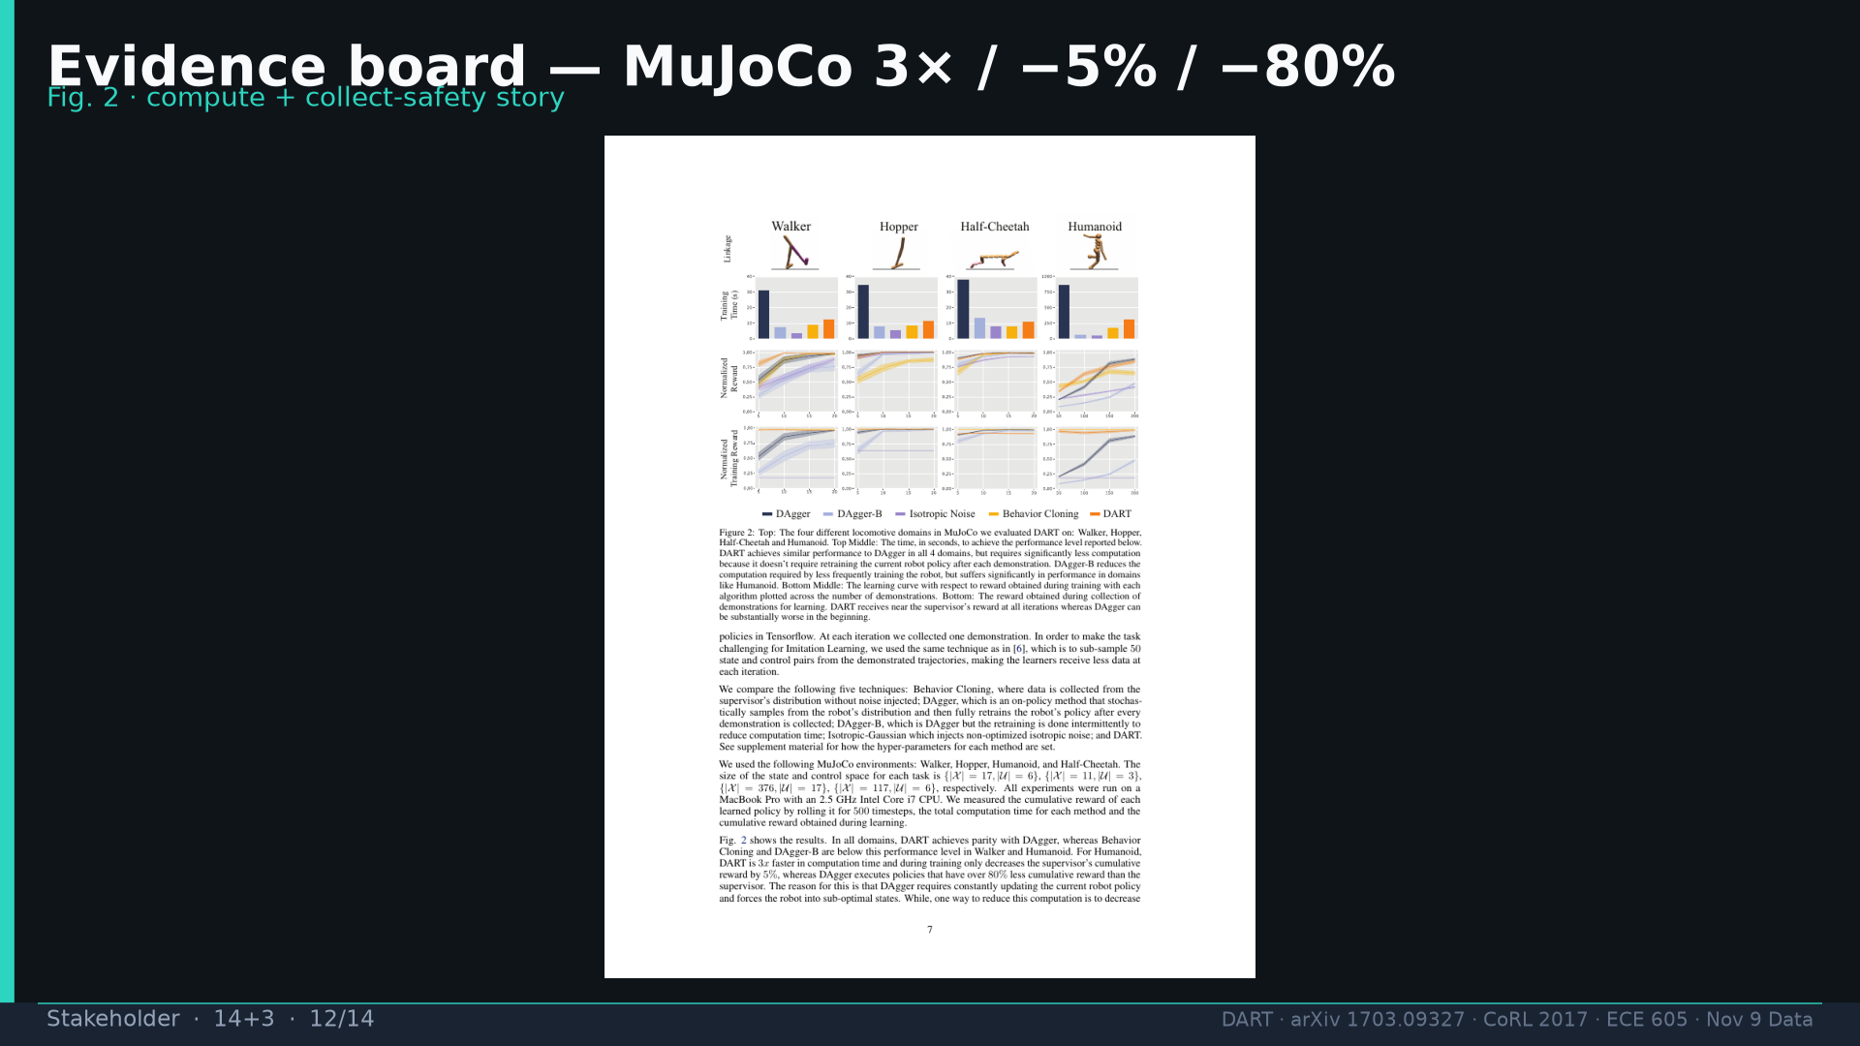
Notes:
Fig.2 MuJoCo evidence board.

Slide 13
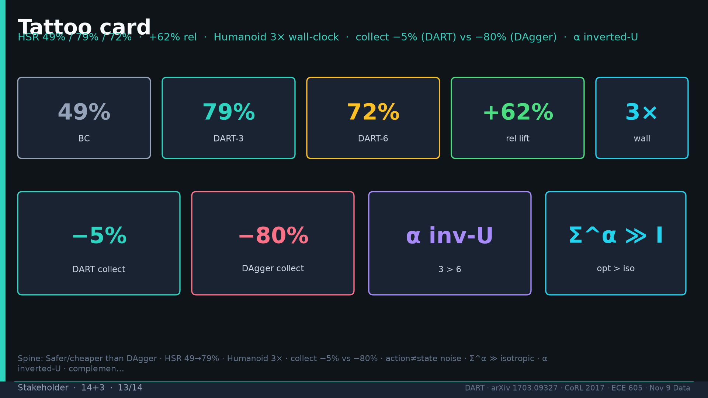
Notes:
Tattoo card shared spine.

Slide 14
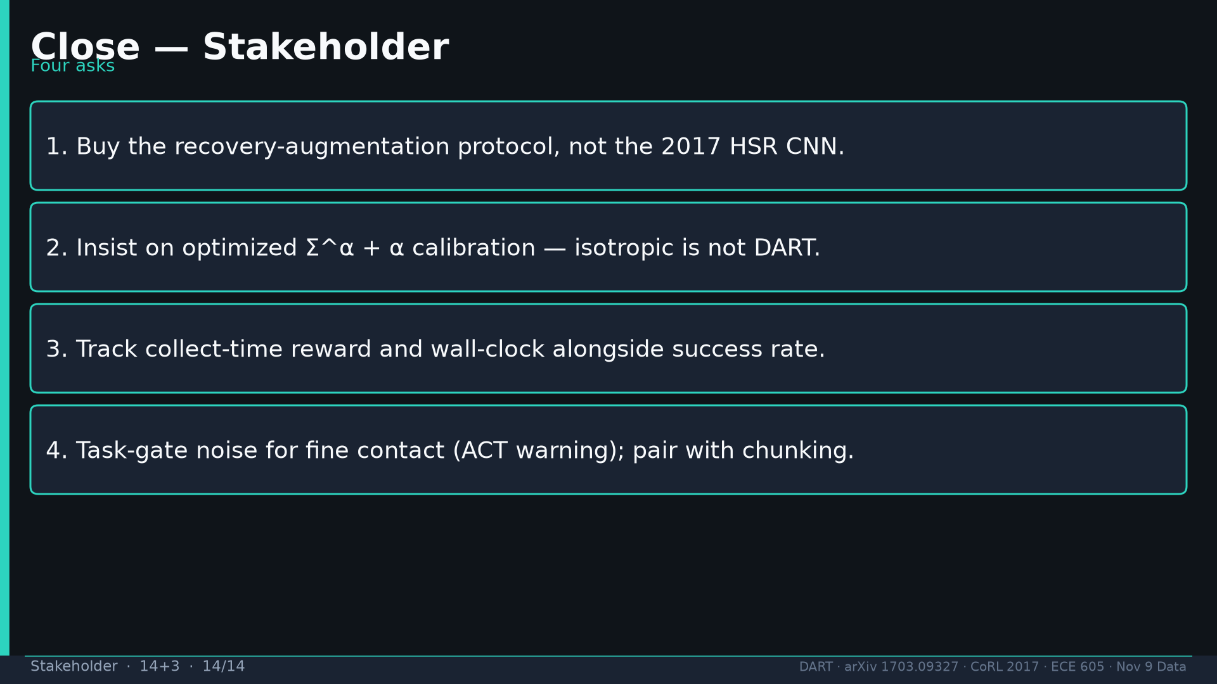
Notes:
Close four asks: buy idea, insist Σ^α, track collect reward, task-gate+chunk.

