Slide 1
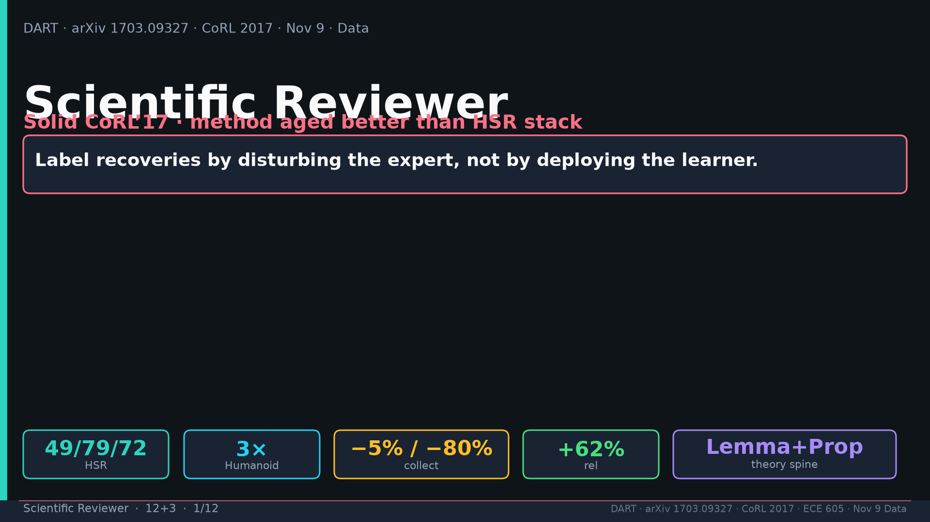
Notes:
Title. Solid CoRL’17; method aged better than HSR stack.

Slide 2
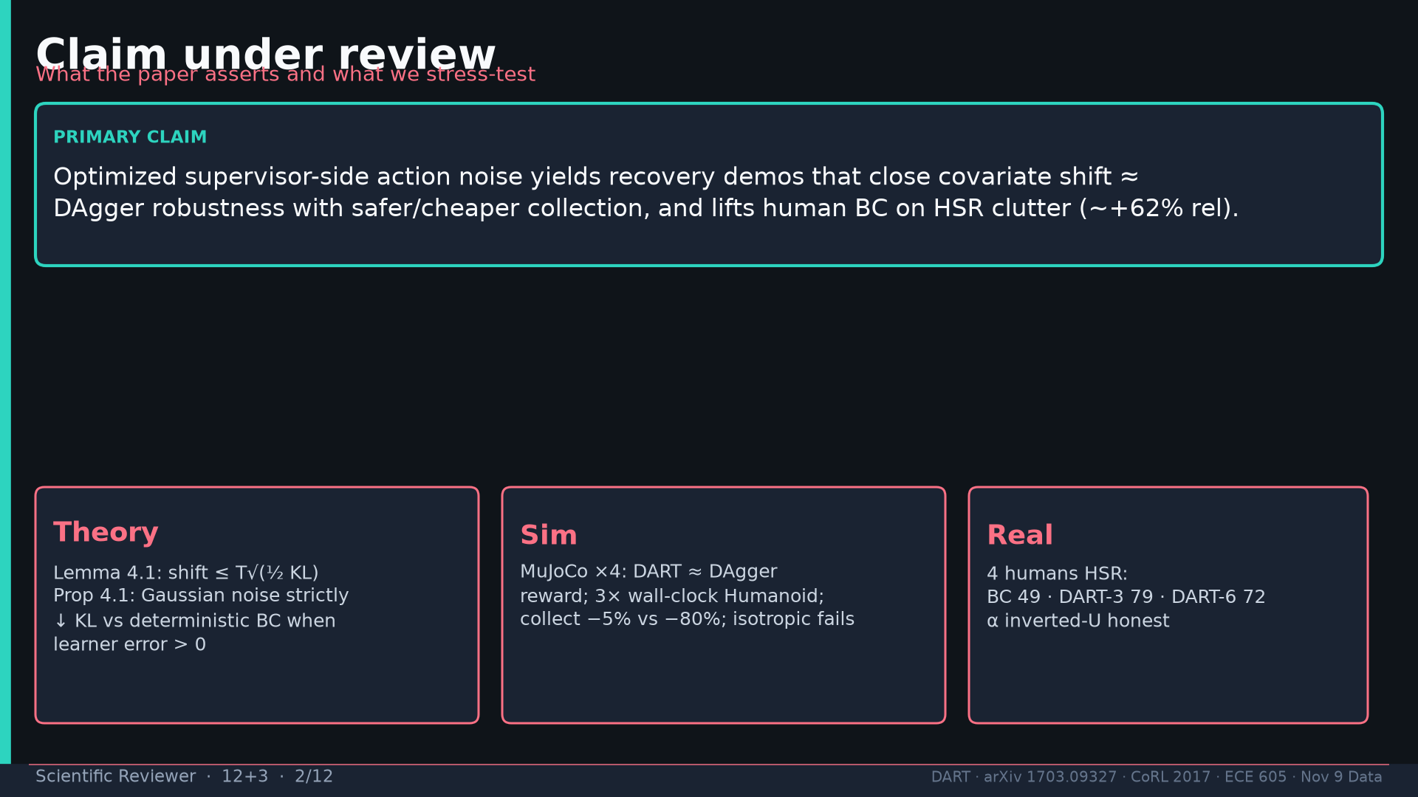
Notes:
Claim: optimized supervisor-side action noise ≈ DAgger robustness, safer/cheaper, HSR +62% rel.

Slide 3
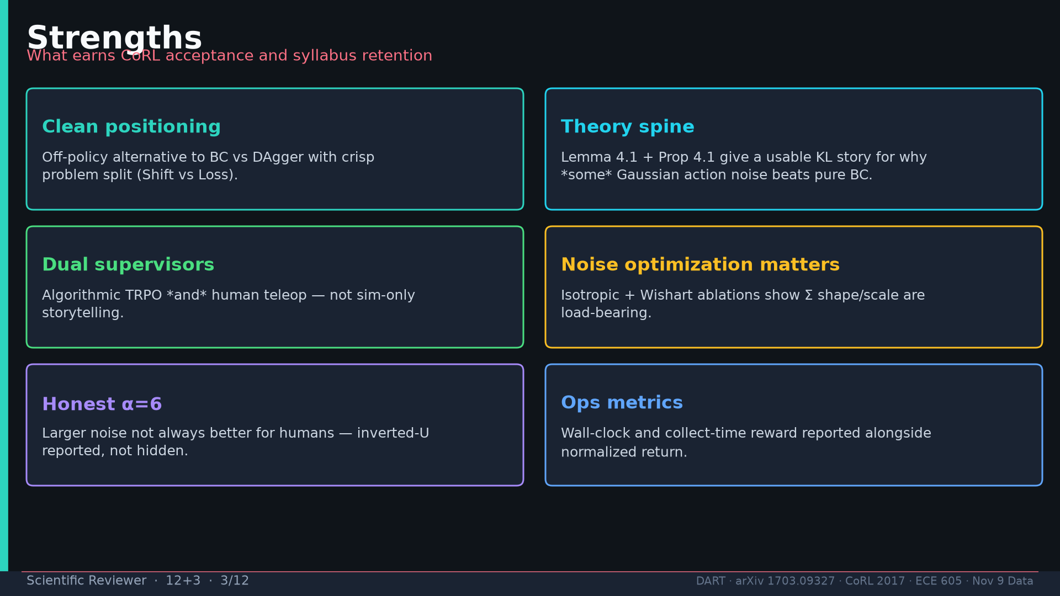
Notes:
Strengths: positioning, Lemma+Prop, dual supervisors, noise opt ablations, honest α=6, ops metrics.

Slide 4
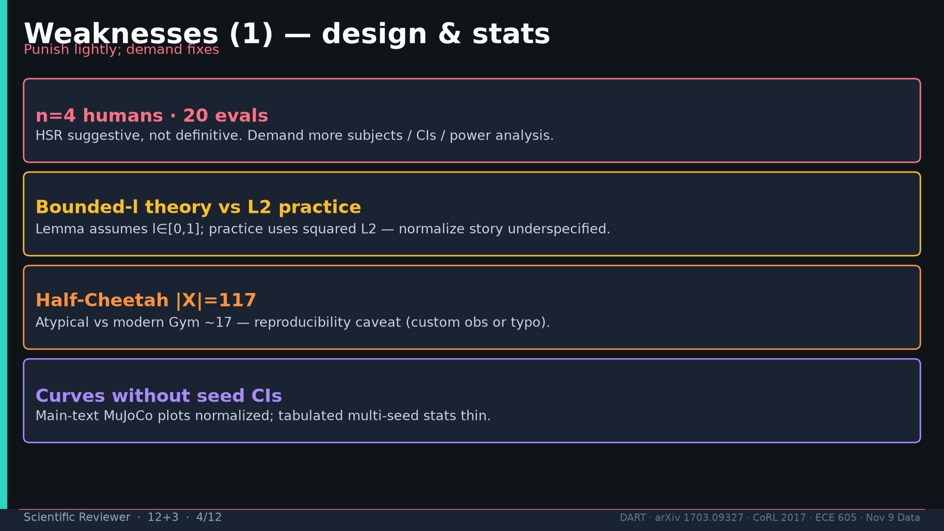
Notes:
Weak1: n=4/20, bounded-l vs L2, Half-Cheetah |X|=117, thin seed CIs.

Slide 5
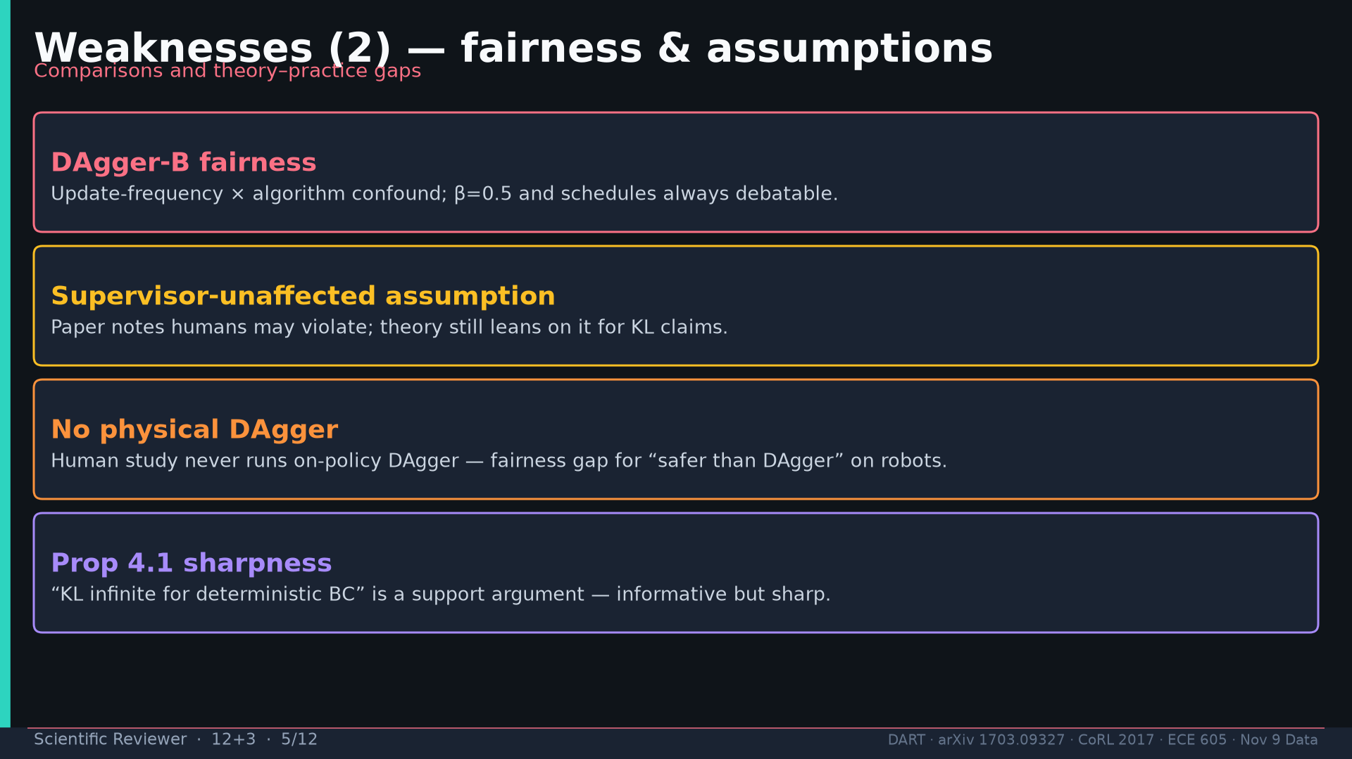
Notes:
Weak2: DAgger-B fairness, supervisor-unaffected, no physical DAgger, Prop sharpness.

Slide 6
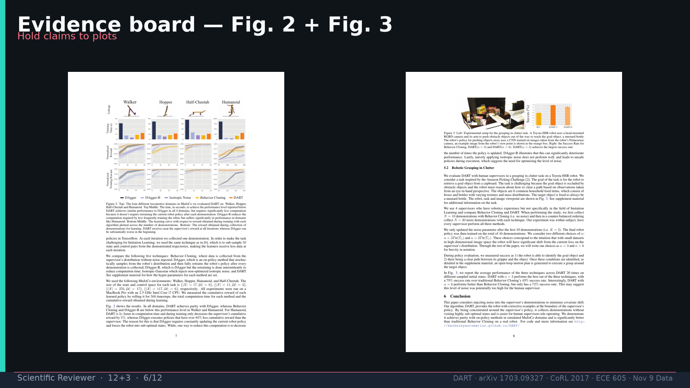
Notes:
Evidence board Fig.2+3.

Slide 7
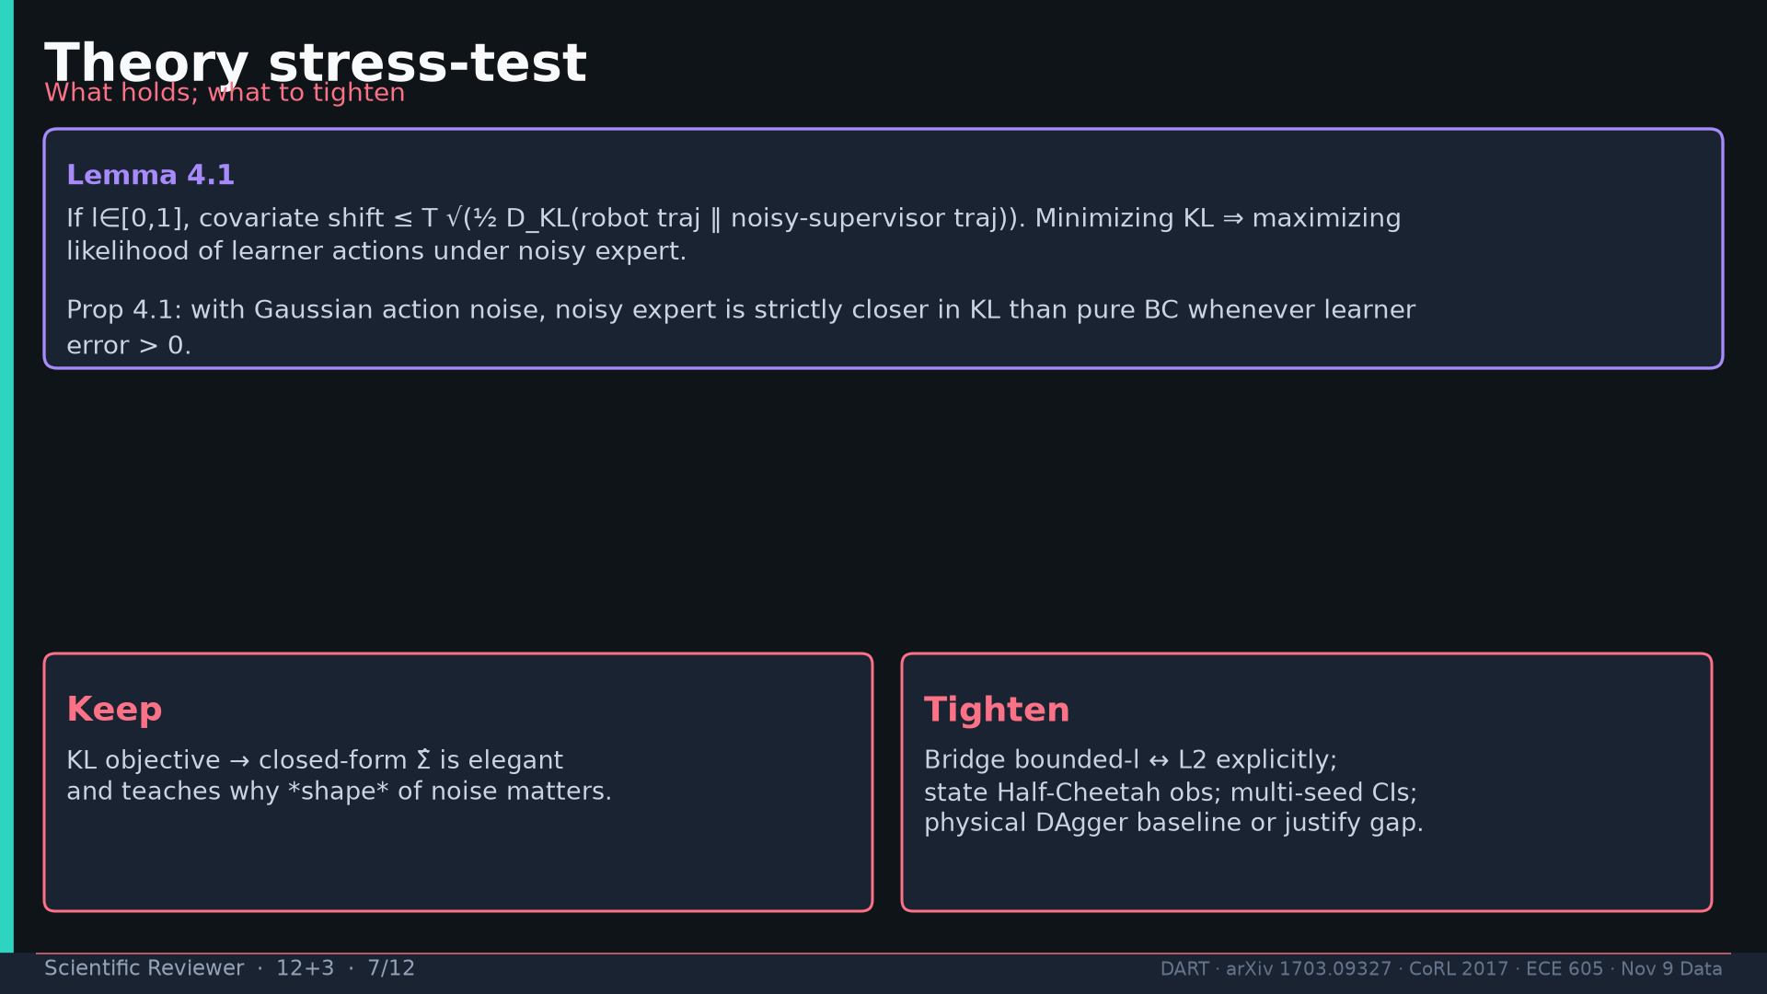
Notes:
Theory stress-test: keep KL→Σ̂ elegance; tighten loss bridge / dim / CIs / physical baseline.

Slide 8
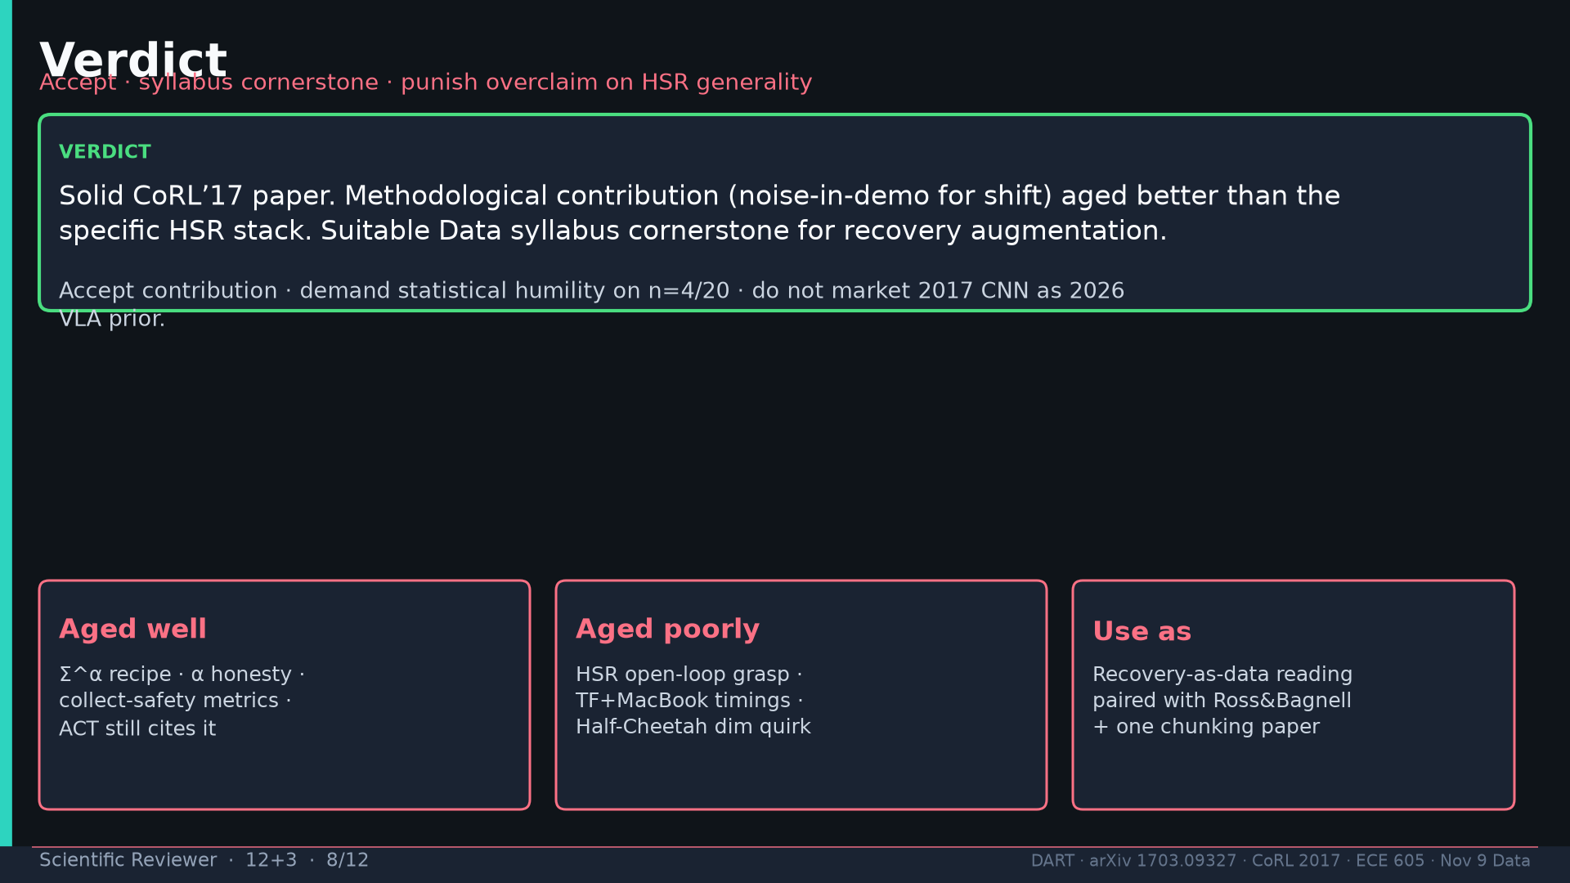
Notes:
Verdict: accept contribution; syllabus cornerstone; punish HSR overclaim.

Slide 9
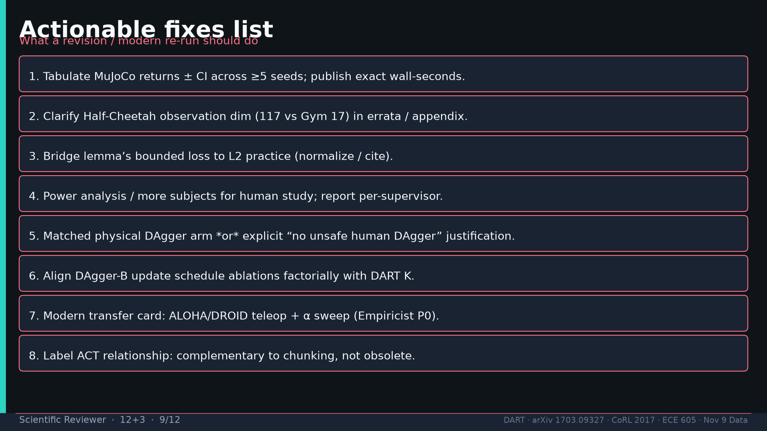
Notes:
Actionable fixes list (8 items).

Slide 10
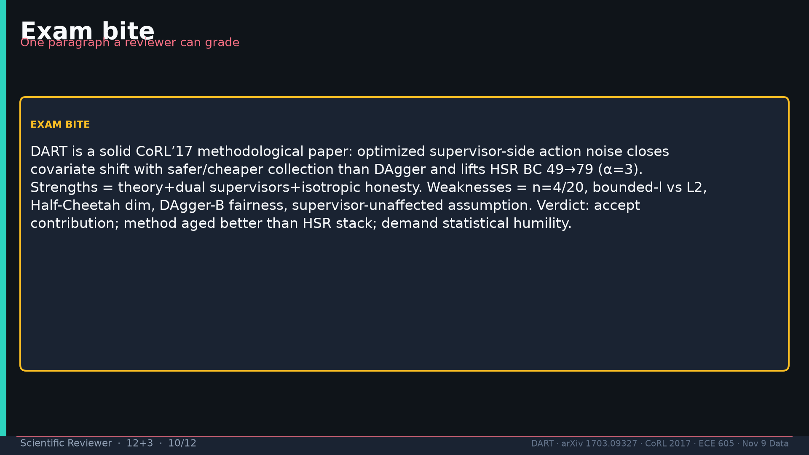
Notes:
Exam bite paragraph.

Slide 11
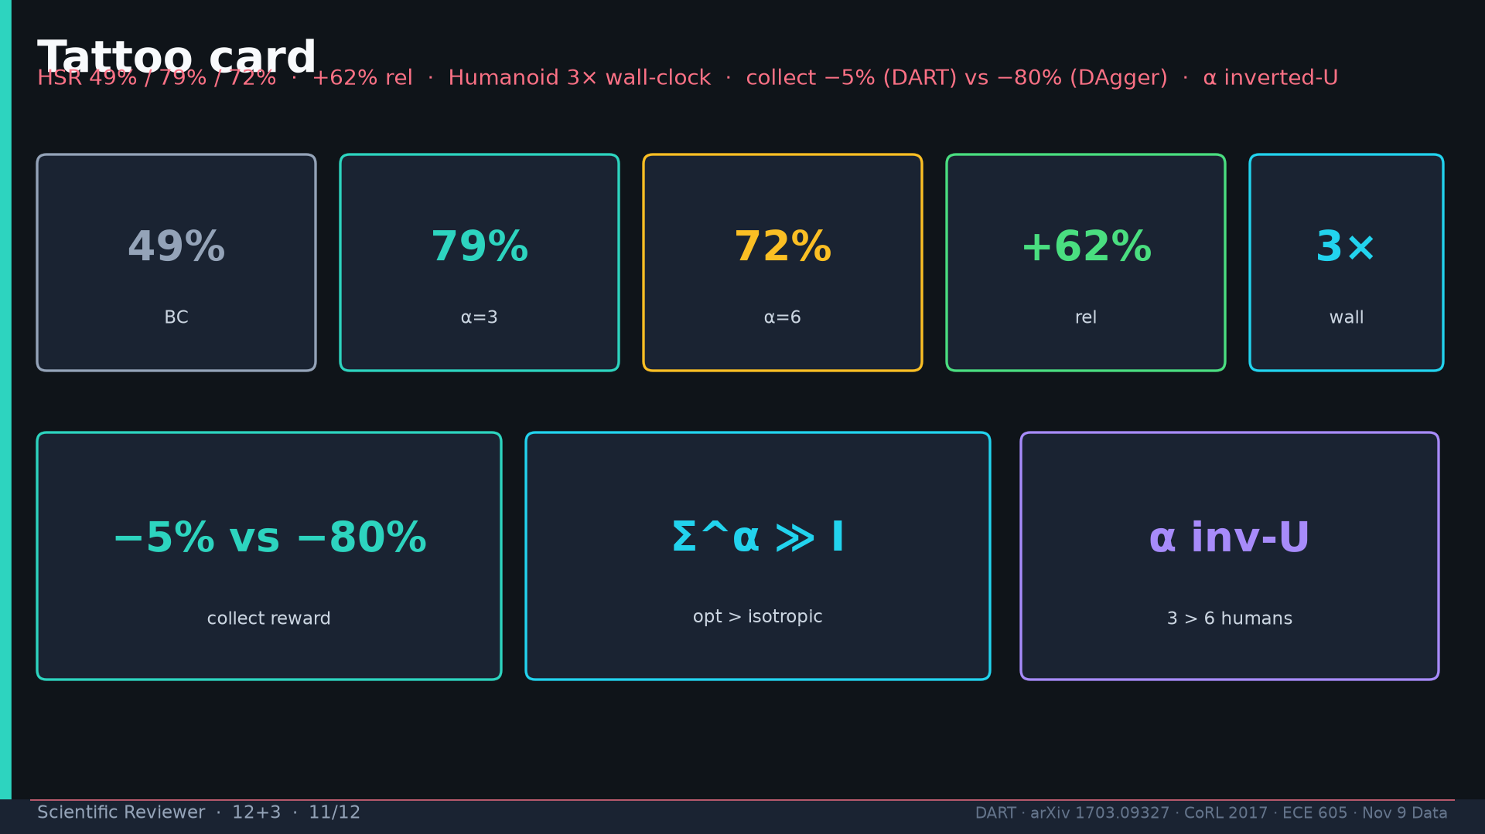
Notes:
Tattoo.

Slide 12
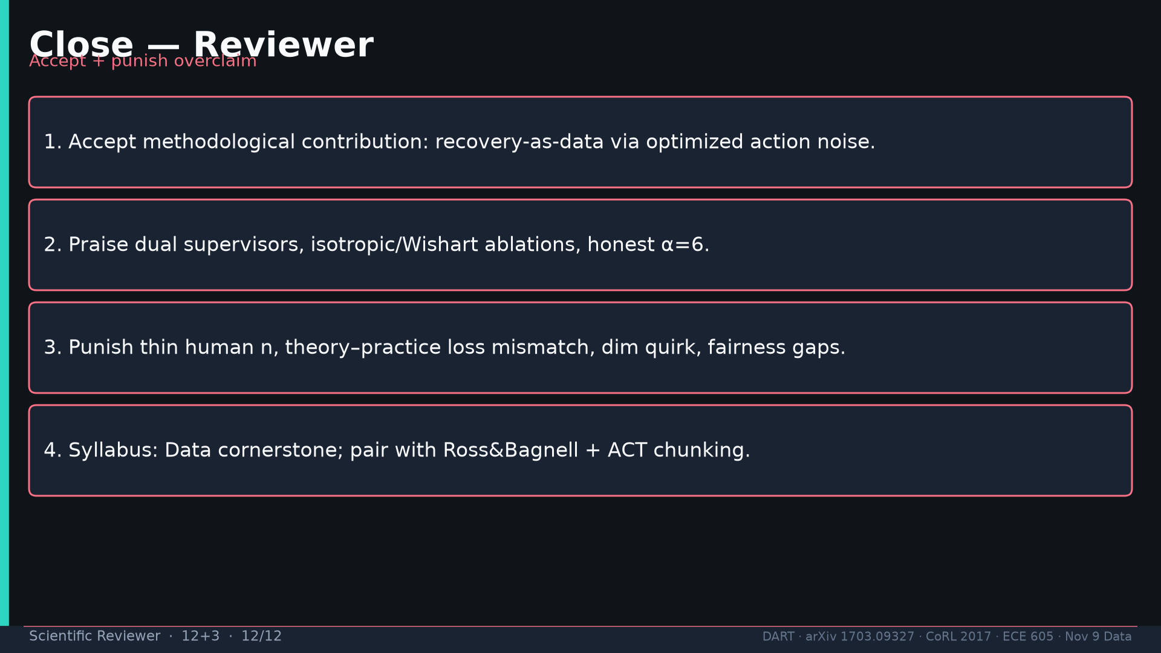
Notes:
Close: accept + praise + punish + syllabus placement.

