Slide 1
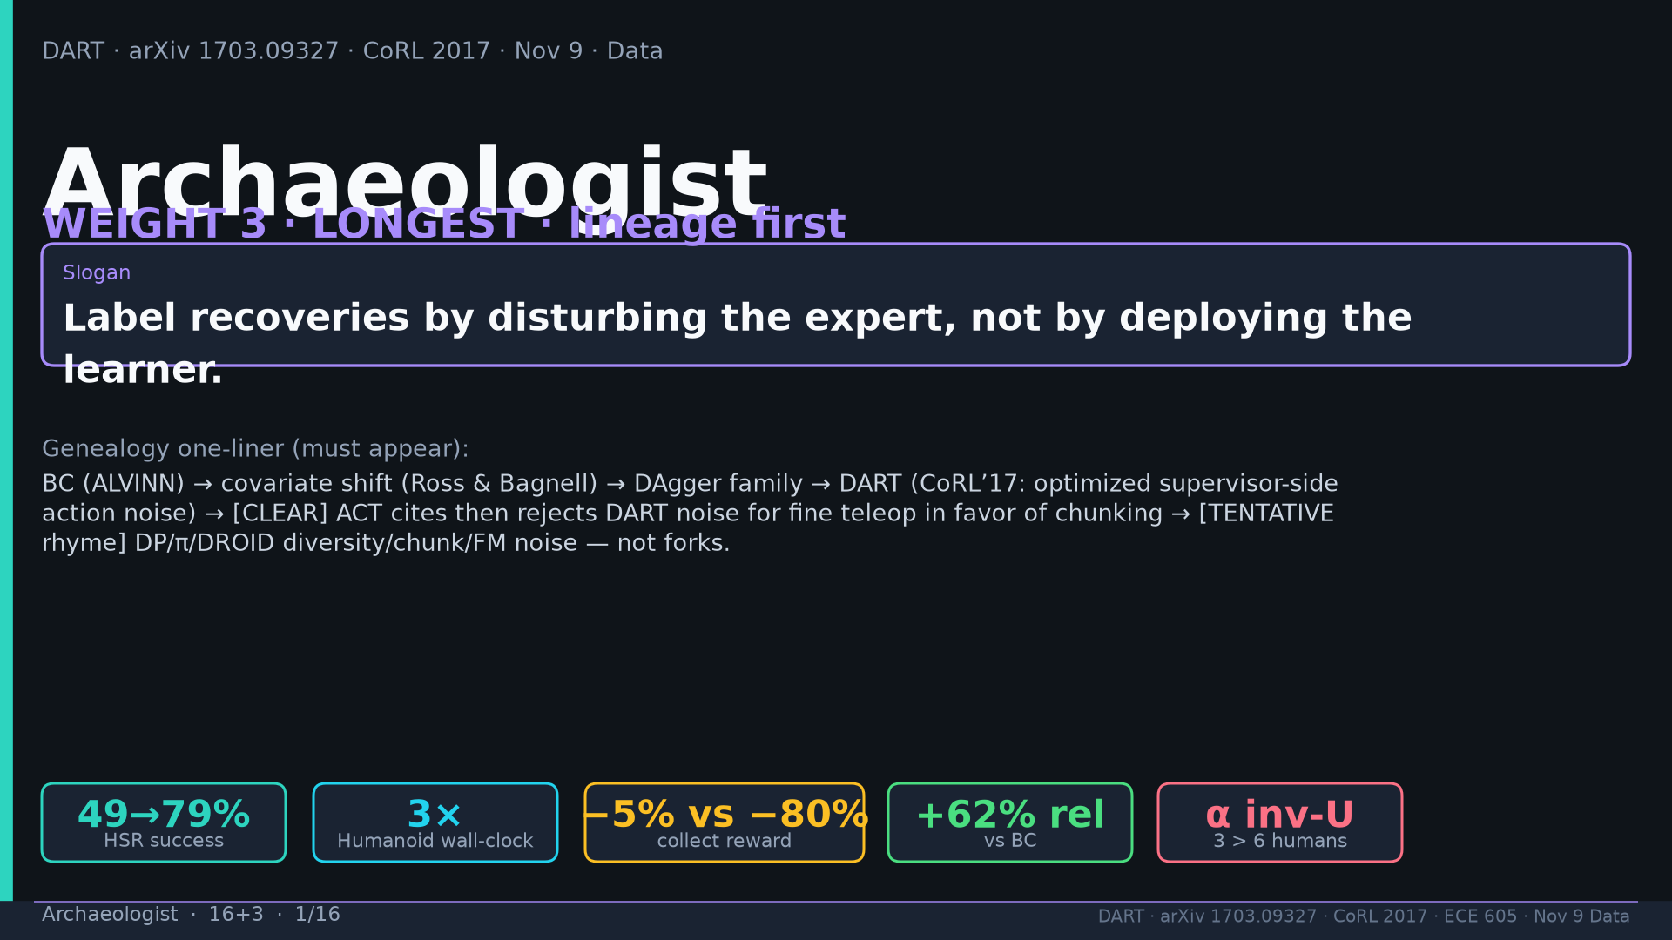
Notes:
Title WEIGHT 3. Slogan + genealogy one-liner with CLEAR/TENTATIVE. Tattoo chips.

Slide 2
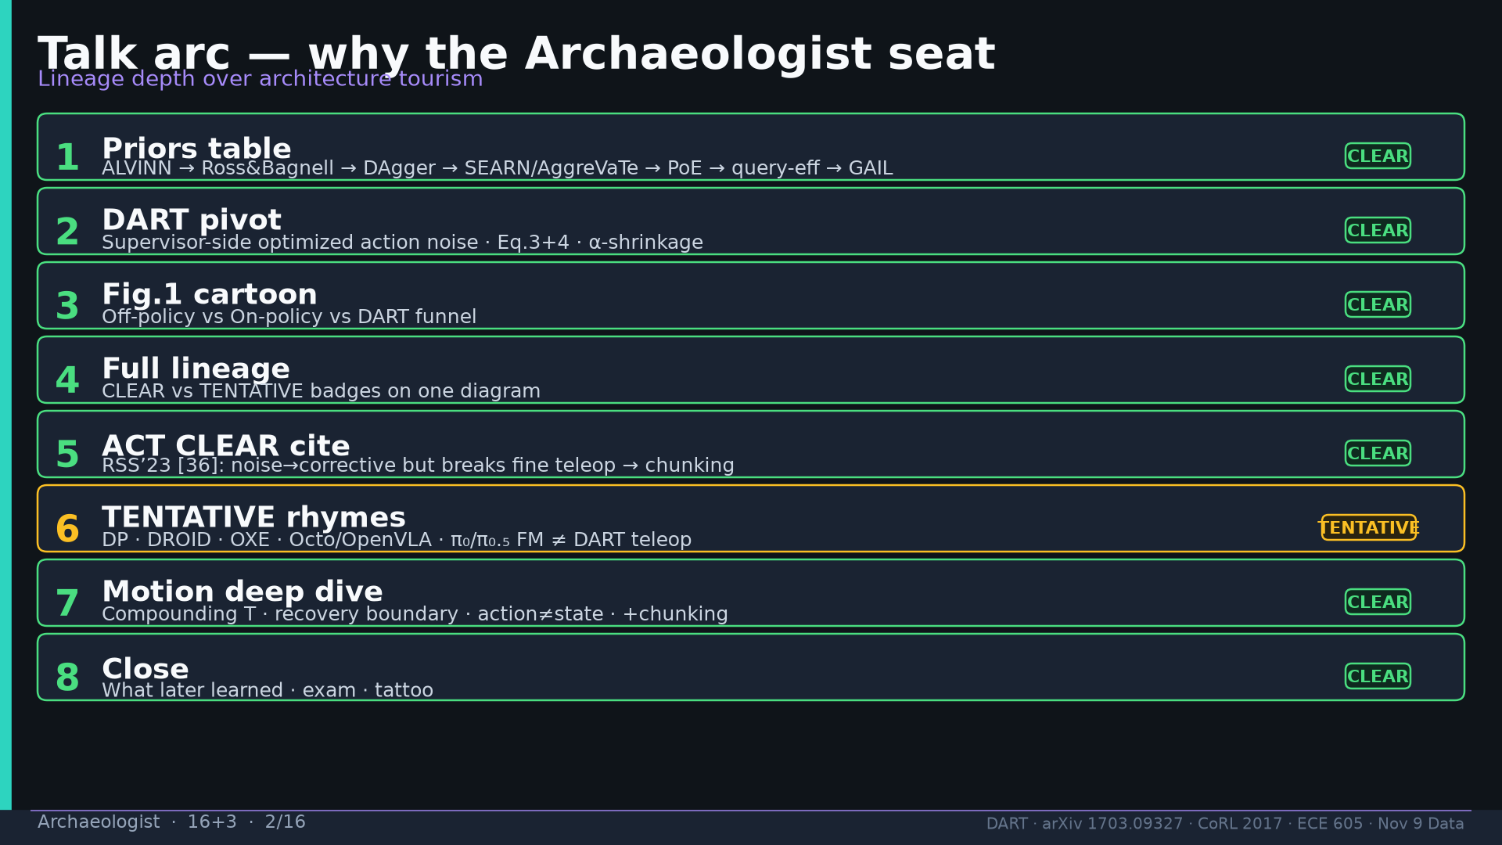
Notes:
Talk arc with CLEAR/TENTATIVE badges on each beat.

Slide 3
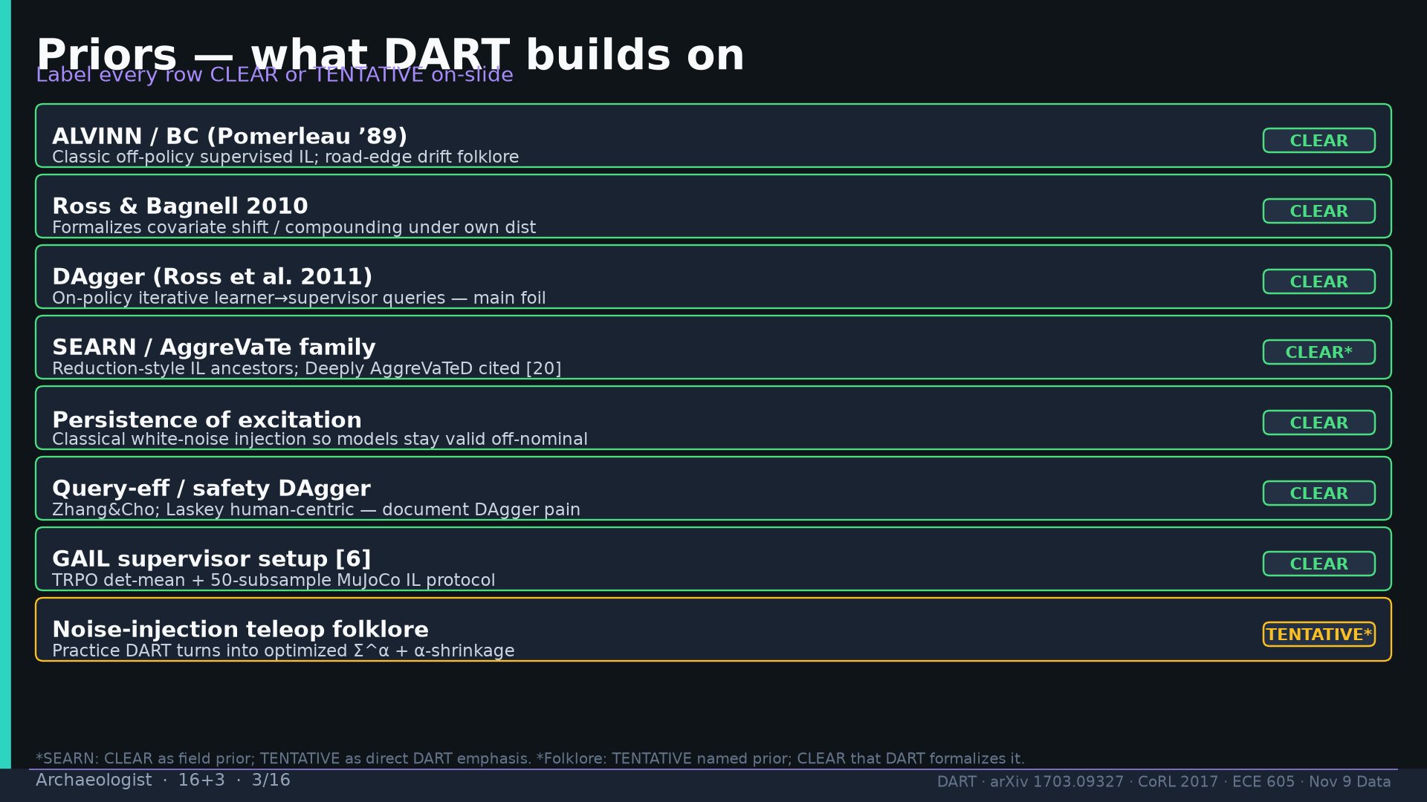
Notes:
Priors table: ALVINN, Ross&Bagnell, DAgger, SEARN/AggreVaTe, PoE, query-eff, GAIL, folklore — labels on-slide.

Slide 4
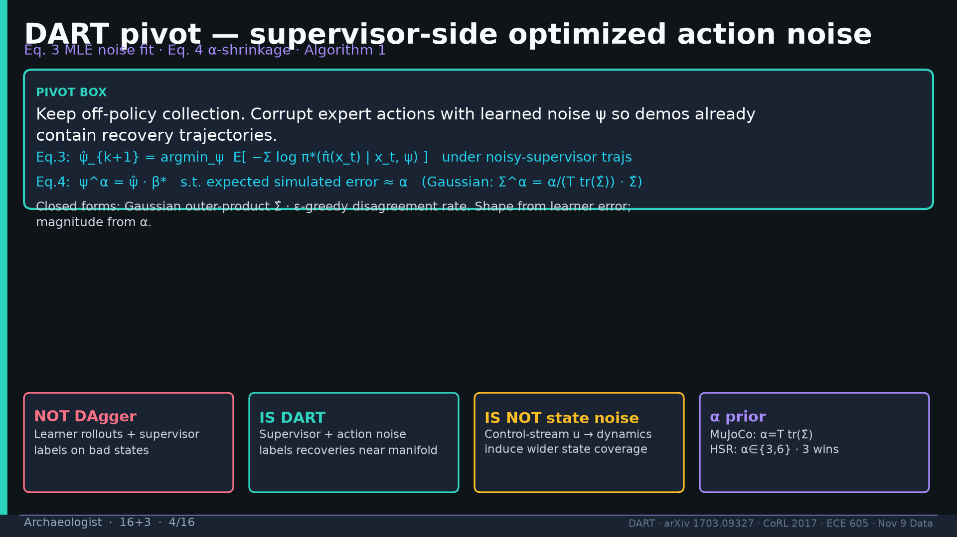
Notes:
DART pivot box Eq.3+4 α-shrinkage; NOT DAgger / IS DART / IS NOT state noise / α prior.

Slide 5
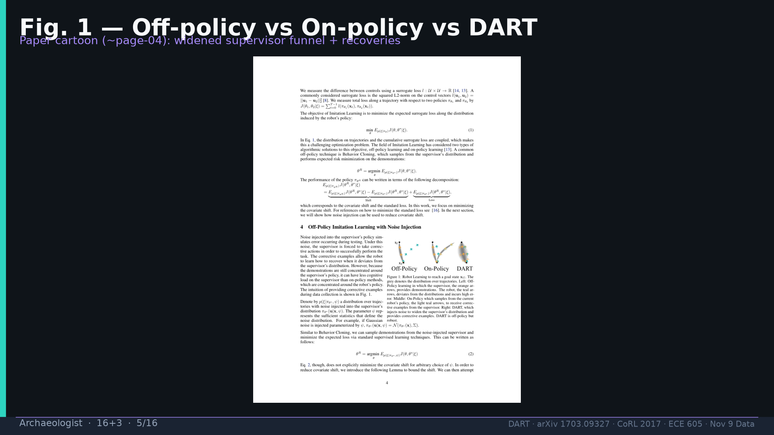
Notes:
Fig.1 cartoon page-04 full-slide.

Slide 6
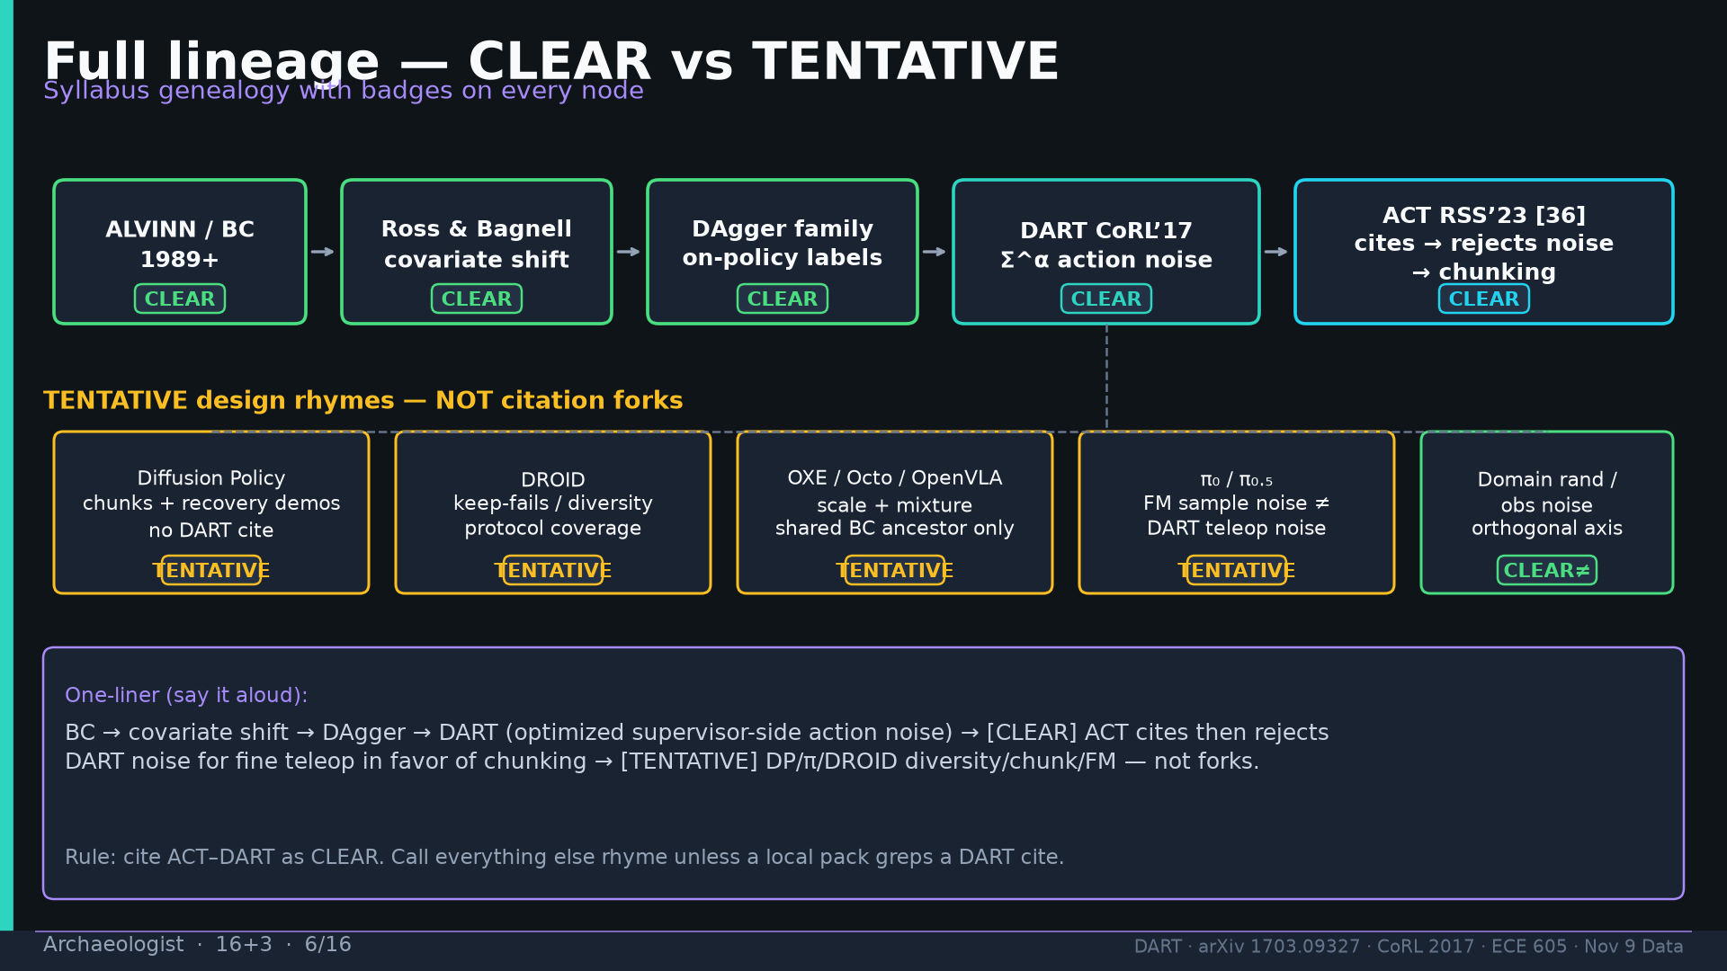
Notes:
Full lineage diagram CLEAR vs TENTATIVE badges + one-liner box.

Slide 7
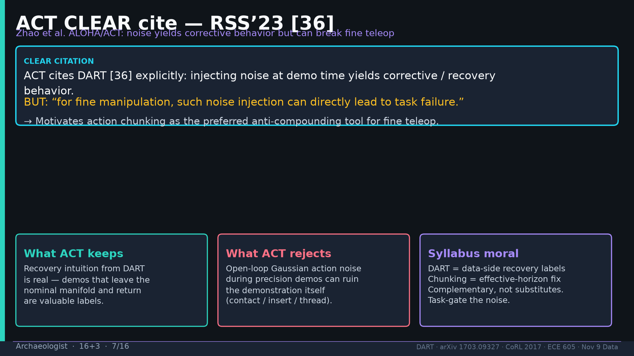
Notes:
ACT CLEAR cite RSS’23 [36]: noise→corrective but breaks fine teleop → chunking. Keep/reject/moral.

Slide 8
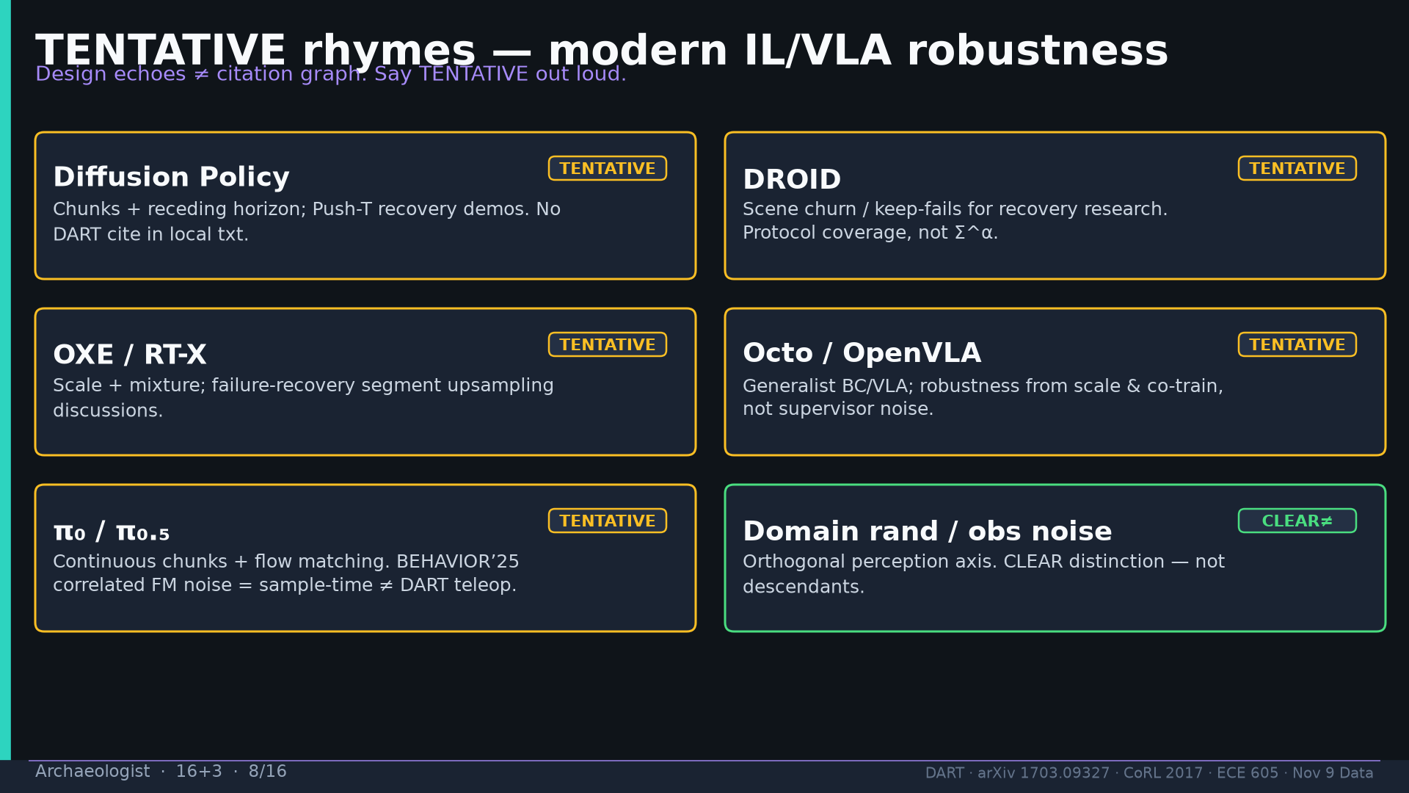
Notes:
TENTATIVE rhymes: DP, DROID, OXE/Octo/OpenVLA, π₀/π₀.₅ FM≠DART, domain rand CLEAR≠.

Slide 9
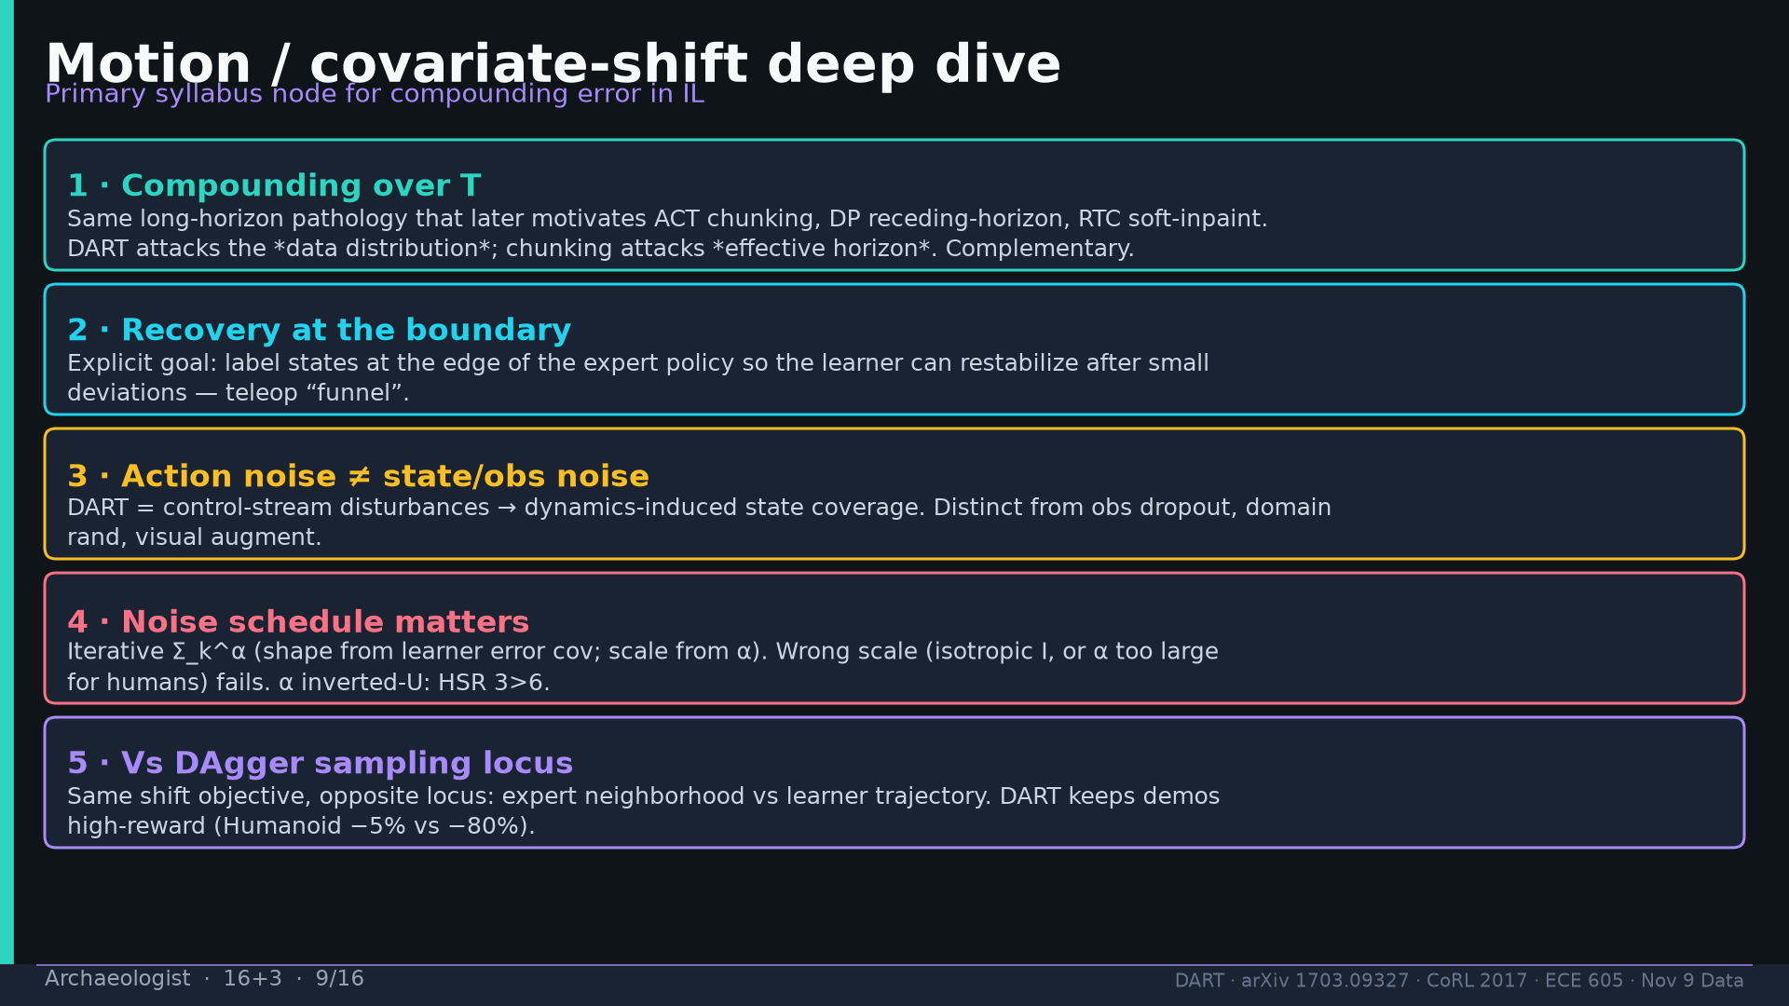
Notes:
Motion deep dive: compounding T, boundary recovery, action≠state, schedule, vs DAgger locus.

Slide 10
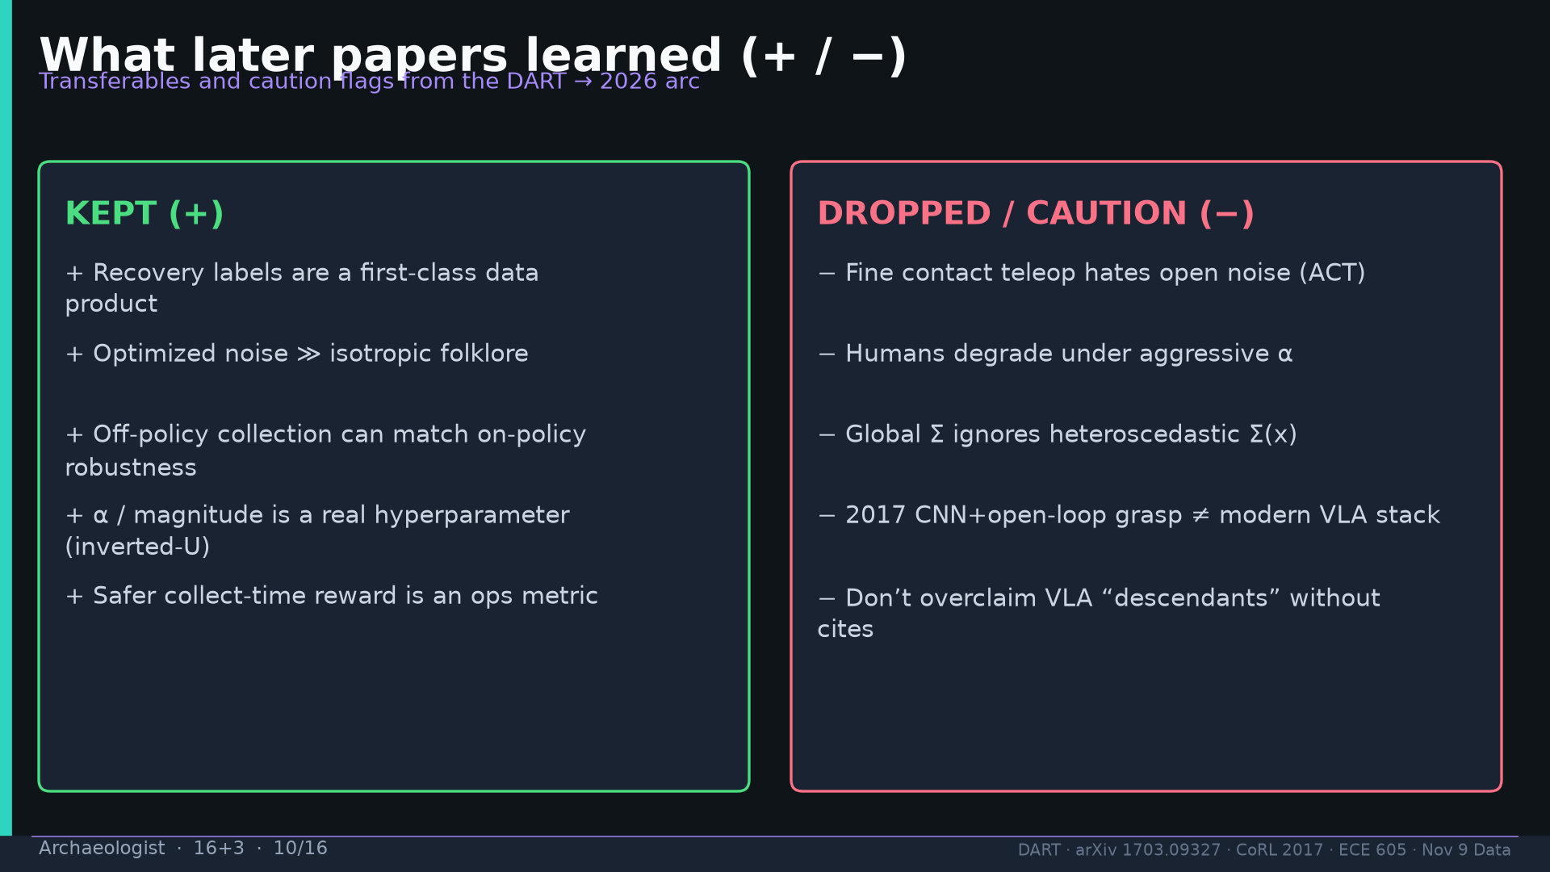
Notes:
What later learned +/−.

Slide 11
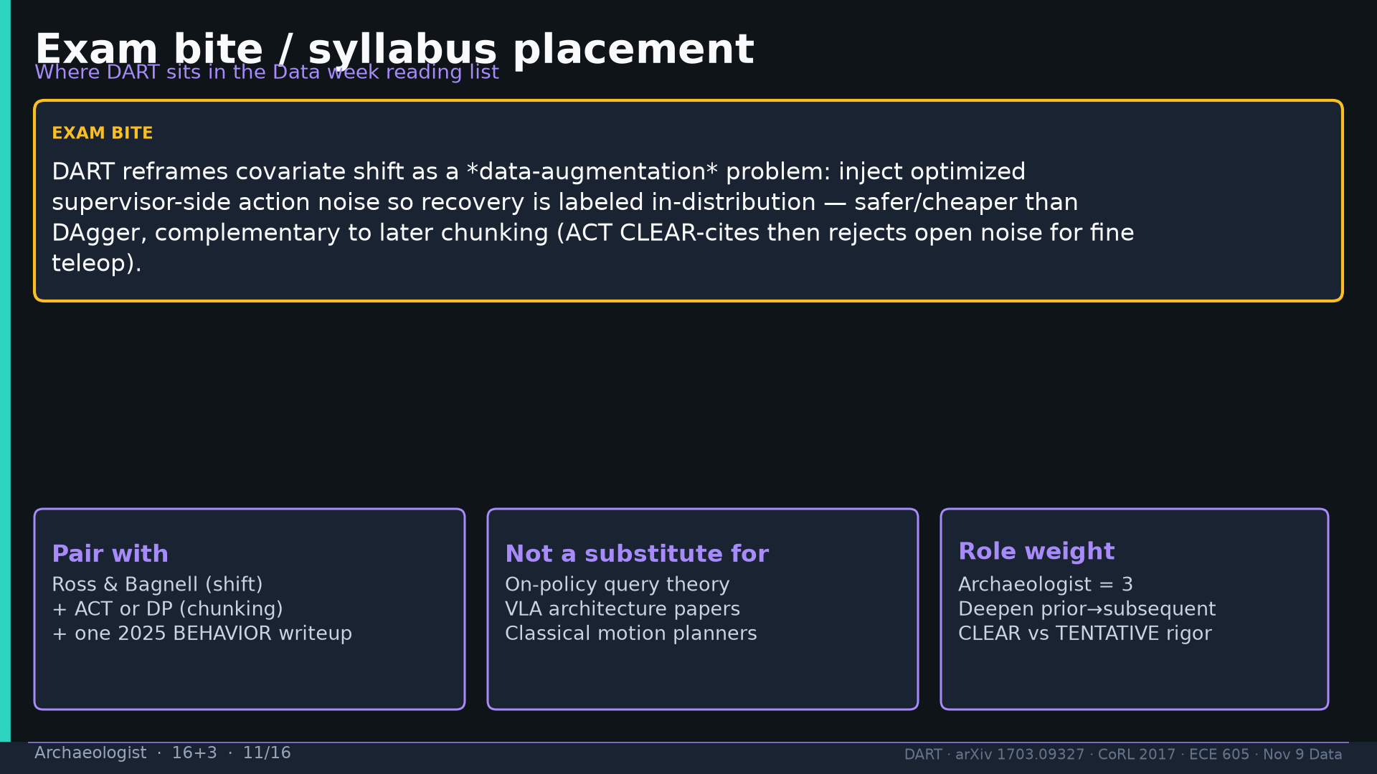
Notes:
Exam bite + syllabus placement.

Slide 12
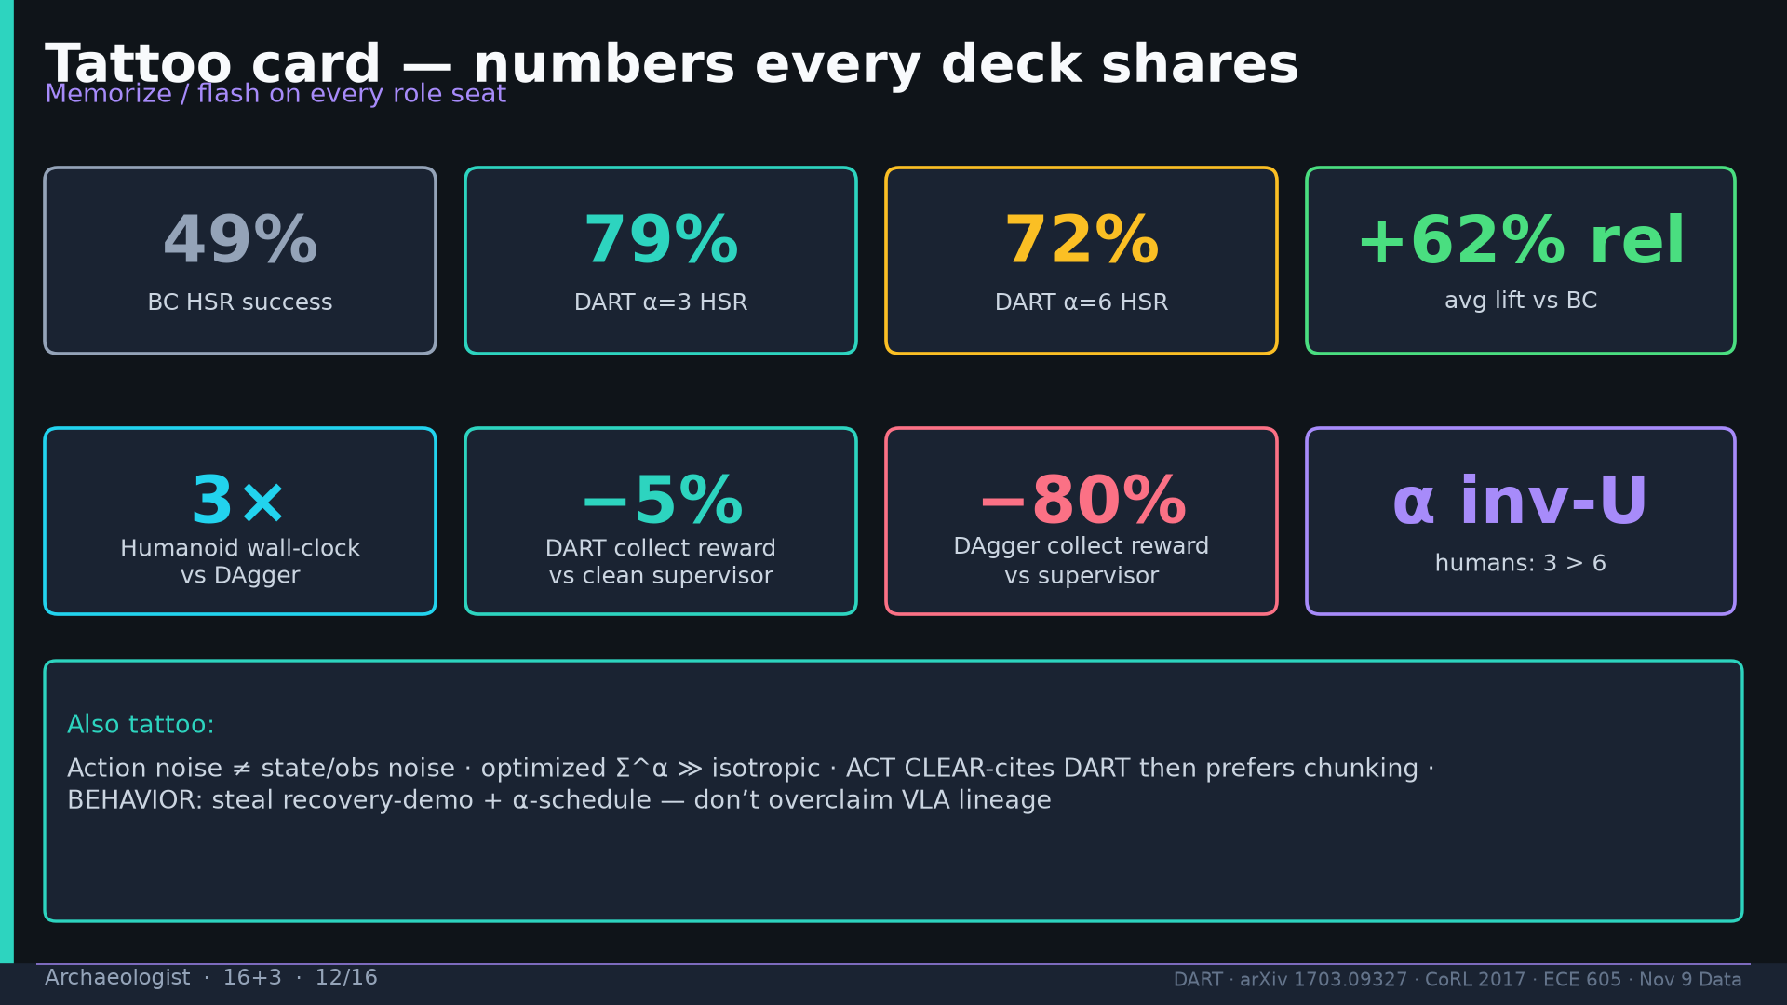
Notes:
Tattoo card shared numbers.

Slide 13
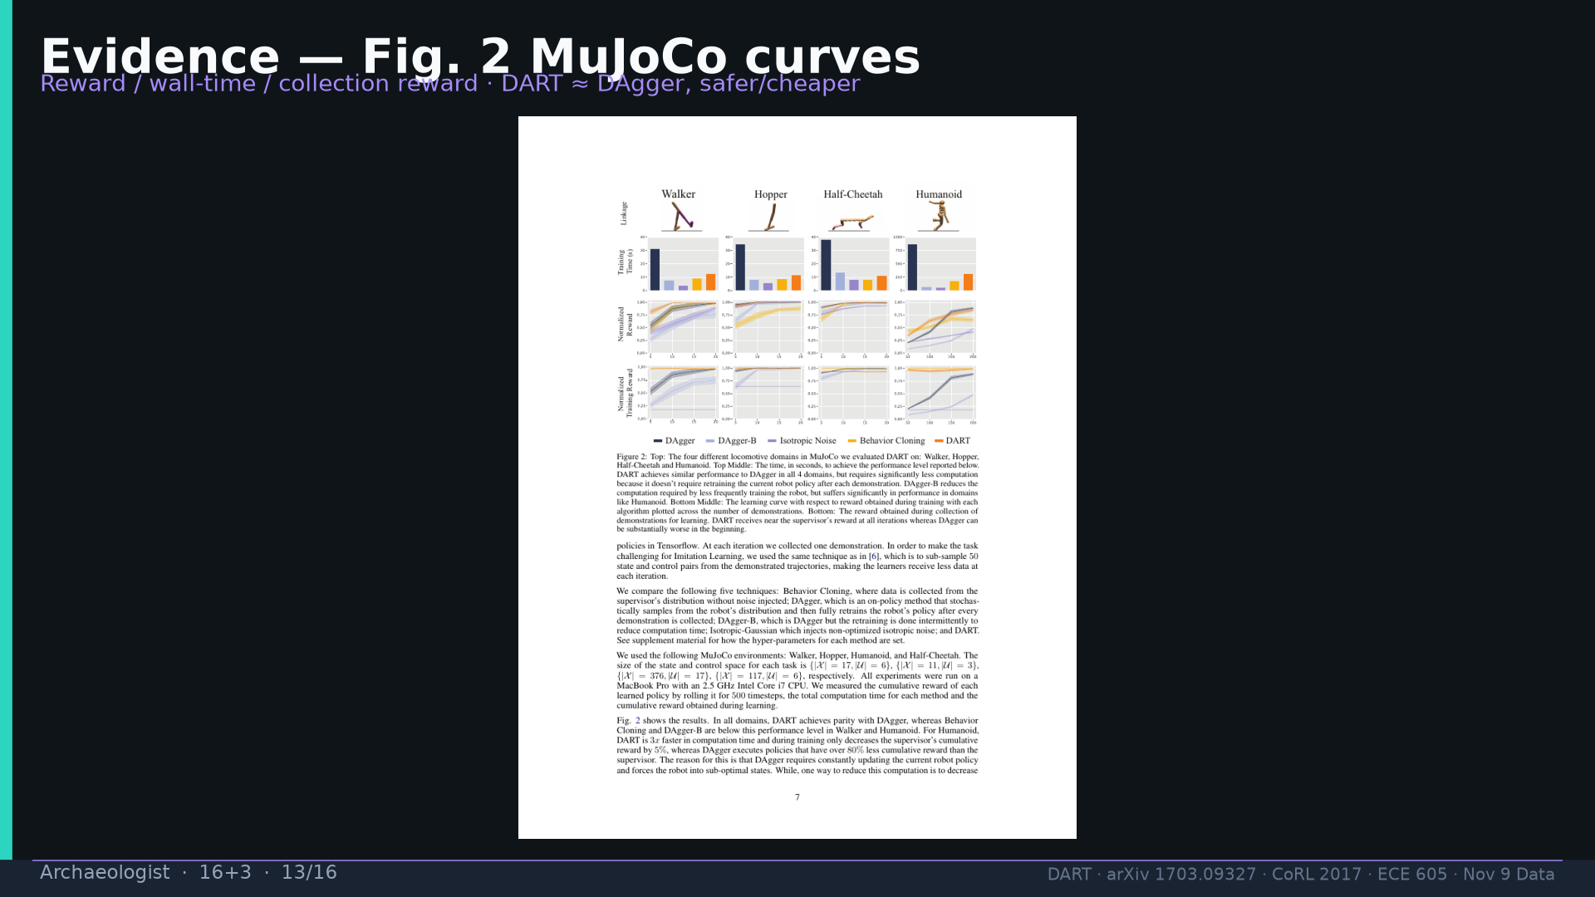
Notes:
Fig.2 MuJoCo evidence.

Slide 14
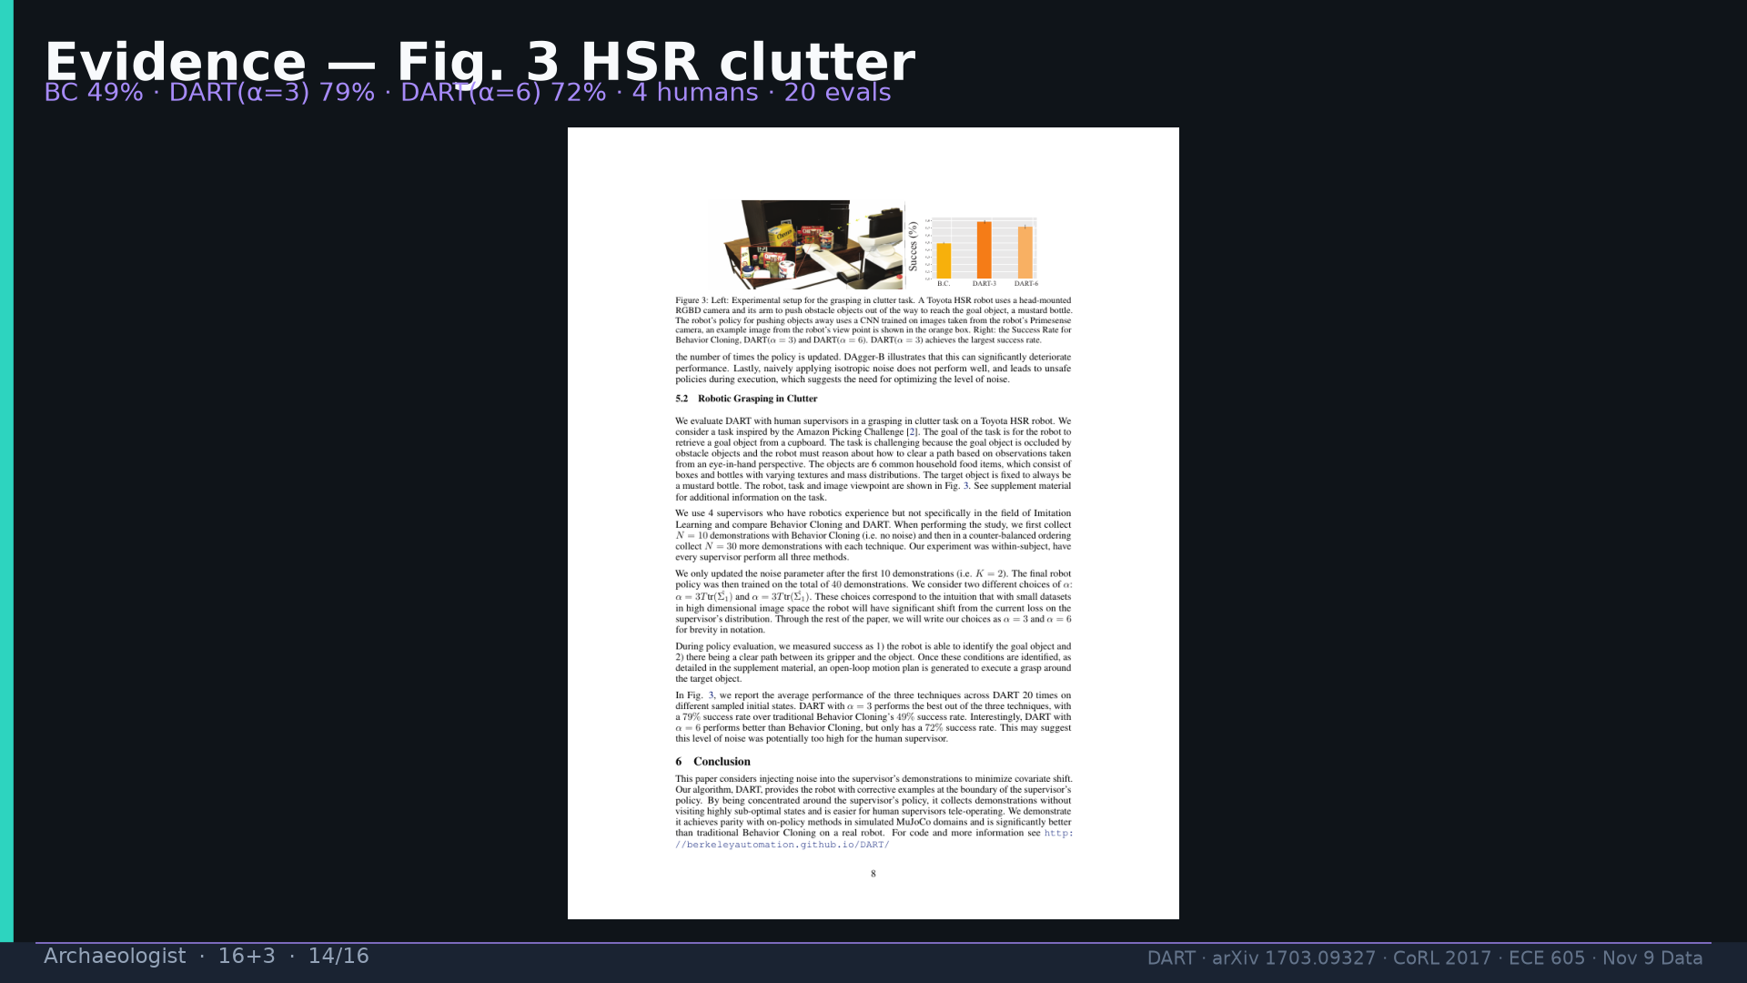
Notes:
Fig.3 HSR 49/79/72.

Slide 15
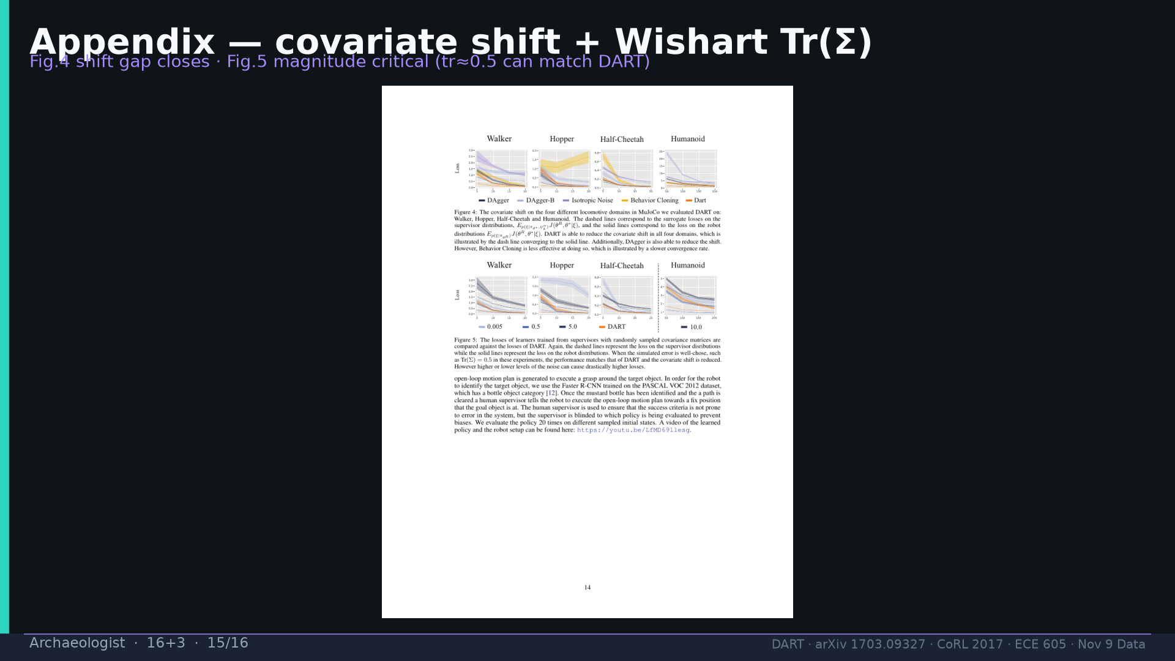
Notes:
App Fig.4–5.

Slide 16
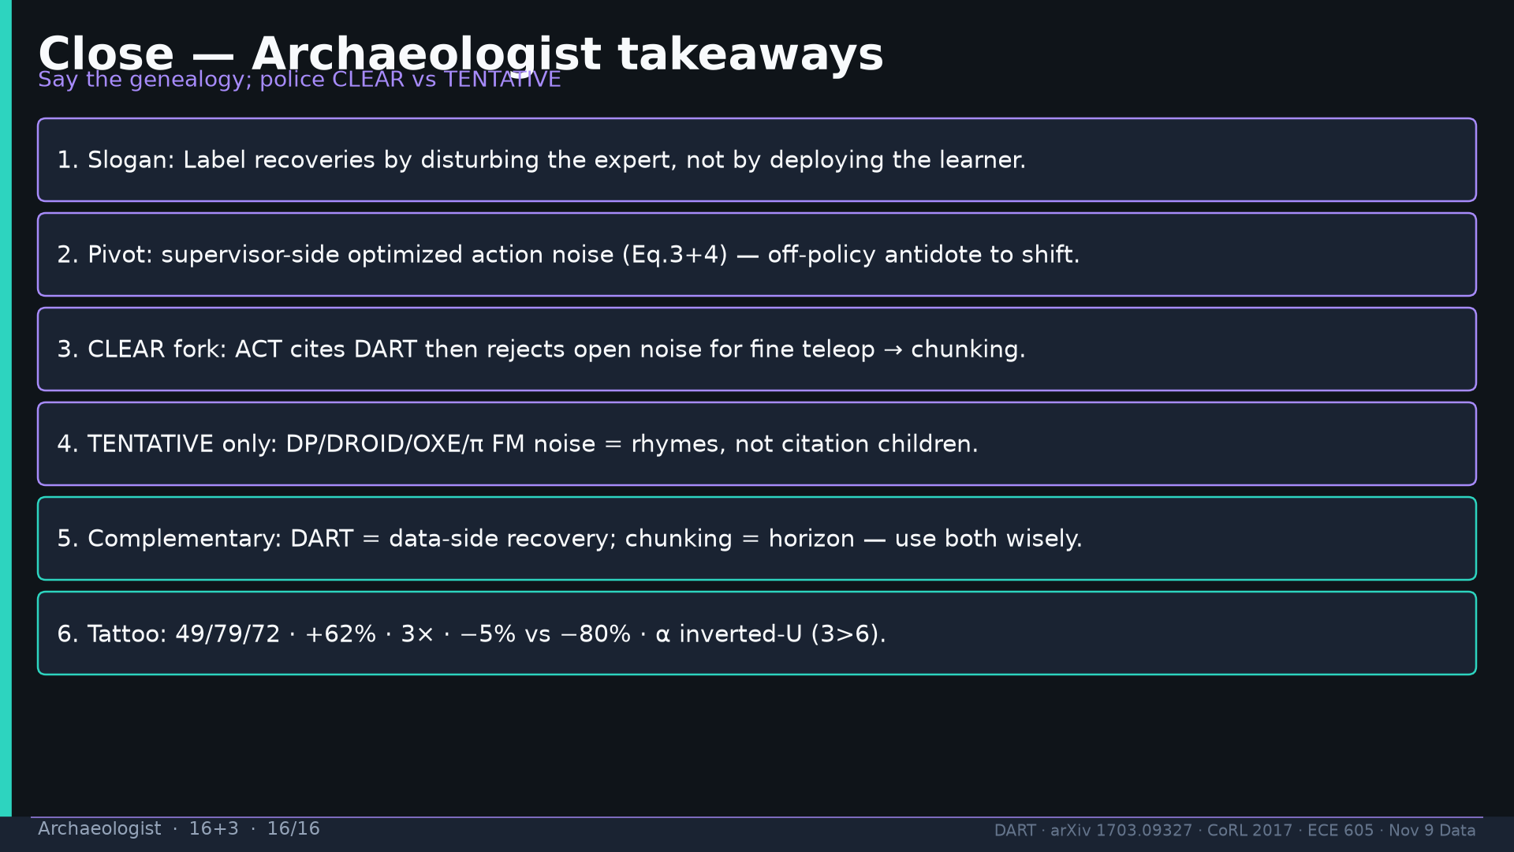
Notes:
Close six takeaways; police CLEAR vs TENTATIVE.

