Slide 1
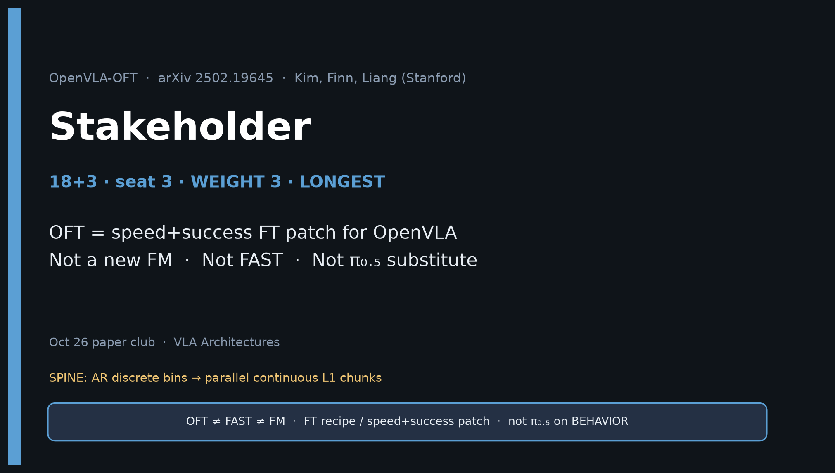
Stakeholder · 18+3 · 1/22
Notes:
STAKEHOLDER OPENING — seat 3 · WEIGHT 3 · Timing 18+3. DENSEST DECK. BUILD FIRST. NO REDO LATER.
You own: buy/build decision — when to adopt OpenVLA-OFT vs π₀.₅/OpenPI vs FAST.
ONE-LINER (say first 30s):
OFT = speed+success FT patch making OpenVLA viable at 25–50 Hz (26–43× throughput, LIBERO 97.1%) — modernize OpenVLA ops, don’t substitute for π₀.₅ on BEHAVIOR.
OFT = FT recipe, not a new foundation model. Not FAST. Not FM.
GitHub title: [ECE 605] - OpenVLA-OFT Making Stakeholder

Slide 2
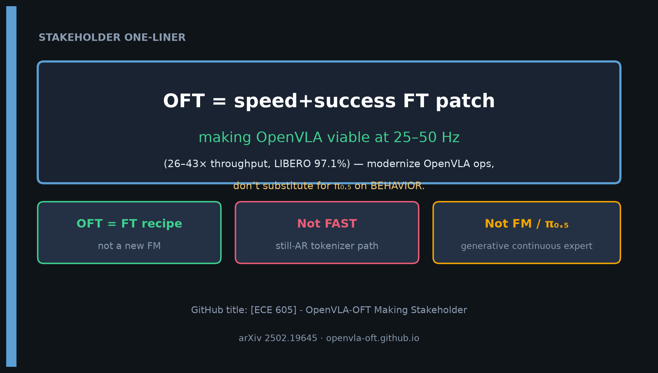
Stakeholder · 18+3 · 2/22
Notes:
ONE-LINER SLIDE — room should leave with this sentence.
Three boxes: OFT=FT recipe · Not FAST · Not FM/π₀.₅.
arXiv 2502.19645 · openvla-oft.github.io

Slide 3
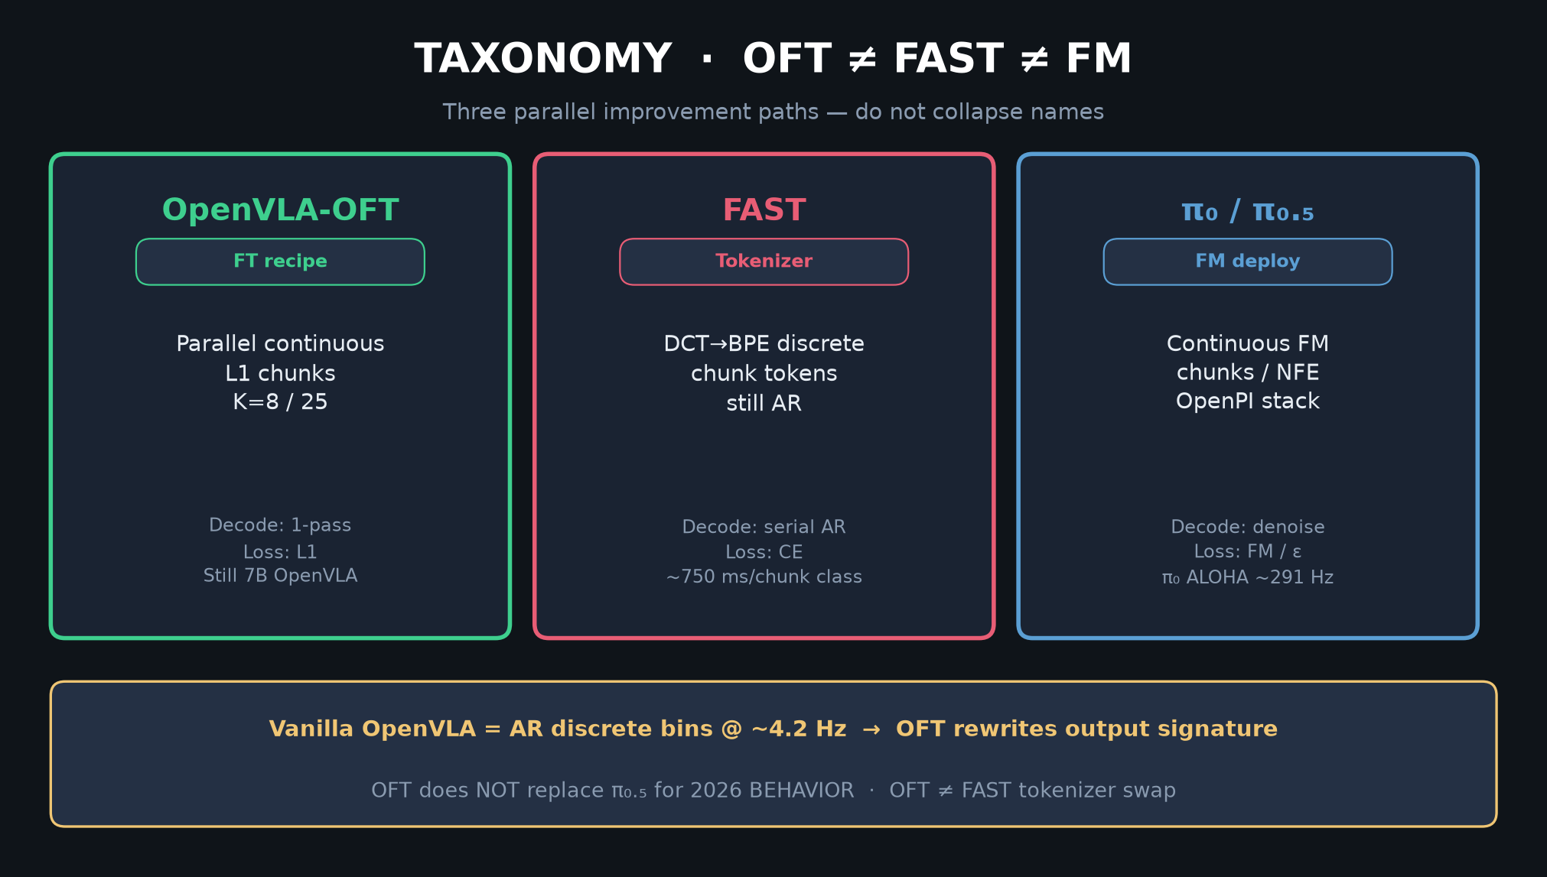
Stakeholder · 18+3 · 3/22
Notes:
TAXONOMY — OFT ≠ FAST ≠ FM. Club spine. Say aloud before numbers.
OFT = parallel continuous L1 FT recipe on OpenVLA.
FAST = DCT→BPE discrete tokenizer (still AR).
π₀/π₀.₅ = FM continuous deploy (OpenPI).
If someone says “OFT replaced π₀,” correct immediately.

Slide 4
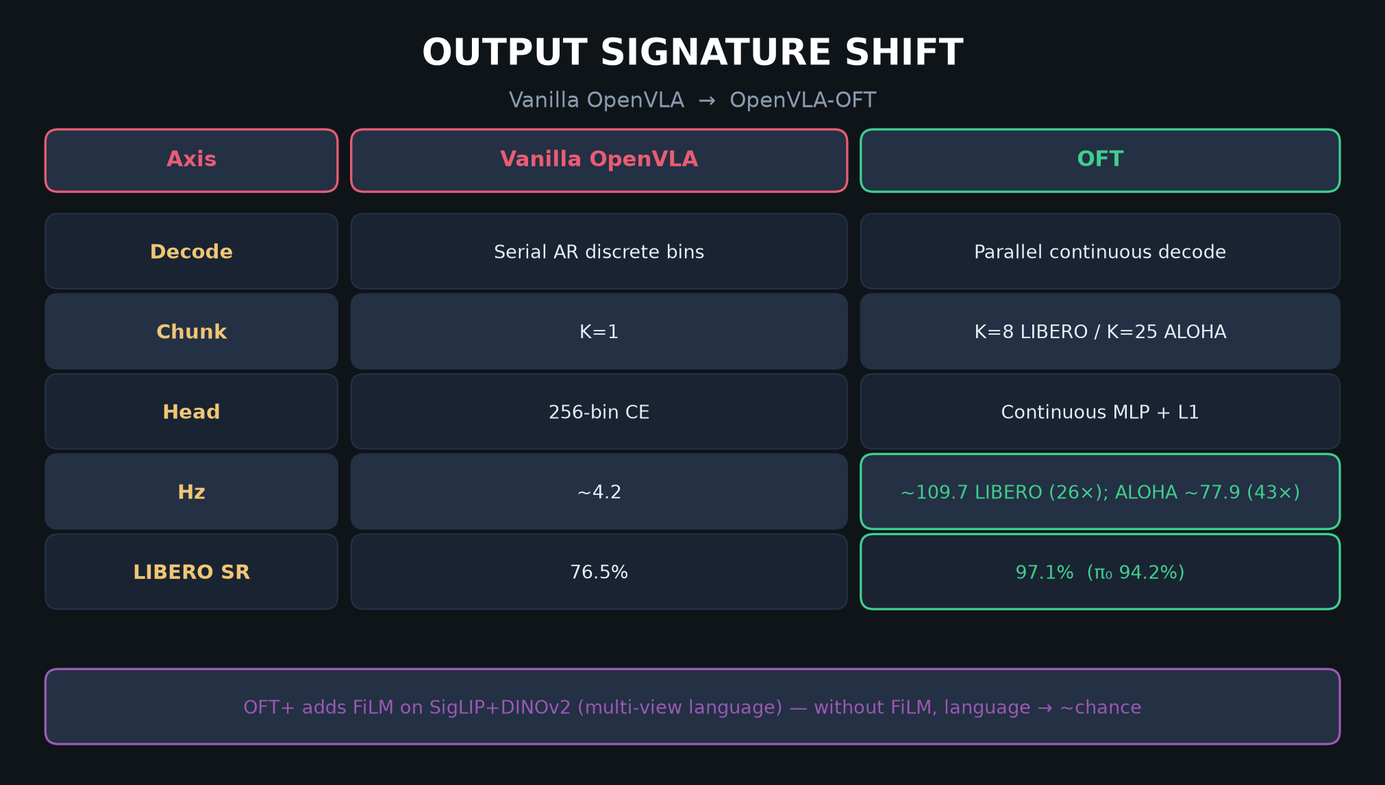
Stakeholder · 18+3 · 4/22
Notes:
OUTPUT SIGNATURE TABLE — CLEAR comparison.
| | Vanilla | OFT |
| Decode | Serial AR discrete bins | Parallel continuous |
| Chunk | K=1 | K=8 / 25 |
| Head | 256-bin CE | Continuous MLP + L1 |
| Hz | ~4.2 | ~109.7 (26×); ALOHA 77.9 (43×) |
| LIBERO SR | 76.5% | 97.1% (π₀ 94.2%) |
OFT+ = FiLM for multi-view language.

Slide 5
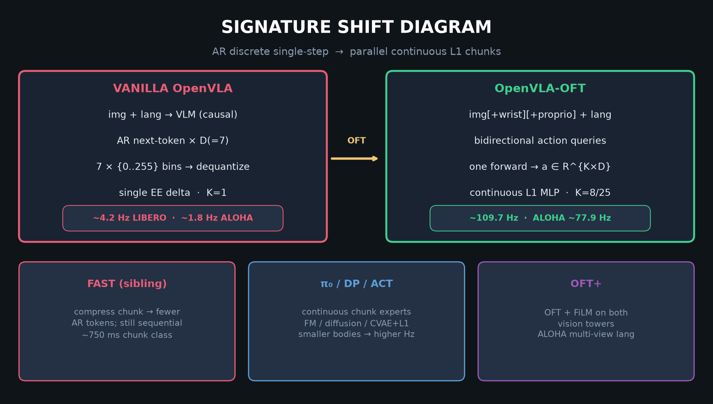
Stakeholder · 18+3 · 5/22
Notes:
SIGNATURE SHIFT DIAGRAM — visual of AR→parallel continuous.
Vanilla: 7 AR bins @ ~4 Hz. OFT: R^{K×D} @ ~110 Hz.
Siblings: FAST still AR; π₀/DP/ACT continuous experts; OFT+ FiLM.

Slide 6
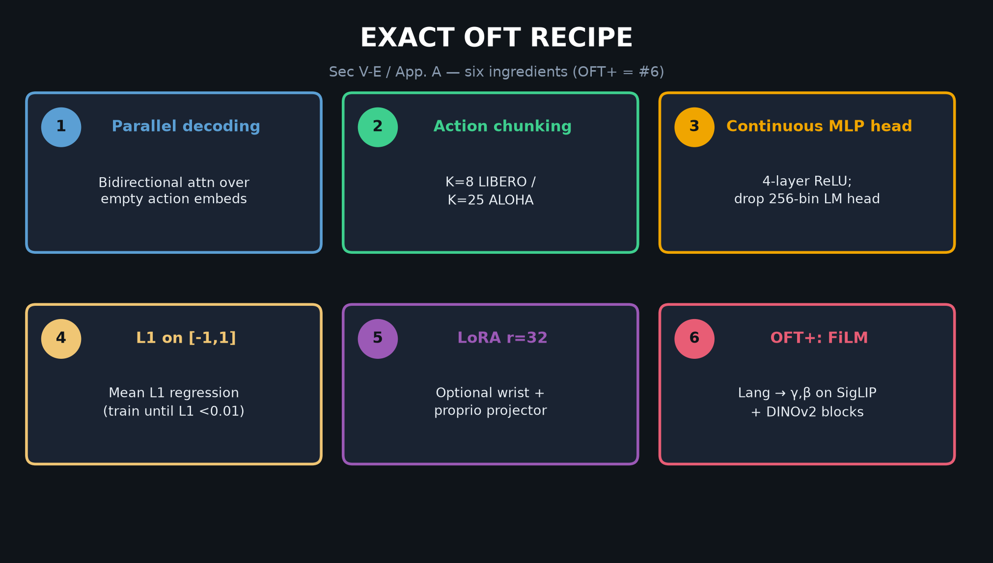
Stakeholder · 18+3 · 6/22
Notes:
EXACT OFT RECIPE 1–6 — memorize.
1 Parallel decoding (bidirectional attn over empty action embeds)
2 Action chunking K=8/25
3 Continuous MLP head
4 L1 on [-1,1]
5 LoRA r=32; optional wrist+proprio
6 OFT+: FiLM on both vision towers
Spend 90s walking the six cards.

Slide 7
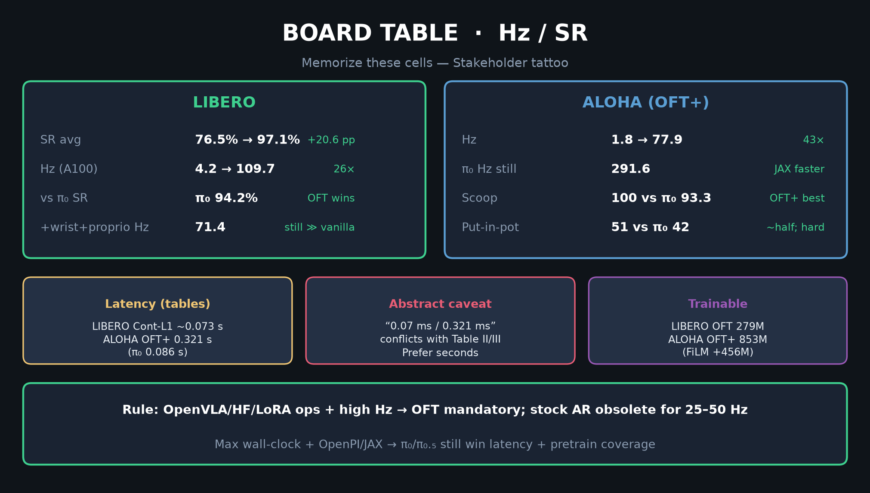
Stakeholder · 18+3 · 7/22
Notes:
BOARD TABLE Hz/SR — tattoo these numbers.
LIBERO: SR 76.5→97.1; Hz 4.2→109.7 (26×)
ALOHA: Hz 1.8→77.9 (43×); π₀ still 291 Hz
scoop 100 vs π₀ 93.3; pot 51 vs 42
Latency tables: ~0.073 s LIBERO; 0.321 s ALOHA (prefer Table II/III over abstract ms)

Slide 8
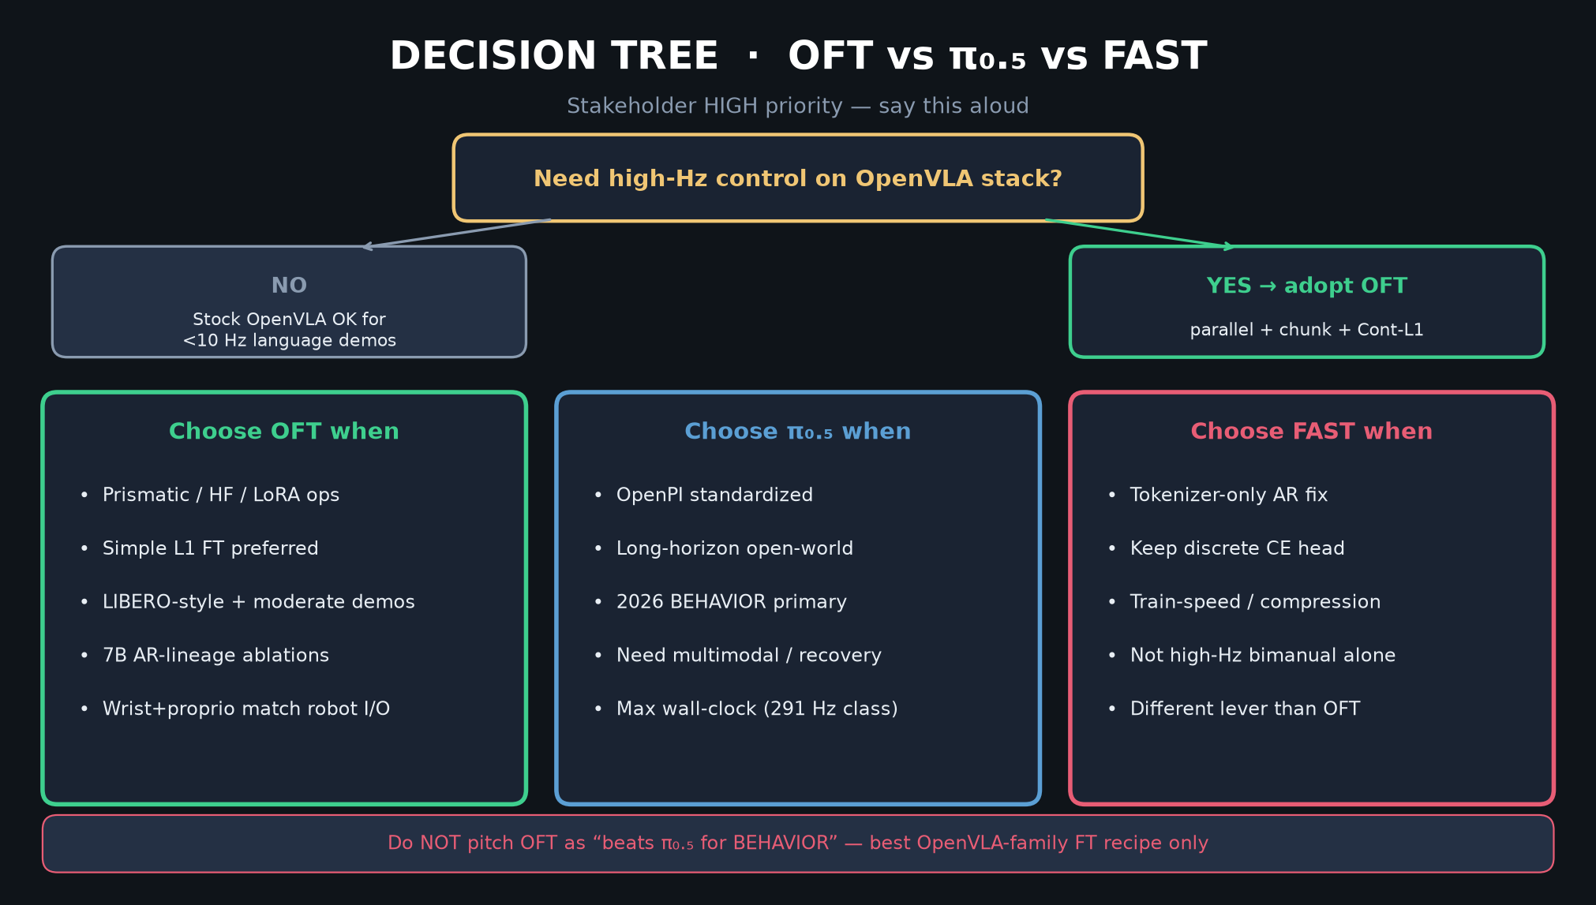
Stakeholder · 18+3 · 8/22
Notes:
DECISION TREE — HIGH PRIORITY Stakeholder slide.
Choose OFT when: Prismatic/HF/LoRA; simple L1; LIBERO-style; 7B AR ablations.
Choose π₀.₅ when: OpenPI standardized; long-horizon; 2026 BEHAVIOR primary.
Choose FAST when: tokenizer-only AR fix (different lever).
Do NOT pitch OFT as beats π₀.₅ for BEHAVIOR.

Slide 9
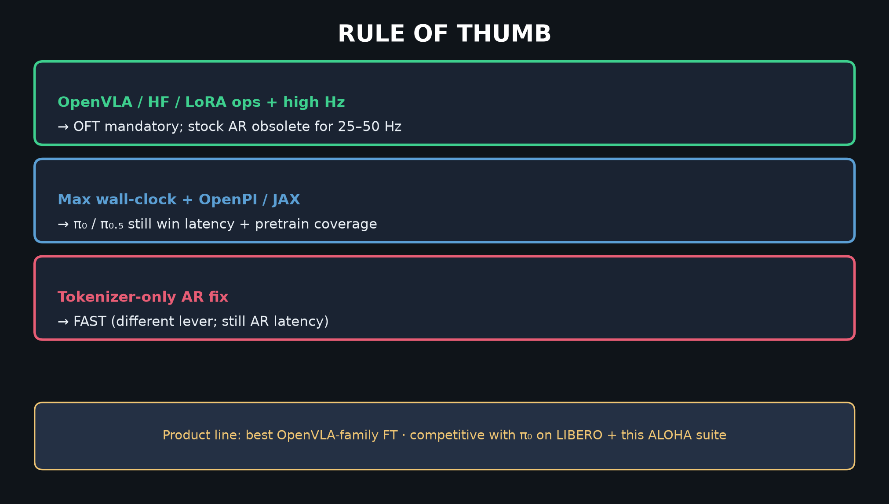
Stakeholder · 18+3 · 9/22
Notes:
RULE OF THUMB — three lines for leadership.
1 OpenVLA/HF/LoRA + high Hz → OFT mandatory
2 Max wall-clock + OpenPI/JAX → π₀/π₀.₅
3 Tokenizer-only AR → FAST

Slide 10
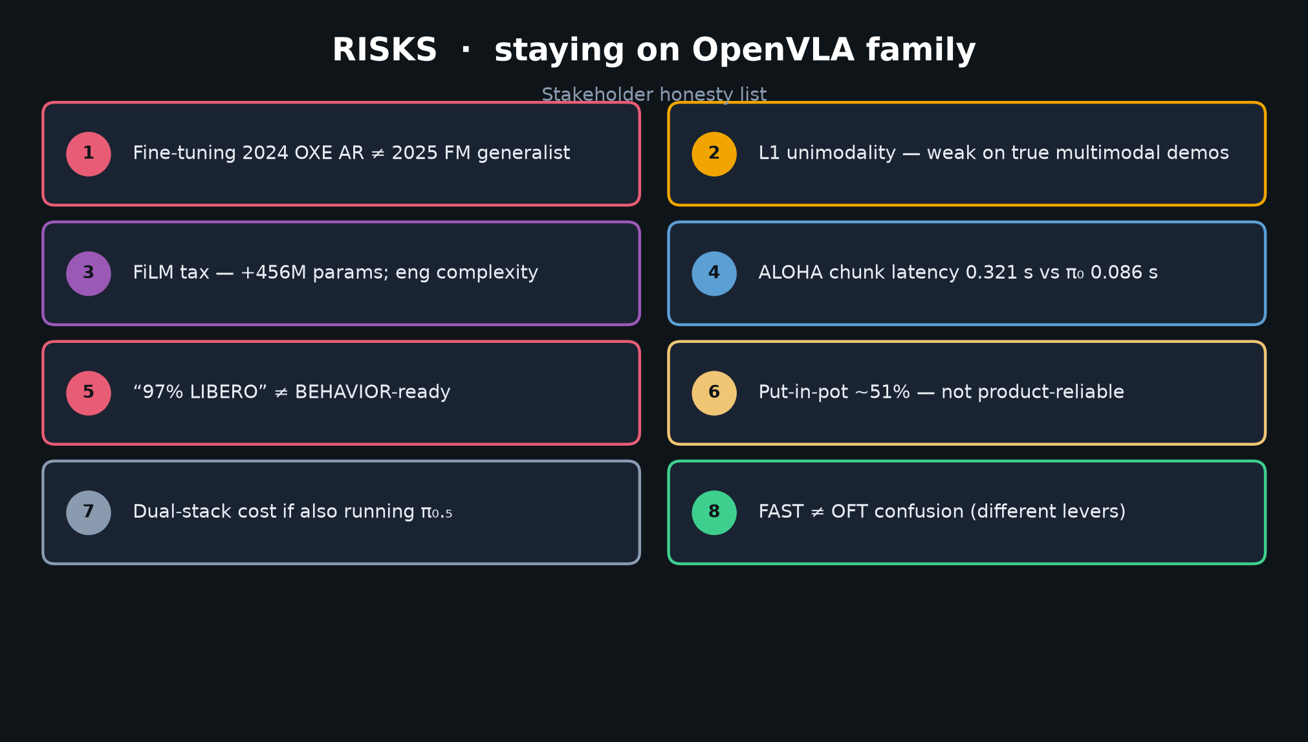
Stakeholder · 18+3 · 10/22
Notes:
RISKS LIST — honesty for 2026.
1 Fine-tuning 2024 OXE AR ≠ 2025 FM generalist
2 L1 unimodality
3 FiLM tax +456M
4 ALOHA latency 0.321 vs π₀ 0.086
5 97% LIBERO ≠ BEHAVIOR-ready
6 pot ~51%
7 Dual-stack cost
8 FAST≠OFT confusion

Slide 11
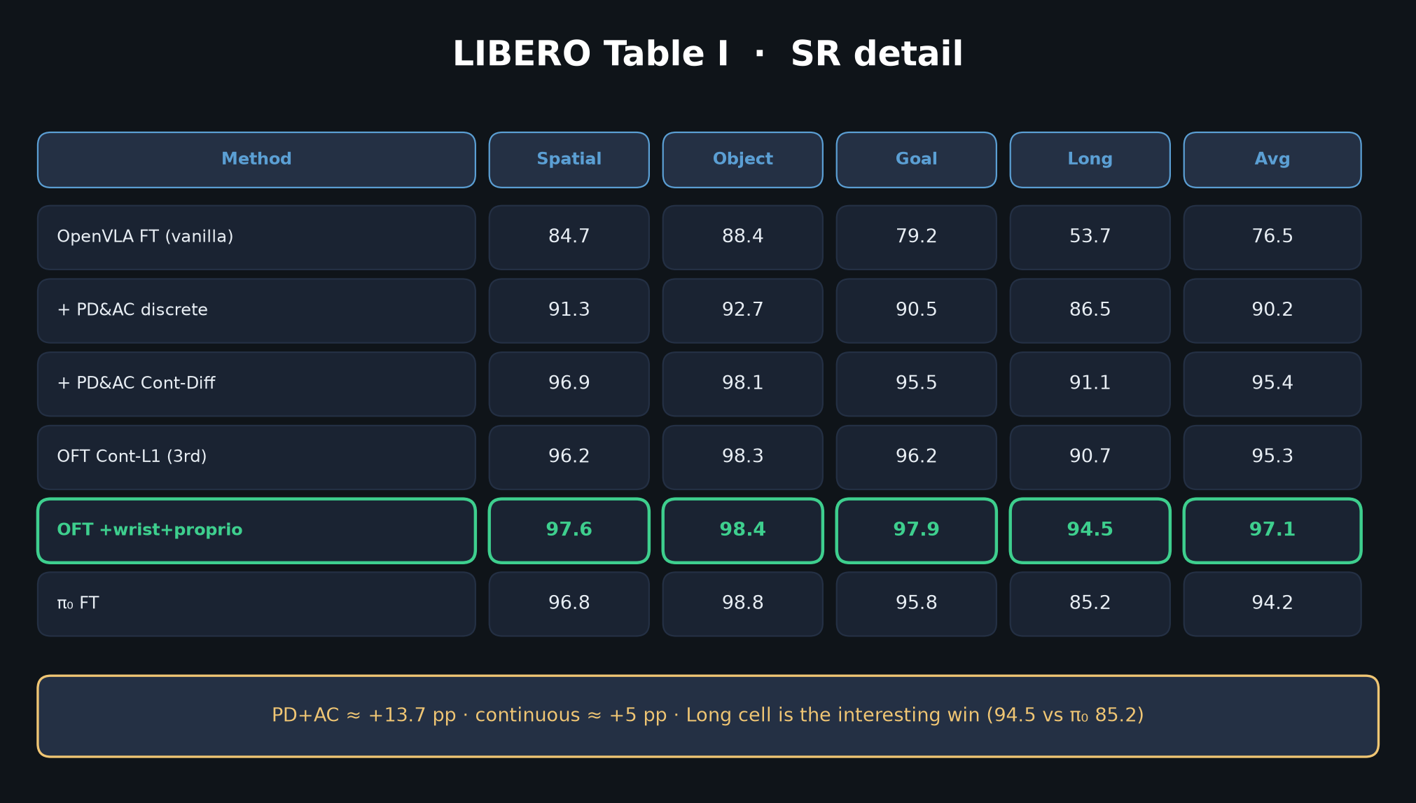
Stakeholder · 18+3 · 11/22
Notes:
LIBERO Table I detail — Long cell is the interesting win (94.5 vs π₀ 85.2).
Headline 97.1 needs wrist+proprio+filtered demos.

Slide 12
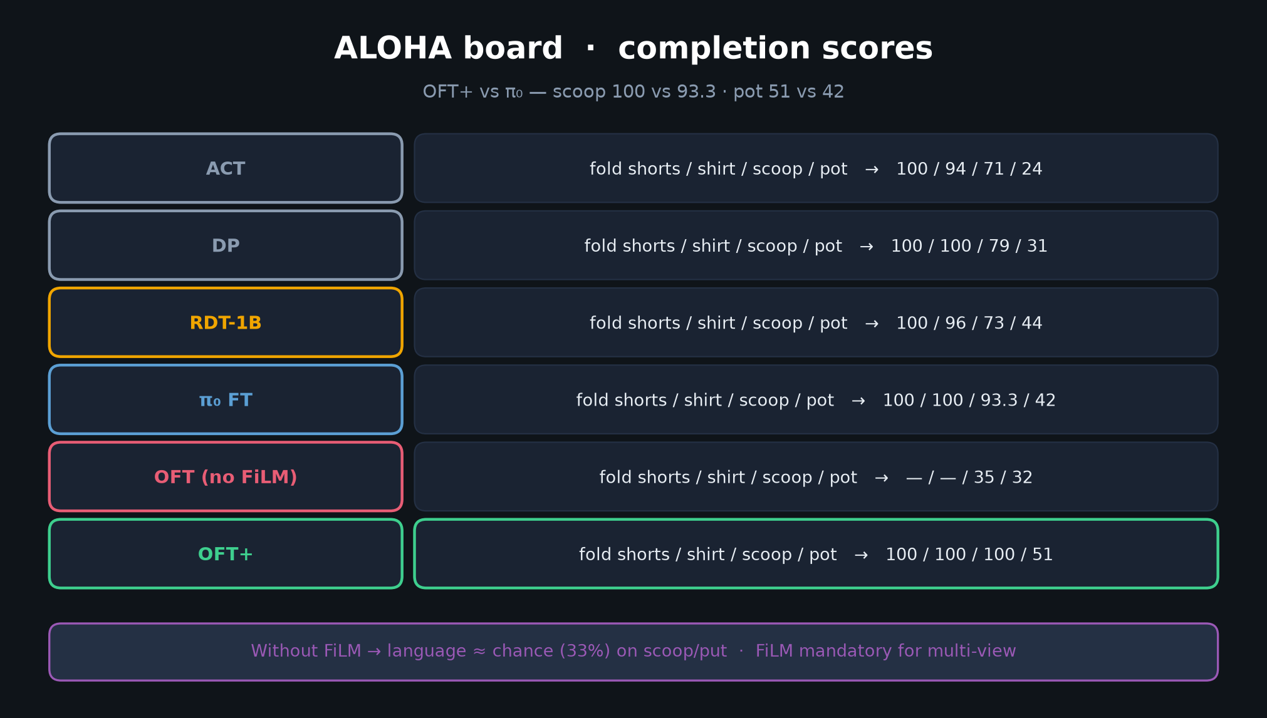
Stakeholder · 18+3 · 12/22
Notes:
ALOHA board — scoop 100 vs π₀ 93.3; pot 51 vs 42.
Without FiLM language → chance. Up to +15 pp absolute avg completion claim.

Slide 13
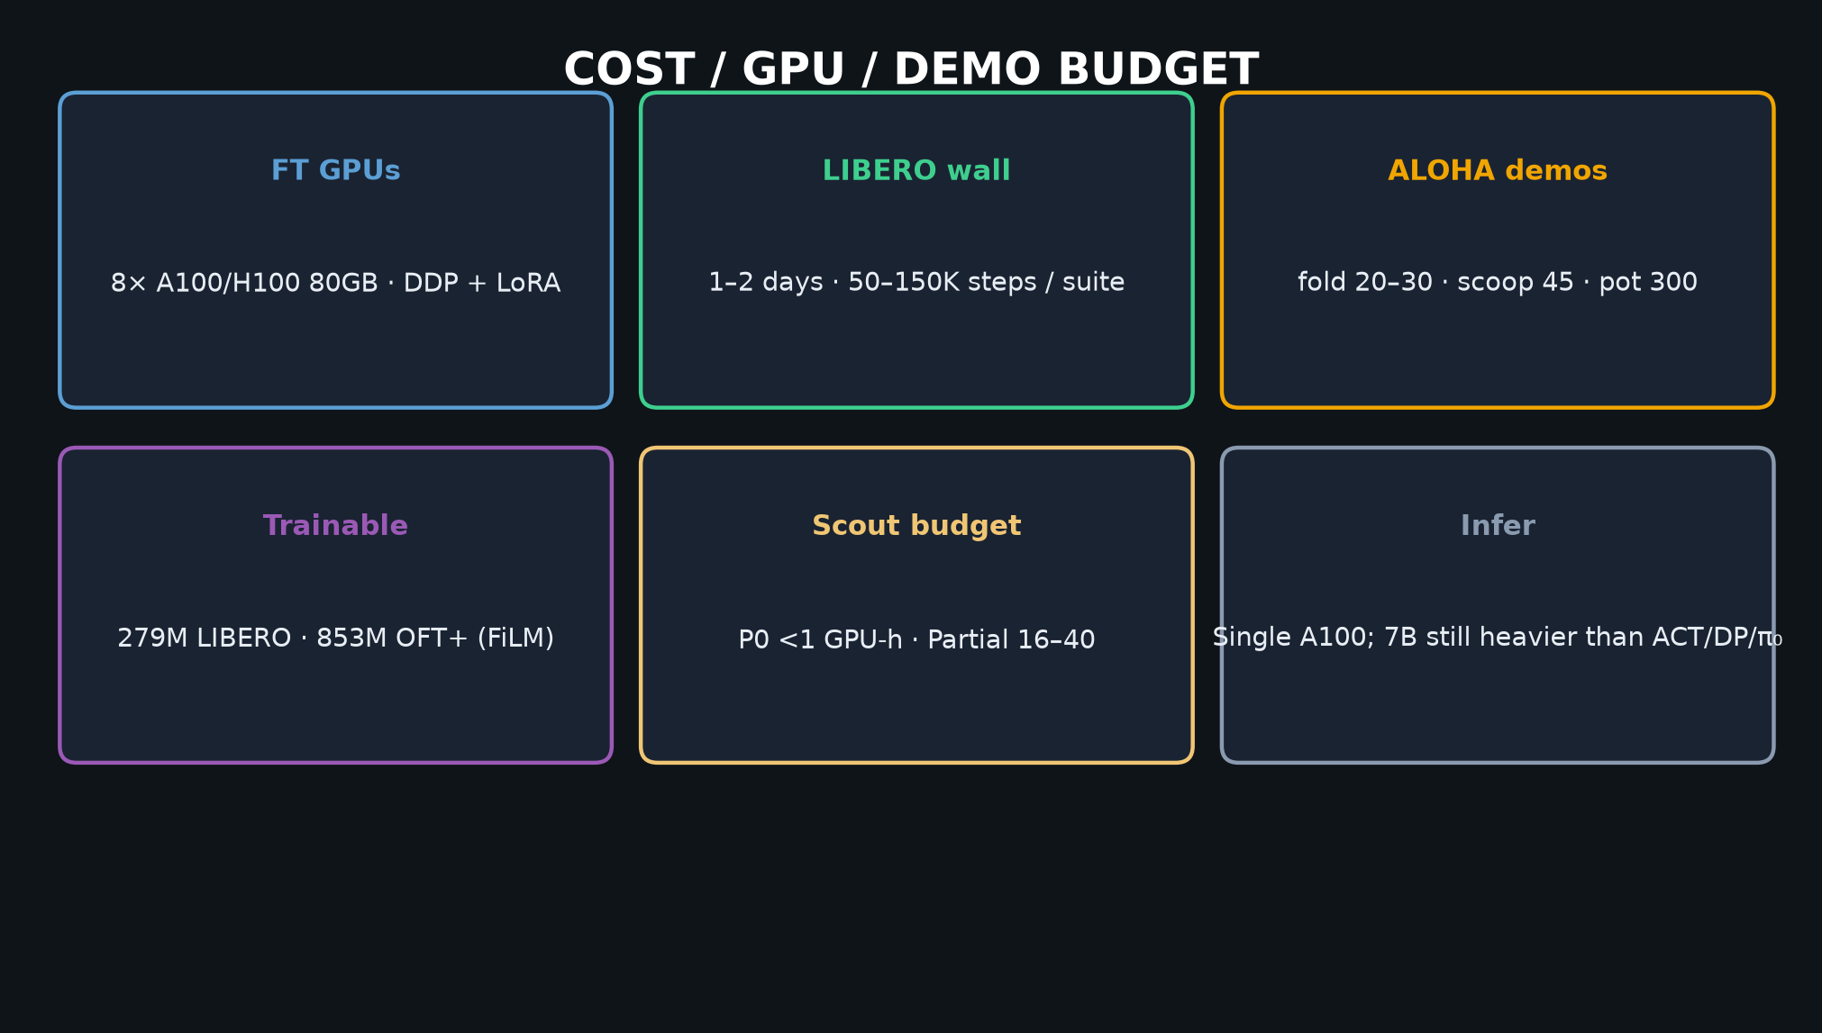
Stakeholder · 18+3 · 13/22
Notes:
COST / GPU — 8×80GB; 1–2 days LIBERO; demos as low as 20–45 for fold/scoop.
Trainable 279M / 853M. Scout Partial 16–40 GPU-h.

Slide 14
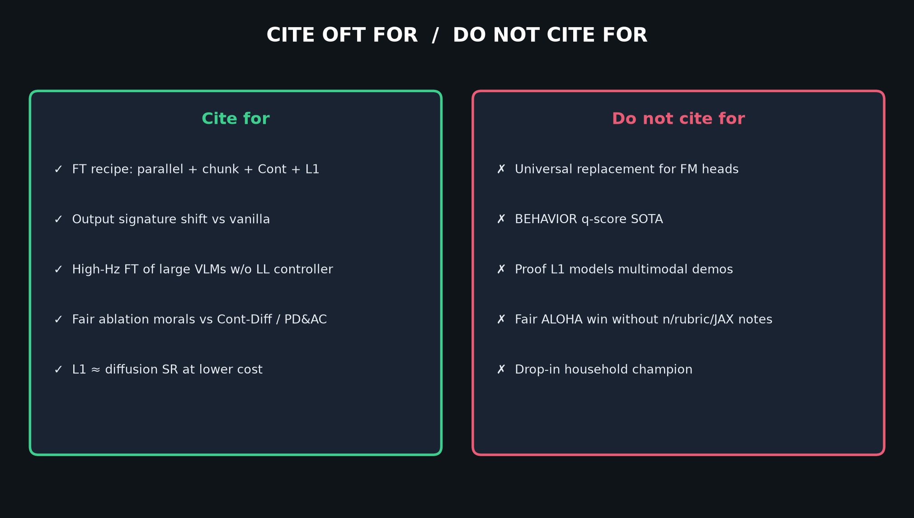
Stakeholder · 18+3 · 14/22
Notes:
CITE FOR / DO NOT CITE FOR — keep marketing honest.
Cite FT recipe + signature shift. Do not cite as BEHAVIOR SOTA or FM replacement.

Slide 15
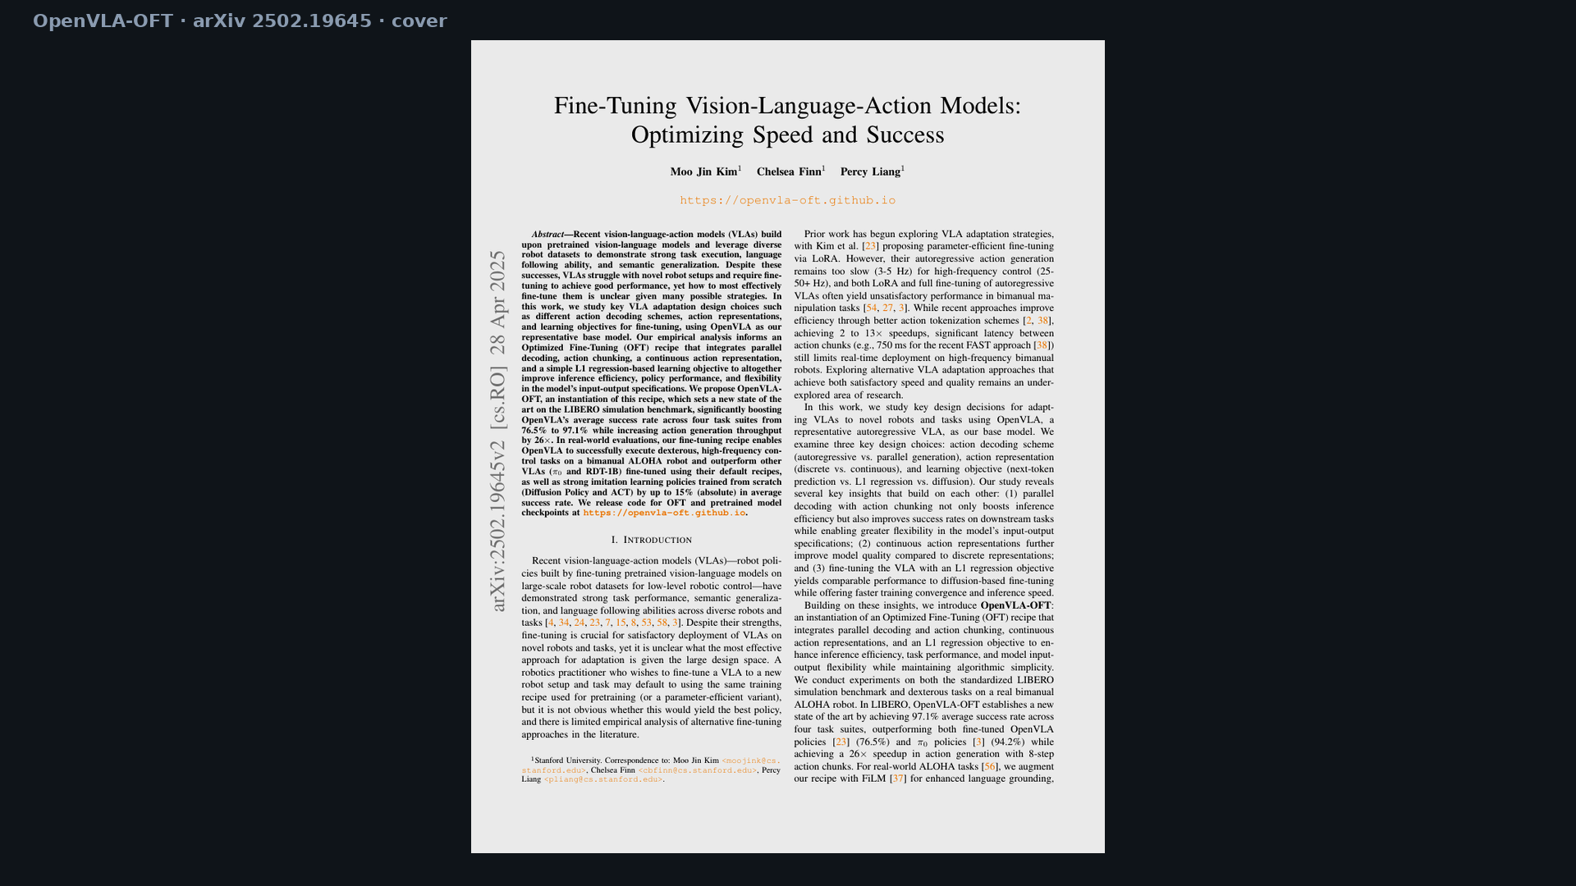
Stakeholder · 18+3 · 15/22
Notes:
PAPER COVER — title/authors/abstract context.
Fine-Tuning VLAs: Optimizing Speed and Success · Kim, Finn, Liang.

Slide 16
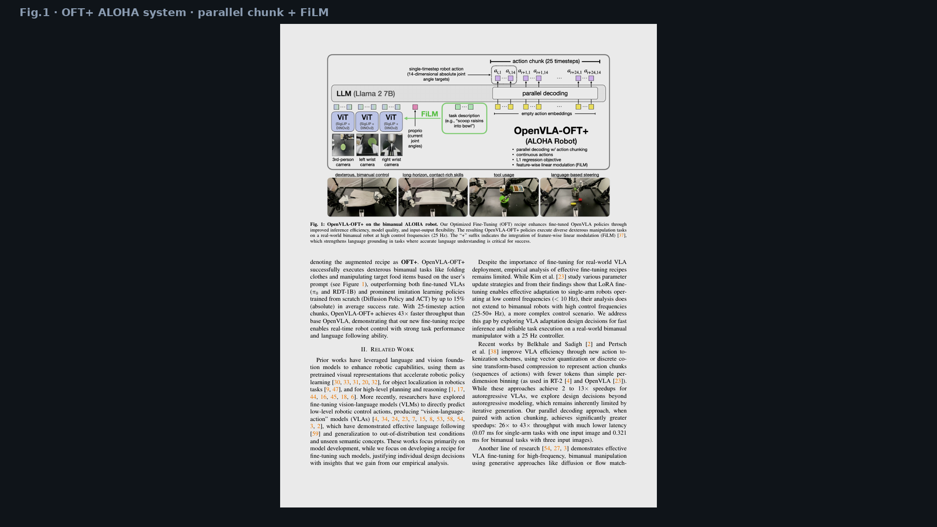
Stakeholder · 18+3 · 16/22
Notes:
FIG.1 — OFT+ on ALOHA @ 25 Hz. Parallel chunk + multi-view + FiLM.
Point at empty action embeddings → K=25 continuous outputs.

Slide 17
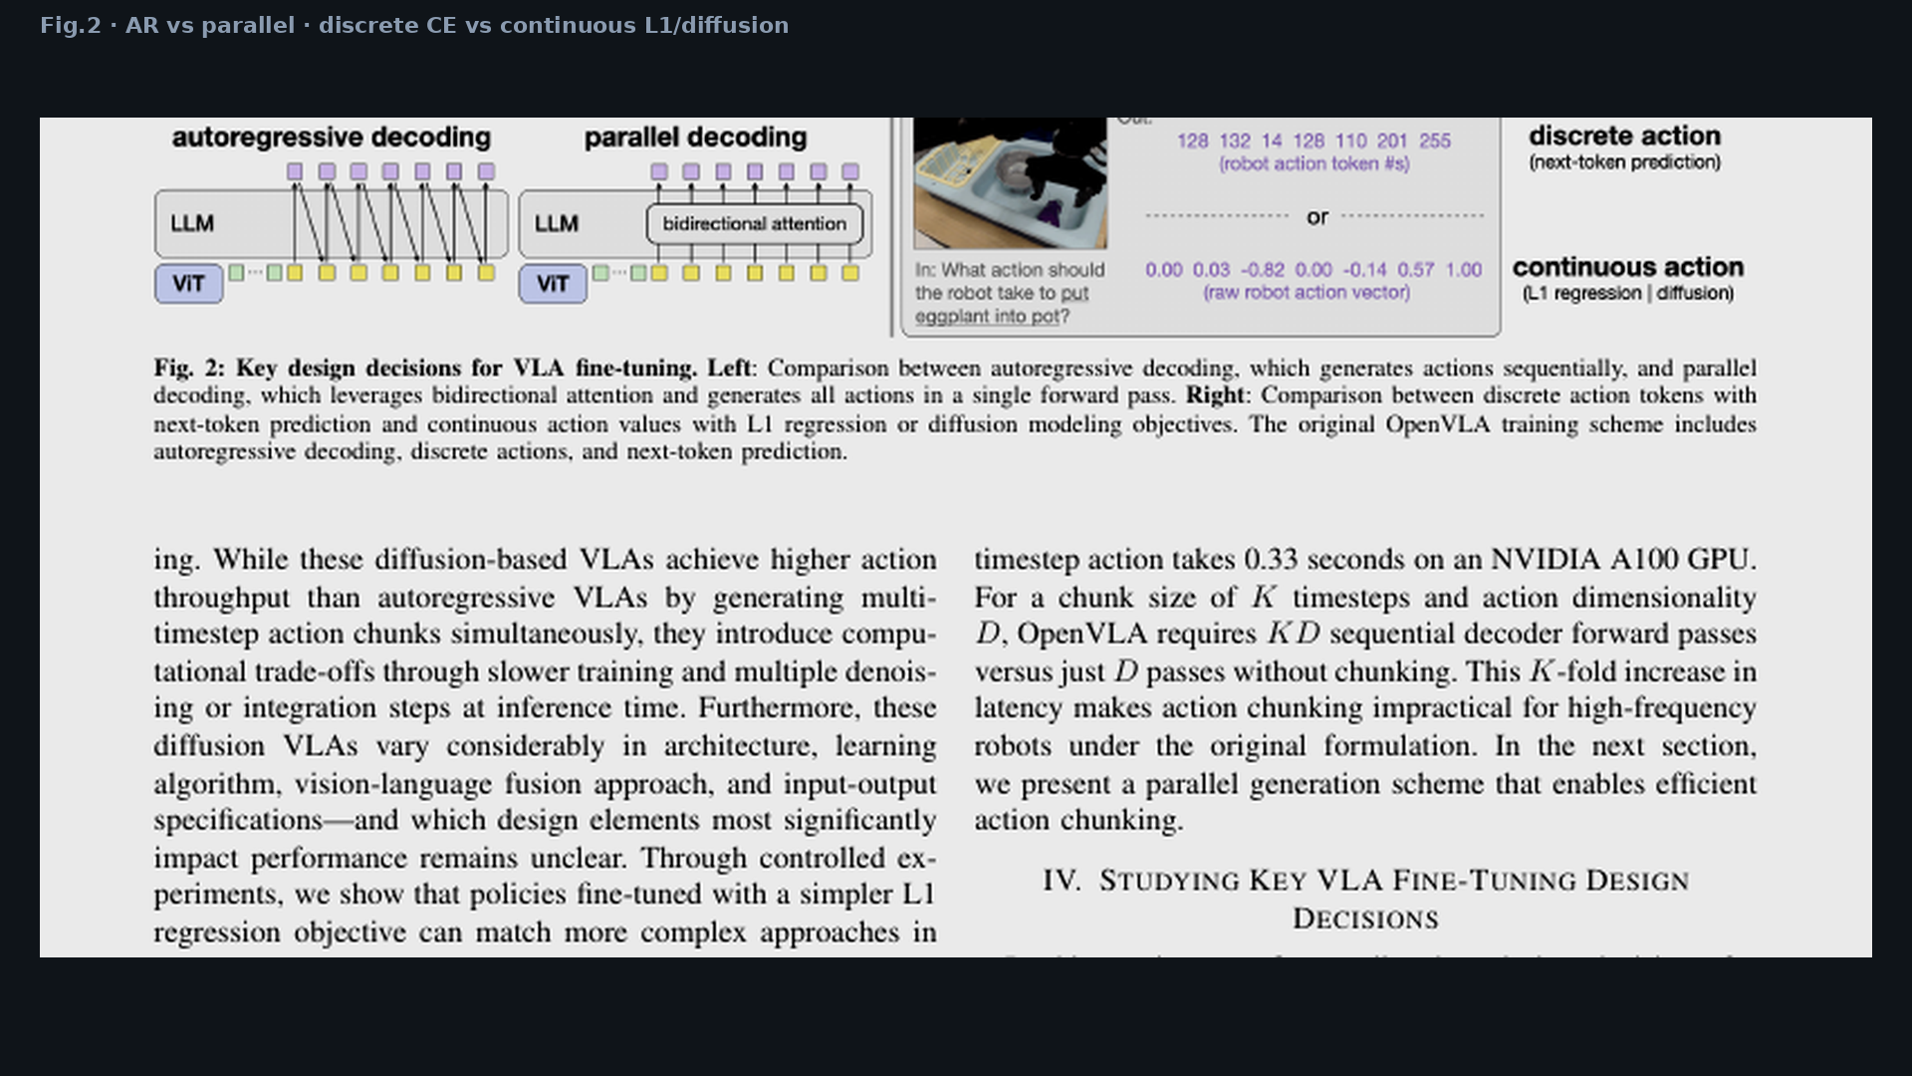
Stakeholder · 18+3 · 17/22
Notes:
FIG.2 — design space visual: AR vs parallel; discrete CE vs continuous L1/diffusion.
This is the recipe axes Stakeholders should recognize.

Slide 18
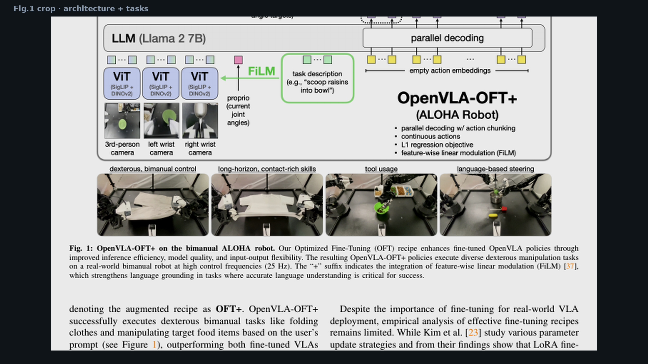
Stakeholder · 18+3 · 18/22
Notes:
FIG.1 CROP — architecture detail if room wants zoom.

Slide 19
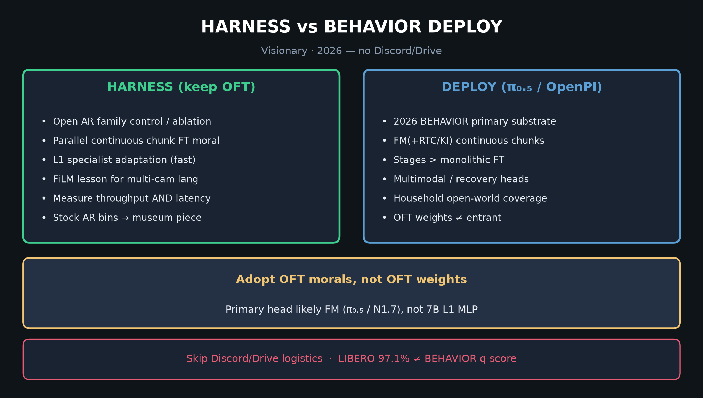
Stakeholder · 18+3 · 19/22
Notes:
HARNESS vs DEPLOY glance — OFT modernizes OpenVLA ops; π₀.₅ remains BEHAVIOR primary.
Bridge to Visionary without Discord/Drive.

Slide 20
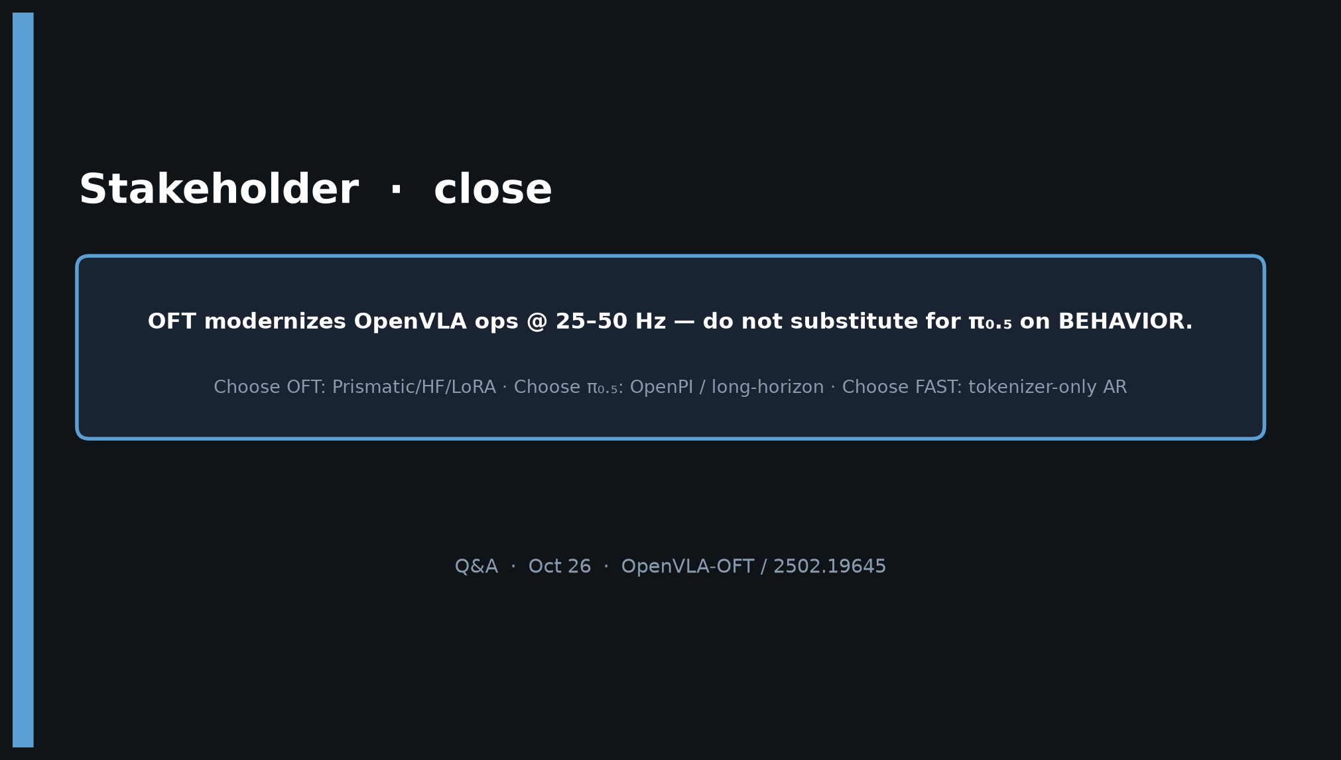
Stakeholder · 18+3 · 20/22
Notes:
CLOSE — OFT modernizes OpenVLA @ 25–50 Hz. Do not substitute for π₀.₅ on BEHAVIOR.
Decision: OFT / π₀.₅ / FAST by stack + horizon + Hz need.

Slide 21
Stakeholder · 18+3 · 21/22
Notes:
BACKUP — decision tree again for Q&A.

Slide 22
Stakeholder · 18+3 · 22/22
Notes:
BACKUP — board numbers if challenged mid-Q&A.

