Slide 1
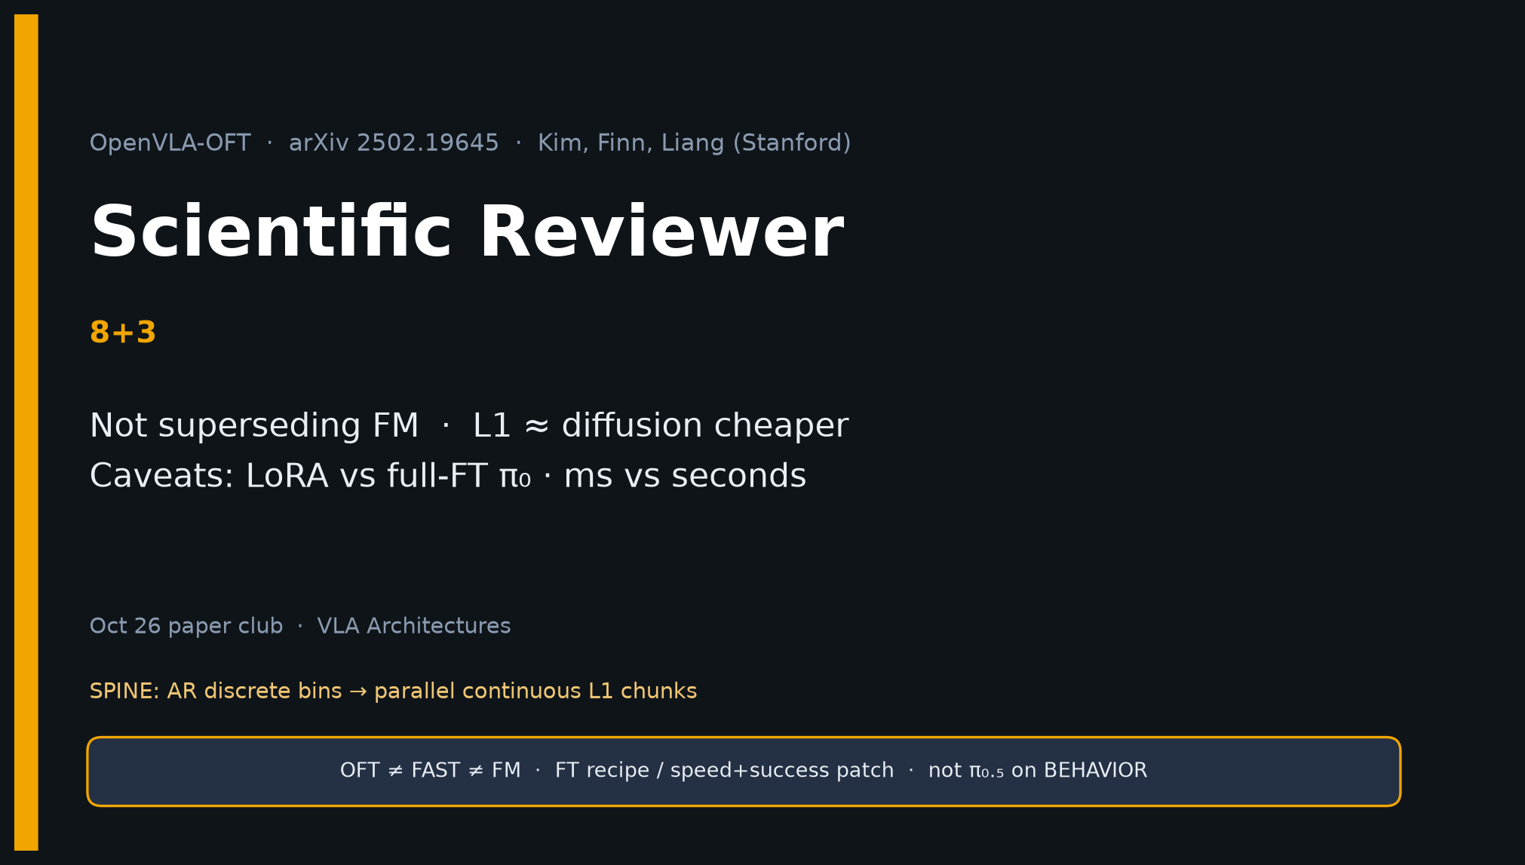
Scientific Reviewer · 8+3 · 1/11
Notes:
SCIENTIFIC REVIEWER — 8+3.
Mission: strengths, caveats, verdict. Not superseding FM.
Novelty = adaptation recipe, not new VLM backbone.

Slide 2
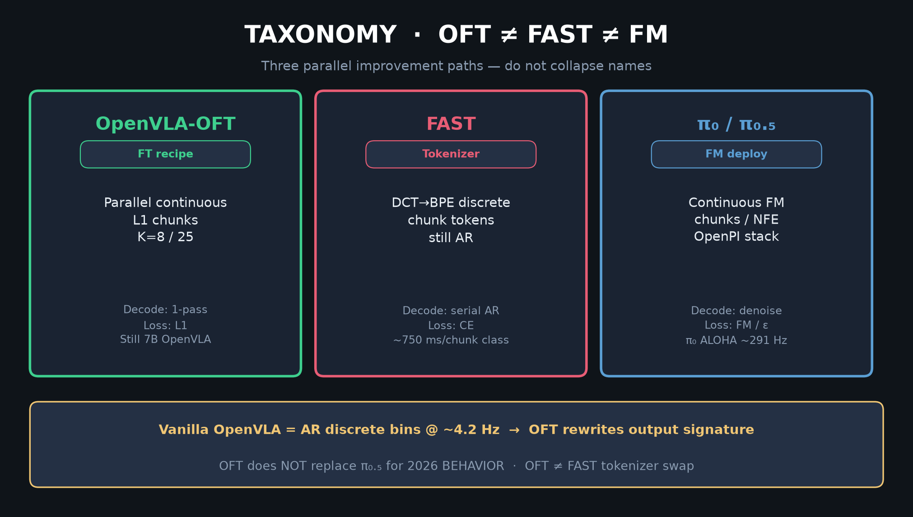
Scientific Reviewer · 8+3 · 2/11
Notes:
TAXONOMY reminder — OFT is FT recipe; do not license supersede FM.

Slide 3
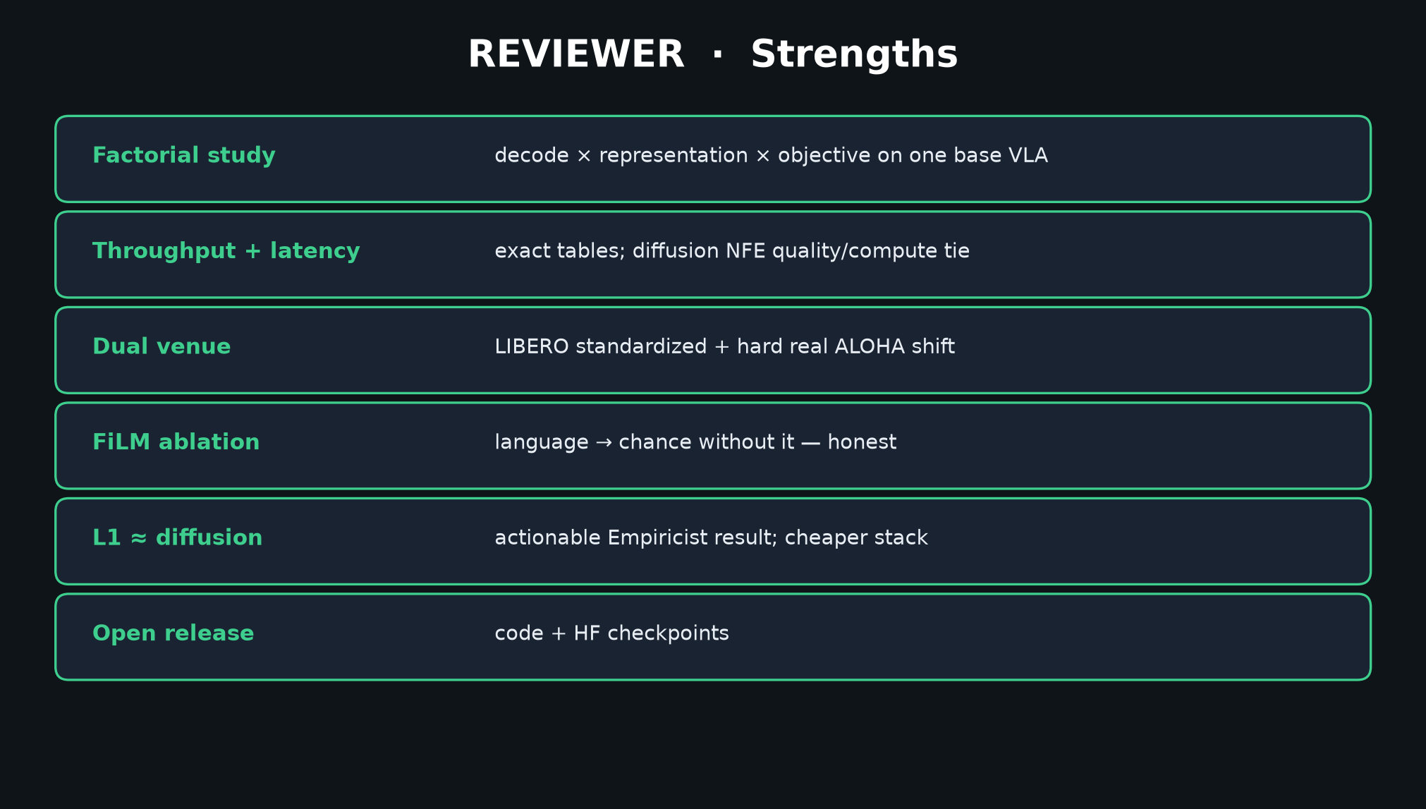
Scientific Reviewer · 8+3 · 3/11
Notes:
STRENGTHS — factorial decode×rep×objective; throughput+latency; FiLM ablation; L1≈diffusion cheaper; open release.

Slide 4
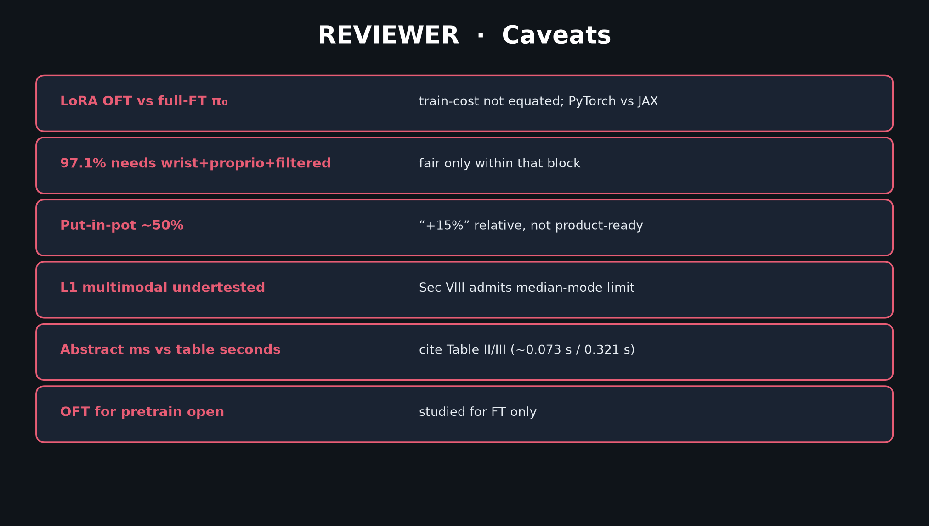
Scientific Reviewer · 8+3 · 4/11
Notes:
CAVEATS — LoRA OFT vs full-FT π₀; 97.1 needs extras; pot ~50%; L1 multimodal undertested; ms vs seconds; pretrain open.

Slide 5
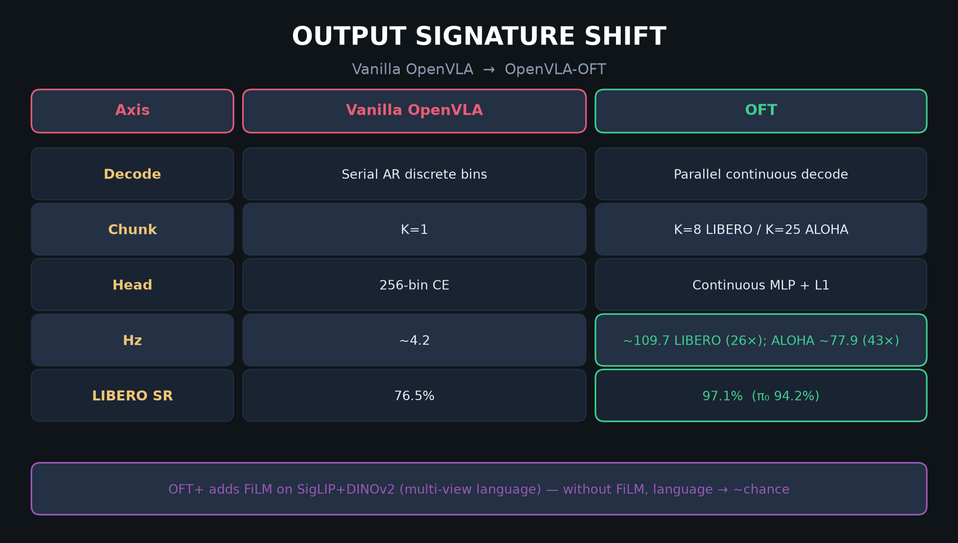
Scientific Reviewer · 8+3 · 5/11
Notes:
SIGNATURE TABLE — what claim actually holds scientifically.

Slide 6
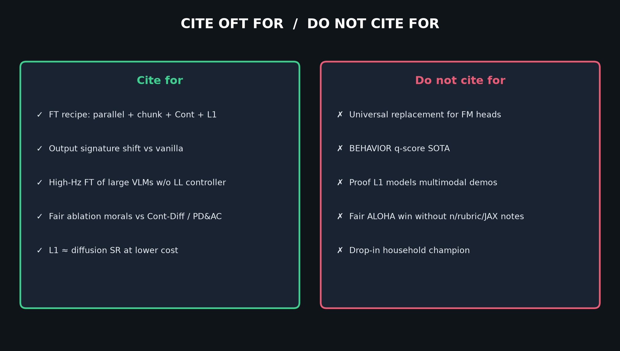
Scientific Reviewer · 8+3 · 6/11
Notes:
CITE / DO NOT CITE — Reviewer framing for 2026.

Slide 7
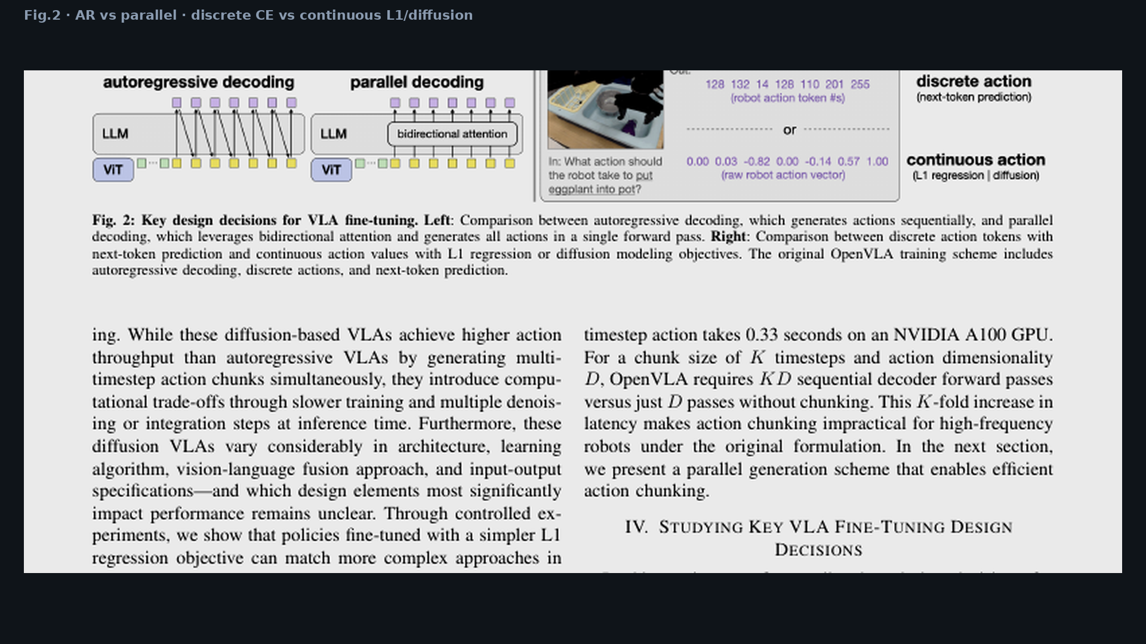
Scientific Reviewer · 8+3 · 7/11
Notes:
FIG.2 — controlled design axes supporting factorial claim.

Slide 8
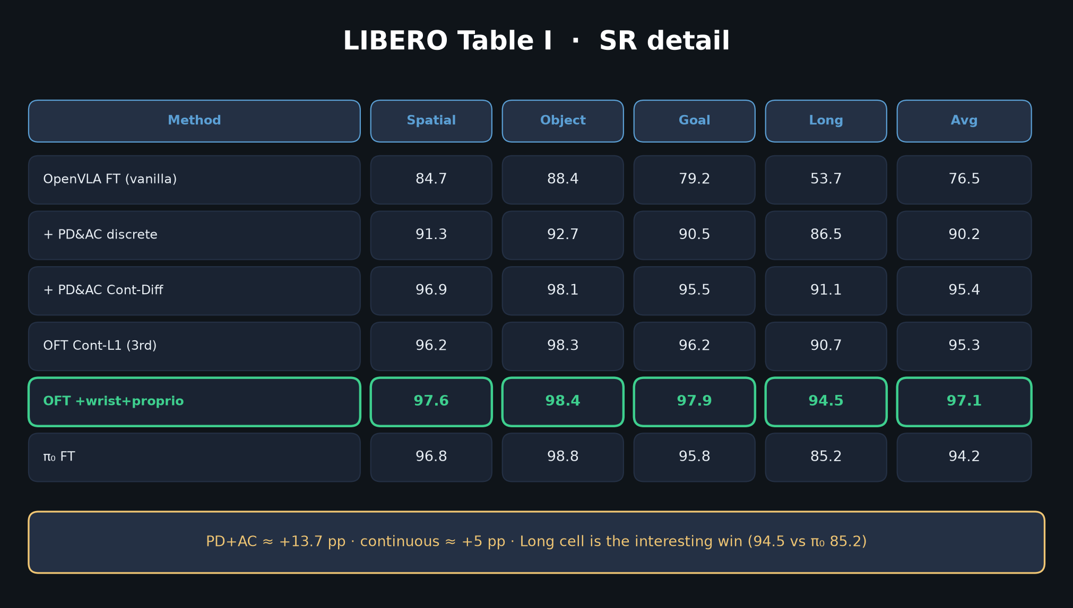
Scientific Reviewer · 8+3 · 8/11
Notes:
LIBERO detail — Long cell more interesting than saturated Spatial.

Slide 9
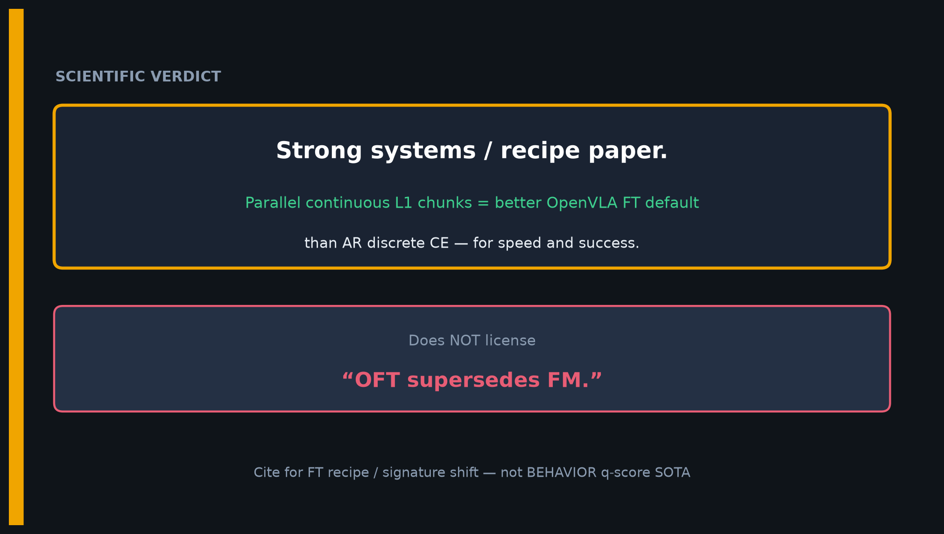
Scientific Reviewer · 8+3 · 9/11
Notes:
VERDICT — better OpenVLA FT default; does NOT license OFT supersedes FM.

Slide 10
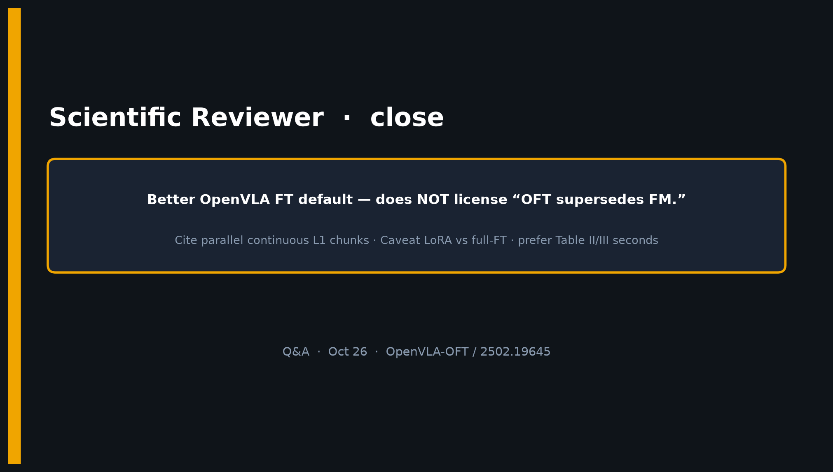
Scientific Reviewer · 8+3 · 10/11
Notes:
CLOSE.

Slide 11
Scientific Reviewer · 8+3 · 11/11
Notes:
BACKUP caveats.

