Slide 1
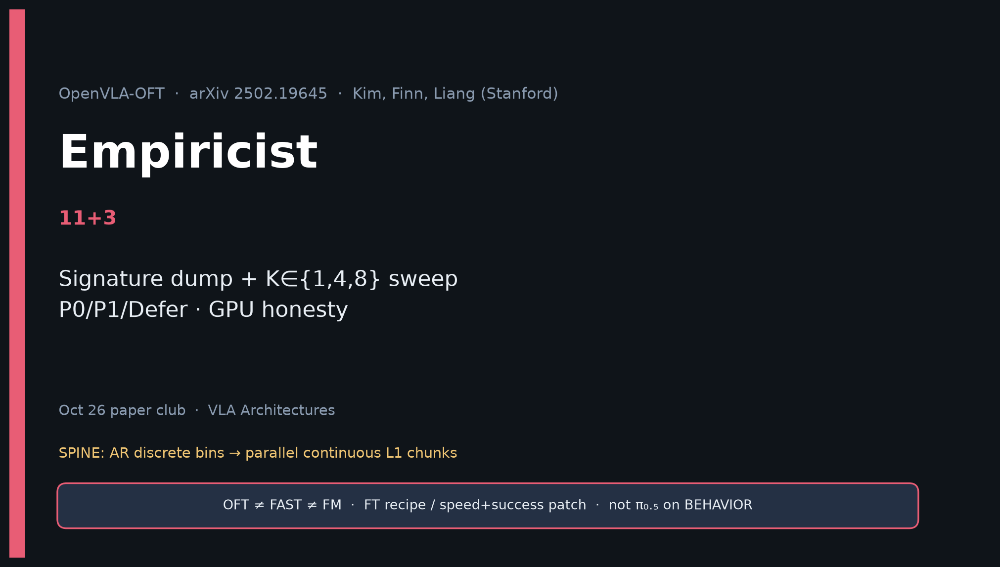
Empiricist · 11+3 · 1/14
Notes:
EMPIRICIST — 11+3.
Own: signature dump + K∈{1,4,8} sweep; P0/P1/Defer; GPU honesty.
Env: /workspace/openvla-oft-quiet/env_outline/

Slide 2
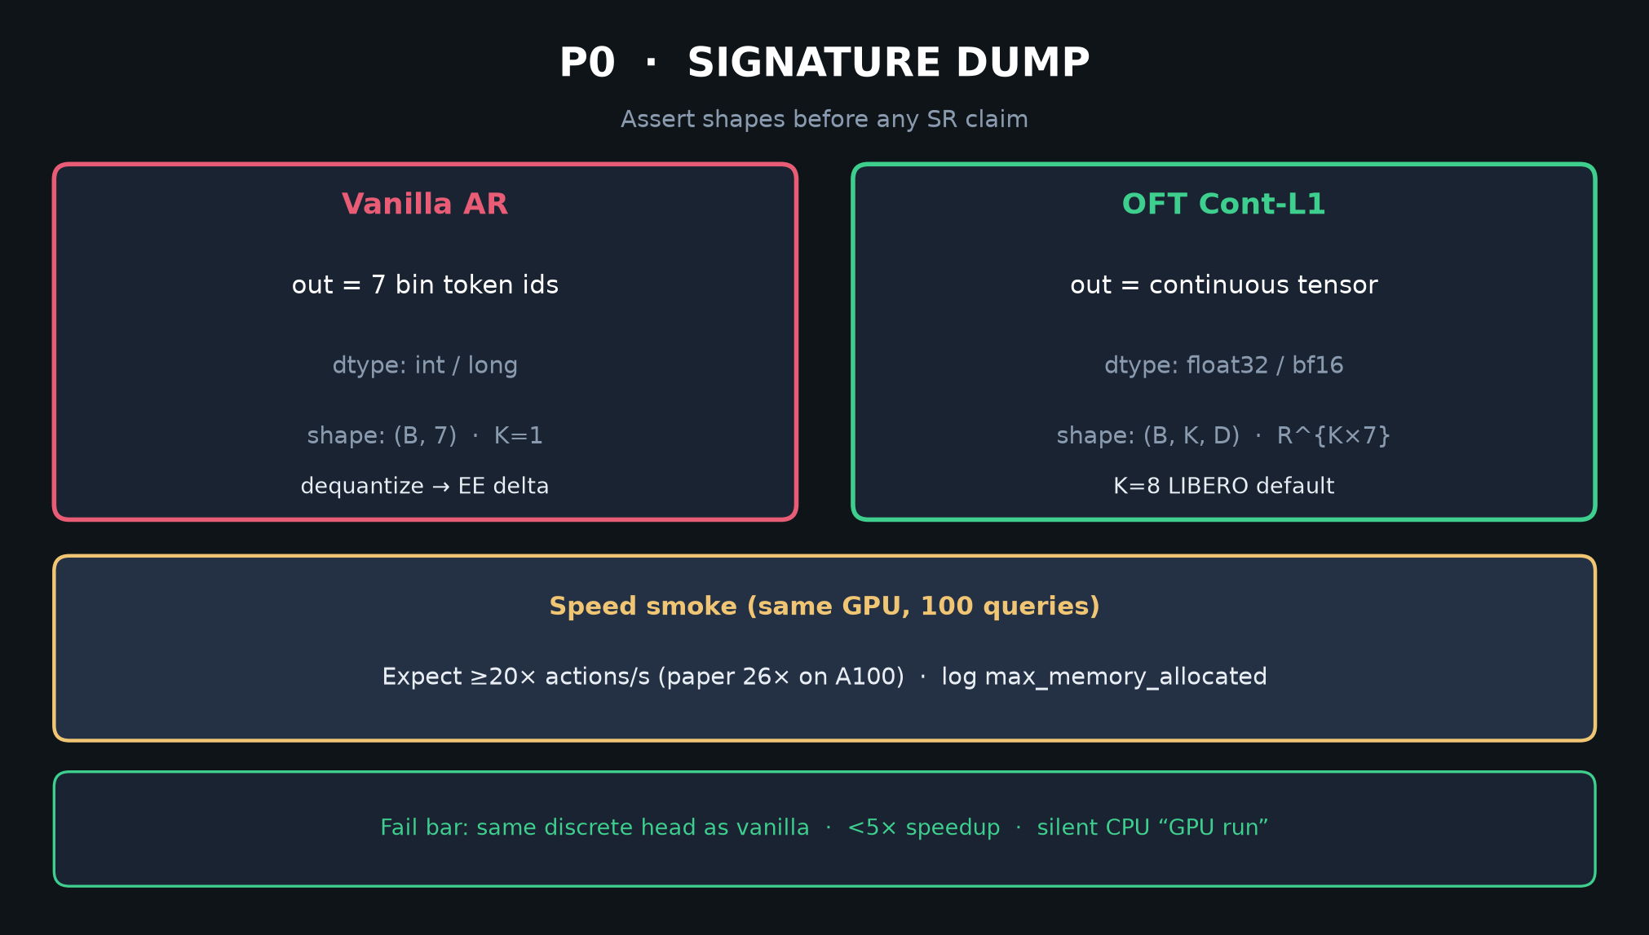
Empiricist · 11+3 · 2/14
Notes:
SIGNATURE DUMP P0 — assert R^{K×D} continuous vs 7 bin ids before any SR.
Expect ≥20× actions/s (paper 26×).

Slide 3
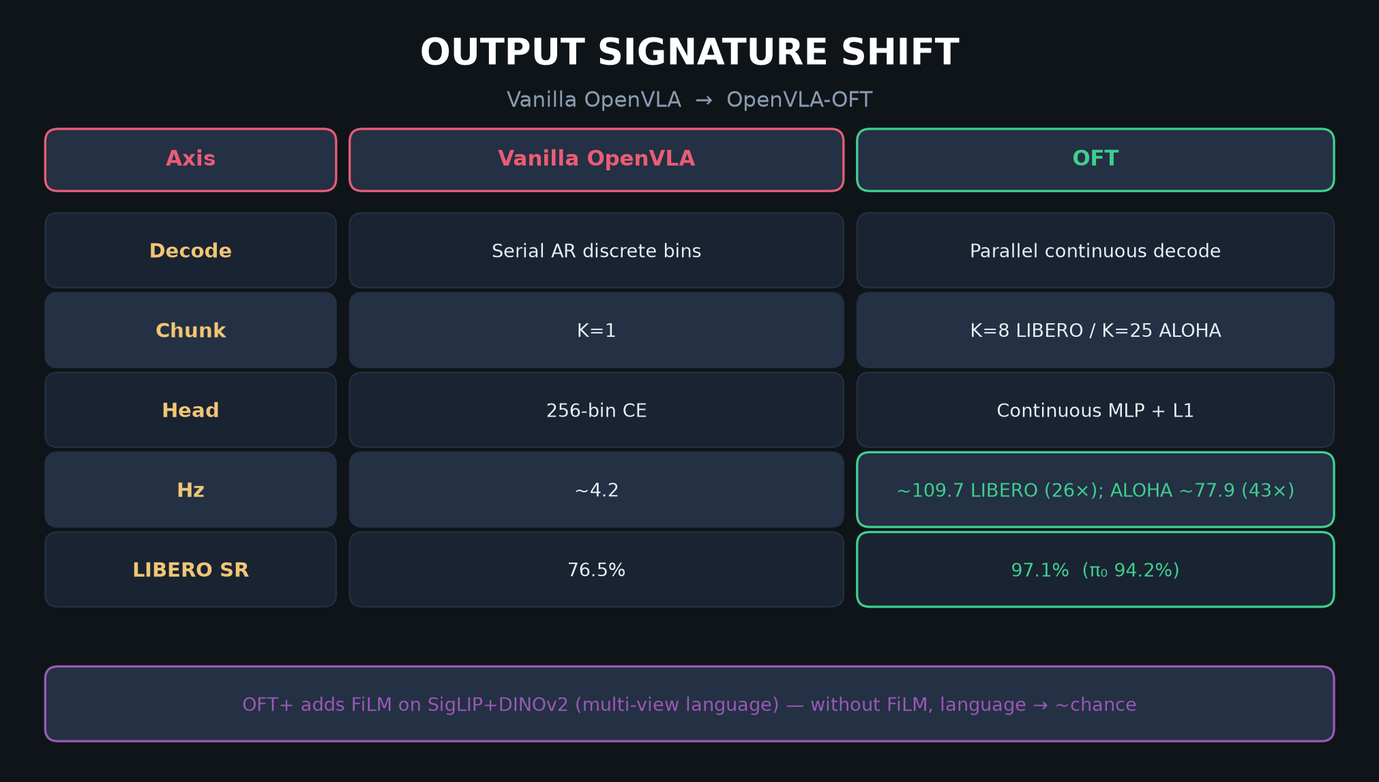
Empiricist · 11+3 · 3/14
Notes:
SIGNATURE TABLE — axes to log.

Slide 4
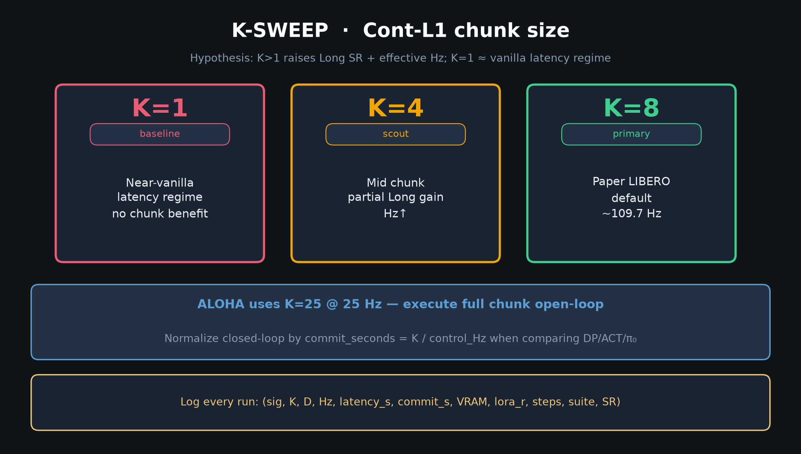
Empiricist · 11+3 · 4/14
Notes:
K-SWEEP Cont-L1 — K∈{1,4,8}. Paper default K=8 LIBERO; K=25 ALOHA.
Log (sig, K, D, Hz, latency_s, commit_s, VRAM, …).

Slide 5
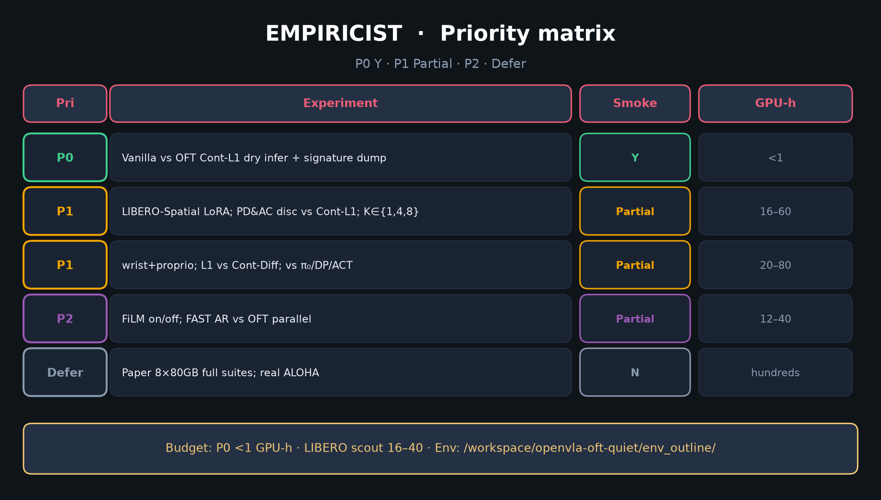
Empiricist · 11+3 · 5/14
Notes:
PRIORITY MATRIX — P0 Y dry infer; P1 Partial LIBERO scout; Defer 8×80GB / real ALOHA.
Budget P0 <1 GPU-h; scout 16–40.

Slide 6
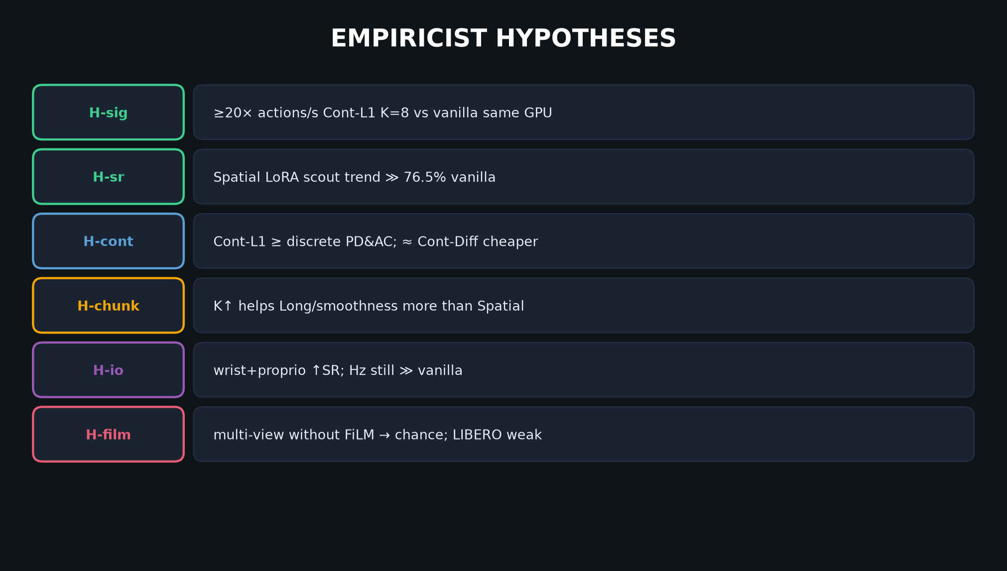
Empiricist · 11+3 · 6/14
Notes:
HYPOTHESES H-sig … H-film — falsifiers in DELIVERABLE §3.

Slide 7
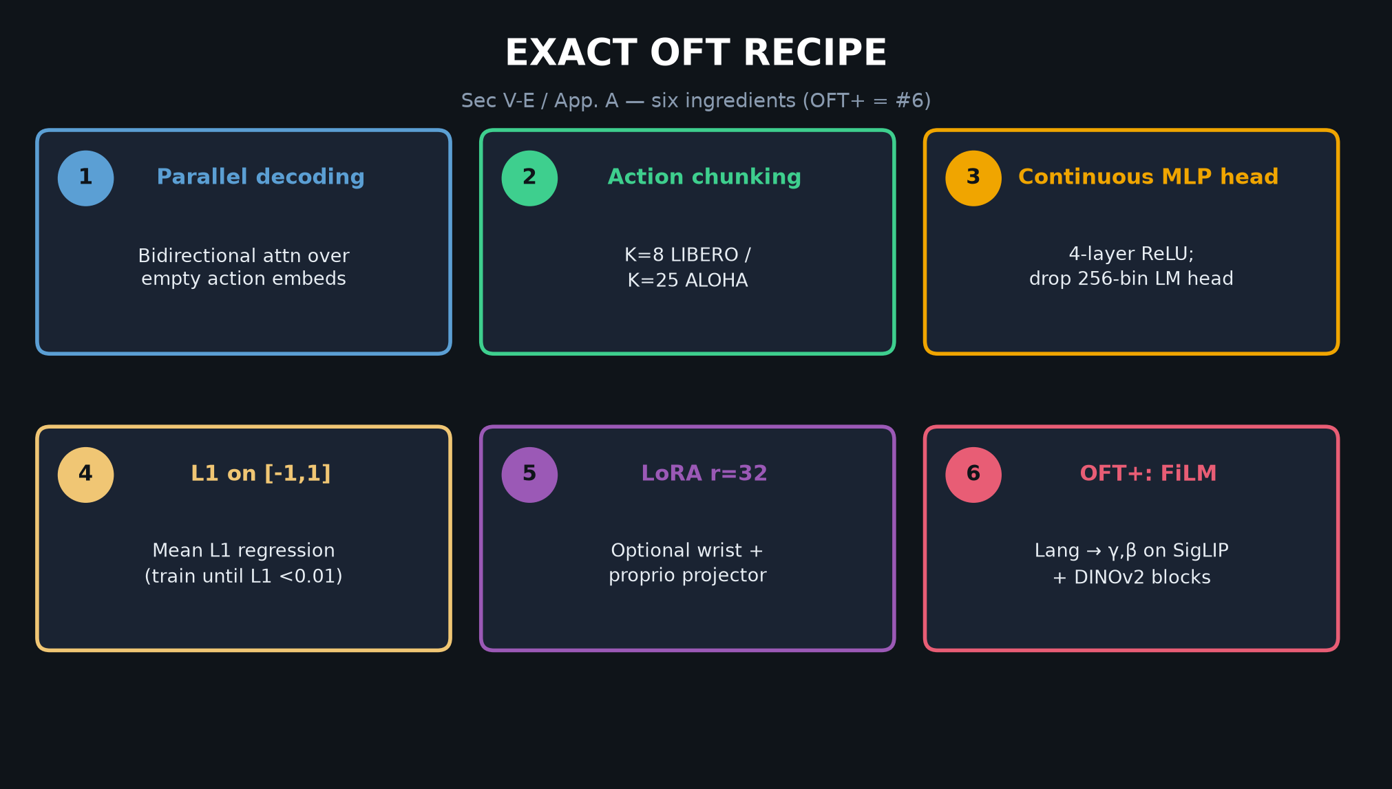
Empiricist · 11+3 · 7/14
Notes:
OFT RECIPE — implement checklist for finetune.py use_l1_regression=True.

Slide 8
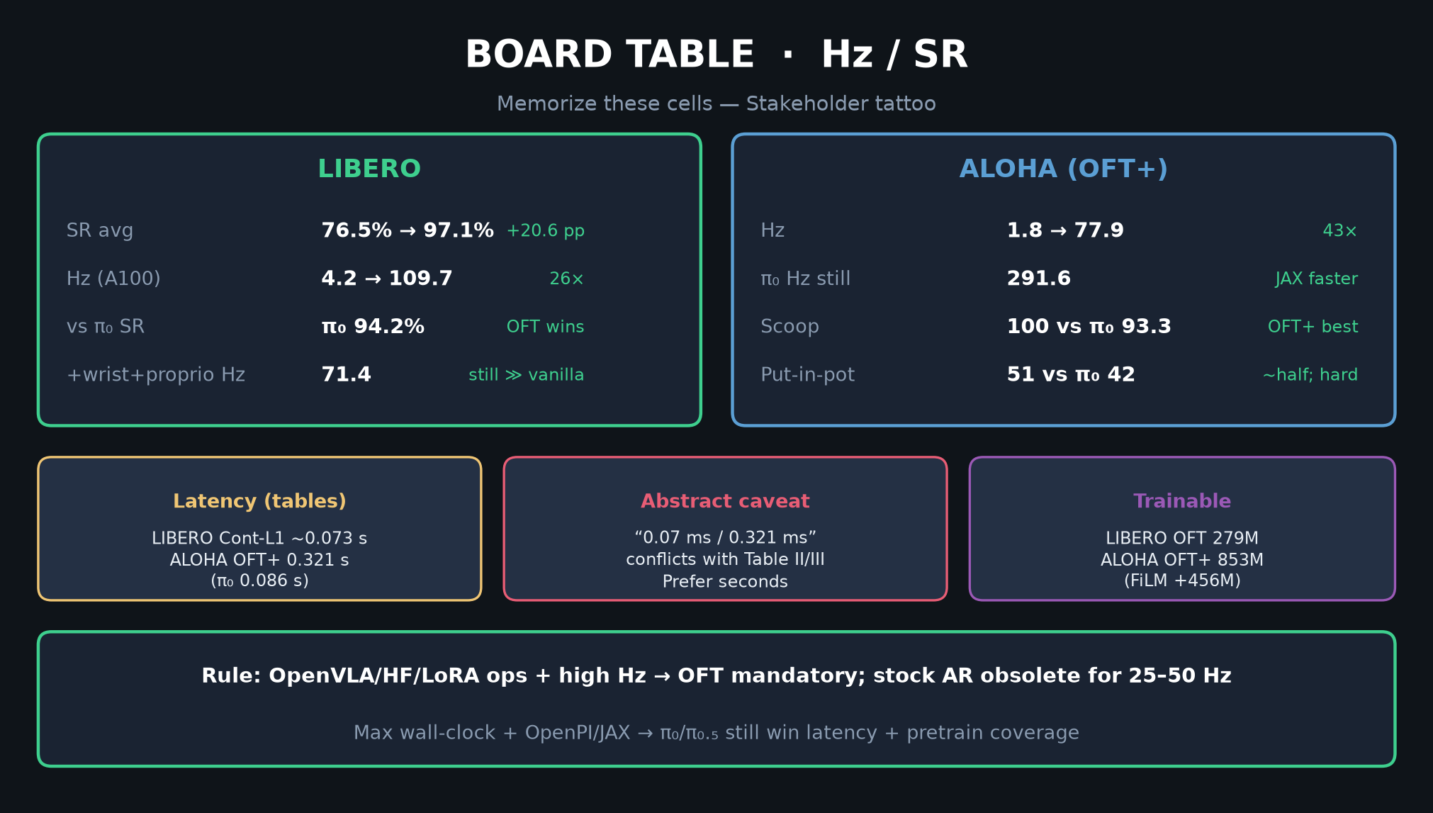
Empiricist · 11+3 · 8/14
Notes:
BOARD NUMBERS — what Partial scout must NOT claim as paper 97.1.

Slide 9
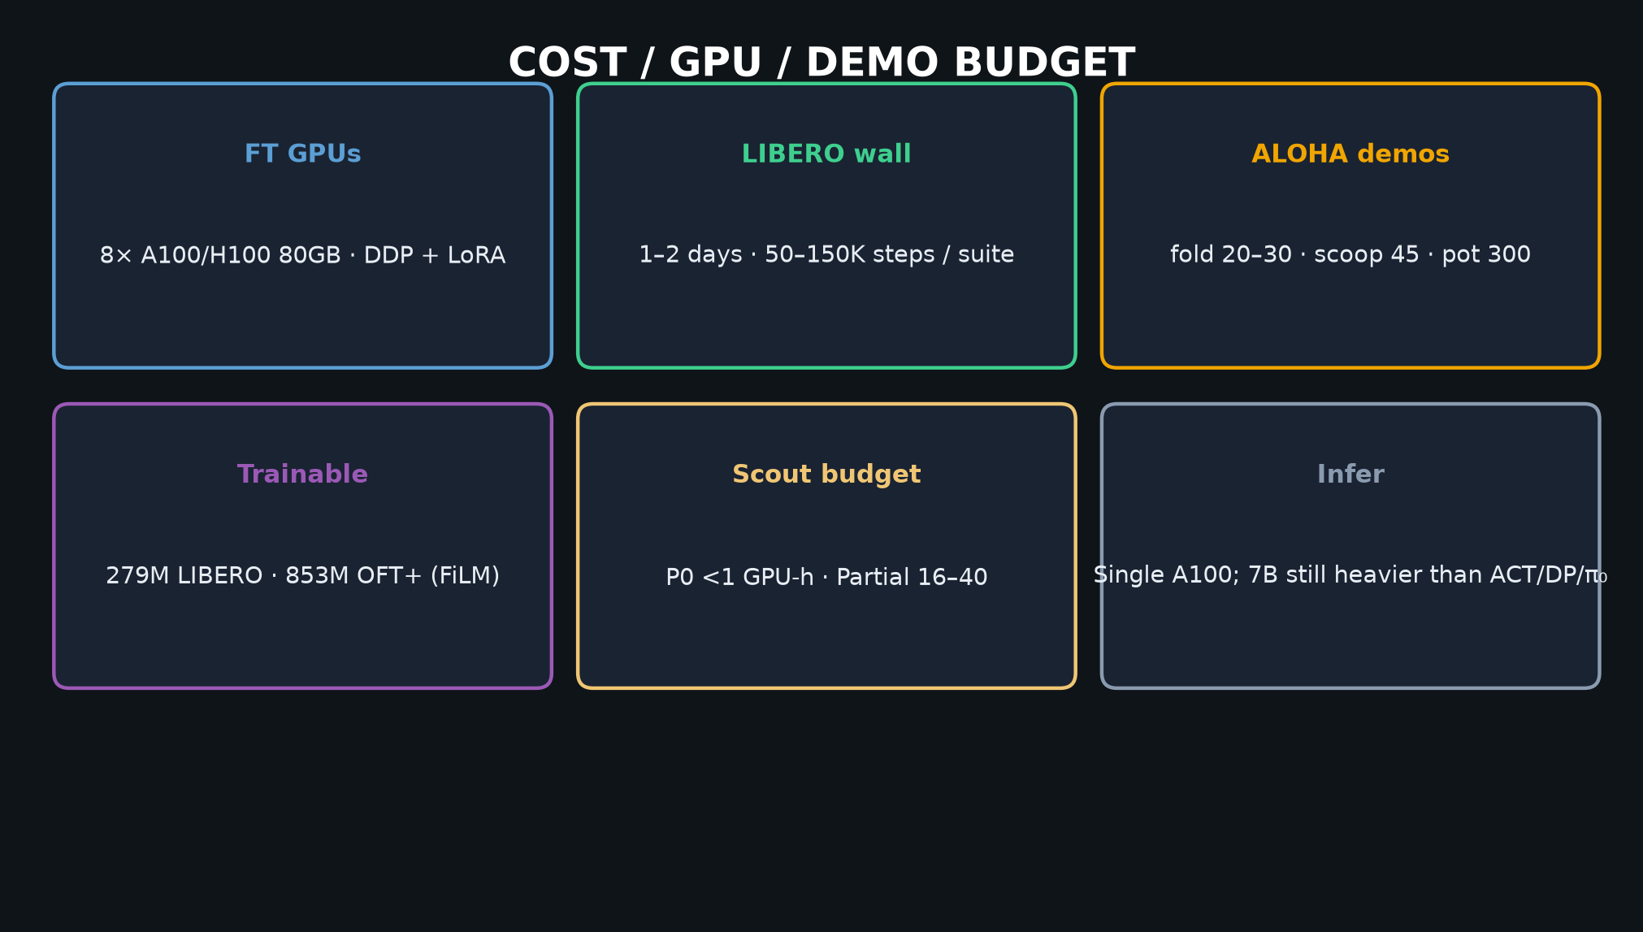
Empiricist · 11+3 · 9/14
Notes:
GPU / cost honesty for scout vs paper FT.

Slide 10
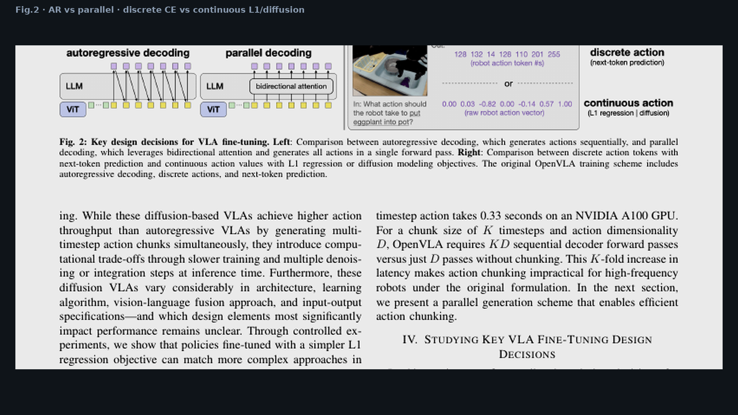
Empiricist · 11+3 · 10/14
Notes:
FIG.2 — design axes you ablate.

Slide 11
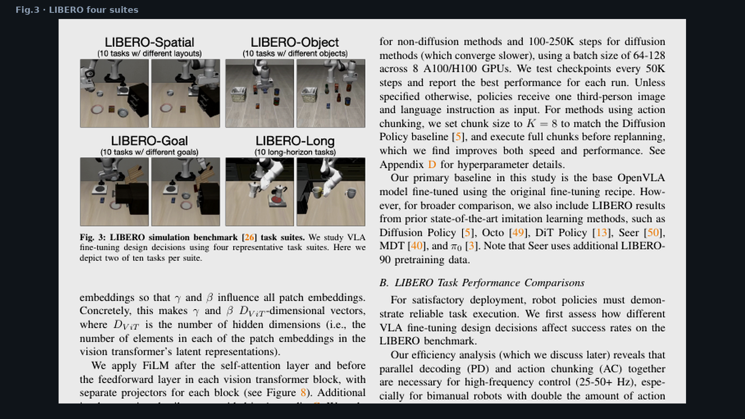
Empiricist · 11+3 · 11/14
Notes:
LIBERO suites Fig.3 — Spatial scout first.

Slide 12
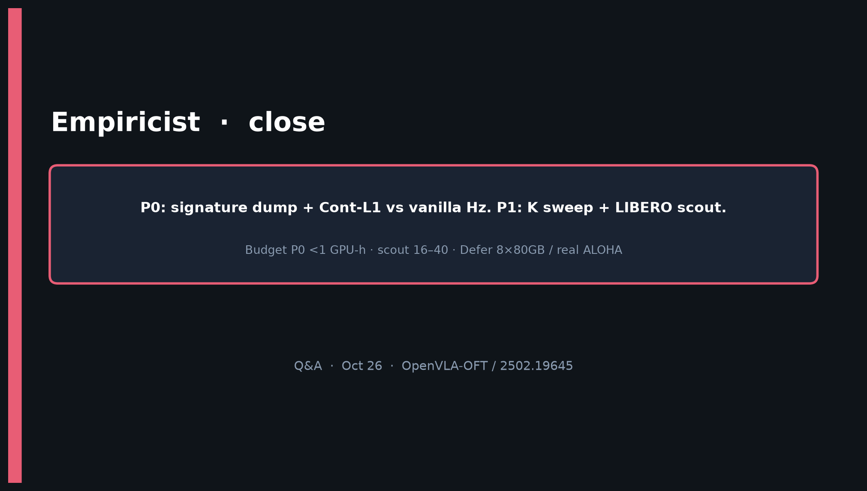
Empiricist · 11+3 · 12/14
Notes:
CLOSE — P0 signature+Hz is the bar; Partial Spatial direction; Defer paper-scale.

Slide 13
Empiricist · 11+3 · 13/14
Notes:
BACKUP K-sweep.

Slide 14
Empiricist · 11+3 · 14/14
Notes:
BACKUP priority.

