Slide 1
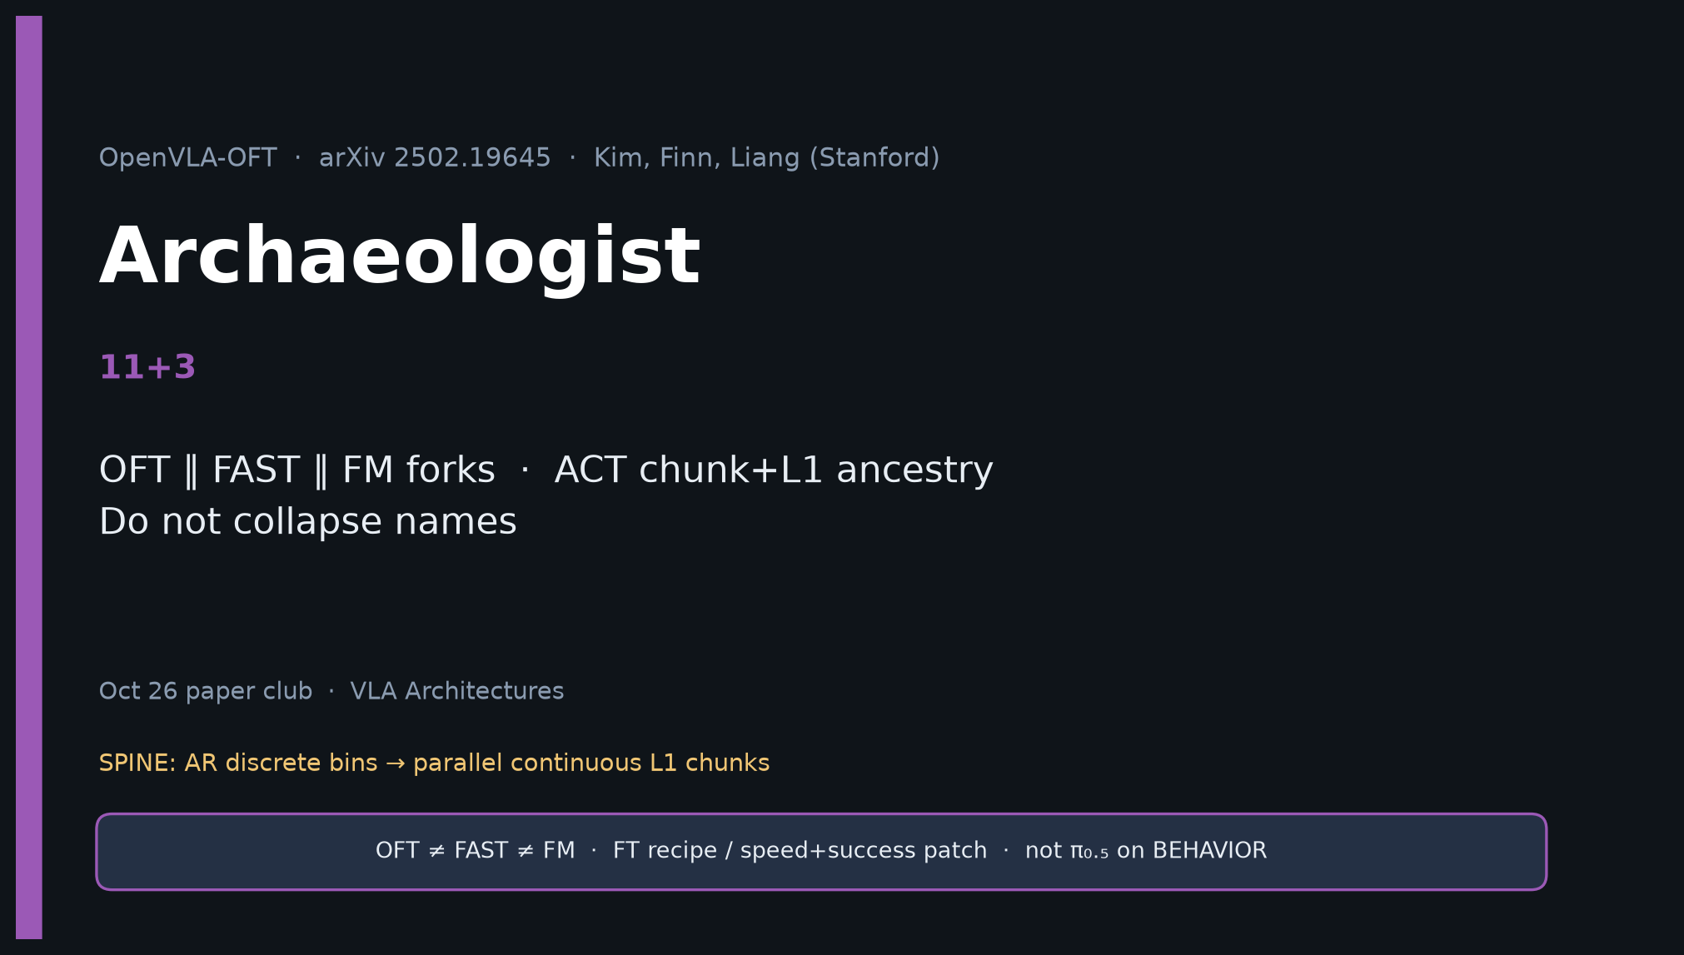
Archaeologist · 11+3 · 1/14
Notes:
ARCHAEOLOGIST — 11+3.
Mission: OFT ∥ FAST ∥ FM forks; ACT chunk+L1 ancestry; do not collapse names.
CLEAR: OFT is FT recipe / output-signature upgrade — not new FM, not π₀.₅ replace.

Slide 2
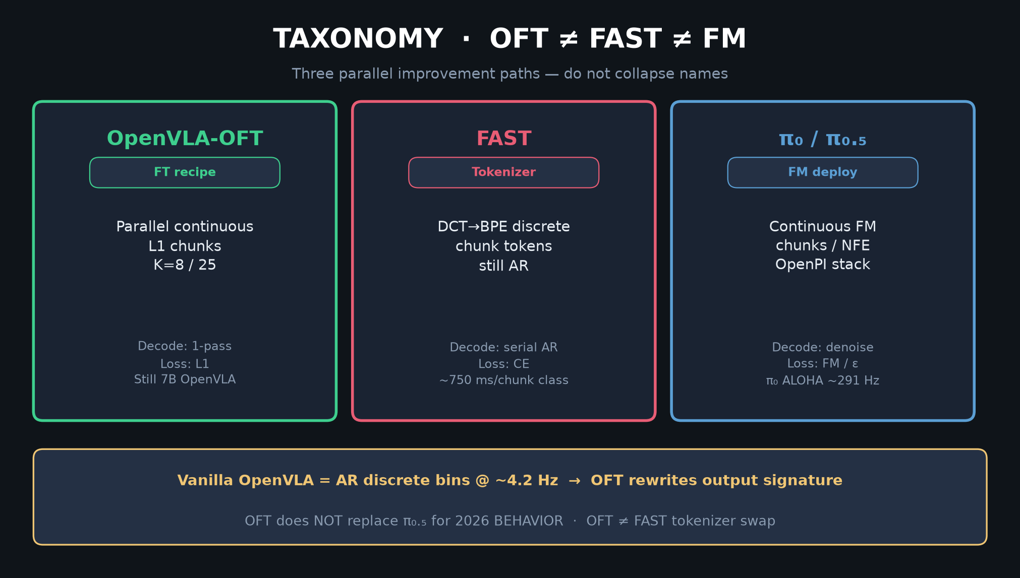
Archaeologist · 11+3 · 2/14
Notes:
TAXONOMY — three named forks. Spend time here.

Slide 3
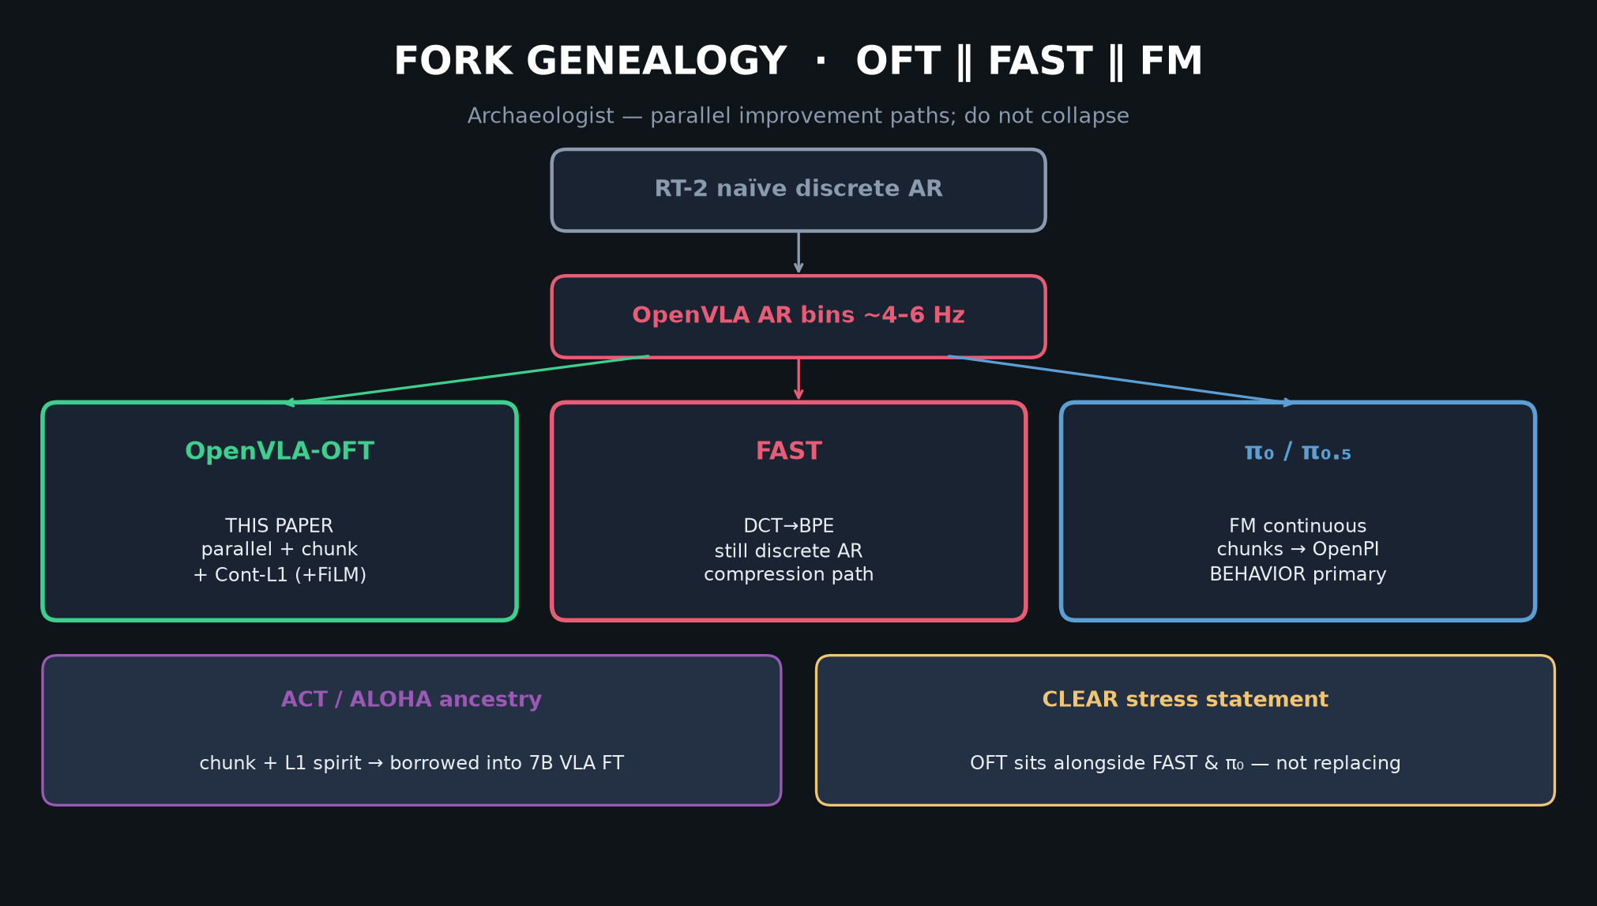
Archaeologist · 11+3 · 3/14
Notes:
GENEALOGY — RT-2 → OpenVLA → OFT ∥ FAST ∥ π₀/π₀.₅.
ACT supplies chunk+L1 ancestry into 7B VLA FT.

Slide 4
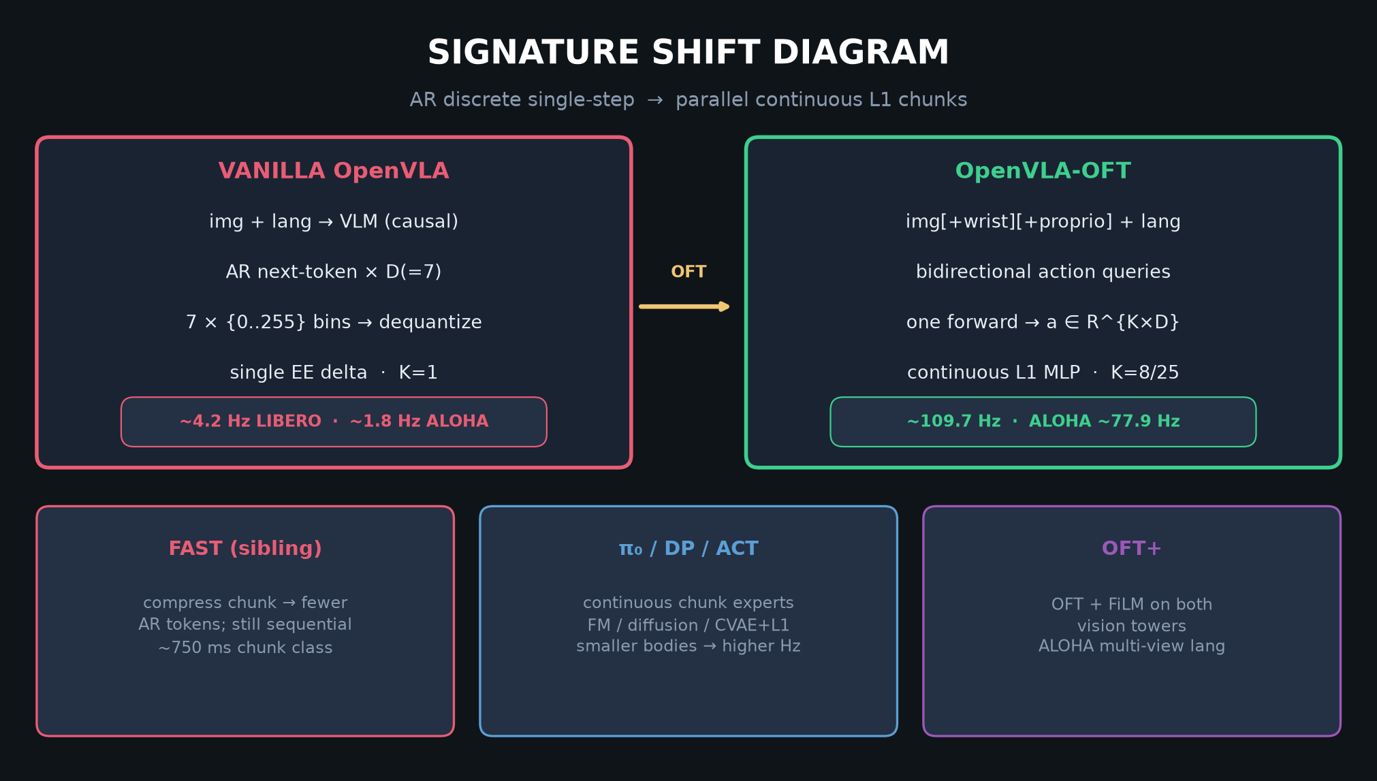
Archaeologist · 11+3 · 4/14
Notes:
SIGNATURE SHIFT — what OFT changes vs vanilla (CLEAR from §IV–V / App. A).

Slide 5
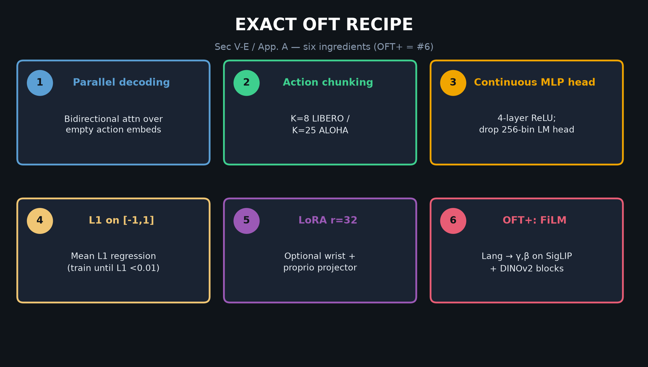
Archaeologist · 11+3 · 5/14
Notes:
RECIPE ingredients as historical deltas vs OpenVLA AR bins.

Slide 6
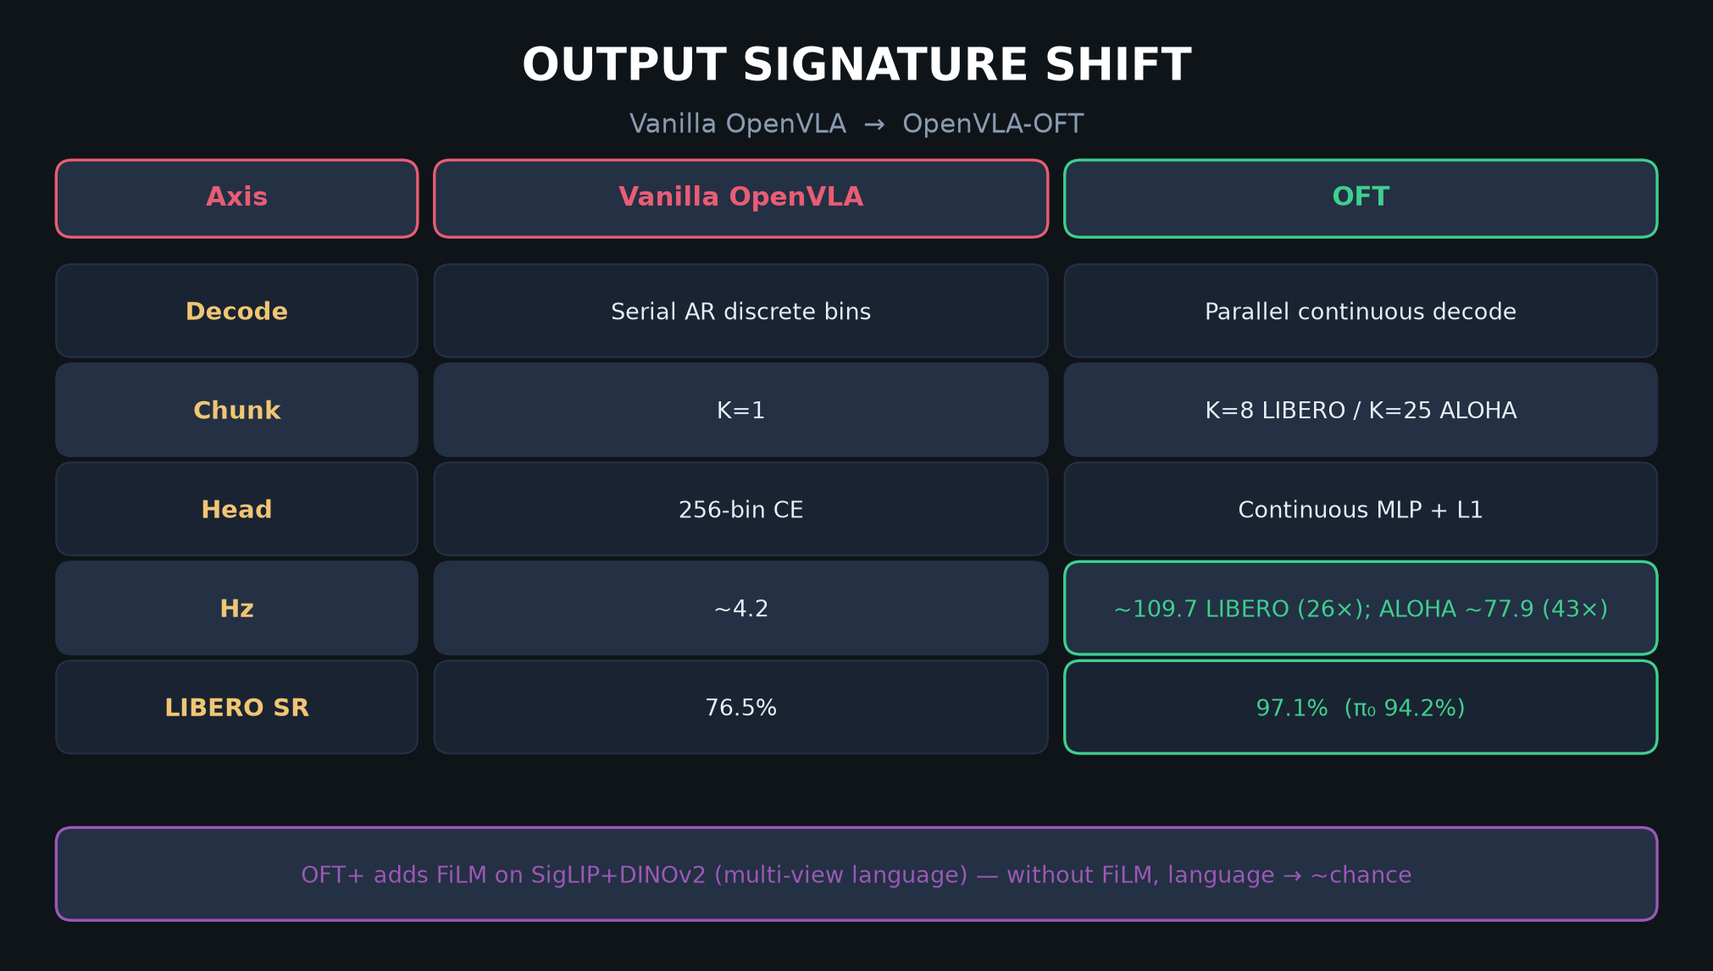
Archaeologist · 11+3 · 6/14
Notes:
SIGNATURE TABLE — axis-by-axis lineage contrast incl. FAST sibling.

Slide 7
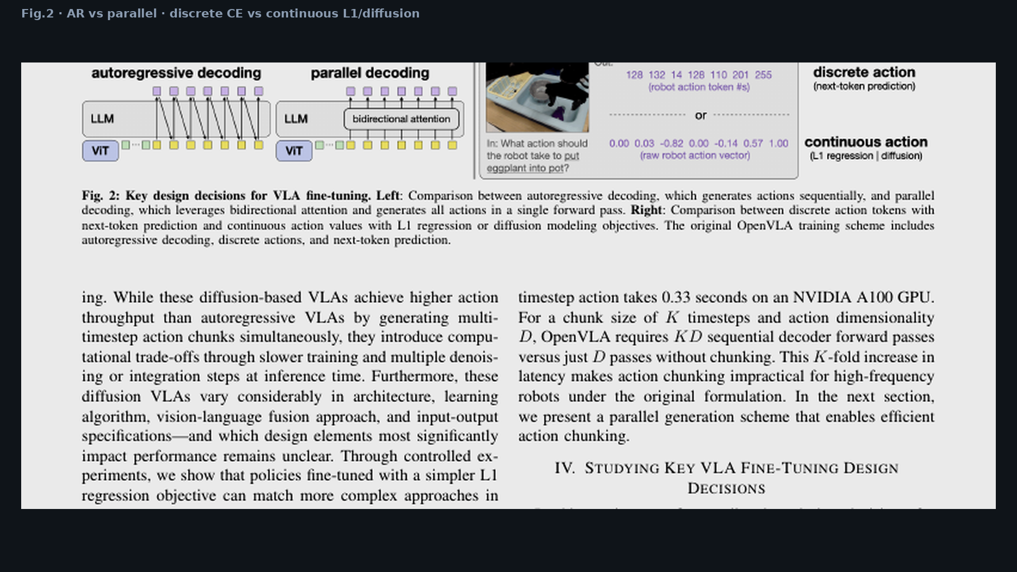
Archaeologist · 11+3 · 7/14
Notes:
FIG.2 design space — paper’s own framing of the fork.

Slide 8
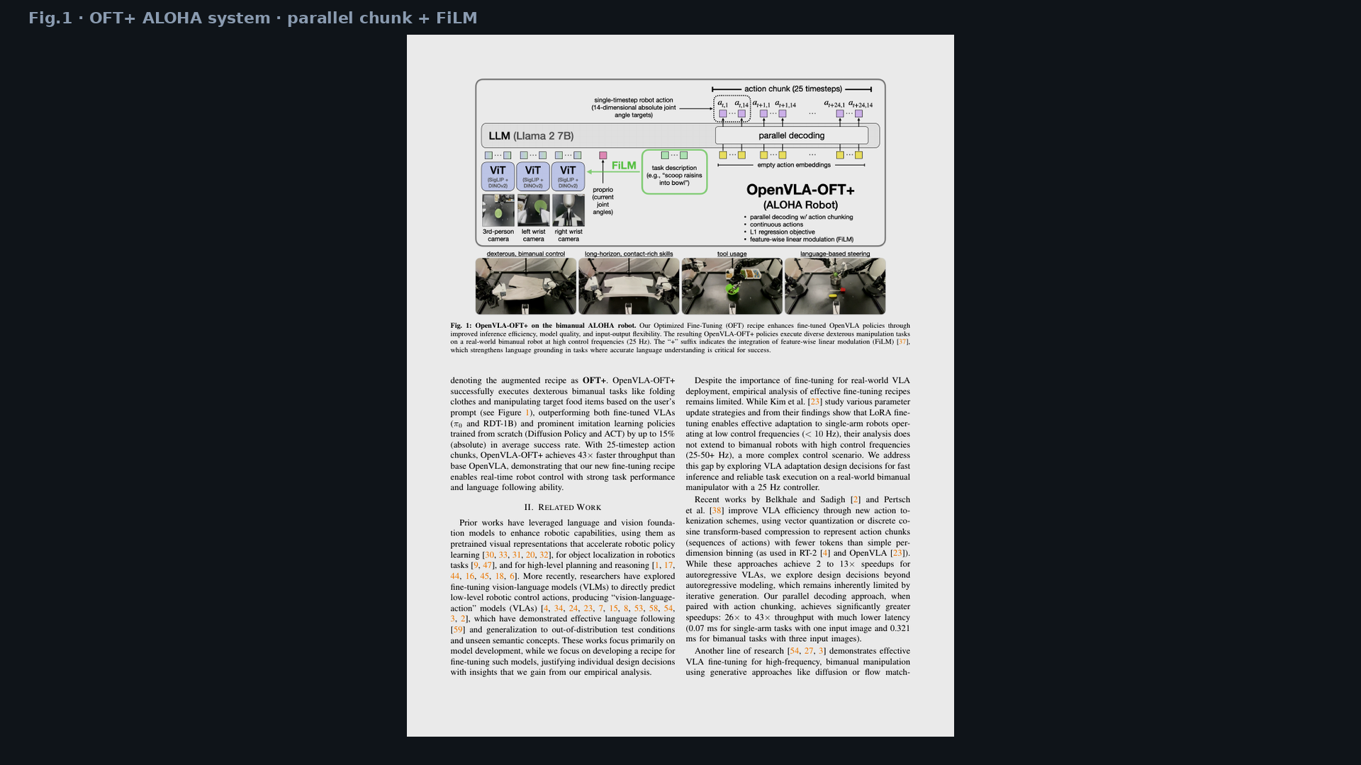
Archaeologist · 11+3 · 8/14
Notes:
FIG.1 — OFT+ instantiation on ALOHA lineage.

Slide 9
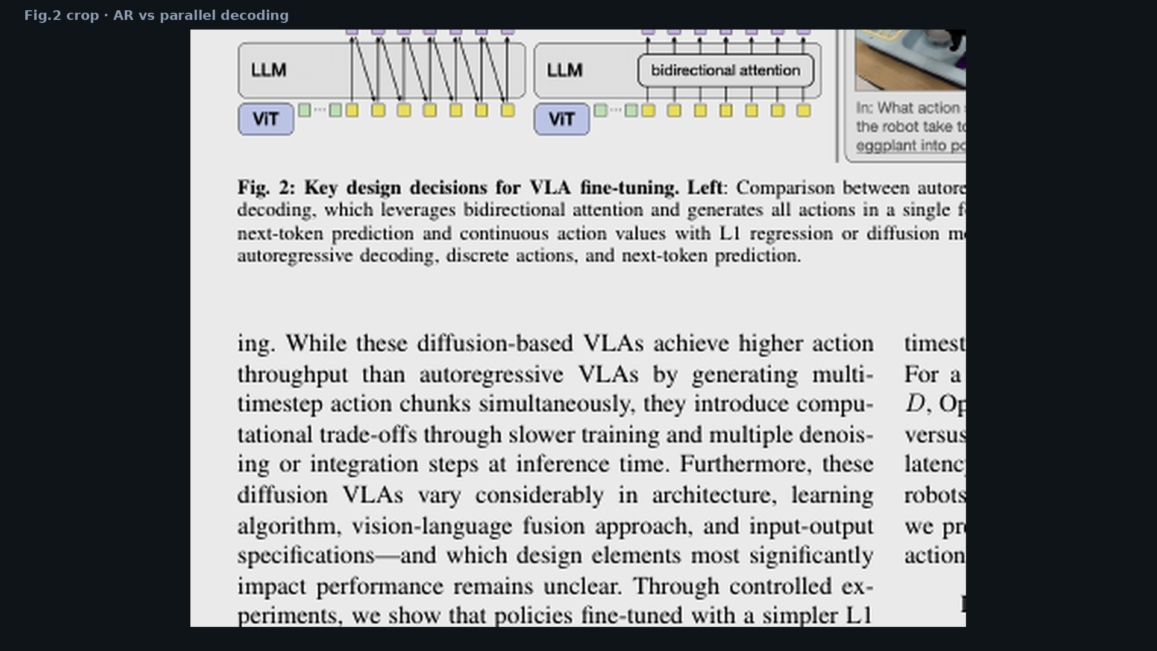
Archaeologist · 11+3 · 9/14
Notes:
PARALLEL DECODE CROP — visual of AR vs bidirectional.

Slide 10
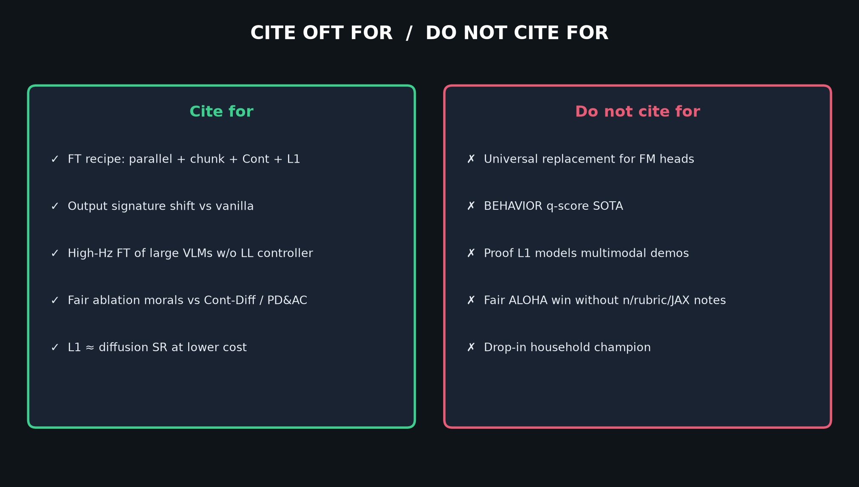
Archaeologist · 11+3 · 10/14
Notes:
CITE table — what lineage claim is safe.

Slide 11
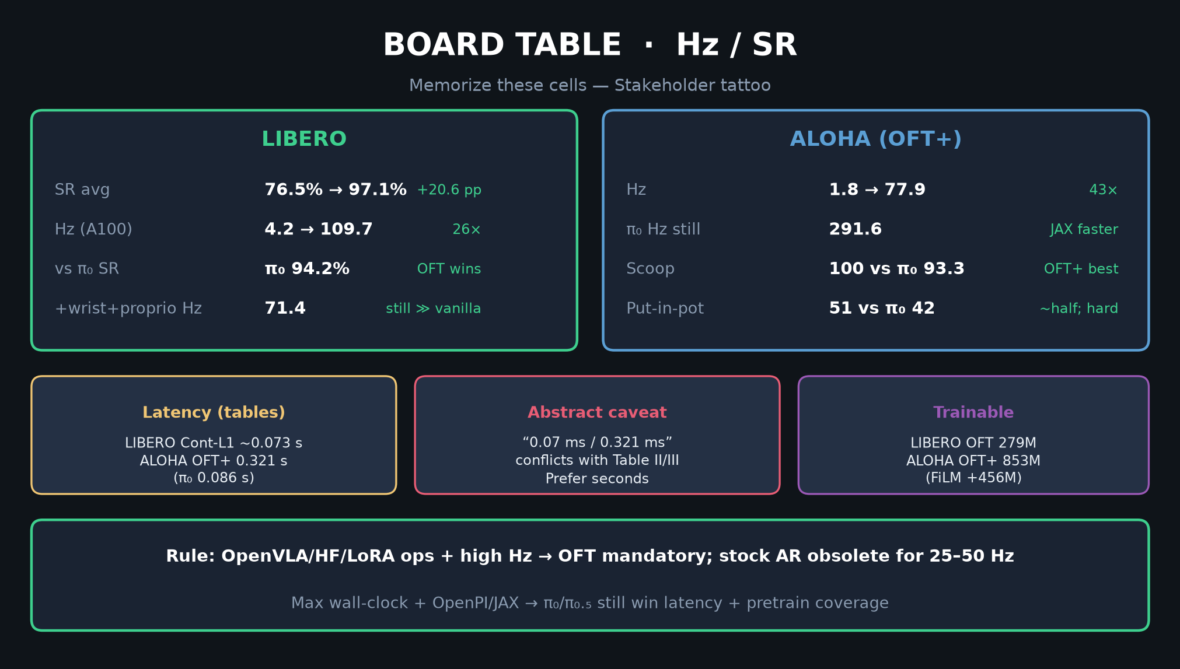
Archaeologist · 11+3 · 11/14
Notes:
BOARD — where OFT sits numerically vs π₀ / vanilla on this paper’s benches.

Slide 12
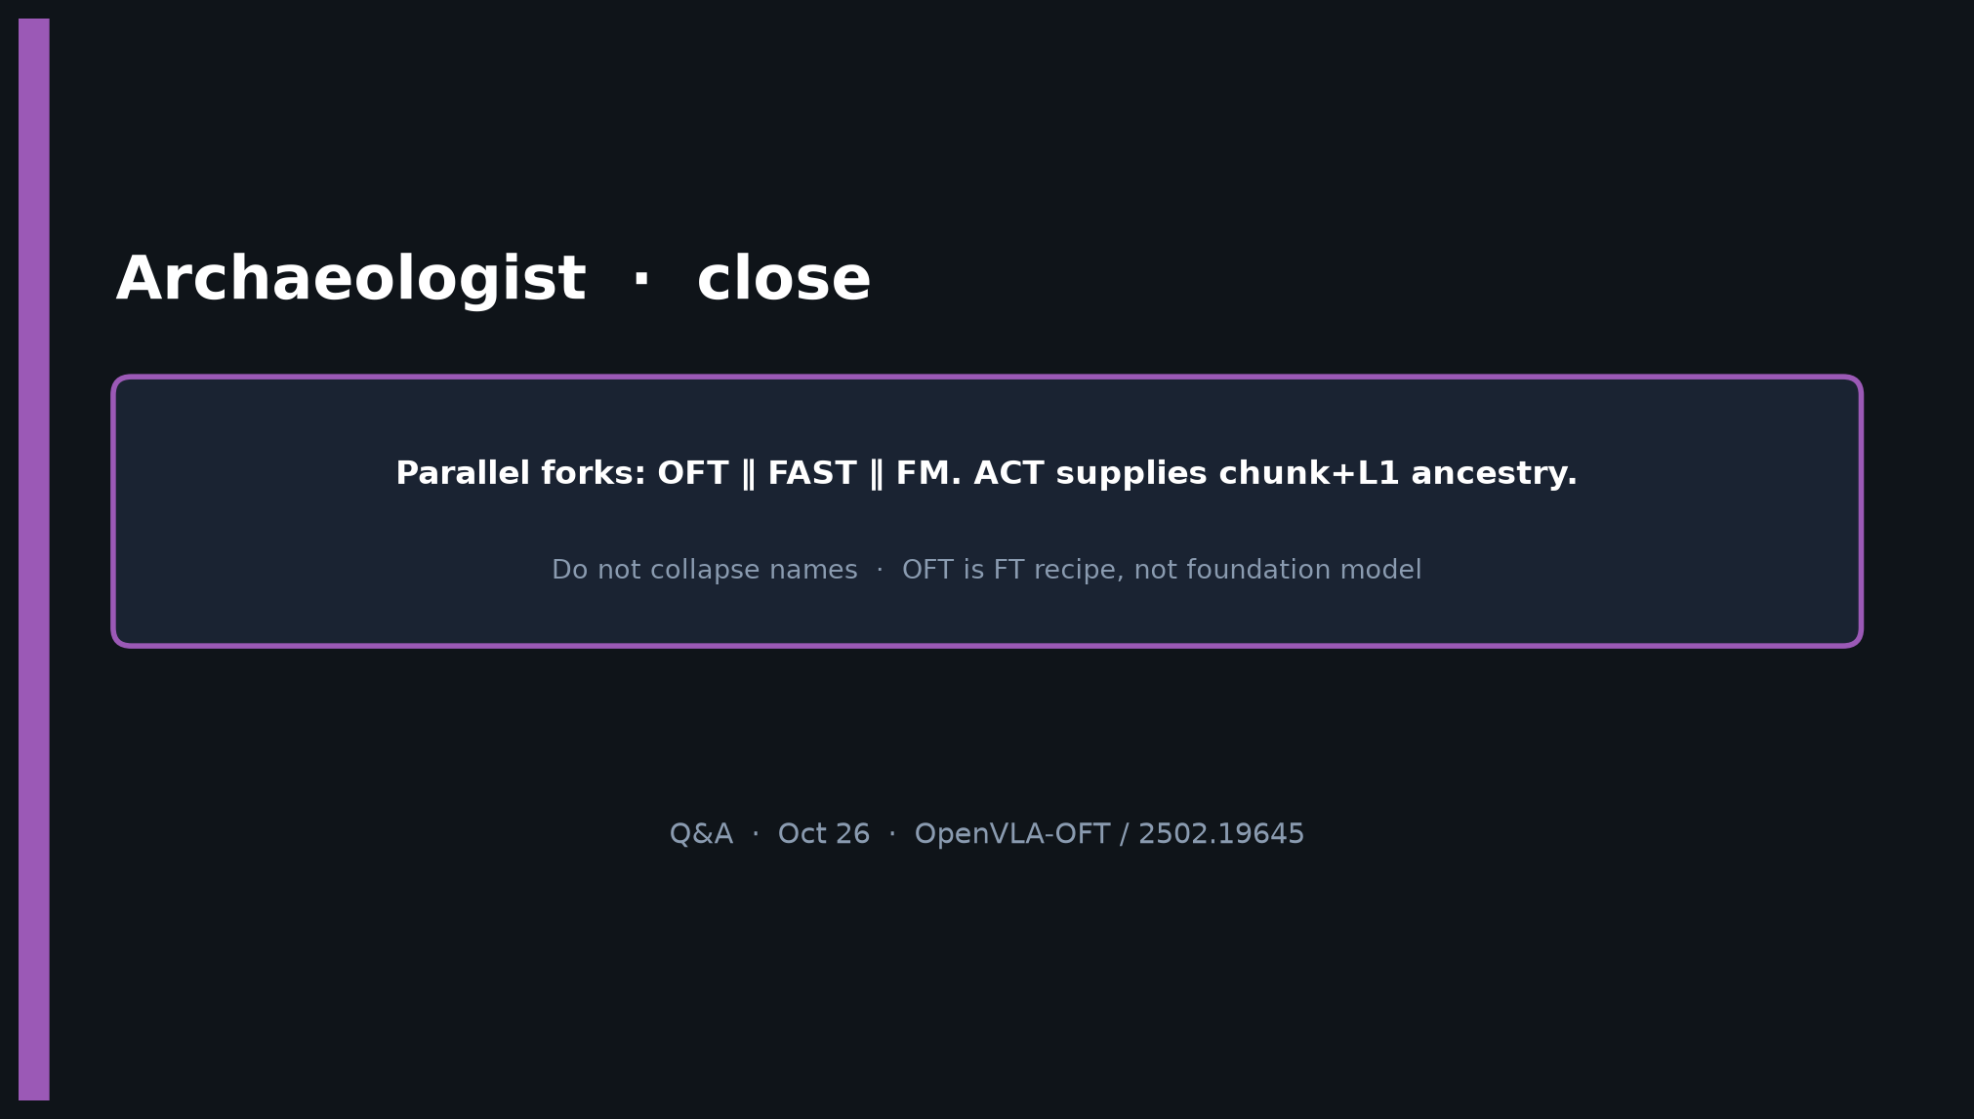
Archaeologist · 11+3 · 12/14
Notes:
CLOSE — parallel forks; do not collapse OFT/FAST/FM names.

Slide 13
Archaeologist · 11+3 · 13/14
Notes:
BACKUP genealogy.

Slide 14
Archaeologist · 11+3 · 14/14
Notes:
BACKUP taxonomy.

