Slide 1
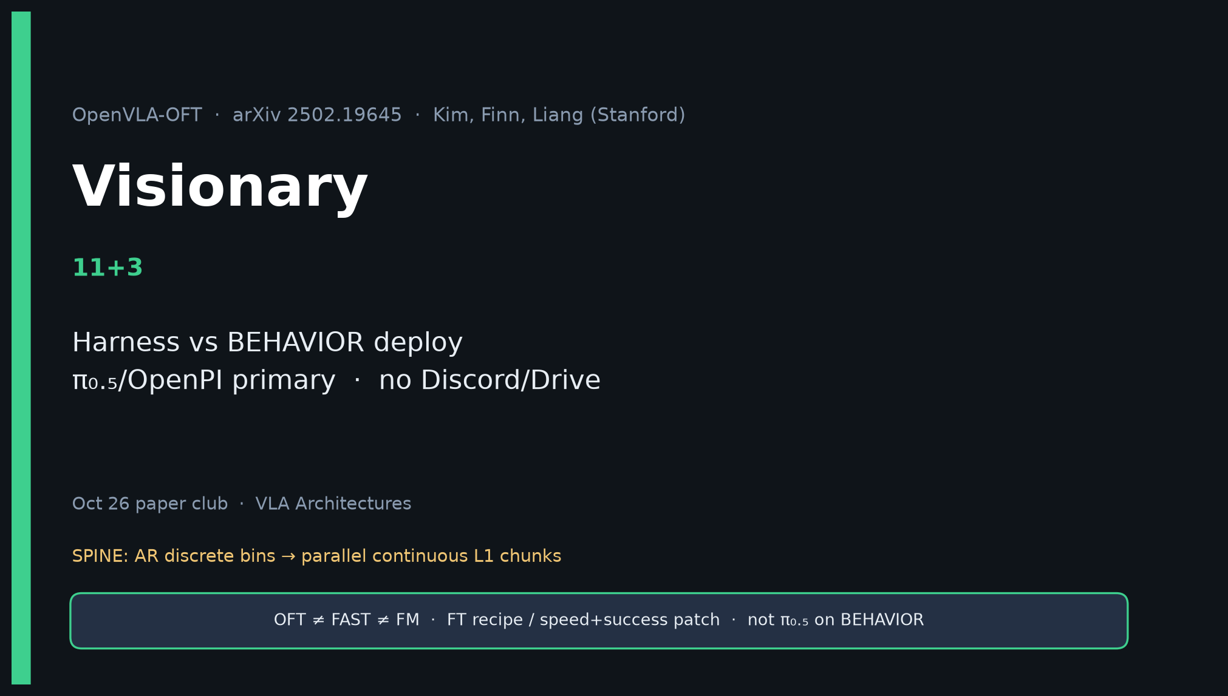
Visionary · 11+3 · 1/14
Notes:
VISIONARY — 11+3 → 2026 BEHAVIOR.
OFT = corrective hygiene for OpenVLA stacks. Primary substrate remains π₀.₅/OpenPI.
Keep OFT in harness as open AR-family control.
SKIP Discord/Drive logistics per assignment.

Slide 2
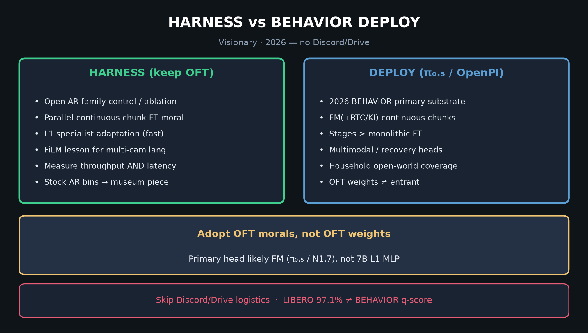
Visionary · 11+3 · 2/14
Notes:
HARNESS vs DEPLOY — primary message.
Adopt OFT morals (parallel continuous chunks, measure Hz, FiLM when multi-view), not OFT weights as entrant.

Slide 3
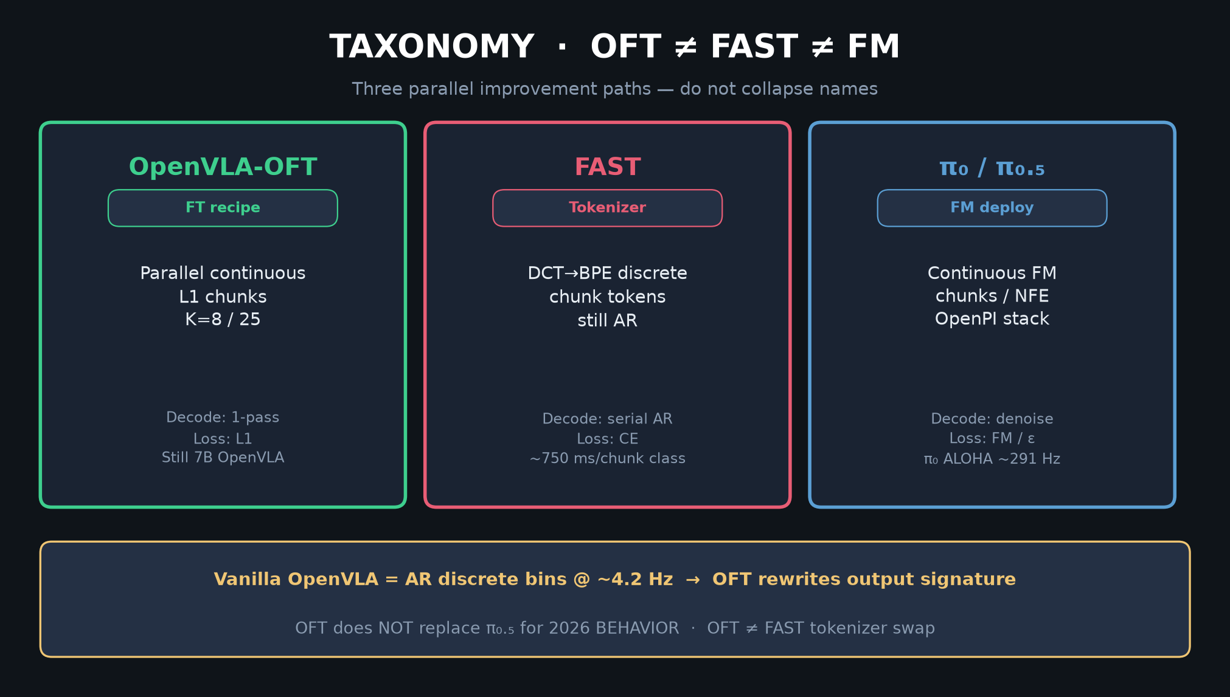
Visionary · 11+3 · 3/14
Notes:
TAXONOMY — position OFT beside FAST and FM for 2026 portfolio.

Slide 4
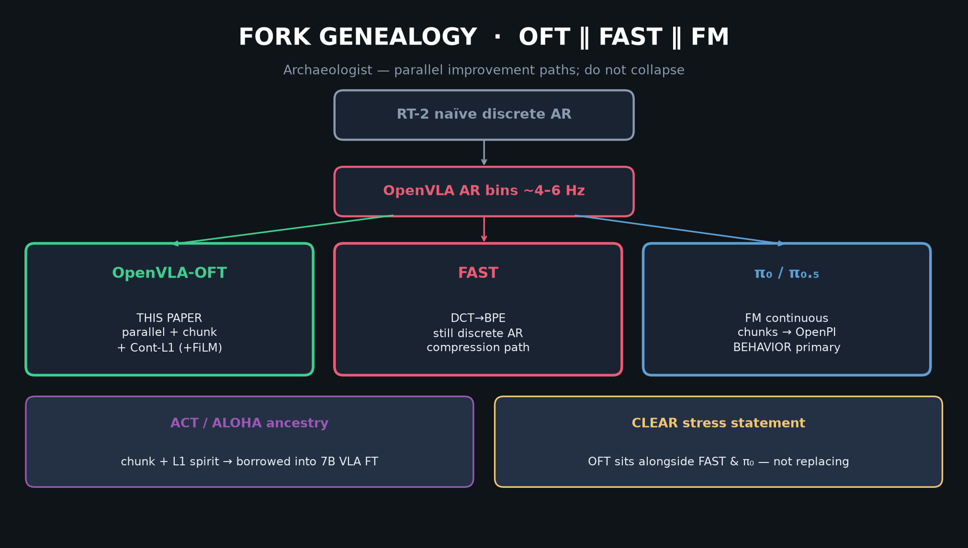
Visionary · 11+3 · 4/14
Notes:
GENEALOGY → BEHAVIOR dual baselines (π₀.₅ & GR00T N1.7-class).

Slide 5
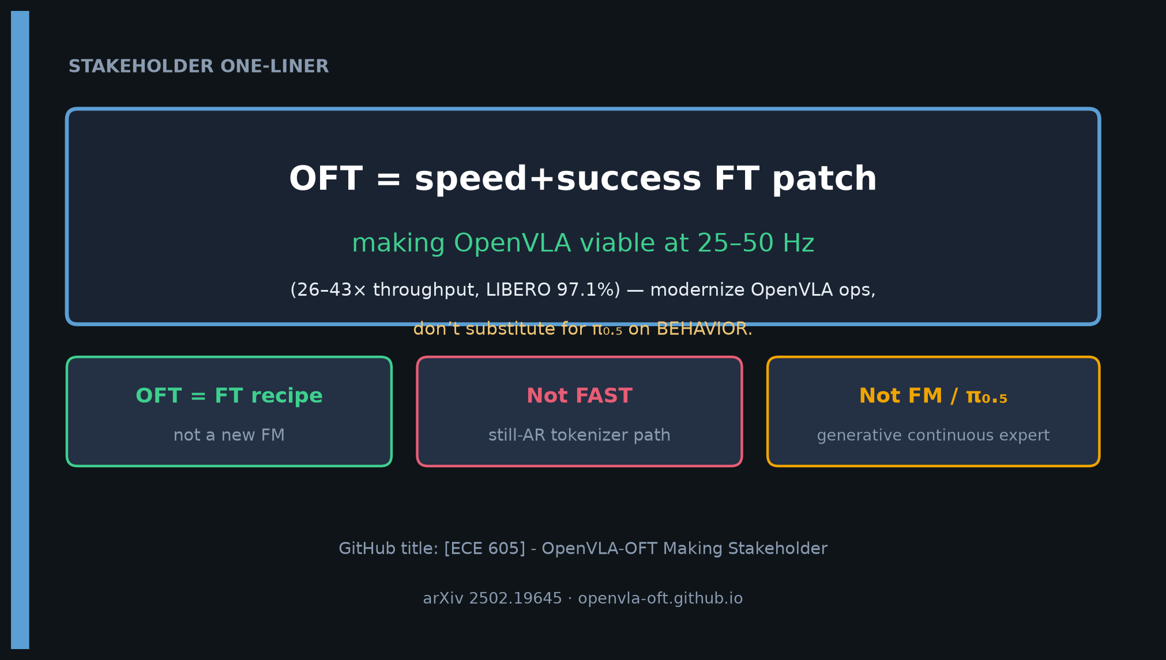
Visionary · 11+3 · 5/14
Notes:
ONE-LINER — OFT turns 4 Hz AR into parallel continuous chunk policy; beside FAST and π₀.₅, not OpenPI replacement.

Slide 6
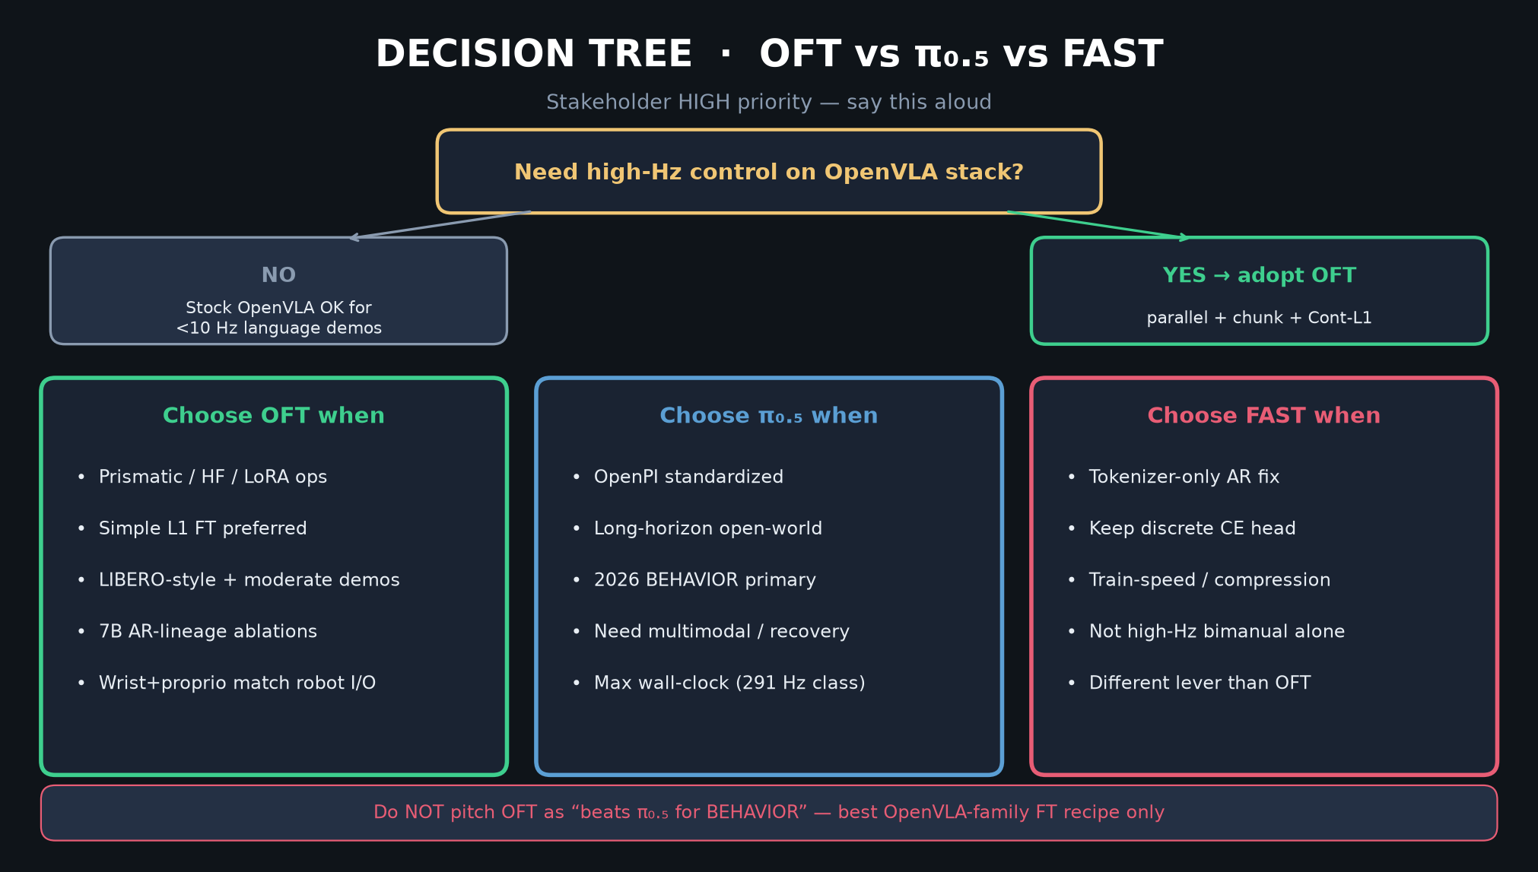
Visionary · 11+3 · 6/14
Notes:
DECISION TREE — BEHAVIOR primary prefers OpenPI; keep OFT as open baseline.

Slide 7
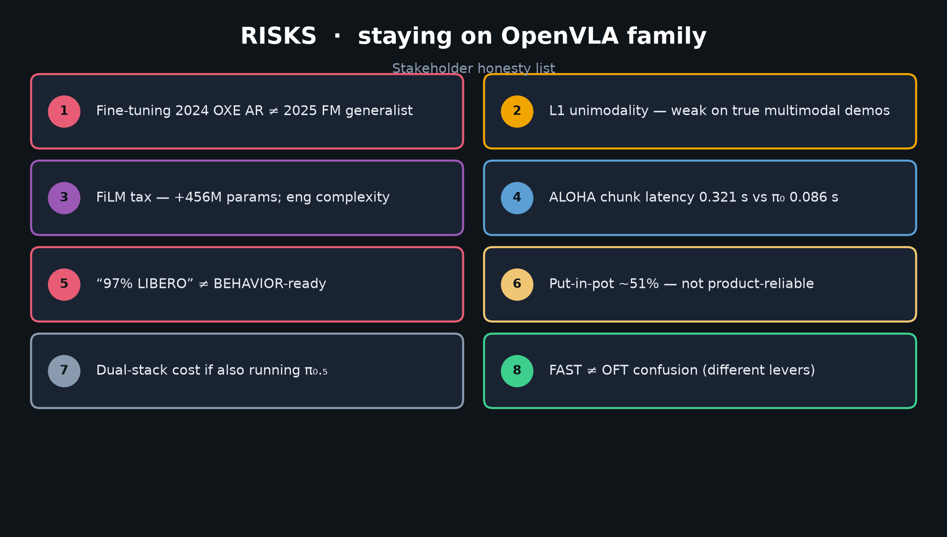
Visionary · 11+3 · 7/14
Notes:
RISKS — myth of 97% LIBERO as BEHAVIOR-ready; L1 multimodal; FiLM tax.

Slide 8
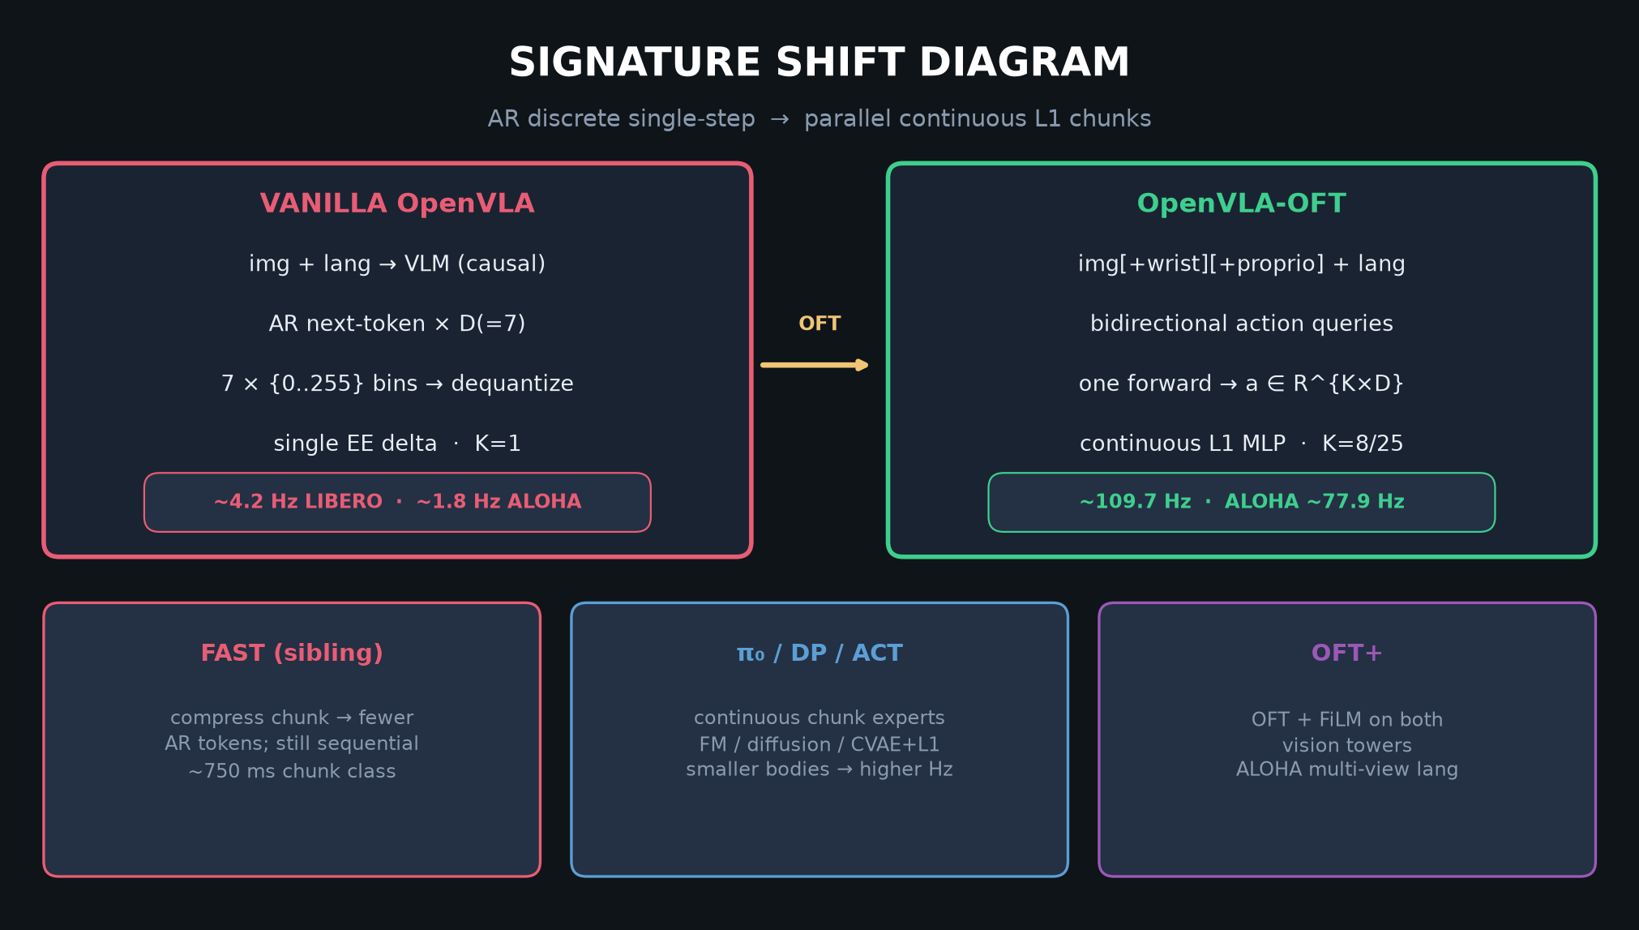
Visionary · 11+3 · 8/14
Notes:
SIGNATURE SHIFT moral — what to steal into FM stacks.

Slide 9
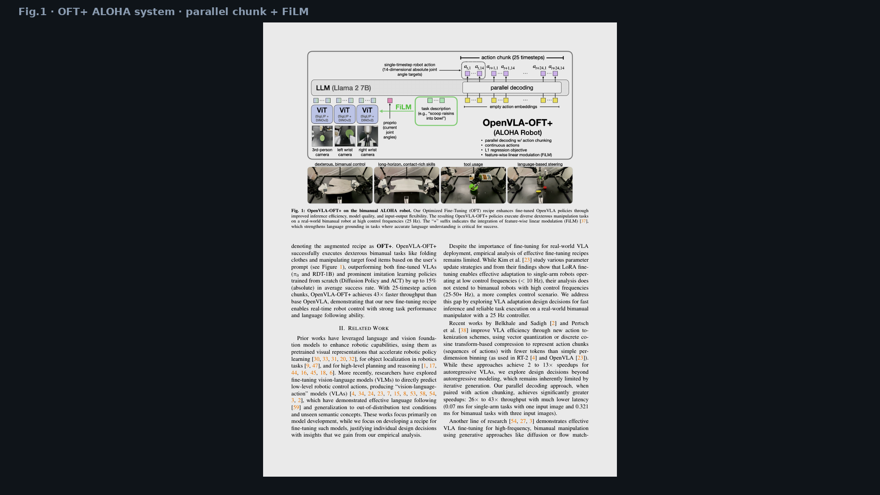
Visionary · 11+3 · 9/14
Notes:
FIG.1 — real bimanual at 25 Hz as existence proof for large VLM continuous chunks.

Slide 10
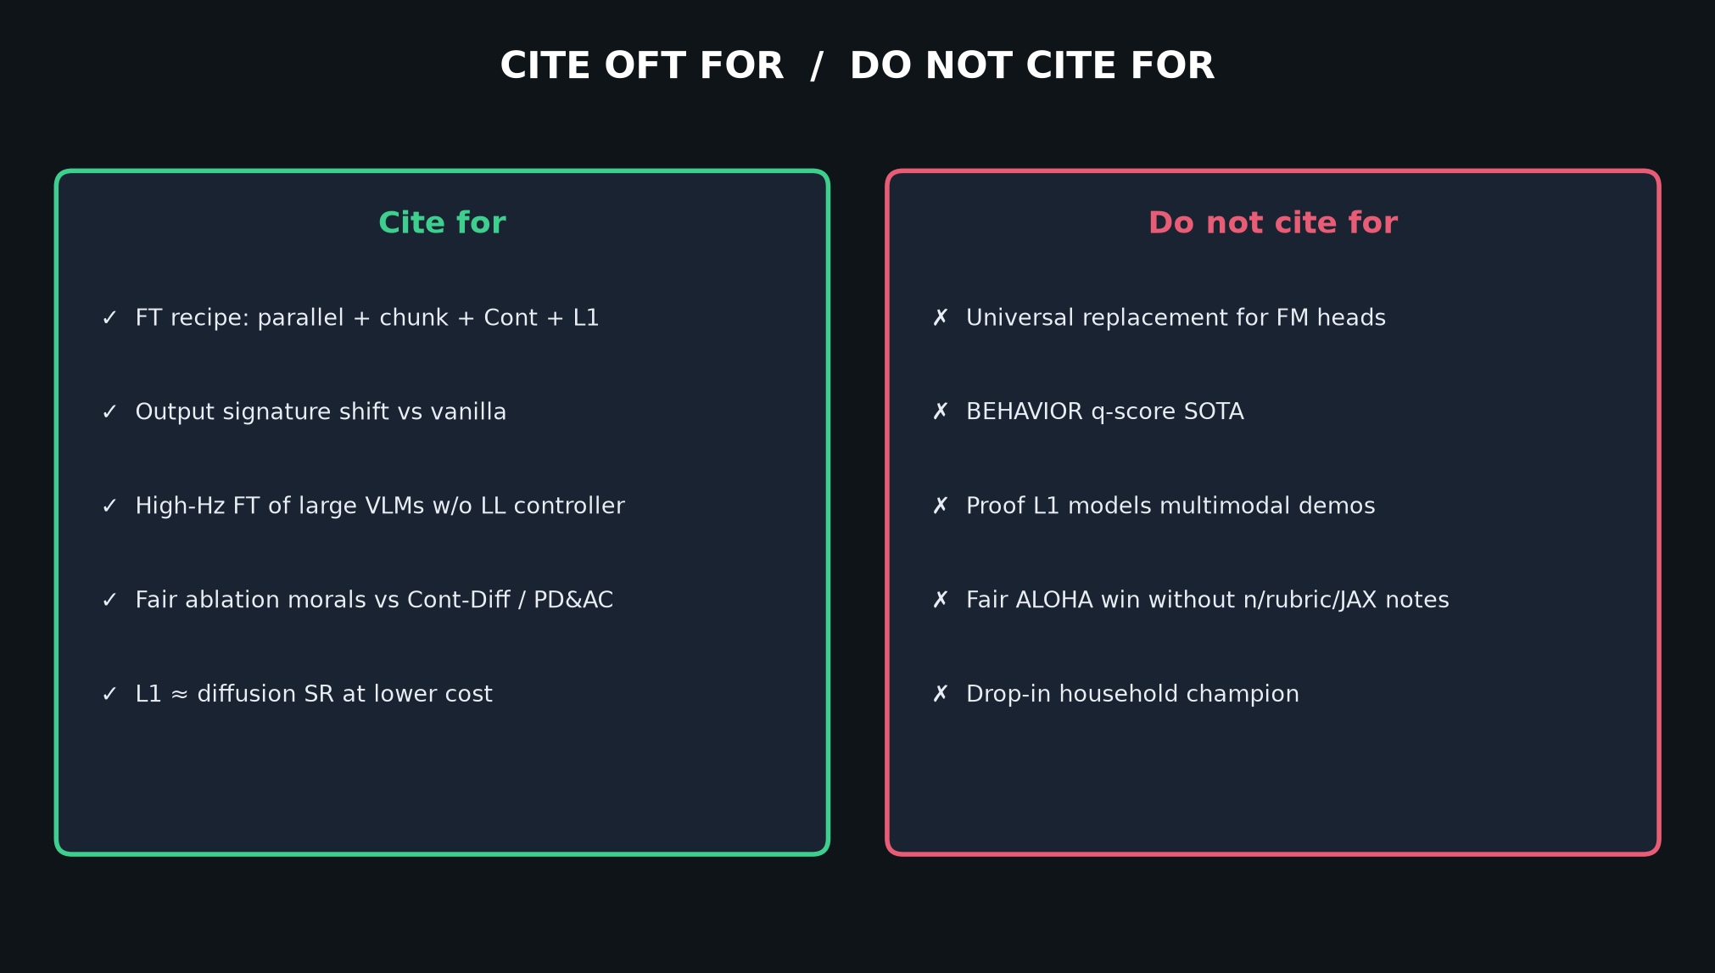
Visionary · 11+3 · 10/14
Notes:
CITE hygiene for Visionary pitches.

Slide 11
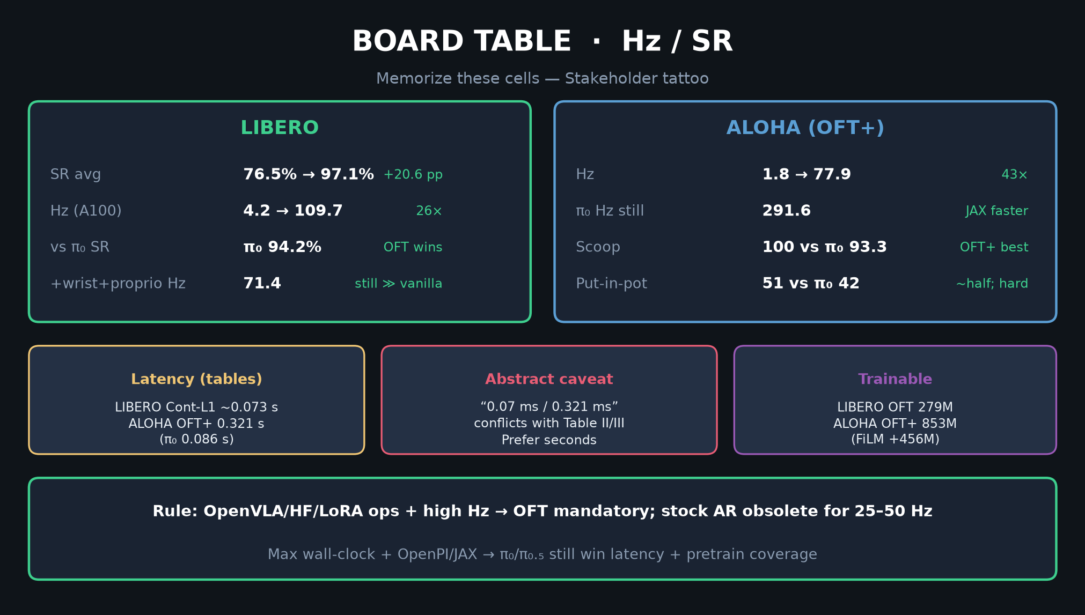
Visionary · 11+3 · 11/14
Notes:
BOARD — π₀ still 291 Hz; OFT is FT evidence not household champion.

Slide 12
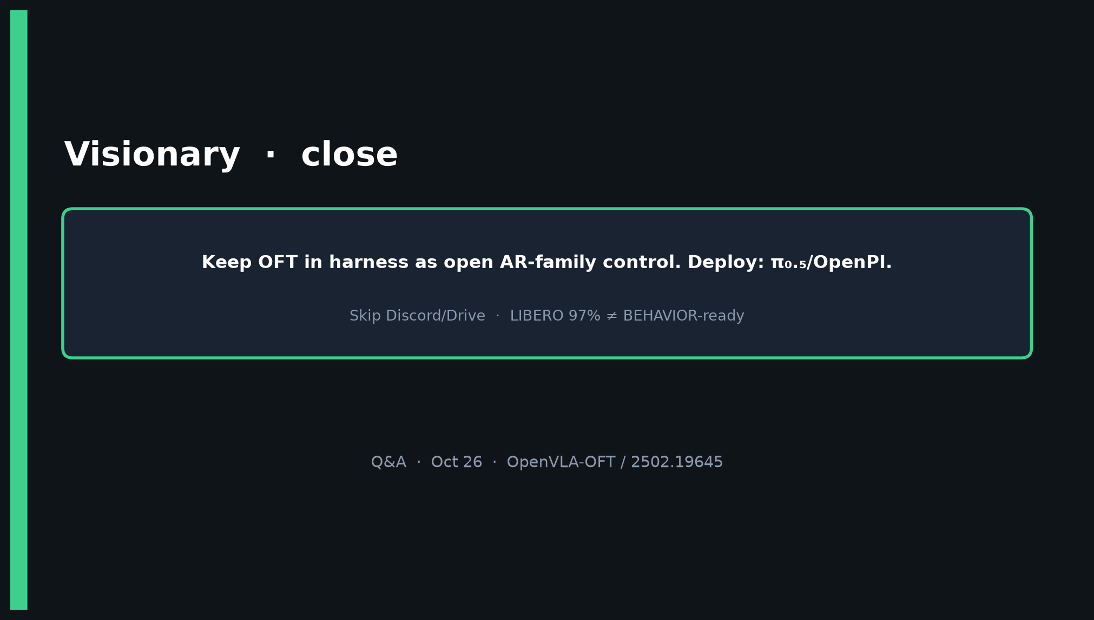
Visionary · 11+3 · 12/14
Notes:
CLOSE — harness OFT; deploy π₀.₅/OpenPI; skip Discord/Drive; 97% ≠ BEHAVIOR.

Slide 13
Visionary · 11+3 · 13/14
Notes:
BACKUP harness.

Slide 14
Visionary · 11+3 · 14/14
Notes:
BACKUP taxonomy.

