Slide 1
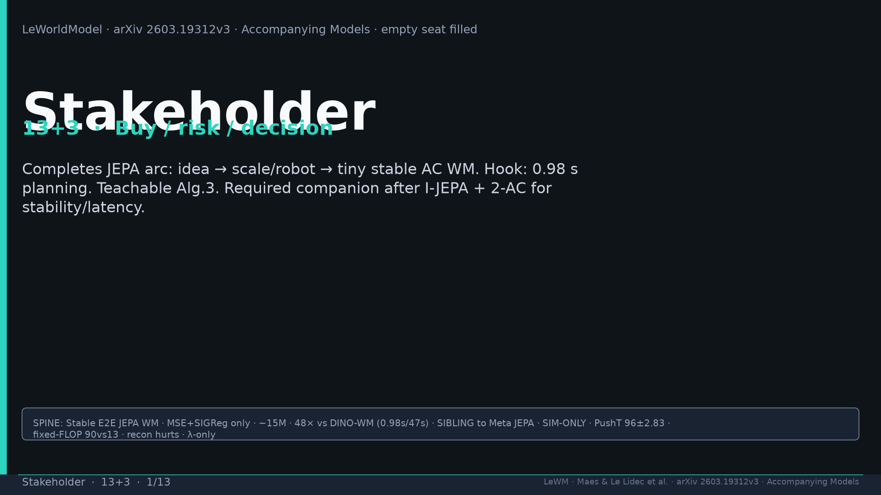
Notes:
Title. Stakeholder empty seat filled. Buy companion after I-JEPA+2-AC for stability/latency. Spine tattoo.

Slide 2
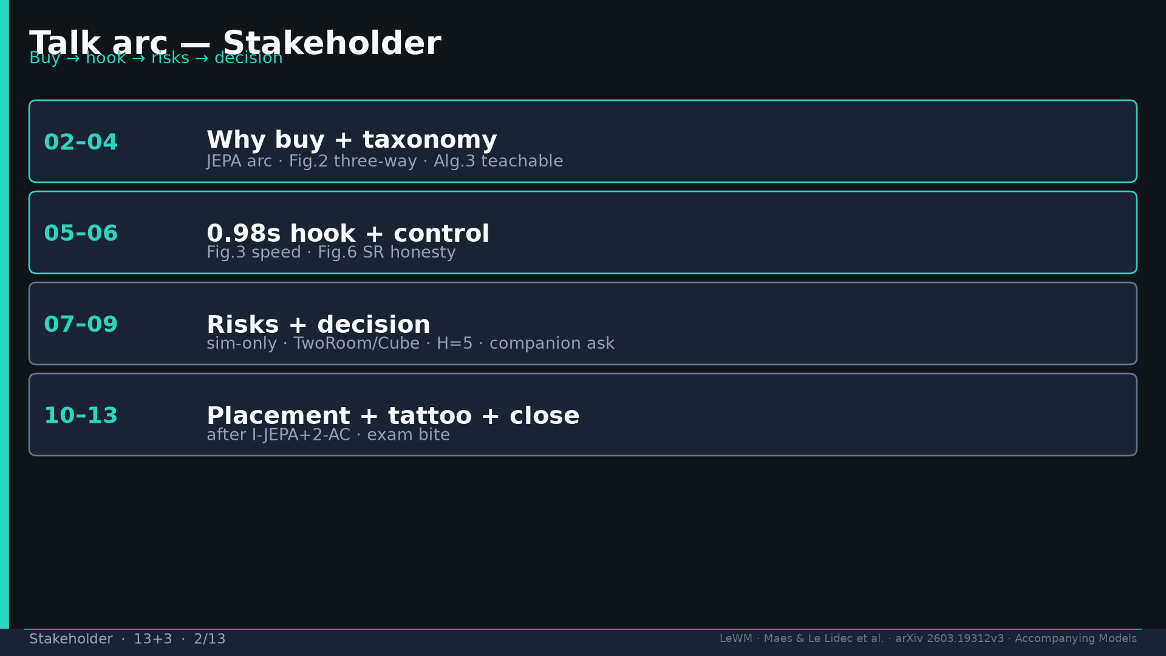
Notes:
Arc: buy → taxonomy → 0.98s hook → risks → decision → placement → exam.

Slide 3
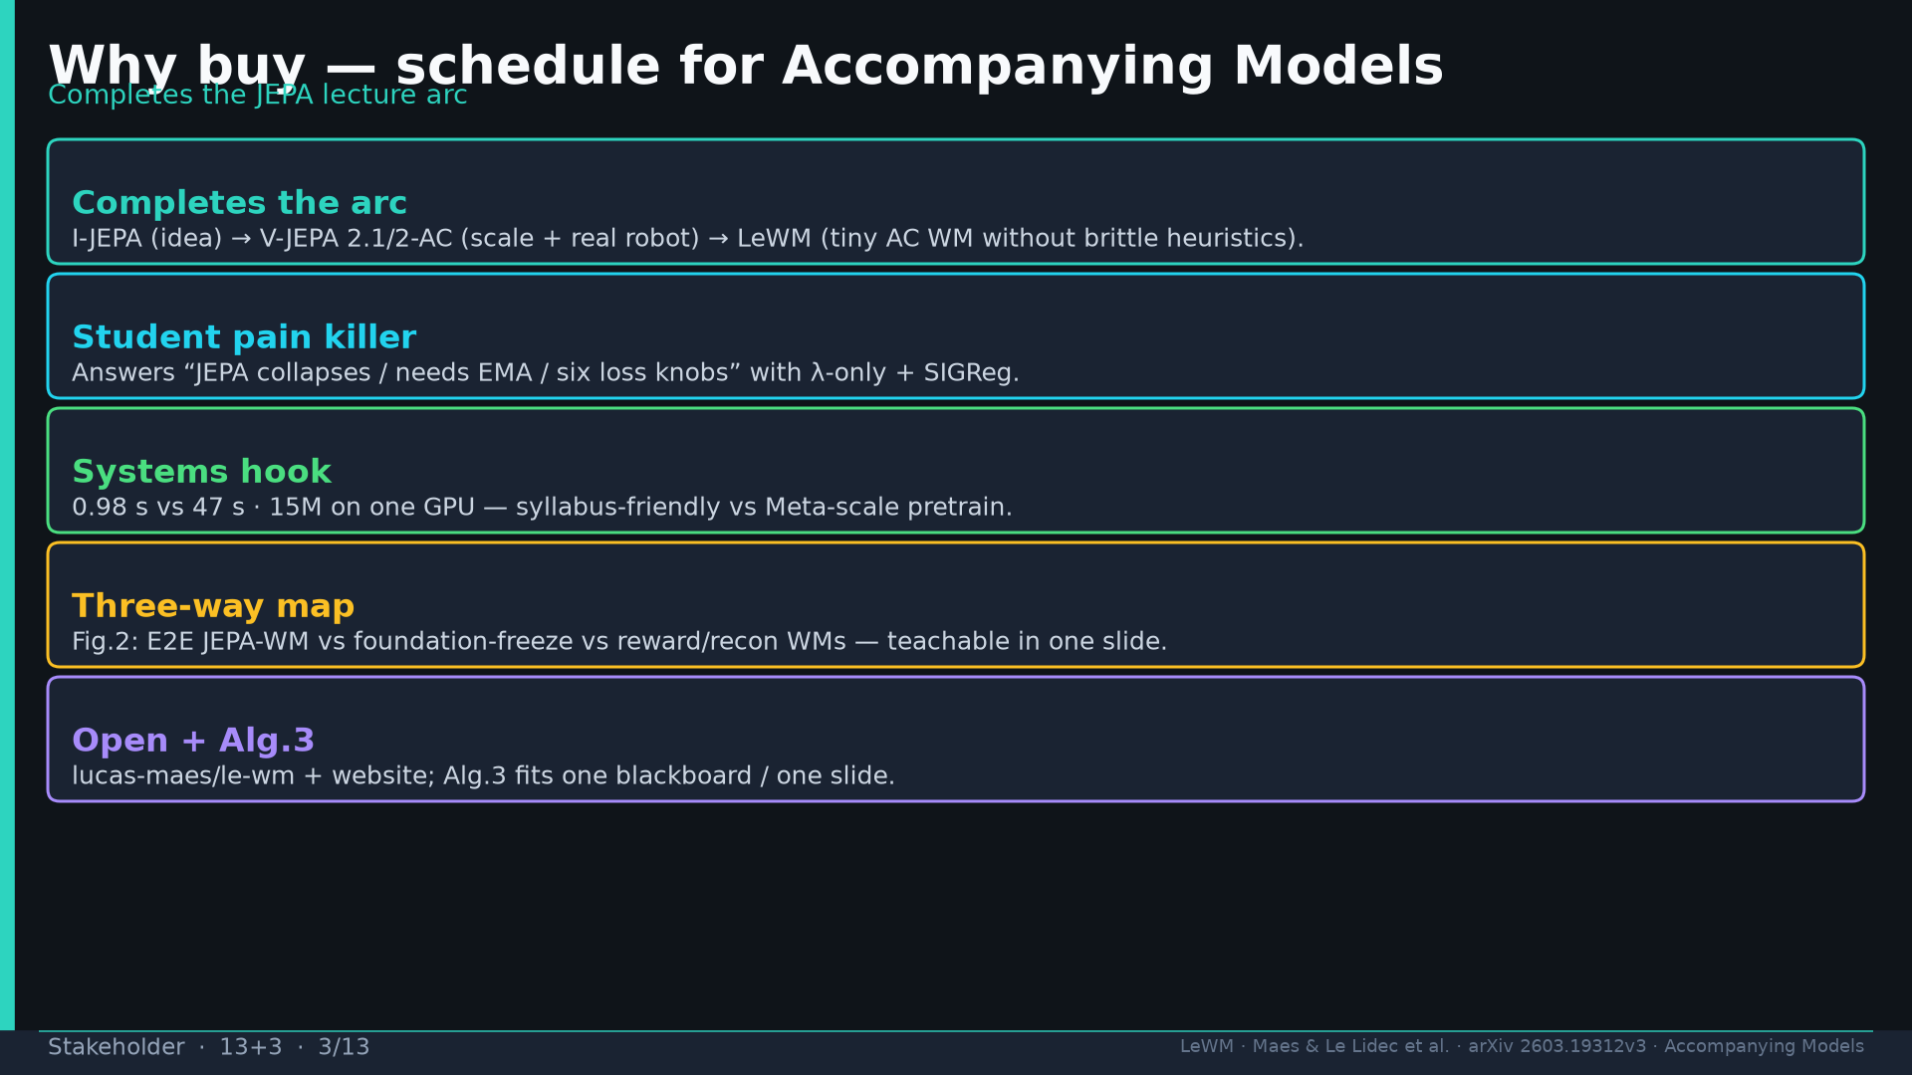
Notes:
Five buy reasons: completes JEPA arc; student pain killer; 0.98s systems hook; Fig.2 map; open Alg.3.

Slide 4
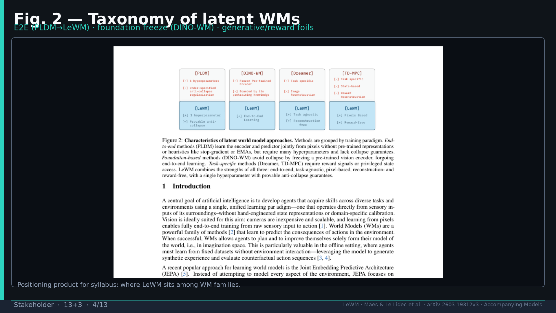
Notes:
Fig.2 taxonomy — E2E vs foundation-freeze vs generative/reward. Teach the three families.

Slide 5
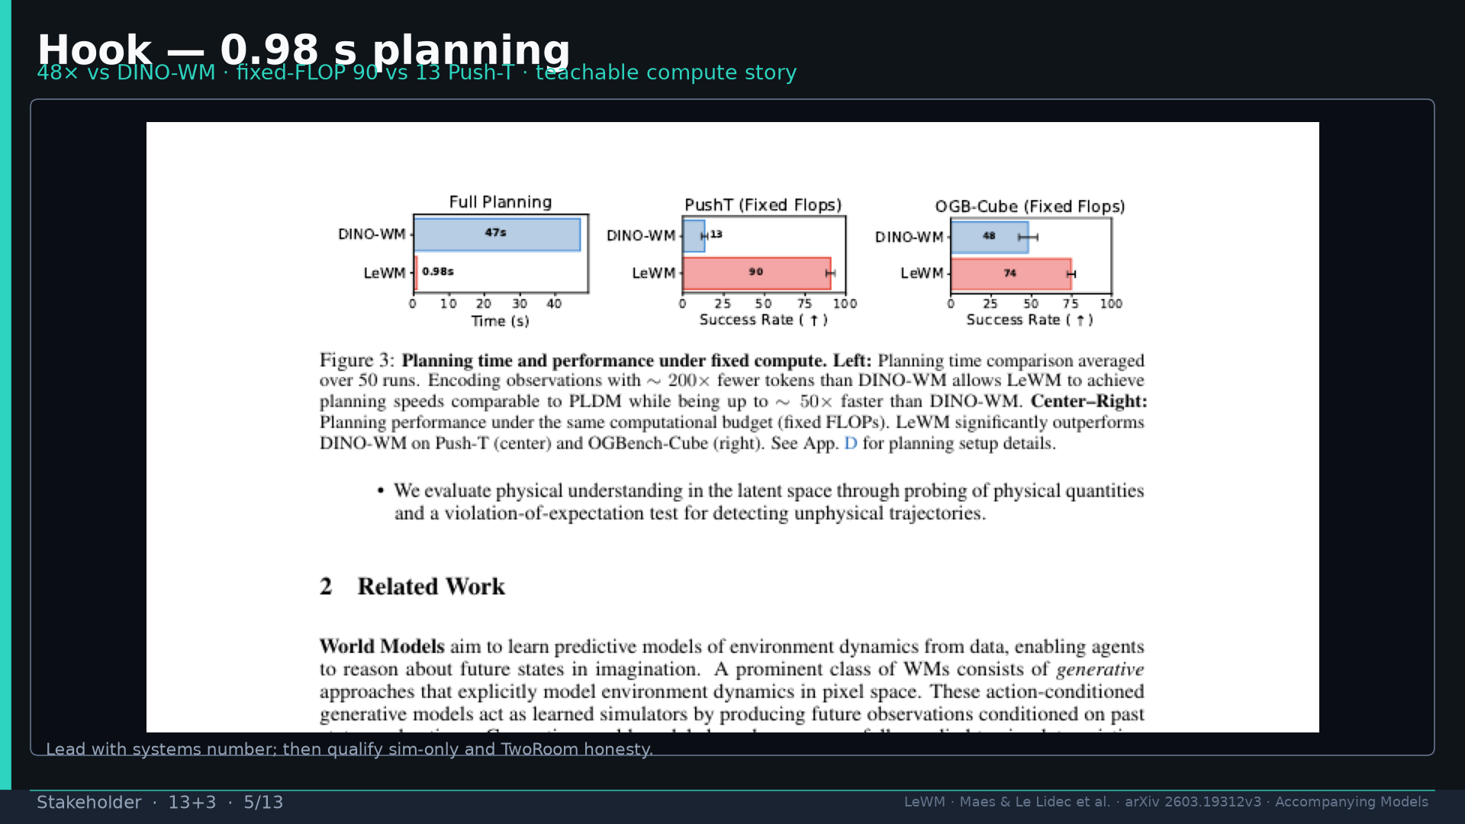
Notes:
Fig.3 hook: 0.98s vs 47s; fixed-FLOP 90 vs 13. Lead systems, then qualify sim-only.

Slide 6
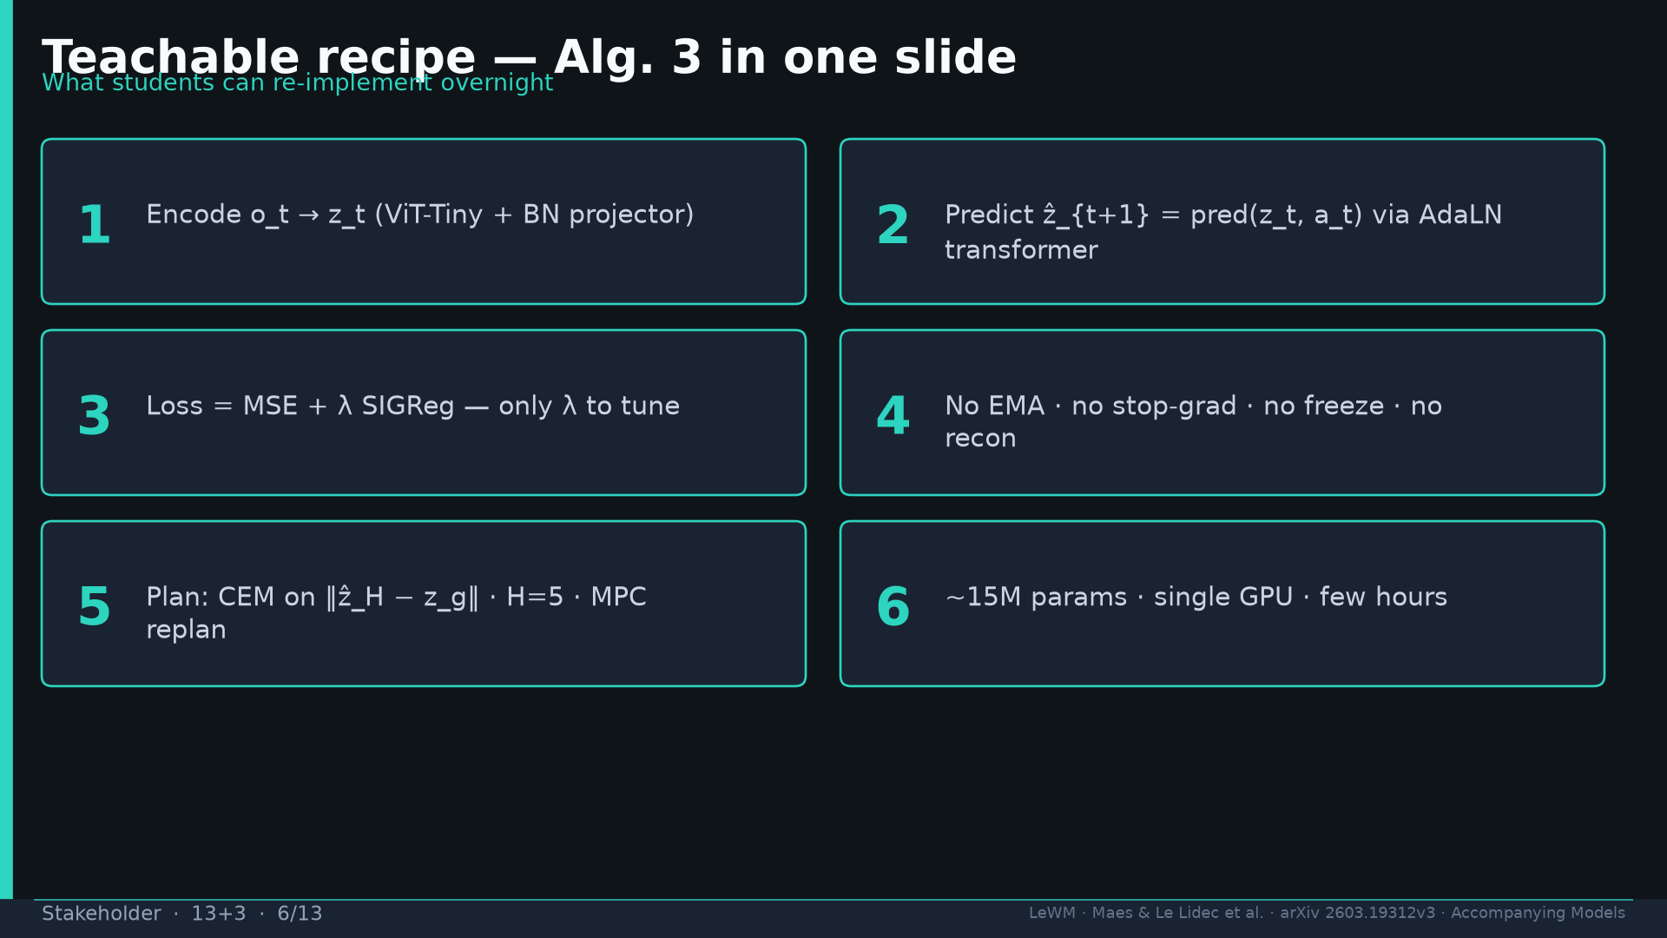
Notes:
Alg.3 teachable: encode → predict AdaLN → MSE+λ SIGReg → no EMA/SG → CEM H=5 → 15M.

Slide 7
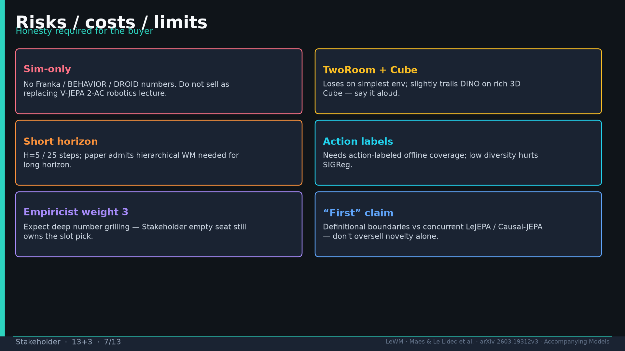
Notes:
Risks: sim-only; TwoRoom/Cube; short H=5; action labels; Empiricist weight 3; “first” boundaries.

Slide 8
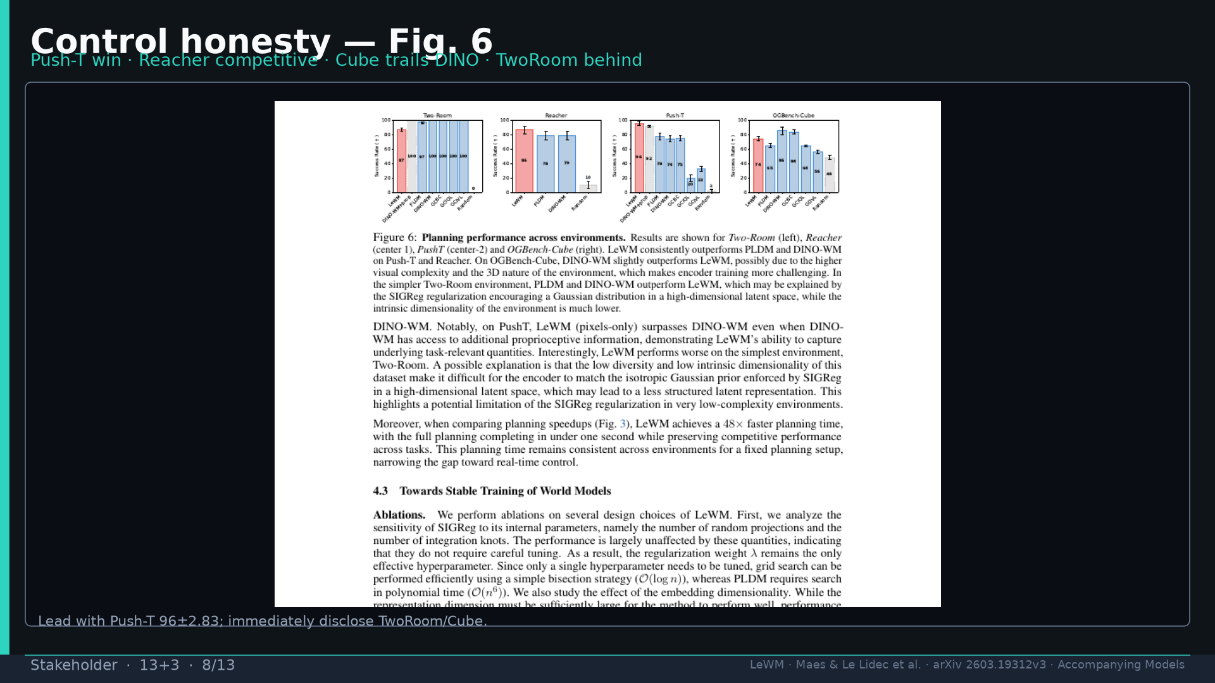
Notes:
Fig.6 honesty: Push-T win; disclose TwoRoom behind and Cube trails DINO.

Slide 9
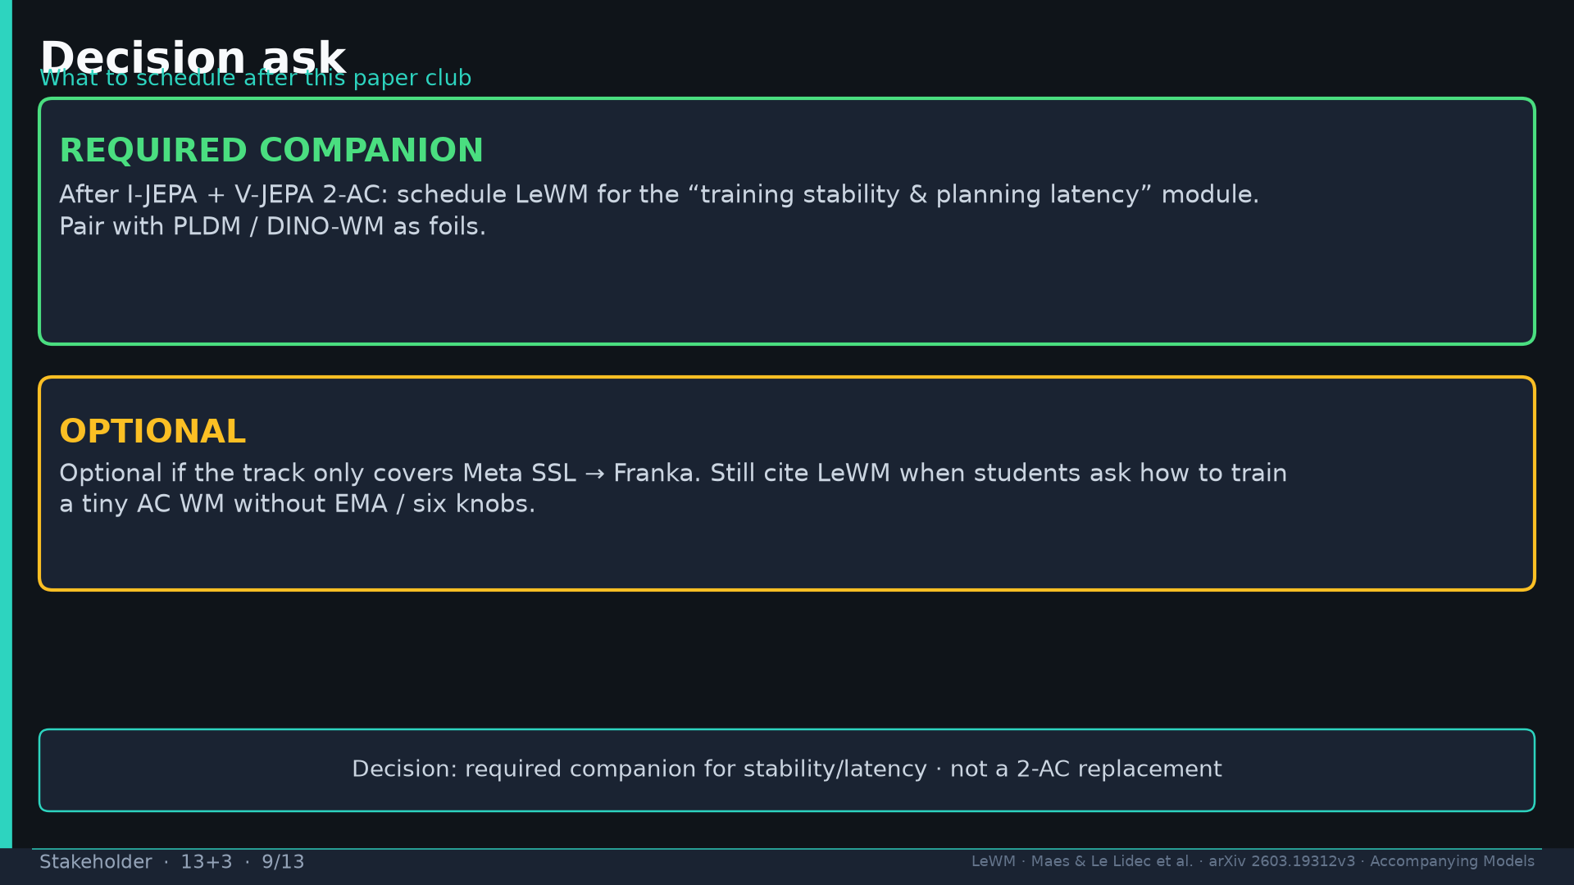
Notes:
Decision: REQUIRED companion for stability/latency after I-JEPA+2-AC; OPTIONAL if Meta-only track.

Slide 10
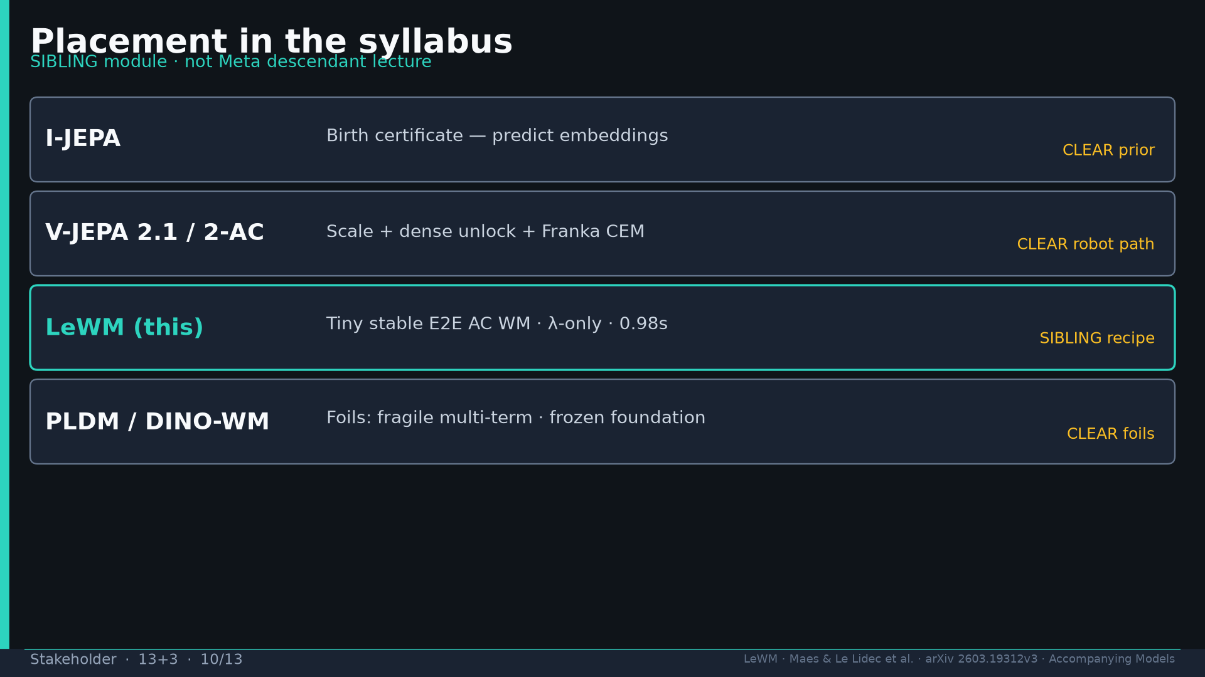
Notes:
Syllabus placement: SIBLING module to Meta chain — not descendant lecture.

Slide 11
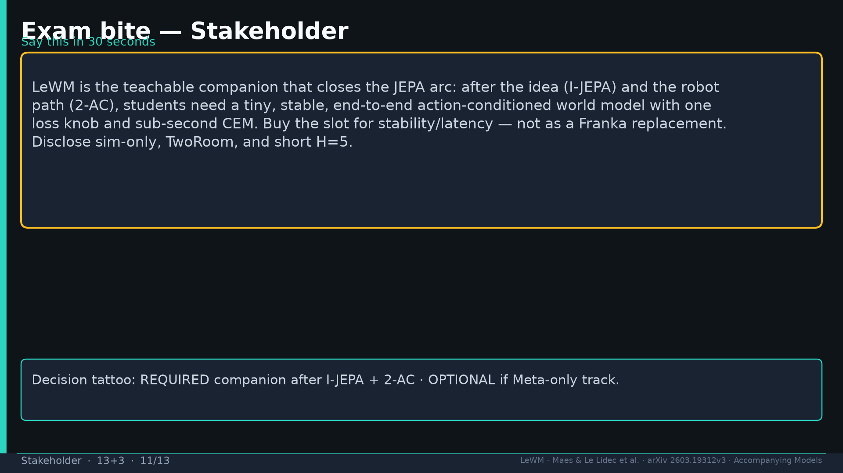
Notes:
Exam bite: teachable companion closes JEPA arc; disclose sim-only/TwoRoom/H=5.

Slide 12
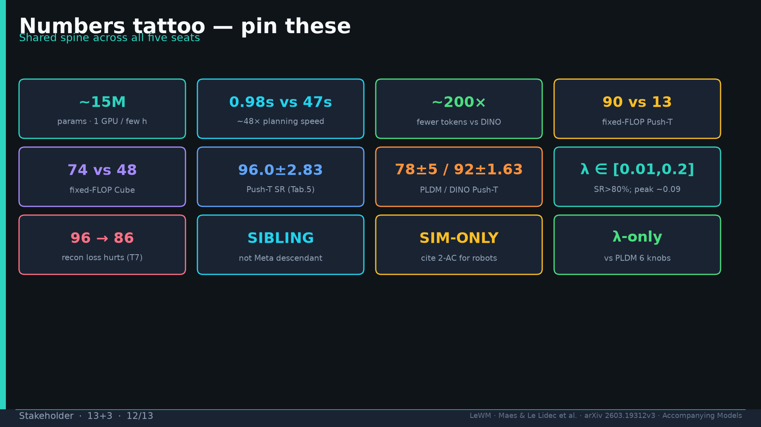
Notes:
Shared numbers tattoo.

Slide 13
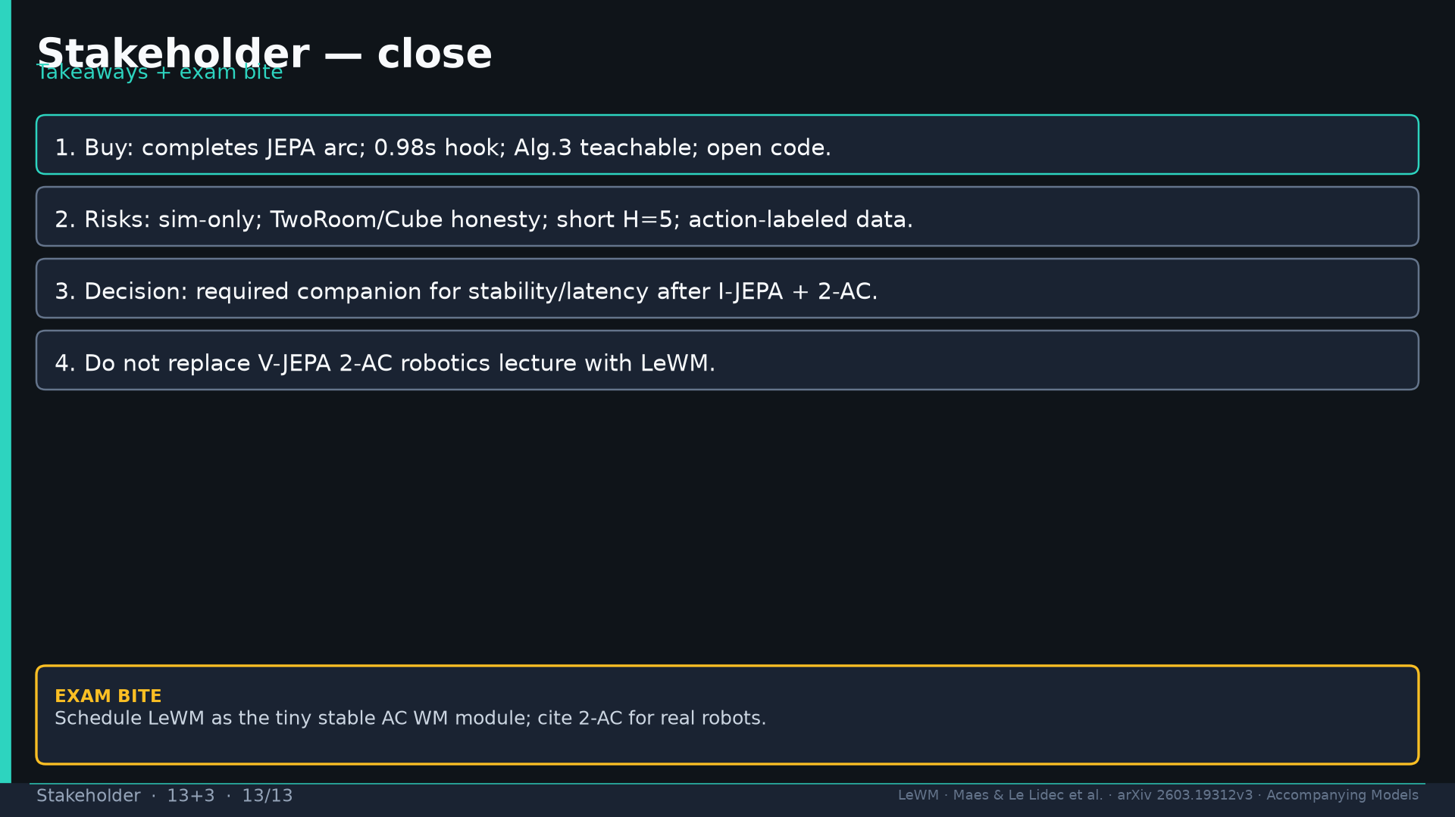
Notes:
Close four takeaways. Do not replace 2-AC robotics lecture.

