Slide 1
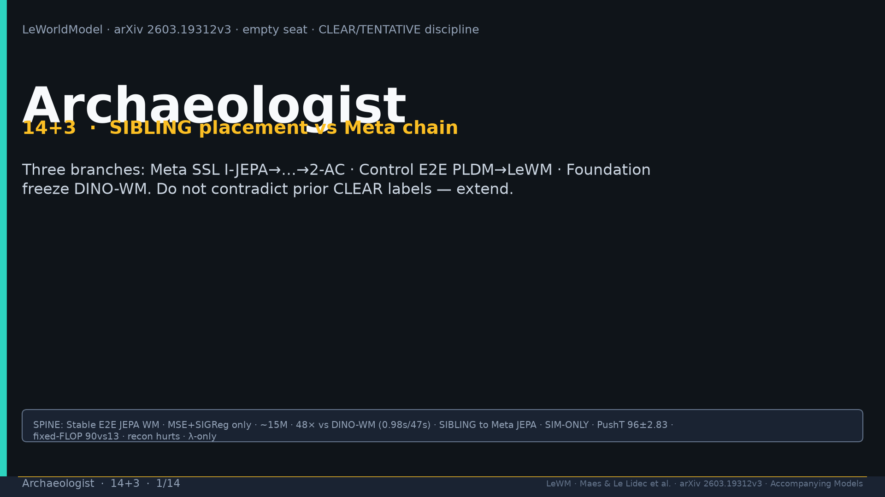
Notes:
Title. SIBLING placement. CLEAR/TENTATIVE discipline. Do not contradict prior packs.

Slide 2
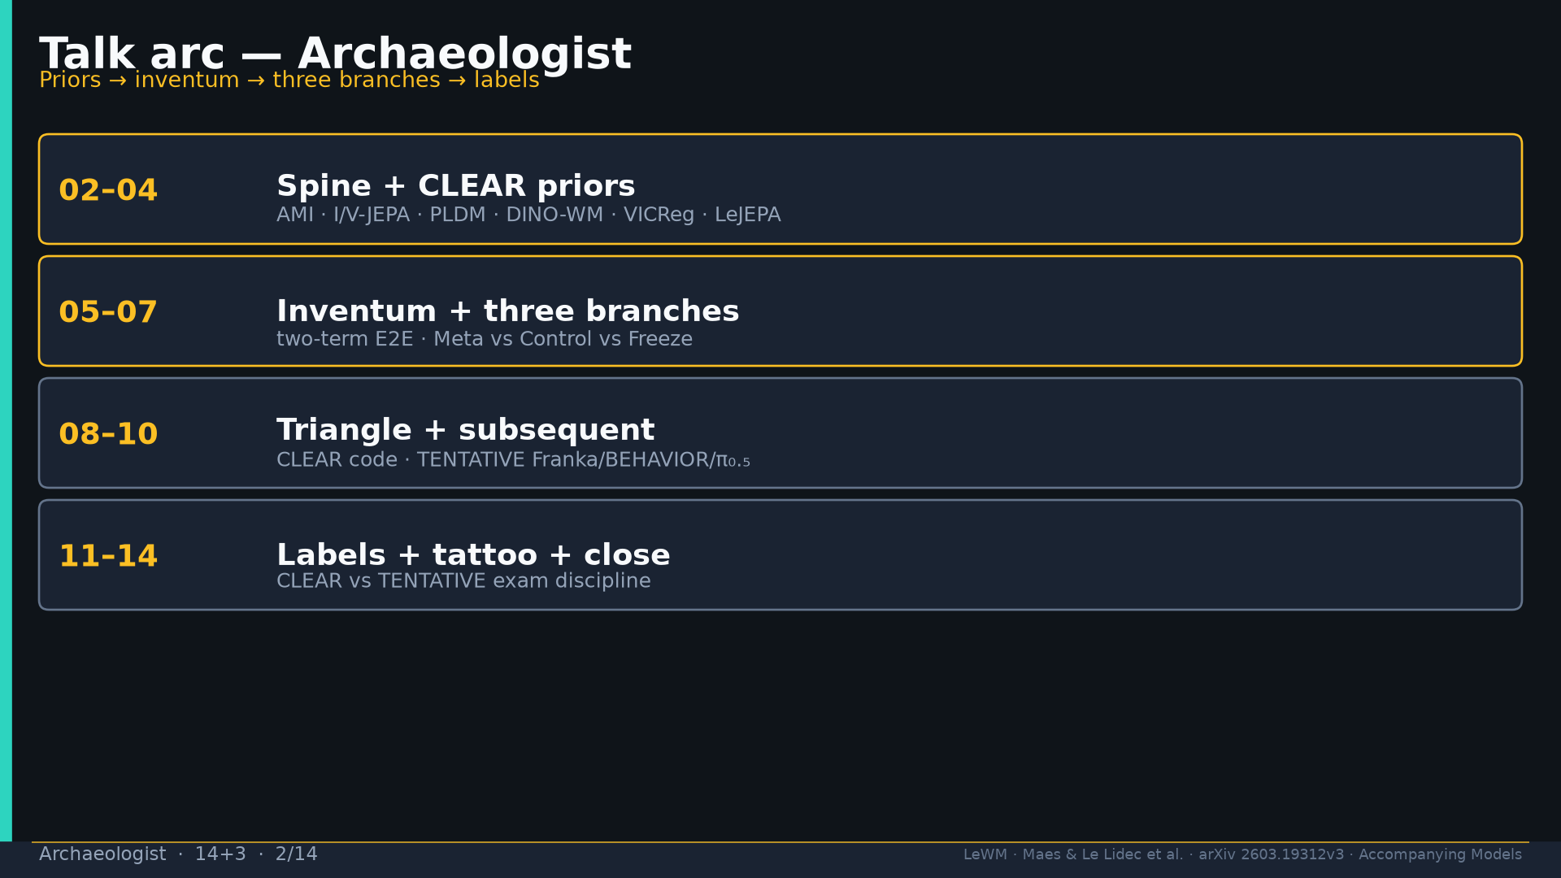
Notes:
Arc: priors → inventum → three branches → triangle → subsequent → labels.

Slide 3
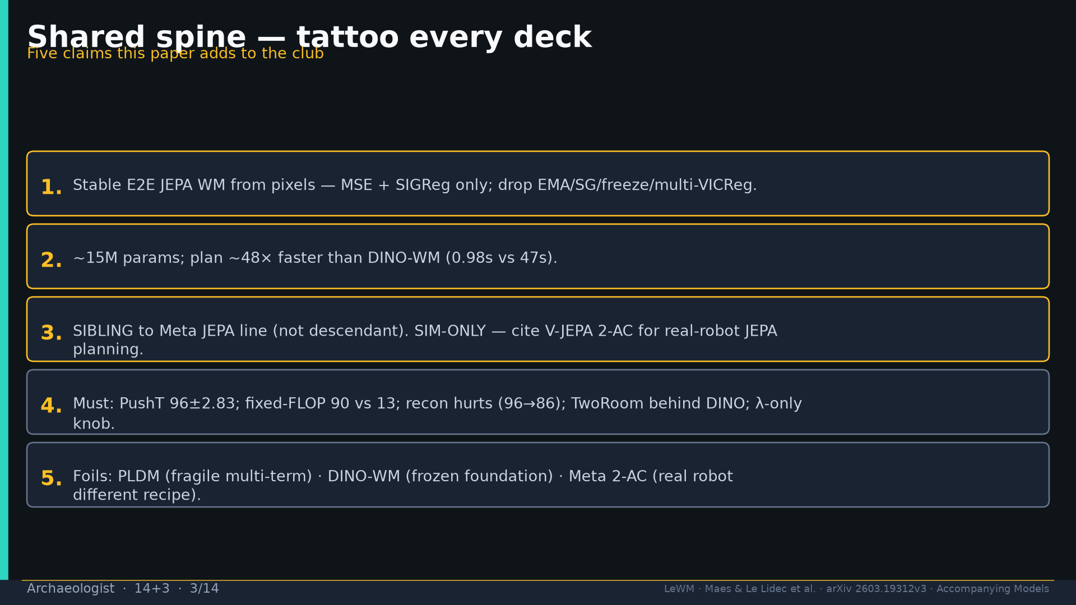
Notes:
Shared spine five claims — tattoo every deck.

Slide 4
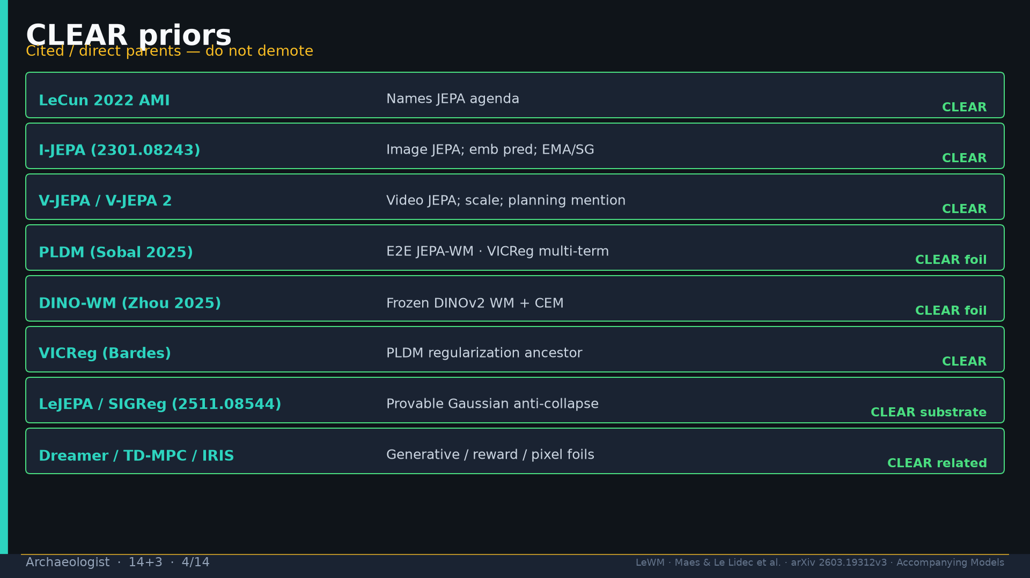
Notes:
CLEAR priors table: AMI, I/V-JEPA, PLDM, DINO-WM, VICReg, LeJEPA/SIGReg, Dreamer foils.

Slide 5
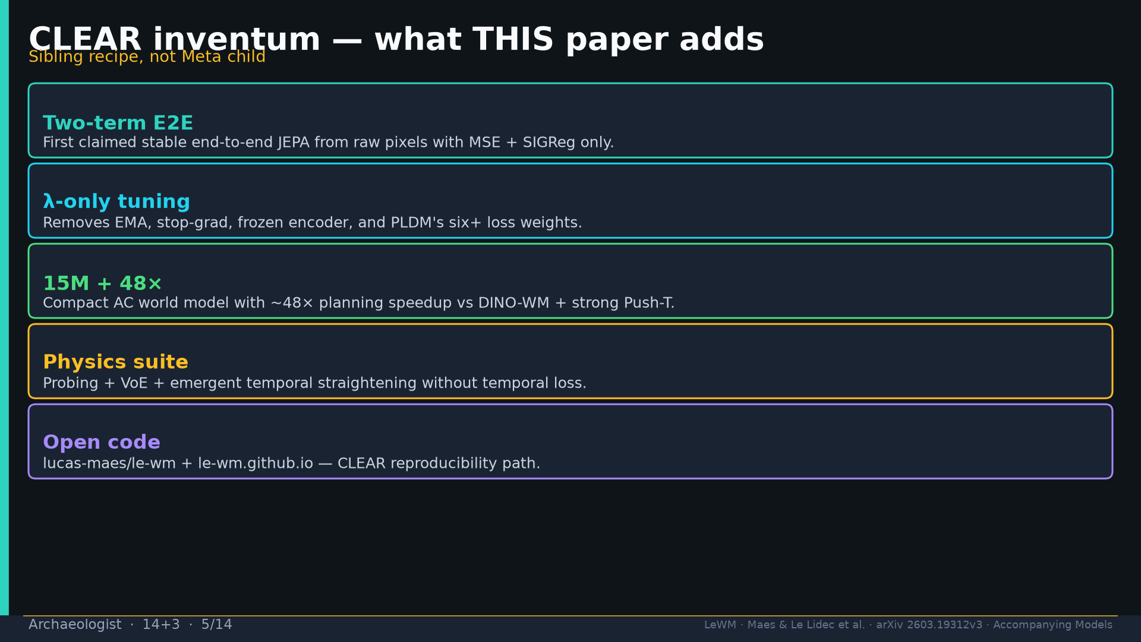
Notes:
Inventum CLEAR: two-term E2E; λ-only; 15M+48×; physics suite; open code.

Slide 6
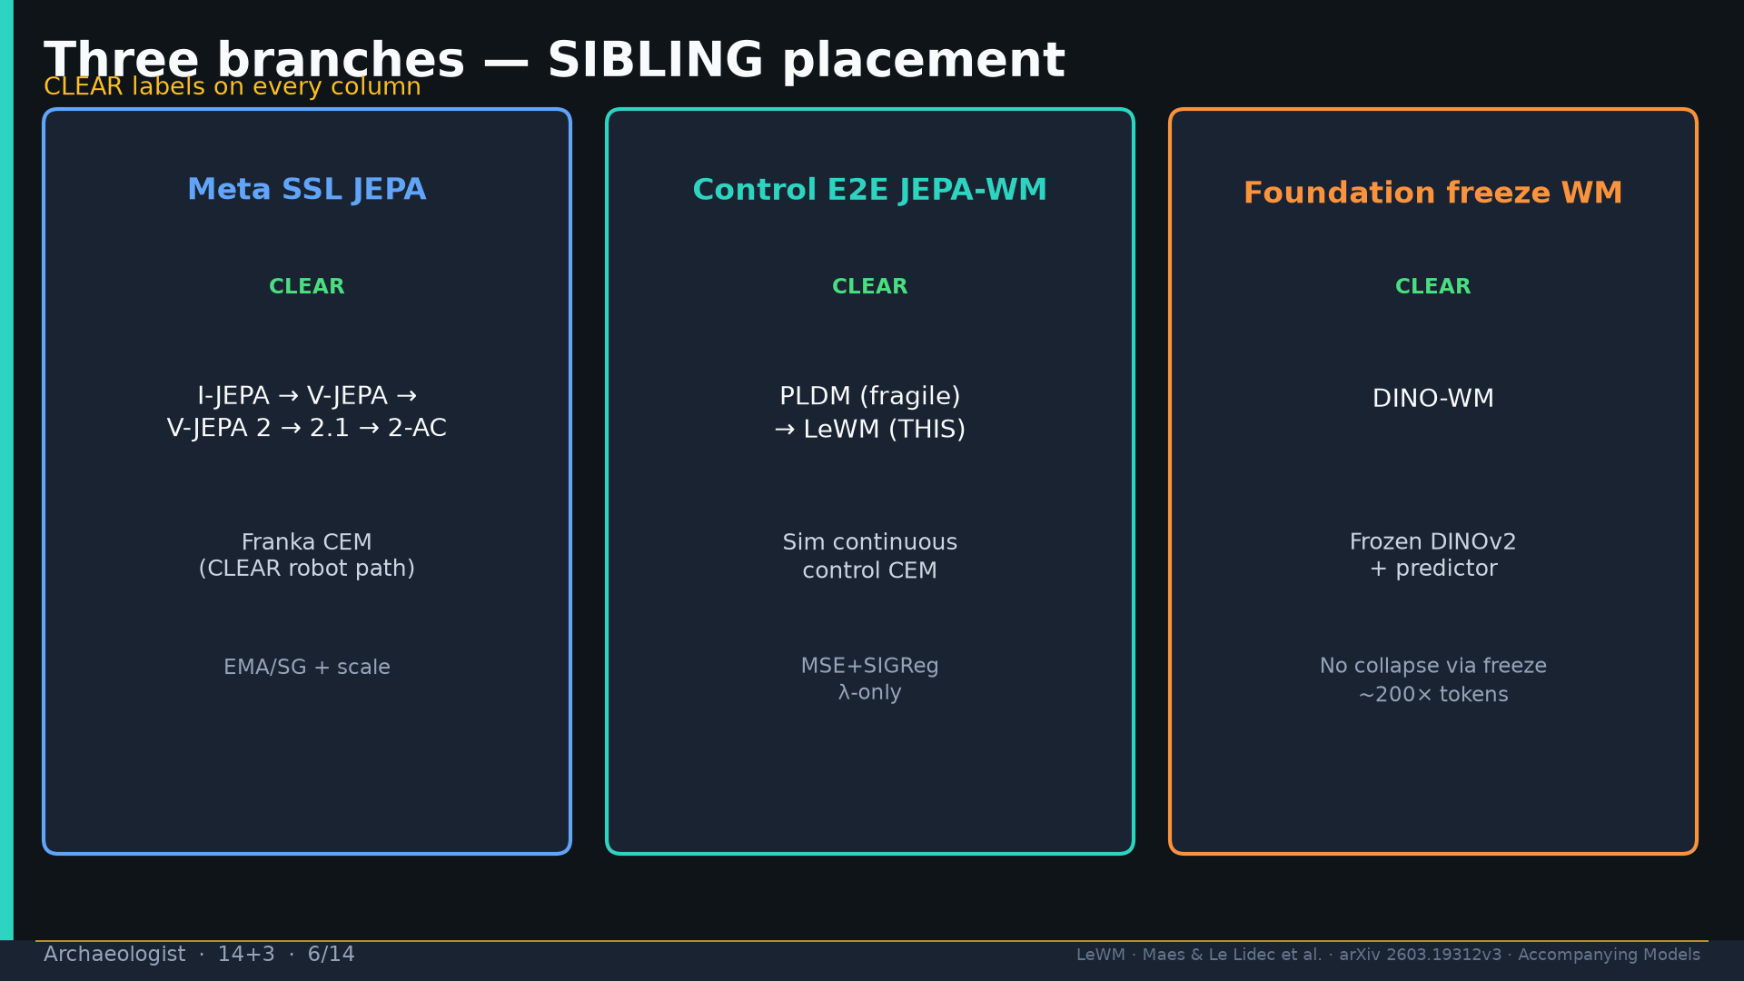
Notes:
Three branches CLEAR: Meta SSL →2-AC | Control E2E PLDM→LeWM | Foundation freeze DINO-WM.

Slide 7
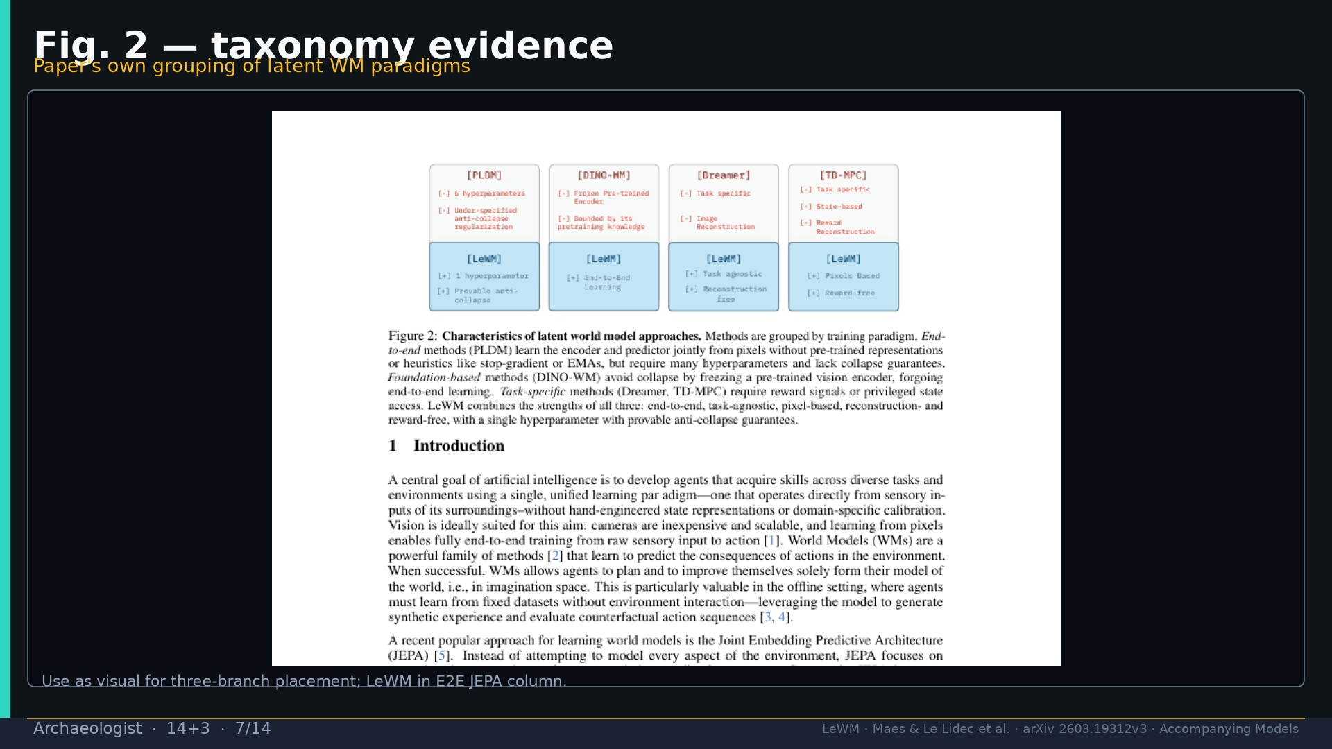
Notes:
Fig.2 taxonomy evidence for branch placement.

Slide 8
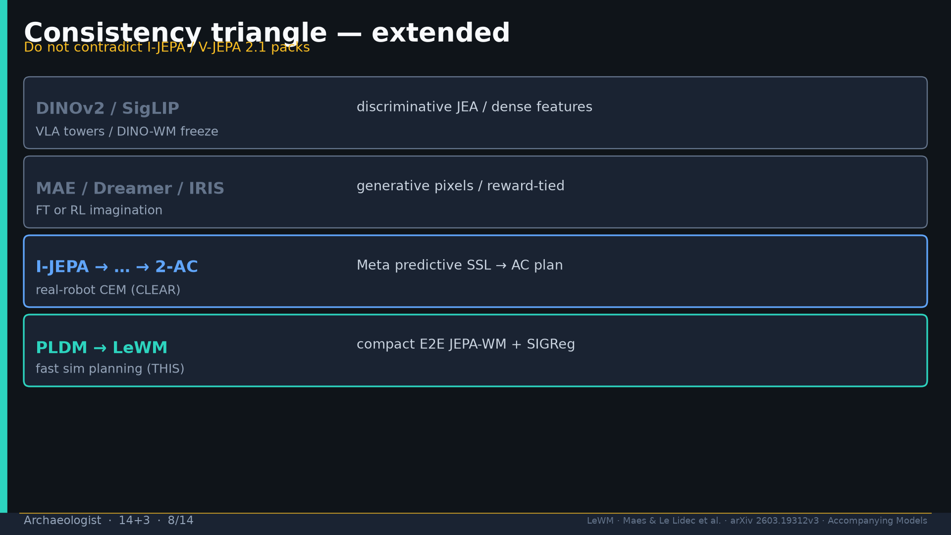
Notes:
Consistency triangle extended — PLDM→LeWM branch added; Meta axis unchanged.

Slide 9
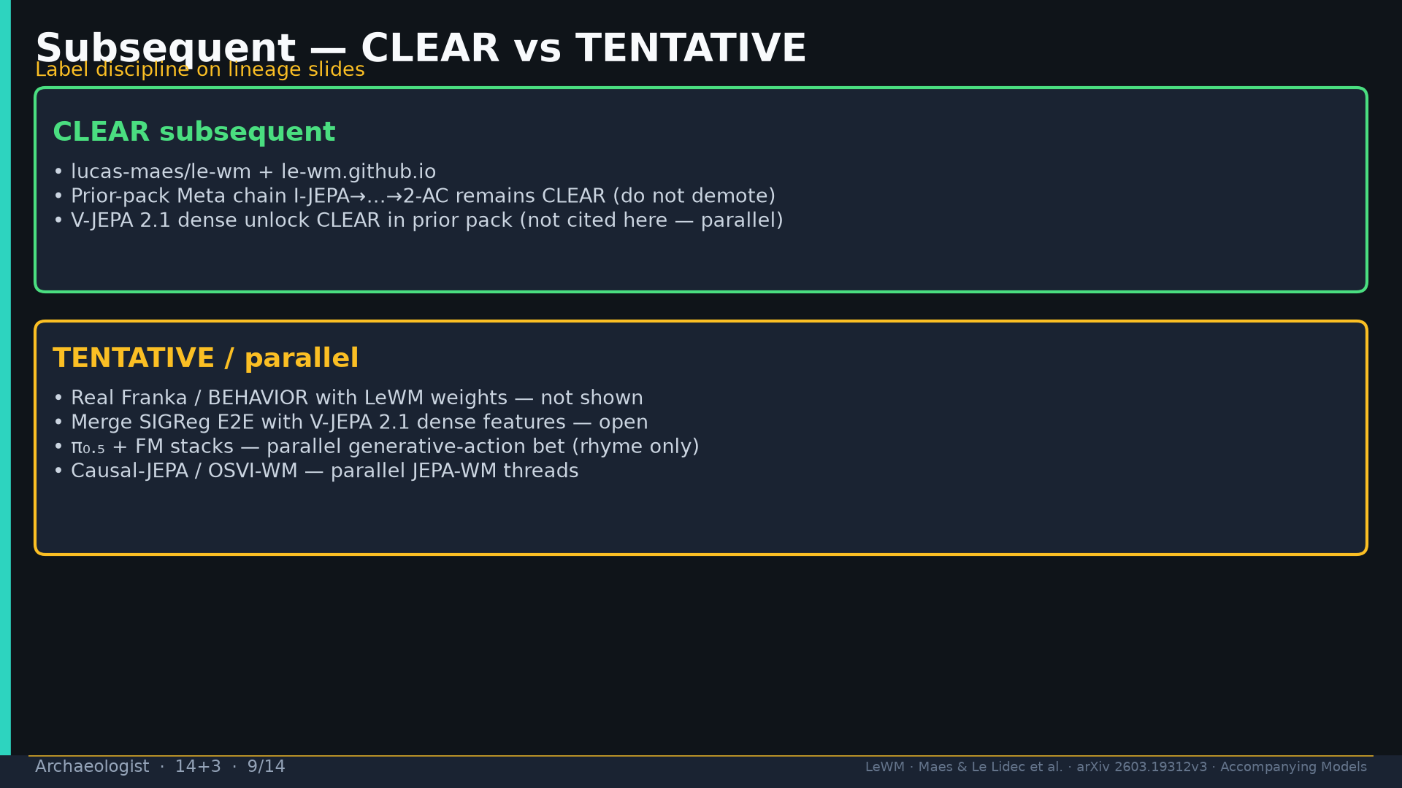
Notes:
Subsequent CLEAR code+Meta chain; TENTATIVE Franka/BEHAVIOR/2.1 merge/π₀.₅ rhyme.

Slide 10
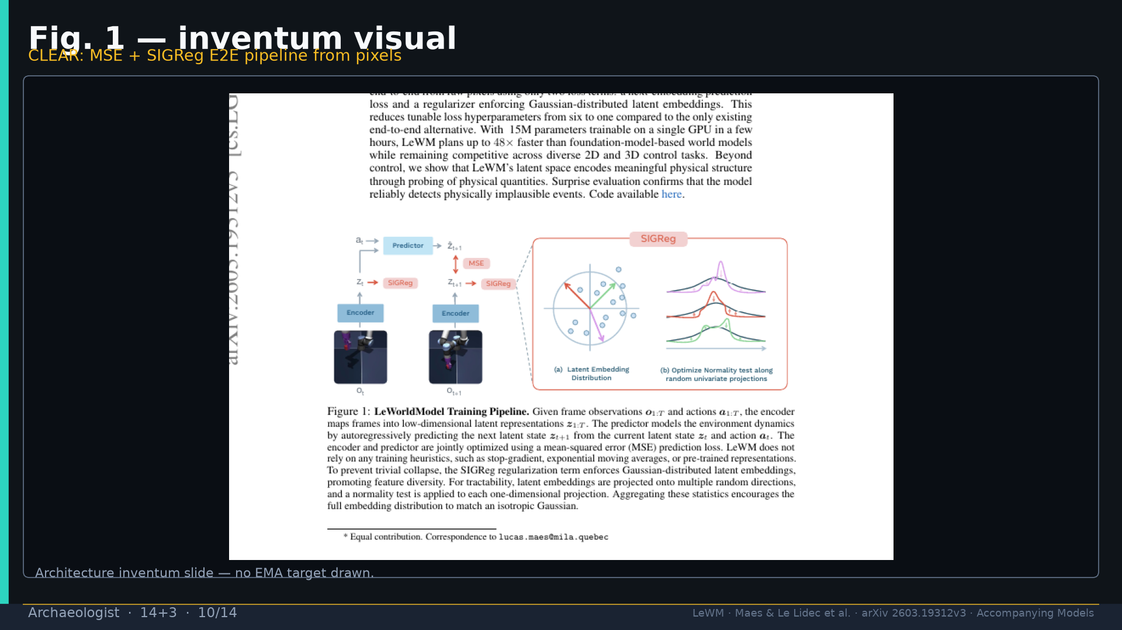
Notes:
Fig.1 inventum visual — no EMA drawn.

Slide 11
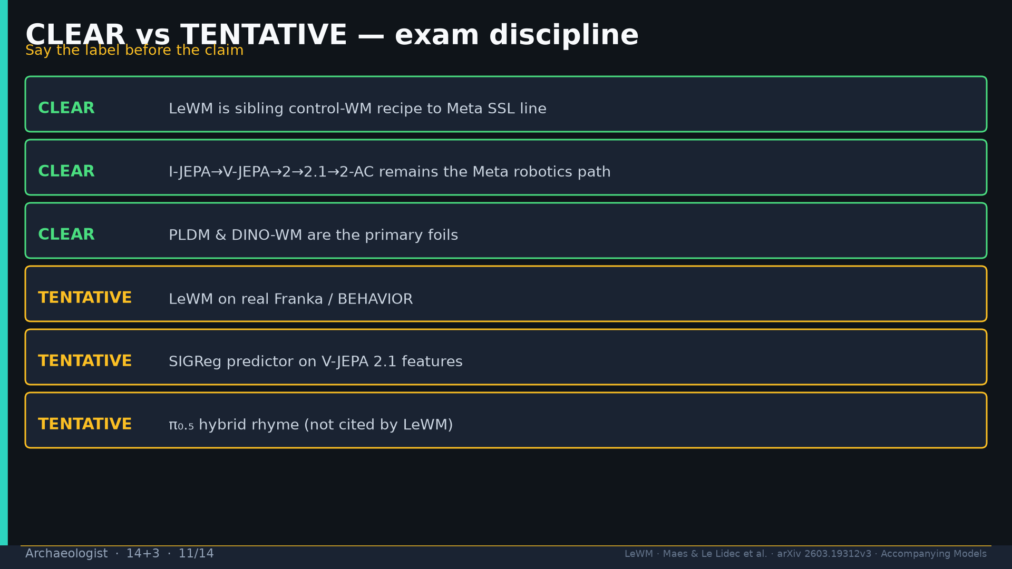
Notes:
CLEAR vs TENTATIVE exam discipline — say label before claim.

Slide 12
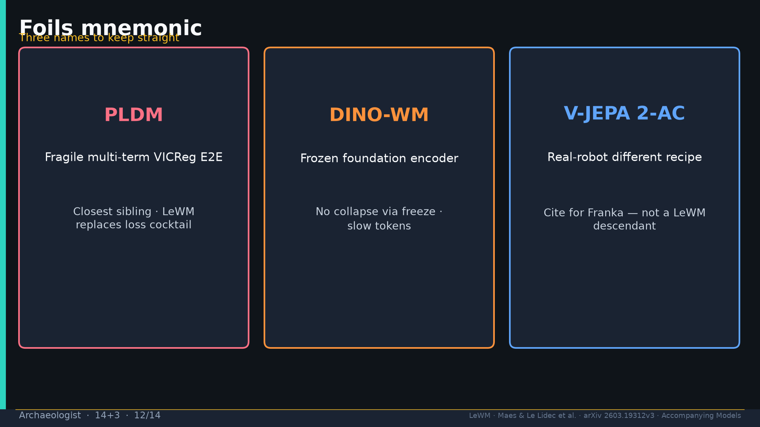
Notes:
Foils mnemonic: PLDM · DINO-WM · V-JEPA 2-AC.

Slide 13
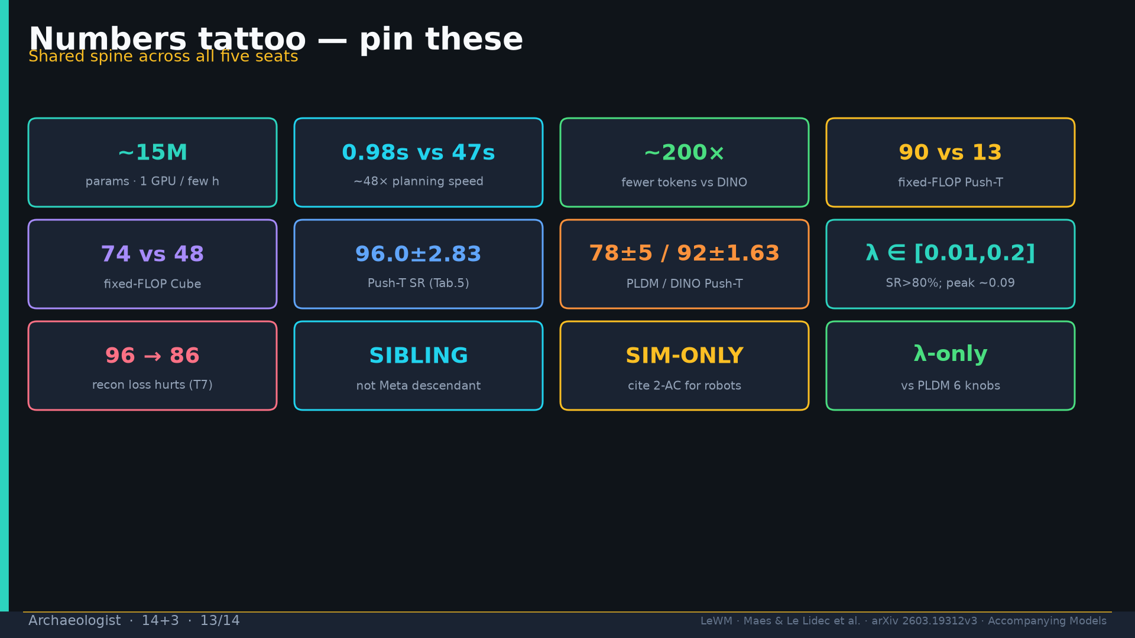
Notes:
Tattoo.

Slide 14
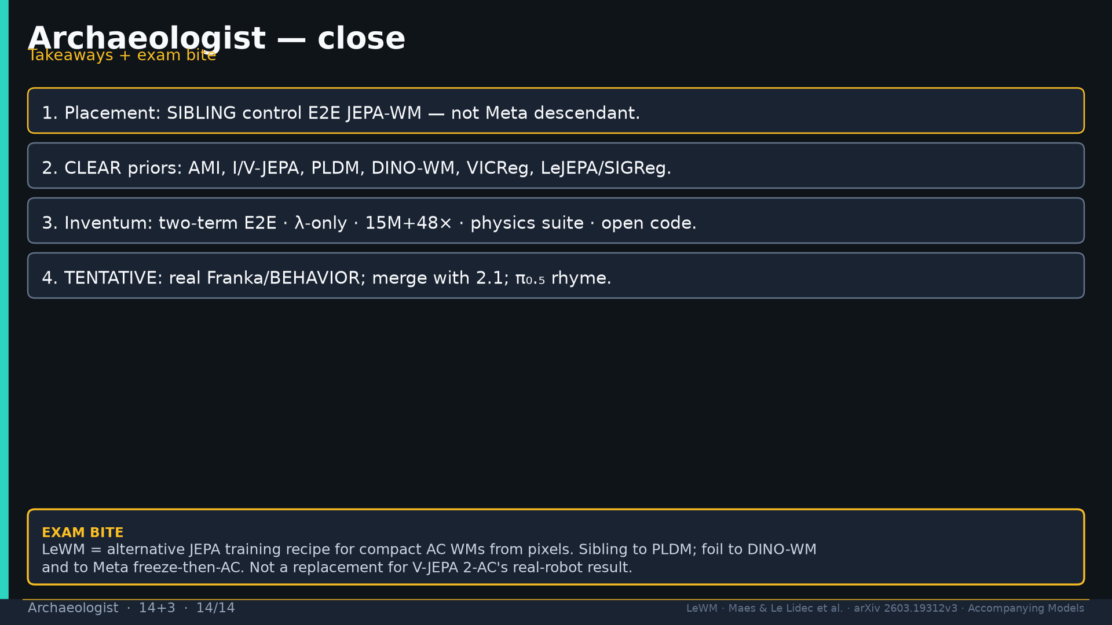
Notes:
Close + exam: sibling recipe; not 2-AC replacement.

