Slide 1
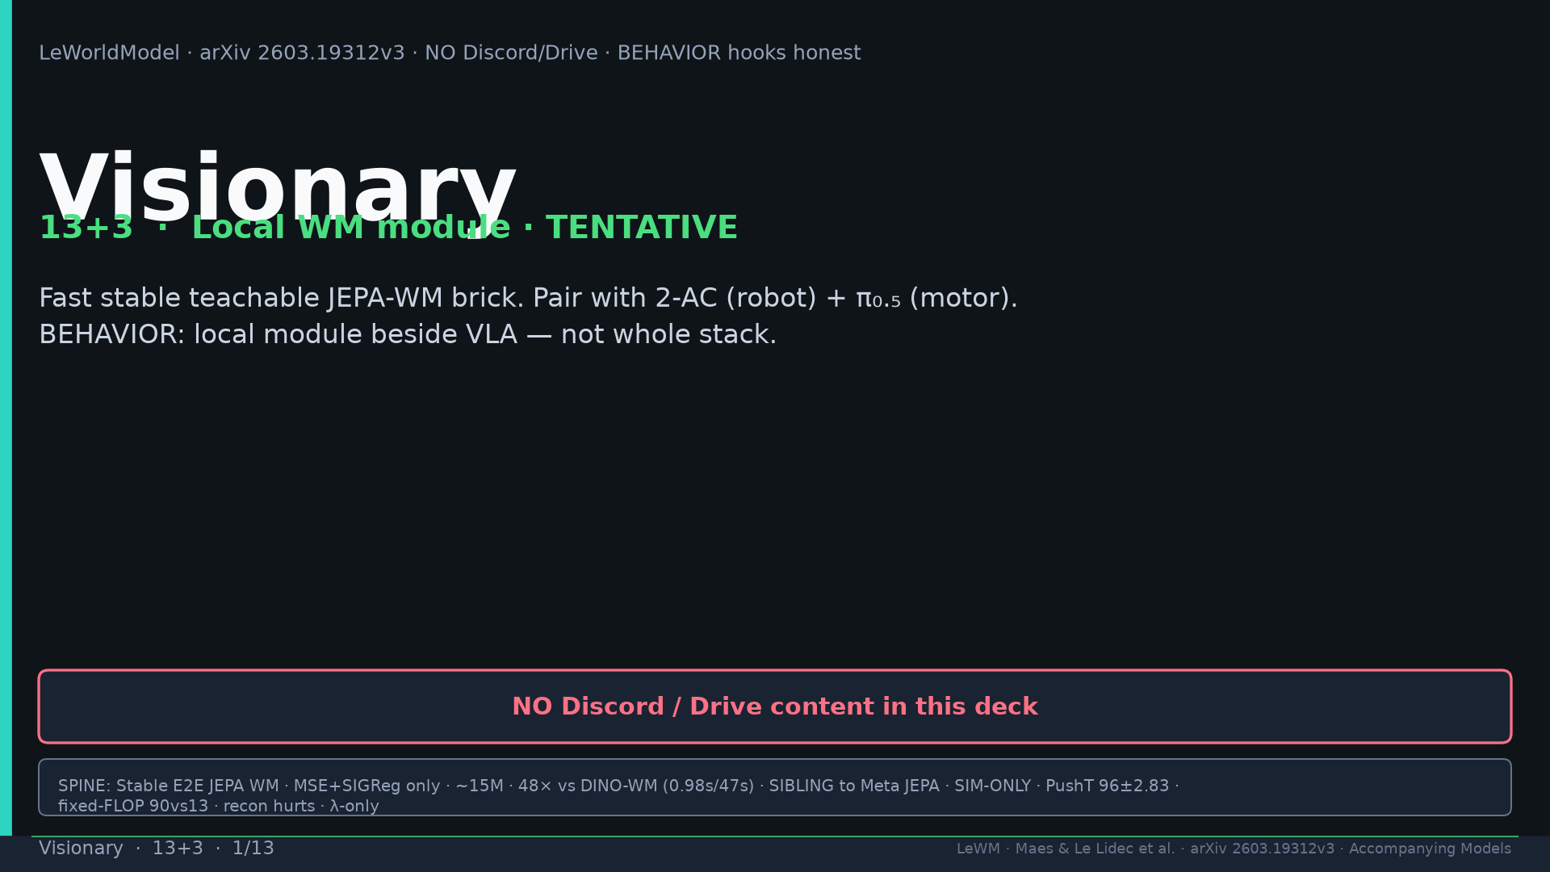
Notes:
Title. NO Discord/Drive. Local WM module TENTATIVE. Pair with 2-AC + π₀.₅.

Slide 2
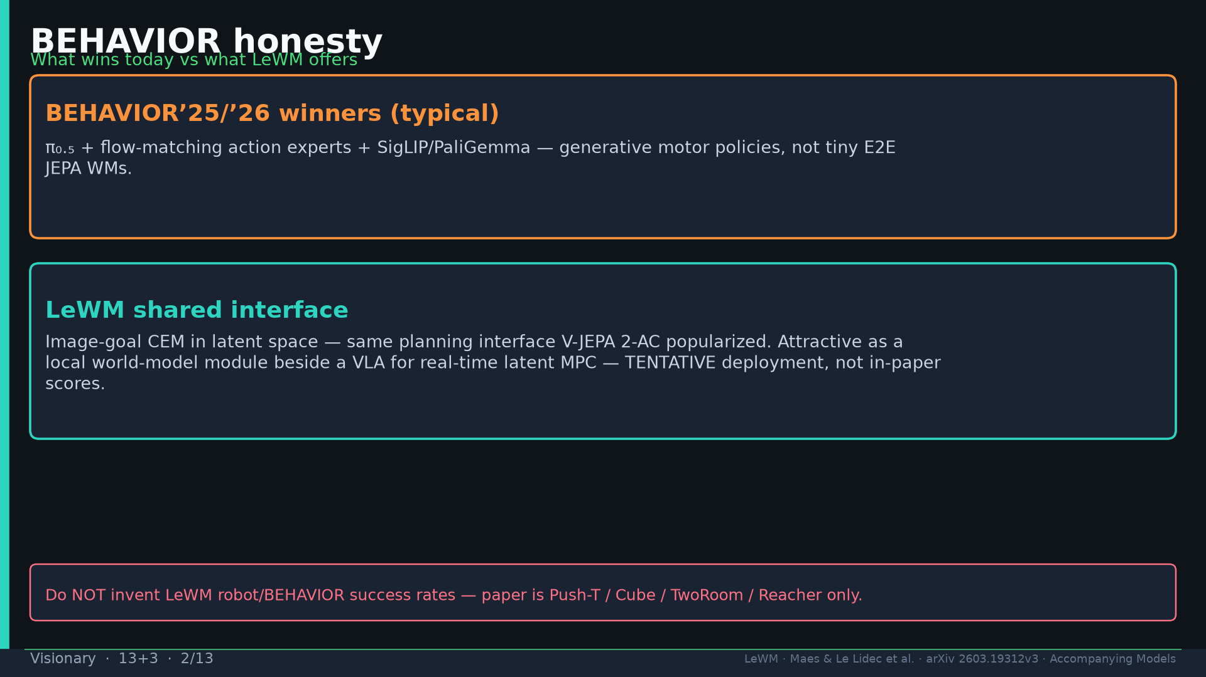
Notes:
BEHAVIOR honesty: winners = π₀.₅+FM+SigLIP; LeWM = shared CEM interface as local module.

Slide 3
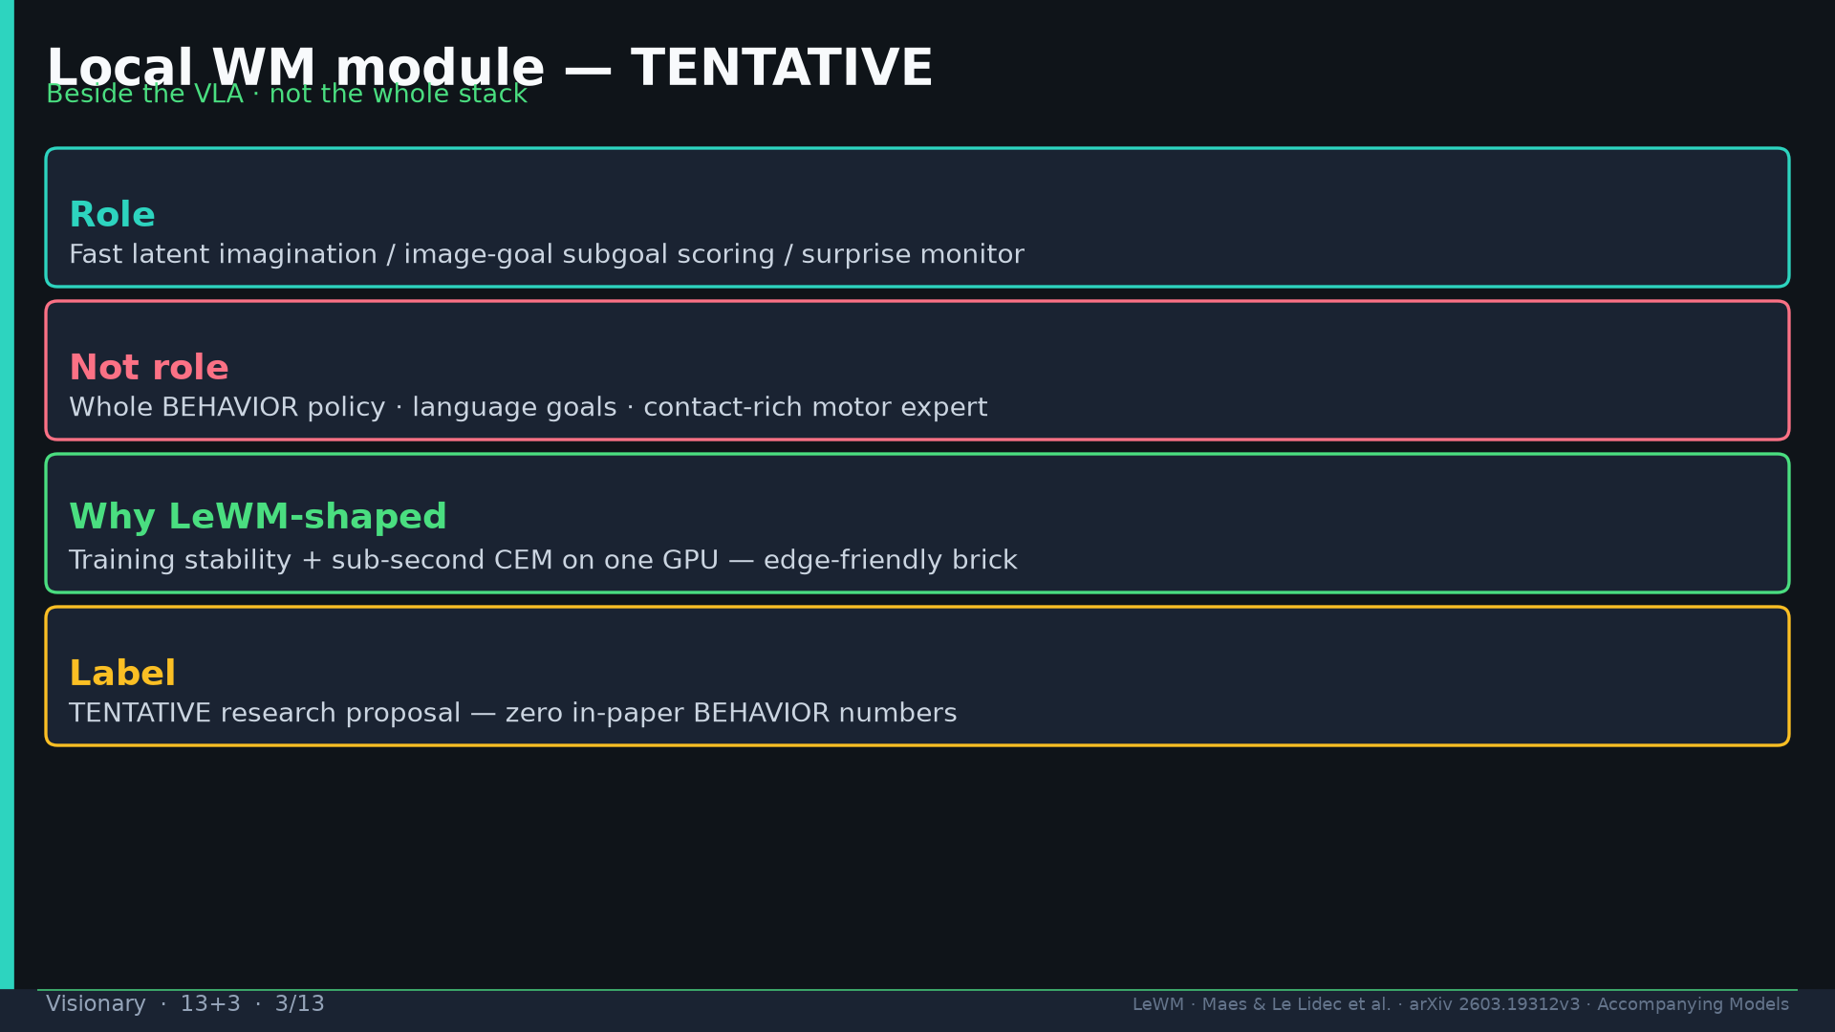
Notes:
Local module TENTATIVE beside VLA — not whole stack. Zero in-paper BEHAVIOR scores.

Slide 4
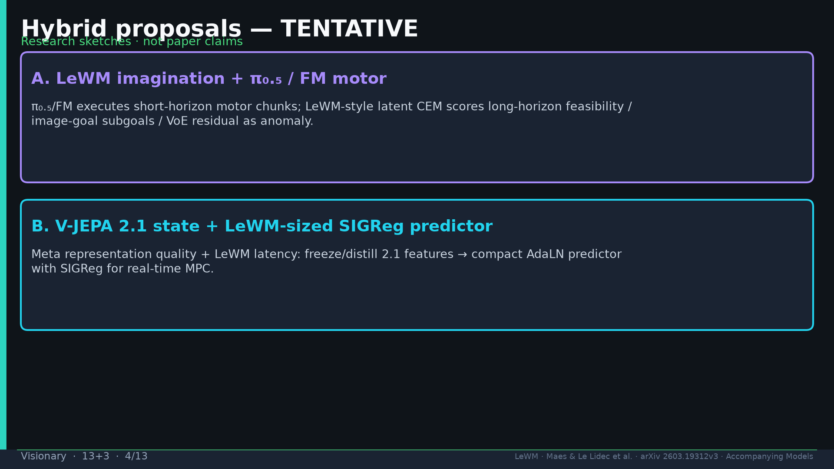
Notes:
Hybrid TENTATIVE: (A) LeWM imagination + π₀.₅/FM; (B) 2.1 state + LeWM-sized SIGReg pred.

Slide 5
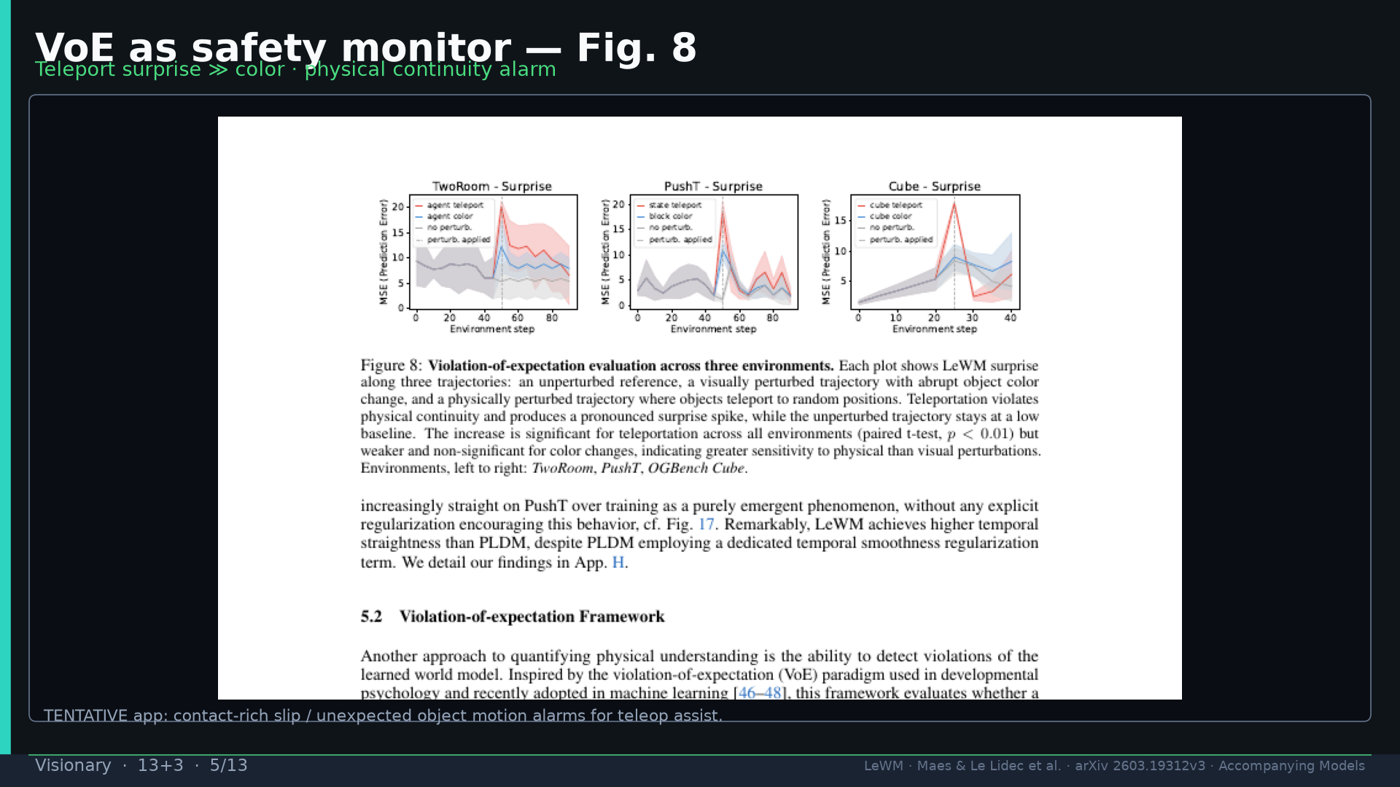
Notes:
Fig.8 VoE as safety monitor for slips / unexpected motion.

Slide 6
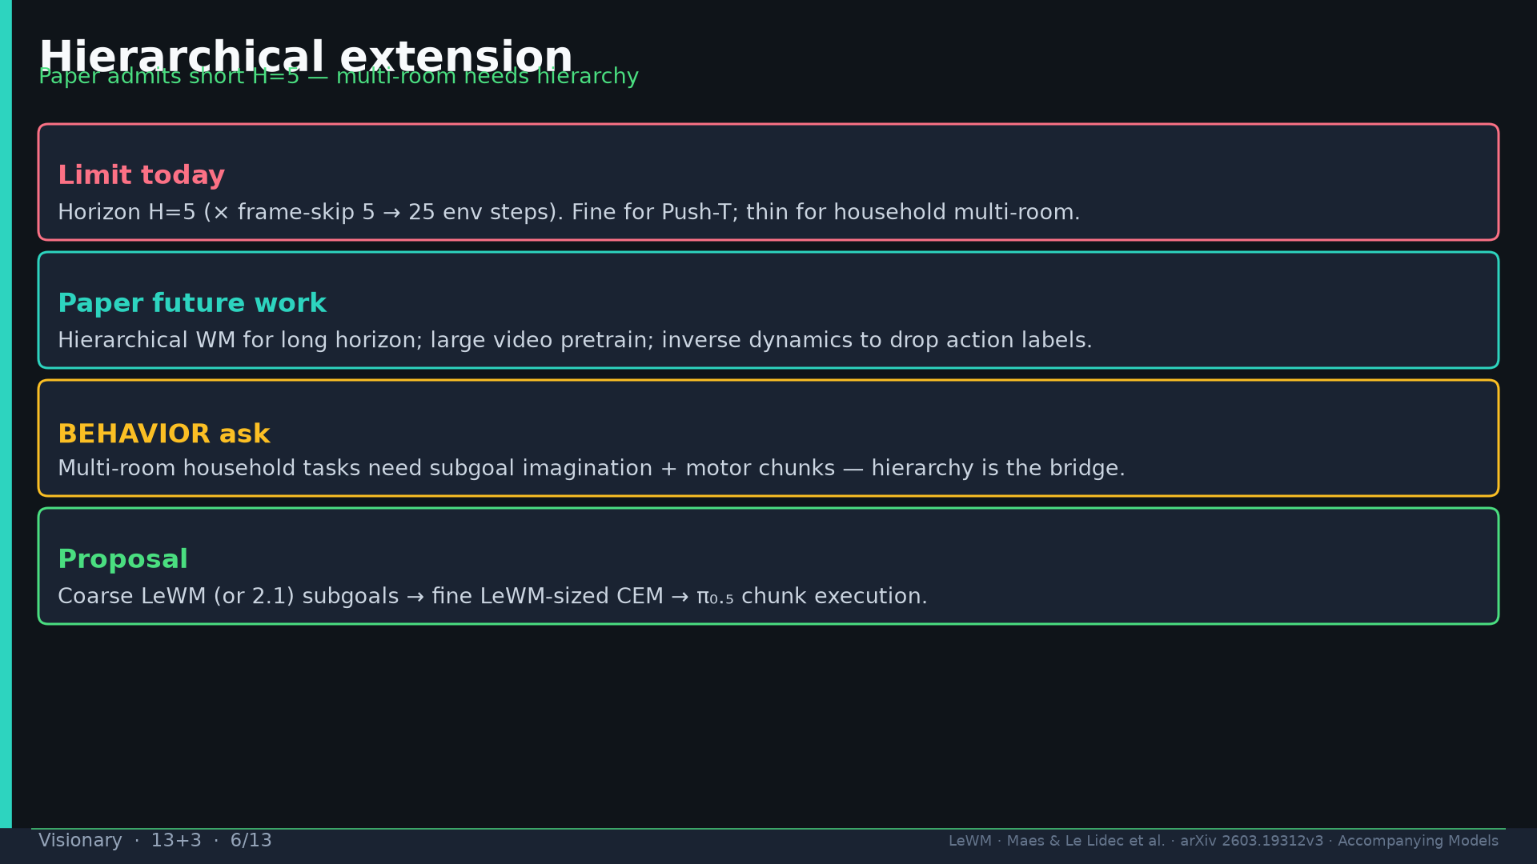
Notes:
Hierarchical for multi-room — paper admits short H=5.

Slide 7
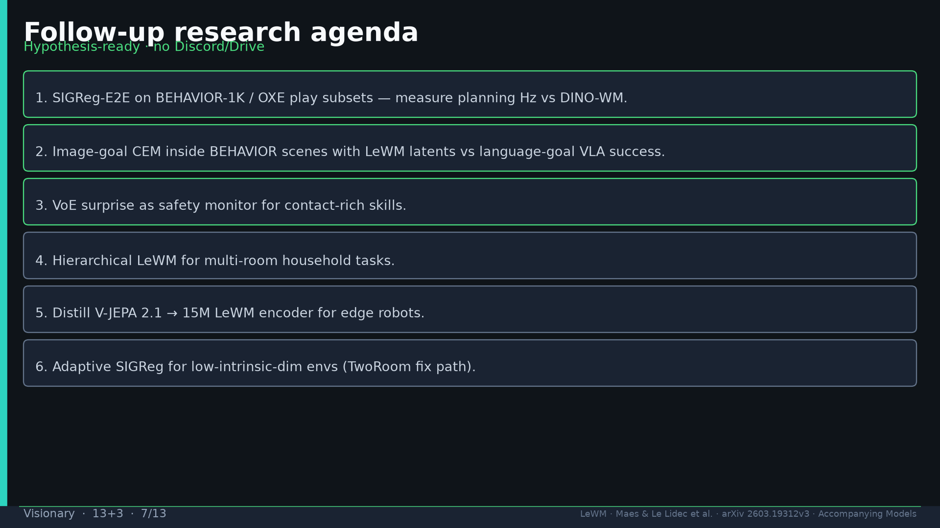
Notes:
Follow-ups six items — BEHAVIOR Hz, image-goal CEM, VoE safety, hierarchy, distill 2.1, adaptive SIGReg.

Slide 8
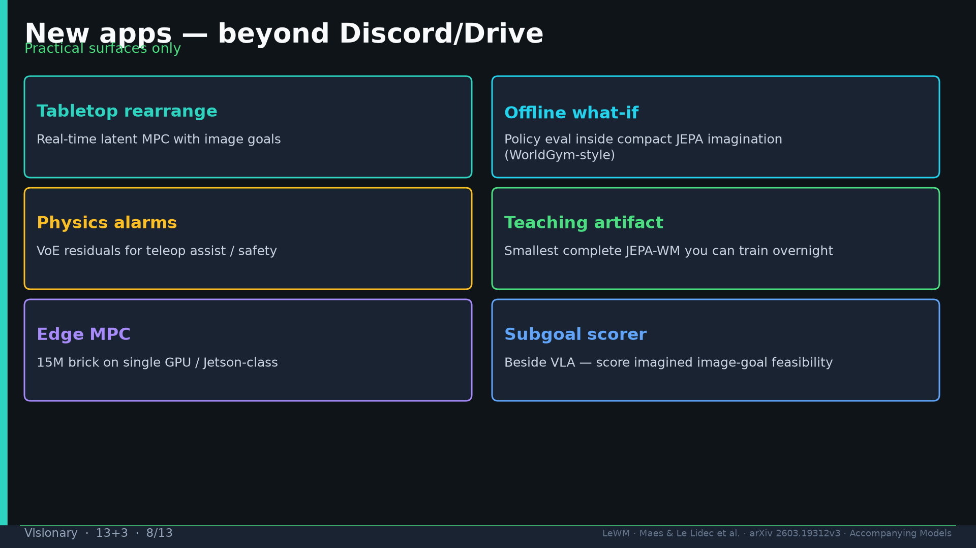
Notes:
Apps: rearrange MPC; offline what-if; physics alarms; teaching artifact; edge; subgoal scorer. No Discord/Drive.

Slide 9
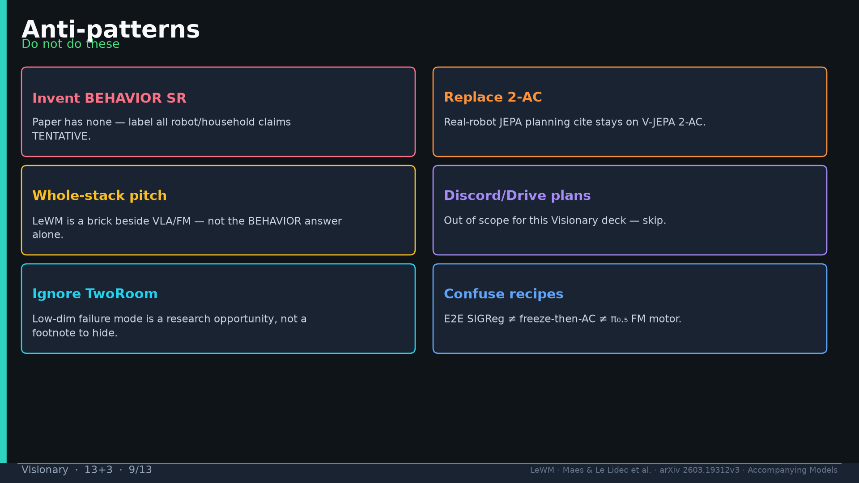
Notes:
Anti-patterns: invent SR; replace 2-AC; whole-stack pitch; Discord plans; hide TwoRoom; confuse recipes.

Slide 10
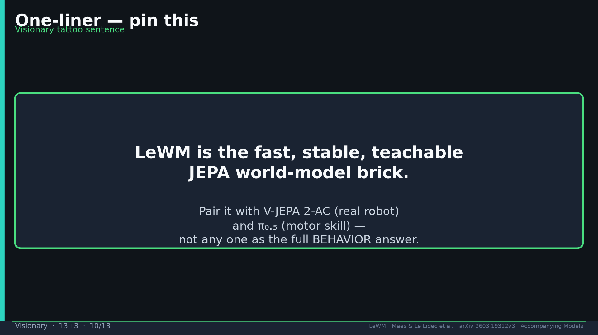
Notes:
One-liner tattoo: fast stable teachable JEPA-WM brick; pair with 2-AC + π₀.₅.

Slide 11
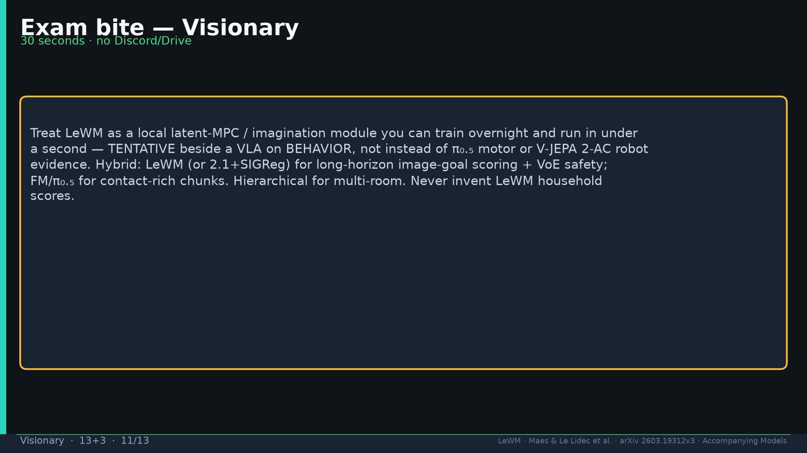
Notes:
Exam bite — local brick not whole stack; label TENTATIVE.

Slide 12
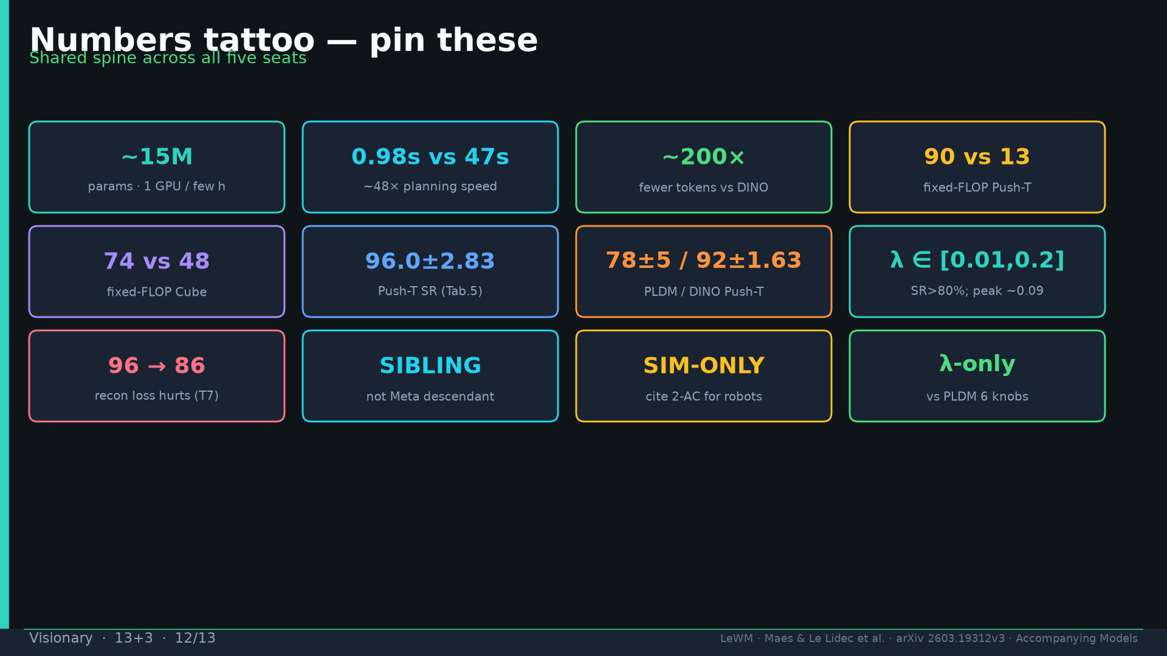
Notes:
Tattoo numbers.

Slide 13
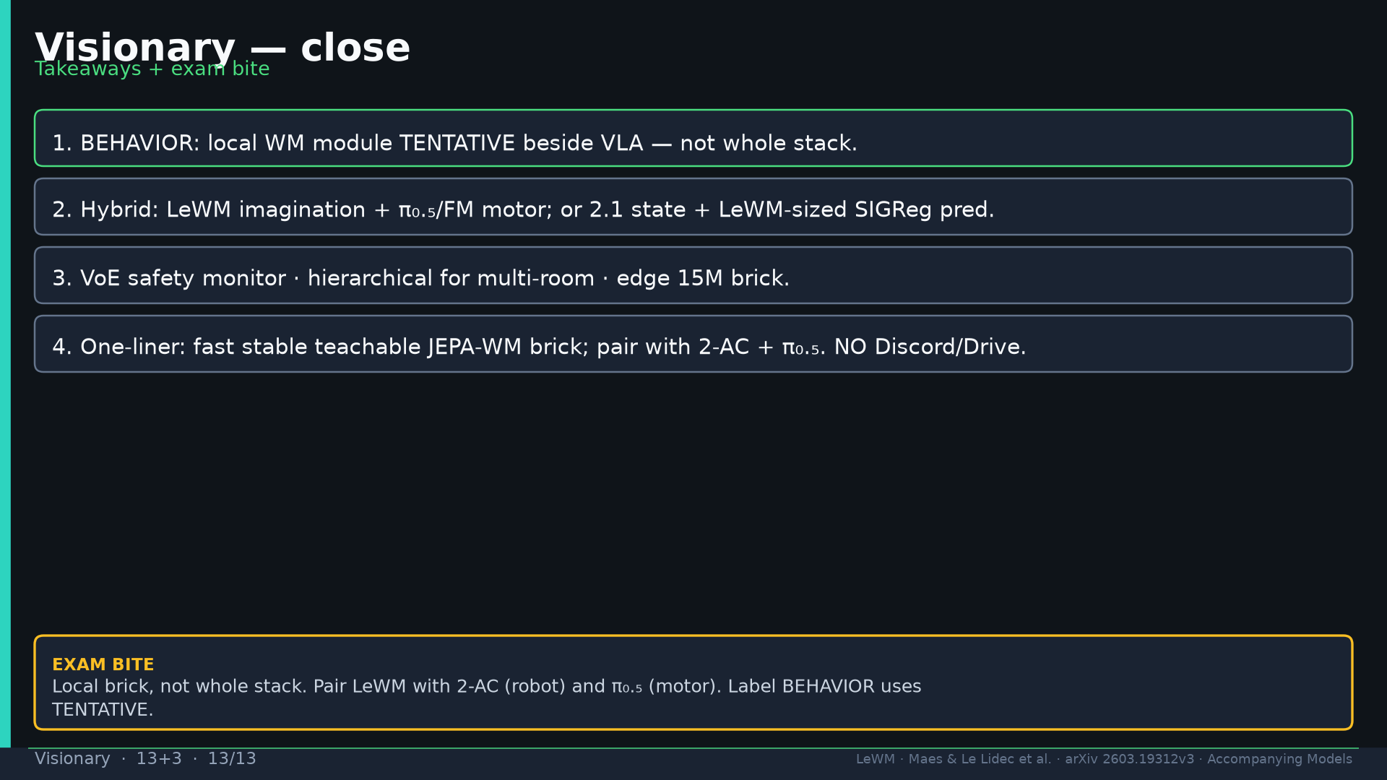
Notes:
Close. NO Discord/Drive.

