Slide 1
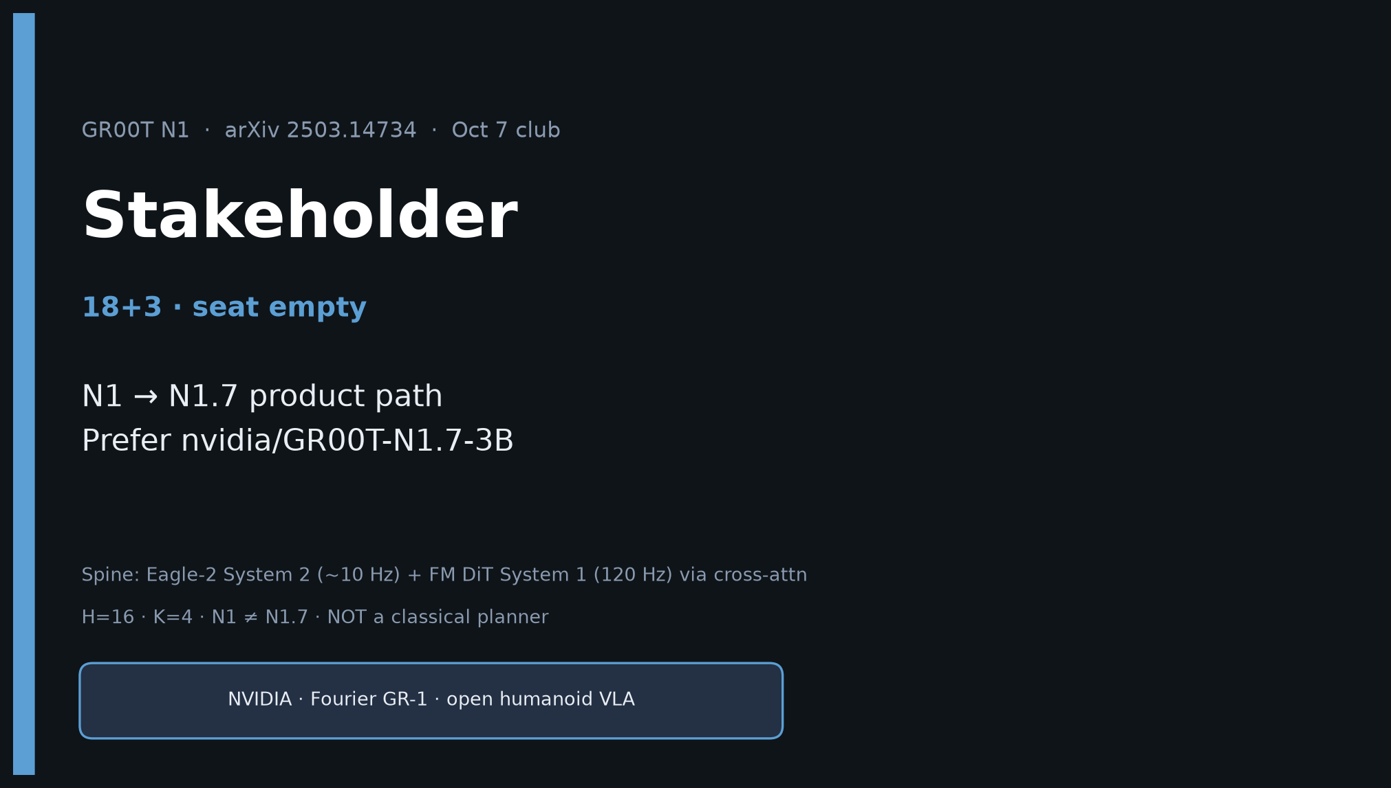
Stakeholder · 18+3 · 1/18
Notes:
STAKEHOLDER — 18+3. Seat empty; still ship durable briefing.
You own: why GR00T N1→N1.7 is the open humanoid VLA product path.
Prefer finetune nvidia/GR00T-N1.7-3B. Risks: N1≠N1.7 API.
No Stakeholder redo later — this deck is the briefing.

Slide 2
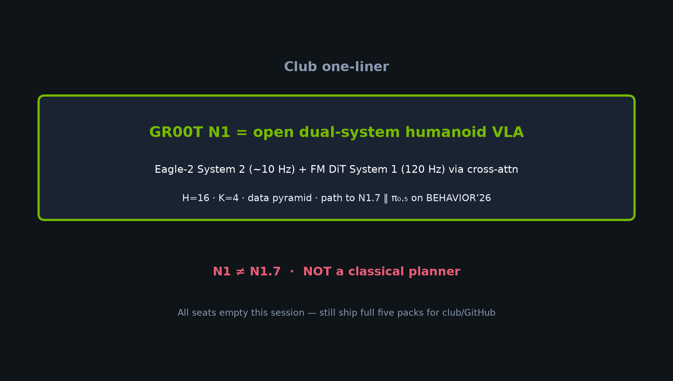
Stakeholder · 18+3 · 2/18
Notes:
ONE-LINER for leadership.
Open dual-system humanoid VLA → Apache N1.7 + BEHAVIOR’26 parity with π₀.₅.
Buy/build: start from released N1.7, do not re-pretrain Eagle-2.

Slide 3
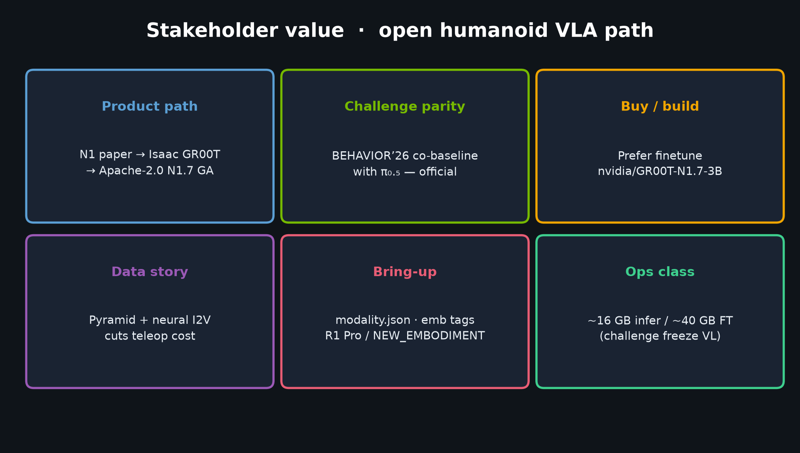
Stakeholder · 18+3 · 3/18
Notes:
VALUE CARDS — product path, challenge parity, buy/build, data story, bring-up, ops class.
Lead with: Prefer nvidia/GR00T-N1.7-3B.

Slide 4
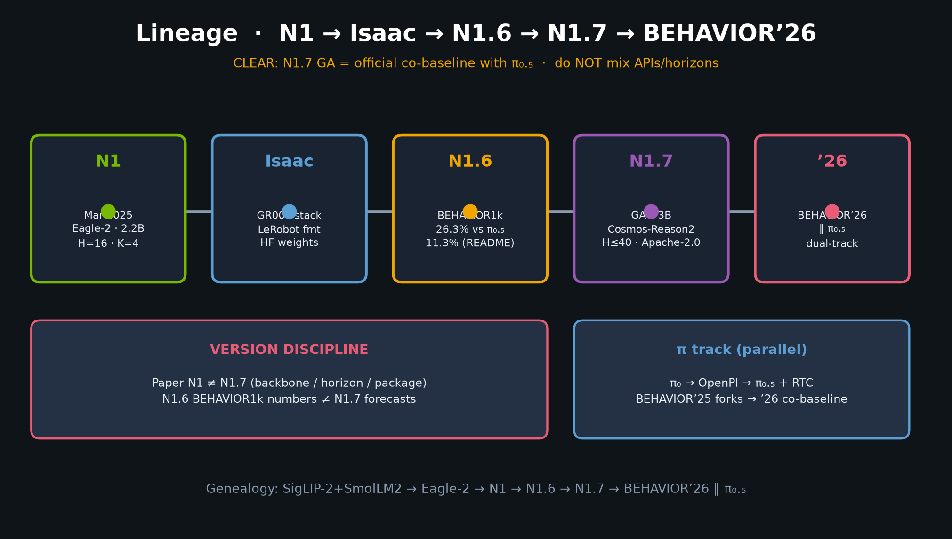
Stakeholder · 18+3 · 4/18
Notes:
PRODUCT PATH TIMELINE — N1 → Isaac → N1.6 → N1.7 → BEHAVIOR’26.
CLEAR: N1.7 is official co-baseline with π₀.₅.
Pin versions in every vendor/partner conversation.

Slide 5
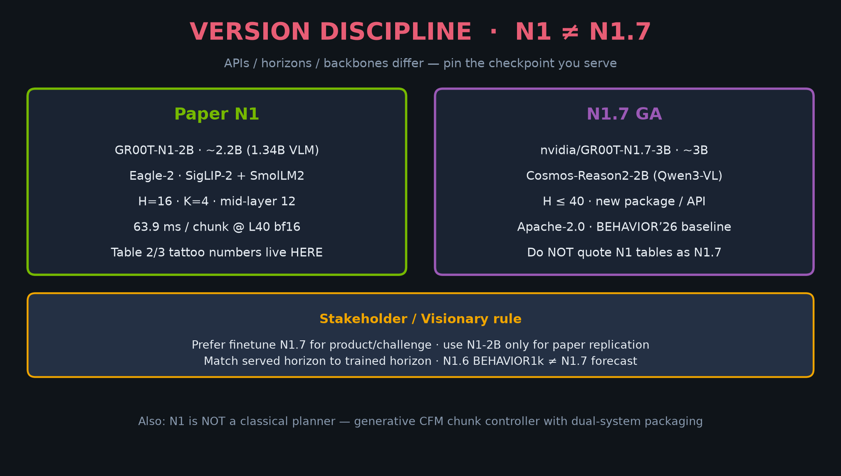
Stakeholder · 18+3 · 5/18
Notes:
VERSION DISCIPLINE — N1 ≠ N1.7.
APIs/horizons/backbones differ. Prefer N1.7 for product; N1-2B for paper replication only.
Match served horizon to trained horizon.

Slide 6
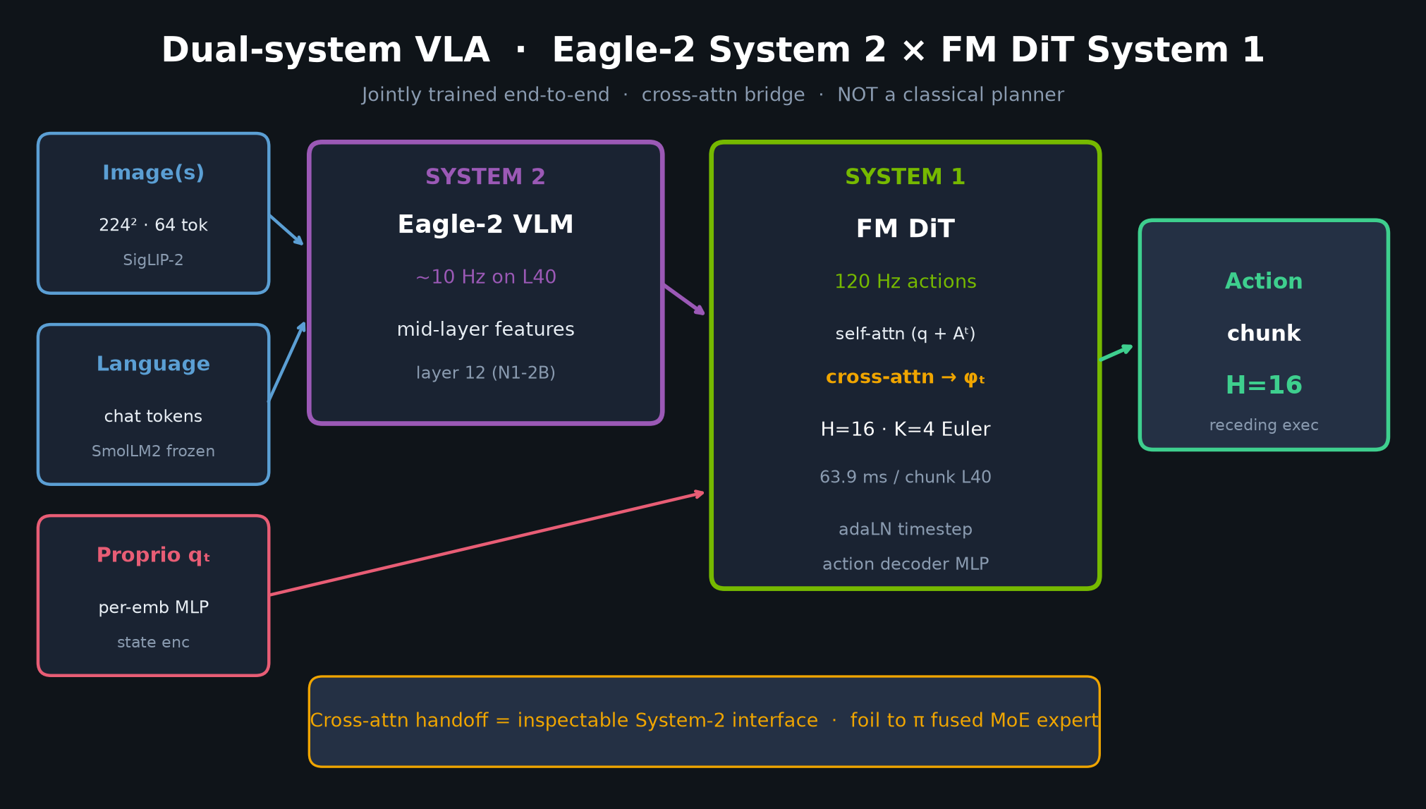
Stakeholder · 18+3 · 6/18
Notes:
DUAL-SYSTEM for non-specialists.
System 2 reasons (~10 Hz); System 1 acts (120 Hz) via cross-attn.
NOT a classical planner — generative chunk controller.
2.2B params; 63.9 ms/chunk on L40.

Slide 7
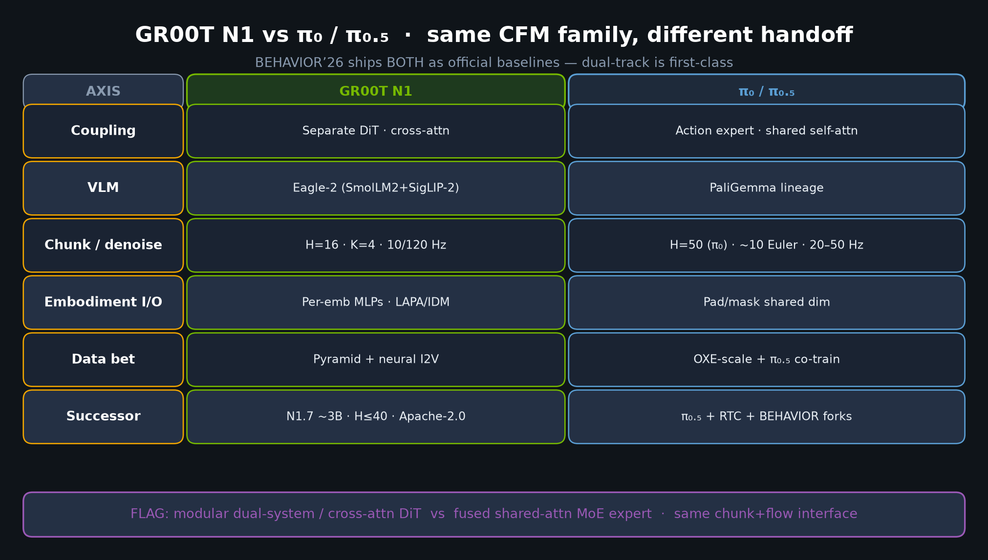
Stakeholder · 18+3 · 7/18
Notes:
VS π₀/π₀.₅ — why both exist on the challenge.
Modular cross-attn DiT vs fused MoE expert. Same CFM family.
Dual-track is a feature for BEHAVIOR’26, not indecision.

Slide 8
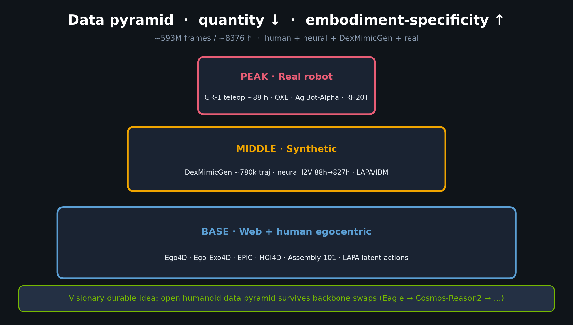
Stakeholder · 18+3 · 8/18
Notes:
DATA PYRAMID — teleop cost story.
Human/web base → synthetic mid → real peak.
Neural 88h→827h; DexMimicGen 780k traj in 11h wall-clock claim.
Stakeholder value: synthetic+neural to cut teleop.

Slide 9
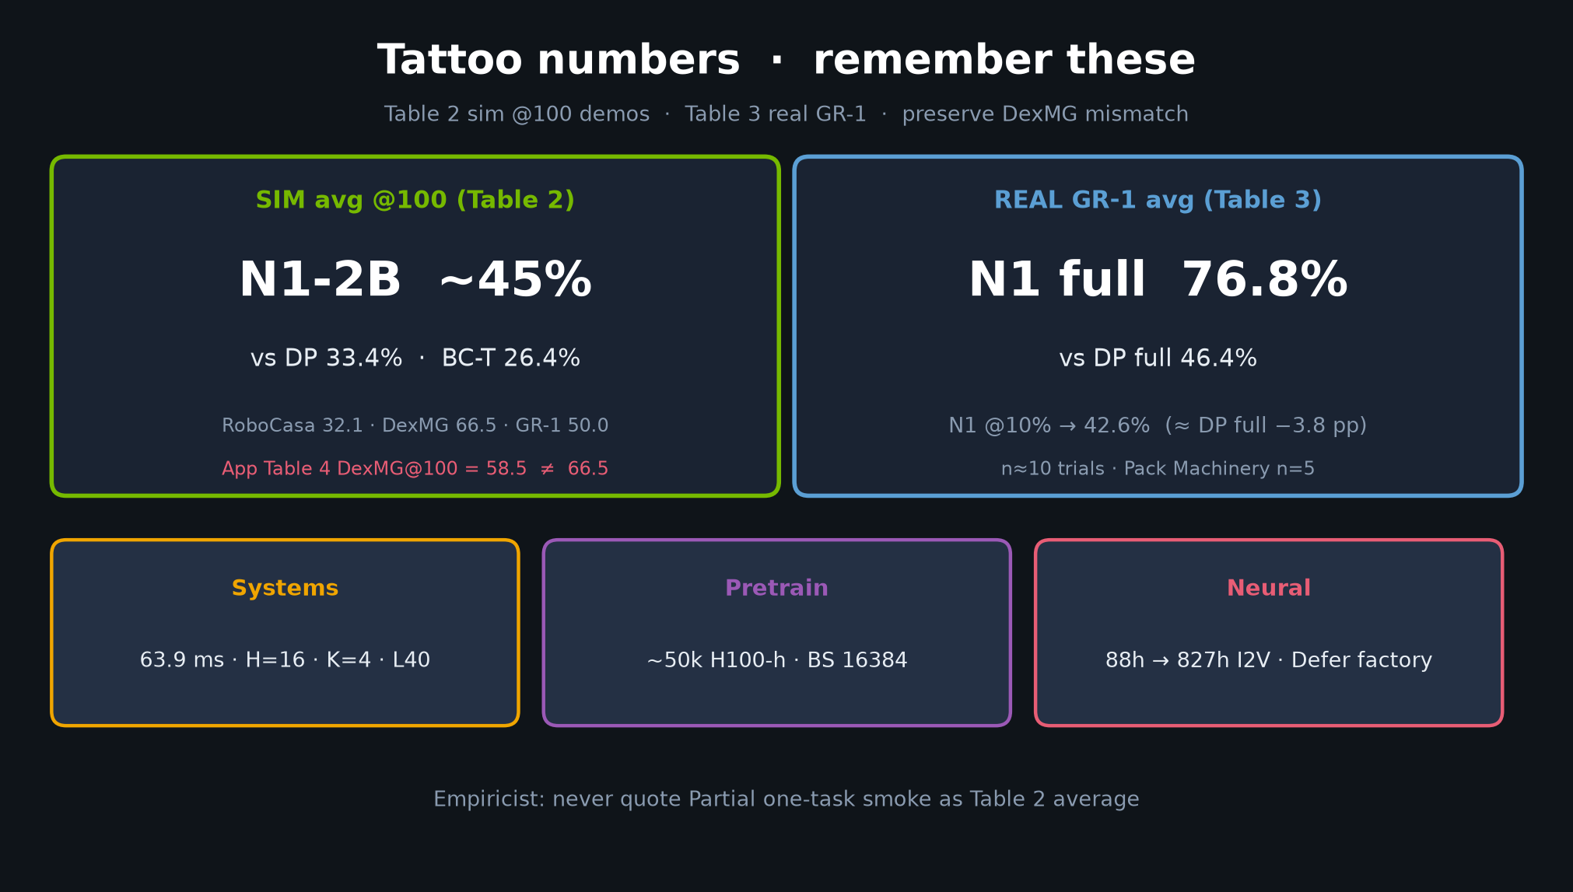
Stakeholder · 18+3 · 9/18
Notes:
TATTOO NUMBERS for leadership memory.
Sim ~45% vs DP 33.4% / BC-T 26.4%. Real 76.8% vs DP 46.4%.
Low-data: N1@10% ≈ DP@full. Pretrain cost ~50k H100-h (not student).

Slide 10
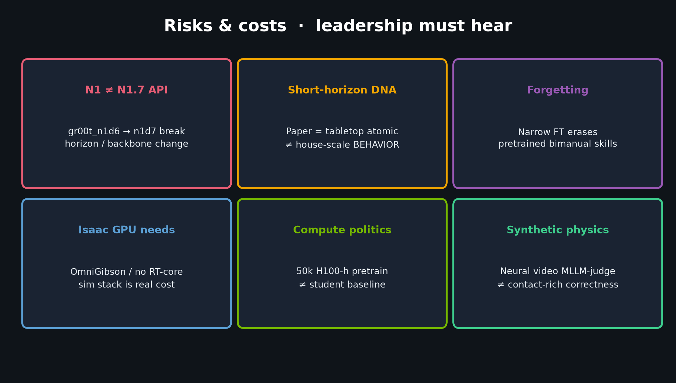
Stakeholder · 18+3 · 10/18
Notes:
RISKS — N1≠N1.7 API; short-horizon DNA; forgetting; Isaac GPU; compute politics; synthetic physics.
Spend time here; leadership underprices API break and forgetting.

Slide 11
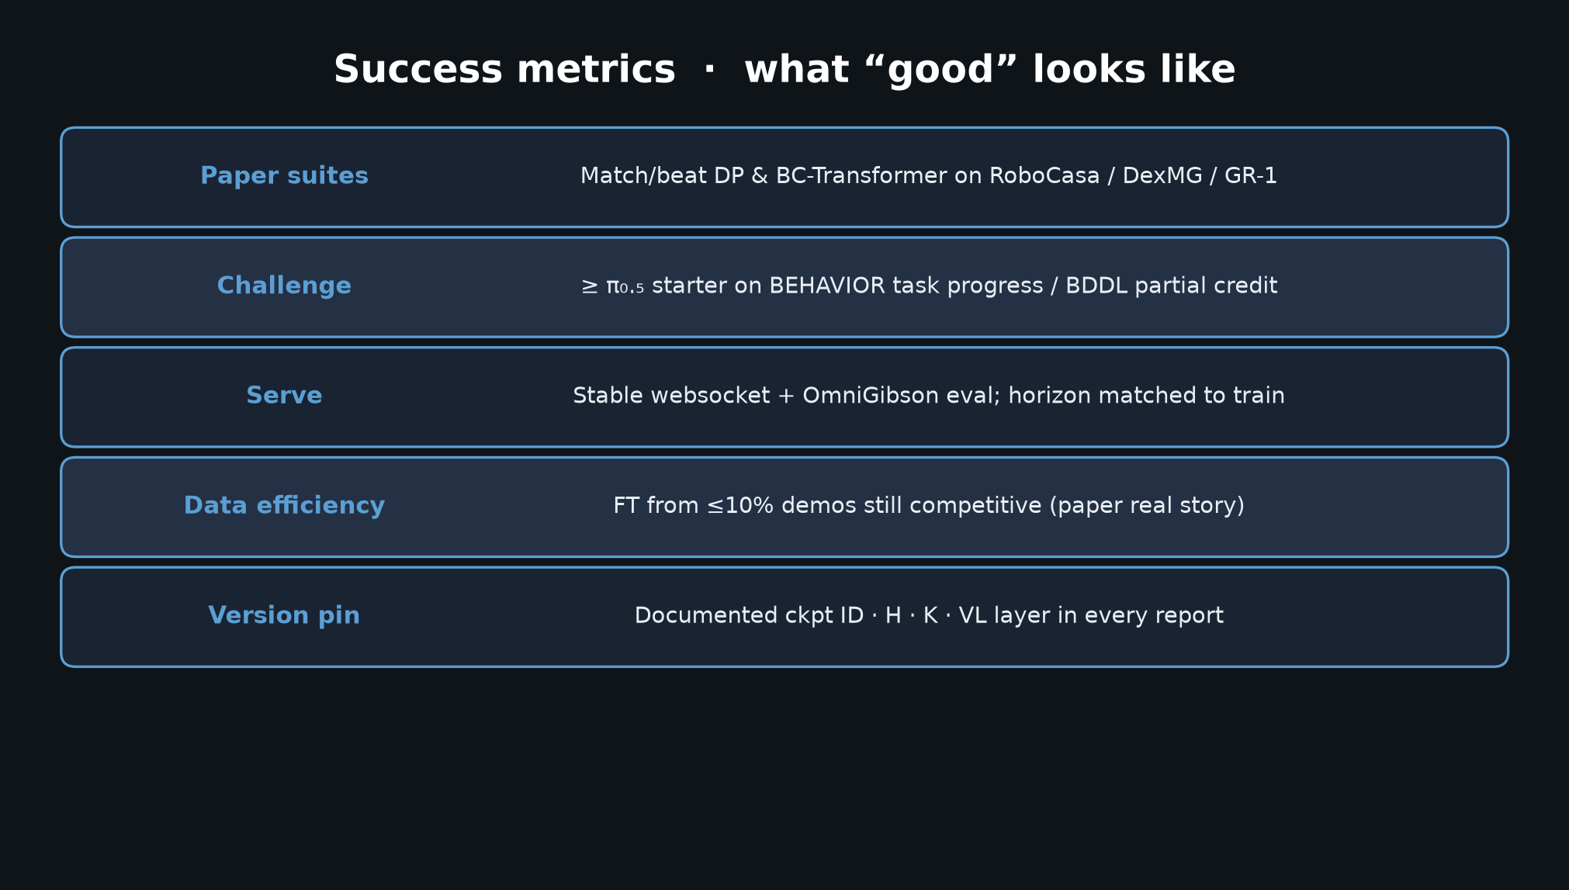
Stakeholder · 18+3 · 11/18
Notes:
SUCCESS METRICS — paper suites, challenge ≥π₀.₅ starter, stable serve, data-efficient FT, version pin.
Organizer metric > paper tabletop % for 2026.

Slide 12
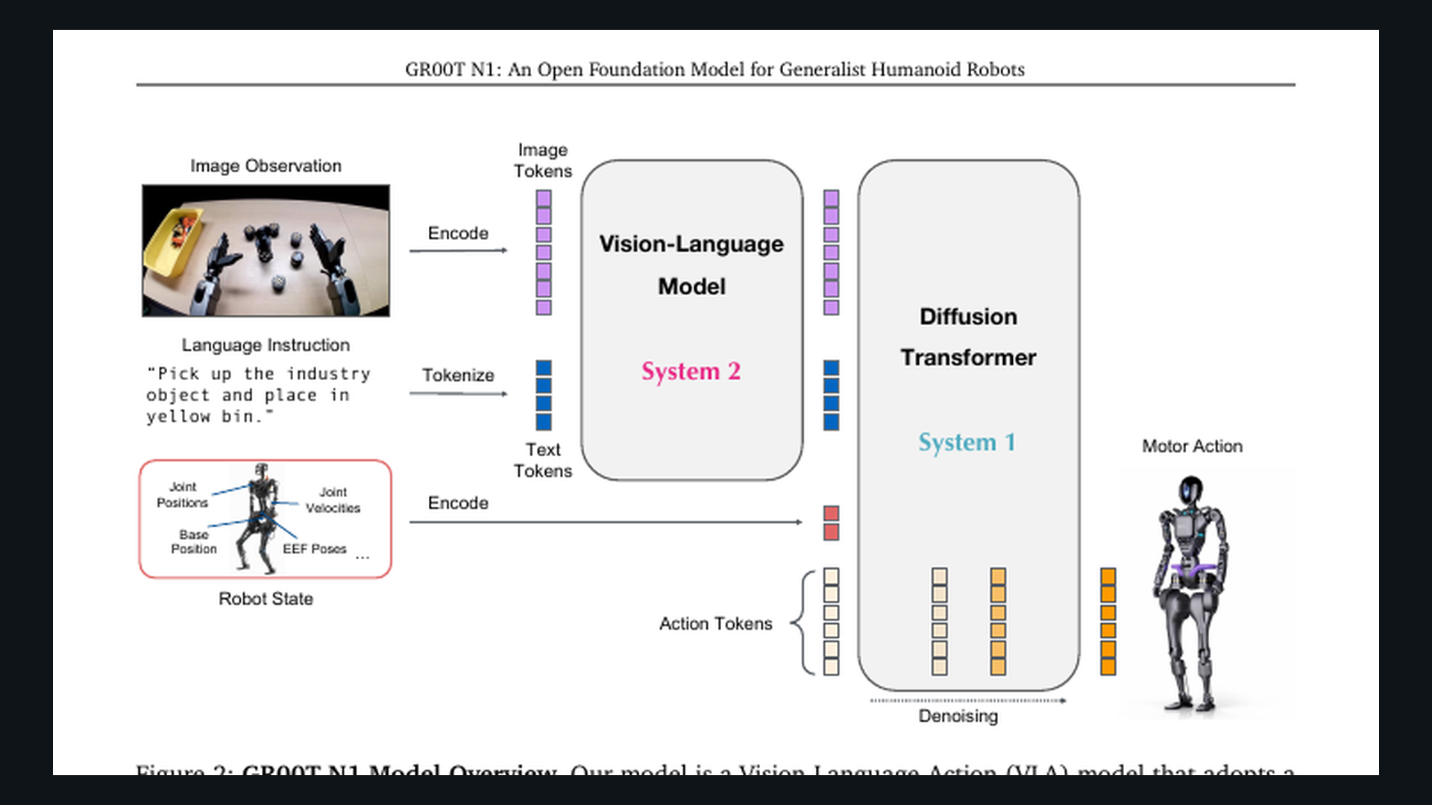
Stakeholder · 18+3 · 12/18
Notes:
PAPER FIG 2 — system overview for stakeholders who want the picture.

Slide 13
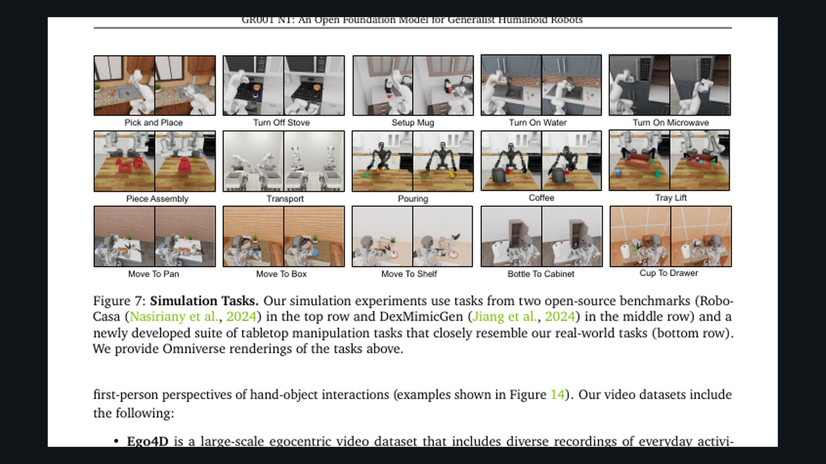
Stakeholder · 18+3 · 13/18
Notes:
PAPER FIG 7 — sim task gallery (RoboCasa / DexMG / GR-1). Scope honesty: tabletop short-horizon.

Slide 14
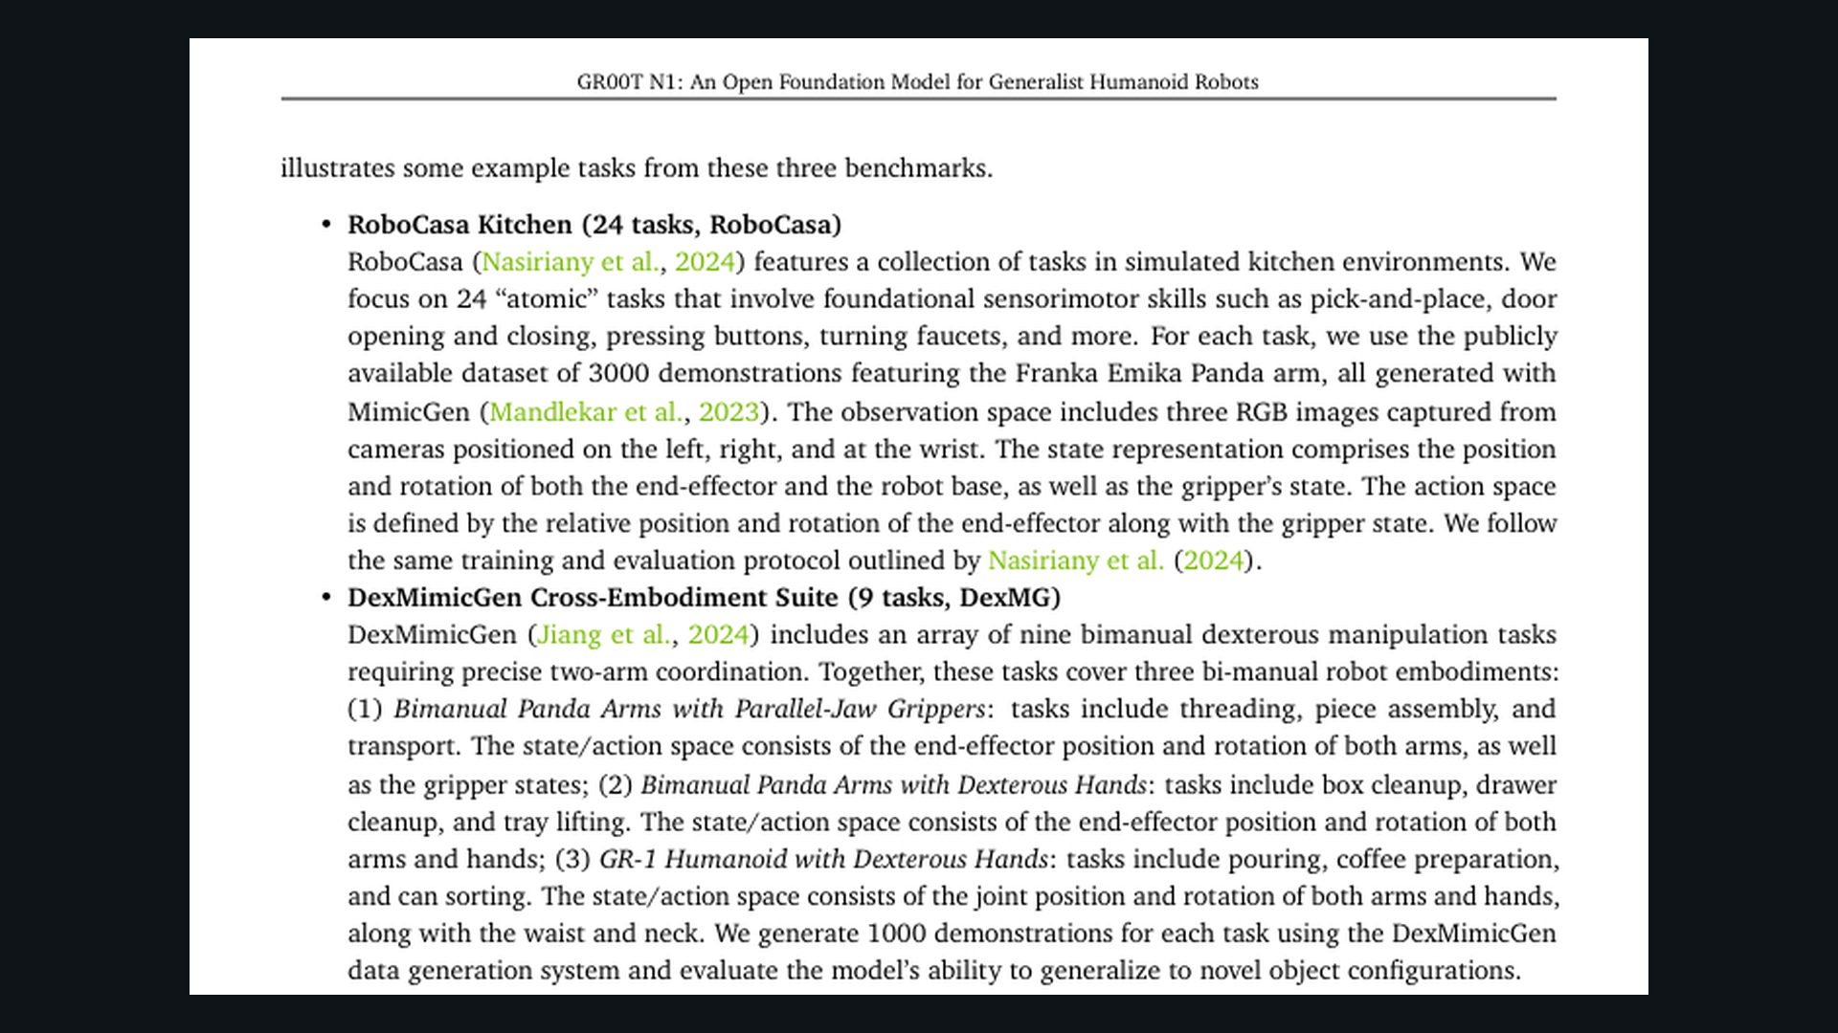
Stakeholder · 18+3 · 14/18
Notes:
PAPER real GR-1 gallery — deployment proof points for leadership.
Language-conditioned bimanual tabletop; strong low-data story (@10% ≈ DP full).
Protocol honesty: n≈10 trials (Pack Machinery n=5).

Slide 15
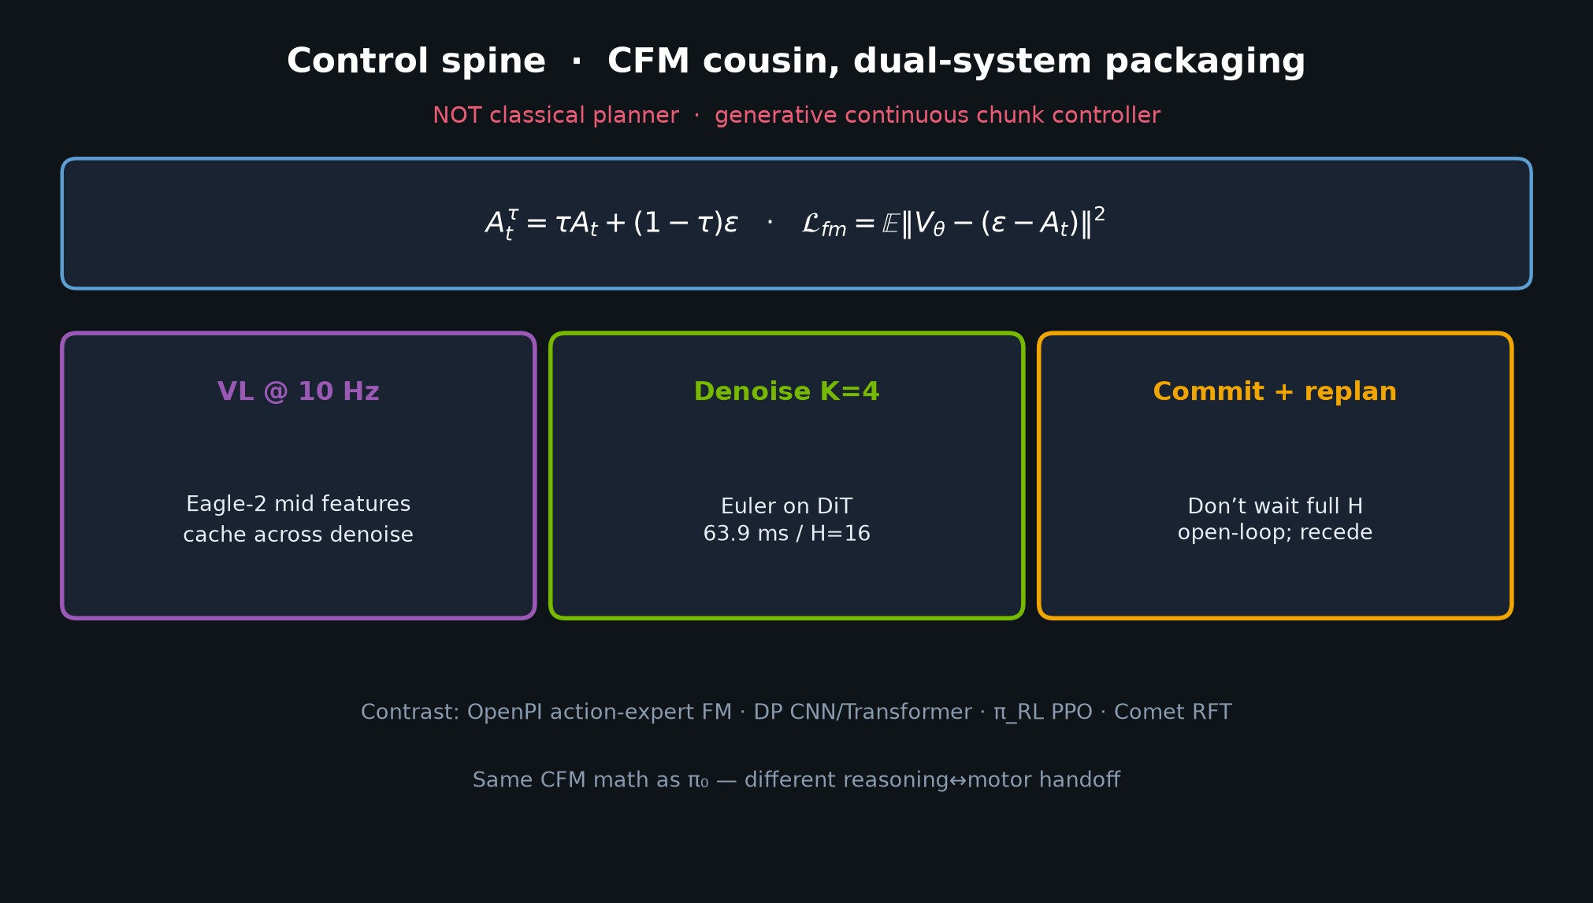
Stakeholder · 18+3 · 15/18
Notes:
CONTROL SPINE spare — CFM cousin; receding exec; not planner.

Slide 16
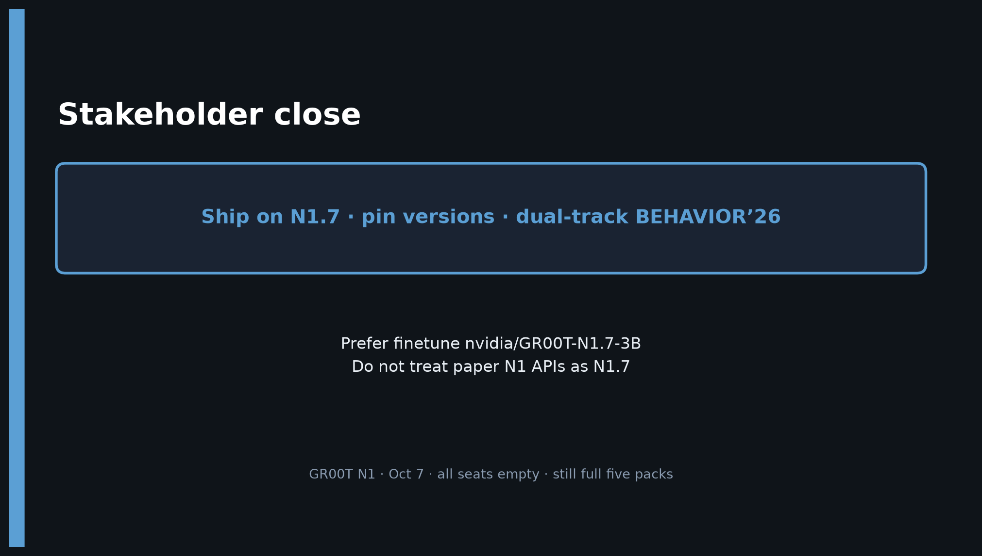
Stakeholder · 18+3 · 16/18
Notes:
CLOSE — Prefer N1.7 · pin versions · dual-track BEHAVIOR’26.
Do not treat paper N1 APIs as N1.7. No Stakeholder redo later.

Slide 17
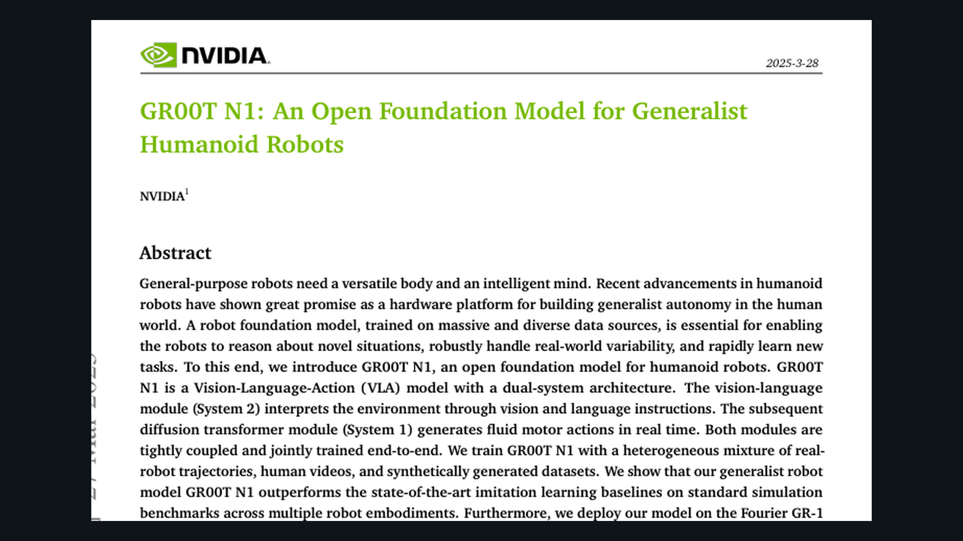
Stakeholder · 18+3 · 17/18
Notes:
BACKUP — paper cover / title block for bibliography and GitHub pack branding.
arXiv 2503.14734 · NVIDIA · Fourier GR-1 deploy story.
Use if someone asks “which paper / which release”.

Slide 18
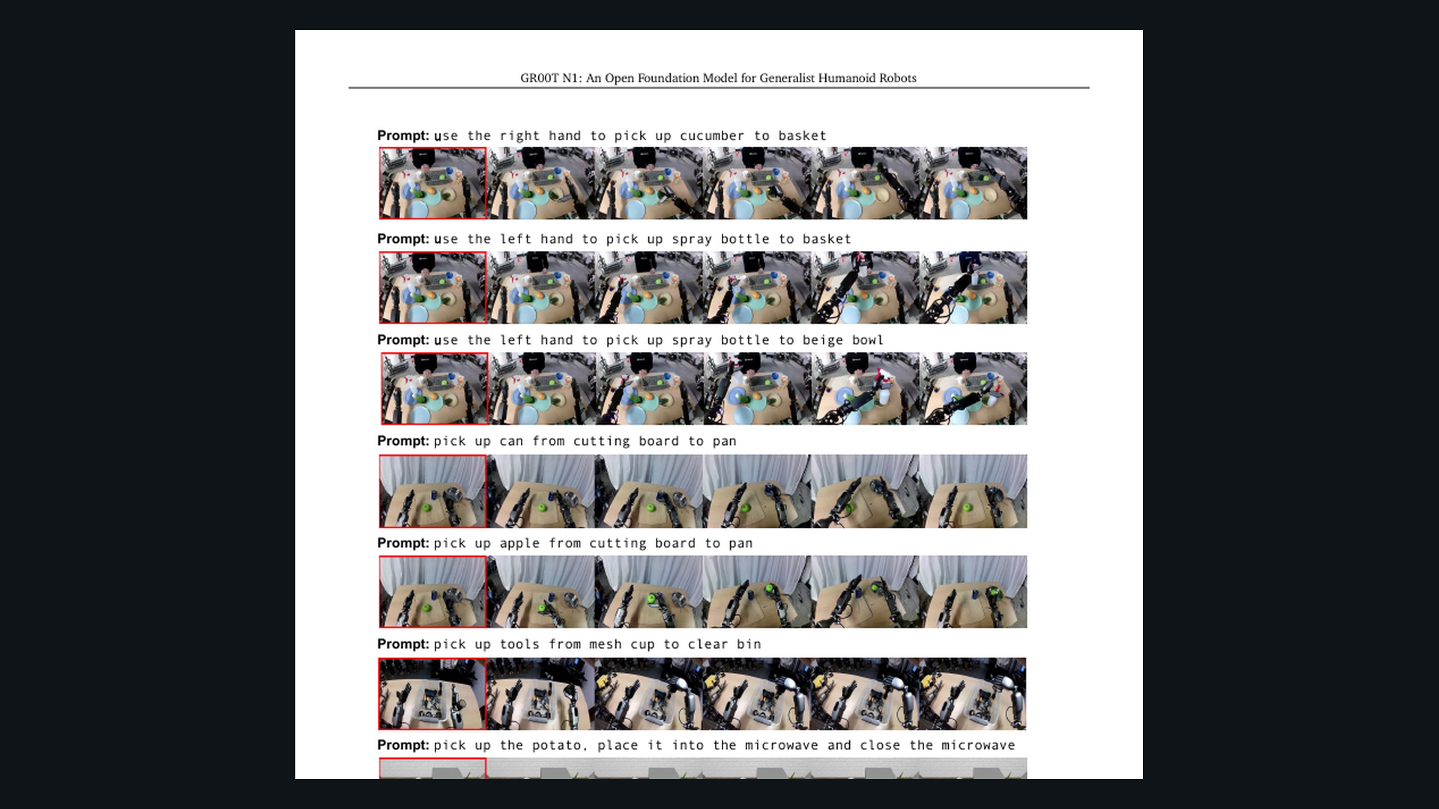
Stakeholder · 18+3 · 18/18
Notes:
SPARE — neural trajectories Fig.5 if asked about synthetic ROI.

