Slide 1
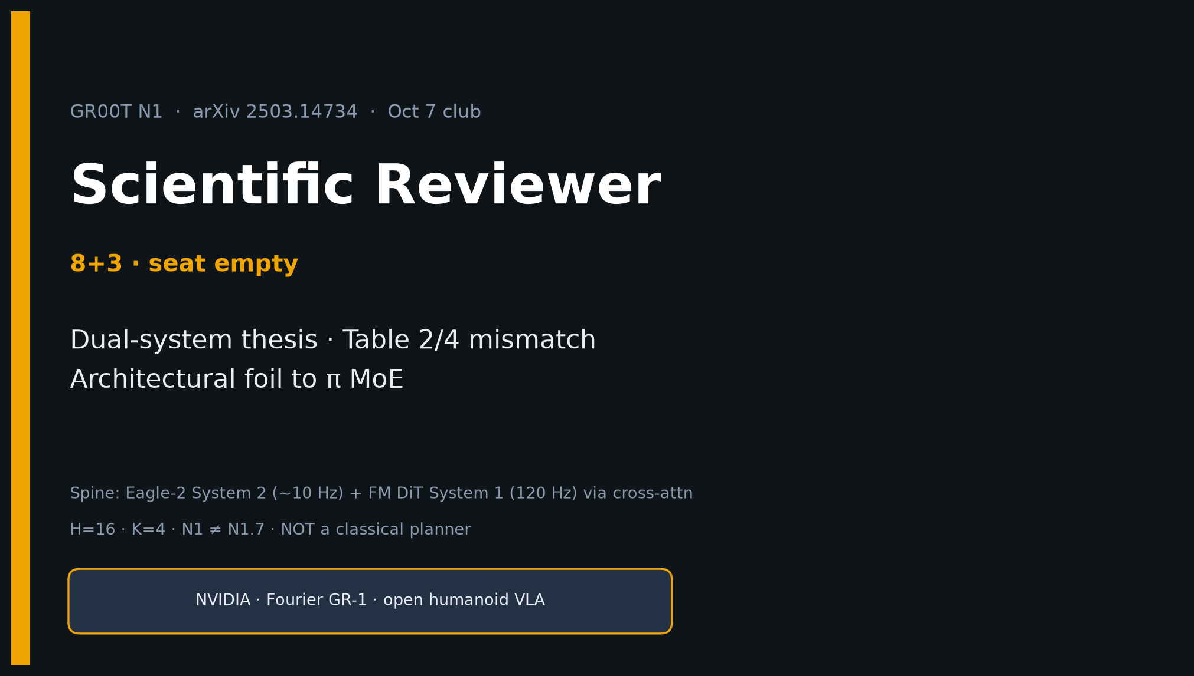
Scientific Reviewer · 8+3 · 1/11
Notes:
SCIENTIFIC REVIEWER — 8+3. Dual-system thesis + Table mismatch + verdict as architectural foil to π MoE.
Be crisp. Preserve BOTH DexMG numbers (66.5 Table 2 / 58.5 Table 4).

Slide 2
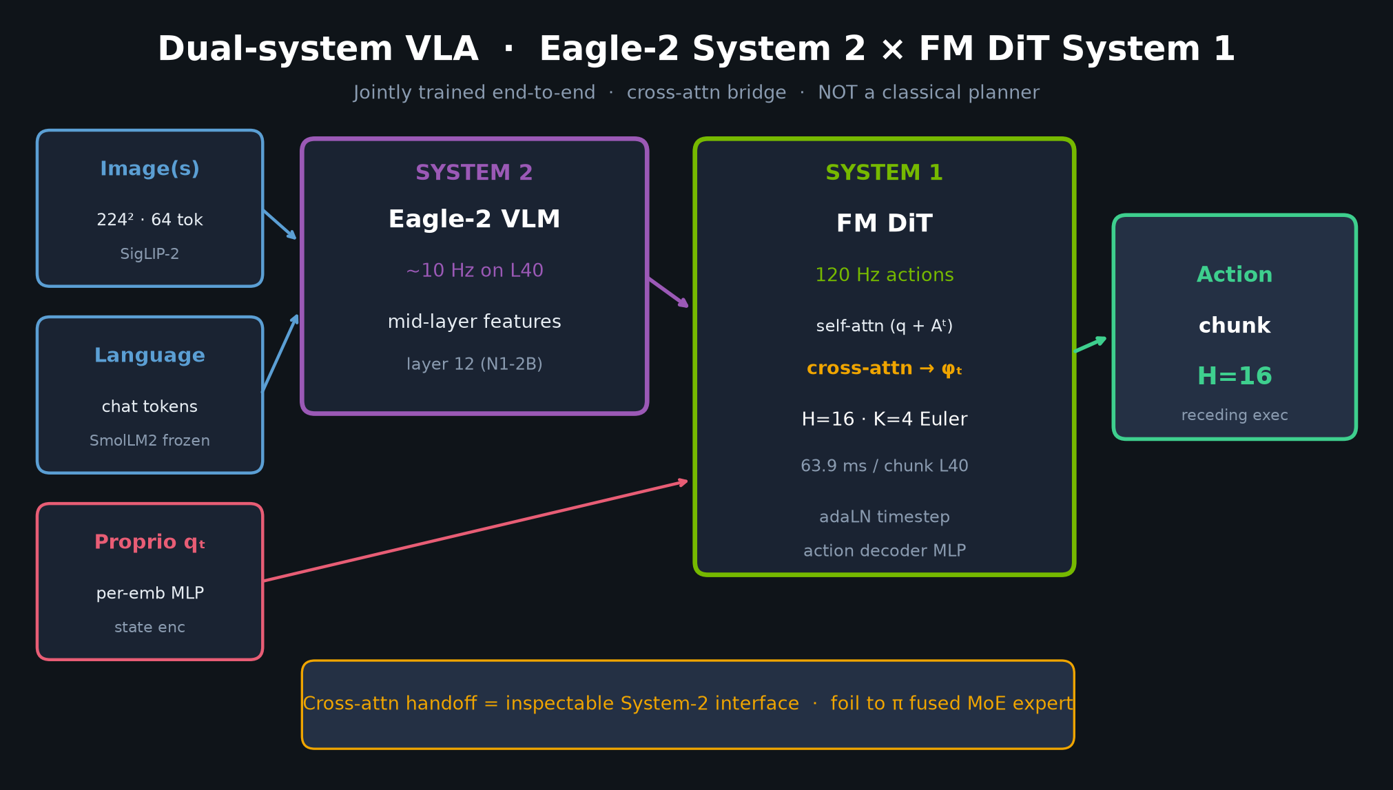
Scientific Reviewer · 8+3 · 2/11
Notes:
CLAIM UNDER REVIEW.
Dual-system VLA (Eagle-2 S2 + FM DiT S1), pretrained on heterogeneous data pyramid, yields generalist humanoid policy beating strong IL baselines with high data efficiency.
Falsifiable architectural claim vs π MoE.

Slide 3
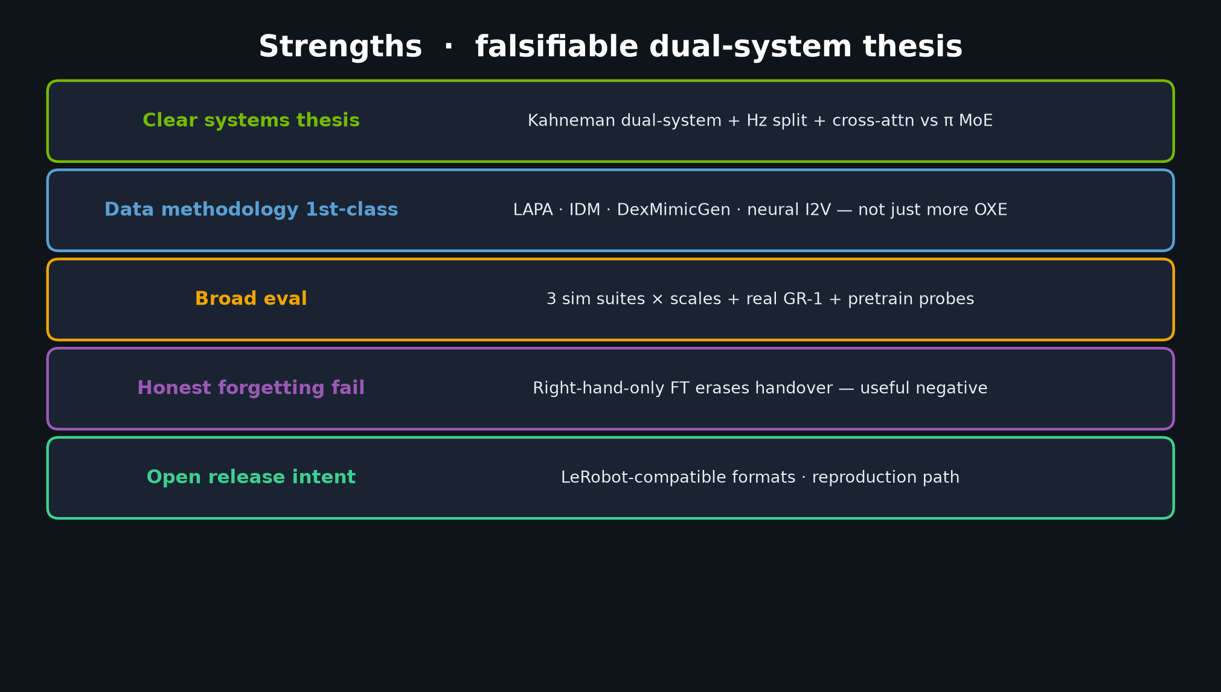
Scientific Reviewer · 8+3 · 3/11
Notes:
STRENGTHS — systems thesis; data methodology; broad eval; honest forgetting; open formats.
Speak 60–75s.

Slide 4
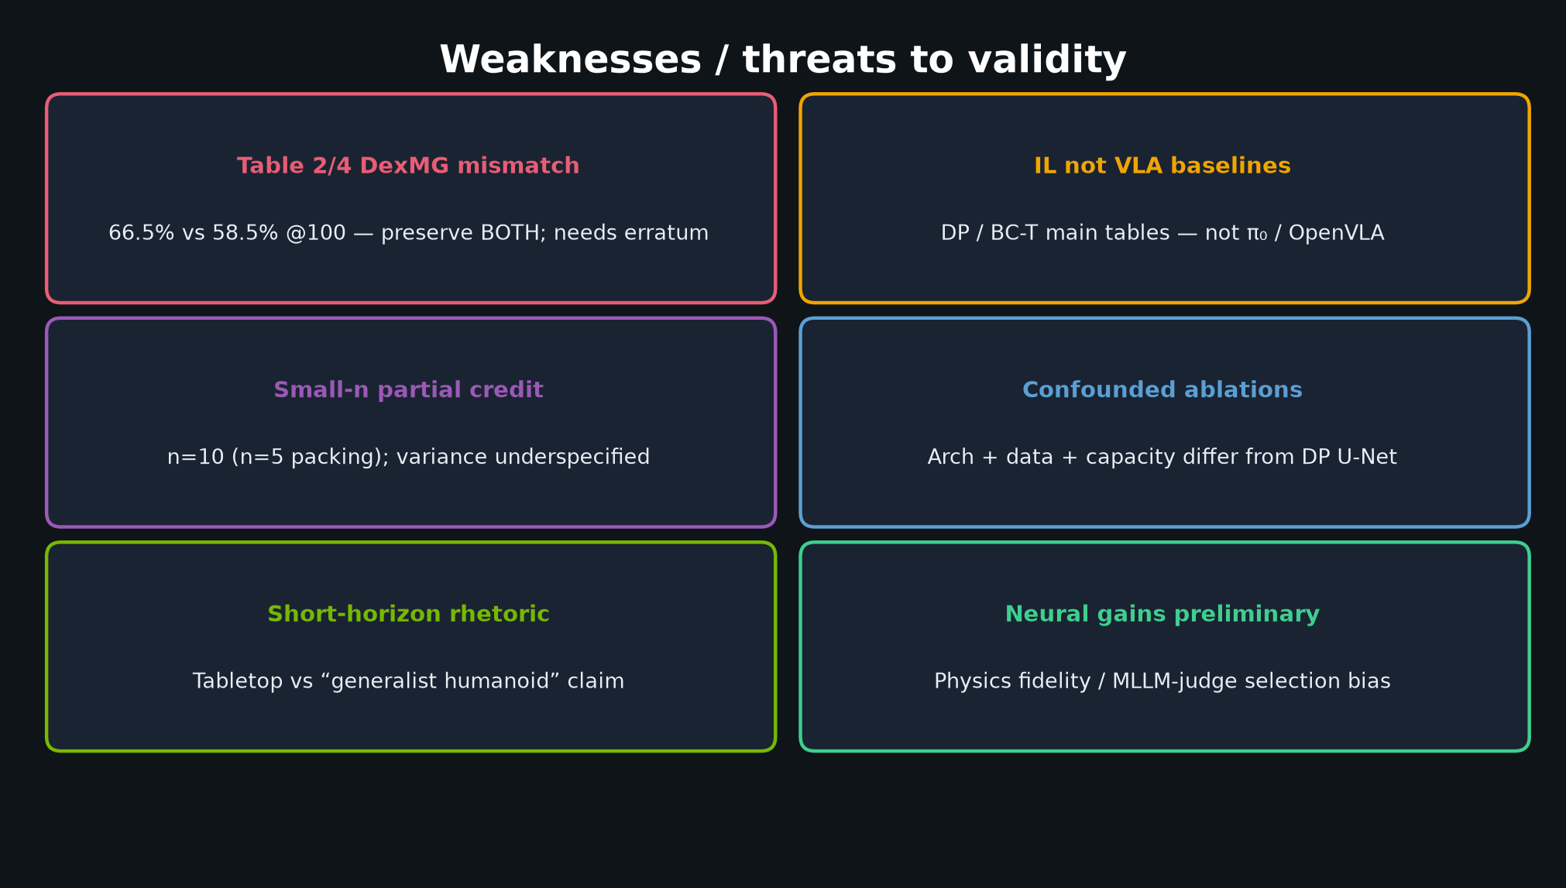
Scientific Reviewer · 8+3 · 4/11
Notes:
WEAKNESSES — Table 2/4 DexMG mismatch (MUST preserve both); IL not VLA baselines; small-n; confounded ablations; short-horizon rhetoric; neural preliminary.
Do NOT silently “fix” DexMG.

Slide 5
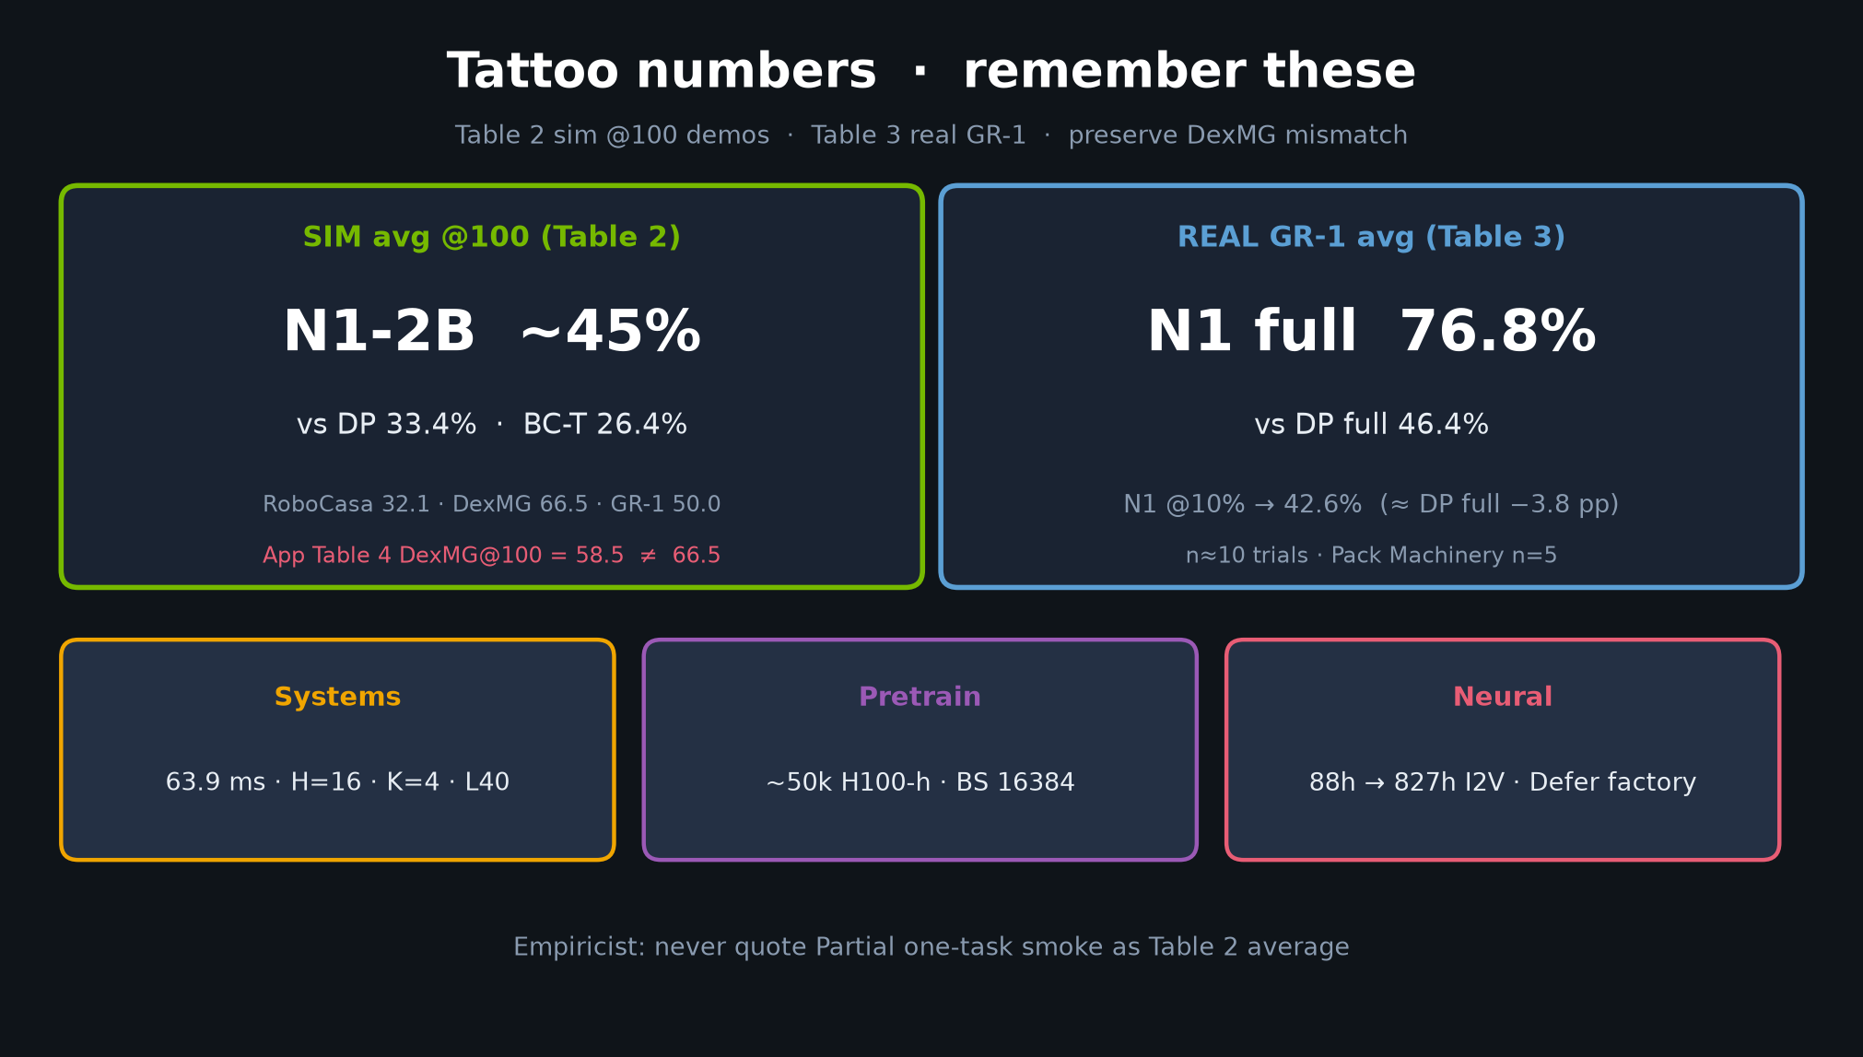
Scientific Reviewer · 8+3 · 5/11
Notes:
TATTOO / EVIDENCE — sim 45 vs 33.4/26.4; real 76.8 vs 46.4; DexMG note on card.
Core DP/BC wins look real; VLA-SOTA needs caution.

Slide 6
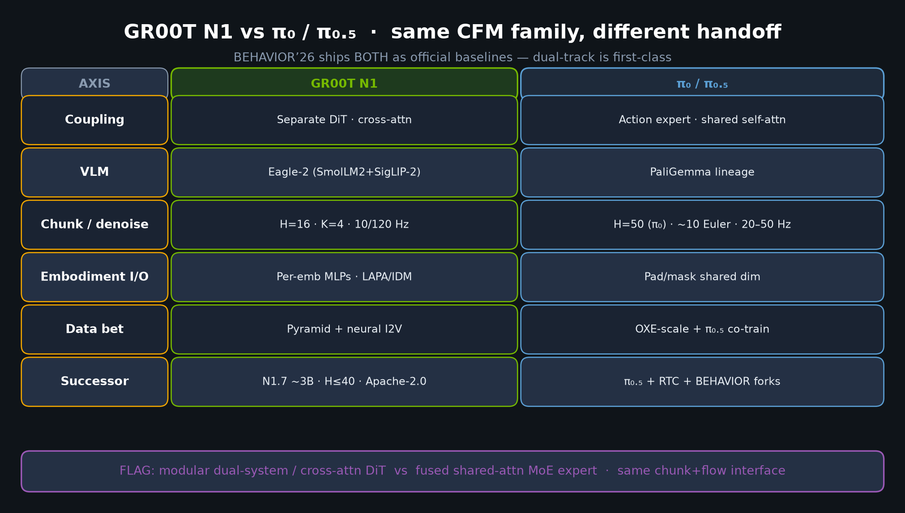
Scientific Reviewer · 8+3 · 6/11
Notes:
ARCHITECTURE FOIL — N1 vs π₀ table.
Modular cross-attn DiT vs fused MoE. Same CFM family.
This is why the paper matters beyond another humanoid demo.

Slide 7
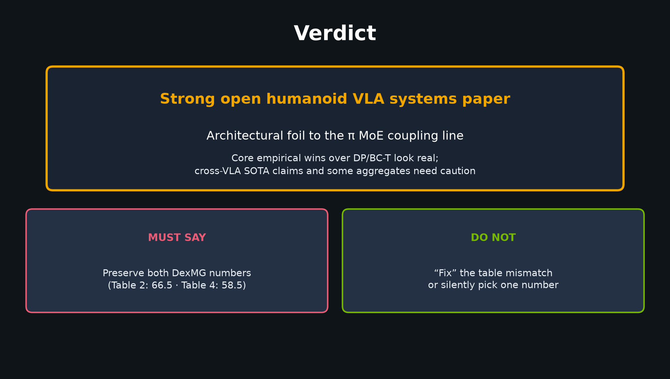
Scientific Reviewer · 8+3 · 7/11
Notes:
VERDICT slide — Strong systems paper; architectural foil to π MoE coupling.
Preserve both DexMG numbers. Do not fix the mismatch.

Slide 8
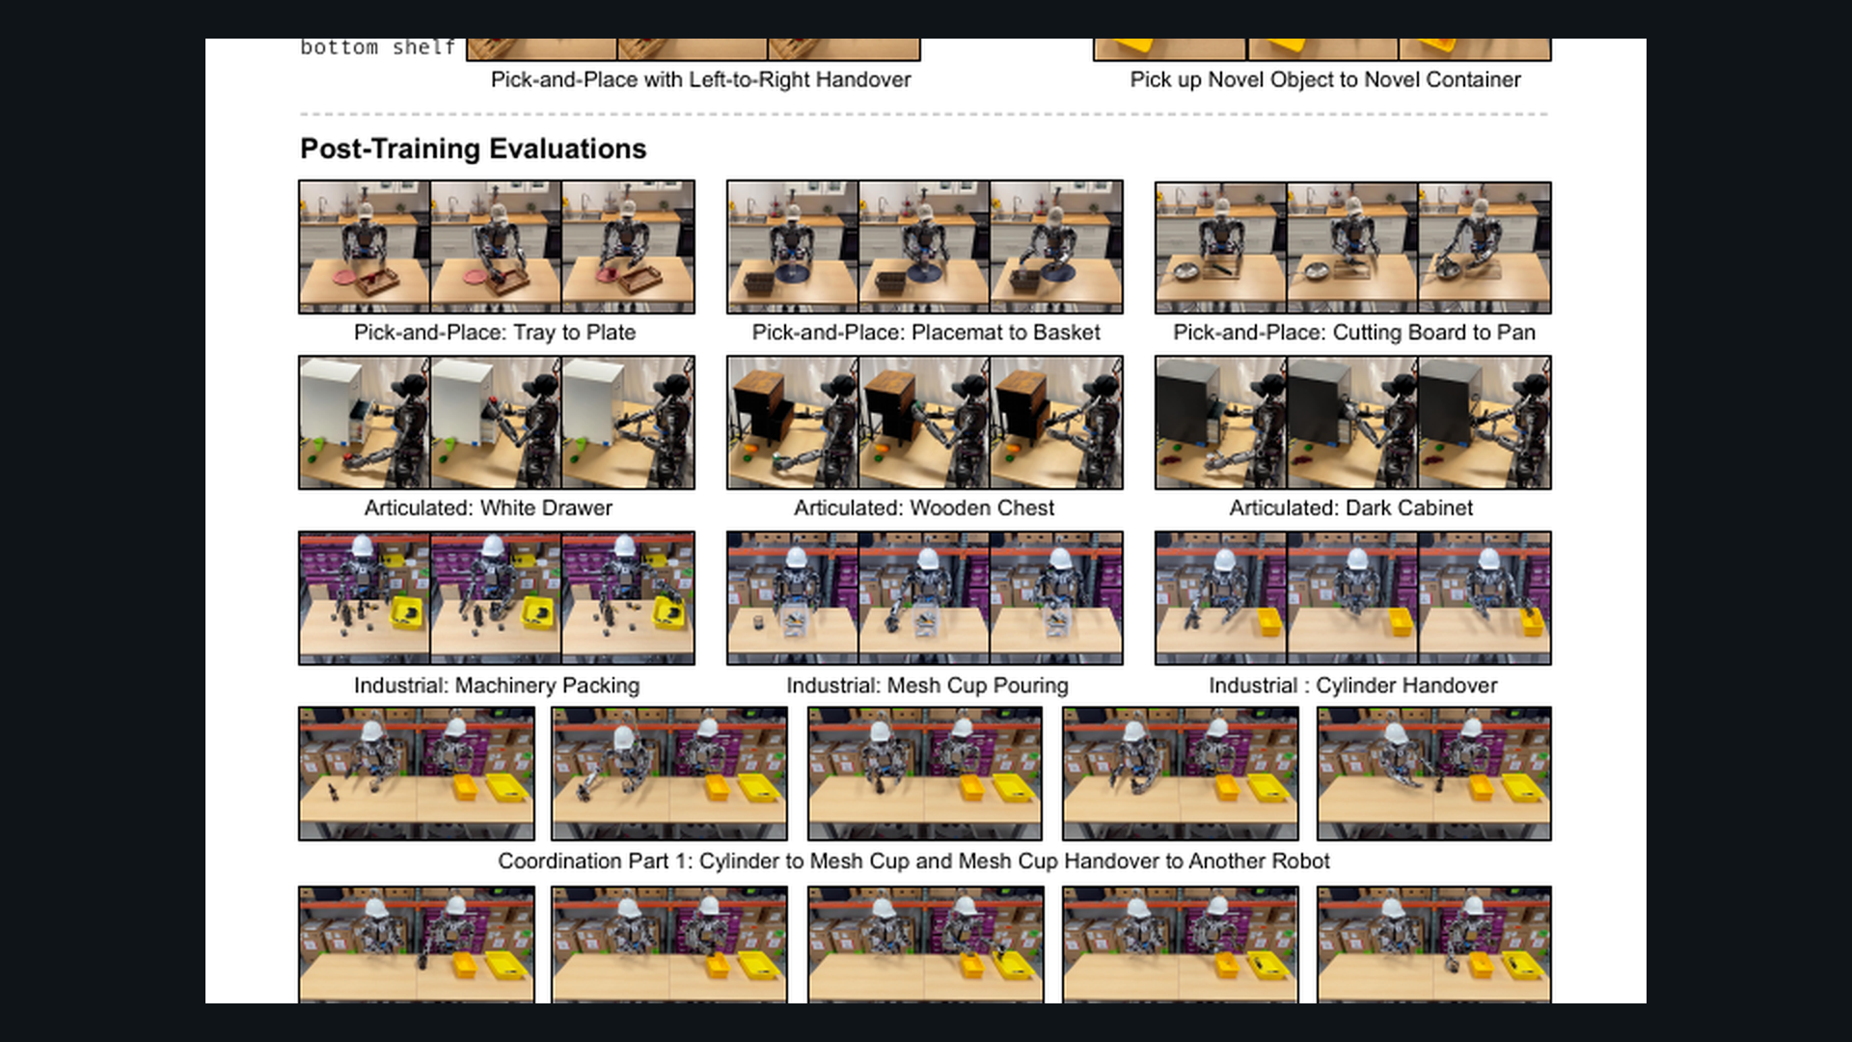
Scientific Reviewer · 8+3 · 8/11
Notes:
PAPER results page crop — glance at tables; Empiricist owns re-run plan.

Slide 9
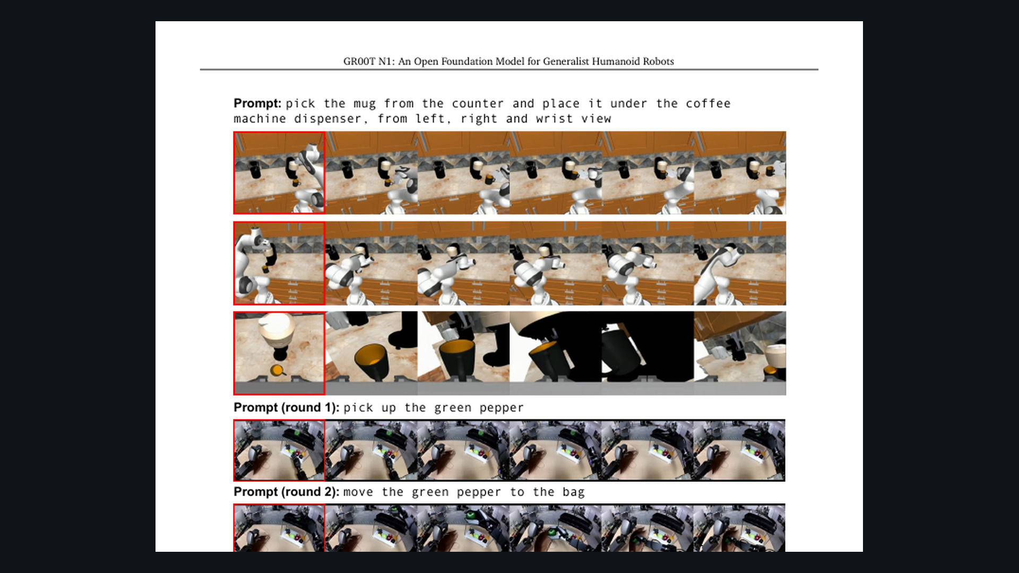
Scientific Reviewer · 8+3 · 9/11
Notes:
PAPER FIG 11 forgetting — honest negative result. Cite as limitation, not cute figure.

Slide 10
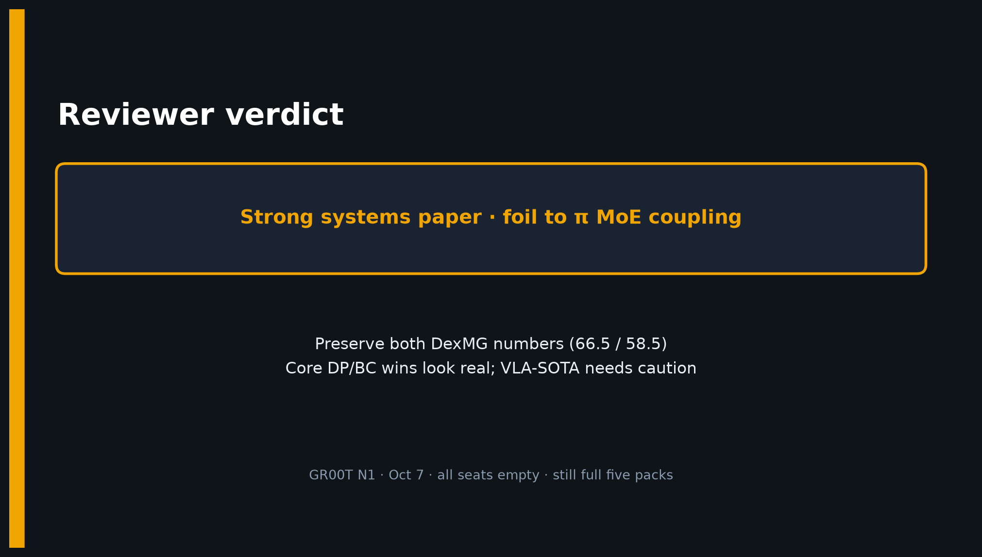
Scientific Reviewer · 8+3 · 10/11
Notes:
CLOSE / Q&A — restate verdict + DexMG discipline + foil framing.

Slide 11
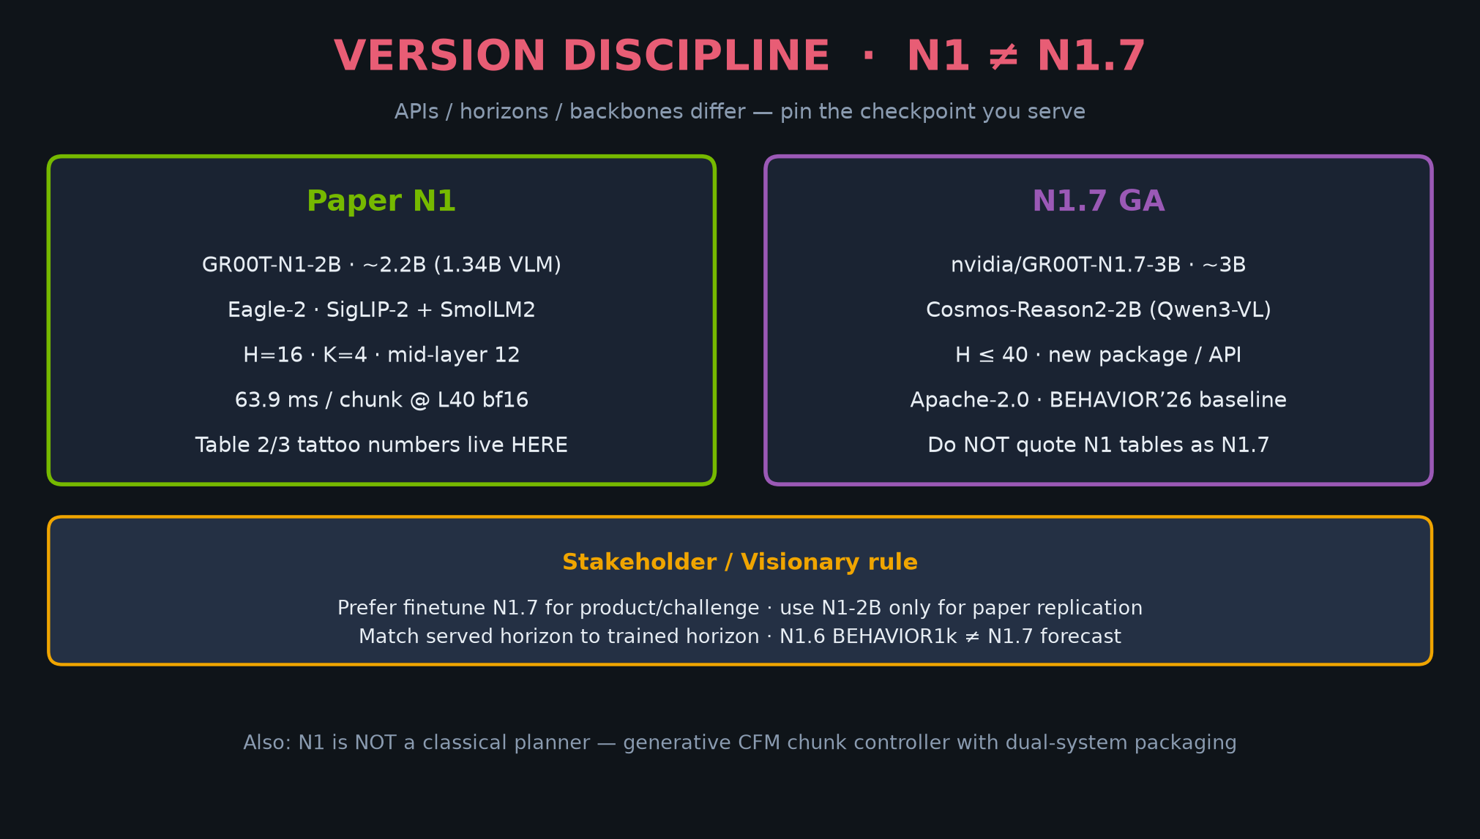
Scientific Reviewer · 8+3 · 11/11
Notes:
BACKUP — version discipline if someone asks N1 vs N1.7 relevance for 2026 review.

